Slide 1
USGS Science in Support of Coastal Issues
October 9, 2015
John Haines
Acting Associate Director, Natural Hazards
U.S. Geological Survey

Slide 2
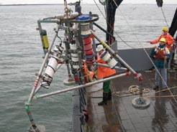
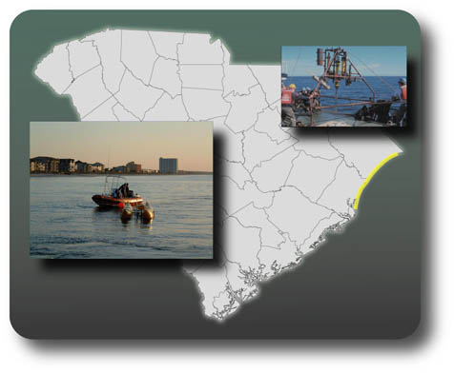
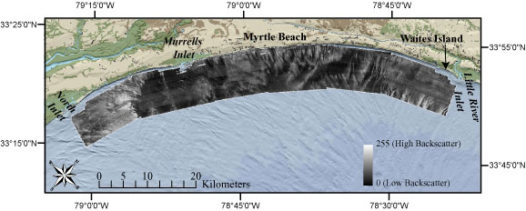
Coastal Marine Geology Program
Past Regional Cooperative Studies
Louisiana Barrier Islands
Louisiana Subsidence
South Carolina Coastal Erosion
S. Lake Michigan Coastal Erosion
Lake Erie Coastal Erosion
Florida Gulf of Mexico Wetlands
West Central Florida Coastal Erosion
Southwest Washington Coastal Erosion
Hawaii Coastal Erosion
North Carolina Coastal Erosion
MassBay/Boston Harbor Contaminants
Southern California Shelf Contaminants

Slide 3
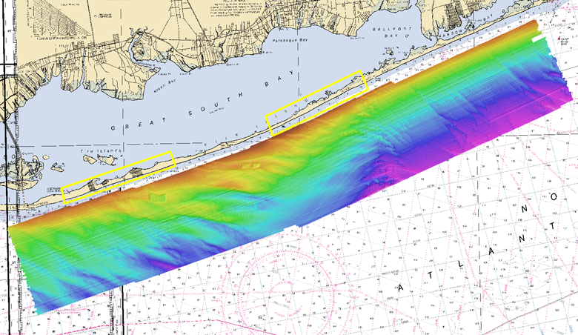

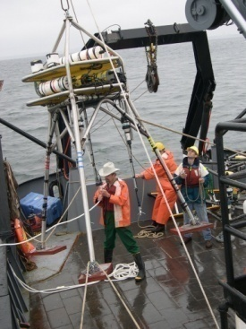
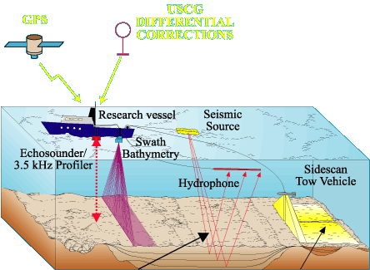
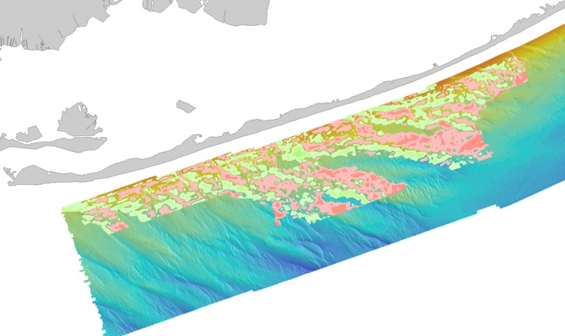
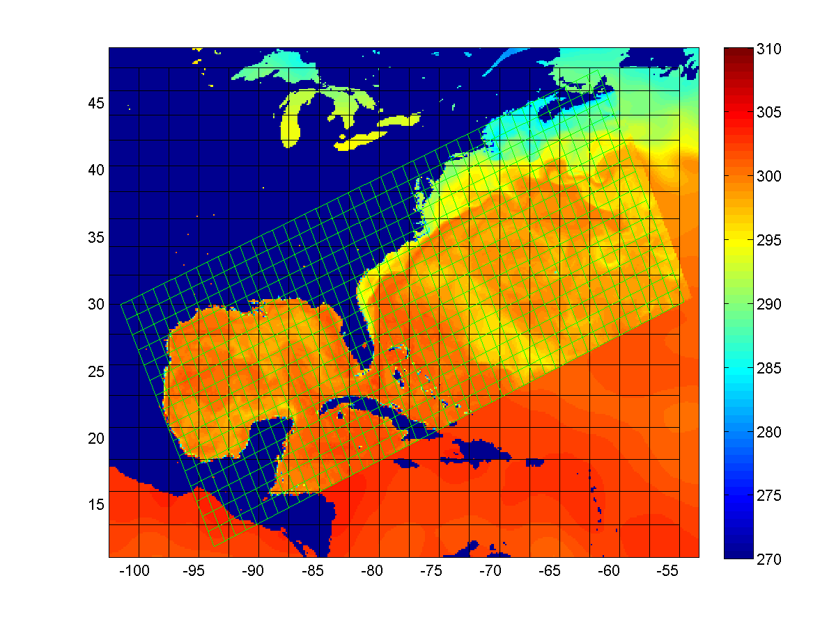
Regional Cooperative Studies Today
Fire Island Coastal Erosion
DelMarVa Coastal Erosion
Gulf of Mexico Barrier Island Evolution
California Coastal Change
Florida/Caribbean Corals
Hawaii/Pacific Corals
Puget Sound Restoration
Shoreline Position at 8000 years B.P.
10 km
Outwash Headland
~200M cubic meters eroded
Marine Transgression
SW Sediment Flux
Erosion of Headland
Source of Holocene Sediment
~160M cubic meters
Integration of Geologic and Shoreline Structure and Change
Oceanographic
Deployments
Seafloor Mapping
Comparison of modeled and observed sediment thickness change
Modeling
Long-term and hurricane-driven shoreline change

Slide 4
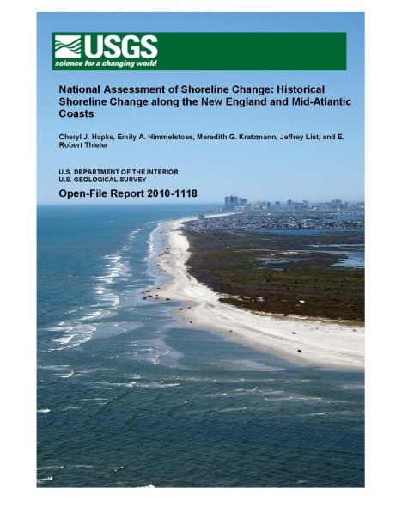
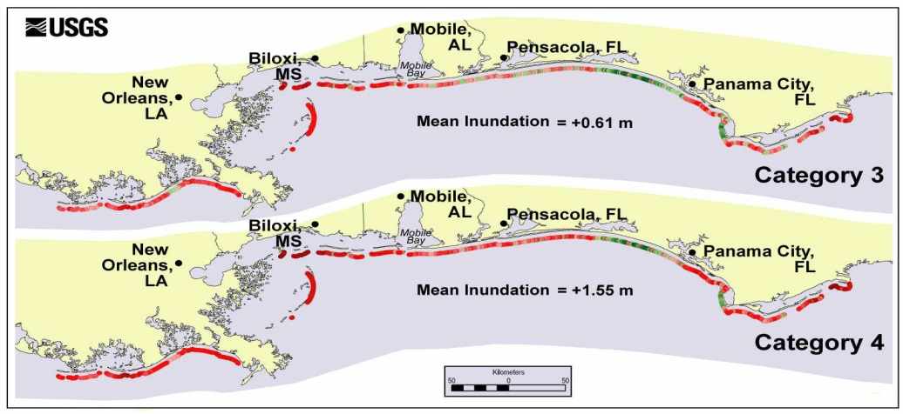
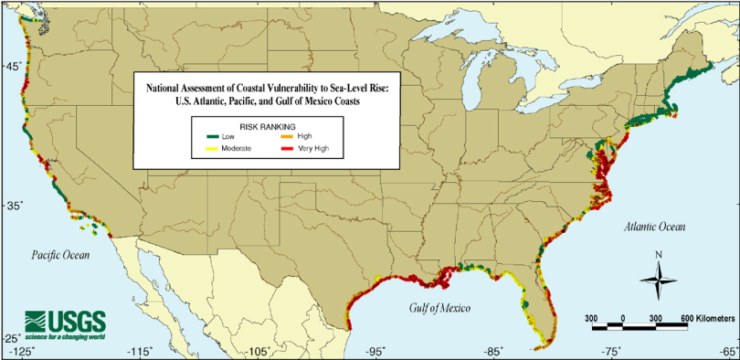
Building National Capacity to Anticipate and Respond to Coastal Change Hazards
Storms, Erosion and Climate Change
Geologic, Geomorphic and Oceanographic Observations
Research
Models, Forecasts, and Assessments
Delivery Mechanisms

Slide 5
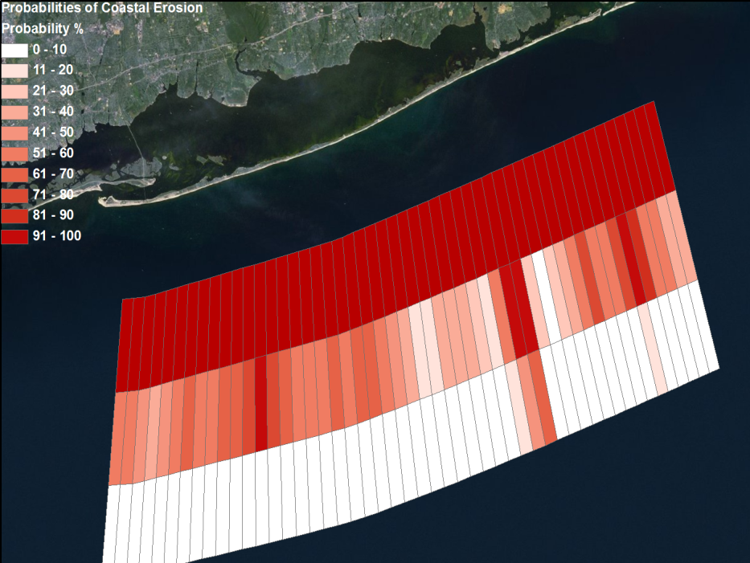
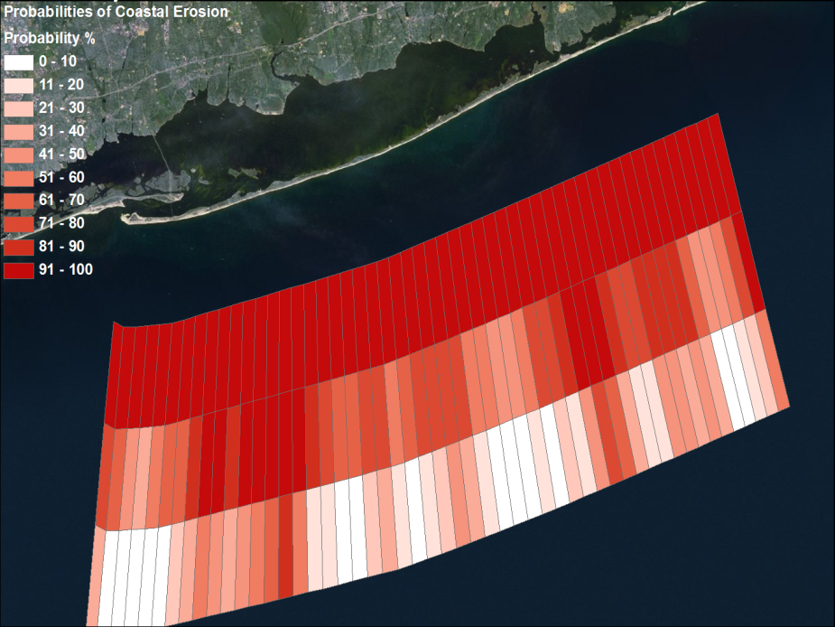
Forecasting Storm Vulnerability
Pre-Sandy (2010) vulnerability
20% of Fire Island was likely to overwash
Post-Sandy (2012) vulnerability
70% of Fire Island is likely to overwash
EROSION
EROSION
OVERWASH
OVERWASH
INUNDATION
INUNDATION

Slide 6
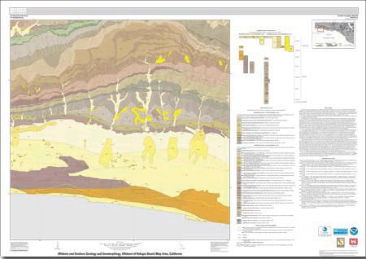
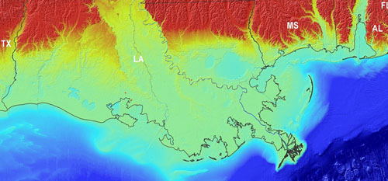
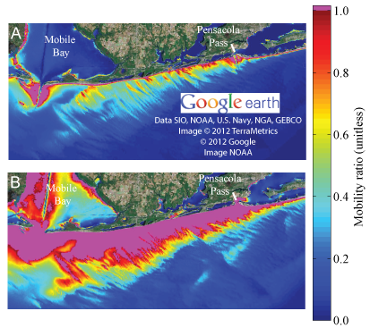
Ensuring Maximum Impact
Coastal National Elevation (CoNED) Datasets
Mapping California State Waters
Predicted Mobility of Oil/Sand “Tarballs”

Slide 7
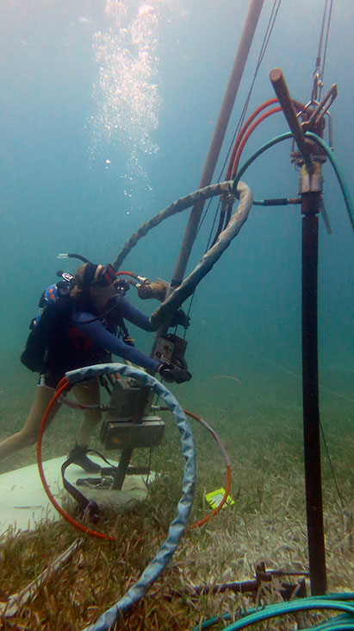
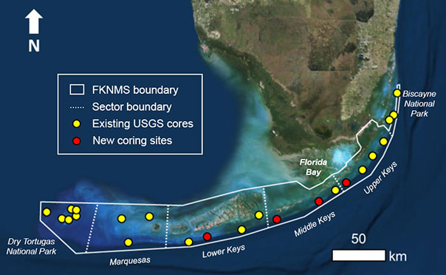
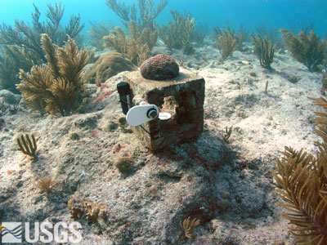
Corals
Florida-based project looks at (1) Reef history, (2) Reef
Geomorphology, (3) Reef Geochemistry, (4) Calcification
Regional studies indicate increase in reef
calcification in Dry Tortugas National Park,
while loss at all other locations.

Slide 8
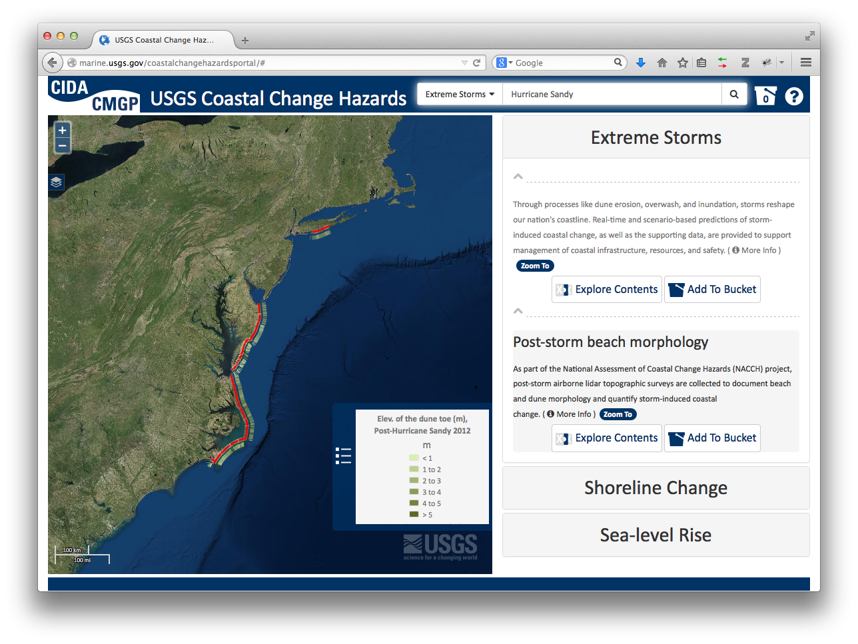
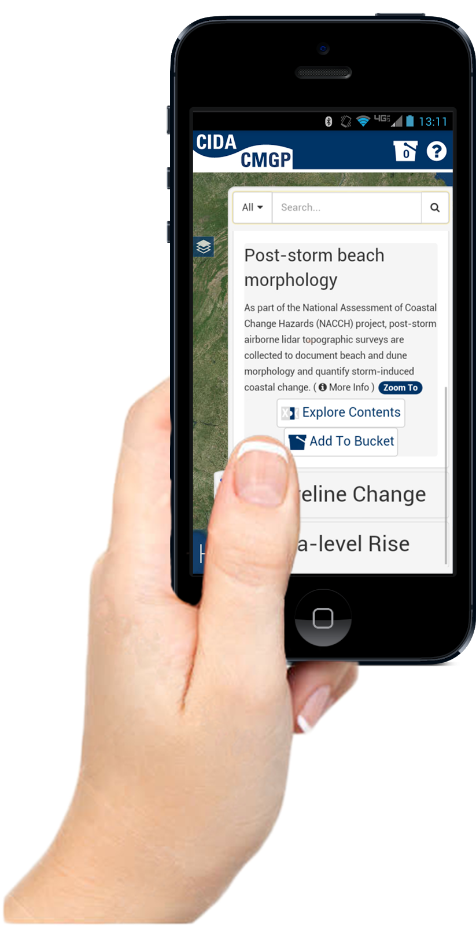
Coastal Change Hazards Portal

Slide 9
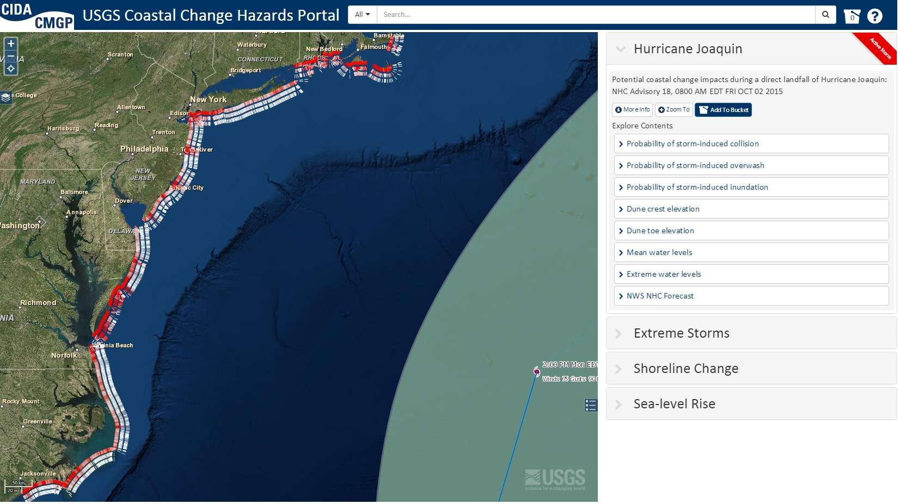
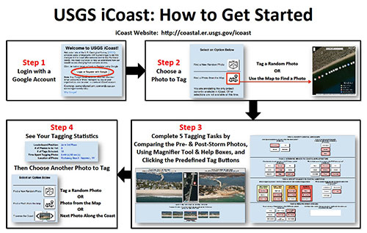
Forecast of Coastal Impacts for Named Storms

Slide 10
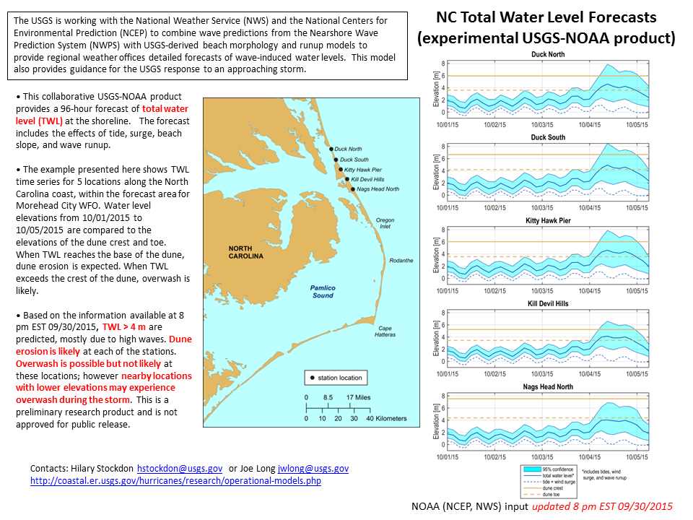
Opportunities & Challenges
Making science actionable
  Communicating risk
Building Research Infrastructure
  Data, models, field capacity
Setting Research Priorities
  National, regional, local
Addressing Complexity and Change

