Slide 1

Extramural Programs at
National Institute of Food and Agriculture
Parag R. Chitnis
National Institute of Food and Agriculture
US Department of Agriculture, USA

Slide 2
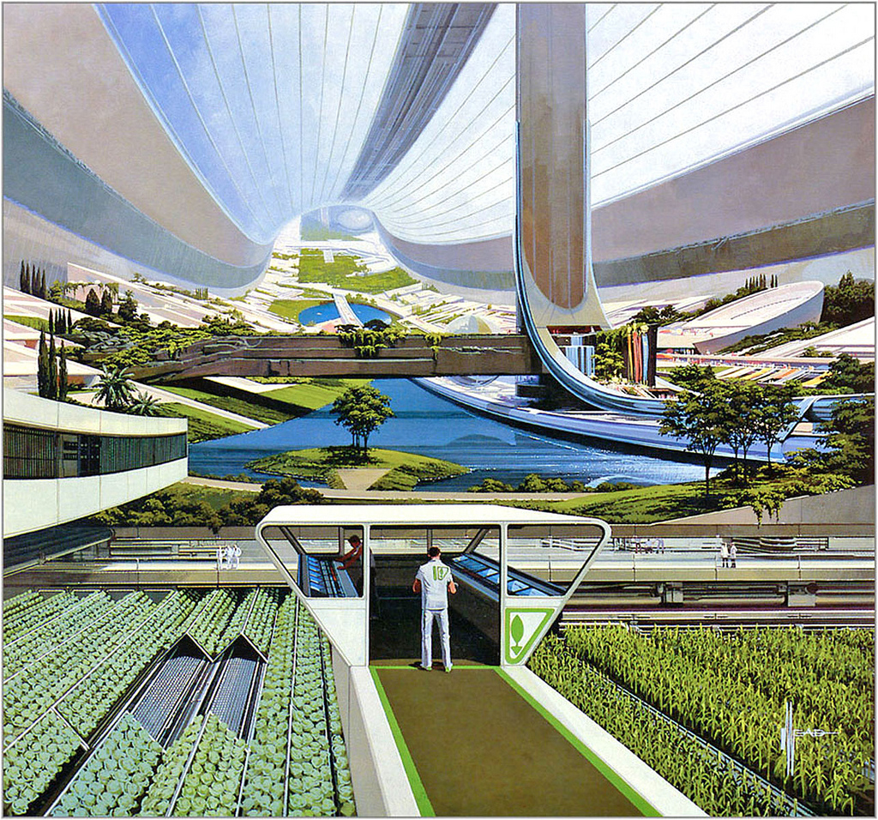
Outline
Introducing NIFA
NIFA Programs
Opportunities for transforming future agriculture
Syd Mead Future Paintings Sci-Fi 12 / 23

Slide 3
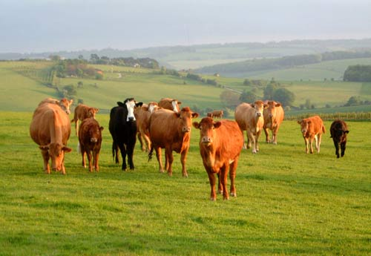
NIFA- An Introduction
Lead federal agency providing extramural funding for food and agricultural sciences
Created through the Food, Conservation, and Energy Act of 2008.
NIFA funding
  1.6B budget in FY2016; 1.8B requested in FY2017
  Competitive and capacity funds
Mission
  User-inspired agricultural research, education, and extension to solve societal challenges
Vision
  Catalyze transformative discoveries, education, and engagement to address agricultural challenges
Discovery
Translation
Innovation
Solution

Slide 4
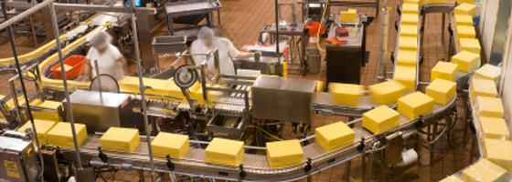
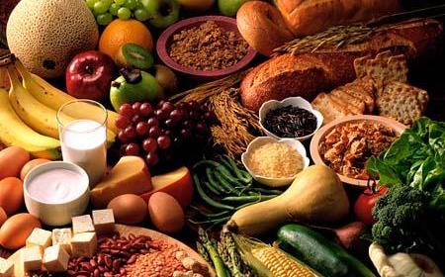
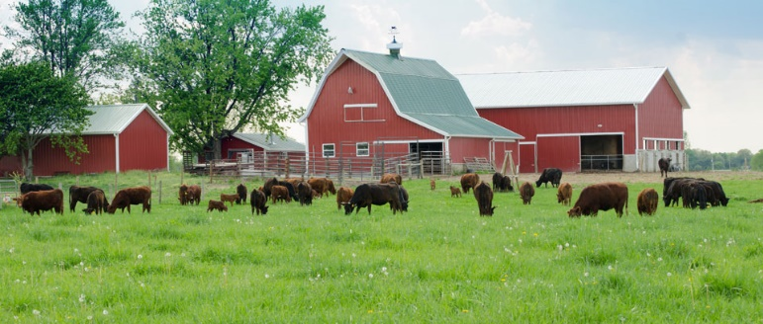
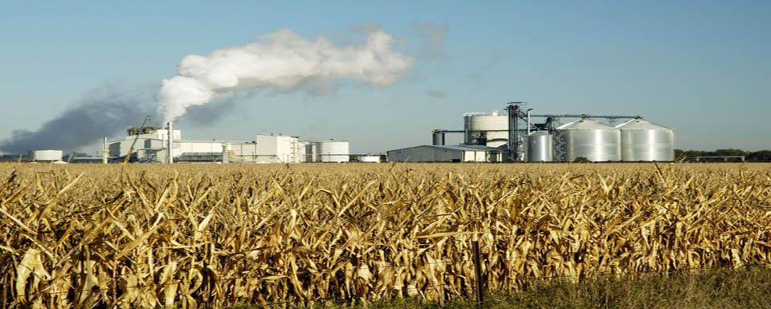
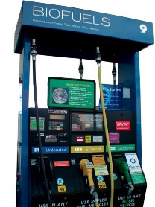
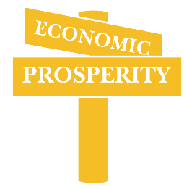
Food
Technology
Human Capital
Natural resources
Consumer use of food
Consumer Preferences
Marketing
Education
Nutritional Security
Processing and Distribution
Inputs
Technology
Human Capital
Production Systems
Crops
Farm animals
Natural resources
Forests
Feedstocks
Technology
Entrepreneurship
Consumer Use of bioproducts
Preferences
Marketing
Education
Economic Security
Processing and Distribution
Education and Global Engagement

Slide 5
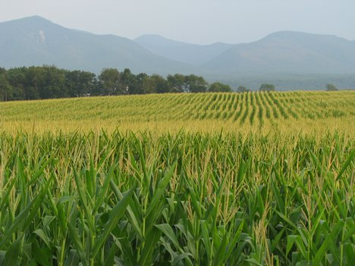

NIFA’s Four Institutes
Institute of Food Production and Sustainability
  enhance global food security through productive and sustainable agricultural systems
Institute of Bioenergy, Climate, and Environment
  enhance sustainable biobased energy systems and products
  enhance adaptive agro-ecosystems in response to climate variability and change
Institute of Food Safety and Nutrition
  ensure safe food supply; improve citizens’ health through nutrition; reduce childhood obesity; and improve food quality
Institute of Youth, Family, and Community
  enable vibrant and resilient communities; enhance youth development
  prepare the next generation of scientists
  enhance science capacity in minority serving institutions
6
Notes:
Mandated by the 2008 Farm Bill, NIFA was restructured in Oct. 2010.

Slide 6
NIFA Programs
Capacity
  For Research or Extension
  by Land Grant Universities (1862, 1890, 1994)
  Funded based on formulas
Competitive
  For broad and foundational or highly targeted applied projects
  Research, extension, education, or integrated

Slide 7
+ SBIR
+ BRAG

Slide 8
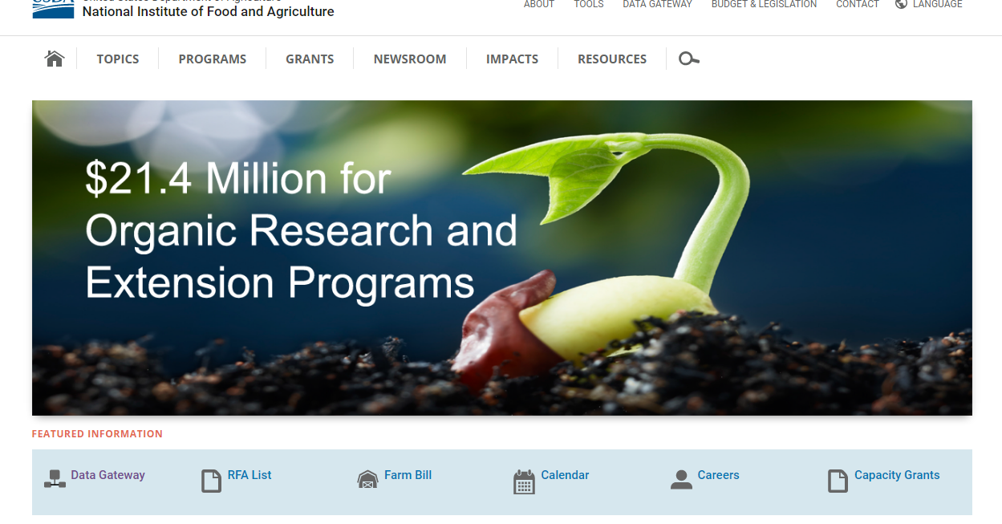
NIFA Data is Readily available
www.nifa.usda.gov

Slide 9
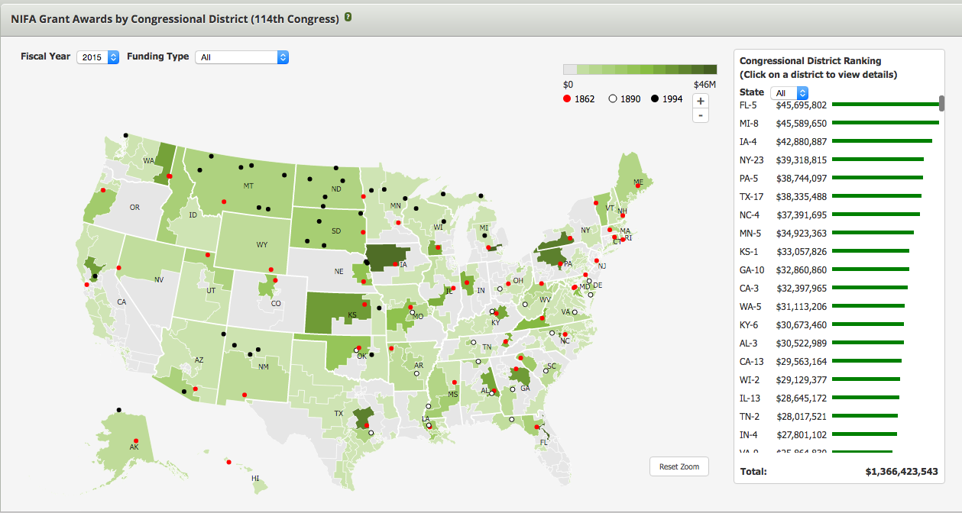
NIFA Funding – Congressional Map

Slide 10
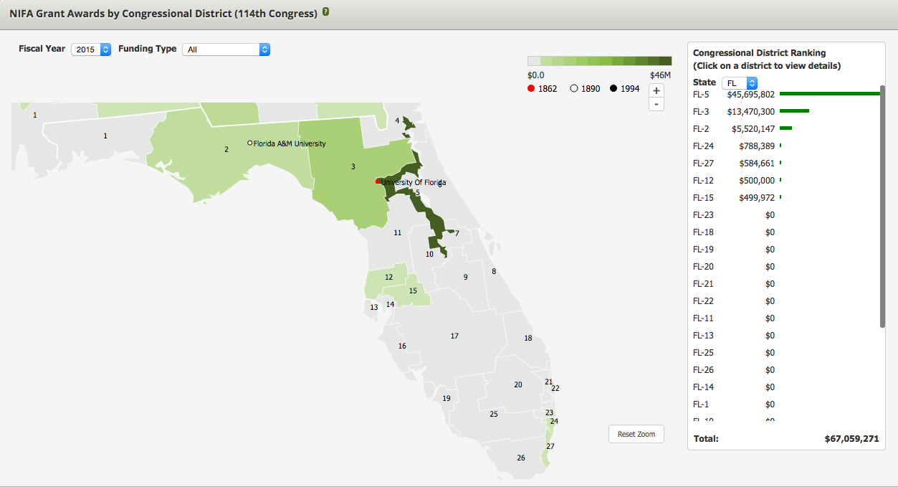
NIFA funding in Florida

Slide 11
AFRI is our largest competitive grant program
Agricultural Food and Research Initiative (AFRI)
$350 million in FY2016
Programs
  Foundational Program
  Education and Literacy Initiative
  Challenge Areas

Slide 12
AFRI- Interagency Activities
National Robotics Initiative (led by NSF)
Cyberphysical Systems (led by NSF)
Plant-Microbe Interactions (with NSF)
Ecology and Evolution of Infectious Diseases (with NSF, NIH, BBSRC)
International Wheat Yield Partnership (BBSRC, USAID, and others)
INFEWS (with NSF)
Dual Purpose Research (with NIH)
Biomarkers for nutrition (with NIH)
Water for Agriculture (with BARD)
Plant and animal health (with Irish agencies)

Slide 13
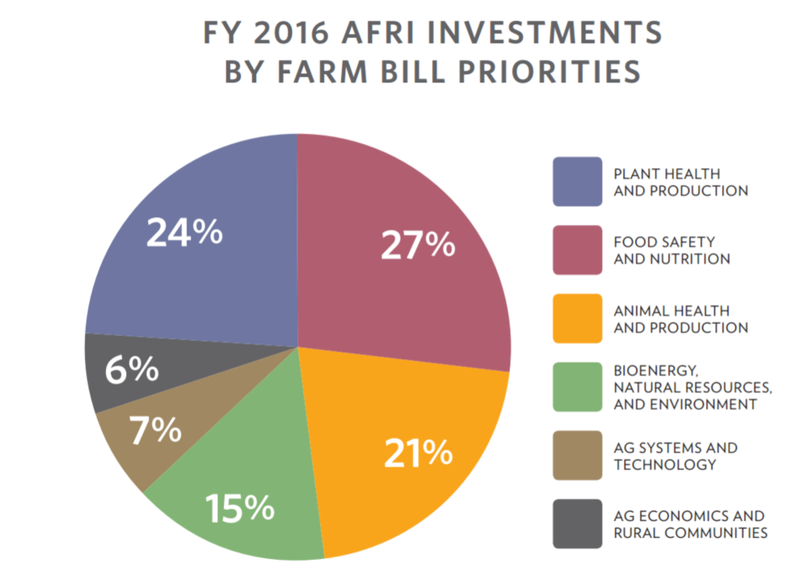

Slide 14
Specialty Crops Research Initiative
Specialty Crops
  55M of mandatory funding
  genomics to robotics to food safety
Citrus Disease Research Initiative
  25M of mandatory funding
  Solely targeted to citrus greening in its first three years
Two stage review
  Relevancy review by agroindustry
  Scientific merit review by peers

Slide 15
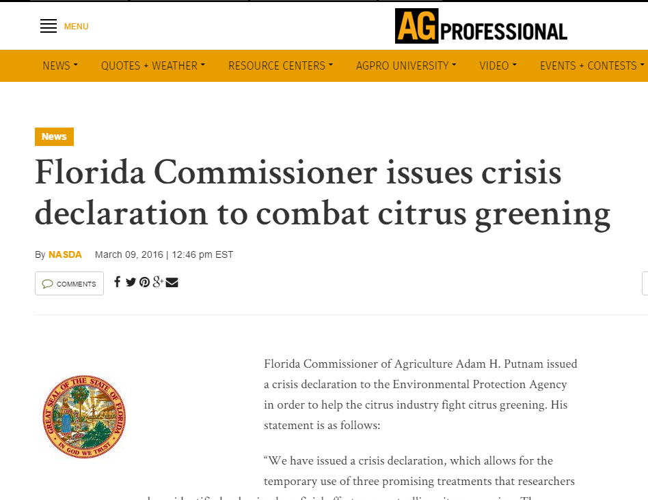
Citrus Greening

Slide 16
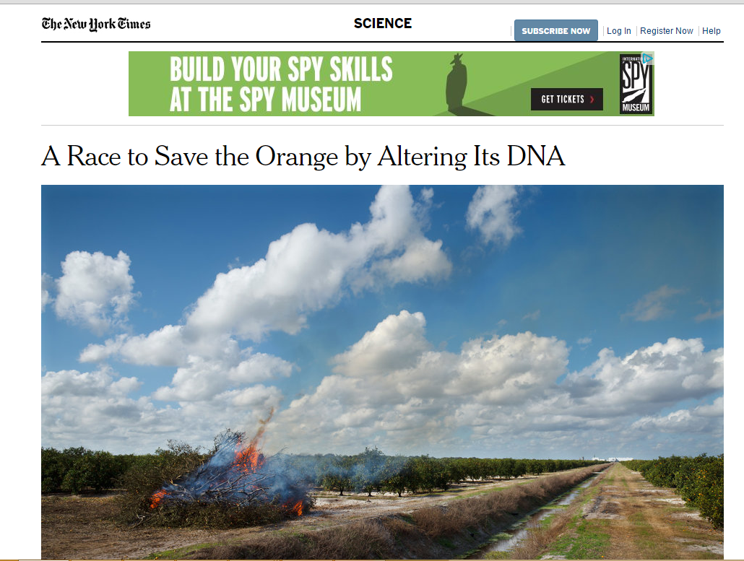
Citrus Greening

Slide 17
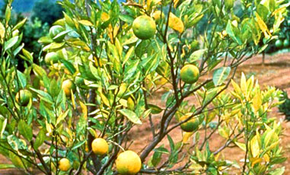

Citrus Greening (Huanglongbing HLB)
Citrus
  Most types
Vector
  Asian Citrus Psyllid
Bacterium
  Candidatus Liberibacter
No Effective Cure or Control
Destroying trees and orchards
is the common option

Slide 18
New Pesticides and Applicators
Zinkicides
  novel vacancy-engineered (VE) Zinc oxide (ZnO) nanoparticles
Novel Attractants into Bait and Kill Stations
Antimicrobials
RNAi treatments
Therapeutic proteins
Trunk applicators
Nanoparticles for pesticide delivery

Slide 19
NIFA Supports
User-inspired Science
For today’s problems
and
Tomorrow’s solutions

Slide 20
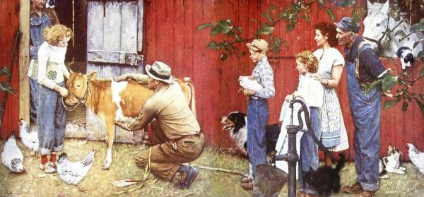
US Farming has come a long way
http://render.globalgallery.com/images/260997--600.jpg

Slide 21
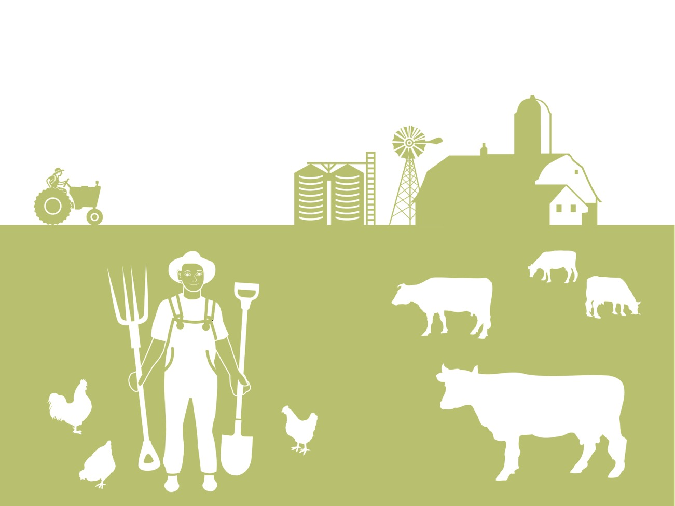
20th Century Farm

Slide 22










21st Century Farm
Smart Strategies for
Sensing
Monitoring
Nutrient delivery
Protection
Water use and quality
Data-driven decisions

Slide 23
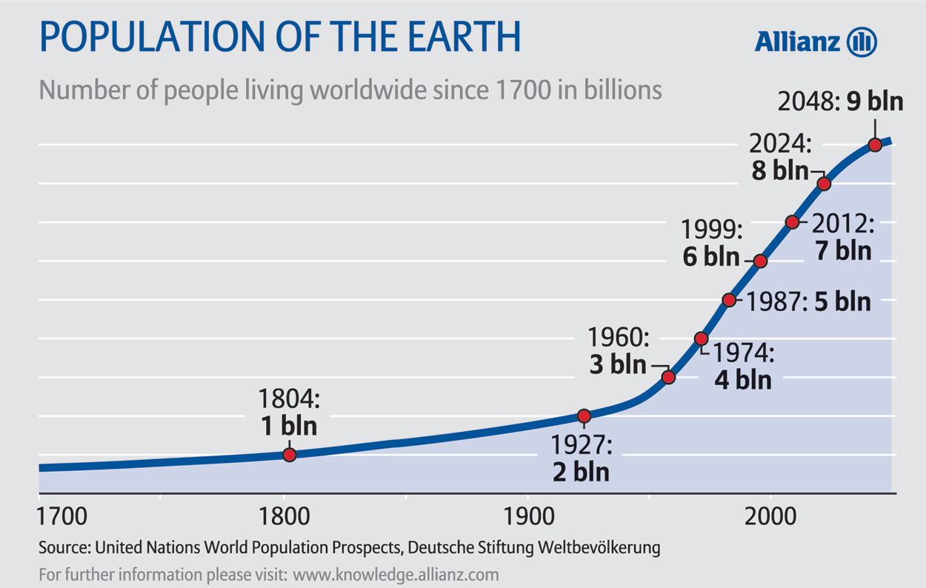
Food for the Growing Population
Not enough for everyone
Greater demand for animal-derived foods
Sufficient
Economical
Nutritious
Safe
Sustainable
Notes:
Current rate of increase in food production is not sufficient

Slide 24

Agriculture of the Future needs to tackle a crowded, hot, flat, and complex world
Notes:
Book Description
Thomas L. Friedman’s phenomenal number-one bestseller The World Is Flat has helped millions of readers to see the world in a new way. In his brilliant, essential new book, Friedman takes a fresh and provocative look at two of the biggest challenges we face today: America’s surprising loss of focus and national purpose since 9/11; and the global environmental crisis, which is affecting everything from food to fuel to forests. In this groundbreaking account of where we stand now, he shows us how the solutions to these two big problems are linked--how we can restore the world and revive America at the same time.
Friedman explains how global warming, rapidly growing populations, and the astonishing expansion of the world’s middle class through globalization have produced a planet that is “hot, flat, and crowded.” Already the earth is being affected in ways that threaten to make it dangerously unstable. In just a few years, it will be too late to fix things--unless the United States steps up now and takes the lead in a worldwide effort to replace our wasteful, inefficient energy practices with a strategy for clean energy, energy efficiency, and conservation that Friedman calls Code Green.
This is a great challenge, Friedman explains, but also a great opportunity, and one that America cannot afford to miss. Not only is American leadership the key to the healing of the earth; it is also our best strategy for the renewal of America.
In vivid, entertaining chapters, Friedman makes it clear that the green revolution we need is like no revolution the world has seen. It will be the biggest innovation project in American history; it will be hard, not easy; and it will change everything from what you put into your car to what you see on your electric bill. But the payoff for America will be more than just cleaner air. It will inspire Americans to something we haven’t seen in a long time--nation-building in America--by summoning the intelligence, creativity, boldness, and concern for the common good that are our nation’s greatest natural resources.
Hot, Flat, and Crowded is classic Thomas L. Friedman: fearless, incisive, forward-looking, and rich in surprising common sense about the challenge--and the promise--of the future.

Slide 25


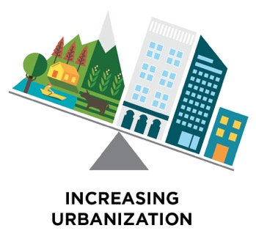
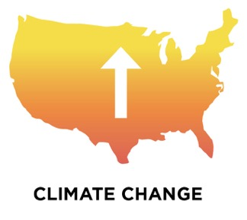
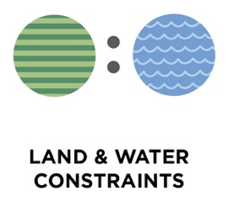



Agriculture in a Complex World

Slide 26
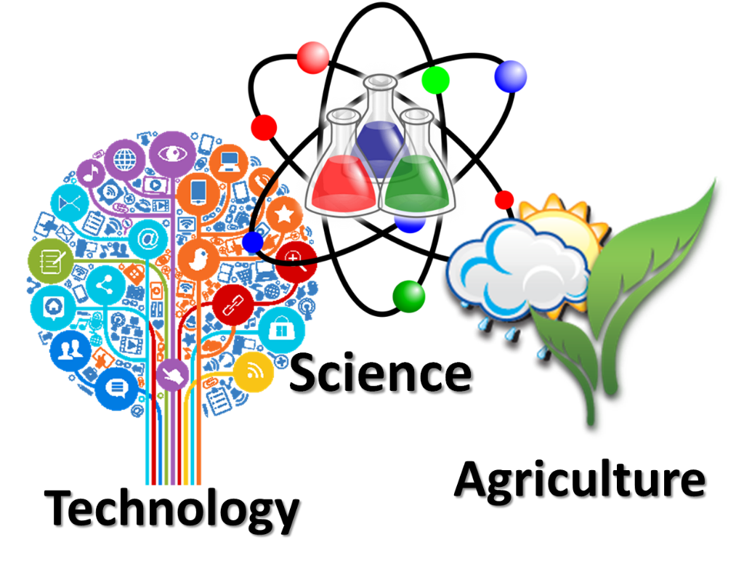
Transformative Solutions
Breakthrough technologies
Innovative management practices
Prudent policies and regulations

Slide 27
Transformative Solutions through Interdisciplinary Approaches
Agricultural Challenges
Engineering
Physical Sciences
Life Sciences
Social Sciences
Data Science

Slide 28
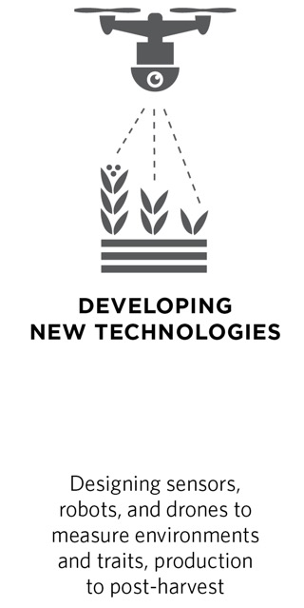
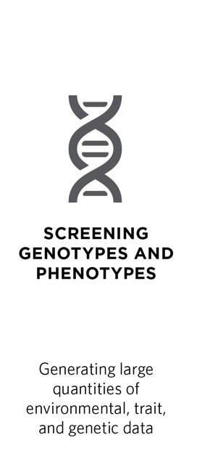
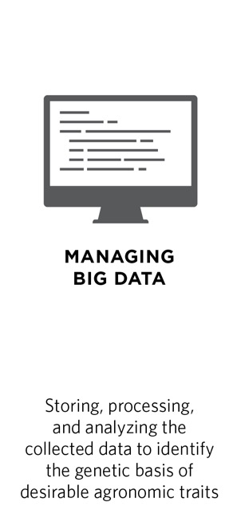
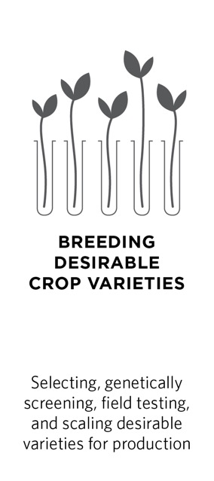
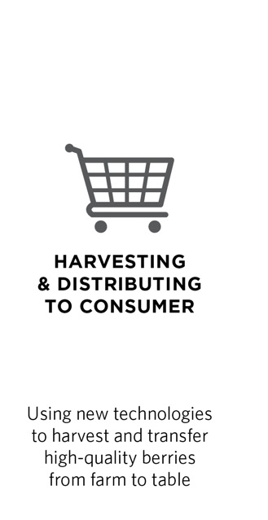
Transformative Technologies to
Smart Systems
Notes:
Frail-bots (AFRI competitive grant): inexpensive, relatively small, harvest-aiding robots
Reduce non-productive time by acting as an intelligent courier service that transports harvested crops.
Protect worker health by reducing slipping accidents.
Attend to harvesting ergonomics.
BIRD (SCRI grant): inexpensive, relatively small, harvest-aiding robots
Sensor goes through handling process with blueberries and measures the mech stress experienced by the blueberry
Goal: aid in selecting blueberries that can withstand mechanical stress during harvesting, post-harvesting, shipping, and handling
Eventually, will also measure microbial contamination
Outcome: better quality blueberries, lower prices, less food waste (fewer discarded bruised berries)
Product of collaboration among 14 researchers across 10 institutions in engineering, microbiology, plant science, economics, and social science

Slide 29
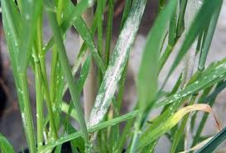
Genome Editing
Editing native genomes
Without leaving transgenes
Knockouts
Multiple genes
Example: Six loci modified to obtain broad spectrum resistance to powdery mildew
Caixia Gao, CAS
Notes:
W598
Developing Genome Editing Technologies for Crop Improvement
Date: Saturday, January 10, 2015
Time: 10:50 AM
Room: Sunrise - Meeting House
Caixia Gao , Institute of Genetics and Developmental Biology, CAS, Beijing, China
A successful example occurred in bread wheat. By knocking out all six alleles encoding the MILDEW-RESISTANCE LOCUS (MLO) protein with one pair of TALENs, we generated a mutant line with broad-spectrum resistance to powdery mildew, a devastating fungal disease. We provide another example of the use of SSN to disrupt biochemical pathways and create plants that accumulate valuable biosynthetic intermediates. We used TALEN technology to knockout OsBADH2 and obtain homozygous mutants with significantly increased content of the fragrant chemical 2AP; the level produced is similar to or even higher than in the fragrant rice cultivar Daohuaxiang. Our work provides plant breeders good examples of the use of SSNs for molecular breeding of crop plants.

Slide 30
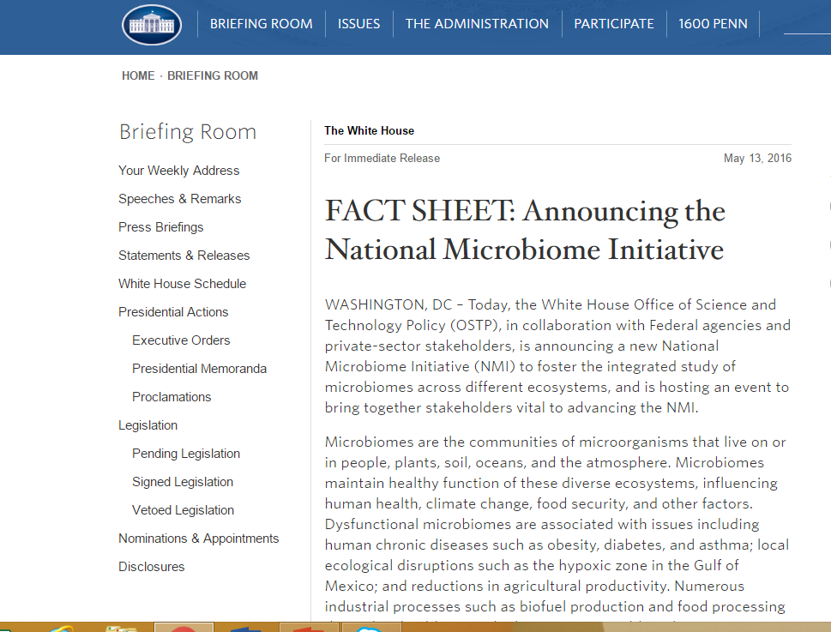
Microbiomes, Phytobiomes, and Beyond
Microbes are everywhere
They are smarter than us
They work as communities
Microbial communities are key players in diseases and health of crops, farm animals, and humans
Looking at the whole system is the key

Slide 31
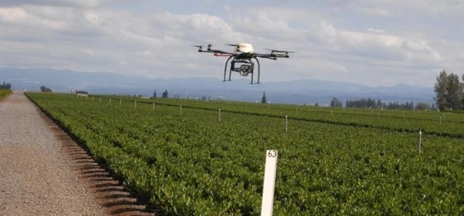
Robotics and Sensors
Nanotechnology enabled sensors
  Detection of pathogens and toxins, for biosecurity, plant diseases (e.g., Citrus Greening), animal health (e.g. avian influenza)
Use of Unmanned Aerial Vehicles (UAVs)
  Engineering coupled with population genetics techniques to track origin, distribution, and spread of populations of fungal plant pathogen, Gibberella zeae, in the planetary boundary layer
http://tinyurl.com/p2qufu6
Notes:
AFRI Foundational Program as well as SCRI
Projects funded

Slide 32
Data Deluge
DNA
Consumer
High throughput phenotyping
Educational Data
Regional Approaches
Climate
Precision agriculture
Nutritional
Economic
Providing Solutions
Analyzing Systems

Slide 33
Data Deluge
Ethics and Policy
Generation and Collection
Extensive collections
High throughput methods
Handling
Cyberinfrastructure
Transfer, storage, security
Data to Impacts
Mining
Synthesis
Standards and metadata
Visualization
Decision Support
Ownership, privacy
Data Literacy and Education

Slide 34

NIFA Summit on Big Data
October 10, 2016
Big 10 Conference Center, Chicago

Slide 35

Agriculture is a Systems Science
Opportunities for Interdisciplinary Research
Nanotechnology, Sensors, data, system studies
Social and economic sciences
Autonomous and precise applications
Sustainable Solutions for Tomorrow’s Problems
Notes:
Parag,
As you know that I have just returned today and been trying to catching up with all my emails, and I saw this rather urgent request from you. I am sure Dionne has provided you her inputs. Let me chime in a bit, if redundant, you may ignore.
For your session on Sustainable Food Systems: The Role of Chemistry and Chemical Engineering, it has a lot to do with what we do at IFSN. Assuming Dionne has covered nutrition, let me focus on food science and technology.
Chemistry and Engineering are two of the three science pillars of modern food science and technology. The scope of chemistry includes all major branches of it such as biochemistry, analytical chemistry and physical chemistry. Engineering includes process engineering, biological and biochemical engineering. The complexity of foods often makes it more challenging.
The applications of chemistry and engineering in food science and technology are very broad:
Quality deteriorations and chemical kinetics
Food texture and rheology
Transport processes – heat and mass transfers, fluid mechanics, reaction kinetics
Energy intensive and extensive nature – efficiency
Water utilization – leading to less-water or waterless processes
Food microbial safety – thermal and nonthermal inactivation of pathogens and spoilage microorganisms
Polymer chemistry – novel packaging
Membrane process – separation and purification of high value components
Colloidal chemistry – encapsulation and equilibrium stability
Nanotechnology to improve stability and efficacy of bioactives and nutrients delivery
Nanobiosensors for detecting pathogens, contaminants, and toxins
Nanotechnology enabled intervention technologies to improve food safety and quality
The list can go long, but for the sake of time, this gives you an idea about what our programs supported in the area of food science and technology.

Slide 36
Extramural Programs at NIFA
Introducing NIFA
NIFA Programs
Opportunities for transforming future agriculture
Syd Mead Future Paintings Sci-Fi 12 / 23

