Slide 1
Dr. Harry Bader
Deputy Executive Director
Notes:
Top Three Talking Points:
The U.S. Global Development Lab serves as an innovation hub within USAID. The Lab takes smart risks to identify, test and scale innovative tools and approaches and works with the Agency and other development actors to mainstream solutions that tackle the world’s most pressing development challenges.
The U.S. Global Development Lab operates under a set of guiding principles to meet our mission and USAID’s development objectives. The Lab is open and inclusive, looking for the best solutions no matter where they come from, and partners across sectors and geographies to integrate and mainstream. The Lab’s investments are catalytic, designed to demonstrate success of new approaches and unlock barriers to adoption in order to attract the support of others who bring far more resources to the table. We enable promising solutions to reach massive scale in the fight against global poverty. The Lab makes evidence-based decisions to increase our impact and limit our risk. We target our investments in what works and learn from what doesn’t.
The Lab has received over 16,000 applications and supported 900 new solutions in food security, health, climate change, energy, and economic growth. We’ve improved over 24.5 million lives and have leveraged $1.20 in private funds for every taxpayer dollar spent.

Slide 2
TWO PART MISSION OF THE LAB
To produce breakthrough development innovations
To accelerate the transformation of the U.S. development enterprise to impact millions of people
Notes:
The U.S. Global Development Lab serves as an innovation hub within USAID. The Lab takes smart risks to identify, test and scale innovative tools and approaches and works with the Agency and other development actors to mainstream solutions that tackle the world’s most pressing development challenges.
Produce Breakthrough Development Innovations: We support USAID Missions and Bureaus to source, test, and scale solutions to improve the lives of those living in extreme poverty.
Accelerate the Transformation of the U.S. Development Enterprise:
We work to advance approaches that leverage the capabilities and resources of the full diversity of stakeholders who are engaged in global problem solving.
We help USAID partners use data and evidence to drive decision making.
We seek to harness scientific and innovative approaches to solve problems.
We pursue innovative approaches to investing and partnering – including new forms of public-private partnerships and multi-stakeholder alliances, open innovation platforms, prizes and grand challenges, and pay-for-performance.

Slide 3
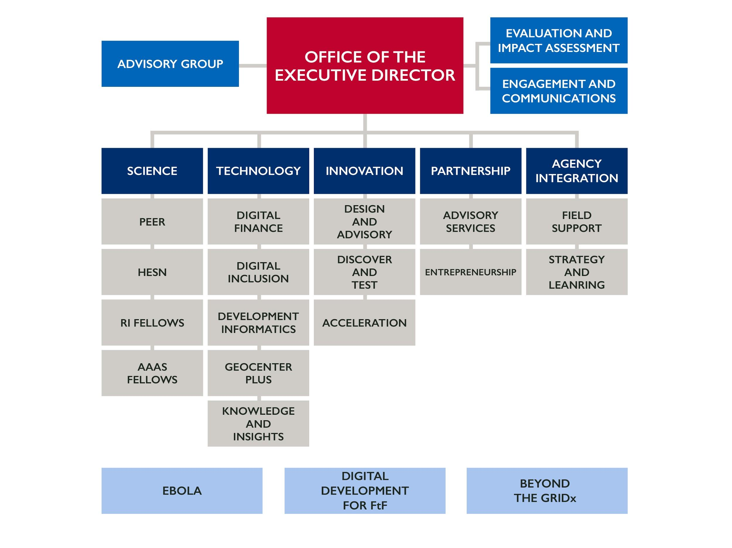
LAB Organization Chart
Notes:
Over 180 dedicated professionals with many technical specialties.
Mechanisms to provide rapid response capability for Missions to accomplish objectives, such as MERLIN, Futures Analysis, geo-mapping, etc.
Repositories of STIP innovations and projects to draw on for future project designs.
Ability to co-partner and co-collaborate through higher education and private sector partnerships.
Focus on Presidential Initiative programs to apply STIP resources towards transnational and chronic issues.

Slide 4
HOW THE LAB WORKS

Slide 5
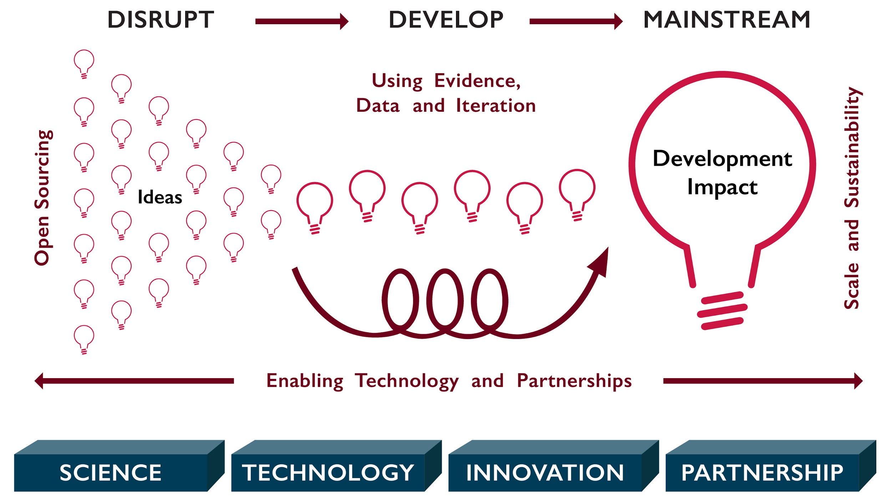
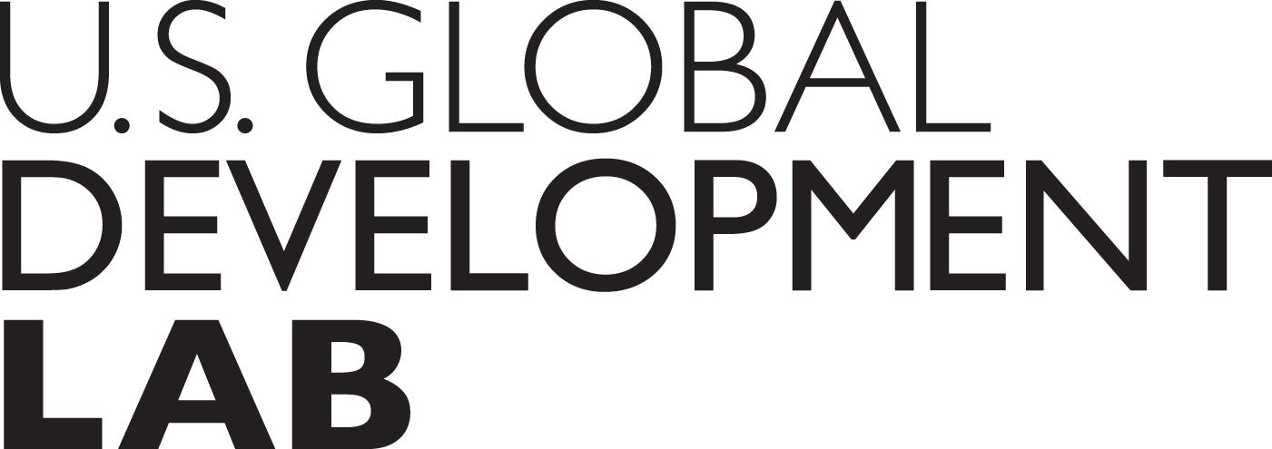
HOW THE LAB WORKS
[Slide 3: USE “A New Model of Global Development”
Notes:
The Lab focuses on a new, 21st century model of development.
Using our expertise in science, technology, innovation, and partnership creation, we apply a number of different approaches to:
Find ideas that have the potential to be disruptive;
Develop those ideas; and
Mainstream the ones that have the most promise for development impact.
We employ a number of different “approaches”, from Open Sourcing to Using Evidence, Data and Iteration to planning for Scale and Sustainability to utilzing Enabling Technologies and Partnerships along a rigorous path to produce breakthrough development innovations and achieving development impact.
These approaches are helping us to re-define how we do development at USAID and throughout the wider development community in an effort to help achieve the Agency’s core mission of ending extreme poverty.

Slide 6
LAB TOOLS AND RESOURCES
STRATEGY
Future’s analysis
Partnership landscape analysis
Technology analysis
PROJECT DESIGN
Co-design with Partners
Identify Innovations
Tap into Technical Expertise
MONITORING, EVALUATING, AND LEARNING
Evaluate impact with data
PROJECT IMPLEMENTATION
Utilize technology
Strengthen local partners
Create partnership
Notes:
The Lab is service-oriented; we support Agency Missions and Bureaus to achieve their objectives through an array of STIP tools and resources.
We provide offerings at every stage of the USAID Program Cycle, from a variety of tools such as future’s analysis or private sector CDCS development to monitoring, evaluating and learning.
Much more detail on our tools, resources, trainings and buy-in opportunities is available on our internal Pages site. If you have any questions, you can reach out to our Agency Engagement leads whose contact information is also on the site.

Slide 7
WHAT WE DO

Slide 8
Our Guiding Principles
Open and Inclusive
Catalytic
Agile
Evidence-based
Notes:
The Lab operates under a set of guiding principles to meet our mission and USAID’s development objectives:
Open and Inclusive: The Lab looks for the best solutions no matter where they come from, and partners across sectors and geographies to integrate and mainstream.
Catalytic: The Lab’s investments are designed to demonstrate success of new approaches and unlock barriers to adoption in order to attract the support of others who bring far more resources to the table and enable our solutions to reach massive scale in the fight against global poverty.
Agile: The Lab creates fast feedback loops that enable continuous monitoring and performance improvement.
Evidence-Based: The Lab makes evidence-based decisions to increase our impact and limit our risk. The Lab targets investments in what works and and learns from what doesn’t.

Slide 9
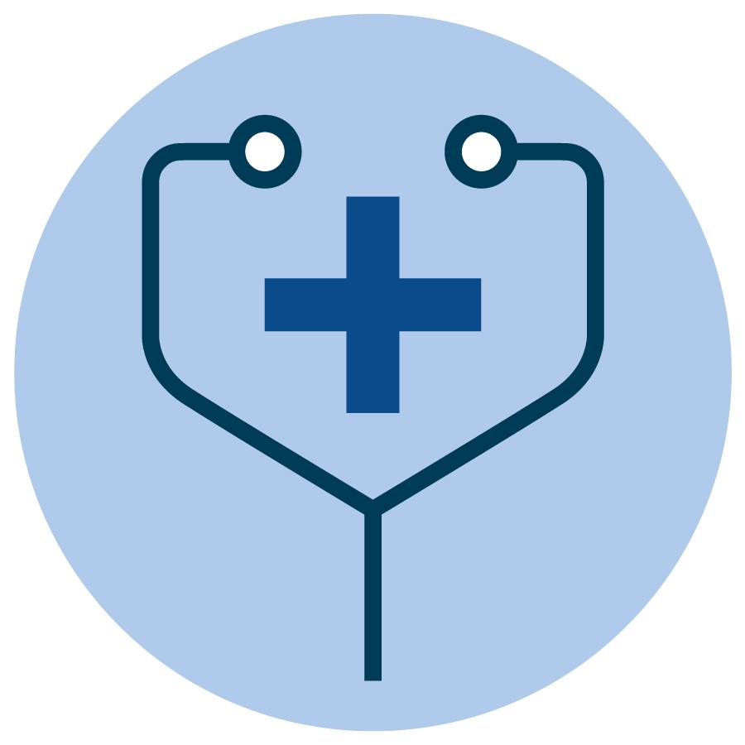
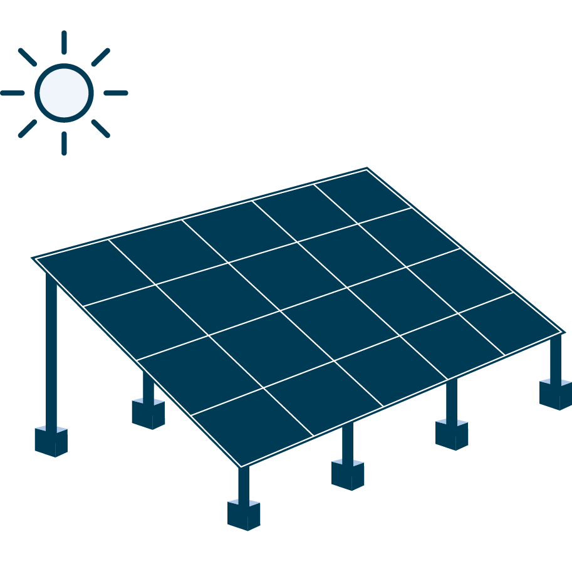
LAB WIDE PRIORITIES
LWP 1: Ebola- Improving West African Resilience through Information, Communication and Technology (ICT)
LWP 2: Digital Development for Feed the Future
LWP 3: Beyond the Grid
Notes:
The Lab is bringing its capabilities and resources to bear on critical Agency priorities and Presidential Initiatives to accelerate development results and mainstream STIP approaches, tools, and innovations.
Lab Wide Priority One is Ebola. We are working with the Africa Bureau, GH, DCHA, FFP and BFS to increase the coverage and quality of mobile networks, foster secure and efficient electronic payment systems, and accelerate the development and deployment of health information systems.
Lab Wide Priority Two is Food Security. We are working with BFS to apply proven digital technologies - specifically digital financial services, real time data collection and analysis, and underlying access and infrastructure systems - to FtF activities in key countries.
Lab Wide Priority Three is Off-Grid Energy (Power Africa). We are working with Power Africa and E3 to accelerate access to off-grid energy at the household level with particular focus on scaling household solar solutions. Ultimately, we want to Increase the number of household electricity connections and spur a market-driven sector that serves poor and rural customers.

Slide 10
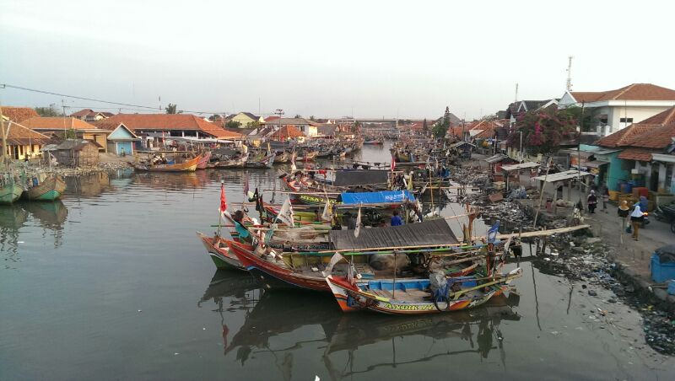
Converting Waste into Energy – Indonesia
Notes:
The Lab works to ensure that USAID is investing sufficiently and strategically in research and development (R&D) and applying research in our decision-making and program design.
To accelerate these efforts, the Lab is connecting the technical expertise of academia to the complex problems faced by people living in poverty.
At universities around the world, professors and students are cultivating methods, conducting analyses, and creating innovations, while the development community is in the field implementing, evaluating, and testing out new ideas.
The Lab brings these communities together to better inform the research community about development needs and ensure that the development community is ready and able to act upon research findings.
The Higher Education Solutions Network (HESN) is a partnership between USAID and seven top universities that is undertaking 55 collaborations with 34 USAID missions and bureaus. HESN has also strengthened connections with the broader development community through its network of more than 685 partners, approximately half of whom are locally-based, across 69 countries.
Two HESN partners (Massachusetts Institute for Technology and Duke University) designed the Ayzh Clean Birth Kit in a Purse to address the problem of Infections at birth that affect more than 6 million women annually.
The kit provides the tools necessary to ensure safe and sterile childbirth conditions at a cost of only $2, or 50 percent less than comparable kits. More than 250,000 kits have been sold in India, Haiti, Lao, Afghanistan and Africa, with plans to reach six million women and babies over the next five years.
The Lab’s Partnerships for Enhanced Engagement in Research (PEER) Program is another way we’re bringing the academic and development communities together.
PEER is an international grants program that funds scientists and engineers in developing countries to address global development challenges. As part of the program, the developing country scientists partner with U.S. scientists and researchers.
The Indonesia Mission has been a leader in supporting scientific research via the PEER Program, with 37 current PEER grants representing $7.6 million in USAID investment.
One such grant is to Dr. Wiratni Budhijanto at the Universitas Gadjah Mada, who is partnering with a researcher at Cornell University to convert municipal solid waste into energy with a series of large bioreactors.
Common practice in Indonesia is to handle organic liquid waste coming from landfills using lagoons - large retention pools that flow liquid waste down the hill from pool to pool before emptying into rivers.
While studying the Piyungan Landfill site in Indonesia, Dr. Wiratni and her fellow PEER-funded researchers discovered that 7 lagoons failed to reduce the organic content to acceptable levels. However, they also discovered that the waste runoff, while a significant source of water contamination, could also be used as bioreactor starting material.
Seeing the opportunity to act, Dr. Wiratni and her colleagues designed 10 laboratory scale reactors to capture, clean and convert this wastewater into energy. The reactors were not only much more compact than earlier designs, but only needed 7-10 days --as opposed to the retention pond’s 50-100 days -- to degrade organic pollutants to safe levels. Dr. Wiratni’s bioreactor speeds up the degradation time of organic solids in wastewater by over 10-fold.
In addition to speeding up the time of wastewater treatment, the technology developed by Dr. Wiratni allows Indonesians to derive energy from the organic degradation process. For example, one local fruit and vegetable market in Indonesia produces 4 tons of rotten fruit per day -- when processed through Dr. Wiratni’s bioreactor, this is enough energy to power an average Indonesian household for more than one month.
Wiratni’s bioreactor technology has the potential to make a big impact in Indonesia organic waste treatment system. Wiratni team has already been approached by a dairy farm and slaughterhouse with interest in using her technology to help treat organic waste. Once tested, theses bioreactors can be used by local municipalities and industrial waste sites across Indonesia.

Slide 11
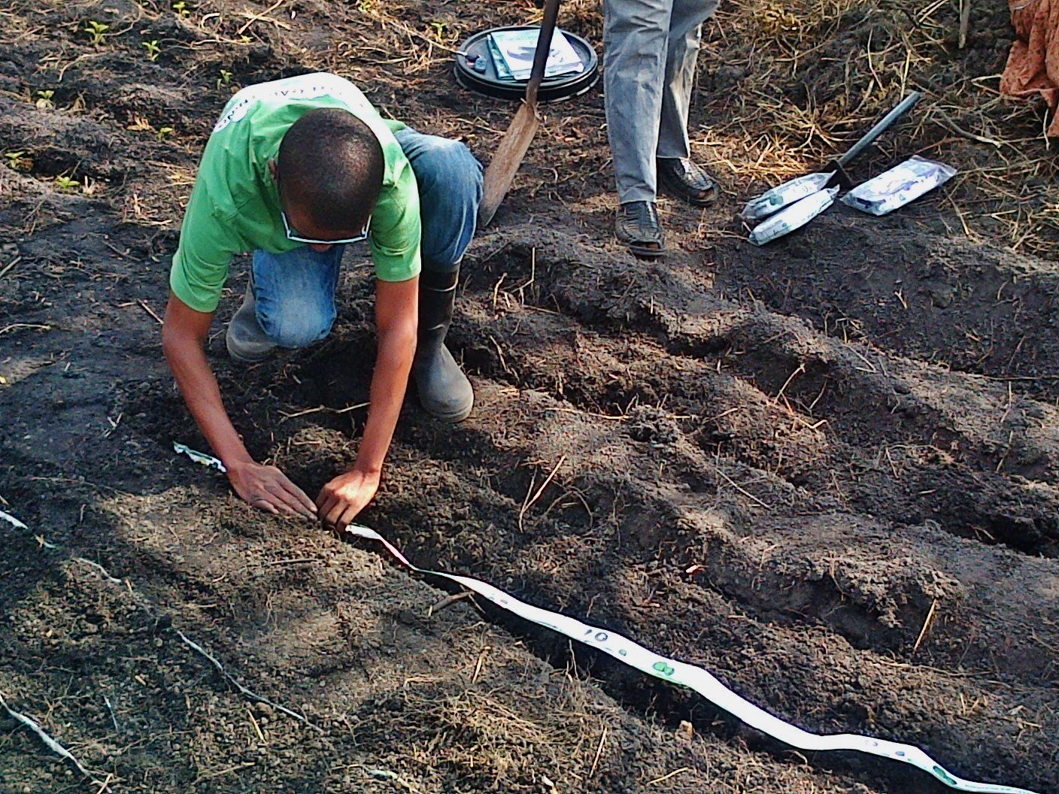
Grand Challenges for Development
Reel Gardening
Development Innovation Ventures:
Off-Grid Electric
Notes:
At USAID, we are experimenting with ways to bring in new ideas and new voices. For example, through directed innovation initiatives like Grand Challenges for Development, we shine a light on critical problems - like improving childhood literacy or saving newborn lives - and seek new solutions from innovators around the world.
In addition, our open innovation funds, such as Development Innovation Ventures (DIV) and the Global Innovation Fund (GIF), seek solutions to development challenges in any sector that can show evidence of significant impact. DIV is modeled after venture-capital funds with tiered funding stages for solutions as they prove their potential for impact at scale.
For example, through the Lab’s Development Innovation Ventures program, we’ve provided grant funding to Off-Grid Electric which is bringing solar power to rural households in Tanzania.
They have able to do this by using mobile money to offer a pay-as-you-go model, so customers can pay off a home solar system over time, at just a few cents a day.
This means that Off-Grid makes a profit, and can plow that money back into serving more customers.
It also means that our funding has been catalytic and helped them to raise almost $100M in debt and equity from the private sector - to continue to fuel their growth.
Off-Grid has already lit over 100k homes and is aiming to reach 1M by the end of next year.
Or take, Reel-Gardening, which has created a simple, quick, and effective biodegradable paper tape that encases organic fertilizer and seeds at the correct depth and distance apart, resulting in 80% reduction in water consumption.
Funding through the Securing Water For Food Grand Challenge for Development. has allowed founder Claire Reed to scale her business to reach over 300,000 households this year.

Slide 12
JOIN US!
Newletter and Listserve: bit.ly/LabInsiders
Visit us at: usaid.gov/GlobalDevLab
Facebook: facebook.com/GlobalDevLab
Twitter: @GlobalDevLab
Email: thelab@usaid.gov

