Slide 1
The Patient-Centered Outcomes Research Institute (PCORI)
Joe Selby, MD MPH
Executive Director, PCORI
Florida State University System
4th Annual Federal R&D Agency Workshop
September 30, 2016

Slide 2
FOR TODAY
PCORI – Clinical Research Done Differently
Introducing PCORnet
PCORI’s Portfolio & Funding Opportunities

Slide 3
Stakeholder-Driven Research
From the Affordable Care Act, 2010
“The purpose of the Institute is to assist patients, clinicians, purchasers, and policy-makers in making informed health decisions by advancing the quality and relevance of evidence concerning the manner in which diseases, disorders, and other health conditions can effectively and appropriately be prevented, diagnosed, treated, monitored, and managed through research and evidence synthesis...and the dissemination of research findings with respect to the relative health outcomes, clinical effectiveness, and appropriateness of the medical treatments, services...”
Notes:
To learn more about PCORI, please see: www.pcori.org/about

Slide 4
PCORI’s Mission
PCORI helps people make informed health care decisions, and improves health care delivery and outcomes, by producing and promoting high integrity, evidence-based information that comes from research guided by patients, caregivers and the broader health care community.

Slide 5
PCORI was Established to Fund Comparative Clinical Effectiveness Research
Compares two or more options for screening, diagnosis, treatment that matter to patients
(one option may be “usual care”)
Considers the range of outcomes that are important to patients
Conducted in real world populations and real world settings
Attends to differences in effectiveness and preferences across patient subgroups

Slide 6
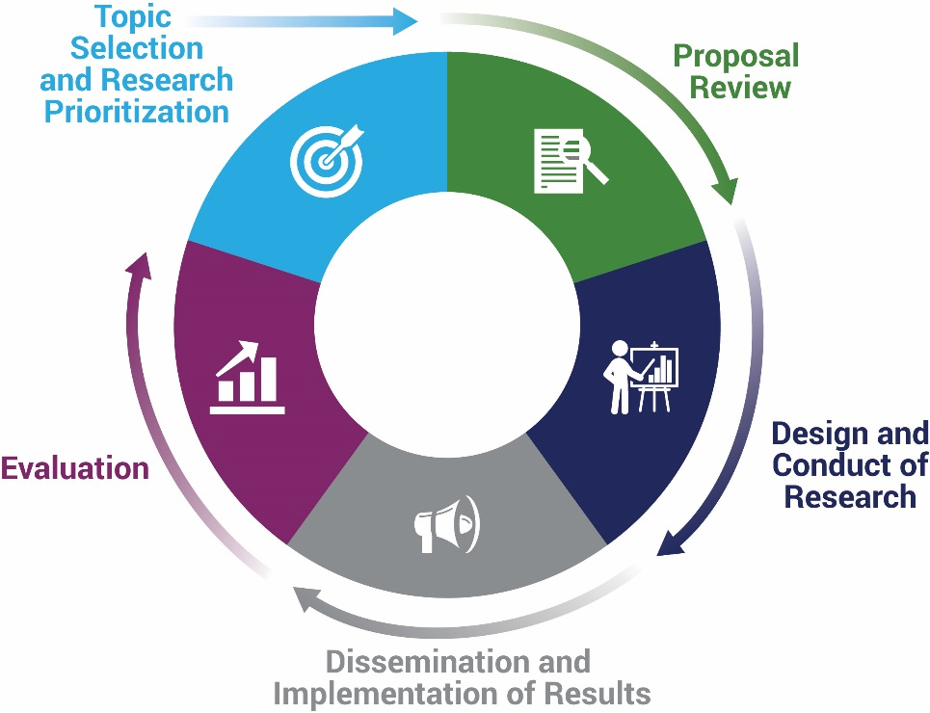
Engagement as a Path to Useful, High-Quality Patient-Centered Research and Dissemination
Notes:
Spend a longer time here, tell em most of what they need to know about each sector

Slide 7
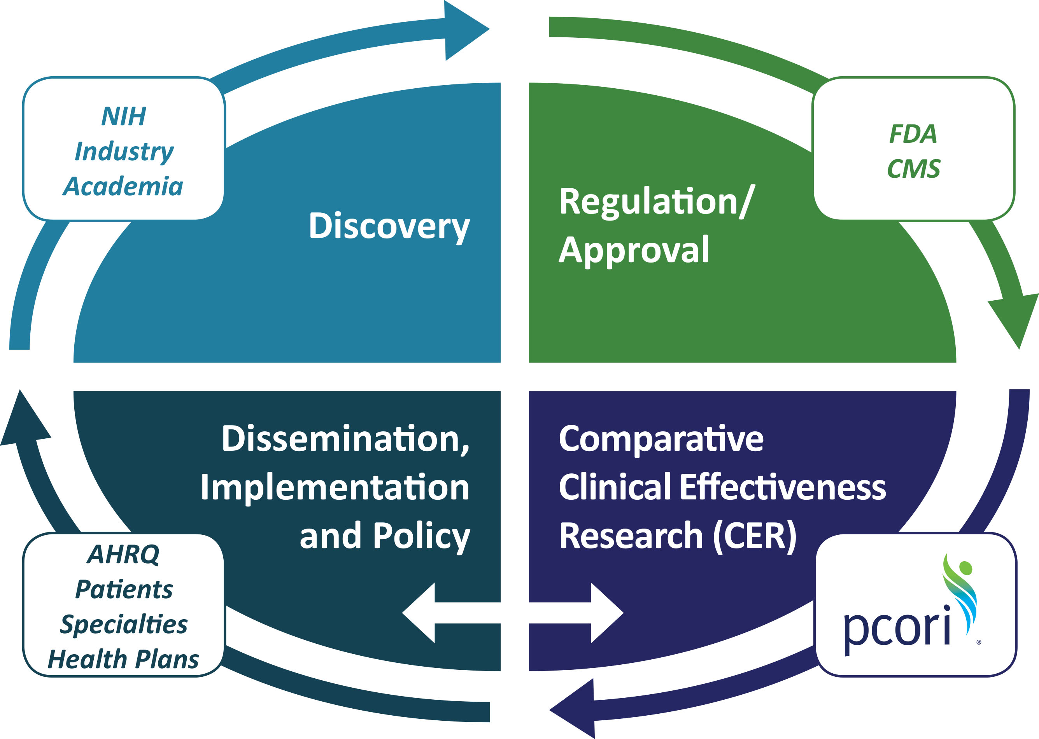
PCORI’s Role in a National Health Research Program

Slide 8
Adrian Felipe Hernandez, MD, MS,
Duke University
How Engaging Patients can Improve Research
Real world effectiveness of warfarin among ischemic stroke patients with atrial fibrillation: observational analysis from Patient-Centered Research into Outcomes Stroke Patients Prefer and Effectiveness Research (PROSPER) study.
Y Xian et al., BMJ 2015; 351:h3786

Slide 9
Impact of Involving Patients (The PROSPER Study)
Study Design: Retrospective, observational cohort study within a registry of persons who had and survived an initial stroke (n=13,000). Patient advisory panel helped to plan the study
Research Question: Does use of warfarin (in A Fib), statins and anti-depressants affect important clinical outcomes (3 analyses)
Outcomes: Patient involvement changed the primary outcome from M.A.C.E. to “home time: days spent at home during follow-up.””
Results: Among 12,553 patients with atrial fibrillation after a stroke, those started on warfarin before discharge enjoyed 47 more days at home during an average of two years of follow-up, as well as lower rates of recurrent stroke, MI, death.
Principal Investigator: Adrian Hernandez, MD, MHS, Duke Clinical Research Institute
Study of safety and long-term effectiveness of stroke therapies with a patient-centered approach.
Primary outcomes identified and prioritized by stroke patients, and will compare warfarin to newer anticoagulants. are “home time” (time spent alive and outside a hospital), and major adverse cardiovascular events.
“These findings support the routine use of warfarin for eligible ischemic stroke patients with atrial fibrillation, including those over 80 years of age, women, those with more severe strokes, and those with comorbid conditions”

Slide 10
Does Engagement Make a Difference?
Recent systematic review* provides first evidence of the impact of patient and public involvement on research on health and social-care research.
Literature search from 1995-2009 identified 66 studies
Analysis showed patient and public involvement enhanced quality and appropriateness of research
Impacts were described for all stages of research
But authors note the evidence base on impact of still needs significant enhancement
*J Brett et al; Health Expectations 2014; 17(5): 637–650.

Slide 11
PCORI Funds CER Through 3 Types of Awards
Since
2012
2013
2015
Broad
CER, patient-centeredness and engagement required
Targeted
Single stakeholder driven clinical topic, narrow questions
Much larger, variable funding amounts, 3-5 years
Up to $1.5 million, three years
Pragmatic
CER, patient-centeredness, robust engagement required
Up to $10 million direct costs, 5 years
Investigator-initiated, any topic that could change practice
CER, patient-centeredness, robust engagement expected
List of stakeholder recommended topics, but investigators can also suggest new topics

Slide 13
Targeted Research Funding Awards
PCOR treatment options in uterine fibroids* Multifactorial fall injury prevention strategy in older persons** Effectiveness of transitional care Treatment options for African Americans and Hispanics/Latinos with uncontrolled asthma Obesity treatment options set in primary care for underserved populations Hypertension Disparities Reduction Awards in African-American and Rural populations** Comparative effectiveness of new treatment options for Hepatitis C Comparative effectiveness of novel oral anti-coagulants (NOACs) Options for treatment-resistant depression Comparative effectiveness of disease modifying treatments for MS
* Project administered by AHRQ ** Projects administered by NIH

Slide 14
PCORI’s Pragmatic Clinical Studies Initiatives
Must address critical clinical choices faced by patients, caregivers, clinicians, systems
Topics of special interest identified by PCORI Advisory Panels, Institute of Medicine, Agency for Healthcare Research and Quality
Typically conducted in routine clinical settings
Though often large, protocols usually less complex than traditional trials
Requires engagement of major stakeholder organizations
Opportunity Snapshot
Number of Anticipated Awards Per Funding Cycle: Six to Nine
Funds Available Per Cycle: Up to $90 Million
Maximum Project Duration: 5 Years
Maximum Direct Costs Per Project: $10 Million

Slide 15
Examples from First 19 Pragmatic Clinical Studies
Operative vs medical endocrine therapy for management of low-risk DCIS patients.
Nerve blocking regional anesthesia vs general anesthesia in older adults undergoing surgery for hip fracture on acute, inpatient morbidity, ability walk without assistance at 60 and 180 days, disability, pain, ability to return home after fracture, and mortality.
Exercise coaching program vs. usual care for older adults who have experienced a low-impact fracture as a result of a fall for preventing further injuries and improving health.
Surgical vs. antibiotic therapy for uncomplicated appendicitis for complications, subsequent appendectomy, safety, patient experience
Uncoated aspirin vs. low intensity warfarin vs. rivaroxaban for prevention of venous thrombosis after hip or knee replacement for aggregate clinical pulmonary embolism/deep vein thrombosis and all-cause mortality, bleeding and patient-reported outcomes.

Slide 16
Eugene Washington PCORI Engagement Awards:
Launched in February 2014.
Supports PCORI’s Engagement Imperative, as defined in our Strategic Plan, to:
Develop a patient-centered outcomes research (PCOR)-ready community to establish an infrastructure for engagement in PCOR;
Engage these communities in the research process; and
Promote dissemination of PCOR/CER evidence.
Funds projects that build a community better able to participate in PCOR and CER, as well as serve as channels to disseminate related study results.

Slide 17
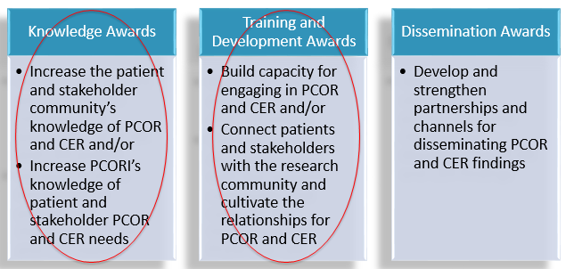
Engagement Awards Programmatic Support Categories
Supports projects and meetings that most fall into one or more of the following categories:

Slide 18
Introducing
Notes:
“Title Slide” format

Slide 19
PCORnet’s Mission
To make it faster, easier, and less costly to conduct health system and clinical research, both observational studies and randomized trials, than is now possible by harnessing the power of large amounts of health data and patient partnerships, and by making contracting negotiations and making IRB approval/oversight more efficient.
To embed the research within health systems and use data and research findings to facilitate health system improvement.
And in the process, transform the culture of clinical research from one directed by researchers acting as entrepreneurs to one driven by collaboration and the needs of patients, clinicians, systems and payers.
Notes:
PCORnet’s infrastructure can also be leveraged to facilitate performance improvement and support other operational efforts.
The purpose of this meeting is to engage you in a meaningful conversation regarding how PCORnet can best leveraged to support your needs and priorities. Individual CDRN discussions with healthcare executives across the country revealed the following key areas of interest.
Identifying and managing high healthcare utilizers
Identifying and managing the needs of specific populations by diagnoses (e.g., behavioral health) or patient characteristics (e.g., socioeconomic status)
Comparative performance of alternative models of healthcare delivery (e.g., ACOs)
Novel analytical tools and methods (e.g. risk adjustment and predictive modeling)
Assessment of value in healthcare (including quality, safety, and utilization)

Slide 20
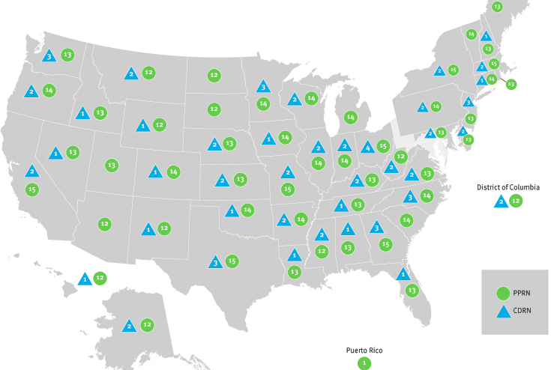
There’s a Site Near You
This map depicts the number of PCORI-funded Patient-Powered or Clinical Data Research Networks that have coverage in each state.
Pragmatic
Notes:
To learn more about PCORI, please see: www.pcori.org/about

Slide 21
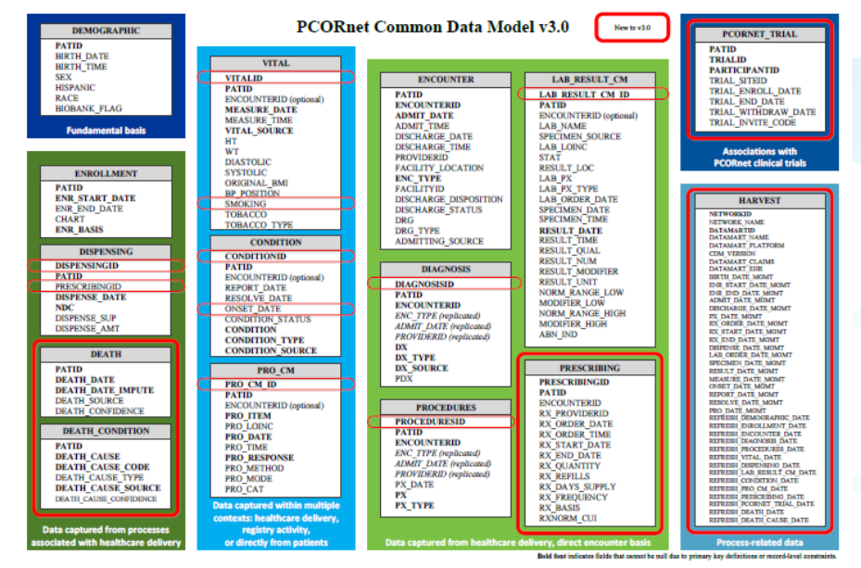
The Common Data Model
PCORnet Common Data Model
Notes:
The Common Data Model (or CDM) is a way of organizing data into a standard structure.
Each PCORnet partner network is mapping data to the same consistent format (e.g., with the same variable name, attributes, and other metadata).
By undertaking this step before initiating any PCORnet research studies, we can create a platform that enables much more rapid responses to research-related questions. Contrast this with having to transform and prepare data each time we want to ask a new research question, and the efficiencies become clear.

Slide 22
Expanding Data in the CDM
Biospecimen & Genomic Data
Prescribing
Condition
Encounters
Death Index
Procedures
Patient Satisfaction
Demographic
Lab Results
Claims

Slide 23
PCORnet
130 health systems across the country
Over 60 data marts Data on over >100 million patients

Slide 24
ADAPTABLE Trial Start-Up Master Slide Set
March, 2016
ClinicalTrials.gov: NCT02697916

Slide 25
ADAPTABLE Study Design
Patients with known ASCVD + ≥ 1 “enrichment factor”*
Identified through EHR (computable phenotype) by CDRNs
(PPRN patients that are already a part of a CDRN are eligible to participate.)
Patients contacted with trial information and link to e-consent;†
Treatment assignment will be provided directly to patient
Exclusion criteria
Age <18 years
ASA allergy or contraindication (including pregnancy or nursing)
Significant GI bleed within past 12 months
Significant bleeding disorder
Requires warfarin, direct oral anticoagulant, or ticagrelor
ASA 81 mg QD
ASA 325 mg QD
*Enrichment factors
Age >65 years
Creatinine >1.5 mg/dL
Diabetes mellitus (T1 or 2)
Known 3-vessel CAD
Current CVD or PAD
Known EF <50% by echo, cath, nuclear study
Current smoker
Electronic follow-up: Every 3–6 months Supplemented with EHR/CDM/claims data
Duration: Enrollment over 24 months; maximum follow-up of 30 months
Primary endpoint: Composite of all-cause mortality, hospitalization for MI, or hospitalization for stroke
Primary safety endpoint: Hospitalization for major bleeding
† A subset of participants who do not have internet access may be consented and followed via a parallel system.
ClinicalTrials.gov: NCT02697916

Slide 26
Informed consent and randomization
Screening of CDRN EHR data with computable phenotype
Electronic outreach to potential patients with trial introduction and link to ADAPTABLE web portal
Web-based, electronic informed consent (English & Spanish)
Initial patient contact via web portal ➔ text and video consent options
Simplified common consent form with selected local adaptations
Focused questions to confirm patient comprehension for informed consent and eligibility for randomization after consent obtained
Randomization and aspirin dose assignment
ClinicalTrials.gov: NCT02697916
Notes:
SUGGESTED NOTE: The electronic informed consent process is the product of a empirical process led by the DCRI Program for Empirical Bioethics and involved patients, ADAPTORS, CDRNS, and other stakeholders.

Slide 27
PCORnet’s first Collaborative Research Groups
Purpose
The purpose is to explore the feasibility, efficiency, and usefulness of cross-Network forums, organized around specific clinical areas, for building capacity within PCORnet to generate multi-network research projects that answer research questions of high priority to patients, clinicians, and health system leaders.
The PCORnet Council approved four exploratory CRG pilots to assess their feasibility, efficiency, and usefulness for building PCORnet capacity to form research communities that develop PCORnet studies.
Topic | Leads
Pediatrics | Chris Forrest [PEDSnet] Betsy Shenkman [OneFlorida]
Cardiovascular Health | Mark Pletcher [Health eHeart] Veronique Roger [LHSnet]
Diversity | Jen Devoe/Jon Puro [ADVANCE] Mitch Lunn [PRIDEnet]
Health Systems | Rainu Kaushal [NYC] Beth McGlynn [PORTAL]
Timeline/Plans
Initial activities are planned for a 6-month period; if successful other CRGs will be added quickly.

Slide 28
Evidence Synthesis—Immediate PCORI plans
Initially, the Evidence Synthesis portfolio will focus on short-turnaround, rigorous, relevant CER or heterogeneity of treatment effect products
Strategic, selective analyses of existing trial data
(e.g., IPD MA focused on treatment variation)
Updating high-quality existing SR
support up-to-date decision-making on critical CER topics
Most ES is conducted through and in collaboration with AHRQ and its EPC’s.
Over time, PCORI will continue to refine its strategy in response to stakeholders’ needs for robust, relevant, non-duplicative evidence synthesis products

Slide 29
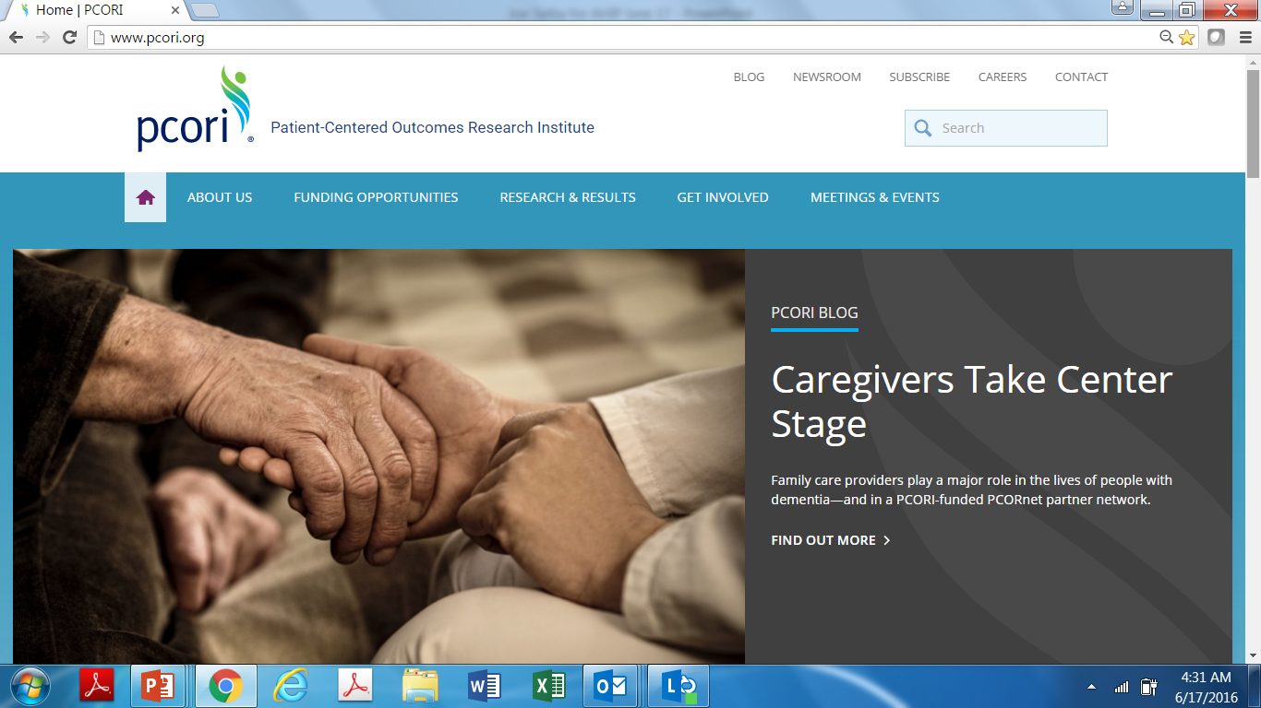
Thanks…….. and Stay in Touch!
Pragmatic
Notes:
To learn more about PCORI, please see: www.pcori.org/about

