Slide 1

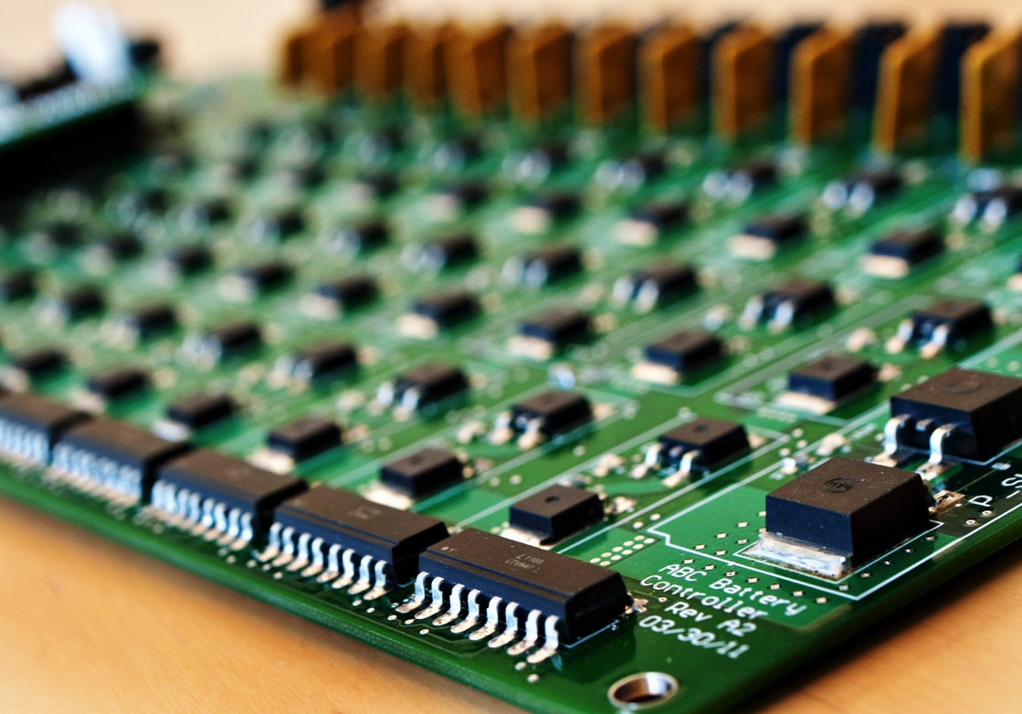

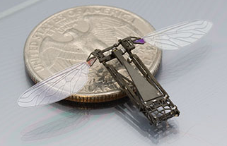
Research Directions: NSF Directorate of Computer and Information Science and Engineering
Advanced
Cyberinfrastructure
Computing & Communication Foundations
Computer & Network
Systems
Information &
Intelligent Systems
Jim Kurose
Assistant Director, NSF
Computer & Information Science & Engineering
4th Annual Federal R&D Agency Workshop
University of Florida System
Sept. 2016

Slide 2
Overview
CISE: the national imperative
NSF CISE: programmatics
Looking forward

Slide 3
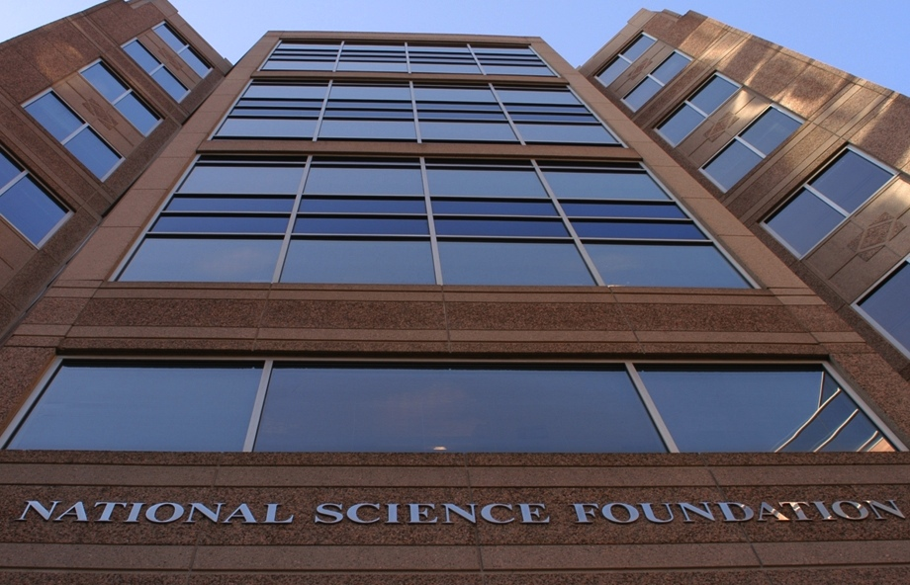
National Science Foundation’s Mission
“To promote the progress of science; to advance the national health, prosperity, and welfare; to secure the national defense...”

Slide 4

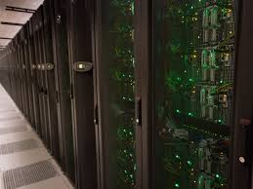


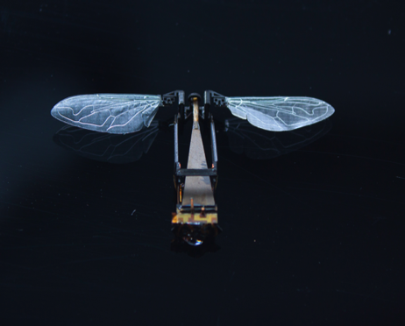

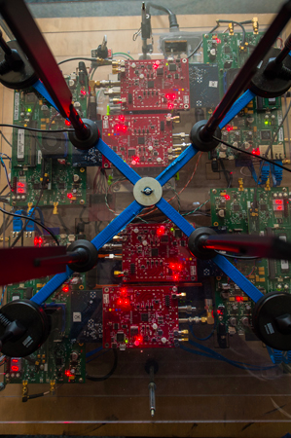

CISE Research: Addressing National Priorities
Big Data R&D
National Strategic Computing Initiative
Smart Cities
National
Initiatives
National Robotics Initiative
CS for All
Advanced Wireless Initiative
Understanding the Brain
Notes:
\CISE is at the center of an ongoing societal transformation and will be for decades to come.
Advances in computing, communications and information technologies and cyberinfrastructure:
underpin economic prosperity, national security;
drive U.S. competiveness and sustainable economic growth;
accelerate the pace of discovery and innovation; and
are crucial to achieving national and societal priorities.

Slide 5


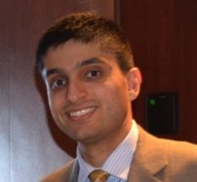
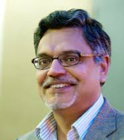
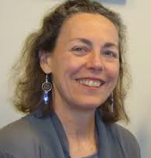
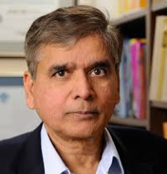

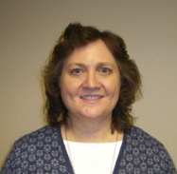
CISE Organization
CISE Directorate
Jim Kurose, AD
Erwin Gianchandani, DAD
Senior Advisor for
Research Cyberinfrastructure
Peter Arzberger
Senior Advisor for
Data Science
Chaitan Baru
Advanced Cyberinfrastructure (ACI)
Irene Qualters, DD
Computing and Communication Foundations (CCF)
Rao Kosaraju, DD
Computer and Network Systems (CNS)
Ken, Calvert, DD
Information and Intelligent Systems (IIS)
Lynne Parker, DD
Data
Algorithmic
Foundations
Computer Systems Research
Cyber Human Systems
High Performance Computing
Communication and Information Foundations
Networking Technology and Systems
Information Integration and Informatics
Networking/ Cybersecurity
Software and Hardware Foundations
Education and Workforce Development
Robust Intelligence
Software

Slide 6

CISE by the Numbers: FY 2015
23%
success rate
7,302
senior researchers
$933 M
FY 2015 research
budget
1,887
awards
1,278
other professionals
8,039
proposals
498
postdoctoral associates
17,868
people supported
6,423
graduate students
342
panels
2,367
undergraduate students

Slide 7
NSF Support of Academic Basic Research
(as a percentage of total federal support)
Source: NSF/NCSES, Survey of Federal Funds for Research & Development, FY 2014

Slide 8
CISE Division Budgets
Modest growth across all CISE divisions
CNS
ACI
IIS, CCF
Obligated funds ($M) eventually spent,
per CISE division
ITR

Slide 9
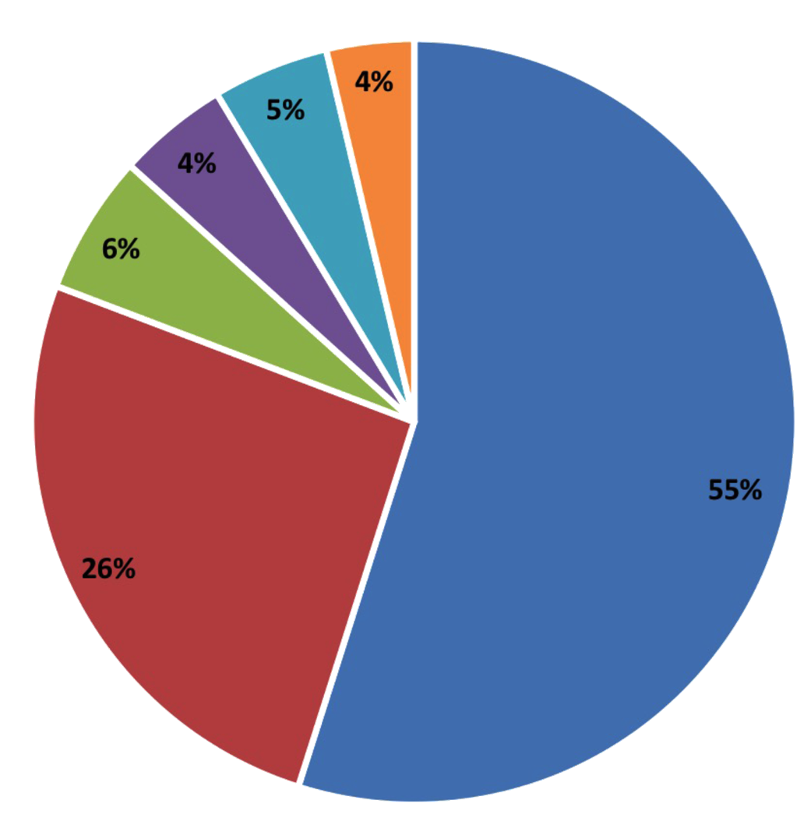
Many STEM jobs are in computing
Math
Social sciences
Physical sciences
Life sciences
Engineers
Computer occupations
Job Openings 2014 – 2024 (growth and replacement)
US Bureau of Labor Statistics
Data from the spreadsheet linked at http://www.bls.gov/emp/ind-occ-matrix/occupation.xlsx

Slide 10
Growth in CS Undergrad Majors
30K
Newly declared undergrad CS/CE majors
30K
Number of students
20K
10K
1995
2000
2005
2010
2015
Source: 2015 CRA Taulbee Survey

Slide 11
An amazing time to be in CISE!
Ubiquity
Computing is everywhere – across all of science and engineering, and all of society
Engagement
Computing intertwines with many communities
Urgency
  Computing is rapidly expanding and evolving. There is tremendous opportunity … now!

Slide 12
Overview
CISE: the national imperative
NSF CISE: programmatics
Looking forward

Slide 13
CISE’s 2017 budget priorities
continued strong commitment to core research programs and cross-cutting programs (e.g., cybersecurity (SaTC), Cyberphysical Systems (CPS), Understanding the Brain, INCLUDES, and more)
new CISE programmatics in 2017:
  Smart and Connected Communities
  Smart and Autonomous Systems
  National Strategic Computing Initiative
  Data for Scientific Discovery and Action (D4SDA)

Slide 14

Smart & Connected Communities (S&CC)
Improving quality of life, health, well-being and learning in communities
Partnership among CISE, EHR, ENG, GEO, SBE
Fundamental research: integrative, socio-technical, community engagement
    Advanced networking; physical sensors/devices; large-scale data management, analysis, and decision making
Builds on previous investments in Urban Science, US Ignite
$24.5M solicitation (NSF 16-610) announced Monday

Slide 15

Wireless, virtualization: recent announcements
PAWR: Platforms for Advanced Wireless Research
at-scale experimental exploration of robust new wireless devices, communication techniques, networks, systems
  dynamic spectrum, mmWave, network architecture, wide-area wireless backhaul, metrology
public-private partnership: $50M NSF/CISE investment, ~ $50M in industry consortium investment (7 years)
Up to 4 wireless research testbeds
Program solicitation NSF 16-585 seeking a project office

Slide 16
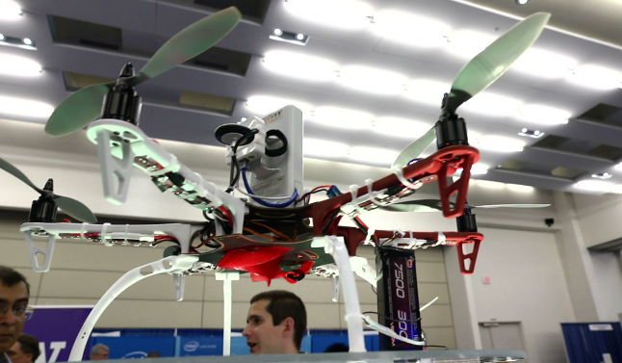
Smart & Autonomous Systems (S&AS)
Fundamental research on intelligent physical systems that sense, perceive, and operate in dynamic, uncertain and unanticipated environments
Research in smart and autonomous systems lies at interstices of NRI and CPS
    NRI: “co-robots” – robots that work alongside, cooperatively with people
    CPS: deeply integrating computation, communication, control into physical systems
  Exceeding today’s capabilities in adaptability, autonomy, functionality, efficiency, reliability, safety, usability, recoverability, recyclability
Notes:
NSF 16-608

Slide 17

National Strategic Computing Initiative (NSCI)
Maximize HPC benefits for economic competitiveness, scientific discovery
National
  “Whole-of-government”, “whole-of-Nation” approach
  Public/private partnership with industry, academia
Strategic
  Leverage beyond individual programs
  Long-time horizon (decade or more)
Computing
  HPC: most advanced, capable computing technology available
  Multiple styles of computing, and all necessary infrastructure
  theory and practice, software and hardware
Initiative
  Above baseline effort

Slide 18
Objectives in the NSCI Executive Order
Accelerate delivery of a capable exascale computing system that integrates hardware and software capability
Increase coherence between technology base used for modeling, simulation and that used for data analytic computing.
Establish, over 15 years, a viable path forward for future HPC systems even after the limits of the current semiconductor technology are reached (the “post Moore’s Law era”).
Increase the capacity and capability of an enduring national HPC ecosystem by employing a holistic approach … networking technology, workflow, scaling, foundational algorithms, software, accessibility, and workforce development.
Develop an enduring public-private collaboration to ensure that the benefits are shared among government, academia, industry.
Notes:
we have supported universities in their deployment of four new national data-focused HPC resources, and a renewal of one our “workhorse” capabilities. These significantly expand the data-intensive capacity within a highly interoperable HPC ecosystem and addresses both Objectives 2 and 4 (the data and ecosystem objectives, respectively).
These four systems are Comet, at the San Diego Supercomputer Center; Bridges, at the Pittsburgh Supercomputer Center; Jetstream, at Indiana University; and Wrangler, at the Texas Advanced Computing Center.
We also announced a renewal award ($30M) to the Texas Advanced Computing Center to acquire and deploy the successor to the highly successful Stampede supercomputing system. Stampede 2, as it is called, will deliver a peak performance of 18 petaflops, over twice the overall system performance of the current Stampede system, when it is deployed.
We also received National Science Board authorization for a renewal award ($110M) for the Extreme Science and Engineering Discovery Environment, or XSEDE 2, which will continue to provide a powerful collection of integrated resources and services for HPC.
Second, we have funded $25M for the first two Software Institutes Tom Kalil referred to these earlier - which we hope will become models of innovative and sustainable scientific software that will strengthen the national HPC ecosystem – in direct alignment with Objective 4
And third, earlier this year we issued a new joint solicitation “Energy-Efficient Computing: from Devices to Architectures (E2CDA)”, with the Semiconductor Research Consortium – or SRC – to support research to minimize the energy impacts of processing, storing, and moving data within future computing systems in the post Moore’s Law era; this aligns with Objectives 3 and 5.

Slide 19
Big Data Regional Innovation Hubs
Northeast: Columbia University
West: UCSD, UC Berkeley, UW
South: NC Capel Hill, Georgia Tech
MidWest: UIUC
Goal: ignite new Big Data public-private partnerships across the Nation
Hub:
  Consortium from academia, industry, gov’t
  focus on Big Data challenges, opportunities for region
Support breadth of local stakeholders, achieve common Big Data goals not be possible alone
Notes:
A little more about the BDHubs. In September, NSF announced four awards totaling more than $5 million to establish regional hubs for data science innovation.
The consortia are coordinated by top data scientists at Columbia University (Northeast Hub), Georgia Institute of Technology and the University of North Carolina (South Hub), the University of Illinois at Urbana-Champaign (Midwest Hub) and the University of California, San Diego, the University of California, Berkeley, and the University of Washington (West Hub).
Covering all 50 states, they include commitments from more than 250 organizations--from universities and cities to foundations and Fortune 500 corporations--with the ability to expand further over time. The organizational structure for each BD Hub varies by region. Some are organized into standing sub committees and task forces, others into flexible working groups. You see on this map not only the Hub coordinators, but also the organizations leading the subcommittes and sub divisions of each Hub.

Slide 20
Big Data Spokes of the BDHubs
Each Hub supports subcommitees on topical areas of interest (“Spokes”)
BDSpokes solicitation aims to support collaborative projects surfaced or developed by the Hubs and Spokes
Geographic Regions
Hubs
1
Partnerships
3
Projects
Priority Areas
Spokes
2
SHARING ASSETS
Two award categories: Planning Grants (100K for 1 year) and Spokes ($1M total over 3 years)
Total anticipated funding: $10M
10 Spokes, 10 Planning Grants anticipated
AUTOMATION
GRAND CHALLENGES
Themes of BDSpokes Solicitation

Slide 21
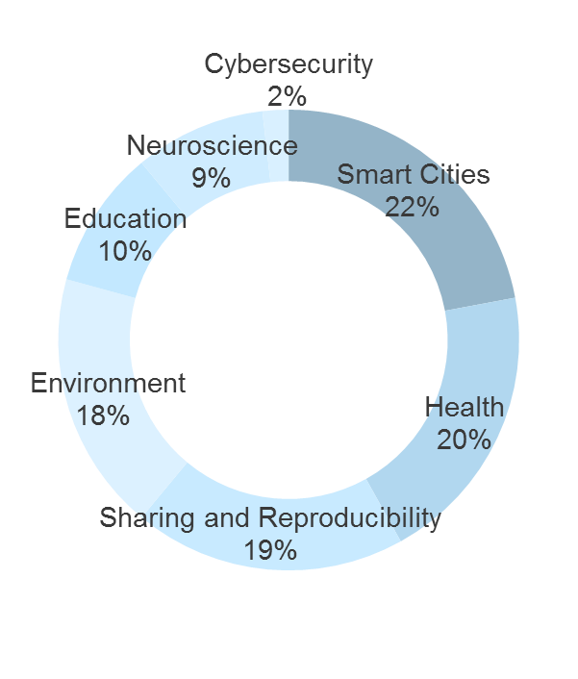
Big Data Spokes of the BDHubs
Each Hub supports subcommitees on topical areas of interest (“Spokes”)
BDSpokes solicitation aims to support collaborative projects surfaced or developed by the Hubs and Spokes
Geographic Regions
Hubs
1
Partnerships
3
Projects
Priority Areas
Spokes
2
Two award categories: Planning Grants (100K for 1 year) and Spokes ($1M total over 3 years)
Total anticipated funding: $10M
10 Spokes, 10 Planning Grants anticipated

Slide 22
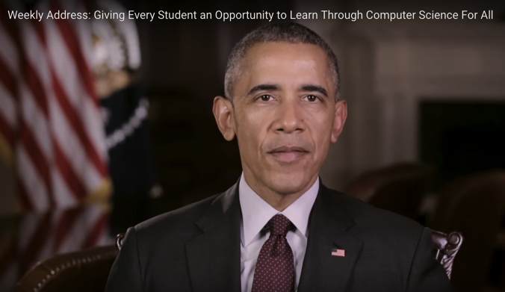
Education: Computer Science for All
2007
2010
2016
BPC Alliances
CS10K
Computer Science For All
Enable all students to have access to high-quality CS education in K-12:
  Knowledge base, capacity for rigorous, engaging CS education
  Teacher PD
“In the new economy, computer science isn’t an optional skill –
It’s a basic skill…”
President’s Weekly Address 1/30/2016
Inter-agency WG under CoSTEM
Collaboration: industry, non-profits
NSF: $120 million over five years

Slide 23
Education: additional activities
National Academies, CSTB Study: Growth of Computer Science Undergraduate Enrollments
  CSTB August workshop
  Snowbird session
CS+X: RED: Revolutionizing engineering and computer science Departments
  Solicitation: NSF 15-607,16-026

Slide 24

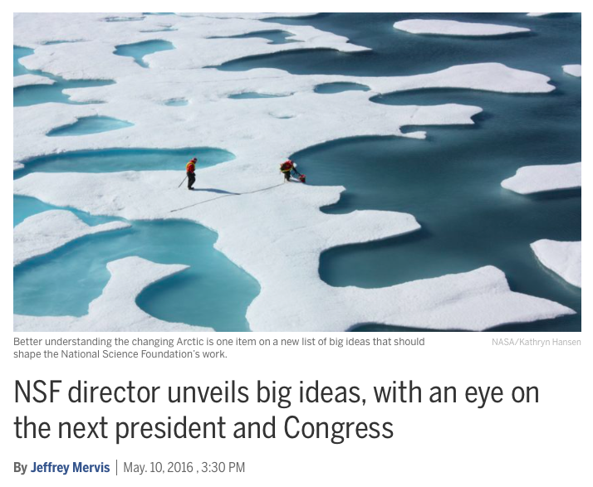
NSF “Big Ideas”

Slide 25
NSF “Big Ideas”
Harnessing Data for 21st Century Science and Engineering
Shaping the new Human – Technology Frontier
Understanding the Rules of Life: Predicting Phenotype
The Quantum Leap: Leading the Next Quantum Revolution
Navigating the New Arctic
Windows on the Universe: The Era of Multi-messenger Astrophysics
RESEARCH
IDEAS
Growing Convergent Research at NSF
Mid-scale Research Infrastructure
NSF 2050
INCLUDES
PROCESS
IDEAS
*Video of NSB presentation and discussion is at:
http://www.tvworldwide.com/events/nsf/160505/globe_show/default_go_archive.cfm?gsid=2957&type=flv&test=0&live=0
(the presentation/discussion starts about 20 minutes into this video)

Slide 26
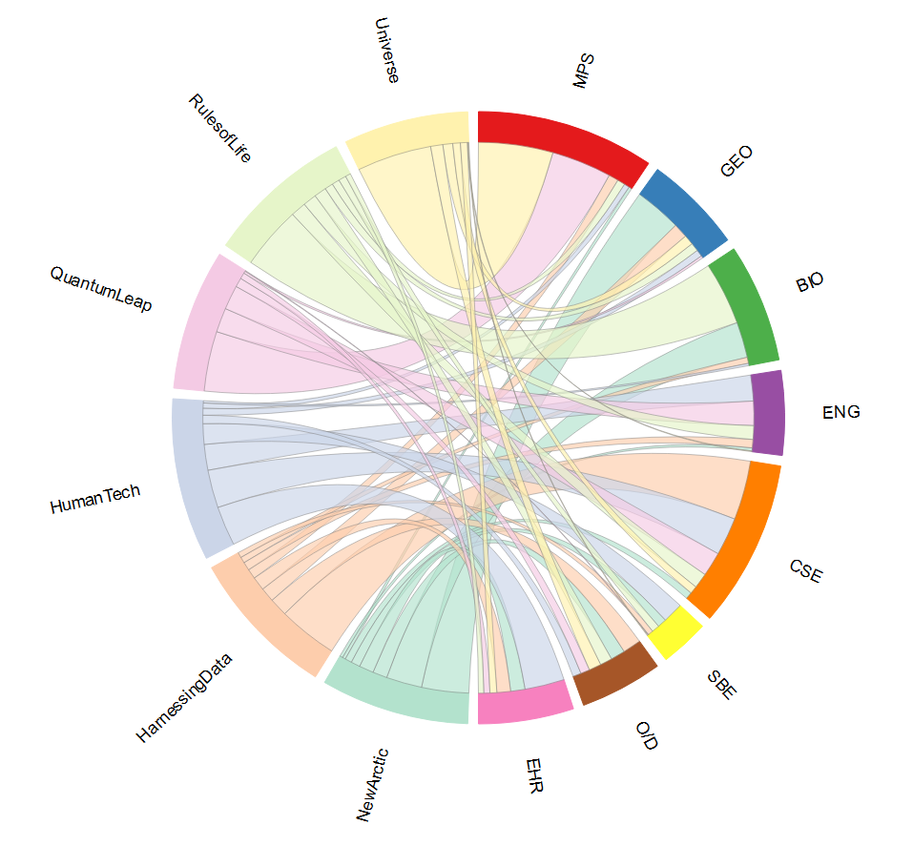
An Interconnected NSF – Solving the Big Idea Challenges Together
Paul Morris OD/OIA
Notes:
This shows the connections between directorates and Big Ideas. The connection width represents the intensity of funding. E.g., the wide orange band between CISE and Harnessing Data shows that CISE has a lot of investments in the harnessing data area. Similarly, the wide band between MPS and Quantum Leap shows that MPS has a lot of existing investments in quantum (and there is some quantum from CISE as well, as you can see). CISE has investments in all six Big Research Idea areas.
Next two slides just focus on Harnessing Data and H-T frontier.

Slide 27

Harnessing the Data Revolution
Research across all NSF Directorates
Theoretical foundations
mathematics, statistics, computer & computational science
Systems foundations
data-centric algorithms, systems
Educational pathways
Innovations grounded in an education-research-based framework
Data-intensive research
in all areas of science and engineering
Advanced cyberinfrastructure ecosystem
Accelerating data-intensive research

Slide 28



Partnerships: Many dimensions
Partnerships build capacity, leverage resources, increase the speed of translation from discovery to innovation
NSF/SRC: E2CDA
NSF/Intel: Information-Centric Networking in Wireless Edge Networks
NSF/VMware: Software Defined Infrastructure as a Foundation for Clean-Slate Computing Security
Innovation Transition DCL
Infrastructure collaborations
New 2016 activities
industry
universities
international
CISE
local gov’t
Federal
agencies
societal org’s
Prescription 3: Establishing a More
Robust National Government-University-Industry Research Partnership
Notes:
Local Govt: US Ignite
Societal orgs: CRA
Fred: GM as a partnership (Ithis

Slide 29
Partnerships: Many dimensions
Partnerships build capacity, leverage resources, increase the speed of translation from discovery to innovation
NSF-BSF (Israel): CCF and CNS core, SATC
US-Japan: interest in BIGDATA, ML
NSF-Finland: WIFUS
NSF-India: S&CC
NSF-Netherlands: privacy
NSF-Brazil: cybersecurity
industry
universities
New 2016 activities
international
CISE
local gov’t
Federal
agencies
societal org’s

Slide 30
Partnerships: Many dimensions
Partnerships build capacity, leverage resources, increase the speed of translation from discovery to innovation
industry
universities
international
Numerous on-going solicitations
NITRD: 13 NSFs (12 CISE) participate in NITRD WGs
NITRD: R&D Strategic plans
OSTP: Public access
CISE
local gov’t
Federal
agencies
New 2016 activities
societal org’s

Slide 31
NSF/CISE: leadership across Federal agencies
2016 NITRD R&D Strategic Plans:
  Privacy
  CyberSecurity
  Artificial Intelligence (underway)
NITRD WGs: 13 NSFers (12 CISE, 1 SBE) participate in NITRD WGs, many in leadership positions

Slide 32
Looking forward:
an amazing time to be in CISE!
Ubiquity
Computing is everywhere – across all of science and engineering, and all of society
Engagement
Computing intertwines with many communities
Urgency
  Computing is rapidly expanding and evolving. There is tremendous opportunity … now!

Slide 33


Slide 34
From federally-funded research to $B industries
  Advances in computing, communications, information technologies, cyberinfrastructure:
    drive U.S. competiveness, sustainable economic growth (IT: 25% of economic growth since 1995)
    underpin national security
    have profound impacts on our daily lives
2010
2000
1990
Product
($B,$10B)
1980
Industry
1970
University
From Continuing Innovation in Information Technology, NRC, 2012.

Slide 35
…. across many industries

Slide 36

The Human-Technology Frontier
Computing will be embedded around, on, and in us. These engineered systems will be more pervasive, more personal, more intimate.
Understanding how constantly evolving technologies are actively shaping our lives and how we in turn can shape those technologies, especially in the world of work
understand benefits, risks of new technologies: efficiency, quality, productivity, human dynamics
science and engineering: creating technologies that promise to enhance work lives
Education: changing workplace demands changing workforce

