Slide 1
Ocean Sciences at NSF
Federal R & D Agency Workshop
October 9, 2015
Rick Murray
Division Director, Ocean Sciences

Slide 2
Ocean Sciences at NSF
Federal R & D Agency Workshop
October 9, 2015
Short Term: Immediate Impact (few years)
Longer Term: Generational Transition

Slide 3
Decadal Survey of Ocean Sciences, 2015-2025
NRC/NAS, Released Jan. 23, 2015

Slide 4
Decadal Survey of Ocean Sciences, 2015-2025
NRC/NAS, Released Jan. 23, 2015

Slide 5
Decadal Survey of Ocean Sciences, 2015-2025
NRC/NAS, Released Jan. 23, 2015
NSF ‘reply’
May 11, 2015

Slide 6
Decadal Survey of Ocean Sciences
Science Priorities
Rates, mechanisms, impacts, etc….sea level rise?
Coastal, estuarine ecosystems and linkages.
Ocean biogeochemistry & physics…and climate.
Biodiversity & resilience of ecosystems, & changes.
Marine food webs in the coming century.
Formation and evolution of ocean basins.
Geohazards (‘quakes, tsunamis, landslides, volc.).
Subseafloor biosphere; biogeochem. cycles & life.

Slide 7
Decadal Survey of Ocean Sciences
As noted by the report, these are not prioritized.
“Rather, they are ordered from the ocean surface, through the water column, to the seafloor.”
…NSF has in the past, and will continue in the future, fund excellent ocean science regardless of topic, maintaining the highest standards of external and internal review.

Slide 8
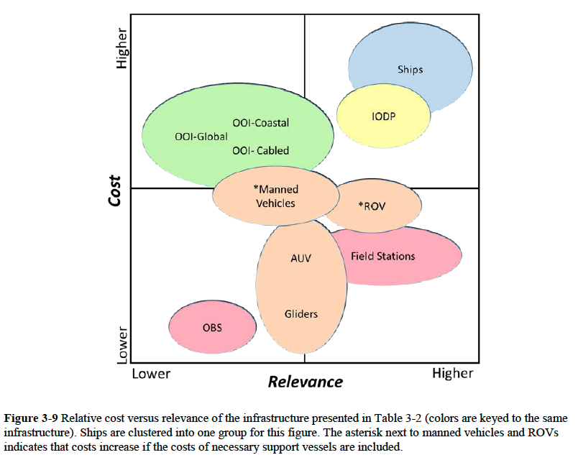
Mapping of Science and Infrastructure

Slide 9
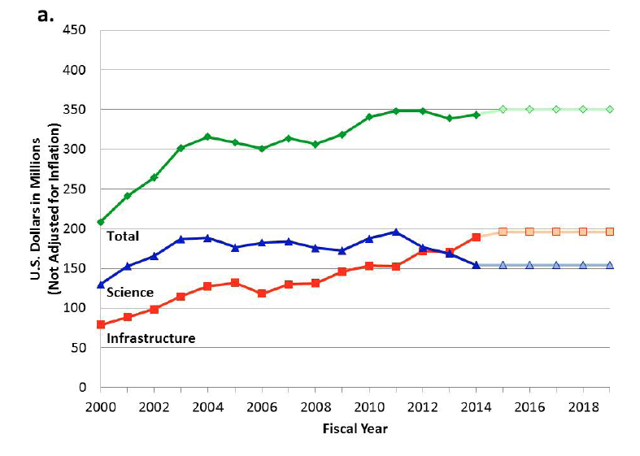
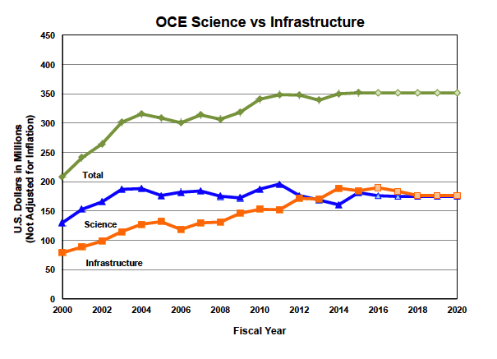
“Sea Change” Implementation Progress
Sea Change, 2014
(the baseline)
September, 2015
(with still more to come)

Slide 10
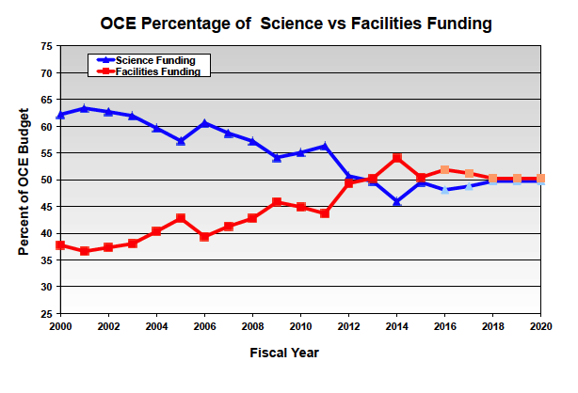
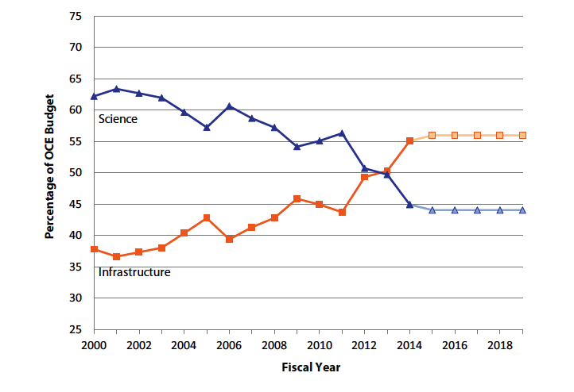
Sea Change, 2014
(the baseline)
September, 2015
(with still more to come)

Slide 11
Ocean Sciences at NSF
Federal R & D Agency Workshop
October 9, 2015
Short Term: Immediate Impact (few years)
Longer Term: Generational Transition

Slide 12
Decadal Survey of Ocean Sciences
Science Priorities
Rates, mechanisms, impacts, etc….sea level rise?
Coastal, estuarine ecosystems and linkages.
Ocean biogeochemistry & physics…and climate.
Biodiversity & resilience of ecosystems, & changes.
Marine food webs in the coming century.
Formation and evolution of ocean basins.
Geohazards (‘quakes, tsunamis, landslides, volc.).
Subseafloor biosphere; biogeochem. cycles & life.

Slide 13
Richard Murray
Division Director (OCE)
Division of Ocean Sciences
Bauke Houtman
Section Head (IPS)
Integrative Programs Section
Lisa Clough
Section Head (OS)
Ocean Section
Donald Rice
Section Head (MGS)
Marine Geosciences Section
Thomas Janacek
Program Director
Ship & Ocean Drilling Support
Rose Dufour
Program Director
Ship Operation
David Garrison
Program Director (Lead)
Biological Oceanography
Eric Itsweire
Program Director (Lead)
Physical Oceanography
Vacant
Program Director (Lead)
Chemical
Oceanography
Candace Major
Program Director (Acting Lead)
Marine Geology & Geophysics
Roxanne Nikolaus
Staff Associate
Jane Montgomery
Program Specialist
James Holik
Program Director
Oceanographic Instrumentation & Tech Services
Jean McGovern
Program Director
Ocean Observatories Initiative
Julie Kellner
Program Director
Biological Oceanography
Baris Mete Uz
Program Director
Physical Oceanography
William Miller
Program Director
Chemical Oceanography
Vacant
Program Director
Marine Geology & Geophysics
Aliceann Phelps
Program Support Manager
Brian Midson
Program Director
Ship & Submersibles Support
Elizabeth Rom
Program Director
Ocean Education
Daniel Thornhill
Program Director
Biological Oceanography
Alberto Mestas-Nunez
Program Director
Physical
Oceanography
Simone Metz
Program Director
Chemical Oceanography
Barbara Ransom
Program Director
Marine Geology & Geophysics
Karen Wiggins-Upson
Operations Specialist
Sheryl Miller
Program Specialist
Kandace Binkley
Program Director
OCE Tech. & Interdisciplinary
John Walter
Expert
IPS
Michael Sieracki
Program Director
Biological Oceanography
Melissa Genazzio
Science Assistant/temp
Physical
Oceanography
Caroline Belleman
Science Assistant
Chemical
Oceanography
Maurice Tivey
Program Director
Marine Geology & Geophysics
JoAnn King
Program Specialist
Gloria Perez
Program Specialist
Jamie Allan
Program Director
Ocean Drilling Program
Vacant
Science Assistant
IPS
Cynthia Suchman
Program Director
Biological Oceanography
Andrea Portier
Science Assistant
Marine Geology & Geophysics
Rasheda Spratley
Program Assistant
Vacant
Program Specialist
and/or
Program Assistant
Blue: Permanent Staff
White: Temporary Staff
Orange: IPA Staff
Yellow: Sea Grant Fellow
Underline: Supervisors
Gayle Pugh
Program Analyst
Biological Oceanography
Aaron Rosenberg
Sea Grant Fellow
OS
Sarah Mesrobian
Pathway Student
Program Specialist
(HRM/FTE)
Kaitlyn Schroeder
Sea Grant Fellow

Slide 14
Infra.
Richard Murray
Division Director (OCE)
Division of Ocean Sciences
BIO
PHY
CHEM
GEOL
Bauke Houtman
Section Head (IPS)
Integrative Programs Section
Lisa Clough
Section Head (OS)
Ocean Section
Donald Rice
Section Head (MGS)
Marine Geosciences Section
Thomas Janacek
Program Director
Ship & Ocean Drilling Support
Rose Dufour
Program Director
Ship Operation
David Garrison
Program Director (Lead)
Biological Oceanography
Eric Itsweire
Program Director (Lead)
Physical Oceanography
Vacant
Program Director (Lead)
Chemical
Oceanography
Candace Major
Program Director (Acting Lead)
Marine Geology & Geophysics
Roxanne Nikolaus
Staff Associate
Jane Montgomery
Program Specialist
James Holik
Program Director
Oceanographic Instrumentation & Tech Services
Jean McGovern
Program Director
Ocean Observatories Initiative
Julie Kellner
Program Director
Biological Oceanography
Baris Mete Uz
Program Director
Physical Oceanography
William Miller
Program Director
Chemical Oceanography
Vacant
Program Director
Marine Geology & Geophysics
Aliceann Phelps
Program Support Manager
Brian Midson
Program Director
Ship & Submersibles Support
Elizabeth Rom
Program Director
Ocean Education
Daniel Thornhill
Program Director
Biological Oceanography
Alberto Mestas-Nunez
Program Director
Physical
Oceanography
Simone Metz
Program Director
Chemical Oceanography
Barbara Ransom
Program Director
Marine Geology & Geophysics
Karen Wiggins-Upson
Operations Specialist
Sheryl Miller
Program Specialist
Kandace Binkley
Program Director
OCE Tech. & Interdisciplinary
John Walter
Expert
IPS
Michael Sieracki
Program Director
Biological Oceanography
Melissa Genazzio
Science Assistant/temp
Physical
Oceanography
Caroline Belleman
Science Assistant
Chemical
Oceanography
Maurice Tivey
Program Director
Marine Geology & Geophysics
JoAnn King
Program Specialist
Gloria Perez
Program Specialist
Jamie Allan
Program Director
Ocean Drilling Program
Vacant
Science Assistant
IPS
Cynthia Suchman
Program Director
Biological Oceanography
Andrea Portier
Science Assistant
Marine Geology & Geophysics
Rasheda Spratley
Program Assistant
Vacant
Program Specialist
and/or
Program Assistant
Blue: Permanent Staff
White: Temporary Staff
Orange: IPA Staff
Yellow: Sea Grant Fellow
Underline: Supervisors
Gayle Pugh
Program Analyst
Biological Oceanography
Aaron Rosenberg
Sea Grant Fellow
OS
Sarah Mesrobian
Pathway Student
Program Specialist
(HRM/FTE)
Kaitlyn Schroeder
Sea Grant Fellow

Slide 15
Decadal Survey of Ocean Sciences
Science Priorities
Rates, mechanisms, impacts, etc….sea level rise?
Coastal, estuarine ecosystems and linkages.
Ocean biogeochemistry & physics…and climate.
Biodiversity & resilience of ecosystems, & changes.
Marine food webs in the coming century.
Formation and evolution of ocean basins.
Geohazards (‘quakes, tsunamis, landslides, volc.).
Subseafloor biosphere; biogeochem. cycles & life.

Slide 16
Key Points
Interdisciplinary science.

Slide 17
Key Points
Interdisciplinary science.
But what does that REALLY mean?

Slide 18
Key Points
Interdisciplinary science.
But what does that REALLY mean?
“Inter-sector”: Industry, Foundations, Int’l.
“Inter-perspective”: Social impact / relevance.
“Inter-technique”: Instrumentation, modeling, data assimilation, data mining.
“Inter-goal”: Eradicate “alternative career”.

Slide 19
Impacts On and Stimuli For…Universities
Interdisciplinary science. Support disciplines.
“Inter-sector”: OSP’s; Don’t treat as cash cows.
“Inter-perspective”: Avoid Ivory Tower values.
“Inter-technique”: Nimble resources.
“Inter-goal”: Educational model.

Slide 20
Impacts On and Stimuli For…Universities
Interdisciplinary science. Support disciplines.
“Inter-sector”: OSP’s; Don’t treat as cash cows.
“Inter-perspective”: Avoid Ivory Tower values.
“Inter-technique”: Nimble resources.
“Inter-goal”: Educational model.
Faculty Governance: Implications for P & T…

Slide 21
Ocean Sciences at NSF
Federal R & D Agency Workshop
October 9, 2015
Short Term: Immediate Impact (few years)
Longer Term: Generational Transition
Rick Murray
Division Director, Ocean Sciences

