Slide 1
MAKING SCIENCE MATTER
Optimizing the Research Portfolio
Rick Spinrad, Ph.D., CMarSci
NOAA Chief Scientist
National Oceanic and Atmospheric Administration | NOAA
SUSF Federal R&D Agency Workshop
October 9, 2015

Slide 2
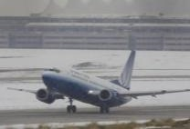
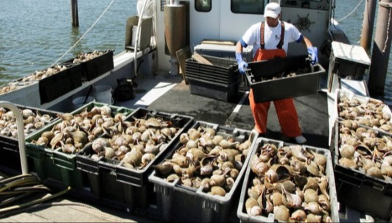
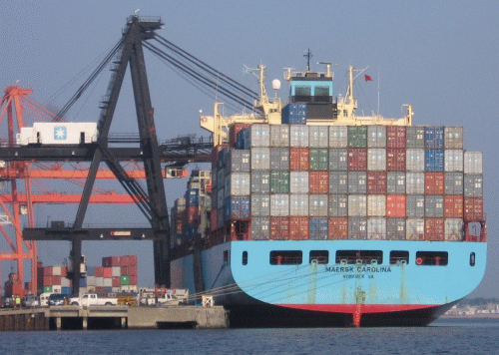
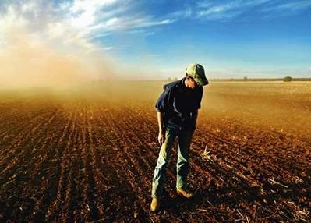
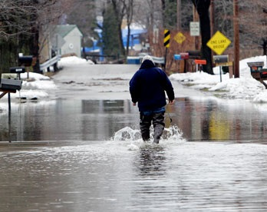
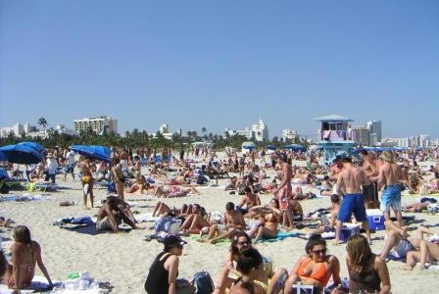
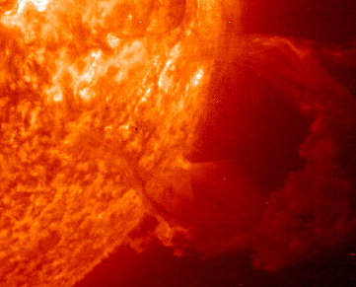
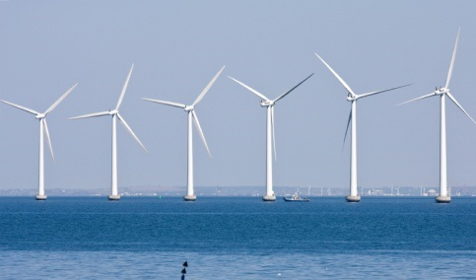
NOAA SUPPORTS BUSINESSES, COMMUNITIES, & THE FUTURE
Support transportation & commerce
Facilitate sustainable agriculture, fisheries, & aquaculture
Protect life & property & create business opportunities
Safeguard communication and electric infrastructure
Assist communities & provide recreationa l opportunities
Inform renewable energy business decisions

Slide 3
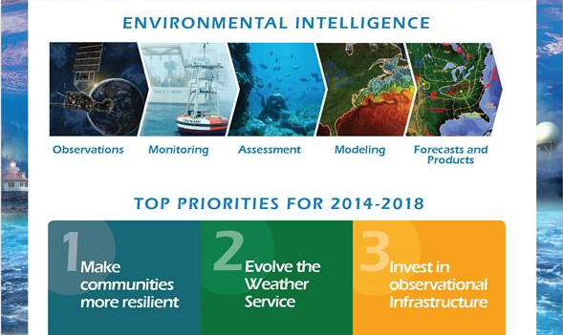
MISSION REQUIREMENTS
“Timely, actionable, reliable”
SCIENCE-BASED SERVICES AGENCY
A predictive understanding of the Earth system

Slide 4
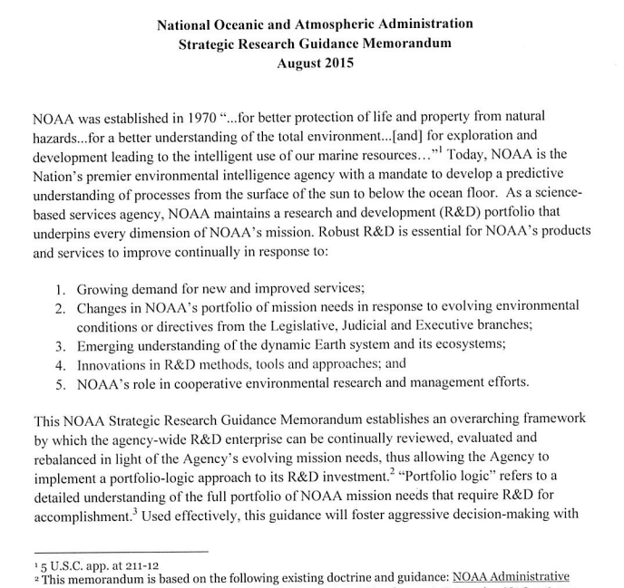
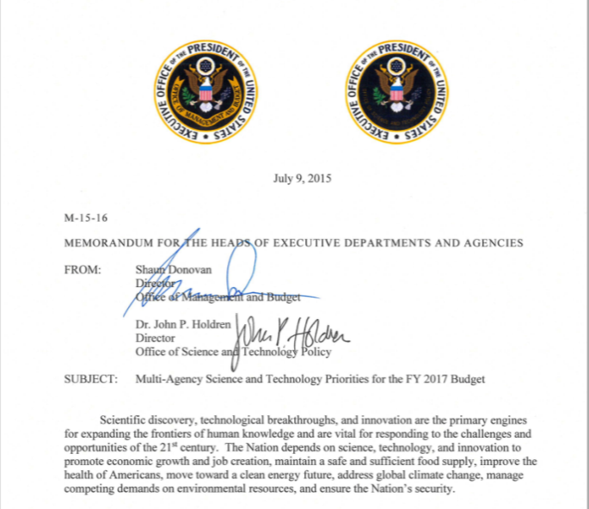
STRATEGIC RESEARCH GUIDANCE MEMORANDUM
Mission alignment
Research balance
Workforce excellence
Scientific integrity
Facilities and infrastructure
Partnerships
Transitioning R&D
Accountability
FRAMEWORK OF PRINCIPLES
FY18 Priorities

Slide 5
STRATEGIC RESEARCH GUIDANCE MEMORANDUM: Part I
Framework of Principles
Mission alignment
Transitioning R&D
Research balance
Partnerships
Facilities and infrastructure
Workforce excellence
Scientific integrity
Accountability

Slide 6
MAJOR CHALLENGE
R2X
Transition into applications, operations, utilizations, and commercialization

Slide 7
PROCESSES
RESEARCH
RLs 1-2
Research & Development
DEVELOP
RLs 3-5
DEMONSTRATE
RLs 6-8
Transition
LIFE CYCLE PHASE OF SCIENCE & TECHNOLOGY
DEPLOY
RL9
Operations & Applications
Tailored to Requirements
Broadly relevant to NOAA mission
SCOPE OF SCIENCE & TECHNOLOGY

Slide 8
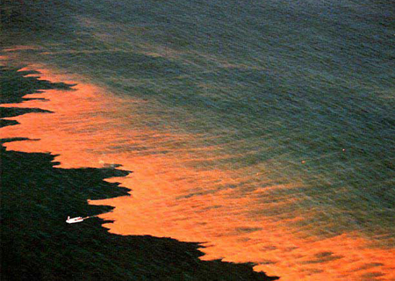
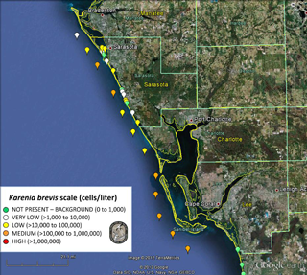
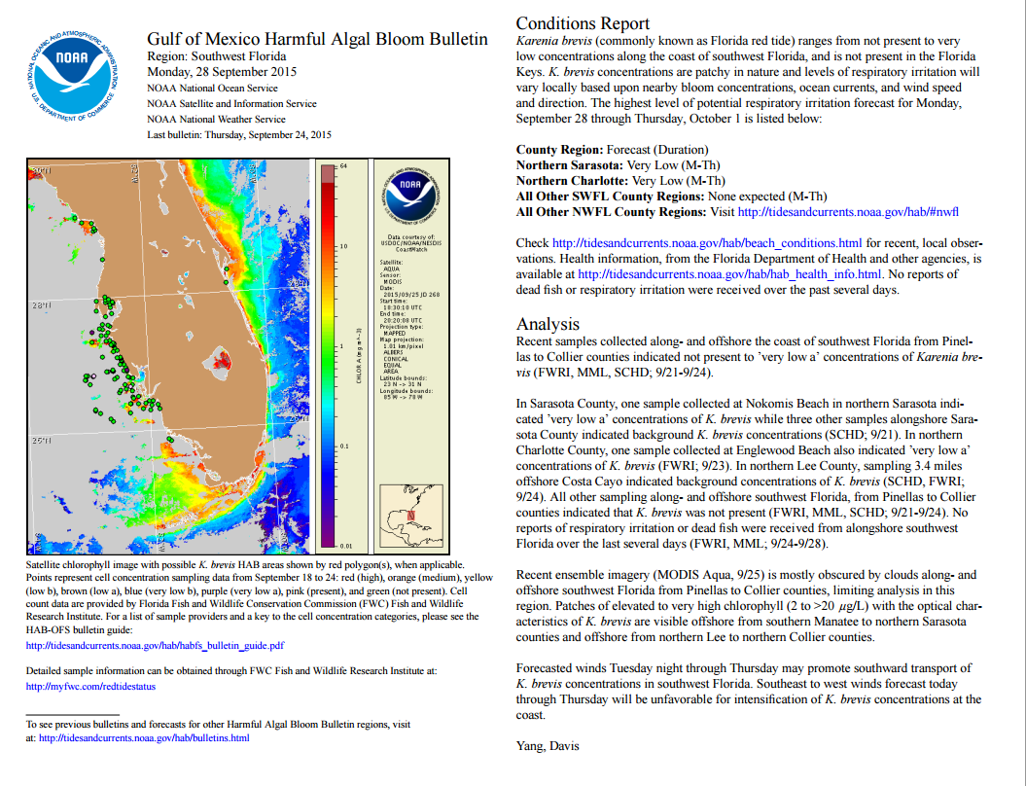
R2X MATTERS
Red tide alerts now in NWS Beach Hazards Statement
ECOLOGICAL FORECASTING
Operational Harmful Algal Bloom Forecasts
Karenia brevis in the Gulf of Mexico

Slide 9
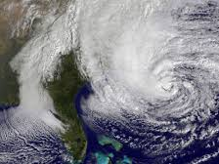
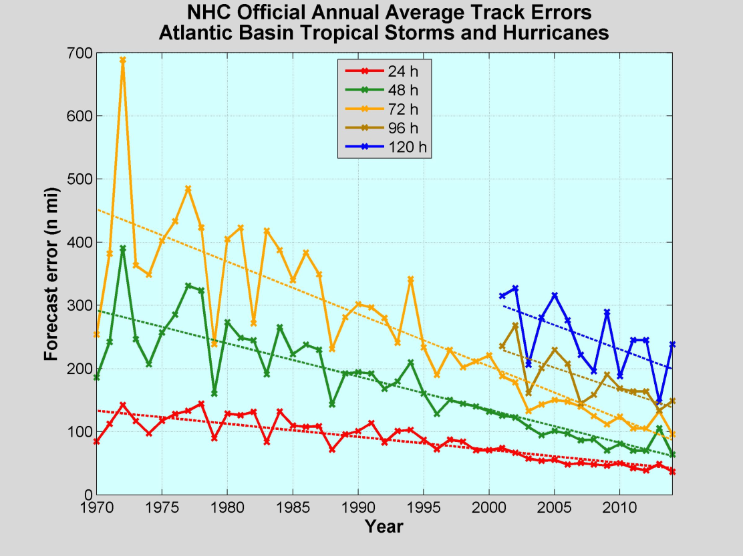
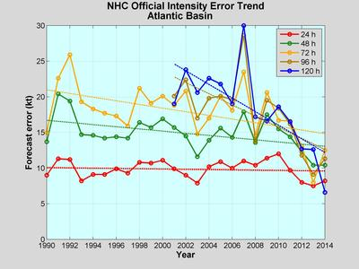
R2X MATTERS
HURRICANE FORECASTING

Slide 10
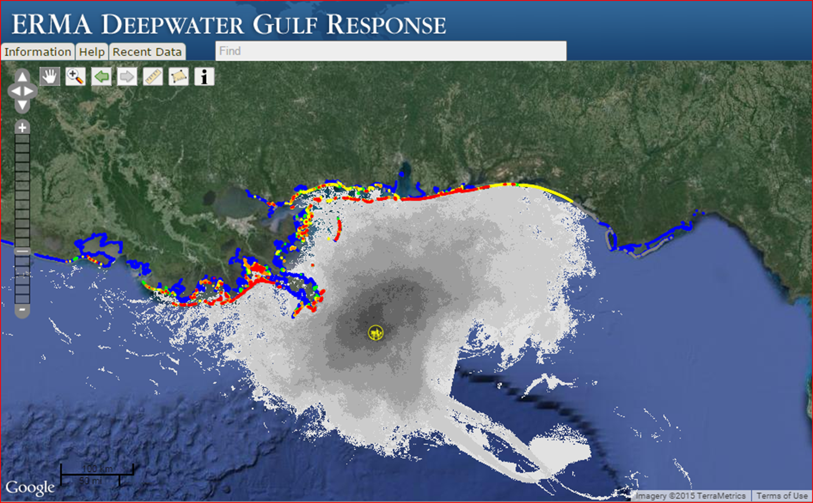
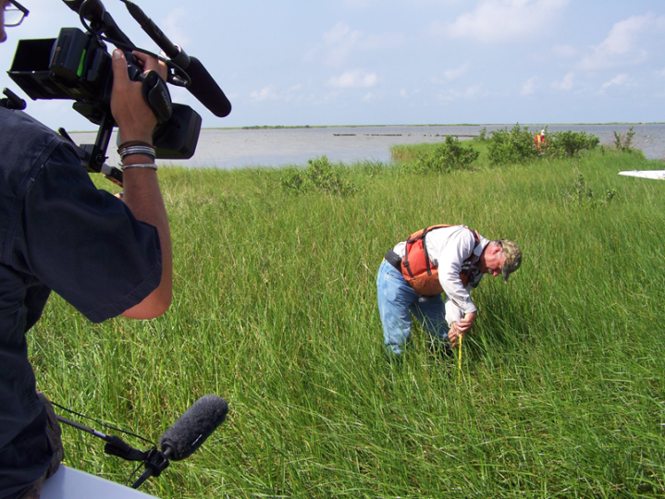
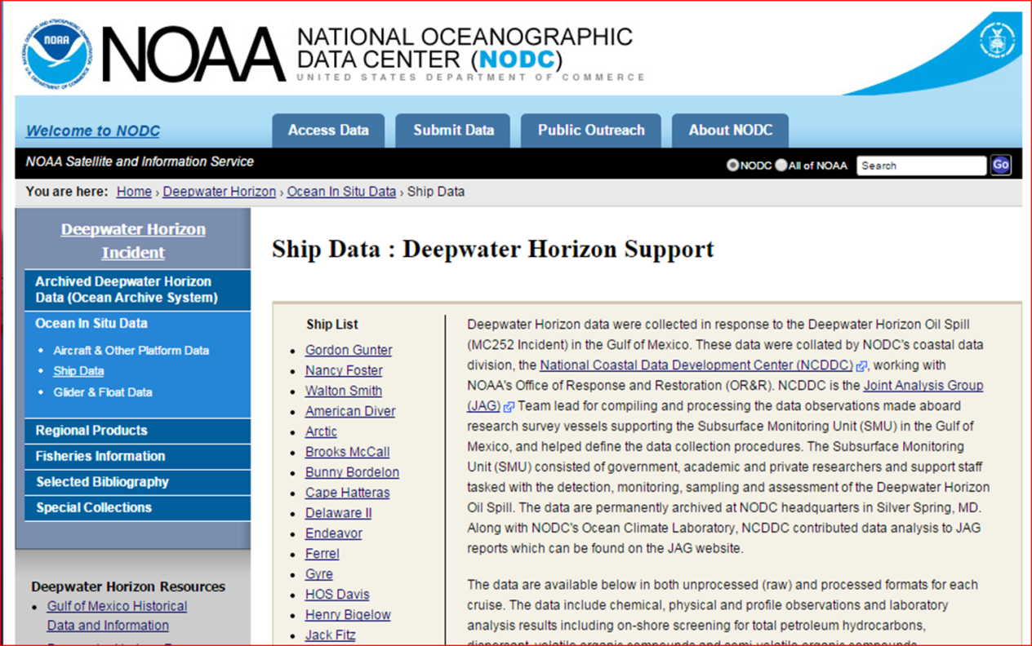
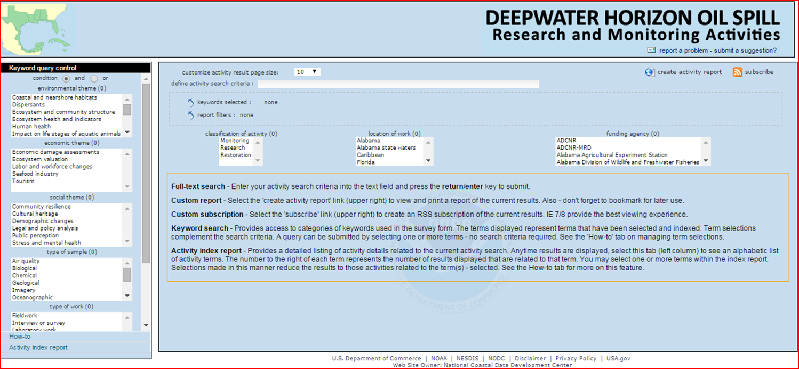
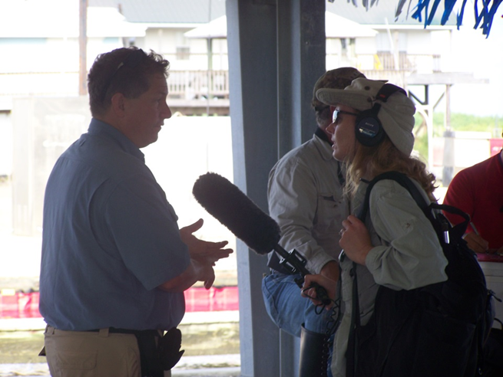
R2X MATTERS: OIL SPILL SCIENCE

Slide 11
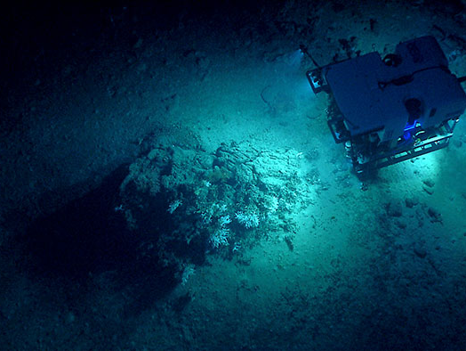
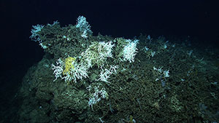
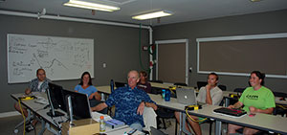
R2X MATTERS
ECOSYSTEM-BASED MANAGEMENT
NOAA 2014 Gulf of Mexico Mission

Slide 12
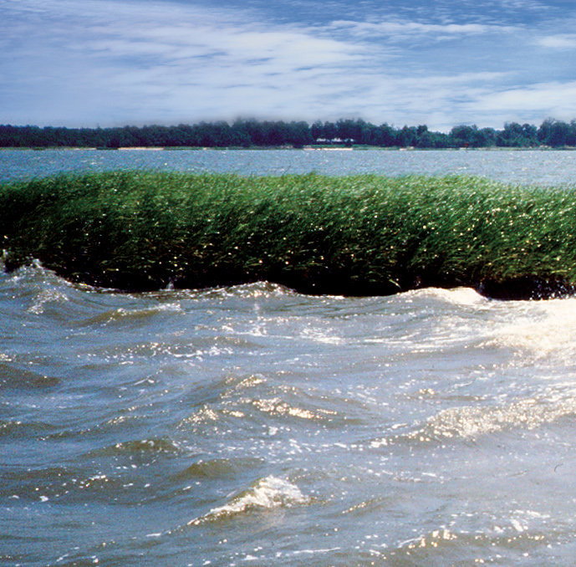
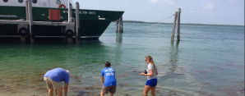
R2X MATTERS NATIONAL CLIMATE INDICATOR SYSTEM
globalchange.gov/ exp.ore/indicators
Physical, ecological, and societal indicators to inform decision making on multiple scales
CITIZEN SCIENCE
CO-DESIGN
BISCAYNE BAY WATER WATCH
Miami Waterkeeper · Florida Sea Grant IF/IFAS Extension Miami-Dade County
University of Miami

Slide 13
What do we want
IN THE FUTURE?

Slide 16
TECHNOLOGY CHALLENGES
Portable devices/communications
Robust observing capabilities
Adaptive sampling
Relocatable, stable systems
Adverse environments
Sensors
Citizen science/dual-use
Affordable
Real-time, accurate, precise
Easy to use
Unattended for extended time
Platforms
Next generation autonomous vehicles

Slide 17
SCIENTIFIC CHALLENGES
Integrated Earth system processes & predictions
Observing system optimization
Decision science, risk analysis and risk communication
Data science
Water prediction
Arctic
Notes:
Message: Scientific challenges (SRGM: part II – FY18 priorities)
Integrated Earth system processes & predictions
Observing system optimization
Decision science, risk analysis and risk communication
Data science
Water prediction
Arctic
Segue: OBTW...challenges beyond what we do with respect to R&D....how we do it

Slide 18
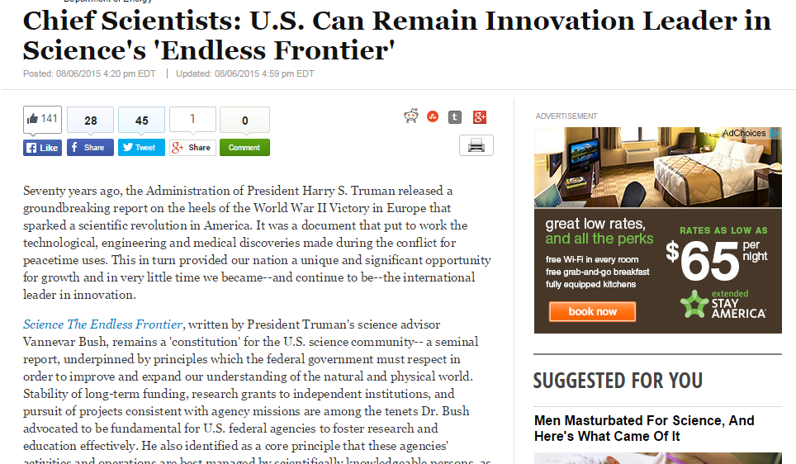
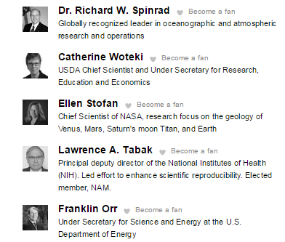
www.huffingtonpost.com

Slide 19
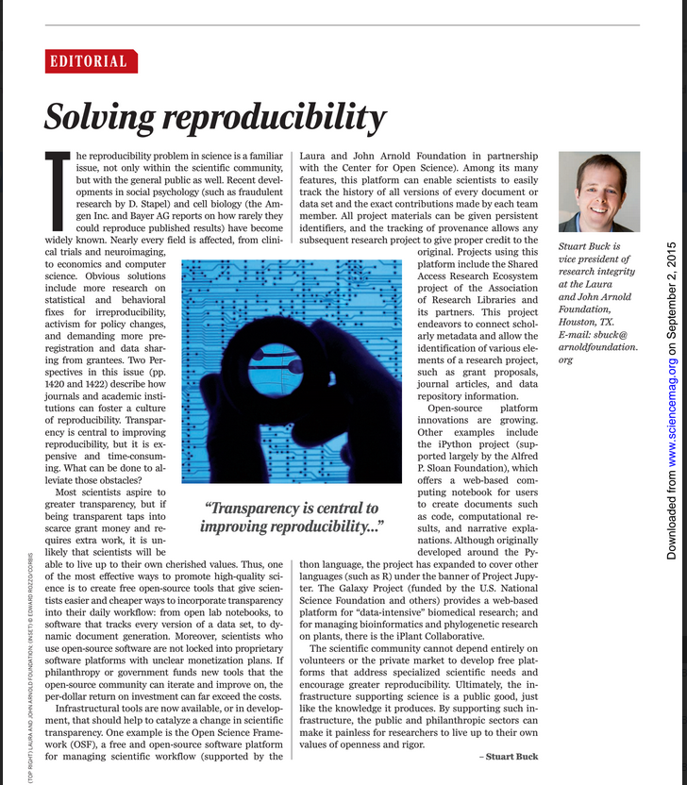
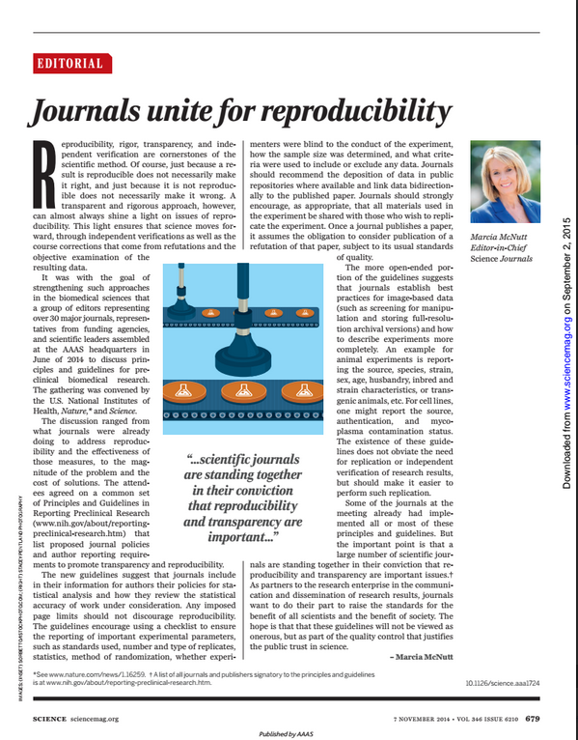
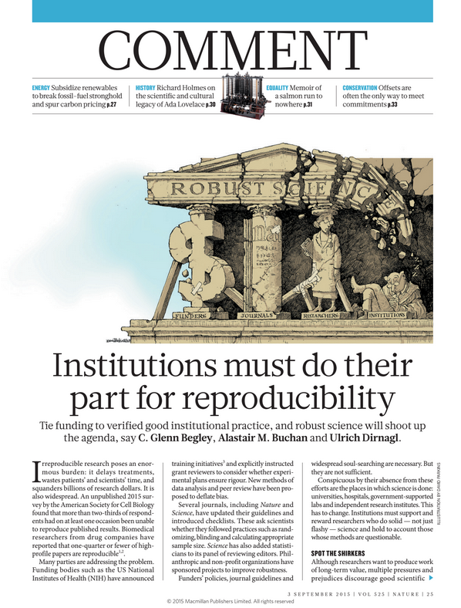

Slide 20
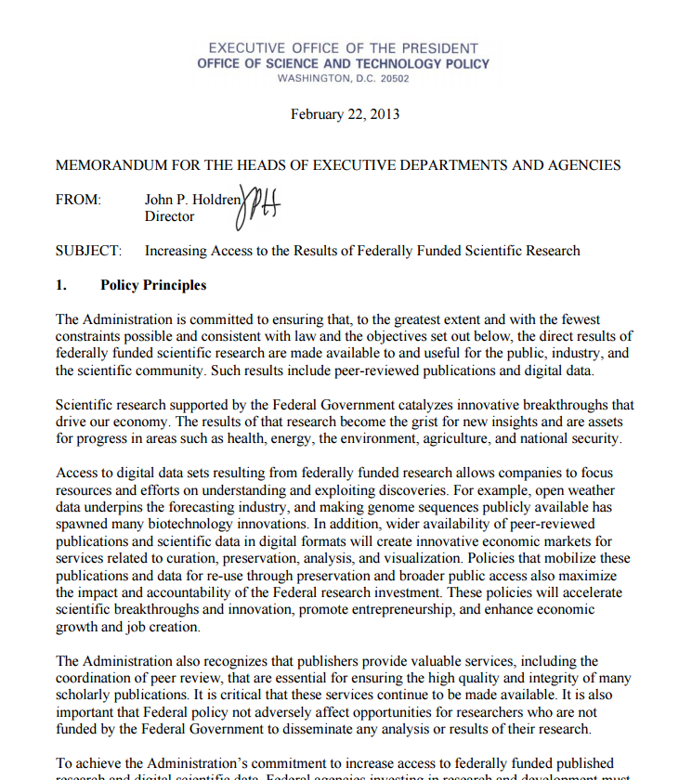
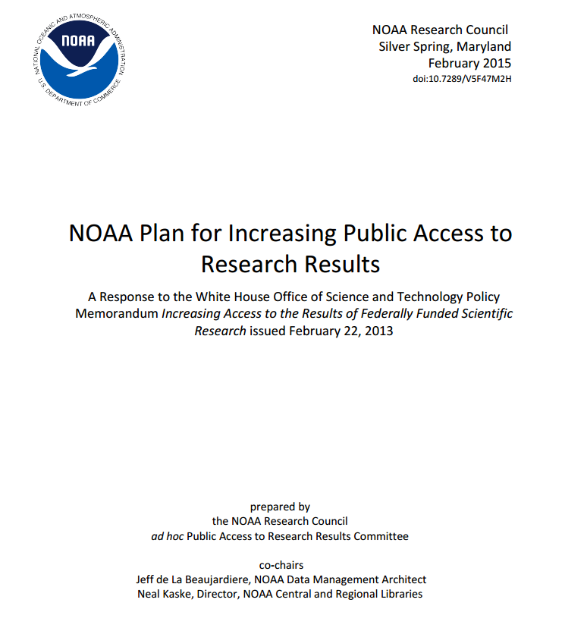
PUBLIC ACCESS TO RESEARCH RESULTS
http://docs.lib.noaa.gov/noaa_documents/NOAA_Research_Council/NOAA_PARR_Plan_v5.04.pdf

Slide 21
STRATEGIC RESEARCH GUIDANCE OUTCOMES
“Better” products
Clearer direction of research priorities
Coordinated priorities & responsibilities

Slide 22
THANK YOU
www.noaa.gov

