Slide 1
Minority Health Research at NIH
Nathan Stinson, Jr, PhD, MD
Director, NIMHD Division of Scientific Programs
4th Annual C.W. Bill Young
Federal R&D Agency Workshop
September 30, 2016

Slide 2
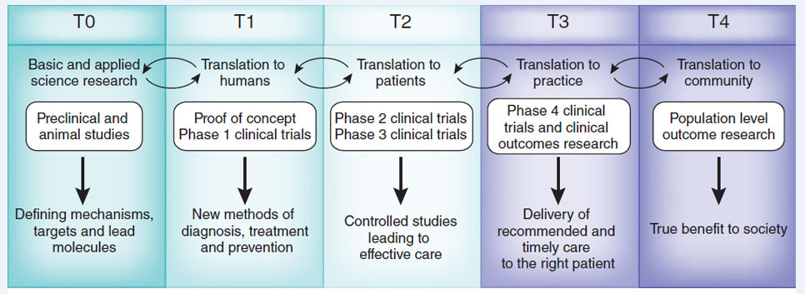
The Focus of NIMHD-supported Research
The Translational Research Spectrum
(From Blumberg, R. S., B. Dittel, D. Hafler, M. von Herrath, and F. O. Nestle. 2012. Unraveling the autoimmune translational research process layer by layer. Nature Medicine 18(1):35–41)

Slide 3
The Focus of NIMHD-supported Research
The Translational Research Spectrum
Majority of NIH-funded Research

Slide 4
The Focus of NIMHD-supported Research
The Translational Research Spectrum
Majority of NIMHD-funded Research

Slide 5
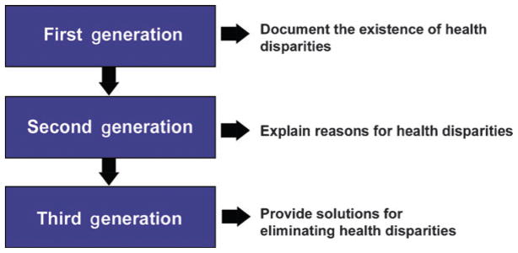
NIMHD Science Vision: Moving Forward and Addressing Gaps
(From Thomas SB, Quinn SC, Butler J, Fryer CS, Garza MA. Toward a fourth generation of disparities research to achieve health equity. Annu Rev Public Health. 2011;32:399-416.

Slide 6
NIMHD Science Vision: Moving Forward and Addressing Gaps
First Generation: Documenting disparities
Large body of research on disparities across populations and health conditions
Gaps: Disparities in understudied populations and subpopulations
Example of initiative to address gap:
RFA-MD-15-011, Building Population Health Research Capacity in the U.S. Affiliated Pacific Islands (U24)

Slide 7
NIMHD Science Vision: Moving Forward and Addressing Gaps
Second Generation: Explaining disparities
Numerous studies documenting associations (e.g., SES and health) and identifying individual-level predictors of health status (e.g., health literacy, insurance status)
Gaps:
Understanding how social determinants impact health through biological pathways
RFA-MD-15-013, NIMHD Transdisciplinary Collaborative Centers for Health Disparities Research Focused on Precision Medicine (U54)
PAR-16-355, Social Epigenomics Research Focused on Minority Health and Health Disparities (R01)

Slide 8
NIMHD Science Vision: Moving Forward and Addressing Gaps
Second Generation: Explaining disparities
Gaps (cont):
Understanding population-level patterns of risk and resilience
Addressing Health Disparities Among Immigrant Populations (approved concept)
Understanding pathways of healthcare disparities
PAR-16-221, Health Services Research on Minority Health and Health Disparities (R01)
PAR-16-391, Surgical Disparities Research (R01)

Slide 9
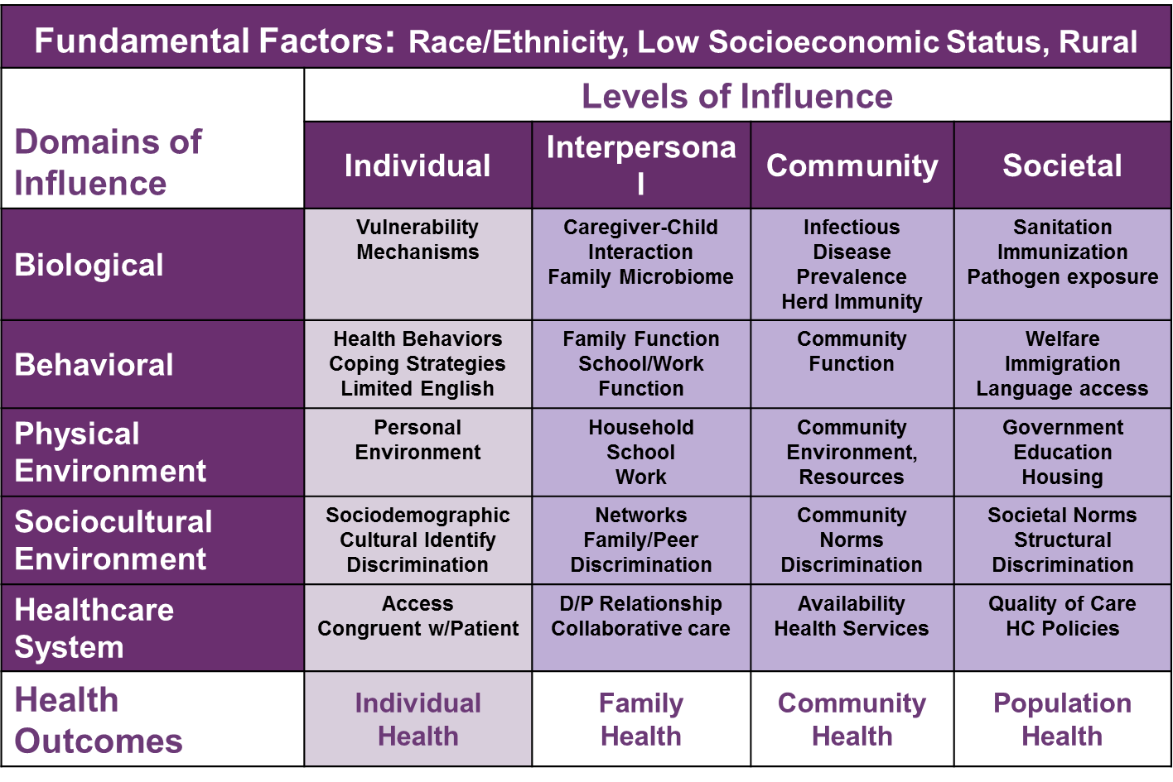
NIMHD Science Vision: Moving Forward and Addressing Gaps
Second Generation: Explaining disparities
Gaps (cont):
Understanding the interaction of multiple determinants and multiple levels across the lifecourse
Development of NIMHD research framework to guide research and evaluate research portfolios.

Slide 10
NIMHD Science Visioning: Moving Forward and Addressing Gaps
Third Generation: Solutions to eliminate health disparities
Most intervention studies have focused on
Health promotion rather than elimination of disparities
Single health disparity populations
Individual knowledge, attitudes, and behavior
Gaps:
Interventions that have broad applicability across different health disparity populations
Example of initiative: RFA-MD-15-012, Behavioral Interventions to Prevent HIV in Diverse Adolescent Men Who Have Sex with Men (U01)

Slide 11
NIMHD Science Visioning: Moving Forward and Addressing Gaps
Third Generation: Solutions to eliminate health disparities
Gaps (cont):
Interventions that address structural determinants of health disparities
Retaining Youth and Young Adults from Health Disparity Populations in the HIV Treatment Cascade (approved concept)
Social Impact Bond Approaches to Eliminate Health Disparities (approved concept)

Slide 12
NIMHD Science Visioning: Moving Forward and Addressing Gaps
Third Generation: Solutions to eliminate health disparities
Gaps (cont):
Multi-level interventions
RFA-MD-15-014, NIMHD Transdisciplinary Collaborative Centers for Health Disparities Research on Chronic Disease Prevention (U54)
RFA-MD-16-003, Engaging Youth and Young Adults from Health Disparity Populations in the HIV Treatment Cascade (R01)

Slide 13
Selected NIMHD Science Advances

Slide 14
Stigma and High Risk Sexual Behavior among HIV+ African American Men
Wagner, GJ; Bogart, LM; Klein, DJ; Green Jr, HD; Mutchler, MG; McDavitt, B; Hilliard, C. Association of Internalized and Social Network Level HIV Stigma with High-Risk Condomless Sex Among HIV-Positive African American Men. Arch Sex Behav (2016): 45(6), 1347-55. R01MD003964, Medical Mistrust, Social Networks, and Disparities in HIV Care among Blacks (PI: Bogart)
Examined relationships of internalized and social network HIV stigma and condomless sex in a sample of 125 African American HIV-positive men in Los Angeles.
Greater internalized HIV stigma and the perception that close members of the individual’s social network endorsed HIV stigma independently predicted higher levels of condomless sex.
Results highlight the importance of stigma reduction efforts to facilitate reduction of HIV risk behavior for individuals and their social networks.

Slide 15
HIV and Violence Risk Reduction in Latinas
McCabe, BE; Gonzalez-Guarda, RM; Peragallo, NP; Mitrani, VB. Mechanisms of Partner Violence Reduction in a Group HIV-Risk Intervention for Hispanic Women. J Interpers Violence (2016): 31(13), 2316-37. P60MD002266, Center of Excellence for Health Disparities Research: El Centro (PI: Mitrani)
Tested whether a culturally tailored group HIV-risk reduction intervention for Hispanic women (n=548) that reduced high-risk HIV behaviors also impacted levels of intimate partner violence.
Women receiving the intervention reported greater HIV risk-related communication with their partner and lower levels of alcohol intoxication and intimate partner violence (IPV) than women in the control condition.
Findings show the importance of enhancing women’s communication with their partners as a means of reducing IPV, even in interventions not focused directly on IPV.

Slide 16
Sociodemographic Differences in Organ Donation Willingness
Sehgal, N K R; Scallan, C; Sullivan, C; Cedeño, M; Pencak, J; Kirkland, J; Scott, K; Thornton, J D. The Relationship Between Verified Organ Donor Designation and Patient Demographic and Medical Characteristics. Am J Transplant (2016): 16(4), 1294-7. P60MD002265, Dissemination of Evidence-Based Health Disparity Interventions (PI: Seghal, Ashwini).
Many studies on organ donation use self-reported willingness to donate, which may be subject to social desirability bias. This study used driver’s license and EHR data to identify correlates of donor willingness in 2,070 primary care patients in a safety net medical system.
Driver’s license donor designation (46%) was lower than in studies of self-reported willingness (66%).
Individuals who were female, non-Hispanic white, English or Spanish speaking, employed, and privately insured were more likely to be designated as donors.

Slide 17
Early Childhood Disparities in Obesity
Taveras, EM; Gillman, MW; et.al. Reducing racial/ethnic disparities in childhood obesity: The role of early life risk factors. JAMA Pediatr, 2013 Aug 1;167(8):731-8. R01MD003963, Racial/Ethnic Disparities in Early Life Risk Factors for Childhood Obesity (PI: Taveras, Elsie)
Cohort study examining obesity risk factors during pregnancy, infancy, and early childhood in a cohort of 1116 mother-child pairs to understand the higher prevalence of obesity in African American and Hispanic children.
Infancy risk factors (e.g., introduction of solid food before 4 months) and early childhood risk factors (e.g., TV in child’s room at age 4) largely explained obesity disparities at age 7
Pregnancy risk factors (e.g., gestational diabetes, maternal depression) were unrelated to obesity disparities at age 7
Findings suggest that efforts to reduce racial/ethnic disparities in obesity should focus on the prevention of early life risk factors.

Slide 18
Connect With Us
Visit us online www.nimhd.nih.gov
Connect with us on Facebook www.facebook.com/NIMHD
Follow us on Twitter
@NIMHD

