Slide 1
Evidence-Based Funding: Thoughts about Extramural Research
Michael S Lauer, MD
Deputy Director for Extramural Research
National Institutes of Health
State University System of Florida Annual R and D Agency Workshop
Friday, September 30, 2016
U.S. Capitol Visitor Center, Room HVC 201
Disclosures: None

Slide 2
A Problem?
Shapiro D, Vrana K. PNAS 2015;112:9496-7

Slide 3
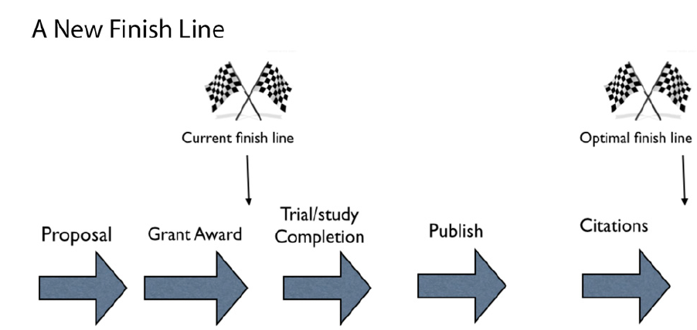
What Should Our Metrics Be?
Shapiro D, Vrana K. PNAS 2015;112:9496-7

Slide 4
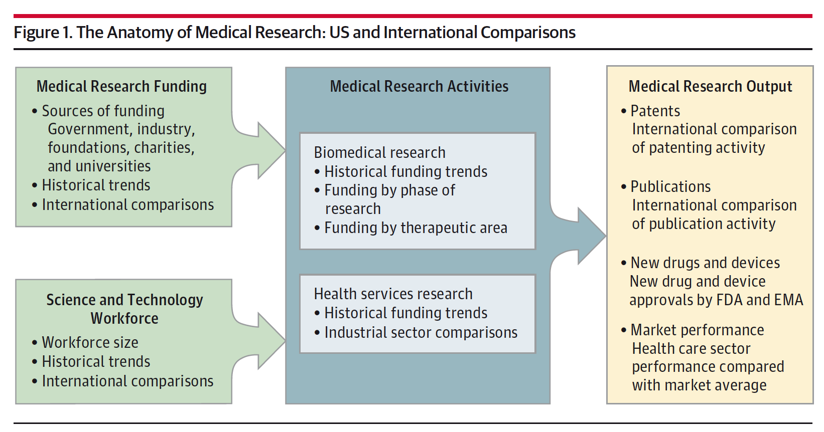
Anatomy and Physiology of Research
Moses H et al. JAMA 2015;313:174-189

Slide 5
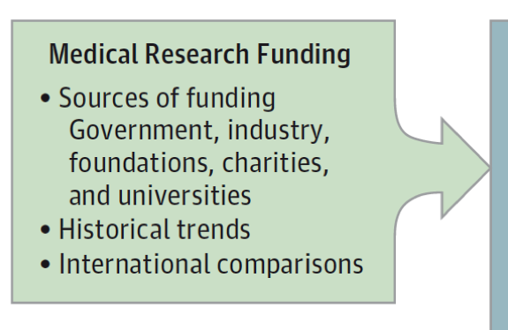
Funding
Moses H et al. JAMA 2015;313:174-189

Slide 6
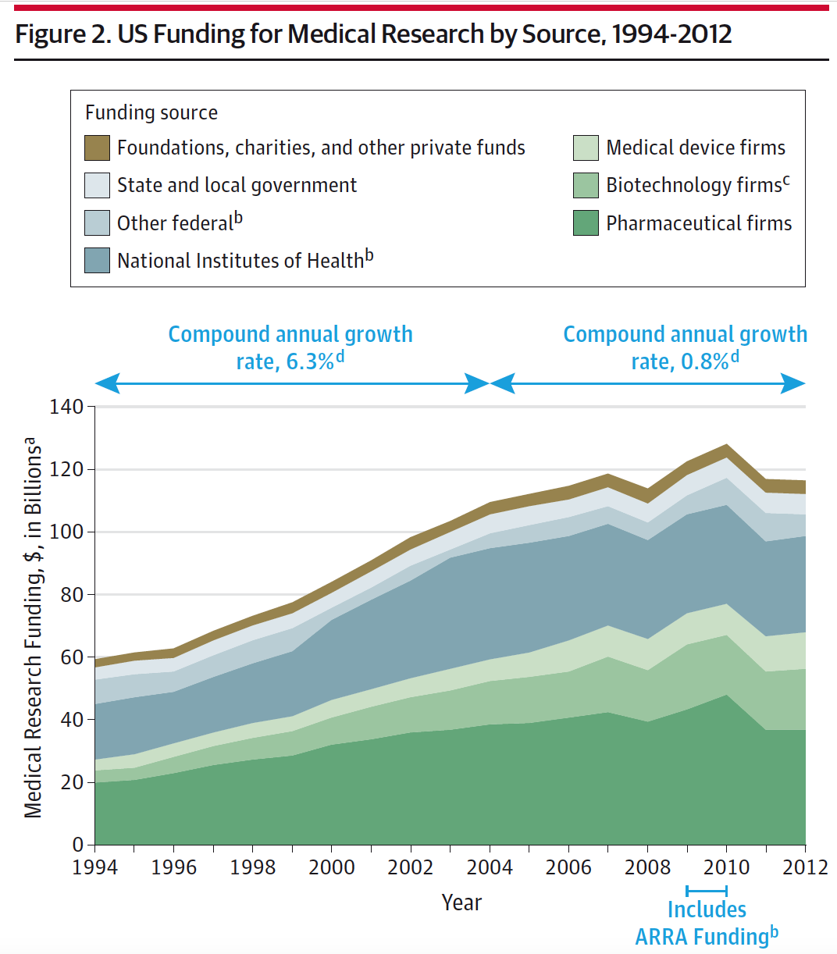
Funding …
Annual Growth
2004 – 2012:
Pharma -0.6%
Device +6.2%
Biotech +4.6%
NIH -1.8%
Moses H et al. JAMA 2015;313:174-189

Slide 7
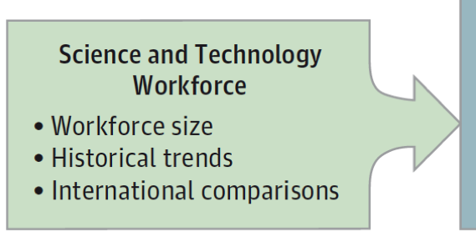
Workforce
Moses H et al. JAMA 2015;313:174-189

Slide 8
Root Causes…
“We identified two core problems:
Too many researchers vying for too few dollars.
Too many postdocs competing for too few positions.
Most other issues can be viewed as symptoms.”

Slide 9
A Different Metric
Changing our funding metric
“A question that at first glance may seem trivial but is, I believe, a significant one is whether our key metric for how… we invest in … research should be the number of grants we award or the number of investigators we support.”
Lorsch JR. Mol Biol Cell 2015;26:1578-82

Slide 10
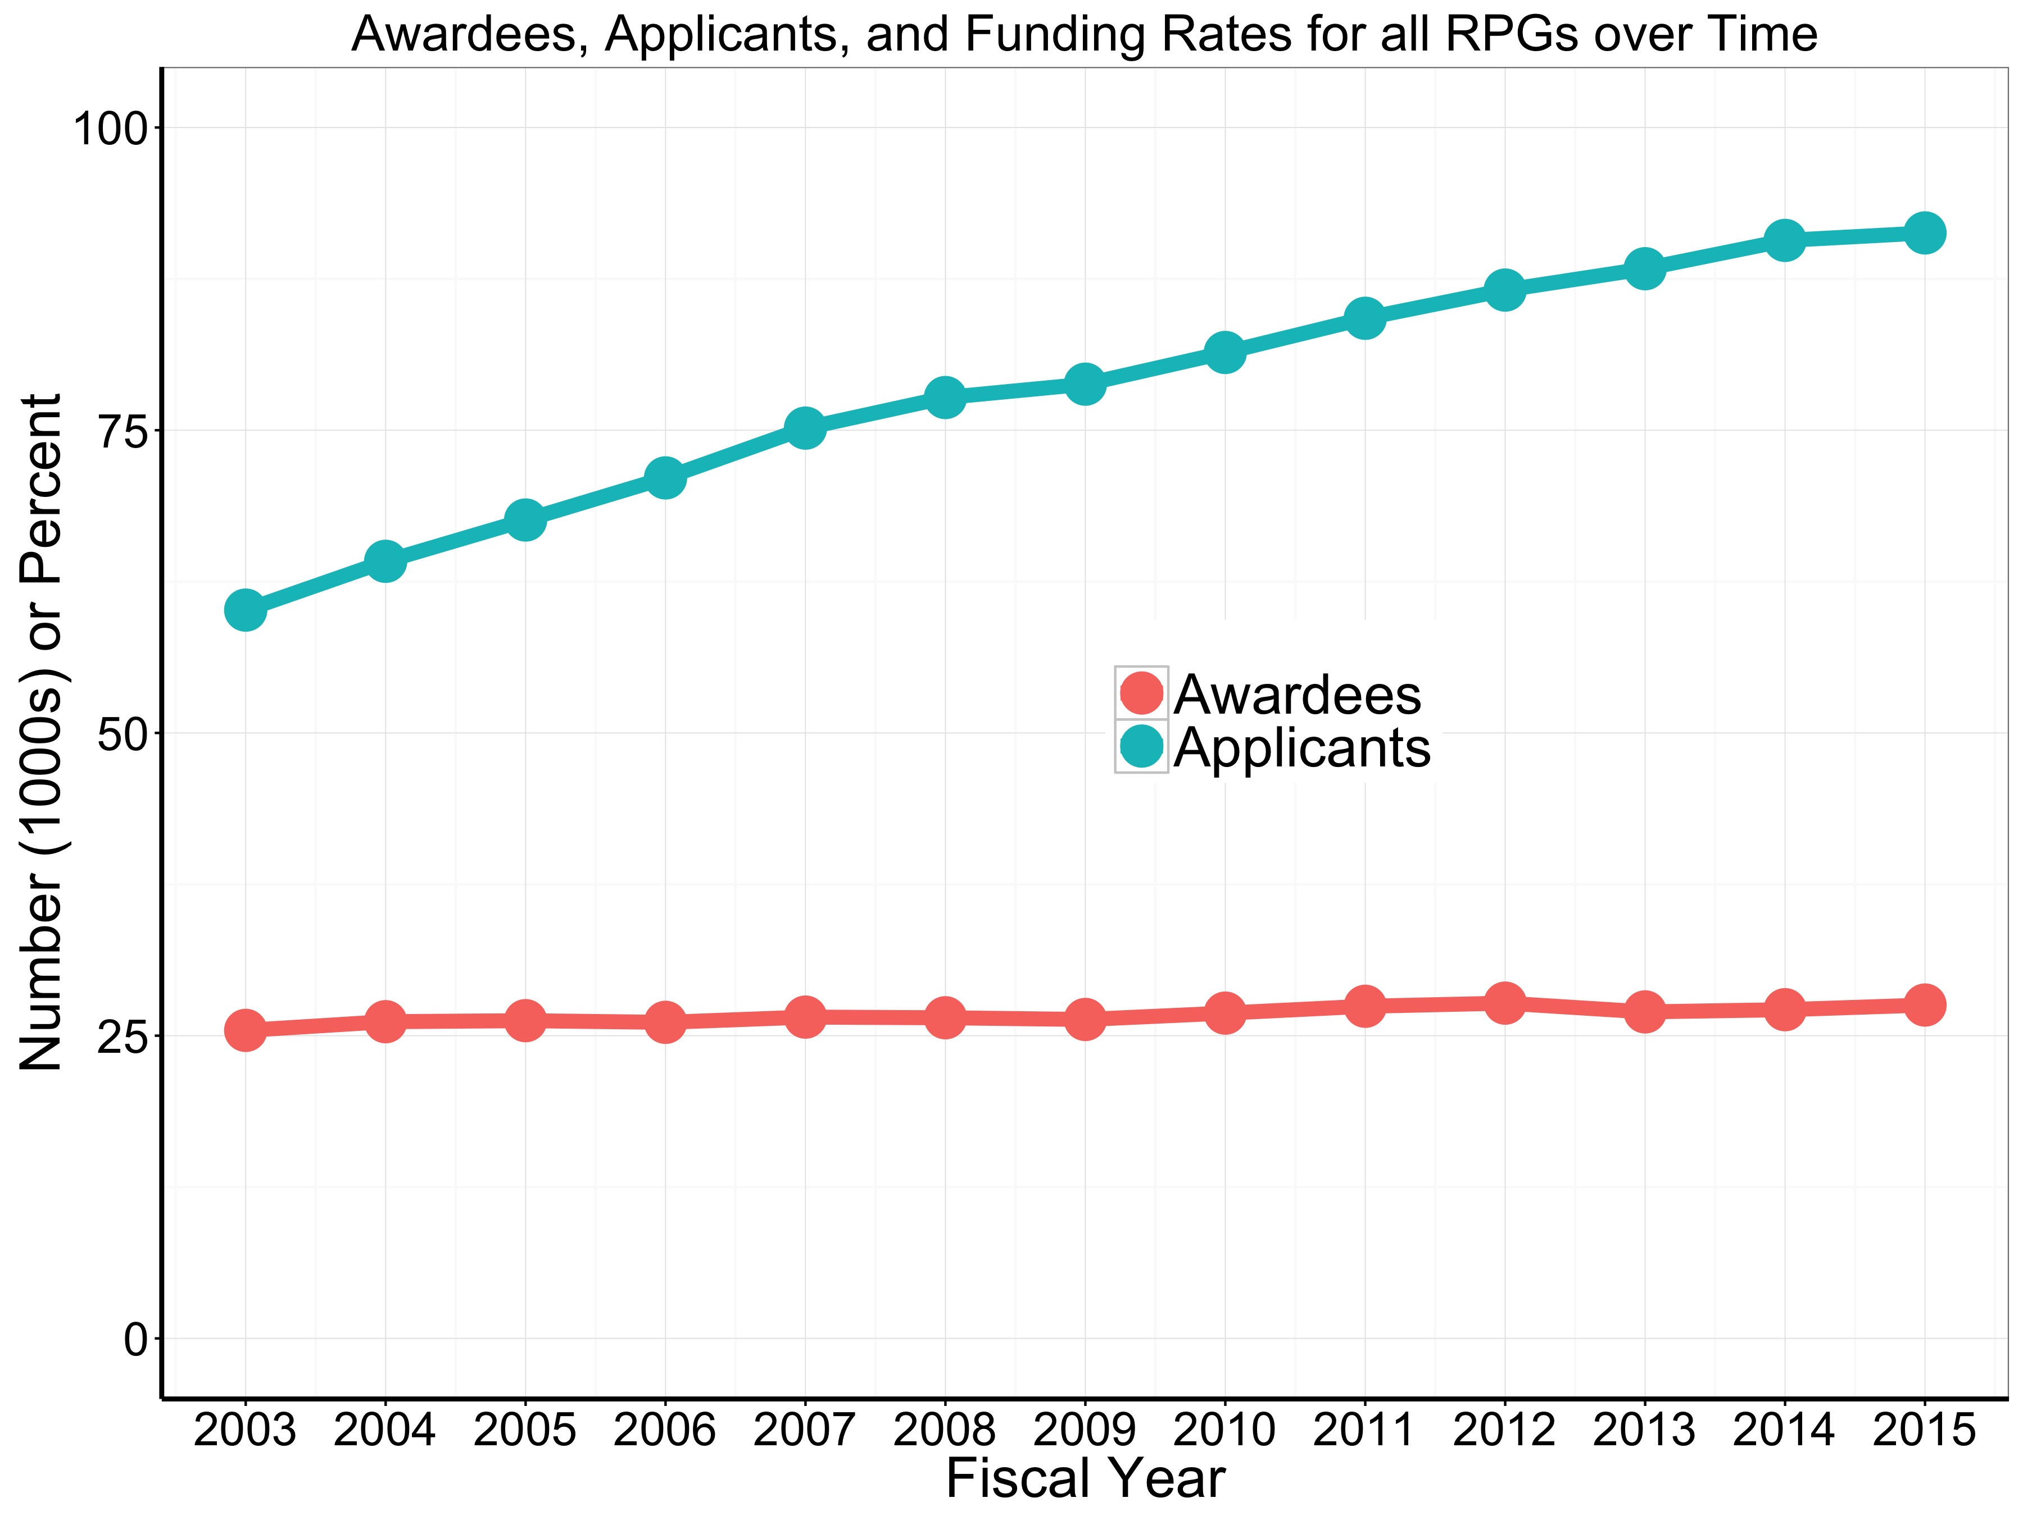
Thanks to OER DPEA and SARB

Slide 11
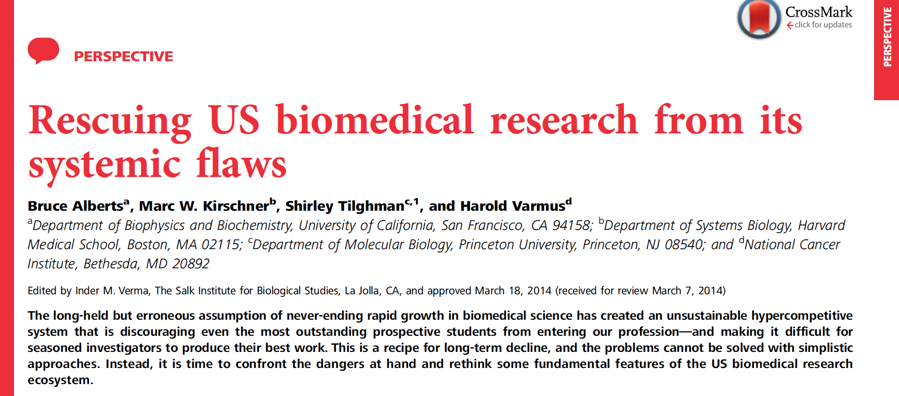
Distribution of Dollars to Awardees …
“Agencies should be sensitive to the total numbers of dollars granted to individual laboratories…—although different research activities have different costs—at some point, returns per dollar diminish. We applaud the recent decision by the NIH to examine grant portfolios carefully before increasing direct research support for a laboratory beyond $1M per year.”
Alberts B et al. PNAS. 2014;111:5773-7

Slide 12
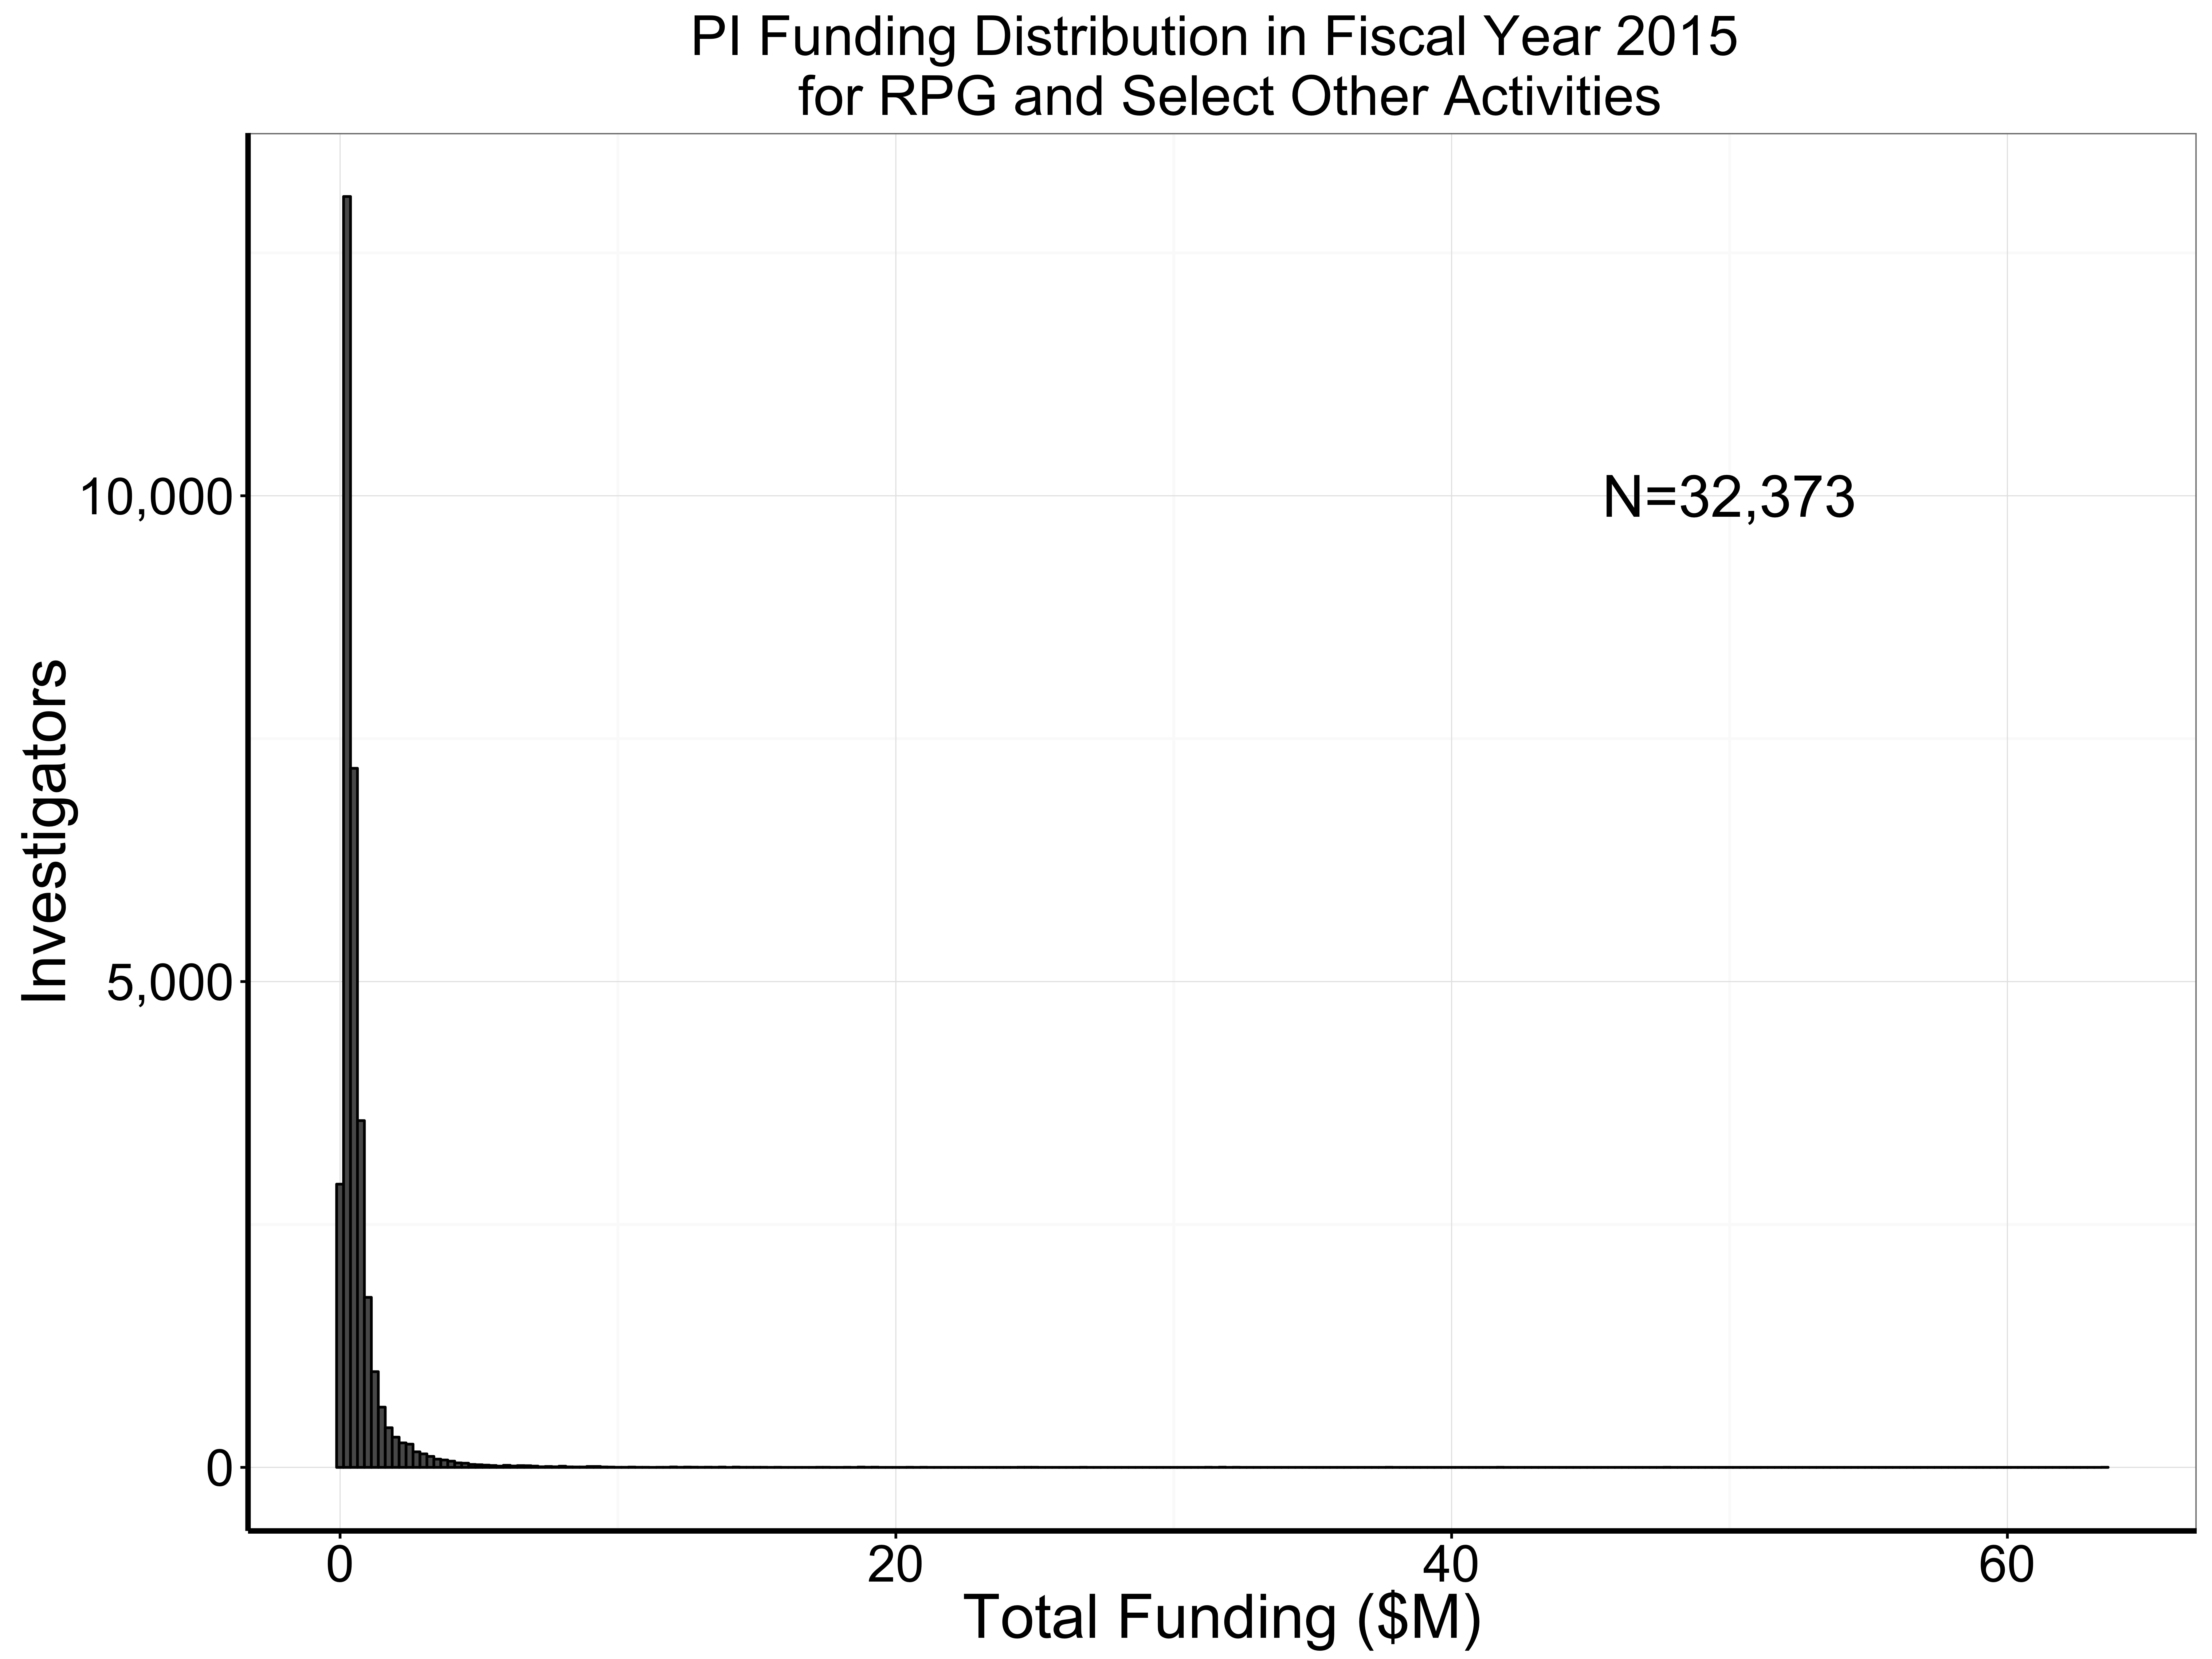
Thanks to OER DPEA and SARB

Slide 13
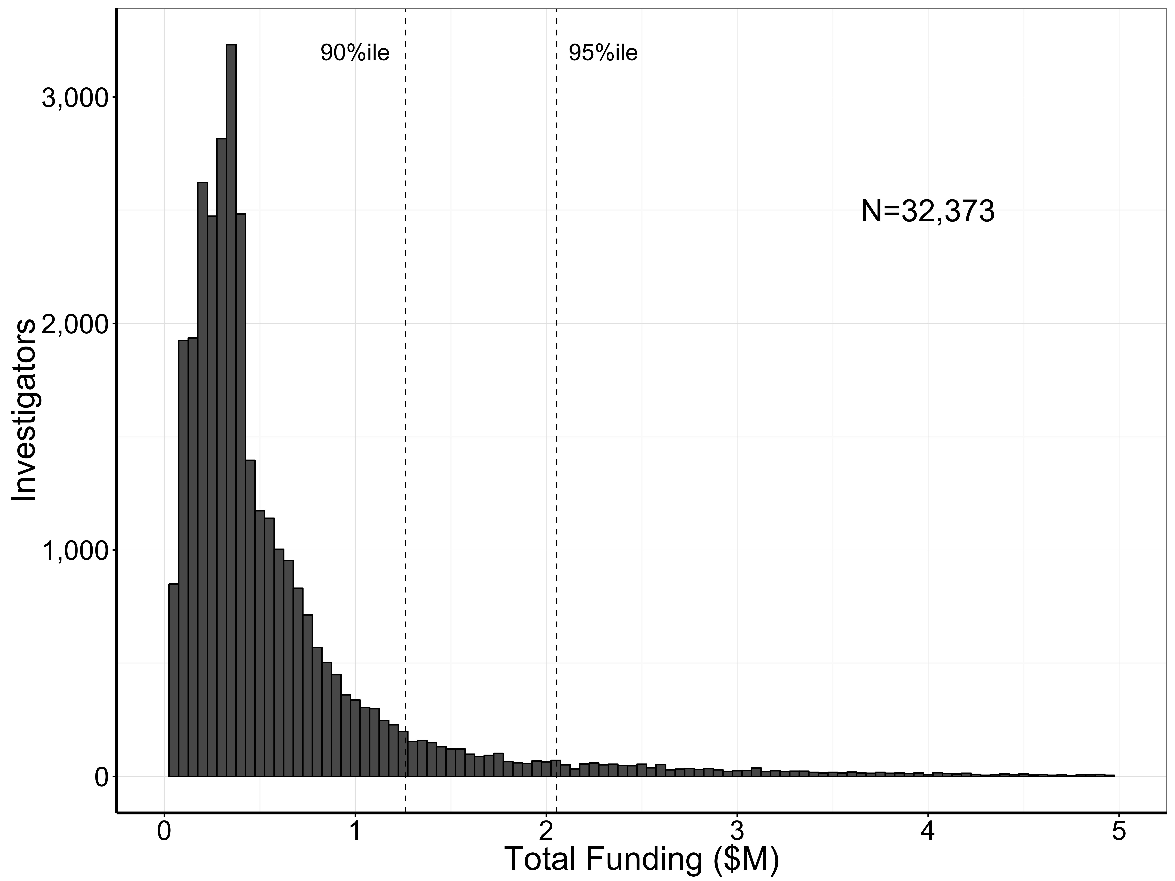
Thanks to OER DPEA and SARB

Slide 14
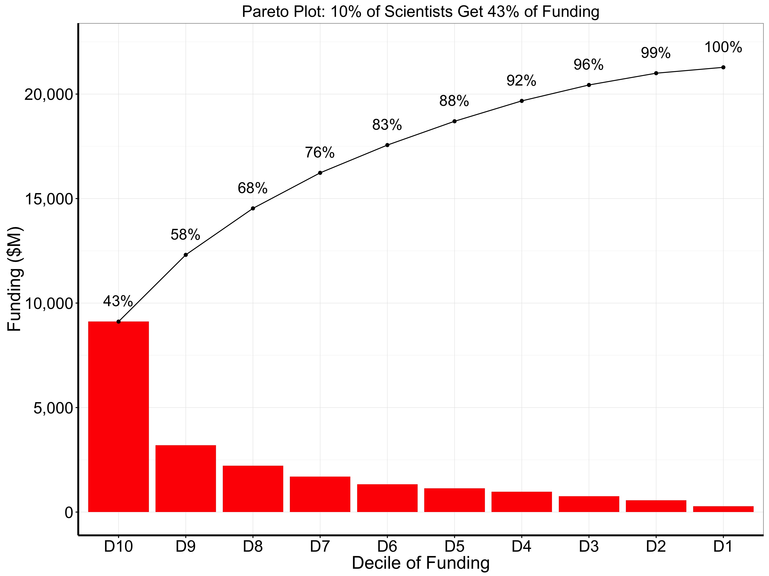

Slide 15
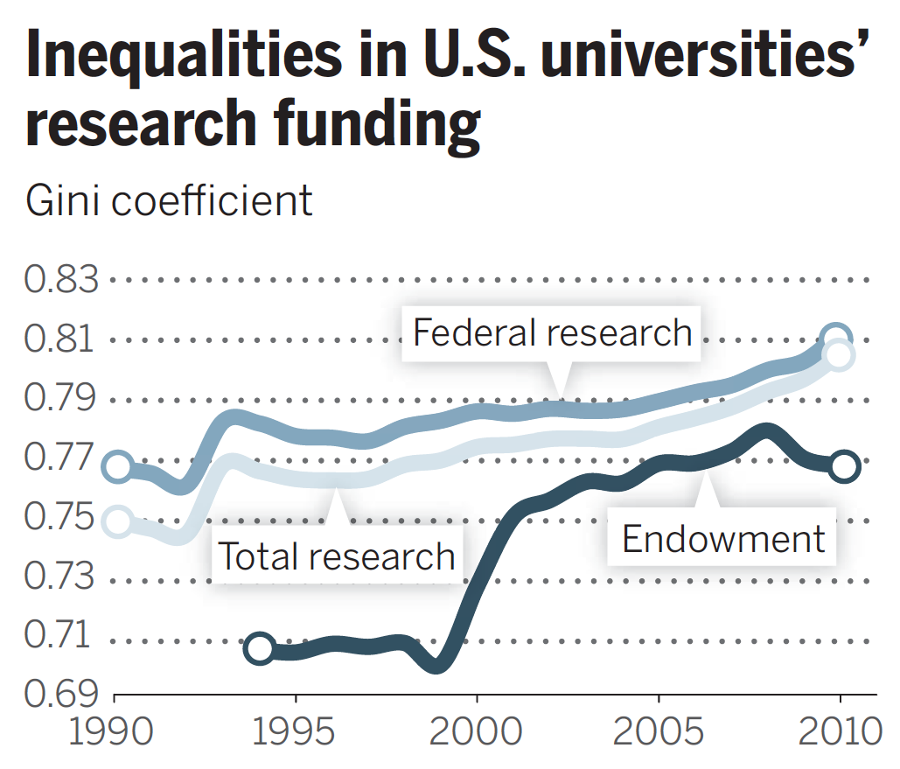
An Ongoing Conversation
Xie Y. Science 2014;344:809-810

Slide 16
Publication and Citations?
Shapiro D, Vrana K. PNAS 2015;112:9496-7

Slide 17
So How Do We Measure Research Impact?
P = productivity
Publish trial results
Highly-cited papers: field-normalized
Q = quality
R = replication
S = sharing
T = translation
Ioannidis JP, Khoury MJ. JAMA 2014 (June 9)

Slide 18
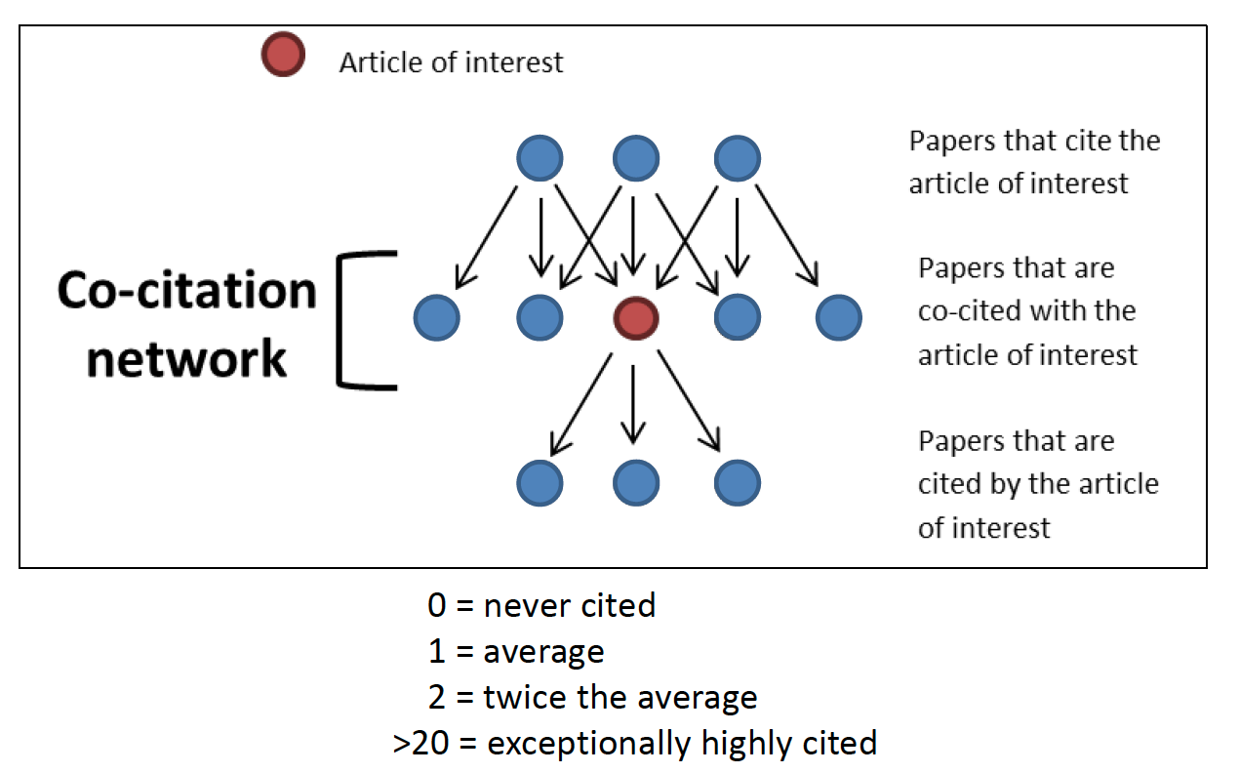
Relative Citation Ratio
NIH Office of Portfolio Analysis
PLoS Biology (September 6, 2016)

Slide 19
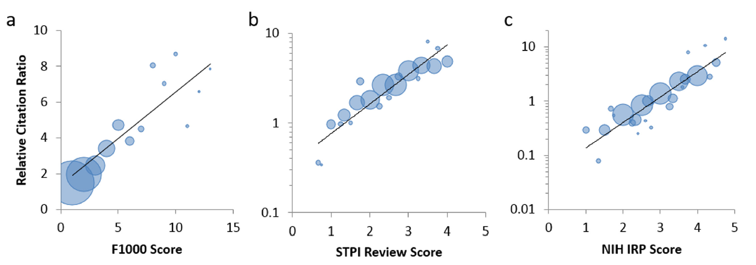
How Do We Know Whether It Means Anything?
2193 R01 papers 430 HHMI/NIH papers 290 R01 papers
NIH Office of Portfolio Analysis
PLoS Biology (September 6, 2016)

Slide 20
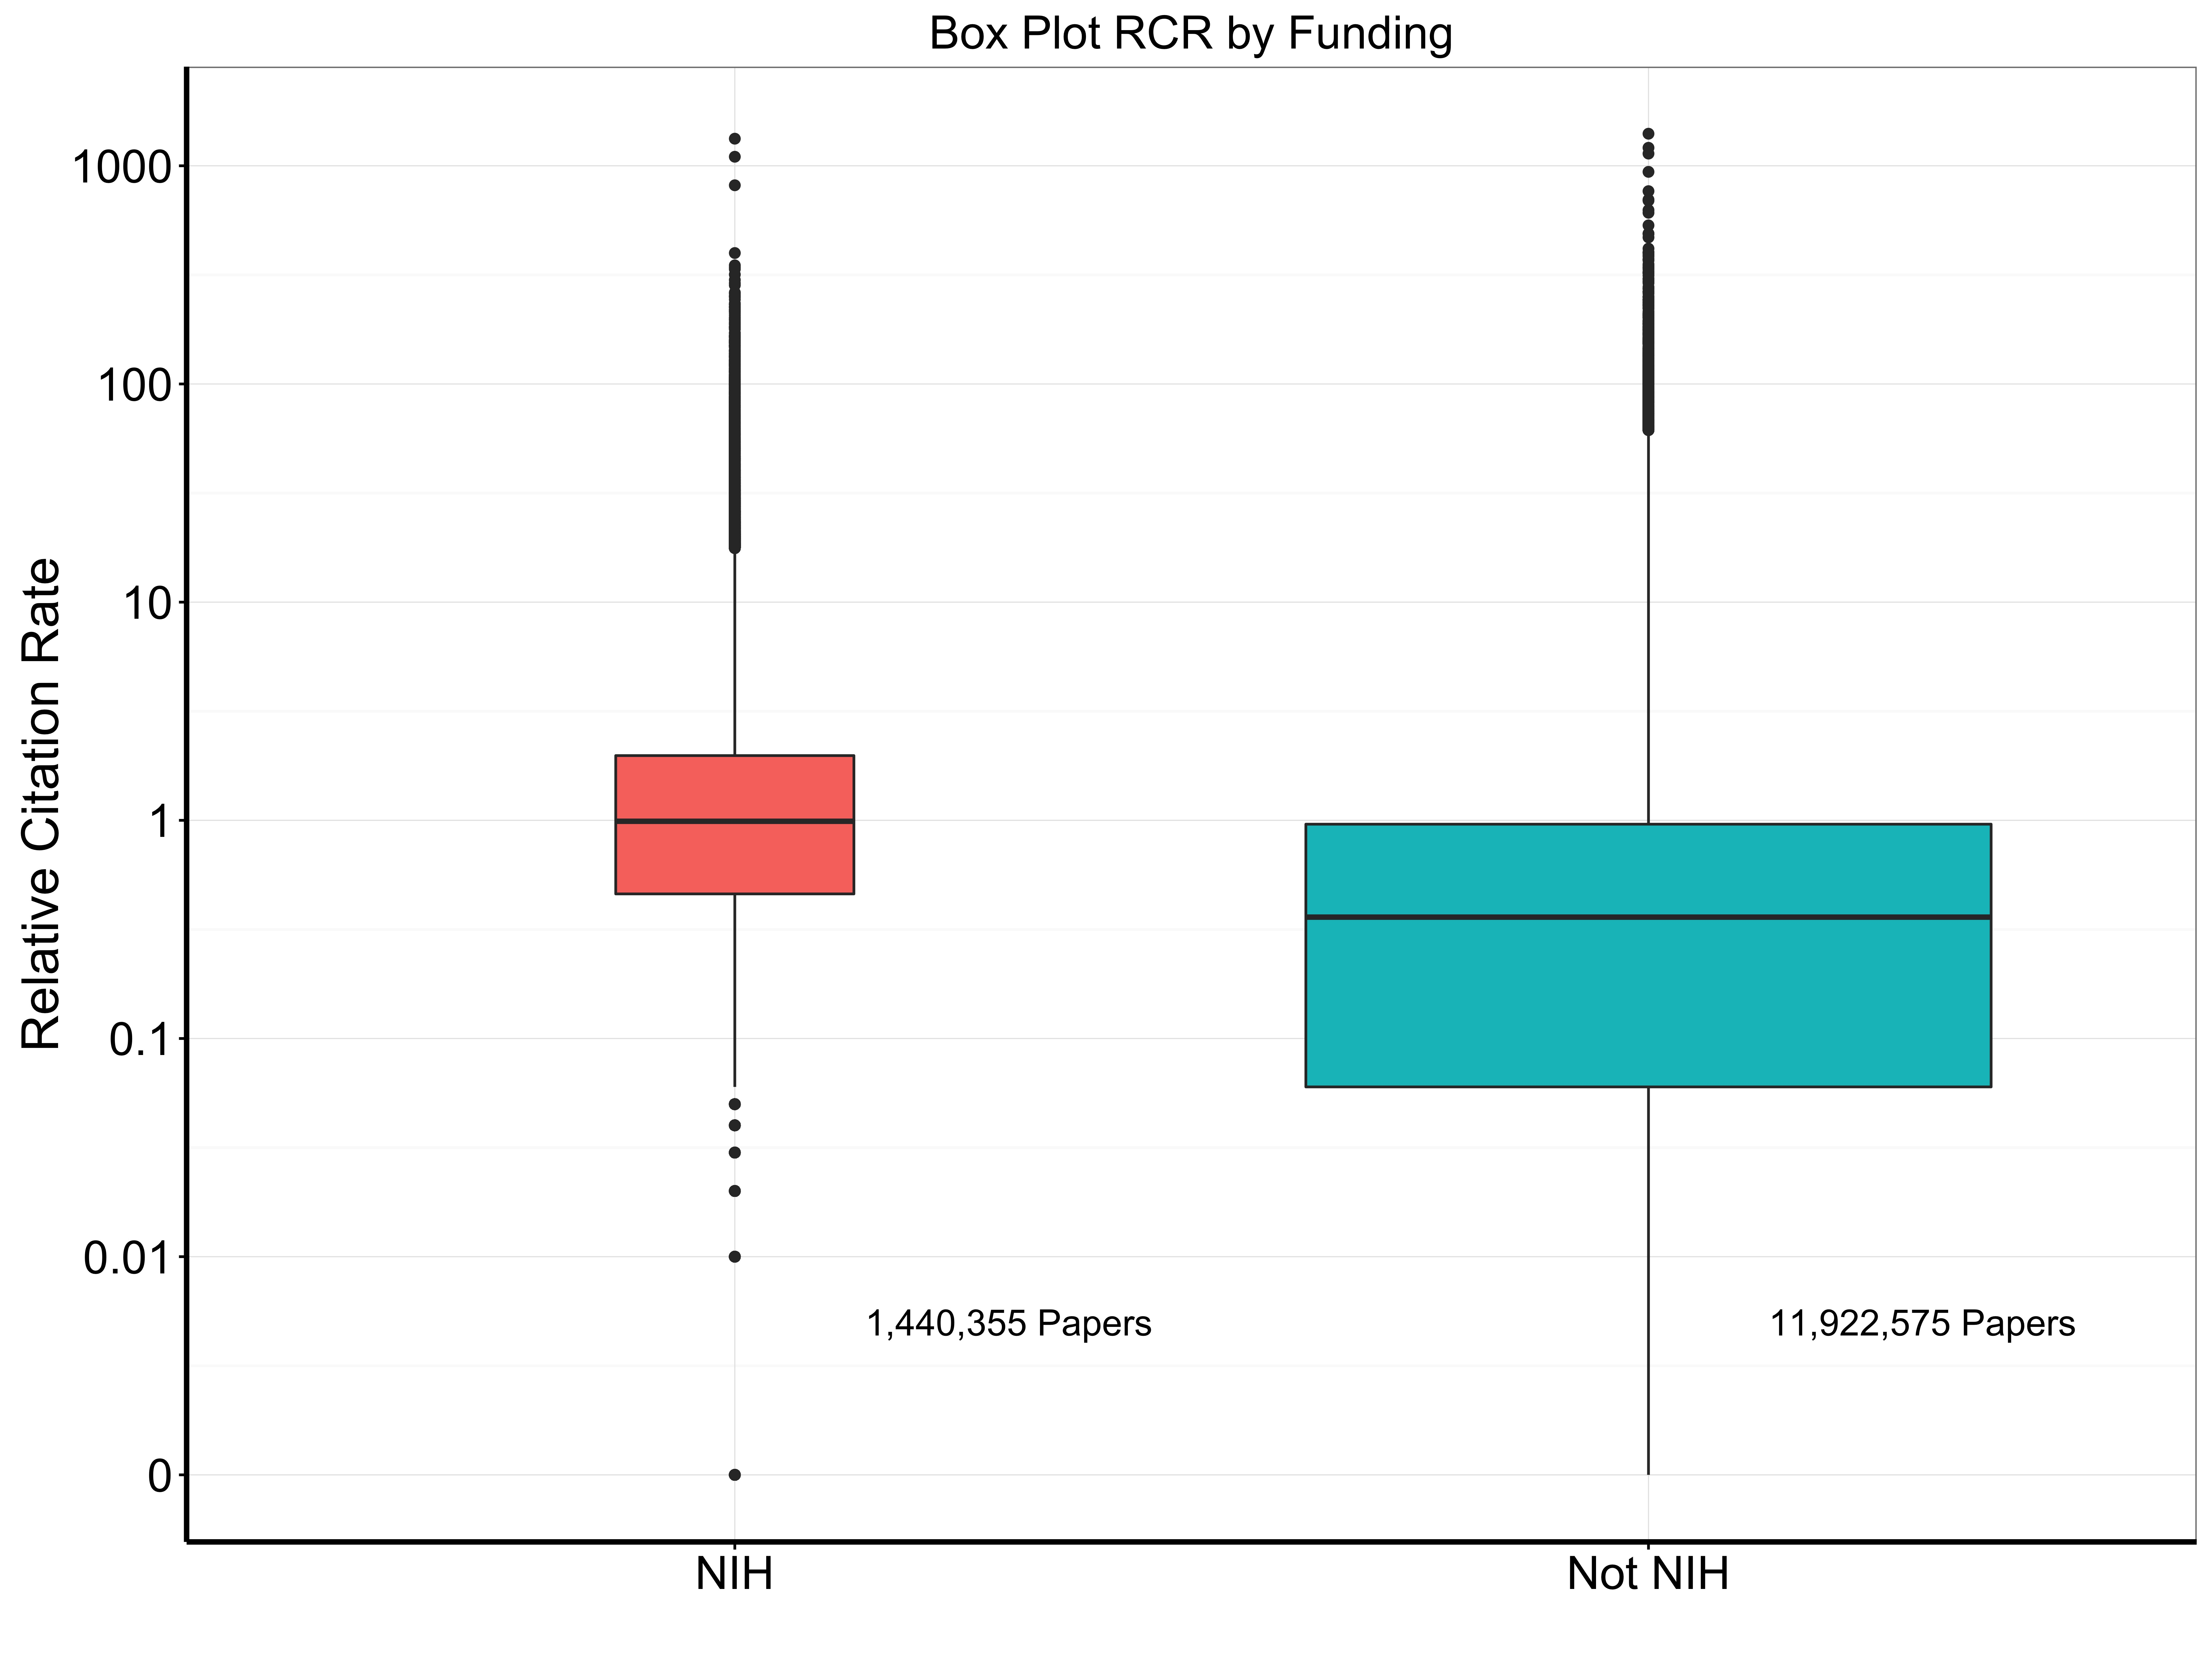

Slide 21
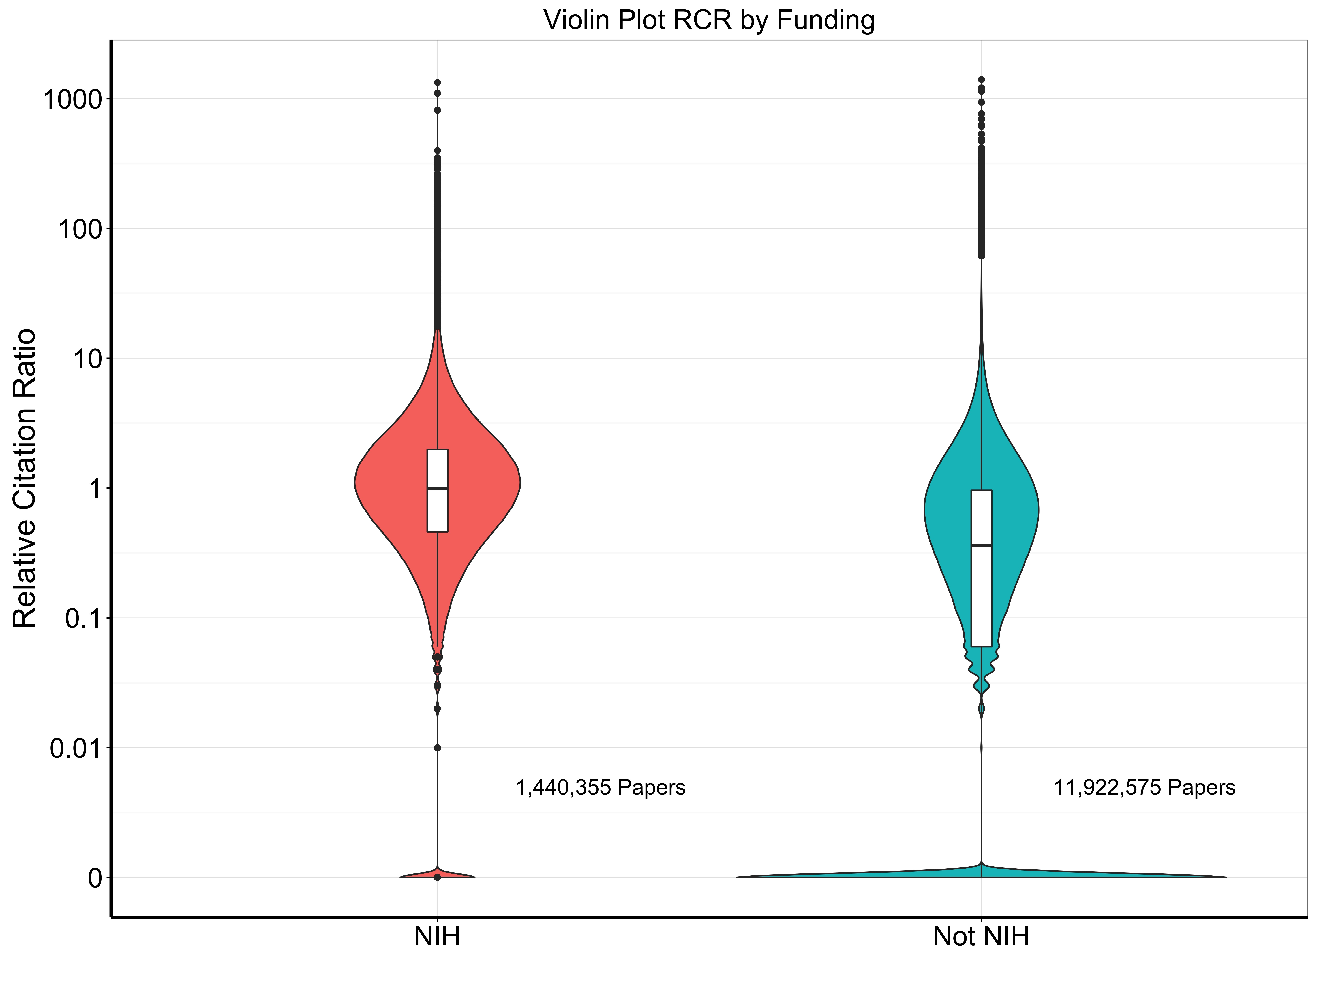

Slide 22
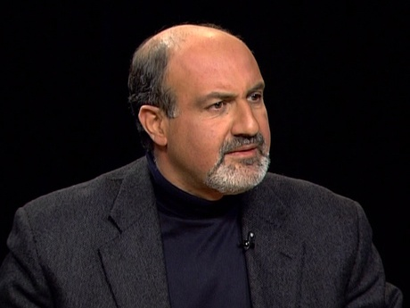
Thoughts About Skewed Distributions …
“Payoffs from research follow a power law, with big, near-unlimited upside but limited downside. Since the winner will have an explosive payoff, the right approach requires a certain style of blind funding … [of] as large a number of projects as possible...” Nassim Nicholas Taleb
Taleb N 2012 Random House

Slide 23
Other Finish Lines?
Shapiro D, Vrana K. PNAS 2015;112:9496-7

Slide 24
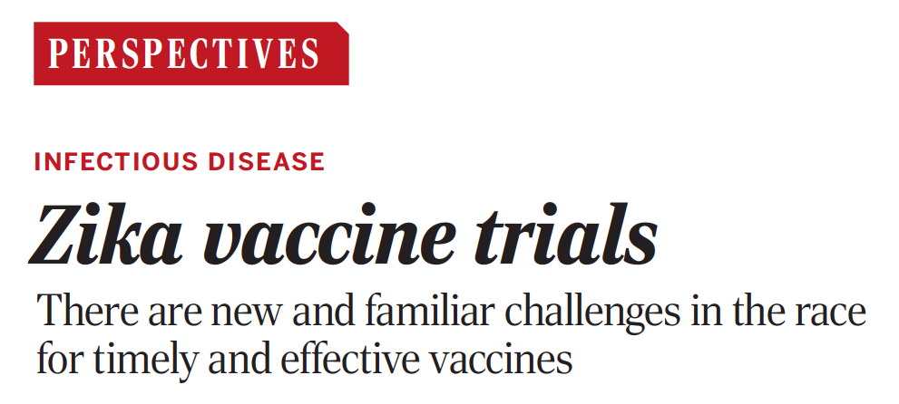
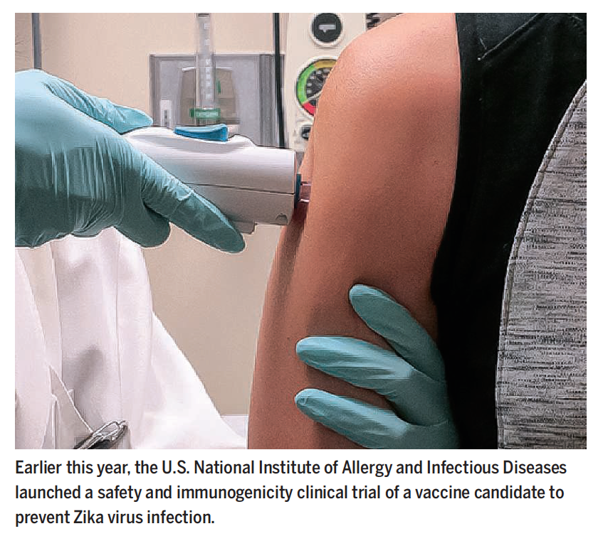
Ability to Respond to Emergencies …
Science 2016;353:1094-5

Slide 25
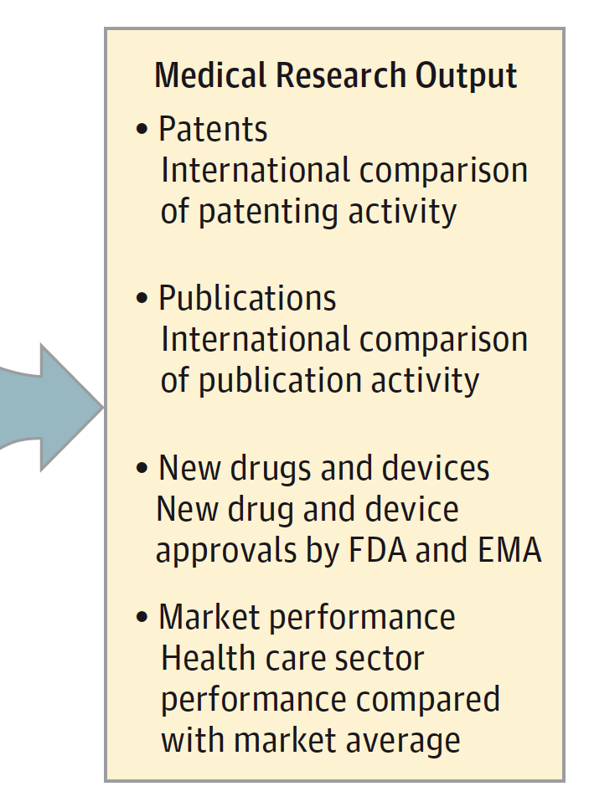
New Drugs, Devices
Moses H et al. JAMA 2015;313:174-189

Slide 26
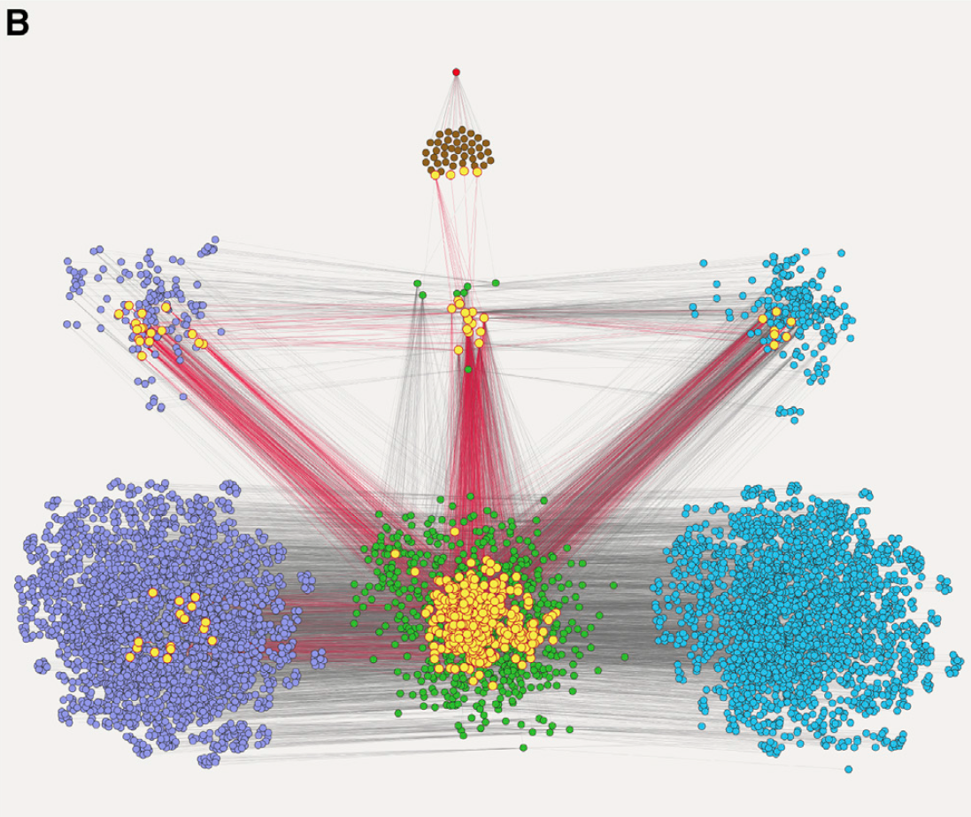
Sanders Williams R et al. Cell 2015;163:21-23
Ivacaftor
FDA trials
Scientists (N=2587) Institutions (N=2516)
Documents / Publications

Slide 27
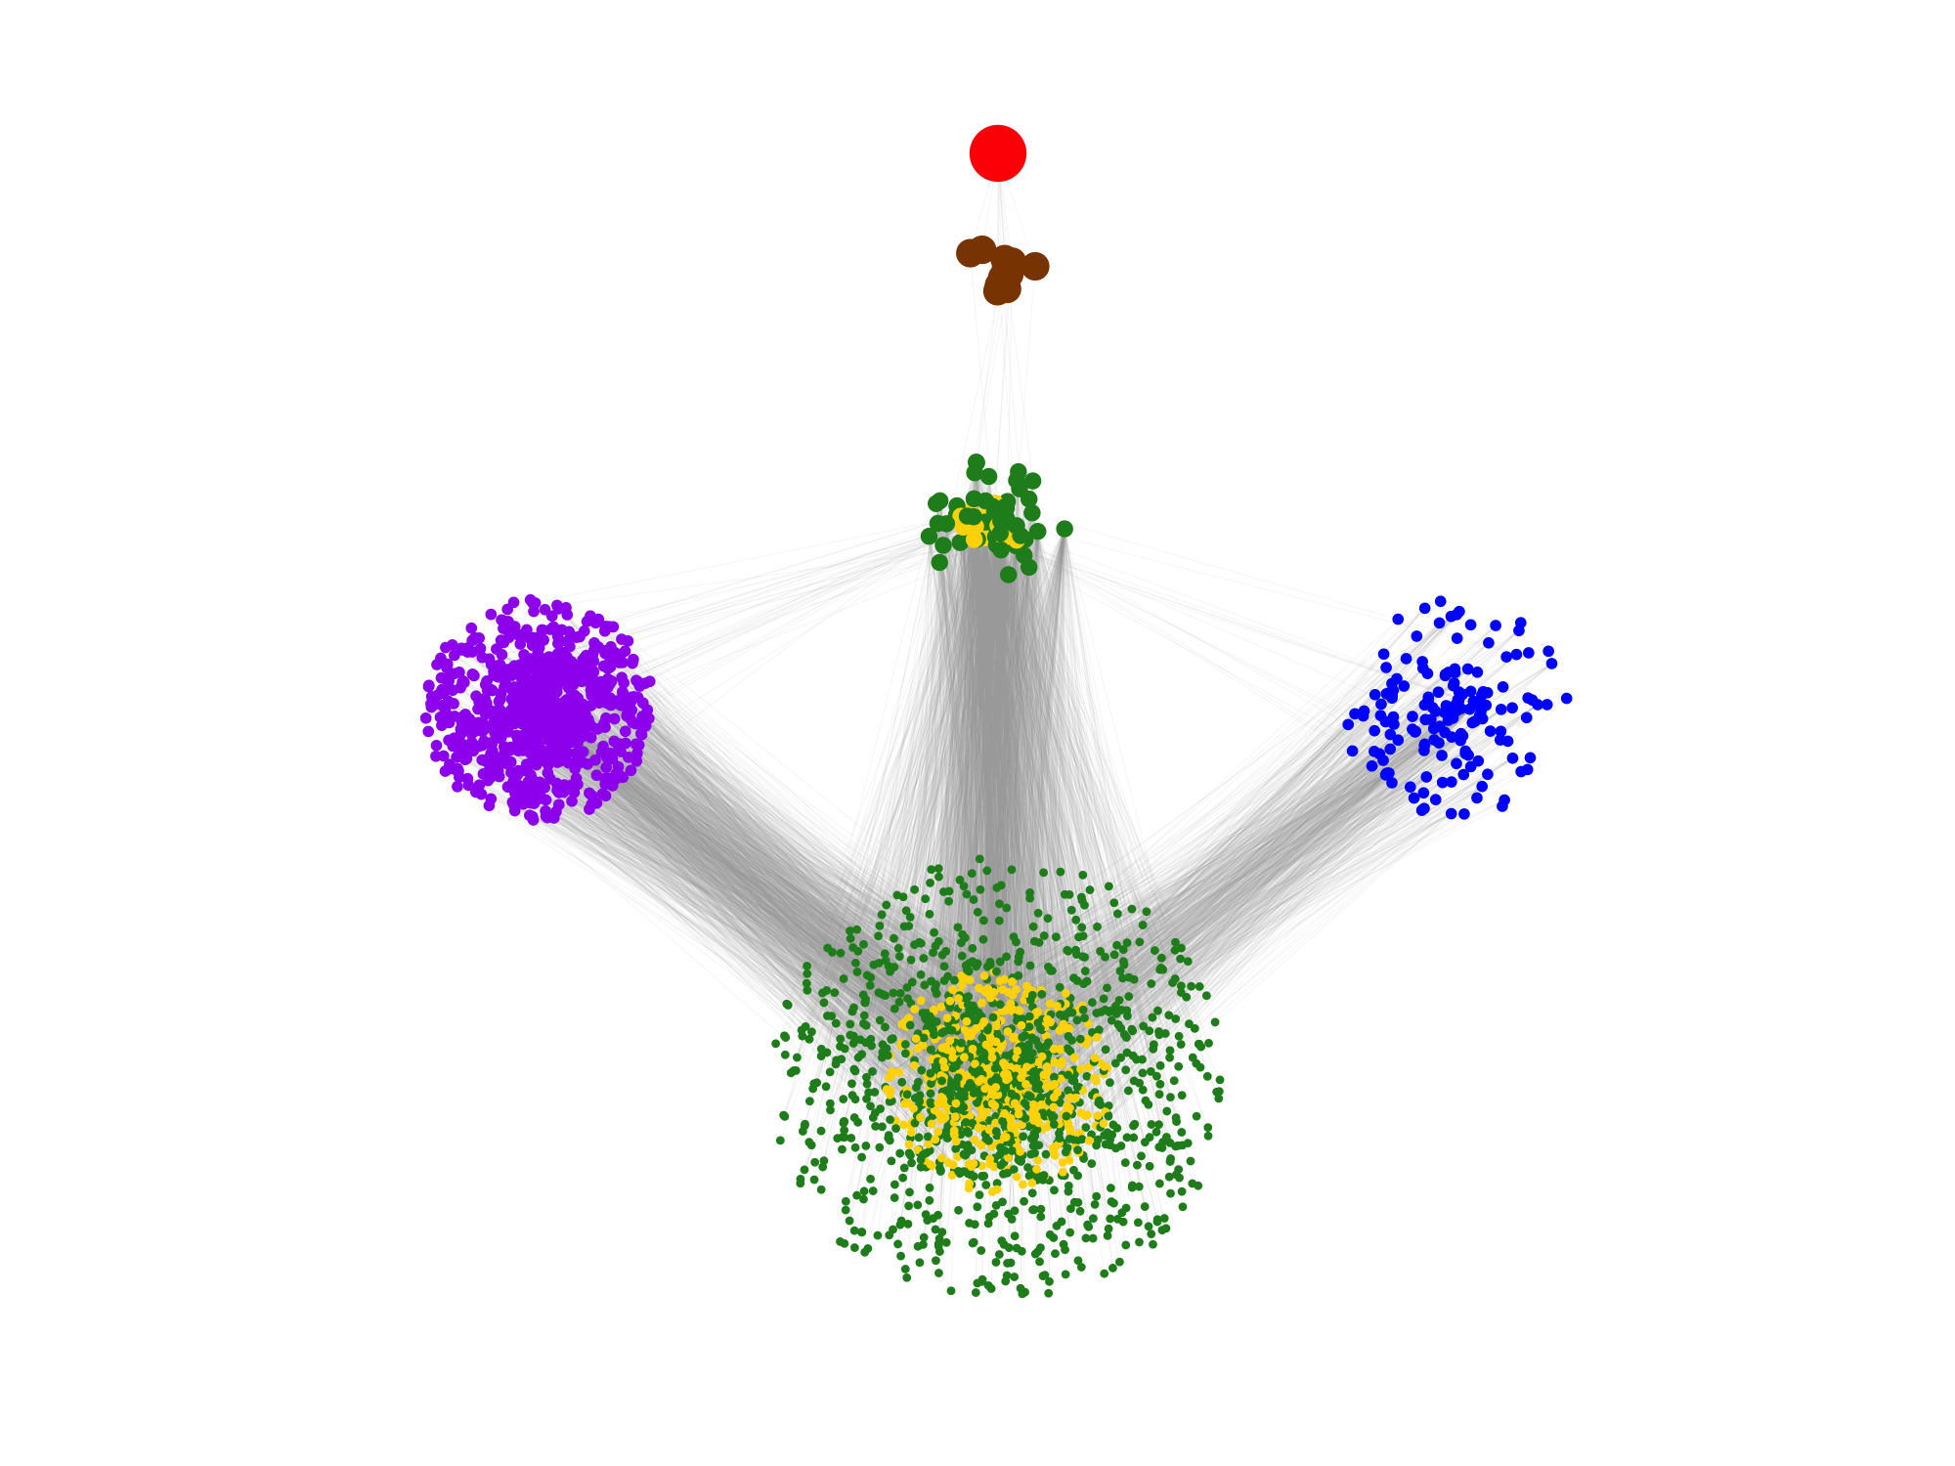
A Metrics Story with Big Data
PCSK9 inhibitor
Trials
Foundational publications
NIH grants
NIH-supported organizations
Cited References
Thanks Jim Onken, Brian Haugan, George Chacko,
Shixin Jiang, Samet Keserci, Alex Pico, and Lindsay Wan

Slide 28
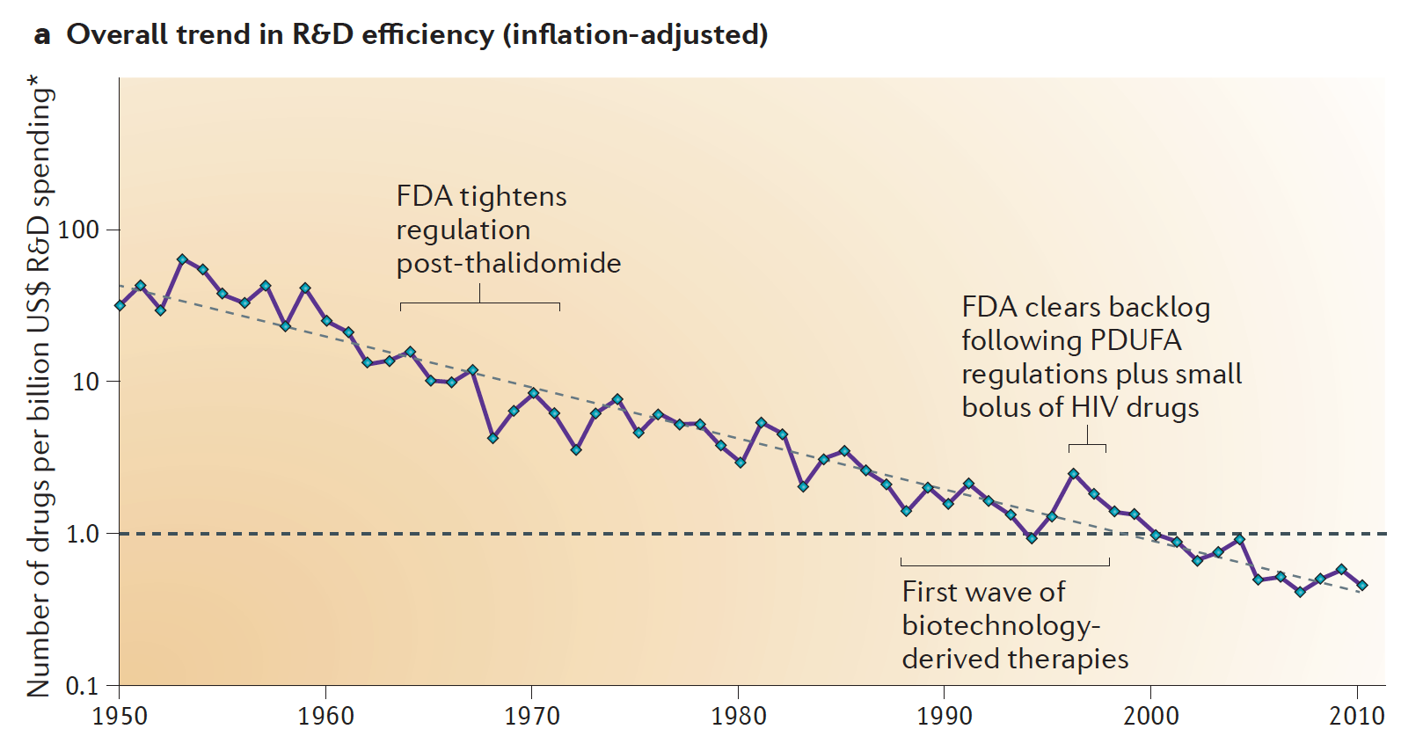
Why Should We Care? “Eroom’s Law”
Scannell JW et al. Nature Reviews Drug Discovery 2012;11:191-200

Slide 29
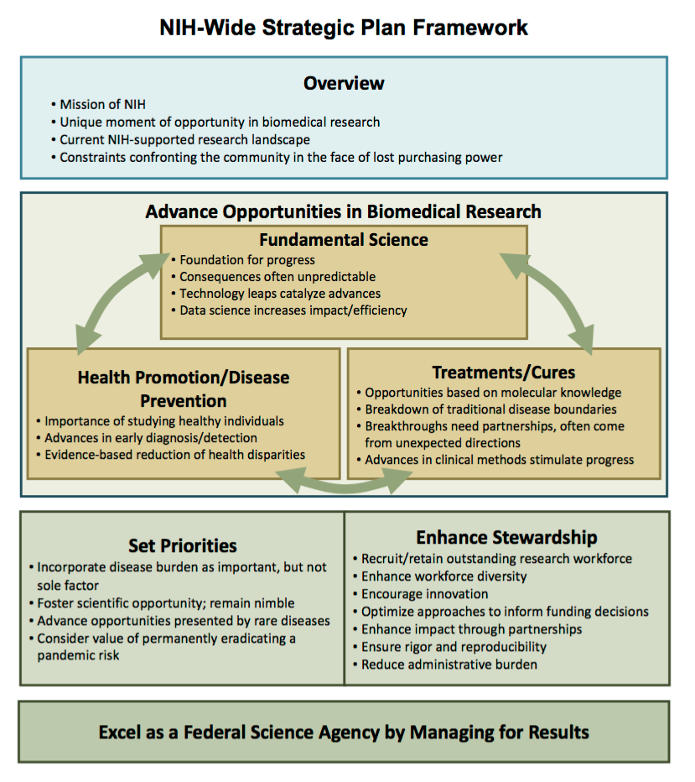
http://www.nih.gov/sites/default/files/about-nih/strategic-plan-fy2016-2020-508.pdf

Slide 30
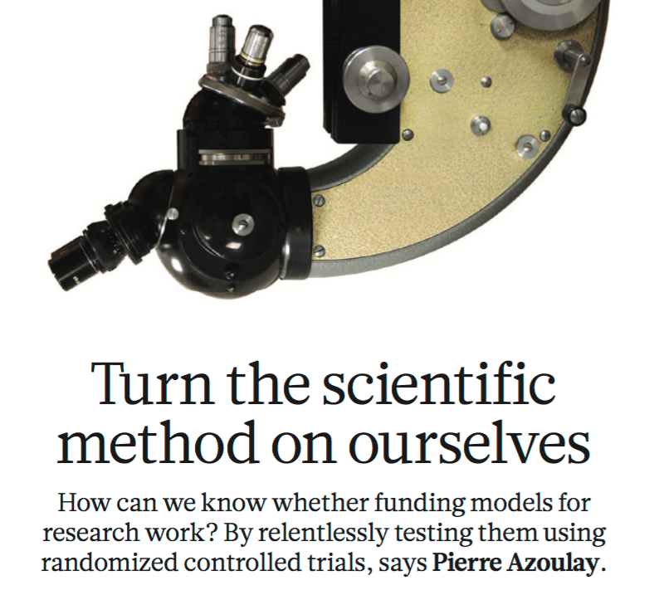
Towards “Evidence-Based Funding” …
“It is a scandal that billions of dollars are spent on research without knowing the best way to distribute that money.”
John Ioannidis
Azoulay P. Nature 2012;484:31-32
Ioannidis J. Nature 2011; 477:529-31

Slide 31
Looking Forward to Open Dialogue …
http://nexus.od.nih.gov/all/category/open-mike/

