Slide 1
Homeland Security Advanced Research Projects Agency (HSARPA)
Federal R&D Agency Workshop
8 October 2015
Dr. Pat Carrick
Director, HSARPA
Science and Technology Directorate

Slide 2
Agenda
DHS Organizational Structure
How Universities Engage with DHS
Opportunities for Graduates at DHS

Slide 3
Department of Homeland Security Organizational Structure
Support Components
(S&T, DNDO, NPPD, OIA, OHA)
Operational Components
(CBP, UCIS, USCG, FEMA, ICE, USSS, TSA)

Slide 4
Department of Homeland Security (DHS)
The vision of homeland security is to ensure a homeland that is safe, secure, and resilient against terrorism and other hazards.

Slide 5
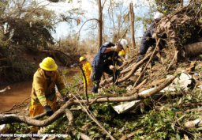
Department of Homeland Security (DHS)
Five Core Missions:
- Prevent Terrorism and Enhance Security
- Secure and Manage Our Borders
- Ensure Resilience to Disasters
- Safeguard and Secure Cyberspace
- Enforce and Administer Our Immigration Laws

Slide 6
Science & Technology (S&T) Directorate
SCIENCE & TECHNOLOGY Directorate
Support Components
(S&T, DNDO, NPPD, OIA, OHA)

Slide 7
Science & Technology (S&T) Directorate Mission
To deliver effective and innovative insight, methods and solutions for the critical needs of the Homeland Security Enterprise.
Notes:
S&T strives to develop and implement technology solutions that address our nation’s most pressing homeland security challenges.
We work collaboratively with many partners in the private and public sectors to identify, develop and share resources, capabilities, ideas and perspectives about best practices and methodologies for protecting the nation.
S&T seeks new and innovative ways to bring our many partners together to stimulate fresh thinking and innovative solutions to ensure the safety and resiliency of our communities, and of those who protect them.

Slide 8
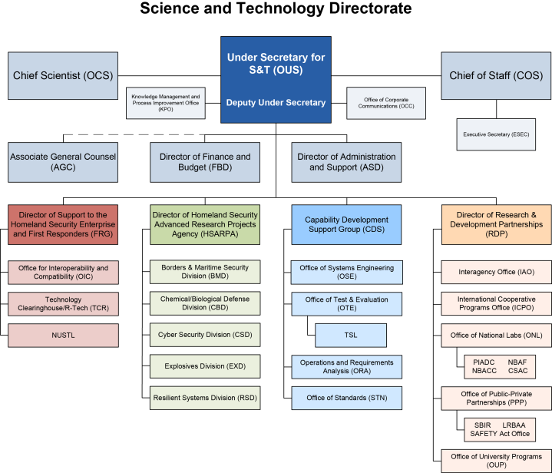
S&T Organizational Chart
Notes:
S&T research programs and core missions are organized under four lead groups:
Homeland Security Enterprise & First Responders Group – collaborates with and finds technology solutions for first responders
Homeland Security Advanced Research Projects Agency – known as HSARPA - executes research mission through five technical divisions, each focused on a major threat area [borders and maritime security, chemical/biological defense, cybersecurity, explosives, and resilient systems].
Capability Development Support Group – focuses on systems engineering, test and evaluation, standards and analyses.
Research & Development Partnerships - coordinates R&D efforts at all levels of government and across borders. Fosters collaborations with the DOE National Labs, private sector, university-based Centers of Excellence and other efforts

Slide 9
HSARPA Goals
Provide a Balance between near term, lower risk technologies and longer term, high-risk/high-payoff technologies
Encourage Opportunities for new ideas and competition from the private sector, small business, industry, academia, and federally funded research and development centers
Identify Technology Solutions from external partners via the concept of technology foraging

Slide 10
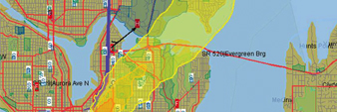
Homeland Security Advanced Research Projects Agency (HSARPA)
 | Borders and Maritime Division: Prevent contraband, criminals, and terrorists form entering the U.S. while permitting the lawful flow of commerce and visitors
 | Chemical / Biological Division: Detect, protect against, and respond to and recover from potential biological or chemical events
 | Cyber Security Division: Create a safe, secure, and resilient cyber environment
 | Explosives Division: Detect, prevent, and mitigate explosives attacks against people and infrastructure
 | Resilient Systems Division: Strengthen situational awareness , emergency response capabilities, and critical infrastructure protection
Notes:
HSARPA performs ~$350M of R&D activities yearly, equating to ~85% of S&Ts overall R&D budget

Slide 11
R&D Within S&T – Apex Projects
 | SCREENING AT SPEED: Security that Matches the Pace of Life
 | A TRUSTED CYBER FUTURE: Protecting Privacy, Commerce, and Community
 | ENABLE THE DECISION MAKER: Actionable Information at the Speed of Thought
 | RESPONDER OF THE FUTURE: Protected, Connected, and Fully Aware
 | RESILIENT COMMUNITIES: Disaster-Proofing Society
Notes:
We are directing our resources to address high-impact, high-threat challenges.

Slide 12
S&T Organizational Chart
Notes:
Research & Development Partnerships - coordinates R&D efforts at all levels of government and across borders. Fosters collaborations with the DOE National Labs, private sector, university-based Centers of Excellence and other efforts

Slide 13
Office of University Programs (OUP) Research and Development Partnerships (RDP)
Centers of Excellence: Perform research and development activities to provide critical homeland security tools, technologies, training, and talent (including over 40 tools, technologies, and knowledge products either in pilot studies or use).
Minority Serving Institutions Program: OUP supports the participation of Minority Serving Institutions in the DHS Centers of Excellence Program by offering programs such as the DHS Summer Research Team Program and the Scientific Leadership Awards (SLA).
Workforce Development: The University Programs network promotes university-based education programs to develop essential scientific and technical expertise through a suite of scholarships, fellowships, and research opportunities.
Notes:
The Office of University Programs engages the academic community to conduct research and analysis, and provide education and training to enhance the Department’s homeland security capabilities. University Programs' three areas include:
Centers of Excellence
Minority Serving Institutions Program
Workforce Development

Slide 14
How Universities Engage with DHS/S&T
Centers of Excellence (COE): University-based program that has significant homeland security-related science, technology, engineering, and mathematics capabilities inclusive of: subject matter expertise, laboratories, engineering and other test facilities, data bases, analytical capabilities, etc.
hsuniversityprograms.org
dhs.gov/science-and-technology/centers-excellence
Notes:
How Universities engage with DHS S&T
Become a Center of Excellence

Slide 15
How Universities Engage with DHS/S&T
Center of Excellence (COE) Lead Universities
Center of Excellence (COE) Partners (45 States)
Department of Energy Lab Partners (11 States)
DHS Science and Technology Directorate Labs (3 States)
Minority Serving Institutions Award Recipients (13 States)
hsuniversityprograms.org
dhs.gov/science-and-technology/centers-excellence
Notes:
The Centers of Excellence (COE) network is an extended consortium of hundreds of universities generating ground-breaking ideas for new technologies and critical knowledge. All Centers of Excellence work closely with academia, industry, DHS components, and first-responders to develop customer-driven research solutions to ‘on the ground’ challenges as well as provide essential training to the next generation of homeland security experts. The research portfolio is a mix of basic and applied research addressing both short and long-term needs. The COE extended network is also available for rapid response efforts.

Slide 16
How Universities Engage with DHS/S&T
How it Works
Step 1: S&T competitively selects COEs and funds research and educational programs under grants and cooperative agreements (limited funds intended to establish a baseline capability at the COEs for unclassified research and educational programs
Step 2: OUP establishes a Basic Ordering Agreement (BOA) with the COE
OUP has established DHS Department-wide Basic Ordering Agreements (BOAs) with 10 University-based Centers of Excellence
Step 3: The BOAs enable all DHS Components, not just S&T, to acquire homeland security-related research, analyses, and services, from the designated lead research COE.
hsuniversityprograms.org
dhs.gov/science-and-technology/centers-excellence
Notes:
OUP funds grants and cooperative agreements to the COEs to establish fundamental research and educational programs in specific multi-disciplinary subject matter areas. The COEs develop countermeasures, mitigation, and prevention approaches and technologies relevant to homeland security. The COEs are designed to (a) work with and complement DHS research and development programs, including Federal laboratories’ homeland security research; (b) take advantage of other related federally-sponsored research, and (c) provide outcomes useful to federal, state, and local governments, private sector, and international partners.

Slide 17
Current and Newly Awarded COEs
COE | Lead University | Area of Major Research | DHS/S&T Division Alignment
ADAC | Univ. of Alaska Anchorage | Maritime Domain Awareness and Situational Response Support | Borders and Maritime Security Division
ALERT | Northern University | Explosives Detection, Mitigation, Response | Explosives Division
CBTIR | Univ. of Houston | Border Security and Immigration | Borders and Maritime Security Division
CIRI | Univ. of Illinois at Urbana-Champaign | Infrastructure Resilience | Resilient Systems Division, First Responders Group
CRC | Univ. of North Carolina at Chapel Hill | Costal Resilience | Resilient Systems Division, First Responders Group
CREATE | Univ. of Southern California | Terrorism Risk, Economics, Operations Research | All DHS S&T Divisions
CVADA | Purdue | Visualization and Data Analytics | All DHS S&T Divisions
FPDI | Univ. of Minnesota | Food Protection and Defense | Chemical and Biological Division
MASC | Stevens Institute of Technology (MSC) | Maritime Security | Borders and Maritime Security Division
START | Univ. of Maryland | Terrorism and the Responses to Terrorism | All DHS S&T Divisions
ZADD | Texas A&M | Foreign Animal and Zoonotic Disease Defense | Chemical and Biological Division
hsuniversityprograms.org
dhs.gov/science-and-technology/centers-excellence

Slide 18
Emeritus COEs
COE | Lead University | Area of Major Research | DHS/S&T Division Alignment
CAMRA | Michigan State and Drexel University | Exposure Assessment, Risk Characterization, and Modeling | Chemical and Biological Division
CHC | Univ. of North Carolina at Chapel Hill and Jackson State University | Costal Resilience | Resilient Systems Division, First Responders Group
MIREES | Univ. of Hawaii | Maritime Security | Borders and Maritime Security Division
NCBSI | Univ. of Arizona and Univ. of Texas as El Paso | Border Security and Immigration | Borders and Maritime Security Division
NTSCOE |  | National Transportation Security | Resilient Systems Division, First Responders Group
PACER | Johns Hopkins University | Health Preparedness and Situational Awareness | Resilient Systems Division, First Responders Group
hsuniversityprograms.org
dhs.gov/science-and-technology/centers-excellence

Slide 19
Opportunities at DHS Through OUP
Workforce Development: helps educate and train homeland security science and engineering professionals for the future workforce through the following initiatives
Summer Internships: Provides juniors and seniors up to 10 weeks of internship support during the summer
Homeland Security Externships: Provides students with quality homeland security science and engineering learning and research opportunities at homeland security research facilities
Military Service Academies Program: Provides faculty and student teams from U.S. military academies the opportunity to conduct research at universities affiliated with the COEs
Graduate Research Internship Program: Pilot program with the National Science Foundation (NSF) to engage NSF graduate fellows in mission-related, collaborative research projects under the guidance of research mentors at DHS to develop expertise in critical homeland security areas
hsuniversityprograms.org
dhs.gov/science-and-technology/centers-excellence
Notes:
The OUP Workforce Development Initiatives help educate and train the current and future homeland security workforce in science and engineering professions to enhance the capabilities and effectiveness of the homeland security community. Through OUP grants, internships and fellowships, students acquire advanced technical knowledge and training and gain exposure to and experience handling complex real-world challenges.

Slide 20
Engage With Us
DHS S&T OUP Website:
dhs.gov/science-and-technology/centers-excellence
Email DHS S&T OUP:
Universityprograms@dhs.gov
Homeland Security University Programs
hsuniversityprograms.org
hsuniversityprograms.org
dhs.gov/science-and-technology/centers-excellence

Slide 21
Engage With Us
NATIONAL
CONVERSATION
WEBSITE
scitech.dhs.gov
STAKEHOLDER
ENGAGEMENT
SOCIAL MEDIA
using “dhsscitech”
PRIZE
AUTHORITY

