Slide 1
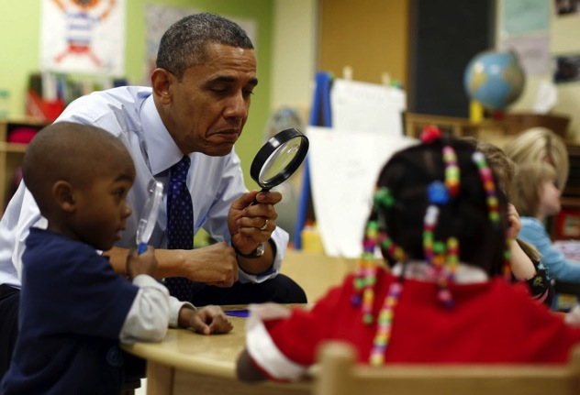
The Need for an Arpa-ed
Russell Shilling
Executive Director
Office of STEM
U.S. Department of Education
RuSSELL.SHILLING@ED.GOV
Oct 2015

Slide 2
Why an arpa-ED?
April 2015 Scientific American
Post-WWII we adopted the Vannevar Bush model
for research
DARPA process is powerful because it operates
within Pasteur’s Quadrant (PQ)
Behavioral Sciences have been shoehorned into
physical science models
May be more successful developing within PQ
Reprinted from “Benefits of Use-Inspired Science”
Princeton Environmental Institute, 2012

Slide 3
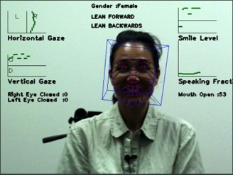
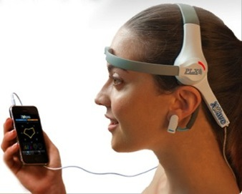
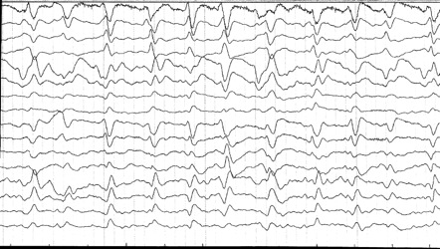
DARPA Concept: Individual Human is a Neurobehavioral “Big Data” Problem (Not affiliated with U.S. Dept of Education)
Speech/Text Analysis Voice Stress Analysis
CAMERA
Eye / Body Movements
Facial Expressions
Heart Rate / HRV
Pupillometry
MICROPHONE
ACCELEROMETER/GPS
Sleep Patterns
Activity Monitor
Social Interaction
Electroencephalography (EEG)
Electrodermal Response (EDR)
KEYBOARD
Input patterns
Keyboard inputs
BLUETOOTH
Notes:
The concept is considered to be platform agnostic, since technology is ever changing. For our purposes we will be concentrating on tablets & PCs. For neurophysiological sensors, we want to use sensors that are already incorporated in mobile technologies, but will branch out to EEG and other basic sensors since these technologies may become more readily available and cheaper in the future.

Slide 4
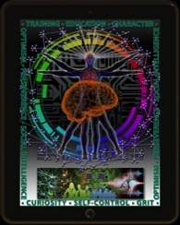
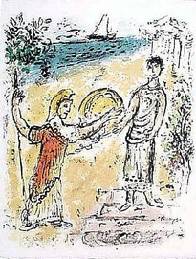
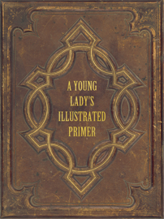
DARPA Concept: A Vision for the Future of Learning (Not affiliated with U.S. Dept of Education)
Combine Best Concepts for Future Education Technology Development:
Intelligent, completely interactive systems that imprint on and adapt to the user
Span years of learning (or a lifetime), not a single course
Content individualized across different media types (games, lectures, e-books, comics, video, etc)
Leverages behavior and neurosciences to assess attention, confusion and comprehension to exceed the capabilities of human tutors
Software grows with the user and presents challenges at appropriate times
Merges academic and non-cognitive (grit, perseverance, etc) factors
Tools improve based on entire population of users
Combining Mentoring of Classical Instruction
With Advanced Technology to Enhance
Modern Education
Mentor & Telemachus
Diamond Age
“Our education system was designed more than a century ago and it has not changed with the times. It needs to change to prepare our children for the new century. We must try new approaches to teaching -new ways of using technology - and better systems of monitoring progress. The only way to get better results is by replacing what doesn't work with what does.” – Arne Duncan
Marc Chagall: Telemach & Athene
Notes:
I’ve been working in the training and education space for 20 years in the Navy. In the past 10 years, I’ve also worked heavily in the psychological health realm. In 2007, I started working with Sesame Workshop on a resilience program for military children. As a result, I started getting invited to high-level meetings on education conducted by Sesame Workshop, PBS, Apple, Microsoft, Gates Foundation, and Dept of Education to name a few. It’s changed my fundamental view on how we should move forward in both military training and civilian education.
In the classical model, education was a one to one process with a tutor and a student. A good example of this can be found in the classical story, The Odyssey. Odysseus leaves his son, Telemachus, in the care of Mentor who educates him academically, socially, and emotionally. When his father does not return when the Trojan Wars end, Athena disguises herself as Mentor, has him dispatch his mother’s suitors, and embark on a search for his father with her help.
The modern education system has adapted to teach masses of children and adults and has transfomed society. However, in the process education ahs lost the one-on-one approach for a primarily one-size-fits-all model. Moderns education has changed little over the past 100 years. Technology wields the promise of combining the best of both systems.
In Neil Stephenson’s novel, the Diamond Age, a small girl obtains a stolen copy of a technological teaching marvel, “The Young Lady’s Illustrated Primer”, code named “Runcible”. She’s uneducated. In poor circumstances. She is sexually, physically, and psychologically abused. The Primer bonds to the child and starts educating her, using different approaches and interwoven with storytelling and narrative specifically tailored to her and her circumstances. The technology imprints on the child and adapts its instruction specifically to the child’s circumstances. It educates both academically and in non-cognitive areas such as resilience, tenacity, & curiosity. And, it follows her through adulthood.
This book is known throughout the education community and is cited widely. Yet, we haven’t asked the question whether such technology could be effective or how we would go about building it. As it turns out, it raises exceptionally exciting and complex research questions.
The program I am about to describe attempts to deconstruct assumptions about how we train and educate and especially how we are using technology.

Slide 5
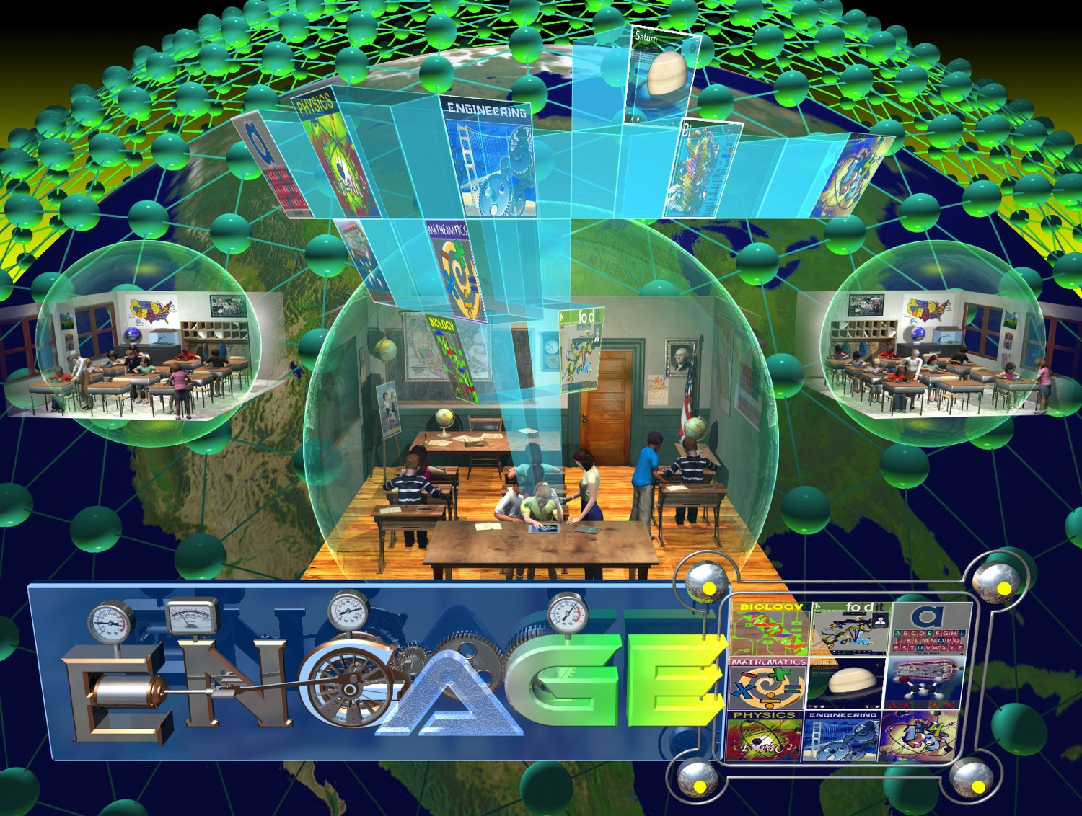

Slide 6
LINKS TO DARPA ENGAGE GAMES
Refractions (Popovic)
http://www.brainpop.com/games/refraction/
Treefrog Treasure (Popovic)
http://www.brainpopjr.com/games/treefrogtreasure/
Washington, Minnesota, & Norway Algebra Challenge (Adapted DragonBox)
Nanocrafter (DNA Science Game ala FOLD-IT from Popovic)
www.nanocrafter.org
Computer Science Student Network (Carnegie Melon Robotics)
www.cs2n.org
Space Force (Intific)
http://www.brainpop.com/games/spaceforce/
“Non-cognitve” factors are secondary goal of all approaches. Assessment conducted by UCLA-CRESST

Slide 7
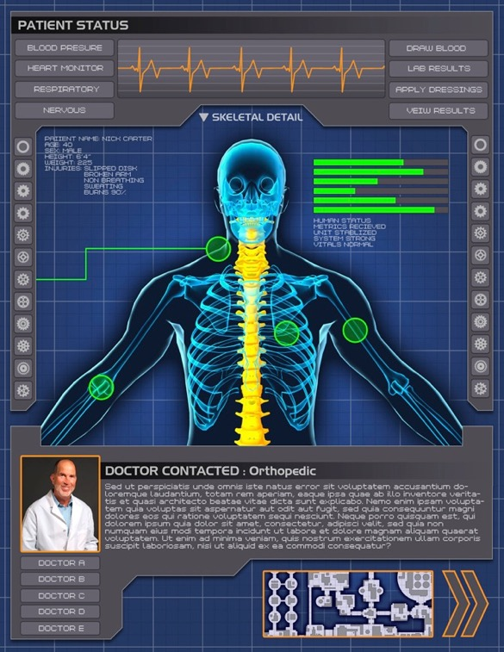
Joint DARPA & Dept of ED SBIR
STEM Meets Procedural Learning

Slide 8
STEM 10 Year Vision Plan (STEM 2025)
Goal: Blue-Sky/Clean Sheet Vision for STEM Education Continuum and Ecosystem
Deconstruct vision to identify policy, research, and practice challenges
Create larger community discussion of STEM vision
Inform ED innovation policy and ARPA-ED
Small working groups
Diverse, interdisciplinary members
Convened one panel at Scientific American Annual STEM conference
Teachers, researchers, administrators, visionaries
Report due by end of December 2015
Have already identified several areas of need
Propagation vs Scaling
Alternative research models
Interdisciplinary research teams
Real-time formative assessment / Active Learning
Reduce stove-pipes between STEM topics (and non-STEM topics)

