Slide 1
Office of Science Overview
4th Annual Federal R&D Agency Workshop of the
State University System of Florida
29 September 2016
Patricia Dehmer, PhD
Deputy Director for Science Programs
Office of Science, US DOE
www.science.energy.gov

Slide 2
Office of Science FY2016 - $5.35B
Largest Supporter of Physical Sciences in the U.S.*
Research: 42%, $2.2B
Facility Operations: 38%, $2.02B
Construction: 13.5%, $723M
Funding to >300 institutions including all 17 DOE Labs
~40% of Research to Universities
> 20,000 Scientists Supported
>35,000 Scientific Facility Users**
* 43% of all physical sciences, 30% of computer science and math
** from all 50 states and DC

Slide 3
SC Investments in Research, Facilities, and Construction

Slide 4
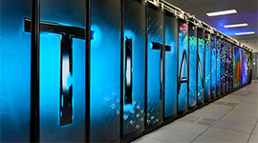
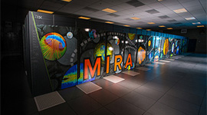
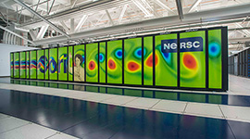
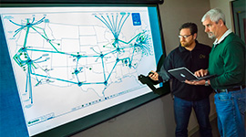
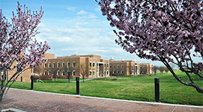
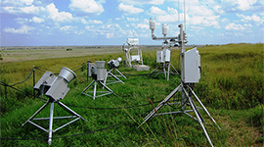
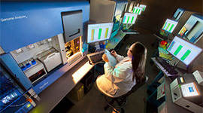
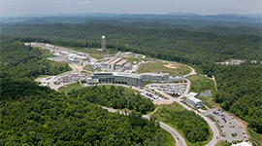
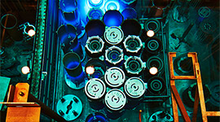
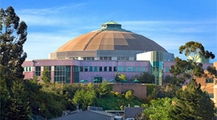
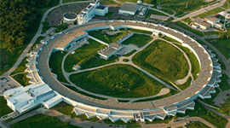
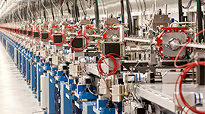
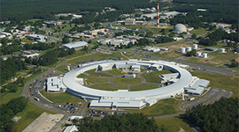
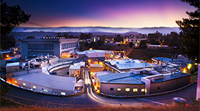
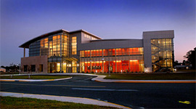
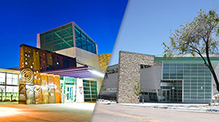
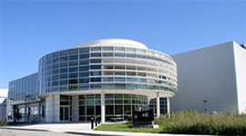
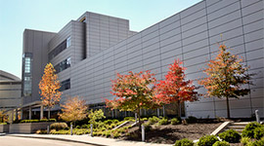
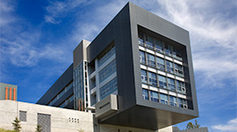
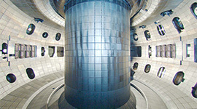
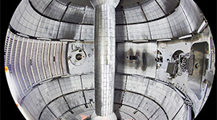
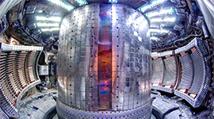
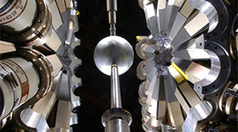
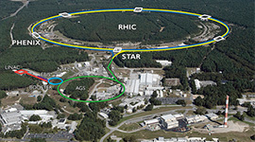
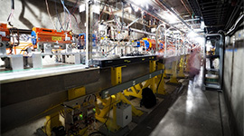
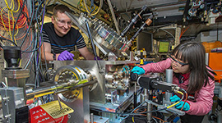
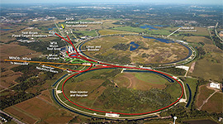
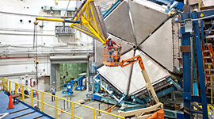
FY 2016
28 user facilities
OLCF
ALCF
NERSC
ESnet
EMSL
ARM
JGI
SNS
HFIR
ALS
APS
LCLS
NSLS-II
SSRL
CFN
CINT
CNM
CNMS
TMF
DIII-D
NSTX-U
C-Mod
ATLAS
RHIC
FACET
ATF
Fermilab AC
CEBAF

Slide 5
Office of Science User Facility Statistics FY 2014
Other includes many institutions, such as: non-DOE labs, federal agencies, research hospitals, K-12 students, and international institutions

Slide 6
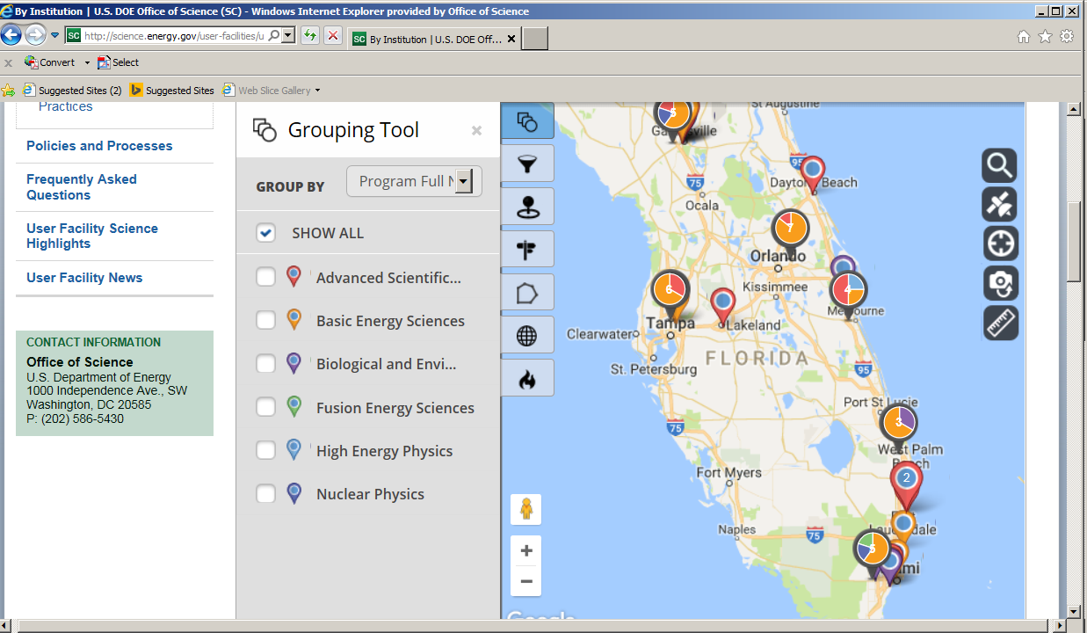
Office of Science User Facility Statistics FY 2014
Other includes many institutions, such as: non-DOE labs, federal agencies, research hospitals, K-12 students, and international institutions

Slide 7
Office of Science Laboratories Total FY2015 $5.5B, SC funding $3.4B
Notes:
Other DOE SPP SC Total
AMES $25.74 $0.91 $30.38 $57.04
ANL $182.71 $116.68 $434.75 $734.14
BNL $27.39 $53.48 $502.88 $583.74
FNAL $0.00 $0.93 $385.75 $386.68
LBNL $113.63 $107.11 $565.16 $785.91
ORNL $485.53 $233.50 $693.04 $1,412.07
PNNL $423.45 $265.16 $186.36 $874.97
PPPL $0.13 $2.29 $87.09 $89.50
SLAC $4.15 $13.69 $411.78 $429.61
TJNAF $- $14.90 $142.95 $157.85

Slide 8
FY 2017 House and Senate Marks for the SC Programs

Slide 9
High Risk,
High Payoff
Venture Capital and
Small Businesses
DOE
Office of Science
DOE ARPA-E
Private Equity/Capital
& Large Corporations
Risk
DOE Applied
Technology Offices
DOE Loan Guarantee
Program
Low Risk,
Evolutionary
Basic
Science
Research
Feasibility
Research
Technology
Development
Technology
Demonstration
Small Scale
Deployment
Large Scale
Deployment
Technology Readiness Level
9

Slide 10
DOE Funding Types
Applied
Research
Technology
Maturation
& Deployment
Discovery
Research
Use-Inspired
Basic Research
Office of Science
Applied Programs
ARPA-E*
Goal: new knowledge / understanding
Focus: phenomena
Metric: knowledge generation
Goal: practical targets
Focus: performance
Metric: milestone achievement
Consortia, Crosscuts
Bioenergy Research Centers, Hubs
Energy Frontier Research Centers
Core Research / Individual PIs
* ARPA-E targets technology gaps, high-risk concepts, aggressive delivery times

Slide 11
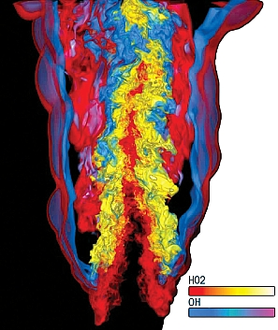
DOE’s Exascale Computing Initiative: Next Generation of Scientific Innovation
Hardware, software, applications, large data, underpinning applied math and computer science
Supports DOE’s missions in national security and science:
Stockpile stewardship – support annual assessment cycle
Discovery science – next-generation materials
Mission-focused basic science in energy – next-generation climate software
Use current Leadership Computing approach for users
The next generation of advancements will require Extreme Scale Computing
100-1,000X capabilities of today’s computers with a similar physical size and power footprint
Significant challenges are power consumption, high parallelism, reliability
Notes:
The Need: DOE needs exascale computing to continue to fulfill its mission into the next generation of scientific breakthroughs. This includes multi-physics, multi-scale simulations with increasingly high spatial and temporal resolution, scientific discovery from experimental and other data, …
Our future will be determined, driven, and (if we fail) restricted by how we form and employ HPC at exascale
Extreme scale science = next generation of scientific breakthroughs
These breakthroughs are critical to future progress in all areas of our lives
But, … these breakthroughs won’t happen without Exascale computing
And, … Exascale computing won’t happen via business as usual – there are no easy fixes, no magic bullets left, no low hanging fruit
Need major re-thinking of computing technology
We’ve done numerous studies to identify requirements, and have determined that exascale computing is challenging but feasible

Slide 12
Long Baseline Neutrino Facility
P5 recommended LBNF as the centerpiece of a U.S.-hosted world-leading neutrino program
P5 recognized LBNF as the highest-priority large project in its timeframe
The world’s most intense neutrino beam will be produced at Fermilab and directed 800 miles through the earth to Lead, South Dakota
Fermilab will lead this effort with a few international partners, most notably CERN
A very large (40 kiloton) liquid argon neutrino detector will be placed in the Homestake Mine in Lead, SD
An international collaboration has been established for the Deep Underground Neutrino Experiment (DUNE)
The U.S. will contribute to the detector as part of the LBNF project

Slide 13
State University System of Florida Awards FY 2016
 | University | # Active Awards | Amount Awarded this Year
FAMU | Florida Agricultural and Mechanical University | 3 | $ 0
FAU | Florida Atlantic University
FGCU | Florida Gulf Coast University
FIU | Florida International University | 4 | $1,256,935
FPU | Florida Polytechnic University
FSU | Florida State University | 22 | $8,809,477
NCF | New College of Florida
UCF | University of Central Florida | 6 | $1,165,000
UF | University of Florida | 14 | $4,470,000
UNF | University of North Florida
USF | University of South Florida | 6 | $1,329,577
UWF | University of West Florida
 | TOTAL | 55 | $17,030,989

Slide 14
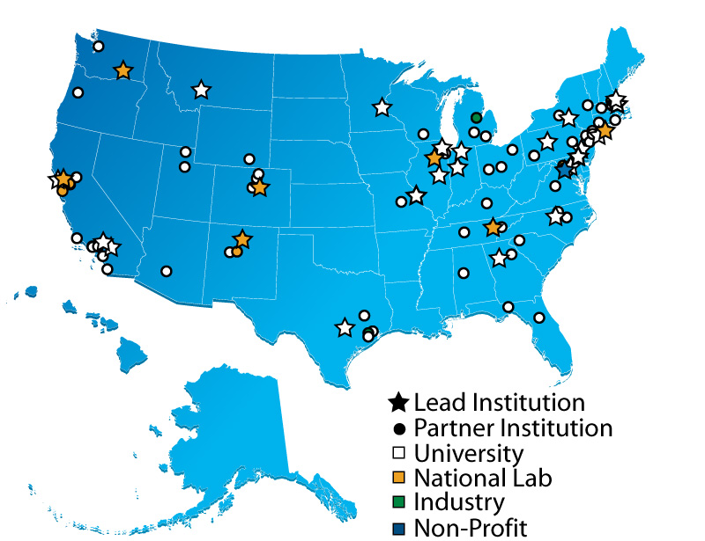
Energy Frontier Research Centers
Current Status
Over 100 participating institutions, located in 33 states plus the District of Columbia
Advisors from:
12 countries
29 states
Website: http://science.energy.gov/bes/efrc/
Data updated on 6/6/2016
14
Notes:
Slide last updated on June 6, 2016 based on the 2016 Annual Progress Reports (submitted on May 2, 2016).
EFRC Members
Last updated May 2, 2016. Senior investigators in more than one EFRC have only been counted once. These are head counts, not person months per year or FTEs.
Scientific Advisory Board
Last updated May 2, 2016 (There may be small changes to the following after EFRCs clarify ambiguous annual report submissions). 12 countries includes USA; 222 unique advisors, 242 EFRC advisors (205 serve on 1 board, 14 serve on 2 boards, and 3 serve on 3 boards); 29 states; Institution Type – Total unique board members (unique institutions): University – 125 (72); National Lab – 36 (13); Government – 4 (3); Non-Profit – 2 (1); Industry – 55 (42)

Slide 15
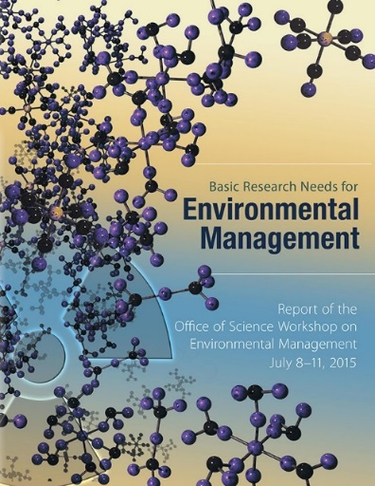
2016 EFRC Awards ($10M/yr for 4 years)
Four new centers announced on July 18, 2016:
Multi-disciplinary basic research teams in areas of relevance to environmental management:
Novel methods for characterization, transformation, and separation of nuclear waste
New materials for long-term storage of nuclear waste, including waste forms
Institutions | EFRC Name | EFRC Director
Lead: Florida State University Partners:* Colorado School of Mines, Florida International, LANL, LBNL, Purdue, Rice, SRNL, Alabama, Missouri, UPenn | Center for Actinide Science and Technology (CAST) | Thomas Albrecht-Schmitt
Lead: The Ohio State University Partners:* CEA, LSU, Penn St, PNNL, Questek Innovations, RPI, Bristol, North Texas, UVA, Western | Center for Performance and Design of Nuclear Waste Forms and Containers (WastePD) | Gerald Frankel
Lead: University of South Carolina Partners:* Alfred, BNL, CEA, Clemson, PNNL, SRNL, Florida | Center for Hierarchical Waste Form Materials (CHWM) | Hanno zur Loye
Lead: Pacific Northwest National Laboratory Partners:* CUNY, Georgia Tech, Notre Dame, ORNL, Washington, Washington St. | Interfacial Dynamics in Radioactive Environments and Materials (IDREAM) | Sue Clark

Slide 16
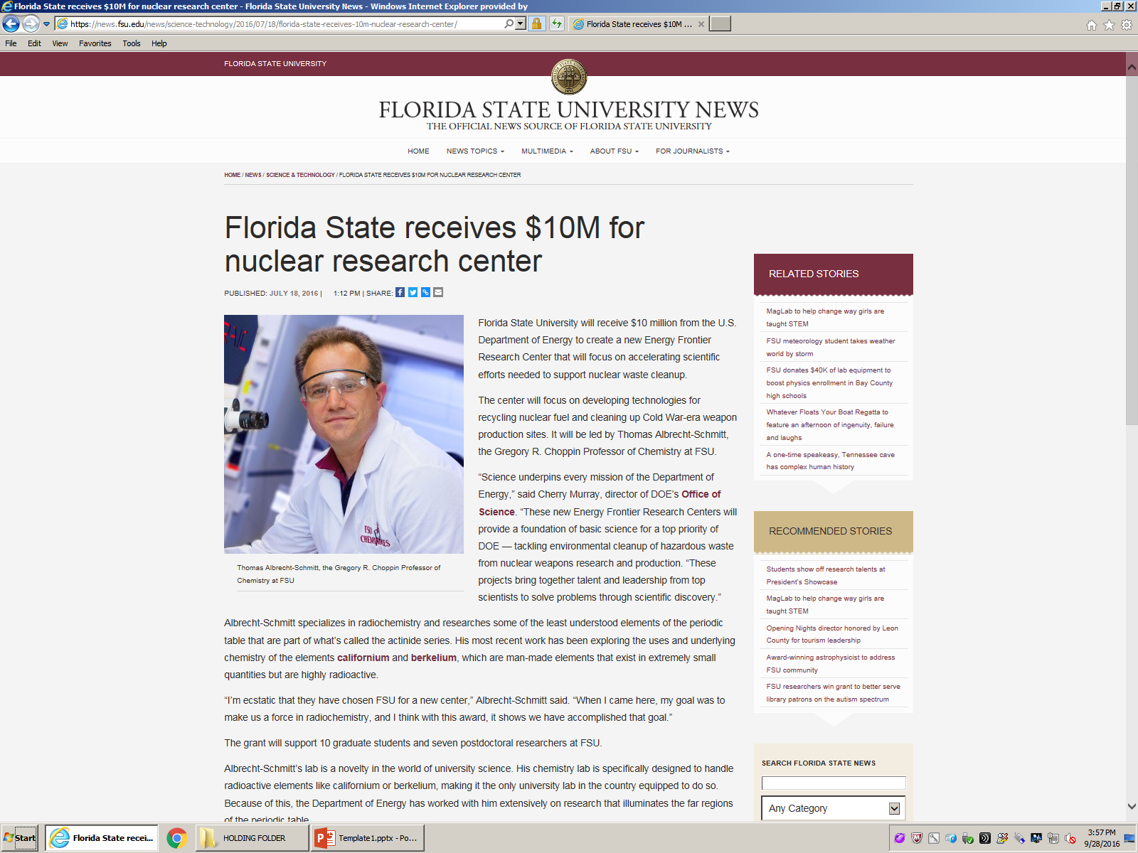

Slide 17
