Slide 1
DoD Mechanisms to Assist in Commercializing Discoveries in Academia
Third Annual C.W. Bill Young
Federal R&D Agency Workshop
U.S. Capitol, Washington, D.C.
October 8, 2015
Camylle Coley
Senior Advisor to the Director
DoD Basic Research Office

Slide 2
Basic Research Office Overview
a. Basic Research in DoD
b. Basic v. Applied Research
c. Emerging Research Areas

Slide 3
DoD’s Definition of Basic Research
“Basic research is systematic study directed toward greater knowledge or understanding of the fundamental aspects of phenomena and of observable facts without specific applications towards processes or products in mind. It includes all scientific study and experimentation directed toward increasing fundamental knowledge and understanding in those fields of the physical, engineering, environmental, and life sciences related to long-term national security needs. It is farsighted high payoff research that provides the basis for technological progress.”
Source: DoD 7000.14-R Financial Management Regulation, §50201 “RDT&E Budget Activities”
http://comptroller.defense.gov/fmr/current/02b/Volume_02b.pdf

Slide 4
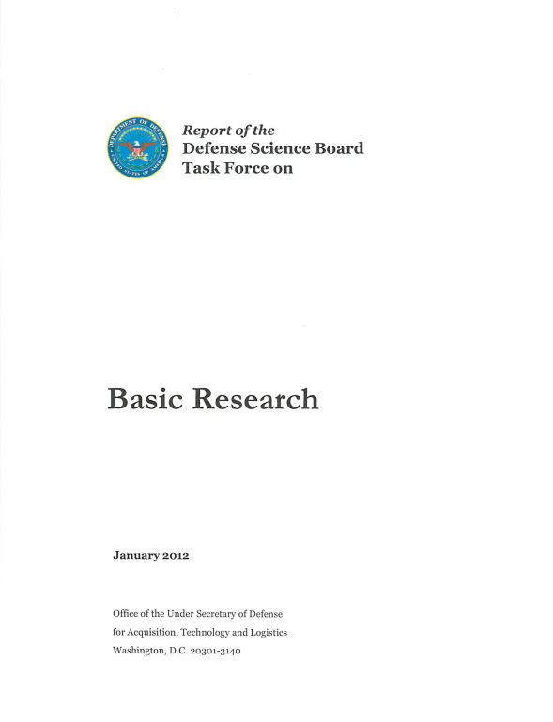
Why DoD Invests in Basic Research
Basic research probes the limits of today’s technologies and discovers new phenomena and know‐how that ultimately lead to future technologies.
Basic research funding attracts some of the most creative minds to fields of critical DoD interest.
Basic research funding creates a knowledgeable workforce by training students in fields of critical DoD interest.
Basic research provides a broad perspective to prevent capability surprise by fostering a community… who follow global progress in both relevant areas, as well as those that may not seem relevant — until they are.
Goal: Create conditions for basic research investments capable of creating high-payoff, transformative scientific breakthroughs

Slide 5
Basic Research versus Applied R&D
S&T ExCom
Strategic oversight and guidance
DBRAG
COIs
DoD manages basic research as a single program through the Defense Basic Research Advisory Group (DBRAG) in parallel to the Communities of Interest (COIs)
More applied R&D is organized under 17 COIs – technical groups that coordinate and plan R&D across the Services
The results of basic research may transition to applied research or advanced technology development
Air Platforms
Autonomy
Biomedical Research (ASBREM)
Counter IED
CounterWMD
Advanced Electronics
Cyber Security
Electronic Warfare & Protection
Energy & Power Technologies
Engineered Resilient Systems
Ground & Sea Platforms
Human Systems
C4ISR
Materials & Manufacturing Processes
Sensors & Processing
Space
Weapons Technologies
Notes:
17 portfolios are comprised of the “S&T priorities” issued by then-Secretary Robert Gates in 2011, supplemented by additional technical areas where multiple components have a substantial investment. We do not have COIs in those technical areas that are the province of a single military department. For instance, oceanography is a Navy responsibility, while terrain and topography is the province of the Army.
17 = 7 S&T priorities + 10 other significant technology areas

Slide 6
Basic Research Program
Six Emerging Research Areas
Engineered Materials
Quantum Information Science
Cognitive Neuroscience
Nanoscience and Nanoengineering
Synthetic Biology
Human and Social Behavior
Prime examples of emerging and active areas of strong interest, but not an exhaustive list of research interests
Trends in basic research are identified and judged through a variety of interactions, including:
Publications, university site visits, conference attendance
Future Directions Workshops (identifying emerging areas for investment and International Centers of Excellence for collaborative opportunities)
Engage expert panels (JASONs, National Academies, etc…)
Understanding and creating the cutting edge
Notes:
(Identified in the 2010 Basic Science Office Strategic Plan.)

Slide 7
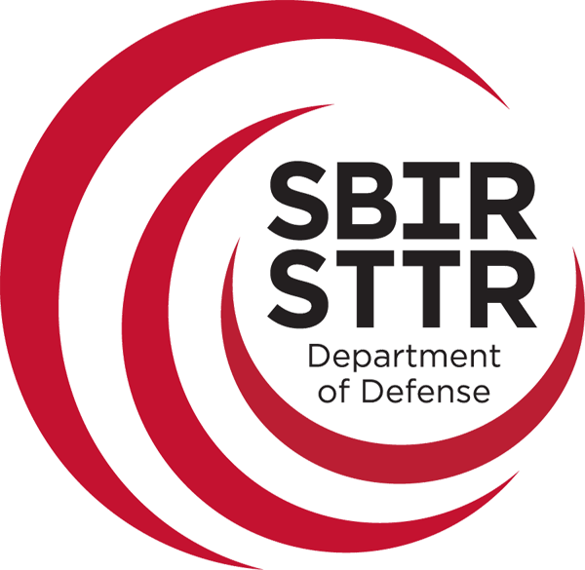
Department of Defense
SBIRSTTR

Slide 8
SBIR/STTR Overview
a. SBIR Impact
b. SBIR/STTR Programs
c. DoD SBIR

Slide 9
SBIR/STTR Programs
The Small Business Innovation Research (SBIR) and Small Business Technology Transfer (STTR) programs are:
Congressionally-mandated programs started in 1982
Mission: to promote technological innovation and economic growth through Federal investment
Established to fund R&D at small businesses
Funds cooperative R&D between small businesses and research Institutions
Encourage participation by minorities and disadvantaged persons in technological innovation
Funded as a set-aside assessment of extramural R&D budget
SBA programmatic authority over federal SBIR & STTR programs (Program Policy Directives

Slide 10
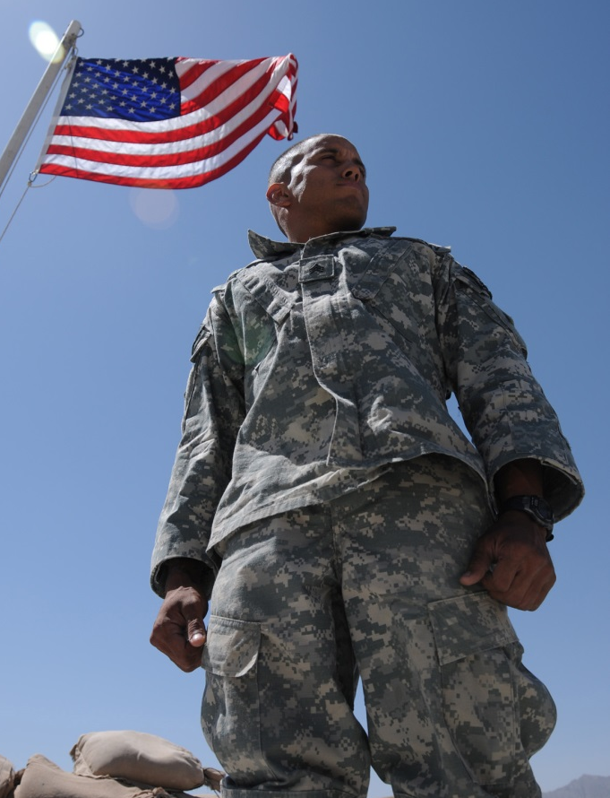
What’s Unique About DoD
Focused on the Warfighter
Largest SBIR program in the Federal Government
DoD is investor and a customer
Sole-sourced follow-on awards
Issues contracts not grants
Retain data rights for 5 years
Prohibits participation from firms majority-owned by multiple VCOCs, equity, or hedge funds

Slide 11
Contracts versus Grants
Contracting Agencies
Granting Agencies
Agency establishes plans, protocols, requirements
Highly focused topics
Procurement mechanism
More fiscal requirements
Invoiced on Progress
Investigator initiates approach
Less-specified topics
Assistance mechanism
More flexibility
Allows upfront payment
DoD, DHS, NASA, EPA, DOT
NSF, DoE, USDA
HHS/NIH, DOC, ED

Slide 12
SBIR Impact to DoD
Founded in 1990
2015
“What we were trying to do was so risky that no rational investor would give us money,” recalls Angle. “The SBIR Program would listen because they were looking for innovative research.”
First SBIR Award: 2001
Total SBIR Funding
$9.39M from 29 awards
Annual Revenue: $487 M
Employees: 528
Effects of SBIR funding
510 PackBot provided soldiers with a tool to identify and dispose of improvised explosive devices (IEDs).
The technology transitioned into the Roomba vacuum and has now sold over 5 MILLION UNITS across the U.S.
Colin Angle, Cofounder of iRobot

Slide 13
Eligibility Requirements
SBIR
At least 51% U.S.- owned by individuals and independently operated
500 or fewer employees
Organized for-profit U.S. business, located in the US
PI’s primary employment with small business during project
2.9% of RDT&E
STTR
Formal Cooperative R&D Effort
Minimum 40% by small business, 30% by U.S. research institution
U.S. Research Institution
Small business is Prime, PI can be from SBC or research Institution
Intellectual Property Agreement
0.4% of RDT&E

Slide 14
SBIR Timeline
1+ Years
4 Years
Deliverable: Feasibility Study or Report
Deliverable: Prototype
Topic Generation & Review
Solicitation & Evaluation
Phase I
(150k)
Phase II Evaluation
Phase II
($1M)
Phase II Enhancement
Phase III
Seek Program Sponsorship to Align with ACAT needs
Begin project interface with PEO/PM & prime
Detail design requirements / define risk and opportunities
Obtain funding from program sponsors; prepare for transition

Slide 15
Phase III - Commercialization
Derives from means that the requirement or contract has its origins in or traces to the previous SBIR efforts of an SBIR firm.
Extends means that the requirement or contract applies or advances prior SBIR efforts to a different application, or uses the prior SBIR efforts in a new way.
Completes means that the requirement or contract involves commercialization or productizing of the prior SBIR efforts. If the agency requirement, intended requirement, or contract meets any one of these tests, and is funded with non-SBIR funds, then it is a Phase III.

Slide 16
Why Participate
1
Largest source of Federal R&D funds for small businesses
5
Follow-on Phase III awards can be sole sourced
2
SBIR invests more than VC community in pre-seed and early stage technology
6
Company may maintain ownership of equipment purchased under Phase I and II
3
No dilution of equity
7
Builds credibility of company’s research while learning government contracting processes to become a supplier
4
Company retains data rights for 4 years (5 years in DoD)
State economic development programs, angels, and VC use SBIR as a pre-qualifier for their investment
8

Slide 17
How DoD Benefits from SBIR
Safe way to try out high-risk R&D
Small businesses are often more cost effective and innovative than large primes (i.e., agile, niche)
Test drive new companies while they establish a track record
Allows Acquisition programs to establish 2nd source/method to augment ongoing programs (risk management)

Slide 18
Rapid Innovation Fund Overview
a. RIF Purpose
b. RIF Implementation
c. RIF Impacts

Slide 19
Rapid Innovation Fund
Established as the Rapid Innovation Program (RIP) by the FY 2011 National Defense Authorization Act (Section 1073)
A competitive, merit-based program
Accelerate fielding of innovative technologies into military systems
Re-designated as the Rapid Innovation Fund (RIF) within the Department of Defense (DoD)
Bottom Line Goal: Transition Small Business Technologies into Defense Acquisition Programs

Slide 20
Incentivizing Productivity in Industry
Over 80% of RIF awardees note that the program is vital to the transition of small business technologies
New employee hires
Teaming opportunities
Increase in market sales
Helps to advance Phase II SBIR-developed technologies, resulting in a finished produce for commercial and government sales
Gets innovation to DoD faster
Large business customers sometimes submit their smaller, supplier-based technologies to the government as an engineering change

Slide 21
Key Requirements
Satisfy an operational or national security need
Accelerate or enhance military capability
In support of a major defense acquisition program
Stimulate innovative technologies
Reduce acquisition/lifecycle costs
Address technical risk
Improve timeliness & thoroughness of test & evaluation outcomes
Can be completed within 24 months of award
Cost is not to more than $3 million

Slide 22
Technology Readiness Levels (TRL)
Maturity Goal: TRL 6-9
System/subsystem model or prototype demonstration in a relevant environment
System prototype demonstration in an operational environment
Actual system completed and qualified through test and demonstration
Actual system proven through successful mission operations
Low TRL accepted ONLY if:
Breakthrough capability or operational game-changer
Cost neutral to acquisition program
Accommodated within program schedule
TRL 4 & 5 Awarded by Exception
Find TRL Assessment Guidance at
http://www.acq.osd.mil/ddre/publications/docs/TRA2011.pdf
Required for Majority of Awards: Facilitates Transition

Slide 23
RIF Implementation
Competitive, Merit-Based Two-Step Process
Step 1:
Issue Broad Agency Announcement (BAA)
Industry Response: 3-page White Paper + Quad Chart
Evaluations are “Go” or “No Go”
Step 2;
Highest rated “Go” offerors invited to submit full proposals
This invitation does not guarantee an award
Highest-rated full proposals lead to award
Public Notice
Federal Business Opportunities: www.FedBizOpps.gov
Defense Innovation Marketplace

Slide 24
RIF Implementation
Competitive, Merit-Based Two-Step Process
Step 1:
Issue Broad Agency Announcement (BAA)
Industry Response: 3-page White Paper + Quad Chart
Evaluations are “Go” or “No Go”
Step 2;
Highest rated “Go” offerors invited to submit full proposals
This invitation does not guarantee an award
Highest-rated full proposals lead to award
Public Notice
Federal Business Opportunities: www.FedBizOpps.gov
Defense Innovation Marketplace

Slide 25
RIF Demand Summary
Over $1.2B Invested (FY11-15)
14 Broad Agency Announcements (FY11-15)
14 Defense Component Participants (Average, FY11-15)
13,000+ White Paper Proposals (FY11-15)
600+ Full Proposals (FY11-14)
367 Contract Awards (FY11-13 funds)
329 awards to Small Businesses (90% of all awards)
275 awards to current or prior Small Business Innovation Research (SBIR) participants (75% of all awards)
4% of awards go directly to colleges/universities

Slide 26
Colleges/Universities Working with DoD RIF
Examples:
Traumatic Brain Injury (Army & Columbia University): An inflatable airhood with an integrated sensor package that deploys the airhood in an extreme impact event, protecting the soldier’s head & neck.
Immediate Concussion Injury Assessment (Army & Emory University): A rapid, self-contained cognitive assessment tool designed for early screening and identification of functional neurologic injury
NANOBRIDGE (Navy & Johns Hopkins University Applied Physics Laboratories): Develop and test a nanosatellite with improved manufacturability that is compatible with legacy communication systems
A Physics-based High Performance Computing (HPC) Capability for Ground Vehicles (Army & University of Wisconsin-Madison): Augment, validate, and deploy an existing modeling/simulation/visualization HPC capability called Chrono to support ground vehicle mobility analysis
Innovative Manufacturing of All-Aluminum 463L Cargo Pallet (Air Force & University of Dayton): Evaluate new manufacturing technologies that will double cargo pallet service life, halve yearly costs, is 100 percent recyclable, and eliminates hazardous outgas and waste stream

Slide 27
RIF Points of Contact
Office | POC | Phone | Email
OSD (R&E) EC&P OSD (OSBP) | Dan Cundiff Sherry Freeman | (571) 372-6807 (571) 969-0660 | thomas.d.cundiff.civ@mail.mil shermain.d.freeman.civ@mail.mil
Army (ASA/ALT) | Rob Saunders | (703) 617-0279 | robert.m.saunders14.civ@mail.mil
Navy (ONR) | Tom Gallagher | (703) 696-6815 | thomas.j.gallagher@navy.mil
AF (SAF) AF (SAF) | LtCol Dan Gallton John (JR) Smith | (571) 256-0332 (571) 256-0316 | daniel.a.gallton.mil@mail.mil john.r.smith346.ctr@mail.mil
http://defenseinnovationmarketplace.mil/RIF.html

Slide 28
My Contact Information Camylle Coley Senior Advisor to the Director Basic Research Office (571) 372-6463 camylle.c.coley.ctr@mail.mil

