Slide 1

Homeland Security Advanced Research Projects Agency
DHS S&T Cyber Security Division: An Overview
Douglas Maughan
Division Director
September 29, 2016
http://www.dhs.gov/cyber-research

Slide 2
Cybersecurity National Action Plan
Establishing a Commission on Enhancing National Cybersecurity on improving our privacy and public safety
Creating a Federal Chief Information Security Officer to lead on cybersecurity oversight, policies, and strategy
Establishing a $3.1 billion Information Technology Modernization Fund to retire, replace, and modernize legacy government IT systems
Working with industry to encourage broader use of security tools like Multi-Factor Authentication

Slide 3
Federal Cybersecurity R&D Strategic Plan
Requested by Congress in the 2014 Cybersecurity Enhancement Act to update and expand the 2011 plan, Trustworthy Cyberspace: Strategic Plan for the Federal Cybersecurity Research and Development Program
Written in 2015 by an interagency working group for the National Science and Technology Council (NSTC) and the Networking and Information Technology Research and Development Program (NITRD)
Considered input from the President’s Council of Advisors for Science and Technology (PCAST), an NSF RFI in May 2015, and DHS S&T community gatherings
Released in February 2016 as a component of the President’s National Cybersecurity Action Plan (CNAP)

Slide 4
DHS and Cybersecurity
MISSION 4: SAFEGUARD AND SECURE CYBERSPACE
Goal 1: Strengthen the Security and Resilience of Critical Infrastructure
Goal 2: Secure the Federal Civilian Government Information Technology Enterprise
Goal 3: Advance Law Enforcement, Incident Response, and Reporting Capabilities
Goal 4: Strengthen the Ecosystem
Drive innovative/cost effective security products, services, and solutions in the cyber ecosystem;
Conduct and transition research and development enabling trustworthy cyber infrastructure;
Develop skilled cybersecurity professionals;
Enhance public awareness and promote cybersecurity best practices; and
Advance international engagement to promote capacity building, international standards, and cooperation.

Slide 5




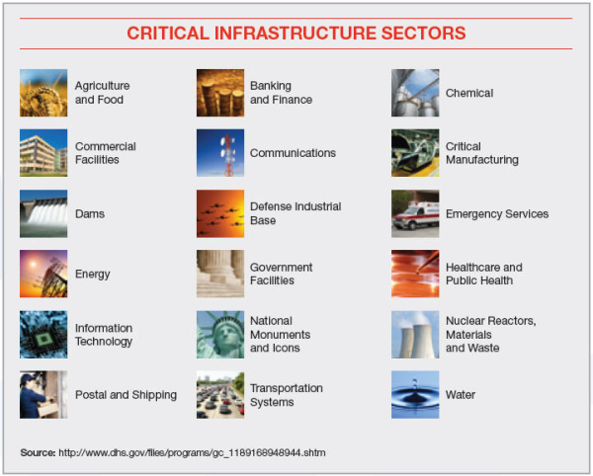











Research Requirement Inputs
Departmental Inputs
Interagency Collaboration
White House
and NSS
Critical Infrastructure Sectors
(Private Sector)
State and Local
Cyber Security Division
International Partners
Notes:
Suggest using icons for WH, State/Local, Departmental, Interagency, Critical Infrastructure and using fewer examples

Slide 6


CSD Mission & Strategy
REQUIREMENTS
CSD MISSION
Develop and deliver new technologies, tools and techniques to defend and secure current and future systems and networks
Conduct and support technology transition efforts
Provide R&D leadership and coordination within the government, academia, private sector and international cybersecurity community
CSD STRATEGY
Trustworthy Cyber Infrastructure
Cybersecurity Research
Infrastructure
Network & System Security and Investigations
Cyber Physical Systems
Transition and Outreach
Stakeholders
Outreach Methods (Sampling)
Government
IT Security Companies
Technology Demonstrations
Social Media
Venture Capital
Open Source
Speaking Engagements
Media Outreach
International
Program Reviews

Slide 7
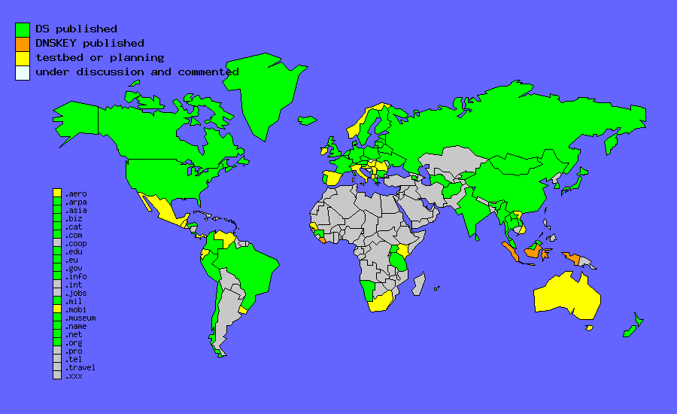
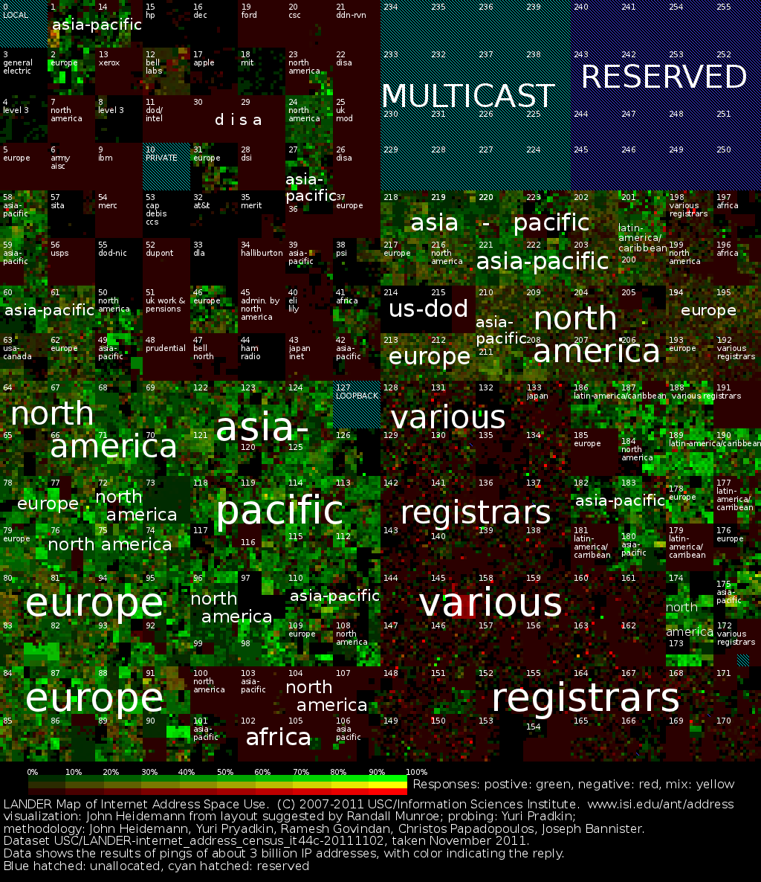
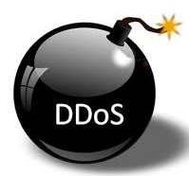
Trustworthy Cyber Infrastructure
Objective: Develop standards, policies, processes, and technologies to enable more secure and robust global cyber infrastructure and to identify components of greatest need of protection, applying analysis capabilities to predict and respond to cyber attack effects and provide situational understanding to providers
Secure Protocols
  Develop agreed-upon global infrastructure standards and solutions
  Working with IETF standards, routing vendors, global registries and ISPs
  Provide global Routing Public Key Infrastructure (RPKI) solutions
  Follow same process used for DNSSEC global deployment
Internet Measurement and Attack Modeling (IMAM)
  Create more complete view of the geographical and topological mapping of networks and systems
  Improve global peering, geo-location, and router level maps to assist automated solutions for attack prevention, detection, response
  Support cross-org, situational understanding at multiple time scales
Distributed Denial of Service Defenses (DDOSD)
  Policy-based technologies to shift the advantage to the defender
  Measurement/analysis tools to test success of BCP38 deployments
  Engaging with major finance sector companies and supporting ISPs

Slide 8

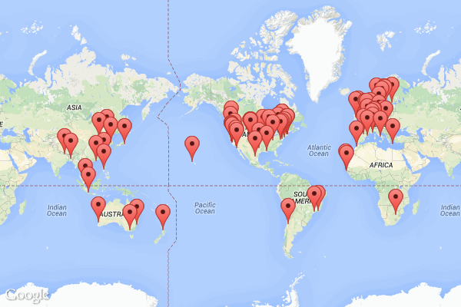

Research Infrastructure
Objective: Develop research infrastructure, such as test facilities, realistic datasets, tools, and methodologies to enable global cybersecurity R&D community researchers to perform at-scale experimentation on their emerging technologies with respect to system performance goals
Experimental Research Testbed (DETER)
  Researcher and vendor-neutral experimental infrastructure
  Used by 300+ organizations from 25+ states and 30+ countries - DARPA
  Used in 40 + classes, from 30 institutions and 3,000+ students
  Open Source code used by Canada, Israel, Australia, Singapore
Research Data Repository (IMPACT)
  Repository of over 1PB of network data for use by community
  More than 250 users (academia, industry, gov’t – NSA SBIR)
  Leading activities on ICT Research Ethics (e.g., Menlo Report)
  Opening up to international partners (JP, CA, AU, UK, IL, NL)
Software Assurance Market Place (SWAMP)
  A software assurance testing and evaluation facility and services
  Advance the quality and usage of SwA tools – commercial & open
  IOC – 2/1/14; 700+ assessments/week; 12 platforms; 10+ SwA tools

Slide 9
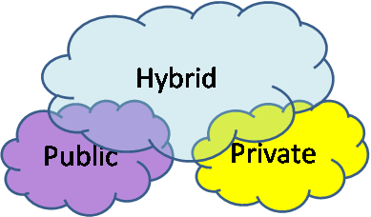


Network and System Security and Investigations – 1
Objective: Develop new and innovative methods, services, and capabilities for the security of future networks and systems to ensure they are usable and security properties can be measured and provide the tools and techniques needed for combatting cybercrime
Security for Cloud-Based Systems
  Develop methodologies and technologies for cloud auditing and forensics in end-point devices
  Identify data audit methodologies to identify the location, movement, and behavior of data and Virtual Machines (VMs)
  Work with DHS CIO/CISOs and datacenters
Mobile Device Security
  Develop new approaches to mobile device security (user identity/authentication, device management, App security and management, and secure data) for government purposes
  Working with DHS CISO and across several components
Identity Management / Data Privacy
  Advance the identity management ecosystem to support Federal, state, local, and private sector identity management functions
  Develop data privacy technologies to better express, protect, and control the confidentiality of private information
  Working with DHS, other Federal, State, Local and Private Sector

Slide 10
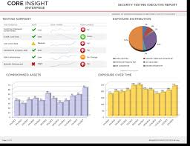
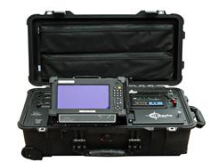
Network and System Security and Investigations – 2
Objective: Develop new and innovative methods, services, and capabilities for the security of future networks and systems to ensure they are usable and security properties can be measured and provide the tools and techniques needed for combatting cybercrime
toolA
Software Quality Assurance
  Develop new methods and capabilities to analyze software and address the presence of internal flaws and vulnerabilities to reduce the risk and cost associated with software failures
  Develop automated capability to bring together independent software and system assessment activities
toolB
toolD
toolC
Usable Security and Security Metrics
  Improve the usability of cybersecurity technologies while maintaining security
  Develop security metrics and tools and techniques to make them practical and useful as decision aids for enterprise security posture
Investigation Capabilities for Law Enforcement
  Develop investigative tools/techniques for LE agencies to address the use of computers/phones in criminal and cyber related crimes
  Develop techniques and tools focused on detecting and limiting malicious behavior by untrustworthy insiders inside an organization
  Cyber Forensics Working Group – USSS, ICE, CBP, FBI, S/L

Slide 11



Cyber Physical Systems / Process Control Systems
Objective: Ensure necessary security enhancements are added to the design and implementation of ubiquitous cyber physical systems and process control systems, with an emphasis on transportation, emergency response, energy, and oil and gas systems.
Cyber Physical Systems Security (CPSSEC)
  Build security into the design of critical, smart, networked systems
  Gain better understanding of threats and system interactions
  Testing and validation of solutions in partnership with private sector
  Working with DoTrans and NPPD and Transportation Sector
Trustworthy Computing Infrastructure for the Power Grid (TCIPG)
  Improve the security of next-generation power grid infrastructure, making the underlying infrastructure more secure, reliable and safe
  4 University consortium – UIUC, WSU, UC-Davis, Dartmouth
  Private sector advisory board provides reqmts and transition path
  Partnership with DOE-OE and Universities
Securing the Oil and Gas Infrastructure (LOGIIC)
  Conduct collaborative RDT&E to identify and address sector-wide vulnerabilities in oil and gas industry digital control systems
  All R&D projects identified and funded by private sector members
  CSD provides project mgmt. support and inter-sector support

Slide 12


Transition and Outreach
Objective: Accelerate the transition of mature federally-funded cybersecurity R&D technology into widespread operational deployment; Educate and train the current and next generations of cybersecurity workforce through multiple methods, models, and activities
Transition To Practice (TTP)
  White House initiated program in FY12; Over 30 technologies explored
  Working with DOE and DOD labs, FFRDCs, UARCs, NSF, SBIRs
  Leveraging over $250M in funding from other Federal Agencies
  Multiple pilots in progress; Multiple commercial licensing deals done
Cybersecurity Competitions
  Provide a controlled, competitive environment to assess a student’s understanding and operational competency
  CSD-funded technologies included for test and evaluation
  200+ schools and 2000+ college students participated in 2016
  Involvement from private sector; Assisting int’l competitions
National Initiative for Cybersecurity Education (NICE)
  Joint DHS/NSF/DOD/DOEd initiative with WH and NIST support
  Enhance Awareness (led by NPPD); Expand the Pipeline (led by CSD, NSF, DOEd); Evolve the Profession (led by NPPD and DOD)
  Regional Alliances for Cyber Education (RACE) – FY16 solicit. thru NIST

Slide 13
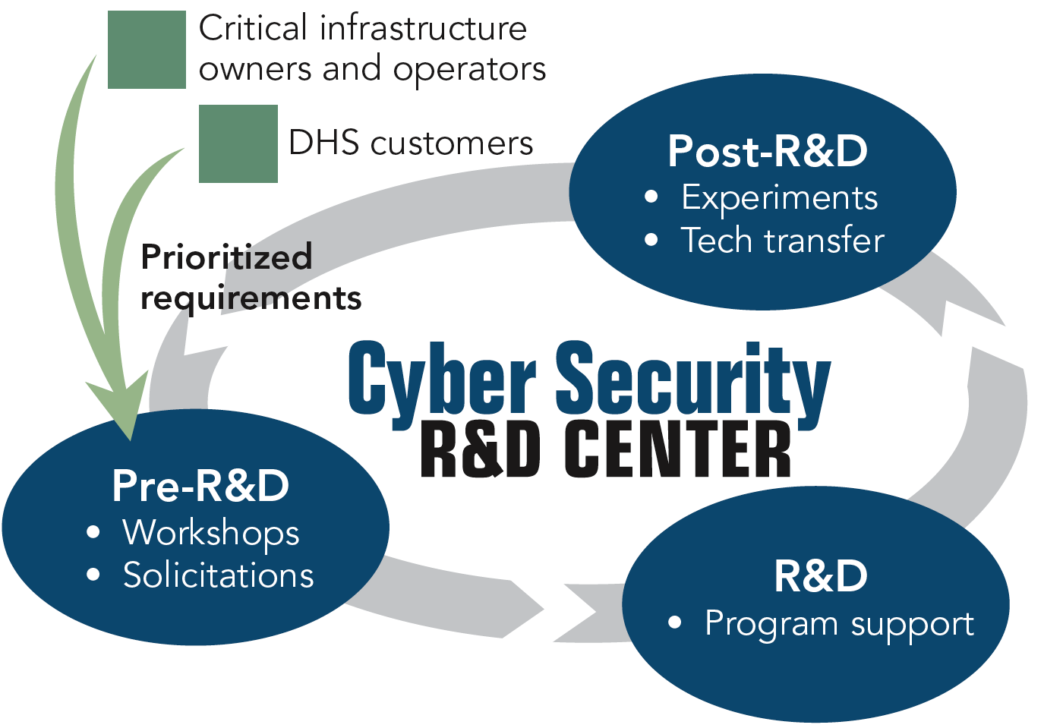
CSD R&D Execution Model
Successes
Over 40 products transitioned since 2004, including:
2004 – BAA 04-17
  5 commercial products
  2 Open Source products
2005 – BAA 05-10 (RTAP)
  2 commercial products
  1 GOTS product
  1 Open Source product
2007 – BAA 07-09
  4 commercial products
2011 – BAA 11-02
  6 commercial products
  1 Open Source product
BAAs – 2014, 2015, 2017
Law Enforcement Support
  4 commercial products
  1 Open Source product
Identity Management
  1 Open Source standard and GOTS solution
SBIRs
  10+ commercial products
  2 Open Source product
Research, Development,
Test and Evaluation &
Transition (RDTE&T)
"Crossing the ‘Valley of Death’: Transitioning Cybersecurity Research into Practice,"
IEEE Security & Privacy, March-April 2013, Maughan, Douglas; Balenson, David; Lindqvist, Ulf; Tudor, Zachary
http://www.computer.org/portal/web/computingnow/securityandprivacy

Slide 14
Recent Pilots and Transitions Highlight the Depth and Breadth of CSD R&D
Technology | Performer | Pilot or Transition Partner | Status
Cauldron Visualization Tool | GMU | CyVision Technologies | Commercialized
Net APT Firewall and Audit Analysis Tool | UIUC | Network Perceptions, primarily w/Energy Sector | Commercialized
Blackthorne GPS Forensics | Berla | ICE, USSS, CBP | Commercialized
Autonomy Forensics platform | Basis Technology | ICE, CBP, USSS | Commercialized
IVE Vehicle and Infotainment | Berla | ICE, CBP, DoD, State/Local, DoJ | Commercialized
Black Light Enhancements | Black Bag Forensics | US CERT, ICE, USSS, TSA, State/Local | Piloting - S&T funded licenses
NIST Forensics Tool Test Reports | NIST | Publically Available | Knowledge Products
Secure Network Attribution Prioritization Protocol | Raytheon | DoD/Army Cyber Command | Schoolhouse pilot and evaluation
Mobile Device Management | Mobile Iron | FEMA | Pilot and adoption by 10K users
Mobile App Security _ Mobile App vetting | Kryptowire | CBP, DHS HQ, US CERT | Pilot
Malware analysis tool | Hyperion | US CERT | Pilot
Hardware Enabled Zero Day Protection | Def-Logix | DoD/USAF | Pilot
Symbiote embedded device protection | Red Balloon Security | Hewlett Packard | Commercialized

Slide 15
Transition to Practice (TTP)
FY13 – 15: 24 technologies from DOE & DoD National Labs
FY16: Added 7-8 new technologies
7 Transition Successes (4 licenses, 2 product additions,1 open source) with more on the way
Technology | Date | Nat’l Lab | Transition Partner
Hone: Host based network sensor | 2014 | PNNL | Open source
Quantum Security: Next-gen encryption system | Sept. 2014 | LANL | Whitewood Encryption
Hyperion: Malware forensics detection and software assurance technology | Feb. 2015 | ORNL | R&K Cyber Solutions
NeMS: Network analysis and visualization | July 2015 | LLNL | Cambridge Global Advisors
PathScan: Network anomaly-detection | Aug. 2015 | LANL | EY

Slide 16
Finance Sector Transition Project
Leverage existing federally funded and private sector research Integration, testing and evaluation Predominantly development
Establish the Cyber Apex Review Team (CART): DHS S&T + FS Critical Infrastructure + Treasury partnership Monthly meetings Collaborate on: Sector needs and gaps identified (relevance) and ranked (direction) Common ontology to join needs to technology areas Task proposal evaluation
Execute via Other Transaction Authority (OTA) Adaptable consortium of performers Quick turn-around for task orders (acceleration) Flexible engagement with CART Iterate through the tech areas defined by CART
Apex Participant Levels:
L₁: Government Only
L₂: CART Members
L₃: CART + OTA Performer
DHS S&T
Treasury
CIPP
Financial Sector
OTA Performer
Notes:
Gaps and risks: Risk is an attribute of a gap. For instance, there may be a gap in data recovery, but the associated risk is deemed low. Alternatively, there is a gap in network event detection, and the CART has indicated that the risk is high. A gap is a gap, but risk says how bad it is.
This is essentially the program plan. We plan to leverage a tech pool, establish a CART, and use an OTA to execute.

Slide 17
Functional Gaps and Technology
Impacts
Hybrid Analysis
Network Characterization
Malware Detection
Data Leakage
Dynamic Defense
Insider Threat
Visual Analytics
Zero Day Protection
Network Mapping
Situational Understanding
Malware Classification
Malware Execution Prevention
Reduce Financial Sector risk due to cyber attack
Intrusion Tolerance
Dynamic Network Architecture
Software Assurance
Defend and deter cyber adversaries and limit the effect of cyber threats to information and operations
Functional Gaps
Identified by the Finance Sector *Subject to revision based on evolving requirements*
Technology Areas
Leverage previous investments and existing technologies
Over $60M in S&T funds invested in cyber security since 2010
Over $20M in Government Lab funds invested in cyber security since 2010
Private funding amounts as identified by the finance sector

Slide 18

Customer Buy-in
Active participation (June 2015 – present):
Strategic Direction
  Ranked capability needs mapped to technology areas, providing roadmap for task selection
Technical Guidance
  Technology and architecture surveys specific to FSS
Initial tasks
  NetAware: net situational awareness
  NetIdentify: net structural awareness
Working with:
Bob Blakley, Global Director for Information Security Innovation, Citigroup
Byron Collie, Vice President, Threat Management, Goldman Sachs
Ellen Moskowitz, Vice President, Corporate Information Security, State Street
Parthiv Shah, SVP, CISO, The Clearing House
George Smirnov, SVP, CISO, Comerica
Sounil Yu, SVP, Director of R&D, Global Information Security, Bank of America

Slide 19














International Engagement
“Cybersecurity is a global sport”
This is not a U.S. only problem, everyone has the same problems; why not work on them together?
Opportunities to leverage international funding for R&D and investment
VISION
Joint Bilateral R&D Calls – Requires U.S. and Foreign researcher teams; to be initiated in FY16 and FY17; partnership with NSF
Create Global Government Cybersecurity R&D Consortium – Similar to an existing First Responder consortium; forum for sharing R&D requirements to global entrepreneur and innovation communities. http://www.internationalresponderforum.org/

Slide 20
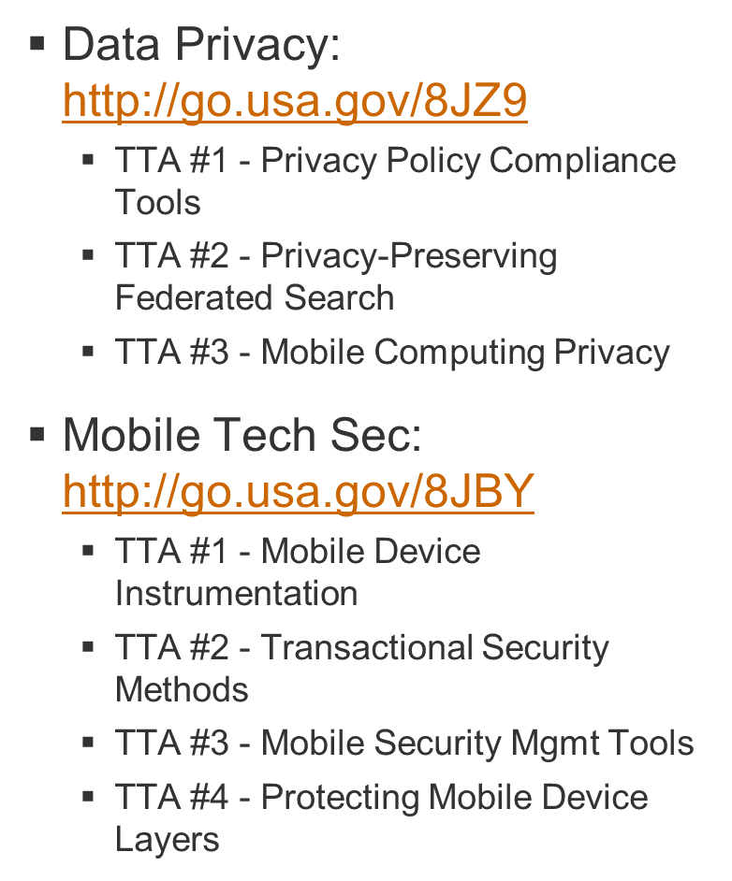
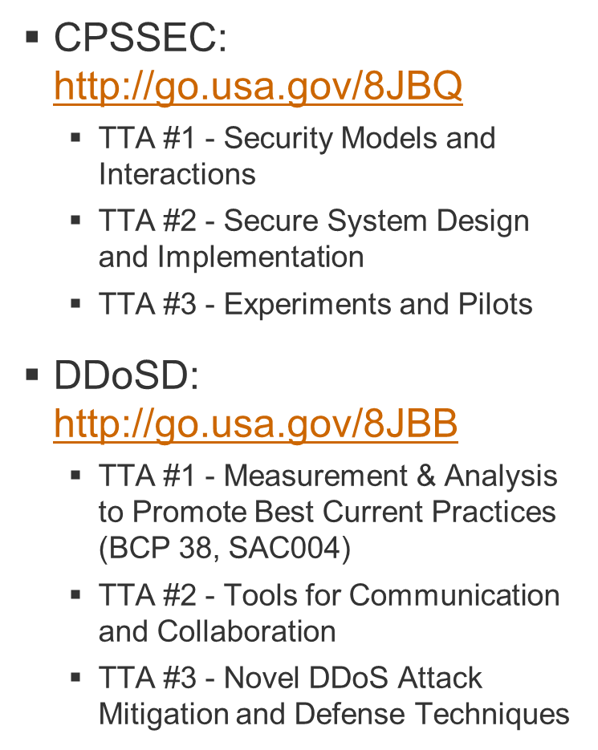





2014 Broad Agency Announcement
  BAA released incl. to participating countries: https://baa2.st.dhs.gov
    $95M over 5 year period

Slide 21
Recent BAA Topics
Static Tool Analysis Modernization Project (STAMP)
  Modernization of static analysis tools is needed to help advance and improve software analysis capabilities, because lower cost software analysis tools will make secure software more prevalent.
  HSHQDC-16-R-B0002 => STAMP: https://www.fbo.gov/spg/DHS/OCPO/DHS-OCPO/HSHQDC-14-R-B0005/listing.html
Application Security Threat Attack Modeling (ASTAM)
  Create a Unified Threat Management (UTM) system that allows cyber security professionals to monitor and manage a wide variety of security-related applications and infrastructure components through a single management console.
  ASTAM should be designed and developed to provide coverage throughout the entire software development lifecycle (SDLC). The goal is to identify weaknesses in software before it leaves the developer’s desk, helping to reduce the attack surface for software applications, as well as reduce the cost of software failures by finding weaknesses before they expose vulnerabilities.
  HSHQDC-16-R-B0003 => ASTAM: https://www.fbo.gov/spg/DHS/OCPO/DHS-OCPO/HSHQDC-14-R-B0005/listing.html

Slide 22
Small Business Innovative Research (SBIR) - 1
Important program for creating new innovation and accelerating transition into the marketplace
Since 2004, DHS S&T Cyber Security has had:
  100+ Phase I efforts
  40+ Phase II efforts (including OATS)
  15+ commercial/open source products available
  Four acquisitions
    Komoku, Inc. (MD) acquired by Microsoft in March 2008
    Endeavor Systems (VA) acquired by McAfee in January 2009
    Solidcore (CA) acquired by McAfee in June 2009
    HBGary (CA) acquired by ManTech in February 2012
S&T BAA / SBIR Website: https://baa2.st.dhs.gov

Slide 23
Small Business Innovative Research (SBIR) - 2
FY04
  Cross-Domain Attack Correlation Technologies (2)
  Real-Time Malic. Code Identification (2)
  Advanced SCADA and Related Distributed Control Systems (5)
FY05
  Hardware-assisted System Security Monitoring (4)
FY06
  Network-based Boundary Controllers (3)
  Botnet Detection and Mitigation (4)
FY07
  Secure & Reliable Wireless Comms for Control Systems (2)
FY09
  Software Testing and Vulnerability Analysis (3)
FY10
  Large-Scale Network Survivability, Rapid Recovery, and Reconstitution (1)
FY11
  Mobile Device Forensics (1)
FY12
  Moving Target Defense (2)
  Solid State Drive Analysis (1)
FY13
  Hybrid Analysis Mapping (2)
  Software Based Roots of Trust for Enhanced Mobile Device Security (3)
FY14
  Embedded System Security (3)
FY15
  Enhanced Distributed Denial of Service Defense (2)
FY16
  Applicability of Blockchain Technology to Privacy Respecting Id Management
  Malware Prediction for Situational Understanding and Preemptive Cyber Defense
  Real-Time Assessment of Resilience and Preparedness
  Remote Identity Proofing Alternatives to Knowledge Based Auth / Verification

Slide 24
DHS Silicon Valley Overview
Designed to accelerate the transition of innovative technologies and solutions into DHS programs and the Homeland Security Enterprise (HSE)
Physically located closer to the birthplace of innovation
EDUCATE
Help investors and innovators understand DHS’s hard problems
FUND
Provide fast non-dilutive funding for product development to address DHS’s needs
TEST
Have operators test and provide end user feedback quickly
Desired outcome:
Better capabilities, more quickly deployed to operators in the field.
Raise the bar in quality and quantity of companies providing the government with mission-critical products.

Slide 25
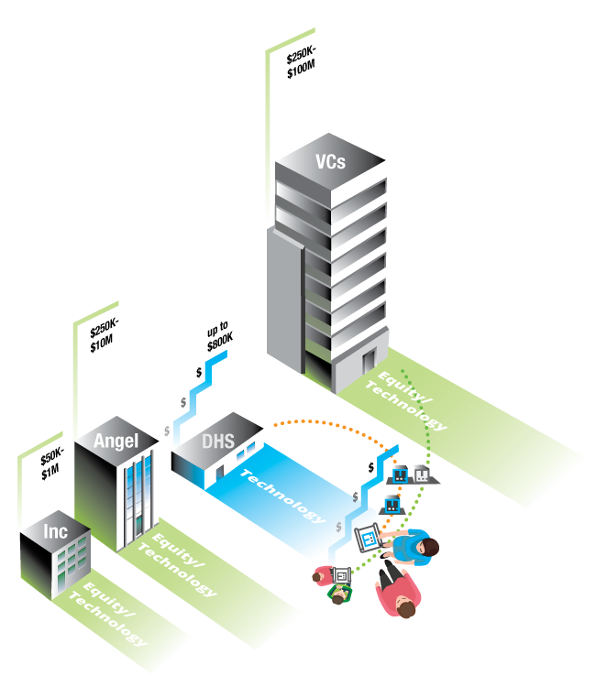
Where DHS Fits
Leverage early stage startup tech receiving accelerator/seed/angel investments
Intersection of commercial investment and DHS/HSE application
DHS funds product development –
dual-use features applicable to
homeland security
Do NOT want startups trying
to pivot; must be able to maintain
commercial roadmap
Not taking equity, not taking IP
(except in form of technical data/reports)

Slide 26

Silicon Valley Innovation Program
scitech.dhs.gov/hsip
Designed to accelerate the transition of innovative technologies and solutions into DHS programs and the Homeland Security Enterprise (HSE)
Other Transaction Authority (OTA)¹ and Solicitation allows DHS to:
  Reach nontraditional companies with “novel technologies and solutions” that DHS would not otherwise be able to access
  Simplify application and pitch process
  Accelerate funding to companies who haven’t had gov’t contracts totaling over $500k within the last 12 months (e.g. startups)
Program Tranches per Startup
Phase 1 | $50-200K | 3-6 mos | Proof of concept demo
Phase 2 | $50-200K | 3-6 mos | Demo pilot-ready prototype
Phase 3 | $50-200K | 3-6 mos | Pilot test prototype in operations
Phase 4 | $50-200K | 3-6 mos | Test in various operational scenarios
¹ Section 831 of the Homeland Security Act of 2002, Public Law 107-296, (6 U.S.C. § 391)
Notes:
Describe:
OTA, working with CPO/OPO & OGC to develop OTS
Streamlined process
“Topic” = Educate the community about DHS’s mission and pain points
Short application and “pitch” with same day funding decision
Award timeframe – 30 days
4 Phased program, funding/length/outcome

Slide 27

First Call – Internet of Things Security
DETECT, the ability to know what Internet of Things (IoT) devices and components are connected to a given network or system
AUTHENTICATE, the ability to verify the provenance of Internet of Things (IoT) components and prevent and detect spoofing
UPDATE, Internet of Things (IoT) security programs must include the ability to securely maintain and upgrade these components
Why it’s important to DHS and critical infrastructure
    As DHS and Critical Infrastructure use more network-enabled sensors (on pipelines, border, airports, etc.), it leaves open other unknown Internet of Things (IoT) devices connecting to network infrastructure.

Slide 28
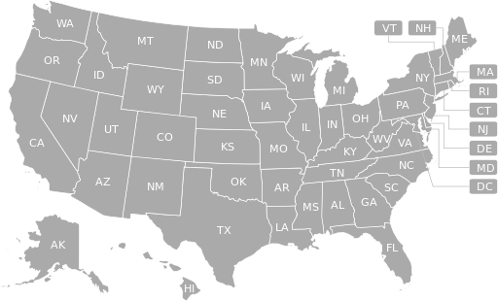
Latest Stats
5 Active calls/funding opportunities
65 Applications received
16 Startups invited to pitch
5 OTA awards signed
10 Business days to get first OTA signed
10 Months in business
2
IoT Awards
3 Silicon Valley
1 Austin, TX
1 Atlanta, GA
2
5
4
25
1
1
10
2
5
2
6

Slide 29




IoT Security Portfolio Companies

Slide 30
Open Calls
Overarching Innovation Other Transaction Solicitation
https://www.fbo.gov/spg/DHS/OCPO/DHS-OCPO/HSHQDC16RB0005/listing.html
Call 1: Internet of Things Security
https://www.fbo.gov/spg/DHS/OCPO/DHS-OCPO/HSHQDC-16-R-00035/listing.html
Call 2: K9 Wearables
https://www.fbo.gov/spg/DHS/OCPO/DHS-OCPO/HSHQDC-16-R-00093/listing.html
Call 3: Open Source Enhancements for the Global Travel Assessment System
https://www.fbo.gov/spg/DHS/OCPO/DHS-OCPO/HSHQDC-16-R-00094/listing.html
Call 4: Small Unmanned Aircraft System Capabilities
https://www.fbo.gov/spg/DHS/OCPO/DHS-OCPO/HSHQDC-16-R-00114/listing.html
Call 5: Enhancing CBP Airport Passenger Processing
https://www.fbo.gov/spg/DHS/OCPO/DHS-OCPO/HSHQDC-16-R-00115/listing.html

Slide 31
Measures of Success
Short Term (FY16)
Outreach | Ability to identify and educate startups, enhance awareness of DHS challenges | # startups attending SVIP events, # startups responding to SVIP solicitations, and # referrals of startup companies to SVIP
Influence | Shape product development in companies to align with the needs of DHS operational components | Degree of product shaping relative to a set of product attributes
Leverage | The “leverage” of DHS funds with private sector investment | Ratio between DHS investment and private sector investment
Speed | Streamline and accelerate the funding process to startups | # days between publishing a call, submission of applications, notification of funding selection, and OTA contract start date
Startup Success | Success in developing product needed by DHS while surviving the commercial market | # startups that complete each phase, # startups that proceed to the next phase, and ultimately the # startups completing the program
Geographic Diversity | Ensure diversity of innovation and support economic development throughout all U.S. regions | # states and countries submitting applications
Longer Term (2-3 years)
Component Acquisition | Ability to identify and educate startups, enhance awareness of DHS challenges | # startups DHS components onramp into programs of record or direct acquisition
Operational Enhancement | Mission enhancement resulting from deployment of SVIP funded innovative technologies and solutions | Component defined improvements, generally operational effectiveness or efficiency (e.g. agent patrols more area in less time)
Valuation | Startups achieve growth in valuation in investment rounds based upon successful execution of milestones | Percentage increase in valuation of a company’s stock following initial SVIP funding

Slide 32
Other Topics of Interest
Deterrence / Adversary Work Factor / Attribution
  Relationship to Identity Management
Human Aspects of Cybersecurity
  Usability and Security
Cybersecurity Metrics
Tools for Analysis of Anonymous Networks and Currencies
Large-Scale Situational Understanding
Coordinated Local Intrusion Management Systems
  Suricata; PRISEM
Predictive Analytics
Cyber Economics – Business Cases, Adversary Impact

Slide 33
Summary / Conclusions
Cybersecurity research is a key area of innovation to support our global economic and national security futures
CSD continues with an aggressive cyber security research agenda to solve the cyber security problems of our current and future infrastructure and systems
  Ever-increasing speed of technology change
  Scope/complexity of the different areas of the problem
  The balance of near-term versus longer-term R&D
Will continue strong emphasis on technology transition
Will impact cyber education, training, and awareness of our current and future cybersecurity workforce
Will continue to work internationally to find and deploy the best ideas and solutions to real-world problems

Slide 34

Douglas Maughan, Ph.D.
Division Director
Cyber Security Division
Homeland Security Advanced Research Projects Agency (HSARPA)
douglas.maughan@dhs.gov
202-254-6145 / 202-360-3170
For more information, visit
http://www.dhs.gov/cyber-research

Slide 35
CSD’s Ten Strategic Visions
International Engagement
Secure Software
Human Centric Cybersecurity
Security of Mobile Computing
Support for Law Enforcement
Critical Infrastructure Security
Measurement and Metrics
Data Privacy
Cybersecurity Education
Technology Transition

