Slide 1

Coastal Research in the U.S. Army Corps of Engineers
Jane McKee Smith, PE, PhD
Research Civil Engineer
Coastal and Hydraulics Laboratory
See instructions for customizing these images on slide 3.

Slide 2
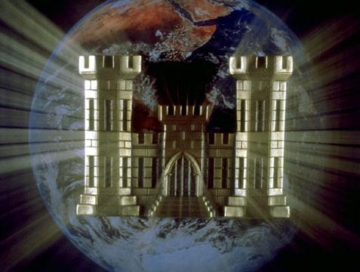
Engineer Research and
Development Center (ERDC)
~2500 Employees
Cold Regions Research &
Engineering Laboratory
Research Laboratories
of the
Corps of Engineers
Construction Engineering
Research Laboratory
Geospatial Research Laboratory
Headquarters
Coastal & Hydraulics Laboratory
Environmental Laboratory
Geotechnical & Structures Laboratory
Information Technology Laboratory
Laboratories
Field Offices

Slide 3
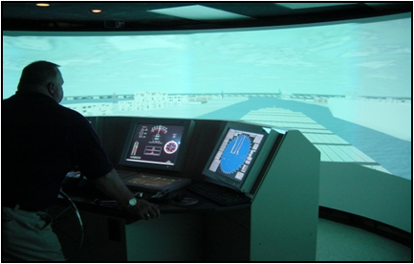
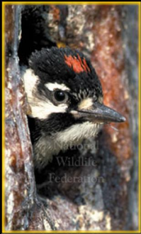
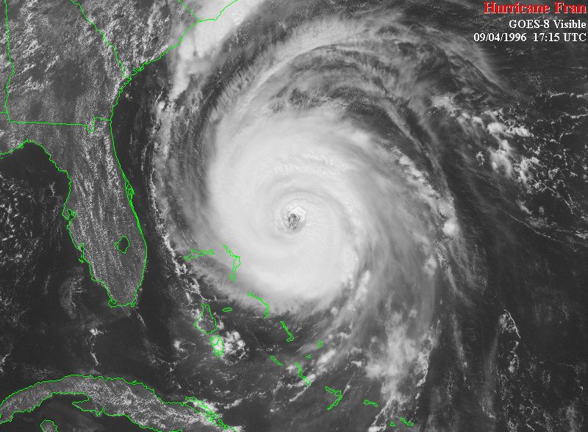
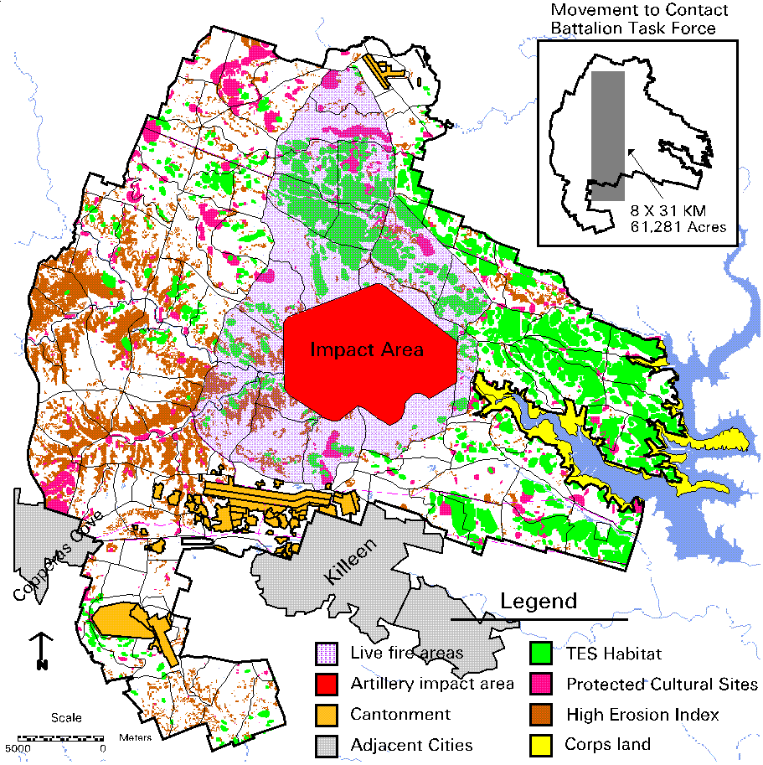
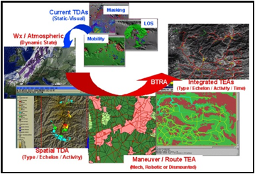
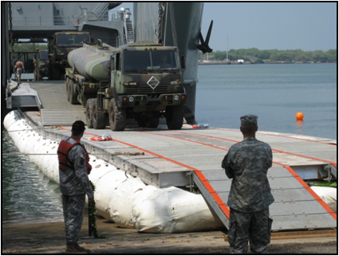
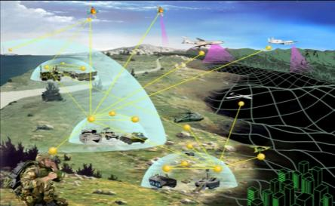
ERDC Business Areas
Environmental Quality/Installations
Civil Works/Water Resources
Military Engineering
Geospatial Research & Engineering
Notes:
Types of work we contract in support of these business areas include:
EQ/I: Unexploded ordnance, cleanup/range sustainment, corrosion prevention/control, contaminants, renewable energy, installation operations and maintenance, hazardous and toxic waste, threatened/endangered species, ecological processes, land and heritage conservation
Military Engineering: Weapons Effects, Vehicle Mobility, Instrumentation, Self-Contained Munitions, Airfields, Pavements, Protective Structures, Materials and Structures, Soil Effects
Civil Works/Water Resources: Wetlands, Ecosystem Restoration, Dredging, Navigation, Aquatic/Nuisance Species, Flood Control, Watersheds, Coastal Engineering/Structures, Erosion Control, Fish Passage, Harbors, Estuaries, Waves, Environmental Fate/Transport, Hydraulics, Terrain Properties/Processes, Computer Science, Geotechnical/Earthquake Engineering, Infrastructure Protection
Geospatial Research and Engineering: Biogeochemical Processes in Earth Materials, Signature Propagation, Mapping, Climate Change, Deicing, Remote Sensing, Fluorescence Spectroscopy

Slide 4


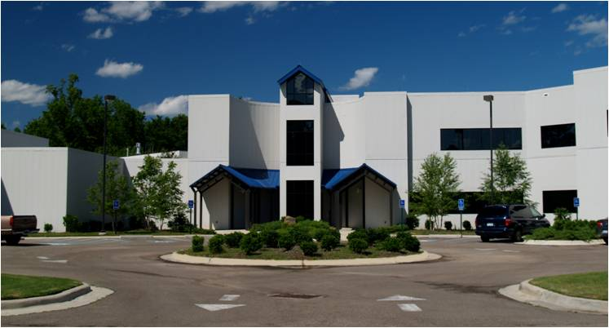



Coastal and Hydraulics Laboratory
Who We Are
CHL is the only federal laboratory dedicated solely for coastal and hydraulic research. Our multi-disciplinary team addresses challenges ranging from groundwater to coastal inlets. More than two-thirds of the laboratory’s engineers and scientists hold advanced degrees, contributing to the production of successful coastal and inland water resources solutions.
Notes:
4
CHL’s Mission: To deliver solutions to our Nation’s most challenging water resources problems through research, development and application of cutting-edge science, engineering and technology for the Army, Department of Defense, civilian agencies and our Nation’s public good.
CHL presently has 18 E&S from Florida universities.

Slide 5

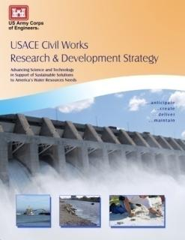
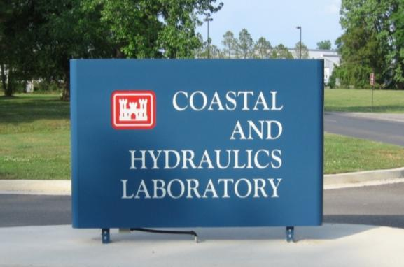
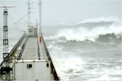
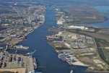
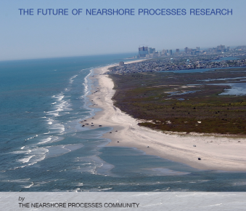
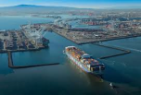
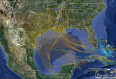
CHL Capabilities and Research Needs
Enabling Coastal R&D Infrastructure
Beaches
Warfighter Support
Wave Science
Coastal Geomorphology
Coastal Sediments
Coastal Resilience
Coastal Navigation Channels
Coastal Hazards Quantification
Coastal Structures
Notes:
CHL Plan informed by the USACE Campaign Plan, the CW Strategic Plan (Sustainable Solutions), and trends we see from the Flood & Coastal and Navigation Research Area Review Groups (top down & bottom up). Our current priorities track with USACE Civil Works priorities established through the CW R&D Steering Committee.
Infrastructure with a current focus on measuring & monitoring to produce data and information for decisions, such as with Asset Management. Coupling our models to provide system-scale tools. Expedient storm response has been heavily leveraged with FEMA to develop. Marine Transportation performance is supporting the CMTS and the DOT MAP21 study, and is an interagency effort. Natural & Nature-based Features focus driven by Sandy and we are working to improve our capabilities to design and predict performance of NNBF. Across our CW programs we have consolidated capabilities and leverage expertise, not only in CW but also from our Military programs.
funding levels for Coastal, Marine, Ocean sciences related research, Nav + F&C ~ $20mill
Heterogeneous sediments & soils are ubiquitous throughout coastal projects and most of our water resources infrastructure and, therefore, are a major consideration in many Corps projects; yet, physical and chemical processes involved in studying a complex environment of sediments, deposited by engineering methods, and soils, developed in place, are poorly understood. Because of the lack of scientific and engineering knowledge in the area of sediment and soil interaction, Corps design and maintenance guidance are based on analyses using homogeneous geotechnical properties.
Geomorphology. As global climate change alters the rates of sea level rise and potentially storm patterns and coastal urbanization increases over the coming decades, an understanding of coastal evolution is critical. Improved knowledge of long-term morphological, ecological, and societal processes and their interactions will result in an improved ability to simulate coastal change. This will enable proactive solutions for resilient coasts and better guidance for reducing coastal vulnerability.
Resilient Coastal Systems is an emerging priority as we have seen through the CERB charge and its spread across Civil Works and Military business lines. It is also an important topic across the Administration and other Federal agencies. The Corps has the leadership in infrastructure resilience based on our national and international review of the state-of-practice and scientific literature.
4. Urban flooding as we saw with Katrina & Sandy is very different than other coastal flooding that we have studied for decades. Wave propagation down main street with vertical buildings (subway tunnels) reflecting energy can not be accurately modeled with today’s knowledge and tools.

Slide 6


Bottom Line Up Front
CHL’s current Navigation & Coastal R&D priorities
  Infrastructure (measure, monitor, assess)
  Coupled models
  Expedient Storm Response Prediction
  Marine Transportation System Performance
  Natural & Nature-based Features
  Collaboration (MIL Programs, other agencies)
Future R&D
  Heterogeneous sediments
  Geomorphology
  Resilient Coastal Systems
  Urban Flooding
Notes:
Our current priorities track with USACE Civil Works priorities established through the CW R&D Steering Committee.
Infrastructure with a current focus on measuring & monitoring to produce data and information for decisions, such as with Asset Management. Coupling our models to provide system-scale tools. Expedient storm response has been heavily leveraged with FEMA to develop. Marine Transportation performance is supporting the CMTS and the DOT MAP21 study, and is an interagency effort. Natural & Nature-based Features focus driven by Sandy and we are working to improve our capabilities to design and predict performance of NNBF. Across our CW programs we have consolidated capabilities and leverage expertise, not only in CW but also from our Military programs.
Heterogeneous sediments & soils are ubiquitous throughout coastal projects and most of our water resources infrastructure and, therefore, are a major consideration in many Corps projects; yet, physical and chemical processes involved in studying a complex environment of sediments, deposited by engineering methods, and soils, developed in place, are poorly understood. Because of the lack of scientific and engineering knowledge in the area of sediment and soil interaction, Corps design and maintenance guidance are based on analyses using homogeneous geotechnical properties.
Geomorphology. As global climate change alters the rates of sea level rise and potentially storm patterns and coastal urbanization increases over the coming decades, an understanding of coastal evolution is critical. Improved knowledge of long-term morphological, ecological, and societal processes and their interactions will result in an improved ability to simulate coastal change. This will enable proactive solutions for resilient coasts and better guidance for reducing coastal vulnerability.
Resilient Coastal Systems is an emerging priority as we have seen through the CERB charge and its spread across Civil Works and Military business lines. It is also an important topic across the Administration and other Federal agencies. The Corps has the leadership in infrastructure resilience based on our national and international review of the state-of-practice and scientific literature.
Urban flooding as we saw with Katrina & Sandy is very different than other coastal flooding that we have studied for decades. Wave propagation down main street with vertical buildings (subway tunnels) reflecting energy can not be accurately modeled with today’s knowledge and tools.

Slide 7
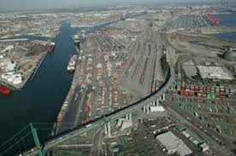
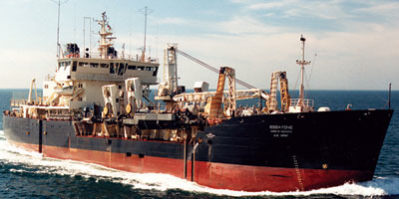
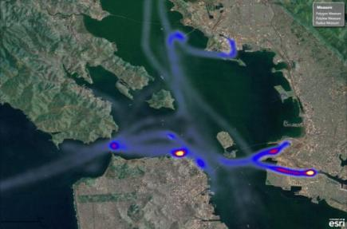

Coastal Navigation Channels
Current
  Enhance hydrodynamic models
  Investigate channel design using AIS
  Probabilistic life-cycle cost analysis of coastal channels for Asset Management
Future
  Update existing under-keel clearance prediction tools for the latest vessel classes using improved 3-D hydrodynamic models
  Validate vessel/current interactions
  Investigate bypassing & back-passing technology to interrupt longshore transport for application at deep-draft channels.
Coastal Processes & Design
Notes:
We use our ship simulator as an engineering design tool, not a training tool. This means that we must be able to accurately model natural processes and forces resulting from vessel movement through a waterway. Today, shallow-draft, 3-D flows are not represented in the ship/tow simulator, therefore, vessel/current interactions are not modeled, which limits our modeling of coastal & riverine locks, terminal channels and berthing areas for simulation. Additionally, the worldwide fleet of commercial vessels using our channels is changing and updates to existing tools such as CADET, which calculates underkeel clearance, is needed to accurately reflect the changing fleet. We also have new tools that can help us understand vessel movement through our channels, such as Automated Identification System (AIS) that tracks every commercial vessel. We can measure movement, speed, and deviations from expected paths, which may indicate shoals, congestion or adverse currents. Using the simulator and AIS we are looking at risk-based design and consequences of our channels.
In the future we need to update our tools and look at methods to reduce channel shoaling.
Background
Research & Expected outcome: Enhance the AdH model to incorporate shallow-draft, 3-D flows and update the ship/tow simulator to include vessel/current interactions. Update the existing under-keel clearance prediction tools for the latest vessel classes using improved 3-D hydrodynamic models. Investigate bypassing & back-passing technology to interrupt longshore transport for application at deep-draft channels.
Benefit to Corps: Increased ship simulator capabilities for channel design and reduced dredging shoaling volumes due to interruption of sediment into navigation channels.
Problem summary: Our inability to detect dispersion and transport of small volumes of sediment placed in the nearshore prevents us from quantifying the value and benefit of nearshore placement. Sediment tracer studies are expensive and often do not provide the required information.
Expected outcome: Understanding sediment transport patterns and quantification of volumes added to the profile would overcome environmental and regulatory challenges allowing the USACE to increase opportunities for nearshore placement of navigation channel sediments.
Benefit to Corps: Reduced costs and increased benefits for navigation and shore protection projects, improved use of sediments, and leveraging across multiple federal and non-federal projects.
Problem summary: National Marine Transportation System (MTS) requires a reliable, resilient network of coastal ports and waterways to ensure cost-effective access to international markets. New analysis techniques are needed to evaluate interdependencies between ports, the influence of landside (road and rail) capacity constraints, and implications for MTS investment decisions.
Expected outcome: new performance metrics and analysis approaches for evaluating MTS resilience in the context of coastal port and waterway functionality, reliability, and safety.

Slide 8
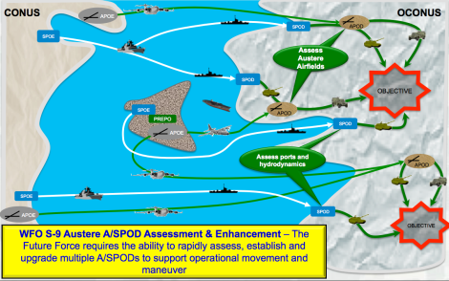
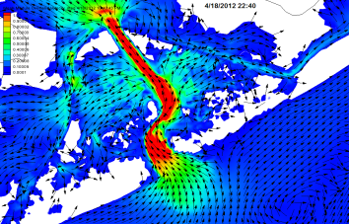
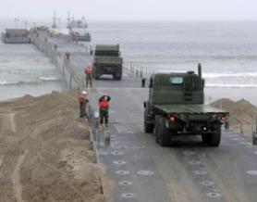
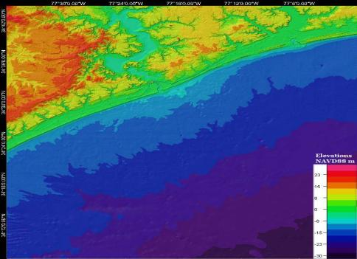
Warfighter Support
Current
  On-site bathymetric sensing
  Predictive littoral modeling
  Inverse modeling
  Reduced order modeling
  Austere Air/Sea Port of Debarkation (A/SPOD) entry assessment
Future
  Drive simulations with non-traditional data
  Engineering assessments in denied areas
  Short-term condition forecasts
MCBCL
Onslow Beach
MCBCL
New River Inlet
Notes:
Current:
Bathymetric sensing in the littoral zone: waves, currents, sediment characterization, morphology, soil moisture, etc.
Modeling in the littoral zone: waves, currents, sediment transport, morphology, coupling with estuarine and upland hydrology models
Inverse modeling: Use high-fidelity forward models to constrain possible scenarios. Combine simulations with remote observations to estimate relevant physical properties
Bathymetry from water surface imagery and satellite imagery for moisture content and soil properties
Reduced order modeling & surrogate modeling: Make model results available in operational timeframes
Tools for assessing potential SPOD (sea port of debarkation) locations to include near shore bathymetry and bank conditions, and for supporting near-shore mobility (soil moisture, wet gap analysis)
Material solutions as well as modeling (quickly stand up ports, breakwaters)
Future:
Tools for APOD (aerial port of debarkation) site selection and evaluation based on multi-sensor input to estimate surface and structural conditions
Rapidly and remotely assess candidate A/SPODs sites to support operational movement and maneuver in austere/denied locations using space-based/local standoff sensors
On-demand, 3-6 day forecasts of environmental conditions to include soil moisture, pavement conditions, waves, currents, depths, inundated areas, and crossing conditions for critical locations

Slide 9
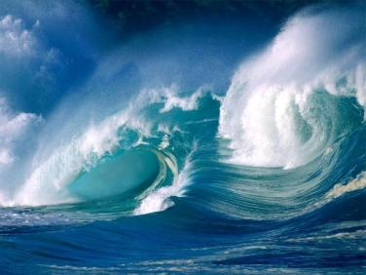
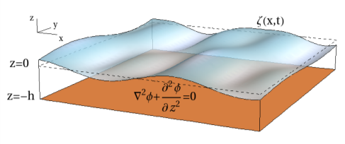
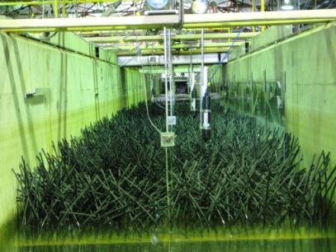
Wave Science
Current
  Improvement and consolidation of wave models
  Improved field measurements
  Development of new phase-resolving (Bouss-type) numerical wave model
  Parameterization of wave-vegetation interaction
Future
  Improved understanding/modeling of wave nonlinearities
  Wave-ice interactions
Notes:
Waves drive coastal processes including sediment transport, morphology change, inundation, nearshore circulation and pollutant transport, and waves damage coastal infrastructure and impede navigation. Accurate and efficient climatological and extreme wave estimates are required for all coastal projects.
Now
Improvement and consolidation of wave models through cyclic evaluation and updates based on project and testbed evaluations
Targeted field measurements, improved measurement capabilities, and expanded use of remote sensing to develop datasets for understanding wave processes and for model validation
New, modernized Bouss-type phase-resolving model is under development (improved wave-run up and vessel interactions calculations)
Wave-vegetation interaction modeling parameterization research in its initial stages.
Future
Research resulting in improved understanding/modeling of wave nonlinearities, overland wave propagation, wave growth and decay, advanced coupling of models, wave interaction with nature-based features, surrogate modeling, inverse modeling, and wave-ice interactions.

Slide 10
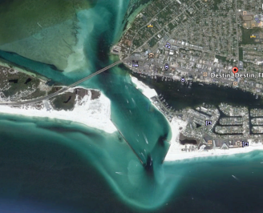
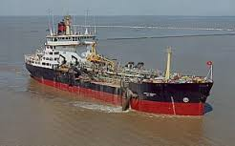
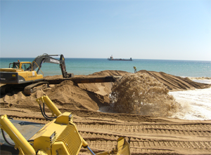
Coastal Sediments
Current
  Sustainable sediment management
  Bed dynamics
  Flocculation, settling, and deposition
  Shoreline evolution and stability
  Channel infilling
Future
  Cohesive sediment processes and transport
  Native sediments versus long term nourishment
Coastal Processes & Design
Notes:
Sediments are ubiquitous throughout our coastal projects, yet, physical, chemical and long-term processes involved in heterogeneous sediments are poorly understood. Because of the lack of scientific and engineering knowledge in sediments, Corps design and maintenance guidance has fundamental gaps because we use simplifying assumptions that make existing tools and models only applicable to specific situations. Without advances in understanding the processes, Corps projects using modeling and predictive capabilities may not reflect realistic sediment and soil properties and associated processes. These limitations usually result in over engineering and higher project costs in order to manage uncertainty.
We have various research underway that look at specific characteristics or issues in a few of our programs including CIRP, DOER (Dredging Operation and Environmental Research), Naviagation, and Flood & Coastal. What we need is a larger integrated effort to address the heterogeneous, chemical and biological properties in an integrated focus and produce new design guidance. These is also discussion across many Districts that as we continue to renourish beaches we are artificially changing the beach characteristics in an adverse way through the sorting of fine material during the dredging. This is changing physical characteristics of the beach and may be affecting turtle nesting and other biological processes.
XXXXXXXXXXXXXXXXXXXXXXXXXXXXX
Deep background information
Problem summary: Requirement for sustainable sediment management in the coastal zone are increasing, including more wetland/habitat restoration, nearshore placement, and Engineering with Nature. These opportunities require improved predictive capabilities for cohesive sediment transport. Cohesive sediment processes and transport impact multiple Corps missions, including navigation, FRM, and environment. Yet we only have a basic understanding of their behavior.
Research & Expected outcome: Research includes improving our understanding of cohesive sediment processes and transport, including erosion, bed dynamics, flocculation, settling, and deposition and development of applications for shoreline evolution and stability, channel infilling, fluid mud movement, dredged material management (DMM), turbidity, sedimentation and flora/sediment interactions.
Benefit to Corps: Reduced DMM costs, beneficial use of dredged material, reduced dredge volumes, improved interactions with regulatory agencies, increased navigation safety, improved FRM capabilities, improved environmental stewardship and ability to meet environment and habitat missions, and reduced uncertainty in newly proposed nearshore sediment management strategies
R&D efforts for FY15 funded by DOER, CIRP, CDR
Cohesive sediments include mixtures of cohesive (silt, clay, organics) and non-cohesive (sand, gravel) particles that behave in a cohesive manner. Interactions between cohesive and non-cohesive particles are critical to predicting sediment fate and are included in this cohesive sediment research.
Capabilities to predict – this means numerical models of varying complexity, application, and spatial domain.
Improved interactions with regulatory agencies will save time and money
Ongoing sediment process R&D will lead to incremental improvements in predictive models. At the present rate of R&D, the numerical models will be better suited to address these new opportunities in a time frame of 5-10 years. It is expected that additional R&D needs will be identified during this time.
Problem summary: Investigate the science behind state regulatory agencies policy for sediment compatibility with native beach sediments. Shoreline sediment s are no longer “native” and have become too course, negatively impacting the sustainability of our coasts.
Expected outcome: Lower percentage of sand required for beach and nearshore placement, increasing use of available sediments from navigation channels and scarce borrow sources.
Benefit to Corps: Reduced costs, increased benefits, leveraging across multiple federal and non-federal projects.

Slide 11
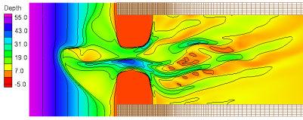
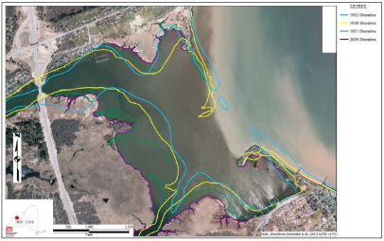
Coastal Geomorphology
Current
  Assess predictive performance on a range of environmental conditions at an idealized inlet
  Investigate SLR volume change and barrier island transgression
Future
  Understand long-term evolution from event and recovery cycles, including extreme events
  Understand temporal component to regional change resulting from SLR
  Long-term evolution spanning 50 to 100 years
Coastal Processes & Design
Notes:
USACE Navigation and Flood Risk Management projects are located along barrier-inlet systems. The long-term geomorphic evolution and regional sediment volumetric change for these systems is not well understood, and the effects of climate change, such as sea level rise, will impact the natural morphodynamics of inlets and beaches and play a role in the long-term availability of our regionally managed sediment resources.
We have research in our CIRP program, one work unit in our entire portfolio, that is researching coastal geomorphology change. This is small compared to what is needed because to accurately assess climate change drivers, such as SLR, we must understand the forces and processes that drive long term geomorphic change.
Today we are investigating how SLR may effect barrier island evolution and applying our current models and understanding over a broader range of conditions. These model runs are for up to a few years. What we need for the future is multi-decadal modeling capability that accurately includes barrier island and other long-term geomorphic processes.
XXXXXXXXXXXXXXXXXXXXX
Research & Expected outcome: The validation of numerical modeling capabilities to reproduce long-term evolution spanning 50 to 100 years under a range of physical forcing conditions for different, idealized barrier-inlet systems will provide a base for climate change scenario modeling for USACE projects.
Benefit to Corps: This modeling capability will provide valuable insight on the importance of different management strategies that could address various climate change scenarios, particularly that of sea level rise and storminess. Coastal numerical models could provide planning-level vulnerability assessment maps for the nation’s inlets and entrance navigation channels to decision makers.
Background
Climate change related sea level rise (SLR) at coastal estuaries cannot be considered as simply “filling up the bathtub”, resulting in deeper water, less shoaling, and, therefore, less dredging. Long-term geomorphic evolution under SLR at this acceleration rate will “abandon” some volume of sediment in the offshore portion of the littoral envelope, though not all of it as, the slower the rate, the more sediment can be transported into estuaries via overwash and inlet processes. This loss of sediment to deeper water follows the Bruun Rule, an engineering concept which defines and quantifies the “rolling backward” of barrier islands under transgression or SLR. The temporal component to regional volumetric change for coastal systems under long-term SLR is not well understood.
For USACE Navigation, this brings up many questions about changes in the morphodynamics of inlets and entrance channels within our Navigation projects. For USACE Flood Risk Management, a question arises regarding the availability of sediment resources for our managed sediment systems where we rely significantly on available sediment resources in our navigation channels and along the continental shelf. The CIRP has proposed two research tasks to assist in answering these questions and elevating the science and our understanding of how SLR and other Climate Change effects may impact the USACE mission.
Background
CIPR Research Tasks:
Long-term Morphology Change at Tidal Inlets. The Coastal Modeling System (CMS) has been applied to barrier-inlet systems to evaluate nearshore sediment transport and tidal inlet processes at and around Navigation and Shore Protection Projects within the USACE on the order of 1-3 year prediction intervals. This research task designs an experiment to test and validate a range of environmental conditions for different, idealized barrier-inlet systems under long-term simulations spanning 50 to 100 years, or, a common timeframe for a natural inlet to form and stabilize under equilibrium conditions. Validation is conducted by analyzing known properties and relationships of each idealized system to real world conditions, and the model grids and environmental forcing parameters will be stored in a database for validation of other numerical models to follow this methodology. The results of this test will provide valuable insight on important parameters that would be sensitive to climate change conditions, particularly that of sea level rise and storminess.
Sea Level Rise Scenarios in the Coastal Modeling System. The CMS is also being applied directly to real-world projects to test the variable responses in sediment transport and morphology change to different initial and variable conditions forced on the modeled project area. This research task will allow the team to better define what characteristics of a coastal region are related and potentially susceptible to significant change due to the effects of SLR on a barrier-inlet system.
Future Work: A future research task to analyze nationwide impacts to Navigation under long-term morphology change and SLR, and to assess the vulnerability and risk, leans heavily on the results and guidance derived from these two ongoing research tasks. With some confidence in the model’s results for various conditions, or at least a range of suitable results and associated error computations, coastal numerical models such as the CMS could be capable of providing vulnerability assessment maps for the nation’s inlets and entrance navigation channels. This would be a tool for decision makers to consider when planning 50-years for regional coastal projects.

Slide 12
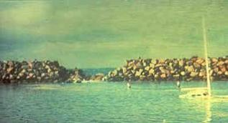
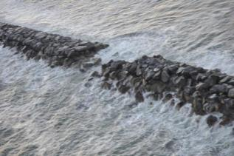
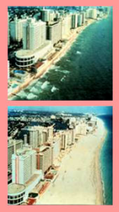
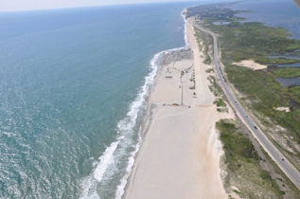
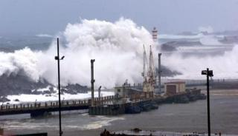
Coastal Structures & Beaches
Current
  Assess uncertainty and reliability of coastal structures
  Improved structure design guidance
  Probabilistic life-cycle cost analysis of coastal flood risk management
  Include unique environmental forcings in coastal settings at project/regional scale
  Development and fielding of the Second Generation Coastal Risk Model (G2CRM)
Future
  Probabilistic life-cycle cost analysis of coastal structures for Asset Management
  Predict natural and nature-based features performance
Coastal Processes & Design
Notes:
Problem summary: Uncertainty is not reflected in a meaningful way in coastal structure design or coastal structure asset management.
Research & Expected outcome: Improve our understanding of aleatory and epistemic uncertainty and related reliability safety coefficients. Assess uncertainty propagation through the modeling chain and sensitivity of designs to uncertainty components. Improved design and asset management methods and guidance.
Benefit to Corps: Products will improve designs and produce more meaningful assessments of capacity, risk and resiliency.
Goals are to collect field and laboratory data and use these data to quantify aleatory (random process) and epistemic (lack of knowledge) uncertainty for major failure modes. Results will include partial safety coefficients for design. Additionally, uncertainty propagation through the modeling chain and sensitivity of designs to uncertainty components will be illustrated. For example, stability and wave overtopping empirical equations contain considerable uncertainty. What is the impact of this uncertainty in NED alternative selection? What is the value of more refined numerical modeling of waves and water levels or physical modeling in reducing this uncertainty? For asset management, if a structure has a few armor stones displaced, what is the capacity reduction and what is the probability of progressing to breach, as illustrated in the picture of Redondo Beach breakwater at the top and LALB breakwater in the middle? What is the probability of complete failure for the design storm as illustrated in the bottom picture of the breakwater at the U.S. Air Force Base in Lajes, Azores?

Slide 13
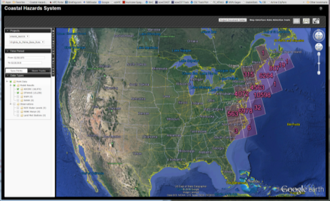

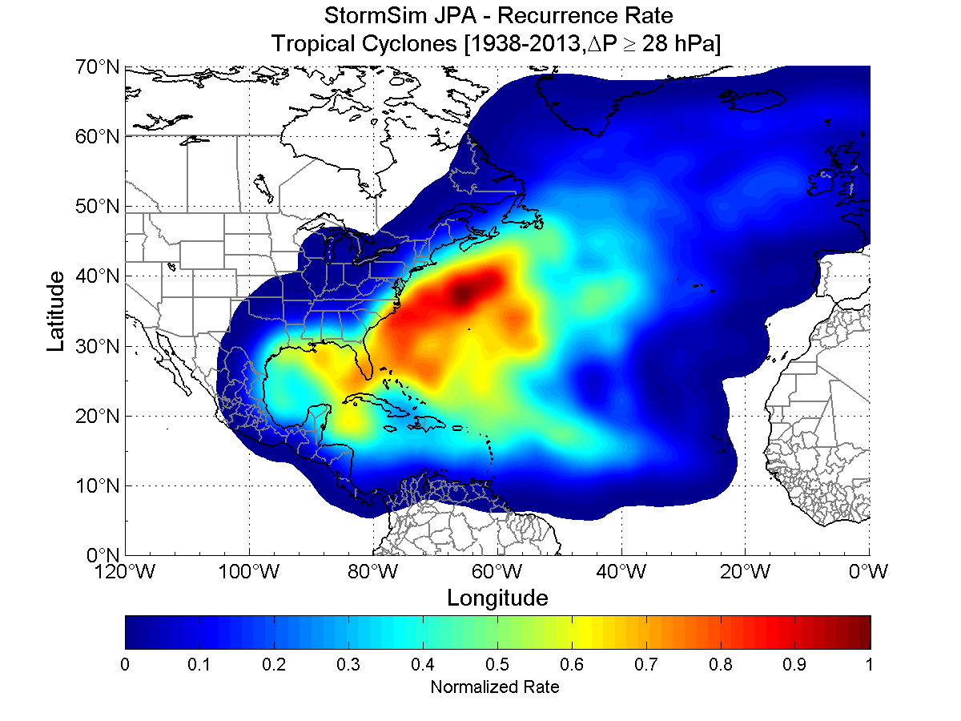
Coastal Hazard Quantification
Current
  Pre-computed high-fidelity coastal storm hazards with uncertainty quantified
  Rapid high-fidelity storm response prediction and distribution
  Development of Coastal Hazards System (CHS) as delivery framework for wide range of coastal hazard tools and capabilities
Future
  Population of CHS database for rest of US coastline
  Incorporation of climate and geomorphological change predictions
https://chs.erdc.dren.mil/
Regional Coastal Systems
Notes:
The Coastal Hazards System represents the significant investment in R&D that USACE and FEMA are making in archiving and distributing the regional coastal hazard study data, the work being done in surrogate modeling (e.g. Neural networks or response surfaces for hazard prediction), and the investment that USACE, FEMA and NRC are making in more rigorous and accurate computation of aleatory and epistemic uncertainties. It all fits together well and meshes nicely with development being done by Chris Massey, Chris Kees, Jane Smith and other hydrodynamic modelers. We have a large cooperative agreements with HR Wallingford and other groups to improve quantification of epistemic uncertainty. The Coastal Hazards System being developed is being developed as a delivery framework for a whole host of capabilities that will make high fidelity modeling results available to classes of studies that previously could never have afforded the costs of this level of data.
Research & Expected outcome: Precomputed high-fidelity coastal storm hazards with aleatory and epistemic uncertainty quantified and distributed through the Coastal Hazards System in easy-to-ingest formats. Rapid high-fidelity storm response prediction and distribution.
Benefit to Corps: Significant savings in project planning and design costs. Higher-fidelity data. More complete understanding of uncertainty and hence risk and resiliency. Higher fidelity hazard predictions with all hazards, not just surge.

Slide 14

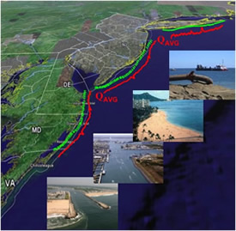

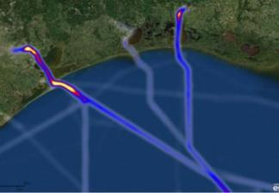
Coastal Resiliency
Current
  Develop and test Tier 2 method to quantify coastal system resilience
  Framework for resilience analysis
  Performance metrics and analysis approaches for evaluating MTS resilience
  Development of coastal resiliency operating principles
Future
  Capability to develop, predict and implement regional strategies across multiple projects and business lines
  Develop tools and methods that represent changing coastal forcing & system dynamics, manage for networked systems, and produce guidance for blended natural & built systems for autonomous recovery & adaptation.
Disturbance
Prepare
Resist
Recover
Adapt
Regional Coastal Systems
Notes:
Problem summary: USACE has shifted management of coastal flood risk, ecosystem, and navigation projects to consider each in the context of an integrated coastal system. Managing sediment regionally, better harnessing natural processes to engineer with nature, incorporating marine transportation and supply chain dynamics, and considering resilience as a engineering consideration in a risk-based design and operations are challenging our knowledge, tools, and performance standards.
Research & Expected outcome: Capability to develop and implement regional strategies which optimize sediments, funding, and benefits across multiple projects and business lines. New performance metrics and analysis approaches for evaluating MTS resilience in the context of coastal port and waterway functionality, reliability, and safety. Need better tools and methods that represent changing coastal forcing & system dynamics, manage for networked systems, produce and guidance for blended natural & built systems for autonomous recovery & adaptation.
Benefit to Corps: Federal leader in integrated water resource management and reduction in overall integrated coastal system cost & risk.

Slide 15
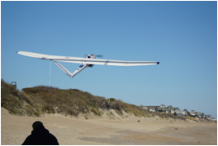
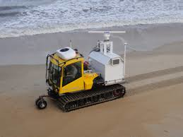
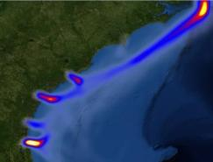
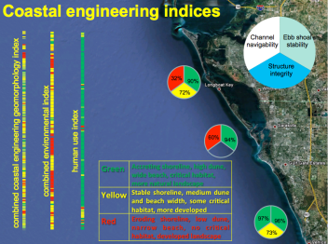
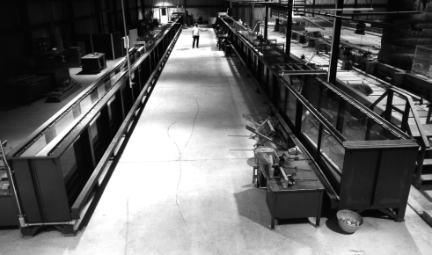
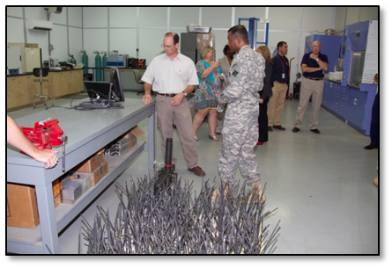
Enabling R&D Infrastructure
Data collection technology
Data Integration Framework
Turning data into knowledge
Numerical Model Modernization
Developing Facility Modernization Plan
  Prioritizing investments
  Supported by field needs
  FRF maintenance/improvements
Data/Compute Cloud
Project Workspace
Models
&
“Toolboxes”
User Interface Tools
Notes:
R&D Focus for future lab needs:
LSTF = mixed sediment
3050 = navigation and F&C infrastructure, condition assessment
3051 = infrastructure operations and rehab
3201 = sediment processes
3202 = sediment processes, field data collection techniques, vessel effects, infrastructure operations and maintenance
3281 = inland navigation structures/mixed sediment and wave/structure interaction
6006 = flood basin, stability basin, fluid/structure interaction, sediment processes and scour near structures - replace DWSG - add real current capabilities to wave flumes
7000/7001/7002 - levee breach testing, lock operations and design, scour near structures, fluid/structure interaction
RRLB - rapid breach repair
STS - navigation design and military operation environments
Future
MHF - Navigation Systems R&D, Flood and Coastal R&D, Logistics over the Shore, All inland and deep draft navigation design projects, lock design projects, hydraulic structures design, and inlet protection design

Slide 16
Summary
CHL’s current Navigation & Coastal R&D priorities
  Infrastructure (measure, monitor, assess)
  Coupled models
  Expedient Storm Response Prediction
  Marine Transportation System Performance
  Natural & Nature-based Features
  Collaboration (MIL Programs, other agencies)
Future R&D
  Heterogeneous sediments
  Geomorphology
  Resilient Coastal Systems
  Urban Flooding
Notes:
Our current priorities track with USACE Civil Works priorities established through the CW R&D Steering Committee.
Infrastructure with a current focus on measuring & monitoring to produce data and information for decisions, such as with Asset Management. Coupling our models to provide system-scale tools. Expedient storm response has been heavily leveraged with FEMA to develop. Marine Transportation performance is supporting the CMTS and the DOT MAP21 study, and is an interagency effort. Natural & Nature-based Features focus driven by Sandy and we are working to improve our capabilities to design and predict performance of NNBF. Across our CW programs we have consolidated capabilities and leverage expertise, not only in CW but also from our Military programs.
Heterogeneous sediments & soils are ubiquitous throughout coastal projects and most of our water resources infrastructure and, therefore, are a major consideration in many Corps projects; yet, physical and chemical processes involved in studying a complex environment of sediments, deposited by engineering methods, and soils, developed in place, are poorly understood. Because of the lack of scientific and engineering knowledge in the area of sediment and soil interaction, Corps design and maintenance guidance are based on analyses using homogeneous geotechnical properties.
Geomorphology. As global climate change alters the rates of sea level rise and potentially storm patterns and coastal urbanization increases over the coming decades, an understanding of coastal evolution is critical. Improved knowledge of long-term morphological, ecological, and societal processes and their interactions will result in an improved ability to simulate coastal change. This will enable proactive solutions for resilient coasts and better guidance for reducing coastal vulnerability.
Resilient Coastal Systems is an emerging priority as we have seen through the CERB charge and its spread across Civil Works and Military business lines. It is also an important topic across the Administration and other Federal agencies. The Corps has the leadership in infrastructure resilience based on our national and international review of the state-of-practice and scientific literature.
Urban flooding as we saw with Katrina & Sandy is very different than other coastal flooding that we have studied for decades. Wave propagation down main street with vertical buildings (subway tunnels) reflecting energy can not be accurately modeled with today’s knowledge and tools.

