Slide 2
Presentation to the Board of Governors Advisory Board for UF Online
April 30, 2014

Slide 3
Overview of UF Online Organization, Majors, Research & Space

Slide 4
Organization
Distance
And
Non-credit
Continuing
Education
Provost
(Academic Affairs)
Associate Provost
(Distance and Continuing Education)
Finance;
Administration, IT
Quality Assurance
Faculty Development
Research Institute
Distance
UF Online (UFO) _{L}
Continuing
UF Outreach (UFO)_{r}
Undergrad Programs
Grad Programs
Courses
FLEX
Not for credit Courses/Programs
Conferences
Coursera

Slide 5
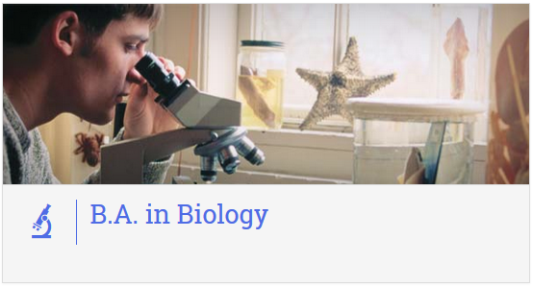
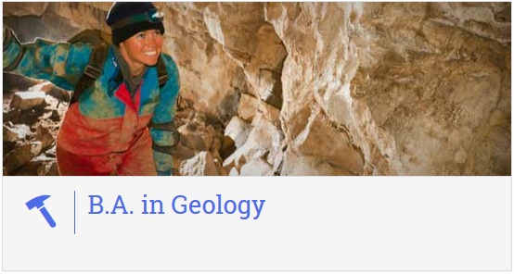
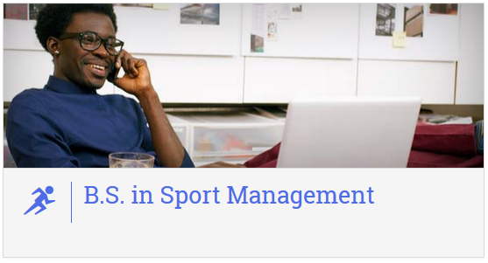
Majors
Original 5 launched
in spring 2014
Next 5 launching
in fall 2014

Slide 6
Majors Roadmap
Academic Year 2013-14
Business Administration
Criminology & Law
Health Education & Behavior
Environmental Management
Sport Management
Academic Year 2014-15
Biology
Computer Science
Geology
Psychology
Telecommunications
Academic Year 2015-16
Accounting
Industrial Engineering
Geography
Nursing
Political Science
Sociology
Academic Year 2016-17
Microbiology & Cell Science
Physiology & Kinesiology
Mechanical Engineering
Civil Engineering
Public Relations
Elementary Education

Slide 7
Majors
Majors accepting new students
per term and student type
 | 2014 Spring | 2014 Summer |  | 2014 Fall |  | 2015 Spring | 2015 Summer |  | 2015 Fall
Major | Tran | FTIC | Tran | FTIC | Tran | Tran | FTIC | Tran | FTIC | Tran
B.A. in Biology |  |  |  | Y |  |  | Y |  | Y | Y
B.S. in Business Administration | Y | Y | Y | Y | Y | Y | Y | Y | Y | Y
B.S. in Computer Science |  |  |  | Y |  | Y | Y | Y | Y | Y
B.A. in Criminology & Law | Y | Y | Y | Y | Y | Y | Y | Y | Y | Y
B.S. in Environmental Management | Y | Y | Y | Y | Y | Y | Y | Y | Y | Y
B.A. in Geology |  |  |  | Y | Y | Y | Y | Y | Y | Y
B.S. in Health Education & Behavior | Y | Y |  | Y |  | Y | Y | Y | Y | Y
B.A. in Psychology |  |  |  | Y | Y | Y | Y | Y | Y | Y
B.S. in Sports Management | Y | Y |  | Y |  | Y | Y | Y | Y | Y
B.S. in Telecommunication Media & Society |  |  |  | Y |  | Y | Y | Y | Y | Y
Tran = Transfer Student
FTIC = First Time in College (Freshmen)

Slide 8
Other Issues
Other Issues
Double Majors
Minors
Business
Others

Slide 9
Course Production & Faculty Development

Slide 10
Spring 2014 Course Offerings
Program | Courses
General Education | 29*
Environmental Management | 10
Business Administration | 11
Health Education | 15
Sport Management | 12
Criminology/ Law | 8
* 7 program courses are also GenEds
Notes:
78 courses offered 45 courses newly designed/redesigned
22 General Education
10 Environmental Management
11 Business Administration
15 Health Education
12 Sport Management
9 Criminology/Law

Slide 11
Summer 2014 Course Offerings
Program | Courses
General Education | 18
Environmental Management | 7
Business Administration | 12
Health Education | 5
Sport Management | 6
Criminology/ Law | 4*
* 4 GenEds fulfill program requirements
Notes:
52 Courses being offered (one less without Stats)
20 Courses newly designed/redesigned
31 Courses in Canvas

Slide 12
Fall 2014 Course Offerings
Program | Courses
General Education | 13
Environmental Management | 12
Business Administration | 9
Health Education | 7
Sport Management | 6
Criminology/ Law | 4*
New Programs | Courses
Geology | 3
Psychology | 7
Biology | 4*
Telecommunications | 4*
Computer Science | 4*
* Currently finalizing offerings
Notes:
120 Courses scheduled
55 Courses newly designed/redesigned
Majority of courses in Canvas

Slide 14
Course Design
Faculty Training
UF Standards & Markers of Excellence
Student Experience Rubric
Quality Assurance Committee

Slide 15
2014 Online Education Excellence Awards
Six of eight winning courses are UF Online:
ISM3004 Computing in the Business Environment
BSC2009 Biological Sciences
CJL3038 Law and Society
AST1002 Discovering the Universe
IDS2338 Rethinking Citizenship
SPN2230 Beginning Spanish I

Slide 16
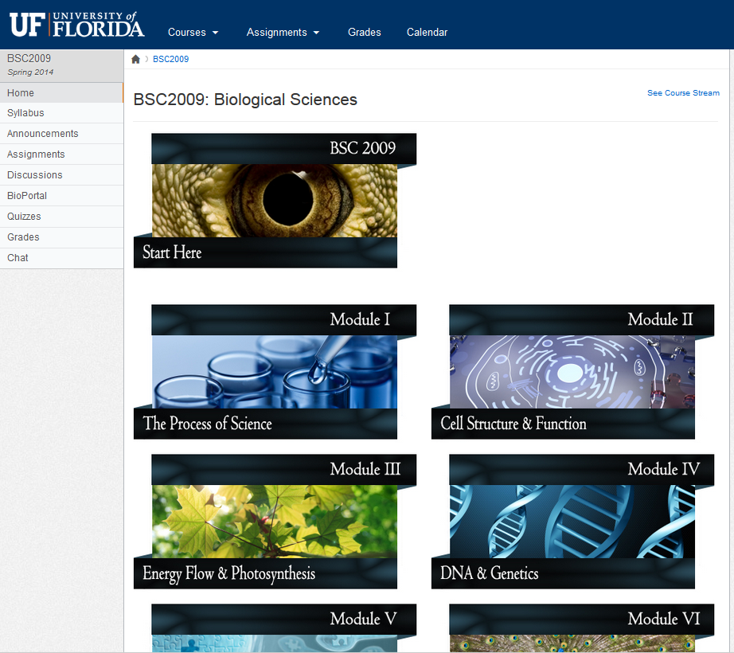

Slide 17
Faculty Development
Faculty Institute
Online workshop
Required prior to course development
Teaching Assistant Institute
Online workshop
Required
TA handbook

Slide 18
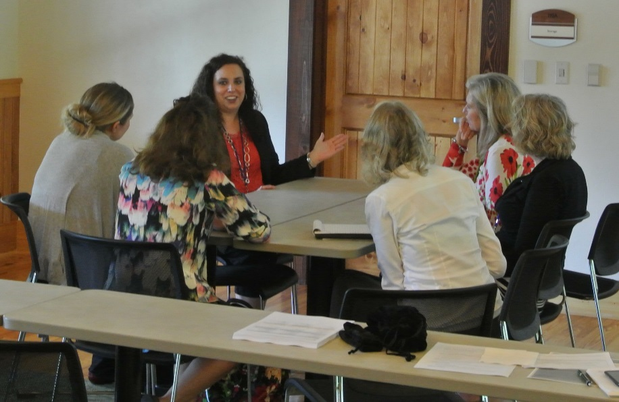
Faculty Development
UF Interface Faculty Seminar
To be presented each term
Faculty discussion Forum
To be presented monthly
Faculty Institute Supplements
Presented online

Slide 20
IT Support Technology Services for Online Student Success

Slide 21
IT Services for UF Online
Course Production
Support & Training
Course Delivery
Administration
Metrics & Analytics
Instructional Design
Faculty
Student
Course Management System
Admissions
Data Collection & Warehousing
Face to Face
Computer
Help Desk
Registration
Web & Programming
Just in Time
Virtual Computer Lab
Student Records
Performance Metrics
Self-service resources
Rich Media Production
CMS Support
Financial Aid
Analytics
Pedagogy for online instruction
Video & Collaboration
Billing and Payments
Reports
IT Services
Partnerships (Integration)
Network
Pearson
MCGraw-Hill
Proctor-U
eMail
Software licenses

Slide 22
Division of Student Affairs
UF Online Orientation
Jaime Gresley & Kris Klann
New Student and Family Programs
Therapist Assisted Online (TAO)
Dr. Sherry Benton
Counseling & Wellness Center
www.dso.ufl.edu/nsfp
www.counseling.ufl.edu

Slide 23
Therapist Assisted Online
Dr. Sherry Benton
Director of the Counseling and Wellness Center

Slide 24
TAO History
The problem:
Supply never matches demand
Distance learners call often, little to offer
Many students find counseling to be inconvenient, time consuming, fear stigma
We are never going to hire our way out of this
TAO
2011 began to build TAO, surveyed students,
Piloted in fall 2013,
Expanded in spring to include distance

Slide 25
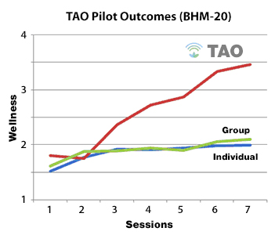
TAO Results
Treatment | Effect Sizes
Meta-analysis, f-t-f psychotherapy | .35-.57
Meta-analysis, medication | .28-.50
CWC f-t-f psychotherapy | .34
TAO | .74

Slide 26
TAO Platform
HIPAA compliant
Self-regulated learning environment
Engaging multimedia learning
Adaptive and personalized
Instructional scaffolding
HIPAA compliant video conferencing, and apps.
Customized analytic tools
Mobile friendly
xAPI
Design Principals
Technology

Slide 27
Pearson Learning Solutions Marketing, Recruitment & Retention

Slide 28
Marketing Services
Marketing Strategy
Branding
Positioning/Messaging
Campaign Strategy
Web Strategy & Design
GTM Planning & Execution
Integrated Marketing Plans
Media Planning
Creative Execution
Media Buys
Ongoing Optimization
Media Tracking
Funnel Tracking
Real-time Optimization
Monthly/Quarterly Planning
Other
Portfolio Recommendations
Target program mapping
Enrollment Predictability

Slide 29
Marketing Strategy
Build awareness of the University of Florida Online brand and individual program offerings
Drive qualified leads from prospective students
Nurture leads through the application, admissions and enrollment process
Measure & improve conversions at each step of the marketing funnel

Slide 30
Creative Approach
Be Greater. Be a Gator. Integrated message and creative acrosss all touch points
Works to promote UF Online brand and individual programs
Flexible across audiences: in state / out of state, FTIC/Completion
Leverage superior UF academic reputation and build on Gator Pride

Slide 31
Media Strategy
Build and optimize direct response marketing channels to drive action with existing intenders, layering on broader media and social media designed to create awareness and drive preference for UF online.
Drive Action via Direct Response Media
Our media foundation
Allows us to capture today’s intenders
Create Awareness via Broad Media
Longer term investment
Layered on to compliment and feed direct response investments over time
Storytelling via PR & Social Media
Platform for rich storytelling and referral
Community building with existing students
Storytelling and Referral
AWARENESS
ACTION

Slide 32
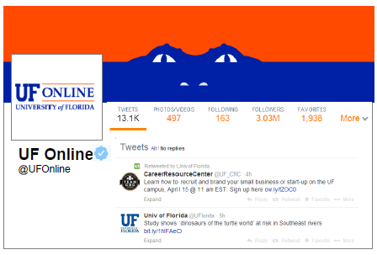
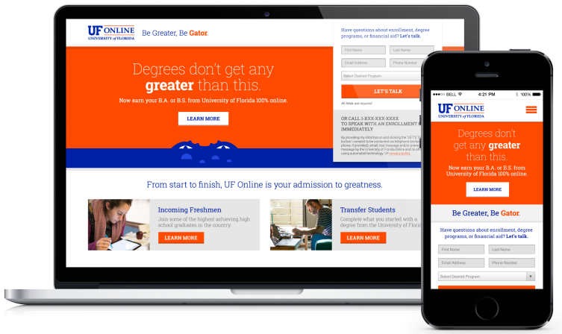
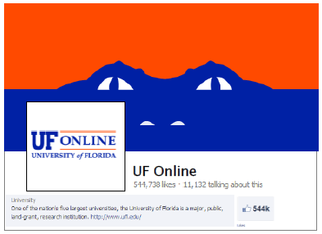
A Consistent Story
Across Touch Points
Display
Social Media
Website
Search Engine Marketing
Radio

Slide 33
Q2 Media Plan
Target : 16–35 year old FTIC & degree completion prospects
 | Search | Radio | Display | Twitter | Facebook
In State | All of Florida | Florida Orlando Jacksonville | All of Florida | All of Florida | All of Florida
Out of State | Rest of US | California San Diego Georgia Atlanta Virginia Norfolk | Rest of US | Rest of US | Rest of US

Slide 34
In State & Out of State Lead Trends
Steady increase in Out of State lead volume; out of state represented 44% of leads Q1 2014 vs.33% in Q4 2013
Q2 Media increased out of state media allocation by 50%
Deeper analysis on in state / out of state conversion rates will be conducted at the close of summer and fall 2014 terms

Slide 35
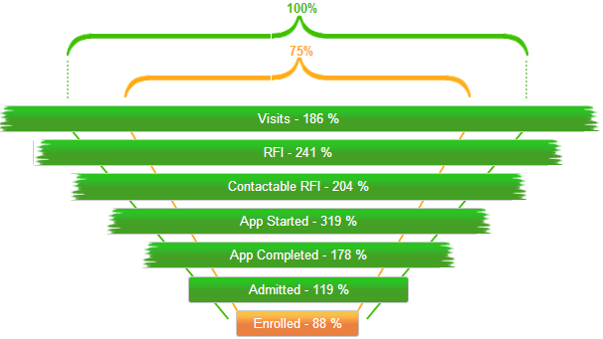
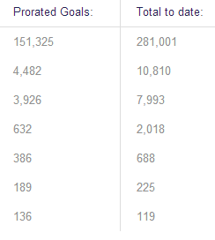
Evaluating Performance
198 %
765
Enrolled 69 %
94
On track to meet/exceed student target of 175 new students for AY13/14 (spring/summer 2014)
94 enrolled for spring 2014 (on a financial forecast of 41 for spring 2014 enrollment)
Summer admitted/enrollments are still in progress
Currently watching bottom of funnel conversion as these will be critical dependencies for hitting our targets; app completed, admitted, and enrolled conversion trends

Slide 36
Core Service: Recruitment Operations
Enrollment Advisors are dedicated team members working on behalf of your institution
Consultative Advisor
Relationship Building – Build rapport, trust, and credibility
Discovery – Ask proper questions to identify needs and motivation
Advocate and Support – Meet the need and recommend best solution-vision match
Recruitment Management
(Process)
Statuses – Effectively move leads through the recruitment process
Calls and E-mails – Number of times per week
Recruitment Reporting– Forecast of projected students
Communication Plans
Automated/ Attempting – Each new lead gets a personalized response upon inquiry and during the attempting process
Accepted – Calls and e-mails to keep prospective students engaged
Registration to Start of Class – Calls and e-mails through the first week of class
Notes:
Rob Bishop

Slide 37
Core Service: Student Support & Retention
Every student is supported by a dedicated Program Coordinator:
Welcome Call
Outlining Keys to Success
Proactive Check-ins
Behind the Scenes Monitoring
Encouragement & Recognition of Efforts
Respond to Program & Service Questions as Needed
Notes:
Rob Bishop

Slide 38
Admissions & Enrollment Management

Slide 39
Enrollment Management (EM) A Team Effort
EM Online One-Stop Center - UF
Four (4) EM staff dedicated solely to assisting students as they move through the application and enrollment process
Work with Colleges to manage application flow and decision notification
Collaborate with call center staff
Pearson Call Center - Orlando
Sixteen (16) staff dedicated solely to assisting students during the outreach, recruitment, enrollment and retention process

Slide 40
Prospects & Applicants (as of April 23, 2014)
Prospects - Requests for Information (RFI)
10,891
Greatest Interest
FL, GA, CA, TX, NY
Demographics
63% FL residents
25% FTIC
32% Associate Degree
Applicants
1193 - Transfer
482 spring
765 summer & fall
114 – Freshmen
Summer & fall
Popular Majors
Business Administration (F/T)
Criminology & Law (T)
Health Education (F)
Increasing Interest
RFI From All 50 States

Slide 41
Transfer Enrollment Spring 2014
 | Enrollment
Major | New | Continuing | Total
Business Administration | 55 | 357 | 412
Criminology & Law | 17 | 48 | 65
Environmental Management | 4 | 8 | 12
Health Education & Behavior | 10 | 34 | 44
Sport Management | 8 | 55 | 63
Total | 94 | 502 | 596

Slide 42
Transfer Applications Summer & Fall 2014
Apps
765
Admits
113
Denied
154
Pending
468
Continue to accept applications
College review and decisions released on a rolling basis

Slide 43
First Time in College: Freshmen
Apps
114
Admits
15
Denied
29
Pending
60
Spring 2014
By design no freshmen admitted for the spring term.
Summer & Fall 2014
Continue to accept applications until June 2014
Decisions released on a rolling basis

Slide 44
First Time in College: Freshmen Applicants: Summer/Fall 2014
Major | Total Apps | Admits
Biology | 15 | 3
Business Administration | 34 | 3
Criminology & Law | 16 | 2
Environmental Management | 7 | 3
Geology | 0 | 0
Health Education | 20 | 1
Psychology | 12 | 0
Sport Management | 7 | 1
Telecommunications Media & Society | 3 | 2
Total | 114 | 15

Slide 45
Considering Modular Terms
Three sessions each Fall & Spring Term
Similar to current summer model
Session C
This 16 week term overlaps with the current term structure
Session A
This term overlaps with first 8 weeks of the semester. Full content of the course would be taught in 8 weeks
Session B
This term overlaps with last 8 weeks of the semester. Full content of the course would be taught in 8 weeks

Slide 46
Finances & Tuition

Slide 47
Financial Performance Revenues
 |  | 2014 Actual | 2014 Budget | Variance
Tuition:
 | In-State | 549,511 | 114,840 | 434,671
 | Out of State | 32,186 | 159,120 | (126,934)
 | Less: Financial Aid | - | (7,352) | 7,352
Fees:
 | Technology Fee | 23,142 | 7,352 | 15,790
 | Capital Improvement Trust Fund Fee | 35,537 | 9,467 | 26,071
 | Financial Aid Fee | 34,601 | 7,352 | 27,248
State Subsidy |  | 15,000,000 | 15,000,000 | -
Total Revenue |  | 15,674,976 | 15,290,779 | 384,197

Slide 48
Financial Performance Non-Recurring Costs
Non-Recurring Expenses: |  | 2014 Actual | 2014 Budget | Variance
 | Initial Production | 552,802 | 1,044,000 | 491,198
 | Upgrades |  | - | -
 | Production Equipment | 51,609 | 500,000 | 448,391
 | Enrollment Management & Marketing | 678,332 | 600,000 | (78,332)
 | Student Services | 178,897 | 400,000 | 221,103
 | Technology | 21,955 | 1,000,000 | 978,045
 | Facilities' Debt Service |  | - | -
 | Overhead |  | 189,274 | 189,274
Total Non-recurring costs |  | 1,483,594 | 3,733,274 | 2,249,680

Slide 49
Financial Performance Recurring Costs and Margins
Recurring Costs |  | 2014 Actual | 2014 Budget | Variance
 | Delivery | 425,663 | 650,771 | 225,108
 | Enrollment Management & Marketing |  | 449,169 | 449,169
 | Direct Administration | 244,150 | 520,000 | 275,850
 | P3 Services | 3,500,000 | 3,641,408 | 141,408
 | Overhead |  | 81,836 | 81,836
 | Technology | 23,051 | 1,197,471 | 1,174,420
 | Facilities' Operations |  | 34,318 | 34,318
 | Library |  | 17,984 | 17,984
 | Student Services |  | 31,678 | 31,678
Total Recurring Costs |  | 4,192,864 | 6,624,635 | 2,431,772
Total Cost |  | 5,676,458 | 10,357,909 | 4,681,451
Net Margin |  | 9,998,518 | 4,932,870 | 5,065,648

Slide 50
Tuition Considerations
Tuition Models being Considered:
Block Tuition
Low hour per semester (11 hours)
High hour per semester (15 hours)
Annual, including summer (30 hours)
Tuition Guarantee
Same rate for four years
Increase to list price after four years
Same rate for up to 120 hours then out of state rate
Rebate if Graduation Within 6 Years
Need to Understand Student Trends

Slide 51
Primary Challenges & Opportunities

Slide 52
Primary Challenges & Opportunities
Assessment Fee
Online Laboratory
U S Navy
Reverse 2+2
E-texts
3/2 programs
Double majors
Minors

Slide 53
Performance Measures

