Slide 1
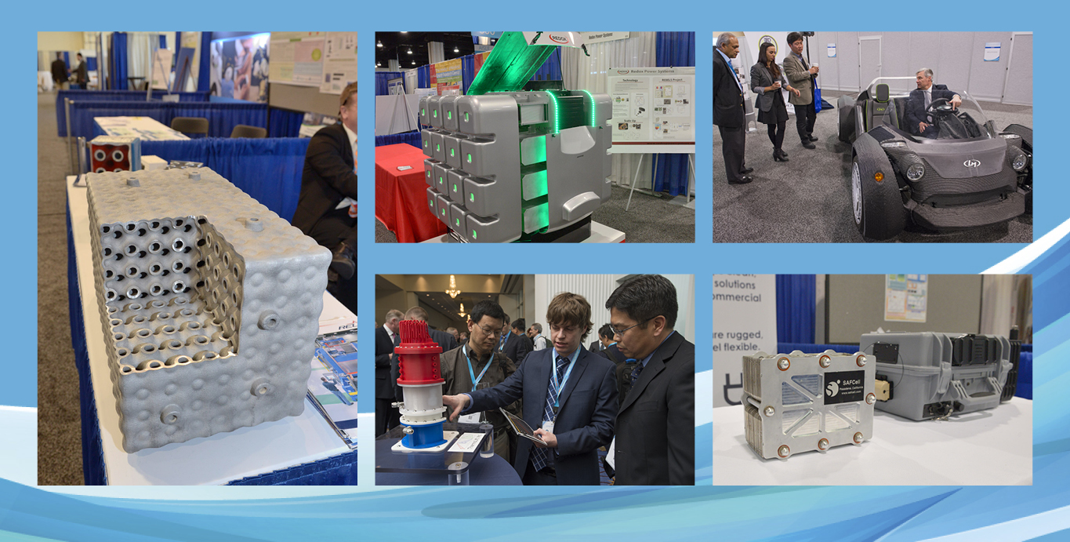
http://www.arpa-e.energy.gov/

Slide 2
ARPA-E’s History
In 2007, The National Academies recommended Congress establish an Advanced Research Projects Agency within the U.S. Department of Energy*
…“The new agency proposed herein [ARPA-E] is patterned after that model [of DARPA] and would sponsor creative, out-of-the-box, transformational, generic energy research in those areas where industry by itself cannot or will not undertake such sponsorship, where risks and potential payoffs are high, and where success could provide dramatic benefits for the nation.”…
450+
30
Awards Announced
37
23
20
16
12
1
7
Programs
To Date
2007
Rising Above the Gathering Storm Published
2009
American Recovery & Reinvestment Act Signed
2010
2011
2012
2013
2014
2015 Anticipated
America COMPETES
Reauthorization Signed
America COMPETES Act Signed
$400 Million
(Recovery Act)
$180 Million
(FY2011)
$275 Million
(FY2012)
$251 Million
(FY2013)
$280 Million
(FY2014)
$280 Million
(FY2015)
* Handouts, Miscellaneous Reports, Gathering Storm
Notes:
Updated to reflect 2015 numbers
Budget (Million) Data Source:
FY2009: $15,000 http://energy.gov/sites/prod/files/FY11Orgsum.pdf ARRA $388,856 http://energy.gov/sites/prod/files/FY11Orgsum.pdf (Note: rounded to $400 million in all public documents, did so here to maintain consistency.)
FY2010 $0 http://energy.gov/sites/prod/files/FY11Orgsum.pdf
FY2011 $179,640 http://energy.gov/sites/prod/files/FY13Volume4.pdf (p. 401)
FY2012 $275,000 http://energy.gov/sites/prod/files/2013/04/f0/orgsum.pdf
FY2013 $250,636 http://energy.gov/sites/prod/files/2014/04/f14/FY%202015%20DOE%20Budget%20by%20Organization.pdf
FY2014 $280,000 http://energy.gov/sites/prod/files/2015/01/f19/FY2016BudgetSummaryTableByOrg_0.pdf
F2015 $279,982 http://energy.gov/sites/prod/files/2015/01/f19/FY2016BudgetSummaryTableByOrg_0.pdf
FY2016 (Requested) 325,000 http://energy.gov/sites/prod/files/2015/01/f19/FY2016BudgetSummaryTableByOrg_0.pdf

Slide 3
ARPA-E Authorizing Legislation
Mission: To overcome long-term and high-risk technological barriers in the development of energy technologies
Reduce Energy Imports
Goals: Ensure America’s
Economic Security
Energy Security
Technological Lead in Advanced Energy Technologies
Improve Energy Efficiency
Reduce Emissions
Means:
Identify and promote revolutionary advances in fundamental and applied sciences
Translate scientific discoveries and cutting-edge inventions into technological innovations
Accelerate transformational technological advances in areas that industry by itself is not likely to undertake because of technical and financial uncertainty

Slide 4
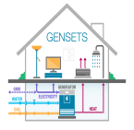
Focused Program Portfolio
Electricity Generation
Impacct
Solar Adept
focus
alpha
Mosaic
Electrical Grid & Storage
Rebels
GENSETS
Grids
Heats
geni
charges
Nodes
Efficiency
Adept
Switches
React
Metals
Monitor
Transportation & Storage
beetit
delta
arid
beest
amped
Range
ElectroFuels
Petro
Move
Remote
TERRA
Transnet
2010
2011
2012
2013
2014
2015

Slide 5
If it works…
will it matter?

Slide 6
Transitions Toward Market Adoption
R&D
Prototype
Demonstration
Commercialization
Investment
Valley of Death #1: Public Funds
Valley of Death #2:
Follow-on Development Funds
Valley of Death #3:
Venture Capital/Private Equity
Time

Slide 7
Program Directors and T2M Advisors
Program Directors and T2M advisors serve 3-year terms
ROLES & RESPONSIBILITIES - PD
Perform technical deep dive soliciting input from multiple stakeholders
Present & defend program concept in climate of constructive criticism
Actively manage portfolio projects from merit reviews through project completion
Develop milestones and work “hands-on” with awardees in value delivery
Represent ARPA-E as a thought leader in the program area
ROLES & RESPONSIBILITIES – T2M
Manage the Commercialization progress of project technologies
Manage project teams’ T2M efforts through T2M Plans and jointly developed milestones
Advise: support project teams with skills and knowledge to align technology with market needs
IP and competitor management
Value Chain and Market analysis
Product hypothesis
Economic analysis
Partner discovery and engagement
Notes:
Shill for PDs!

Slide 8
Programs
OPEN programs support the development of potentially disruptive new technologies across the full spectrum of energy applications.
Complement focused programs
Support innovative “one off” projects
Provide a “snapshot” of energy R&D
OPEN Solicitations
Focused programs prioritize R&D topics by their potential to make a significant difference in ARPA-E’s mission space.
Size of the potential impact
Technical opportunities for transformation
Portfolio of projects with different approaches
Focused Solicitations

Slide 9
Program Development: Concept to FOA
Program Concept Proposed
Community Input & Detailed Techno-Economic Analysis
Assess against ARPA-E Strategic Goals
Internal Research, challenge and response
PD-Led External Engagement (representative examples):
Discussions with other DOE offices or other agencies
Site visits (academia, industry)
Attendance at conferences
Webinars
Workshop (mandatory)
Funded external study (ARID, NODES)
Requests for Information (RFIs)
No
End
Yes

Slide 10
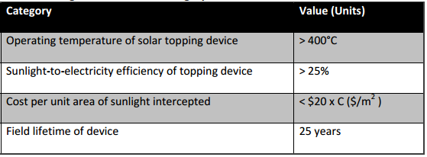
Program Example:
FOCUS Full-Spectrum Optimized Conversion and Utilization of Sunlight
Program Directors: Dr. Eric Schiff; Dr. Michael Haney; Dr. Christopher Atkinson Tech-to-Market Advisor: Dr. James Zahler
Mission
To provide disruptive new solar energy conversion and storage options to enable increasingly economical penetration of solar energy generation into the US energy mix.
Program Goals:
Develop technology options to deliver low-cost, high-efficiency solar energy on demand:
Category 1:
New hybrid solar energy converters to turn sunlight into electricity for immediate use, while also producing heat that can be stored at low cost for later use
Technoeconomic Goals
Category 1a: (Topping Devices)
Year | 2013
Projects | 12
Total Investment | $30 Million

Slide 11
FOA Success Rates
Average for 20 Focused FOAs
Average for OPEN 2009 & 2012
34%
10%
11%
1.3%
blank1

Slide 12
ARPA-E Project Portfolio by Lead Organization
ARPA-E supports multi-institutional teams with substantial involvement from the private sector:
74% of projects involve more than one institution
79% of projects include the private sector, as leads or partners
Notes:
Update data on distribution of lead institutions (not funding) and then look at same distribution of funding (but may not use it). Also, assess what fraction of projects have teams that span institution types, e.g., academia with small business or large business, lab with small or large business, lab with academia, etc.

Slide 13
Project Milestones
Negotiation and setting milestones
Each awardee is required to have T2M milestones integrated along-side technical milestones
Ongoing management
Frequent discussions with awardees
Quarterly reviews: evaluate progress, provide oral and written feedback
Technical conferences and meetings
1:1 deep dive of milestone reports and strategy discussions
Content includes milestone review, technical deep dives, market observations, evaluation of development pathway, ideation, and analysis of opportunities
Team approach
Participation from PD’s, Tech SETA’s, T2M Advisors

Slide 14
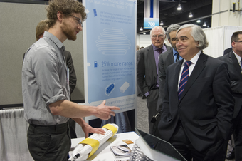
ARPA-E Summit – Partner Discovery and Engagement
Technology Showcase: ARPA-E-funded project teams as well as a selective group of researchers and technologists from other companies and organizations.
Formal Partner Engagement:
Corporate Acceleration Program
Networking Receptions
Industry trade association sponsored
Government
Regional development groups
Outreach:
Student Program
Women in Energy Networking Breakfast
http://www.arpae-summit.com

Slide 15
Measurable Metrics of Path Toward Market
Since 2009 ARPA-E has invested approximately $1.1 billion across more than 400 projects through 23 focused programs and two open funding solicitations.
34 ARPA-E projects have attracted more than $850 million in private-sector follow-on funding
Cumulative numbers of project that have:
Cumulative Number
End End End
2012 2013 2014
Notes:
At least 30 ARPA-E project teams have formed new companies to advance their technologies and more than 37 ARPA-E projects have partnered with other government agencies for further development. Additionally, 34 ARPA-E projects have attracted more than $850 million in private-sector follow-on funding after ARPA-E’s investment of approximately $135 million and several technologies have already been incorporated into products that are being sold in the market. To date, ARPA-E has invested approximately $1.1 billion across more than 400 projects through 23 focused programs and two open funding solicitations (OPEN 2009 and OPEN 2012).

Slide 16
Sign up for our newsletter at www.arpa-e.energy.gov
Join us at our 2016 Summit February 2016
Gaylord National Convention Center
just outside Washington, DC.

Slide 17
ARPA-E Impact
INNOVATION OPPORTUNITIES
PATH TO COMMERCIALIZATION
EVOLVING PORTFOLIO
OPTIONS FOR THE FUTURE

