Slide 1
AHRQ Research Priorities Andrew B. Bindman, M.D. Director, Agency for Healthcare Research and Quality
State University System of Florida
Fourth Annual C.W. Bill Young Federal R&D Agency Workshop
Washington, D.C.
September 30, 2016

Slide 2
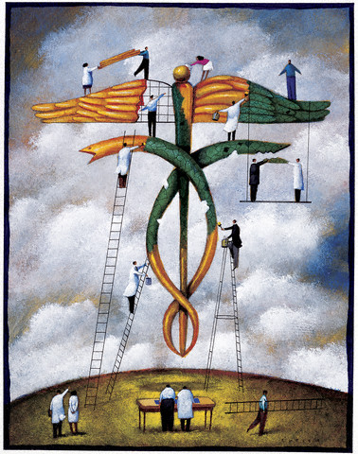
Agenda
Who We Are, What We Do
AHRQ’s Research Funding and Priorities
Supporting a Learning Health System
Your Questions
Notes:
Here are the high points I’d like to cover this morning, and leave time for your questions.

Slide 3
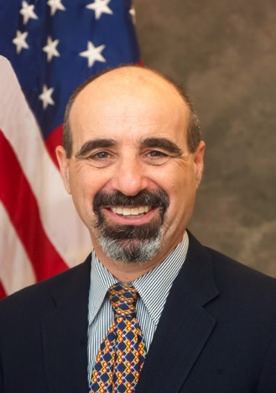
My Story
Became Director May 2016
Primary care physician
Academic medicine background
San Francisco General Hospital
UC San Francisco Institute for Health Policy Studies
Policy experience
Senior advisor to CMS, ASPE: 2011-2015
RWJF Health Policy Fellow, assigned to U.S. House Committee on Energy and Commerce, 2009-2010
Director, California Medicaid Research Institute, University of California, 2009-2016
Notes:
Personal bio

Slide 4
How AHRQ Makes a Difference
Evidence and Tools fr Implementation
AHRQ invests in research and evidence to understand how to make health care safer and improve quality
AHRQ creates materials to teach and train health care systems and professionals to catalyze improvements in care
AHRQ generates measures and data used to track and improve performance and evaluate progress of the U.S. health system
Notes:
Even as a relatively small health services research agency – about 300 people, proposed FY 2017 budget of roughly $470 million – we have a lot of resources.
In the context of a $2.7 trillion health care system, with 800,000 physicians, 5,000 hospitals, millions of nurses, we can’t actually change health care by ourselves. We can produce evidence, and our mission statement acknowledges that. We produce tools based on that evidence. But we depend on you in the academic community to help us produce the evidence that that creates the tools and, ultimately, promotes better and safer care.
Here are three critical ways in which AHRQ makes a difference.
AHRQ invests in research and produces evidence on how to make health care safer and improve quality, affordability, and access to services.
Second, the production of research and evidence by itself doesn’t help anyone unless the evidence is understood and used. To get to the ‘understood and used’, we create tools and resources to train health system and professionals and to catalyze improvements in care.
Third, AHRQ generates measures and data to track and improve performance and allow policymakers to evaluate the progress of the U.S. health system in meeting those goals.

Slide 5
AHRQ Support for Investigator-Initiated and Targeted Research
Total AHRQ grant funding (investigator-initiated and targeted research):
FY 2017: $192.3 million*
FY 2016: $189.6 million
FY 2015: $200.6 million
FY 2014: $148.8 million
*Assumes 2017 funding is consistent with 2016 through Continuing Resolution

Slide 6
Evidence
Synthesize research findings from multiple studies on a topic area:
Evidence-based Practice Centers (EPCs)
U.S. Preventive Services Task Force
These activities depend on AHRQ’s longstanding partnerships with academic and federal partners
Notes:
Investigator initiated research to AHRQ is an integral part of what AHRQ does. We support investigator-initiated research across all Agency program areas, and we also support grants from the Patient-Centered Outcomes Research Trust Fund. Our combined total grant funding for FY 2017 is $192.3 million.
And, AHRQ is the home of the U.S. Preventive Services Task Force; we provide administrative and scientific support for the Task Force’s activities. The Task Force is an independent body and speak for themselves when making recommendations about preventive services, screenings, and tests.
The Evidence-based Practice Centers (EPCs) are 5-year contracts awarded to a standing group of institutions that review all relevant scientific literature on a wide range of clinical and health services topics to produce evidence reports. These reports are used for informing and developing coverage decisions, quality measures, educational materials and tools, clinical practice guidelines, and research agendas. The EPCs also conduct research on methodologies for evidence synthesis.

Slide 7
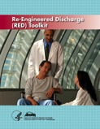
Tools and Training Materials
Patient Safety Culture Surveys
Comprehensive Unit-based Safety Program (CUSP) toolkits to reduce CLABSI, CAUTI
Re-Engineered Discharge (RED) tools to reduce avoidable hospital readmissions
TeamSTEPPS®
Total: 36 tools to support translating research into practice improvement
Notes:
The second bucket is Tools and Training Materials. Here you see just a few examples of these.
This bucket is of primary interest to practicing clinicians—the doctors and nurses who are at the bedside providing care to patients. We take the evidence we have generated in the first bucket and elsewhere and translate it into usable tools that improve the quality and safety of care actually delivered to patients.
As an example, let me point to TeamSTEPPS. This is a curriculum that AHRQ developed along with our colleagues at the Department of Defense.
The curriculum takes principles of teamwork familiar to the military —things like communication, clear delineation of roles, and mutual accountability—and applies them to the health care setting. This has proven extraordinarily popular with health care providers.
Materials include an instructor manual, case studies, and videos illustrating teamwork opportunities and successes. Instructor and Trainer workshop materials focus on change management, coaching, and implementation. The course is free and available on DVD.
Here you see other examples of tools, such as the CUSP, which has been demonstrated to reduce healthcare-associated infections and save lives in a variety of settings; and surveys of patient safety culture, which also have been used to catalyze change in many settings of care.
I also want to mention CANDOR—a new toolkit the Agency just introduced. It’s a Communication and Resolution Program. CANDOR gives guidance to hospitals on how to handle communication with patients and families after an adverse event—including, when appropriate, an apology.

Slide 8
Measures and Data
Medical Expenditure Panel Survey (MEPS) − Insurance and Household components
Healthcare Cost and Utilization Project (HCUP)
Consumer Assessment of Healthcare Providers and Systems (CAHPS)
National Healthcare Quality and Disparities Report
Notes:
And finally, the third bucket of AHRQ’s major activities consists of our data products and measures. Providers, policymakers and researchers all rely on the work that’s generated here.
The core products I want to mention here are MEPS and HCUP. These two products represent the gold standard of such information in their respective fields.
HCUP is a group of related databases that captures information extracted from administrative data. HCUP includes data from 47 states, making it the largest and most robust database available of the care provided to hospital patients in the United States. HCUP captures data from all kinds of insurance, including Medicare and commercial payers.
MEPS is a set of large-scale surveys of families and individuals, their medical providers, and employers across the United States. It’s the most complete source of data on the cost and use of health care and health insurance coverage in the United States.
HCUP and MEPS are both very rich sources of data. AHRQ uses them to produce statistical briefs analyzing different medical and economic implications of our health care system. Researchers can crunch the numbers in a variety of ways to analyze health care spending and utilization.
I also want to mention our quality and disparities report, now in its 13th year. The National Healthcare Quality Report and National Healthcare Disparities Report have been combined into a single report, the National Healthcare Quality and Disparities Report. These reports measure trends in effectiveness of care, patient safety, timeliness of care, patient centeredness, and efficiency of care, all in a variety of formats.

Slide 9
AHRQ Funding Announcements
Notes:
The “Funding & Grants” page on the AHRQ website will give you detailed information on everything from research training and education opportunities, a searchable database of AHRQ grants, profiles of our research training grantees, and much more

Slide 10
AHRQ’s Research Priorities
Make health care safer
Identify risks and hazards; design and spread interventions to improve patient safety through evidence-based strategies
Improve health care quality
Demonstrate effectiveness of synthesizing evidence to facilitate informed care planning decisions
Discover techniques for health care practice improvement, especially in ambulatory settings
Improve health care through use of information systems and data resources
Notes:
Source: Funding Opportunity Announcement Guidance (AHRQ website)
http://www.ahrq.gov/funding/policies/foaguidance/index.html
Here’s a closer look at AHRQ’s 4 research funding priorities.
First, we collaborate closely with the Patient-Centered Outcomes Research Institute (PCORI) and the NIH on ways to accelerate this type of research through projects that:
Synthesizing evidence to inform better care planning decisions,
Discovering technique to improve health care practice,
Improving health care through the use of information systems and data resources
Developing methods that underlie evidence synthesis, stakeholder and patient engagement, decision making and practice improvement.
AHRQ is also committed to making health care safer by identifying risks and hazards, and designing and spreading interventions to improve safety through evidence-based strategies. Our Patient Safety Research Program identifies areas of focus through grant funding announcements and encourages investigators to to apply this framework to other patient safety threats.
Third, we fund research in the area of increasing access to health care and health insurance to assist federal and state policymakers and private payers in their decisions in these important areas.
And finally, we look to produce evidence that can increase the affordability, efficiency, and cost transparency for all Americans. Areas include reducing cost growth, comparing performance of systems and providers, incentives for improving performance, and interventions to improve performance.

Slide 11
AHRQ Grant Mechanisms and Continuum of Research
Discovery
Demonstration
Implementation
Dissemination
R18
R13
R01
R03
K02
K01
K08
R36
Training/Career Development
K08, K01, K02 –
Research Career Dev. and
Mentorship
R36 – Health Services
Research
Dissertations
Health Services Research
R03 – Small Research
Grants
R01 – Large Research
Grants
R18 – Large Demonstration/
Dissemination Grants
Conferences
R13 – Conference Grants

Slide 12
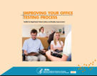
AHRQ’s Unique Role: Evidence and Implementation
Evidence
Tools for Implementation
Data and Measures
Notes:
As a health services research agency, AHRQ understands that patient safety is a holistic problem. Therefore we generate holistic solutions. This means developing evidence to understand where patient safety problems truly lie. And then it means creating tools that providers can employ in the real world to attack those problems.
We believe that there is a straight line between research and the development of tools for implementation
So we fund research. Some of you in this room have been the beneficiaries of that funding. But we also fund tools to make sure that that research actually gets used.

Slide 13
Improvements in Patient Safety 2010 - 2014
17% reduction in HACs
87,000 lives saved
2.1 million patient harms avoided
$19.8 billion in savings
Saving Lives and Saving Money: Hospital-Acquired Conditions Update Interim Data From National Efforts To Make Care Safer, 2010-2014:
www.ahrq.gov/news/newsroom/press-releases/2015/saving-lives.html
Notes:
The report on Hospital-Acquired Conditions that came out last year summarizes how our understanding of data contributes to our understanding of patient safety.
HACs include adverse drug events, catheter-associated urinary tract infections, central line associated bloodstream infections, pressure ulcers, and surgical site infection. AHRQ developed the measurement strategy, the evidence base, and many of the tools that hospitals are using to achieve these results.
To determine these results, AHRQ analyzed the incidence of a number of avoidable hospital-acquired conditions compared with 2010 rates, using as a baseline estimates of deaths and excess health care costs that were developed when the HHS Partnership for Patients initiative was launched.
That 17% reduction meant 2.1 million fewer instances of harm, 87,000 patient lives saved, and almost $20 billion in health care spending that was averted. Even with that reduction, there are still far too many patients who are harmed in the course of receiving care – 121/1,000 is still a lot of adverse events. But, 87,000 patient lives equates to more than an entire year with no deaths from breast cancer.
Before any of us can start down the road of improving safety, quality, affordability, or accessibility, we have to know how to do that. We need to know more than just what to do, we also need to know how to do it. Again, addressing HACs shows how the Agency’s research provides answers in all of these areas.

Slide 14
Improving Diagnostic Safety in Ambulatory Settings
Diagnostic error: An under-recognized but significant problem
Most patients will experience at least one diagnostic error in their lifetime
AHRQ funding opportunities to:
Gain understanding of complexity/incidence, and expand knowledge of contributing factors (R01)
Evaluate strategies and interventions for reducing diagnostic failures and patient harms (R18)
Notes:
Another example of work we’re funding is in the area of diagnostic errors, especially as they occur in ambulatory settings.
It’s safe to say that few outside of this small but growing field recognized the magnitude of the problem. A report from the National Academies of Medicine released last year revealed the broad impact: incorrect diagnoses occur up to 20% of the time, and affect 12 million people in the U.S. Half of these could cause harm.
AHRQ has issued two funding opportunities addressing diagnostic errors:
One seeks projects to gain a better understanding of their complexity and incidence, and more breadth and depth of the contributing factors (R01)
Another looks to evaluate the strategies and interventions for reducing diagnostic failures and patient harms (R18).

Slide 15
Research Summit on Improving Diagnosis in Health Care
Evidence and Tools fr Implementation
Define diagnostic safety and diagnostic error
Begin to understand how to measure it
Explore potential solutions
Technology
Organizational factors
Commit to a research agenda
Notes:
Just two days ago, AHRQ convened a research summit on this very topic, which brought about 200 experts and individuals interested in learning more about how to improve diagnostic safety.
Here’s an overview of what we examined in our one-day meeting. We welcome your participation this issue as we commit to a research agenda.

Slide 16
The Continuous Feedback Loop
Research
Practice
Notes:
Very simply put, this is what health IT can achieve when it lives up to its promise.
It can extract data to provide measurement in real time, and find and analyze trends far faster than humans can.
And it can get needed information to clinicians at the point of care, when and where they need it.
When systems are in place and incentives are aligned, IT can create a continuous feedback loop so that we are always learning—and that is the foundation of a learning health care system.

Slide 17
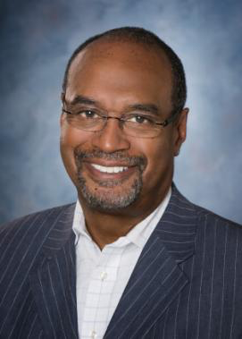
Shortcomings of Health System
“Our health care system lags in its ability to adapt, affordably meet patients' needs, and consistently achieve better outcomes. But we have the know-how and technology to make substantial improvement on costs and quality.”
Mark D. Smith, M.D., M.B.A.
Former President and CEO
California HealthCare Foundation
Notes:
Mark Smith, who chaired the study committee, defines what we lack and what we need succinctly.

Slide 18
Moving Evidence to Frontlines
17 years from discovery to practice change
Delays health benefits
Contributes to disparities
Learning Health Care Systems could lead to improvements in safety and quality of care
Evidence and Tools fr Implementation
Notes:
As a relatively small health services research agency – about 300 people, proposed FY 2017 budget of roughly $470 million – we have a lot of resources.
In the context of a $2.7 trillion health care system, with 800,000 physicians, 5,000 hospitals, millions of nurses, we can’t actually change health care by ourselves. We can produce evidence and this mission statement acknowledges that. We produce tools based on that evidence. But we depend on you to help us create and put into practice those tools.
Here are three critical ways in which AHRQ makes a difference.
AHRQ invests in research and produces evidence on how to make health care safer and improve quality, affordability, and access to services.
Second, AHRQ generates measures and data to track and improve performance and allow policymakers to evaluate the progress of the U.S. health system in meeting those goals.
Third, the production of research and evidence by itself doesn’t help anyone unless the evidence is understood and used. To get to the ‘understood and used’, we create tools and resources to train health system and professionals and to catalyze improvements in care.

Slide 19
Learning Health Care System
“A learning health care system is [one that] is designed to generate and apply the best evidence for the collaborative healthcare choices of each patient and provider; to drive the process of discovery as a natural outgrowth of patient care; and to ensure innovation, quality, safety, and value in health care.”
Institute of Medicine/National Academy of Medicine. The Learning Healthcare System: Workshop Summary. Olsen L, Aisner D, McGinnis JM, eds. Washington, DC: National Academies Press; 2007
Notes:
As you may know, the Institute of Medicine in 2012 published a report calling for creation of a Learning Health Care System.
The report had nine recommendations:
Digital infrastructure
Data utility
Clinical decision support
Patient-centered care
Community links
Care continuity
Optimized operations
Financial incentives; and
Performance transparency
Obviously, you have a role to play in at least some of these goals—and maybe all of them.

Slide 20
Why Now?
Emergence of EHRs
Growing in availability and power to support effort
Health care practice is rapidly consolidating
Large systems becoming more prevalent
Potential to systematically generate and incorporate evidence
Notes:
So, what’s changed?
I think the promise of IT is getting closer to fulfillment. It’s not there yet. But we are finally seeing the infrastructure developed at a level that is both broad and deep.
The small number of large systems is an opportunity because we can work with fewer points of contact at a higher level in order to achieve major gains.
But, as we will demonstrate later, that can only take us so far—because that can address hospital and health system issues, but not physician practice-level issues.

Slide 21
EvGen: The Vision
A national system for evidence generation (“EvGen”)
As health care data become increasingly digitized, we should be able to do research faster, better, and more cheaply
Can also transfer knowledge from research more efficiently
Could fuel evidence-based care
Notes:
This takes us back to the point of a learning health care system—a system in which we use data to its highest capacity by getting evidence to the point of care and using EHRs to generate evidence themselves.

Slide 22
Clinical Decision Support (CDS) Learning Network
Accelerate collaborative learning opportunities
Identify barriers and facilitators to incorporating evidence related to patient-centered outcomes research in CDS
Monitor use of patient-centered outcomes research evidence in vendor-based and open source CDS tools
www.pcorcds-ln.org
Notes:
Source: https://healthit.ahrq.gov/ahrq-funded-projects/patient-centered-outcomes-research-clinical-decision-support-learning-network
Starting in 2016, AHRQ funded the PCOR Clinical Decision Support Learning Network, which will create a community of stakeholders that will work toward disseminating and implementing PCOR findings through CDS in clinical practice. (RTI International, Research Triangle Park, NC).
The four-year (2016-2020) project aims to address some of the barriers to the effective use of PCOR in CDS at a larger scale. These include:
Limited awareness and availability of PCOR findings
Limited expertise with interpreting and embedding findings into CDS
Lack of widely adopted standards for CDS
Limited use of portals and personal health records by patients
Lack of a model for creating and managing best practice knowledge repositories.
The project began in April of this year.
(Next slide)

Slide 23
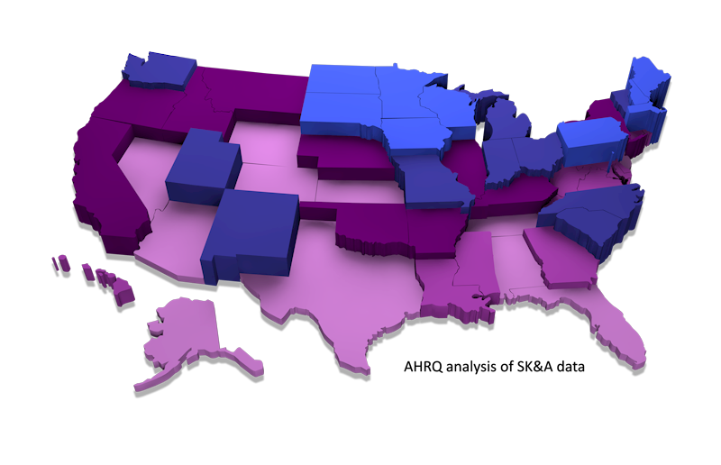
Percentage of Physicians in Health Systems: 2013
Percentage of Physicians in a Health System
>46%
45%-36%
36%-32%
31%-28%
Overall: 34%
<28%

Slide 24
AHRQ and Health Care Systems
Characterizing all U.S. health systems
Identification of factors impacting delivery system performance
What is the structure and organization of workforce, IT, and other resources?
How do health systems engage in the generation of evidence?
How do health systems adopt/apply evidence?
How does the adoption of evidence impact outcomes such as quality and value?

Slide 25
Comparative Health System Performance—Data Compendium
A “compendium” on comparative health system performance being developed that will:
Identify health systems and their physician characteristics
Descriptive data on each health system’s progress toward becoming a learning health system
Illuminate health systems’ characteristics associated with high performance
Be accessible to the public to support research and shared learning

Slide 26
Training the Next Generation of Learning Health System Researchers
Initiative: To construct a set of core competencies to guide the development, implementation and evaluation of training programs for learning health systems researchers
Goal: To develop and embed researchers within learning health systems who can lead efforts to generate and use evidence

Slide 27
Let’s Work Together
Notes:
We are excited to have the priorities and funding structures in place to support research that can help grow a learning health system. We still have much to build that can support practice, support research, and improve quality. But we are starting to make headway.
We look forward to working with you in helping to learn about what works, what doesn’t work, and why, as we move toward a 21st century health system that fulfills the goals of better care and safer care for all Americans.

Slide 28
Your Questions
Notes:
I welcome any of your questions.

