Slide 1


uwf.edu
Notes:
Campus community. Outstanding programs. Affordable tuition.
An overview of today’s presentation. We will talk a little about UWF and what makes us special. Then we will review our Freshman Class profile, the application and admissions process and admissions scholarships.

Slide 2
UWF 2026 FLORIDA BOARD OF GOVERNORS
STATE UNIVERSITY SYSTEM RANKINGS
1
2
3
1
2
3
#
#
#
For graduates
employed or furthering their education
Public university statewide
Highest average salary for new bachelor’s graduates: $54,600
Performance-based metrics, original scoring methodology; 1, 3 are within one year of graduation.

Slide 3

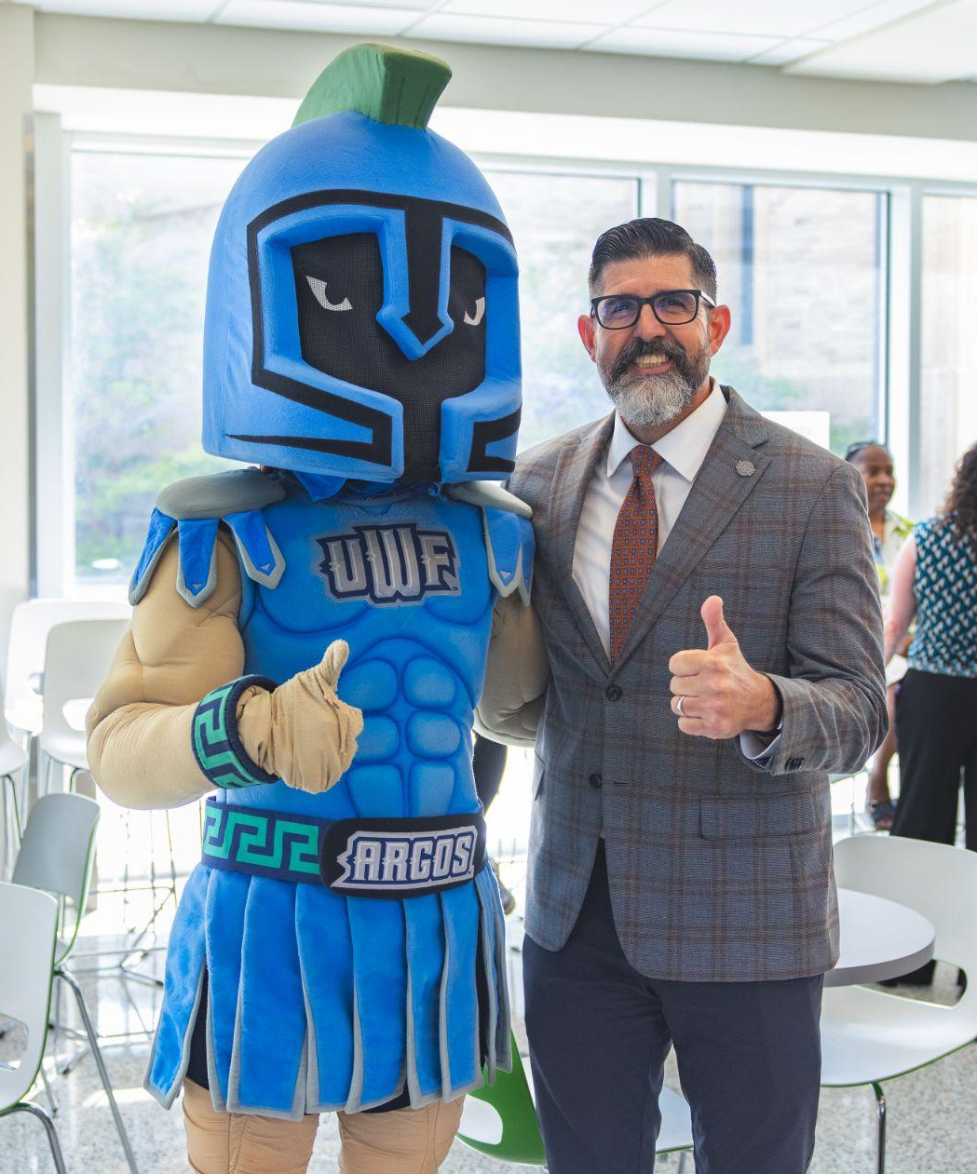

PRESIDENT
Manny
Diaz, Jr.

Slide 4
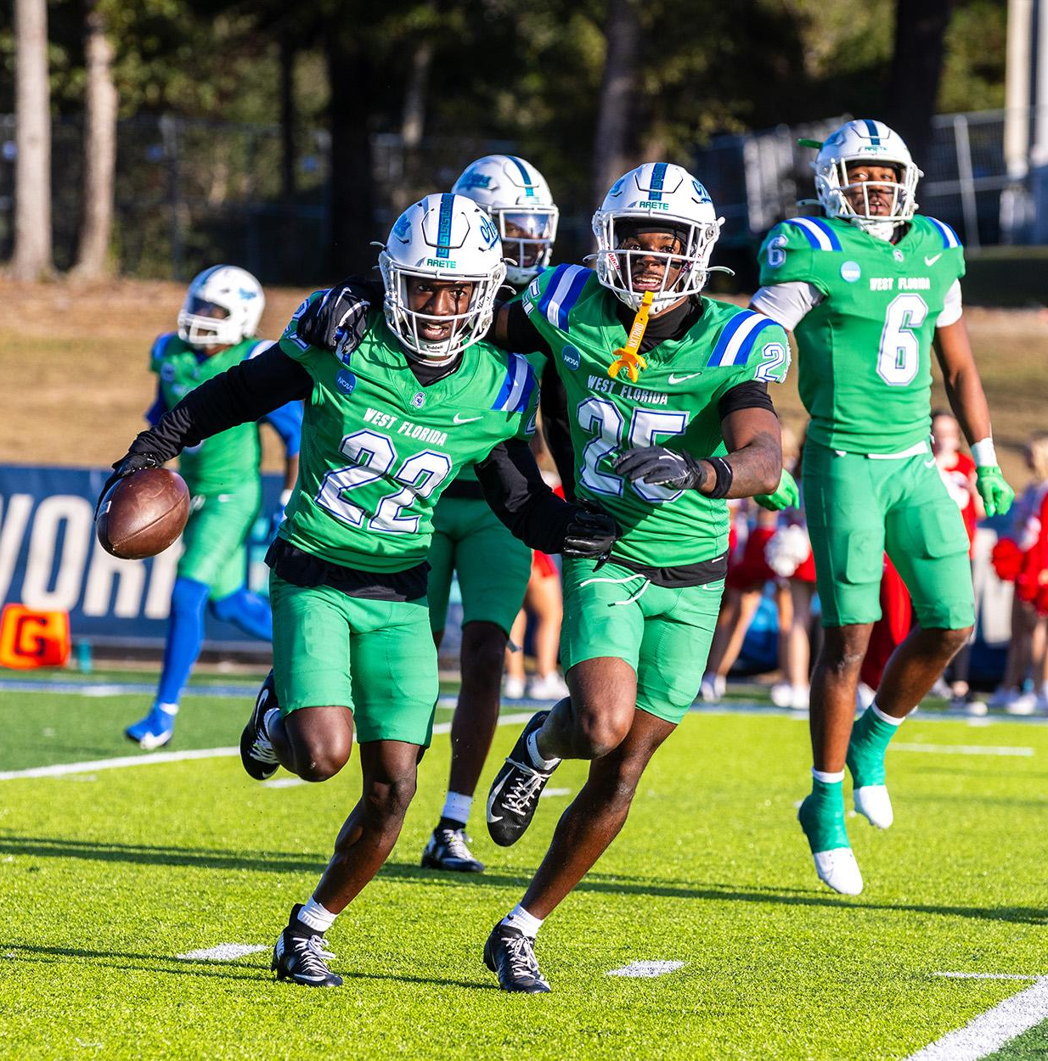


2026-2027: FIRST YEAR IN
NCAA Division I
GoArgos.com
Notes:
Moving into Division I
Atlantic Sun Conference as a multi-sports member
United Athletic Conference as a football member

Slide 5

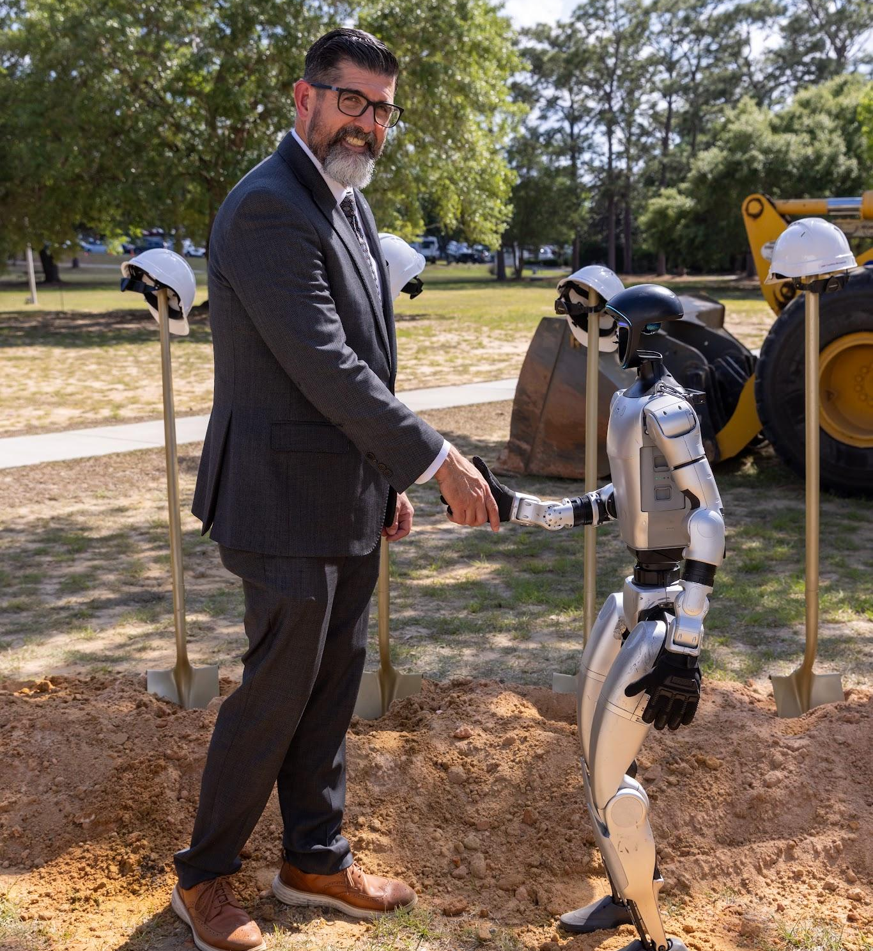
Pensacola
CAMPUS GROWS
Darrell Gooden Stadium
  Planned for Fall 2027
The Synapse
  The latest Cybersecurity, AI, and Engineering research building

Slide 6

UPDATED UWF
Brand
Argo Navy
Argo Green
Notes:
Images are from the 2026-2025 FTIC Viewbook

Slide 7
Admissions Deadlines
Dec. 1
April 1
May 1
Scholarship Priority Consideration Deadline
Freshman Application Deadline
Confirmation Deadline
uwf.edu/Deadlines
Notes:
UWF is highly ranked …

Slide 8
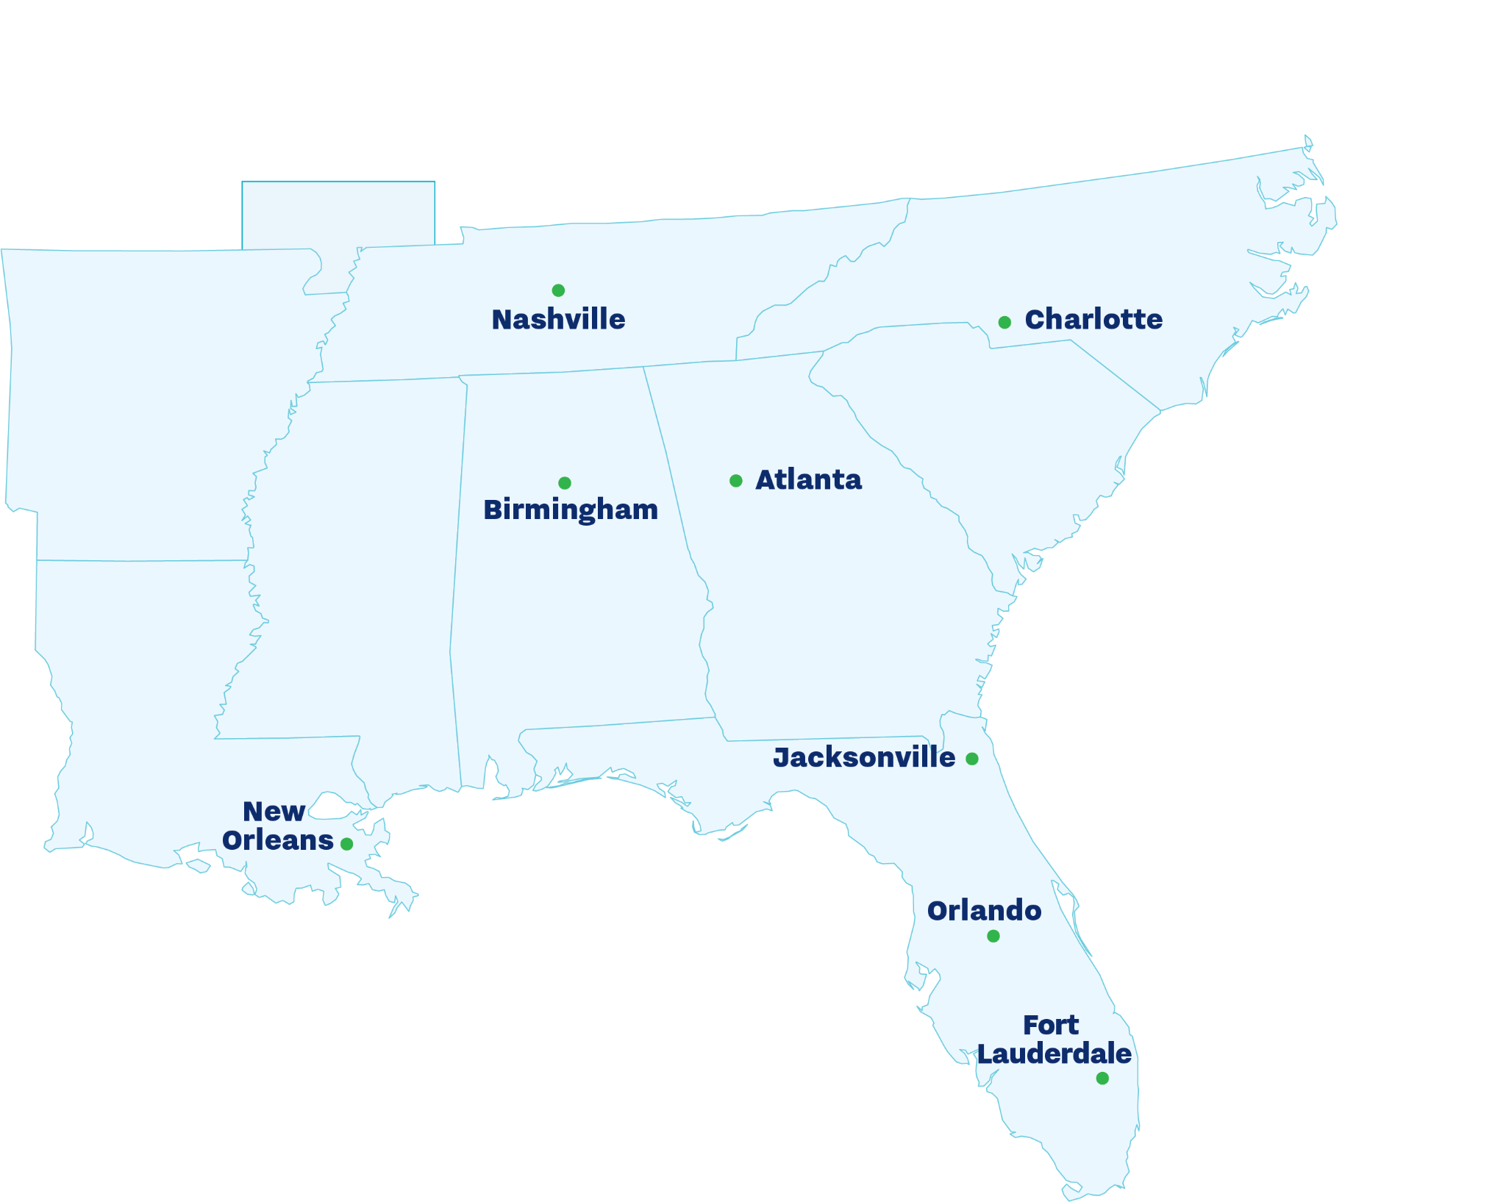

Pensacola
FLORIDA
#1 Coastal City
— ConsumerAffairs’ Top Coastal Cities to Move to, 2025
#5 of “Best Places
to Live in Florida"
— U.S. News & World Report, 2026-2027
#10 of “Best Small
Cities in the U.S.”
— Condé Nast Traveler's Readers' Choice Awards, 2025
1 of “America’s Best Cities”
— WorldsBestCities.com, 2025
Just minutes from downtown and beautiful beaches, UWF is driving distance of major cities.
Notes:
Located in Pensacola

Slide 9

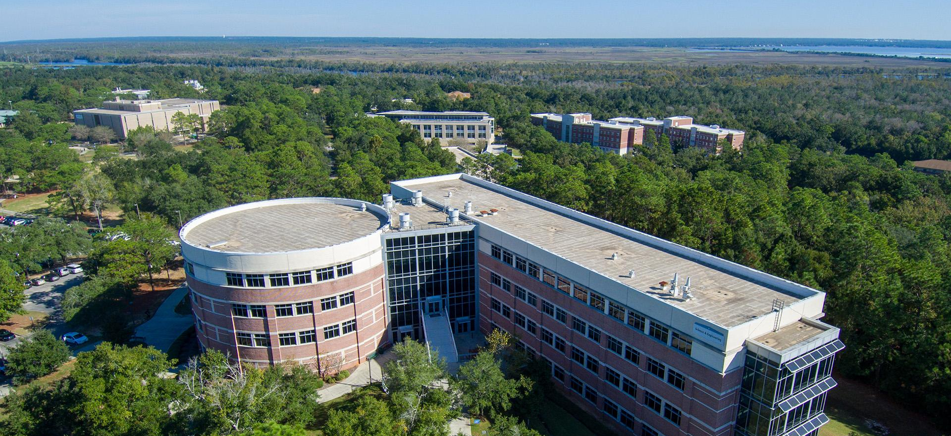
Pensacola
CAMPUS
One of the “Best College
Campuses in Florida”
— Niche, 2025
A “Tree Campus Higher Education”
— Arbor Day Foundation
1,600
ACRES
20+
MILES OF TRAILS
uwf.edu/Visit

Slide 10
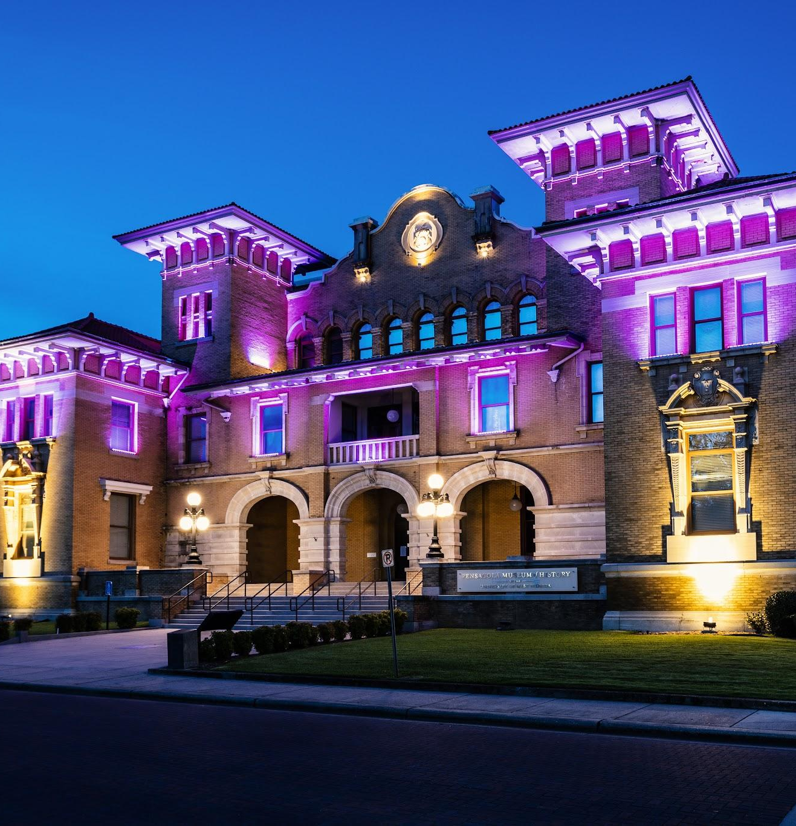
Downtown
PENSACOLA
UWF students receive free entry to UWF Historic Trust locations, including:
Pensacola Museum of History
Pensacola Museum of Art
Historic Pensacola Village
1,600
ACRES
20+
MILES OF TRAILS
uwf.edu/HistoricTrust

Slide 11
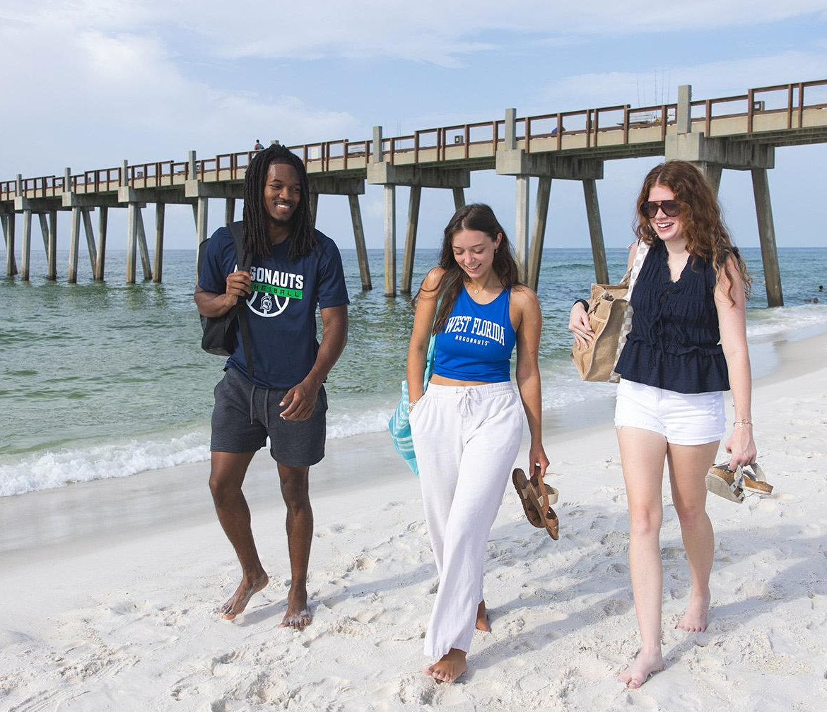
PENSACOLA
Beach
A Top 20 U.S. Beach
— TripAdvisor, 2025

Slide 12

15,000
STUDENTS
105,000
ALUMNI
Notes:
At UWF we have more than 14,500 students — the perfect size because you see a familiar, friendly face every day, but there are always still new people to meet.

Slide 13
Academics
uwf.edu/Academics

Slide 14
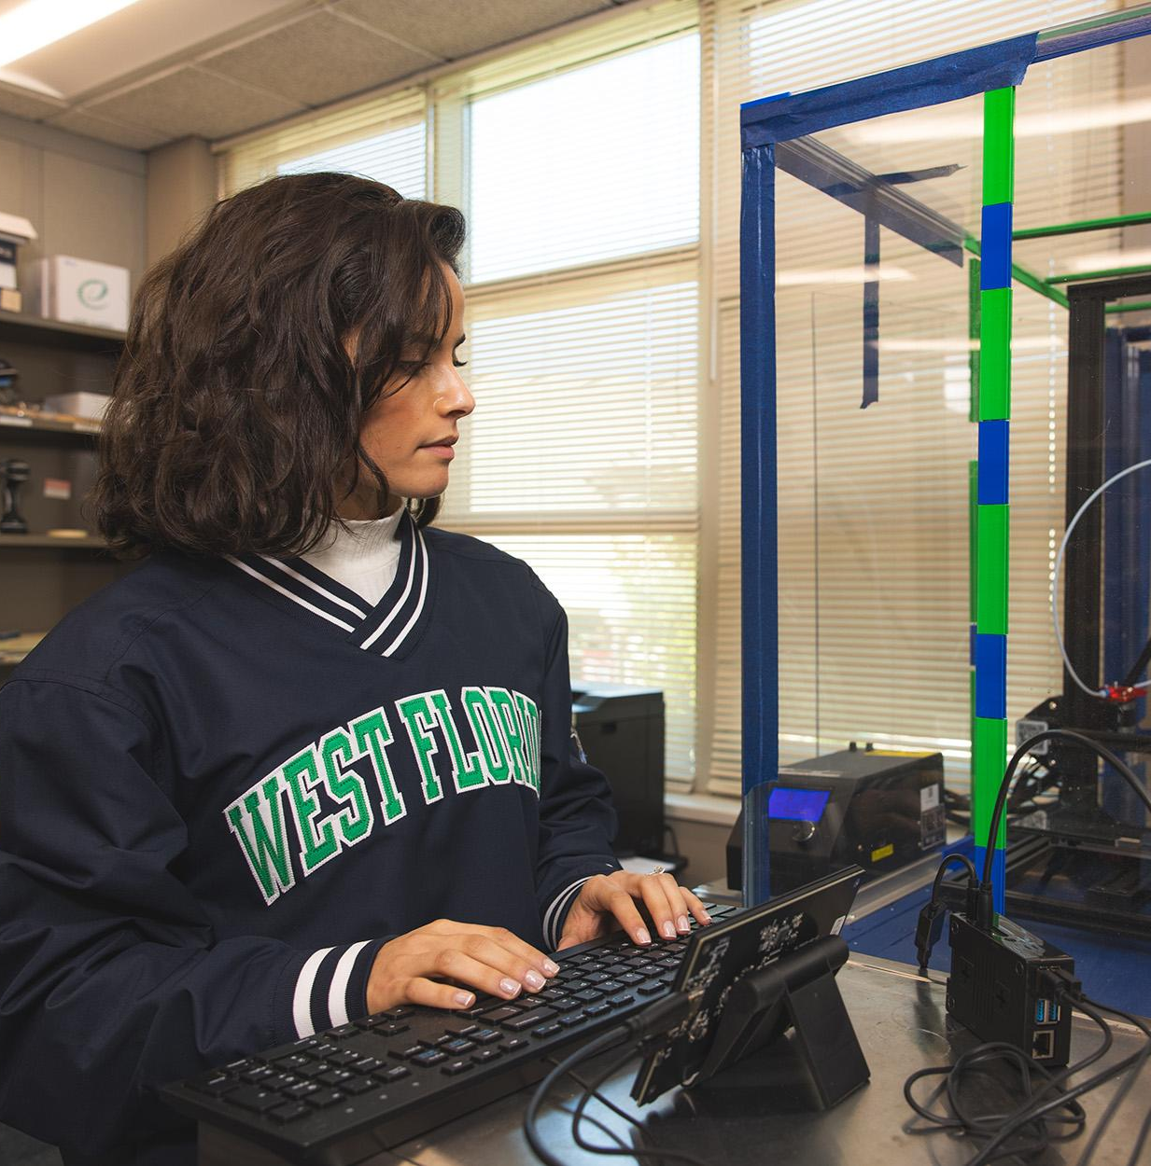
UWF
Colleges
College of Arts, Social Sciences, and Humanities
Hal Marcus College of Science and Engineering
Lewis Bear Jr. College
of Business
School of Education
Usha Kundu, MD College
of Health
Notes:
Located in Pensacola

Slide 15

22:1
STUDENT-TEACHER RATIO
TOP
Majors
70+
UNDERGRADUATE PROGRAMS
Nursing (Pre-BSN)
Biomedical Sciences
General Business
Psychology
Biology
Mechanical Engineering
Marine Biology
Exercise Science
Criminal Justice
Elementary Education
uwf.edu/Programs
Most popular majors among Summer/Fall 2026 freshman admits
Notes:
Nursing lab. Last year, more than 97% of UWF School of Nursing graduates passed their national licensure exam on the first attempt, exceeding state and national averages.

Slide 16
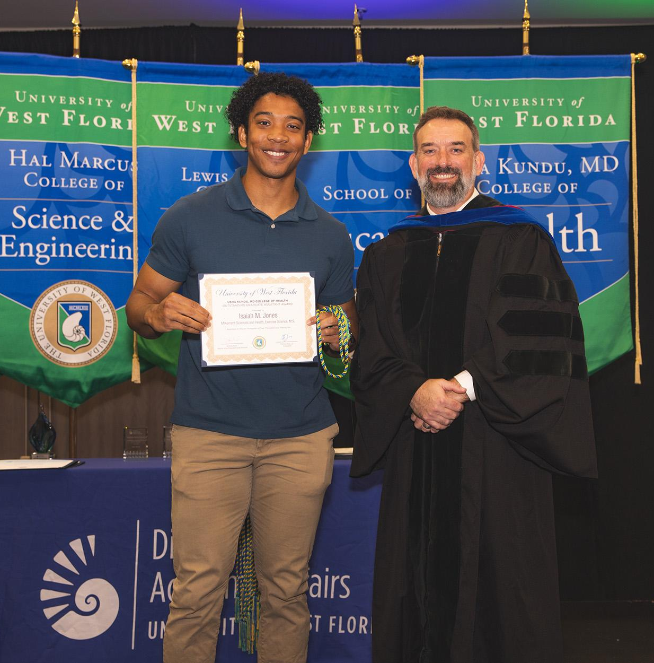
KUGELMAN
Honors
Two- and four-year pathways
Research support
Exclusive summer study abroad opportunities
Priority registration and
honors advisor
Scholarship opportunity
Living Learning Community
uwf.edu/Honors
Notes:
Nursing lab. Last year, more than 97% of UWF School of Nursing graduates passed their national licensure exam on the first attempt, exceeding state and national averages.

Slide 17

GOLD LEVEL
Military-
Friendly
®
Office of Military Services
Army and Air Force ROTC
Military and Veterans Resource Center
Scholarship opportunities
uwf.edu/MilitaryServices
The appearance of U.S. Department of Defense visual
information does not imply or constitute DoD endorsement.
Notes:
Nursing lab. Last year, more than 97% of UWF School of Nursing graduates passed their national licensure exam on the first attempt, exceeding state and national averages.

Slide 18
Admissions
uwf.edu/Freshman

Slide 19
Admissions Deadlines
Dec. 1
April 1
May 1
Scholarship Priority Consideration Deadline
Freshman Application Deadline
Confirmation Deadline
uwf.edu/Deadlines
Notes:
UWF is highly ranked …

Slide 20

Application
REQUIREMENTS
Self-Reported Transcript and Academic Record System (STARS) Record
ACT, SAT, or CLT scores
$30 application fee
  Pell-eligible and Title I school students receive in-app waiver offer

Slide 21
Freshman
ADMISSIONS CONSIDERATION
GPA
3.20+
Cumulative Weighted
State and subject-area minimum test scores
(ACT, SAT, or CLT)
+
ACT
Reading: 19
Math: 19
English: 17
SAT
Reading/Writing: 490
Math: 480
CLT
Sum-Verbal Reasoning and Grammar/Writing: 38
Quantitative Reasoning: 16
or
or
Minimum requirements for the strongest admissions consideration
Notes:
3.00+ GPA plus state and subject-area minimum test scores for the ACT, SAT, or CLT

Slide 22
Freshman
CLASS PROFILE
GPA
3.62-4.23
Cumulative Weighted
ACT
20-27
Composite
CLT
47-63
Total
SAT
1020-1230
Combined
Middle 50th percentile of admitted full-time students

Slide 23
Cost and Financial Aid
uwf.edu/Costs

Slide 24
Affordability
MATTERS
FRESHMAN FINANCIAL AID
2025-2026
$12M
OFFERED IN GIFT AID
89%
OF NEW STUDENTS
WERE OFFERED AID
Automatic-consideration
merit scholarships
Argo 30 Guarantee: Fall/spring tuition coverage for eligible
Pell Florida residents
Full-ride scholarship opportunities

Slide 25
ESTIMATED FIRST-YEAR COSTS BEFORE FINANCIAL AID
RESIDENCE | FLORIDA | ALABAMA | OUT OF STATE
$/Credit Hour | $214 | $319 | $708
Tuition¹ | $6,420 | $9,570 | $21,240
Housing² | $6,622 | $6,622 | $6,622
Meals³ | $5,136 | $5,136 | $5,136
Total Estimated Cost | $18,178 | $21,328 | $32,998
Based on 2026-2027 costs for fall/spring semesters. Costs are subject to change. ¹30 credit hours of tuition and fees ²Shared Suite (Martin/Pace Halls: $3,311/semester) ³Argo 15 plan: 15 meals/week + $300 Dining Dollars ($2,568/semester), other options available

Slide 26

COMPLETE THE
FAFSA
Free Application for Federal Student Aid
StudentAid.gov
UWF Code: 003955

Slide 27
Dec. 1
SCHOLARSHIP PRIORITY CONSIDERATION DEADLINE
FRESHMAN ACADEMIC MERIT SCHOLARSHIP CONSIDERATION
HS GPA¹ | SAT² or | ACT³ or | CLT | FLORIDA | ALABAMA | OUT OF STATE
4.00+ | 1400+ | 31+ | 101+ | $16,000 | $16,000 | $32,000
3.80-3.99 | 1260-1390 | 27-30 | 89-100 | $12,000 | $12,000 | $24,000
3.70-3.79 | 1160-1250 | 24-26 | 79-88 | $8,000 | $8,000 | $8,000
¹Cumulative weighted ²SAT Total ³ACT Composite
uwf.edu/FreshmanScholarships

Slide 28
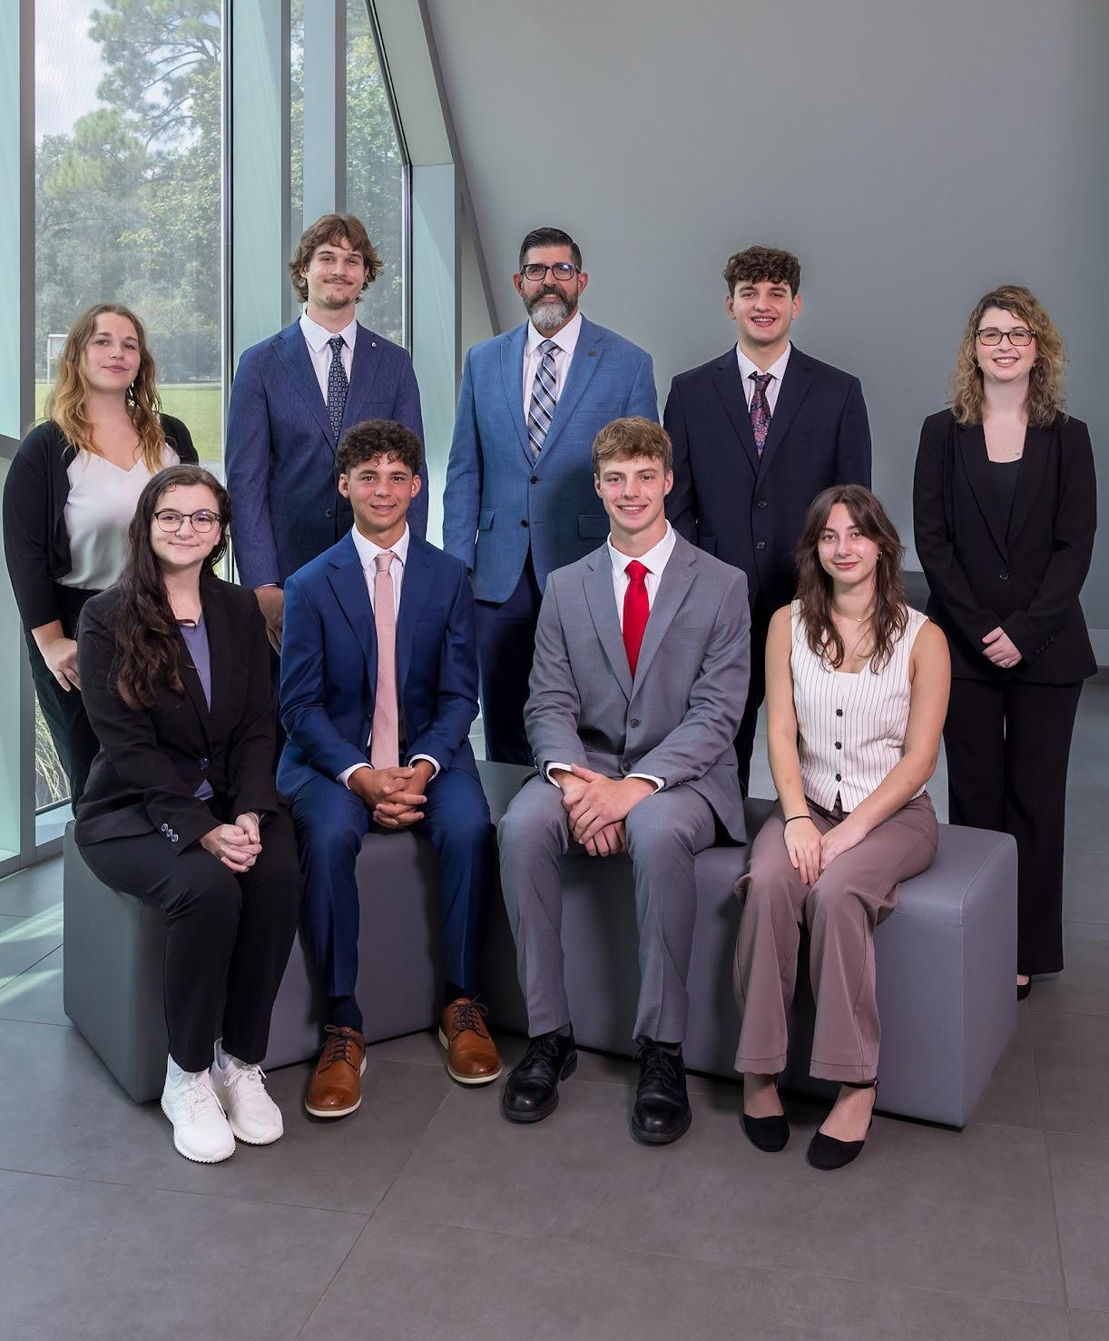
FULL-RIDE
Scholarships
Pace Presidential
Invites sent to qualifying admitted students
who meet the Dec. 1 deadline
Determined by essay and interview scores
Competition dates in early 2027
National Merit
Finalists qualify
Must start at UWF the fall immediately after
high school graduation
Argo Spirit
For Pell-eligible first-year Florida residents
Contest based on video and written essays
March 1, 2027, deadline
Notes:
Nursing lab. Last year, more than 97% of UWF School of Nursing graduates passed their national licensure exam on the first attempt, exceeding state and national averages.

Slide 29
FULL-RIDE SCHOLARSHIP BENEFITS
Scholarship | Fall and Spring Tuition | Meal Plan | Campus Housing | $800 Textbook Stipend per Semester | Paid Research or Study Abroad (up to $1,500 value)
Pace Presidential
National Merit Finalist
Argo Spirit
✓
✓
✓
✓
✓
✓
✓
✓
✓
✓
✓
✓
✓
✓
uwf.edu/FreshmanScholarships

Slide 30
Learn More
uwf.edu/Freshman

Slide 31
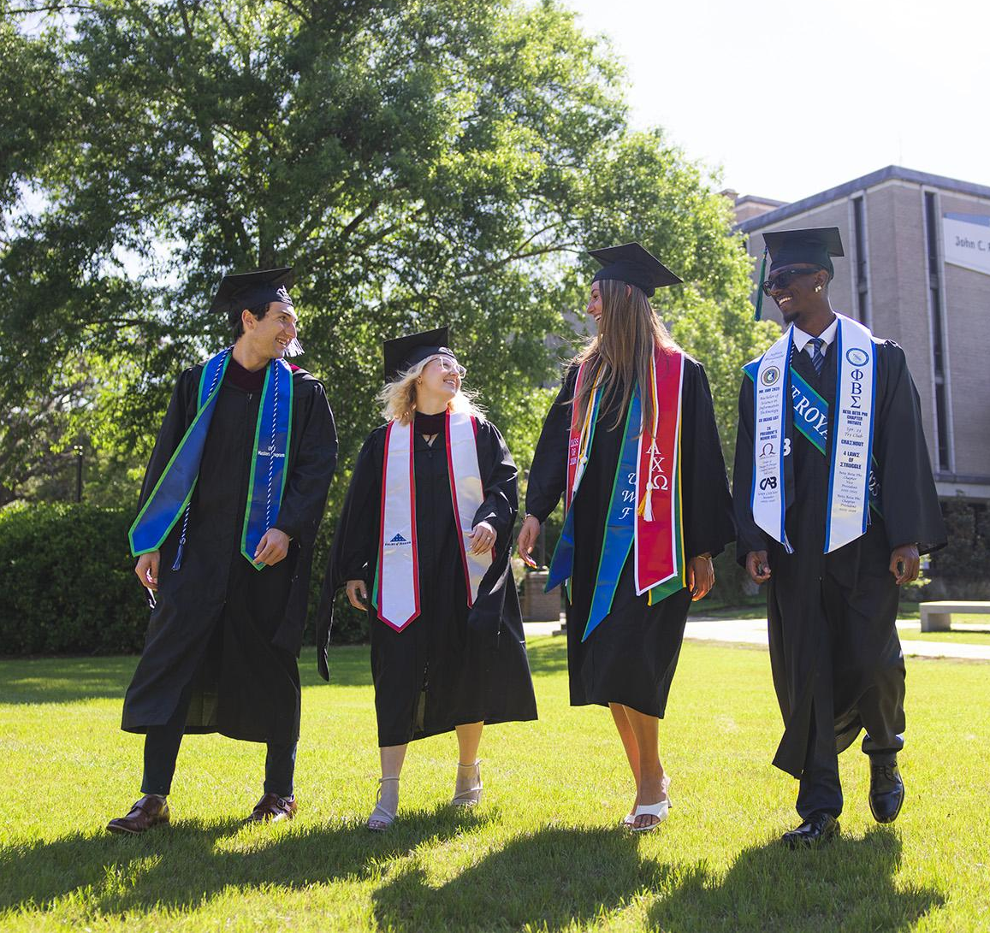
ADMISSIONS
Events
Explore UWF! Open House
  Fall: Nov. 14
  Spring: April 17
Argo Information Virtual Sessions (interested students)
Argo Enrollment Virtual Sessions (admitted students)
uwf.edu/AdmissionsEvents

Slide 32
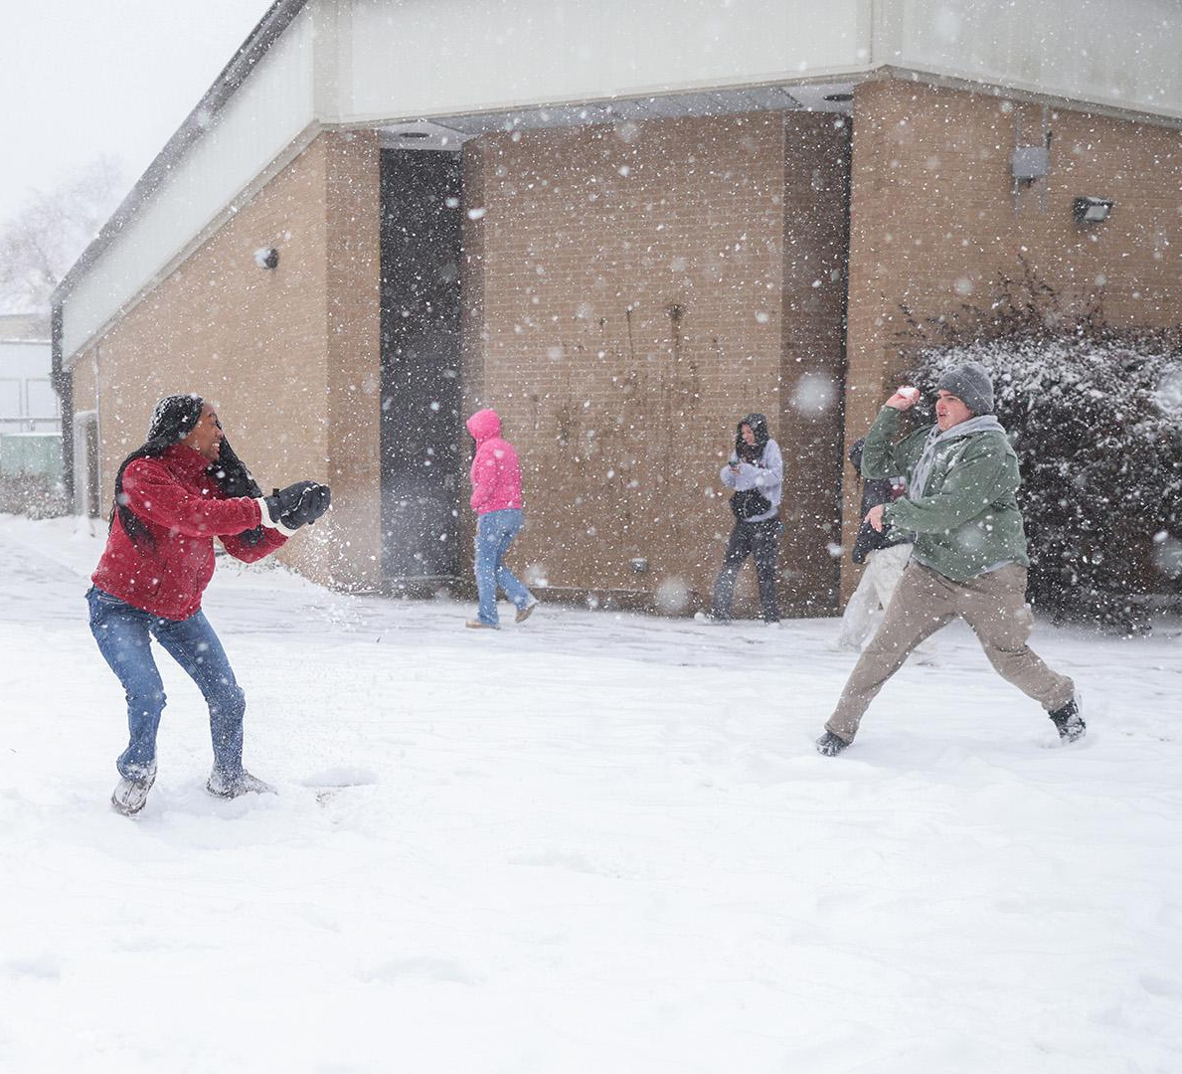







DOWNLOAD
ZeeMee
Learn about life in Pensacola and at UWF from current students in the UWF community on the free ZeeMee app.
Connect With UWF
/uwf
/westfl
Notes:
This past winter, UWF experienced a record-breaking snowfall of nearly 10 inches!

Slide 33


