Slide 1
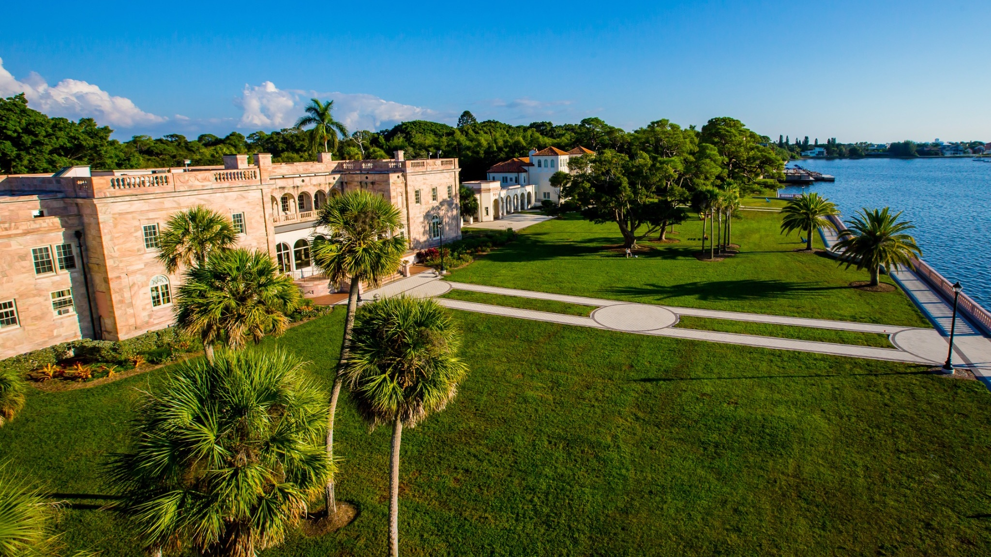
New College of Florida
Florida’s Public Honors College
Rooted in the classics. Shaped by the demands of tomorrow.
Florida State University System Tour

Slide 2

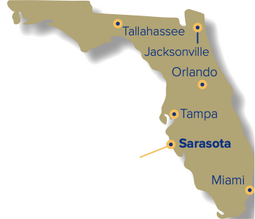
Small by Design. Public by Mission.
The New College Difference.
1,000+
8:1
Total students
Student-to-faculty ratio
14
90%
Average class size
Faculty with doctorate or terminal degree
A close-knit academic community at a statewide public institution.
Sources: Fact Book 2025–26, Enrollment and Persistence; Instructional Faculty and Class Size

Slide 3
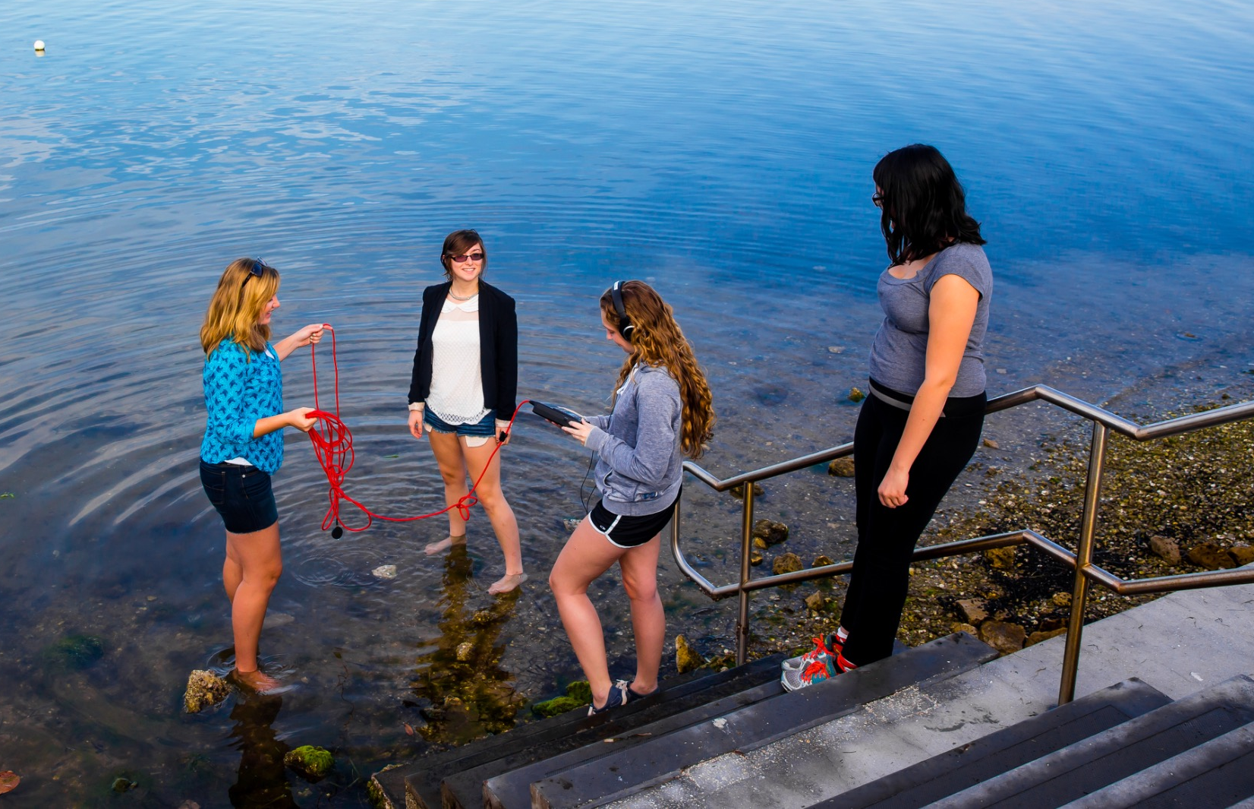
Academic Pathways Built Around Students
Breadth across disciplines, flexibility across interests.
Humanities
Social Sciences
Natural Sciences
Art • Creative Writing
History • Philosophy
Classics
Psychology • Economics
Anthropology
Political Science
Biology • Marine Biology
Data Science • Physics
Applied Mathematics
Interdisciplinary by design
Environmental Studies • Global Studies
Student-Designed Pathways
Students can combine fields, pursue double concentrations, or build individualized pathways with faculty approval.
Sources: Fact Book 2025–26, Academic Offerings and Policies; Admissions Info Session Outline 2026–27

Slide 4
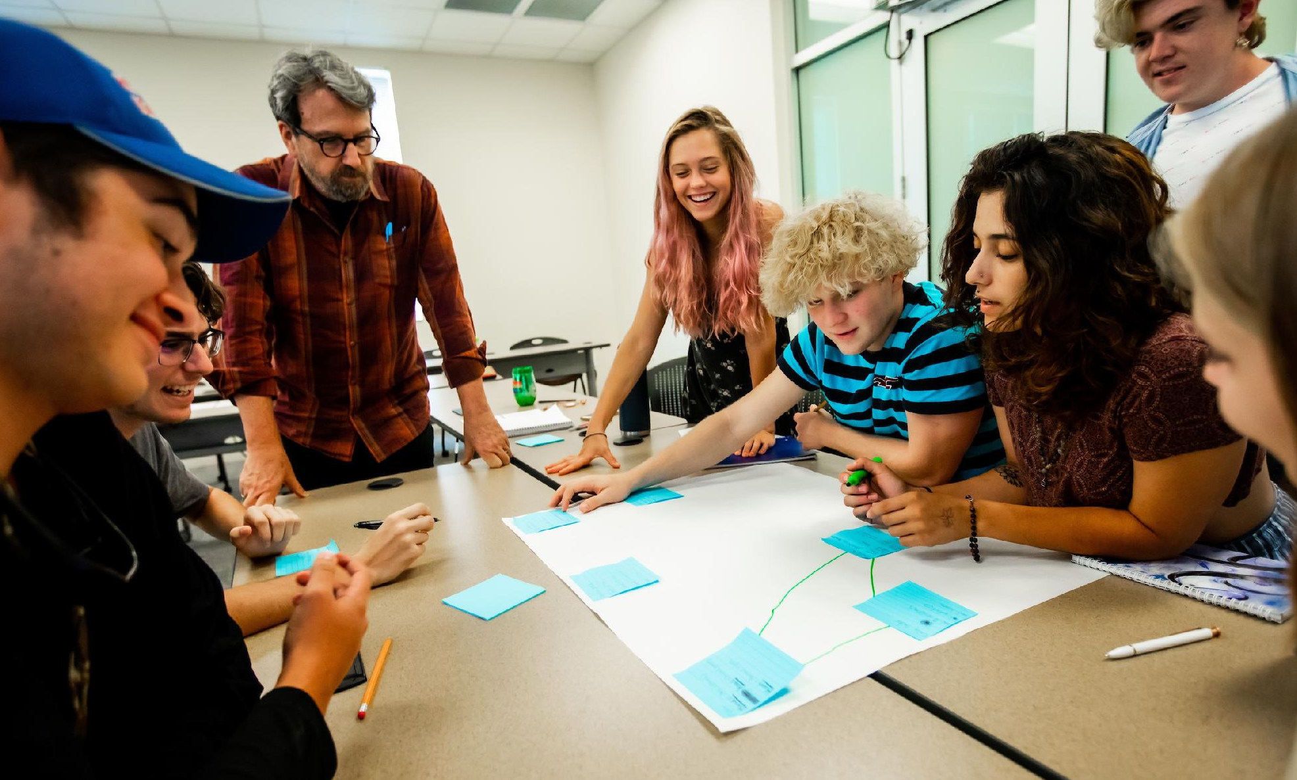
Academic Model
A rigorous honors structure with room to explore.
Academic Contract
Personalized academic plan built with faculty guidance.
GPA + Narrative Evaluations
Detailed feedback on learning, growth, and performance.
Independent Study Project
A dedicated month for research, internship, study abroad, or exploration.
Senior Capstone
A culminating project students develop and defend.
Best-fit student profile
Curious • self-directed • ready for faculty-guided independence
Counselor translation
Think of New College as a place for students who want close faculty mentorship, intellectual independence, and real ownership of their education.
Sources: Fact Book 2025–26, Academic Offerings; Admissions Info Session Outline 2026–27

Slide 5

Life on the Bay
A residential, waterfront campus with growing student life.
24
NAIA athletic teams
SUN
Conference affiliation
50+
Student organizations
150+
Acre bayfront campus
Campus-life note
Community through residential life, clubs, athletics, and bayfront traditions.
Sources: Fact Book 2025–26, Student Life; Admissions Info Session Outline 2026–27

Slide 6

Sarasota: A Destination
Students Get to Call Home
Culture, coast, and career momentum beyond the classroom.
#1
#4
Best Town to Visit
in America
Cities on the Rise
for jobs + talent
Why it matters for students
• Florida’s Cultural Coast - arts, museums, performance venues, and creative energy.
• Gulf Coast lifestyle - bayfront campus, beaches, downtown Sarasota, and outdoor recreation.
• Career momentum - a growing regional economy surrounds the NCF experience.
Counselor takeaway
Students live and learn in one of Florida’s most distinctive coastal communities.
Sources: CNN Travel 2026; LinkedIn 2026

Slide 7
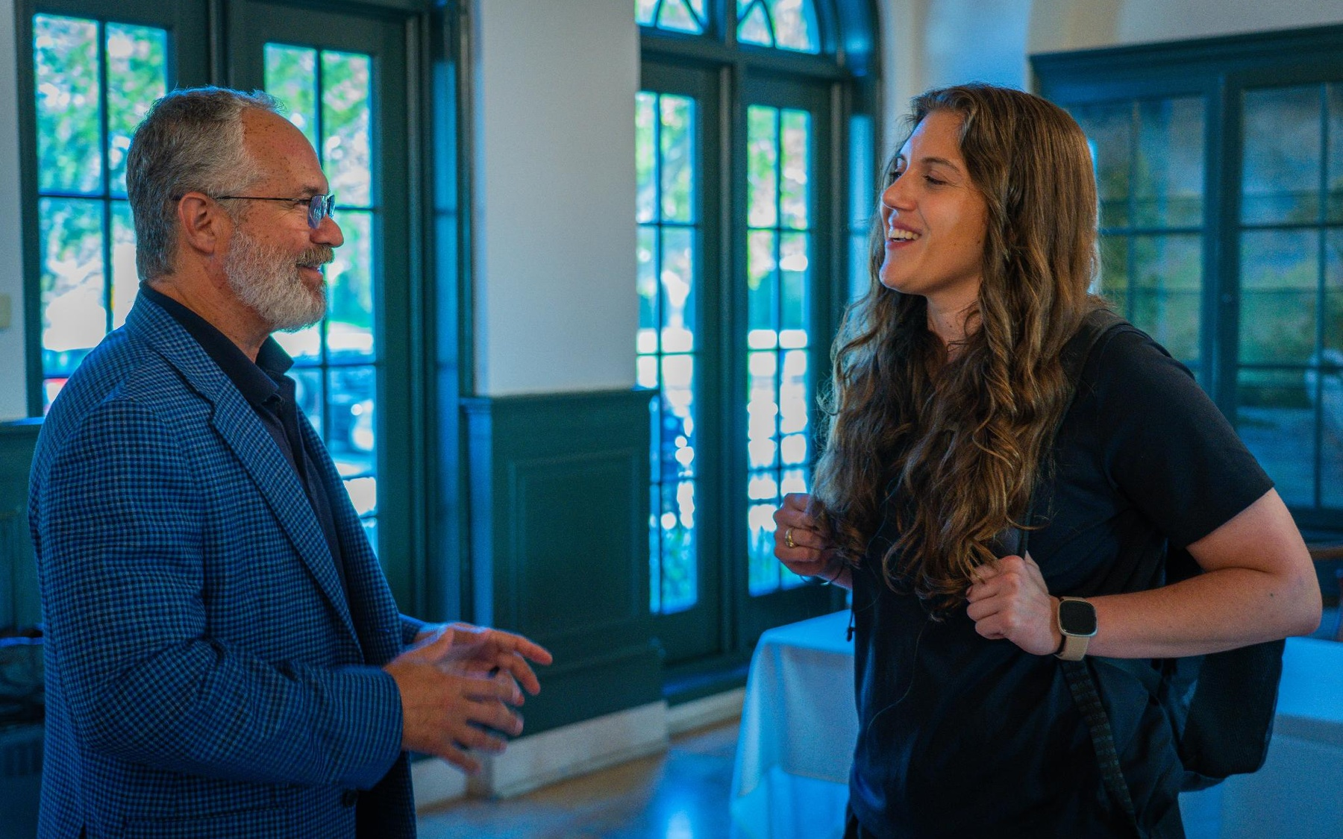
Career Momentum from Year One
Career coaching, fellowships, internships, and graduate pathways.
3,105
80+%
Career Center
interactions
Of students engaged
with Career Center
1:1
8
Career coaching
available
Full-time career
advising staff
How counselors can describe it
Students are connected early to coaching, fellowships, grad school advising, employers, and internships.
Source: Fact Book 2025–26, Career Facts

Slide 8

Admissions: What Counselors Need to Know
Simple application process, comprehensive review, clear deadlines.
How to apply
Middle 50% Admit Profile
1.
New College App or Common App - no application fee
GPA
3.8–4.3
2.
Application essay
SAT
1130–1320
ACT
23–29
3.
High school academic record through STARS
4.
SAT, ACT, or CLT scores - self-reported or unofficial
Use these ranges as guideposts - not automatic cutoffs.
Sources: Fact Book 2025–26, First-Time First-Year Admissions; Admissions Info Session Outline 2026–27

Slide 9
Dates Students Should Know
Give families a simple timeline and a clear next step.
EARLY ACTION
Nov. 1
Early Action
deadline
Nov. 15
Early Action
supporting documents
Dec. 15
Early Action
decision by
REGULAR / ENROLLMENT
Apr. 1
Regular
deadline
May 1
Enrollment
deposit deadline
July 1
Final
deadline
Best counselor move
Encourage students to apply by Early Action so scholarship conversations can start earlier.
Source: Admissions Info Session Outline 2026–27

Slide 10
Cost, Aid and Value
Public-university tuition, generous merit aid, and access to state and federal aid.
Estimated 2026–27 Direct Cost
Scholarship & Aid Pathways
Florida resident living on campus
Merit-based options
$22,084
•
Presidential Honors Scholarship
•
President’s Inner Circle
•
Foundation Awards
$6,689
$15,395
State + federal aid
Tuition & fees
Room & board
•
Florida Bright Futures
•
Pell Grant
Estimated direct cost assumes Florida residency, full-time undergraduate enrollment, and on-campus housing with a meal plan. Final charges may vary based on credit hours, housing selection, and meal plan.
Counselor translation
Strong value when families pair public tuition
with merit, state, federal, and institutional aid.
Sources: Fact Book 2025–26, Annual Expenses and Financial Aid; Admissions Info Session Outline 2026–27

Slide 11
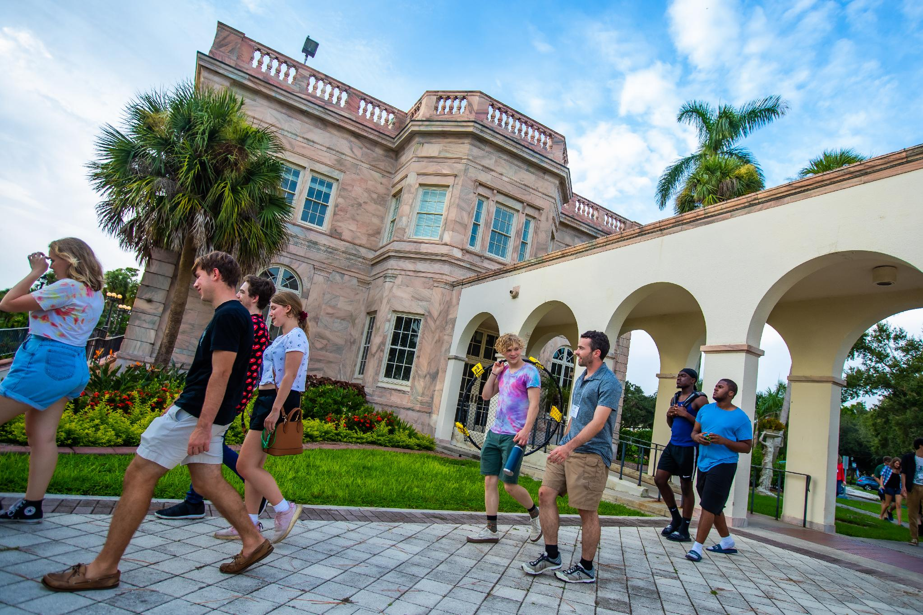
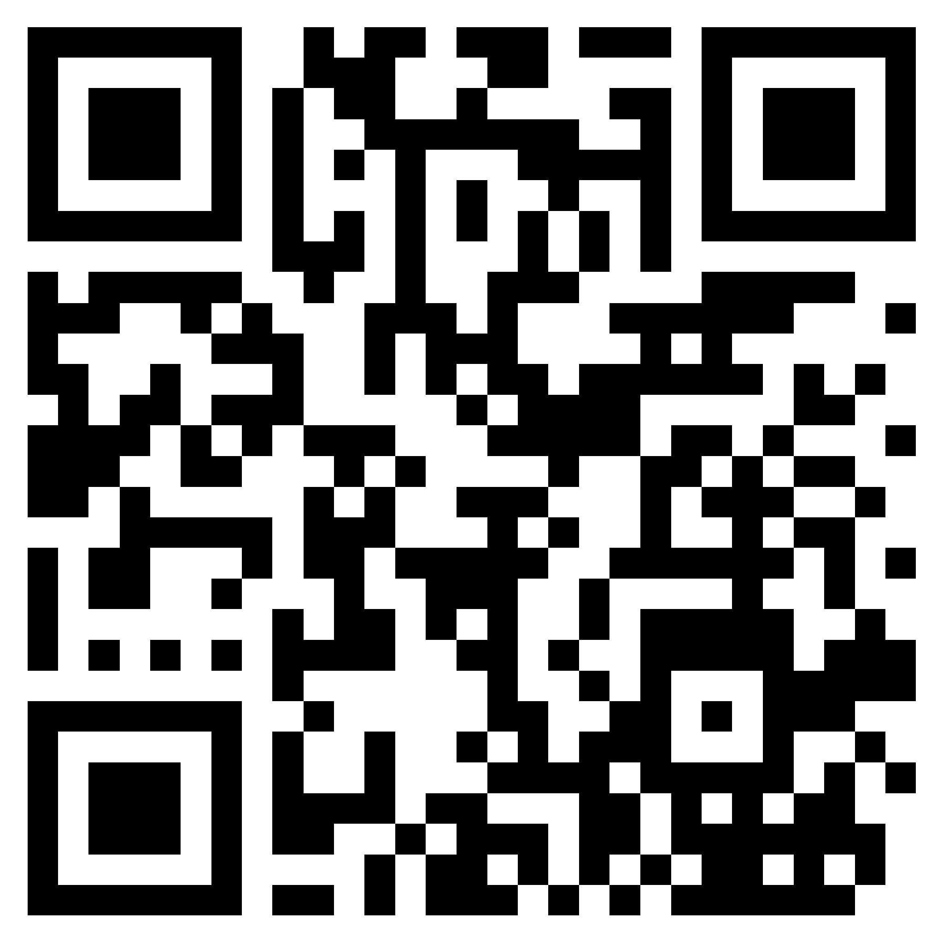
Preview Days
Open houses for students and families ready to experience New College.
2026–2027 Open House Dates
October 3, 2026
Preview Day
December 5, 2026
Preview Day
February 20, 2027
Preview Day
9:30 AM – 2:00 PM
Continental breakfast • lunch vouchers
Counselor takeaway
Preview Days are the best fit for students who need to feel the NCF experience - academics, admissions, student life, and campus community in one visit.
Preview Day
registration
Source: 2026–2027 Admissions Events Calendar

Slide 12


We’re Here for Your Students
Contacts and counselor next steps.
First-Year Students (FTIC)
Cliff Lundin, Director
941-487-4874
clundin@ncf.edu
Richelle Porambo, Associate Director
941-487-4746
rporambo@ncf.edu
Main admissions contact
admissions@ncf.edu • 941-487-5000 x1 • ncf.edu
Three takeaways to remember
1. Public honors college access.
2. Faculty mentorship and individualized academics.
3. Strong value through aid, scholarships, and Bright Futures.
Schedule
a visit
Sources: Admissions materials and Fact Book 2025–26

Slide 13
