Slide 1


Notes:
No requests

Slide 2




#1
STARTING SALARIES OF GRADUATES
in the State of Florida University System
#1
PUBLIC
COLLEGE
in the South
NATIONALLY
TOP 30
PUBLIC
ENGINEERING
PROGRAM
without a Ph.D.
BEST VALUE
PUBLIC SCHOOL
in the South
“5 years in a row”
- U.S. News & World Report

Slide 3





Academic Profile
*based on Fall 2026 admitted class
SAT
1160-1360
Middle 50%
Average GPA
4.1
ACT
24-31
Middle 50%
STEM Courses Pre-Calc, Calculus, Physics, Chemistry

Slide 4
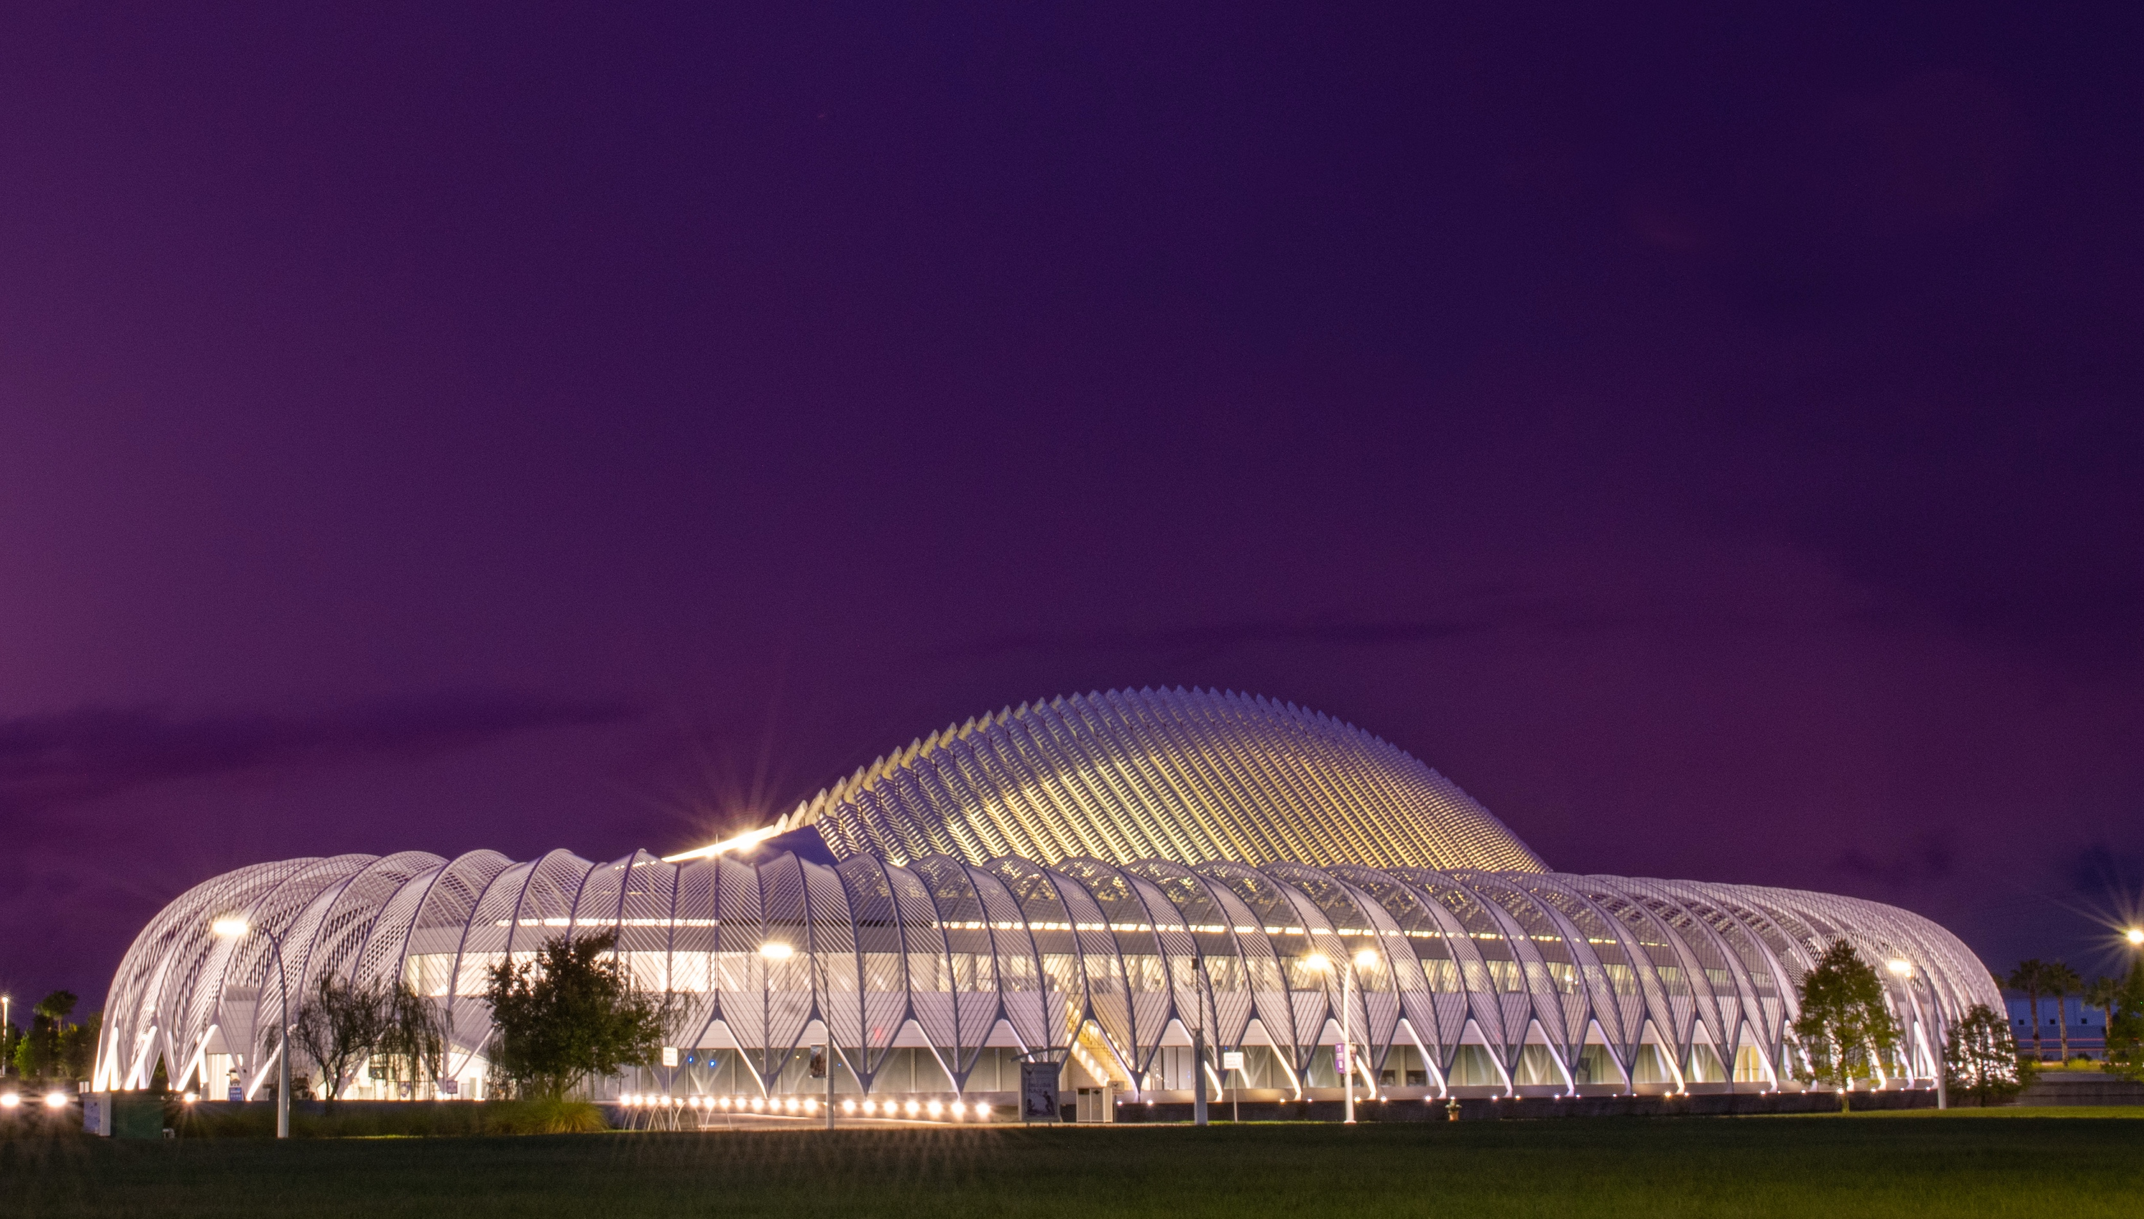
Application Process
Step 1
Step 2
Step 3
Submit Application (Common App or Florida Poly website)
Submit Transcripts or STARS
Submit
Test Scores
(ACT, SAT, CLT)
*$30 Application Fee waived until Nov. 15
*Essays and Letters of Recommendation are not required

Slide 5

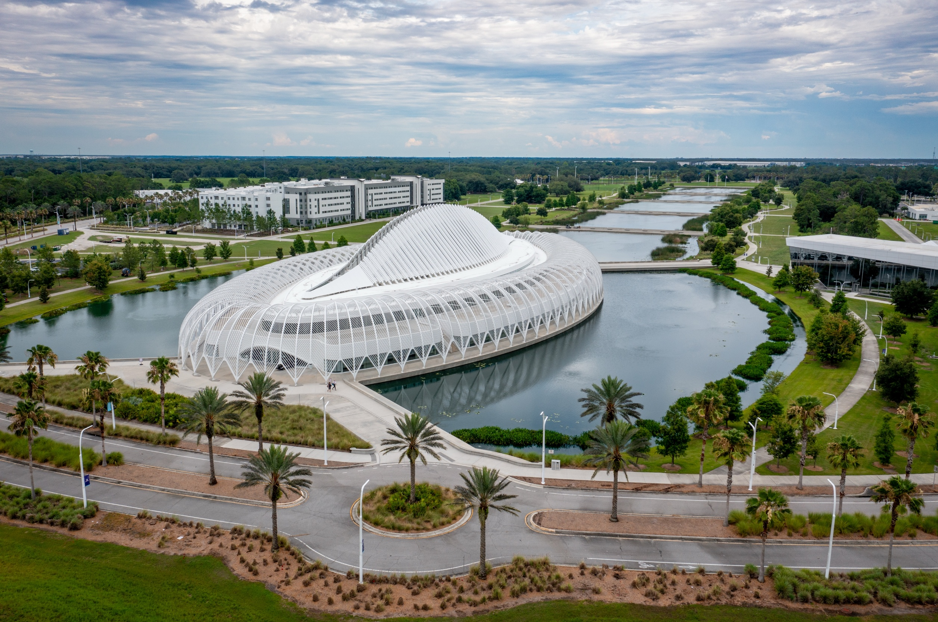

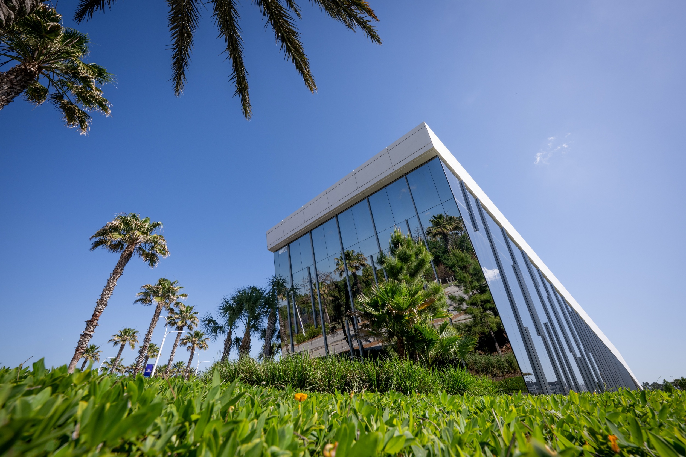

Application Deadlines
AUG.
01
NOV.
15
JAN.
15
MARCH
01
MAY
01
Application
Opens
Early
Action I
Deadline
Early
Action II
Deadline
Regular
Decision
Deadline
Enrollment
Deposit
Deadline

Slide 6
Undergraduate Majors
Aerospace Engineering
Applied Mathematics
Biomedical Sciences
Business Analytics concentrations in:
Analytical Finance
Quantitative Business Economics
Supply Chain Management
Management Science
Civil Engineering
Computer Science
Computer Engineering
Cybersecurity
Data Science
Electrical Engineering
Engineering Physics
Environmental Engineering
Industrial Engineering
Mechanical Engineering
Physics
Undergraduate Minors
Aerospace Engineering
Applied Mathematics
Business
Chemistry
Computer Engineering
Computer Science
Cybersecurity
Economics
Electrical Engineering
Environmental and Water Resource Engineering
Industrial Engineering
Interdisciplinary Humanities
Mechanical Engineering
Performance Engineering
Physics
Professional and Technical Communication
Statistics and Machine Learning
Transportation Engineering
Undergraduate Certificates
Artificial Intelligence (AI)
Astrophysics
Biomedical Devices
Cybersecurity
Game Development
Lean Six Sigma
Pre-Health
Software Engineering
Storytelling and Digital Media
Quantum

Slide 7

Transfer Credits
AICE - Advanced International Certificate of Education Exam
AP - Advanced Placement
CLEP - College-Level Examination Program
DE - Dual Enrollment
IB - International Baccalaureate

Slide 8






























Internships are Required

Slide 9


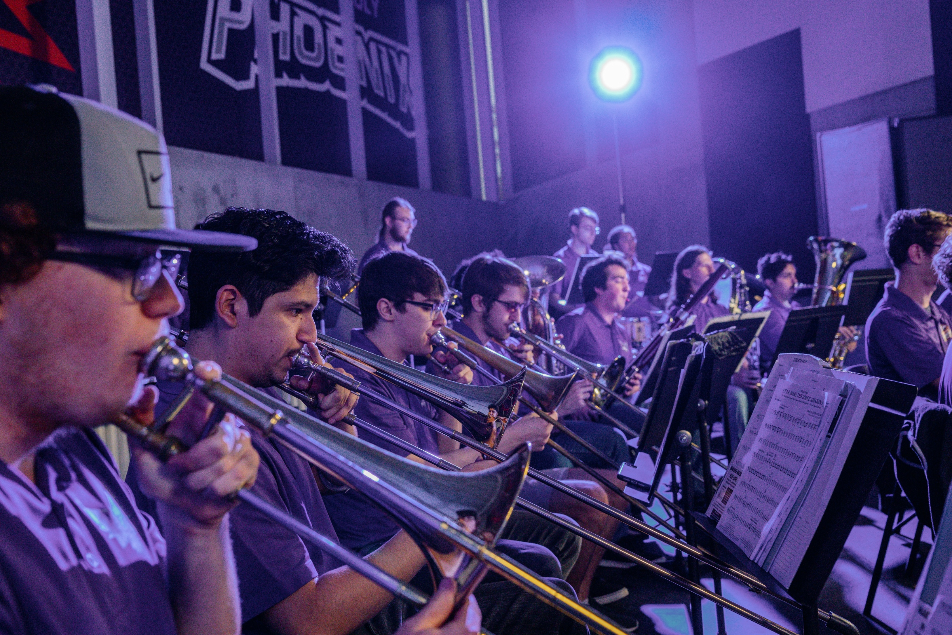


NUPOC (Navy Officer Pipeline Program)
Campus Events & Activities
Esports Gaming Arena
50+ Student Clubs & Organizations
Intramural & Club Sports

Slide 10
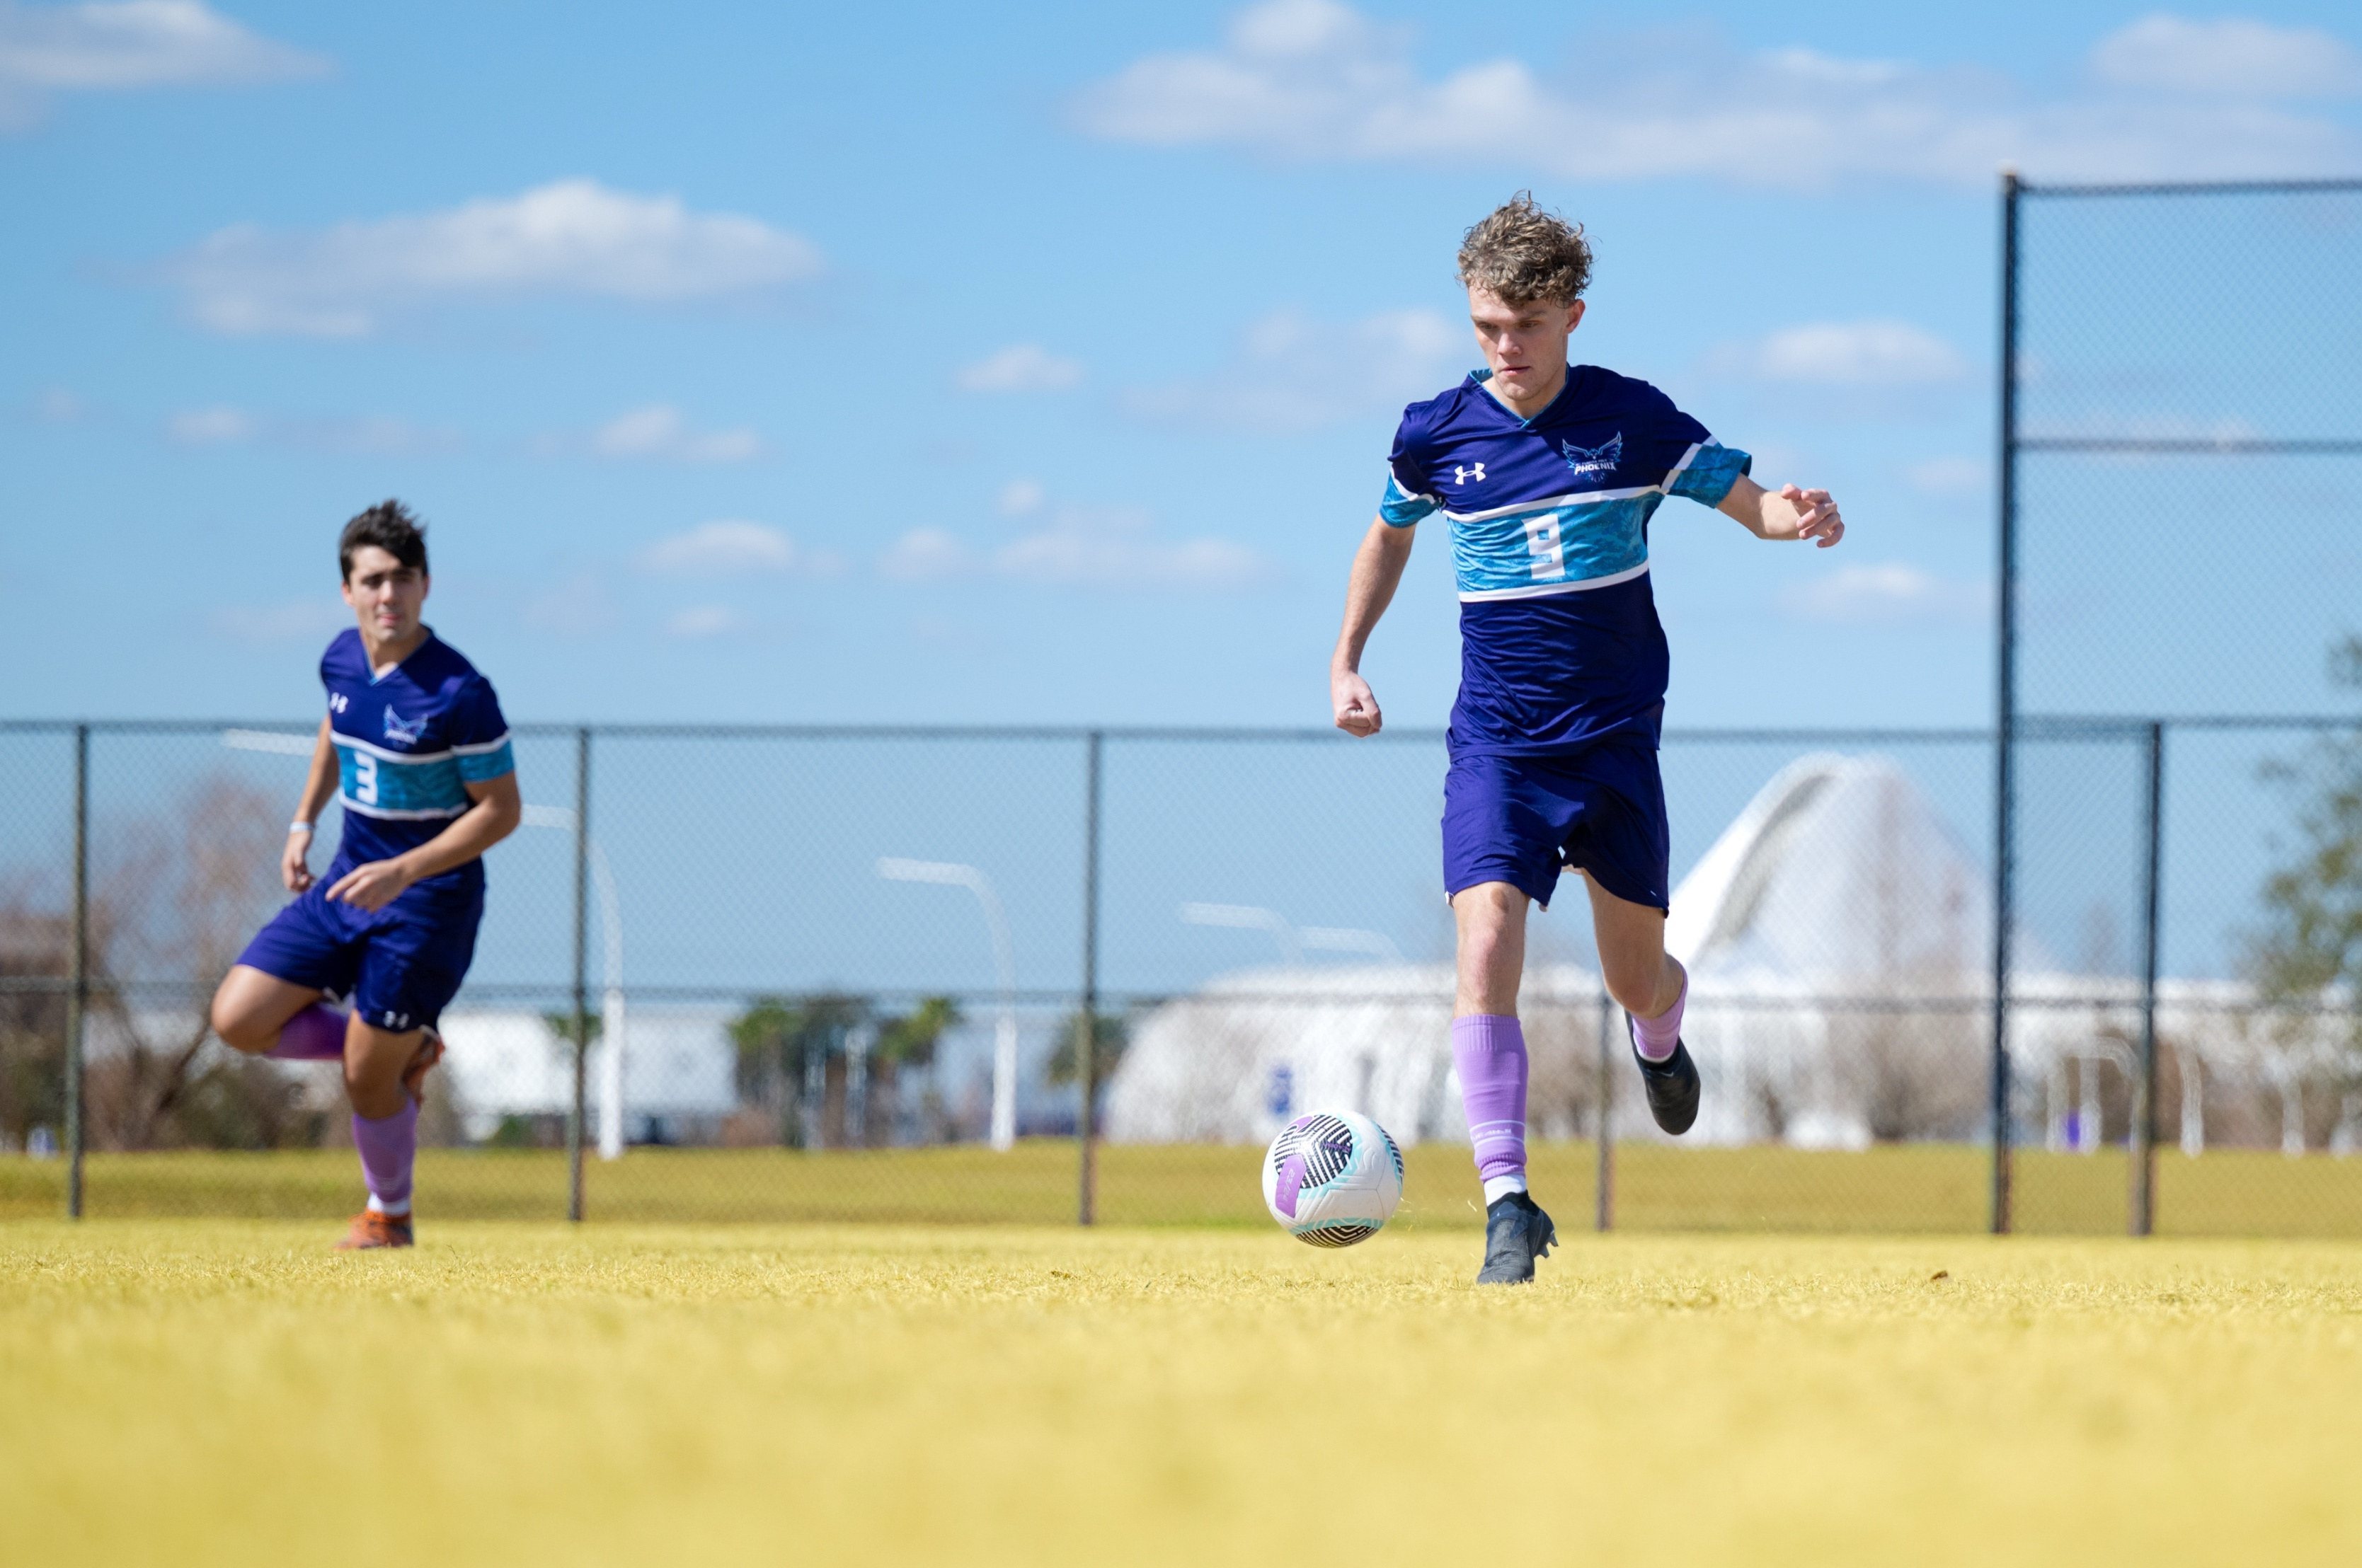

Intercollegiate Athletics
Men’s Sports
Women’s Sports
Baseball
Basketball
Soccer
Cross Country
Softball
Basketball
Soccer
Cross Country

Slide 11

In-State Cost of Attendance
Tuition & Fees = $4,940
Total
$25,601
Room & Board = $15,501
Books, Supplies, Misc. = $5,160
*Estimated costs for a full-time student (30 credits) for one academic year

Slide 12



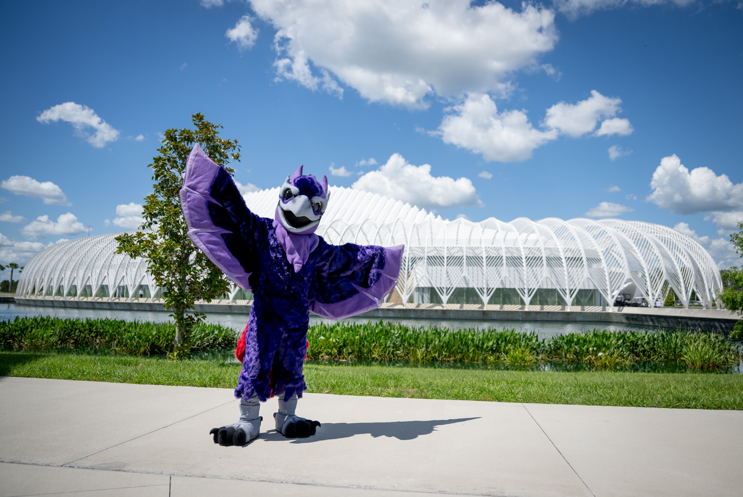
In-State Merit Scholarships
*scholarship amount per year; estimated costs for a full-time student (30 credits) for one academic year
Presidential Scholarship
$4,940
Full Tuition
Provost Scholarship
$3,000
Phoenix Scholarship
$2,500
Solaris Scholarship
$1,500

Slide 13
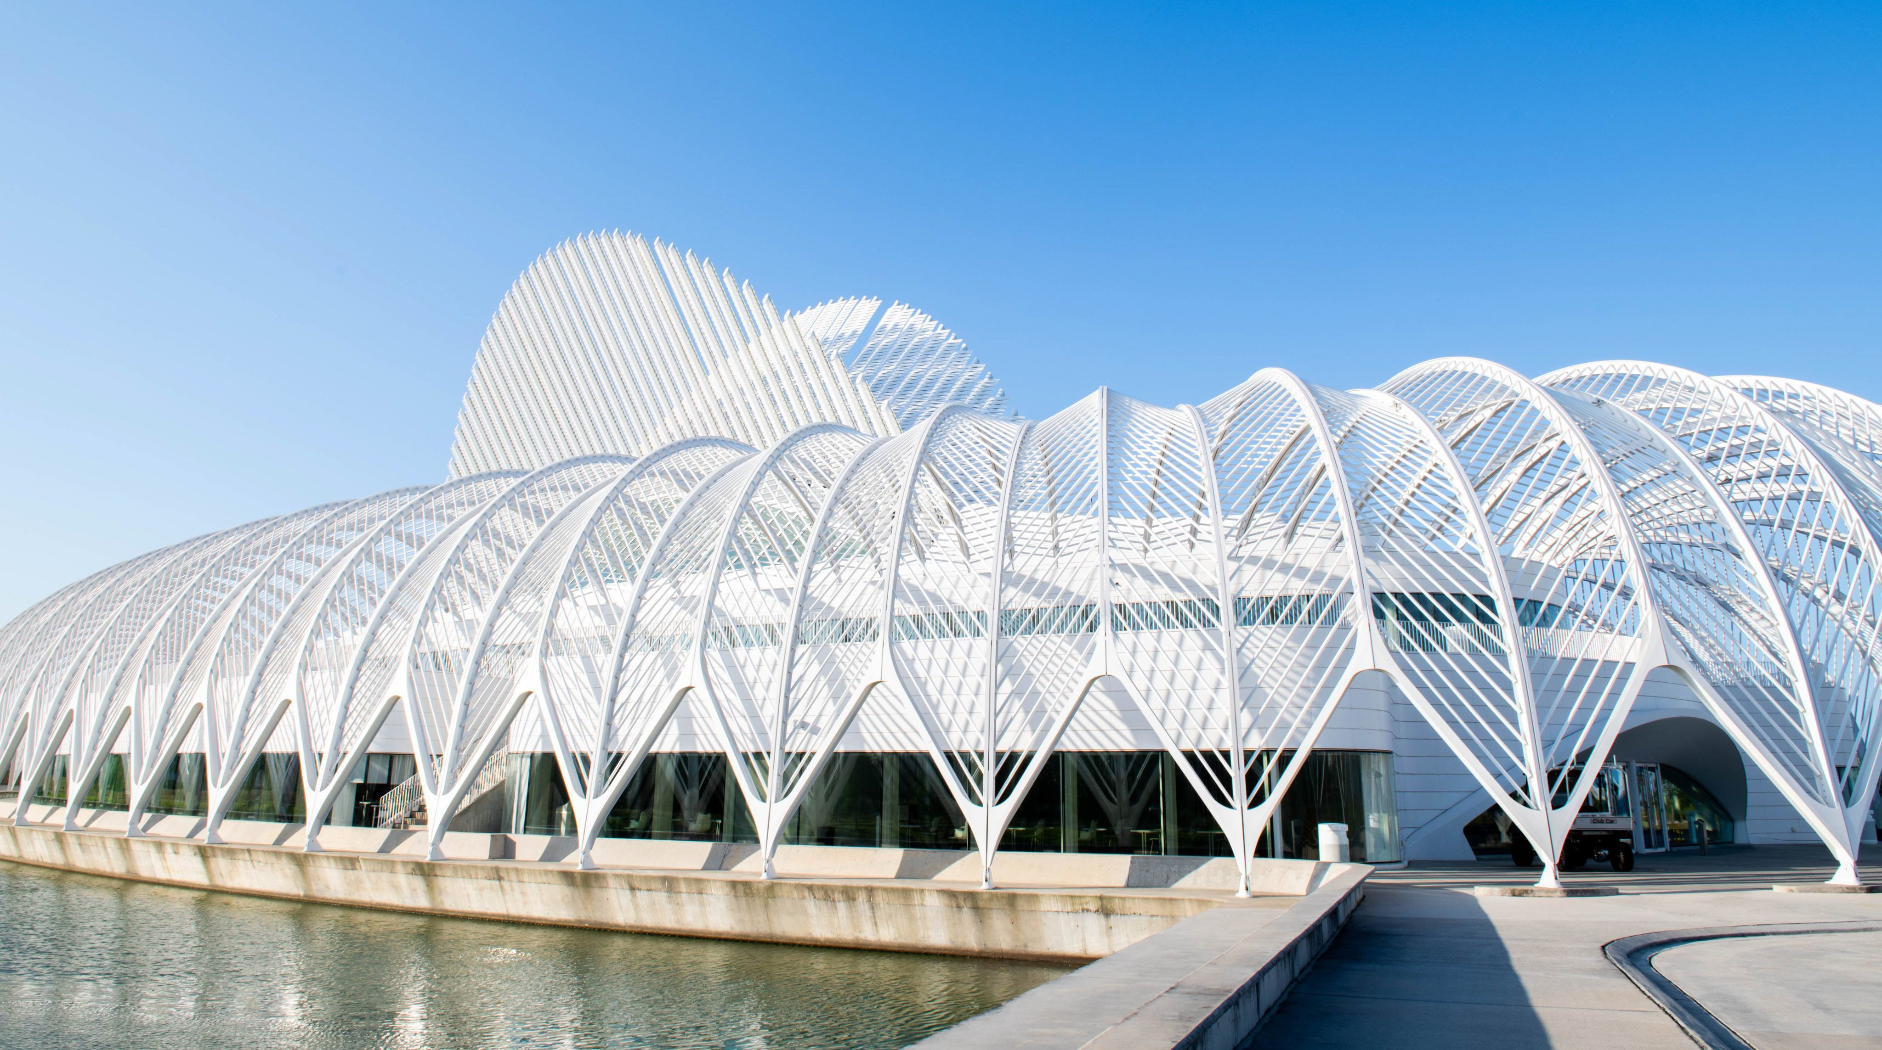
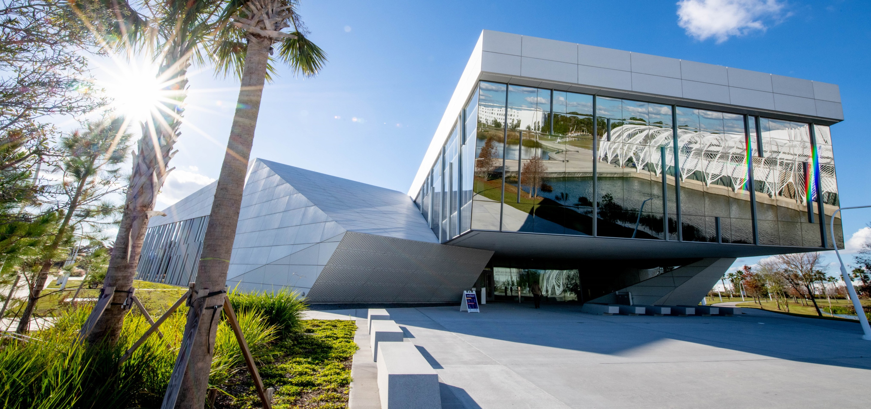
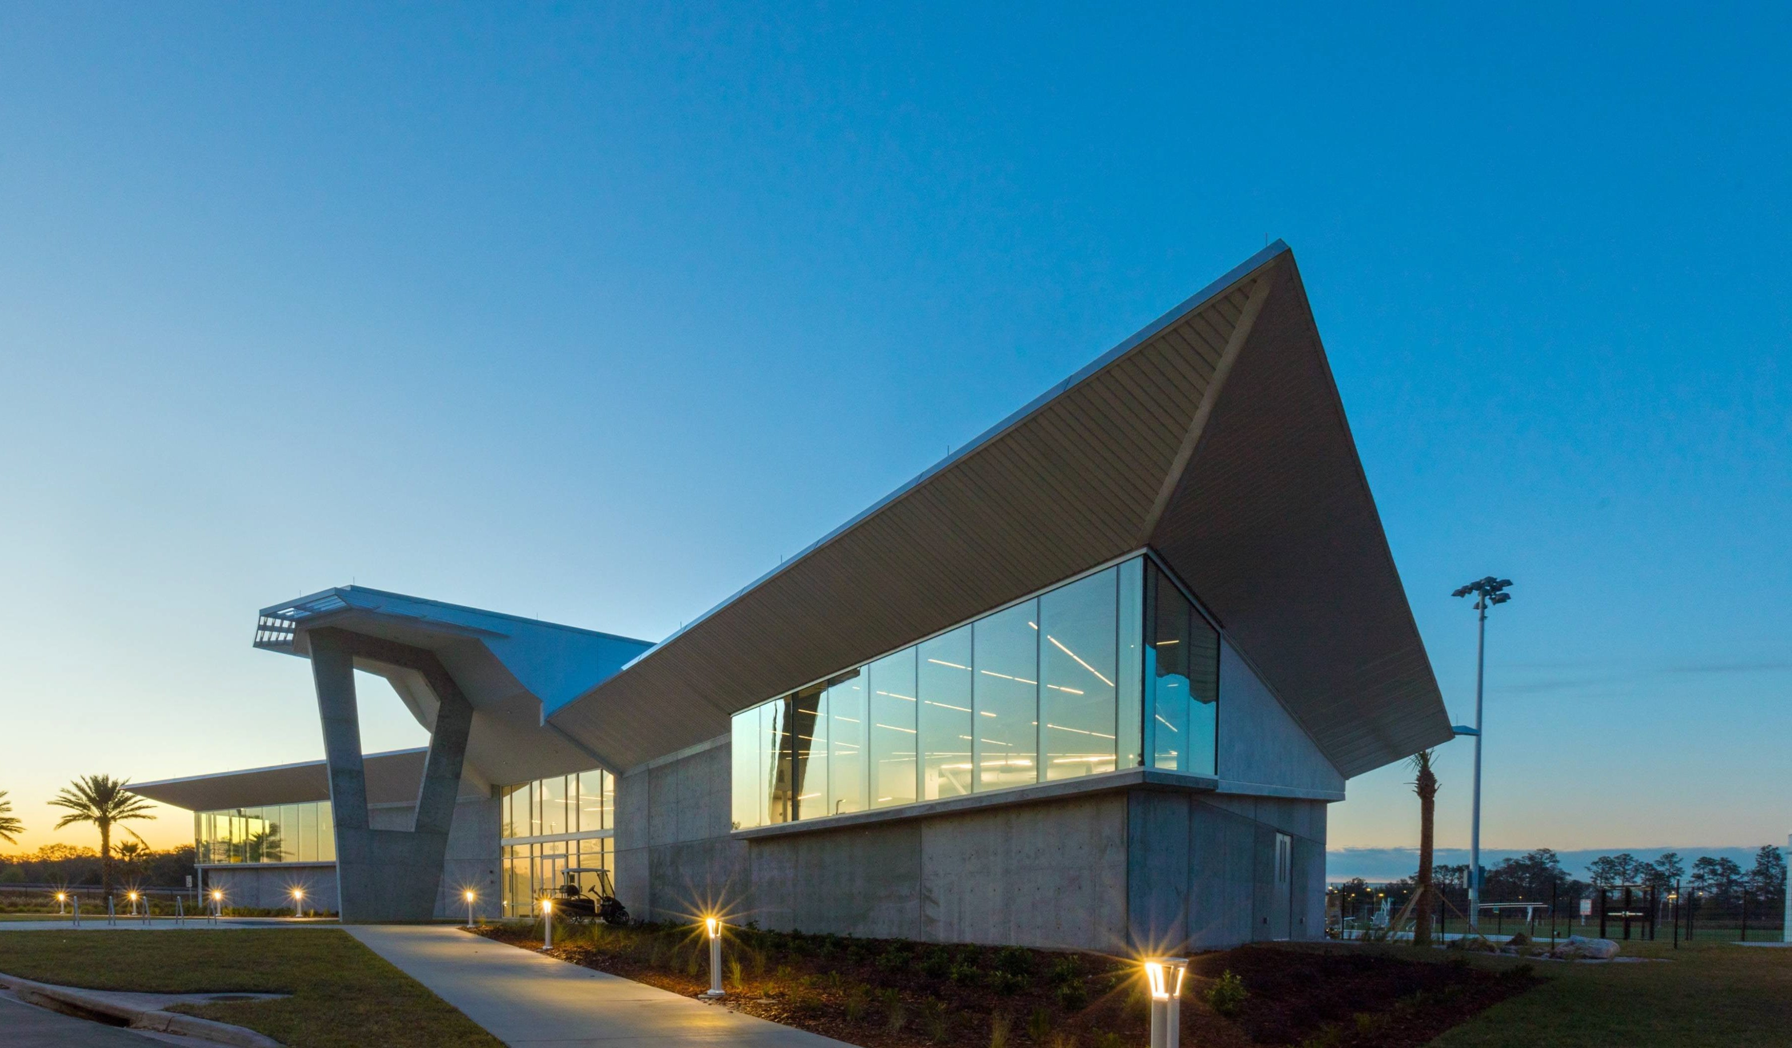
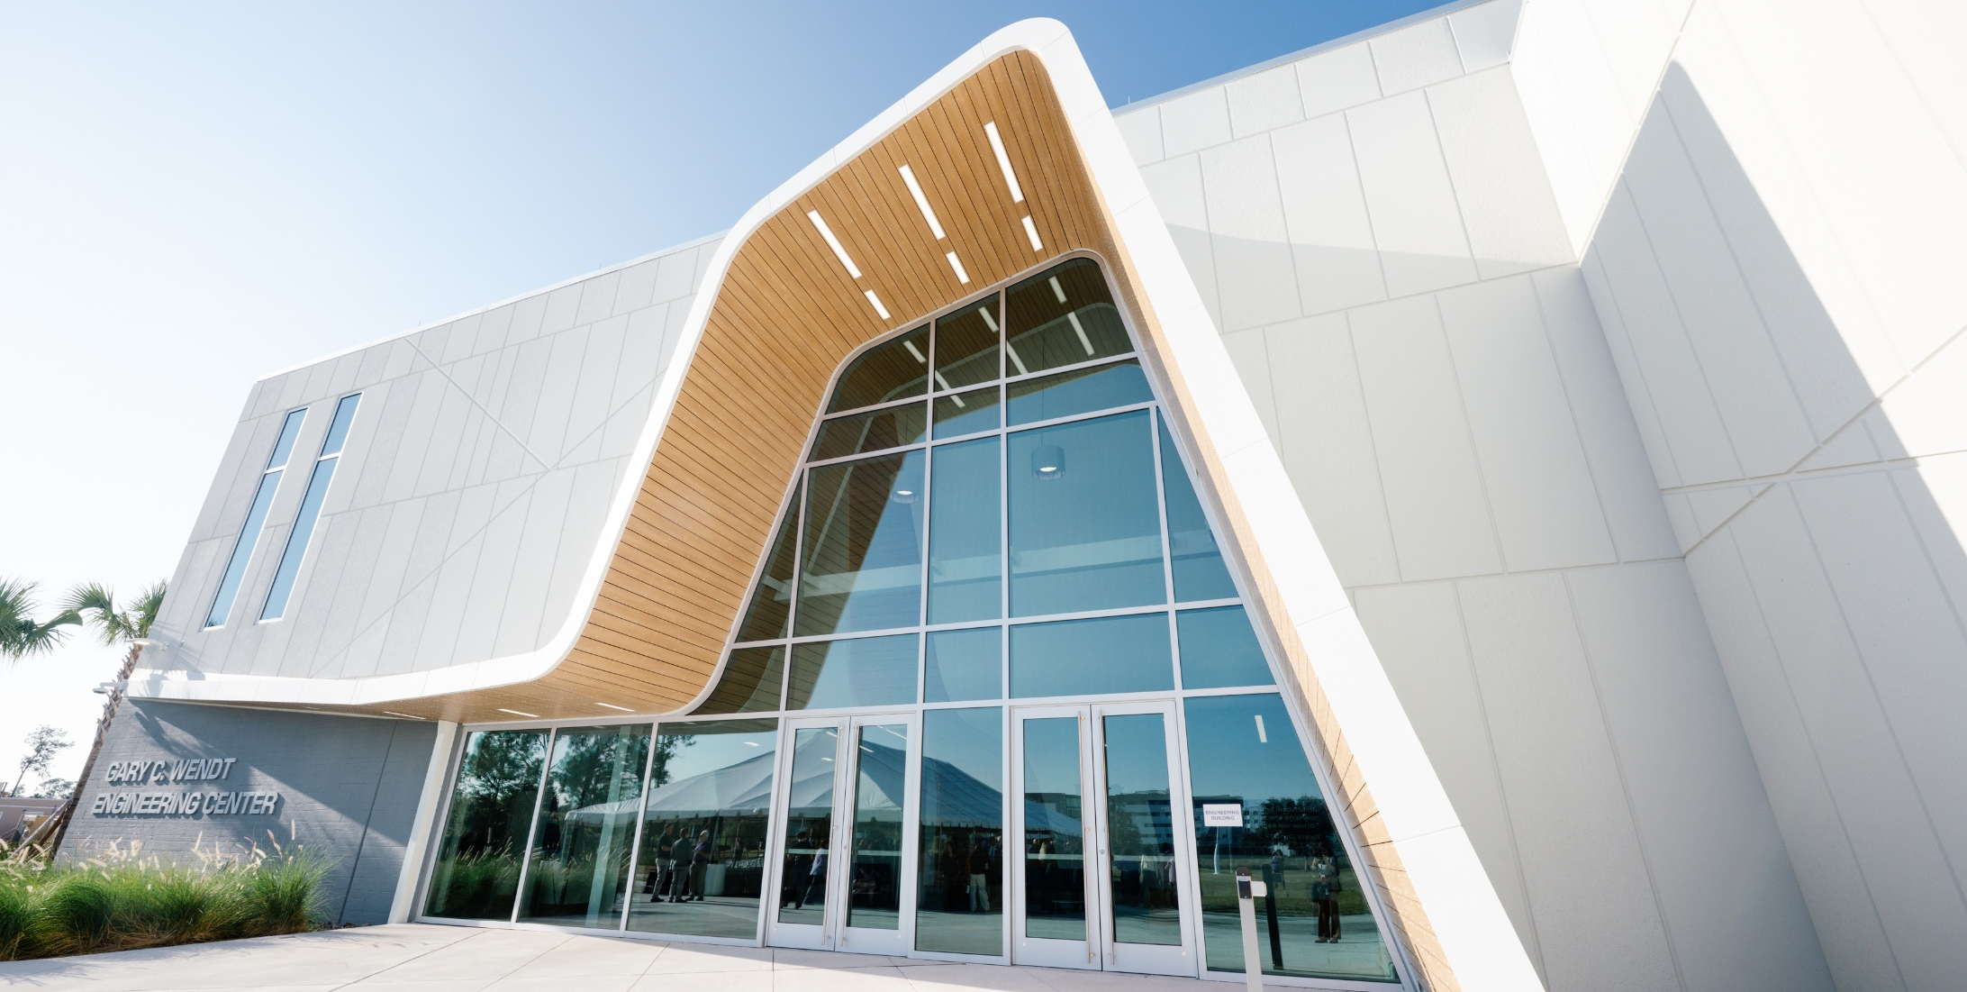
Innovation Science & Technology
Barnett Applied Research Center
The Phoenix
Gary C. Wendt Engineering

Slide 14
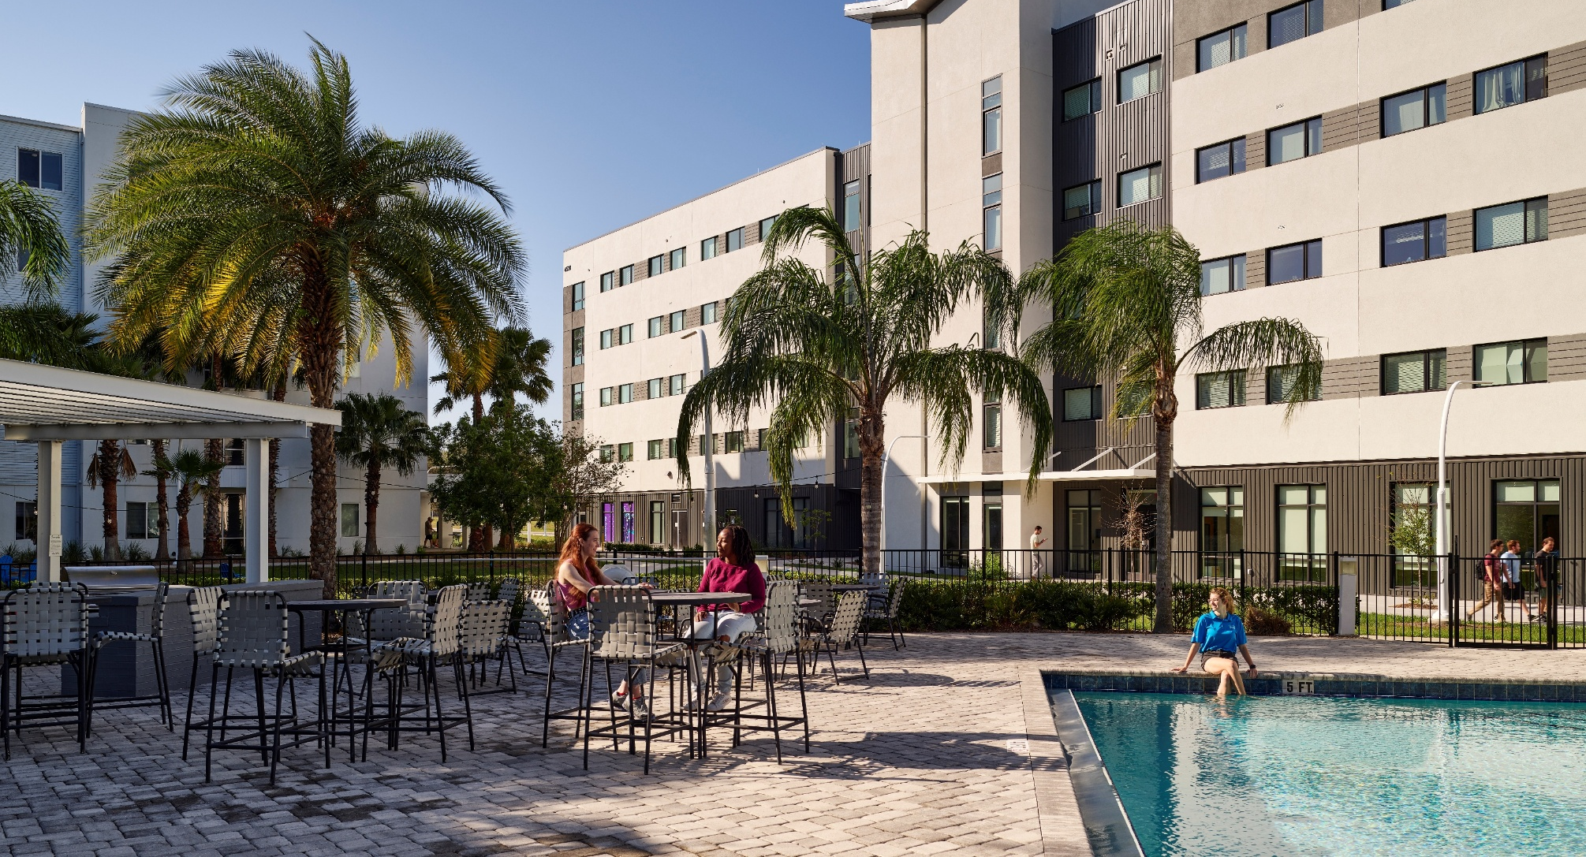
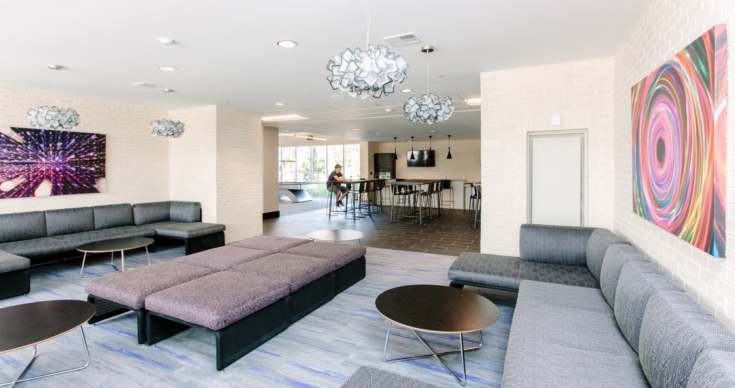
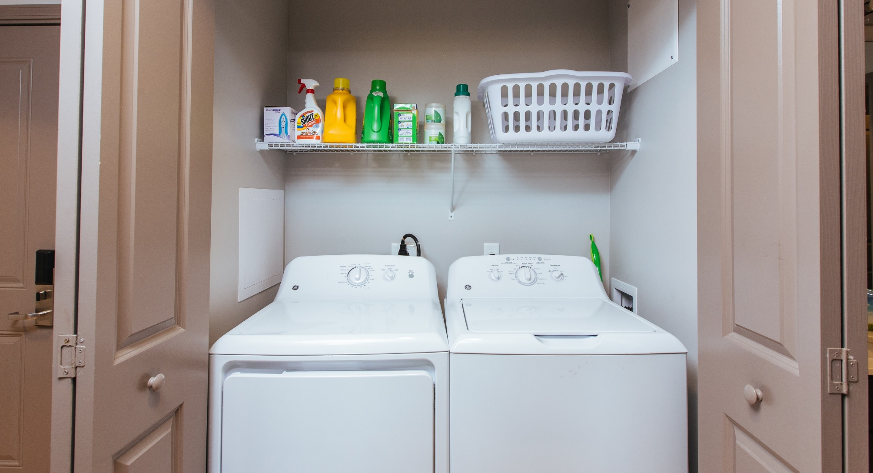
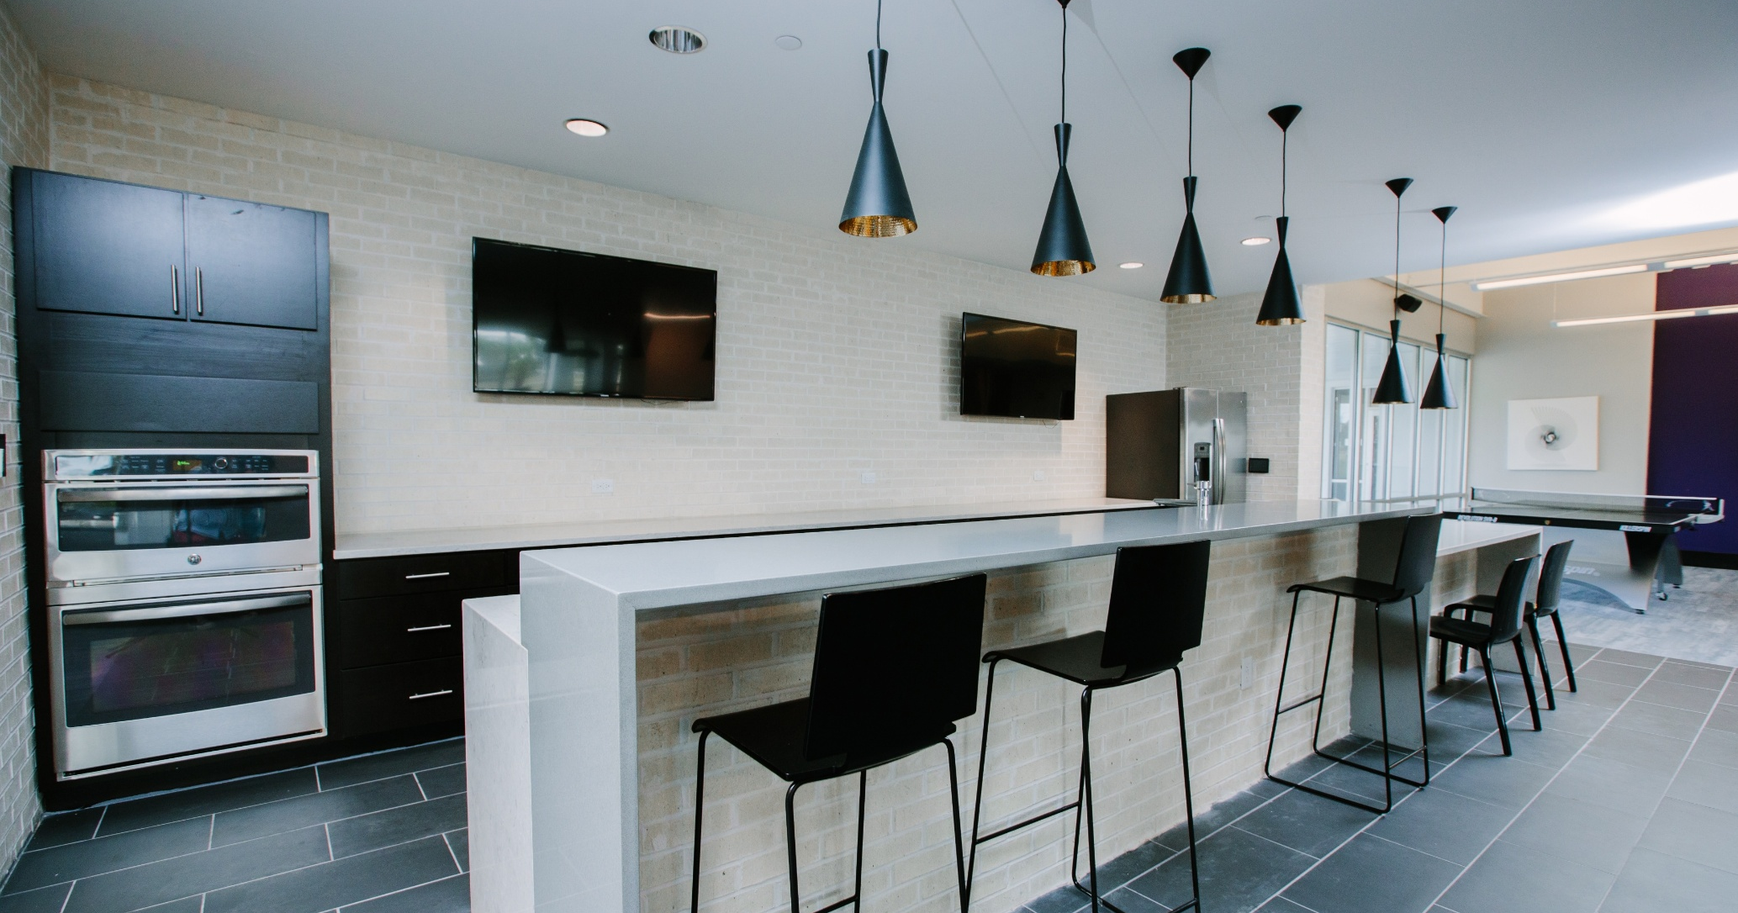
Resort Style Pool Area
Common Areas
In-Unit Laundry
Shared Kitchen Space

Slide 15
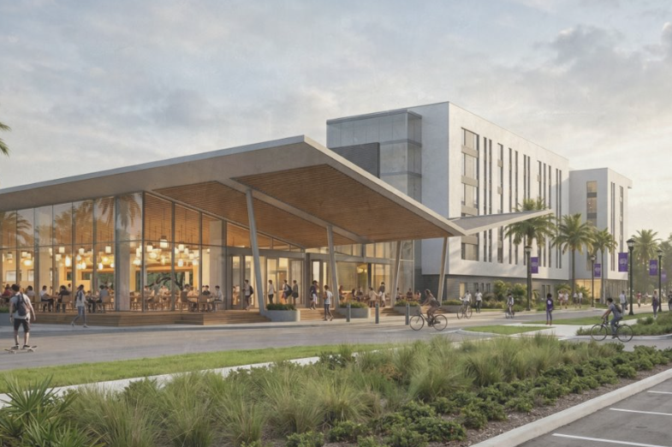
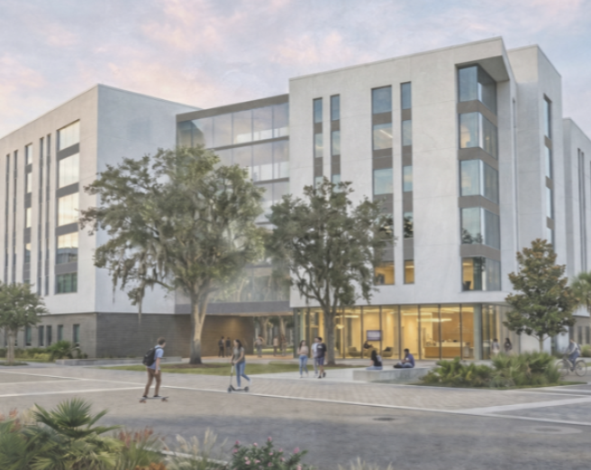
Future Growth
Expected Fall 2028
25,000 Sq. Ft. Dining Hall
Phase IV Residence Hall
138,000 Sq. Ft. Student Achievement Center

Slide 16
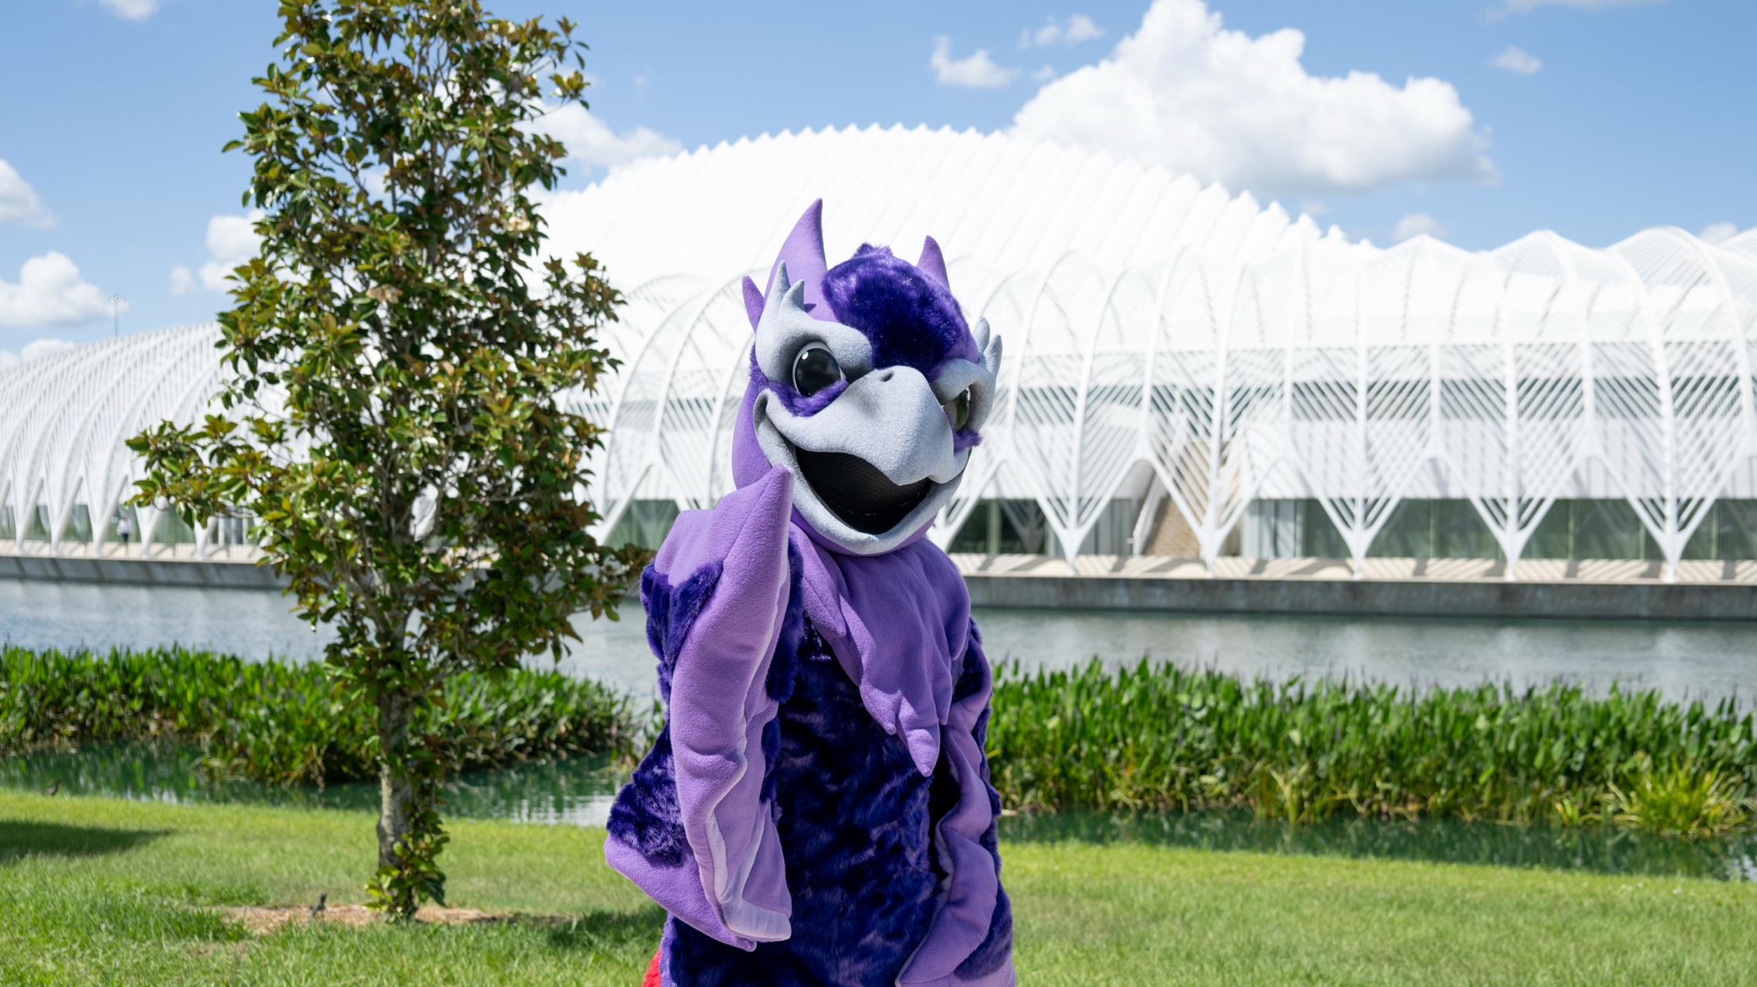
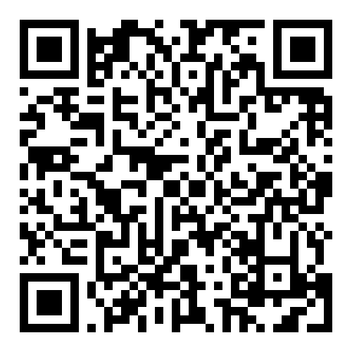
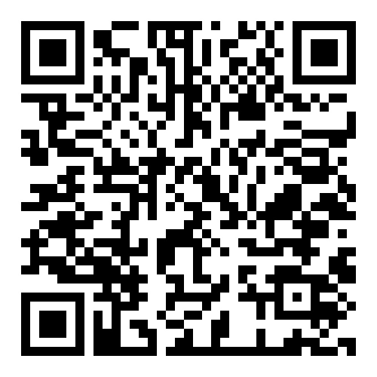
Applications are now open!
Check out our Virtual Viewbook
Meet the Admissions Team
4700 Research Way Lakeland, FL 33805 | floridapoly.edu | (863) 874-4774

