Slide 1
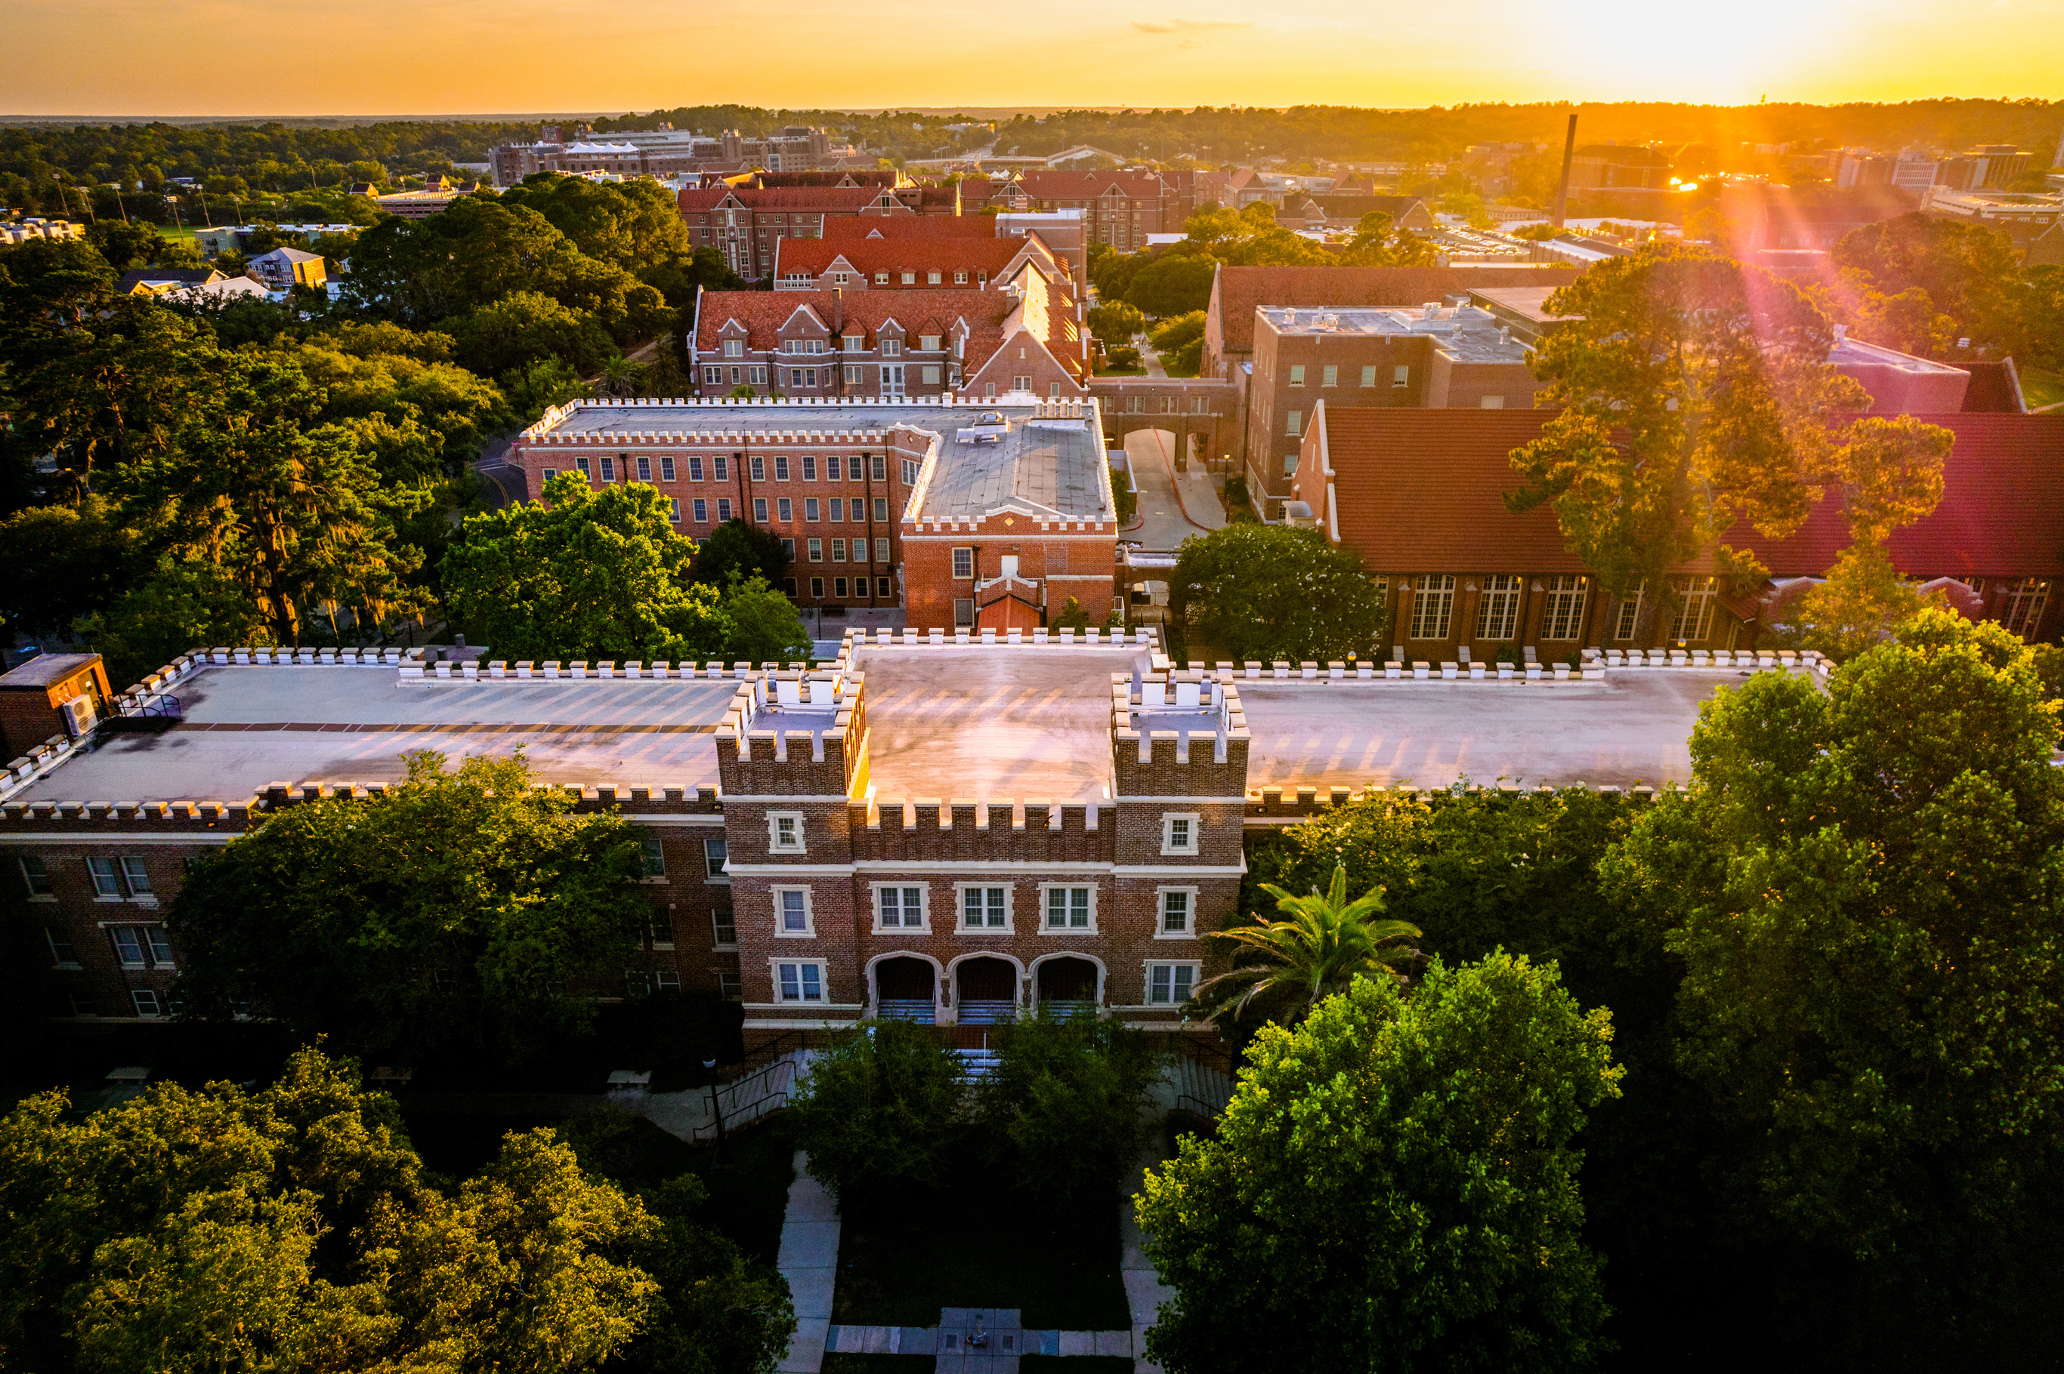

Slide 2
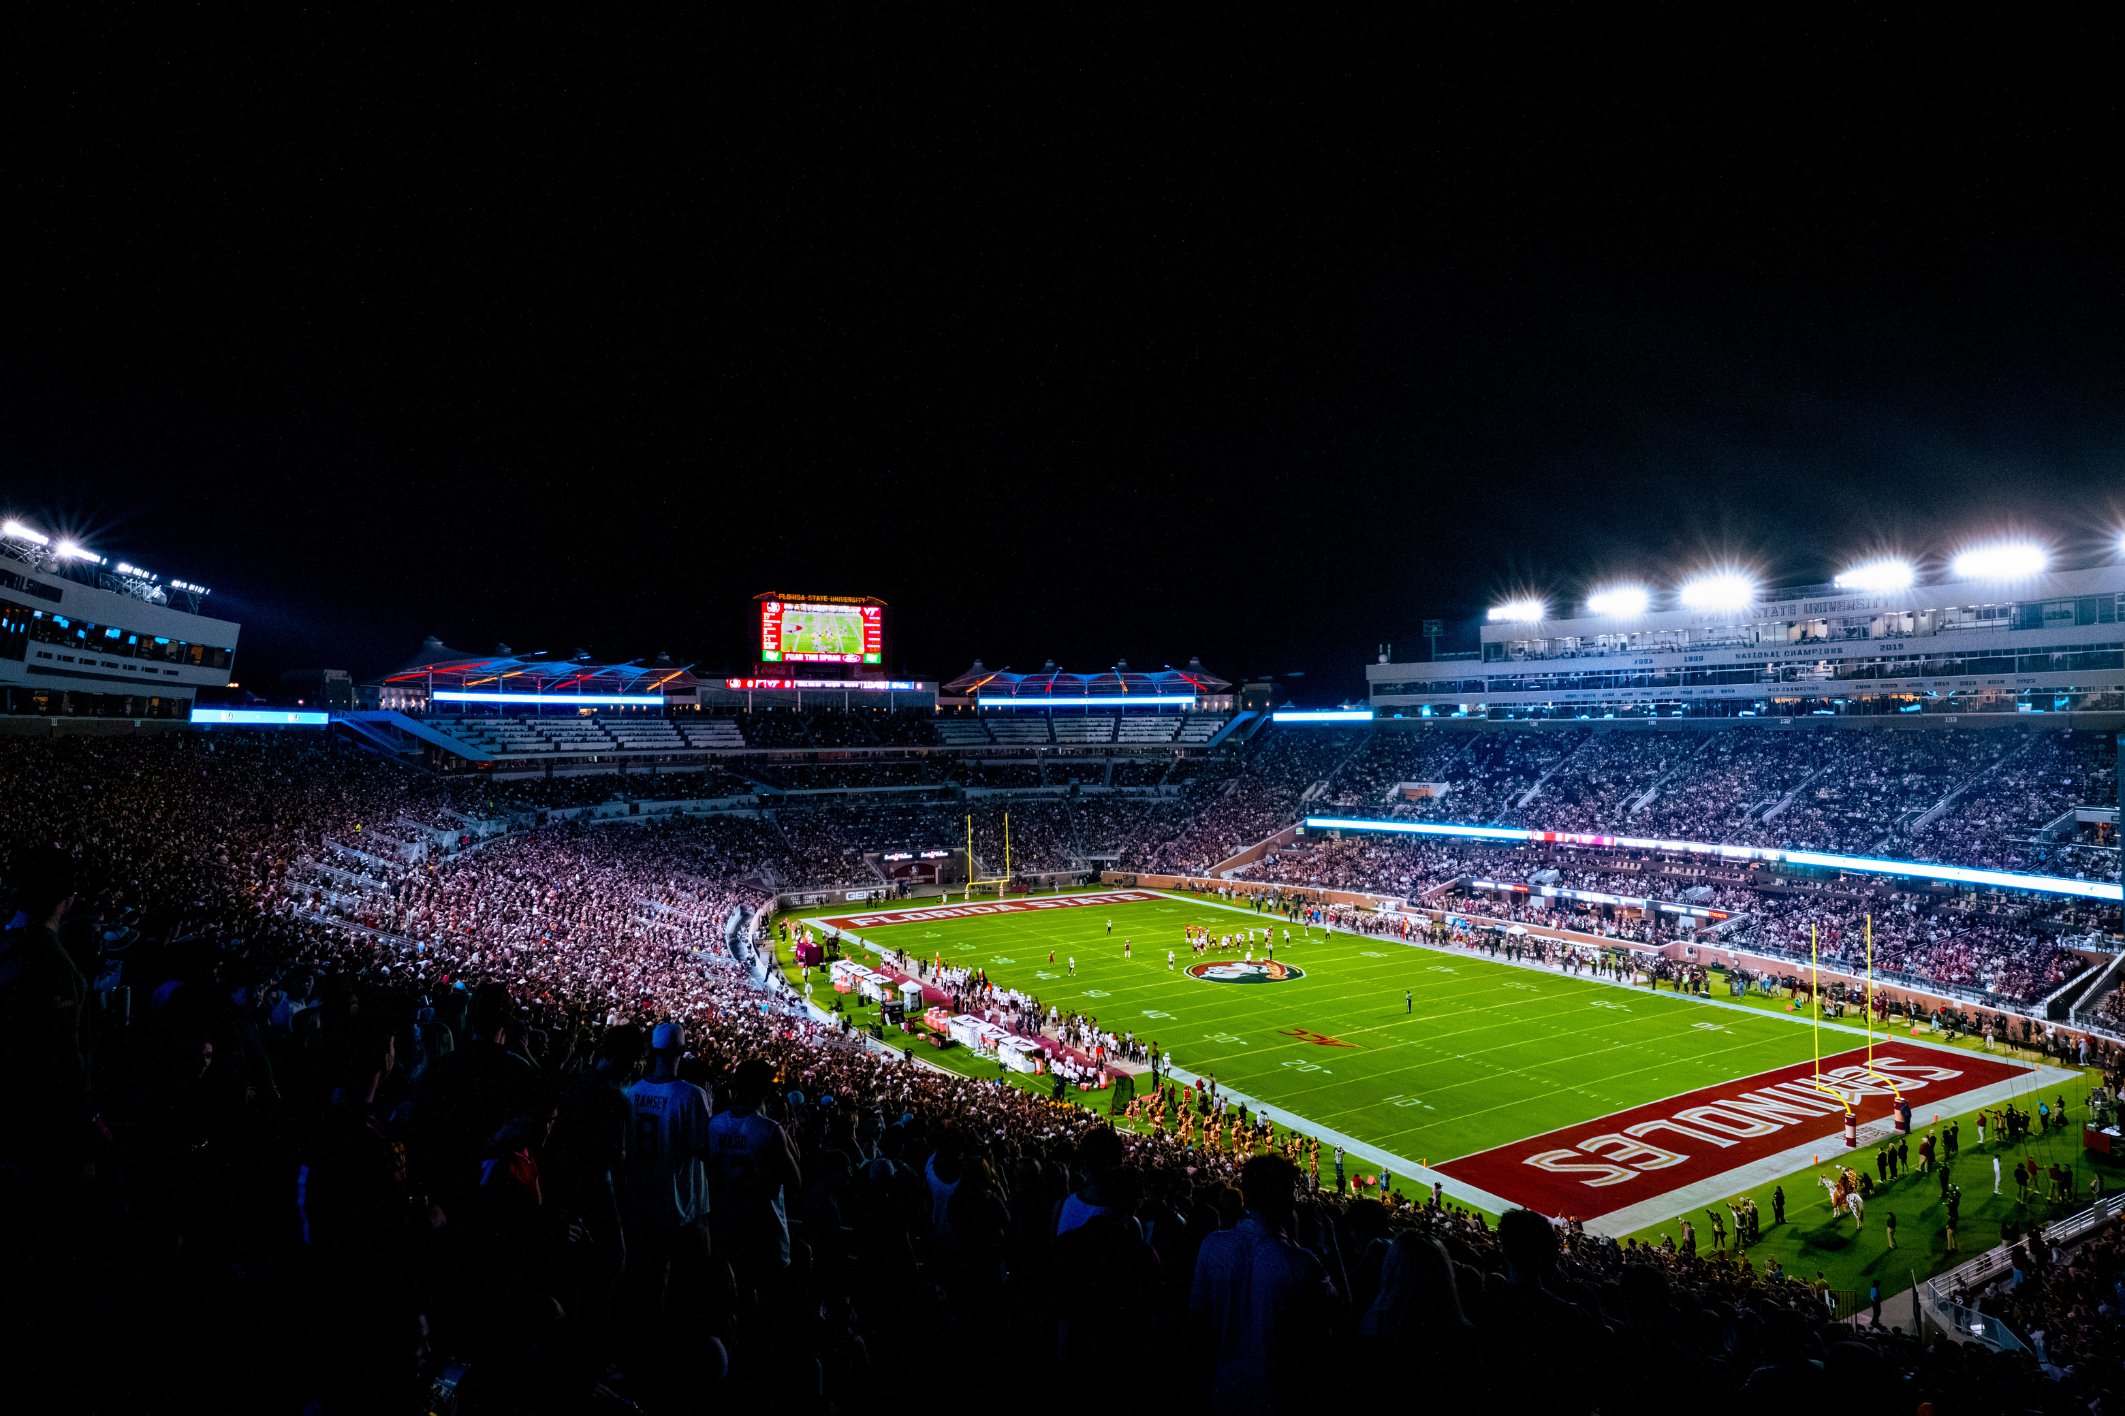
UNCONQUERED SPIRIT
UNPARALLED EXCELLENCE
#1
#11
97%
82%
1 in 4
BEST VALUE COLLEGE IN FLORIDA
PUBLIC
UNIVERSITY
RETENTION RATE
FOUR-YEAR GRADUATION RATE
UNDERGRADUATE STUDENTS CONDUCTING RESEARCH
Princeton Review 2026
FSU ranks in the Top 5 among national public universities.
FSU ranks in the Top 7 among national public universities.
Niche 2026

Slide 3

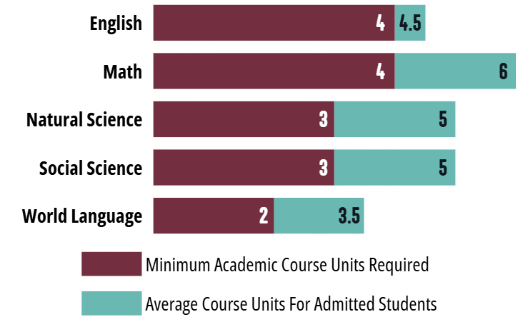
CLASS OF 2030
ADMITTED STUDENT ATTRIBUTES
Profile | Mid-Range*
Core GPA | 4.3- 4.6
ACT | 31 - 34
SAT | 1380 - 1480
CLT | 102 - 104
~96,500
67
50
*Represents the middle 50% of all admitted students for Fall 2026
TOTAL APPLICATIONS
Admits from all FL counties
Admits from all U.S. states
25%
OVERALL ADMIT RATE
33%
14%
80%
92%
All A/B grades in high school
Ranked top 10% in their class
FL ADMIT RATE
NON-FL ADMIT RATE
Admit rates are based on percentages of completed applications who were admitted for the summer/fall terms
TOP AREAS OF STUDY
1. Business 2. Engineering 3. Biology 4. Exploratory 5. Political Science

Slide 4

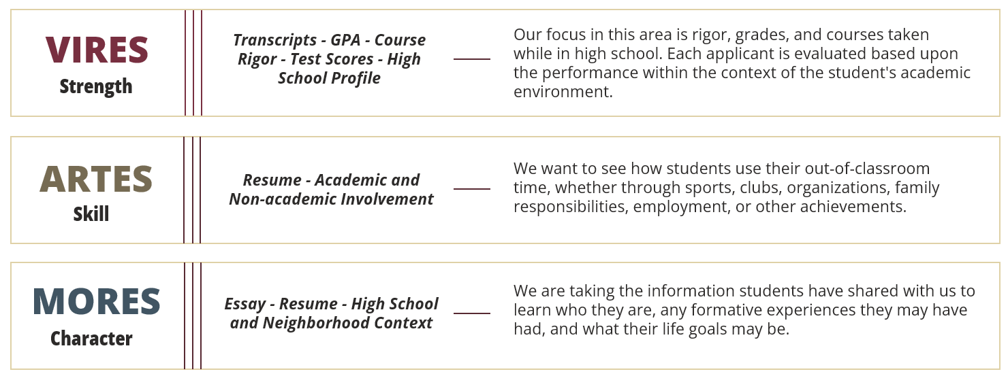
HOLISTIC ADMISSIONS REVIEW
Our application review process is a holistic and selective process, where no single criterion guarantees admission. Our holistic review is centered on three of our institutional core values represented as torches on our university seal - Vires, Artes, Mores.

Slide 5
APPLICATION PLANS
EARLY DECISION
EARLY ACTION
REGULAR DECISION
ROLLING
Eligible Applicants | Domestic Students (No Talent-Based Majors or CARE Summer Bridge) | FL Residents Only | All Students | All Students
Application Deadline | October 15 | October 15 | December 1 | March 1
Materials Deadline | October 22 | October 22 | December 8 | March 8
Decision Release Date | December 17 | December 17 | February 18 | Rolling basis in April
Decision Type | Binding | Non-binding | Non-binding | Non-binding

Slide 6
EARLY DECISION
Starting for Summer/Fall 2027, our binding Early Decision application plan for domestic first-year applicants will run concurrently with Early Action.
  Full scholarship consideration for Early Decision applicants
  Domestic applicants only (U.S. citizens and permanent residents)
  Not available for student-athletes, talent-based programs, or CARE Summer Bridge
  December decisions: Admit, Defer, or Deny
    No Seminole Pathways or FSU Next offers in Early Decision or Early Action
APPLICATION DEADLINE:
OCTOBER 15
MATERIALS DEADLINE (INCLUDING EARLY DECISION AGREEMENT):
OCTOBER 22
DECISION RELEASE:
DECEMBER 17

Slide 7
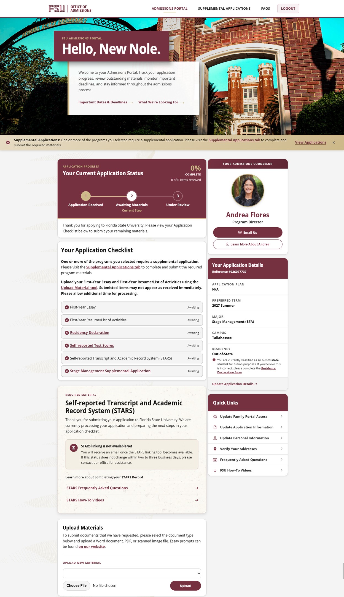
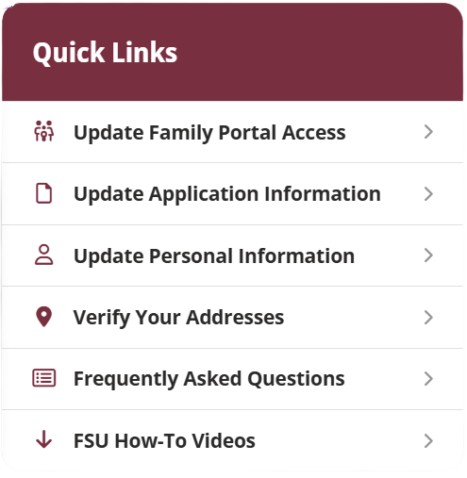
ADMISSIONS PORTAL
FSU’s Admissions Portal is the primary source for students to check for updates and monitor their application progress.

Slide 8
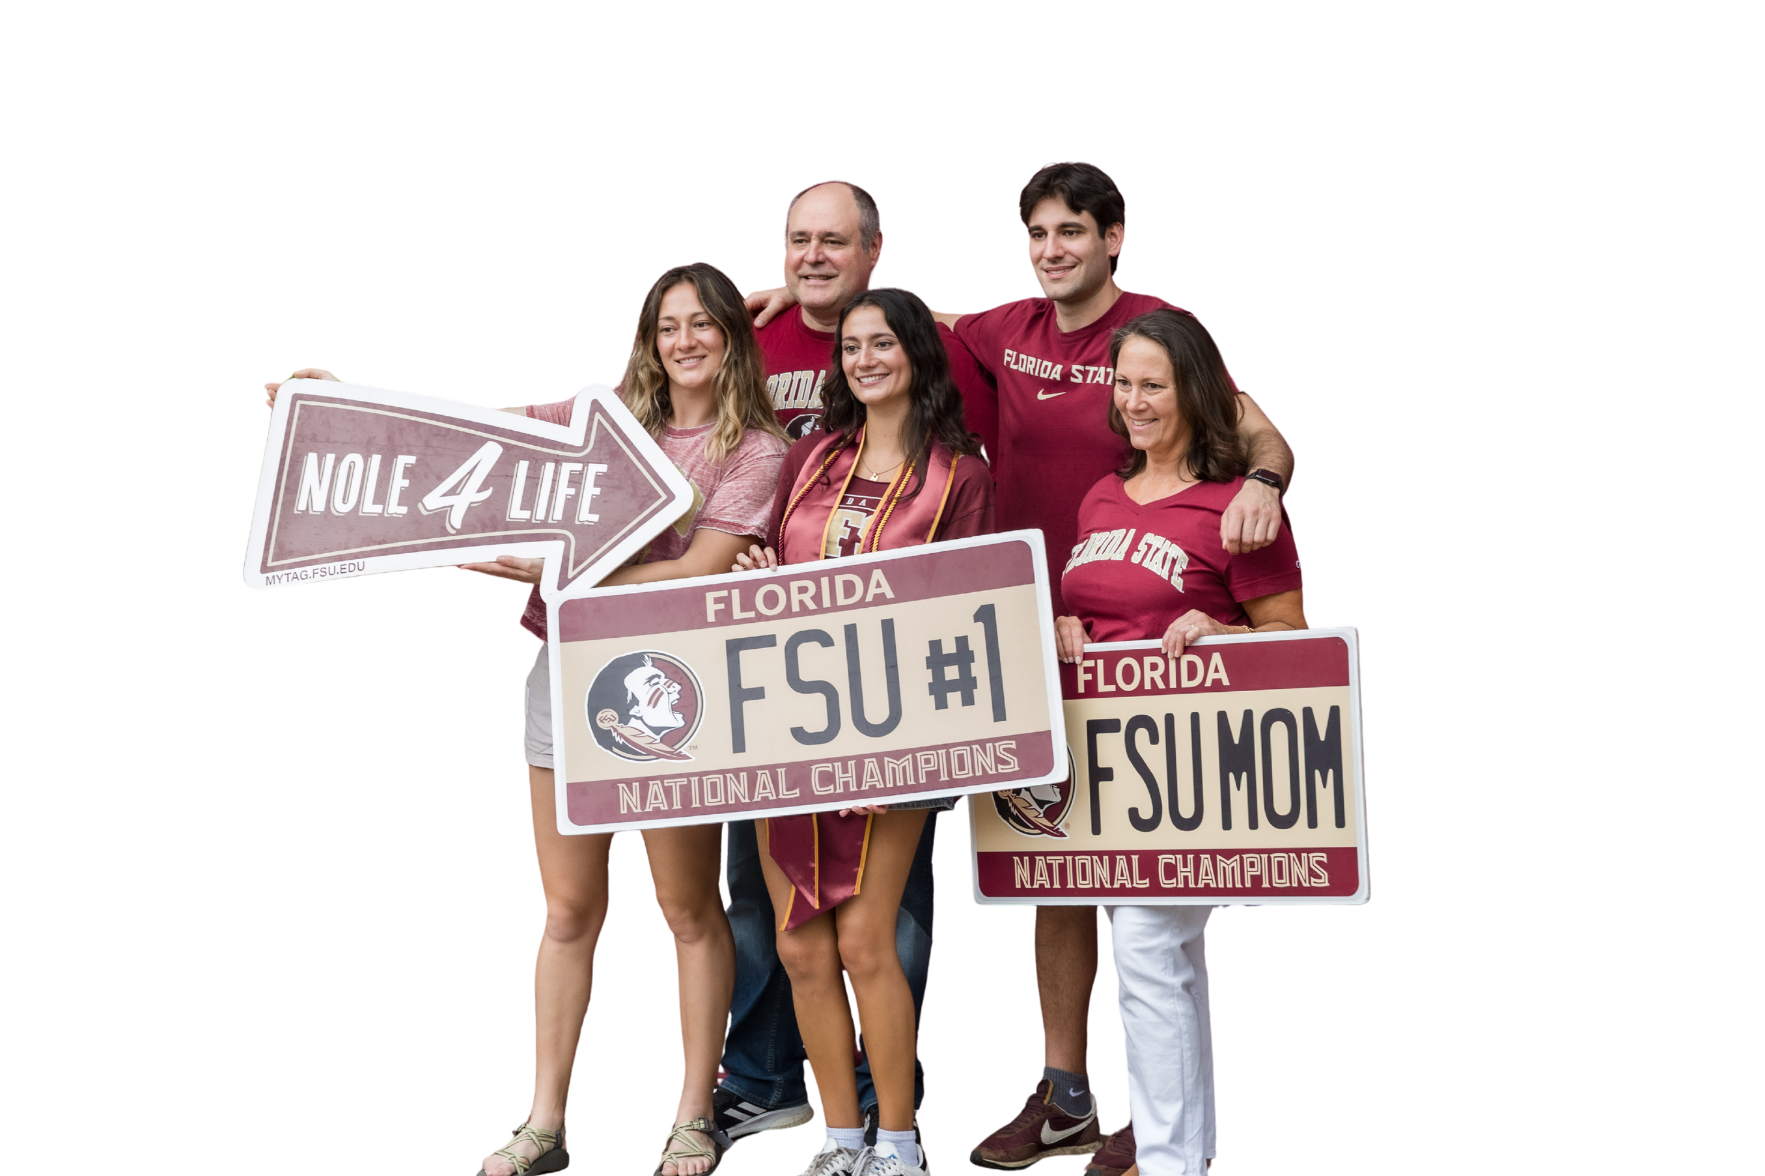
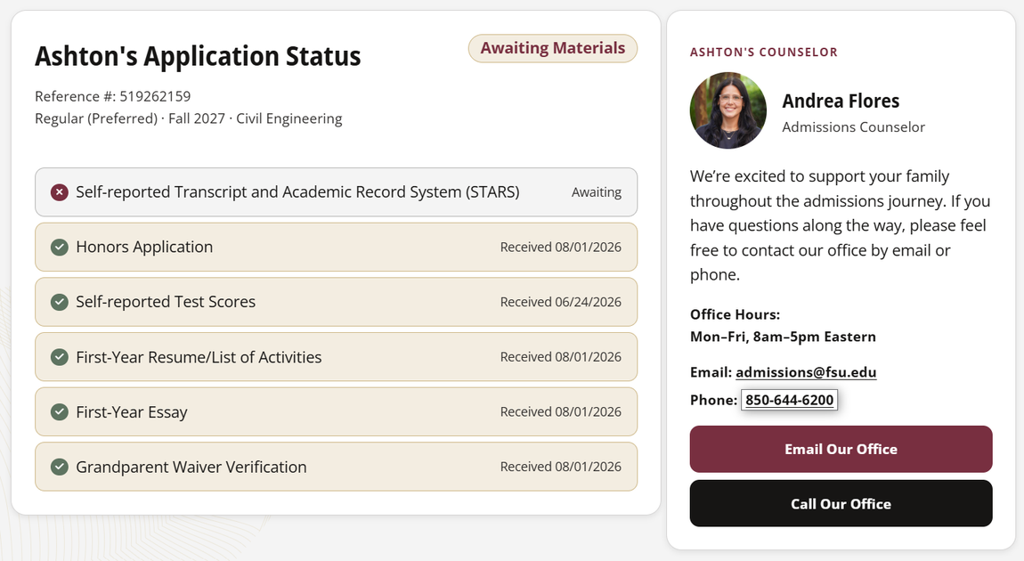
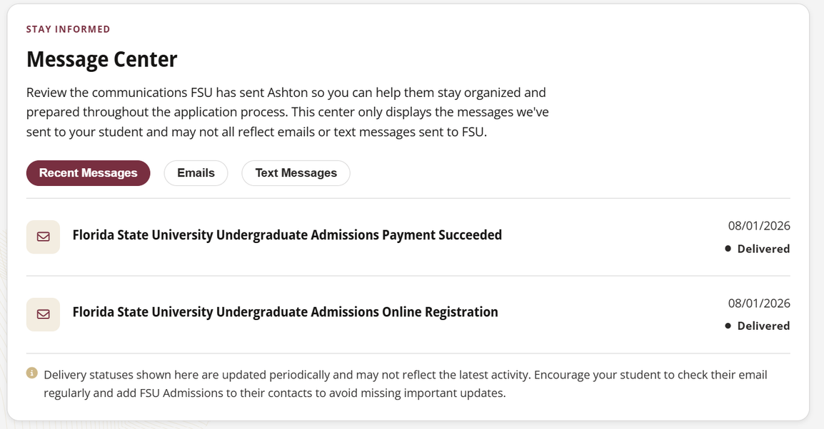
FAMILY PORTAL

Slide 9
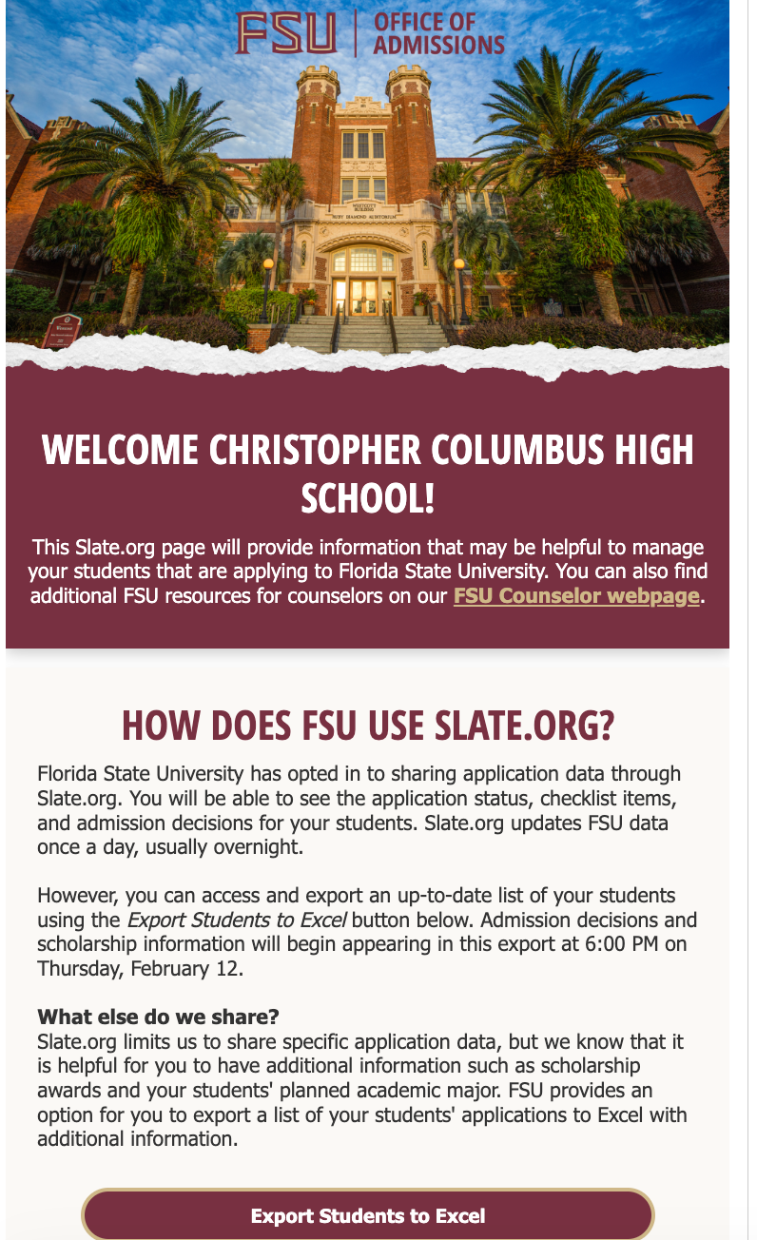

SLATE.ORG AT FSU
We encourage the use of Slate.org, a free tool that allows high school and independent counselors to view their students' application status.
In Slate.org, counselors can upload:
  Official transcripts
  High school profiles
  Other documents as requested
Counselors can also download an FSU-specific report of their students that includes:
  Major
  University Decision
  Scholarships
  Honors Decision

Slide 10
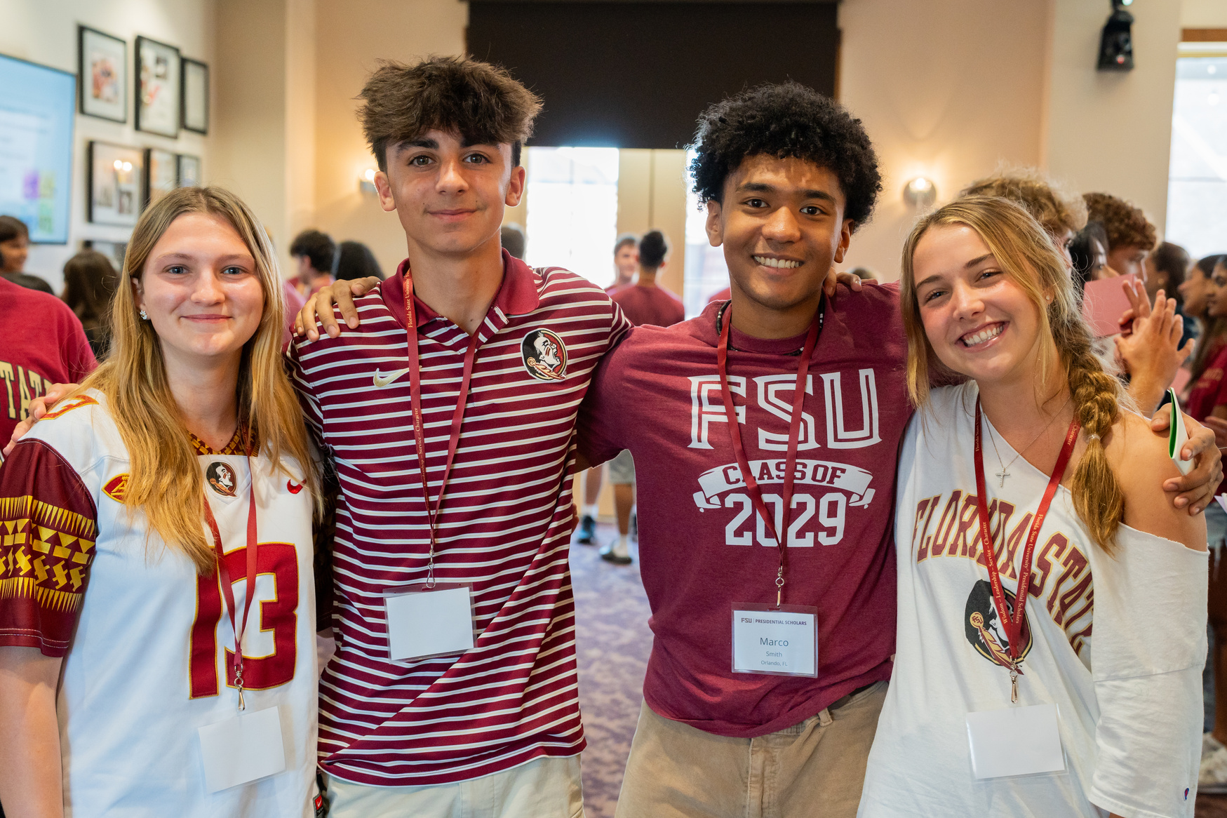
UNIVERSITY HONORS PROGRAM
DEADLINE
All Honors applications are due December 1
REMINDERS
  All students need to apply to Honors to be considered for Presidential Scholars, Honors Medical Scholars, and/or Stamps Scholars
  There will continue to be an Honors waitlist
#1
ADMITTED HONORS PROFILE
Core GPA: 4.4 - 4.7 | ACT: 32 - 35 | SAT: 1420 - 1510
HONORS PROGRAM IN FLORIDA
College Transitions, 2026
Middle 50% of University Honors Program admits for Summer/Fall 2026

Slide 11


STAMPS SCHOLARS PROGRAMS
FSU is proud to announce its partnership with the prestigious Stamps Scholars Program for two new scholarship programs.
Stamps Veteran Scholars Program
As the first Stamps program for veterans in the country, this scholarship seeks to recruit the best and brightest student veterans and foster their development as scholars and leaders. Every year, five veteran scholars will receive two-year undergraduate merit scholarships worth full cost of attendance and $10,000 in enrichment funding.
Stamps Scholars Program
Five FSU Stamps Scholars are selected annually from admitted students in FSU's premier Presidential Scholars Program and represent a community of scholars with extraordinary potential to be transformational leaders. Recipients will receive a four-year scholarship worth full cost of attendance and $20,000 in enrichment funding.

Slide 12
CARE PROGRAMS
The Center for Academic Retention and Enhancement (CARE) supports students who are first-generation, limited income, or facing unique challenges that could be a barrier to higher education.
Summer Bridge Program
QUEST Scholars
7-week program for first generation, Pell-eligible students designed to ease students’ adjustment to college
Invitation-only program with $6,000 scholarship
Unconquered Scholars
Illuminate Scholars
Support program for students who have experienced homelessness, foster care, relative care or ward of the state status
Invitation-only program for Pell-eligible students with $6,000 scholarship

Slide 13
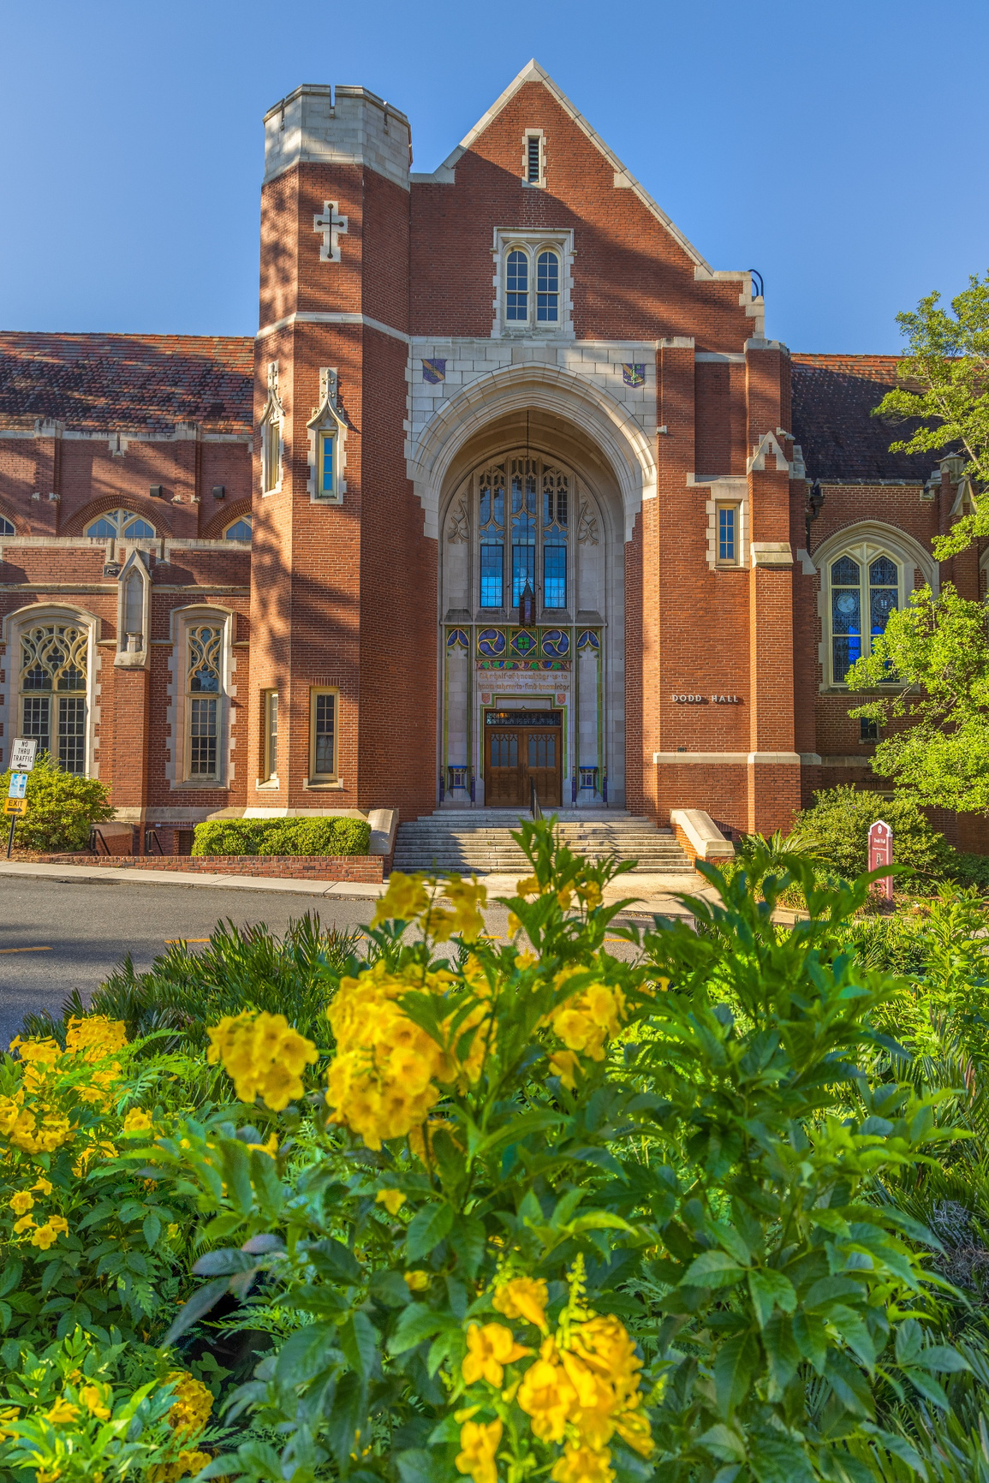
NEW MAJORS
  Civics and Liberty Studies - BS
  Community Music - BA
  Music Business - BA
  Design and Visual Communication - BS
  Stage Management - BFA
  Emergency Management - BS
  US Intelligence Studies - BS
  Event Management - BS

Slide 14
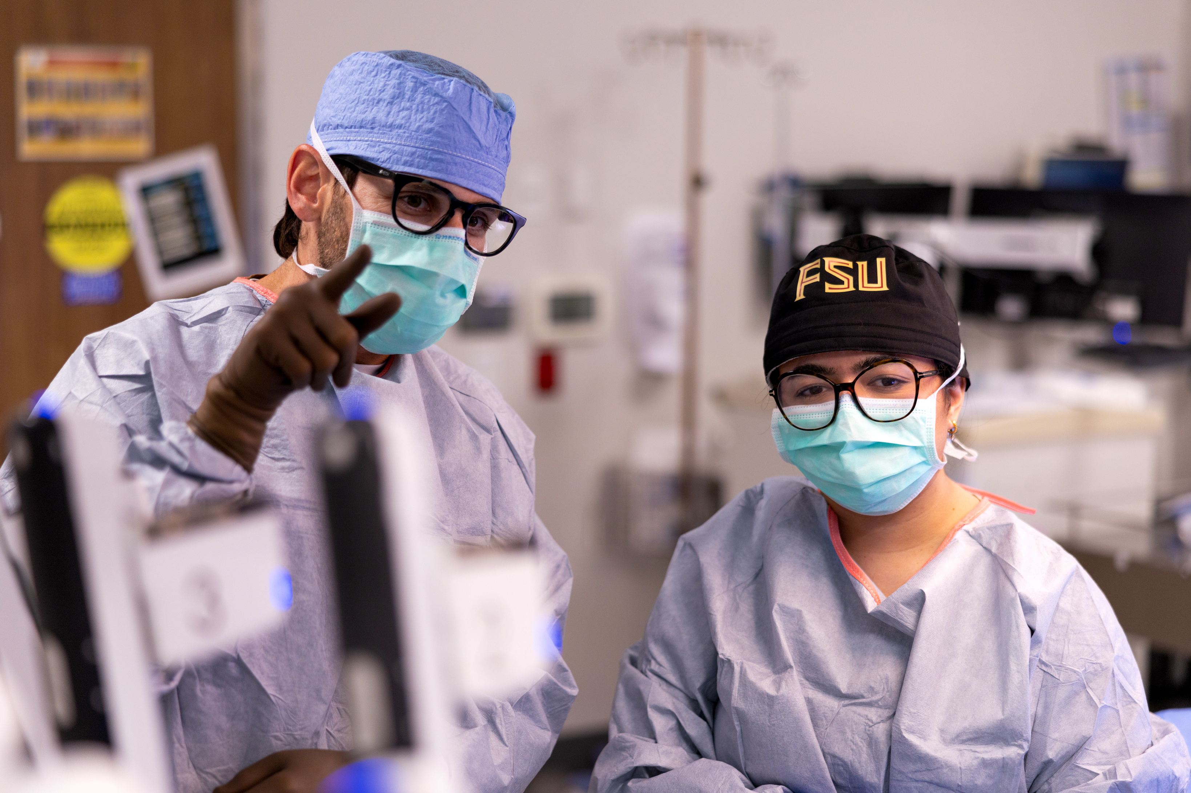
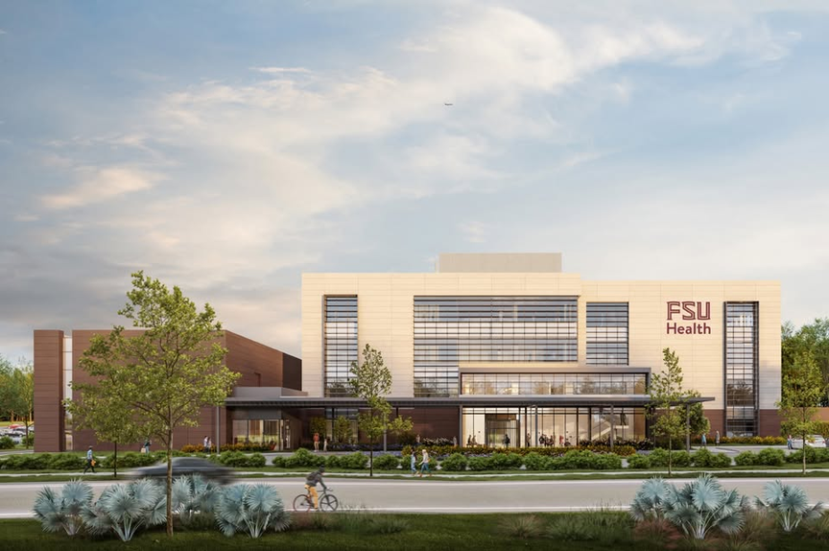
Key growth of FSU’s integrated academic health care system includes the acquisition of Tallahassee Memorial Hospital, the construction of the FSU Health Research and Collaboration Center in Tallahassee, and construction of an FSU Health hospital in Panama City.

Slide 15
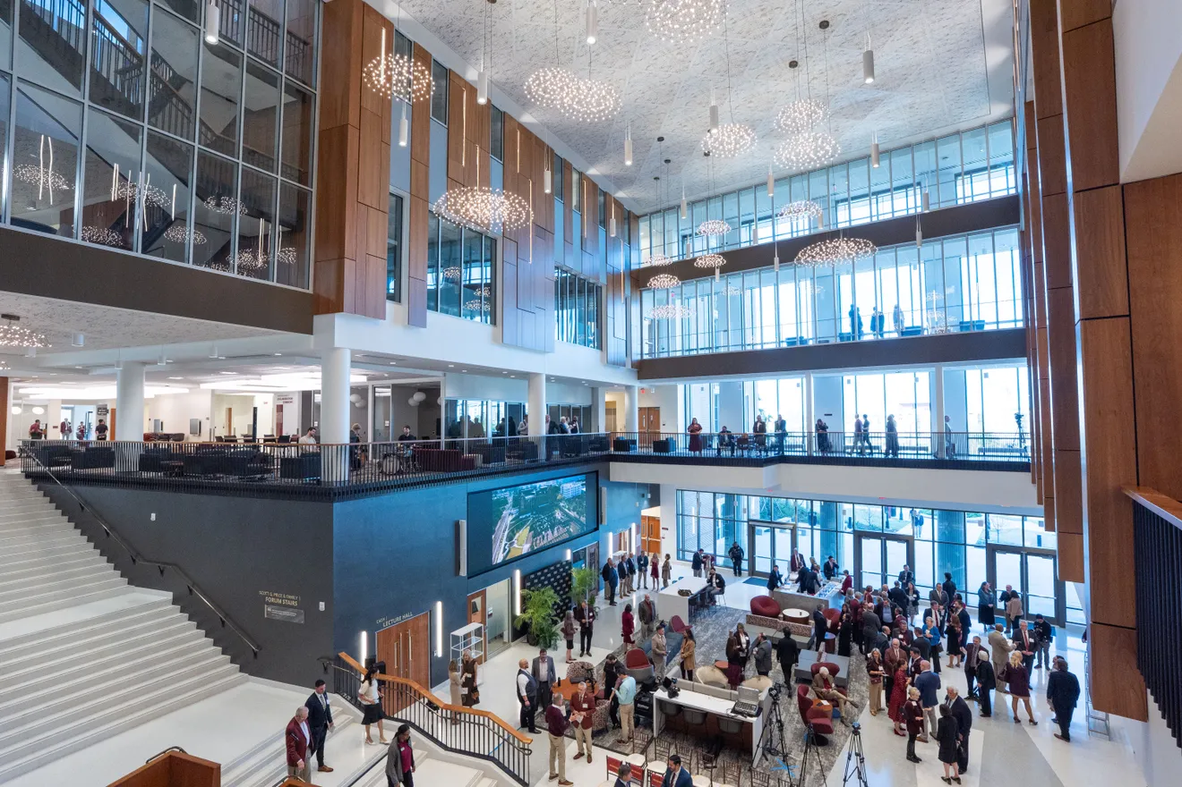
WERTHEIM COLLEGE OF BUSINESS
FSU celebrated the naming of the Wertheim College of Business and the grand opening of the Herbert Wertheim Center for Business Excellence. The 218,000 square-foot facility is the largest academic facility on campus.
#10
BEST COLLEGES FOR BUSINESS IN AMERICA
Niche, 2026

Slide 16
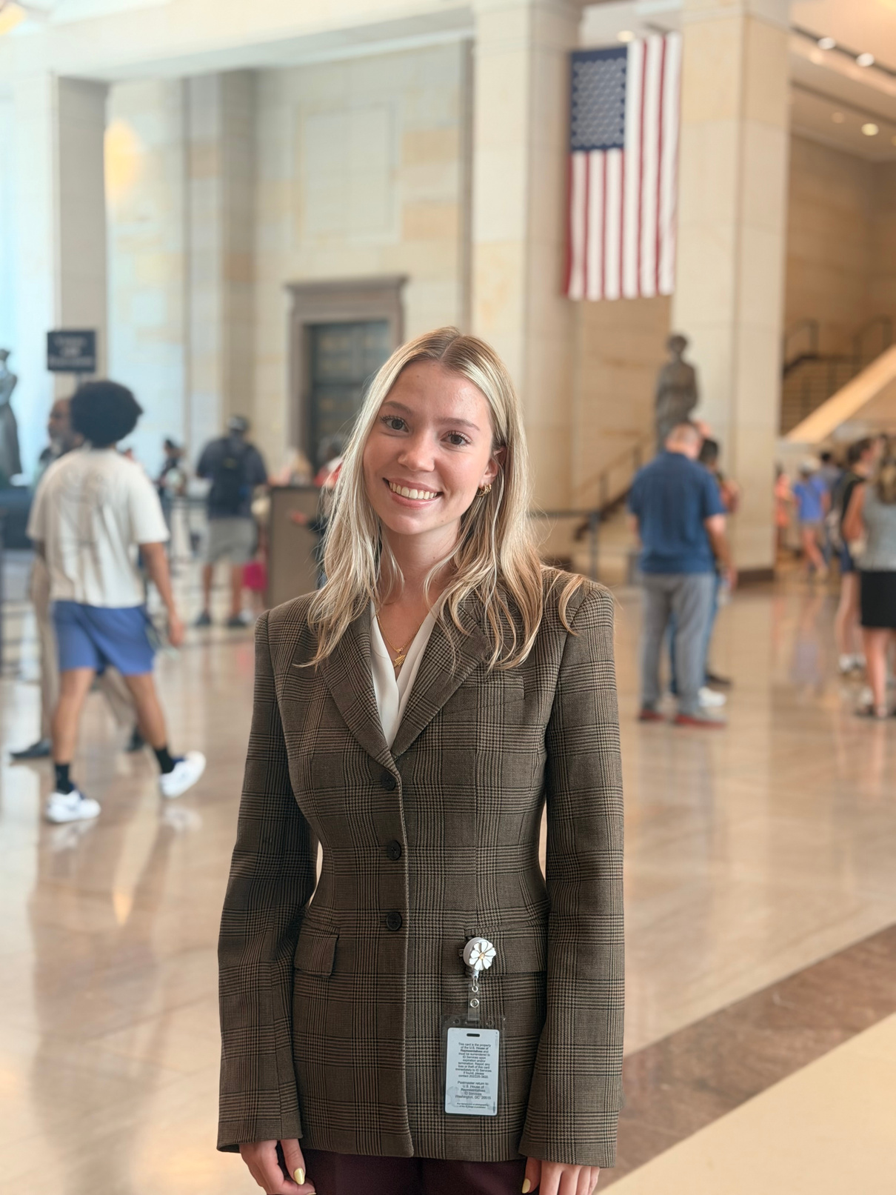
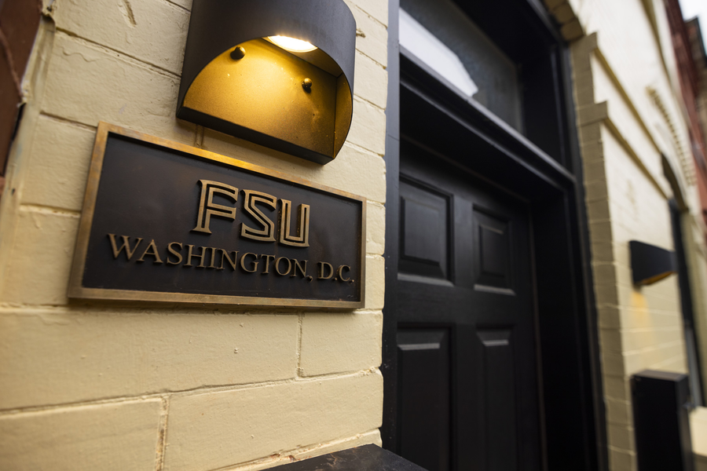
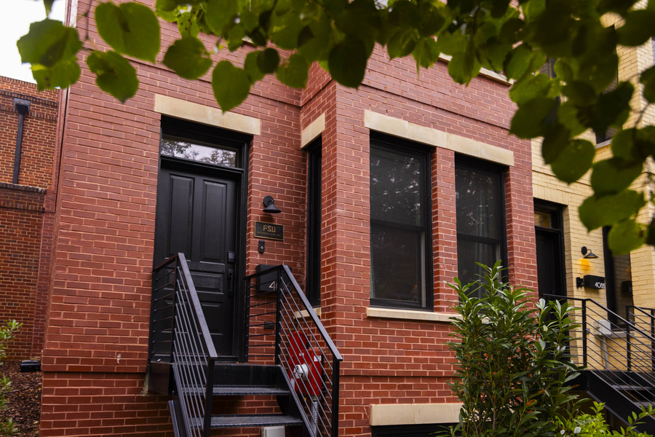
WASHINGTON DC STUDY AWAY
Florida State University purchased two townhomes in a residential neighborhood to provide FSU students with a supportive cohort-based living environment as they pursue internships in Washington D.C.

Slide 17
PATHS TO FSU
Our goal is to provide a pathway to FSU for every student who seeks one. While we cannot guarantee admission to a student's preferred first-year entry term, we remain committed to helping qualified students achieve their ultimate goal of graduating from Florida State University.
Seminole Pathways
Aspire Transfer Program @ TSC
International Program First Semester Abroad
International Program First Year Abroad
FSU NEXT
FSU Panama City, FL Campus
Aspire Traditional AA Transfer
Aspire Elite
Aspire Honors
Aspire Online

Slide 18
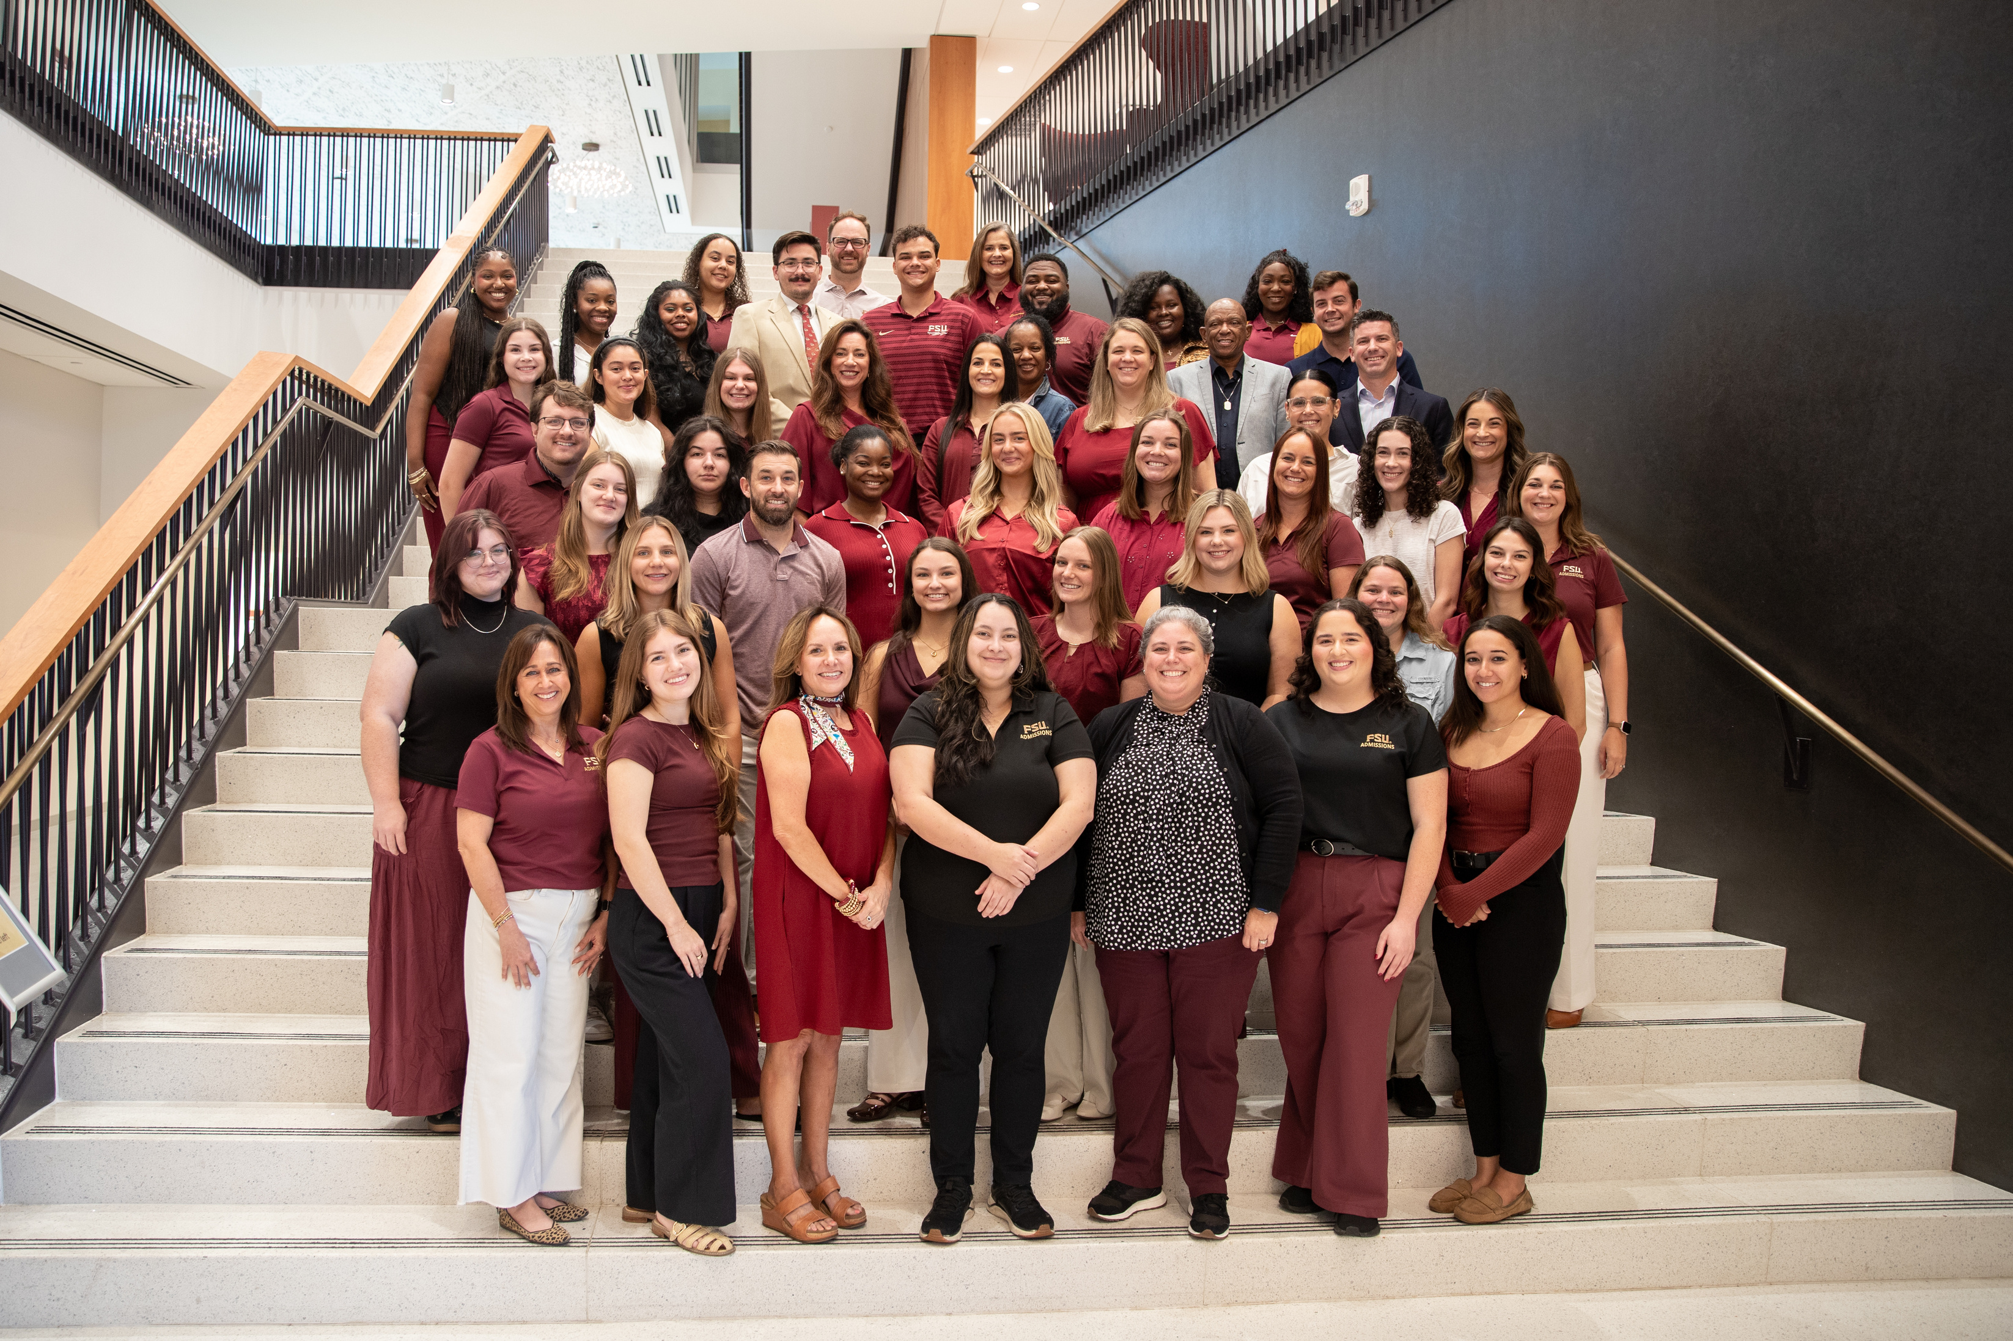

admissions.fsu.edu | (850) 644-6200 |admissions@fsu.edu
Notes:
SLIDE 18: CONTACT
Ask if anyone has questions. Allow guests to use the restroom in the side hallway before the tour leaves. This is when you should push the button to call the ambassadors.

