Slide 1
Dean Batchelder
Associate Director of Admissions
SUS Tour 2026

Slide 2
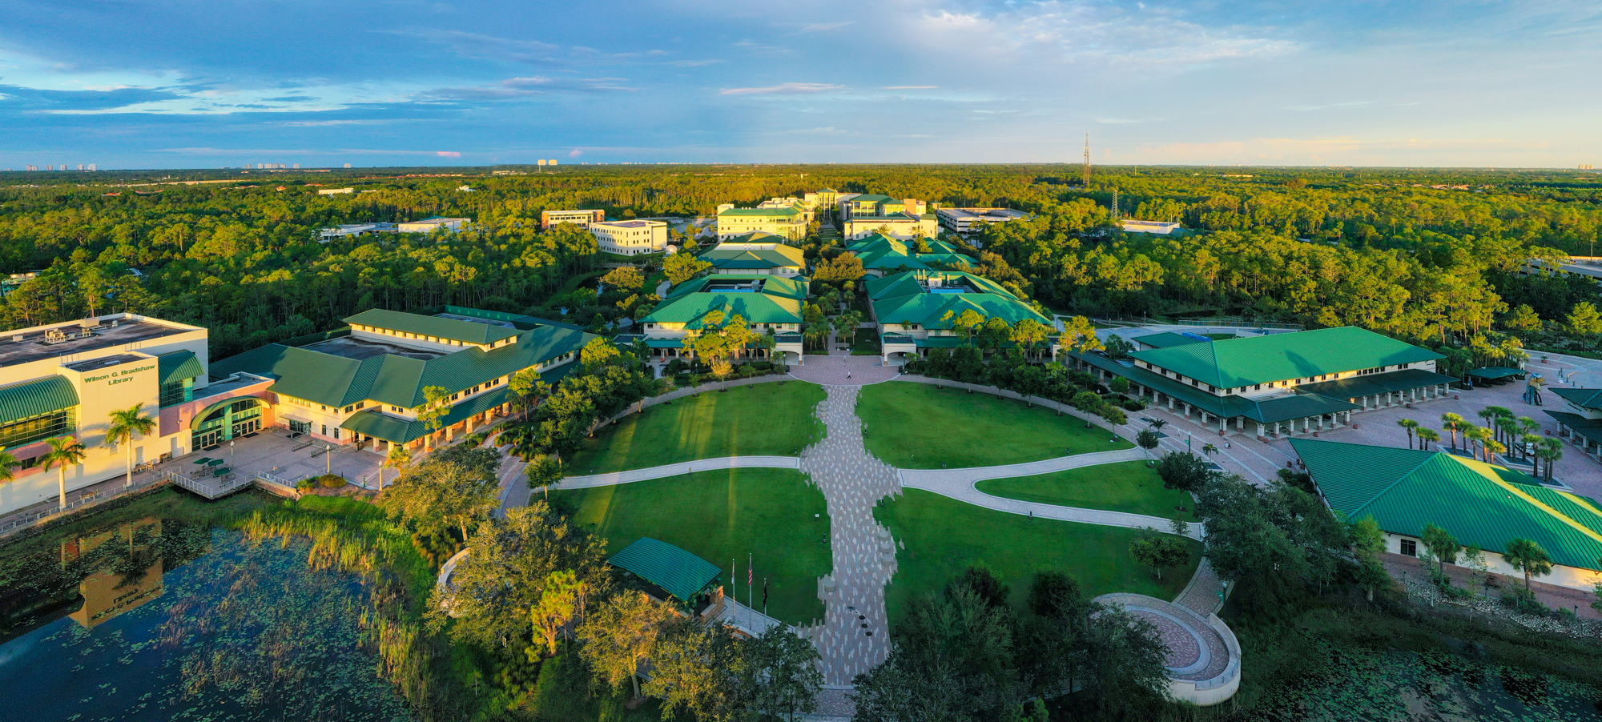
WELCOME TO THE NEST

Slide 3
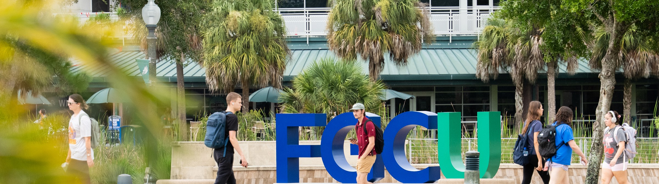
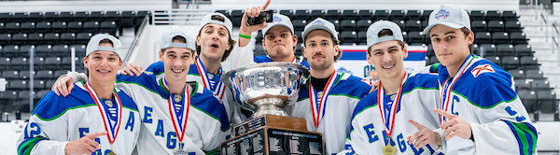
FGCU Fast Facts
THE NUMBERS BEHIND THE FGCU EXPERIENCE.
16,000+
66
57
19:1
STUDENTS
UNDERGRADUATE DEGREES
MINORS
STUDENT-TO-FACULTY RATIO
64%
71%
160+
15
GRADUATE WITH ZERO DEBT
RECEIVE SCHOLARSHIPS
& AID
STUDENT ORGANIZATIONS
NCAA DIVISION I TEAMS
BUILDING FOR THE FUTURE
FGCU continues to strengthen academic programs, student success initiatives and campus infrastructure to meet growing demand.

Slide 4
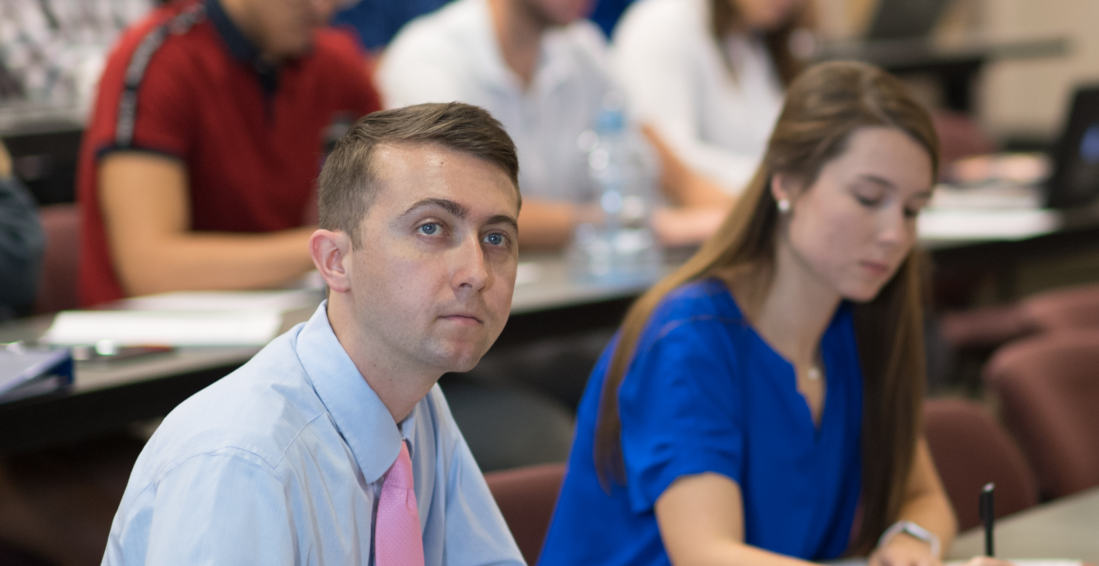
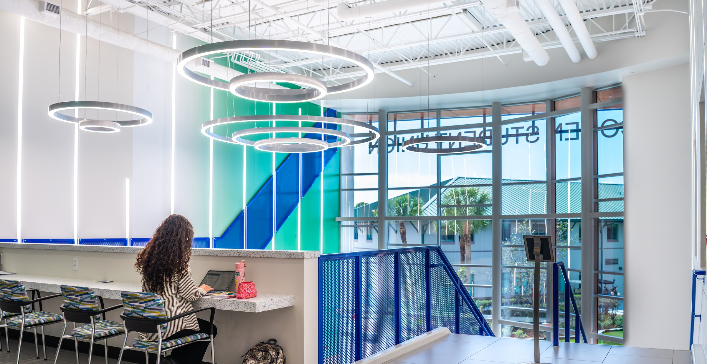
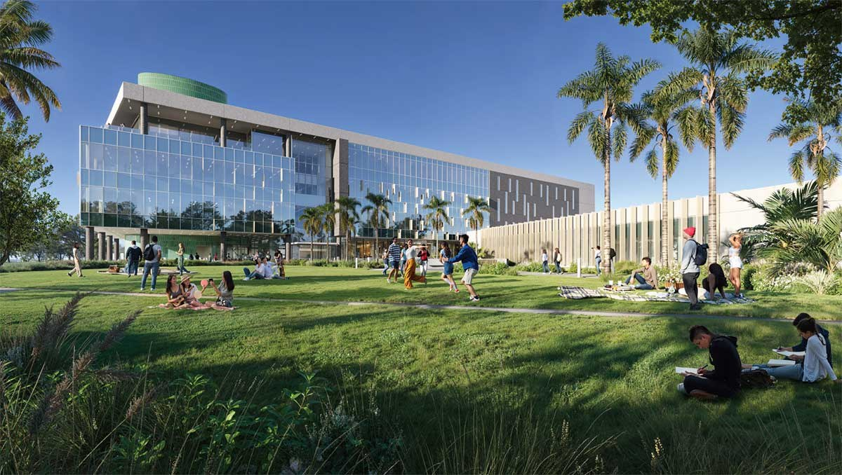
What's New at FGCU
NEW SPACES. NEW PROGRAMS. NEW OPPORTUNITIES.
MARKETING ANALYTICS & AI
COHEN STUDENT UNION
MARIEB HALL SOUTH
A new Marketing concentration built for data-driven business careers.
Renovations are complete, refreshing a central hub for campus life and connection.
Now underway, the newest academic building will expand preparation for future healthcare professionals.

Slide 5
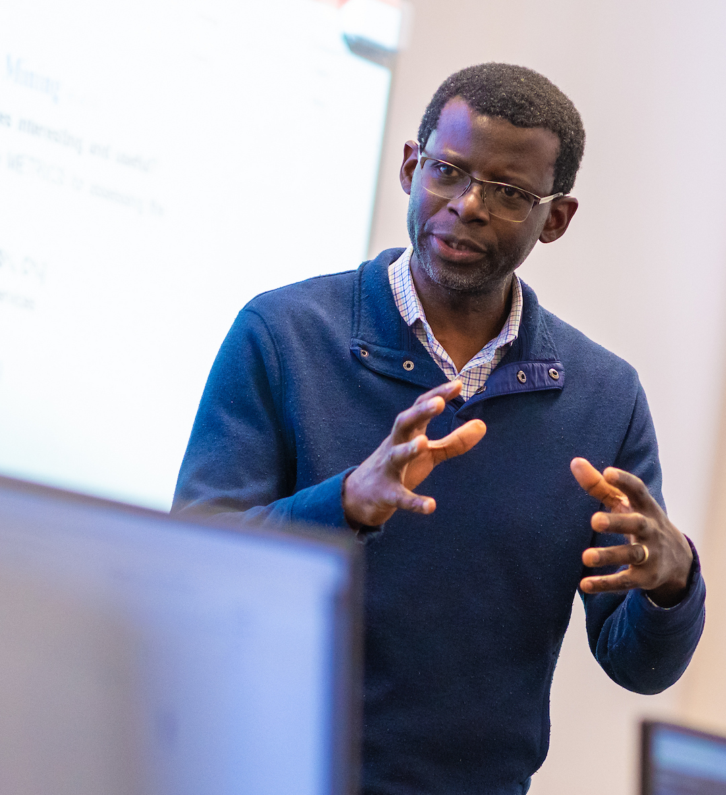
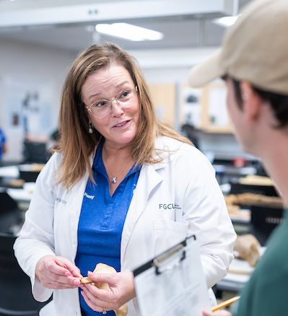
What Sets FGCU Apart?
LEARNING CONNECTED TO EXPERIENCE, PLACE, PEOPLE AND PURPOSE.
BUILD YOUR EXPERIENCE
Your students will put what they learn into practice through internships, research, clinical experiences, service-learning and hands-on projects that help them build confidence before graduation.
FIND YOUR PLACE
Southwest Florida becomes part of your students’ education, connecting them with real opportunities in healthcare, business, education, water and environmental research, and the surrounding community.
KNOW YOUR PEOPLE
With a 19:1 student-to-faculty ratio, your students can build meaningful connections with faculty and staff who know them, support them and are invested in their success.
SERVE WITH PURPOSE
Your students will have opportunities to use what they are learning to make a difference, continuing an FGCU tradition that has contributed more than 5.6 million service-learning hours since 1997.

Slide 6
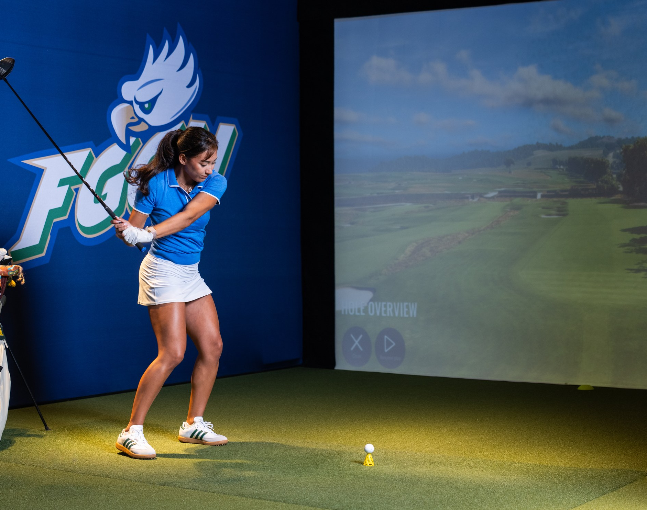
Academic Highlights
TURN YOUR STUDENTS' INTERESTS INTO EXPERIENCE.
66
57
UNDERGRADUATE DEGREES
MINORS
ONLY PGA-ACCREDITED GOLF MANAGEMENT PROGRAM IN FLORIDA
1 of 16 in the country
NO. 1-RANKED BSN PROGRAM IN FLORIDA'S SUS
for NCLEX pass rates
Popular programs: Entrepreneurship • Business • Nursing • Engineering

Slide 7
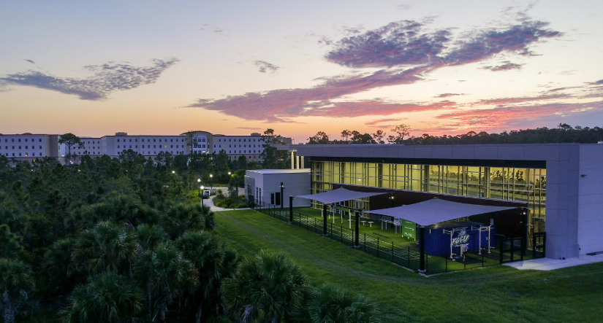
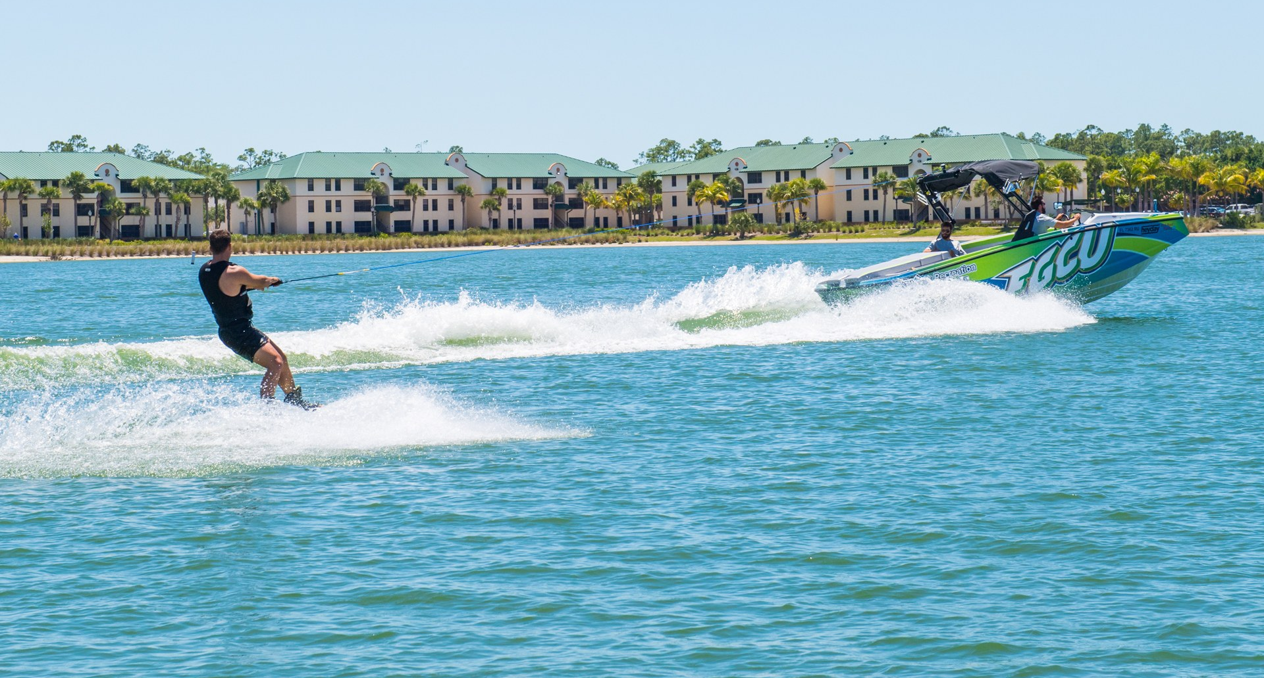
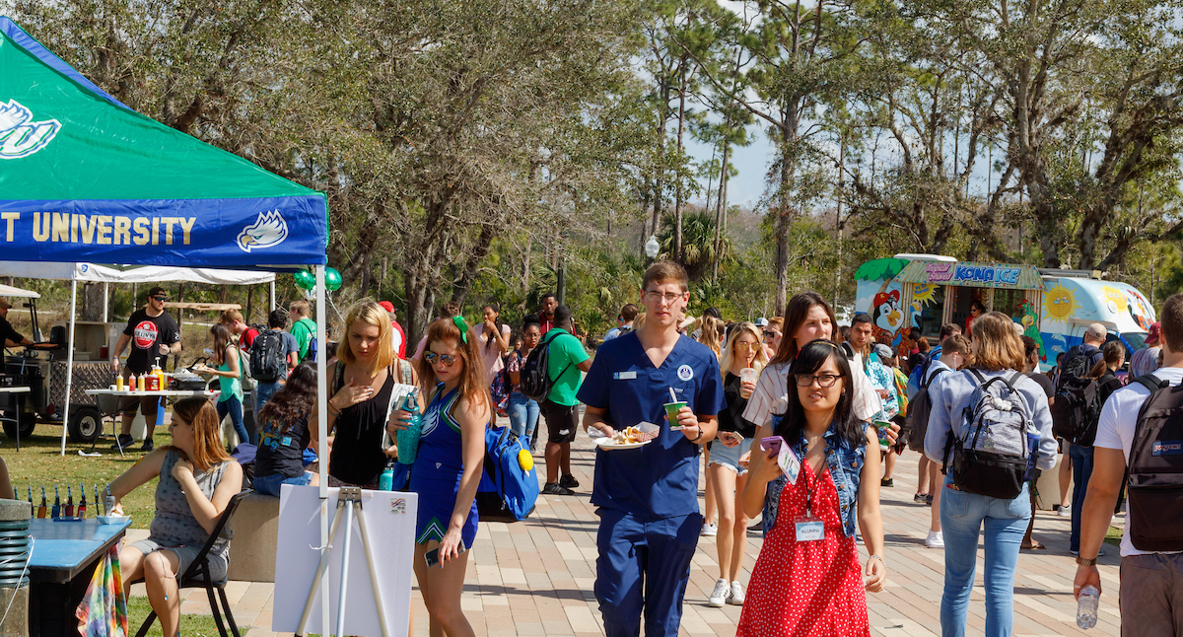
Campus Life
EXPLORE MORE. CONNECT MORE. EXPERIENCE MORE.
160+
26
30+
2026
CLUBS & STUDENT ORGANIZATIONS
FRATERNITIES & SORORITIES
STUDENT-LED COMPETATIVE SPORT CLUBS
NATIONAL CHAMPIONS: ICE HOCKEY, BASEBALL & ESPORTS
2-story Recreation & Wellness Center • Award-winning Rec Deck • Waterfront beach • 800 acres of preserved nature trails
Kayak, sail, paddleboard or ride the wake boat. Plus, campus favorites like Starbucks, Chick-fil-A, Einstein's and Dunkin'

Slide 8


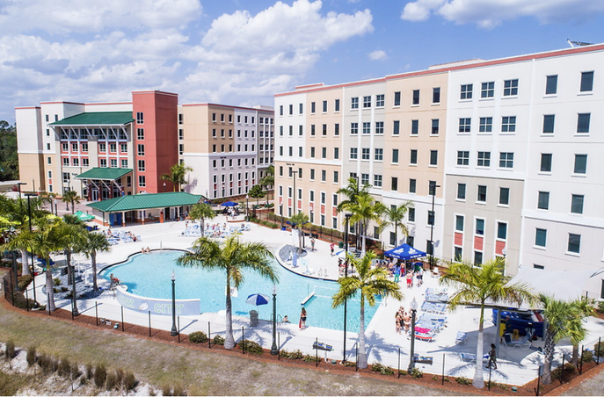
MAKE THE NEST YOUR HOME
SOUTH VILLAGE • FIRST-YEAR HOUSING
2-BEDROOM SINGLE
3-BEDROOM SINGLE
95%
ON-SITE ACCESS
OF ON-CAMPUS RESIDENTS LIVE IN THEIR OWN BEDROOM
SoVi Dining • classrooms • tutoring • study spaces
Living on campus keeps your students close to the people, places and experiences that make FGCU feel like home.
RESORT-STYLE POOL • FITNESS ROOMS • COMMUNITY KITCHENS • GAME ROOMS • MOVIE THEATER
Housing application opens December 1. Please encourage your students to apply early!
Our on-campus housing is very popular and in high demand!

Slide 9
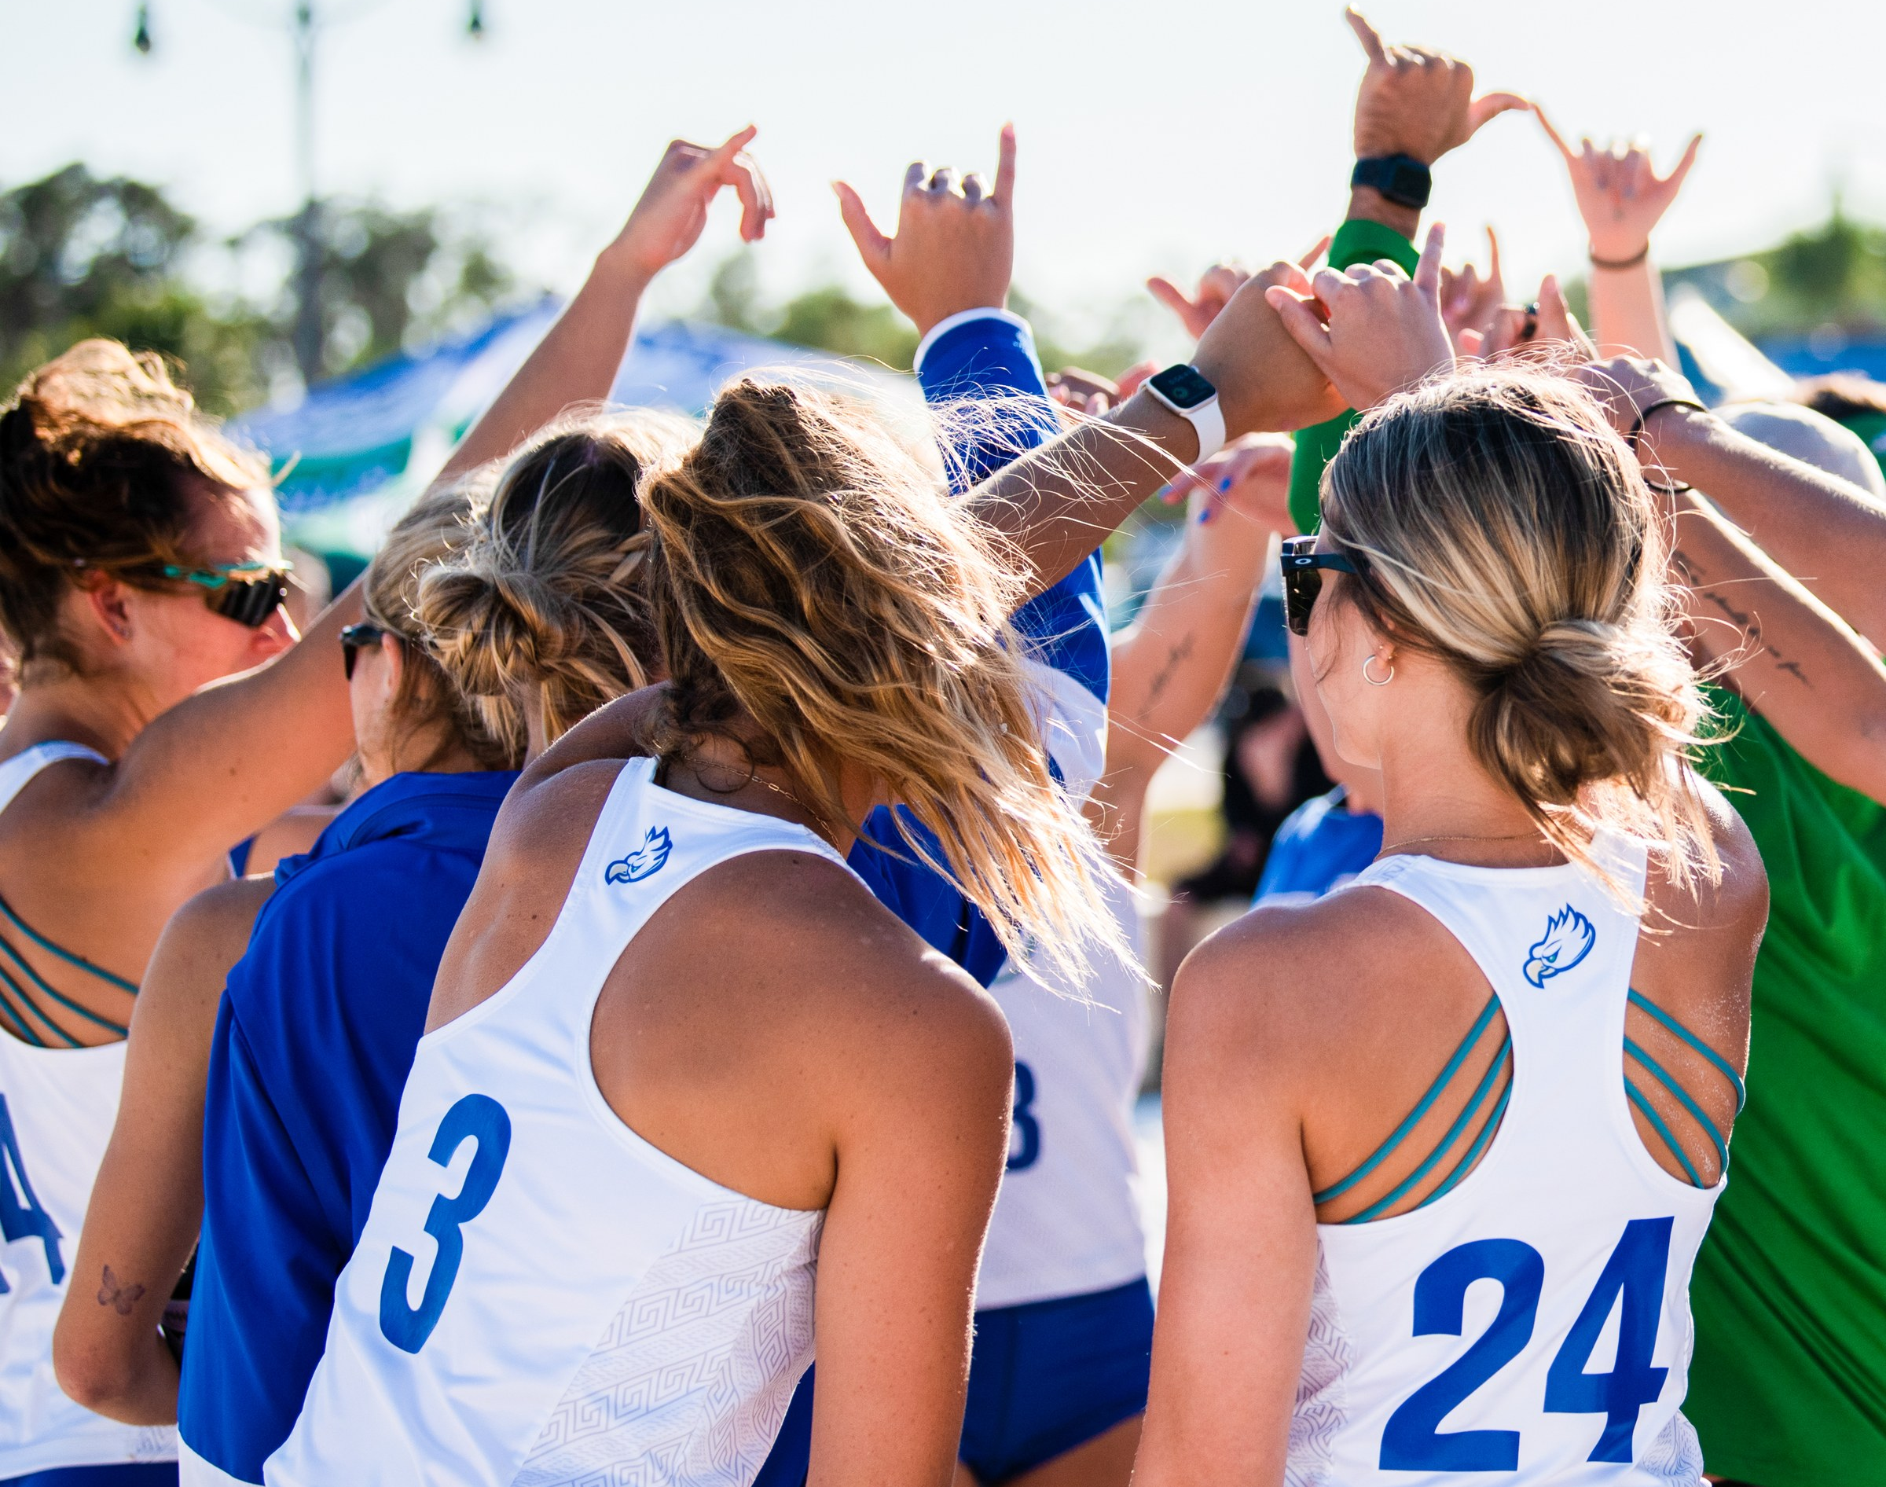
FGCU Athletics
GAME DAY BRINGS A DIFFERENT KIND OF ENERGY TO THE NEST.
59
14
100+
NCAA TOURNAMENT APPEARANCES
NCAA TOURNAMENT VICTORIES
ASUN CHAMPIONSHIPS
CHAMPIONS ON AND OFF THE FIELD
FGCU earned the Sherman Day Trophy for the second consecutive year as the ASUN's top women's athletic program
Student-athletes achieved a 3.55 cumulative GPA and a 95% graduation success rate
Men's Golf won its first ASUN Championship in 2026 and advanced to the NCAA Division I Men's Golf Championship Regionals

Slide 10

YOUR STUDENTS CAN START NOW
HOW TO APPLY
APPLY ONLINE
1
Complete the FGCU Admission Application at apply.fgcu.edu or use the Common App.
SEND THEIR TRANSCRIPT
2
Submit their official high school transcript.
SUBMIT TEST SCORES
3
Send official SAT, ACT or CLT scores.
The application includes a brief personal essay. Florida Dual Enrollment students earning an AA may apply without test scores.

Slide 11
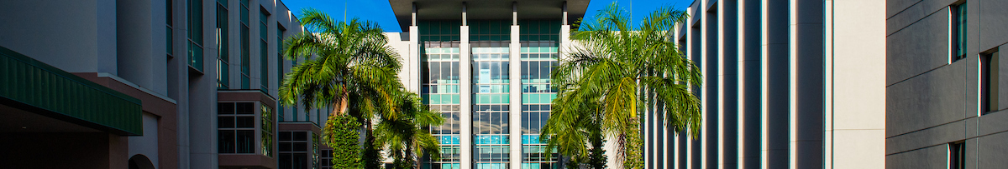
FALL 2026 FRESHMAN PROFILE
A rising academic profile reflects growing student interest in FGCU.
4.16
1140
23
76
WEIGHTED GPA
SAT
ACT
CLT
*Averages based on the Fall 2026 freshman class.
FALL 2026 ENTERING CLASS AVERAGES

Slide 12
FRESHMAN MERIT SCHOLARSHIPS
INVEST IN YOUR FUTURE
Merit awards are competitive and not guaranteed. Encourage students to apply by the Early Action date.
FLORIDA RESIDENTS
NON-FLORIDA RESIDENTS
PRESIDENT’S GOLD
$5,000/year
BLUE & GREEN SCHOLARS
$15,000/year
3.75 weighted GPA AND 1300 SAT, or 28 ACT, or 92 CLT
3.75 weighted GPA AND 1300 SAT, or 28 ACT, or 92 CLT
PRESIDENT’S SILVER
$3,000/year
3.5 weighted GPA AND 1200 SAT, or 25 ACT, or 83 CLT
BLUE & GREEN DIRECTORS
$10,000/year
PRESIDENT’S BRONZE*
$2,000/year
3.5 weighted GPA AND 1200 SAT, or 25 ACT, or 83 CLT
3.5 weighted GPA AND 1100 SAT, or 22 ACT, or 72 CLT
*President's Bronze: Awarded by test score priority and availability of funds
SCHOLARSHIP DETAILS: FGCU.EDU/SCHOLARSHIPS

Slide 13
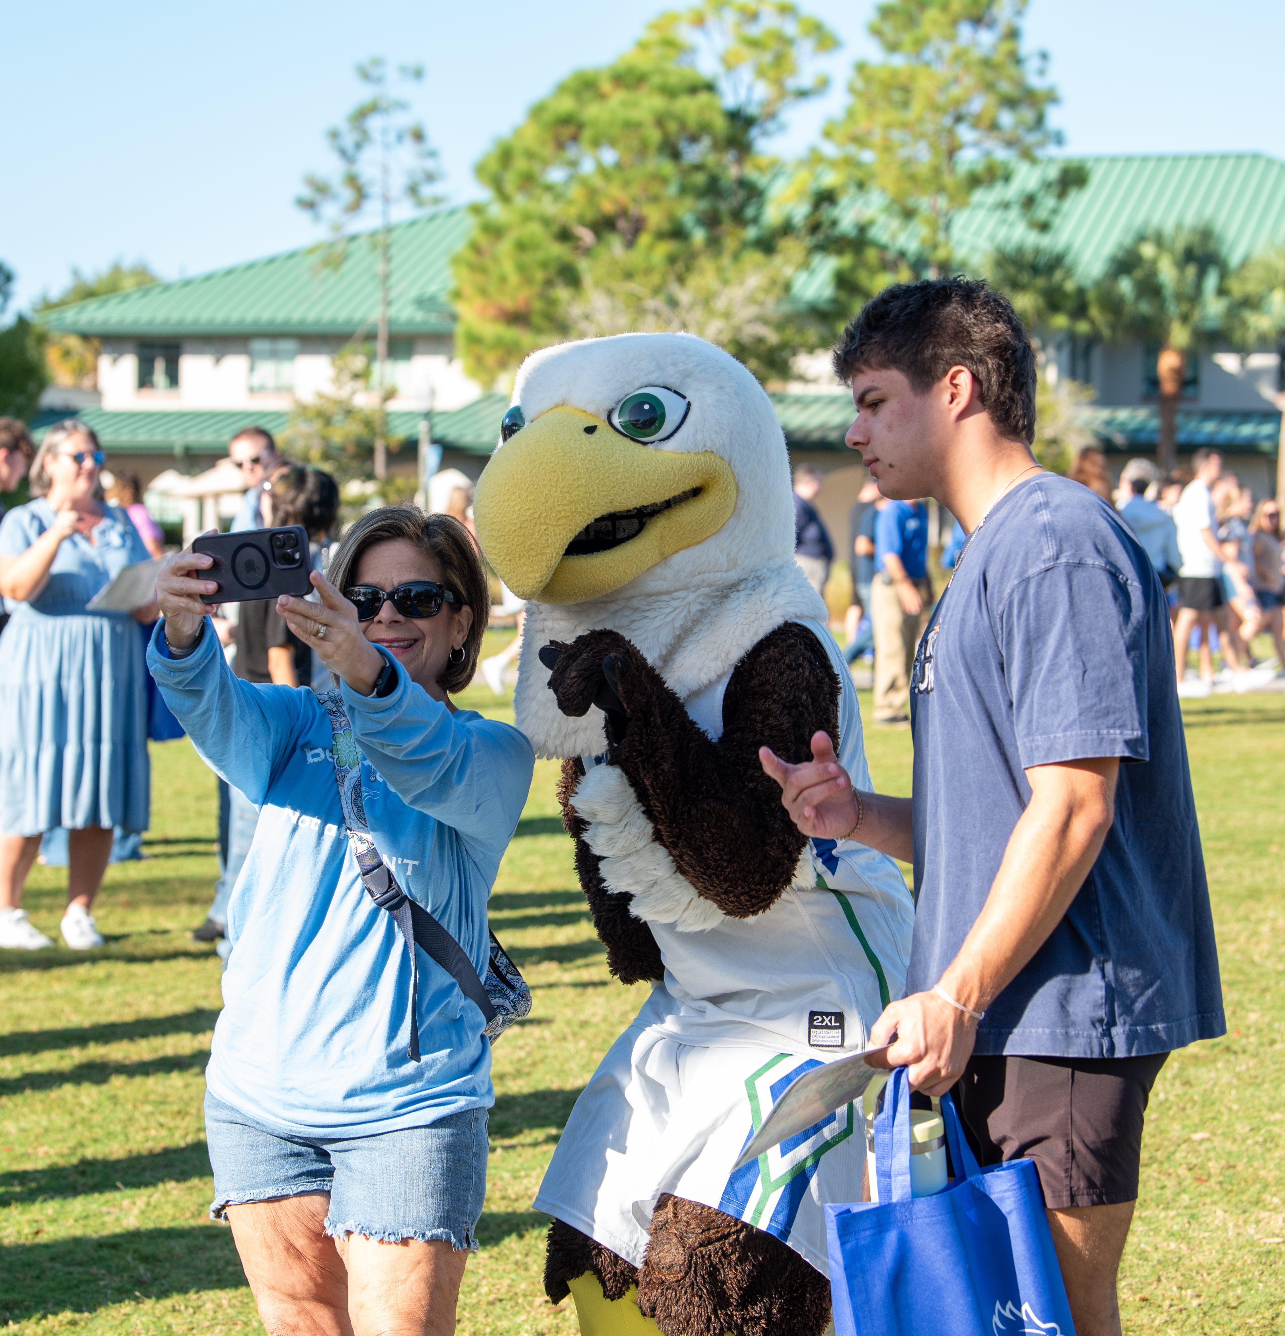
Upcoming Events
WE CAN'T WAIT TO MEET YOUR STUDENTS!
EAGLE EXPO OPEN HOUSE
Saturday, October 17, 2026
Saturday, February 20, 2027
SAY YES TO THE NEST
Admitted Students Event
Saturday, January 23, 2027
Saturday, March 20, 2027
Daily visits are available year-round. Learn more at fgcu.edu/visit.

Slide 14
PHOTO/TITLE
ONCE AN EAGLE. ALWAYS AN EAGLE.

