Slide 1
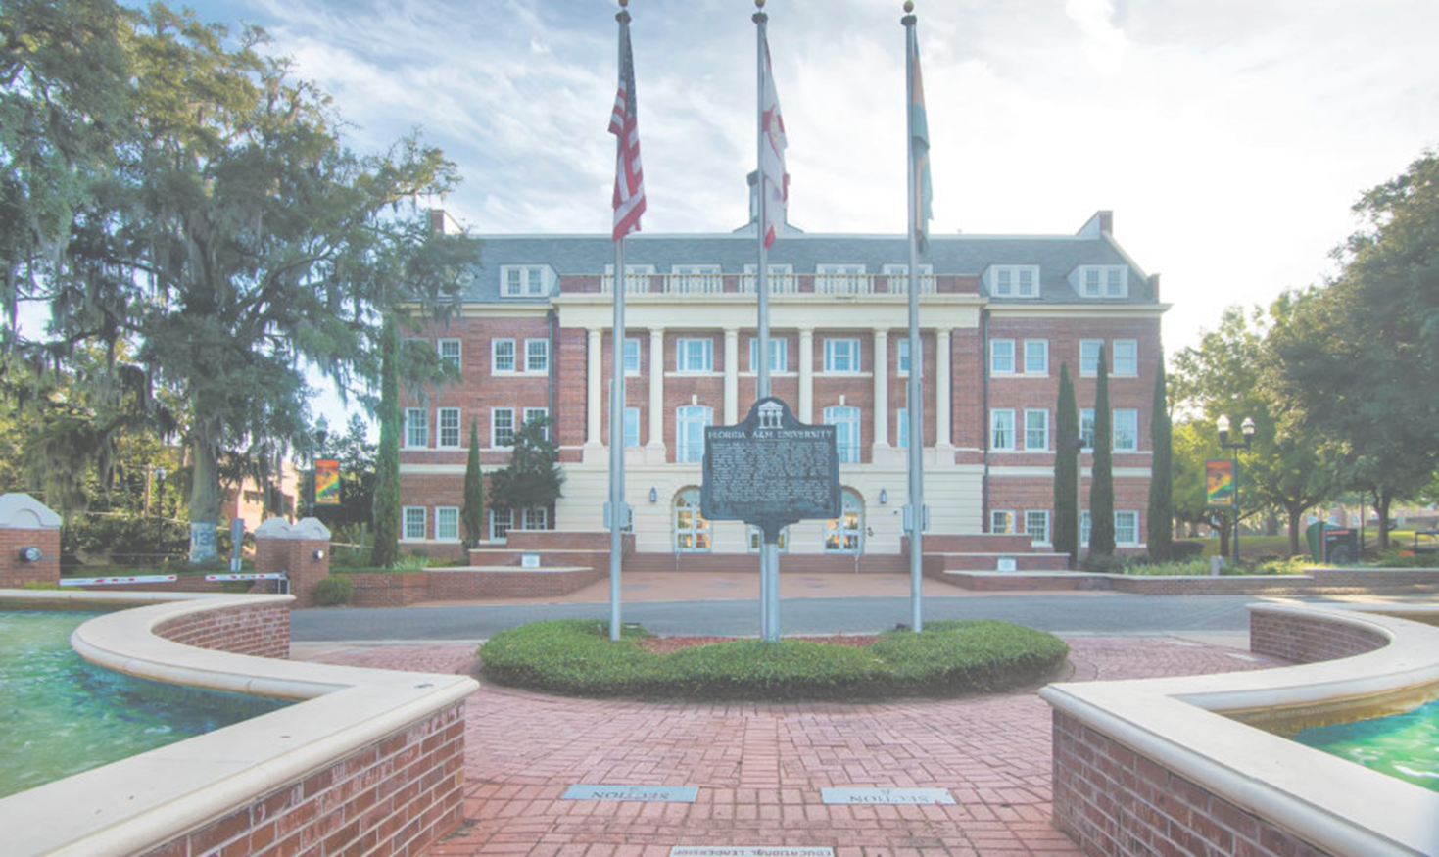

FLORIDA A&M UNIVERSITY
The Public HBCU in the Nation
No. 1

Slide 2


Slide 3

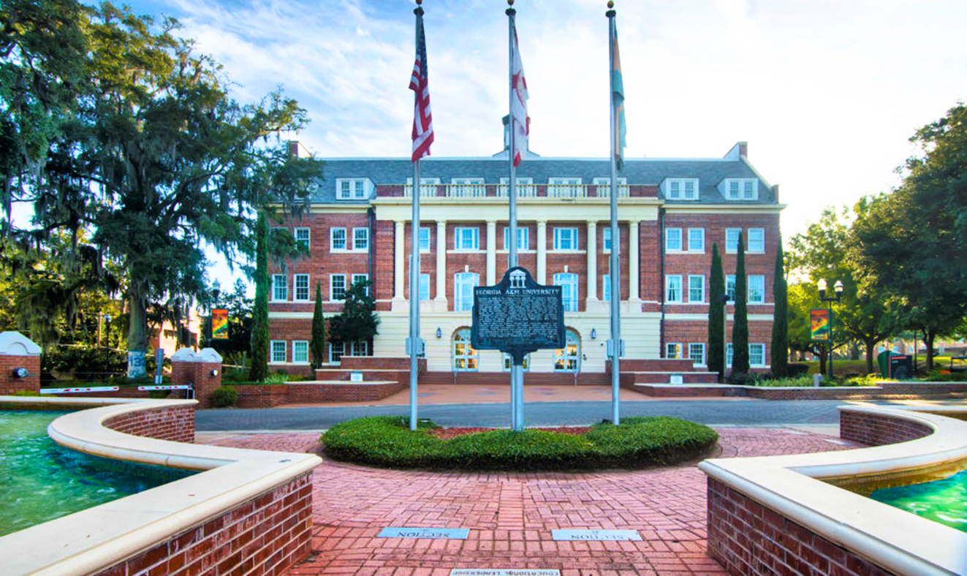
OVERVIEW
Introduction
Florida A&M University, established in 1887, is a historically Black university devoted to student success and renowned for academic excellence, world-class faculty, and research innovation.
Quick Facts:
  Enrolls nearly 10,000 students from the U.S. and more than 70 countries.
  15:1 student-faculty ratio
  94.6% retention rate | ~23% acceptance rate
  Only HBCU land-grant institution in Florida.
  The nation’s only joint College of Engineering (HBCU/R1).
Notes:
State normal college for colored students with 15 students and 2 professors and have now grown to just under 10,000 students

Slide 4


FAMU RANKING
Our Reputation...
Florida A&M University is a Top 100 ranking university in Tallahassee, Florida. It is ranked as the No.1 Public HBCU in the nation.
Ranked in the top 25 for Social Mobility Index.
Ranked in top 10 for 23 degree programs.
Ranked No. 1 for research and development by the
National Science Foundation (NSF).
Designated as a Fulbright HBCU Institutional Leader.
Designated a Collegiate Purple Star Campus for
supporting military connected students.

Slide 5














OUR 14 COLLEGES & SCHOOLS
Discover the Possibilities
College of Agriculture & Food Sciences
College of
Education
College of
Law
College of Pharmacy, Institute of Public Health
College of Science & Technology
College of Social Sciences, Arts & Humanities
FAMU-FSU College of Engineering
School of Architecture + Engineering Technology
School of Business & Industry
School of Allied Health Sciences
School of Graduate Studies & Research
School of Journalism & Graphic Communcation
School of
Nursing
School of the Environment

Slide 6

ACADEMIC PROGRAMS
Explore the Possibilities
Florida A&M University prepares its scholars to be leaders in their chosen fields within 14 colleges and schools.
BACHELOR
MASTER
PROFESSIONAL
DOCTORAL
70+
Bachelor
Degree Programs
32
Master
Degree Programs
3
Professional
Degree Programs
14
Doctoral
Degree Programs

Slide 7

1,925 FTIC Enrollment!
Over 70% increase from last year
Notes:
Wyoming?? anyone

Slide 8

APPLICATION INFORMATION
Steps
Apply via The Common App (no essay required)
Submit Test Scores – SAT/ACT/and or CLT
Submit High School and College Transcripts
Submitting Transcripts
Students should have their official high school and dual enrollment transcripts sent electronically or mailed in the official sealed envelope. FAMU is NOT using STARS this cycle.
Notes:
Not on the common black app, all students apply for Fall and we will assign summer students

Slide 9
New Dates
Early Action
Early Action II
Regular Decision
Rolling Admission
Application | November 1st
Documents | November 14th
Decision Release | December 4th
Application | November 1st
Documents | January 22nd
Decision Release | February 5th
Application | February 1st
Documents | February 14th
Decision Release | March 5th
Application | May 1st
Documents | May 1st
Decision Release | Beginning in April

Slide 10

TUITION
In State Tuition
$5,697.30
Out of State Tuition
$19,291.20

Slide 11
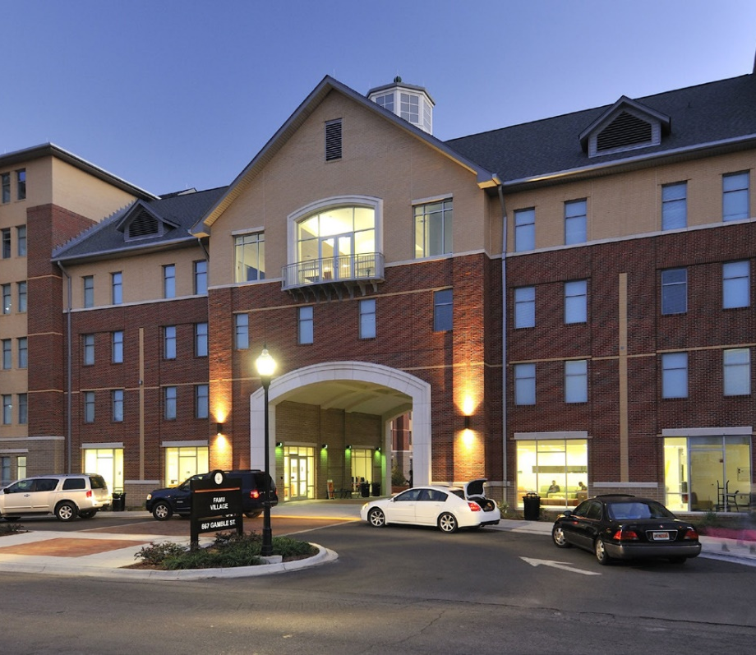
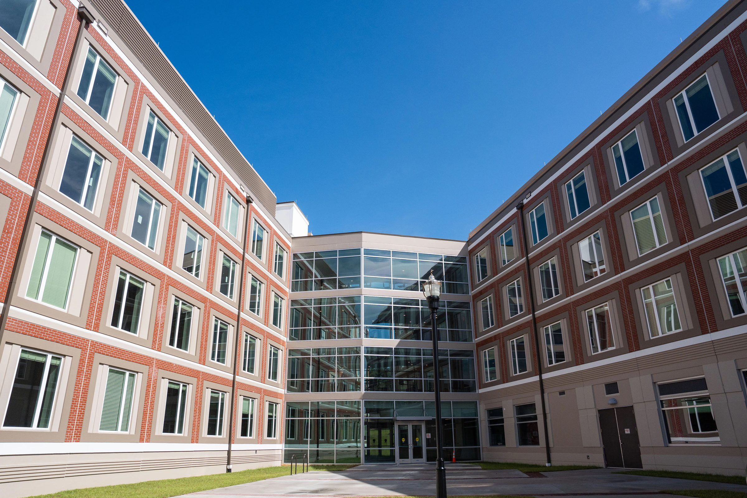
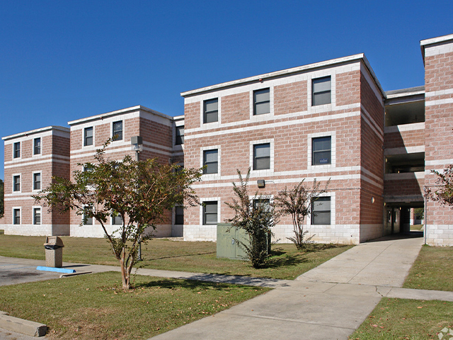
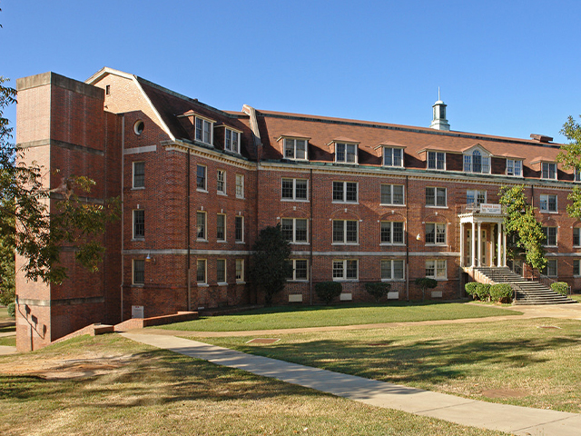
RESIDENTIAL HALLS
Traditional Housing
Polkinghorne
Village
Venom Landing
&
FAMU Towers
Palmetto South
&
Phase III
Sampson Hall
&
Young Hall
Notes:
Housing for Fall 2026 & Spring 2026 is now open for incoming students and Transfers.
Polkinghorne Village Houses 800+
Venom Landing Houses 700+
FAMU Towers Houses 800+
Palmettos South & Phase III Houses 200+
Sampson Hall has about 70 males
Young Hall Houses 40+ Females

Slide 12


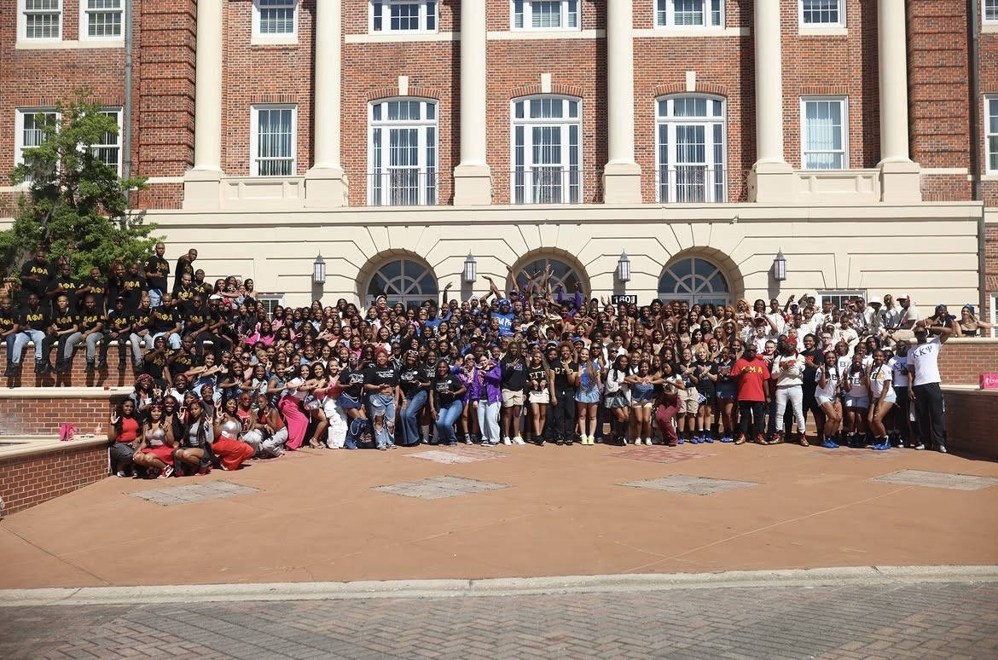
CAMPUS LIFE
FAMU has over 300 registered student organizations, 30+ fraternity and sorority chapters, and Student leadership positions and student leadership roles.
Student Government, Presidential Ambassadors, and more
Homecoming, Set Fridays, and more
Greek Life, Student Organizations, and more

Slide 13



SCHOLARSHIP SPORTS
BASEBALL // BASKETBALL (M&W) // BOWLING (W) // CROSS COUNTRY(M&W) // FOOTBALL
GOLF // SOFTBALL // TENNIS (W) // TRACK AND FIELD (M&W) // VOLLEYBALL (W)
Notes:
Script sample:
Up to this point I hope you can see that we strive for excellence here at FAMU. This trend continues into our athletics! We are D1 and have most collegiate scholarship sports. We constantly dominate in the SWAC (Southwestern Athletic Conference) and are are sponsored by Lebron James and Nike. Our Women's volleyball won a SWAC Championship, our Football team won a SWAC championship, and our track team keeps all competitors on their heels. If you are interested in being a student athlete please either contact the folks associated with your sport of interest, or chat with me after this and I can provide some words of advice.

Slide 14

HONORS PROGRAM
Three Curriculum Tracks
Graduate with honors.
Students enrolled in FAMU honors courses receive more individualized resources. The program is designed for students who like a highly interactive and challenging learning environment.
Benefits:
  Honors notation on transcript
  Certificate of Completion
  Honors Plaque
  Commencement Medallion

Slide 15

CAREER DEVELOPMENT
Prepared for Success
Career & Professional Development
The FAMU Career and Professional Development Center helps students discover their passions, build experience, and connect with employers so they graduate career-ready.
  Career Coaching
  Major Exploration
  Internships
  Job Search Support
  Career Planning

Slide 16
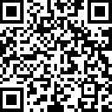
Scan to be added to our counselor database to receive periodic updates!
Also, we’re now using Slate.org!

Slide 17
@famuadmissions
Follow Us on Instagram!

Slide 18
STRIKE BOLD!
STRIKE PROUD!
STRIKE !

