Slide 1
2026 Admissions Tour
Celebrating Over 50 Years of Excellence
in Education

Slide 3
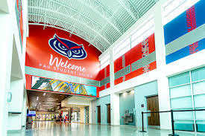
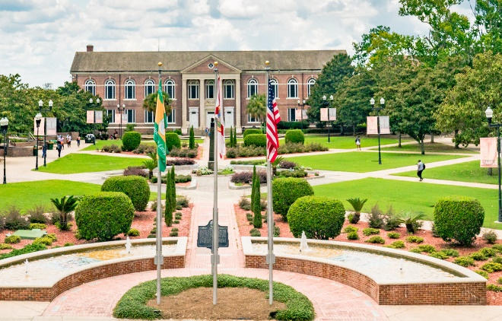
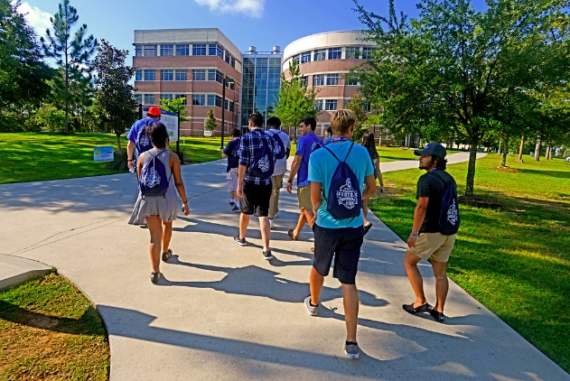
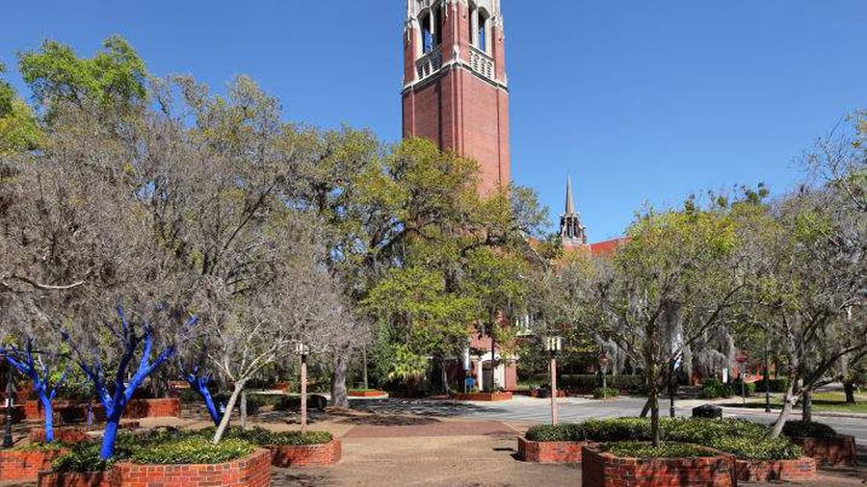
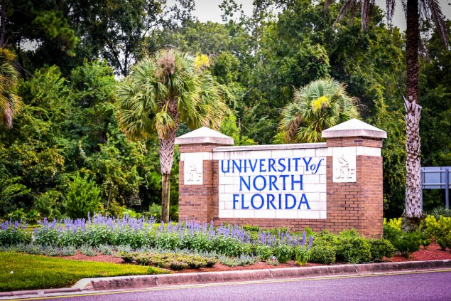
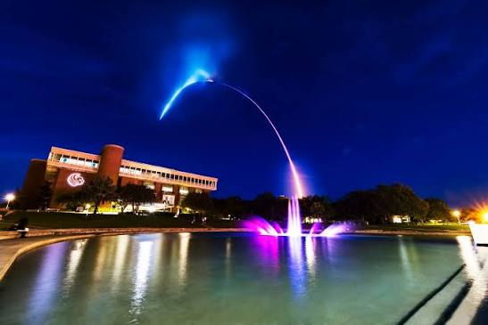
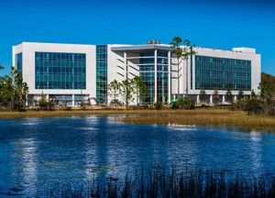
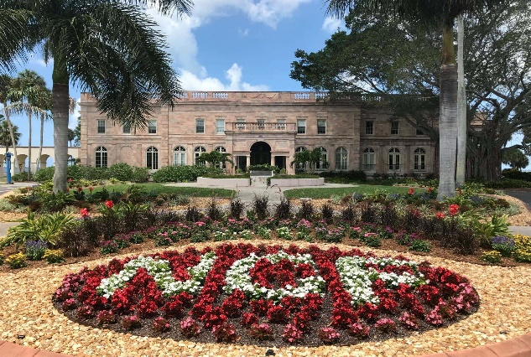
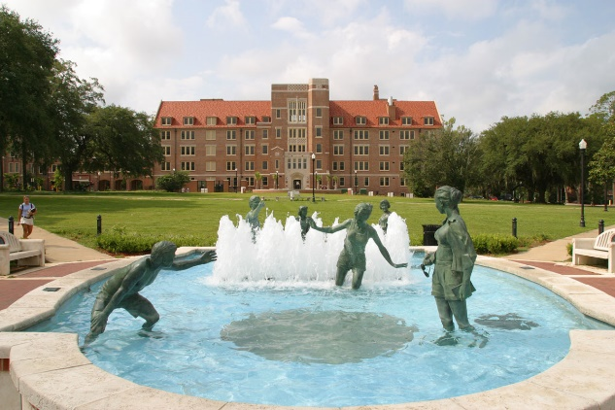
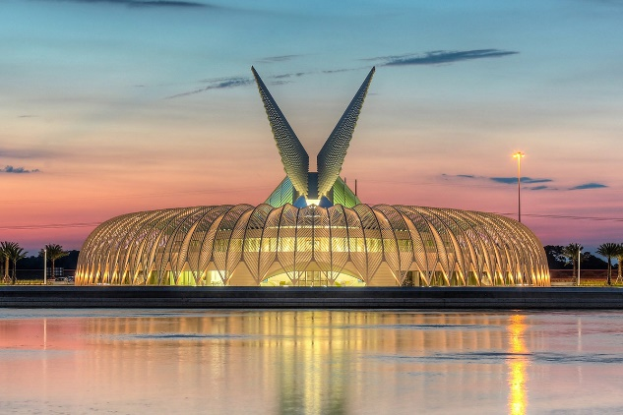
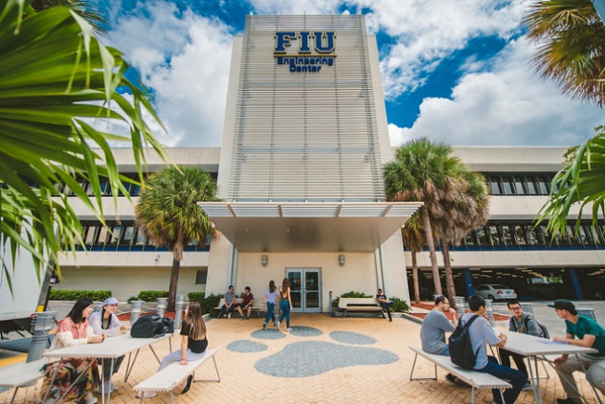
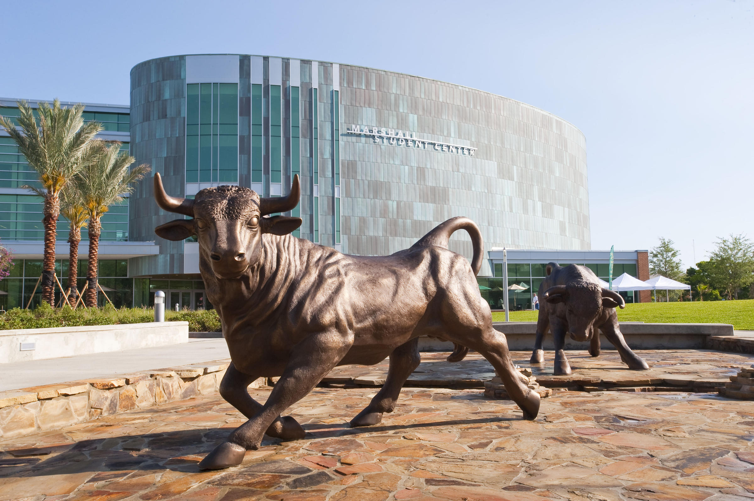
3

Slide 4

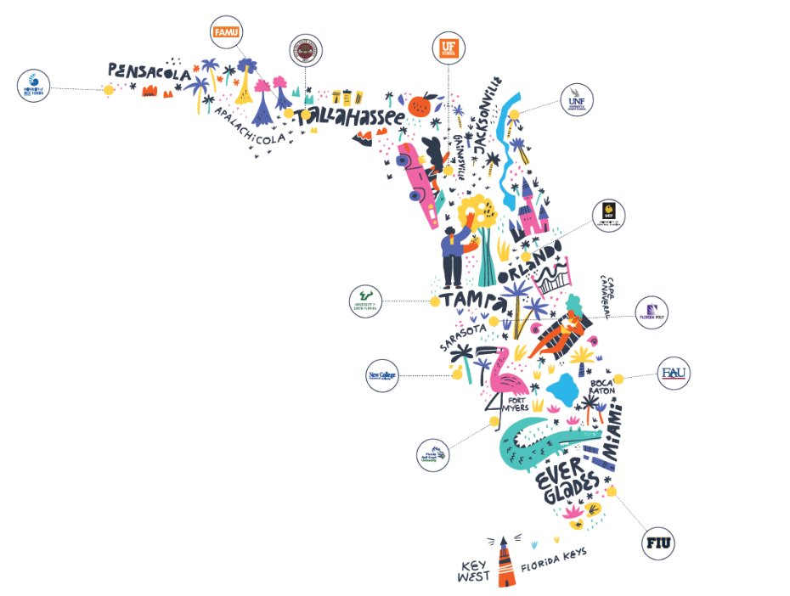
Digital 2026 Admissions Matrix
The digital and printed matrix are publicly available materials from the State of Florida. Printing, reproducing or publishing copies of the document in a for-profit environment is prohibited under Florida Statutes, unless a specific statement of free availability is included. ​
​
A free version of this publication is available on the Florida Board of Governors website. ​

Slide 5
The State University System of Florida
10 consecutive years as the #1 state for higher education
#1 in the nation for lowest tuition
284,388 Fall 2025 Undergraduate Headcount
49,046 FTIC Fall 2025
73,276 Bachelor’s Degrees Awarded in 2024-25
29,319 Master’s Degrees Awarded in 2024-25
Nearly 75% of graduates are employed or continuing their education, with a median salary of $52,600 within one year of graduation

Slide 6
Seven System institutions ranked in the nation’s top 100 public universities (U.S. News and World Report)
  #7 University of Florida
  #21 Florida State University
  #43 University of South Florida
  #46 Florida International University
  #57 University of Central Florida
  #92 Florida A&M University
  100 Florida Atlantic University

Slide 7
SUS Metrics
Academic Progress Rate First to Second Year – 90.7%
Percentage of FTIC with High School GPA of 4.0+ – 76%
University Access Rate (Undergraduates with a Pell Grant) – 37.8%
FTIC 4-Year Graduation Rate – 68.5%
Pell Recipient 4–Year Graduation Rate – 64%
Pell Recipient 6–Year Graduation Rate – 75.9%

Slide 8
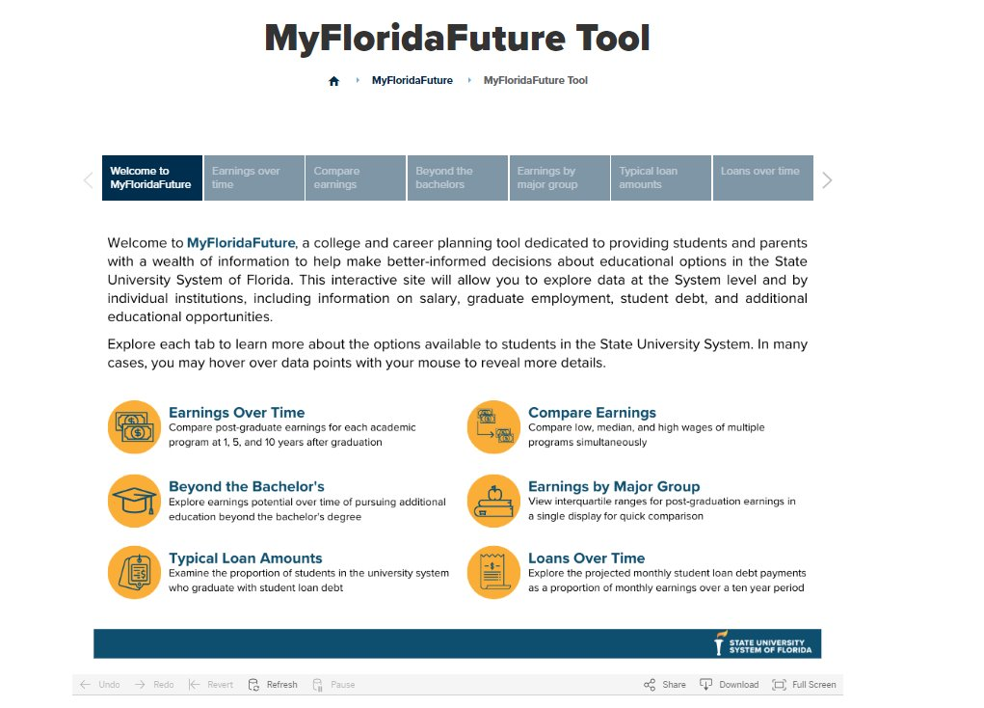
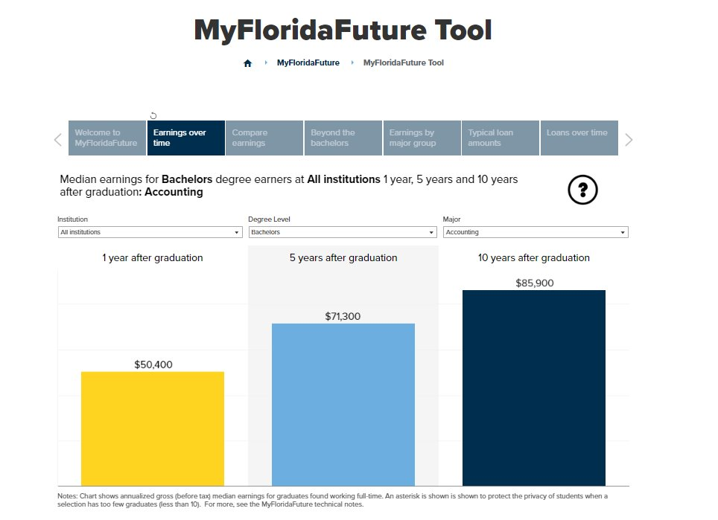
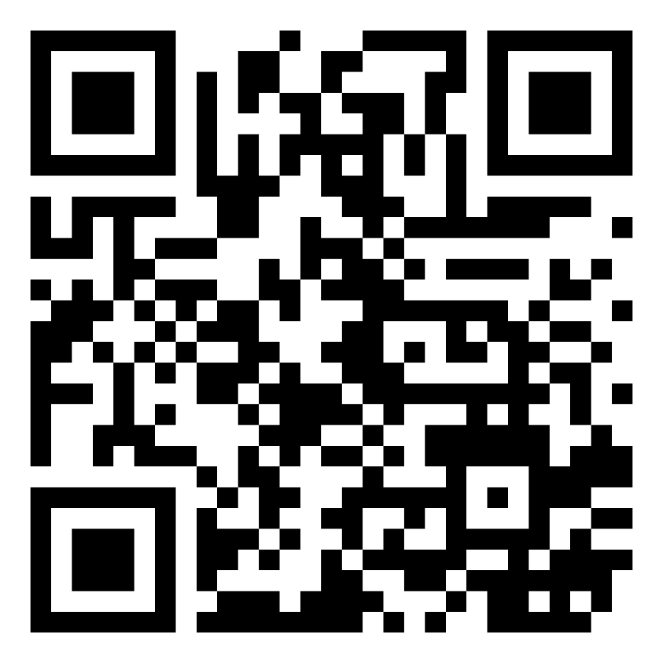
MyFloridaFuture
MyFloridaFuture is a free, online college and career planning tool to assist students and families in making better-informed decisions about postsecondary educational options in the State University System of Florida​
Try it here!

Slide 9

The College Tour – Florida’s College Fair Circuit
Email: thefltour@gmail.com
Series of college fairs across the state of Florida
Fairs are coordinated by Florida Tour committee members in partnership with schools and school districts.
Over 150+ college fairs held in districts and high schools across Florida from Pensacola to the Florida Keys
Consolidates the college fair schedule to promote outreach and the opportunity to talk with the most colleges possible when reps are in the area.
Find out more: thefltour.org
Founded in the early 1950s: originally named Florida Schools & College Relations Committee; the Committee is comprised of secondary and post‐secondary school personnel including representation from the SUS.
Self‐sustaining and Voluntary
Meets several times per year
Creates and coordinates college fair schedule for Florida for Fall beginning in January and Spring beginning in August

Slide 10
Alternative Pathways
Students can attend a Florida College System institution to receive their A.A. degree and transfer those credits to a SUS institution
SUS institutions must partner with at least one Florida College System institution to provide targeted programs
Talk to the admission director for the institution of interest about programs specifically tied to that institution

Slide 11
Talented 20 Program
Students who are in the top 20% of their graduating class are guaranteed admission to a State University System of Florida institution
Requirements and Process
Rejected from 3 SUS institutions, and accepted to none
Top 20% of graduating class as recognized by FLDOE
Has taken ACT, SAT, or CLT
Counselor submits all documentation by May 1st
Email SUSTalented20@flbog.edu for appeals

Slide 12
Digital 2026 Admissions Matrix
The digital and printed matrix are publicly available materials from the State of Florida. Printing, reproducing or publishing copies of the document in a for-profit environment is prohibited under Florida Statutes, unless a specific statement of free availability is included. ​
​
A free version of this publication is available on the Florida Board of Governors website. ​

