Slide 1
Notes:
Campus community. Outstanding programs. Affordable tuition.
An overview of today’s presentation. We will talk a little about UWF and what makes us special. Then we will review our Freshman Class profile, the application and admissions process and admissions scholarships.

Slide 2
Notes:
Campus community. Outstanding programs. Affordable tuition.
An overview of today’s presentation. We will talk a little about UWF and what makes us special. Then we will review our Freshman Class profile, the application and admissions process and admissions scholarships.

Slide 3
Notes:
UWF is highly ranked …

Slide 5
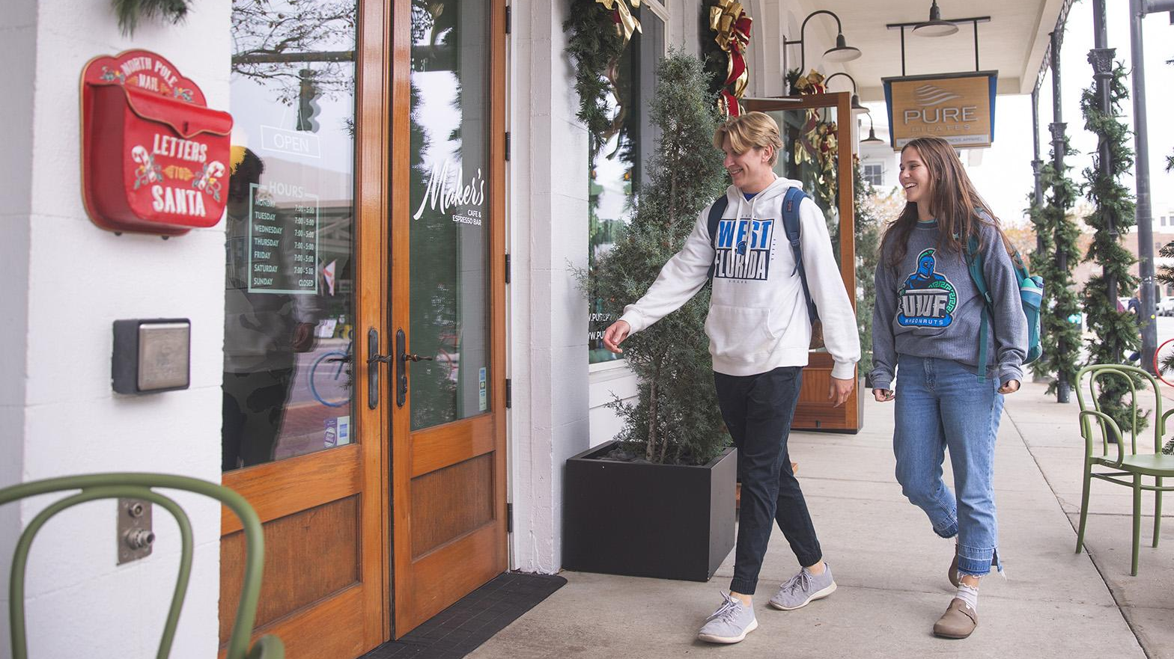
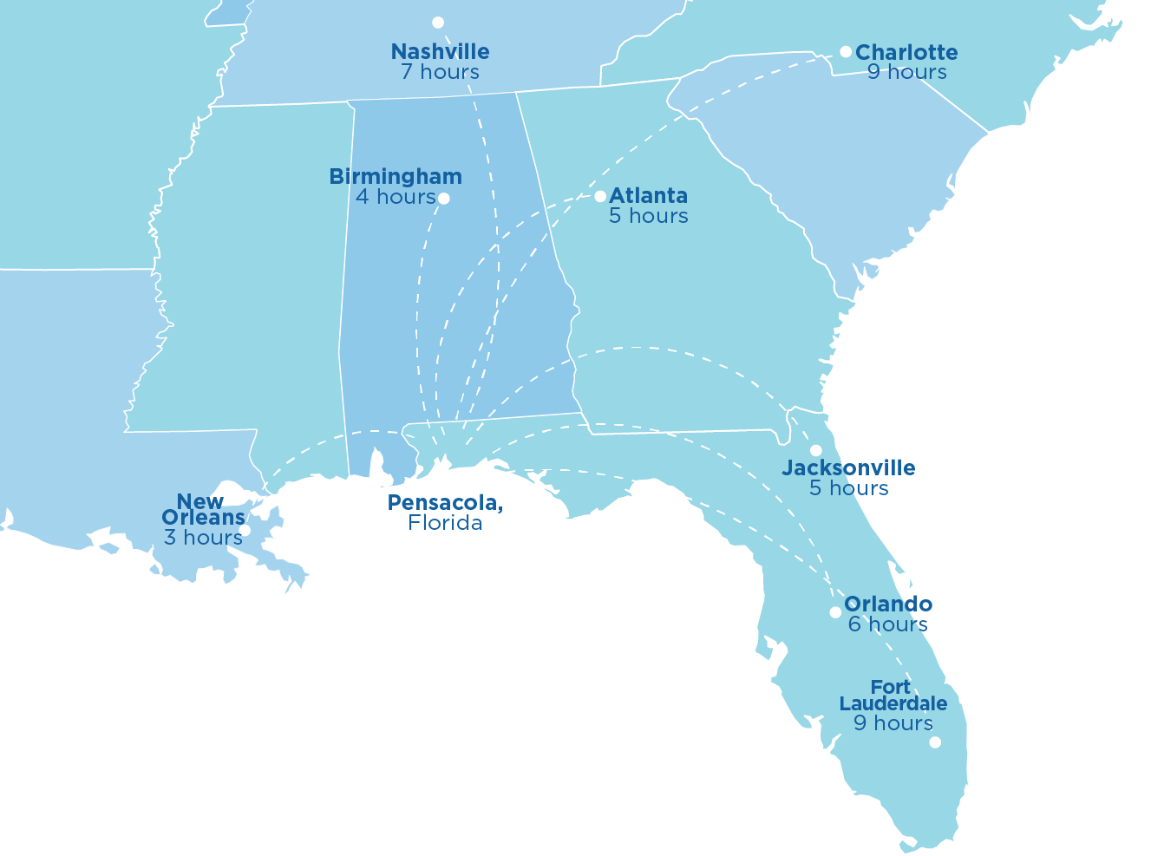


Pensacola
FLORIDA
#7 of “Best Small Cities in the U.S.”
— Condé Nast Traveler's
Readers' Choice Awards, 2024
One of “America’s Best Cities”
— WorldsBestCities.com, 2025
Notes:
Located in Pensacola

Slide 6
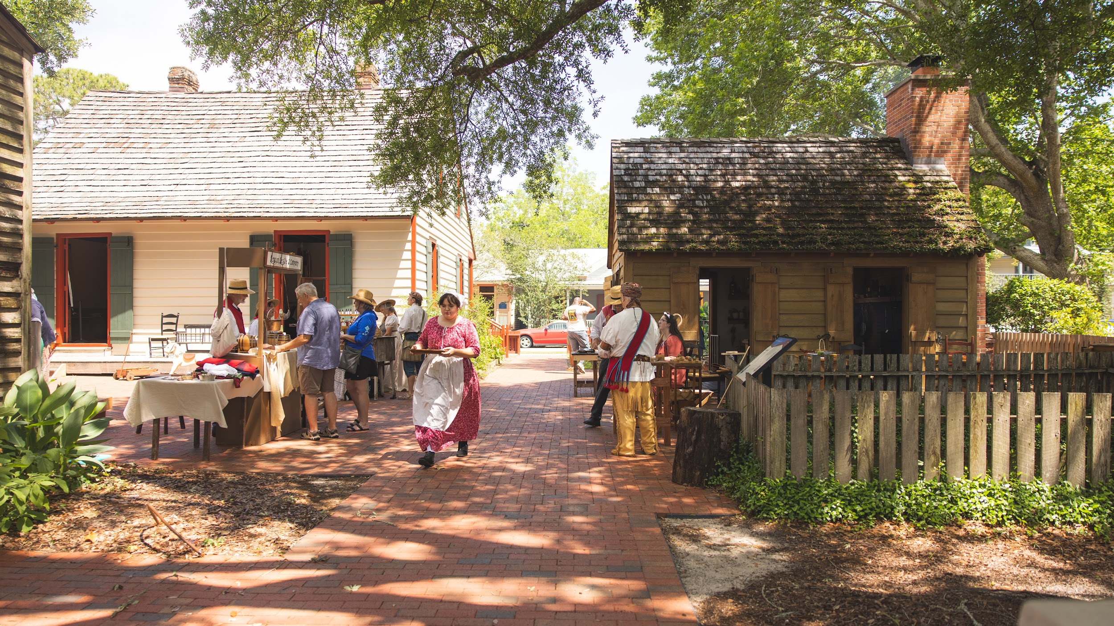
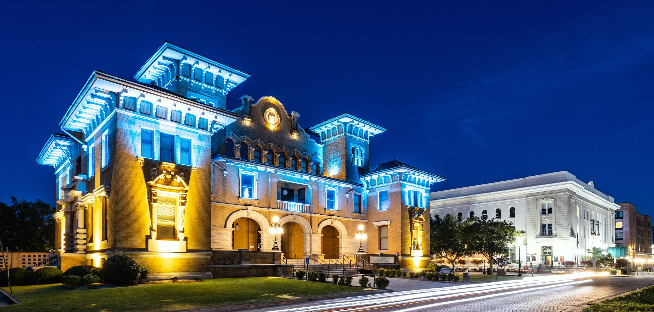
Pensacola Museum of History
Downtown
HISTORIC PENSACOLA +
PENSACOLA MUSEUM OF ART
Notes:
The UWF Historic Trust creates opportunities for our visitors, community, students, faculty and staff to experience the authentic and rich art and history of Northwest Florida. The trust operates several historical sites and museums downtown, as well as the Pensacola Museum of Art and Pensacola Children’s Museum. Full list:
Pensacola Museum of History
Pensacola Children's Museum
Museum of Commerce
Museum of Industry
Voices of Pensacola
Old Christ Church
Tivoli High House
Lavalle House
Lear/Rocheblave House
Dorr House
Manuel Barrios Cottage
Julee Cottage
Barkley House
John Appleyard Cottage
Fountain Park
Colonial Archaeological Trail
Pensacola Museum of Art

Slide 7
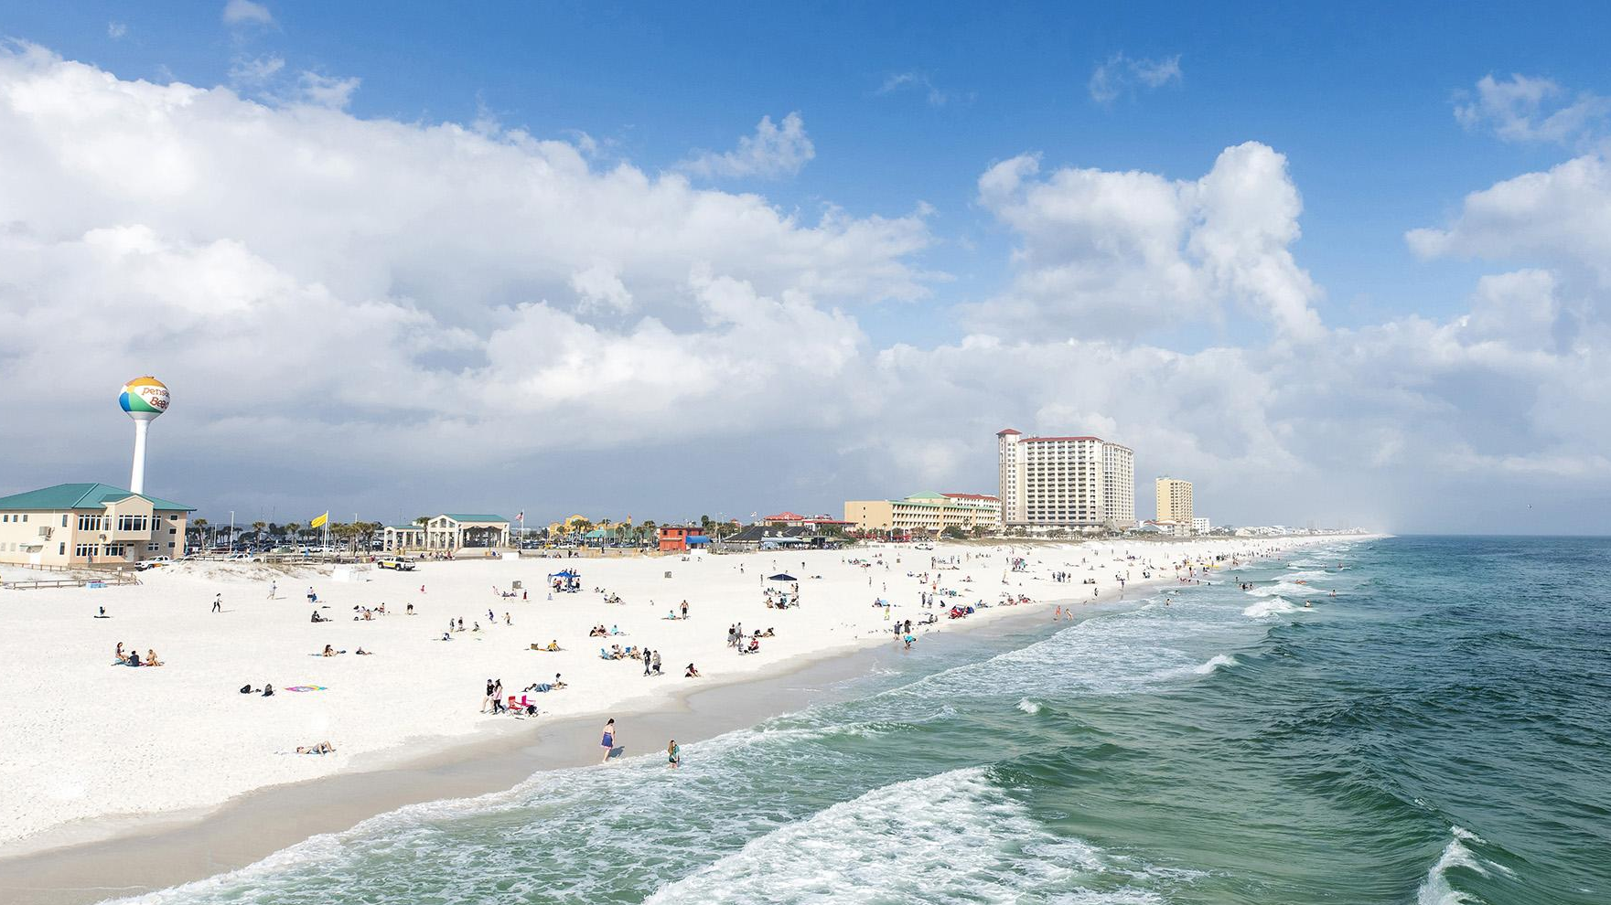
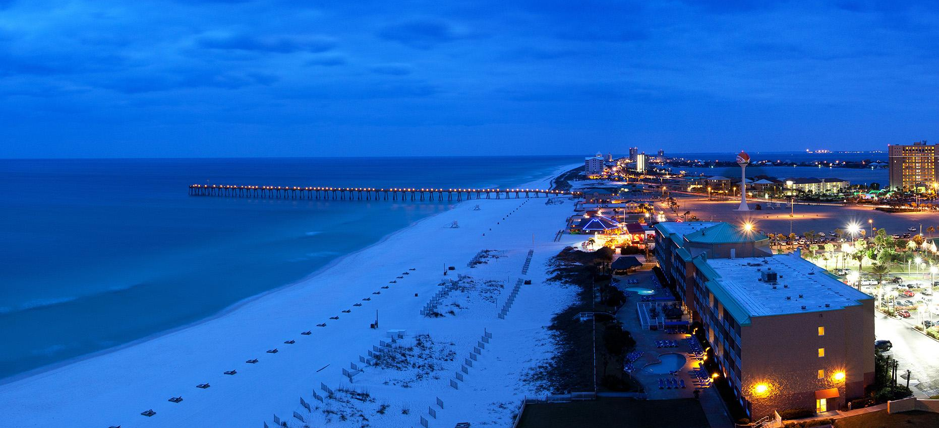
ABOUT 30 MINUTES FROM
Pensacola Beach
A Top 20 U.S. Beach
— TripAdvisor, 2025

Slide 8
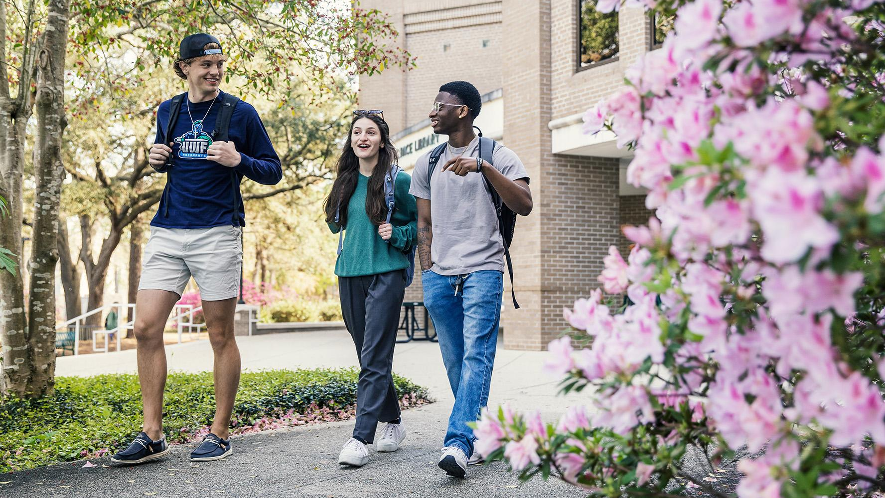
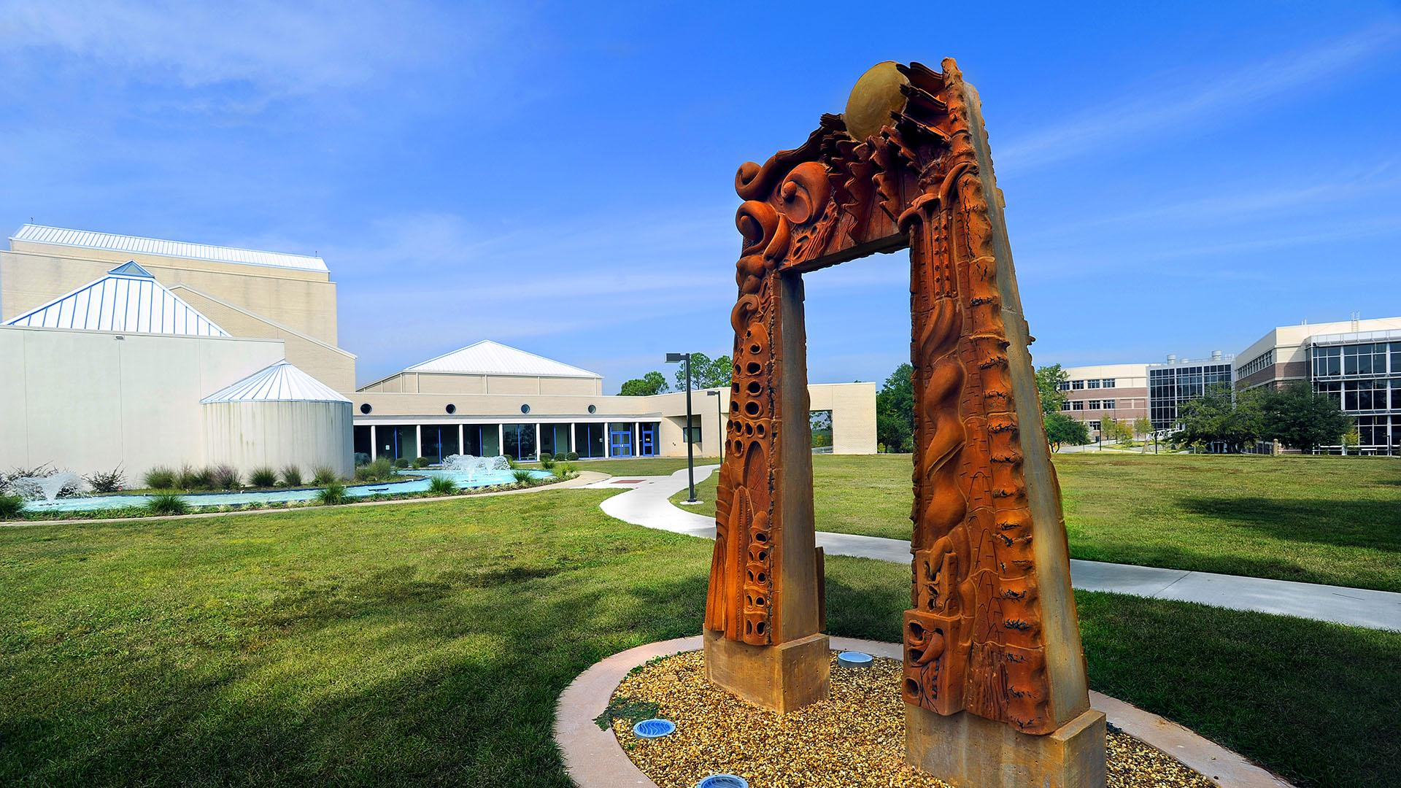
One of the “Best College
Campuses in Florida”
— Niche, 2025
A “Tree Campus Higher Education”
— Arbor Day Foundation
1,600
ACRES
20+
MILES OF TRAILS
uwf.edu/Visit

Slide 9
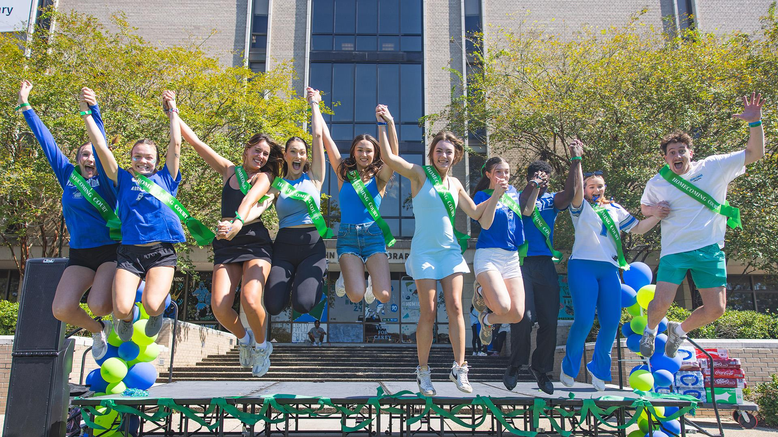
14,500+
STUDENTS
101K+
ALUMNI
Notes:
At UWF we have more than 14,500 students — the perfect size because you see a familiar, friendly face every day, but there are always still new people to meet.

Slide 10
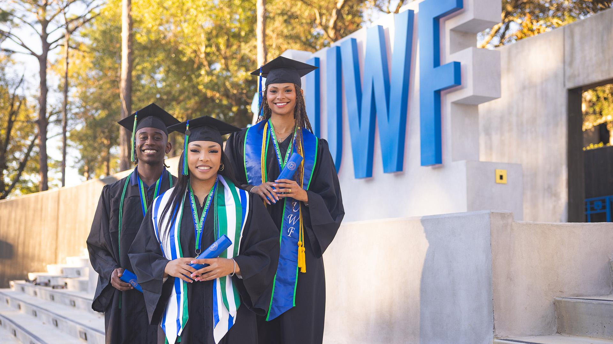
ONE YEAR AFTER GRADUATION
80%
OF GRADS ARE EMPLOYED
(at $40K+) OR CONTINUING THEIR EDUCATION
2nd highest in FL SUS
$54,000
MEDIAN WAGES
3rd highest in FL SUS
— UWF 2025 Accountability Plan (undergraduate), State University System Performance-Based Funding Metrics

Slide 11
Academics

Slide 12





College of Arts, Social Sciences and Humanities
Lewis Bear Jr.
College of Business
School of Education
Hal Marcus College of Science and Engineering
Usha Kundu, MD College of Health
Notes:
Four colleges plus the School of Education

Slide 13
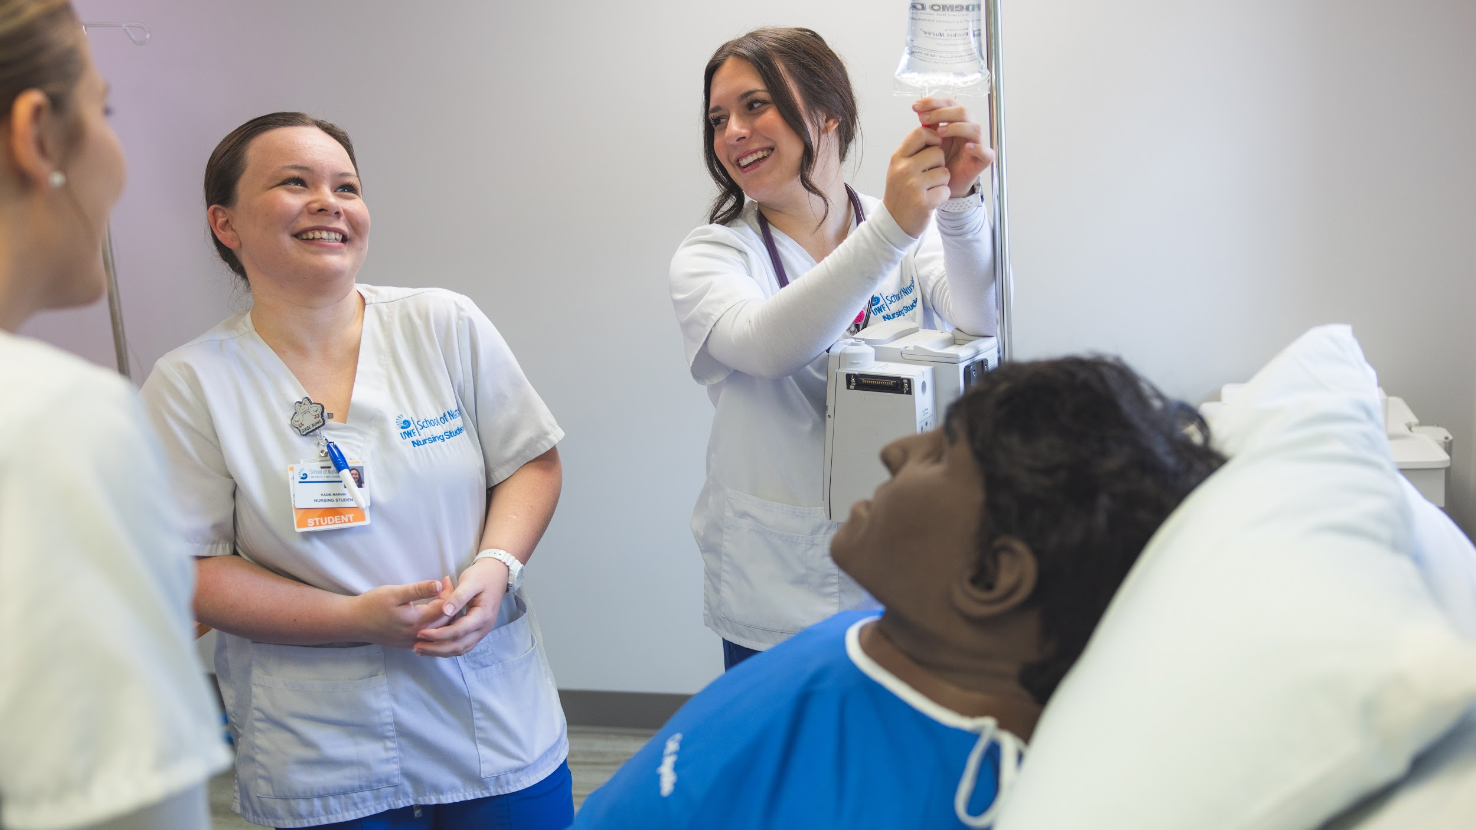
Top 10 Majors
Nursing (Pre-BSN)
2. General Business
3. Biomedical Sciences
4. Psychology
5. Marine Biology
6. Mechanical Engineering
7. Biology
8. Exercise Science
9. Computer Science
10. Criminal Justice
— Most popular majors among Summer/Fall 2025 freshman admits
70+
UNDERGRADUATE PROGRAMS
22:1
STUDENT-TEACHER RATIO
uwf.edu/Programs
Notes:
Nursing lab. Last year, more than 97% of UWF School of Nursing graduates passed their national licensure exam on the first attempt, exceeding state and national averages.
Lewis Bear Jr. College of Business accredited by AACSB International - The Association to Advance Collegiate Schools of Business, only about 6% of business schools have this accreditation.
6 ABET-Accredited programs—assurance that a program meets the quality standards established by the profession for which it prepares its students: Computer Engineering, Computer Science, Cybersecurity, Information Technology, Electrical Engineering, Mechanical Engineering. Information Technology was announced in Sept. 2024.

Slide 14

Undecided?
About 6% of admitted freshmen are! Explore your options with a free
Focus 2 Career assessment:
Mapping of career to UWF majors
Career planning tools
Career options by education level
Side-by-side job comparisons
uwf.edu/Focus2Career
Notes:
You can take a free assessment before you even apply. It’s a free tool to help you in planning an education that matches your career interests. It will even show you which UWF majors can help you achieve your goals.

Slide 15
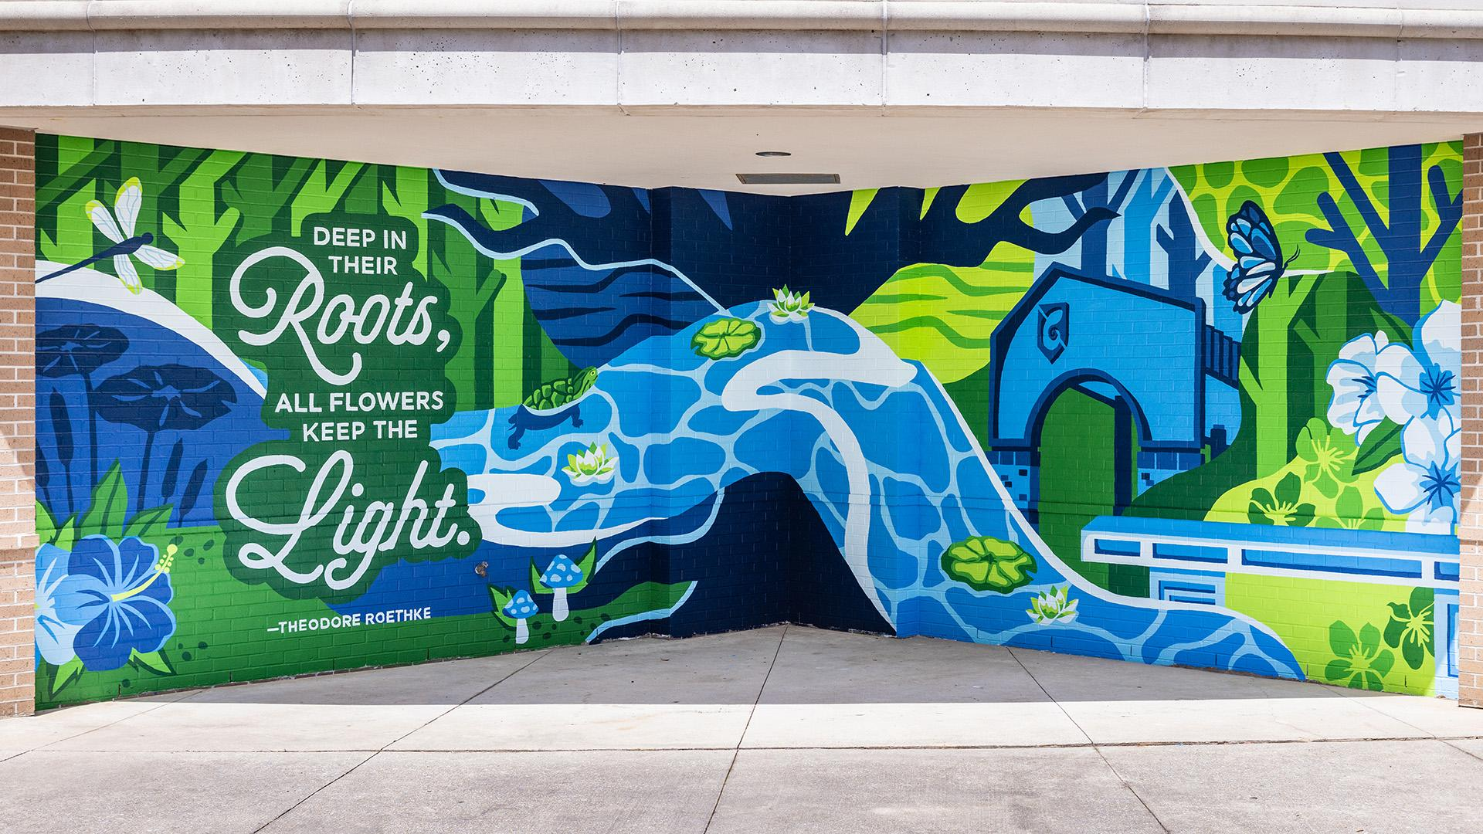
Kugelman Honors Program
Two- and four-year pathways
Research support
Exclusive summer
study abroad opportunities
Priority registration
and honors advisor
Scholarship opportunity
Living Learning Community
uwf.edu/Honors

Slide 16
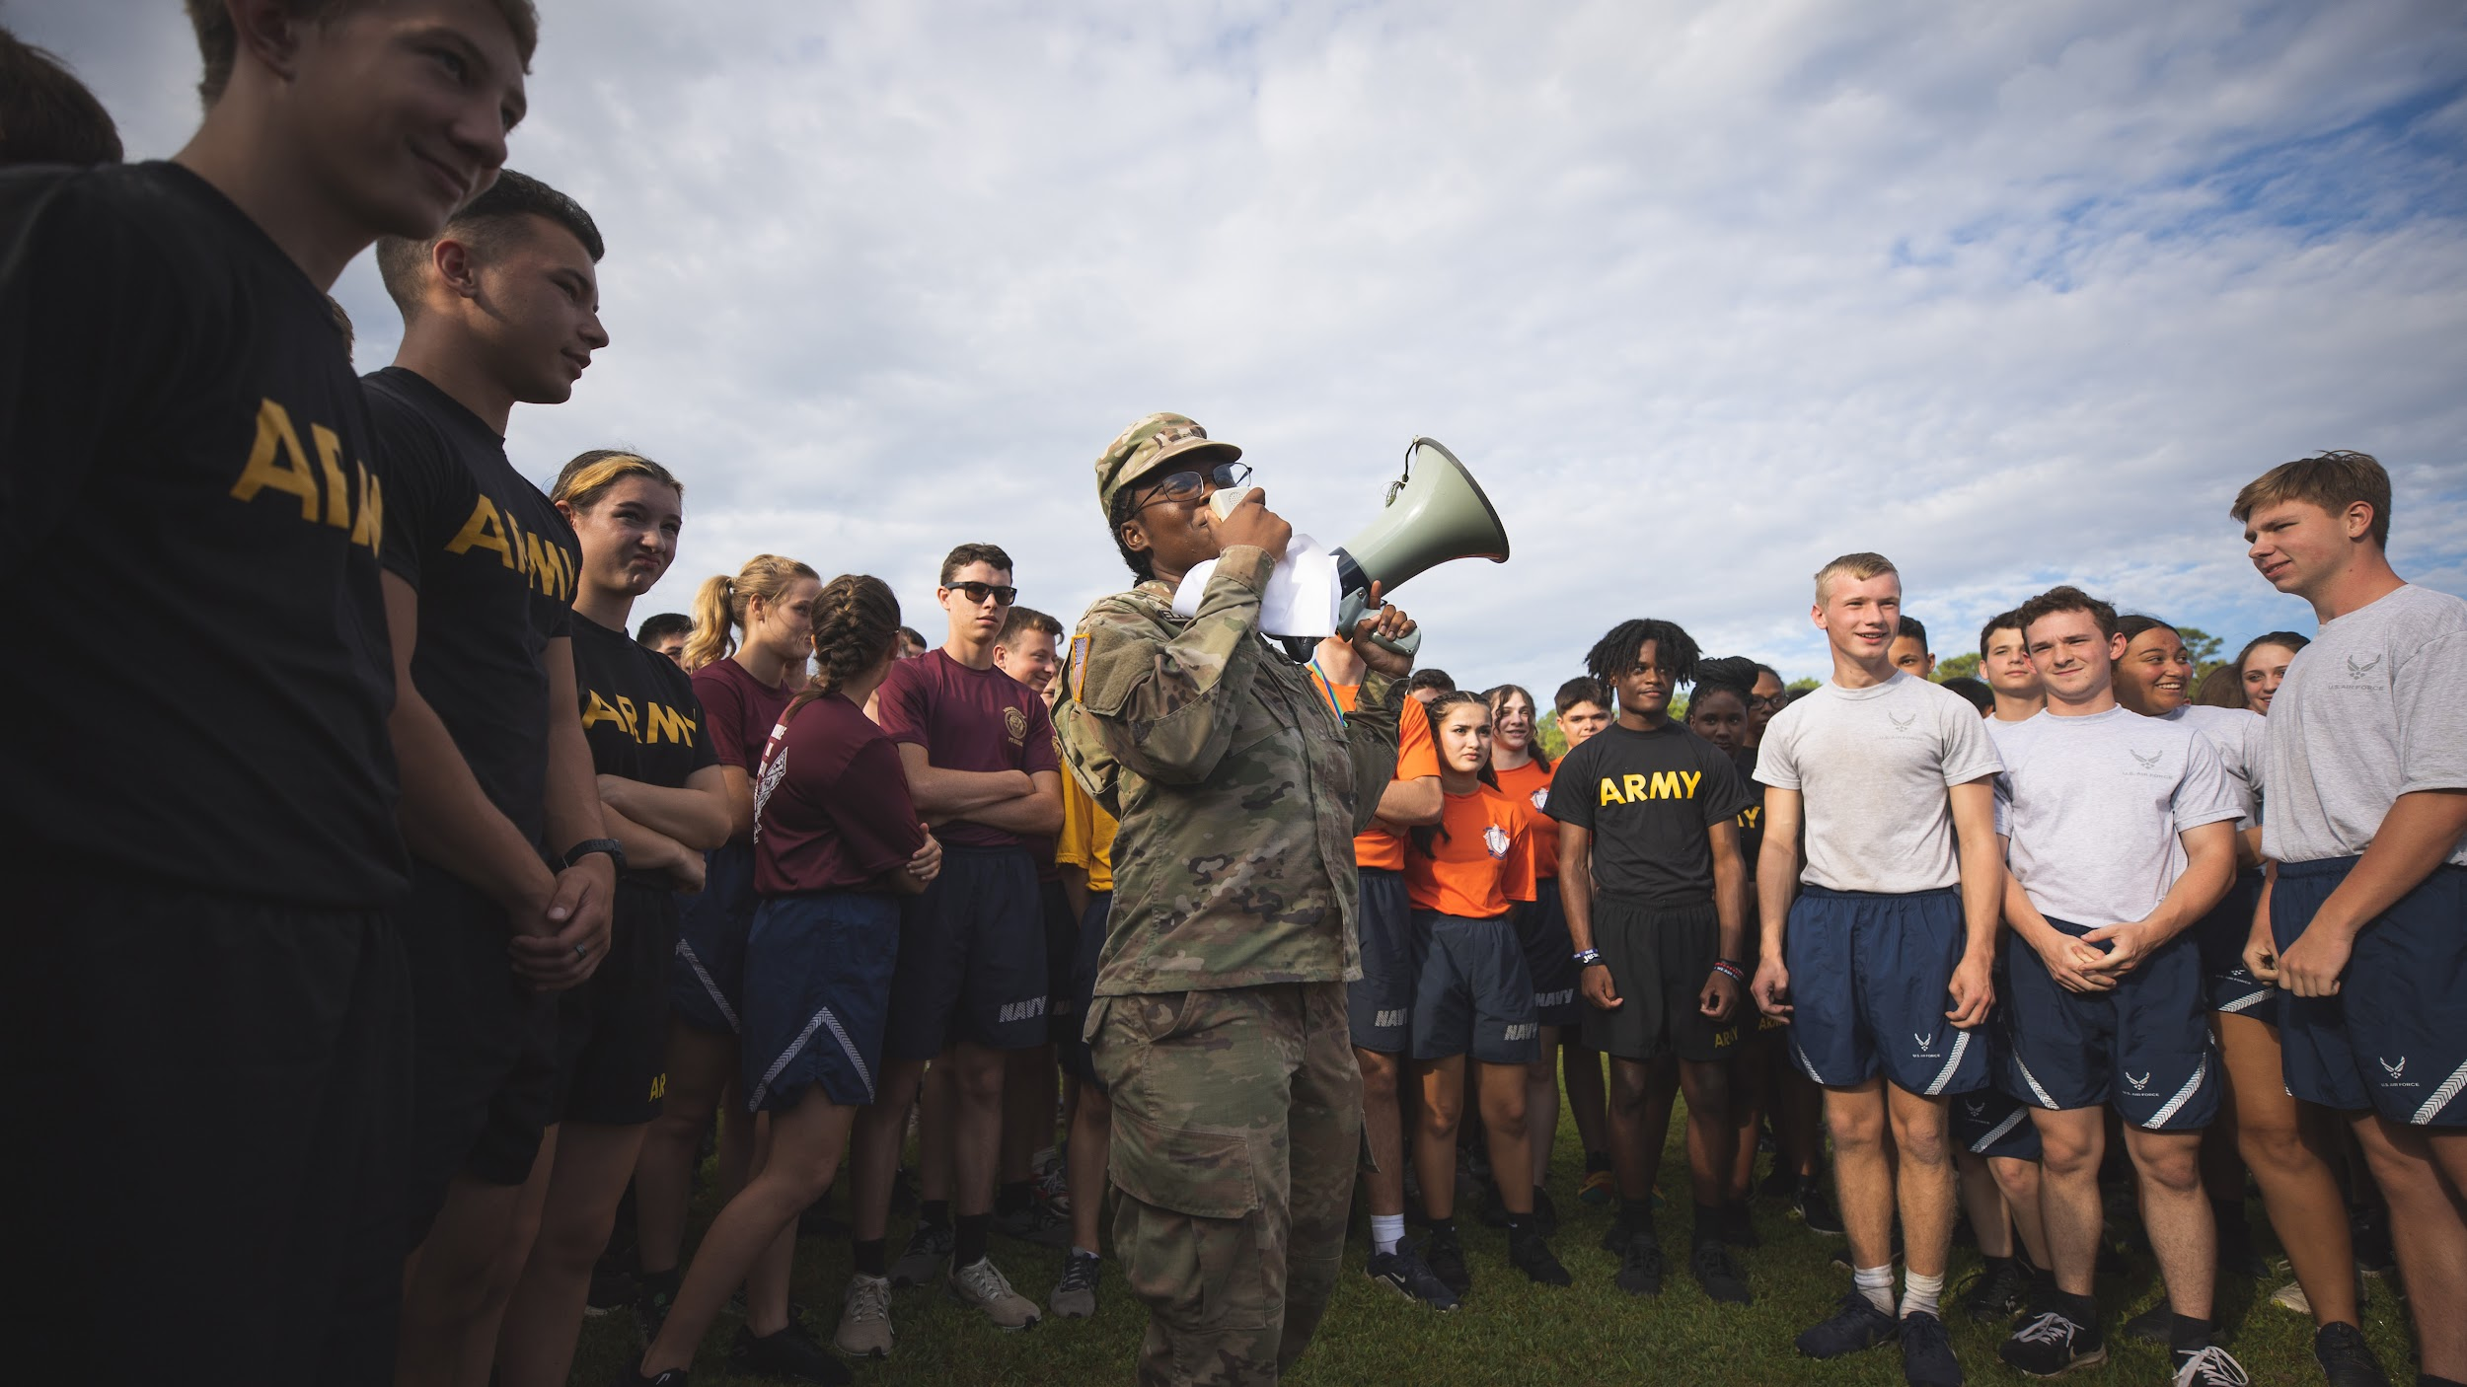
Gold Level Military-Friendly®
Army and Air Force ROTC programs
Military and Veterans Resource Center
Scholarship opportunities
The appearance of U.S. Department of Defense visual
information does not imply or constitute DoD endorsement.
Notes:
UWF has been named a Gold Level Military Friendly School by Military Friendly (militaryfriendly.com).

Slide 17
Experiential Learning

Slide 18

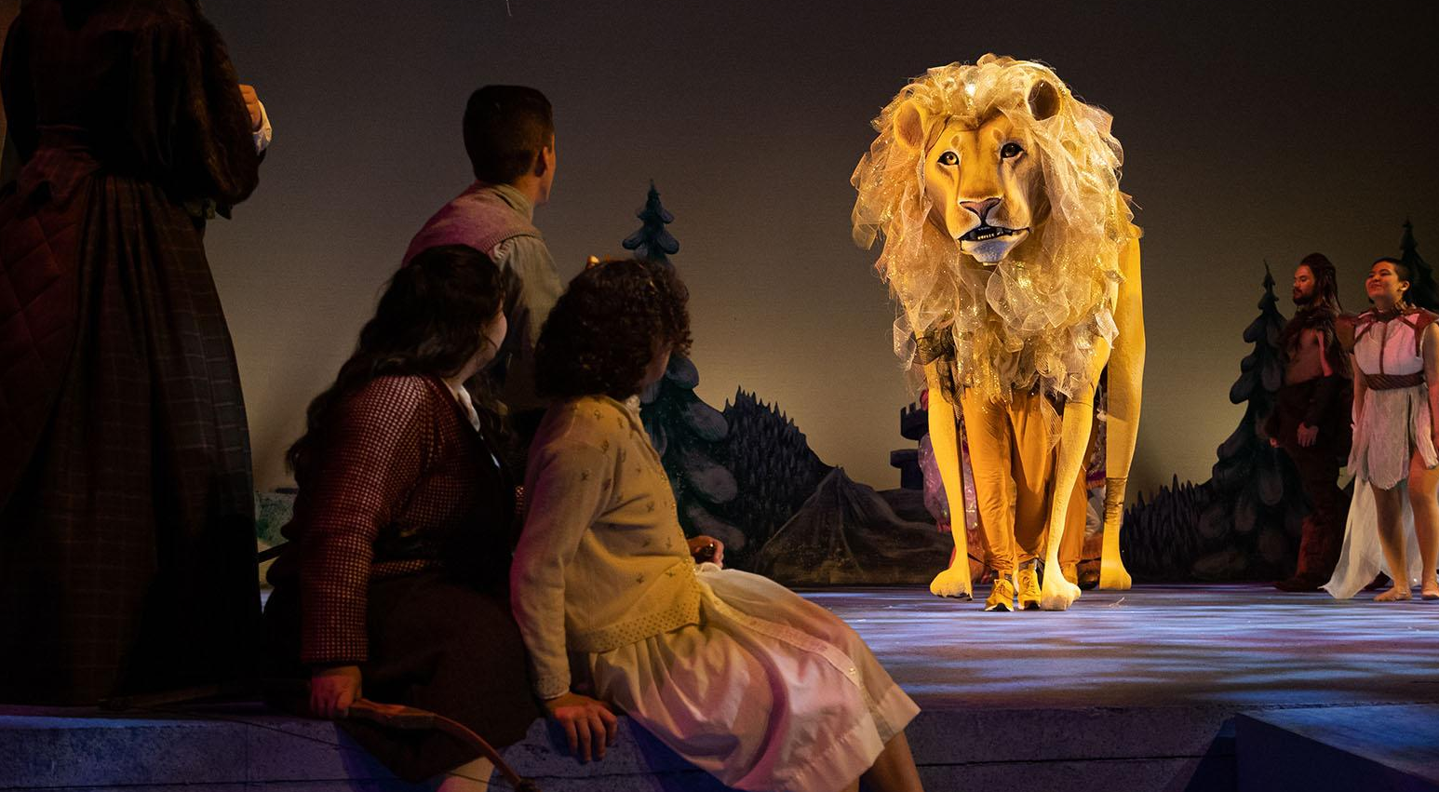
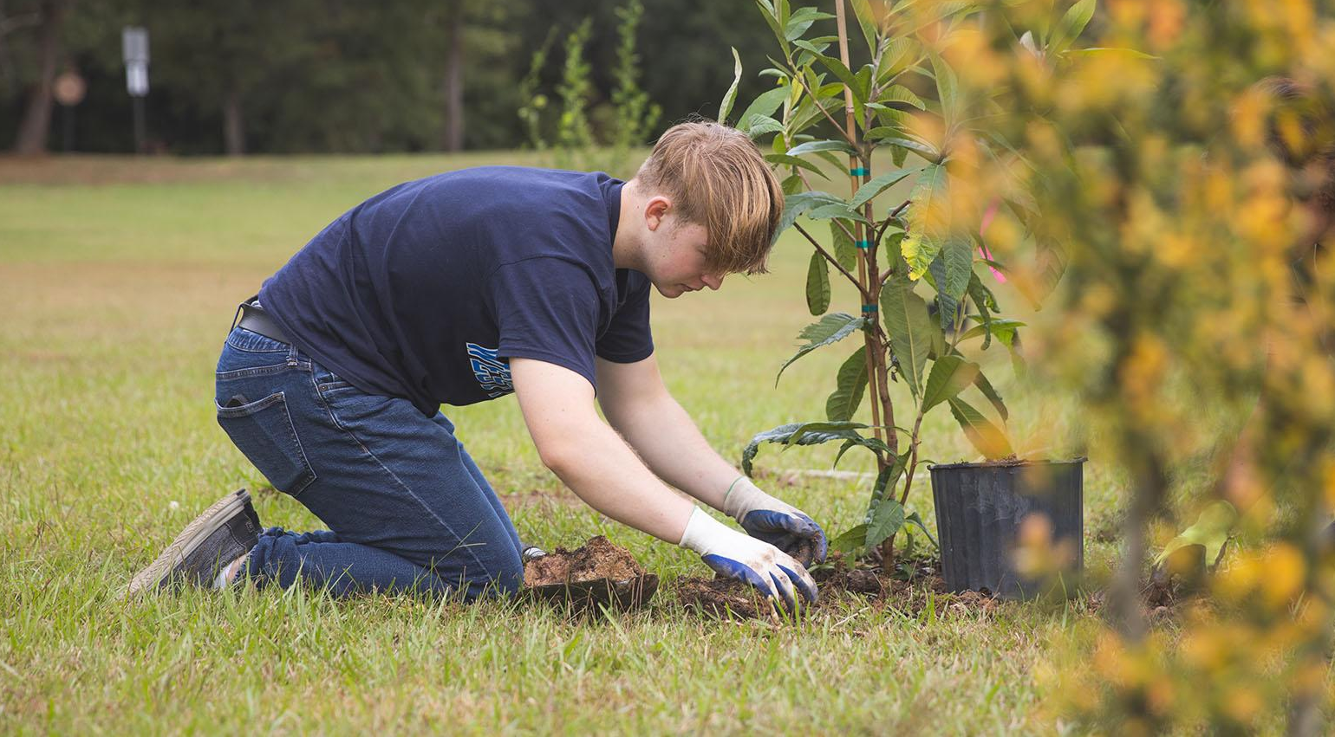
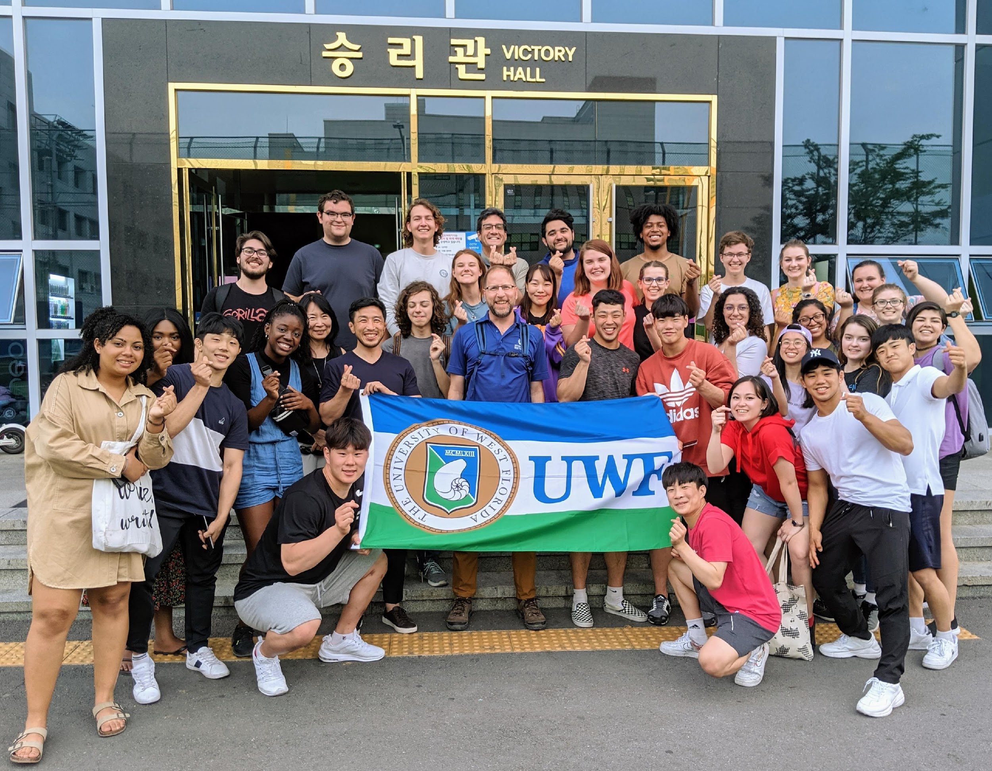
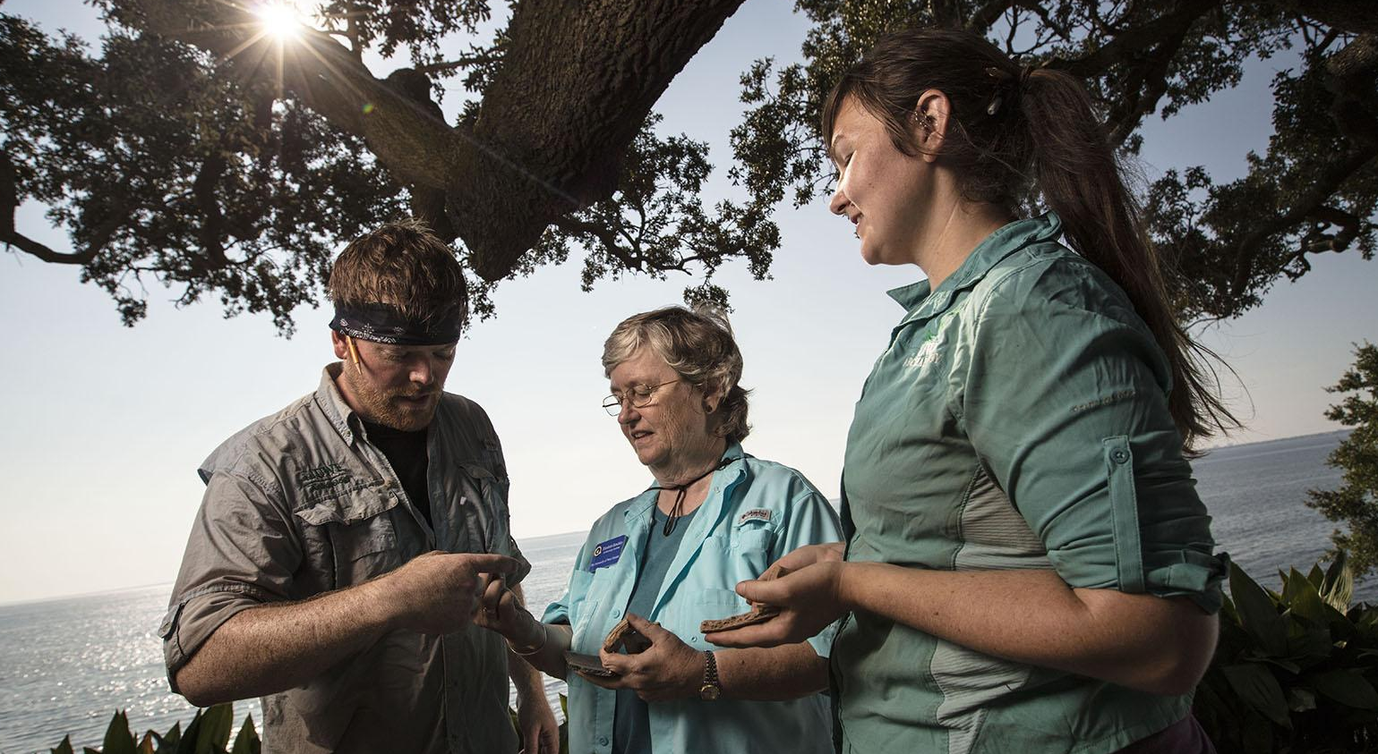

Undergraduate Research
Collaborative Learning
Service Learning
Study Abroad
Fieldwork
Internships and Mentorships
Notes:
Collaborative Learning photo: Engineering and theatre students collaborated to bring Aslan the lion to life for a production of “The Lion, the Witch, and the Wardrobe.” Service Learning: Students and faculty planted fruit-bearing trees as part of an edible campus initiative.

Slide 19
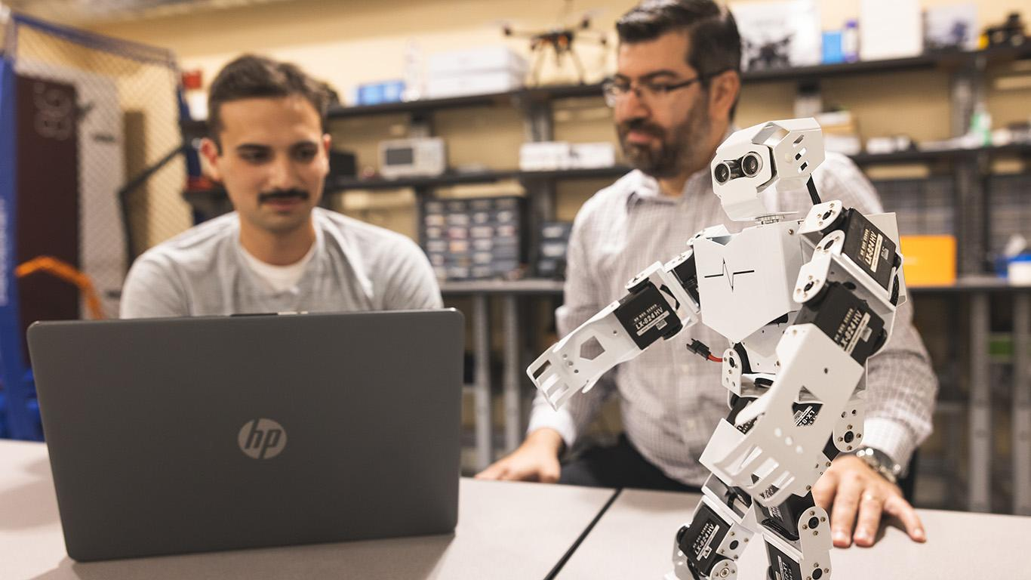
Undergraduate Research
Available to all majors
Explorers Program
Annual Student Symposium & Faculty Research Showcase
Faculty mentors
Notes:
Students from all majors can start pursuing undergraduate research opportunities their first year.

Slide 20
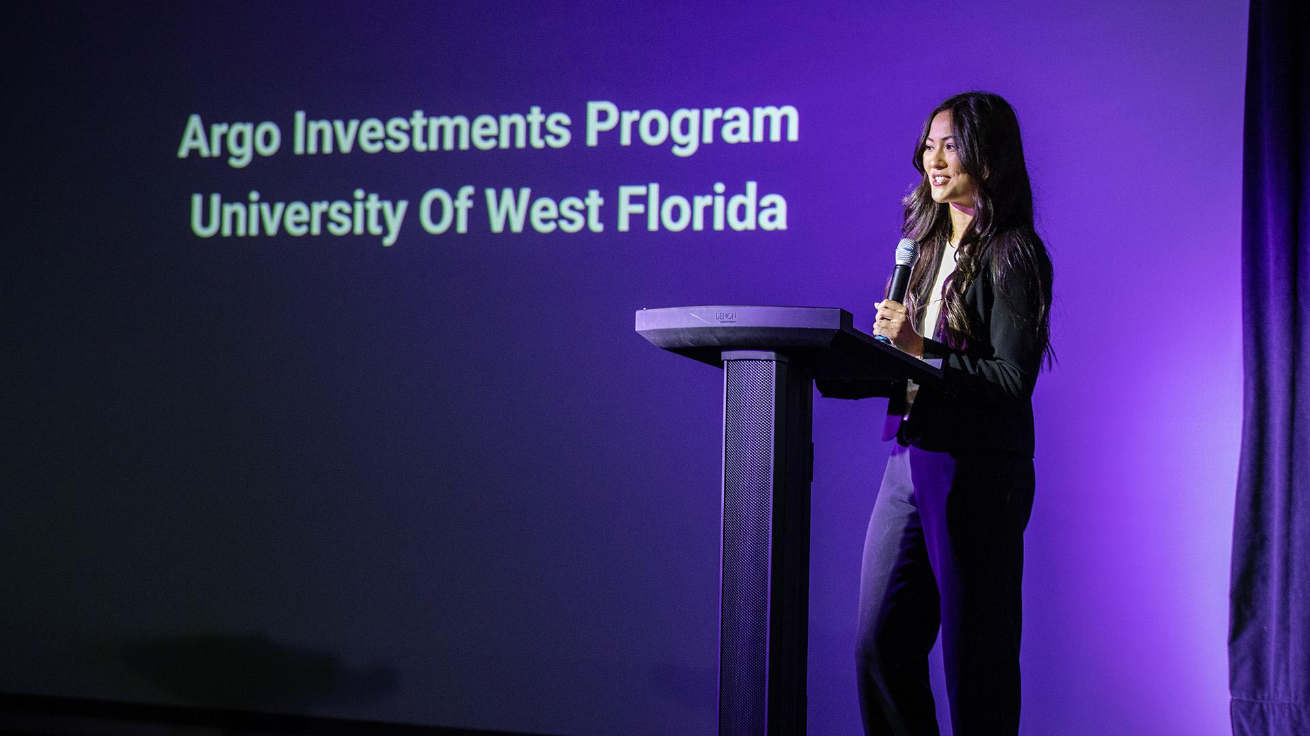
Collaborative Learning
Competition teams
Projects across majors and colleges
BY GRADUATION
68%
OF STUDENTS HAVE COMPLETED TWO HIGH-IMPACT PRACTICES LIKE INTERNSHIPS OR STUDY ABROAD
— UWF 2025 Accountability Plan
Notes:
More than 68% of students have completed two high-impact practices, such as internships or study abroad, by graduation. Photo: Argo Investments Program. Students from the AIP program develop their own investment goals, objectives and criteria for managing their portfolio.

Slide 21
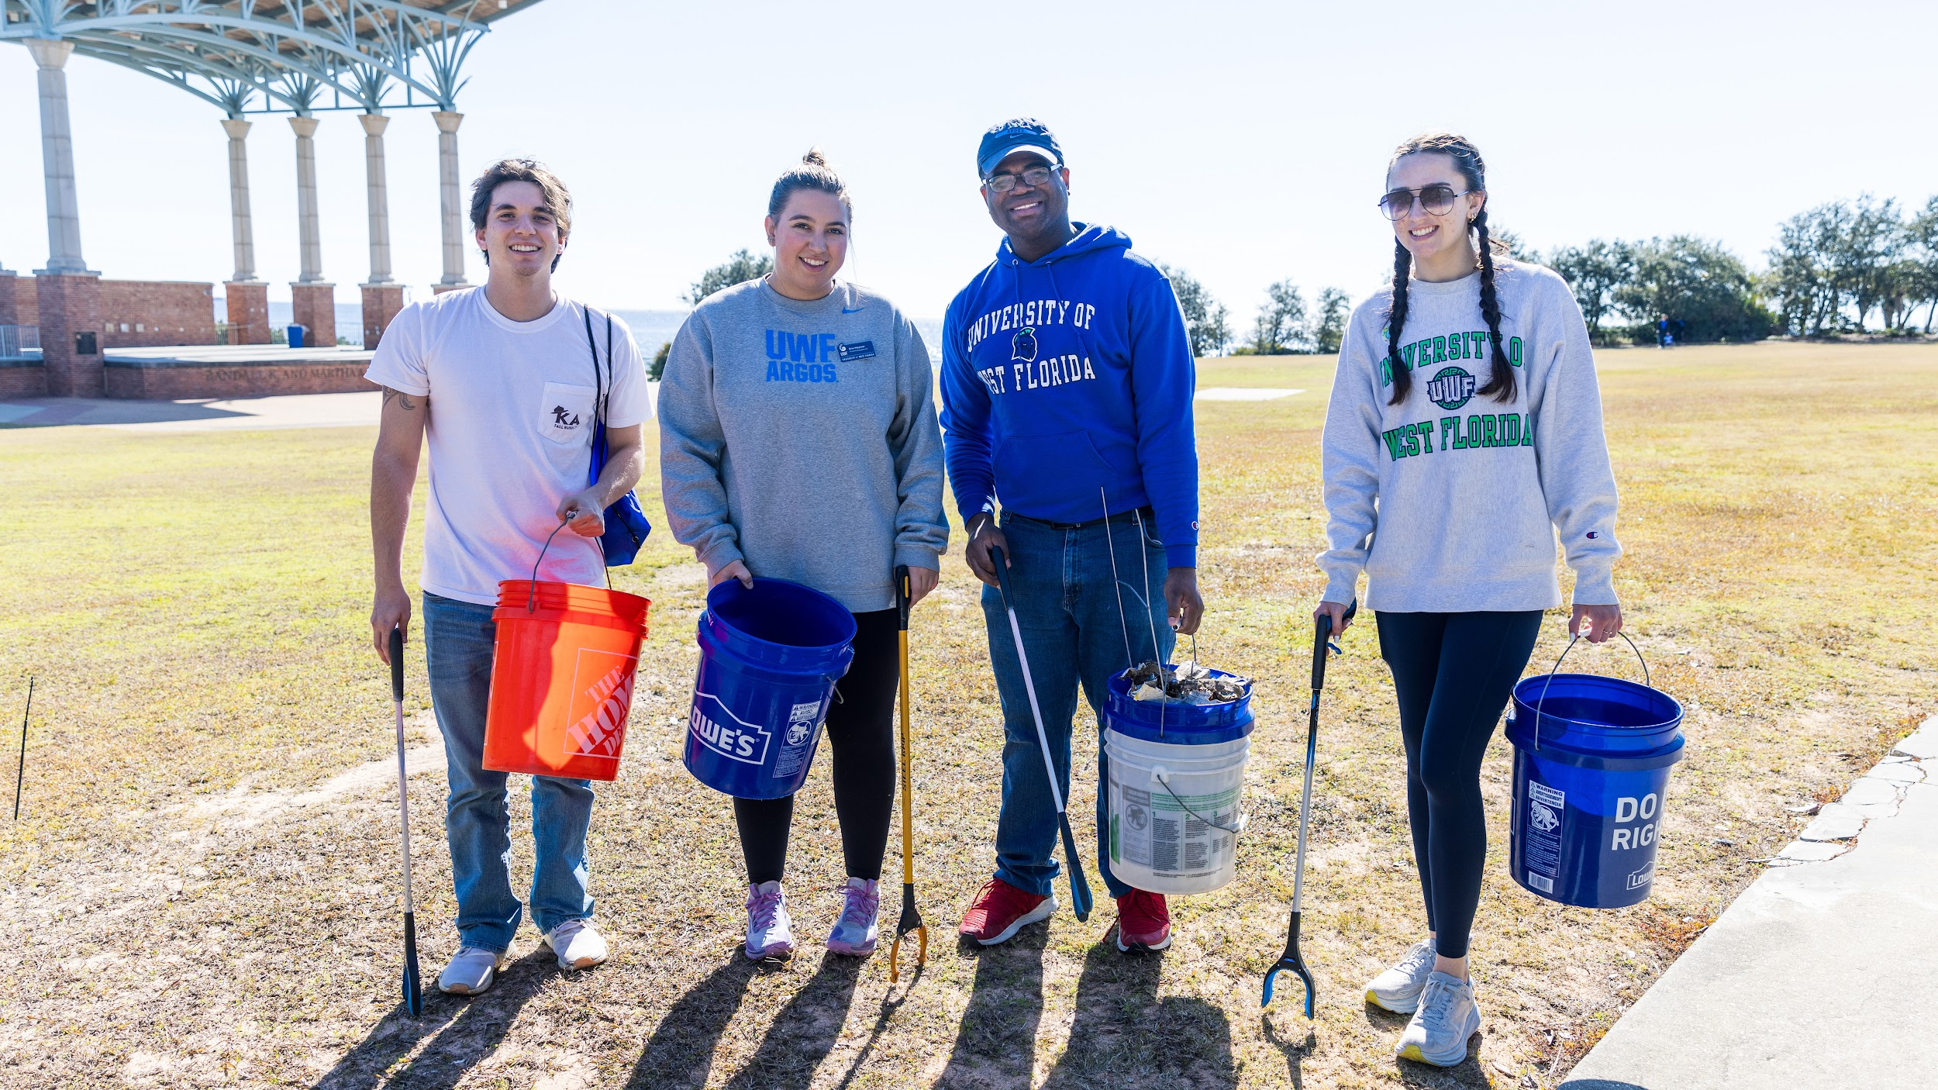
Service Learning
Notes:
Argos volunteering to pick up trash at Community Maritime Park in Downtown Pensacola. Part of UWF's Spring it On events in 2025.

Slide 22
Study Abroad
Exchange partnerships in Europe and Asia
Peace Corps Prep Program
Faculty-led programs across the globe
Planning info to help you prepare

Slide 23

Fieldwork
Notes:
The UWF Archaeology Institute and Department of Anthropology are currently engaged in teaching several undergraduate and graduate students in archaeological methods through a summer 2025 field school, the last half of which is taking place at the site of a former Spanish mission in what is now Molino, Florida.

Slide 24
Internships
Traditional internships
Micro-internships
Project-based experiences

Slide 25
Campus Life
uwf.edu/CampusLife

Slide 26
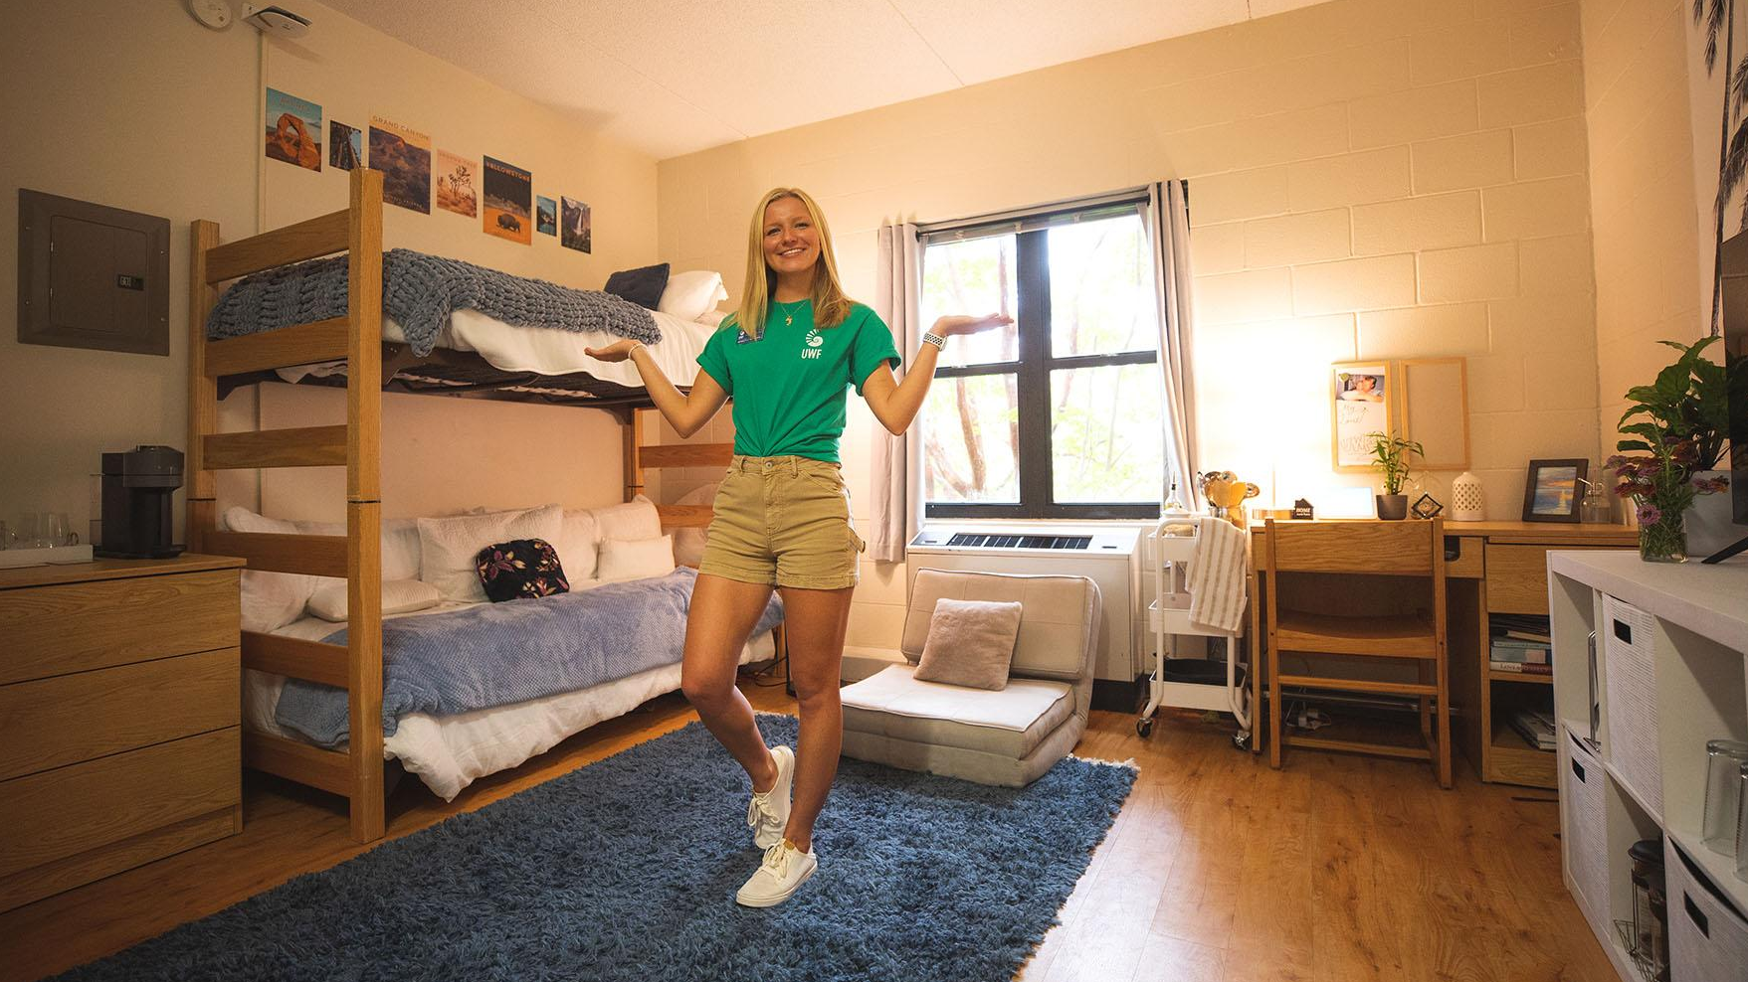
Top reasons to live on campus
Close to class
Close to dining
Amenities included
Financial aid applies
Social opportunities
Notes:
Inside a campus residence hall.

Slide 27

UWF traditions
Freshman Orientation
Argo Arrival
Homecoming and Colchis concert
Spring It On
Founders Week
Notes:
Students celebrate at the Colchis Homecoming concert featuring Big X tha Plug.

Slide 28
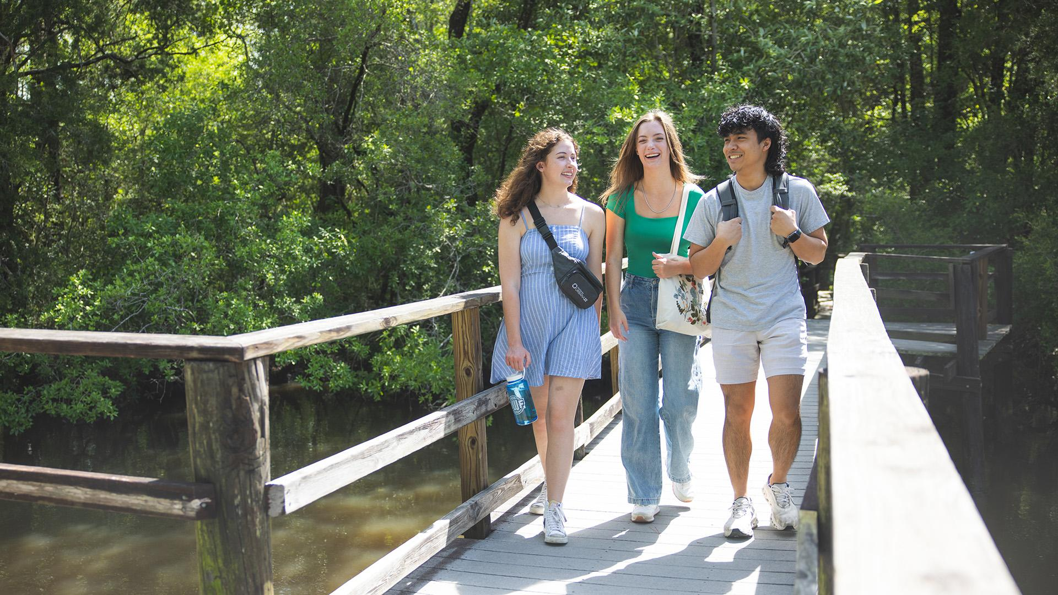
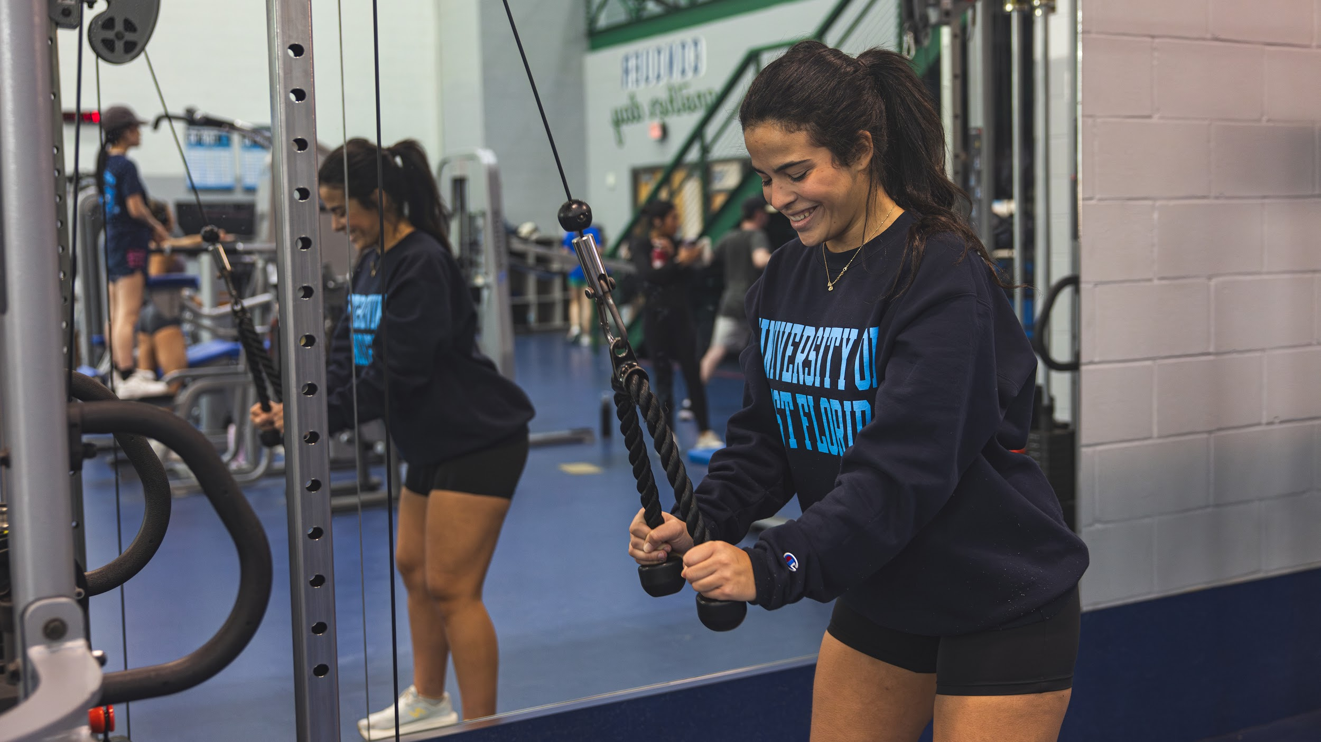
130+
STUDENT ORGANIZATIONS
Things to do!
Recreation and aquatic facilities
Center for Fine and Performing Arts
Canoe rentals
Campus walking and biking trails
Pickleball courts
Disc golf course
17
FRATERNITY AND SORORITY CHAPTERS
Notes:
Students walk the half-mile Edward Ball Nature Trail over Thompson Bayou on campus.

Slide 29
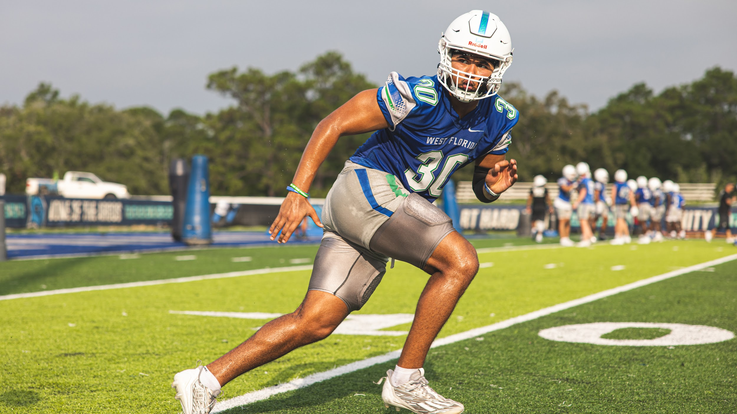

15
NCAA DIVISION II INTERCOLLEGIATE ATHLETICS TEAMS
141
CHAMPIONSHIPS
11 National | 130 Conference

Slide 30
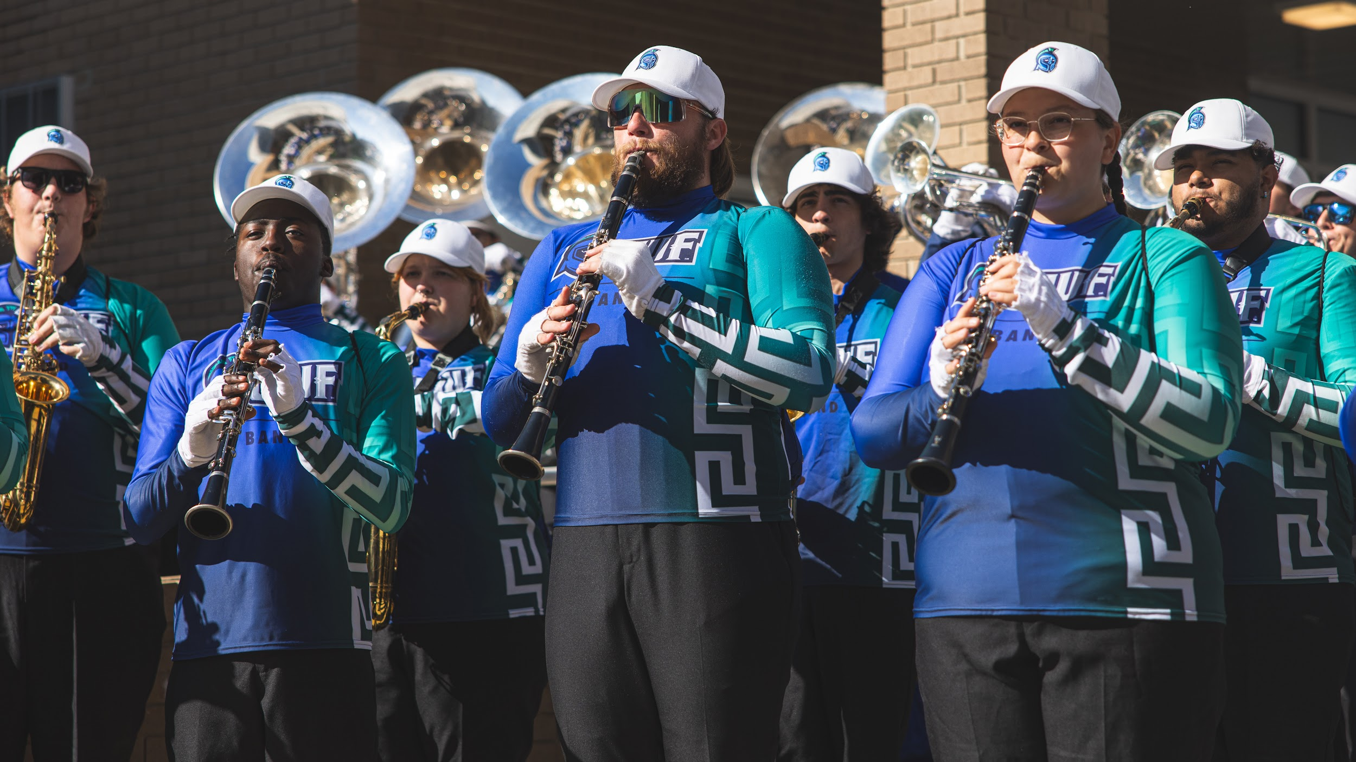
Argo Marching and Pep Bands
Argo Marching Band members of any major can apply for a music scholarship.

Slide 31
Admissions
uwf.edu/GoApply

Slide 32
ADMISSIONS DEADLINES
Dec. 1
Scholarship Priority Consideration
Deadline
April 1
Freshman Application Deadline
May 1
Confirmation Deadline
Notes:
MAIN POINTS: Freshman Fall 2026 admissions decision days. Emphasize that all materials must be submitted by the 1st of the month to get a decision on the 15th. After that, decisions take typically 2 weeks.
We are excited to be accepting applications for our Fall 2026 freshman class! Students can apply online at uwf.edu/GoApply. Then, they can have their high school transcripts and ACT/SAT/CLT scores sent to us electronically or through the mail service. It is important to apply in the fall so they can get an admissions decision as soon as possible! Completed applications that are submitted by the first of the month will get a decision on the 15th. After that, decisions take typically 2 weeks. Applications anticipated to close on April 1st.
Transfer students are issued decisions all year-round for Spring, Summer, and Fall terms. We will need the student’s official transcripts from every other college or university they have attended in order to make an admissions decision. Some transfer students may be required to send us high school transcripts and ACT/SAT/CLT scores. More information on transfer admissions requirements can be found on our website: uwf.edu/transfer.

Slide 33

Application Requirements
Self-Reported Transcript and Academic Record System (STARS) Record
ACT, SAT, or CLT scores
$30 application fee
  Pell-eligible and Title I students receive in-app waiver offer

Slide 34
FRESHMAN ADMISSIONS CONSIDERATION
Minimum requirements for the strongest admissions consideration
GPA
3.00+
Cumulative Weighted
State and subject-area minimum test scores
(ACT, SAT, or CLT)
+
ACT
Reading: 19
Math: 19
English: 17
SAT
Reading/Writing: 490
Math: 480
CLT
Sum-Verbal Reasoning and Grammar/Writing: 38
Quantitative Reasoning: 16
or
or
Notes:
3.00+ GPA plus state and subject-area minimum test scores for the ACT, SAT, or CLT

Slide 35
FRESHMAN CLASS PROFILE
Middle 50th percentile of admitted full-time students
GPA
3.57-4.21
Cumulative Weighted
ACT
20-27
Composite
CLT
48-69
Total
SAT
1020-1220
Combined

Slide 36

Transfer Pathways Program
Advising from a UWF transfer Coach
Degree plan and prerequisites review
Guaranteed admissions to UWF, with no application fee, upon completion of a Associates of Arts Degree.1
2UWF Nautilus Card with access to
UWF libraries, events, intramural sports,
and services
34%
OF INCOMING FIRST-TIME STUDENTS HAVE DUAL ENROLLMENT CREDIT
— Summer/Fall 2025 enrolled students
uwf.edu/Pathways
Notes:
Have dual enrollment credit and want to finish your AA before joining UWF? Consider completing your AA as a transfer student through one of our transfer pathways: uwf.edu/pathways.
Mention our four 2UWF partnered institutions: Pensacola State College, Northwest Florida State College, Gulf Coast State College and Coastal Alabama Community College.
Transfer students are issued decisions all year-round for Spring, Summer, and Fall terms. We will need the student’s official transcripts from every other college or university they have attended in order to make an admissions decision. Some transfer students may be required to send us high school transcripts and ACT/SAT/CLT scores. More information on transfer admissions requirements can be found on our website: uwf.edu/transfer.
1 Coastal Alabama2UWF participants may complete an A.S.

Slide 37
Cost and Financial Aid
uwf.edu/Costs

Slide 38
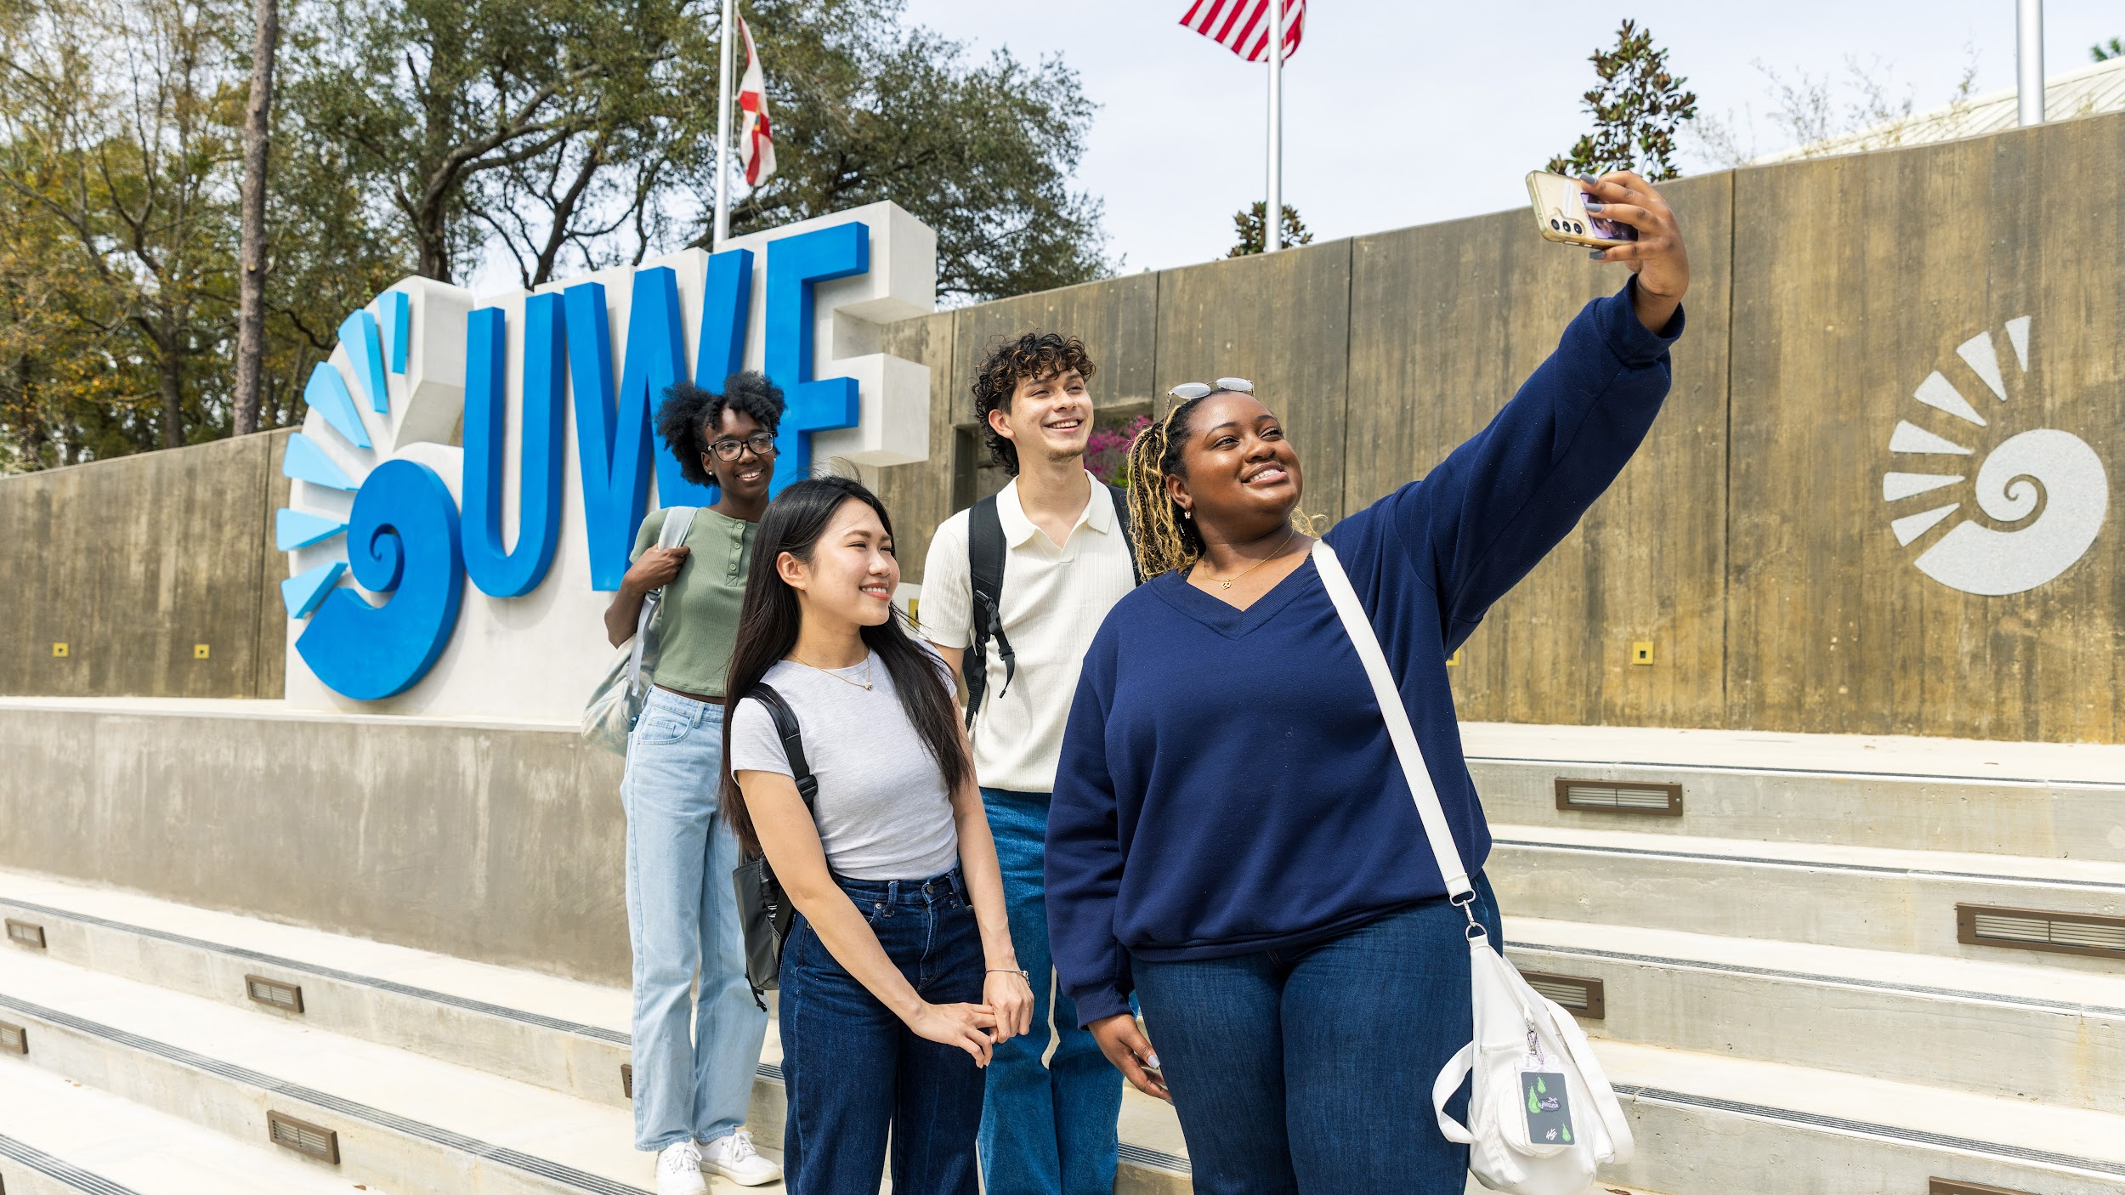
FRESHMAN FINANCIAL AID
2024-2025
$11M
OFFERED IN GIFT AID
90%
OF NEW STUDENTS WERE OFFERED AID
Affordability
In-state tuition unchanged for 10+ years
Automatic-consideration merit scholarships
Argo 30 Guarantee: Fall/spring tuition coverage for eligible Pell Florida residents
Full-ride scholarship opportunities

Slide 39
ESTIMATED FIRST-YEAR COSTS BEFORE FINANCIAL AID
RESIDENCE | FLORIDA | ALABAMA | OUT OF STATE
$/Credit Hour | $212 | $317 | $642 Increase anticipated for 2026-2027
Tuition¹ | $6,360 | $9,510 | $19,260 Increase anticipated for 2026-2027
Housing² | $6,366 | $6,366 | $6,366
Meals³ | $5,136 | $5,136 | $5,136
Total Estimated Cost | $18,074 | $21,329 | $31,404
Based on 2025-2026 costs for fall/spring semesters. Costs are subject to change. ¹30 credit hours of tuition and fees ²Shared Suite (Martin/Pace Halls: $3,183/semester) ³Argo 15 plan: 15 meals/week + $300 Dining Dollars ($2,568/semester), other options available

Slide 40
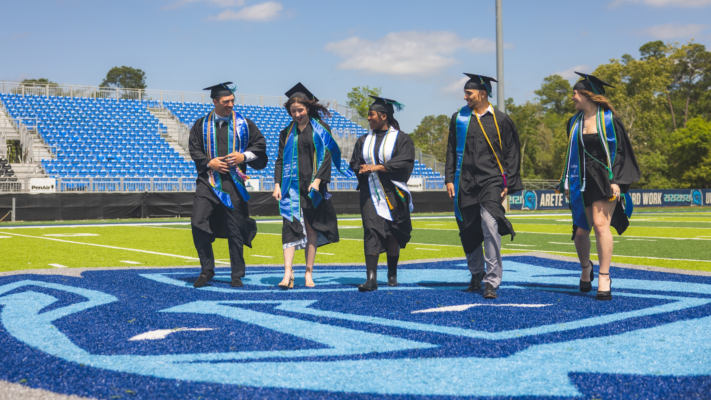
Complete
the FAFSA!
StudentAid.gov
UWF Code: 003955
Notes:
Students, regardless of Florida Bright Future eligibility, other tuition coverage, and income, should complete the FAFSA.

Slide 41

Scholarship Priority Consideration Deadline
Dec. 1
uwf.edu/Deadlines

Slide 42
FRESHMAN ACADEMIC MERIT SCHOLARSHIP CONSIDERATION
HS GPA¹ | SAT² or | ACT³ or | CLT | FLORIDA | ALABAMA | OUT OF STATE
4.00+ | 1400+ | 31+ | 101+ | $16,000 | $16,000 | $32,000
3.80-3.99 | 1260-1390 | 27-30 | 89-100 | $12,000 | $12,000 | $24,000
3.70-3.79 | 1160-1250 | 24-26 | 79-88 | $8,000 | $8,000 | $8,000
¹Cumulative weighted ²SAT Total ³ACT Composite
uwf.edu/FreshmanScholarships

Slide 43

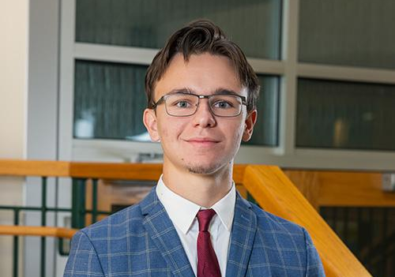
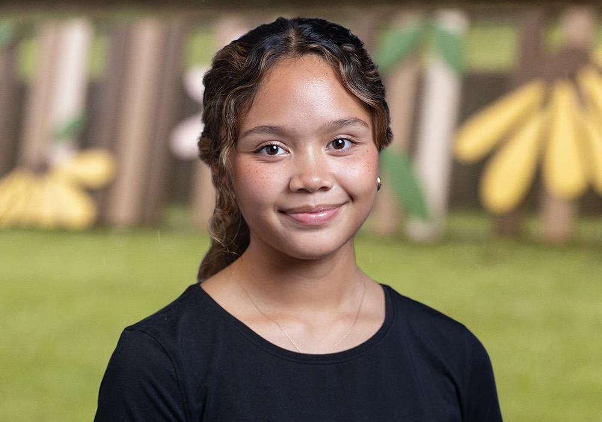
FRESHMAN FULL-RIDE SCHOLARSHIPS
Pace Presidential
National Merit Finalist
Argo Spirit
Pace Presidential
Invites sent to qualifying admitted students who meet the Dec. 1 Merit Scholarship Consideration Deadline
Winners chosen by combined essay and interview scores
Competition dates early 2026
National Merit
Finalists qualify
Must start at UWF the fall immediately following high school graduation
Argo Spirit
For Pell-eligible first-year Florida residents
Contest based on video and written essays
March 1, 2026, deadline
Notes:
Image 2: 2024 National Merit Finalist Garrett Smith of Gulf Breeze. Image 3: Ikia Urap Cook, one of five Argo Spirit winners for 2024.

Slide 44

FULL SCHOLARSHIP BENEFITS
Scholarship | Fall and Spring Tuition | Meal Plan | Campus Housing | $800 Textbook Stipend per Semester | Paid Research or Study Abroad (up to $1,500 value)
Pace Presidential
National Merit Finalist
Argo Spirit

Slide 45
Learn More
uwf.edu/GoApply

Slide 46
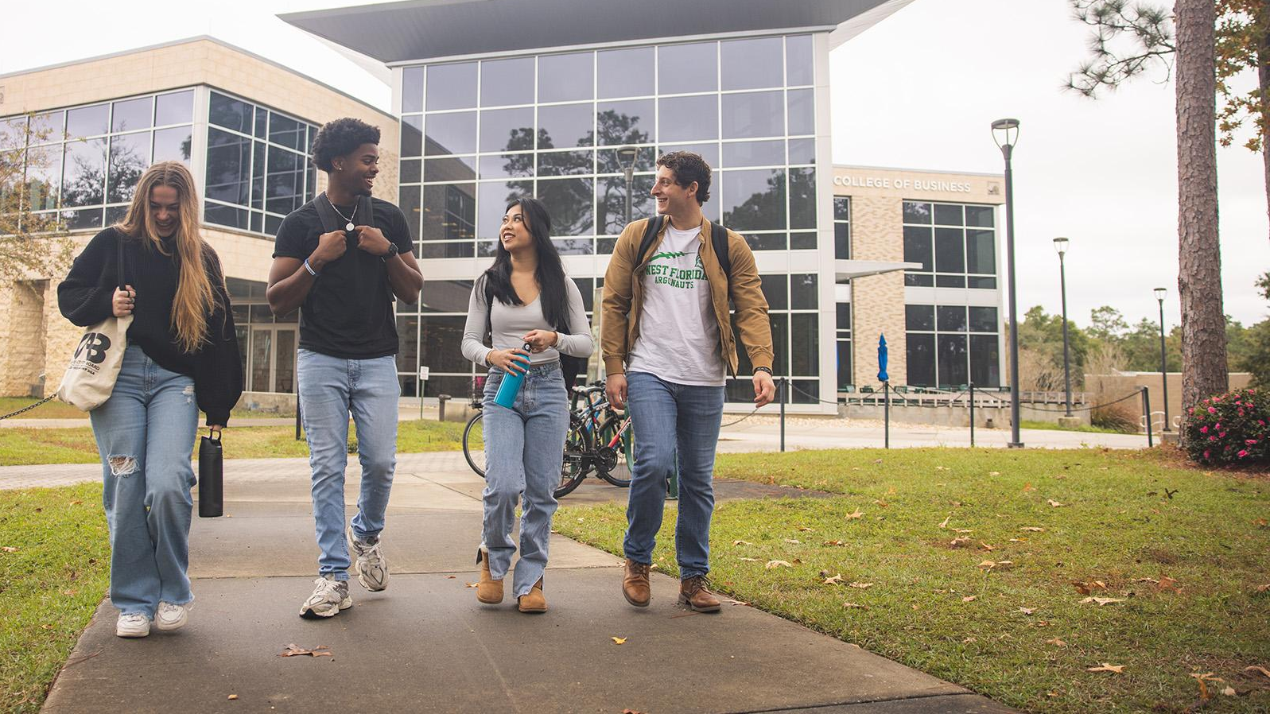
Events
Explore UWF! Open House
Fall: Nov. 15 | Spring: April 18
Argo Information Virtual Sessions
For prospective students
Argo Enrollment Virtual Sessions
For admitted students
uwf.edu/AdmissionsEvents

Slide 47
Notes:
This past winter, UWF experienced a record-breaking snowfall of nearly 10 inches!

