Slide 1
SHAPE THE FUTURE
// At the University of South Florida //
e
Being Bold is Who We Are
usf.edu/admissions

Slide 2
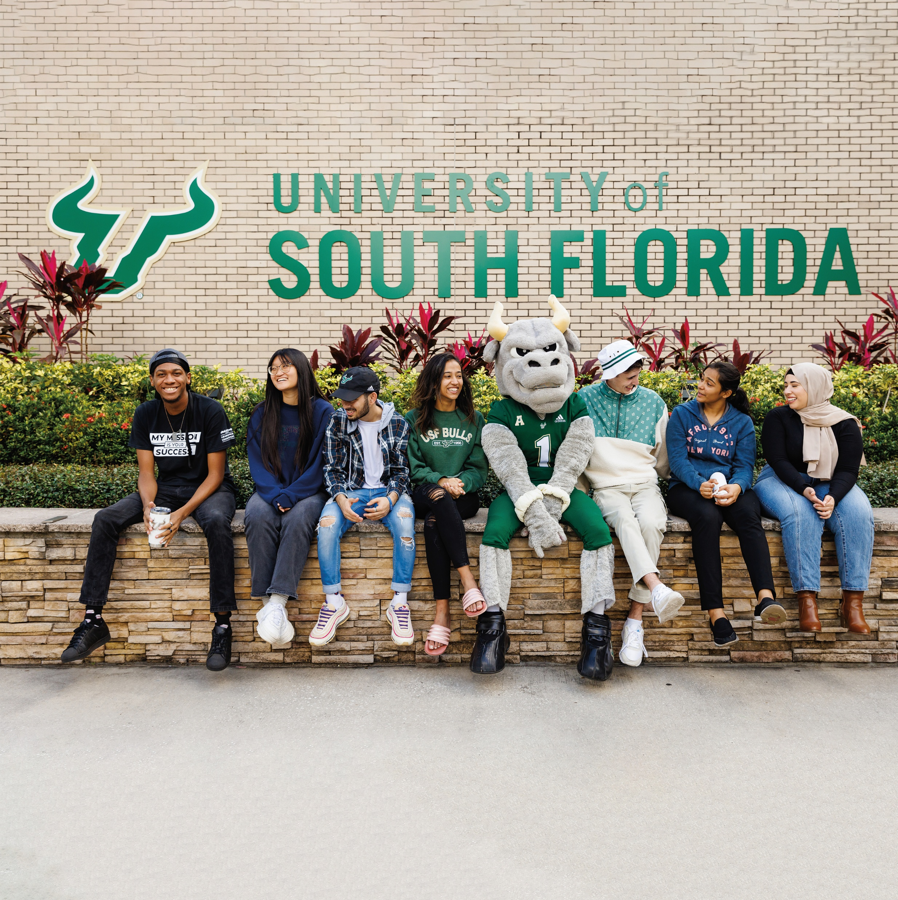
Get to Know USF
Over 48,000 enrolled students call USF home. Here’s why they chose us.
3
Campuses along the Gulf Coast
1000⁺
On-campus events each year
21
NCAA Division I Athletics Teams
700⁺
Student clubs
and organizations

Slide 3
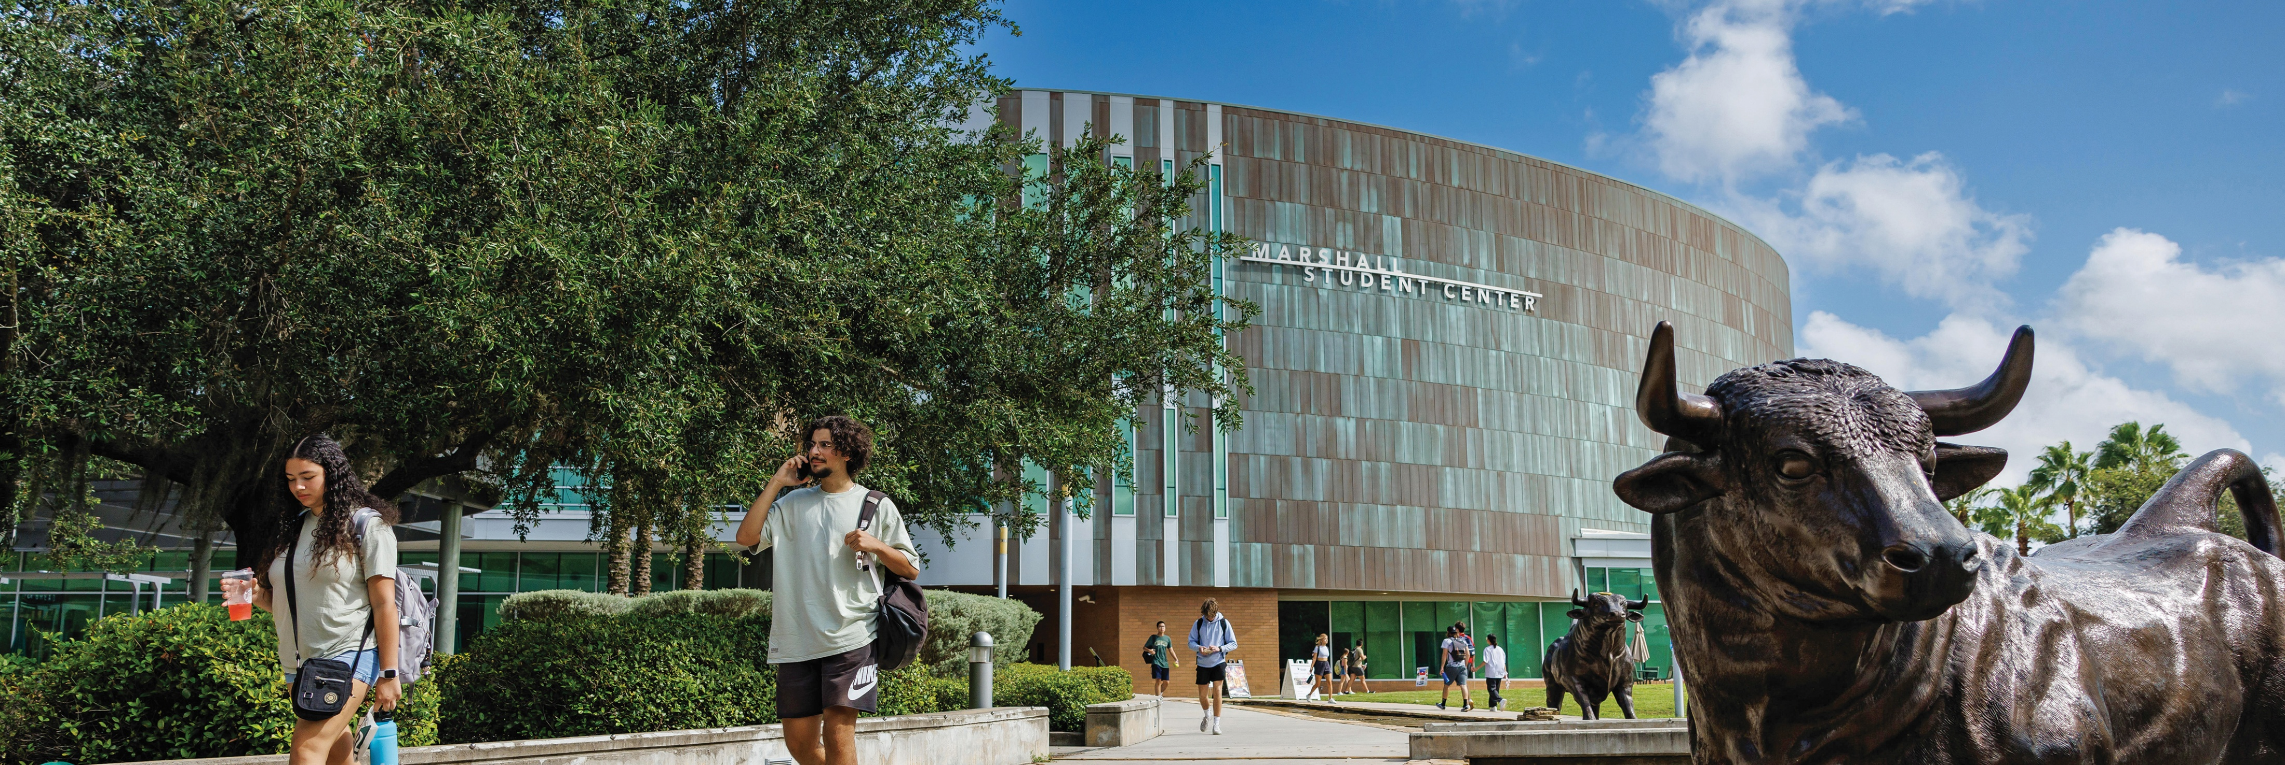
Bulls Have a Lot to Brag About // How We Rank
Top 3
among Florida universities in
four-year
graduation rate
Florida Board of Governors, 2025
Top 50
among U.S. public universities
U.S. News and World Report National University Rankings, 2025; Forbes America’s Top Colleges, 2024
#1
among U.S. public universities for commitment to industry, innovation and infrastructure
Times Higher Education’s (THE) University Impact Rankings, 2024
AAU
Joined the prestigious AAU in 2023 in recognition of excellence in research

Slide 4
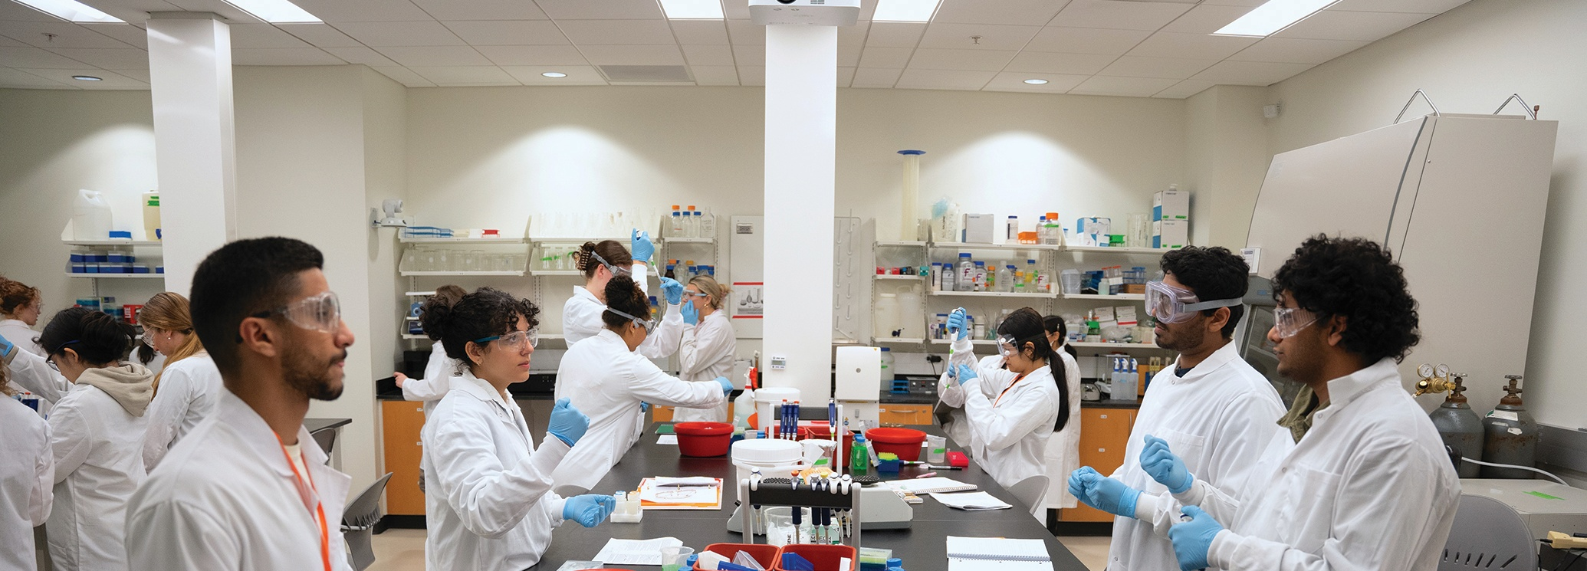
Bulls Get More but Pay Less
#1
best value among all Florida universities
U.S. News and World Report, 2025
Top 50
best value college
The Princeton Review, 2023
Top 5
Most affordable U.S. college
Research.com, 2024

Slide 5
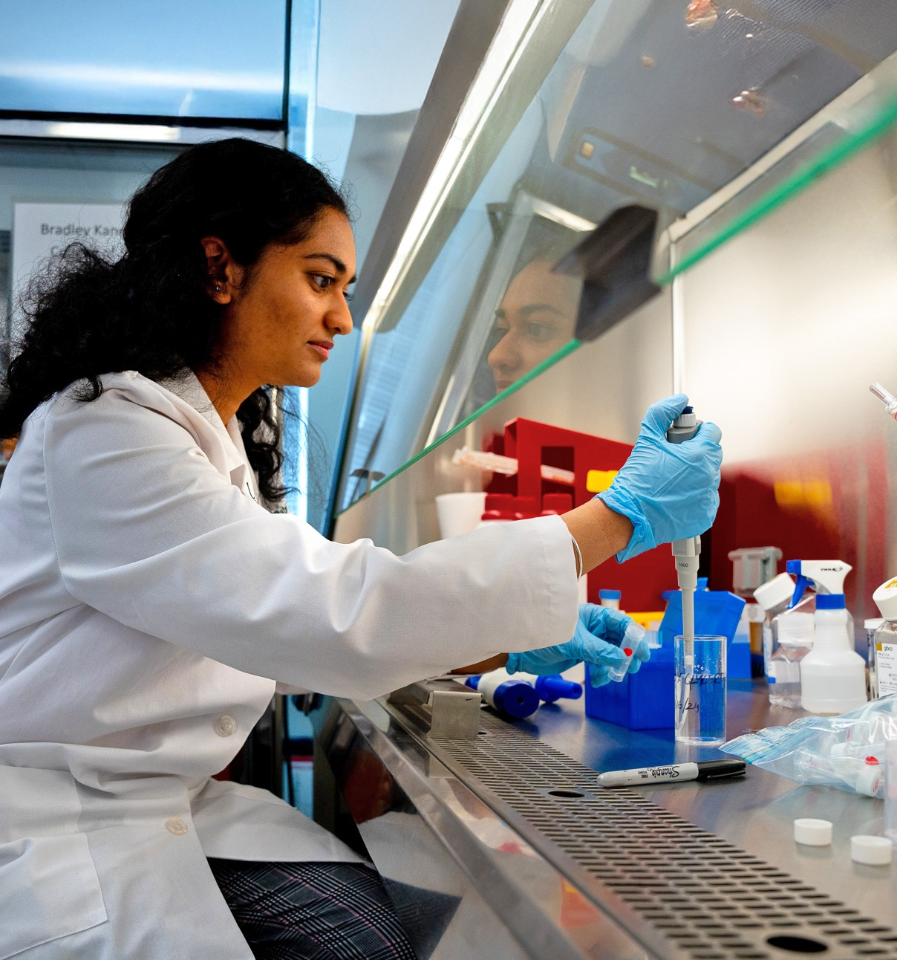
Bulls are
Building Momentum
What’s New in 2025?
The USF Health Morsani College of Medicine was ranked #1 in Florida
and joined the highest tier of medical schools (U.S. News and World Report).
We’ve launched the Bellini College of Artificial Intelligence, Cybersecurity
and Computing to probe new frontiers.
We’ve broken ground on a new
on-campus football stadium,
opening fall 2027.
Each year, we mark new milestones.
UNIVERSITY OF SOUTH FLORIDA // 5

Slide 6
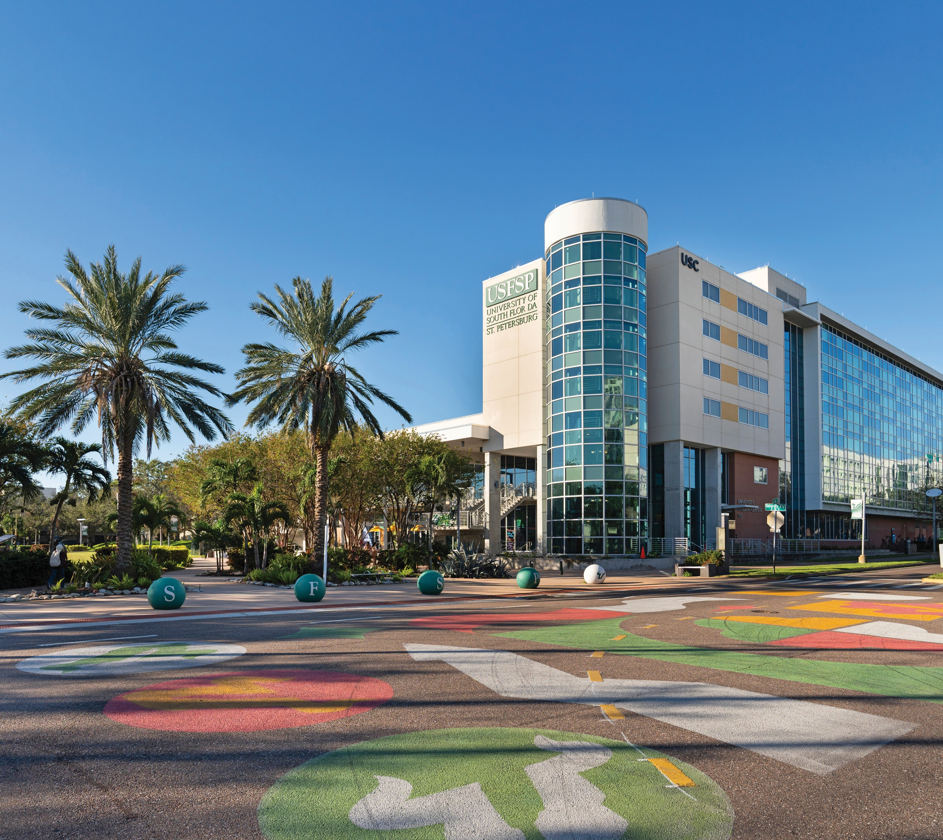
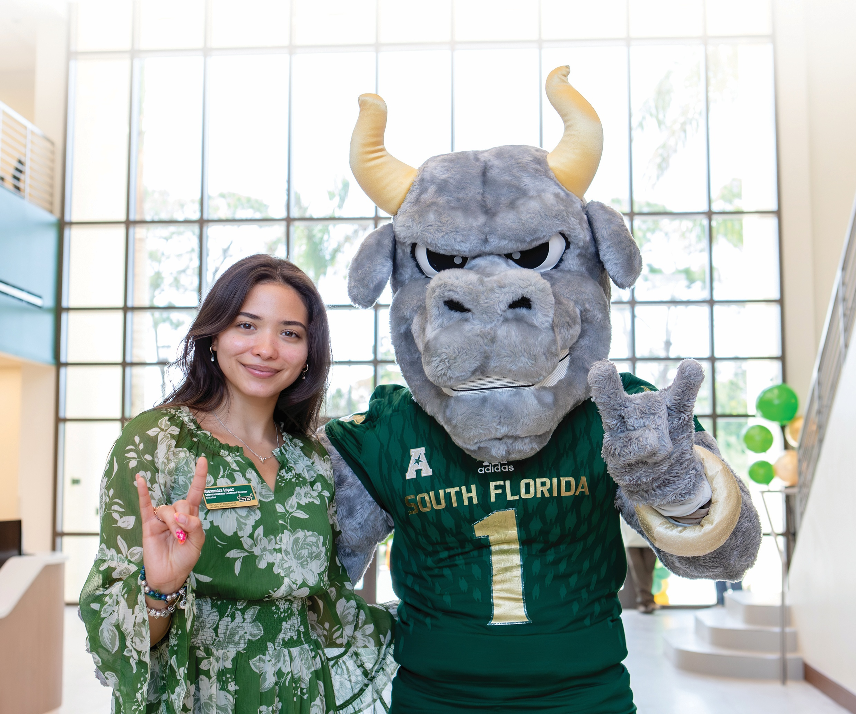
Tampa Campus
St. Petersburg Campus
Sarasota-Manatee Campus
Where there’s more to explore.
Where city meets sand.
Where community creates opportunity.
HIGHLIGHTS
HIGHLIGHTS
HIGHLIGHTS
~40,000 students
Signature Programs include: Computer Science, Nursing, Engineering, Design, Art & Performance
~4,000 students
Signature programs include: Marine Biology, Graphic Arts, Sustainability Studies, Digital Communication
~2,000 students
Signature programs include: Business Analytics & Information Systems, Elementary Education, Nursing
(accelerated 2nd degree)

Slide 7
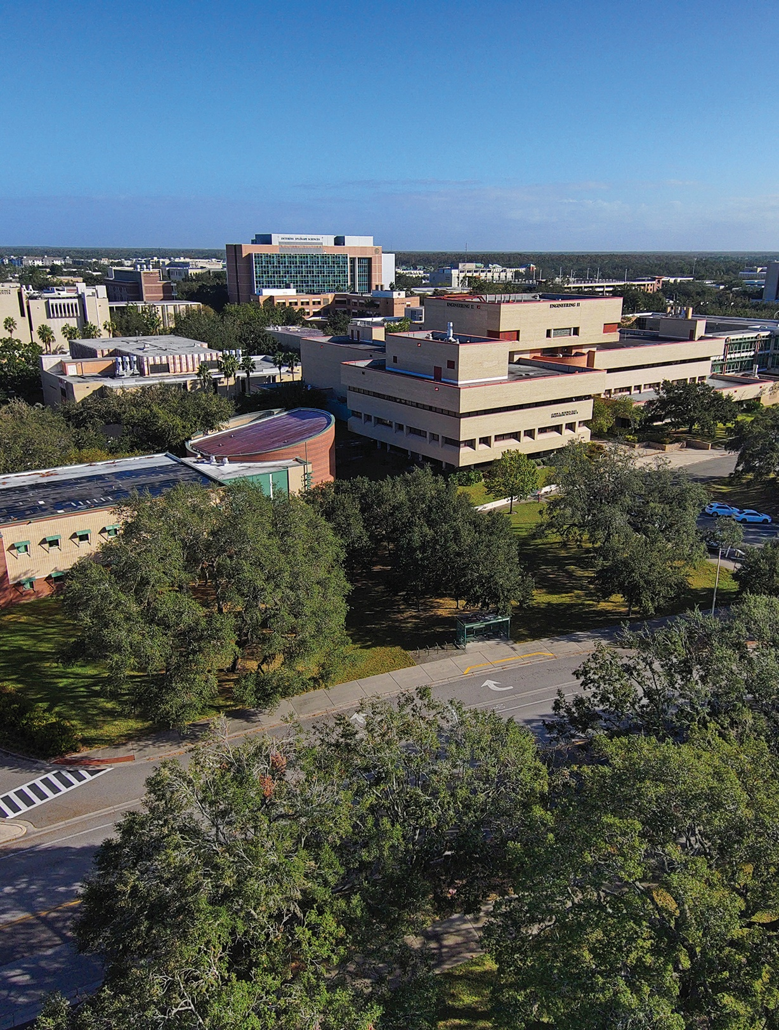
Bulls Can Follow
Their Precise Passion
240⁺
Majors and Concentrations
USF surges with academic opportunity.
Drive progress through research:
$738 million in research funding (2024) with opportunities as early as freshman year
Pushing limits through the Judy Genshaft Honors College: Innovative courses, experiential learning, accelerated programs and a supportive community
This is where personal inspiration produces
transformative results.
14
Colleges
22:1
Student-to-Faculty Ratio

Slide 8
Meet Our Bold Bulls
Essential admissions info incoming!
Take notes now or wait to receive a copy
of these slides later.
Admitted Student Profile
Middle 50% of admitted USF students for 2025
 | Middle 50% GPA | Middle 50% SAT Scores | Middle 50% ACT Scores | Middle 50% CLT Scores
Fall Admits | 4.03-4.55 | 1260-1410 | 27-31 | 86-97
Summer Admits | 3.61 | 1110-1220 | 23-26 | 71-85

Slide 9
Admission Dates and Deadlines
Fall/Summer 2026 Semester Start
 | Early Action | Regular Decision | Rolling
Application Deadline | November 1 | December 15 | March 1
Materials Deadline | November 15 | January 15 | March 15
Decision Release | December 10 | February 11 | Released on a rolling basis in early March

Slide 10
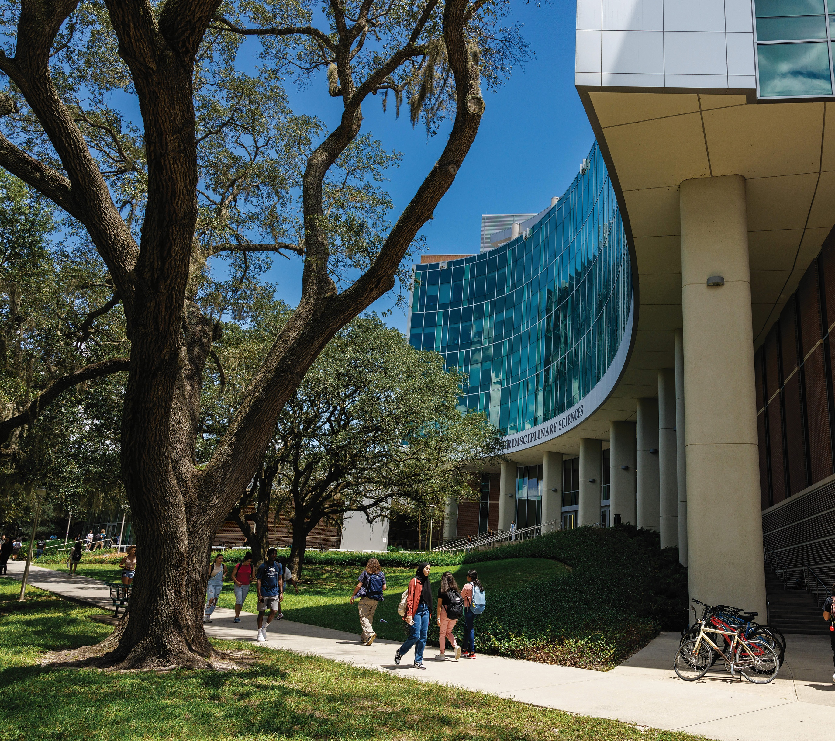
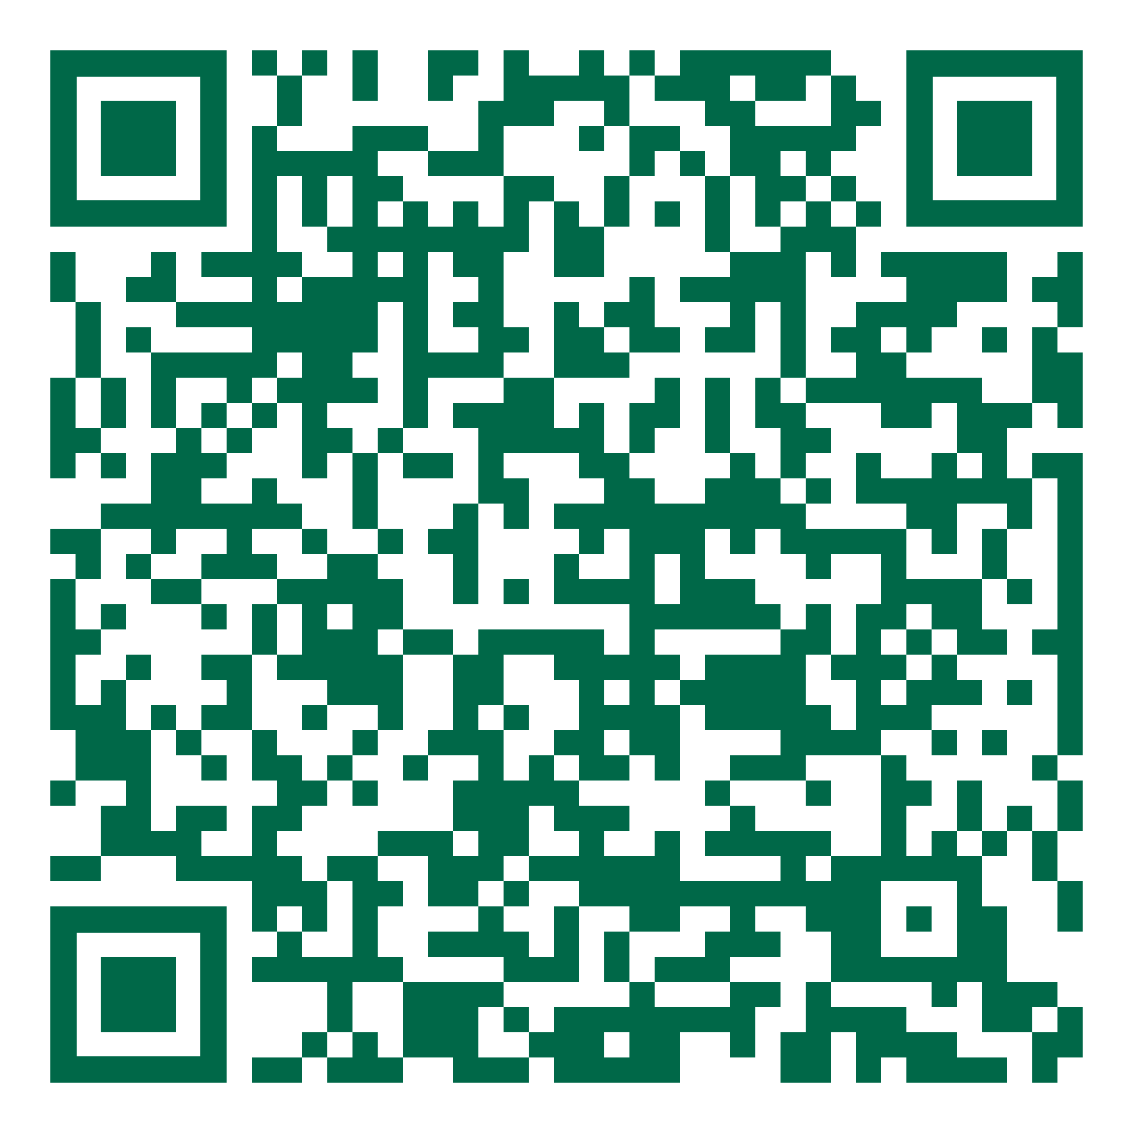
Become a Bull
Application Process
Academic Requirements
Apply
usf.edu/application
$30 application fee
STARS
(Self-reported Transcript and Academic Record System)
Test Scores
ACT, SAT or CLT (superscored)
admissions.usf.edu/
academic-requirements

Slide 11
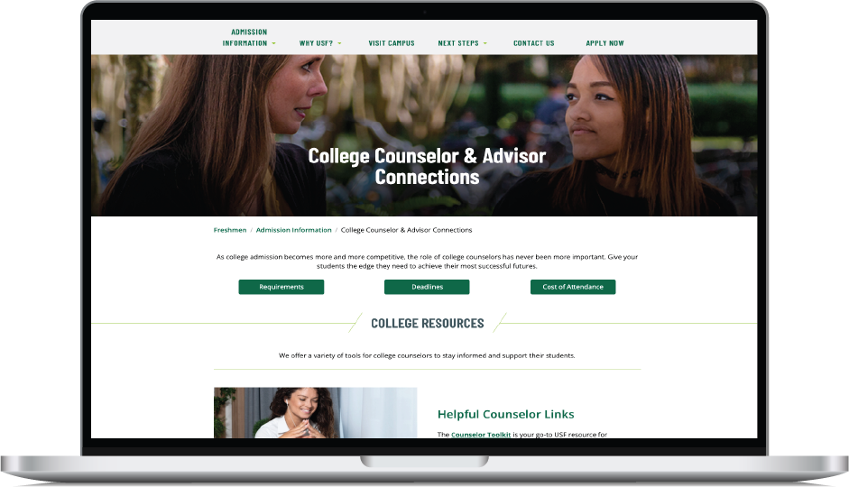
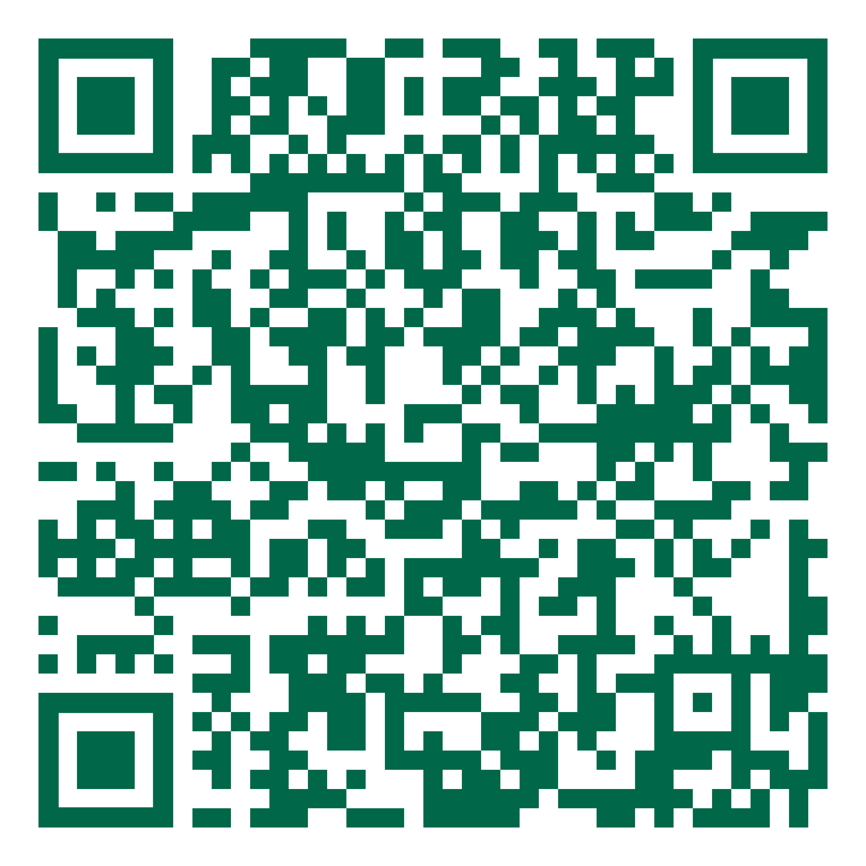
Bulls Want to Connect with You!
Curated Resources for College Counselors
Sign up for our Counselor Newsletter!
admissions.usf.edu/
counselor-resources

Slide 12

Bulls Can Find Their Perfect Campus Fit
Tampa Campus
Where there’s more to explore.
Bustling, metropolitan campus
30 residence halls
3 dining halls
20+ restaurants
Signature Programs
Computer Science
Nursing
Business
Engineering
Design, Art & Performance
St. Petersburg Campus
Where city meets sand.
Artsy, waterfront campus
3 residence halls
3 restaurants
15-minute ride to St. Pete Beach
Signature Programs
Marine Biology
Graphic Arts
Sustainability Studies
Digital Communication
Finance
Sarasota-Manatee Campus
Where community creates opportunity.
Tight-knit, hometown campus
1 new residence hall and
student center
200 students living on campus
15-minute drive to Siesta Beach
(#1 in U.S.A.)
Signature Programs
Business Analytics & Information Systems
Elementary Education
Biomedical Sciences
Criminology
Nursing (accelerated 2nd degree)

