Slide 1
2025 Admissions Tour
Celebrating 50 Years of Excellence
in Education

Slide 3
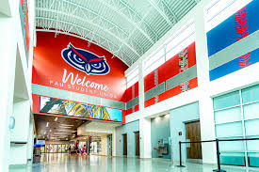
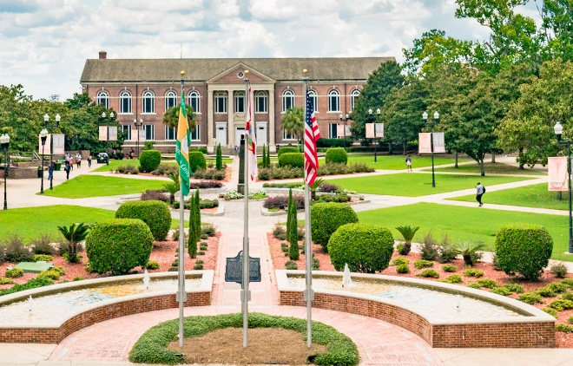
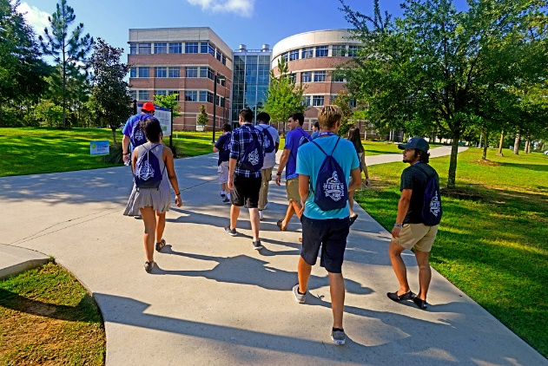
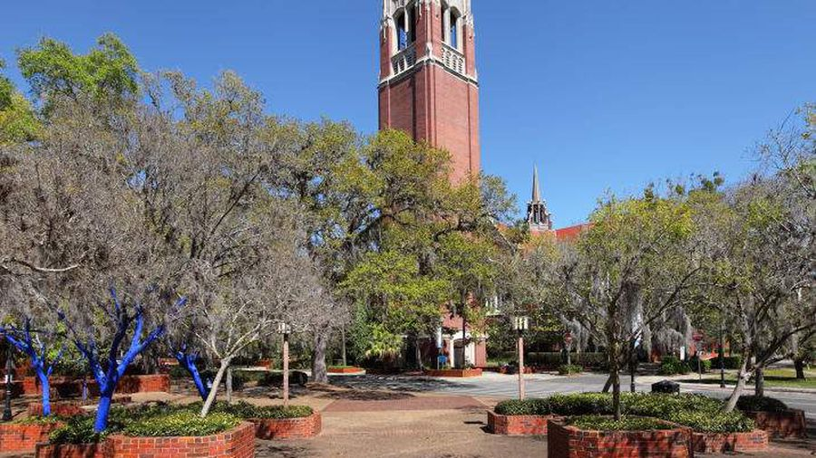
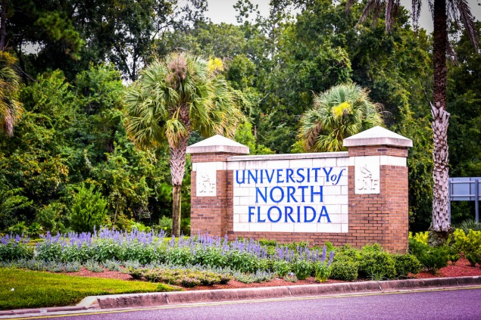

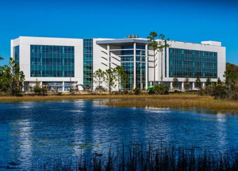
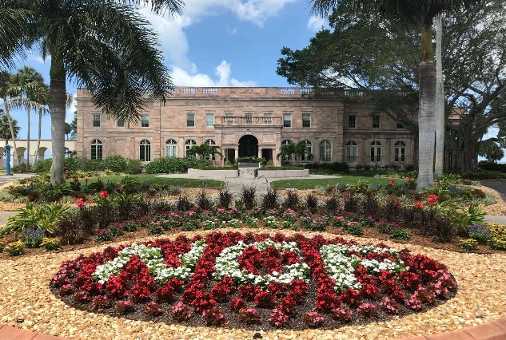
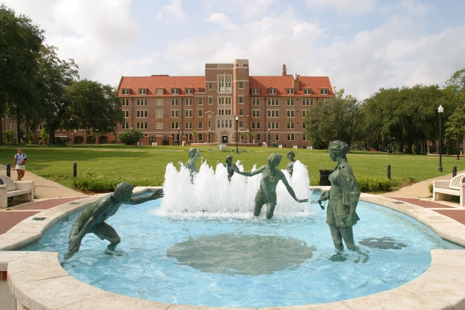
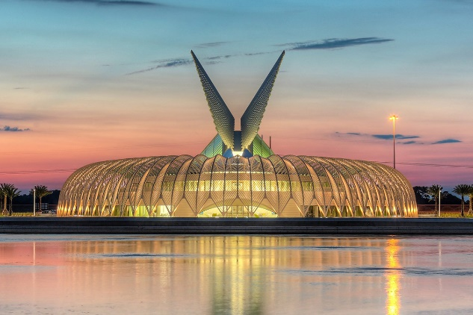
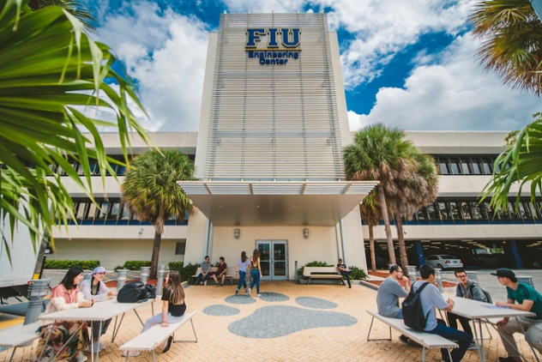
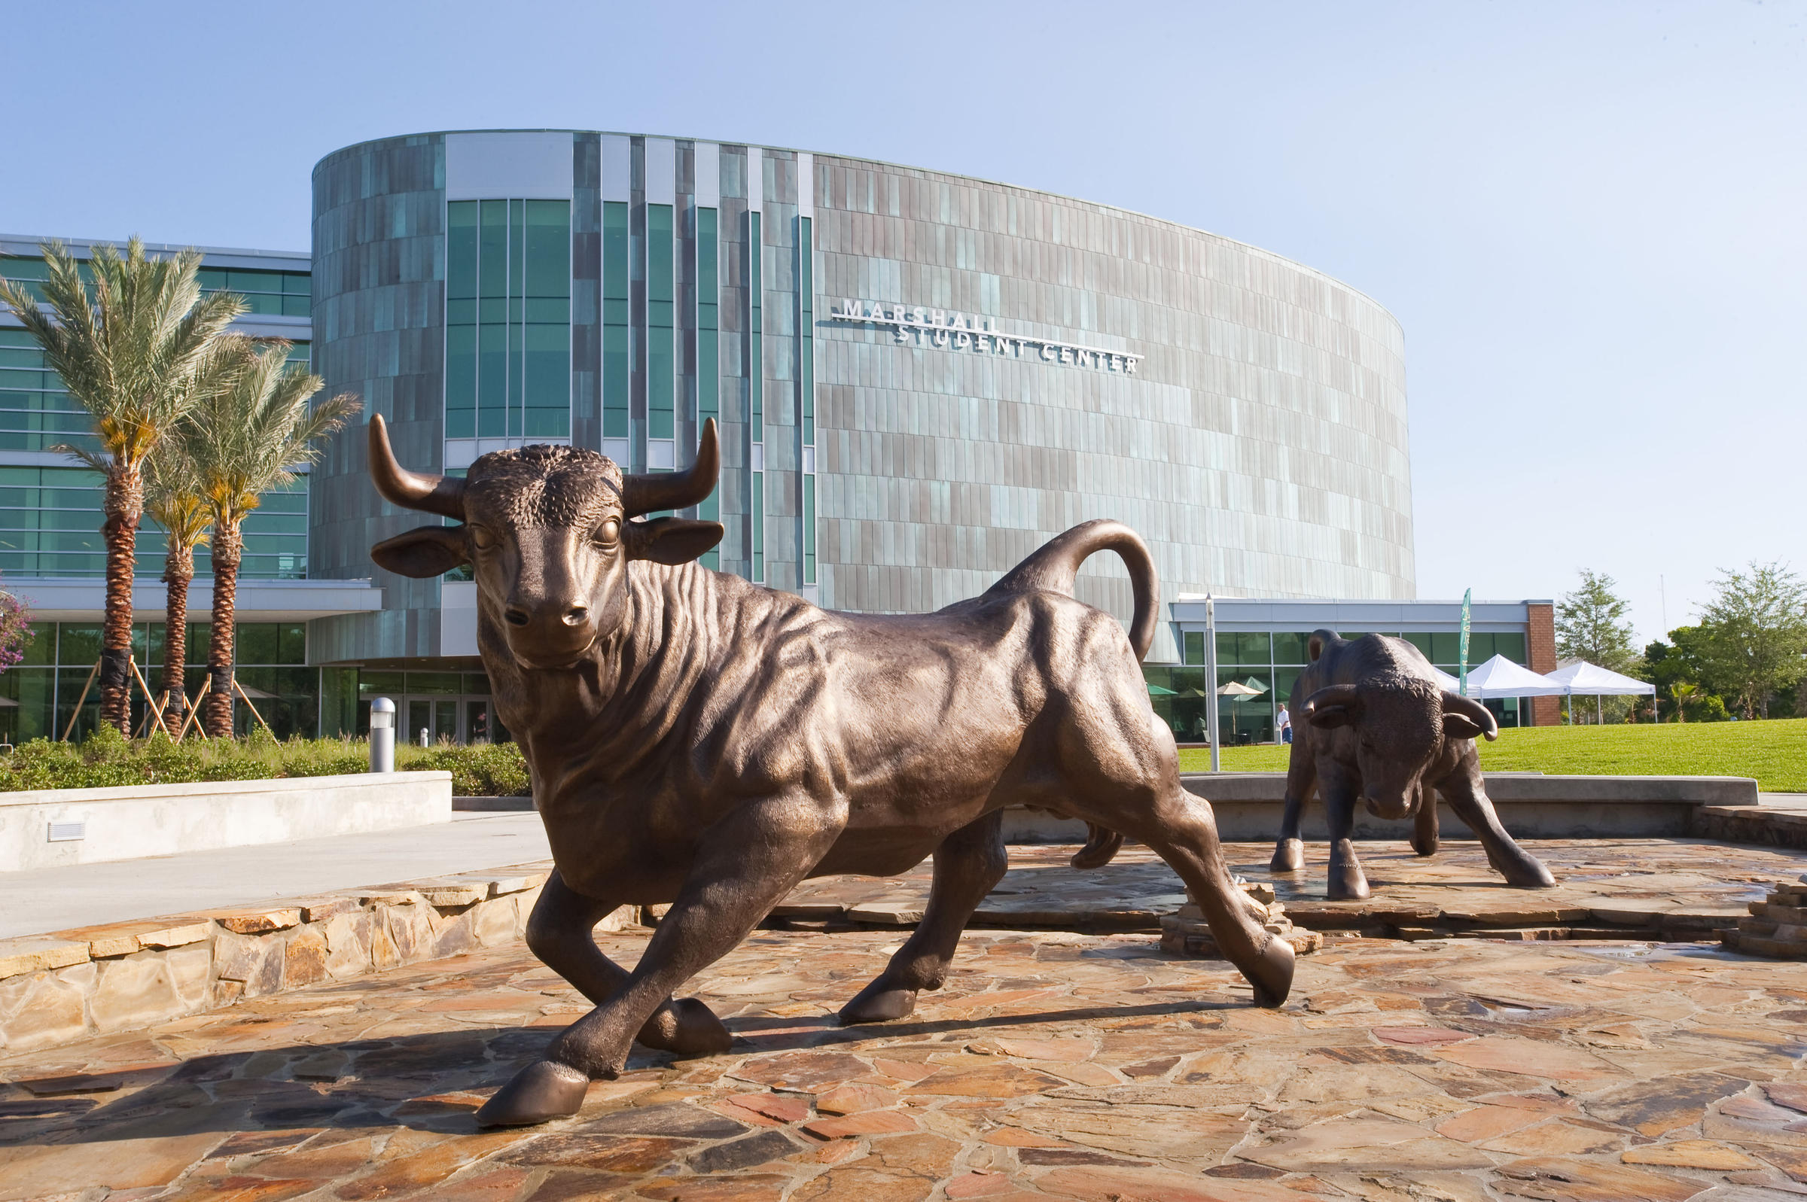
3

Slide 4
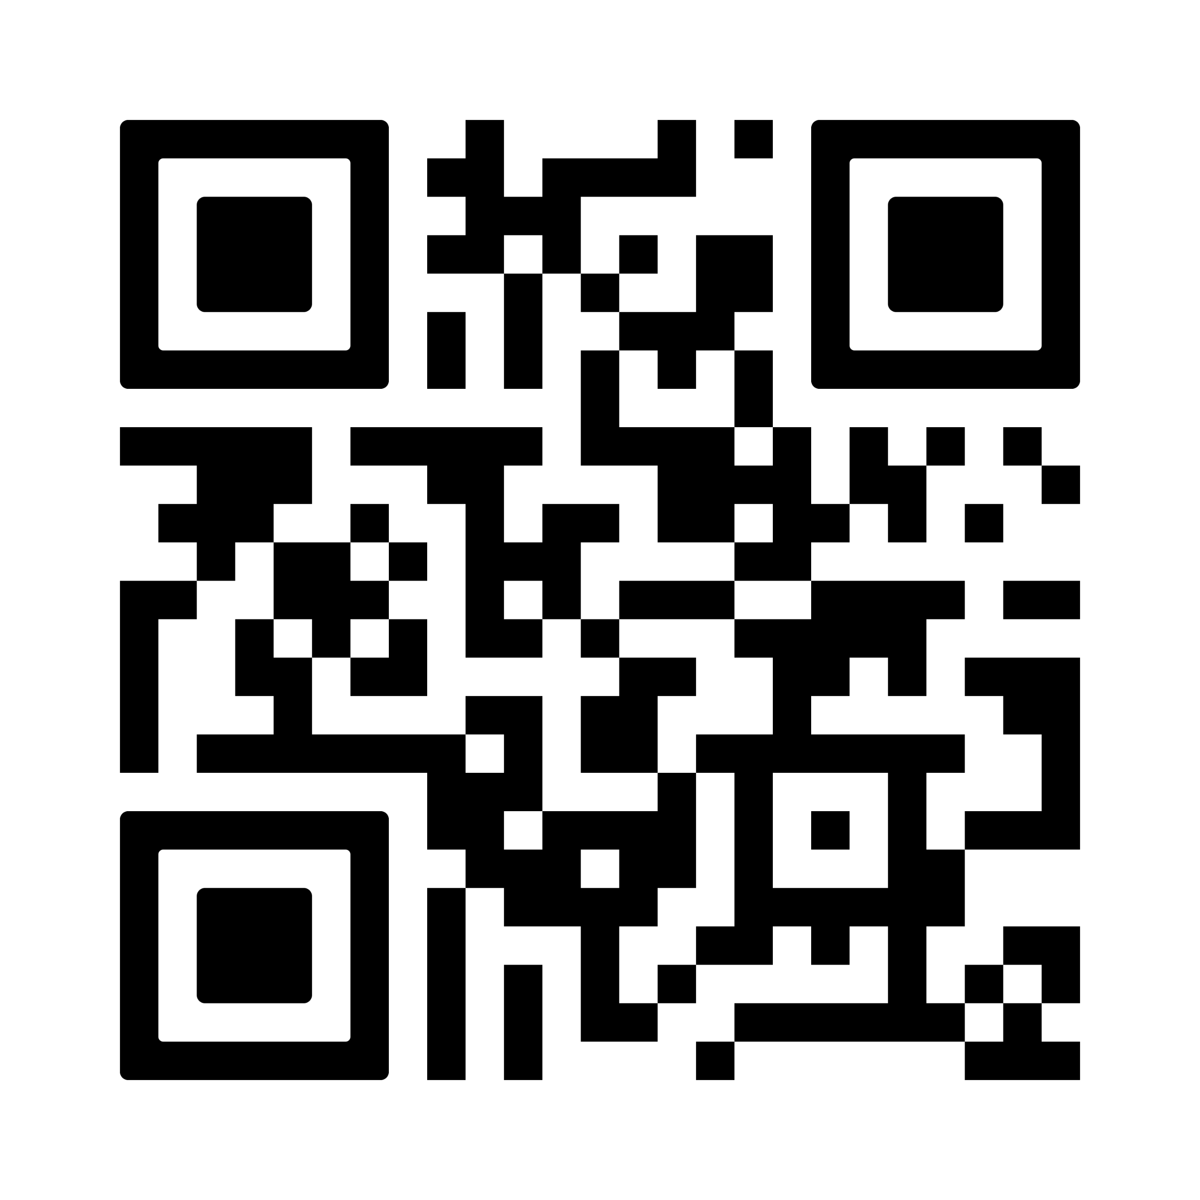
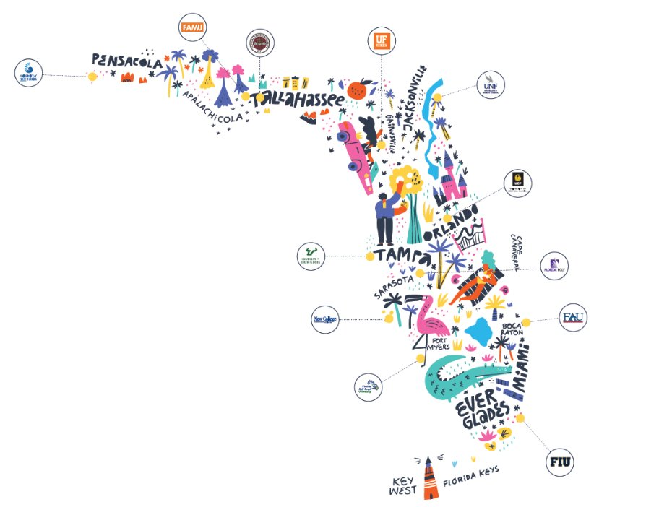
Digital 2025 Admissions Matrix
The digital and printed matrix are publicly available materials from the State of Florida. Printing, reproducing or publishing copies of the document in a for-profit environment is prohibited under Florida Statutes, unless a specific statement of free availability is included. ​
​
A free version of this publication is available on the Florida Board of Governors website. ​

Slide 5
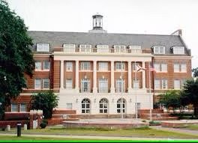
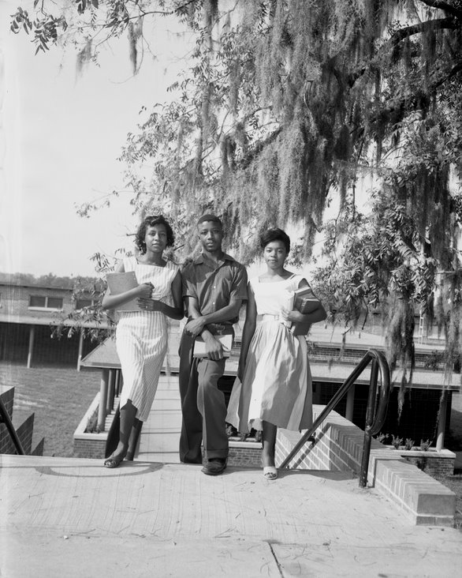
FAMU
A Blast From the Past…

Slide 6
Fast Facts
Comprised of 12 universities
Serves more than 354,000 students
72,055 Bachelor’s degrees awarded in the 2023-2024 academic year
Second-largest public university system in the nation
66% System 4-year graduation rate
62% System 4-year Pell graduation rate

Slide 7
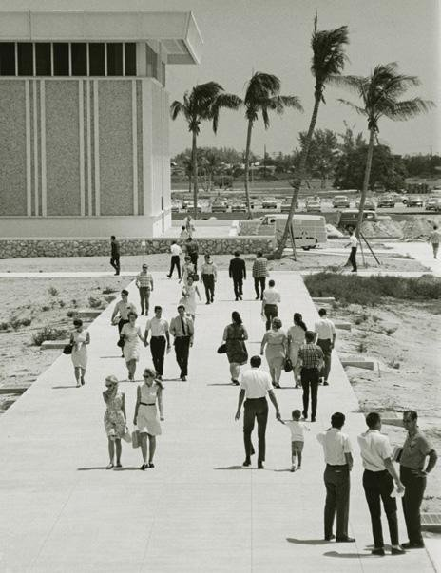
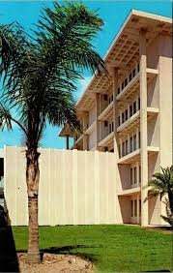
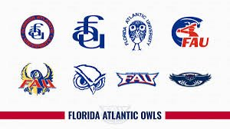
FAU
A Blast From the Past…

Slide 8
ACT Changes & Updates
The State University System of Florida does not require an ACT Science score for admission, regardless of institution.
The ACT composite score (or, if using multiple test attempts, the composite super-score) used by SUS institutions for admissions only includes the English, mathematics, and reading subsections.​
The composite super-score would include only the English + math + reading subsection scores, regardless of the exam date.​

Slide 9
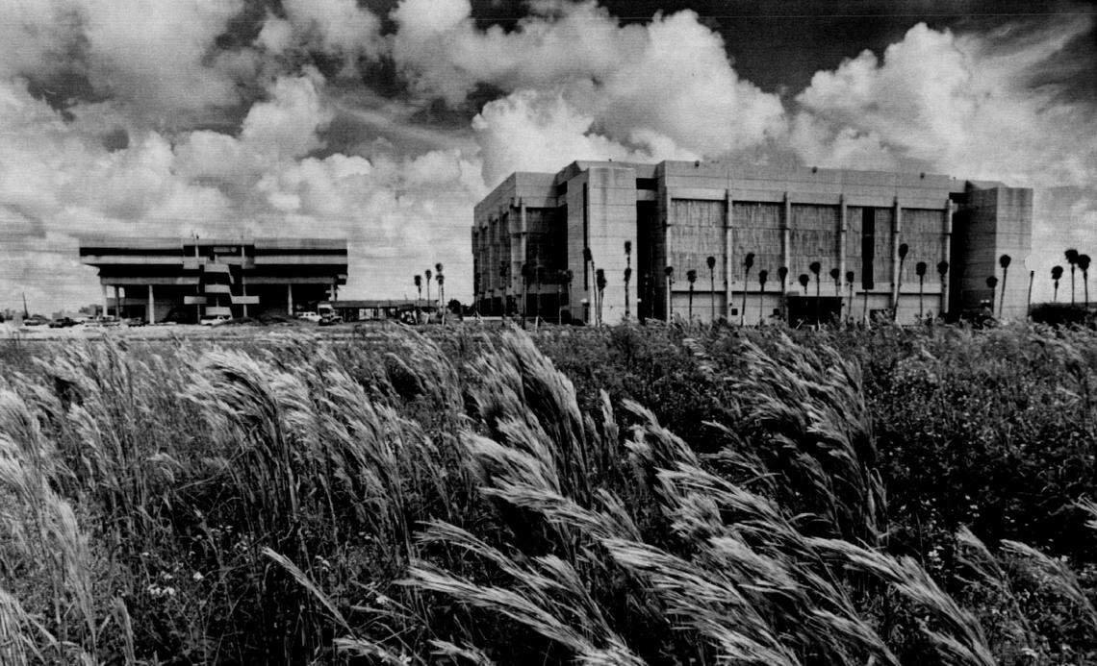
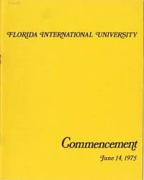
FIU
A Blast From the Past…

Slide 10
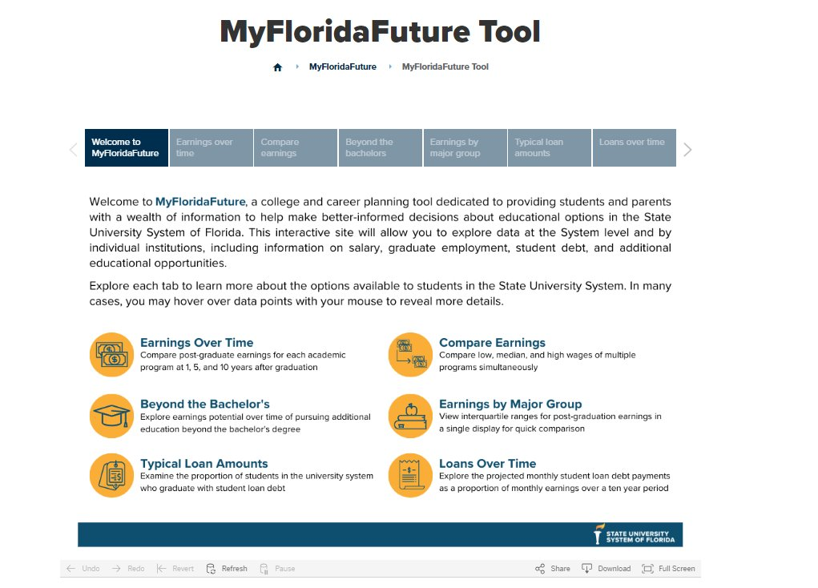
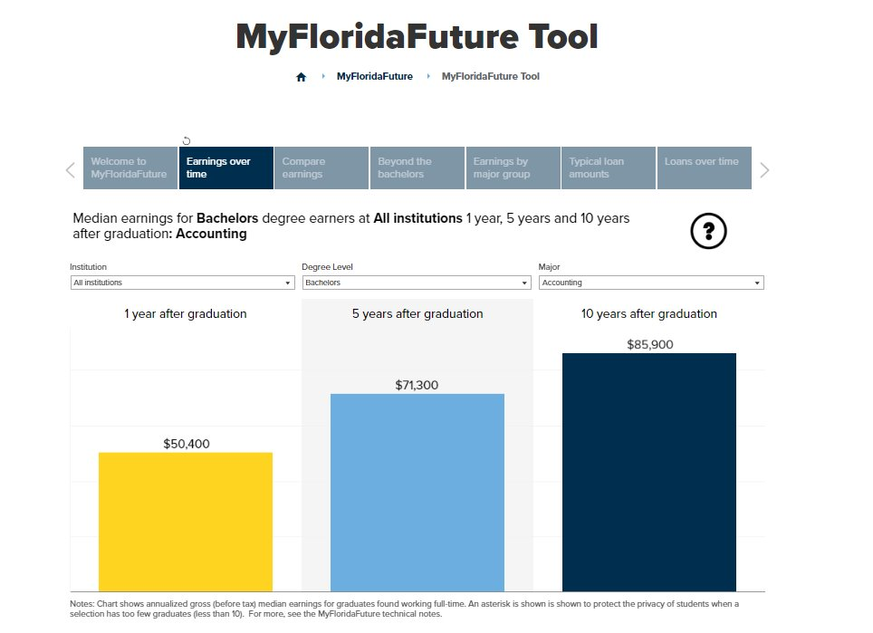
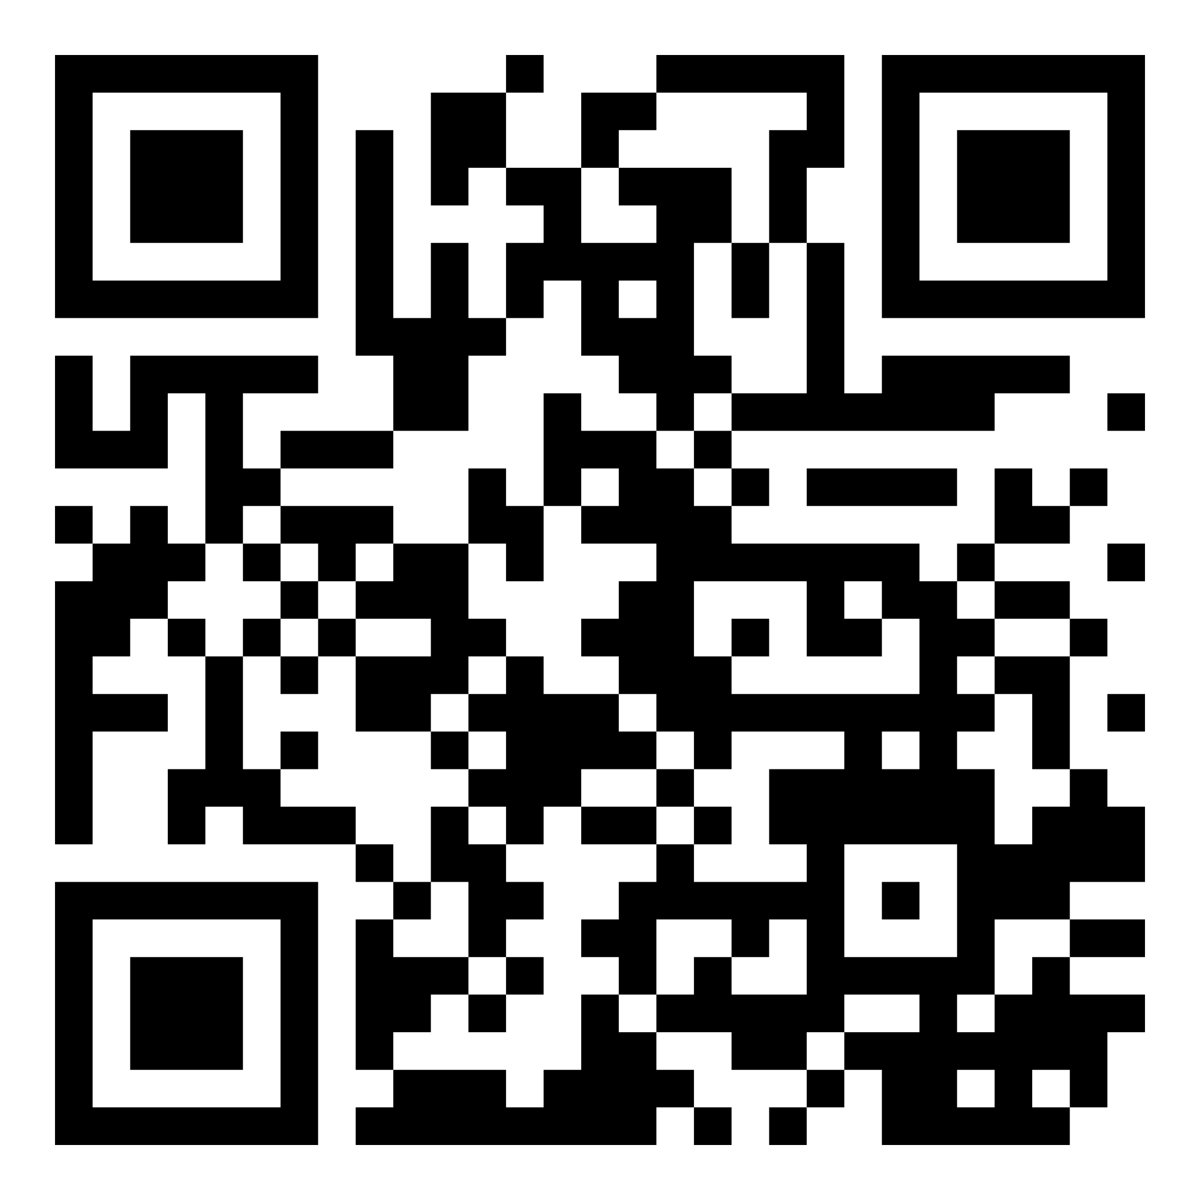
MyFloridaFuture
MyFloridaFuture is a free, online college and career planning tool to assist students and families in making better-informed decisions about postsecondary educational options in the State University System of Florida​
Try it here!

Slide 11
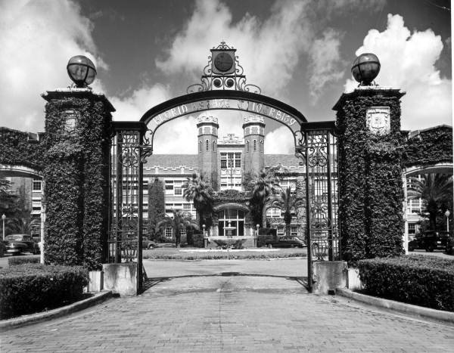
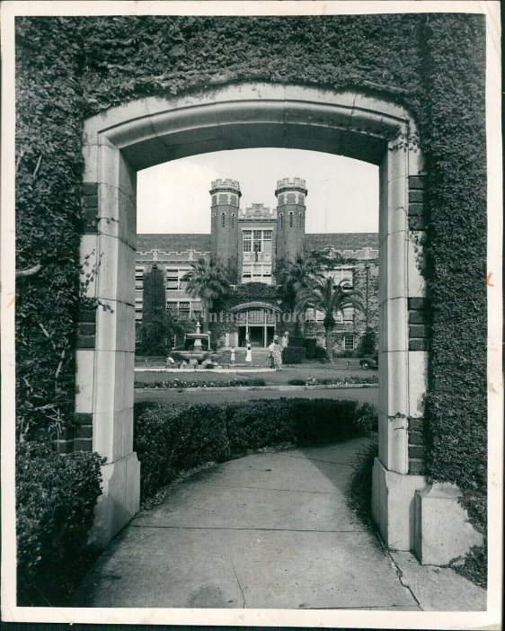
FSU
A Blast From the Past…

Slide 12

The College Tour – Florida’s College Fair Circuit
Email: thefltour@gmail.com
Series of college fairs across the state of Florida
Fairs are coordinated by Florida Tour committee members in partnership with schools and school districts.
Over 150+ college fairs held in districts and high schools across Florida from Pensacola to the Florida Keys
Consolidates the college fair schedule to promote outreach and the opportunity to talk with the most colleges possible when reps are in the area.
Find out more: thefltour.org
Founded in the early 1950s: originally named Florida Schools & College Relations Committee; the Committee is comprised of secondary and post‐secondary school personnel including representation from the SUS.
Self‐sustaining and Voluntary
Meets several times per year
Creates and coordinates college fair schedule for Florida for Fall beginning in January and Spring beginning in August

Slide 13
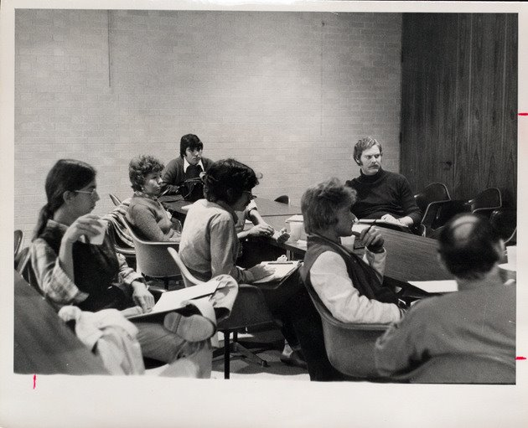
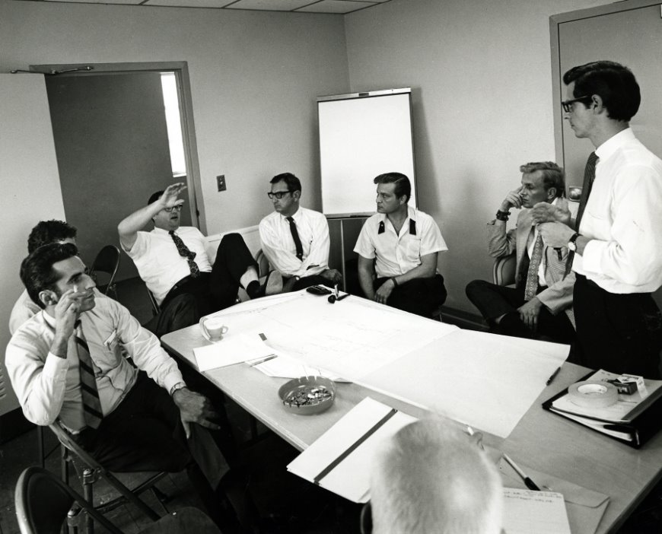
New College of Florida
A Blast From the Past…

Slide 14



Alternative Pathways
Students can attend a Florida College System institution to receive their A.A. degree and transfer those credits to a SUS institution
SUS institutions must partner with at least one Florida College System institution to provide targeted programs
Talk to the admission director for the institution of interest about programs specifically tied to that institution

Slide 15
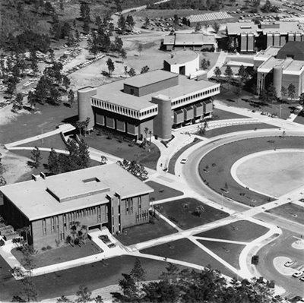

UCF (Opened as Florida Tech)
A Blast From the Past…

Slide 16





Talented 20 Program
Students who are in the top 20% of their graduating class are guaranteed admission to a State University System of Florida institution
Requirements and Process
Rejected from 3 SUS institutions, and accepted to none
Top 20% of graduating class as recognized by FLDOE
Has taken ACT, SAT, or CLT
Counselor submits all documentation by May 1st
Email SUSTalented20@flbog.edu for appeals

Slide 17
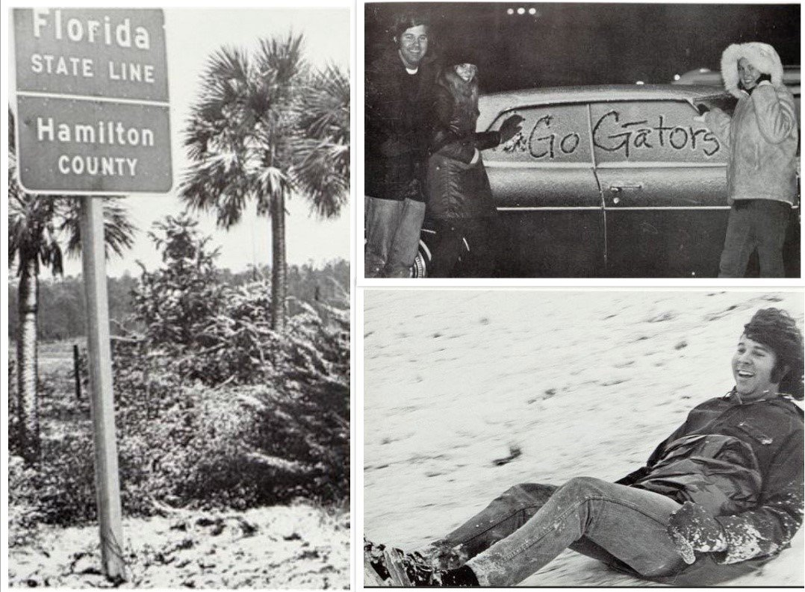
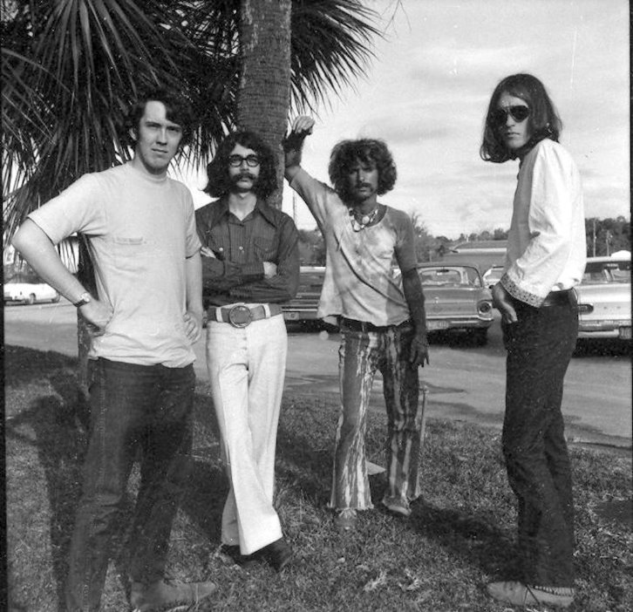
UF
A Blast From the Past…

Slide 18
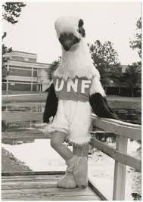
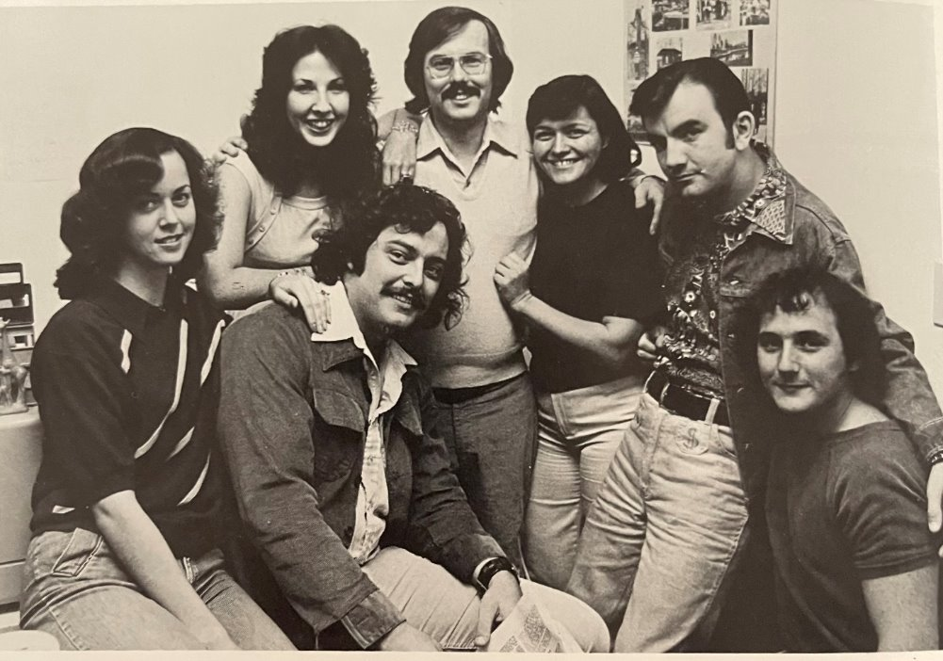
UNF
A Blast From the Past…

Slide 19
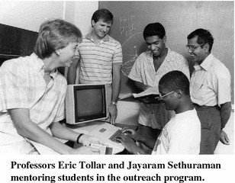
The State University System of Florida
A Blast From the Past…
In 1975, E.T. York, Jr., became Chancellor of The State University System
Members:
Florida State University
University of Florida
Florida A&M University
University of South Florida
New College of Florida
Florida Atlantic University
University of Central Florida (as Florida Tech Univ)
University of West Florida
Florida International University
University of North Florida

Slide 20
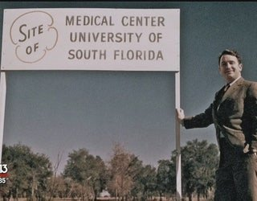
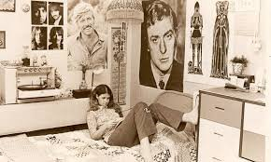

USF
A Blast From the Past…

Slide 21
Digital 2025 Admissions Matrix
The digital and printed matrix are publicly available materials from the State of Florida. Printing, reproducing or publishing copies of the document in a for-profit environment is prohibited under Florida Statutes, unless a specific statement of free availability is included. ​
​
A free version of this publication is available on the Florida Board of Governors website. ​

Slide 22
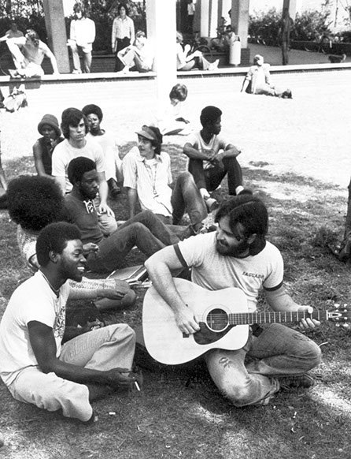
The World in 1975
A Blast From the Past…
Median Household Income - $11,800​
​
Cost of a First-Class Stamp - $.10​
​
Super Bowl – Pittsburgh vs Minnesota (Pittsburgh wins)​
​
World Series – Cincinnati vs Boston Red Sox (Cincinnati wins)​
​
Academy Award Best Picture – The Godfather II​
​
Major networks launch a "family hour" of television​
​
Saturday Night Live premieres – George Carlin first host​
​
VCRs are developed, and Microsoft is founded​

