Slide 1

SUS 50th Anniversary
Directors Tour

Slide 2

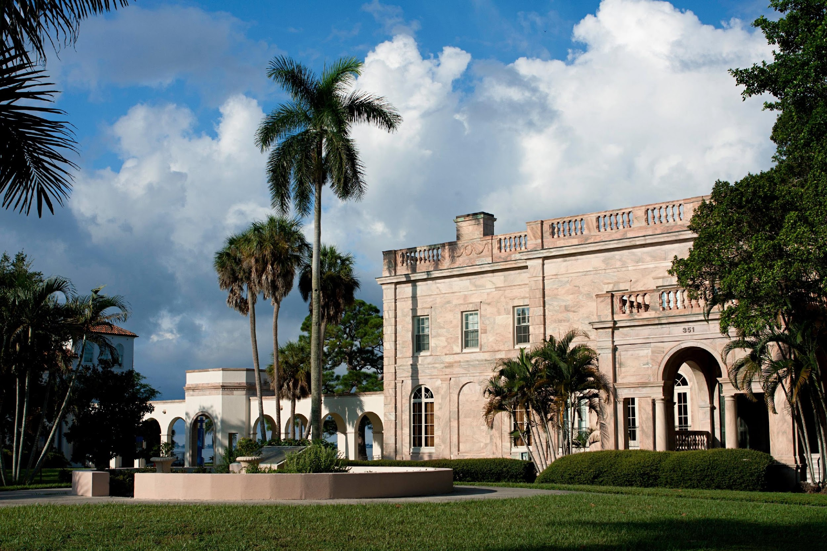
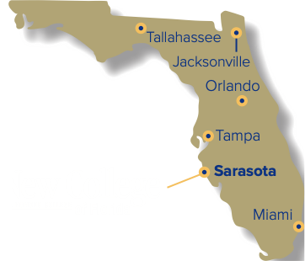
New College of Florida
Florida’s Public Honors College at a Glance
Header
Subheader
Paragraph
Bulletsv
13
Average
Class size
#1 Small Public Liberal Arts College for Value
(Princeton Review, 2024)
8:1
Student-to-Faculty
Ratio
850+
Undergraduate
Students

Slide 3

Undergraduate Majors
Humanities
History, Creative Writing, Philosophy
Interdisciplinary
Environmental Studies, Global Studies
Social Sciences
Psychology, Economics, Anthropology
Pre-Professional
Natural Sciences
Pre-Law, Pre-Health
Biology, Data Science, Physics
An honors curriculum built on flexibility, depth and real-world application.

Slide 4
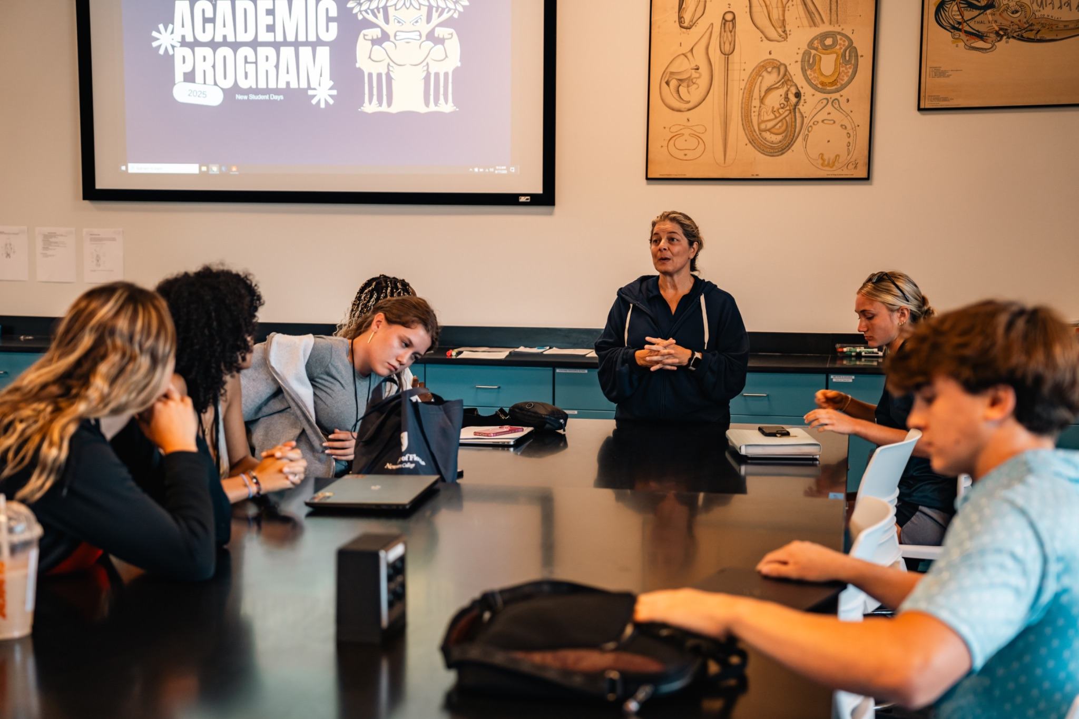
Distinctive Academics
Where Drive Becomes Direction
Narrative Evaluations
  Letter Grade and GPA Available
Contract System
  Enhanced Accountability
Small Class Sizes
Student Focused Teaching
Independent Study Projects (ISP’s)
  Month of Academic Exploration
Required Senior Thesis
  Capstone that Sets Graduates Apart
Every student is challenged to think boldly, write powerfully, and graduate with distinction.

Slide 5
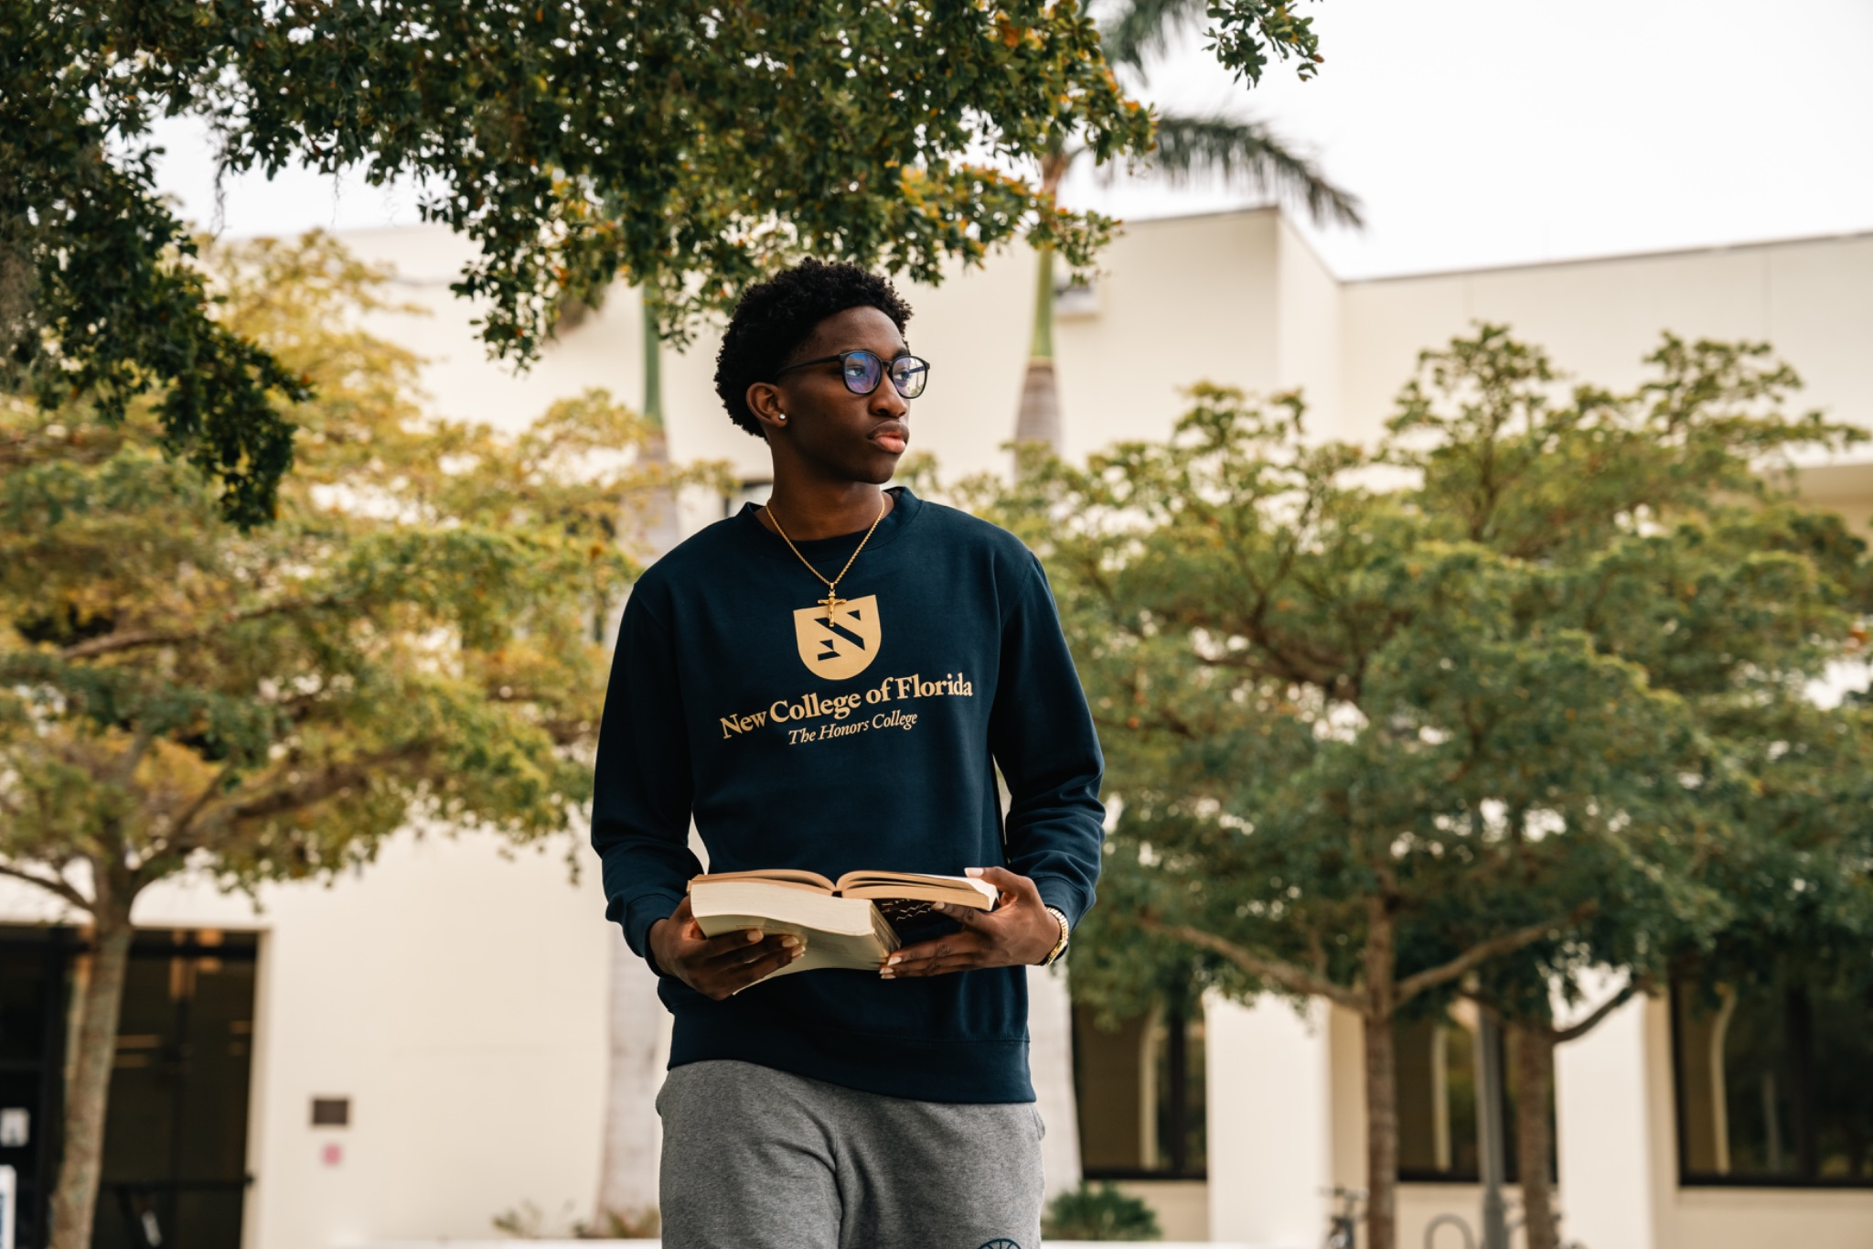
Elevate Your Education
Distinctive Academic Programs
Innovative Programs
Transformative
Opportunities
AI for Learning and Research
One of Florida’s only undergrad AI programs
Environmental Studies
Hands on, field based-learning
Marine Biology
Sarasota Bay as a living laboratory
Pre-Health and Pre-Law
Structured tracks for professional prep
Study Abroad
Several semester abroad options
Faculty Research
Students involved from Year one
Innovative Programs that ensure your students stand out in competitive fields.

Slide 6
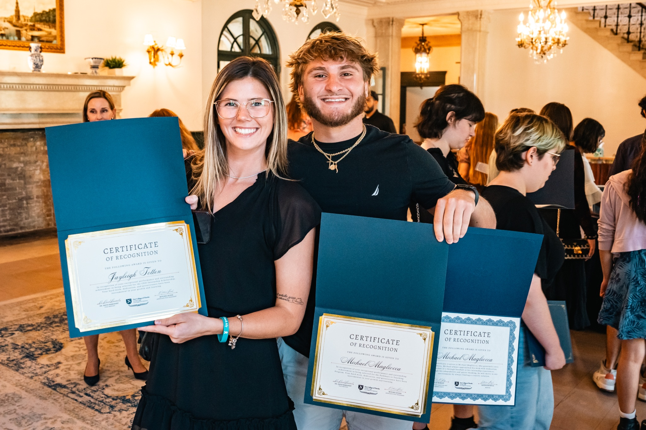
Career Engagement & Opportunity
From Discovery to Direction
Students Gain Access To:
Award-Winning Career Center
Fellowships & Funding
Career Coaches
Grad School Advising
From the first semester to the first job, we connect students with opportunities to set them apart.

Slide 7
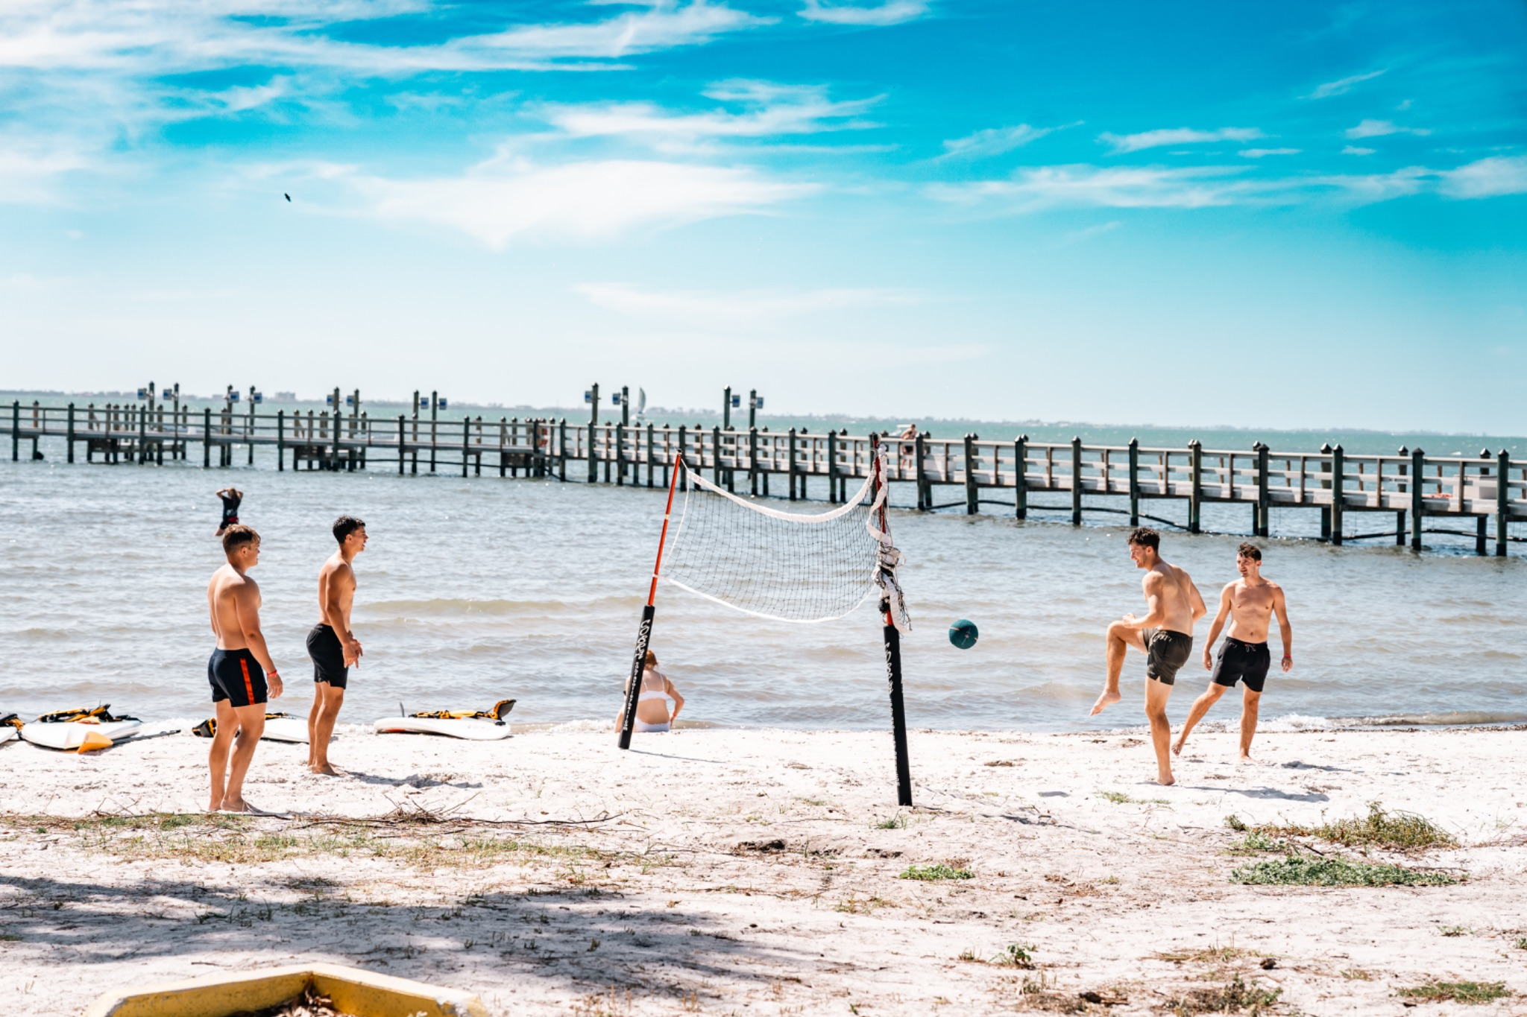
Life on The Bay
The Horizon of Experience
Student Life by the Bay
18 NAIA Athletic Teams
  SUN Conference Affiliation
50+ Student Organizations
  Student Engagement
  Campus Traditions
  Leadership Opportunities
Waterfront Living
  Paddleboarding, Volleyball & Fishing
and so much more
From competition to community to the coast, life here happens on the bay.

Slide 8
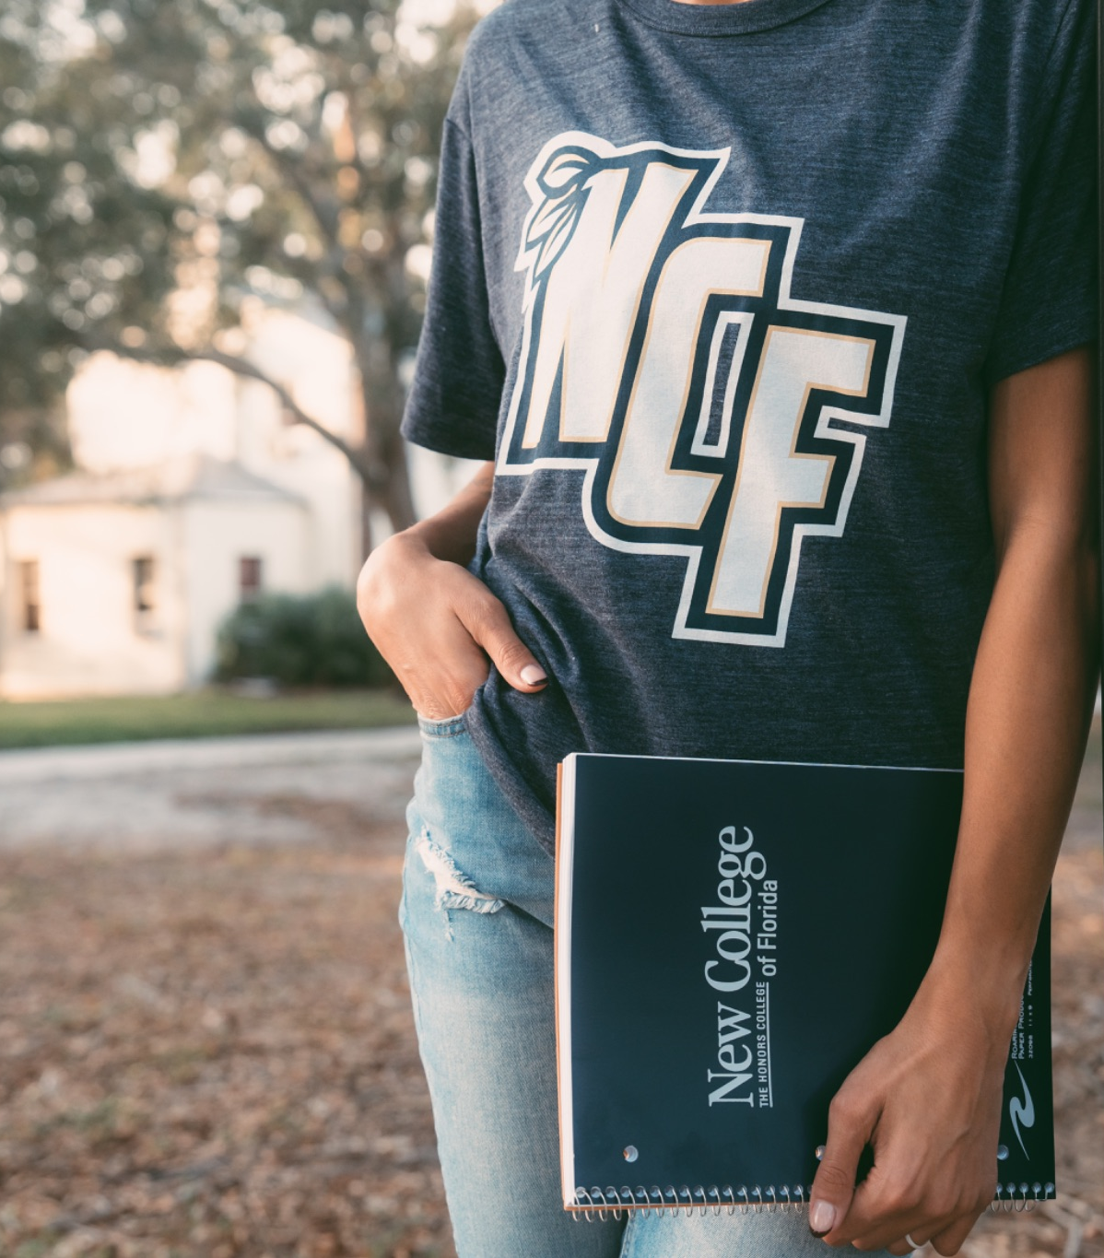
Admissions
Your Path to NCF
How To Apply
Common App or NCF App - no fee required
Personal Essay - strongly suggested
Transcripts - official or self reported
Test Scores - SAT, ACT, or CLT required
Fall 2025 Enrolled
Class Profile
GPA: 3.96 average
SAT: 1209
ACT: 25
Deadlines
Nov. 1 - Early Action (priority scholarships)
Feb. 1 - Regular Decision
June 1 - Final Deadline
A streamlined process designed to make it simple for students to apply.

Slide 9
Cost & Value
Estimated Direct Costs for a Florida Resident
$21,233
#3 in the Southeast for Best Bang for Your Buck
90% of students receive aid, ensuring access and affordability for the high-achieving students you serve.

Slide 10

Scholarships & Aid
Rewarding Achievement, Increasing Access
Key Awards
Quick Facts
President’s Inner Circle Scholarship - Full direct cost +$2,500 for related expenses
Presidential Honors Scholarship (PHS) - competitive merit aid
NCF Foundation Awards - donor supported opportunities
63% of students graduate with zero debt
$8,603 average net cost after scholarships
$11,886 average financial aid award
90% of students receive aid
Top 25 nationally for value & outcomes
Scholarships and aid make an honors education at New College accessible to the students you serve.

Slide 11
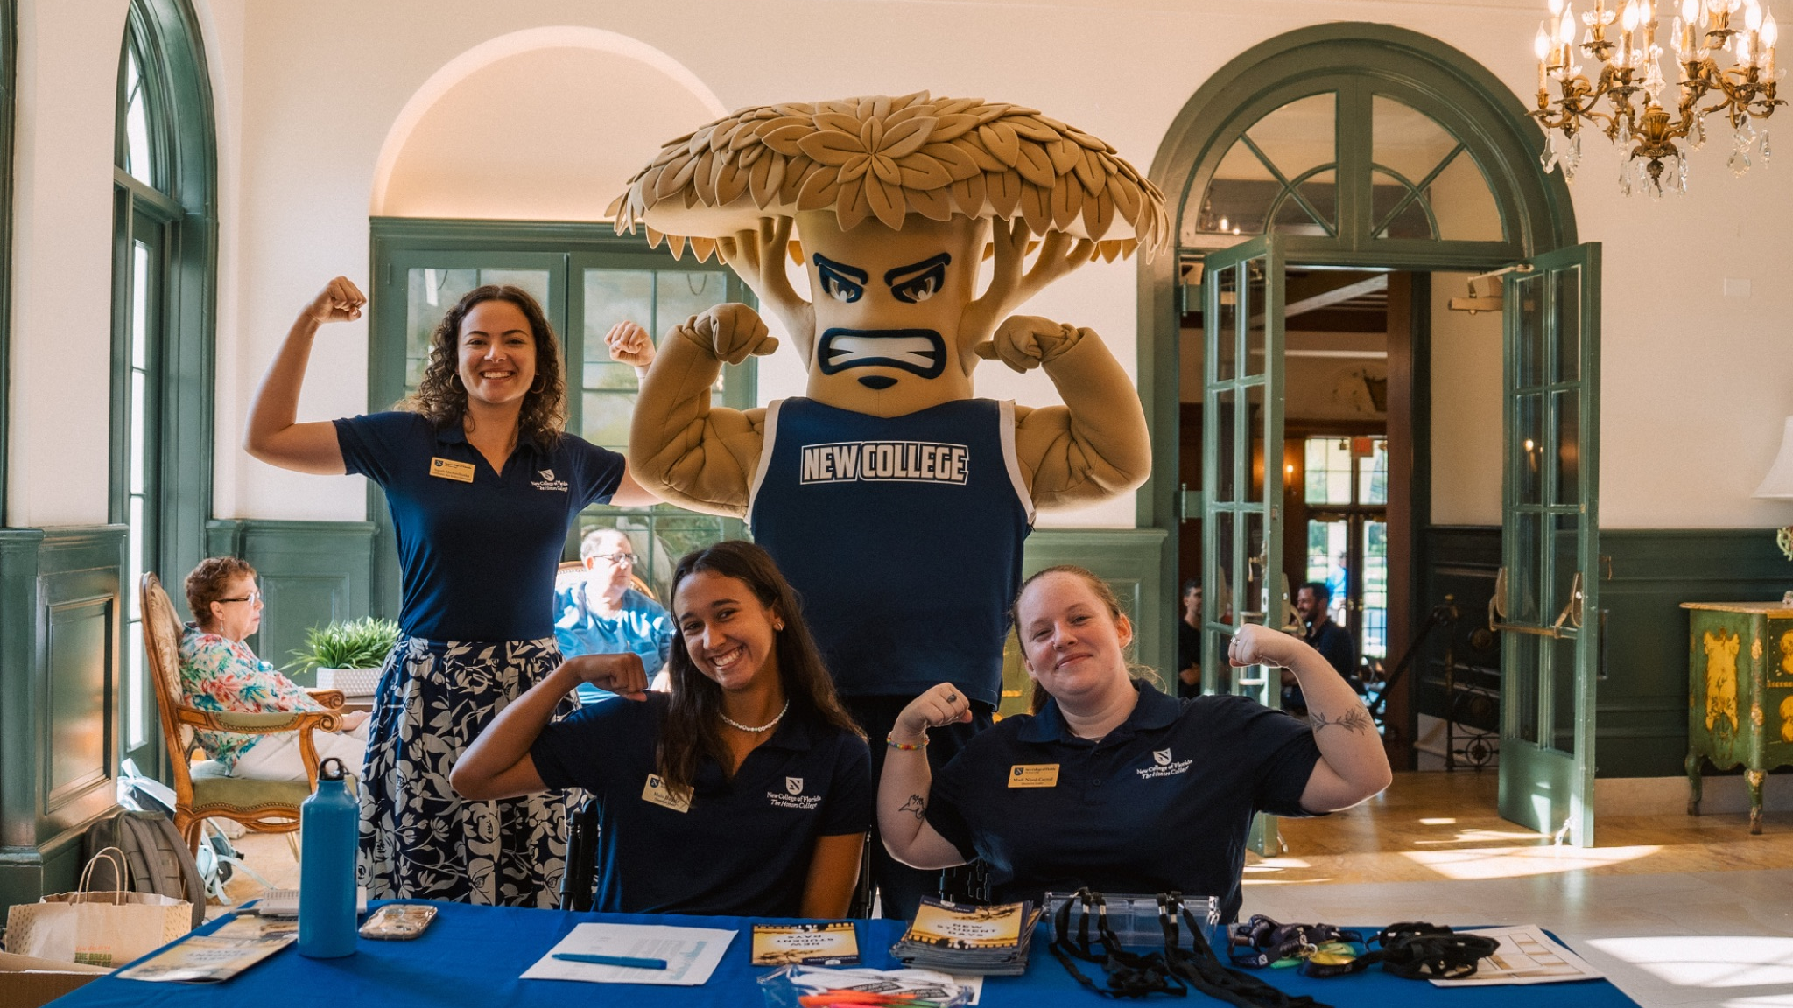
We’re Here for Your Students
Counselor Contacts
First-Year Students (FTIC)
Cliff Lundin, Director
941-487-4874
clundin@ncf.edu
Richelle Porambo, Associate Director
941-487-4746
rporambo@ncf.edu
Richelle Pora
admissions@ncf.edu
941-487-5000 x1
ncf.edu
Our admissions team is here to partner with you and support your students every step of the way.

Slide 12
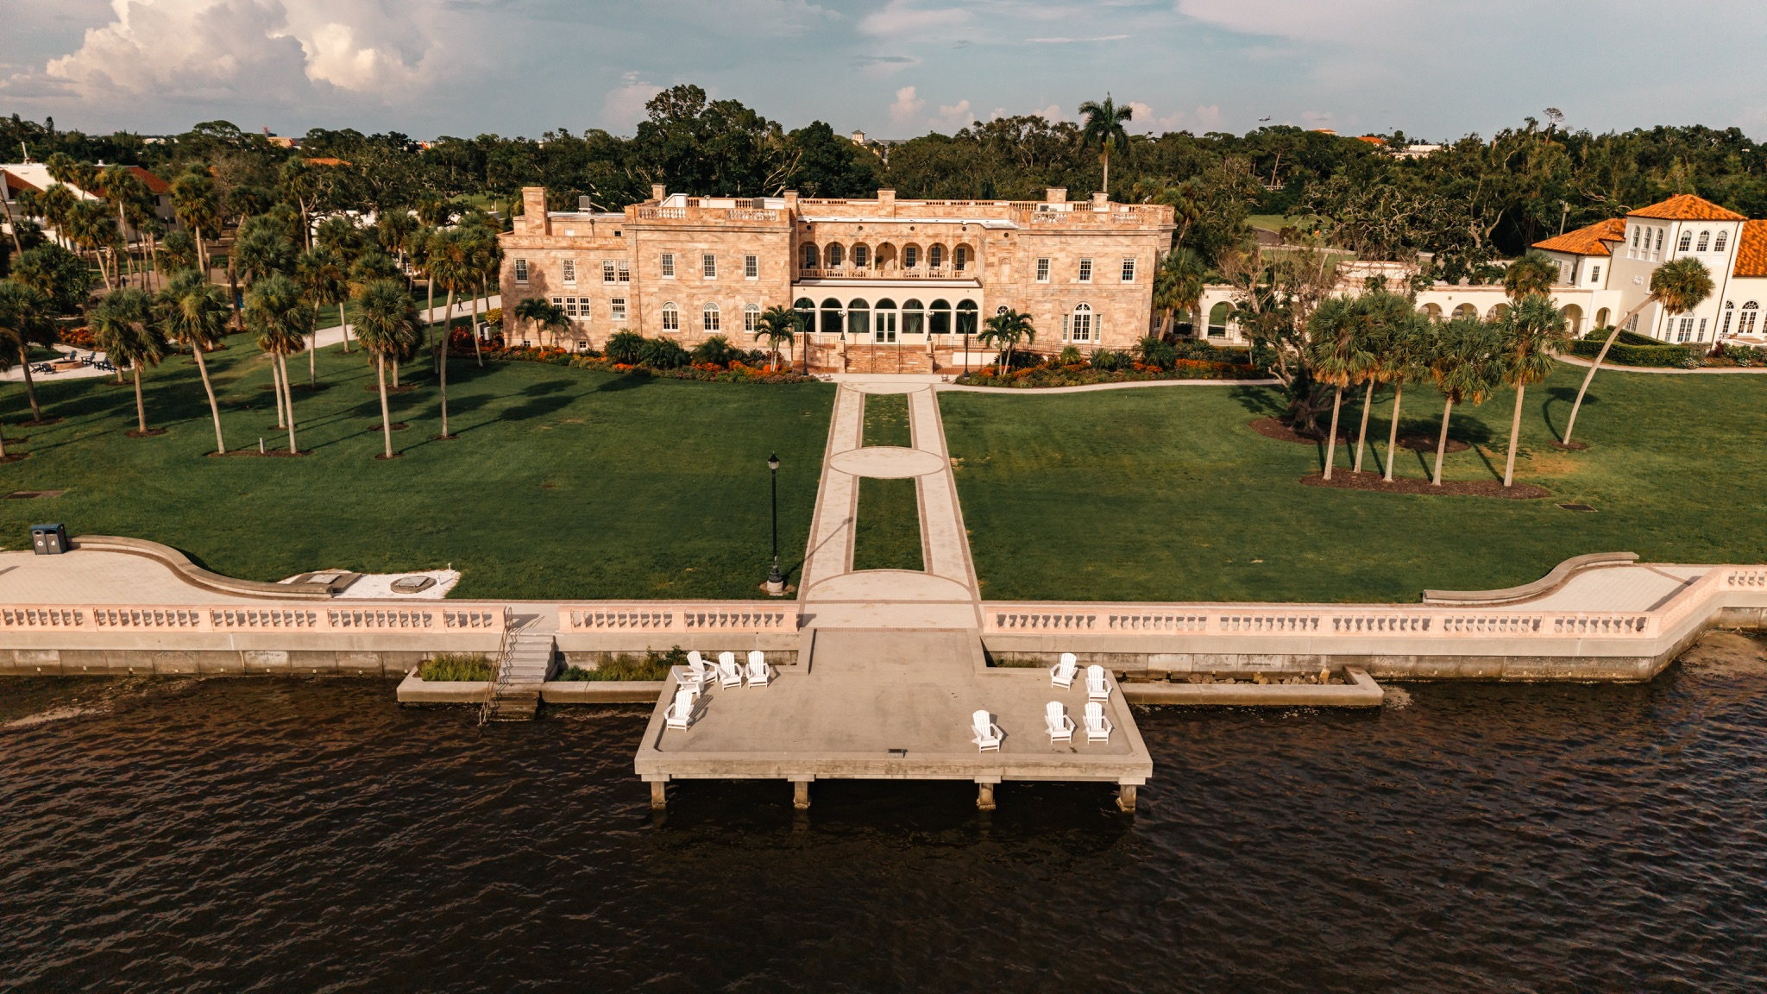

ROOTED IN THE CLASSICS.
SHAPED BY THE DEMANDS OF TOMORROW.

