Slide 1
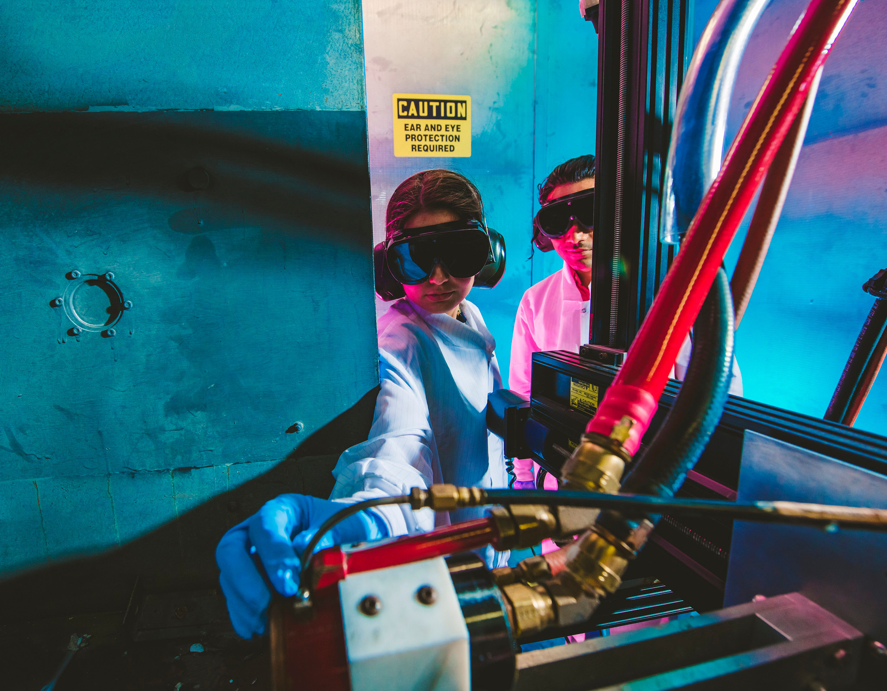

FORWARD THINKING.
INNOVATIVE.
UNSTOPPABLE.
Florida International University is an empowering force for good in the world.

Slide 2


PREEMINENT
Excellence yesterday, today and tomorrow

Slide 3


#21
top 25
Top Public University in America - Niche 2025
Best Value Public University
U.S News & World Report
2024 Rankings
TOP 8
#46
University
Washington Monthly
2025 Rankings
Public University
U.S News & World Report 2024 Rankings
Top 20
#1
Economic ROI
Among Public Universities
Degree Choices
Best Bang for the Buck: Southeast
Washington Monthly

Slide 4
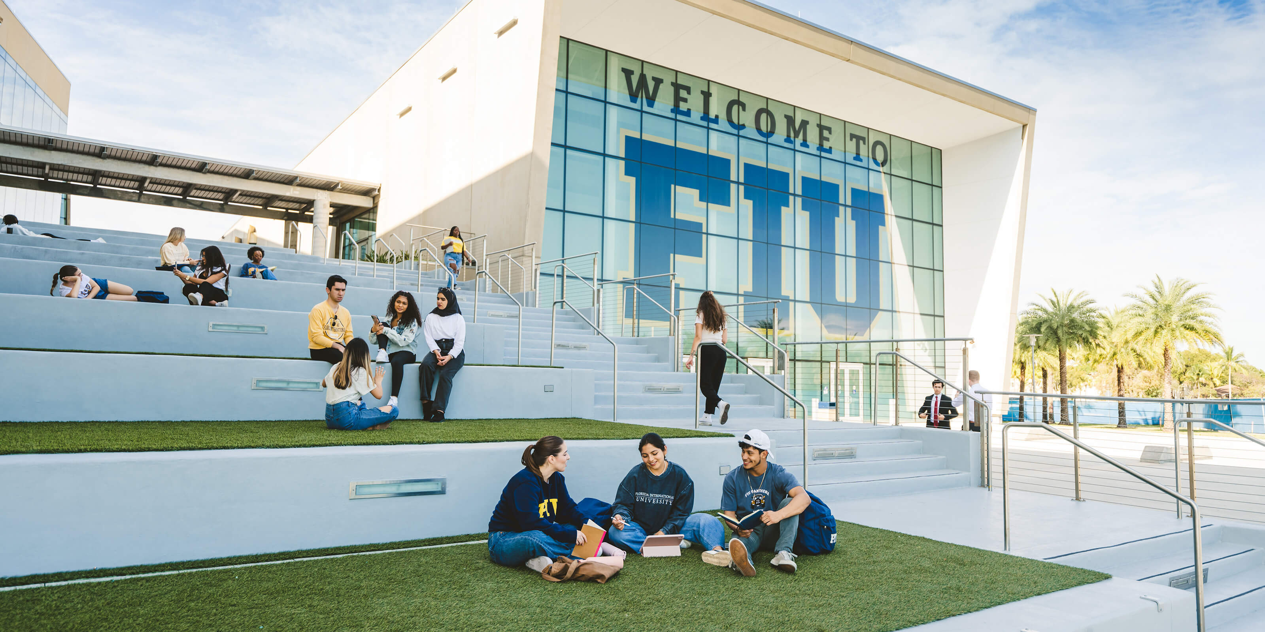
2025
freshman profile
GPA
SAT
4.23
1223
ACT
CLT
26
77
  42,000+ Applications from all 50 states
  52% acceptance rate (excludes spring)
  40% acceptance rate for fall

Slide 5

Early Action
Complete App with Docs
Notification
Deposit
Early Fall 2026
November 3
December 11
May 1
Fall 2026
November 3
December 11
May 1
  No rolling admissions​
  Non-Binding Early Action Florida HS Students​
  No scholarship application is required for admissions merit scholarships​

Slide 6

All First-Year Applicants
Complete App with Docs
Notification
Deposit
  Applications must be complete by the deadline; this includes application, application fee or waiver, transcript, test score.​
  To ensure delivery, applicants should request SAT, ACT and CLT scores be sent to FIU when registering for an exam.​
  Deferred applications are reviewed after each deadline and considered for all pathways.​
  Admission to a pathway is final.​
  Admission to the Early Fall / Summer pathway requires the completion of courses during Summer B at FIU.​
Early Fall 2026
December 17
January 21
May 1
Fall 2026
December 17
January 21
May 1
Final Deadline
Complete App with Docs
Notification
Deposit
Early Fall 2026
March 4
April 2
May 1
Fall 2026
March 4
April 2
May 1

Slide 7
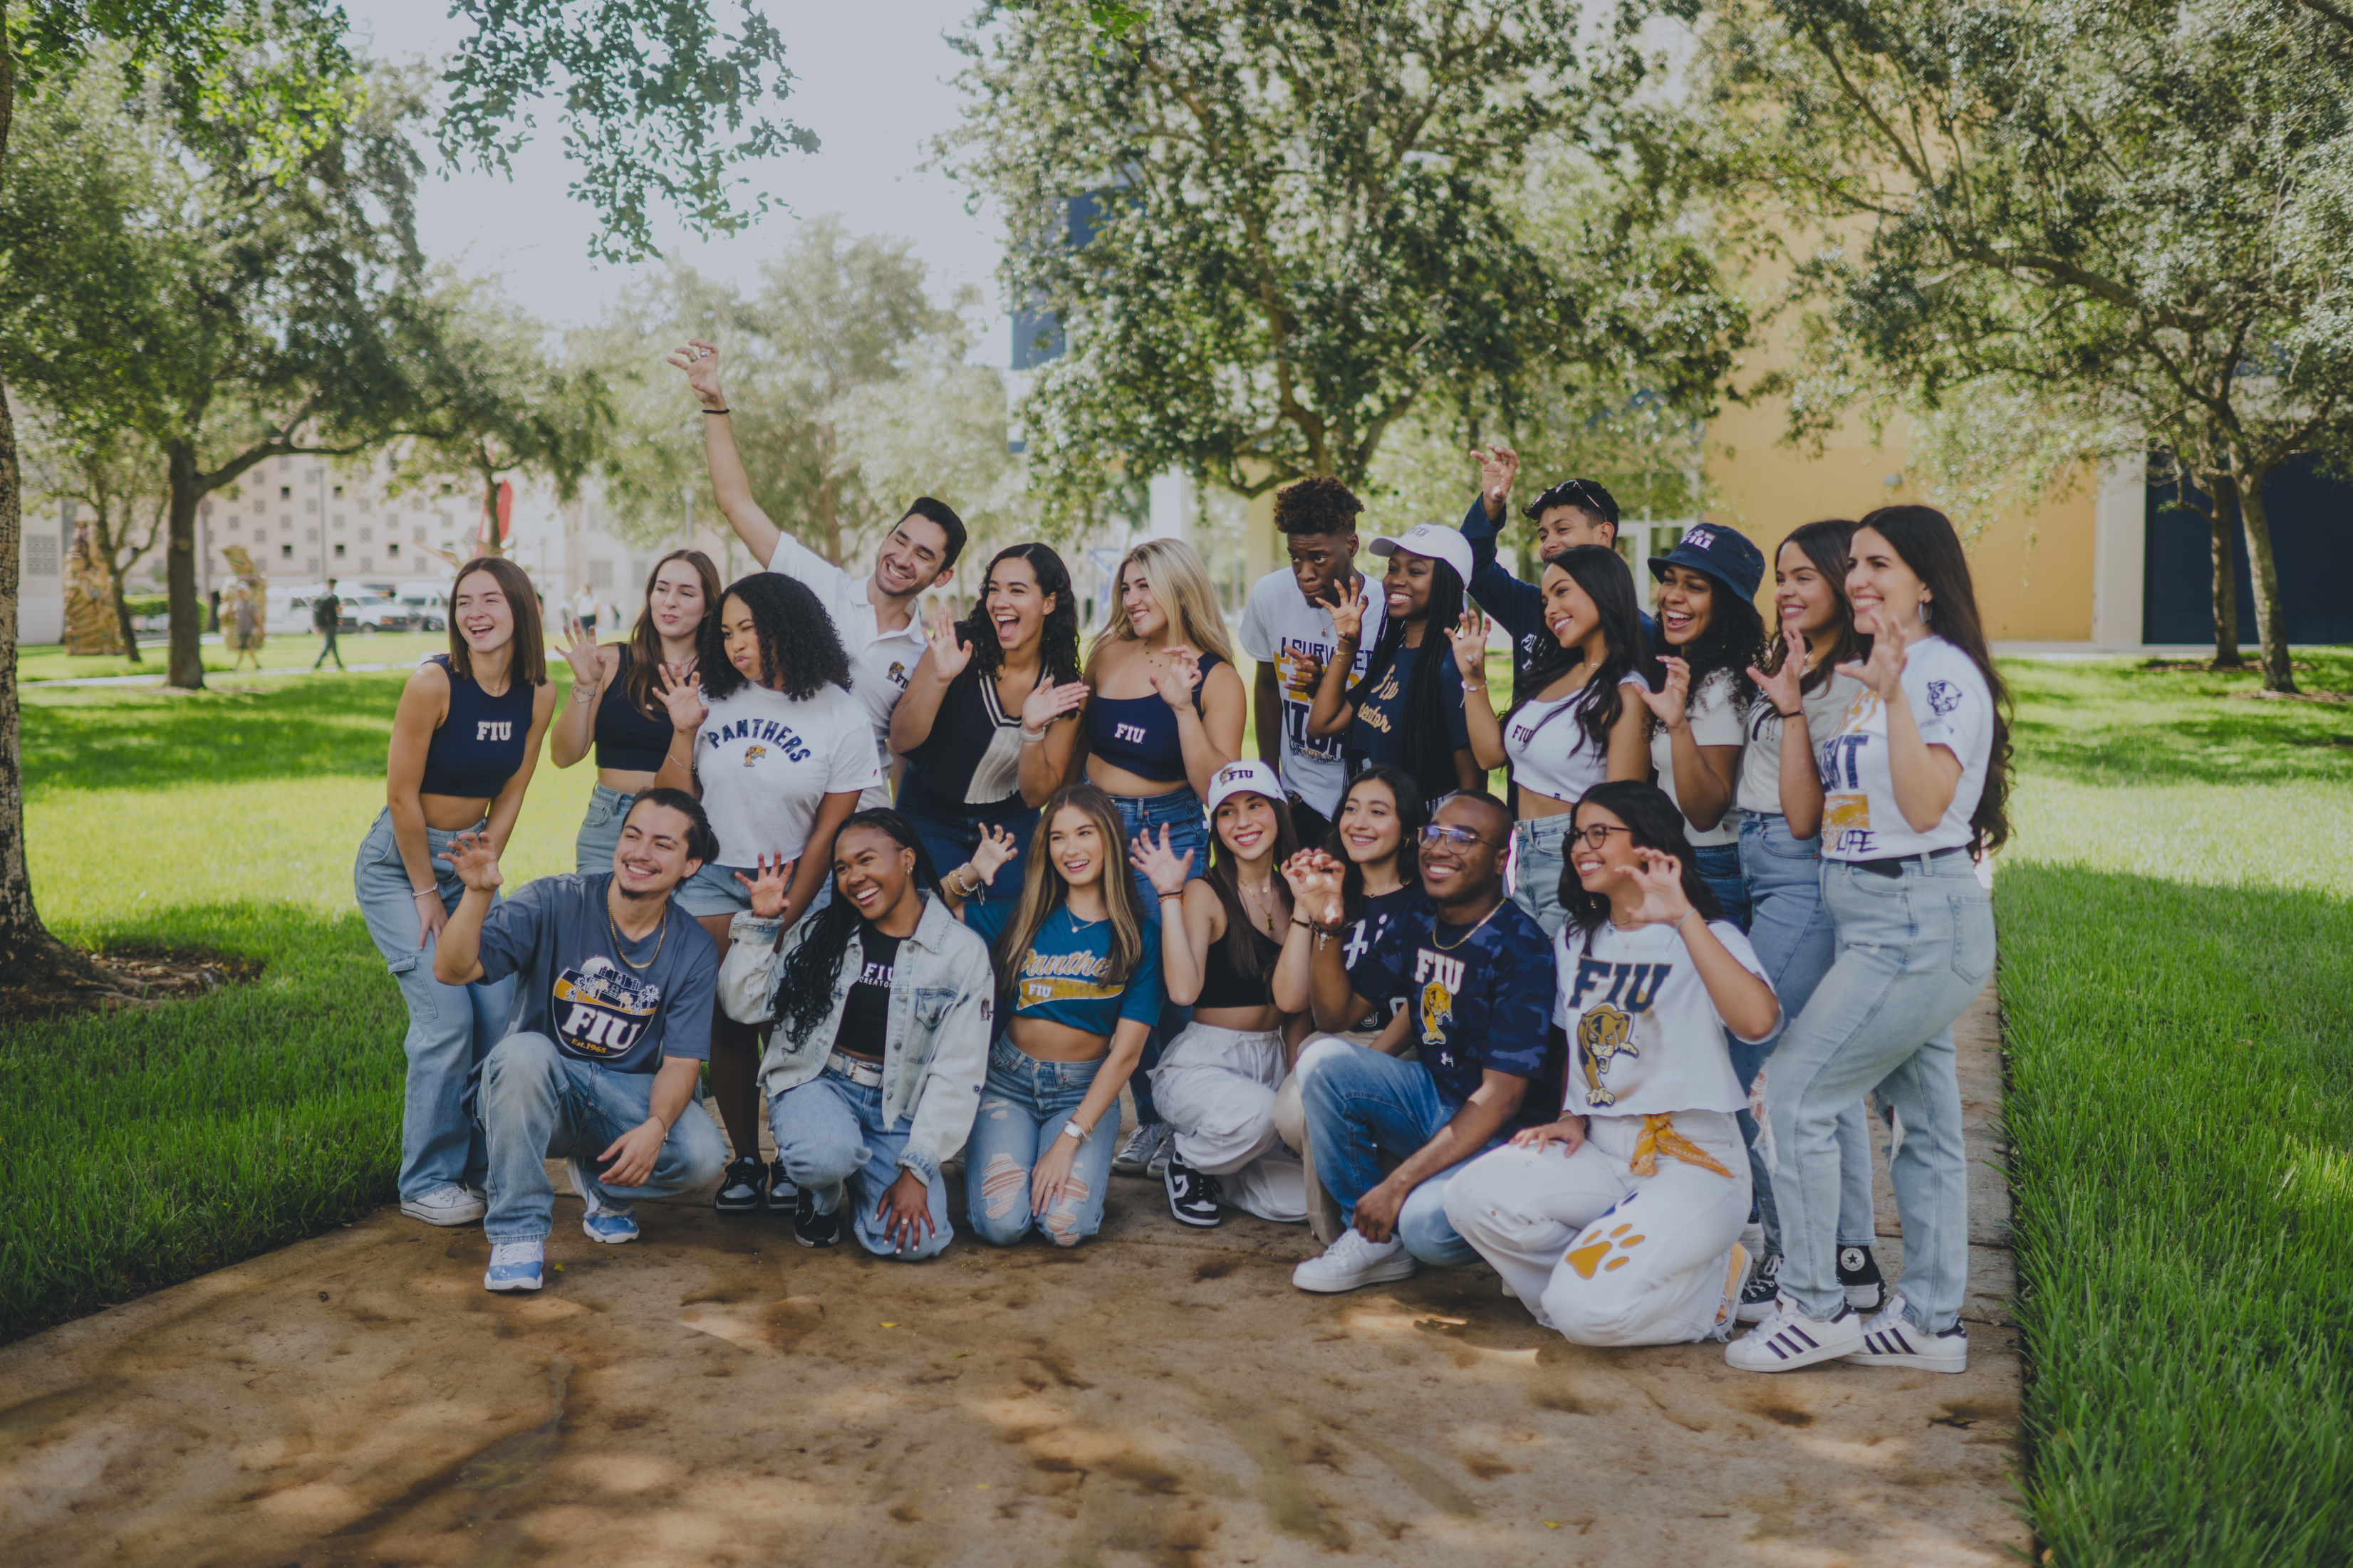
The Common App is now open!
FIU application will open up later this fall

Slide 8

Gold & Blue​
  $1,000 - $12,000​
National Merit Finalist​
  Tuition, fees, room, board, and books (est. $24,000 per year)​
RaiseMe Micro scholarships
  (up to $2,500 per year)​
​
Fiu.academicworks.com​
Admissions.fiu.edu/cost-and-aid​

Slide 9


50 Years
This year celebrates the 50th anniversary of the FIU Board of Governors.

Slide 10
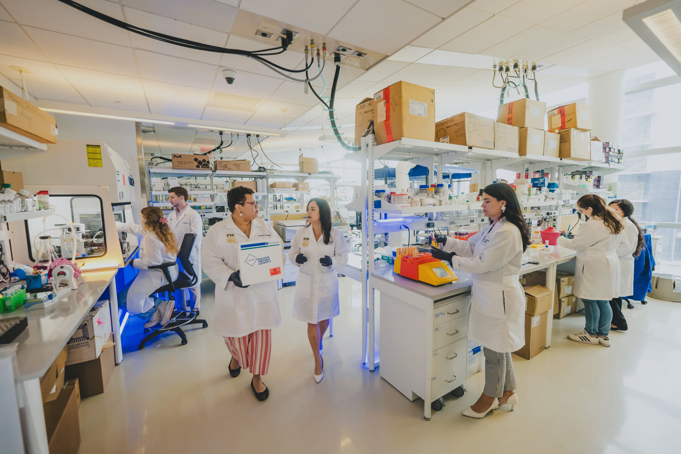
REDEFINING CANCER TREATMENT
Diana Azzam’s laboratory is poised to be the first in Florida dedicated to functional cancer drug testing. Most notably, this testing will be accessible to individuals beyond Azzam’s existing clinical trials.

Slide 11
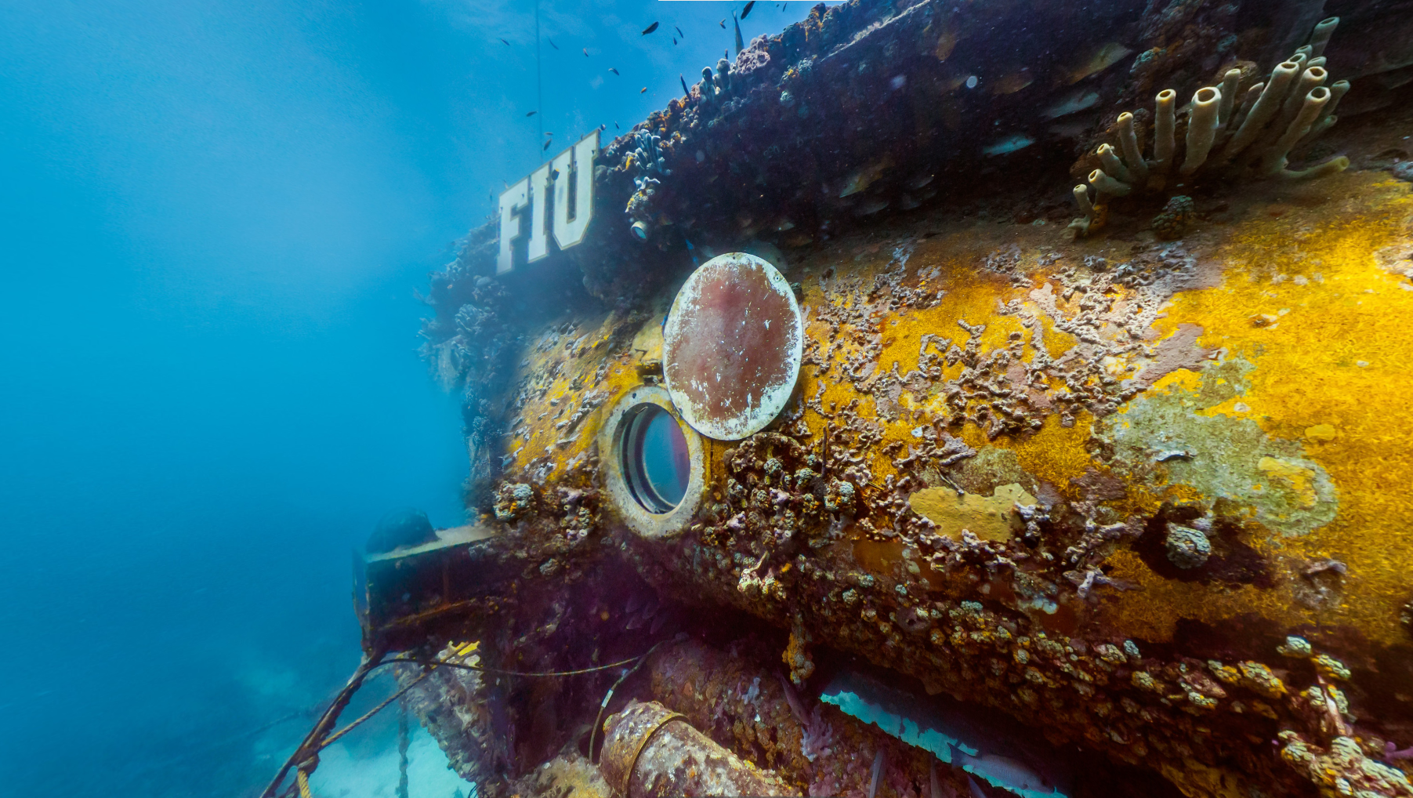
Medina Aquarius
Aquarius is the only operational underwater science lab in the world, located four miles south of the Florida Keys, where the FIU Aquarius Reef Base conducts vital research on the Florida Reef Tract and monitors environmental threats impacting ocean ecosystems.

Slide 12
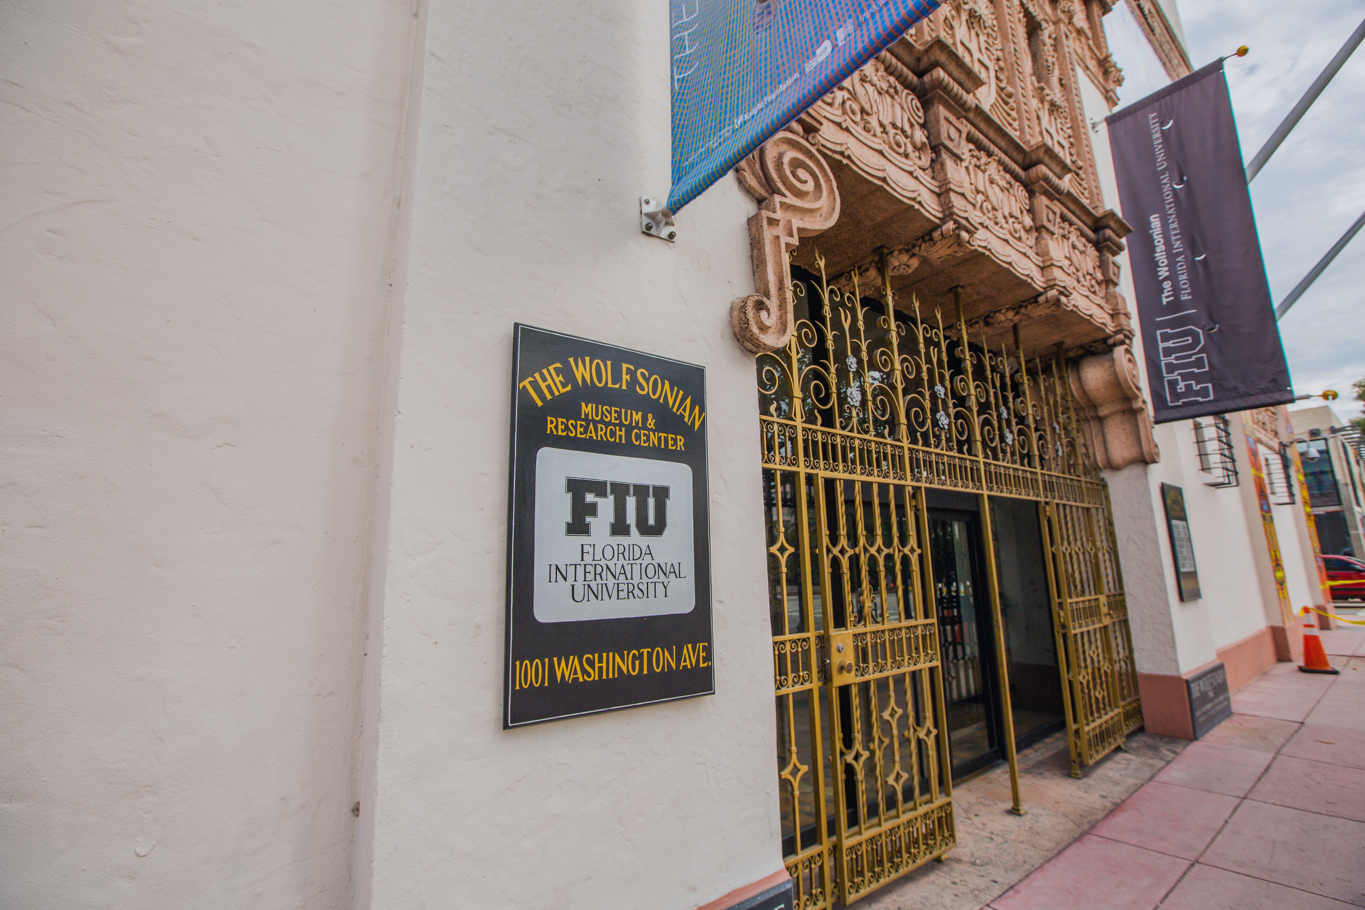
The Wolfsonian
The Wolfsonian houses one of the largest American university art collections focused on design, propaganda, and the decorative arts, with over 200,000 objects from 1850–1950. Located in a restored 1927 Mediterranean Revival building, the museum also features a design-focused gift shop with books, jewelry, toys, and more.

Slide 13
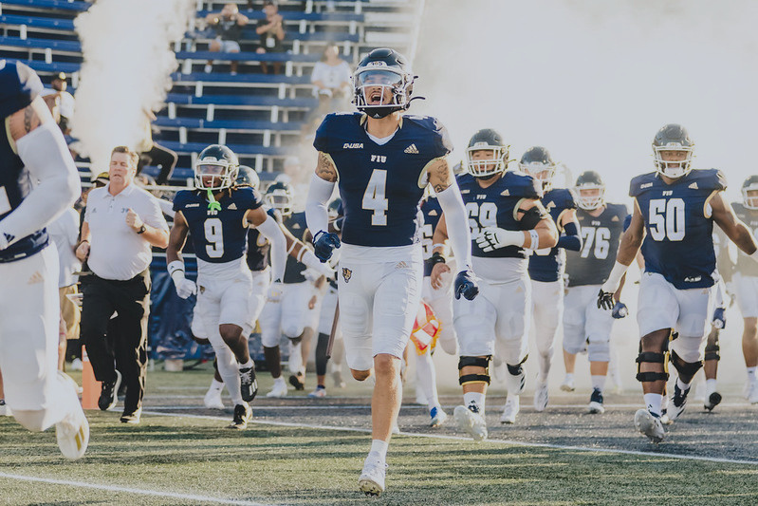

PITBULL STADIUM
FIU Athletics and Pitbull Announce Historic Partnership, Naming Football Stadium the First Ever Artist-Branded Venue

Slide 14
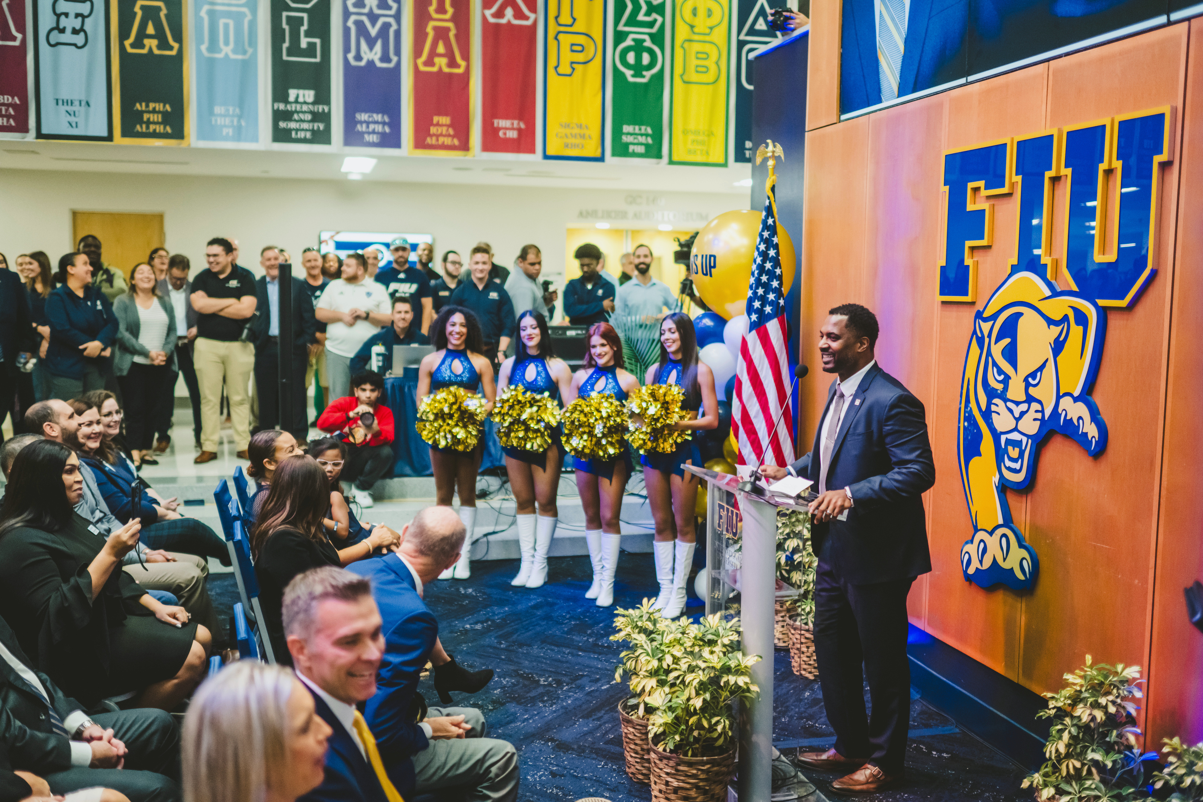
WILLIE SIMMONS
FIU introduced new head coach Willie Simmons at a press conference in the Graham Center.
Simmons holds a 66-24 record, eight straight winning seasons, and was named 2023 SWAC Coach of the Year after leading Florida A&M to the HBCU National Championship.

Slide 15
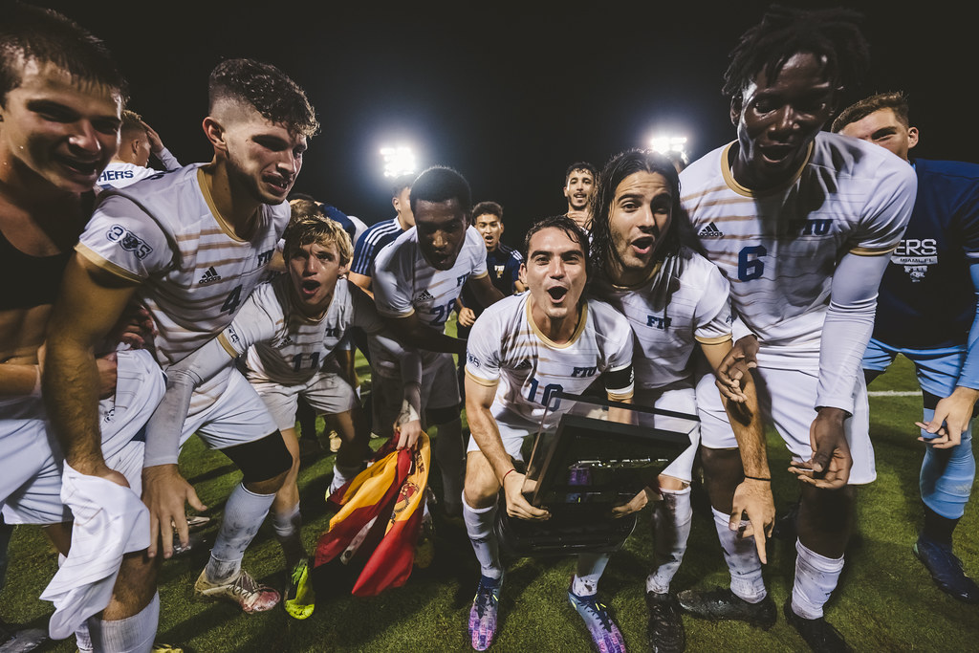
17 NCAA DIVISION I-A SPORTS PROGRAMS
Panther sports
15
7
Number of programs that exceeded an average GPA of 3.0
Number of programs that exceeded an average GPA of 3.5
123
52
All-American honors earned
NCAA tournament appearances
70
Conference titles

Slide 16

Education Abroad
FIU offers 60+ faculty-led programs, international exchanges, and third-party options for students to study, research, or intern abroad. Each year, over 1,000 Panthers gain global experience in dozens of countries.
studyabroad.fiu.edu

Slide 17
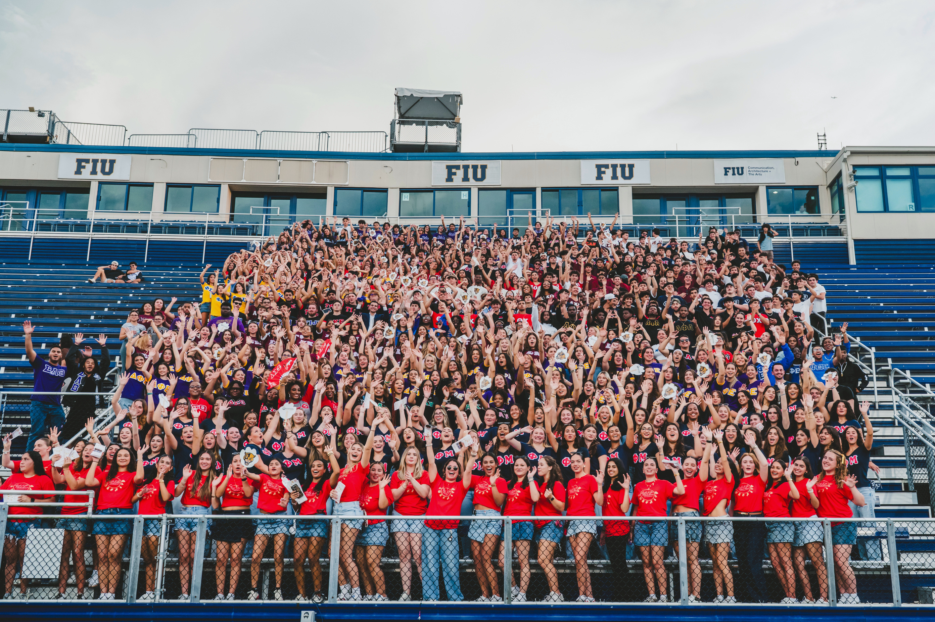
Greek Life
FIU is home to 45+ fraternities and sororities with over 2,000 students, organized into five councils.

Slide 18
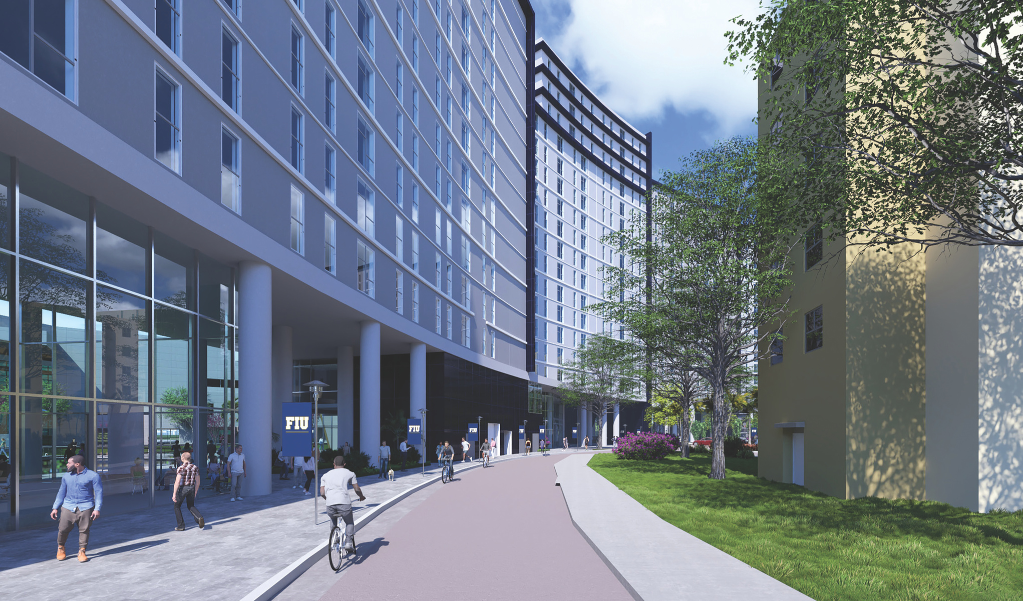

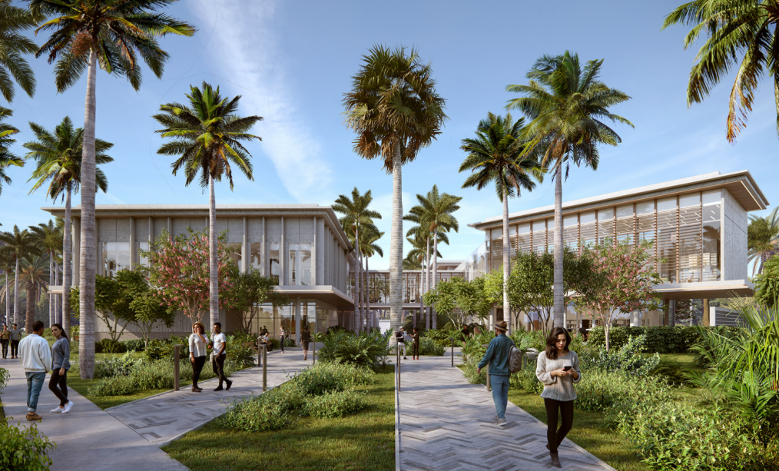
investing in growth
Recent and Upcoming Enhancements to Our Campus and Community
CASACUBA
  Groundbreaking 2025
TAMIAMI HALL II
  Groundbreaking TBD
  1,200 new dorm beds

Slide 19

admissions.fiu.edu

