Slide 1
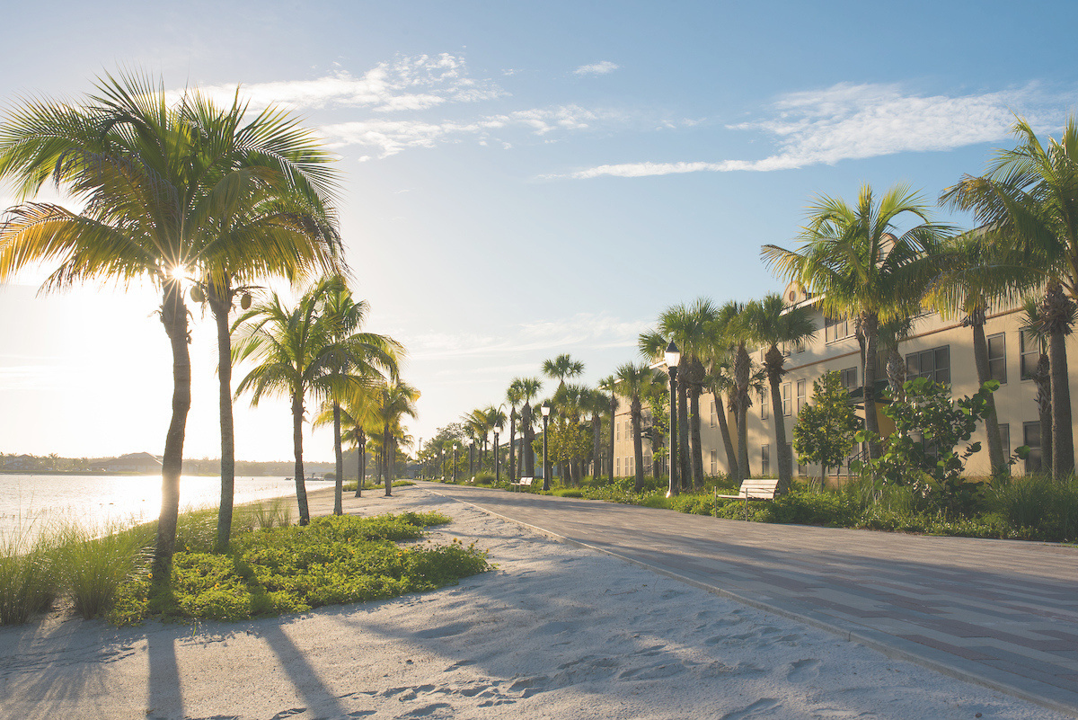

SUS TOUR 2025
Dean Batchelder
Associate Director of Admissions

Slide 2


FGCU Fast Facts
Total headcount = 16,000+
No tuition increase in 11 years!
Nearly 60,000 degrees awarded since 1997
20:1 student to faculty ratio
62% students graduate with zero debt
Specialized accreditation for all eligible programs
SUS TOUR 2025

Slide 3
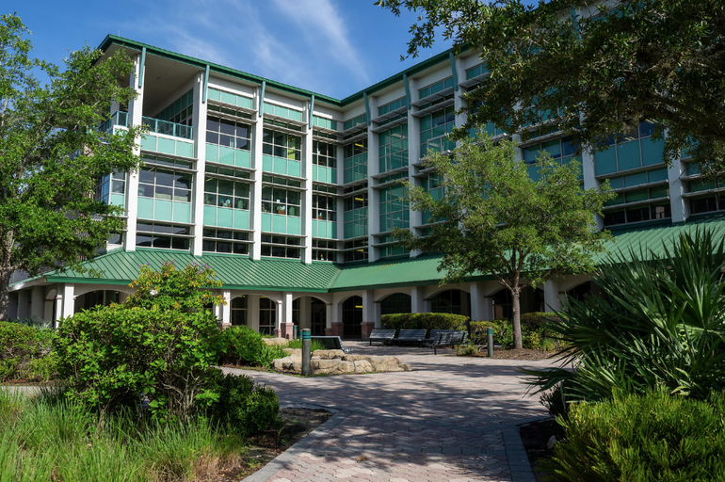

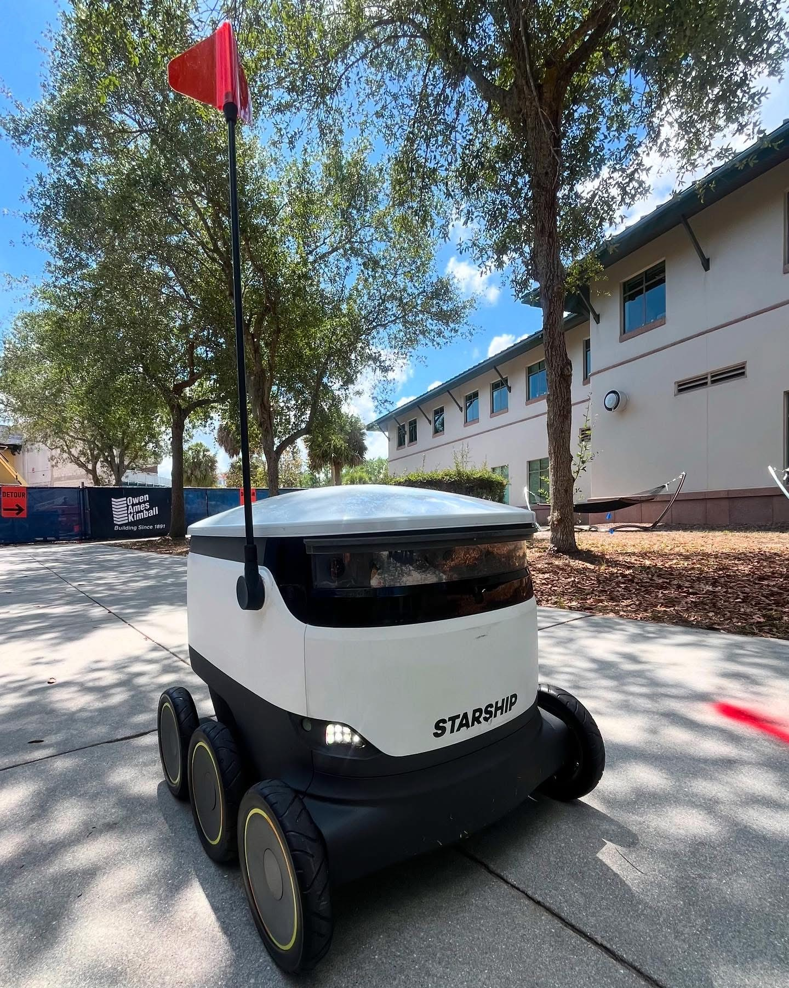

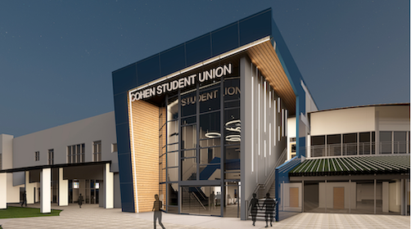
What’s New At FGCU?
  $22 million donation to FGCU going towards Marieb College of Health & Human Services
  Food delivery robots are now on campus
  Expanding/Renovating Cohen Student Union
SUS TOUR 2025
Notes:
- We received a $22 million donation—the largest donation yet—from the Elaine Nicpon Marieb Charitable Foundation. The donation will go towards construction for Academic Building 10, which will be an extension of the Marieb College of Health & Human Services, and it will be named in Elaine Marieb’s honor. The gift will also go towards new cutting-edge technology, such as “high tech patient simulation labs and holographic-style imaging” that will allow our students within the healthcare field practice safely.
- We are in the second phase of renovations for Cohen Student Union, which is set to be completed March 2026. The new and improved Cohen will provide students and employees with a more welcoming, living room-style atmosphere to gather for meals, meetings and more.

Slide 4
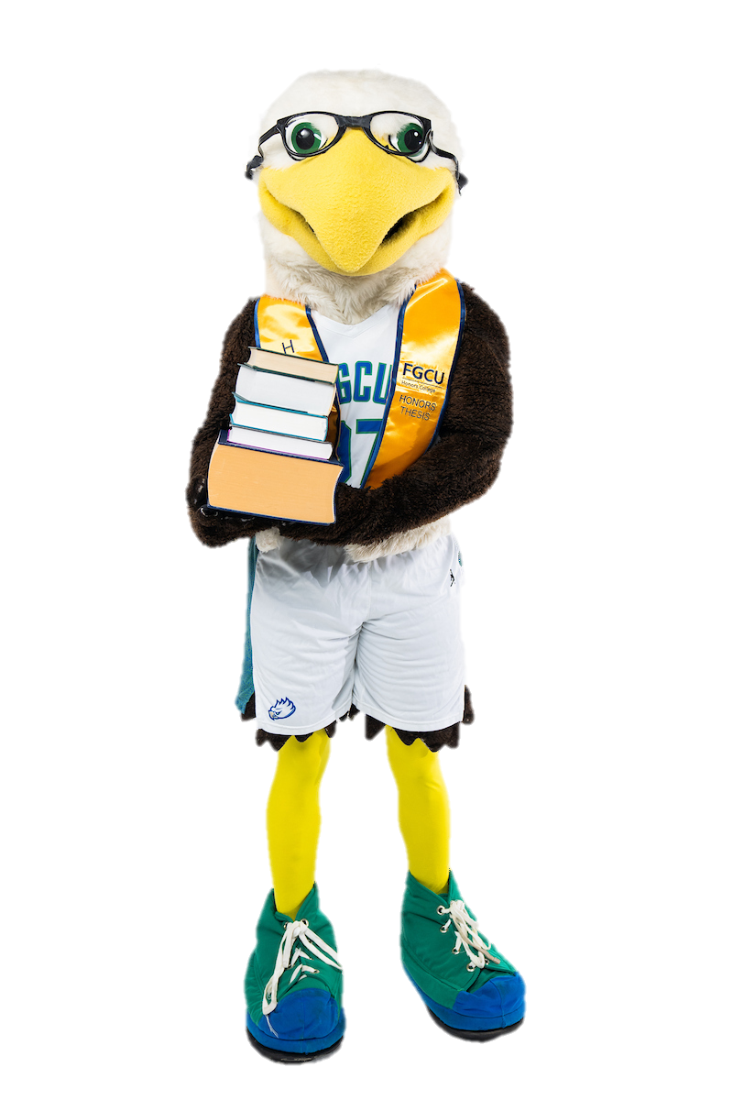
Academic Highlights
74% of classes taught by full-time faculty​
FGCU's School of Nursing achieves a 100% NCLEX pass rate​
31 medical-focused students participated in the Global Medical Brigade this past spring
Study abroad opened to first year students
A personalized Honors College experience
SUS TOUR 2025
SUS TOUR 2025
Notes:
- For the second year in a row, FGCU’s School of Nursing achieved a 100% pass rate on the NCLEX—and were the only public university to meet this achievement this year.
-31 FGCU students went to Panama this spring as part of their Global Medical Brigades trip, in which they worked alongside medical professionals and translators using classrooms as stations for consultation, dentistry, physical therapy, and more. The student volunteers treated over 450 patients over three clinics allowing them to gain invaluable hands-on experience.
For the first time ever, FGCU opened its study-abroad program to first-year students, beginning spring 2025, starting with a cohort at the University of Limerick in Ireland
Small classes, faculty mentorship, and unique pathways give students a tailored, high-impact education and create a personalized and supportive environment. Students integrate service-learning, cultural immersion, and civic impact into their academic journey, setting FGCU apart.

Slide 5
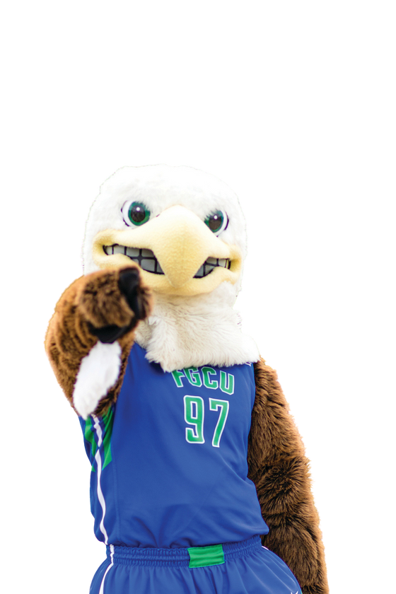
FGCU Athletics in the News
Women’s Basketball 2025 ASUN Champions!
Won Bill Bibb & Sherman Day Trophies
ASUN Female Athlete of the year
FGCU pitcher drafted by Cincinnati Reds
SUS TOUR 2025
SUS TOUR 2025
Notes:
- FGCU’s women’s basketball team won the 2025 ASUN Tournament, marking their 12th championship title.
- FGCU claimed the Bill Bibb Trophy and the Sherman Day Trophy. FGCU secured the Bill Bibb Trophy, awarded to the ASUN institution with the best overall finish across all sports, by earning 342.5/410 points (a 81.74% performance). FGCU also secured the Sherman Day Trophy, which recognizes the top-performing school in women’s sports, by earning a 90.08% mark (218/242 points). It was our first Sherman Day Trophy since 2017-18.
-Jaci Carpenter, beach volleyball player, was named the Female Athlete of the Year at the ASUN Awards ceremony. To be considered for this top honor, a student-athlete must also excel in academics: she graduated summa cum laude with a 4.0 GPA in Communication, and served over 300 service learning hours while at FGCU.
-For the third consecutive year, an FGCU pitcher has been selected in the MLB. Justin Henschel was picked by the Cincinnati Reds in the seventh round.

Slide 6

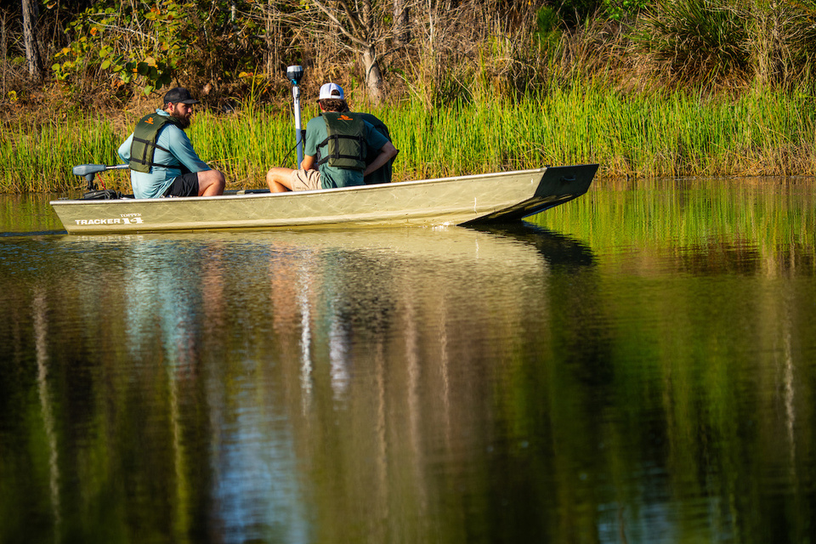

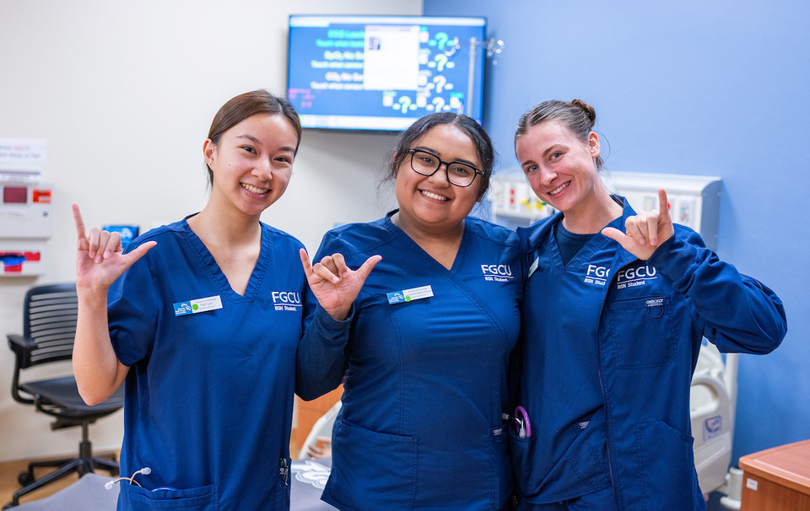
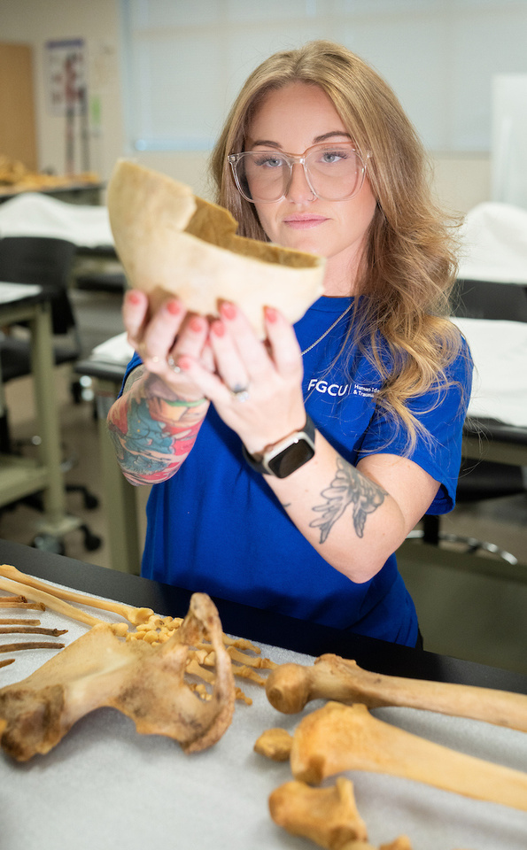

Academics: Five Colleges
College of Arts & Sciences​
Lutgert College of Business​
College of Education​
U.A. Whitaker College of Engineering​
Marieb College of Health & Human Services
SUS TOUR 2025

Slide 7

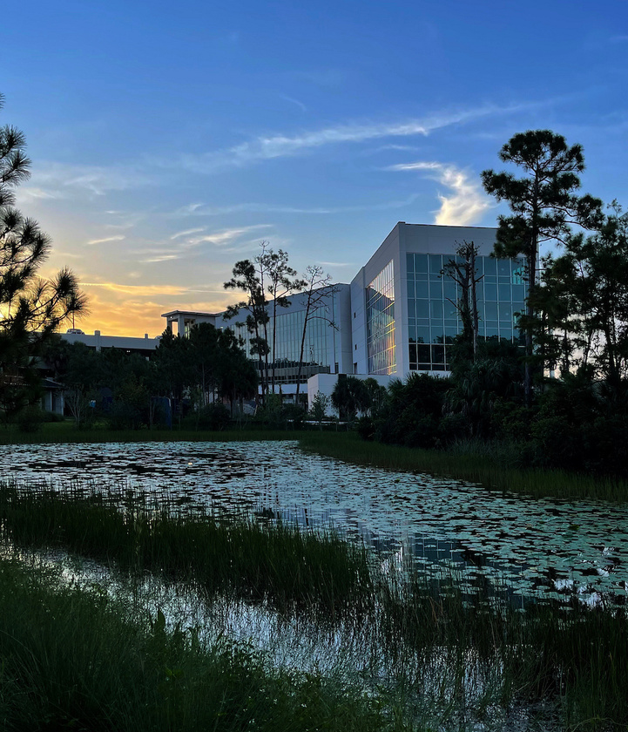
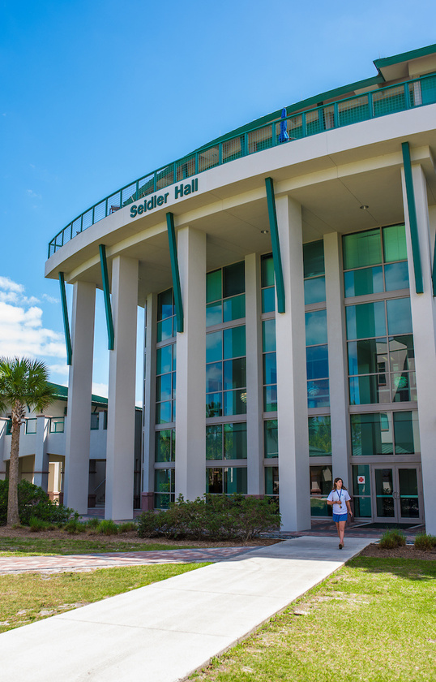
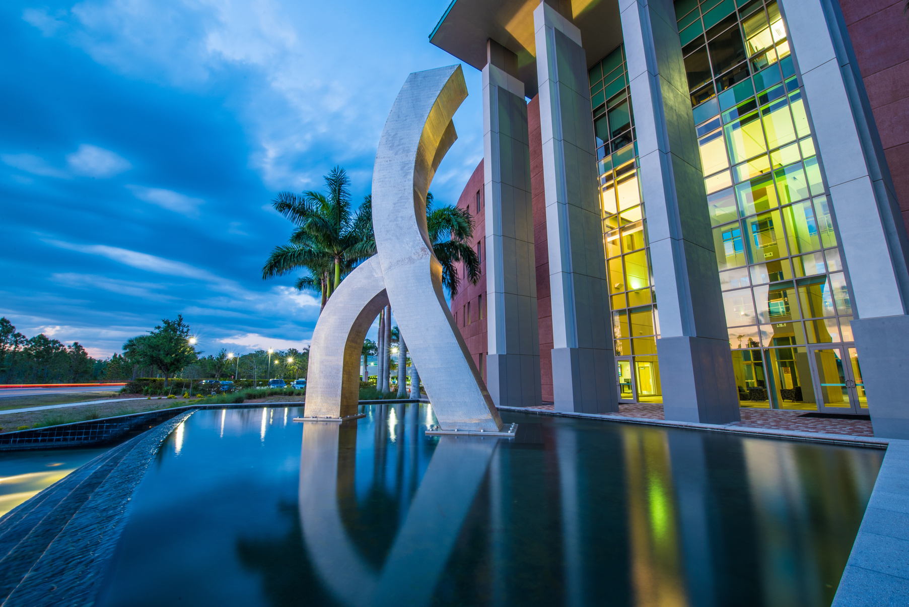
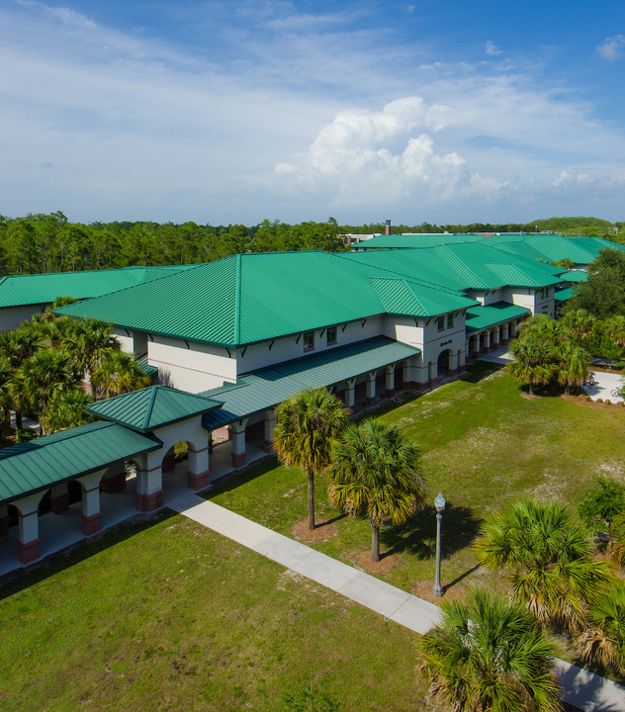
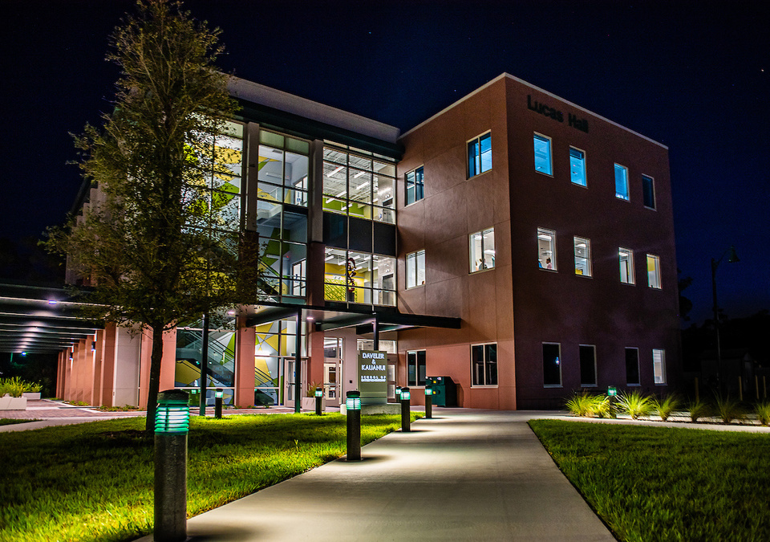
Academics: Five Schools
Bower School of Music & the Arts​
Daveler & Kauanui School of Entrepreneurship​
School of Nursing​
School of Resort & Hospitality Management​
The Water School
66 majors & 54 minors-
now including B.S. Hospitality & Tourism Management!
SUS TOUR 2025

Slide 8

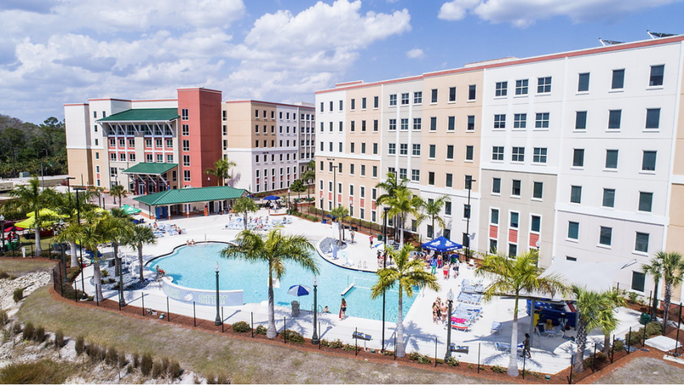
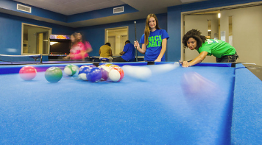

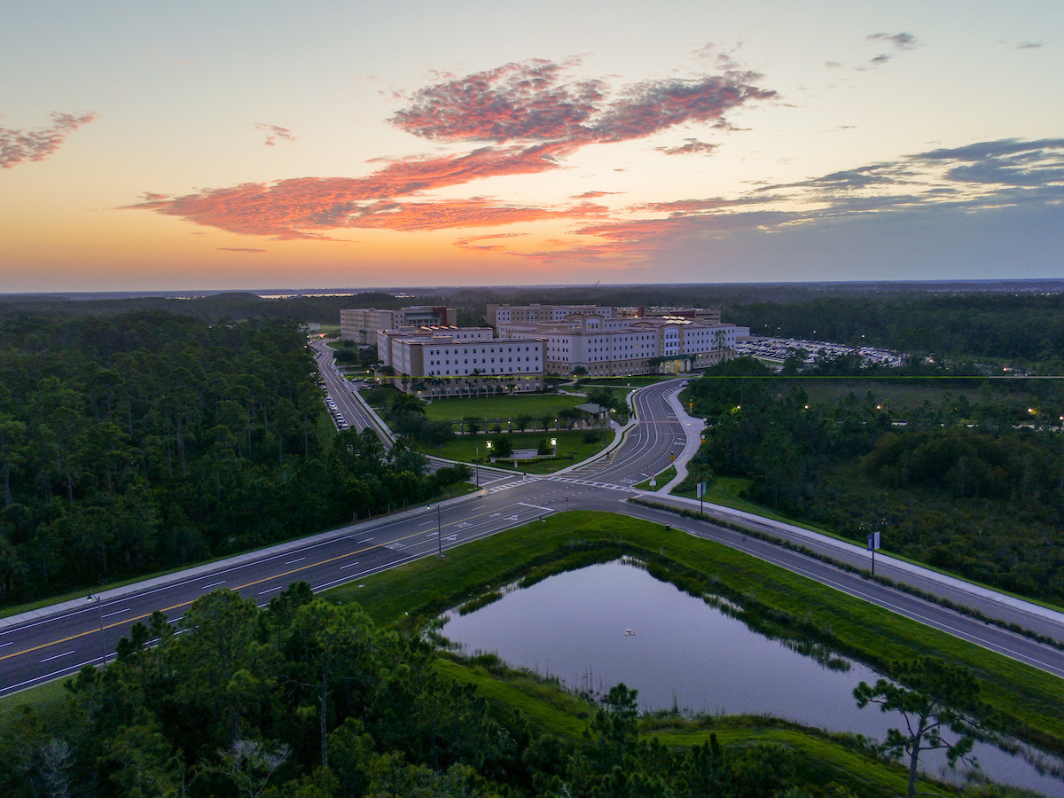
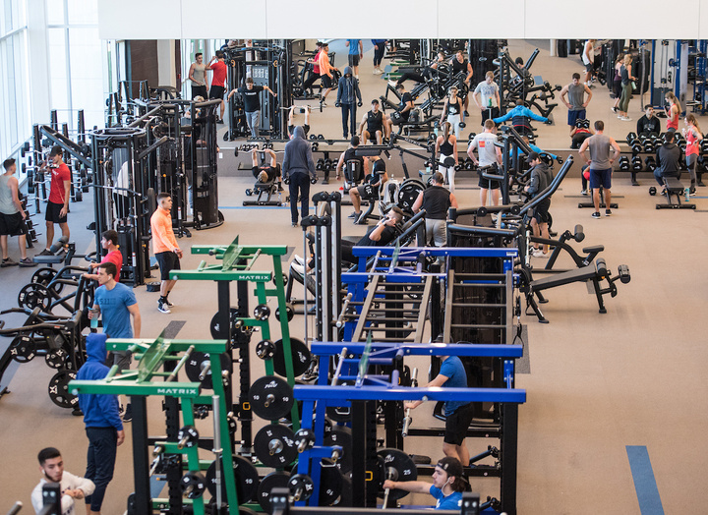
South Village: Freshman Housing
SoVi Dining: Buffet Style
  Resort-style pool
  Recreation Center
  First Year Experience
  2-bedroom and 3-bedroom options
  Suite-style living with your own bedroom!
  Apply EARLY!!
SUS TOUR 2025

Slide 9

How to Apply
  Complete the FGCU Admission Application at apply.fgcu.edu or the Common App​
  Application includes a brief, personal essay​
  Submit official high schools transcripts​
  Submit official SAT/ACT/CLT scores​
  Florida Dual Enrollment students earning an AA can apply test optional
SUS TOUR 2025

Slide 10
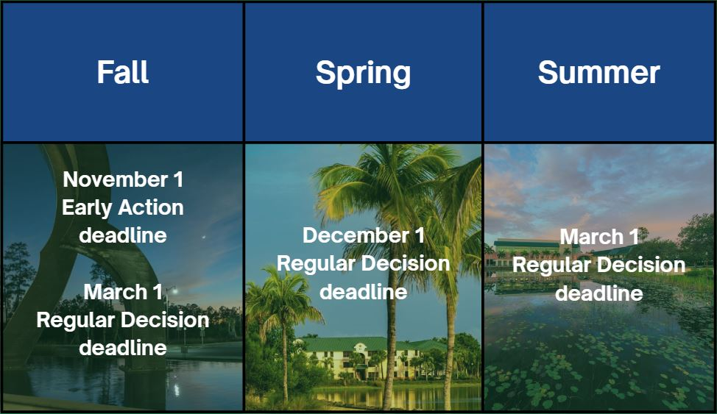
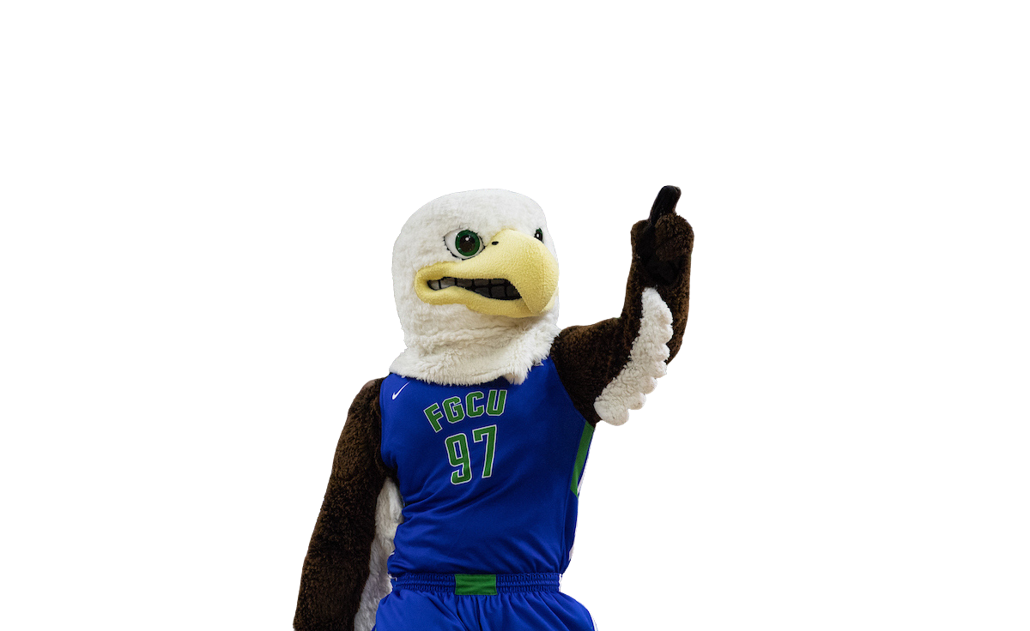
Important Dates
The housing application opens early December. Apply as early as possible to secure on-campus housing!
SUS TOUR 2025

Slide 11

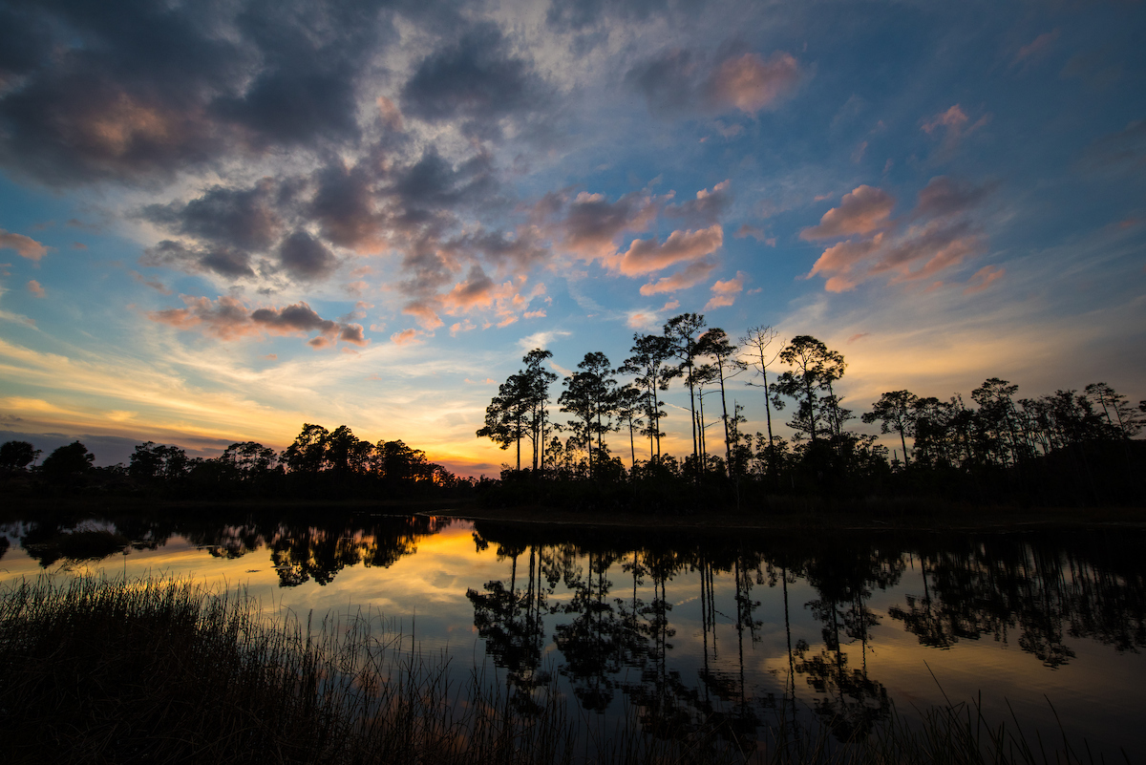
Freshman Scholarships
Merit Award | Award | Requirements
President’s Gold Florida Residents Only | $5,000/year | 3.9 weighted GPA 1320 SAT, 28 ACT, or 94 CLT
President’s Silver Florida Residents Only | $3,000/year | 3.5 – 3.89 weighted GPA 1220 SAT, 25 ACT, or 85 CLT
Blue & Green Scholars Non-Florida Residents Only | $10,000/year | 3.9 weighted GPA 1320 SAT, 28 ACT, or 94 CLT
Blue & Green Directors Non-Florida Residents Only | $15,000/year | 3.5 – 3.89 weighted GPA 1220 SAT, 25 ACT, or 85 CLT
Students may submit a separate application for the Foundation Scholarship– open from October 1st to May 1– and are eligible for one or more of 2,000 scholarships!
SUS TOUR 2025

Slide 12

Admission Tips
Javier García
Apply EARLY
  Take the SAT/ACT/CLT multiple times. Send all scores to us - we super score!
  Check your status through your Future Eagle Account and read your emails
  Email questions to admissions@fgcu.edu
SUS TOUR 2025

Slide 13
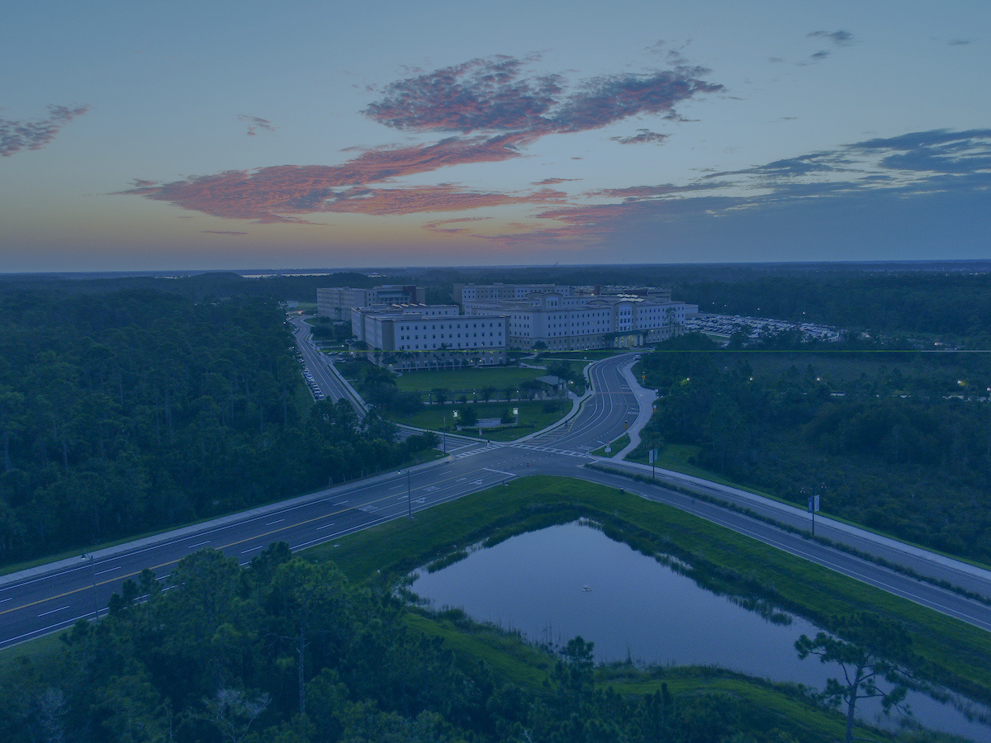
Upcoming Dates
Eagle Expo Open House
Saturday, 10/18/25
Saturday, 2/21/26
Say Yes to the Nest (Admitted Students Event)
Saturday, 1/24/26
Saturday, 3/21/26
SUS TOUR 2025

Slide 14
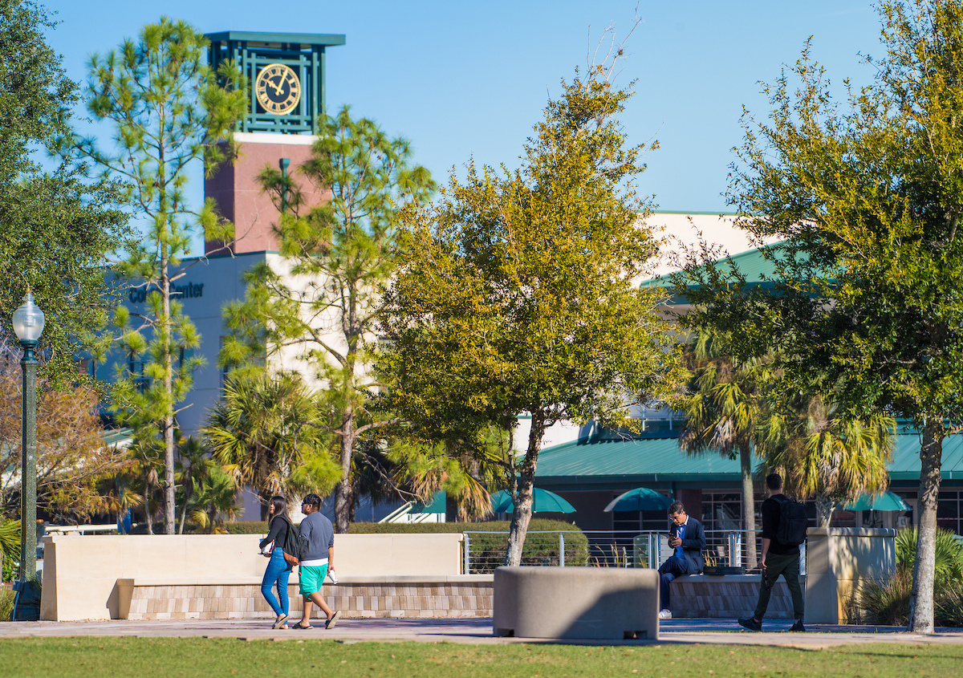





Follow us!
@fgcu​
floridagulfcoastuniversity​
​​​
@fgcu​
​​
florida-gulf-coast-university​
​
@fgcu
SUS TOUR 2025

