Slide 1
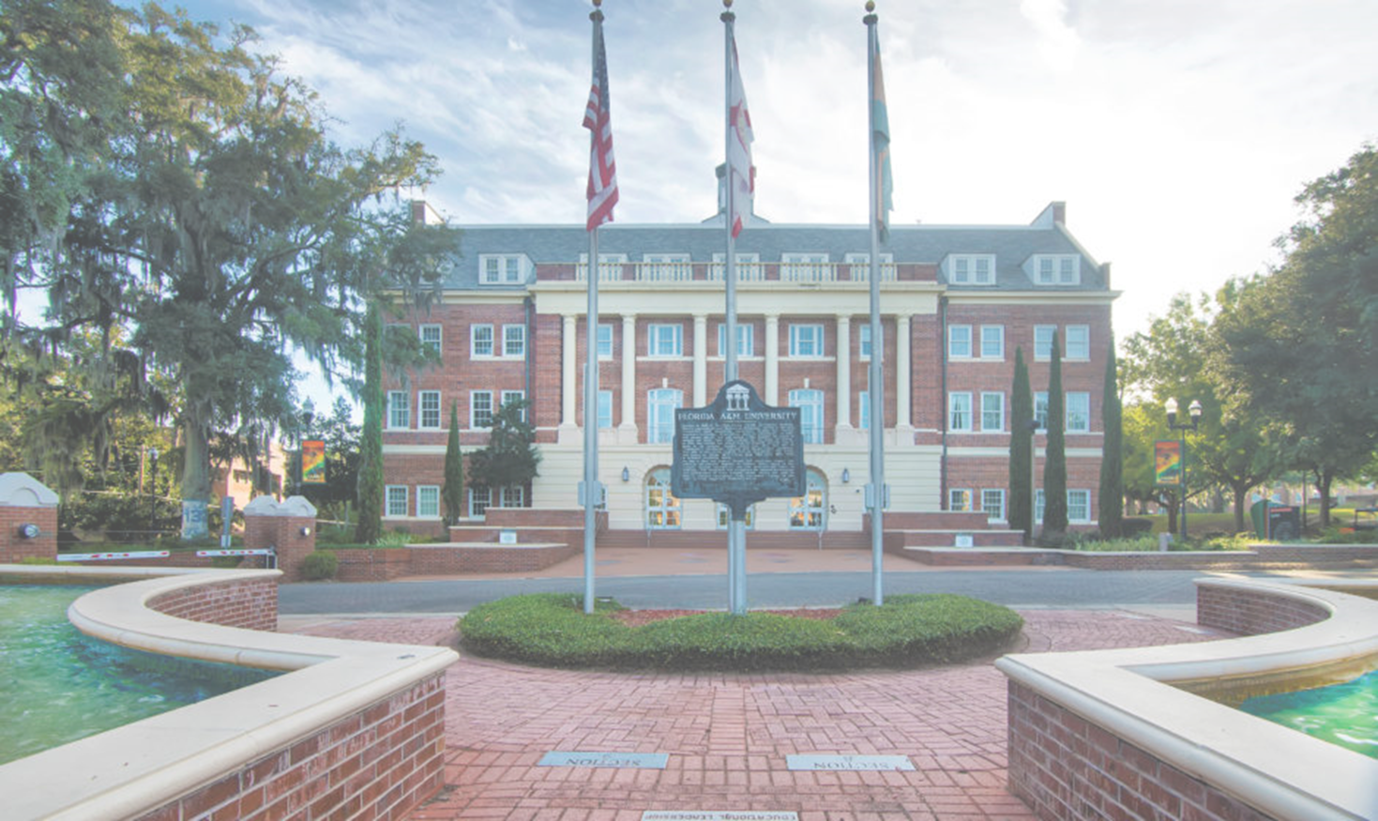


FLORIDA A&M UNIVERSITY

Slide 2

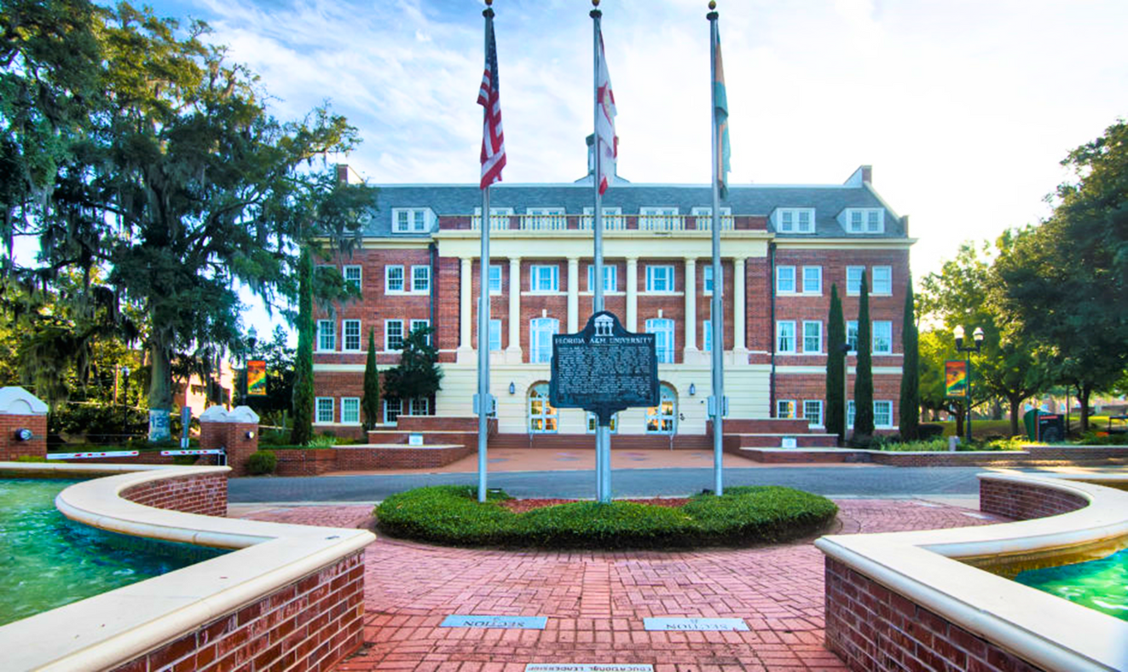
OVERVIEW
Florida A&M University, established in 1887, is a historically Black university devoted to student success and renowned for academic excellence, world-class faculty, and research innovation.
Quick Facts:
  Enrolls nearly 10,000 students from the U.S. and more than 70 countries.
  15:1 student-faculty ratio
  94.6% retention rate | 33% acceptance rate
  Only HBCU land-grant institution in Florida.
  The nation’s only joint College of Engineering.

Slide 3


FAMU REPUTATION
Florida A&M University is a Top 100 ranking university in Tallahassee, Florida.
Ranked No. 1 Public HBCU in the nation.
Ranked No. 1 for Research and Development.
Ranked in the top 20 for Social Mobility Index.
Designated as a Fulbright HBCU Institutional Leader.
Designated a Collegiate Purple Star Campus.

Slide 4














OUR 14 COLLEGES & SCHOOLS
Discover the Possibilities
College of Agriculture & Food Sciences
College of
Education
College of
Law
College of Pharmacy, Institute of Public Health
College of Science & Technology
College of Social Sciences, Arts & Humanities
FAMU-FSU College of Engineering
School of Architecture + Engineering Technology
School of Business & Industry
School of Allied Health Sciences
School of Graduate Studies & Research
School of Journalism & Graphic Communcation
School of
Nursing
School of the Environment

Slide 5

ACADEMIC PROGRAMS
Explore the Possibilities...
Florida A&M University prepares its scholars to be leaders in their chosen fields within 14 colleges and schools.
BACHELOR
MASTER
PROFESSIONAL
DOCTORAL
55
Bachelor
Degree Programs
32
Master
Degree Programs
3
Professional
Degree Programs
14
Doctoral
Degree Programs

Slide 6
ACADEMIC AREAS OF EXPERTISE
Overview
Florida A&M University is a top-performing institution within the State University System of Florida, nationally known for its ability to produce highly prepared graduates who advance critical workforce and research priorities in three areas of expertise.
1
Health, Pharmacological Research, Allied Health Sciences and Workforce Readiness
2
Business Innovation in Supply Chain, Accounting, and Cyber Policy
3
Architecture, Agricultural Engineering, and Environmental Design

Slide 7

FALL 2025 ADMITTED PROFILE
Middle 50% Ranges
Weighted Core GPA: 3.69 - 4.24​
SAT: 1080 – 1230 ​
ACT: 22 – 27​
CLT: 61 – 73
Top Areas of Interest
Pre-Med
Pre-Nursing
Business
Computer Science
Mechanical Engineering

Slide 8
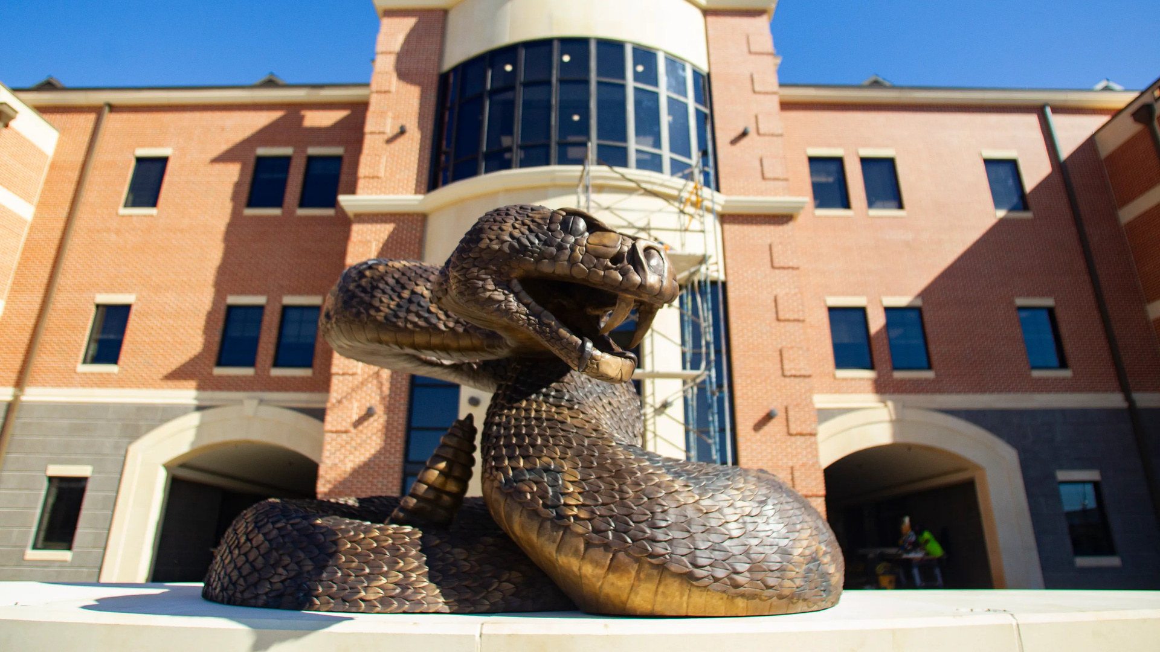
IMPORTANT INFORMATION
Deadlines
Early Action - November 1
Regular Decision - February 1
Rolling Admission - May 1
Submitting Transcripts
Students should submit their Self-Reported Transcript and Academic Record System (STARS). FAMU also accepts official transcripts electronically.

Slide 9
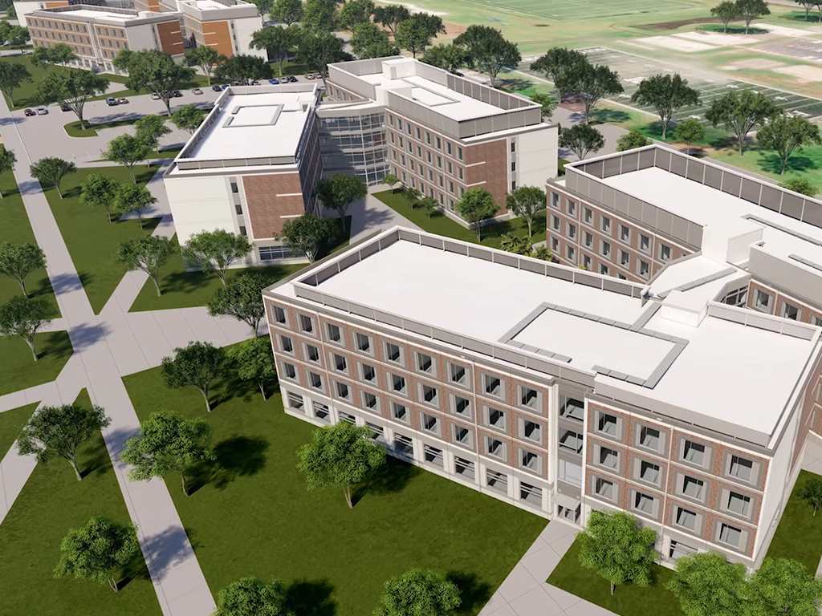
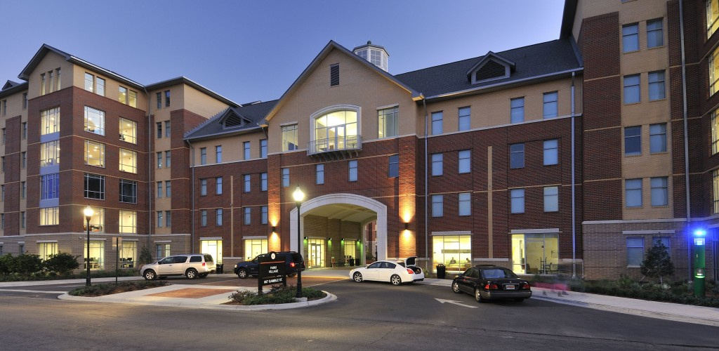
RESIDENTIAL HALLS
Venom Landing & Towers
Polkinghorne Village
@famuhousing1887

Slide 10

LIVING LEARNING COMMUNITIES
First-Year Experience
Designed for first-year students, FAMU’s Living Learning Communities (LLCs) motivate, cultivate, and challenge student residents both in and outside of the classroom. Programing includes:
  Meetings/Study groups
  Group activities/projects
  Leadership development
  Research
  Study abroad/field trips
  Shared classes
  Service Learning
  Career/Experiential Learning
  Cultural and social events

Slide 11

HONORS PROGRAM
Excellence and Distinction
Students enrolled in FAMU honors courses receive more individualized resources. The program is designed for students who like a highly interactive and challenging learning environment.
Benefits:
  Honors notation on transcript
  Certificate of Completion
  Honors Plaque
  Commencement Medallion

Slide 12

STUDENT SUPPORT SERVICES
Student Success
We are committed to providing the tools and support students need to thrive. From academic guidance to personal well-being, we offer a range of resources designed to help every student reach their full potential
  Academic advising
  Academic coaching and tutoring
  Health and wellness resources
  Counseling and psychological services
  Peer mentoring

Slide 13
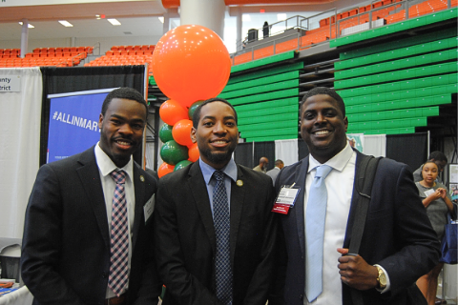
CAREER DEVELOPMENT
Equipped to Lead
The FAMU Career and Professional Development Center helps students discover their passions, build experience, and connect with employers so they graduate career-ready.
  Career Coaching
  Major Exploration
  Internships
  Job Search Support
  Career Planning

Slide 14



Prepare future Rattlers...
Come Math Ready
Encourage your students to complete College Algebra as dual enrollment by their senior year of high school.
Highlight Scholarships and Florida Bright Futures
Host sessions for your students to learn about all scholarships but specifically those from the Thurgood Marshall College Fund. Practice essay preparation and key details about major specific scholarships.
Career Focus Surveys
Princeton Review and others have career focused surveys to help your students align their realistic goals with careers and college majors.
Connection to Admissions Team
and FAMU Alumni Groups
Develop a Timeline Leading to Application Day
Help your students prepare their application information early, encourage tracking of community service hours and leadership roles.
GET READY TO APPLY!
FAMU is the No. 1 Public HBCU for the sixth consecutive year and remains a Top 100 University by U.S. News and World Report we are waiting for your students!

Slide 15
STRIKE BOLD!
STRIKE PROUD!
STRIKE !

