Slide 1

College Board SUS Tour
“A Shared Vision for Readiness”
Fall 2025
Notes:
Introduction

Slide 2
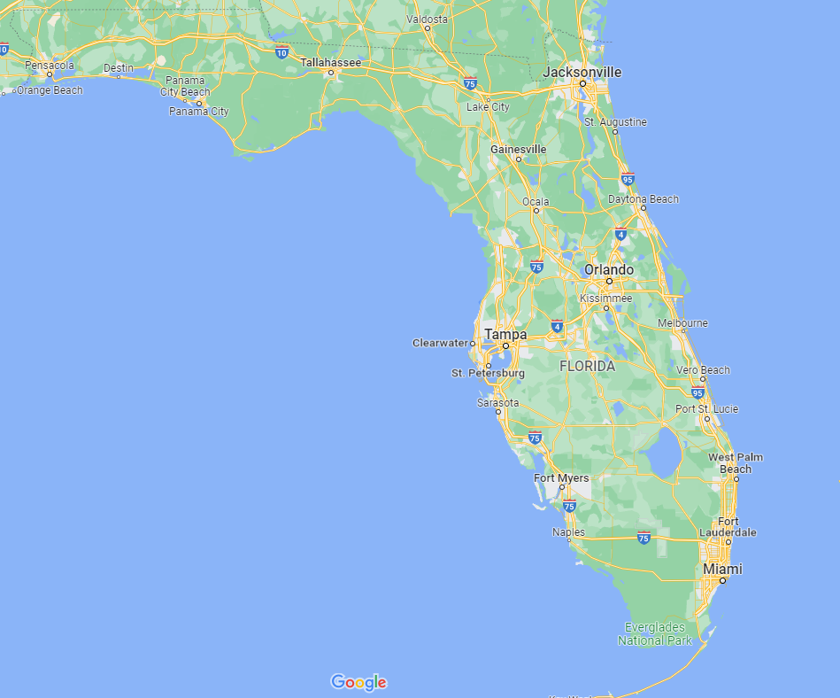



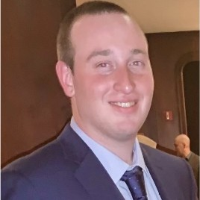
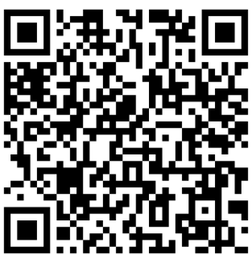

Florida Team Works Directly With You
Success is NOT for the gifted. Success is for the PREPARED!
PREPARATION is the KEY!
Dr. Robert Britton
Director
Stephanie Tate
Director
Tikini Thompson Sr. Director
John McGrath
Assoc. Director
Dr. Mirynne Igualada
Sr. Director
September 9th - AP Ordering Office Hours
Notes:
September 9th- AP Ordering Office Hours
Direct ordering and registration support
Assist with data analysis and professional learning support after the assessments

Slide 3








Solutions to Help Students Navigate and Prepare Their Path
Purposeful Assessments
Access for
All
Opportunity that
Counts
Shorter, digital, and instructionally aligned assessments that give students a better experience and educators meaningful insights.
Connecting students, educators, schools, and communities to expand access to high quality post-secondary opportunities.
Opening doors to postsecondary success through advanced coursework and personalized guidance.
Notes:
​A Collaborative Vision for Assessment, Access, and Opportunity
At the heart of our work are shared goals:
Ensuring every student is ready for college, career, and life.
Expanding opportunity—so that access to success isn’t determined by zip code.
Equipping educators with actionable data that supports real-time decisions.
And building a system of assessment that is sustainable, future-ready, and truly serves our students and schools.
Let’s explore how we can move forward—together.

Slide 4
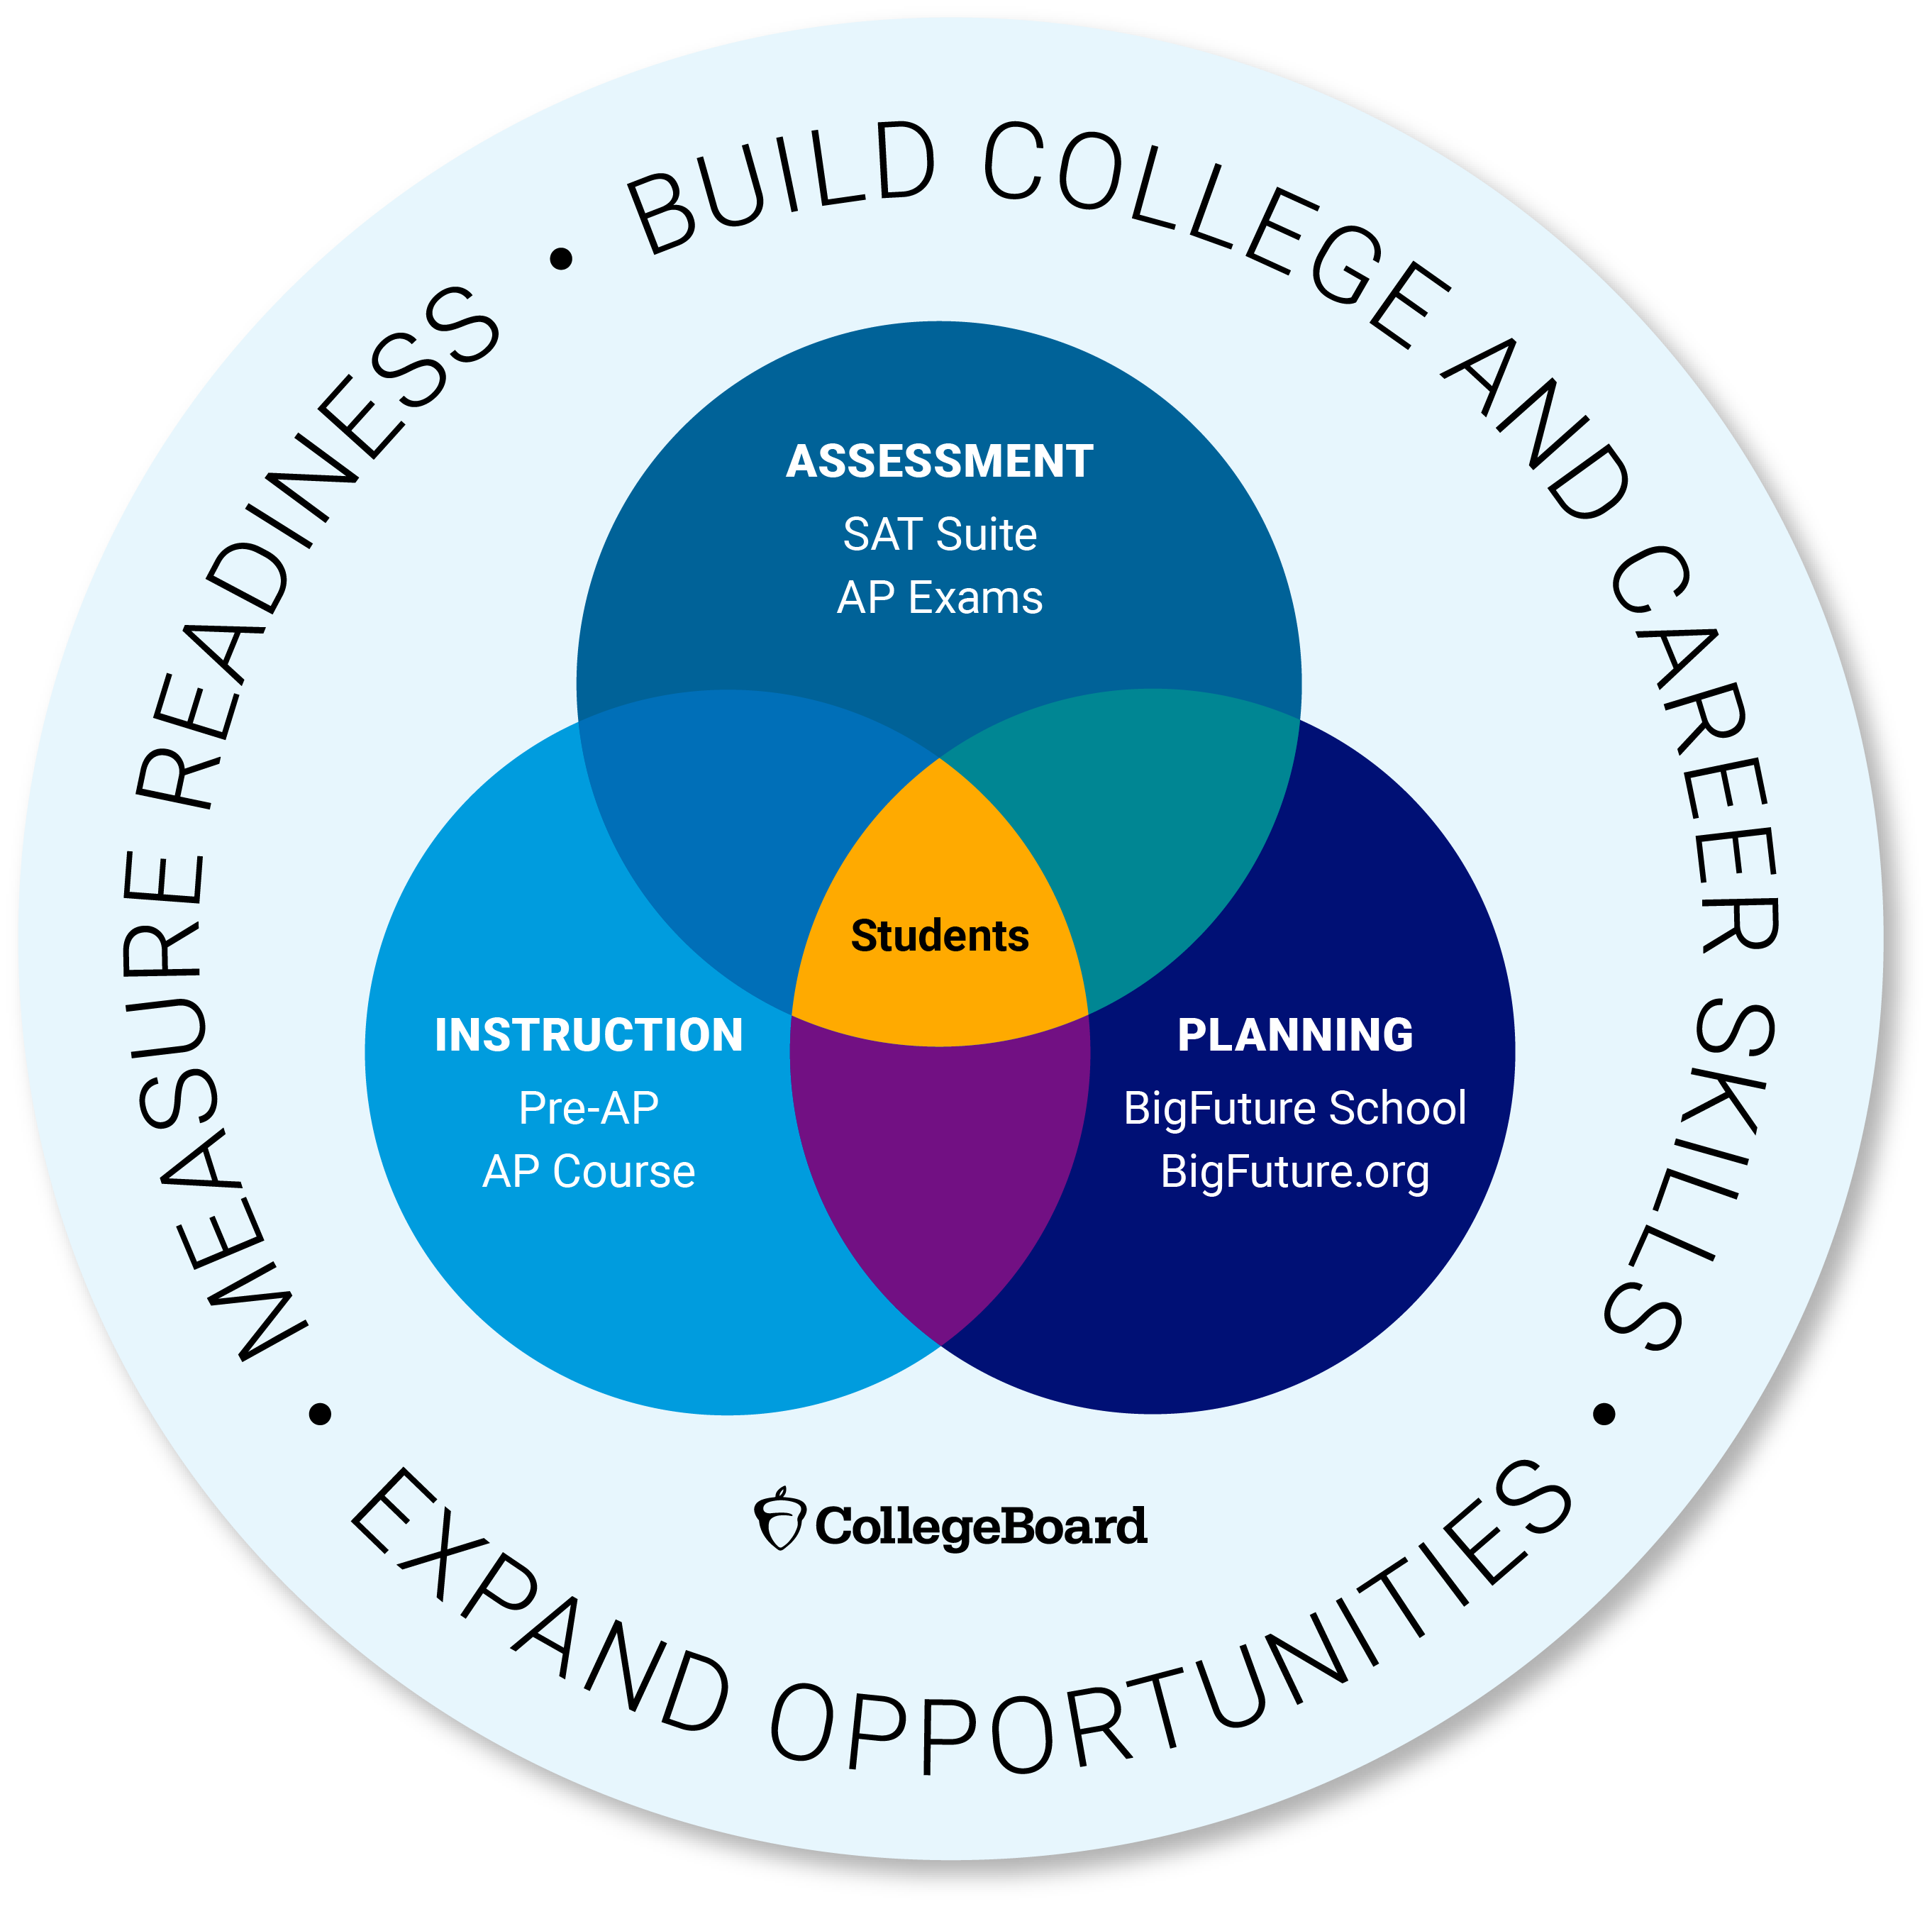
Alignment Starts Here!

Slide 5
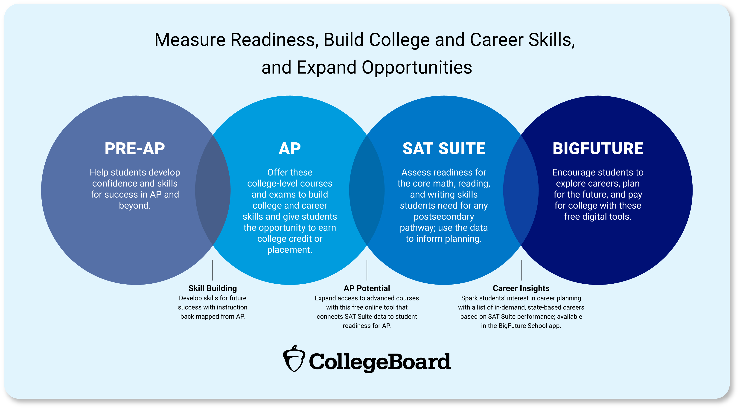

Slide 6



The SAT Suite: Delivering on Opportunity
The SAT is a globally recognized credential that connects students to college and career opportunities.
Our Bluebook testing platform and adaptive design ensures testing is secure, valid, and student-friendly.
Shorter testing time (~2hr) allows educators to spend more time on instruction and reduces testing anxiety for students.
Score reports help
educators monitor student progress, inform curricular decisions, develop targeted interventions and identify AP Potential.
The SAT opens doors to college admissions, scholarships, and personalized career exploration that can transform future generations.
Gateway to Opportunity
Seamless Digital
Administration
Shorter Testing Time
Comprehensive Data & Insights
Connections to College and
Career
Purposeful Assessments
Notes:
For millions of students, the SAT is more than just a test—it’s a gateway to opportunity. It helps open doors to college admissions, scholarships, and career pathways, providing students with a globally recognized credential that helps them take the next step in their educational journeys.
The SAT has also led the way in digital assessment innovation, making testing more secure, reliable, and student-friendly.
The digital SAT offers a shorter, multi-stage adaptive format that maintains high reliability while reducing test fatigue for students.
We built the best student digital testing app in the world that can be administered on school-managed and personally-owned devices spanning laptops and tablets + was designed to only need a few moments of internet connectivity. And have an integrated set of tools and apps for districts, schools and educators, responding to the needs of our state and district partners. The SAT Suite has already been used to test 7.5M students in nearly 20,000 schools across the U.S. and in over 170 countries around the world.
This is the same testing application powering AP tests – your students know the platform. Your educators know the platform.
One of the reasons institutions and educators continue to rely on the SAT Suite is the depth of data and insights it provides. These data and score reports come back within weeks, not month.
The SAT doesn’t just assess student readiness—it generates data that helps schools, districts, and higher education institutions make informed decisions.
Educators use SAT data to track student progress, inform curriculum decisions, and develop targeted interventions to support student success.
Connections to career information and opportunity through the core SAT (i.e. doesn’t require an additional test or test section), which can be personalized based on student performance and interests as well as localized to state

Slide 7
In-School Testing Dates 2025-2026
FALL 2025
SPRING 2026
TEST | TESTING DATES
PSAT 8/9 | Oct. 1st- 31st
PSAT/NMSQT | Oct.1ST – 31st
SAT School Day | Oct. 1st– 31st
TEST | TESTING DATES
PSAT 8/9 | March 2–April 30, 2026
PSAT 10 | March 2–April 30, 2026
SAT School Day | March 2–April 30, 2026
CHEAPER Testing Option
MORE Flexibility
NEW Concordant Opportunities
Notes:
Highlight concordance changes here.
Vast majority of districts will pay around $10 for PSAT 10.
Bookend the population

Slide 8
Proportion of SAT takers who take the SAT on a School Day in Florida Public Schools 2022-2024
SAT School Day
Removes barriers
Provides access
Can help to address financial burdens
56%
63%
50%
Took the SAT
In-School
Took the SAT
In-School
Took the SAT
In-School
Class of 2022
Class of 2023
Class of 2024

Slide 9
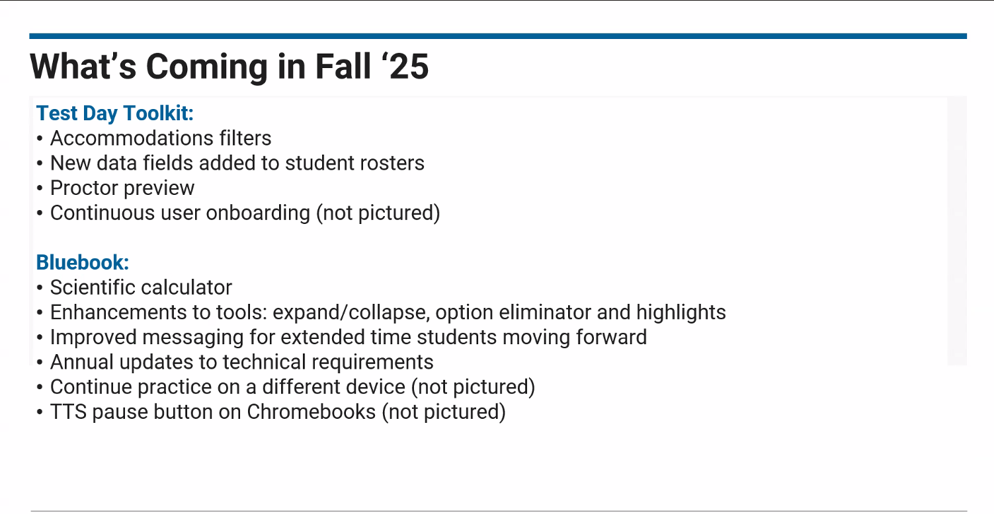
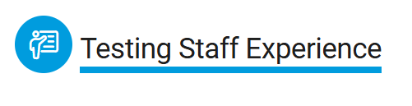
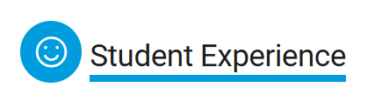
Updates for Fall 2025 Testing
Notes:
Student Experience- Big Future School app will now be available to all in-school test takers, including students who take the PSAT 8/9
Changes to Bluebook- Time paused on exit. The test timer will pause for a limited time if students exit the Bluebook app, giving them a chance to recover from technical issues.
New calculator options- All students taking SAT Suite of Assessments can now toggle between scientific and graphing options in the embedded Desmos calculator.
Changes to Accommodations- Reminder from Spring 2025- once standard time elapses, students with extended time accommodations have the option to click “Next” to continue or end their test.
Testing Staff Experience-
Test Day Toolkit Proctor Preview- After receiving access to Test Day Toolkit, staff will be bale to walk through all the proctoring screens like they would on test day.
Shortened Readiness Timeline- The in-school readiness timeline has been updated from five weeks to three weeks to reflect the actual time it takes to prepare for an administration.
Staff Training- Modules have been updated to be more customizable.

Slide 10


Purposeful Practice for All Students
COMPREHENSIVE SET OF FREE RESOURCES
Khan Academy
Practice Tests
Question Bank
7 full-length, adaptive practice tests on the Bluebook testing platform
Over 3,500 real SAT questions tagged to state standards
Lessons and quizzes from College Board’s test prep partner
Check OUT the Educator Bank and SAT Question of the Day

Slide 11
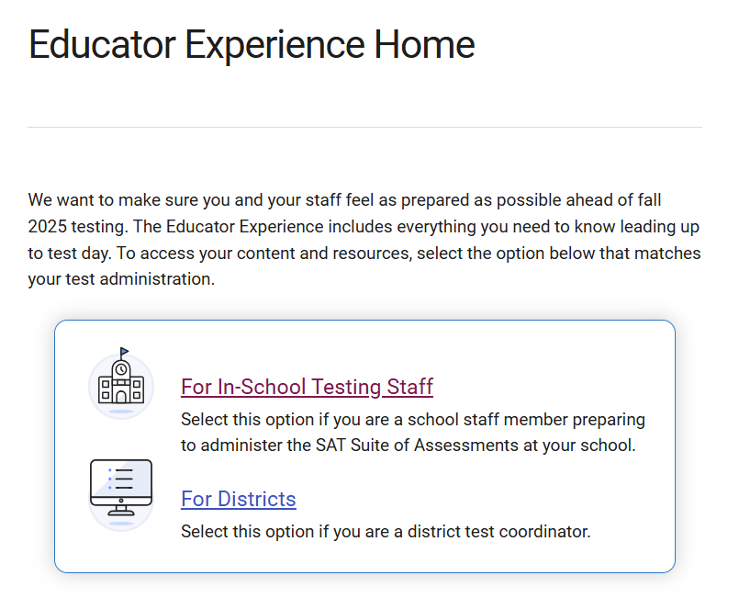
Resources for Educators
Digital SAT Suite of Assessments
In-School Educator Experience

Slide 12
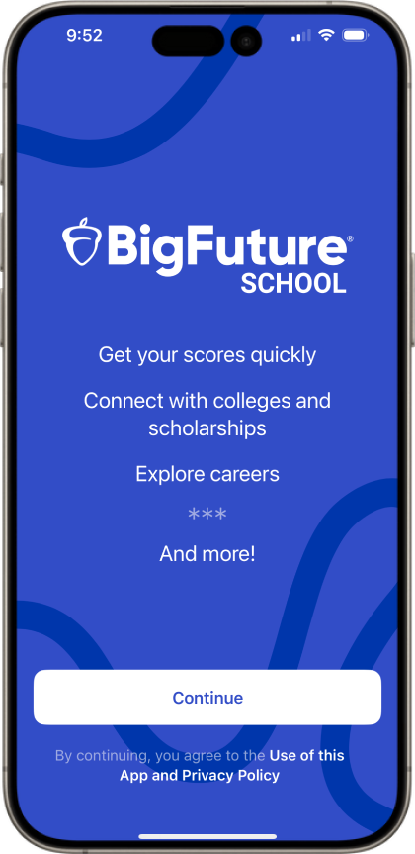
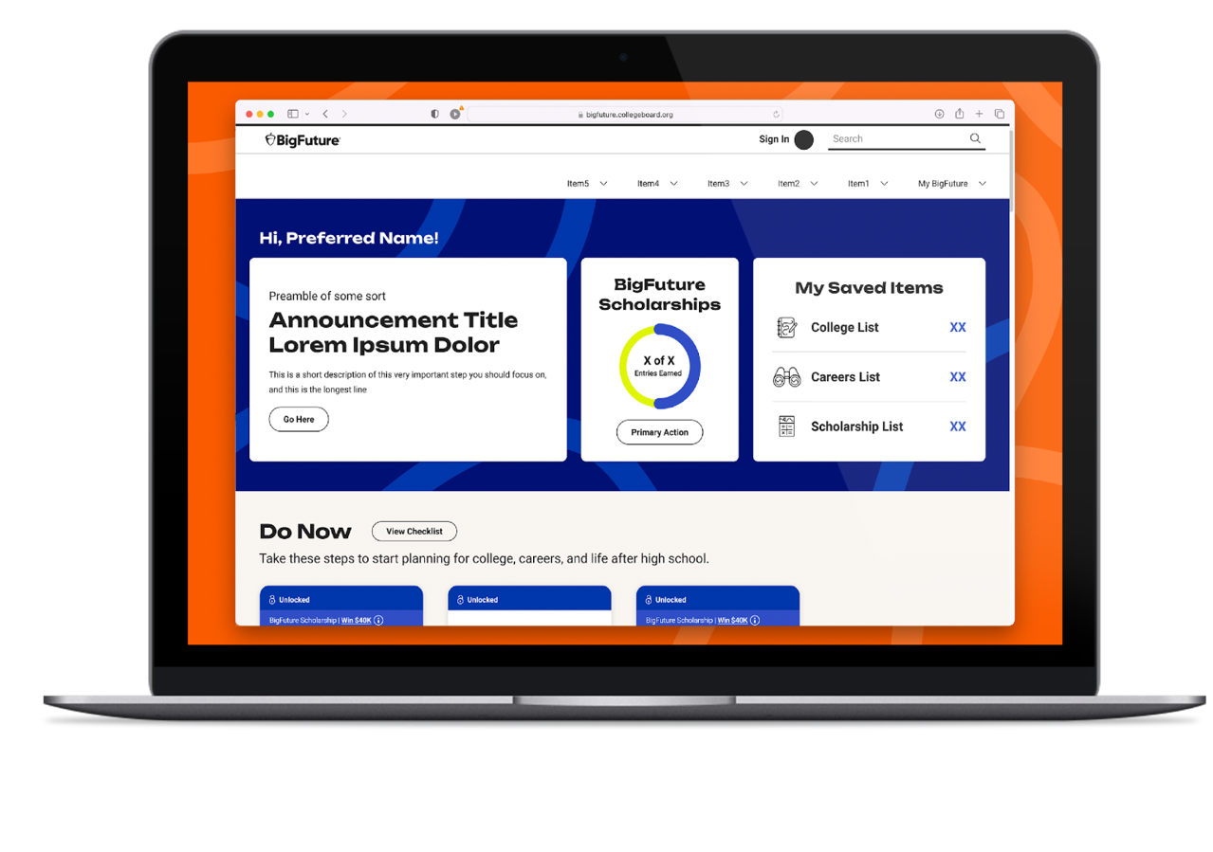
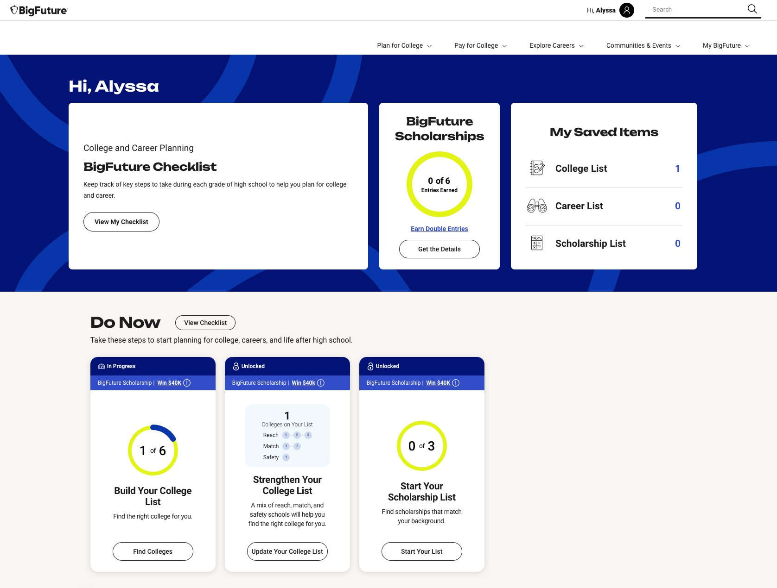
What Is BigFuture?
BigFuture brings together a trusted community to help every learner own their future.
BigFuture provides two complementary tools to help students explore their college and career options and plan for what comes next
.
BigFuture School
BigFuture.org
(Available to all students)
(Available to in-school SAT Suite of Assessments test takers 13 or older)
Notes:
Within BigFuture there are two free, complementary solutions: BigFuture.org and BigFuture School mobile app.
Both tools work to help students discover what comes next after graduation.
​BigFuture.org is a free website for all students to explore careers, plan and pay for college, and access scholarships and recognition.
BigFuture School is a mobile app for students 13+ who take in-school SAT Suite assessments. It connects test-takers with their scores and timely college and career guidance.
Each platform is built with privacy and student choice at the core. Whether students are planning college, career, or still figuring it out—BigFuture and its tools are designed to meet them where they are.

Slide 13

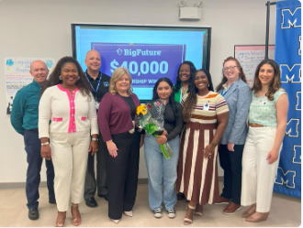



Class of 2025, 2026 and 2027 Winners
Recent Scholarship Winners in FL
800+
Total Winners
Five $40,000
Will one of your students be our next winner?
Scholarships Awarded
$600,000+
Scholarships Awarded
https://bigfuture.collegeboard.org/

Slide 14
AP Captone now counts for Florida Bright Futures
®
For specific inquires, please contact the Office of Student Financial Assistance at 888.827.2004 or email at osfa@fldoe.org
2025-26 School Year

Slide 15

Digital Exams
Remaining
Paper Exams Require
Secure Audio
Fully
Digital Exams
Hybrid Digital Exams
AP Digital Portfolio
Chinese & Japanese Exam Application
Language & Music Exams with Audio Files
16 Exams
12 Exams
6 Exams
2 Exams
6 Exams

Slide 16












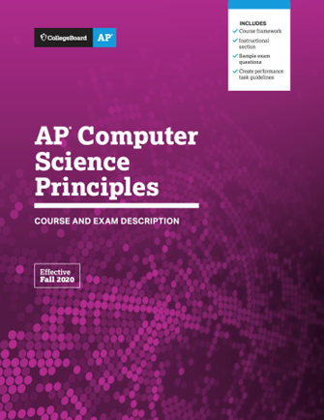
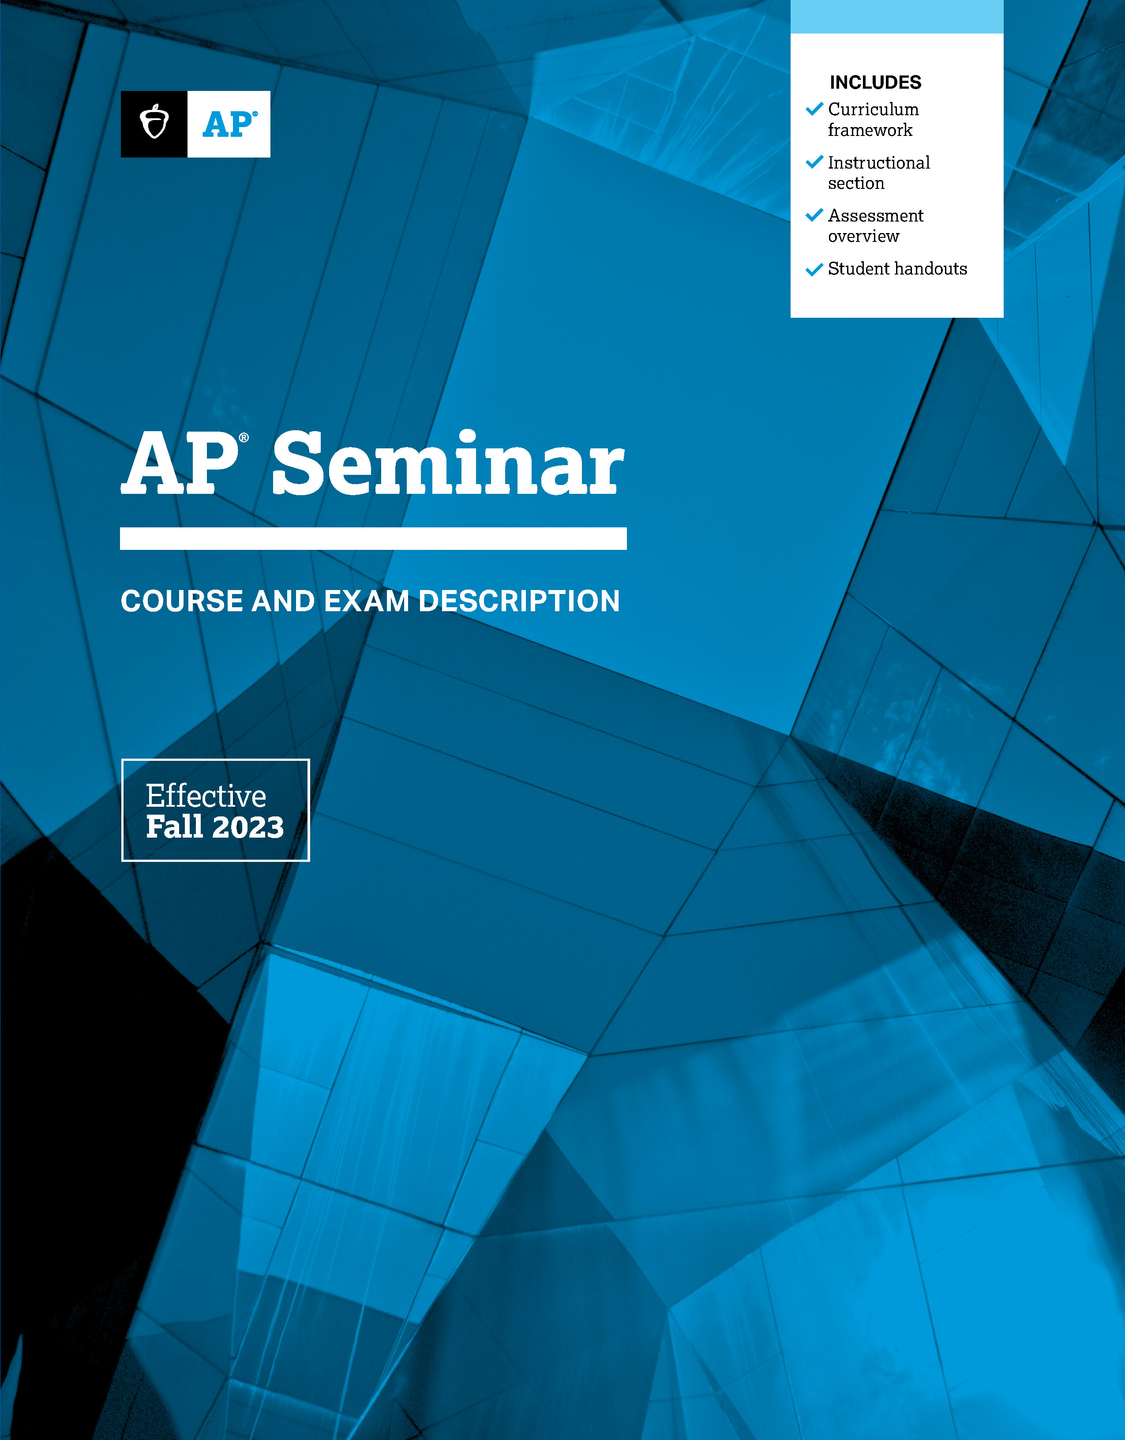
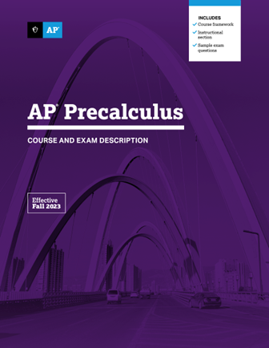
























Changing the Invitation to AP
The right AP® classes at the right time can open college and career opportunities.
NEW: 2026-2027 AP Cybersecurity and AP Business with Personal Finance
Notes:
We’re changing the invitation to AP. Taking the right AP course at the right time can open college and career opportunities for students.
The Power of One AP Course:
Research shows that taking even one AP course can improve students’ first-year college GPA and chances of graduating in four years.
The courses shown here explore topics and teach skills relevant beyond the classroom.
These courses are designed to invite a wider range of students into AP.
Expand access to your AP program starting with these four courses, programmed in these ways:​
AP CSP is a course that will build interest in the STEM field so it should be offered to students as early as possible – as early as 9th grade.​
AP Seminar is a course that will build the skills necessary to be successful in future courses and in college – we suggest offering it as your 10th grade English to enhance what you already have in place.​
AP Precalculus is a new course built for all precalculus students, not just honors students. The course can replace ALL levels of high school precalculus classes. ​

Slide 17
Students Benefit No Matter Their Score
Build skills and confidence.
AP students learn essential time management and study skills needed for college and career success.
They dig deeper into subjects that interest them and learn to tap their creativity and their problem-solving skills to address course challenges.
Get into college.
Students who take AP courses send a signal to colleges that they’re serious about their education and that they’re willing to challenge themselves with rigorous coursework.
85% of selective colleges and universities report that a student’s AP experience favorably impacts admission decisions.

Slide 18
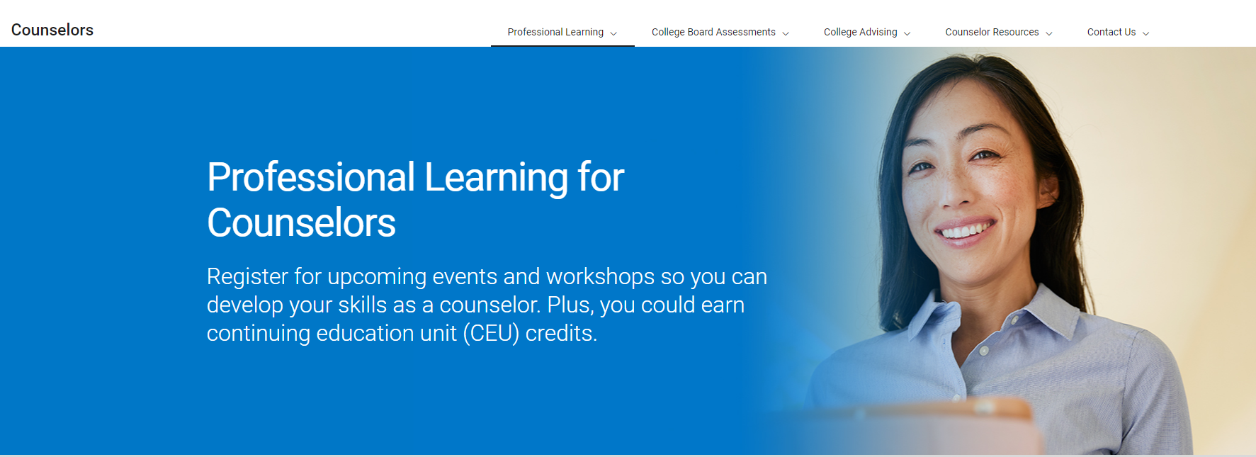
Ongoing Professional Learning
Monthly Webinars
Join these 1-hour webinars that cover timely topics that impact a counselor’s work.
Modules
Find helpful courses on important College Board programs that will help you assist your students and families on their path to the future.
PD Shorts
View these brief 15−20-minute offerings that provide vital information on frequently utilized student College Board programs.
Counselor Summer Institute 2024 Sessions
9 recorded sessions on critical aspects of college counseling presented by higher education personnel and high school counselors are available for viewing and CEU credits.
Visit collegeboard.org/counselors
Notes:
Your schedules are incredibly hectic, so we recognize that you are not always available to engage in all professional learning activities. That is the reason that we are committed to providing a variety of opportunities to keep you abreast of critical counseling topics that affect your work.
Our monthly webinars, frequently presented live and on demand, focus on current topics. We set these a few months before they are available so that the sessions address the most pressing needs in your work.
Our modules help you gain, or review, information on programs such as the College Board accommodations process, the digital SAT Suite of Assessments procedures and reports, use of the K12 reporting portal, and several others.
Our new PD shorts are designed as quick, informative segments on programs that are important to your students such as the National Recognition Programs, BigFuture Events, the CSS Profile, and several others.
And if you could not join us for the Counselor Summer Institute in July, we do not want you to miss out on the great presentations, including sessions on: the trend in testing in college admissions, navigating AI for school counselors, and one providing great tools and resources for you.
And we have one more Professional Learning opportunity to highlight…

Slide 19
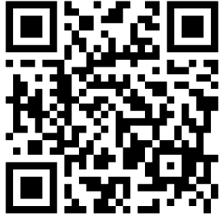
"AMBITION is the path to success. PERSISTENCE is the vehicle you arrive in."
THANK YOU SO MUCH, HAVE A GREAT YEAR
FLPScholarships@collegeboard.org

