Slide 1


Classic Learning Test

Slide 2


CLT Team
Amanda Bernath
CLT Florida Schools Associate
Wesley Gentry
CLT Director of Florida School Partnerships
Soren Schwab
CLT Vice President of Partnerships
CLTEXAM.COM
PAGE 01

Slide 3

The CLT Story in Florida
Adoption in Fall 2023
Schools from 60 districts tested during the 24-25 year
Over 700 public schools offered the In-School CLT
CLTEXAM.COM
PAGE 02

Slide 4


How can the CLT be used in the state of Florida?
Bright Futures Scholarship Qualification
Admissions for FL University System
Graduation Equivalence (New Table!)
Dual-Credit Eligibility
CLT Verbal Reasoning + Grammar/Writing = 38
CLT Quantitative Reasoning = 16
CLTEXAM.COM
PAGE 03

Slide 5
How can CLT10 be used in the state of Florida?
Dual enrollment qualification
Concordant option for state testing requirements
District choice assessment for all 10th graders
CLT10 National Award scholarships ($2,500) to top 50 students
CLTEXAM.COM
PAGE 04

Slide 6
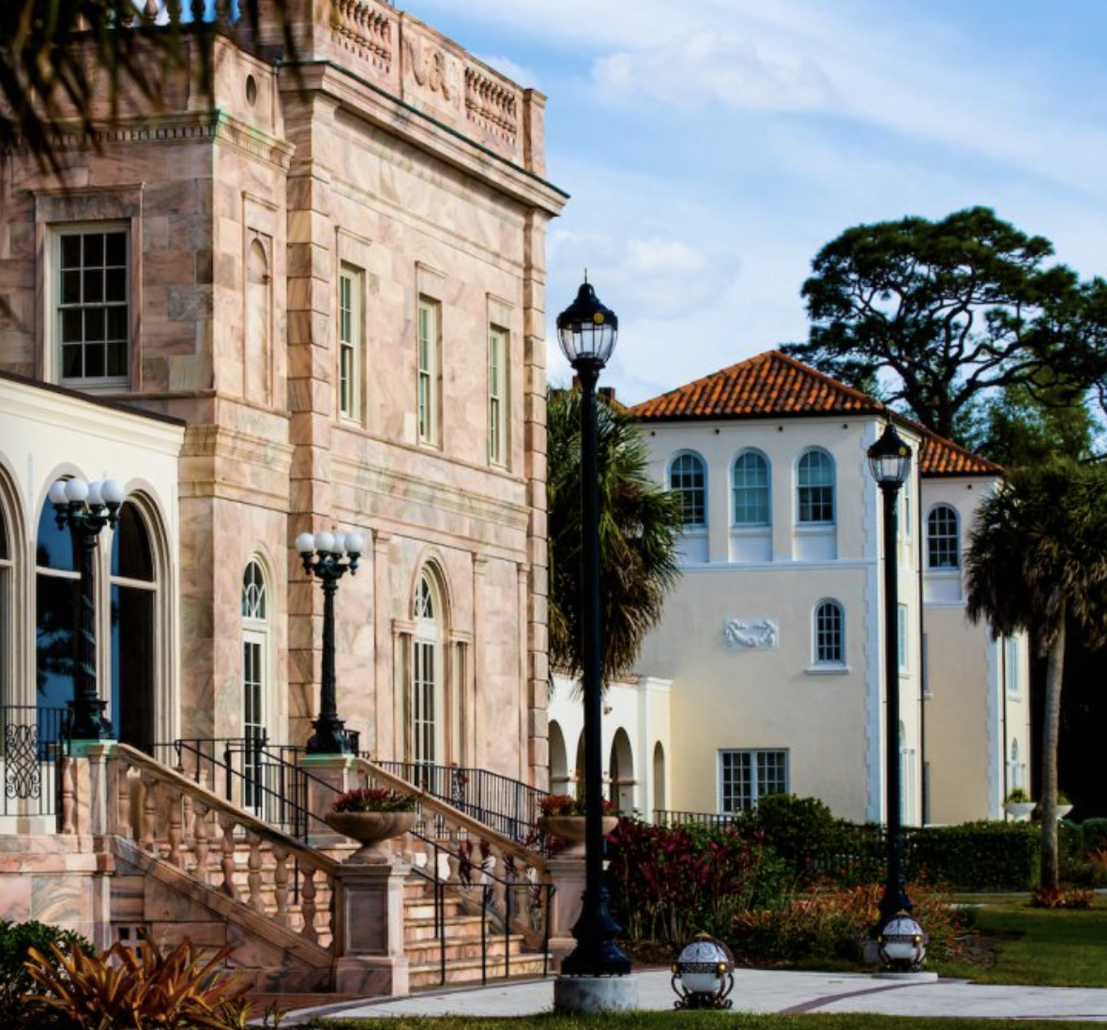
CLT for Florida Bright Futures
Florida Academic Scholarship (FAS)
100% tuition to public FL universities
2026 Grads - Eligible with a 95 or above
2027 Grads – Eligible with a 95 or above
Florida Medallion Scholarship (FMS)
75% tuition to public FL universities
2026 Grads - Eligible with an 82 or above
2027 Grads – Eligible with an 82 or above
CLTEXAM.COM
PAGE 05

Slide 7


FL State Test Concordance –NEW!
ELA Grade 10 Assessment | CLT Verbal Reasoning + Grammar/Writing | CLT10 Verbal Reasoning + Grammar/Writing
2026 Graduates | 36/80 | 39/80
2027 Graduates+ | 39/80 | 39/80
Algebra 1 EOC Concordance | CLT Quantitative Reasoning | CLT10 Quantitative Reasoning
2026 Graduates | 11/40 | 14/40
2027 Graduates+ | 14/40 | 14/40
PAGE 06

Slide 8

CLT Distinctives
The CLT was designed with the student’s experience in mind.
  2 hours long
  Online (or on paper on select test dates)
  Free and unlimited score sharing
  In-School CLT scores available the Wednesday after test date
  Frequent CLT test dates
  Exceptional customer service
CLTEXAM.COM
PAGE 07

Slide 9

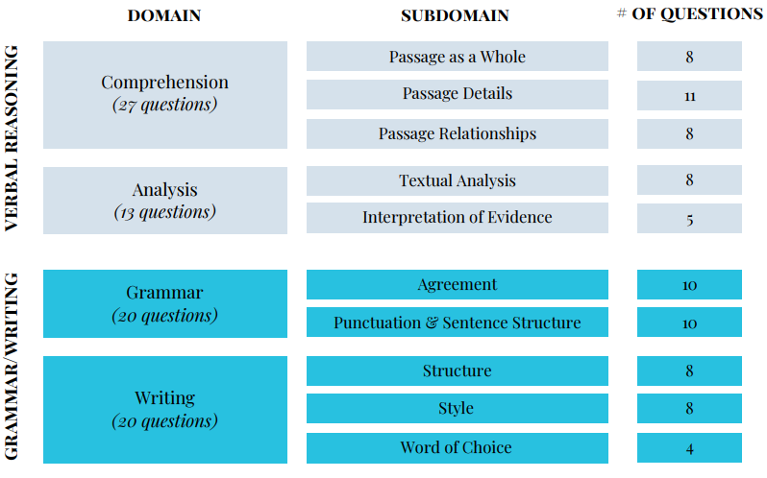
CLT & CLT10 Sections and Domains
PAGE 10

Slide 10
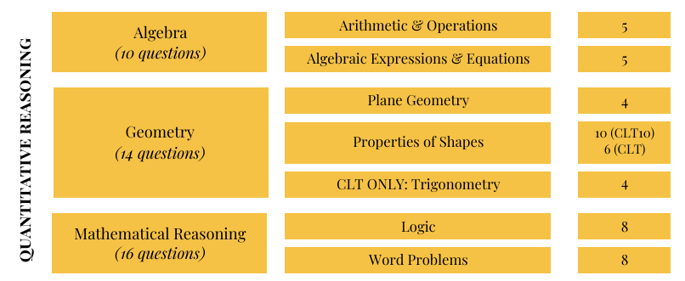
CLT & CLT10 Sections and Domains
PAGE 11

Slide 11
When can schools administer the CLT?
25-26 In-School CLT Test Dates
September 18, 2025*
October 11, 2025
October 22, 2025*
November 8, 2025
December 3, 2025*
January 24, 2026
February 19, 2026*
March 12, 2026*
March 21, 2026
April 16, 2026*
May 16, 2026
June 11, 2026*
* Denotes weekday CLT
Order form: info.cltexam.com/getclt
CLTEXAM.COM
PAGE 08

Slide 12

When can schools administer the CLT10?
September
November
February
April
23
12
3/4
22/23
2025
2025
2026
2026
CLTEXAM.COM
PAGE 09

Slide 13

What is the pricing for the CLT & CLT10?
  Online, In-School CLT -- $34.50 per student
  Online, In-School CLT10 --$24.50 per student
  Surcharges for paper test printing and shipping apply ($10 per student for both assessments).
CLTEXAM.COM
PAGE 12

Slide 14

How do students prepare?
Three, free full-length practice CLT exams within the CLT student dashboard
One, full-length practice CLT10 within the CLT student dashboard
Students may review their score in addition to:
  Their answer
  The correct answer
  An answer explanation for each question
CLTEXAM.COM
PAGE 13

Slide 15
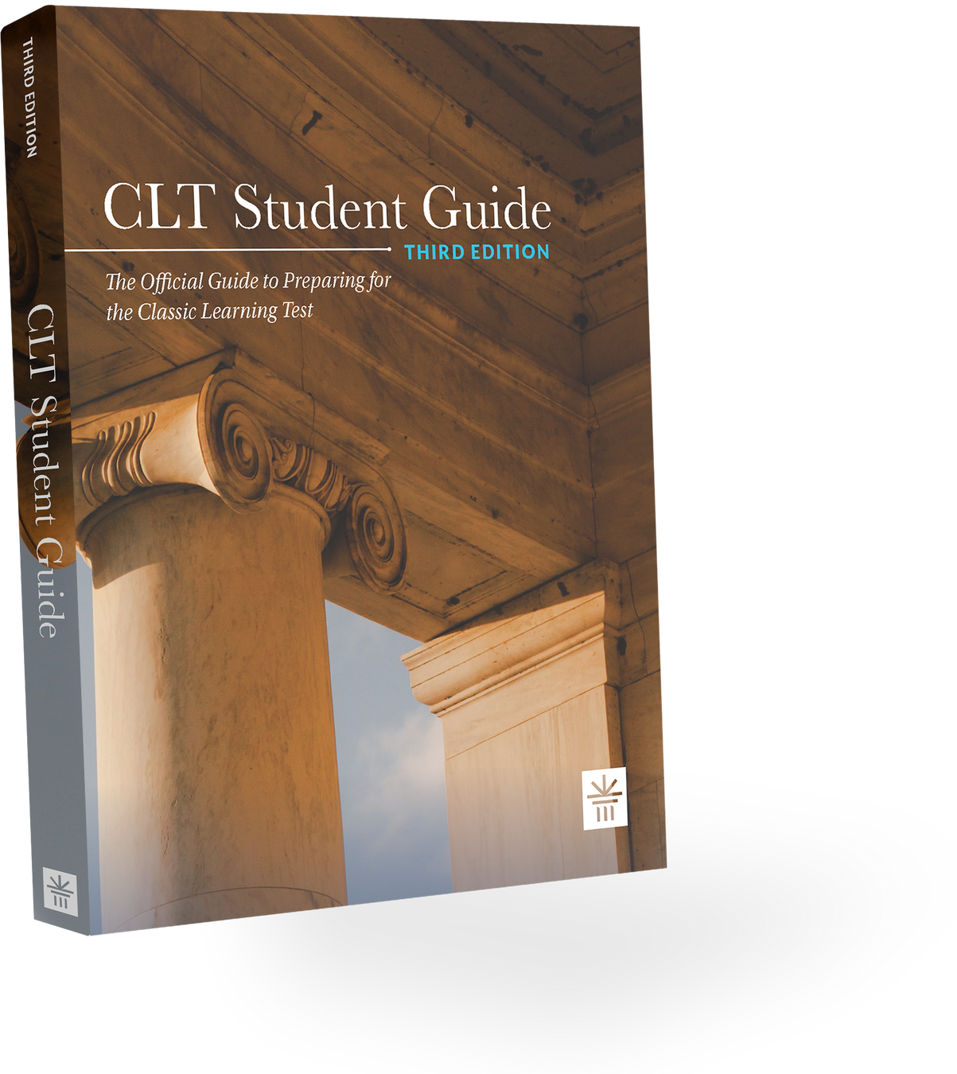
How do students
prepare for the CLT? (cont.)
An official CLT Student Guide with three additional practice exams is available for purchase ($45). Schools or districts may purchase Student Guides in bulk orders for a reduced rate.
The CLT Student Guide also features:
  Answer key and detailed explanation of the correct answers for each question
  Best practices for test-taking
  Detailed breakdown of test content and question types
  Test day checklist
CLTEXAM.COM
PAGE 14

Slide 16
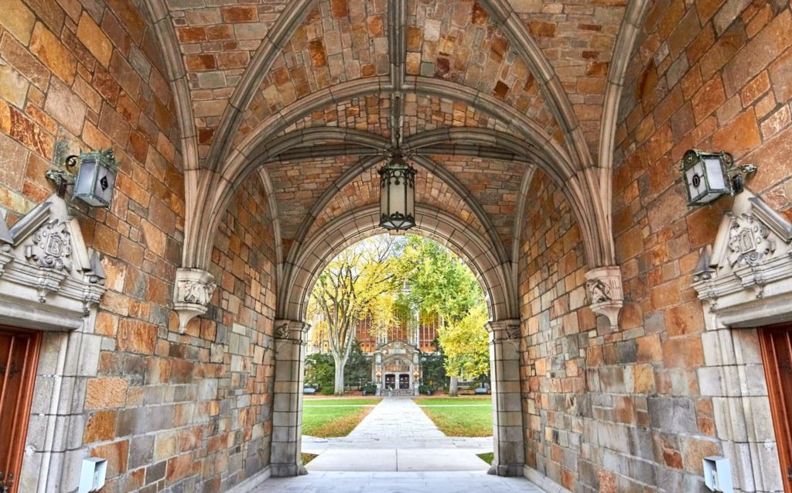
FLDOE funded 11th grade & 10th grade testing
Schools are allotted one state-funded college readiness exam per 11th grader & one state-funded pre-college exam per 10th grader
Districts choose to administer the CLT, ACT or SAT & CLT10, PreACT or PSAT for these state-funded experiences
Charter schools or networks can elect to offer the CLT or CLT10
CLTEXAM.COM
PAGE 15

Slide 17

Thank you!
Wesley Gentry
Director, Florida School Partnerships
wgentry@cltexam.com
443-569-7665 – ph
CLTEXAM.COM
PAGE 16

