Slide 1

ACT Florida Client Relations
Amber Dowdy, North and Central Florida
Jessica Duesler, South and Central Florida
Samantha Southall, Program Manager II
Ginger Green , Southeast Regional Director

Slide 2

Enhancements to the ACT Test - Timeline
Sept 2025
ACT National Paper & International
Updated Composite Score for All ACT Tests
April 2025
ACT National Online Only
(Science option begins)
Spring 2026
State & District Spring 2026 Testing

Slide 3




Key Updates to the ACT
44 items shorter across sections.
Composite score in ~2 hours.
~10 seconds + per item.
Eliminate 5th test.
Shorter Test, More Time Per Item
More Flexibility
Expand Online Testing
Content Update
Science is optional – like Writing.
Composite Score based on English, Math & Reading.
Now available to National testers.
Online test is linear, not adaptive.
Committed to paper testing.
Rebalance reporting categories.
Math – 4 answer choices.
Science – engineering & design.

Slide 4


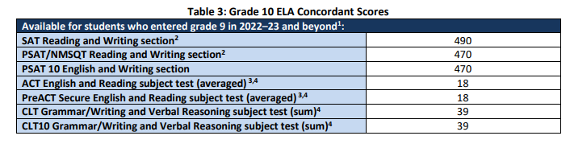

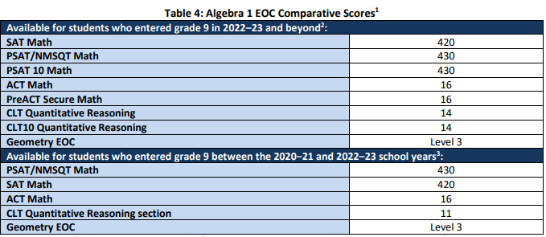


ACT Concordance Scores 2025-2026
Grade 10 ELA Concordant Scores
Algebra 1 Concordant Scores
Notes:
Mention that ELA can be scored for ACT across experiences CR and NCR; PreACT must be SECURE version and stands in isolation

Slide 5
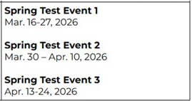
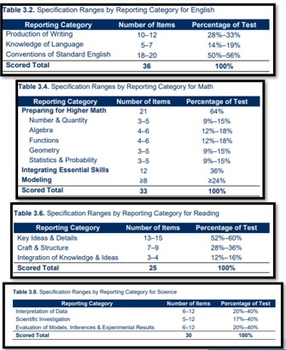
PreACT Secure
Information
Added as concordance option for both ELA 10 and Algebra 1
21.00 per completed assessment
ONLINE ONLY
Desmos Embedded into the testing platform: PreACT Secure practice
3 Test Events pictured above
You may use ALL Test Events, but a student may test only once
No conflict with any ACT administration, so students can sit for Secure and an ACT administration
Deadline to enroll is March 27

Slide 6
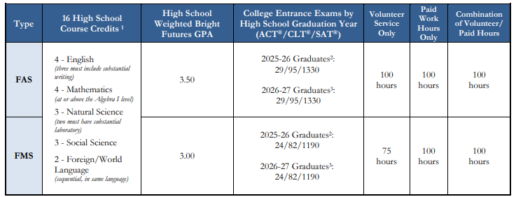
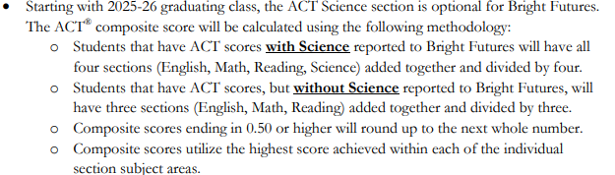
ACT Bright Futures Scores 2025-2026
ACT Bright Futures Scores 2025-2026
-Questions about BF policy should be directed to their offices:
Toll Free Customer Service Line: 888-827-2004
E-mail: osfa@fldoe.org
-As of 8/18/25, FL DOE WILL be including Science as part of the state contract
-ACT has a wealth of research, including information about scores:
Interpreting Scores on the Enhanced ACT: Guidance for K-12 and Higher Education Institutions
Initial Evidence Supporting Interpretations of Scores from the Enhanced ACT Test

Slide 7
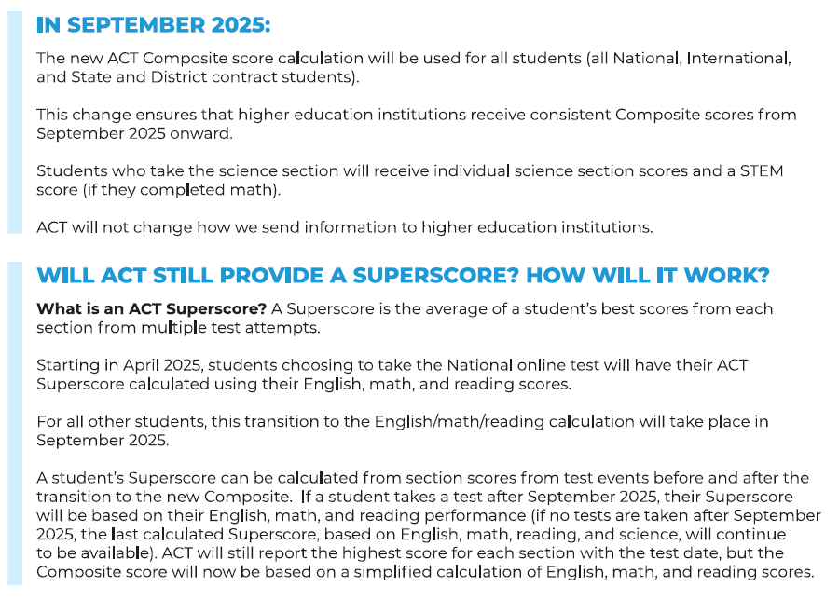
Changes to Composite and Super Scores:
September 2025 for all ACT tests (EMR)

Slide 8
Legacy and new Composite scores will be in the market simultaneously
Legacy and new Composite can be used interchangeably with the understanding that there are some practical differences between the two scores.
The Composite scores can be used interchangeably:
This means that either score can be used:
  as a measure of general academic readiness for college.
  as a predictor of general academic performance in college.
  as a criterion for decisions that are based on general academic readiness.
The scores have practical differences:
This means that:
  A student’s EMR Composite score may not always equal their EMRS Composite score.
  The scores will not follow the exact same distribution.
Notes:
Speaker Notes: So what does that mean when since both EMR and EMRS scores will be in the market at the same time? We know that for your juniors testing this spring as part of school-day testing, they will all receive the legacy ACT blueprint and the legacy EMRS composite score. That means it will take a few annual reporting cycles and college admissions cycles for the enhanced EMR composite to fully take the place of the legacy EMRS composite as used by states, districts, and higher ed.
The technical brief that is forthcoming focuses on research done comparing the new composite score to the legacy composite. Based on our research, we want to underscore that during this period of transition you can use EMR and EMRS interchangeably, as well as the understanding that there are some practical differences between the two scores.
Let’s start by tackling the first part of that statement, about interchangeability.
[click]
When we say that EMR and EMRS can be used interchangeably, we mean that either score can be used:
as a measure of students’ general academic readiness for college
as a predictor of students’ general academic performance in college (e.g., cumulative GPA, persistence, timely degree attainment)
as a criterion for decisions that are based on students’ general academic readiness (e.g., scholarships, admissions)
We can say that based on our analyses, which looked back at historical data for over a million students and compared their EMRS scores with the EMR scores that we recalculated for that cohort. We found that the scores were almost perfectly correlated – a 0.99 correlation coefficient, to be specific. A correlation of +1 itself would indicate a perfect 1:1 relationship between the two measures.
Let’s now look at the second part of that statement, about practical differences.
[click]
When we say that EMR and EMRS scores have practical differences, we mean that:
There are potential individual differences: a student’s EMR score will not always equal their EMRS score. For some students, their EMR score will be higher than their EMRS score would have been; and for other students, their EMR score will be lower than their EMRS score would have been.
There are potential distribution differences: As a result of the difference just mentioned, EMR and EMRS scores will not have the exact same distribution. Given the overlap between the two scores that we noted earlier, the distributions for EMR and EMRS will be very similar, but they will not be identical.
As part of that same analysis, looking at over one million students who took the ACT, over 92% of students in that cohort had a calculated EMR score that were either the same or within one point of the EMRS composite score they received.

Slide 9
Waivers: Two fee waivers per student
ACT Test Fees Are Covered
The registration fee for up to two ACT tests, plus the add-on fee(s) for optional science and/or writing is covered. Late fees are ALSO covered.
Free Learning Resources
  Students registering with a fee waiver will also receive free access to The Official ACT® Self-Paced Course, Powered by Kaplan® where you can find bite-sized, on-demand lessons, which offer the perfect mix of structure and flexibility. The offering is automatically added to your order at no cost.
  Learn anywhere, anytime with on-demand tutorials through 30 short, self-paced video lessons
  Access 2,000+ ACT test questions and answers; 5 full-length ACT practice tests; 1 year of access
Free ACT My Answer Key (formerly TIR)
Students who register for the ACT with a fee waiver qualify to add ACT My Answer Key (TIR) to their registration at no extra cost. Offered on three test dates a year, ACT My Answer Key (TIR) allows you to see your test questions and answers after your test. Free
Additional Score Reports
You can send additional ACT score reports for free to colleges and/or scholarship agencies at any time during your college search process. Your fee waiver covers one report to your high school and up to six college choices. After registration, you can request unlimited score reports for free.
Apply to Colleges—For Free
College application fees can really add up, but there’s good news! Students who test with an ACT fee waiver may also request a Waiver or Deferral of College Admission Applications Fee. To have a college application fee waived, you must submit your fee waiver directly to the college to which you are applying (not to ACT).

Slide 10
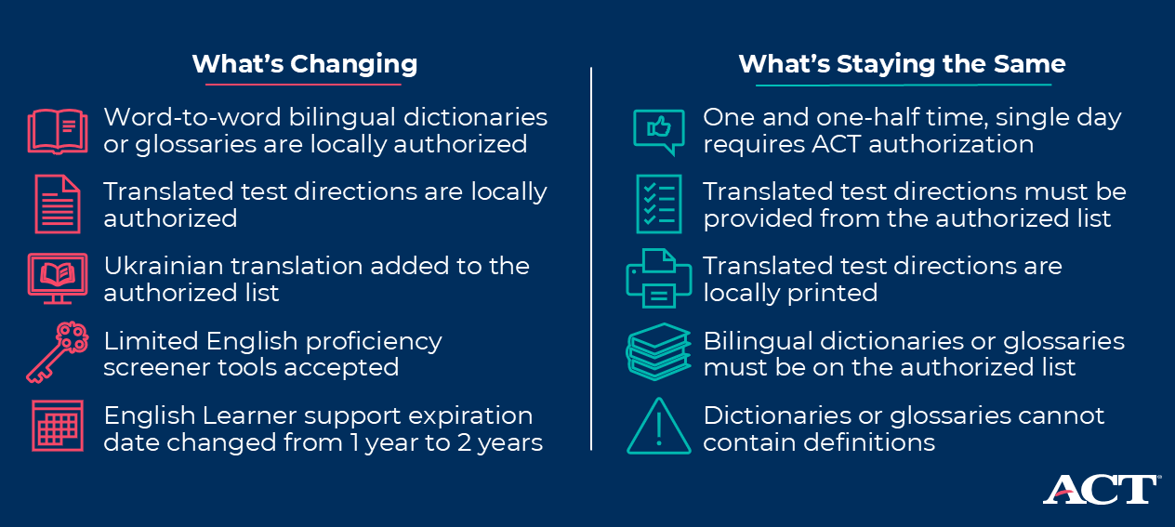
Changes to EL Accommodations Processes
New EL policy changes take effect September 2025.
ACT wants to simplify the process, remove unnecessary barriers, and allow EL students to demonstrate their true potential and abilities.
Notes:
Exited kids can get everything except time and a half; apply for 10th grade for soon to be exited

Slide 11

Preparing for the ACT Test 2025-2026
A Message to Students – Pg. 2
Overview of the ACT – Pg. 2
Test-Taking Strategies – Pg. 3
Prohibited Behavior at the Test Center – Pg. 5
Content of the ACT Sections – Pg. 5
Taking the Practice Tests – Pg. 12
Practice Multiple-Choice Sections – Pg. 13
Practice Writing Test – Pg. 60
Practice Answer Document – Pg. 64
How to Score the Multiple-Choice Tests – Pg. 72
Scoring the Practice Writing Test – Pg. 78
Next Steps – Pg. 81
Notes:
Educators and students can use this free resource to provide targeted practice for areas of need based on ACT data because along with an answer key for the complete test, it also lists what reporting category each test item comes from.

Slide 12


Counselor Resources
K-12 Toolkits
25-26 Counselor Toolkit
ACT Counselor Blog

Slide 13
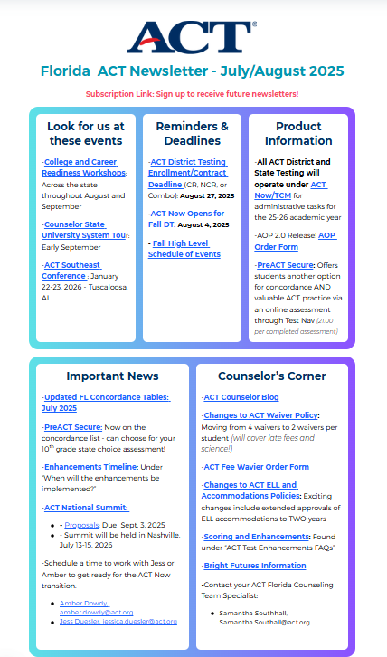
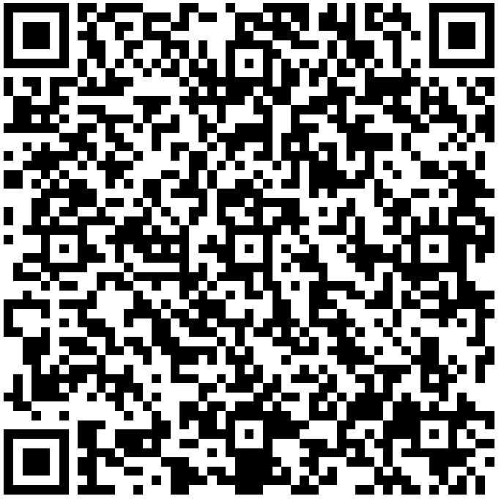
Stay Connected to ACT News and information!
Access the Newsletter by using the QR code to the LEFT!
Sign up to receive alerts once you visit the Newsletter.

Slide 14

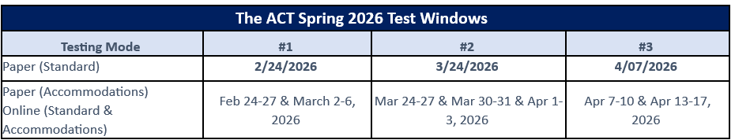
State Testing Windows
Paper Standard Testing MUST occur on the Standard Testing date for primary testing; Accommodated Testing may occur throughout the window.
  NOTE: Paper make-up testing MUST be scheduled for a different window. It cannot occur throughout the primary chosen window.
Digital Testing (both Standard and Accommodated) may occur throughout the window. This includes make-up testing.
Both PreACT & PreACT Secure will be options for 10th grade State Test option this year.
The ACT State Schedule of Events will be published later; plan NOW for accommodation processes. Accommodations deadlines will be published soon for ACT. Plan now to complete prior to Winter Break.
Notes:
-Discuss makeup paper testing.
-Paper Standard tests are ONLY valid for the primary listed date. Any other test date will be a misadministration.
-Discuss Accommodations deadline generally.
-Discuss checking TAA in Pearson, adding any missing pins.

Slide 15
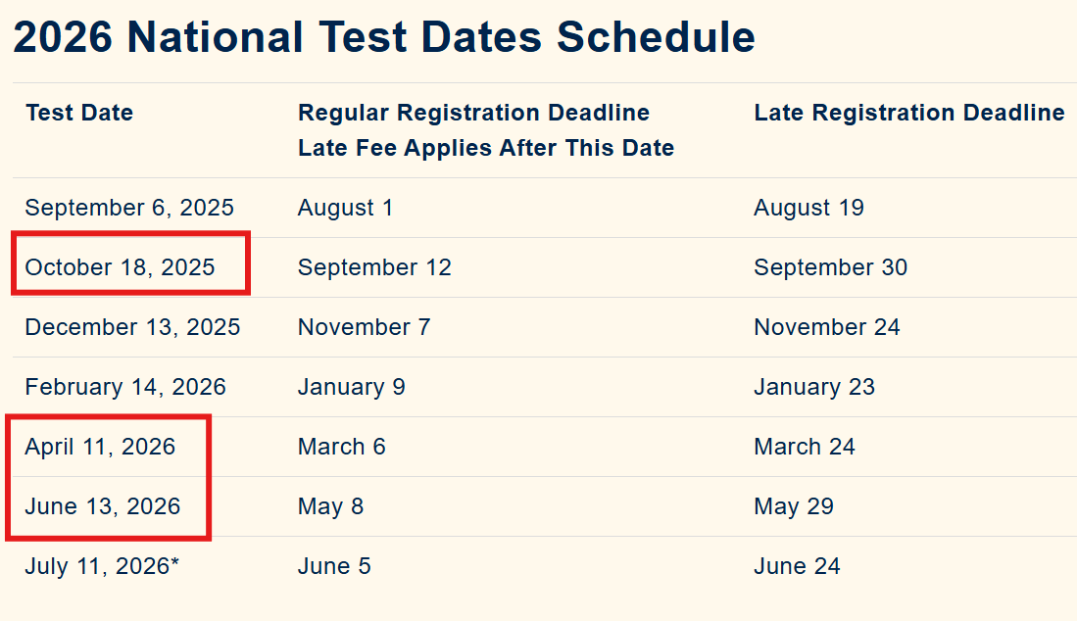
ACT National Test
Dates available for My ACT Answer Key purchase are outlined in RED

Slide 16
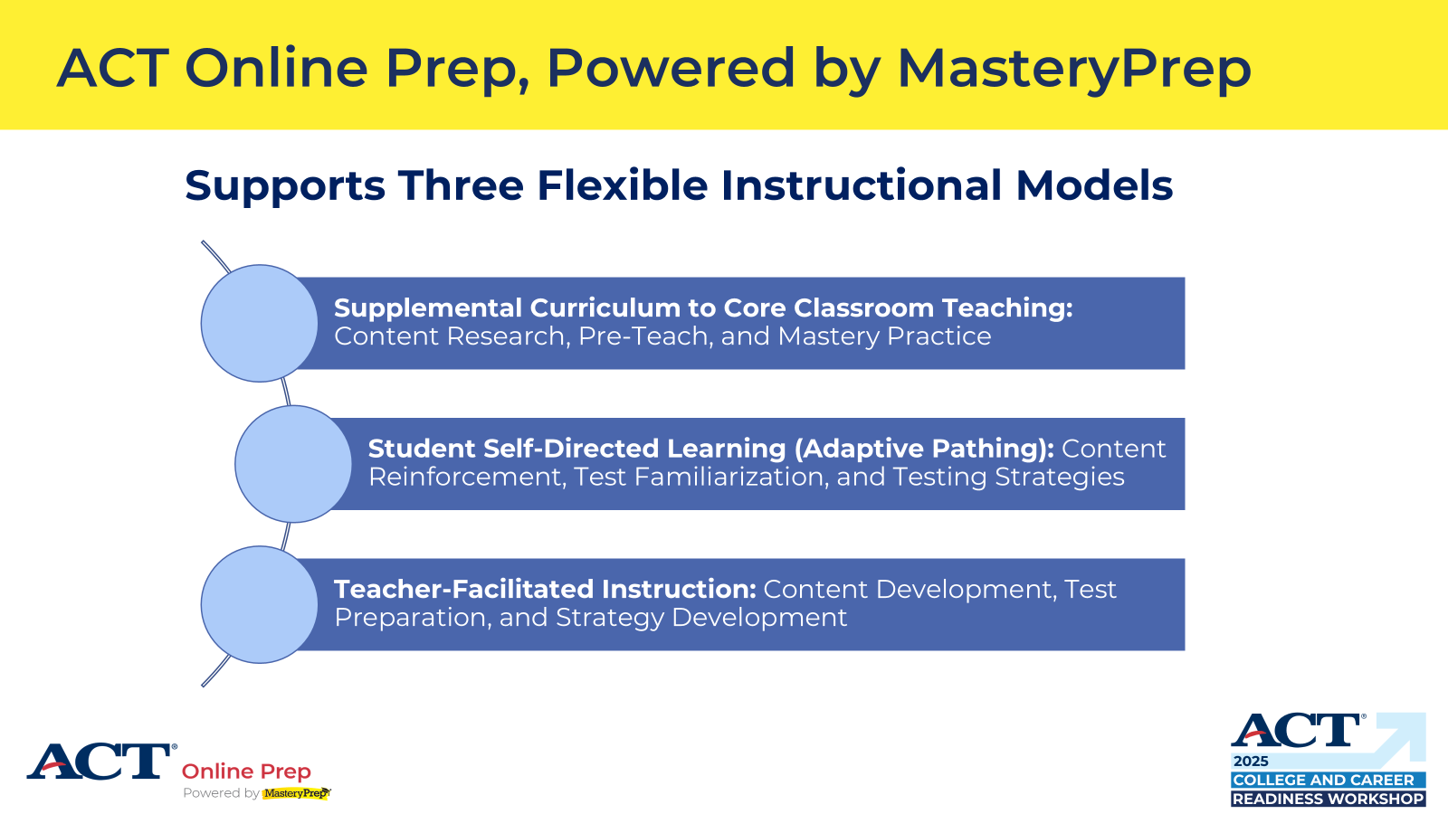
act.org/aop

Slide 17
ACT Florida Contacts
Amber Dowdy, Client Relations North and Central Florida: Amber.Dowdy@act.org, 813.690.4678
Jessica Duesler, Client Relations South and Central Florida: Jessica.Duesler@act.org, 239.398.8702
Ginger Green, Southeast Region Director: Ginger.Green@act.org
Samantha Southall, Program Manager: Samantha.Southall@act.org
Customer Support
1.800.553.6244
Test Administration: 2800
Accommodations: 1788

