Slide 1
A UNIVERSITY BUILT FOR
YOU
uwf.edu/Freshman
Notes:
Campus community. Outstanding programs. Affordable tuition.
An overview of today’s presentation. We will talk a litte about UWF and what makes us special. Then we will review our Freshman Class profile, the application and admissions process and admissions scholarships.

Slide 2
Admissions 101
About UWF
Class profile
Applying
Scholarships
Notes:
An overview of today’s presentation. We will talk a litte about UWF and what makes us special. Then we will review our Freshman Class profile, the application and admissions process and admissions scholarships.

Slide 3
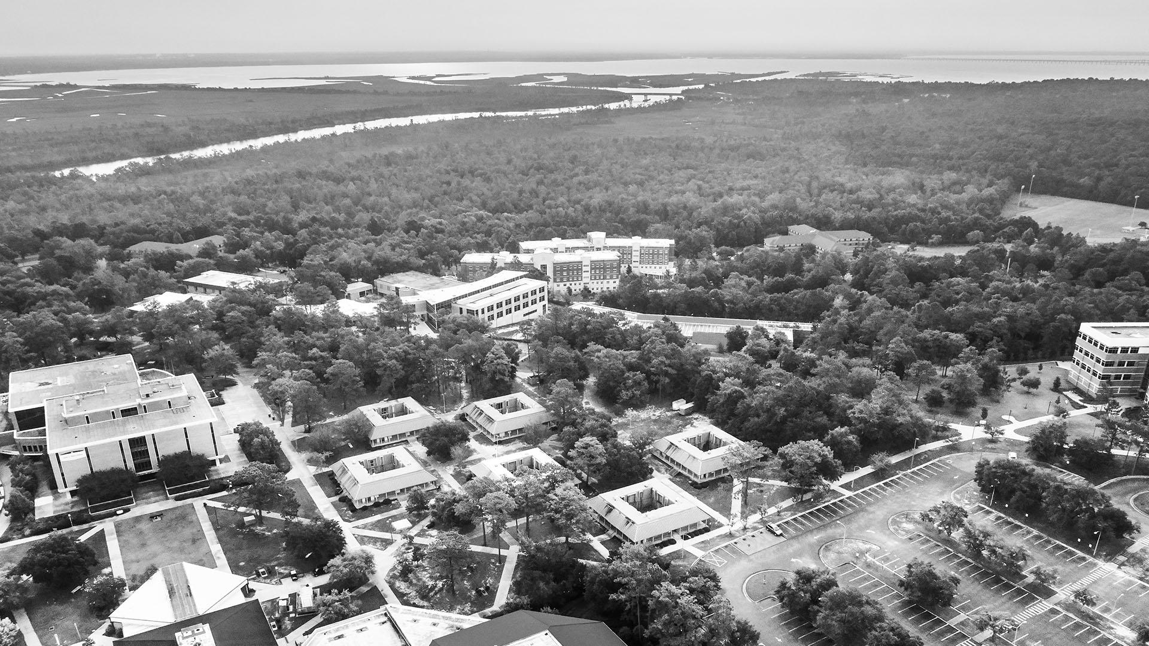
Find it All at UWF
Campus community.
Outstanding programs.
Affordable tuition.
Most Innovative among “Best Colleges in Florida”
— Intelligent.com, 2021
A “Best Regional College - Southeastern”
— The Princeton Review, 2003-2022
Higher Education Excellence in Diversity Award
— INSIGHT Into Diversity magazine, 2015, 2016, 2018, 2019, 2020, 2021
#16 “Top Public Schools - Regional Universities South”
— U.S. News & World Report, 2022
uwf.edu/Rankings
Notes:
An overview of today’s presentation. We will talk a litte about UWF and what makes us special. Then we will review our Freshman Class profile, the application and admissions process and admissions scholarships.

Slide 4
#1 For Employed Grads
Among Florida public universities for alumni employed / continuing education a year after graduating
uwf.edu/Employed
Notes:
For the second year in a row, UWF is first among Florida public universities for recent graduates’ professional success: More than
72% of UWF bachelor’s graduates are employed or furthering their education one year after graduation.

Slide 5
13,000+
STUDENTS
Notes:
At UWF we have about 13 thousand students, I always say this is the perfect size because you see a familiar, friendly face every day - but there are always still new people to meet.

Slide 6
Small Classes
50%
OF CLASSES HAVE FEWER THAN
20
STUDENTS
21:1
STUDENT-TEACHER RATIO
Notes:
The average class size is 28 students allowing our faculty to provide personalized attention and support for each student. Our faculty and staff are at UWF because they love to teach. They will not be hiding back in a lab working on research, sending their TA to teach the class. They want to work with students, be in the classroom and then of course out of the classroom to help them apply their knowledge.

Slide 7
Hello, Argodillo!
Big campus
Notes:
While we have a large campus, it can feel intimidating, but UWF is focused on the undergraduate experience - making sure that we build a community of Argos who have the resources and support that they need. That's why…..

Slide 8
1,600
ACRES
20+
MILES OF TRAILS
Notes:
Our campus is tucked right up next to a beautiful wildlife sanctuary on the north side of Pensacola. Here you can see the boardwalk over Thompson’s Bayou that leads to the Edward Ball Nature TRail. There you can take in all the beautiful foliage and fauna and maybe even spot our resident Alligator...

Slide 9
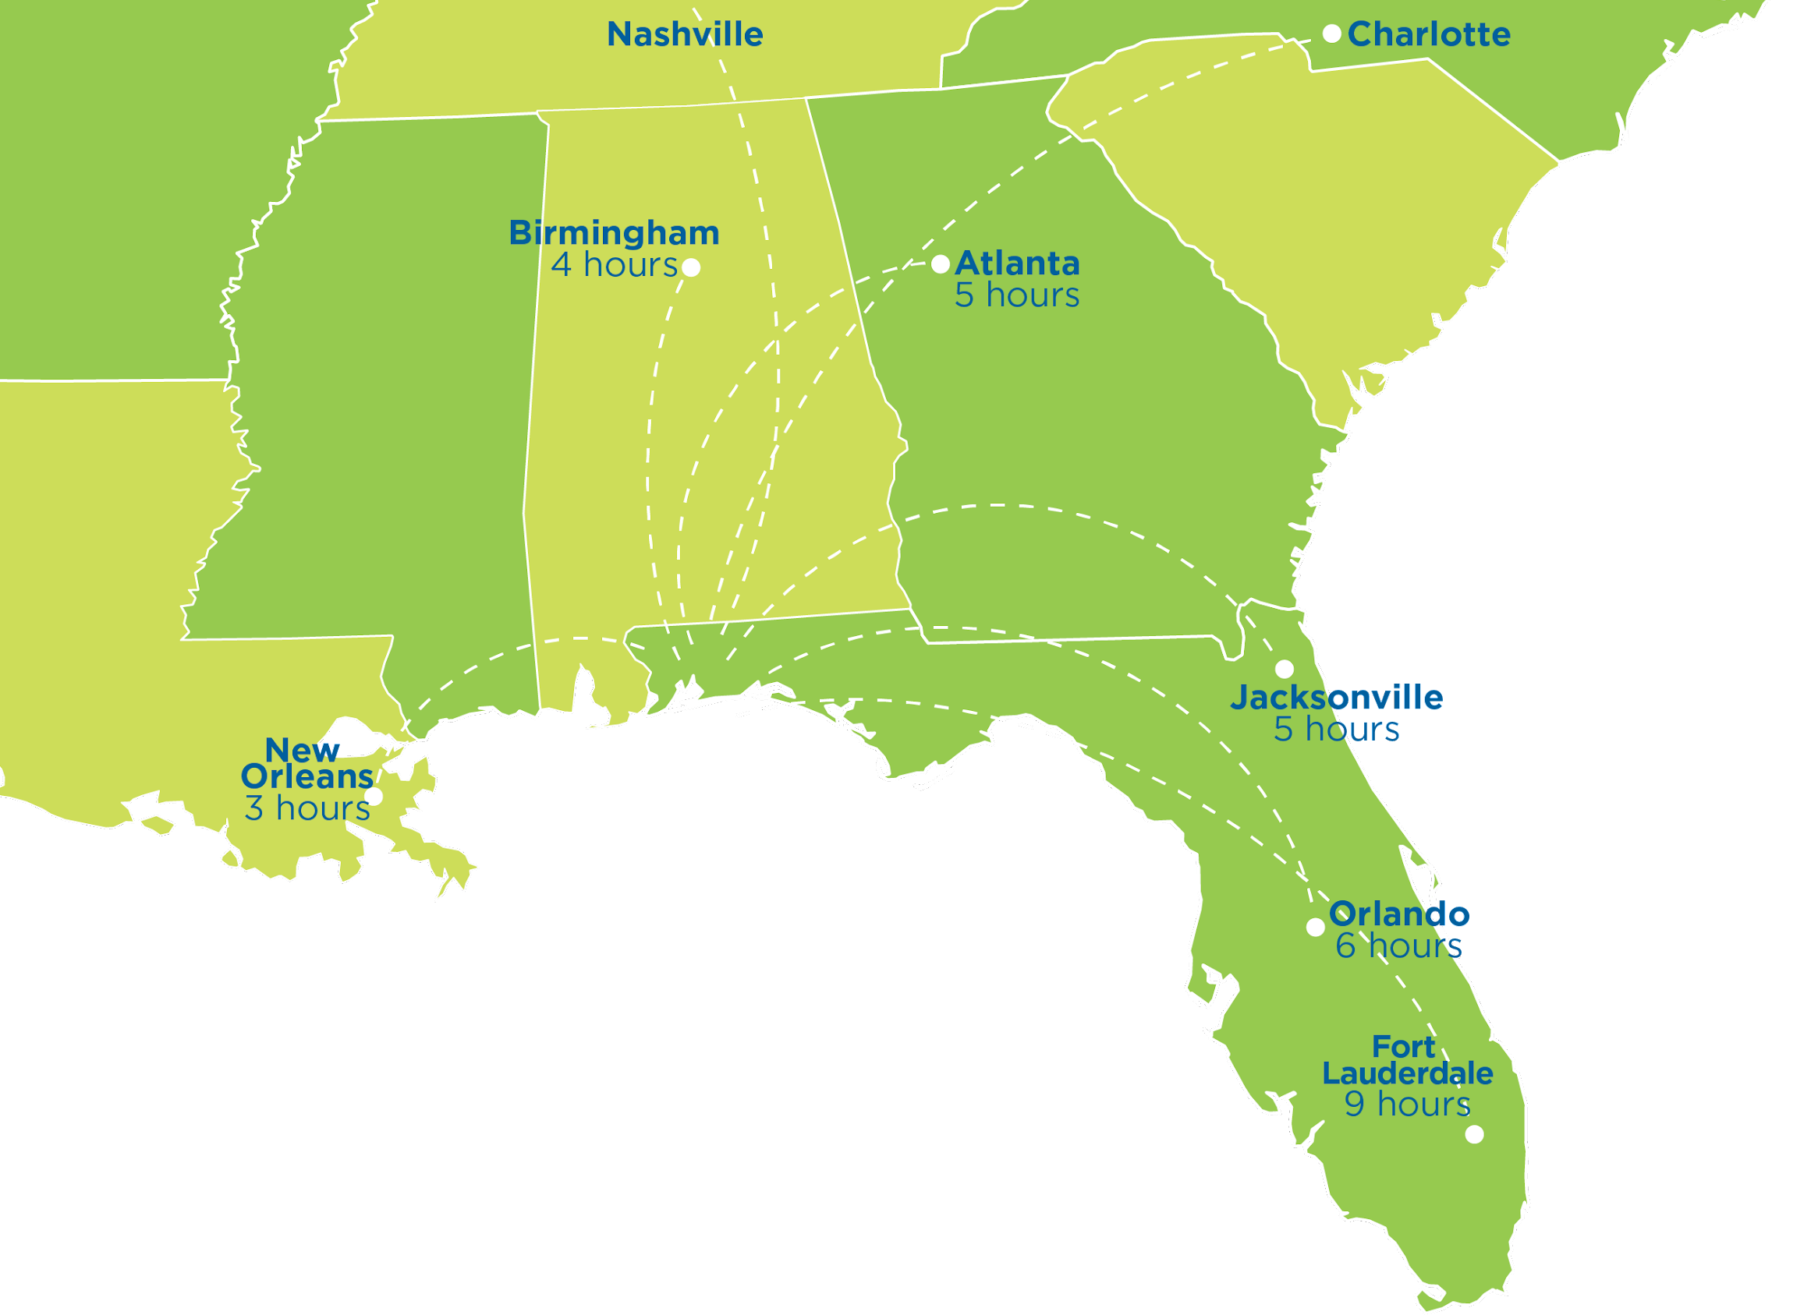
One of America’s 100
Best Cities
— BestCities.org, 2022
Notes:
Pensacola is a celebrated midsize city in the coastal Southeast. The area is within driving distance of major cities and has a population of more than 500,000.
— U.S. Census Bureau
UWF is 30 minutes away from the sugar-white sands of Pensacola Beach, a Top 25 U.S. beach.
— TripAdvisor, 2022

Slide 10
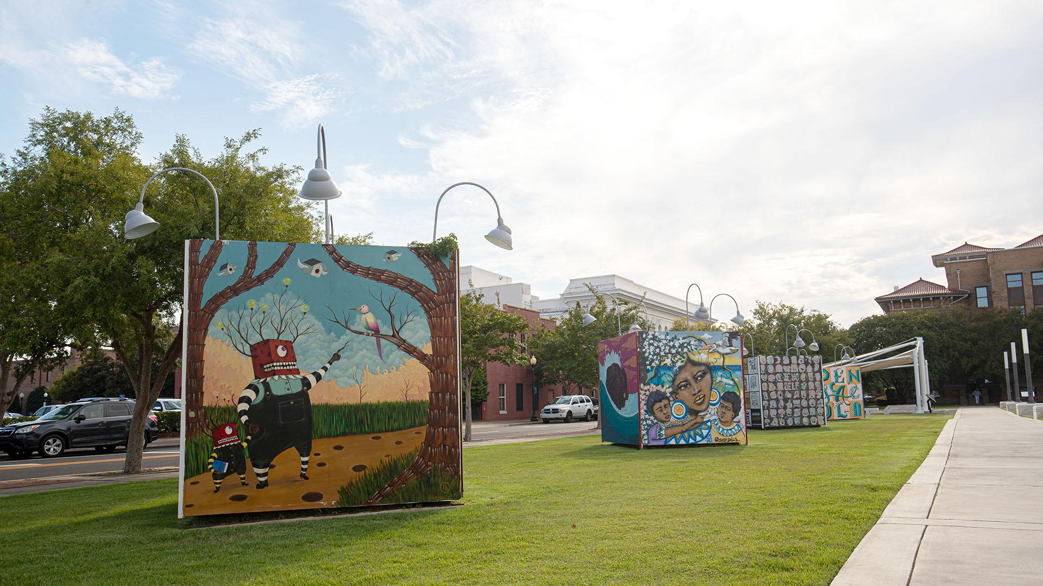
A U.S. Top 20
‘Safest Places to Live’
— U.S. News & World Report, 2022
Notes:
Pensacola is a celebrated midsize city in the coastal Southeast. The area is within driving distance of major cities and has a population of more than 500,000.
— U.S. Census Bureau
UWF is 30 minutes away from the sugar-white sands of Pensacola Beach, a Top 25 U.S. beach.
— TripAdvisor, 2022

Slide 11
A short drive from a
Top 25 U.S. Beach
— TripAdvisor, 2022
Notes:
UWF is 30 minutes away from the sugar-white sands of Pensacola Beach, a Top 25 U.S. beach.
— TripAdvisor, 2022

Slide 12
Five Academic Colleges
College of Arts, Social Sciences and Humanities
College of Business
College of Education and Professional Studies
Hal Marcus College of Science and Engineering
Usha Kundu, MD College of Health
Notes:
We have 5 academic colleges at the University of West Florida
The College of Arts, Social Sciences and Humanities houses our fine arts programs like the Bachelor of Fine Arts in Musical Theater as well as our anthropology and archaeology programs.
Our AACSB accredited college of business has the same accreditation as Harvard’s college of business. Only the top 5% of business schools have this accreditation so we are very proud of our programs. The College of Business features everything from Supply Chain Logistics to Global Economics.
The College of Education and Professional Studies houses our education programs like our Elementary Education program and our ESE program as well as the UWF Teach program. Through UWF Teach, student can study the subject area that they are interested in teaching at the middle or high school level while achieving the teaching certification needed to become a teacher. CEPS is also home to our Criminal Justice program and our full-size mock trial room.
The Hal Marcus College of Science and Engineering features our biomedical sciences program which is our pre professional biology -or pre-med as it is more commonly known as. Also in the department of Biology - our Marine Biology program! Who wants to study marine biology at a landlocked institution. At UWF the geographical location provides access to so much biodiversity that is beneficial to many programs but especially Environmental Science, Marine Bio, Biology, etc. Also in the Hal Marcus College of Science and Engineering is the Cybersecurity program, we are one of the few institutions that has a Cybersecurity Bachelor’s program. UWF was named a NSA and Homeland Security Training Center of Excellence. Our Engineering programs are incredible due to the small class sizes and the curriculum that not only focuses on their classes but also their long-term projects like the Argo Tots project.
The Usha Kundu College of Health includes our BSN program, our nursing students have one of the highest rates of employment within 6 months of graduation! The Public Health Admin degree is an excellent degree for anyone who wants to be more on the communications side of things, it is obviously ess

Slide 13
Explore Programs
70+
UNDERGRADUATE PROGRAMS
uwf.edu/Programs
Notes:
70+ academic programs and 60 minors; Use our program finder to explore by college, location, or subject.

Slide 14
Top 10
Majors
Nursing
General Business
Biomedical Sciences
Marine Biology
Computer Science
Biology
Mechanical Engineering
Psychology
Exercise Science
Cybersecurity
— Summer/Fall 2022, first-time college students
Notes:
Pic: Biomechanics lab

Slide 15
Find Your Fit
uwf.edu/Focus2Career
Notes:
You can take a free assessment before you even apply. It’s a free tool to help you in planning an education that matches your career interests. It will even show you which UWF majors can help you achieve your goals.

Slide 16
Learn by
Doing
uwf.edu/HIP
Notes:
By graduation, almost 50% of students have completed at least two high-impact practices. Students have many experiential learning opportunities. This past spring, engineering and theatre students collaborated to bring Aslan the lion to life for a production of “The Lion, the Witch, and the Wardrobe.”

Slide 17
Collaborative Learning
Notes:
Under faculty guidance, first-year students in an Introduction to Engineering class designed the lion’s head, body, and some of the animation features, while theater students built Aslan and developed the costume, makeup and wig.

Slide 18
10
Service Learning
Notes:
Students from our Social Work & Nursing programs went to Guatemala for a service-learning trip. The 9-day trip included providing donations and applying public health services in a health care system and community that is vastly different from the United States.

Slide 19
Research
uwf.edu/OUR
Notes:
Students have opportunities to begin exploring undergraduate research their first year, from any major.

Slide 20
Mentorship
Notes:
Programs include the College of Business Executive Mentor Program, STEM peer coaching and industry mentoring, and the College of Education and Professional Studies Mentor Collective.

Slide 21
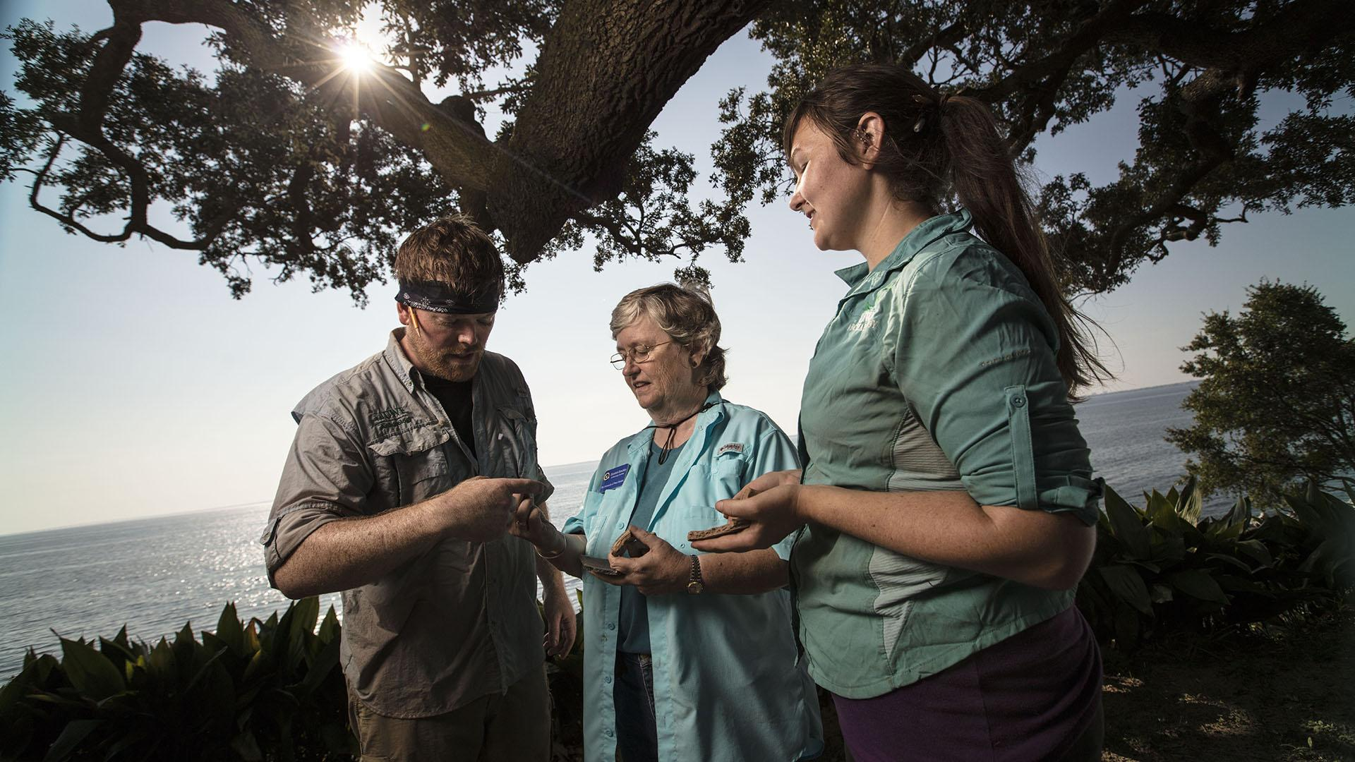
Fieldwork
Notes:
UWF Archaeology students and faculty discovered the archaeological site of the Tristan de Luna settlement – the first multi-year European settlement in the United States.

Slide 22
Internships
Notes:
An overview of today’s presentation. We will talk a little about UWF and what makes us special. Then we will review our Freshman Class profile, the application and admissions process and admissions scholarships.

Slide 23
Kugelman Honors
Program
uwf.edu/Honors
Notes:
An overview of today’s presentation. We will talk a little about UWF and what makes us special. Then we will review our Freshman Class profile, the application and admissions process and admissions scholarships.

Slide 24
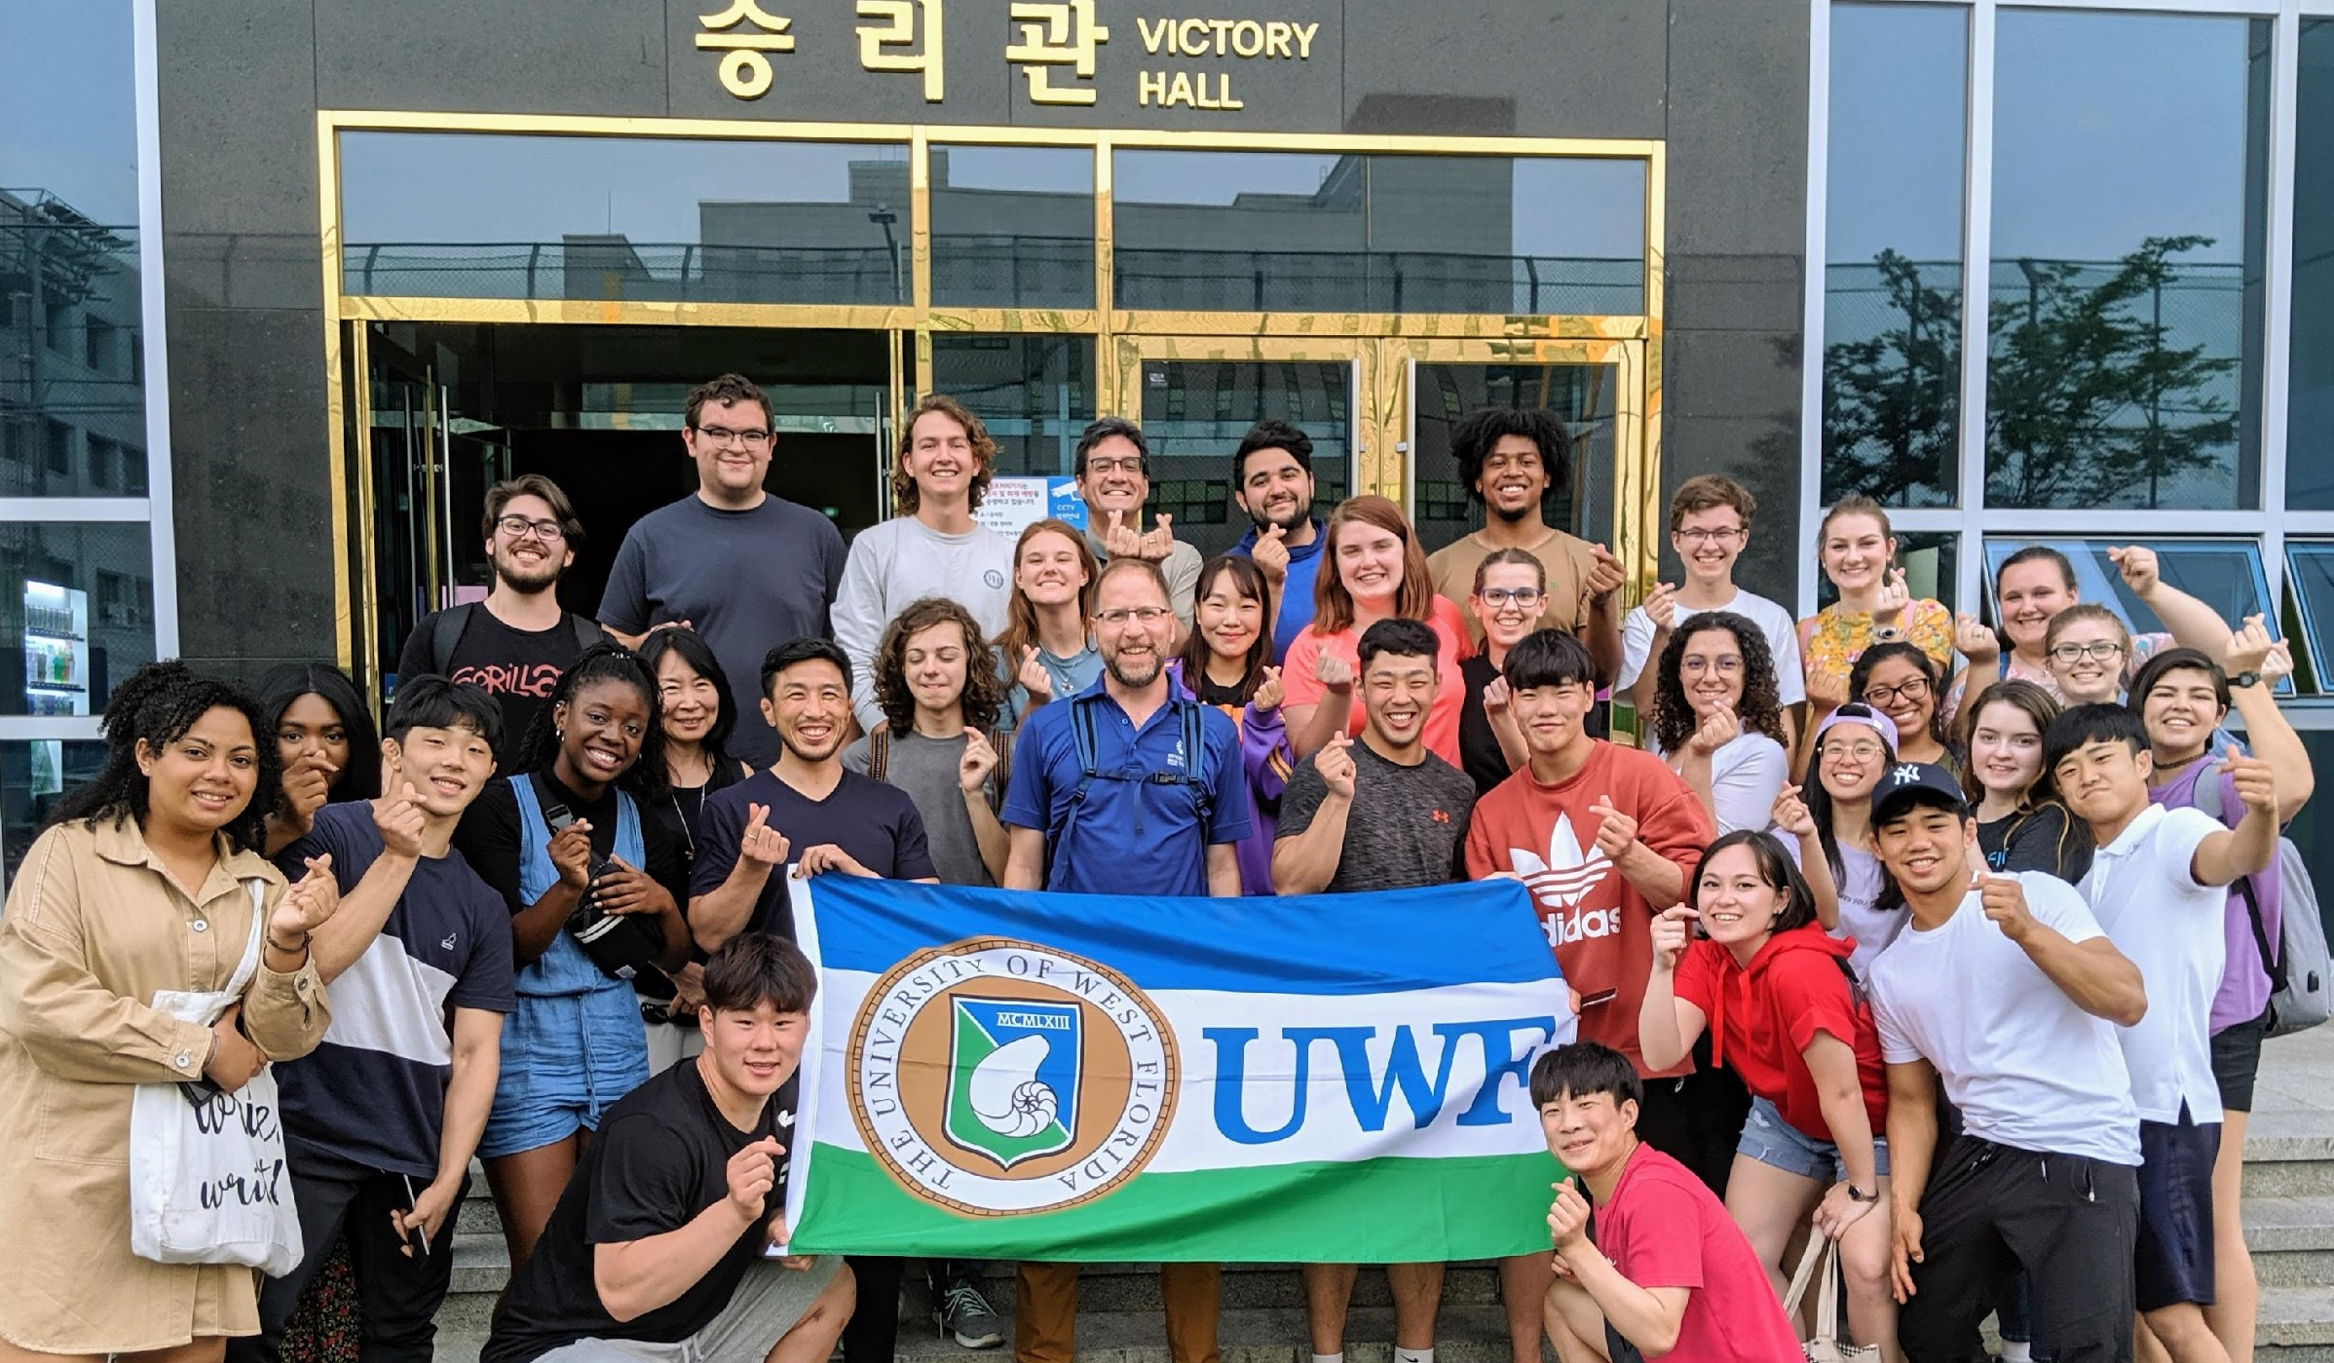
Study Abroad
uwf.edu/StudyAbroad
Notes:
An overview of today’s presentation. We will talk a little about UWF and what makes us special. Then we will review our Freshman Class profile, the application and admissions process and admissions scholarships.

Slide 25
UWF IS A
TOP 10
MILITARY FRIENDLY SCHOOL
Air Force and Army ROTC
The appearance of U.S. Department of Defense visual information does not imply or constitute DoD endorsement.
Notes:
UWF has been named a Gold-level and Top 10 Military Friendly School by Military Friendly (militaryfriendly.com).

Slide 26
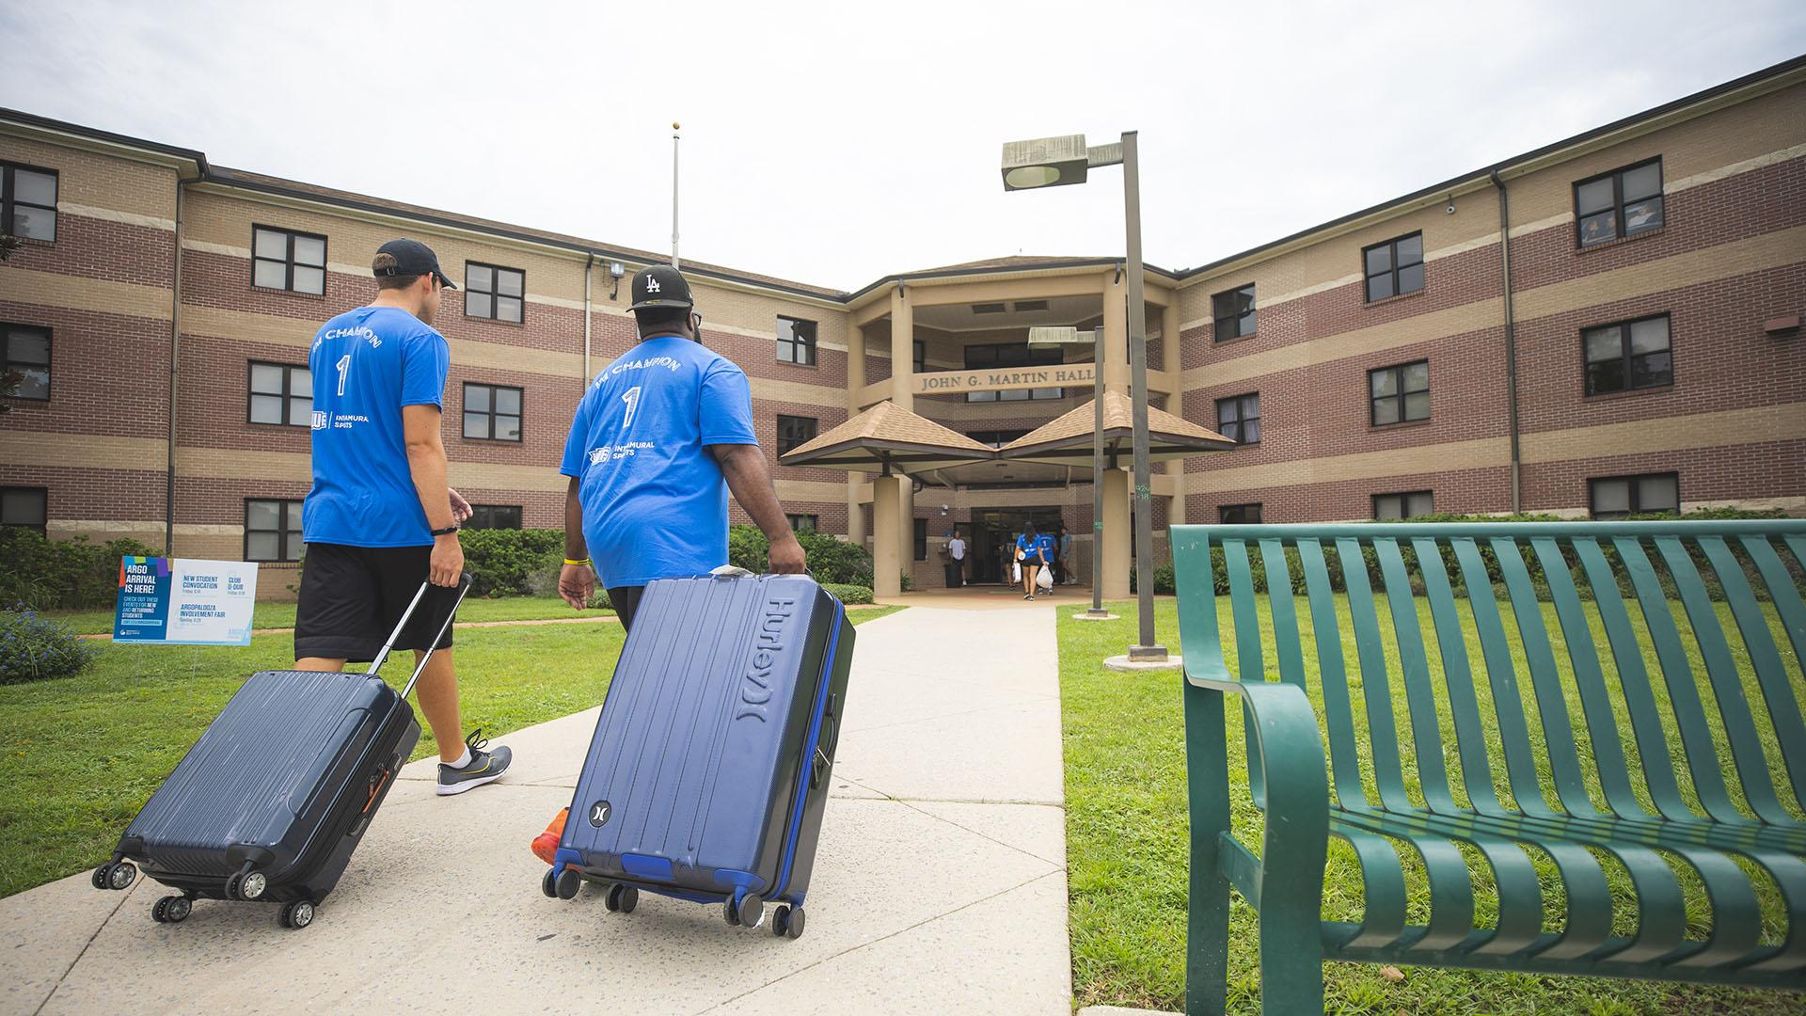
Reasons to Live on Campus
uwf.edu/Housing

Slide 27
Close to Class

Slide 28
Nautilus Market, University Commons
Close to Dining
uwf.edu/Dining
Notes:
Nautilus Market, Pace Library Coffee House, Chick-fil-A, Which-Which, Twisted Taco, Bento Sushi

Slide 29
Amenities Included
Notes:
Includes utilities (cable, electricity, water/sewer), internet, furniture, security

Slide 30
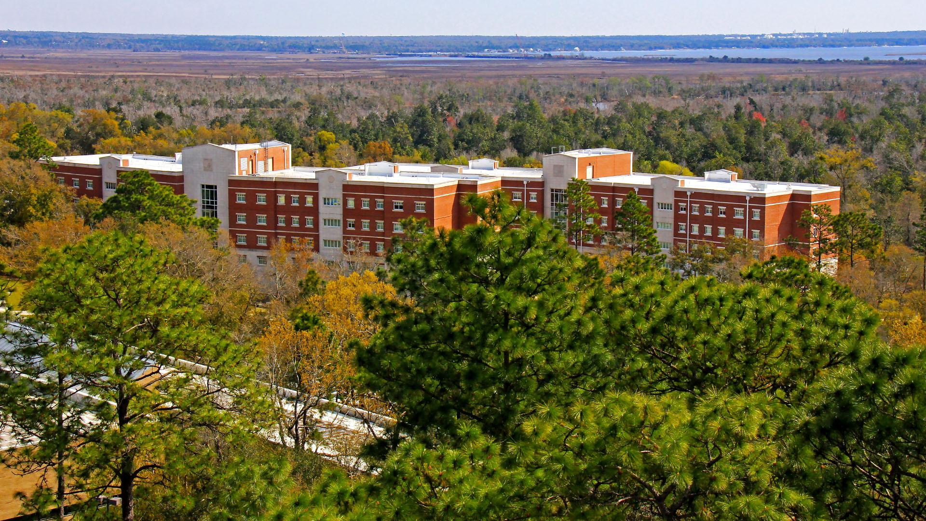
Financial Aid / Scholarships Apply

Slide 31
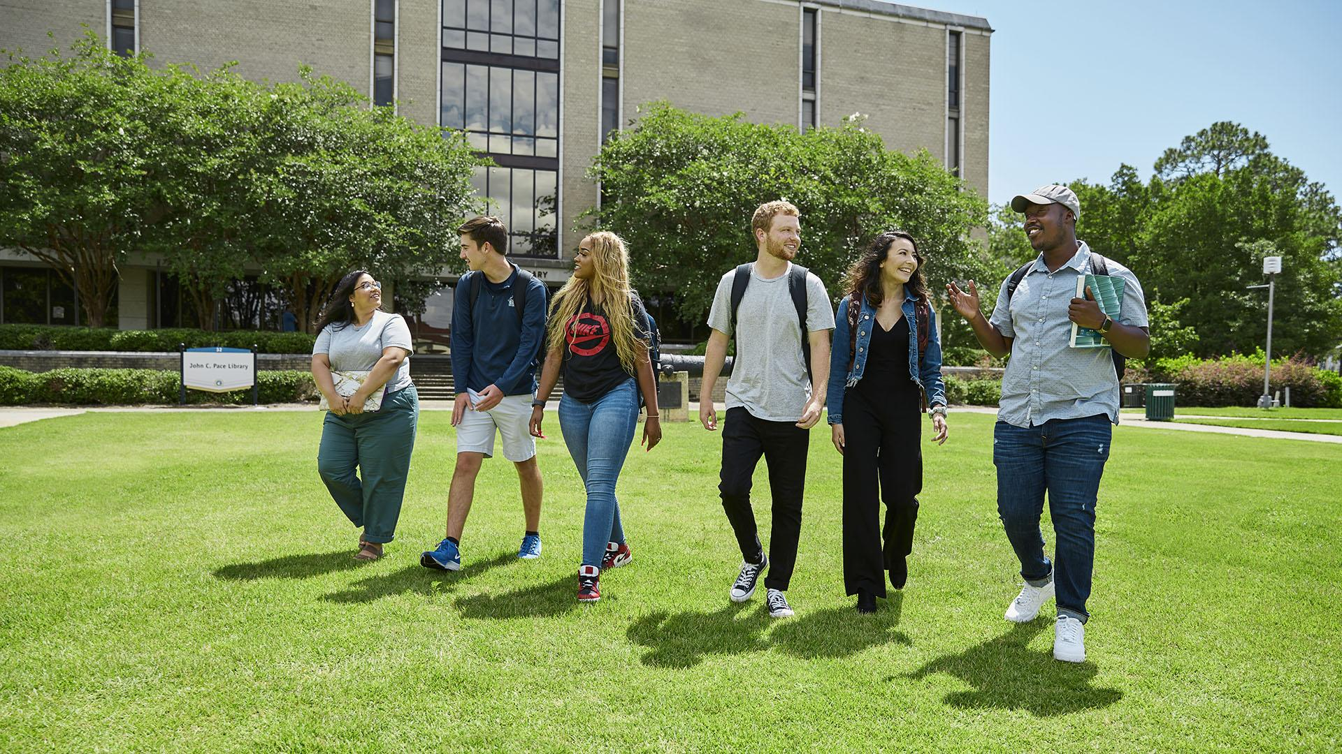
Meet New Friends
Notes:
MAIN POINT: Living on campus is awesome! Read aloud and elaborate on the Top Reasons block. We have a variety of dining options scattered throughout campus. You will get to see a room in Pace hall today.
DO NOT MENTION IT’S OPTIONAL UNLESS ASKED.
A huge part of getting the college experience is living on campus, and living on campus has so many benefits. You’re living right in the heart of campus which means you’re close to your classes, the library and tutoring centers, food, office hours, and activities. You can also use financial aid and scholarship money to pay for housing on campus, which you couldn’t do if you were renting a house or apartment. The housing fee is a one-time payment that includes utilities and furniture, and you don’t have to worry about collecting rent money from roommates and paying on time every month. It’s easier to get involved on campus since you are close to the action, and RA’s always have activities going on in the residence halls to get you out of your room and meeting people!
On your tour you’ll learn more about the specific housing options available and get the opportunity to visit Pace Hall and see the layout of the room!
We also have multiple dining options right here on campus. You’ll get the opportunity to see a few today including our main dining hall the Nautilus Market and the Galley. A student favorite is the Bene’s Pizza located right inside President’s Hall! Some classroom buildings that we will go to today also have grab-n-go food and even smoothies!
On-campus housing is optional for all students, however when you live on campus as a freshman you will be required to have a meal plan to ensure you don’t go hungry!

Slide 32
130+
STUDENT ORGANIZATIONS
Notes:
MAIN POINT: Living on campus is awesome! Read aloud and elaborate on the Top 5 Reasons block. We have a variety of dining options scattered throughout campus. You will get to see a room in Pace hall today.
DO NOT MENTION IT’S OPTIONAL UNLESS ASKED.
A huge part of getting the college experience is living on campus, and living on campus has so many benefits. You’re living right in the heart of campus which means you’re close to your classes, the library and tutoring centers, food, office hours, and activities. You can also use financial aid and scholarship money to pay for housing on campus, which you couldn’t do if you were renting a house or apartment. The housing fee is a one-time payment that includes utilities and furniture, and you don’t have to worry about collecting rent money from roommates and paying on time every month. It’s easier to get involved on campus since you are close to the action, and RA’s always have activities going on in the residence halls to get you out of your room and meeting people!
On your tour you’ll learn more about the specific housing options available and get the opportunity to visit Pace Hall and see the layout of the room!
We also have multiple dining options right here on campus. You’ll get the opportunity to see a few today including our main dining hall the Nautilus Market and the Galley. A student favorite is the Bene’s Pizza located right inside President’s Hall! Some classroom buildings that we will go to today also have grab-n-go food and even smoothies!
On-campus housing is optional for all students, however when you live on campus as a freshman you will be required to have a meal plan to ensure you don’t go hungry!

Slide 33
15
FRATERNITY AND SORORITY CHAPTERS

Slide 34
Argo
Athletics
GoArgos.com
Arete = excellence
Notes:
G

Slide 35
NCAA DII
Gulf South Conference
NCA College Game Day National Champions, 2021

Slide 36
15
INTERCOLLEGIATE ATHLETICS TEAMS
Golf conference champions, 2022
Arete = excellence
Notes:
Arete is Greek for excellence. Won the 2022 Gulf South Conference Women's Golf Championship.

Slide 37
112
CONFERENCE CHAMPIONSHIPS
Volleyball conference champions, 2021

Slide 38
10
NATIONAL CHAMPIONSHIPS
National champions, 2019
Notes:
MAIN POINTS: Pensacola has something for everyone. UWF students can get special student discounts at certain local establishments. Ask your StAR for recommendations.
UWF is located in the beautiful city of Pensacola. Once here, you truly fall in love with the history and events in the area. There truly is something for everybody.
We are the city of five flags. The flags that fly downtown represent all of the flags that have flown over Pensacola since the original Spanish settlement. are the American, Confederate first national pattern, British, French, and Spanish (in order of picture). We even have a piece of Pensacola history right here on campus. A UWF Student, Robert Annin, was diving and discovered a 18th-century, British, 32-pound garrison gun thought to have been part of a battery that guarded the entrance to Pensacola Bay. He donated it to the campus and now it sits in front of Pace Library on what we call the “Cannon Green.” A lot of student events take place there, and it’s a great place to sit and read on a sunny day. We will be able to see it today on our tour.
For people who love action and sports we are home of the U.S. Navy Blue Angels flight demonstration squadron, the Pensacola Ice Flyers, and Blue Wahoos AA baseball for the Cincinnati Reds.
There certainly is plenty to do in Pensacola. We have so many great restaurants in the area, both in town and out at the beach. You can visit our Naval Aviation Museum for free, then go across the street to climb the Pensacola Lighthouse for a few bucks. We also have Fort Pickens and another Fort on NAS Pensacola called Fort Barrancas.
Pensacola also takes pride in our love for the arts. Every month on a Friday night, downtown Pensacola closes off Palafox Street for Gallery Night, you can go to the Saenger theater to watch a play, visit Vinyl Music Hall for a weekend concert, and explore all of the good eats in town while doing it!
If you’d like to learn a little more about Pensacola and the different events in our area, please go to visitpensacola.com. They have a list of all of the upcoming festivals and events in the city! We also can provide you with any food recommendations!

Slide 39
8
WOMEN’S TEAMS
7
MEN’S TEAMS
Notes:
8 MEN’S AND S

Slide 40
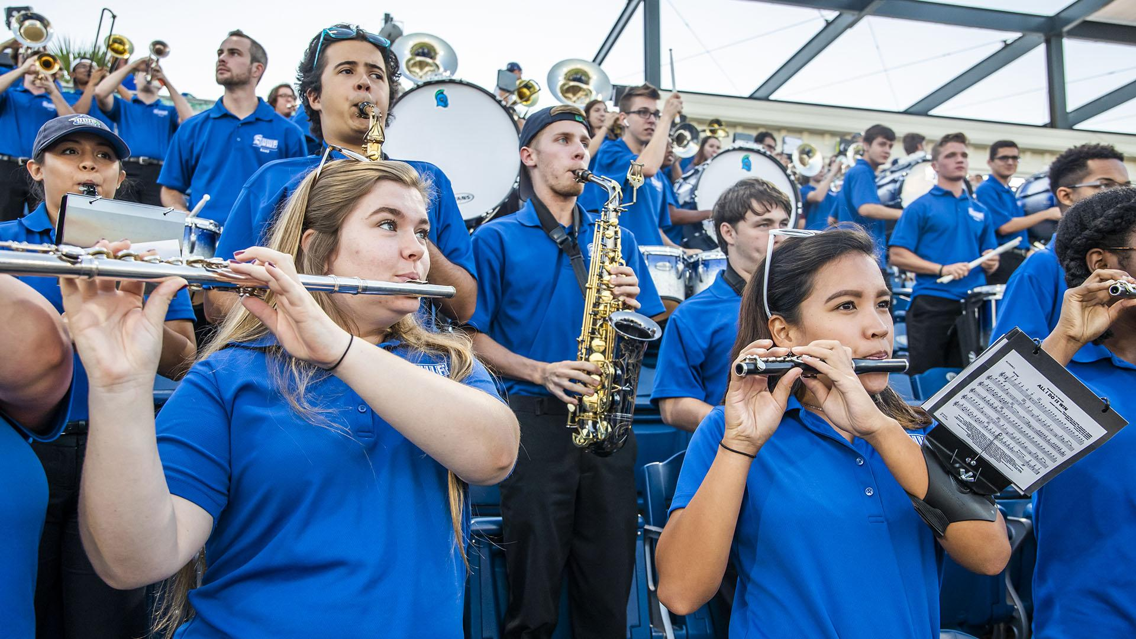
Argo
Athletic Band

Slide 41
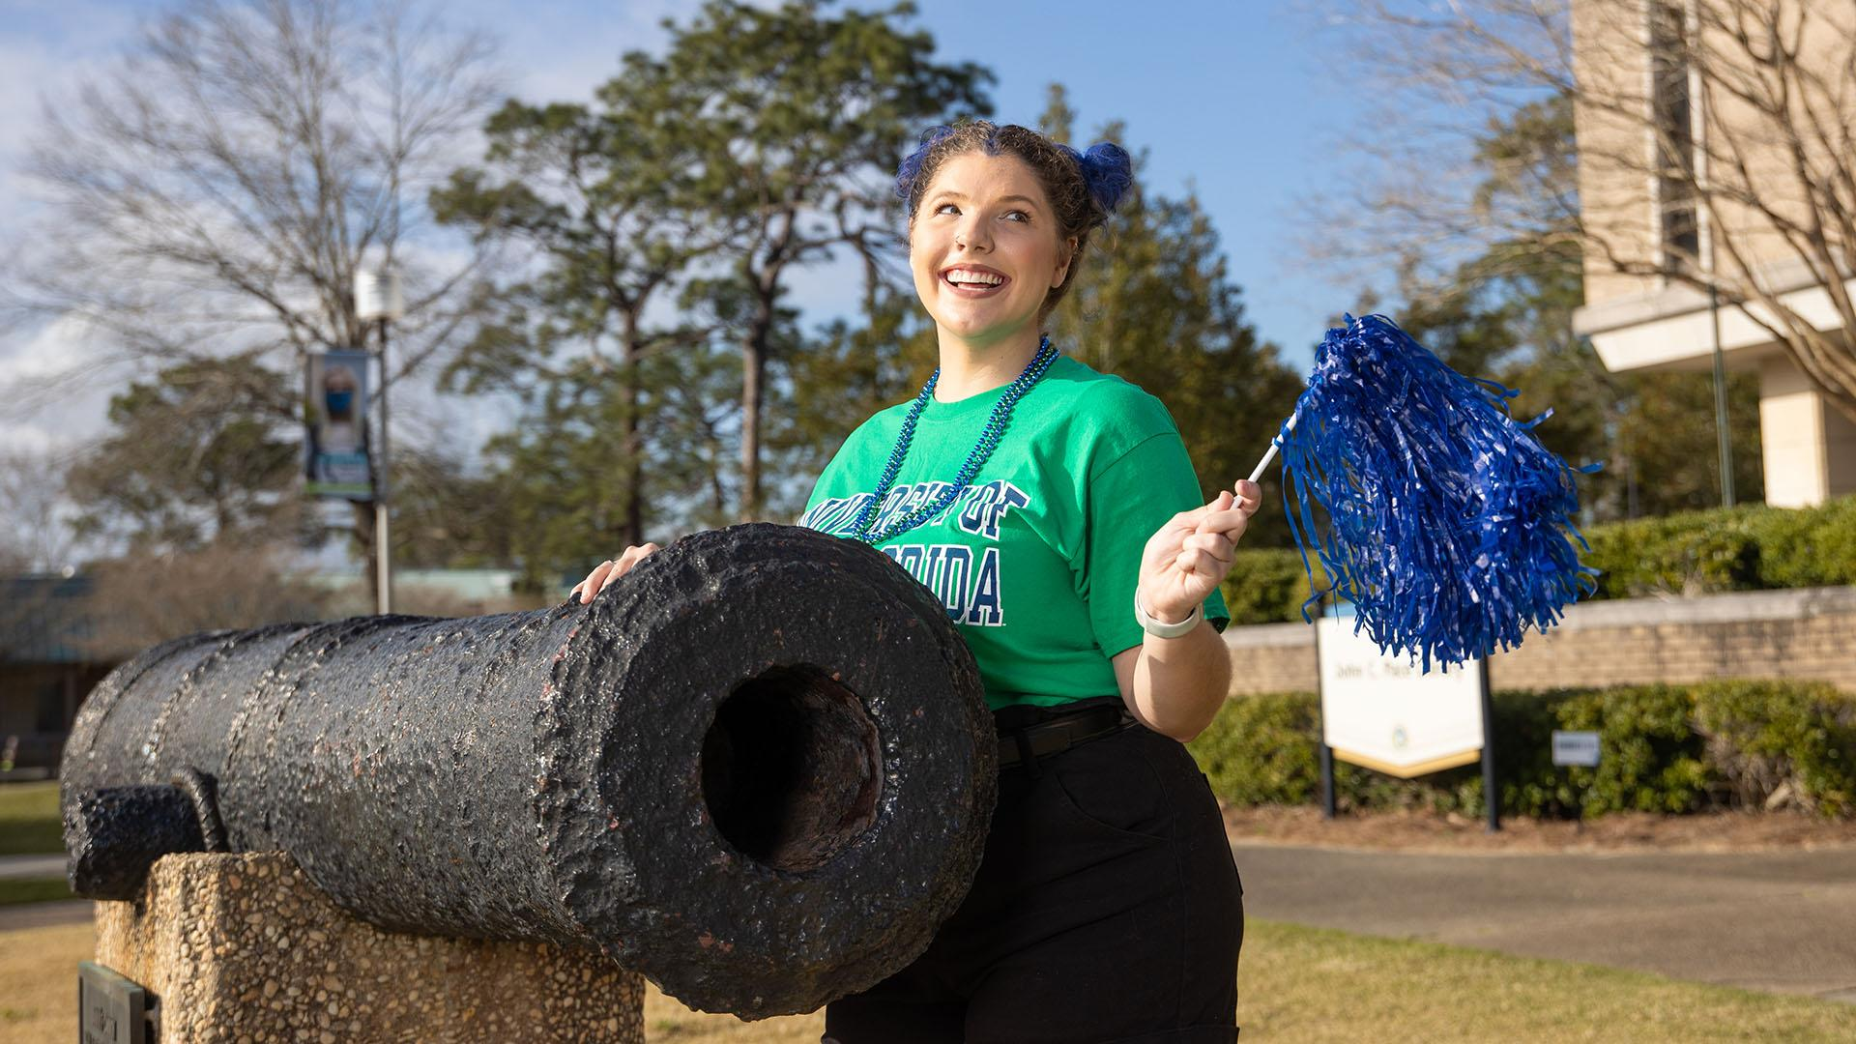
Become an
Argo
uwf.edu/GoApply

Slide 42
Application Requirements
Student Self-Reported Academic Record (SSAR)
ACT OR SAT
Test Scores
$30
Application Fee or Waiver

Slide 43
Freshman Admissions Consideration
2.50+
GPA, Weighted
ACT OR SAT
State Minimum Test Scores / Subject-Area Test Scores

Slide 44
We Superscore
ACT/SAT Scores
Notes:
MAIN POINTS: Freshman Fall 2020 admissions decision days. Emphasize that all materials must be submitted by the 1st of the month to get a decision on the 15th.
We are excited to be accepting applications for our Fall 2020 freshman class! You apply online through our Splash Portal, which can be accessed through the Admissions part of uwf.edu. Then, have your high school transcripts and ACT or SAT scores sent to us. Make sure to apply during the fall so you can get an admissions decision as soon as possible! Completed applications that are submitted by the first of the month will get a decision on the 15th.
Also, don’t forget to fill out the FAFSA so you are eligible for financial aid and scholarships.

Slide 45
Freshman Class Profile
3.5-4.2
GPA, cumulative weighted
21-27
ACT composite
1050-1220
SAT combined
Estimated middle 50%, Fall 2022 admitted first-time college students

Slide 46
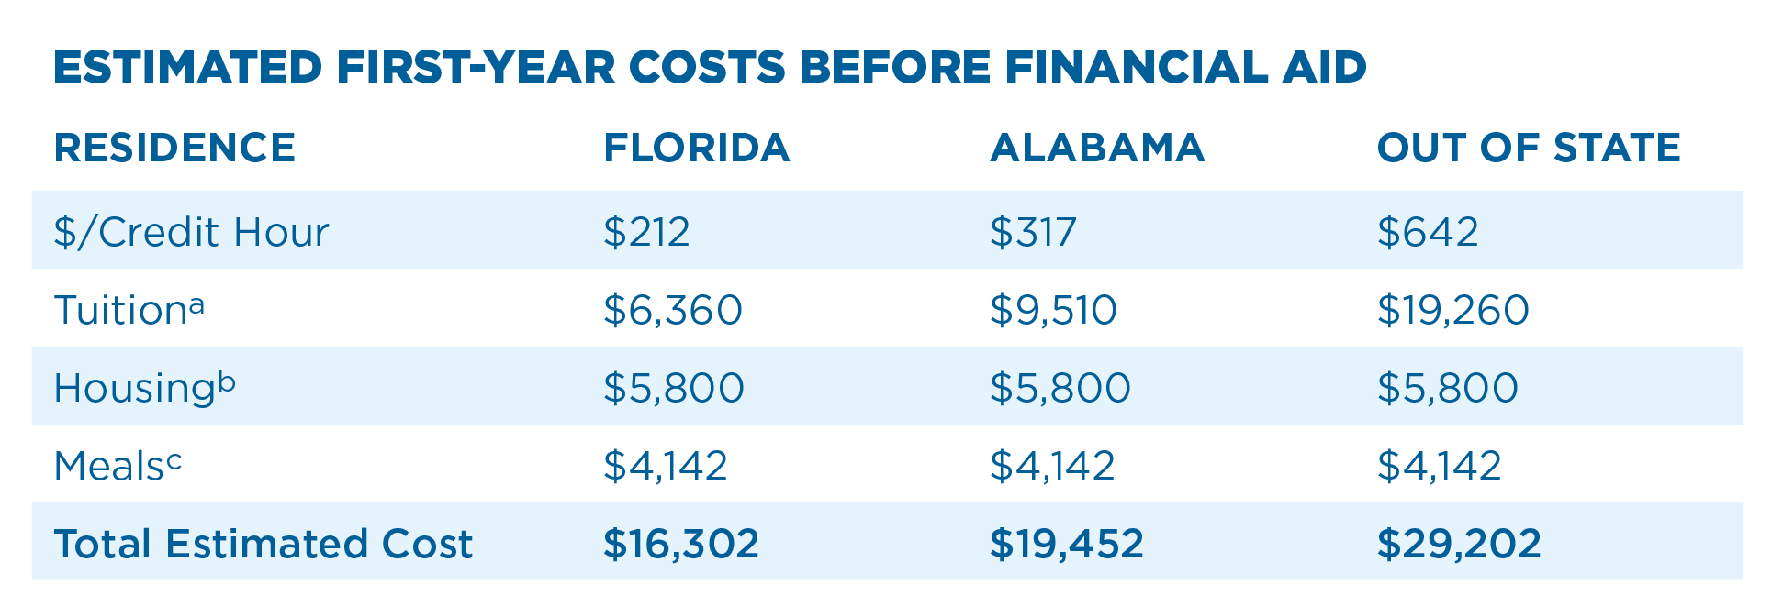
Estimated First-Year Costs
Based on 2022-2023 costs for fall and spring semesters. Costs are subject to change.
30 credit hours of tuition and fees
Shared Suite (Martin/Pace Halls: $2,900/semester)
Argo 10 plan: 10 meals/week + $300 Dining Dollars ($2,071/semester); other options available.
Notes:
G
MAIN POINTS: Freshman Fall 2020 admissions decision days. Emphasize that all materials must be submitted by the 1st of the month to get a decision on the 15th.
We are excited to be accepting applications for our Fall 2020 freshman class! You apply online through our Splash Portal, which can be accessed through the Admissions part of uwf.edu. Then, have your high school transcripts and ACT or SAT scores sent to us. Make sure to apply during the fall so you can get an admissions decision as soon as possible! Completed applications that are submitted by the first of the month will get a decision on the 15th.
Transfer students are issued decisions all year-round. We will need your official transcripts from every other college or university you have attended in order to make an admissions decision. Some transfer students may be required to send us high school transcripts and ACT or SAT scores. More information on transfer admissions requirements can be found on our website.
Also, don’t forget to fill out the FAFSA so you are eligible for financial aid and scholarships. We will talk more about that later.
**Important note: please stress that the student information in the blue box (gpa, test scores) is the average NOT minimums to be admitted.

Slide 47
89%
OF FRESHMEN RECEIVE FINANCIAL AID, 2021-2022
Notes:
G
MAIN POINTS: Freshman Fall 2020 admissions decision days. Emphasize that all materials must be submitted by the 1st of the month to get a decision on the 15th.
We are excited to be accepting applications for our Fall 2020 freshman class! You apply online through our Splash Portal, which can be accessed through the Admissions part of uwf.edu. Then, have your high school transcripts and ACT or SAT scores sent to us. Make sure to apply during the fall so you can get an admissions decision as soon as possible! Completed applications that are submitted by the first of the month will get a decision on the 15th.
Transfer students are issued decisions all year-round. We will need your official transcripts from every other college or university you have attended in order to make an admissions decision. Some transfer students may be required to send us high school transcripts and ACT or SAT scores. More information on transfer admissions requirements can be found on our website.
Also, don’t forget to fill out the FAFSA so you are eligible for financial aid and scholarships. We will talk more about that later.
**Important note: please stress that the student information in the blue box (gpa, test scores) is the average NOT minimums to be admitted.

Slide 48
$9.3M
AWARDED TO FRESHMEN, 2021-2022
Notes:
G
MAIN POINTS: Freshman Fall 2020 admissions decision days. Emphasize that all materials must be submitted by the 1st of the month to get a decision on the 15th.
We are excited to be accepting applications for our Fall 2020 freshman class! You apply online through our Splash Portal, which can be accessed through the Admissions part of uwf.edu. Then, have your high school transcripts and ACT or SAT scores sent to us. Make sure to apply during the fall so you can get an admissions decision as soon as possible! Completed applications that are submitted by the first of the month will get a decision on the 15th.
Transfer students are issued decisions all year-round. We will need your official transcripts from every other college or university you have attended in order to make an admissions decision. Some transfer students may be required to send us high school transcripts and ACT or SAT scores. More information on transfer admissions requirements can be found on our website.
Also, don’t forget to fill out the FAFSA so you are eligible for financial aid and scholarships. We will talk more about that later.
**Important note: please stress that the student information in the blue box (gpa, test scores) is the average NOT minimums to be admitted.

Slide 49
Complete the FAFSA
Free Application for Federal Student Aid
StudentAid.gov
UWF Code: 003955
Notes:
MAIN POINTS: Freshman Fall 2020 admissions decision days. Emphasize that all materials must be submitted by the 1st of the month to get a decision on the 15th.
We are excited to be accepting applications for our Fall 2020 freshman class! You apply online through our Splash Portal, which can be accessed through the Admissions part of uwf.edu. Then, have your high school transcripts and ACT or SAT scores sent to us. Make sure to apply during the fall so you can get an admissions decision as soon as possible! Completed applications that are submitted by the first of the month will get a decision on the 15th.
Also, don’t forget to fill out the FAFSA so you are eligible for financial aid and scholarships.

Slide 50
Tuition Covered
For Qualifying Pell-Eligible Florida Residents (Fall and Spring)
uwf.edu/Argo30
Notes:
MAIN POINTS: Freshman Fall 2020 admissions decision days. Emphasize that all materials must be submitted by the 1st of the month to get a decision on the 15th.
We are excited to be accepting applications for our Fall 2020 freshman class! You apply online through our Splash Portal, which can be accessed through the Admissions part of uwf.edu. Then, have your high school transcripts and ACT or SAT scores sent to us. Make sure to apply during the fall so you can get an admissions decision as soon as possible! Completed applications that are submitted by the first of the month will get a decision on the 15th.
Also, don’t forget to fill out the FAFSA so you are eligible for financial aid and scholarships.

Slide 51
Automatic Consideration
Scholarships
uwf.edu/FreshmanScholarships
Notes:
G
MAIN POINTS: Freshman Fall 2020 admissions decision days. Emphasize that all materials must be submitted by the 1st of the month to get a decision on the 15th.
We are excited to be accepting applications for our Fall 2020 freshman class! You apply online through our Splash Portal, which can be accessed through the Admissions part of uwf.edu. Then, have your high school transcripts and ACT or SAT scores sent to us. Make sure to apply during the fall so you can get an admissions decision as soon as possible! Completed applications that are submitted by the first of the month will get a decision on the 15th.
Transfer students are issued decisions all year-round. We will need your official transcripts from every other college or university you have attended in order to make an admissions decision. Some transfer students may be required to send us high school transcripts and ACT or SAT scores. More information on transfer admissions requirements can be found on our website.
Also, don’t forget to fill out the FAFSA so you are eligible for financial aid and scholarships. We will talk more about that later.
**Important note: please stress that the student information in the blue box (gpa, test scores) is the average NOT minimums to be admitted.

Slide 52
Admissions Merit Scholarship
Eligibility does not guarantee an award. Admissions can award students with only one academic or full-ride scholarship; scholarships may not be combined. Students who have already earned a bachelor’s degree will not receive priority scholarship consideration. Some scholarships are renewable pending continued and veriﬁed eligibility, and others are one-time awards.
Cumulative Weighted
SAT Total
ACT Composite
Notes:
G
MAIN POINTS: Freshman Fall 2020 admissions decision days. Emphasize that all materials must be submitted by the 1st of the month to get a decision on the 15th.
We are excited to be accepting applications for our Fall 2020 freshman class! You apply online through our Splash Portal, which can be accessed through the Admissions part of uwf.edu. Then, have your high school transcripts and ACT or SAT scores sent to us. Make sure to apply during the fall so you can get an admissions decision as soon as possible! Completed applications that are submitted by the first of the month will get a decision on the 15th.
Transfer students are issued decisions all year-round. We will need your official transcripts from every other college or university you have attended in order to make an admissions decision. Some transfer students may be required to send us high school transcripts and ACT or SAT scores. More information on transfer admissions requirements can be found on our website.
Also, don’t forget to fill out the FAFSA so you are eligible for financial aid and scholarships. We will talk more about that later.
**Important note: please stress that the student information in the blue box (gpa, test scores) is the average NOT minimums to be admitted.

Slide 53
Dec. 1
Scholarship Priority Consideration Deadline
uwf.edu/Deadlines

Slide 54
Invite-only
Scholarship Competition
Invitations Sent in December to Qualifying Admitted Students
UWF President Martha Saunders
Notes:
Scoring based on academic profile, essay, and interview.

Slide 55
Pace Presidential Scholarship
Tuition
Meal Plan
Campus Housing
$800 Textbook Stipend per Semester
Paid Research or Study Abroad Experience Valued at up to $1,500
Notes:
MAIN POINTS: Freshman Fall 2020 admissions decision days. Emphasize that all materials must be submitted by the 1st of the month to get a decision on the 15th.
We are excited to be accepting applications for our Fall 2020 freshman class! You apply online through our Splash Portal, which can be accessed through the Admissions part of uwf.edu. Then, have your high school transcripts and ACT or SAT scores sent to us. Make sure to apply during the fall so you can get an admissions decision as soon as possible! Completed applications that are submitted by the first of the month will get a decision on the 15th.
Also, don’t forget to fill out the FAFSA so you are eligible for financial aid and scholarships.

Slide 56
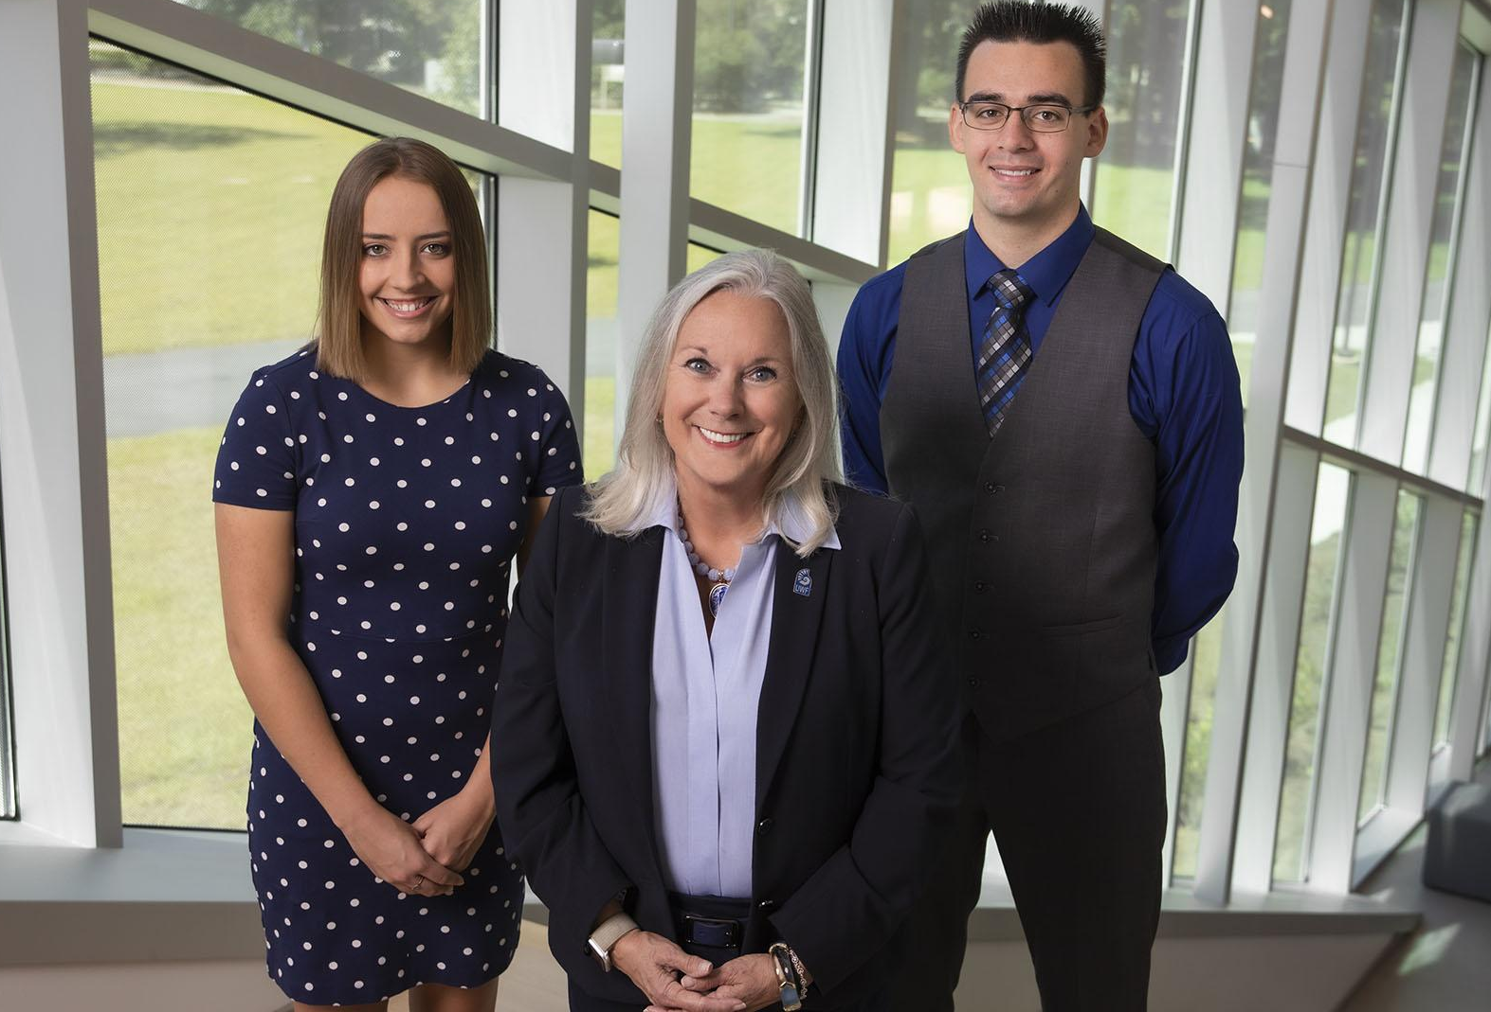
National Merit Finalist Scholarship
Tuition
Meal Plan
Campus Housing
$800 Textbook Stipend per Semester
Paid Research or Study Abroad Experience Valued at up to $1,500
Notes:
MAIN POINTS: Freshman Fall 2020 admissions decision days. Emphasize that all materials must be submitted by the 1st of the month to get a decision on the 15th.
We are excited to be accepting applications for our Fall 2020 freshman class! You apply online through our Splash Portal, which can be accessed through the Admissions part of uwf.edu. Then, have your high school transcripts and ACT or SAT scores sent to us. Make sure to apply during the fall so you can get an admissions decision as soon as possible! Completed applications that are submitted by the first of the month will get a decision on the 15th.
Also, don’t forget to fill out the FAFSA so you are eligible for financial aid and scholarships.

Slide 57
Argo Spirit Scholarship
Tuition
Meal Plan
Campus Housing
$800 Textbook Stipend per Semester
Notes:
MAIN POINTS: Freshman Fall 2020 admissions decision days. Emphasize that all materials must be submitted by the 1st of the month to get a decision on the 15th.
We are excited to be accepting applications for our Fall 2020 freshman class! You apply online through our Splash Portal, which can be accessed through the Admissions part of uwf.edu. Then, have your high school transcripts and ACT or SAT scores sent to us. Make sure to apply during the fall so you can get an admissions decision as soon as possible! Completed applications that are submitted by the first of the month will get a decision on the 15th.
Also, don’t forget to fill out the FAFSA so you are eligible for financial aid and scholarships.

Slide 58
uwf.edu/ZeeMee
Notes:
1- we superscore so encourage to send all scores

Slide 59
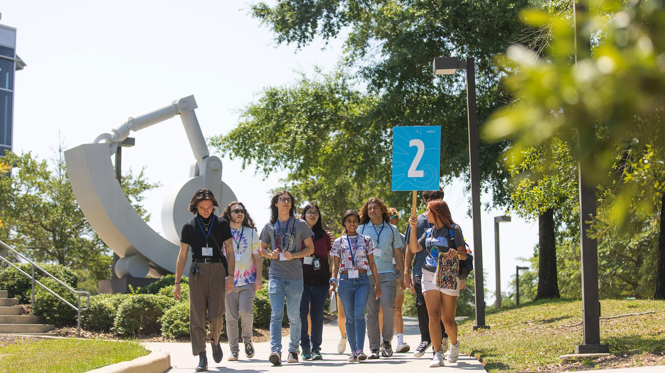
Schedule Your
Campus Visit
uwf.edu/Visit

Slide 60
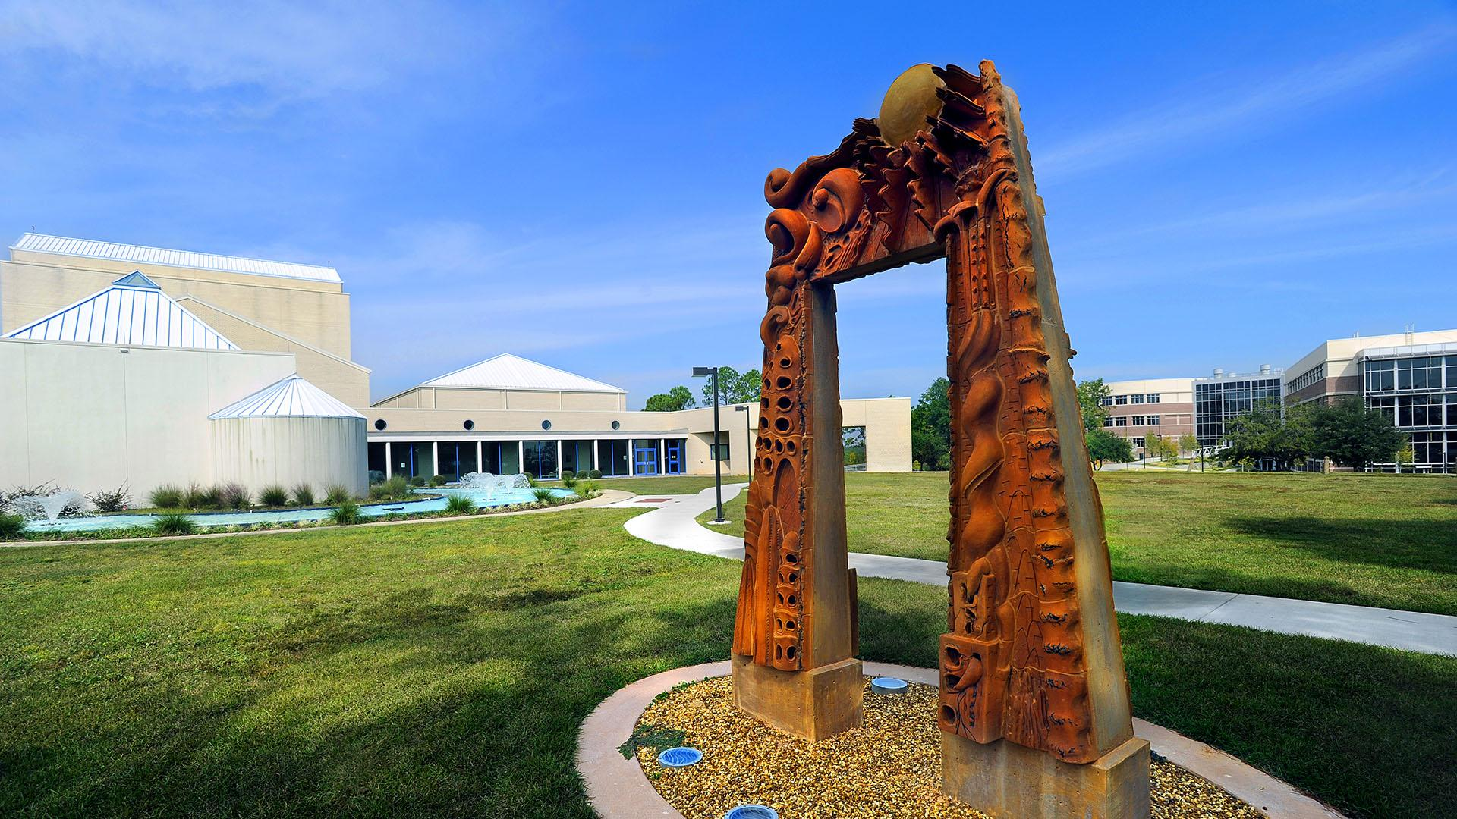
Join In-Person and Virtual
Events
uwf.edu/AdmissionsEvents

Slide 61
Connect With Us
/uwf
/westfl

