Slide 1
GO BIG. GO BOLD.
GO BULLS.

Slide 2
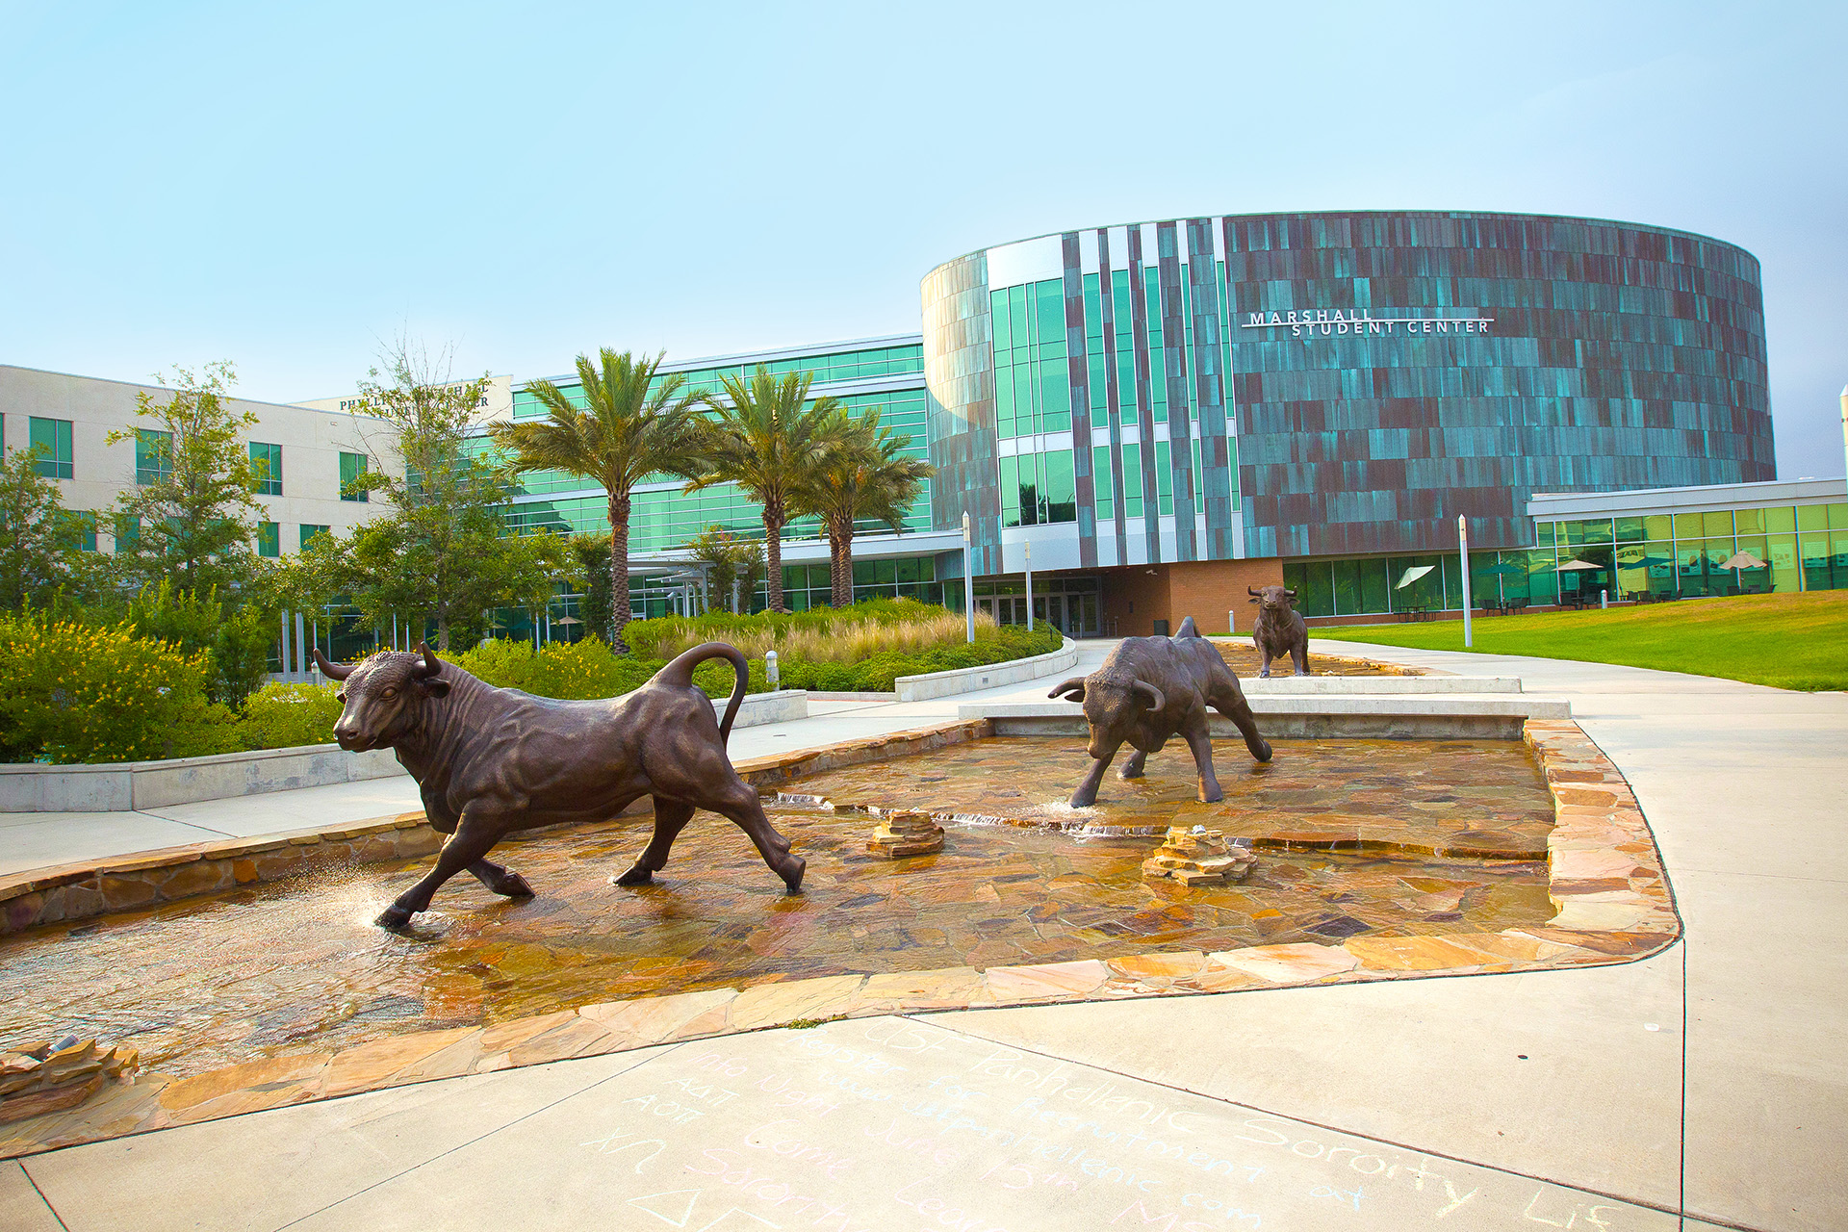
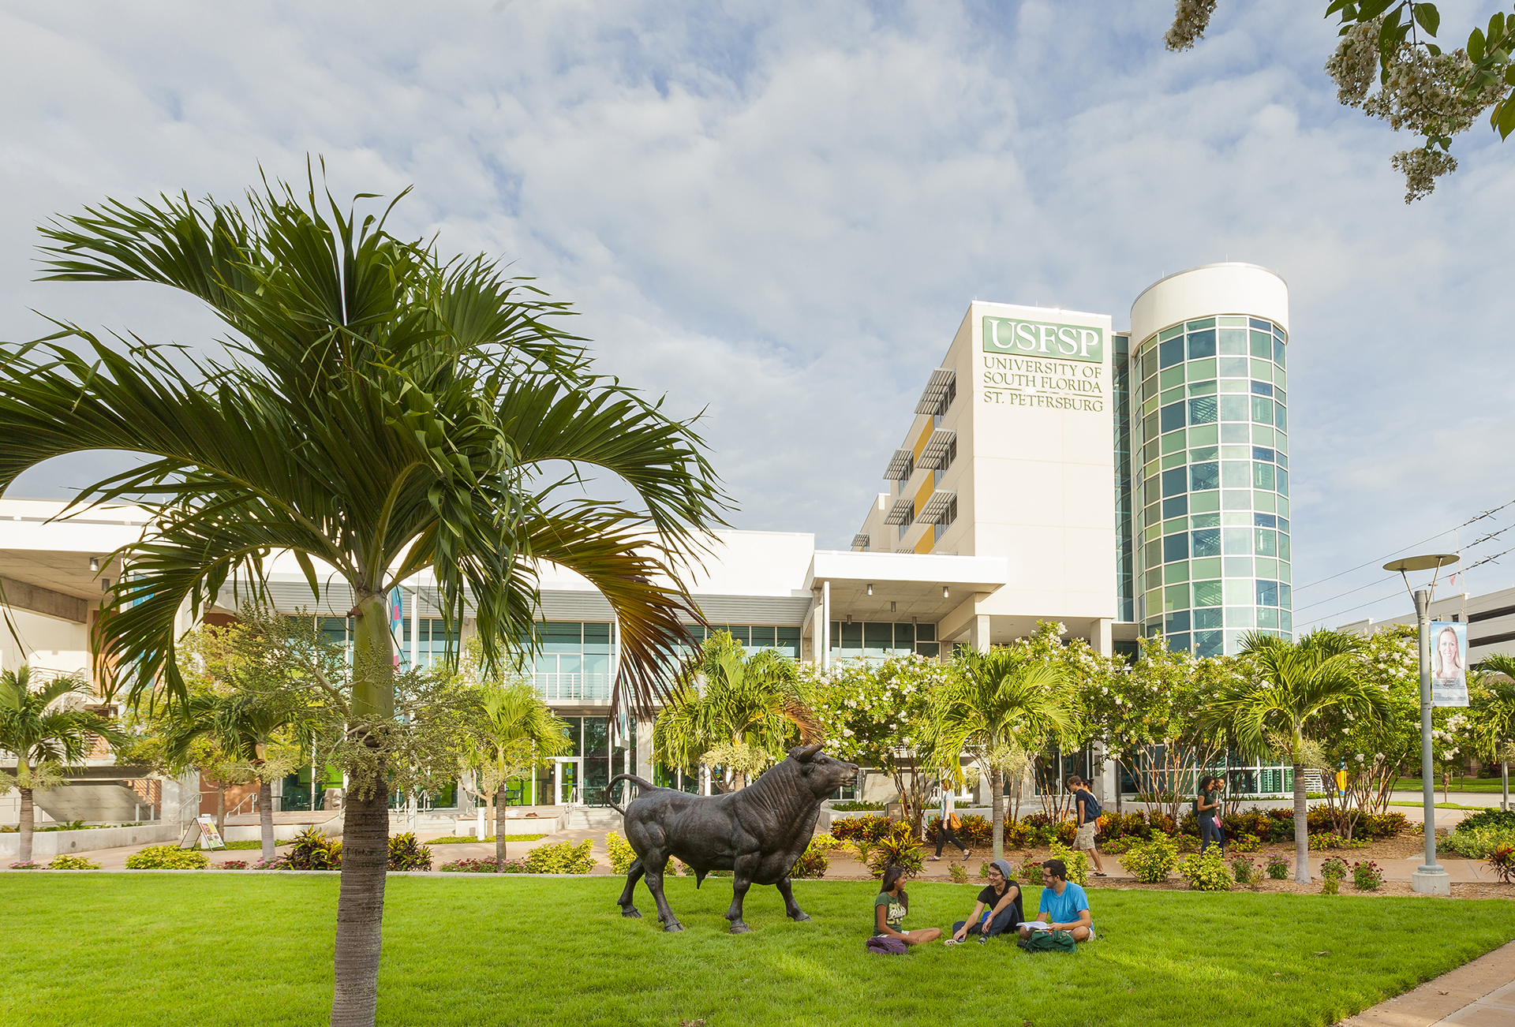
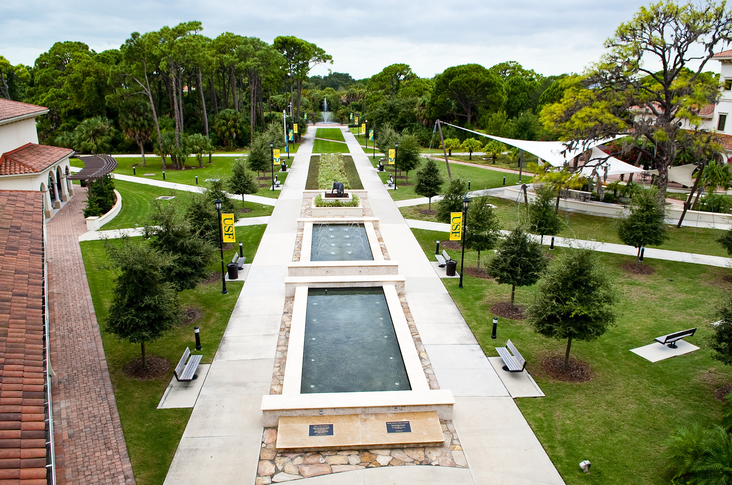
ONE USF
TAMPA CAMPUS ST. PETERSBURG CAMPUS SARASOTA-MANATEE CAMPUS

Slide 3
ONE USF
One application
One set of dates and deadlines
One admission criteria and grid
One scholarship grid
One consolidated admissions process
One unified recruiting plan
One unified marketing plan

Slide 4
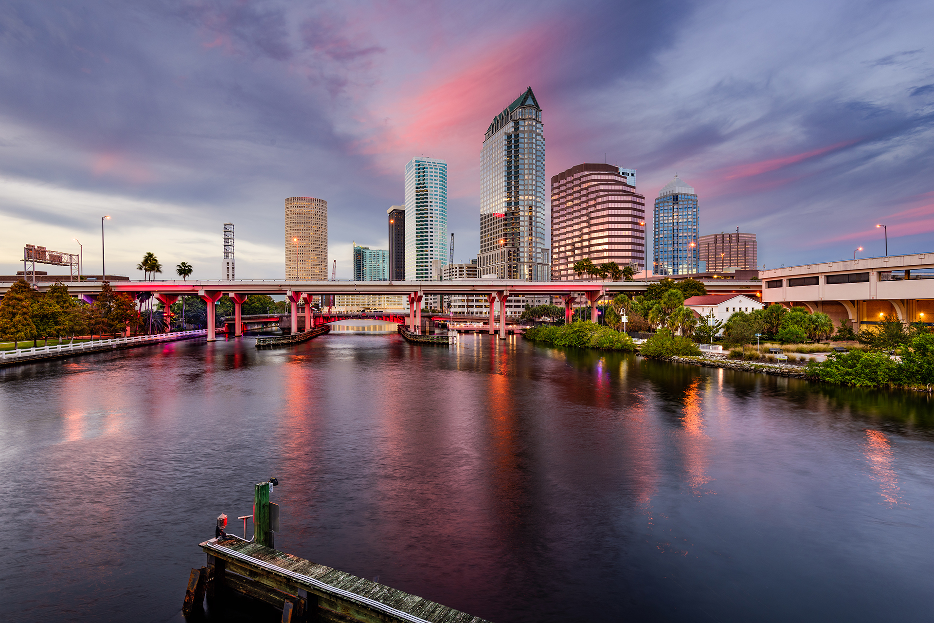
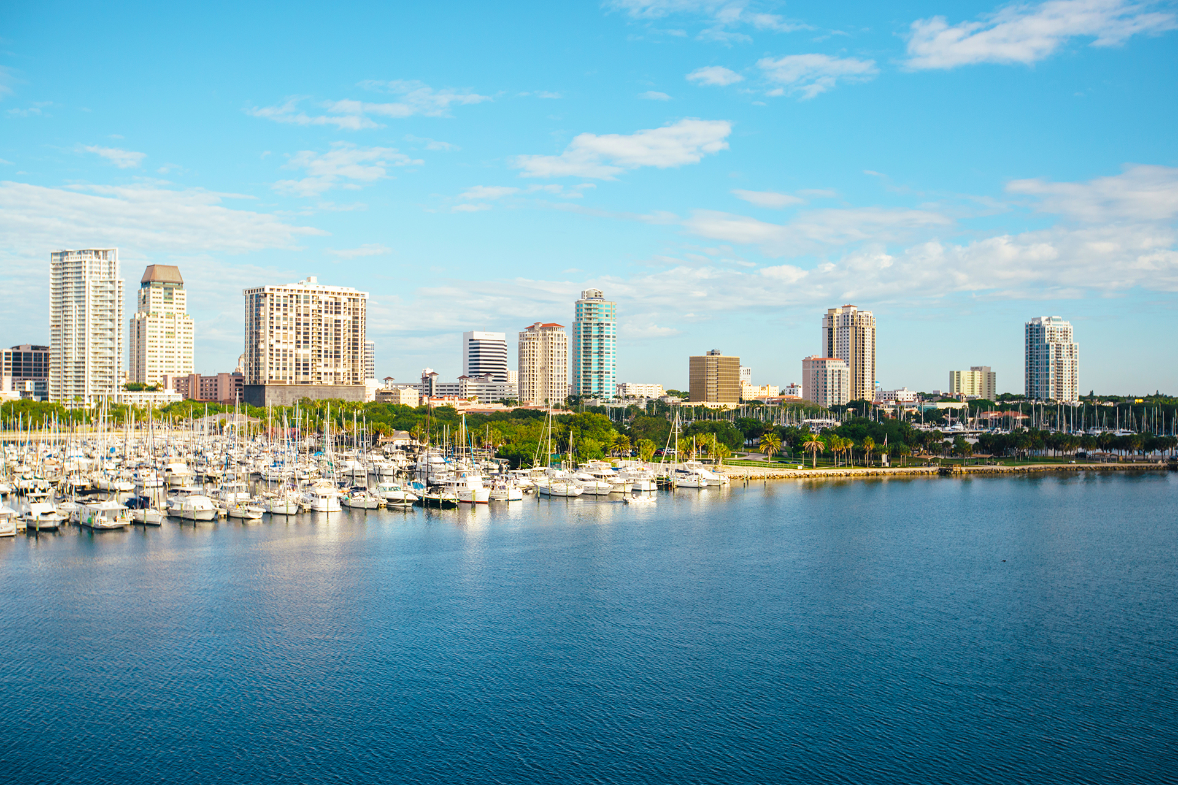
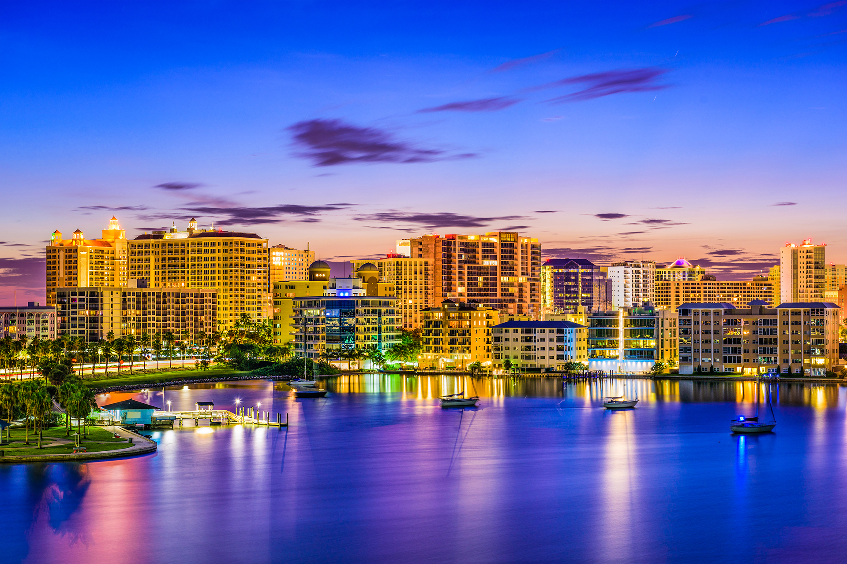
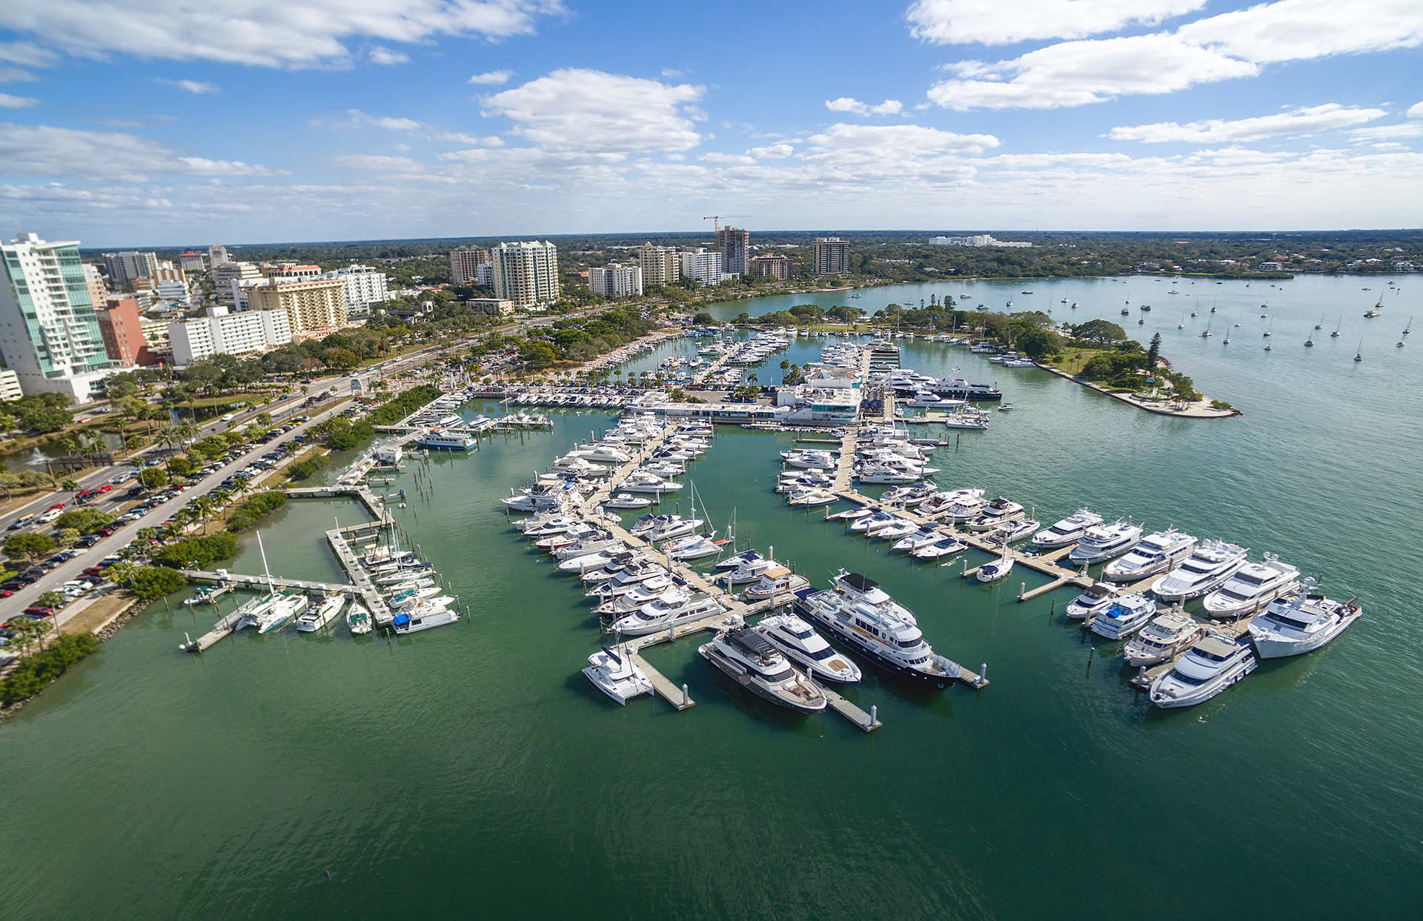
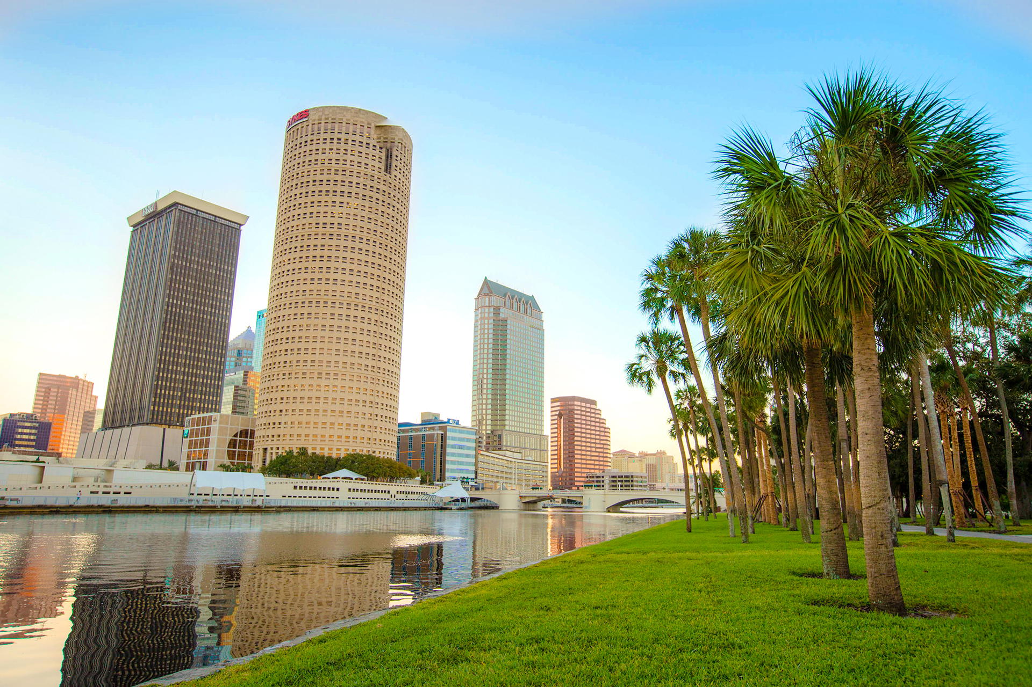
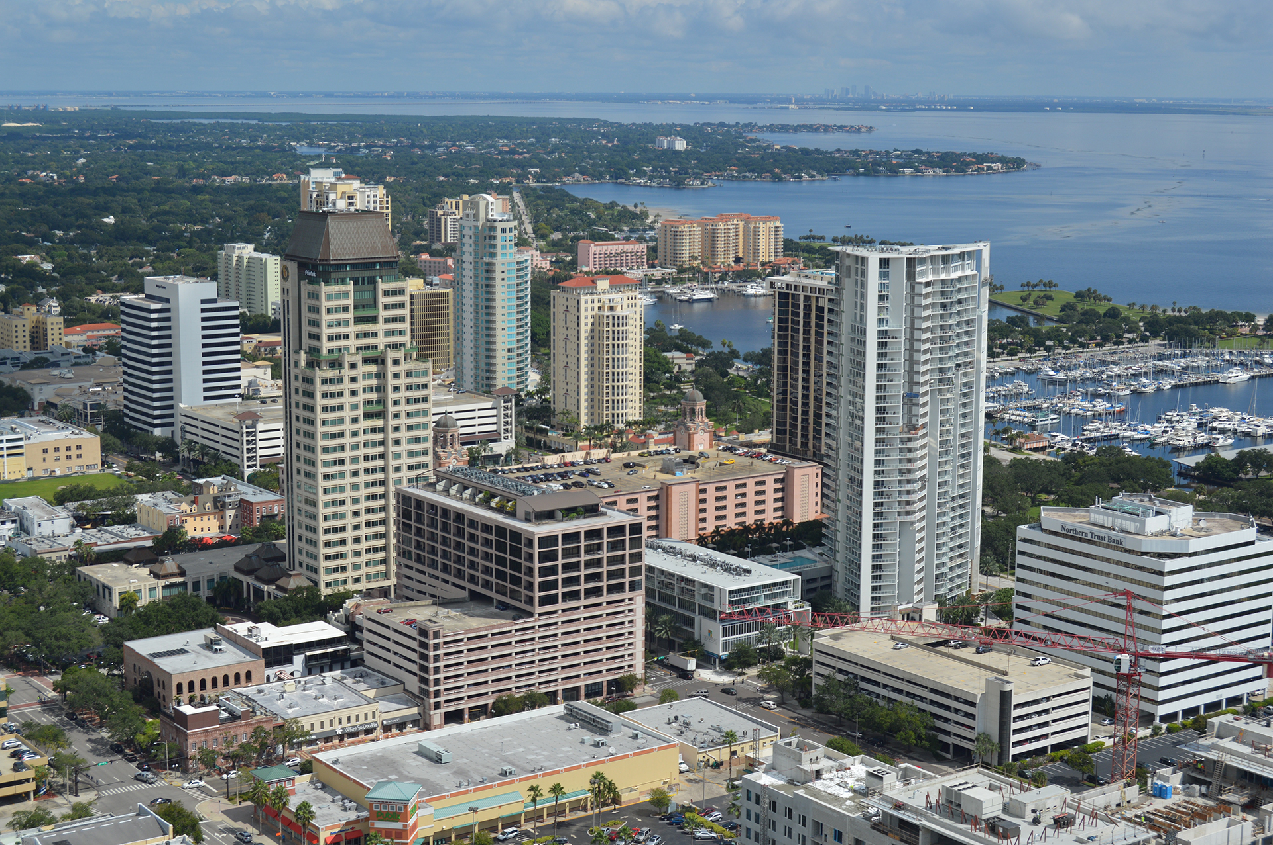
VIBRANT METROPOLITAN UNIVERSITY
TAMPA
ST. PETERSBURG
SARASOTA-MANATEE
SARASOTA-MANATEE
TAMPA
ST. PETERSBURG

Slide 5
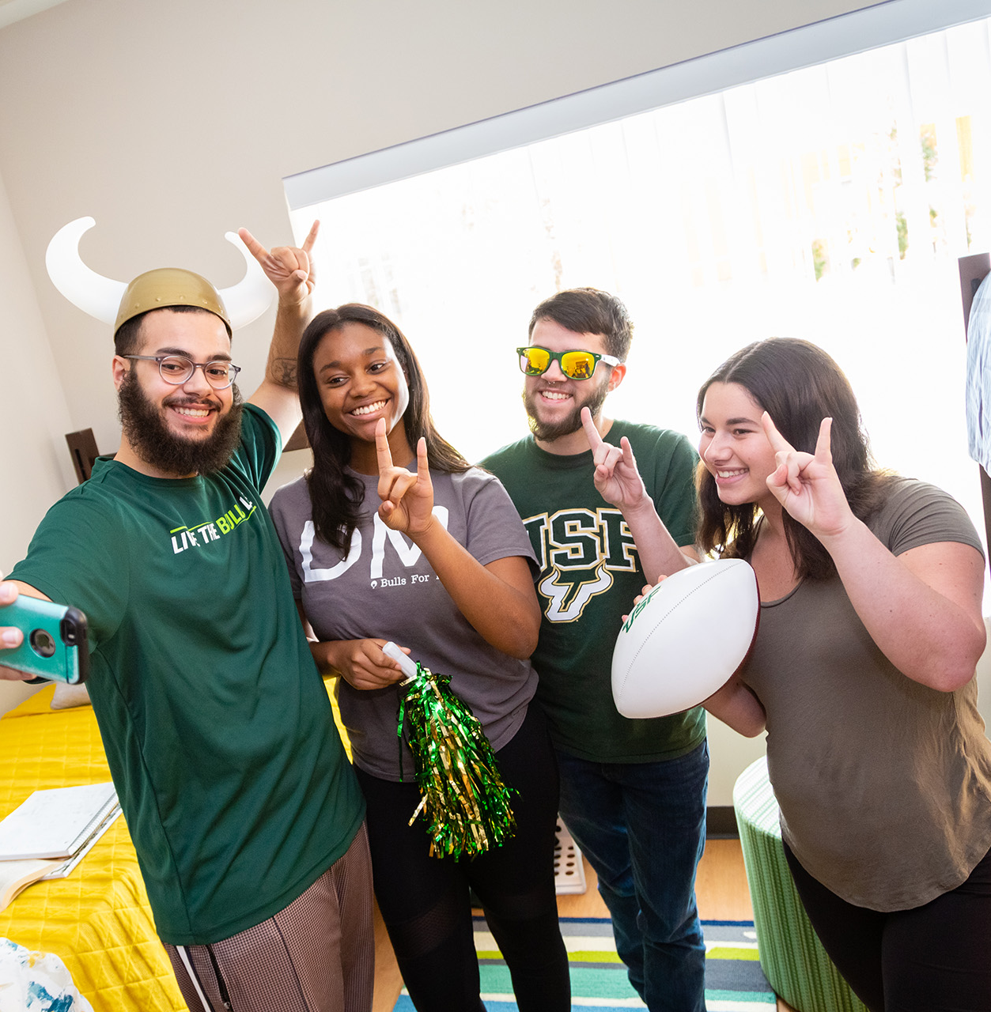
ONE USF
USF RANKS
8th IN THE NATION
among American public research universities in
generating new patents
- Intellectual Property Owners Association/NAI, 2020
BEST VALUE COLLEGE
or providing high-quality education and career readiness at an affordable cost.
– Princeton Review, 2021
AROUND 50,000 STUDENTS
across all three campuses.

Slide 6
FRESHMEN PROFILE
FALL 2022 ADMITTED FRESHMAN PROFILE
GPA: 4.00 – 4.50
SAT: 1240 – 1390
ACT: 27 – 31
SUMMER 2022 ADMITTED FRESHMAN PROFILE
GPA: 3.62 – 4.12
SAT: 1100 – 1190
ACT: 22 – 25
2022 FALL ADMIT RATE
43%
FRESHMAN CLASS SIZE
~7,000

Slide 7
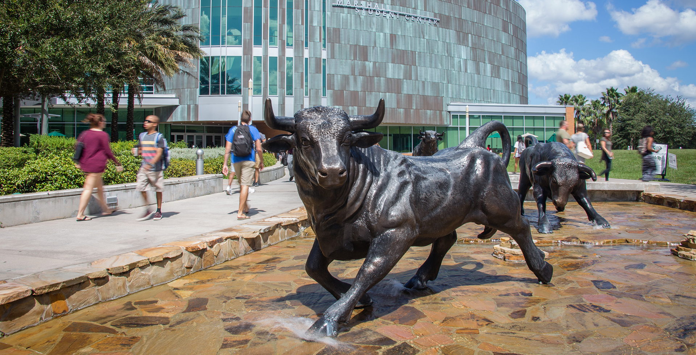
TAMPA CAMPUS

Slide 8
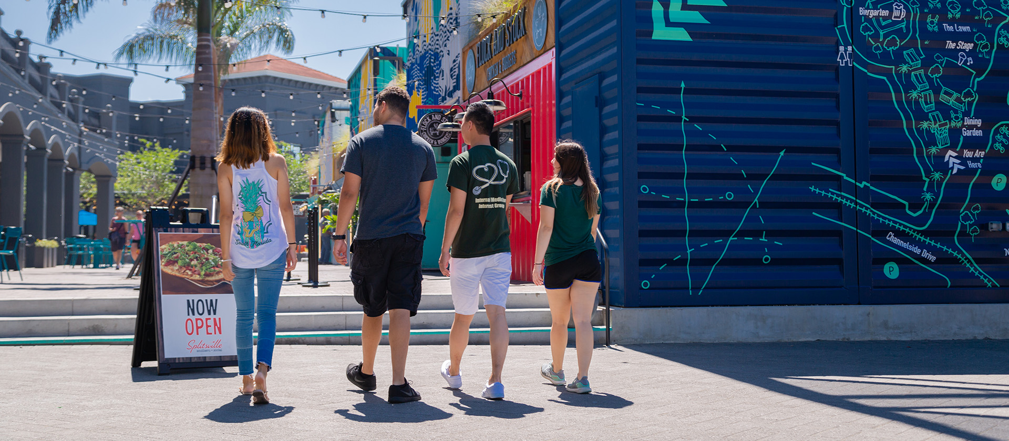
TAMPA CAMPUS: LOCATION
Just a short drive from incredible beaches, a bustling downtown and historic Ybor City

Slide 9
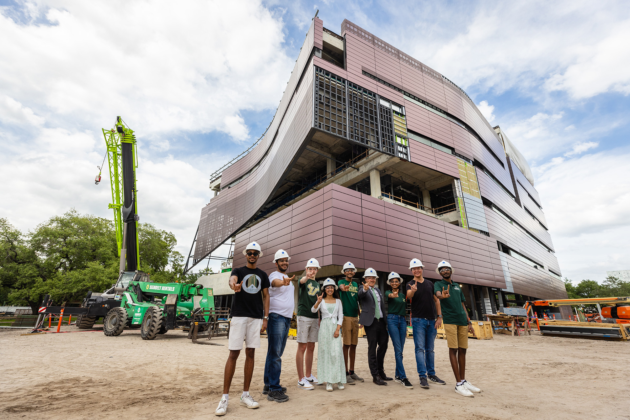
NEW: In Spring 2023, the Tampa campus will open the state-of-the-art Judy Genshaft Honors College building with interwoven classrooms, study areas, faculty and advisor offices, event venues, a music and computer lab, and numerous collaborative spaces.

Slide 10
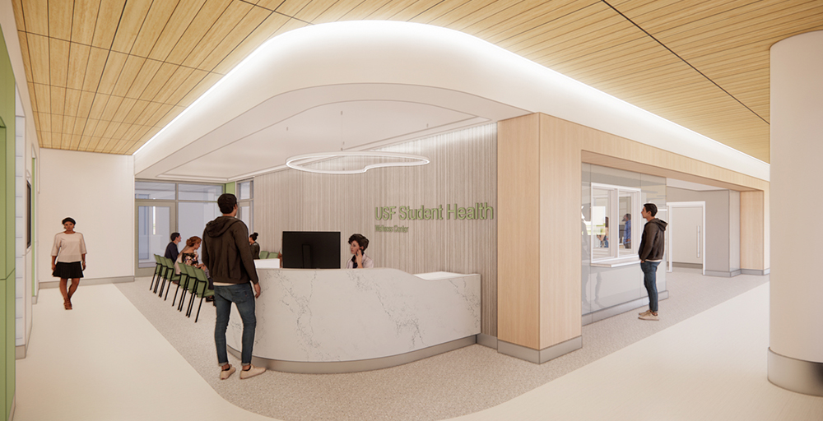
NEW: In Fall 2022, the Tampa campus will open a new 7,000-square-foot Student Wellness Center as part of USF’s commitment to health and wellness for student success.

Slide 11
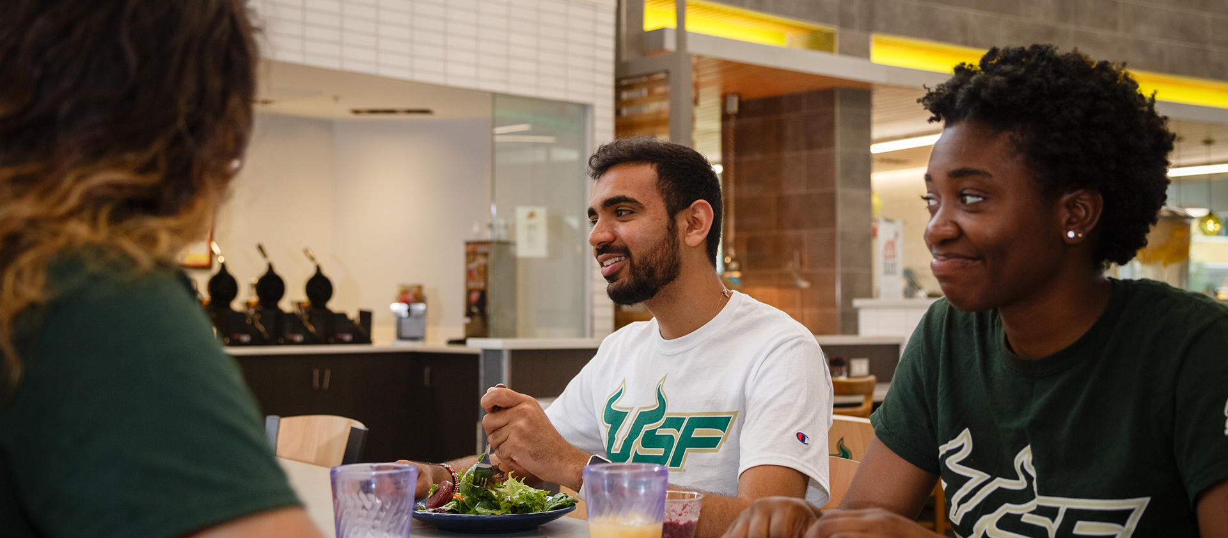
TAMPA CAMPUS: DINING
30+ dining locations offer traditional buffets, cafés and nationally known favorites—plus an on-campus Publix

Slide 12
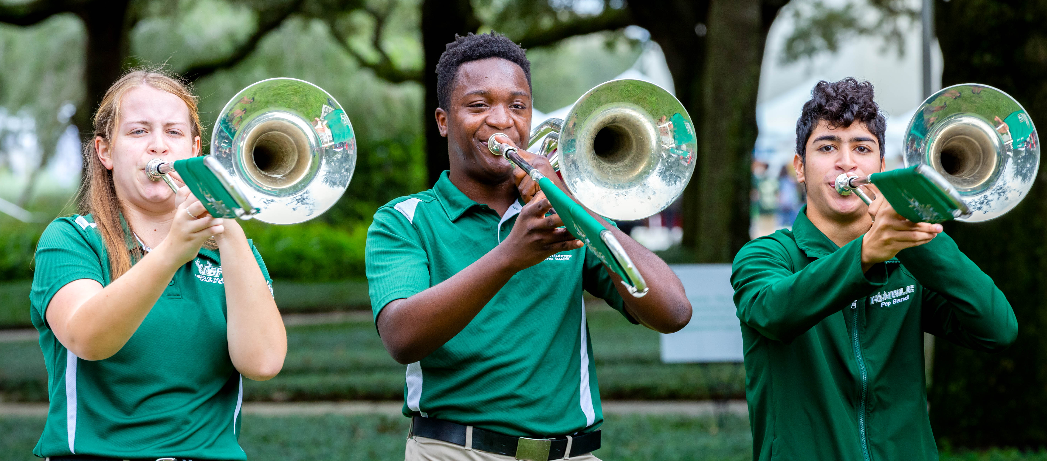
TAMPA CAMPUS: STUDENT ORGANIZATIONS
600+ clubs and organizations to get involved and make friends

Slide 13
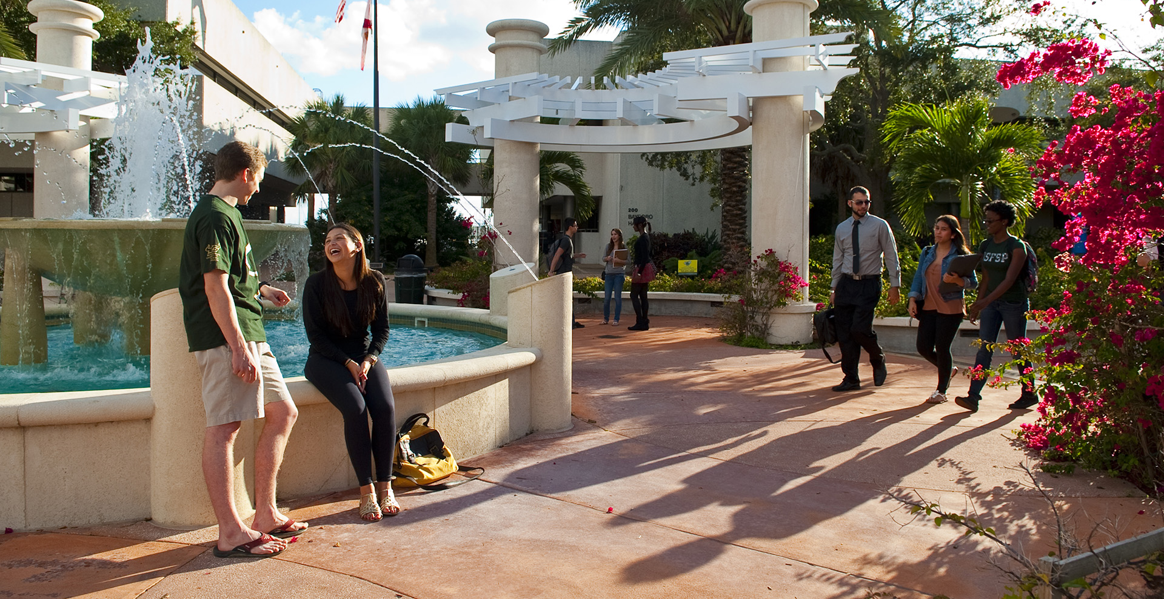
ST. PETERSBURG CAMPUS

Slide 14
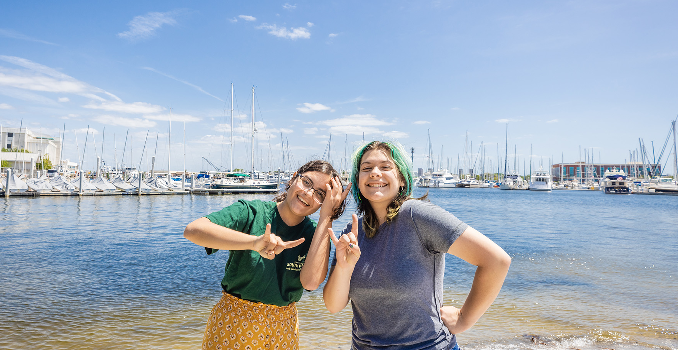
Located on beautiful Bayboro Harbor in the heart of downtown St. Petersburg

Slide 15
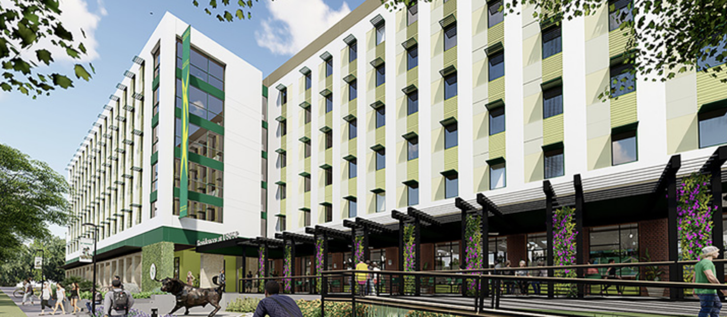
ST. PETERSBURG CAMPUS: HOUSING
Osprey Suites, our new, 375-bed residence hall, includes a full-service dining hall

Slide 16
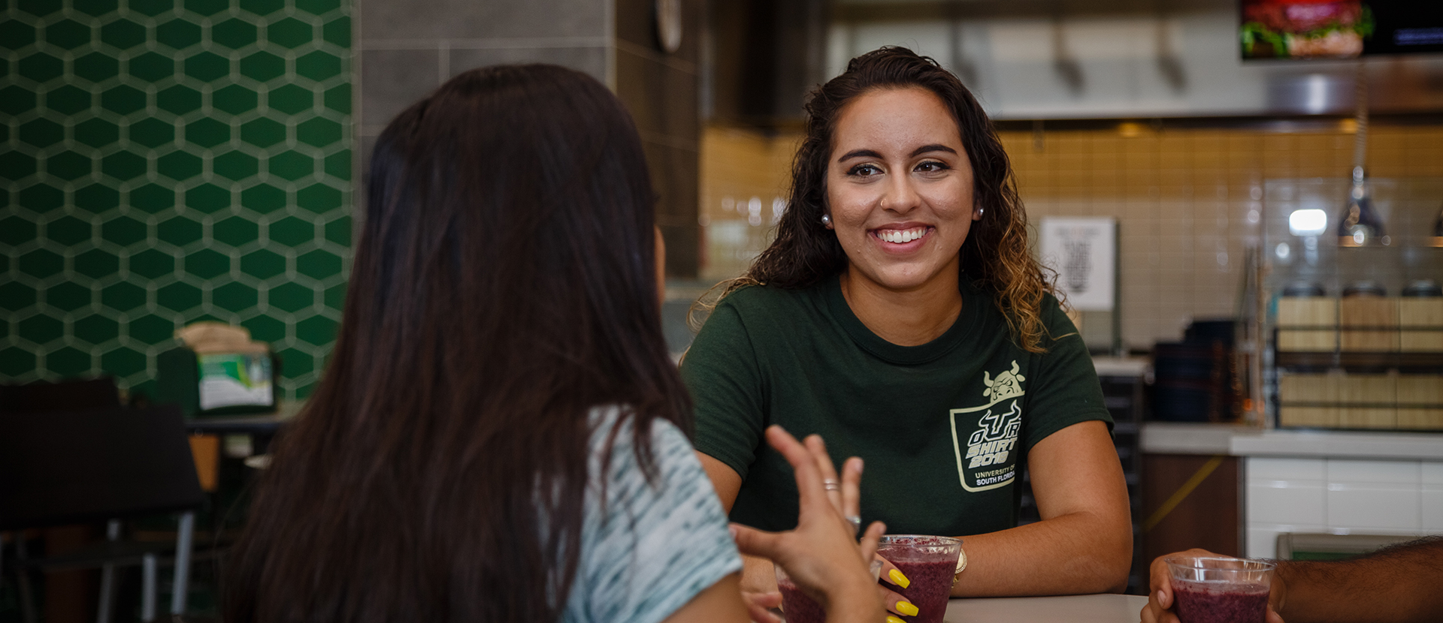
ST. PETERSBURG CAMPUS: DINING
Quality on-campus dining and café locations, plus convenient meal plan options

Slide 17
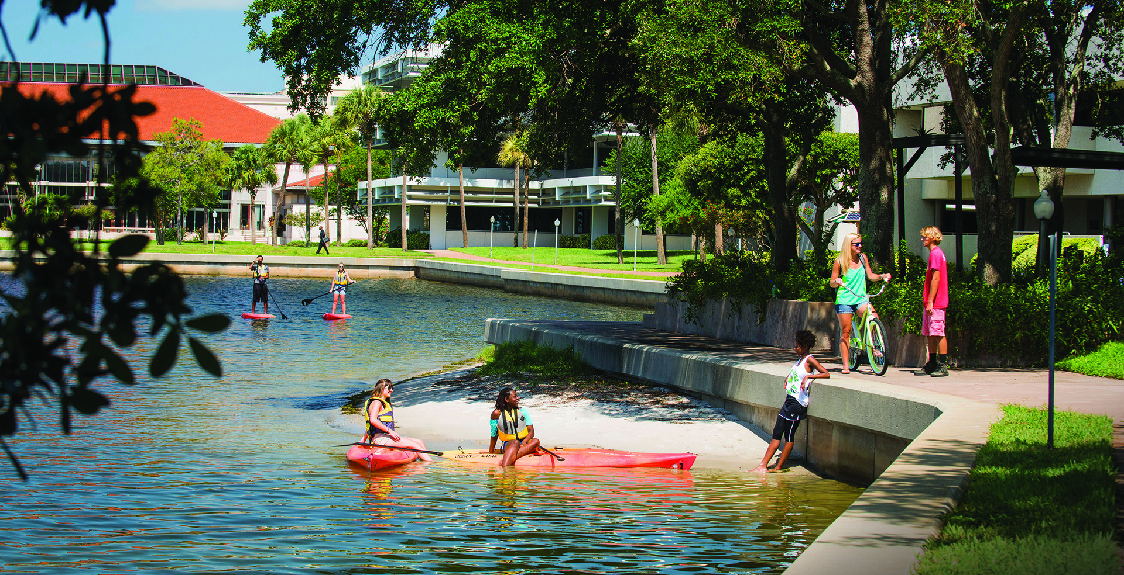
On-campus opportunities for swimming, canoeing, kayaking and paddle-boarding

Slide 18
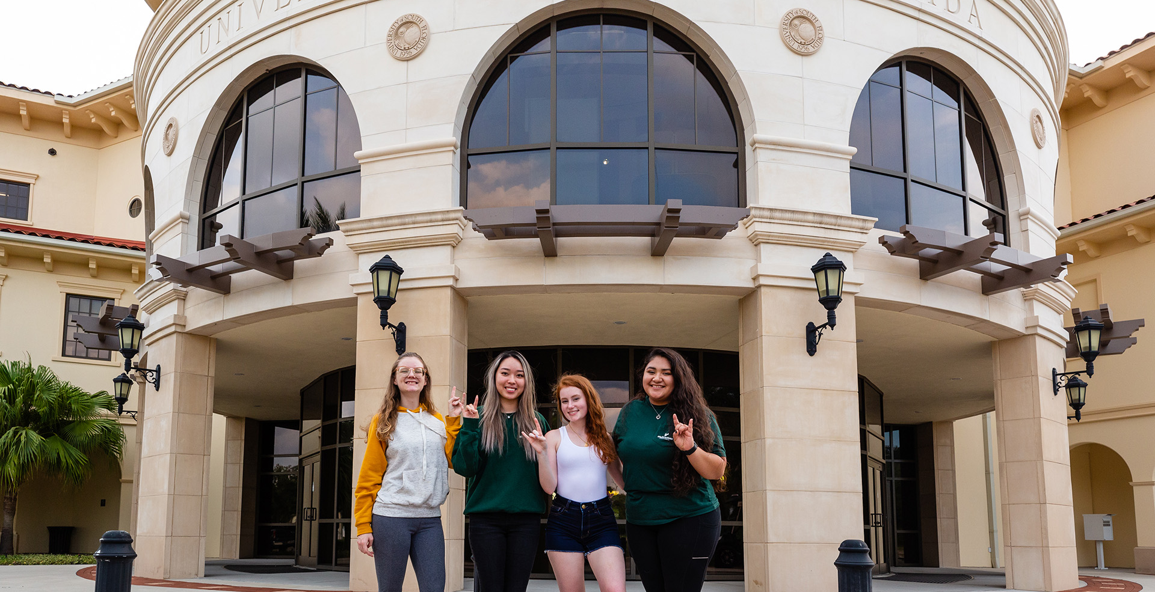
SARASOTA-MANATEE CAMPUS

Slide 19
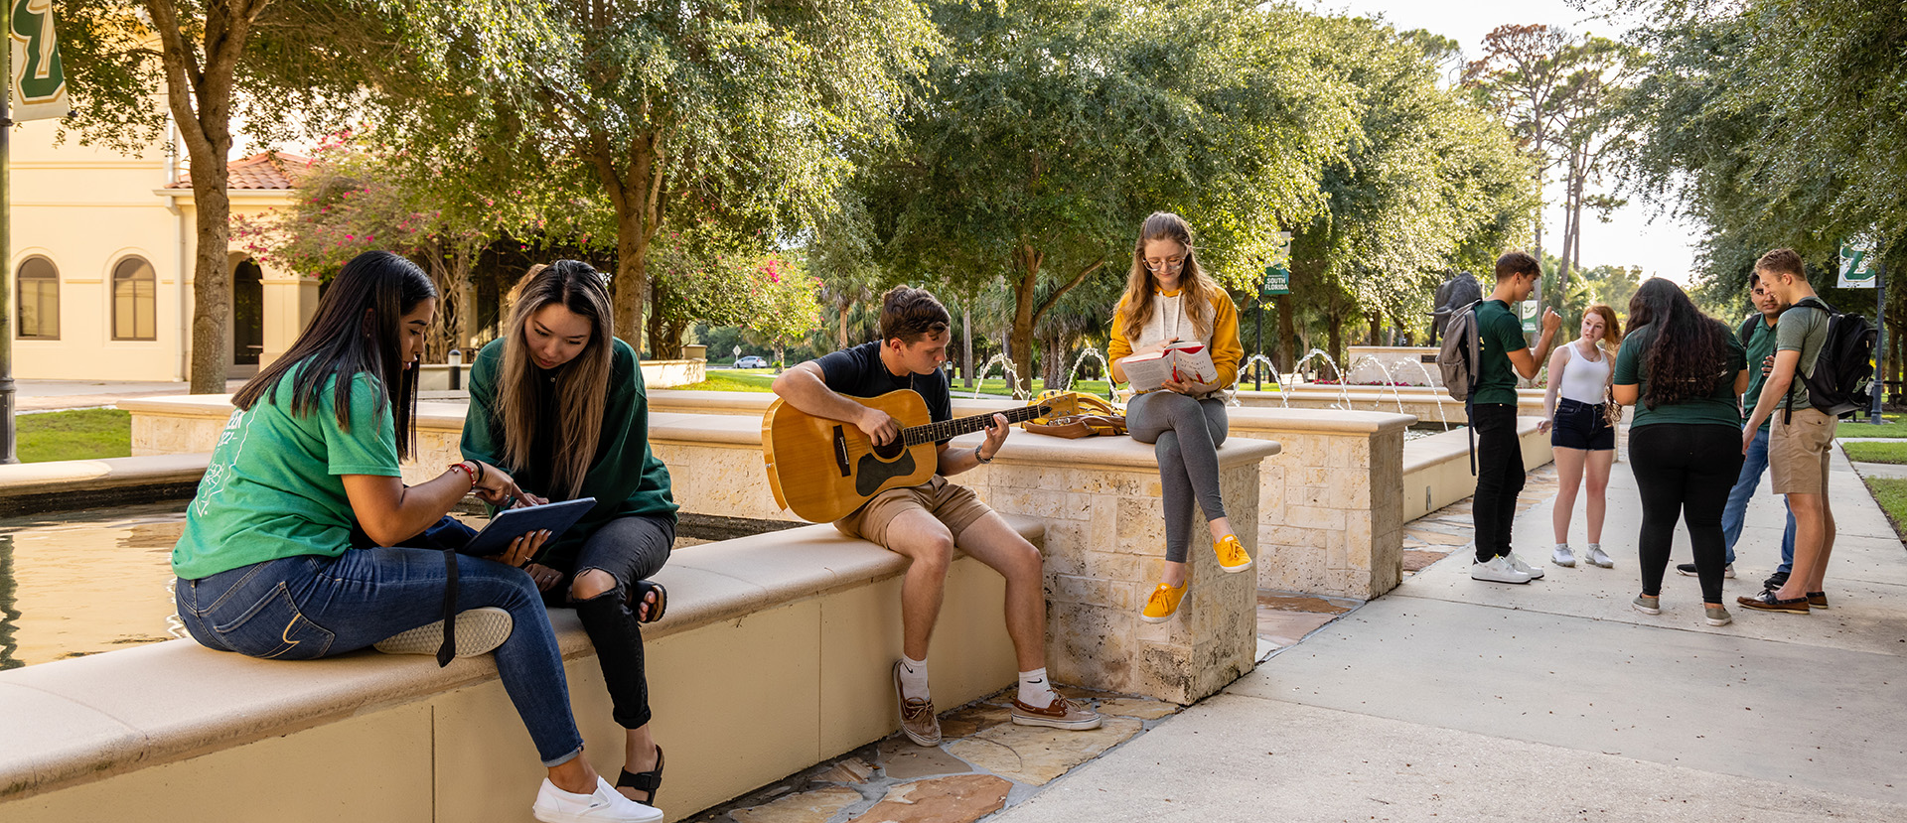
SARASOTA-MANATEE CAMPUS: LOCATION
Located on stunning Sarasota Bay just a short drive from some of the nation’s best beaches

Slide 20
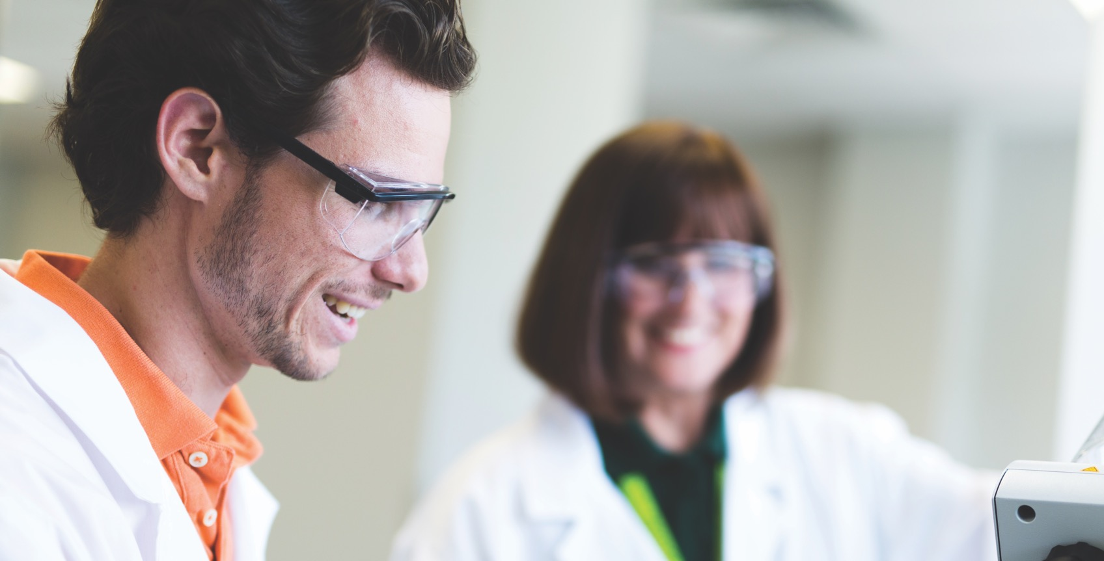
Experimental learning labs, including the Mote Marine Laboratory at Sarasota Bay and the Bloomberg Lab

Slide 21
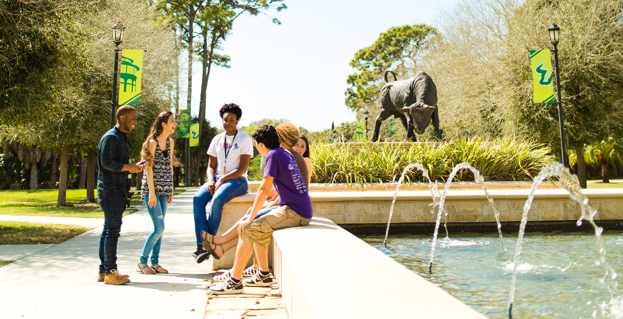
NEW: In 2024, the Sarasota-Manatee campus will open their first on-campus housing and Nursing/STEM building to build campus resources and student life.

Slide 22
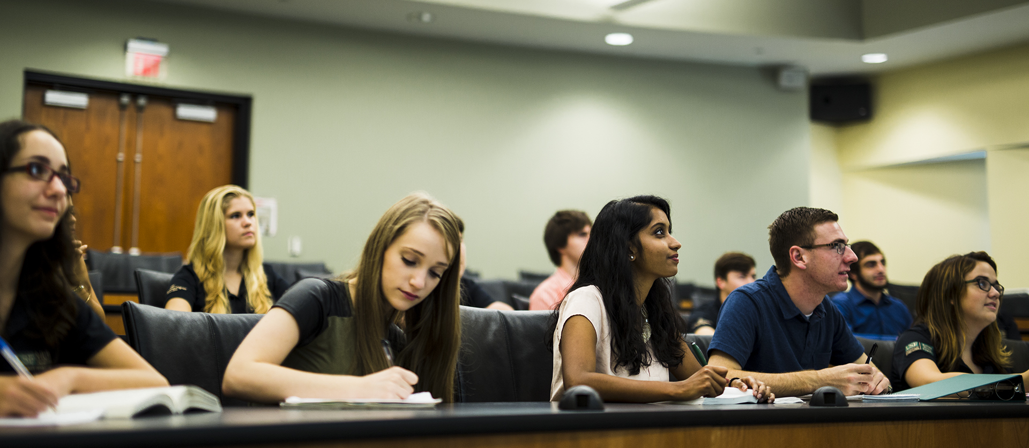
SARASOTA-MANATEE CAMPUS: SMALL CLASS SIZE
Offering the smallest class sizes at USF, the Sarasota-Manatee campus provides a tight-knit community for students

Slide 23
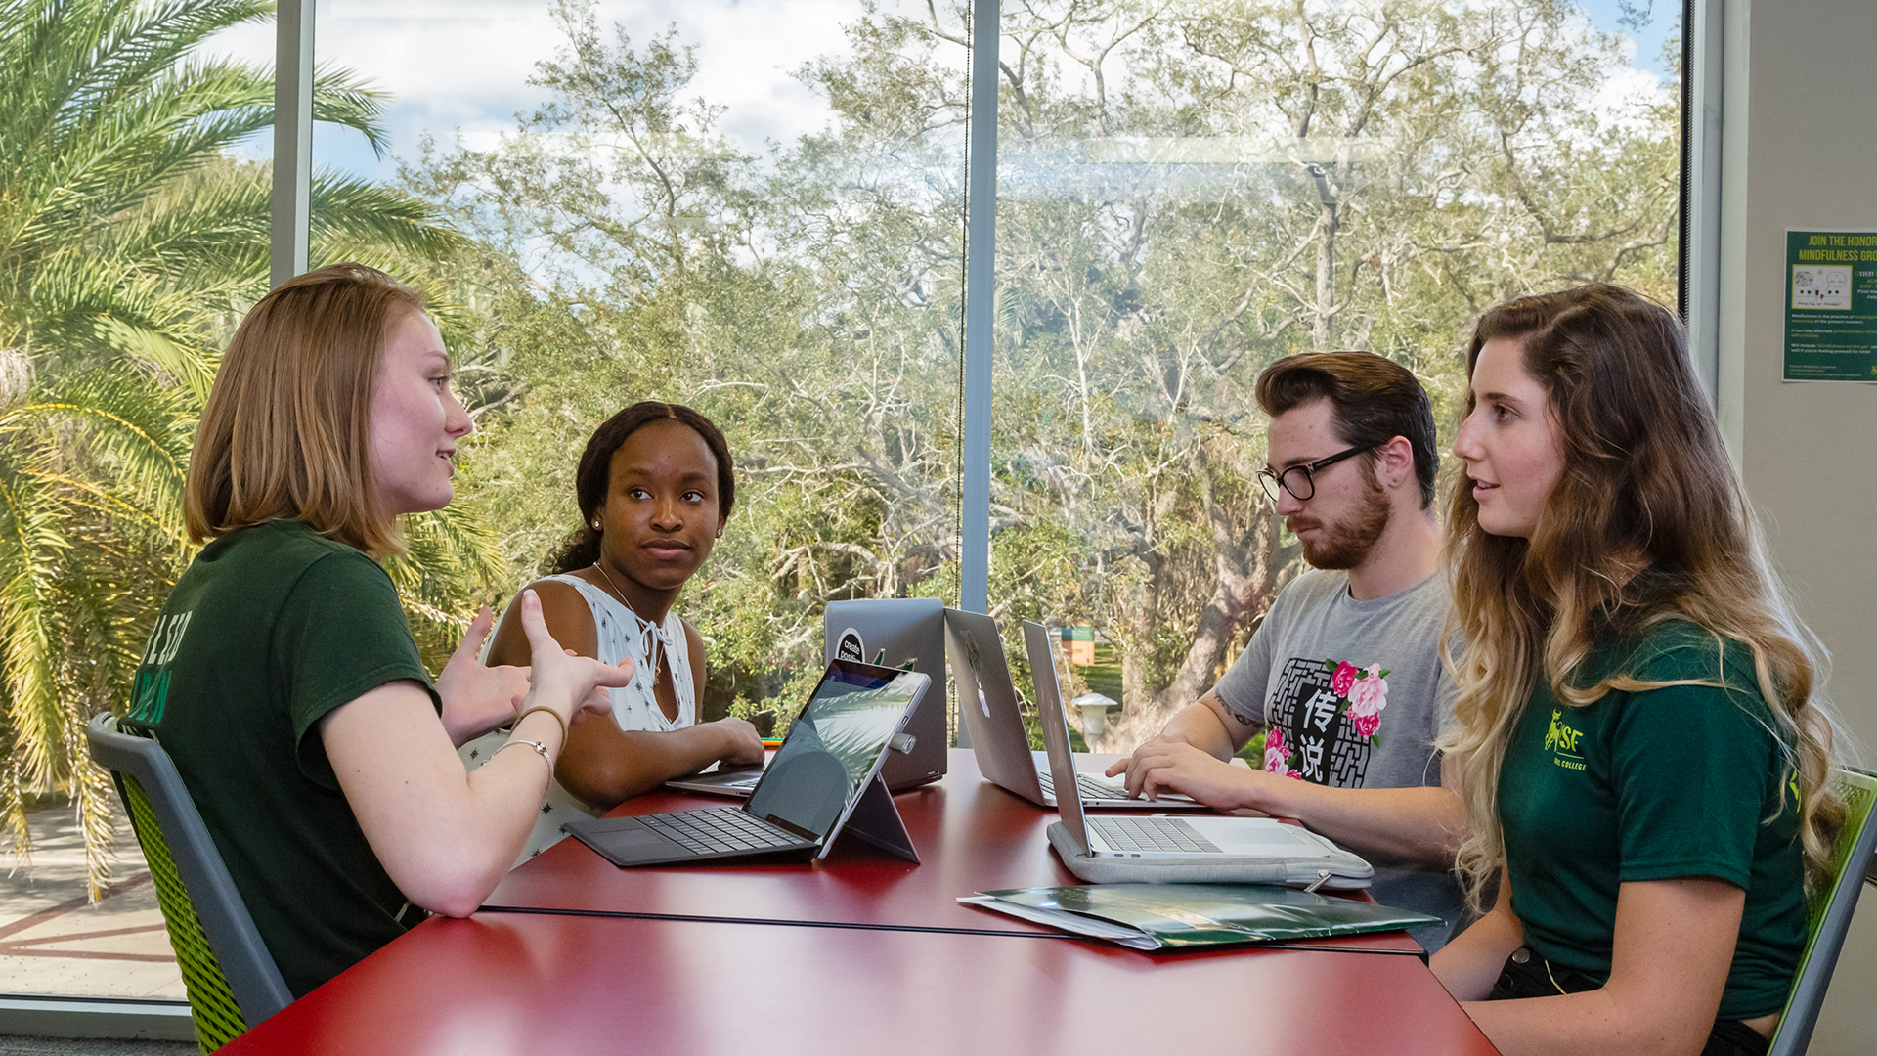
ACADEMICS

Slide 24
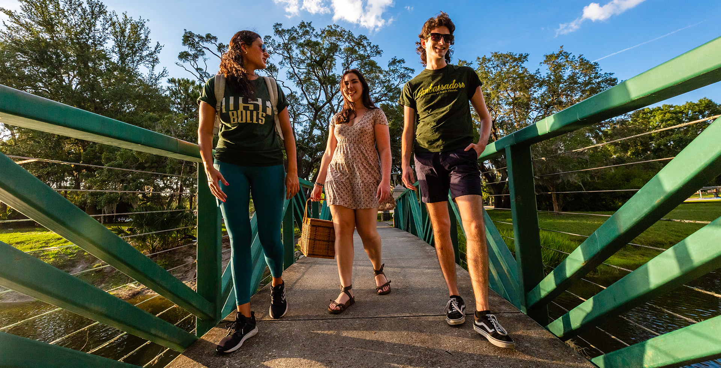
Top 250 in the world out of 20,000 universities by Times Higher Education and Academic Ranking of World universities 2021

Slide 25

Top 50 among 4-year public colleges and universities for best 6-year graduation rate.
- The Chronicle of Higher Education, 2019

Slide 26
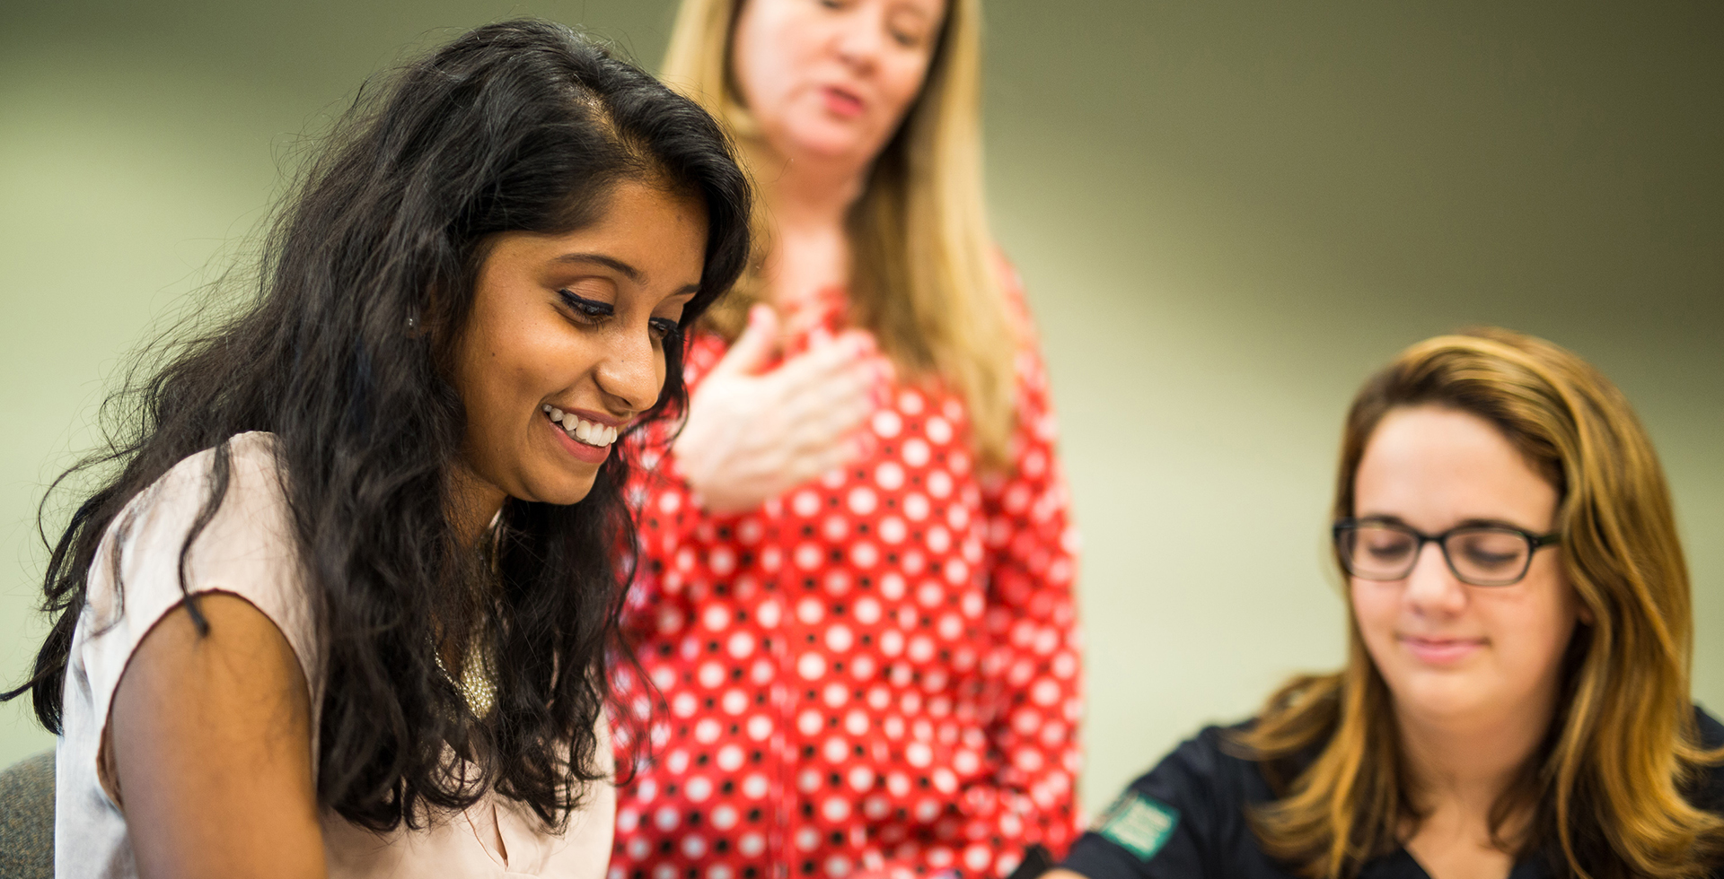
Top 3 in Florida for performance-based funding (PBF) in the State University System (BOG, 2022)

Slide 27
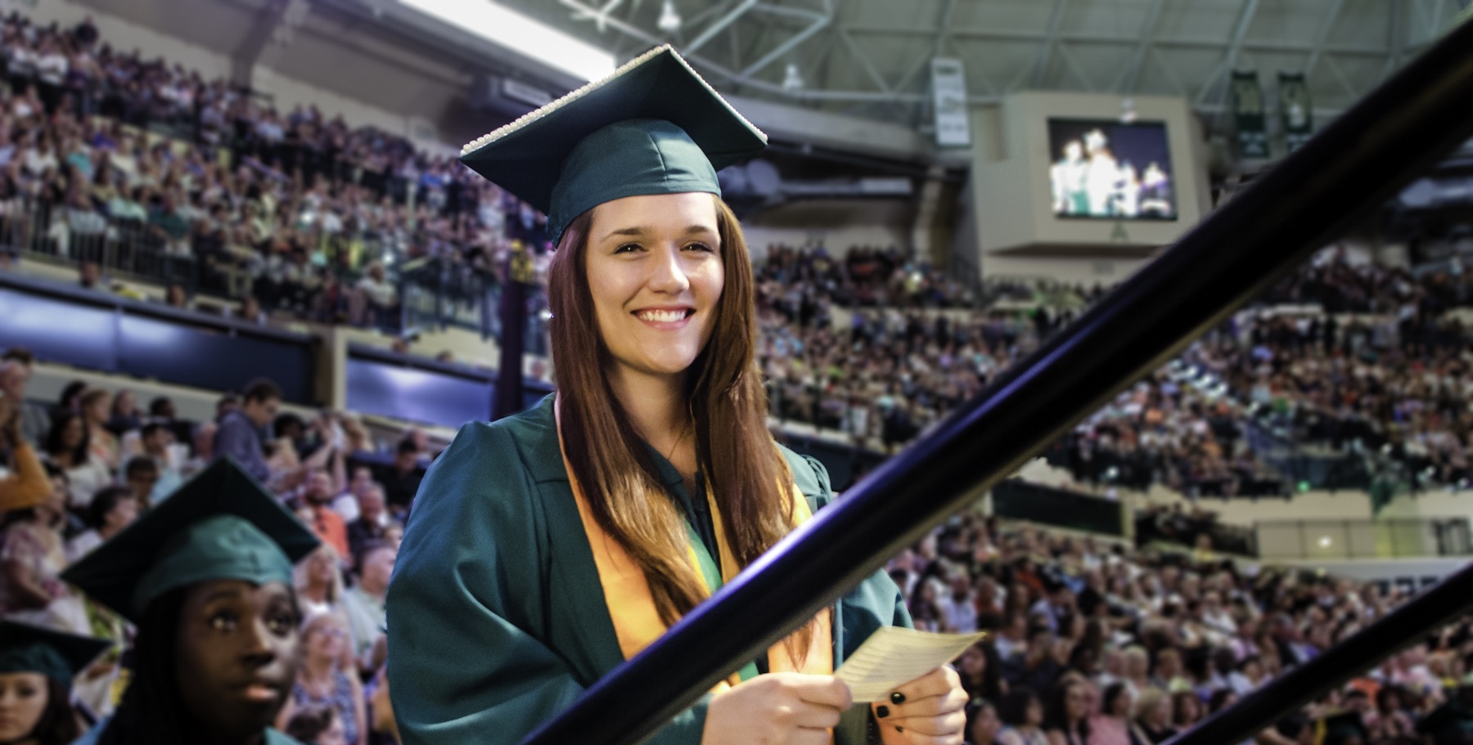
#1 Among 4-year Public Colleges and Universities with the Greatest Improvements in 6-year Graduation Rates
Recognized by the Chronicle of Higher Education (2017)

Slide 28
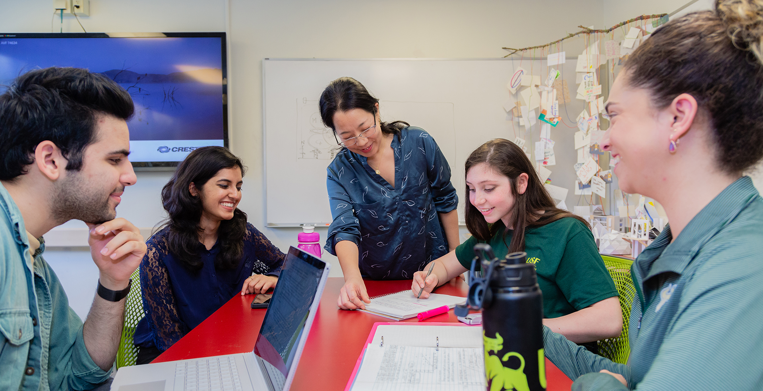
Leads Florida with #1 performance-based funding (PBF) scores in the State University System (BOG, 2020)

Slide 29
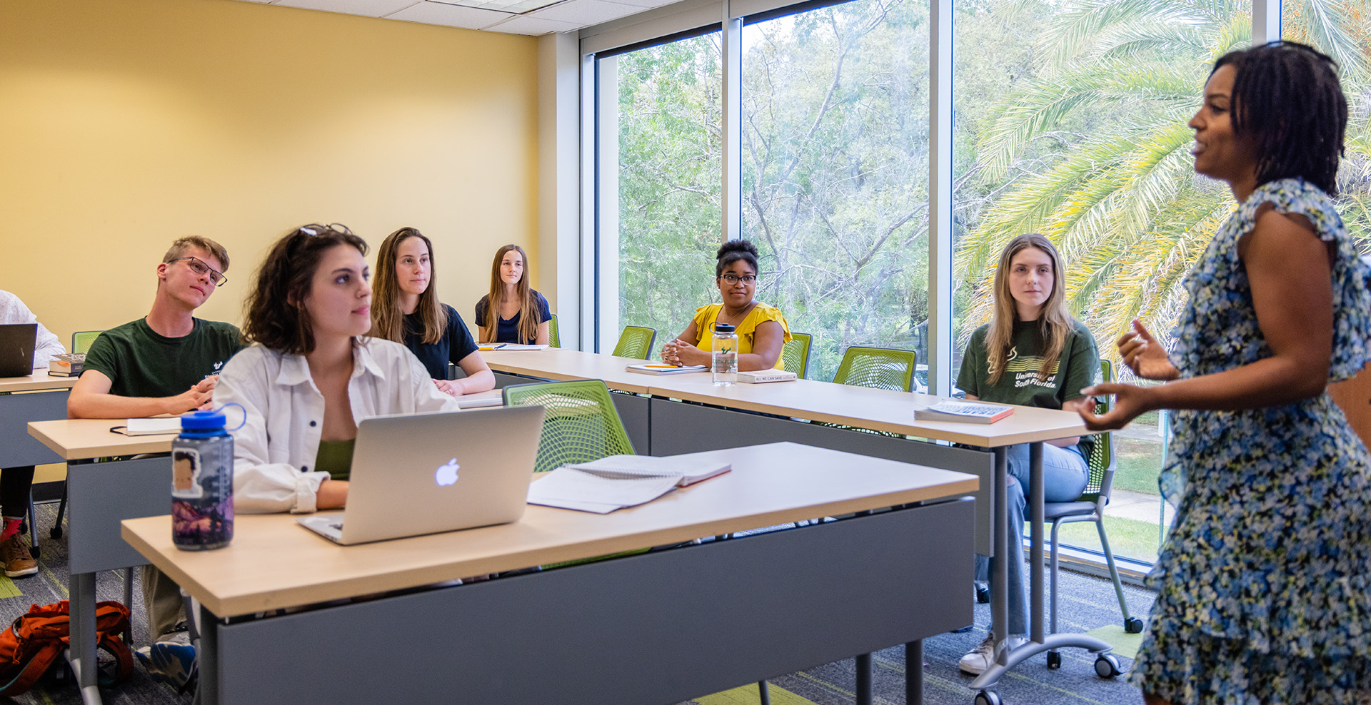
Prestigious Judy Genshaft Honors College

Slide 30
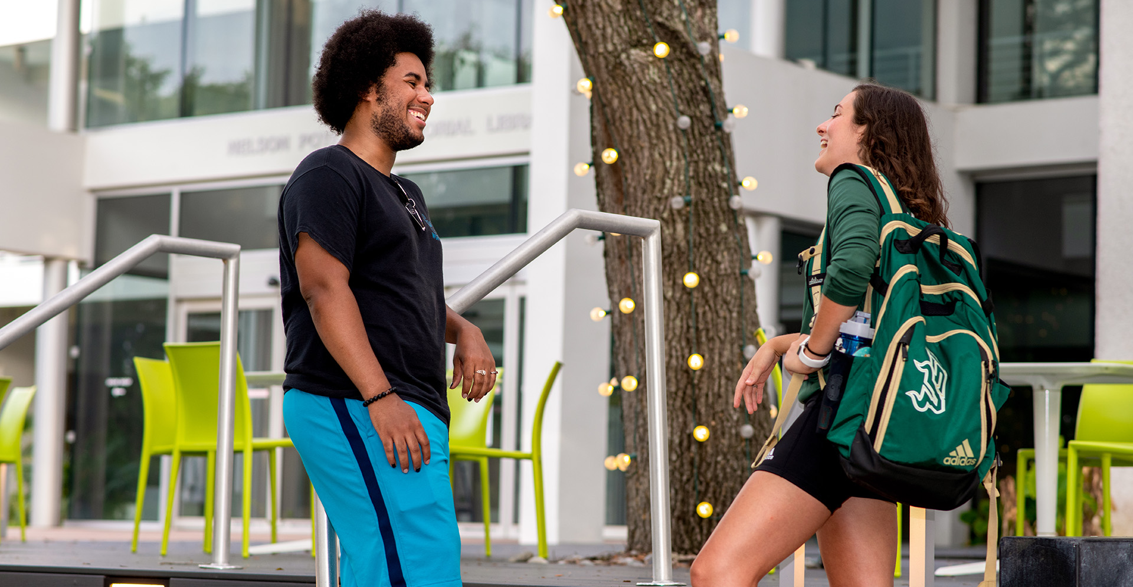
America’s Fastest-Rising University
- U.S. News and World Report (USNWR) National University Rankings, 2021

Slide 31
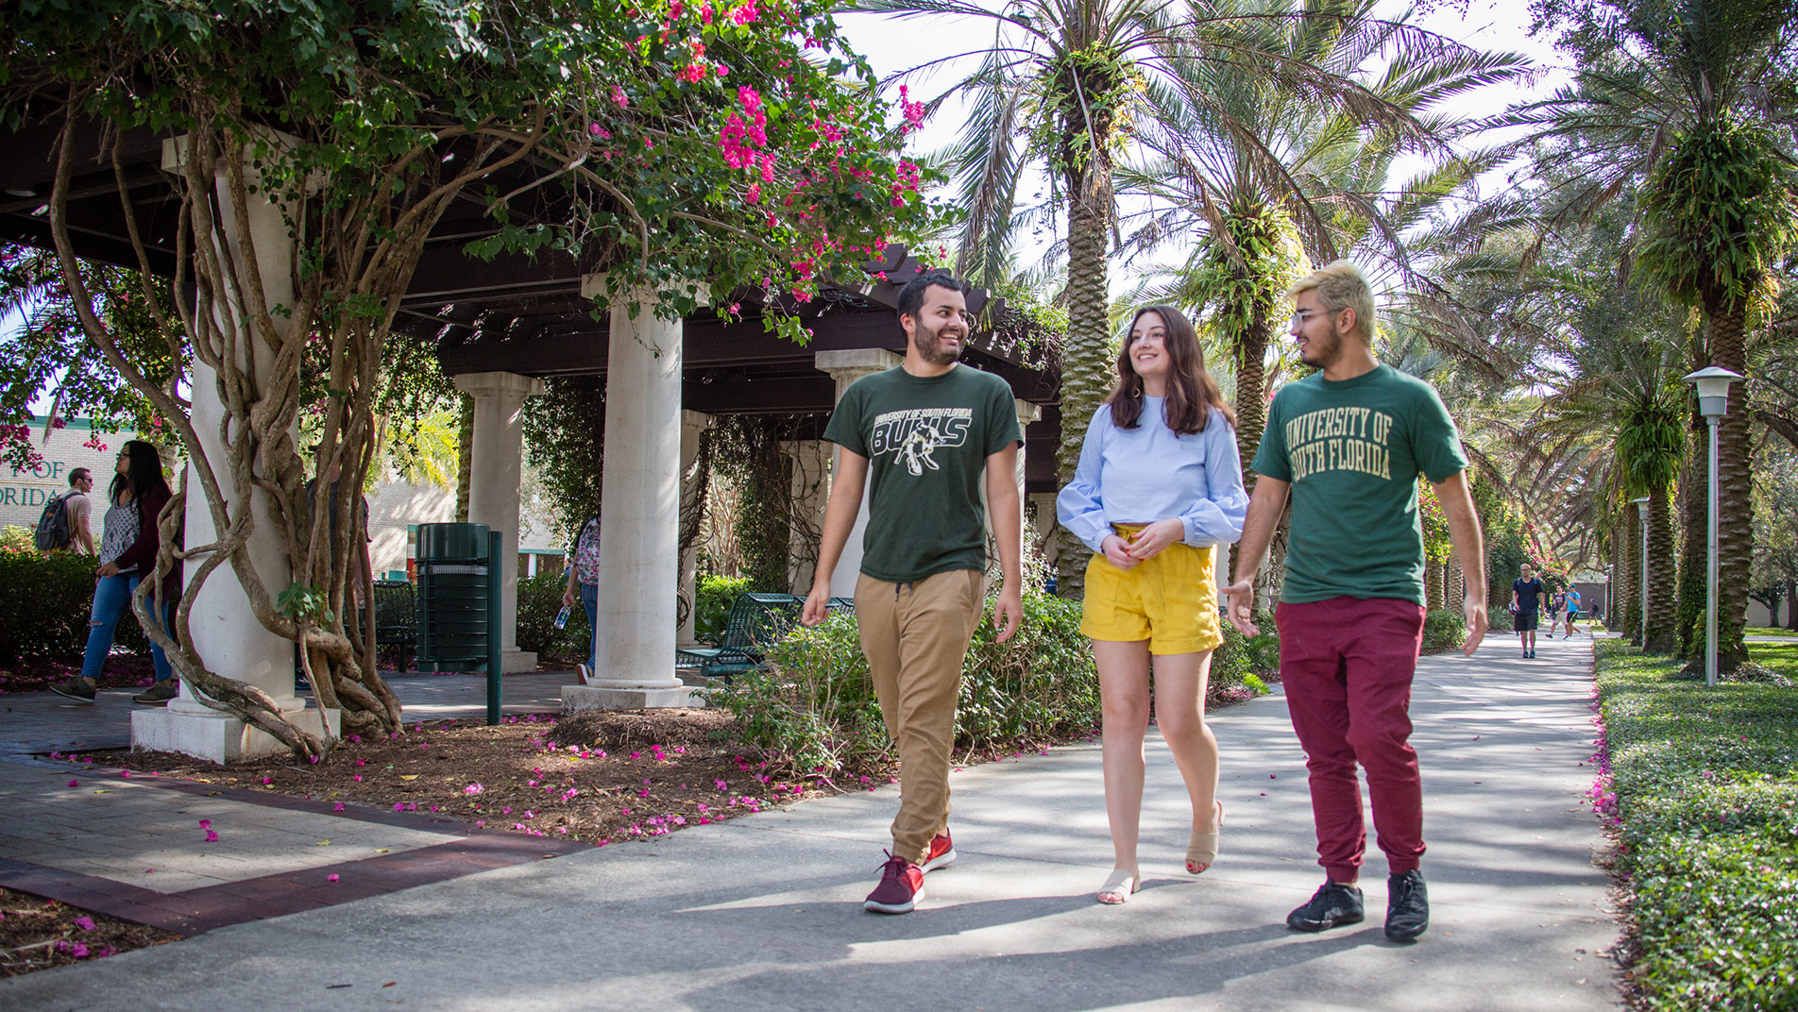
STUDENT LIFE

Slide 32
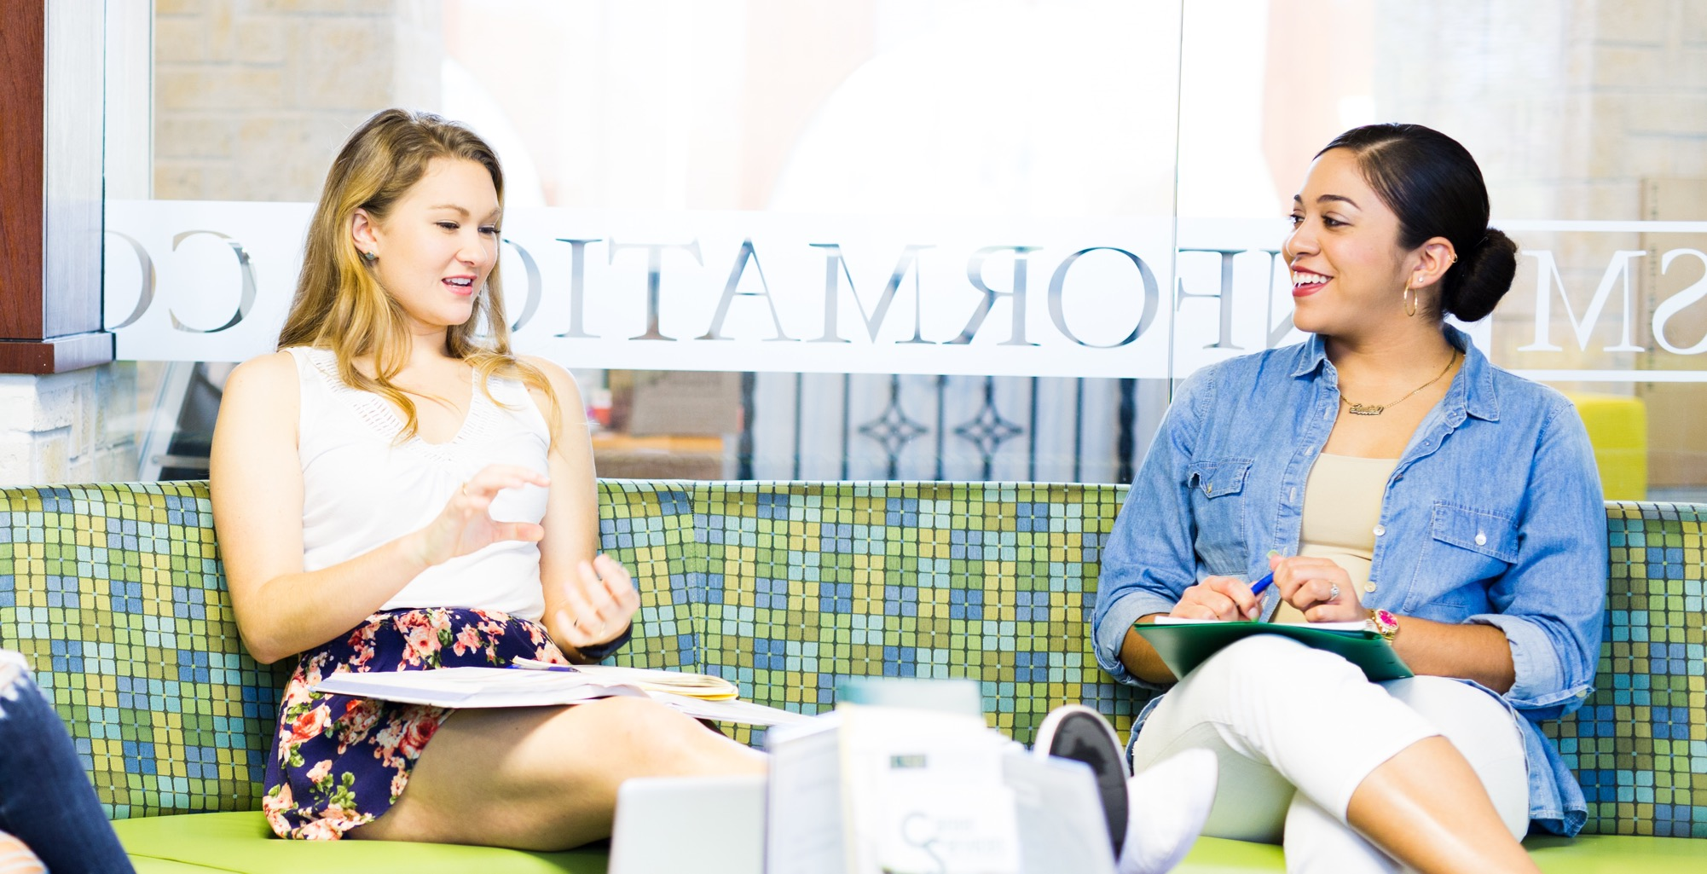
Hundreds of internships, co-ops, service-learning opportunities and more available to students

Slide 33
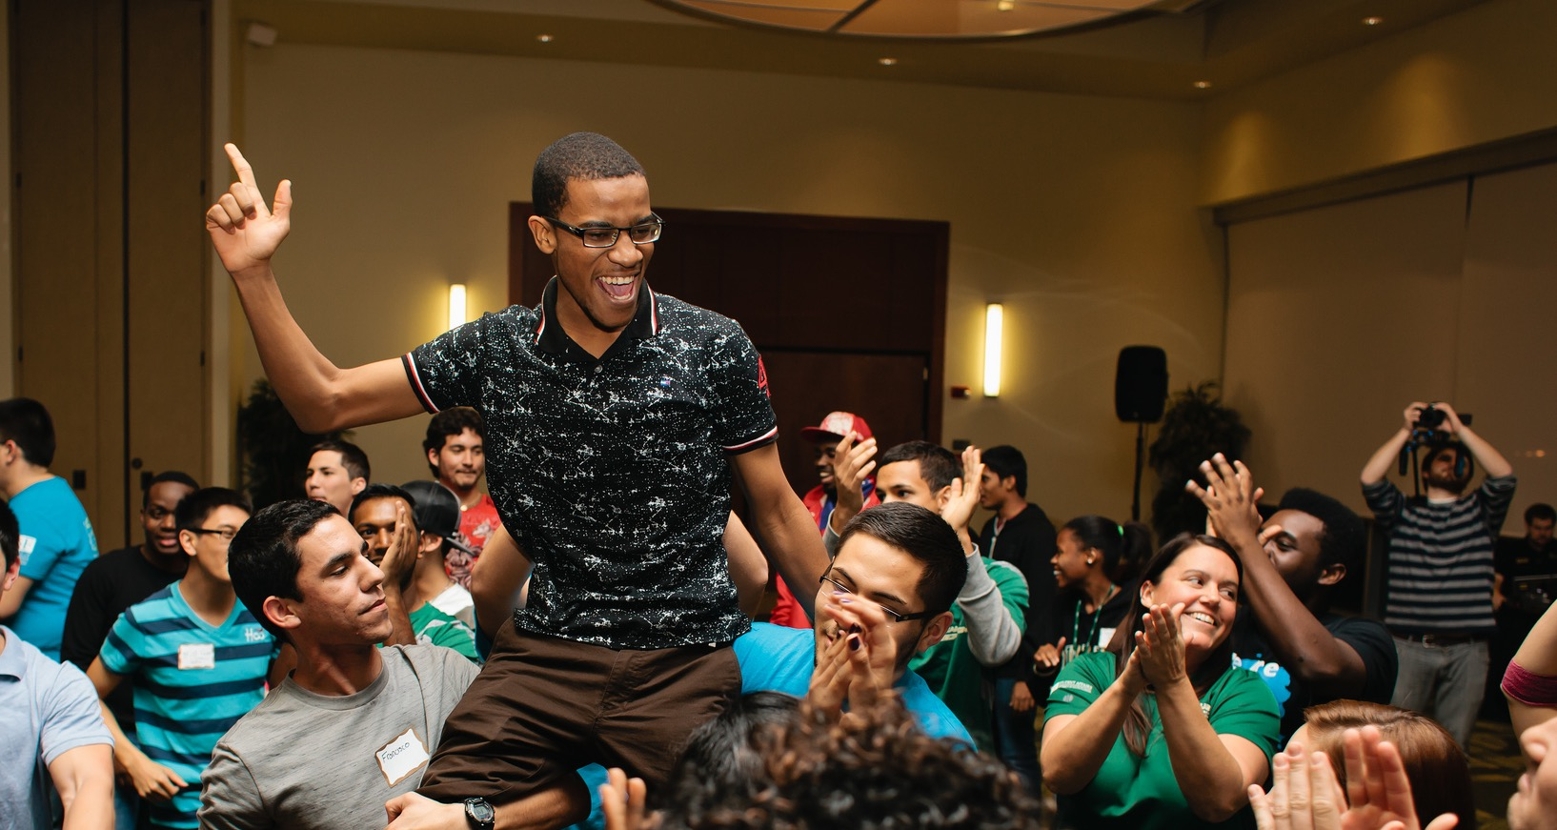
Almost 700 clubs and organizations

Slide 34
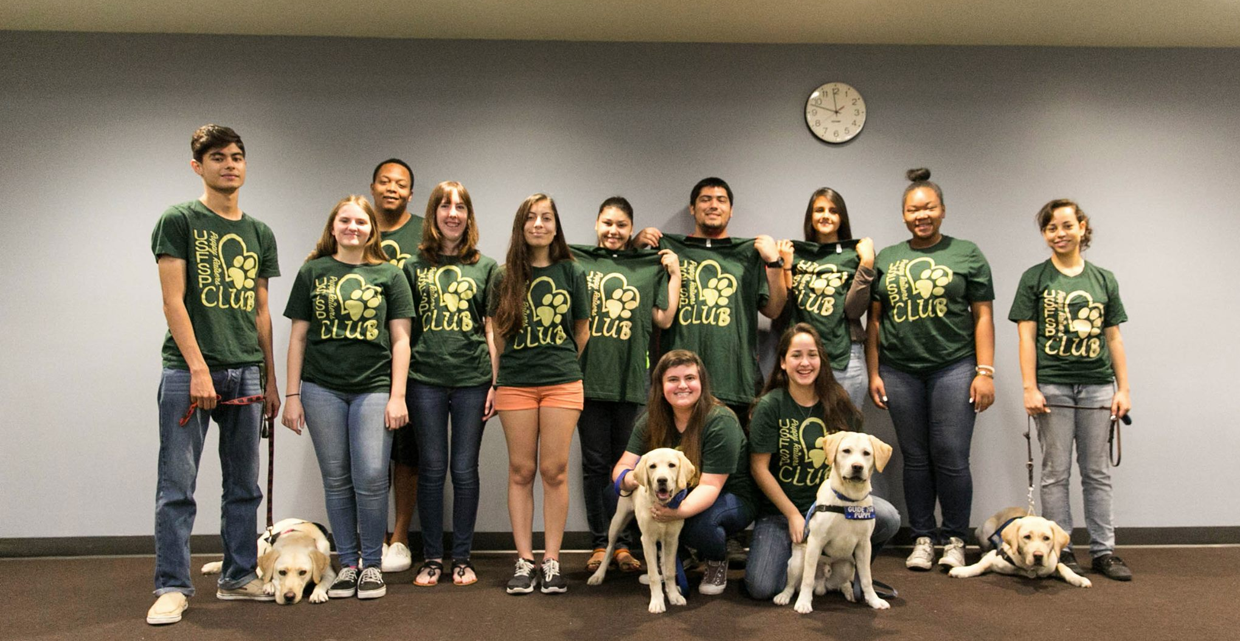
Living-Learning Communities allow students to live, play and learn alongside those with similar interests

Slide 35
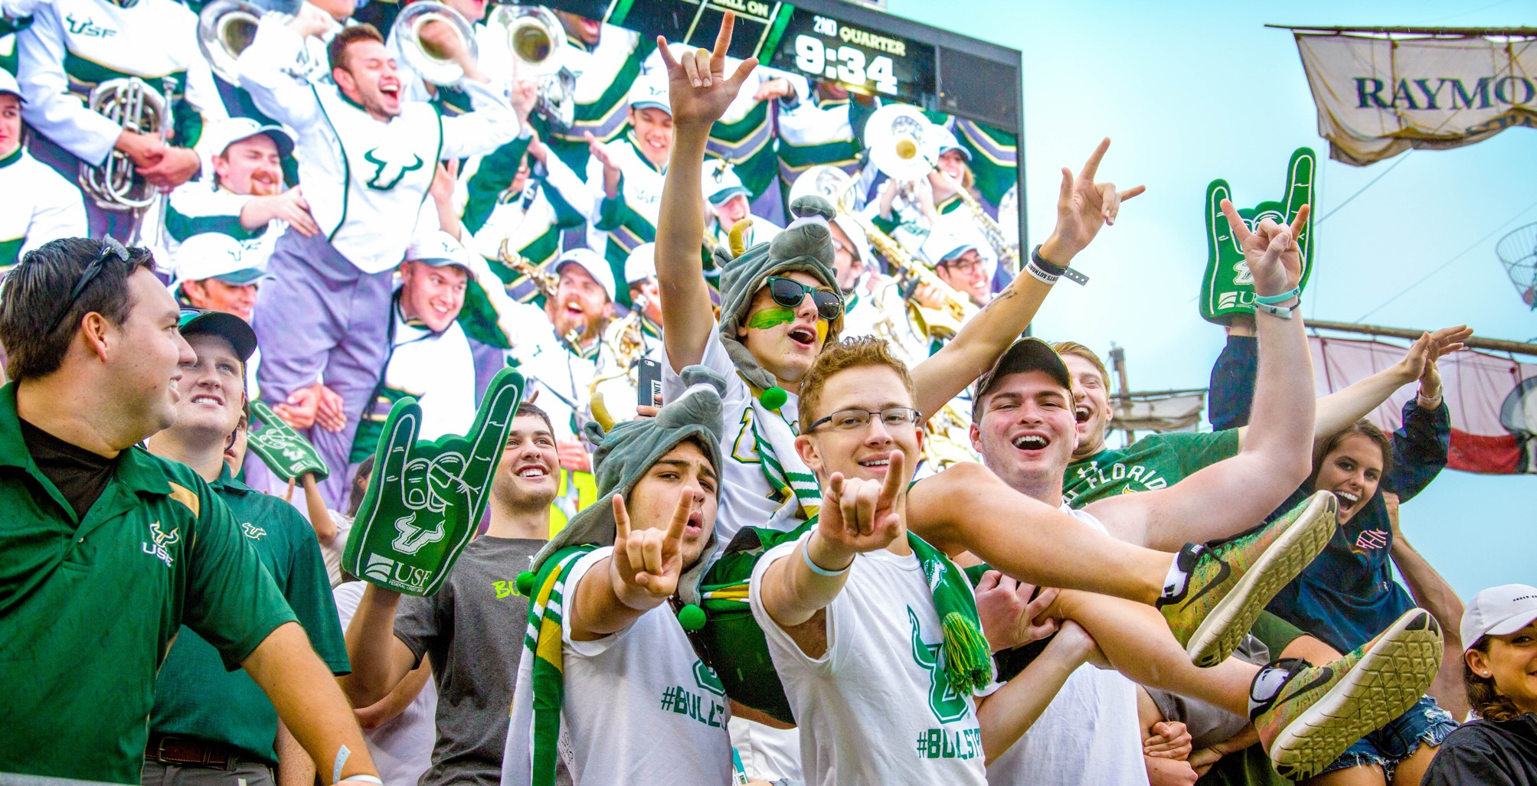
19 men’s and women’s varsity sports, recreation facilities, intramurals and more

Slide 36
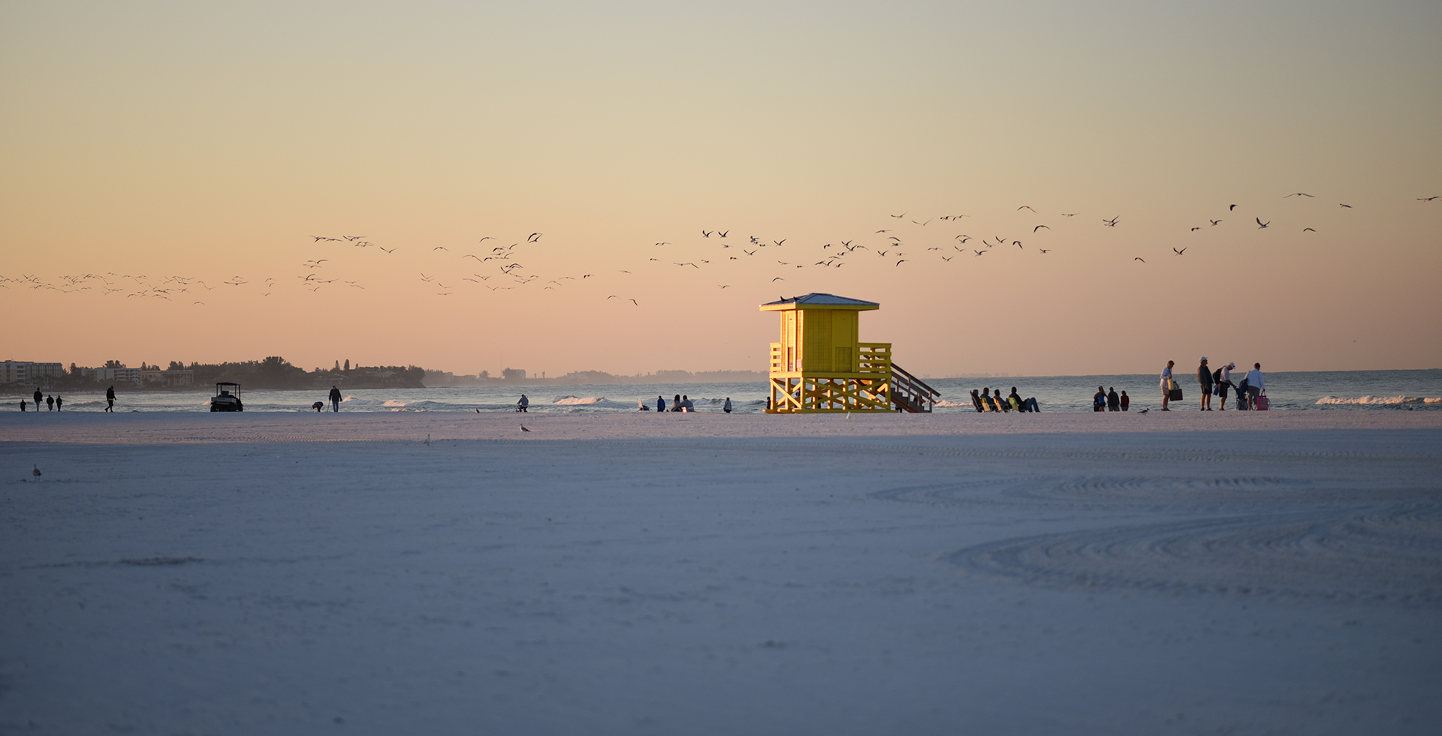
Top Ranked Beaches
Siesta Beach, #2 in the U.S.
St. Pete Beach, #22 in the U.S.
Clearwater Beach, #24 in the U.S.
- TripAdvisor 2020

Slide 37
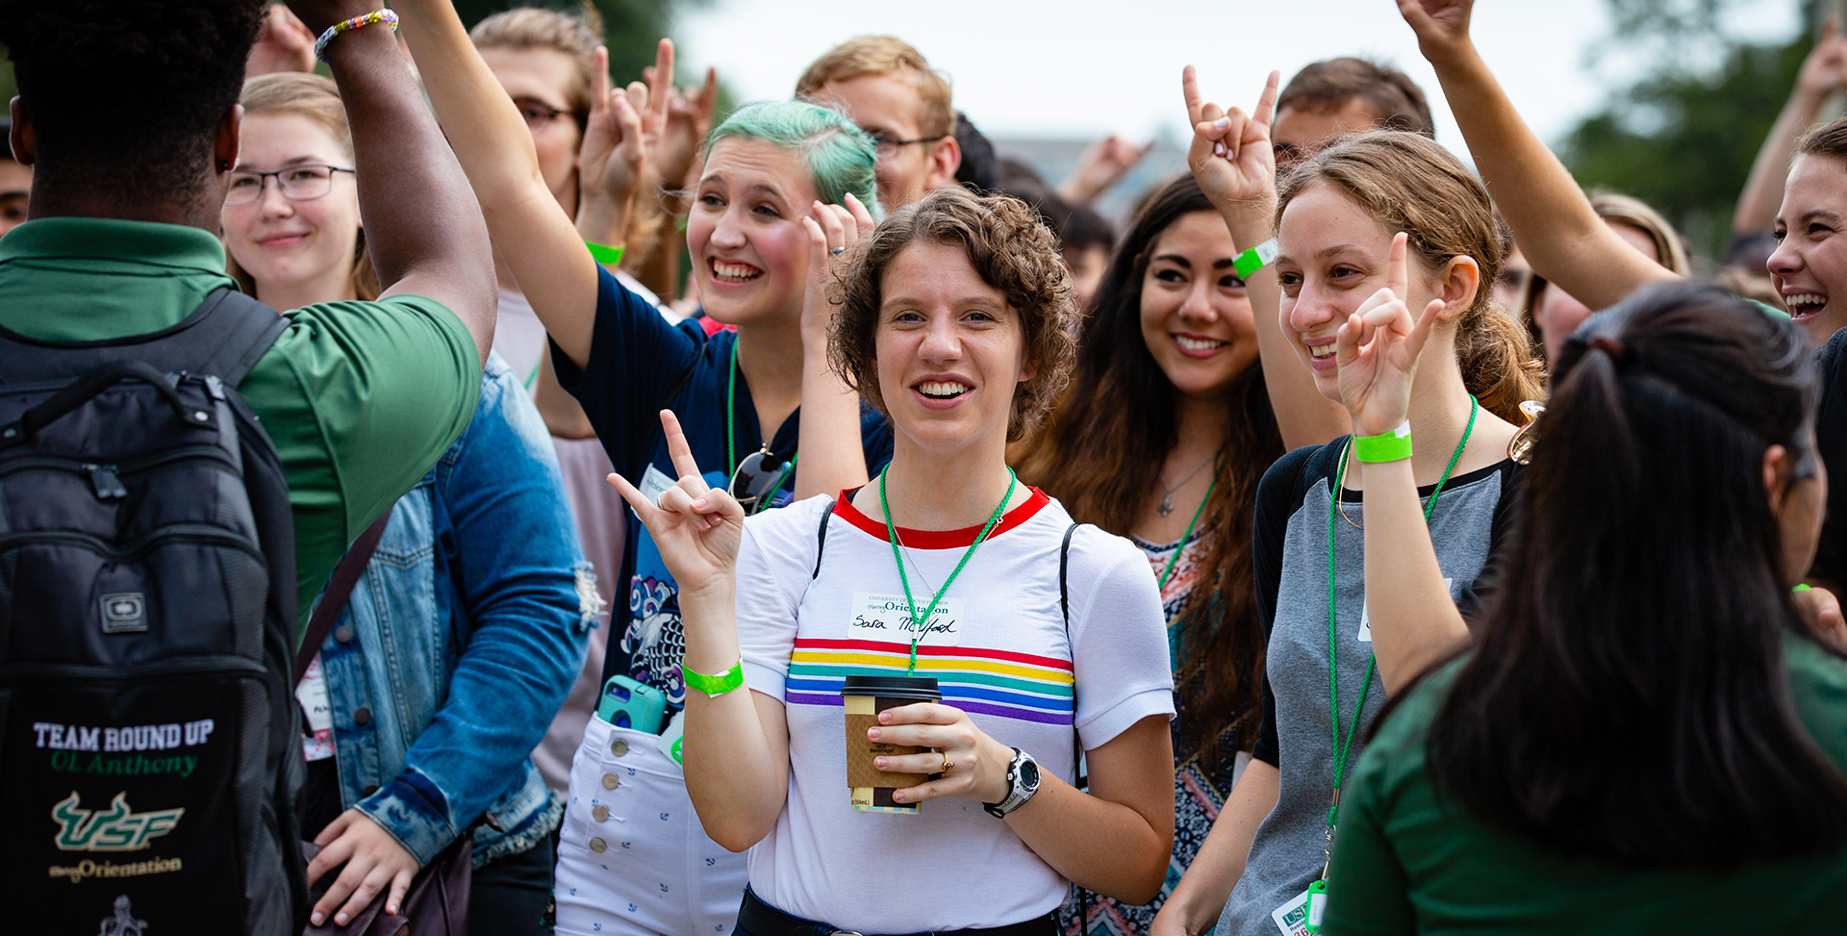
From concerts and cultural celebrations to art exhibits and theatre productions, there's always something exciting happening at USF

Slide 38
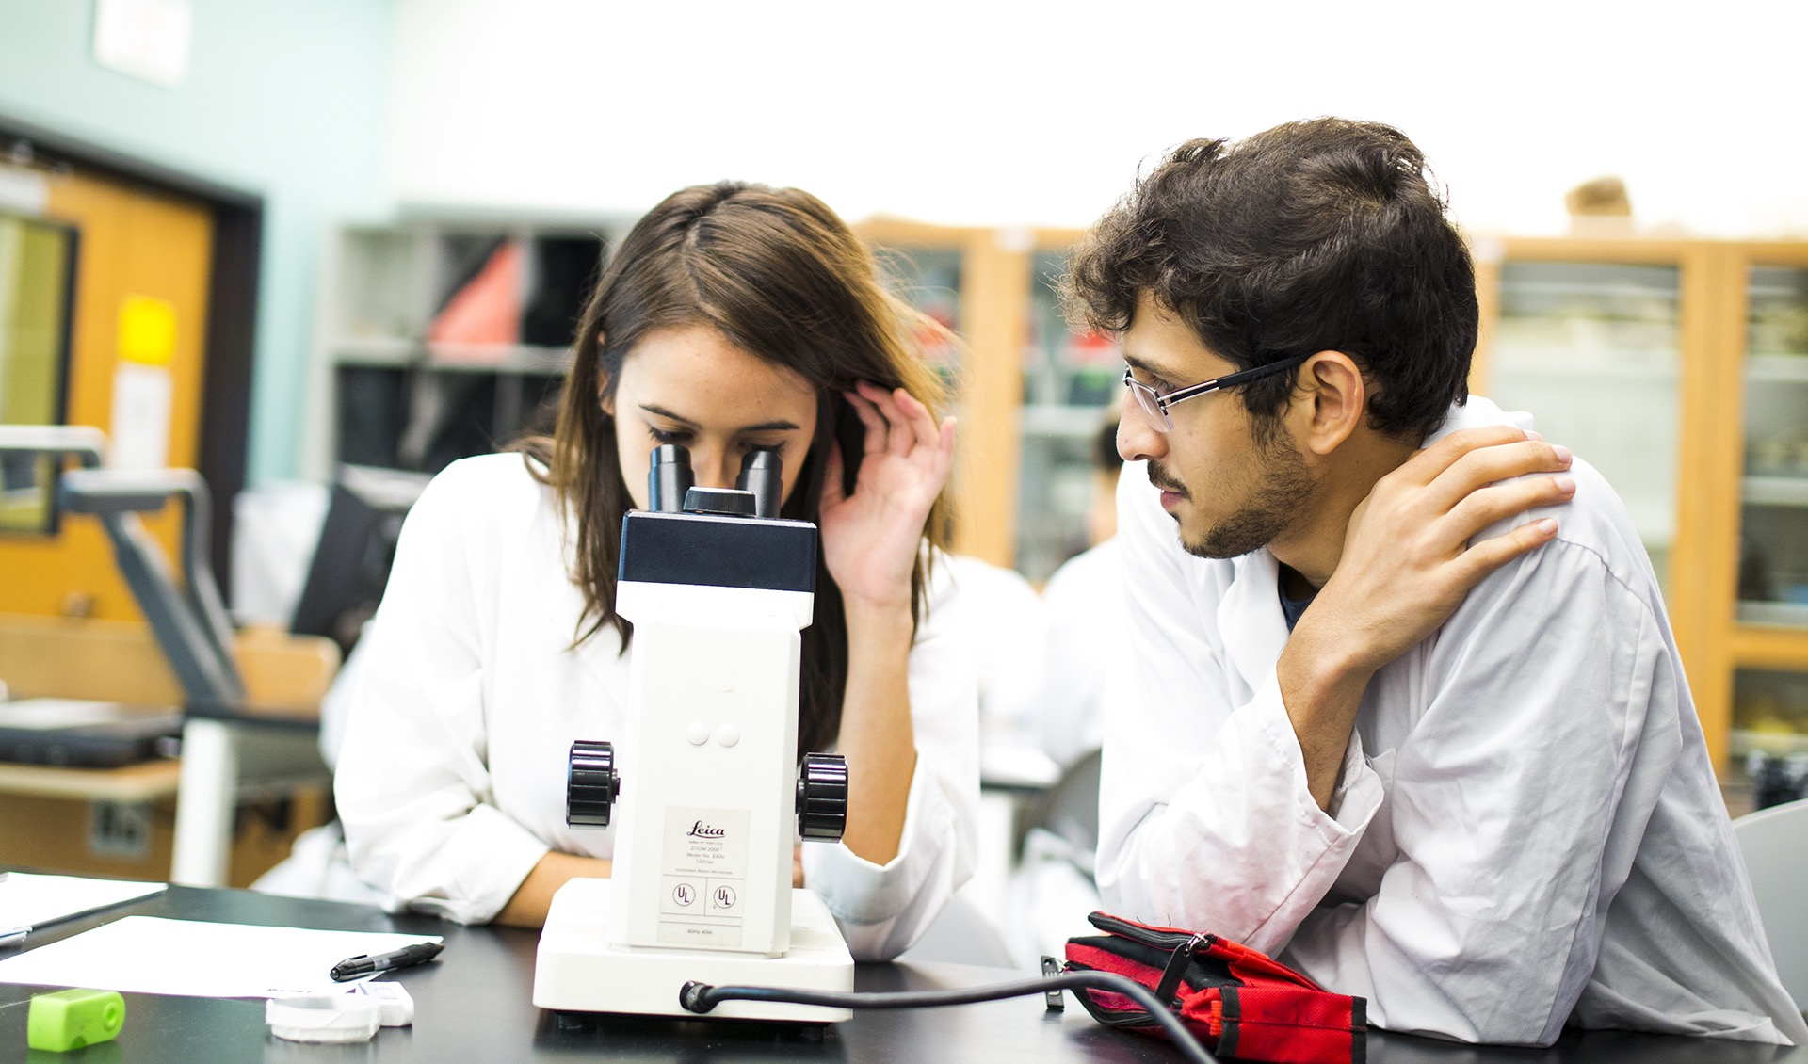
RESEARCH

Slide 39
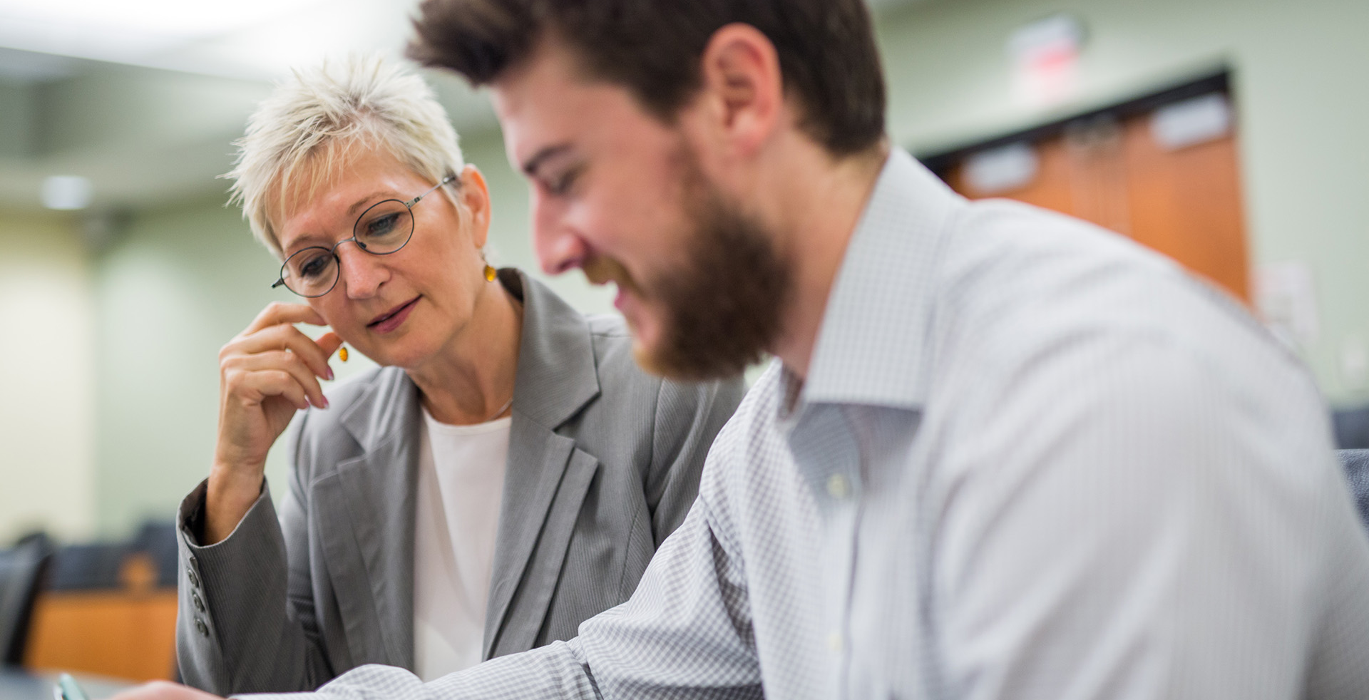
#46 among public research institutions and #103 among all universities in U.S. News and World Report rankings of National Universities (2021)

Slide 40
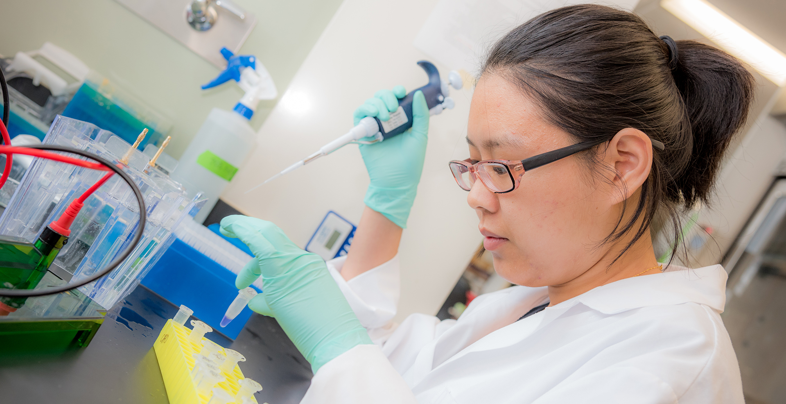
USF to partner with CDC
on creating new infection
control resource center for emergency responders

Slide 41
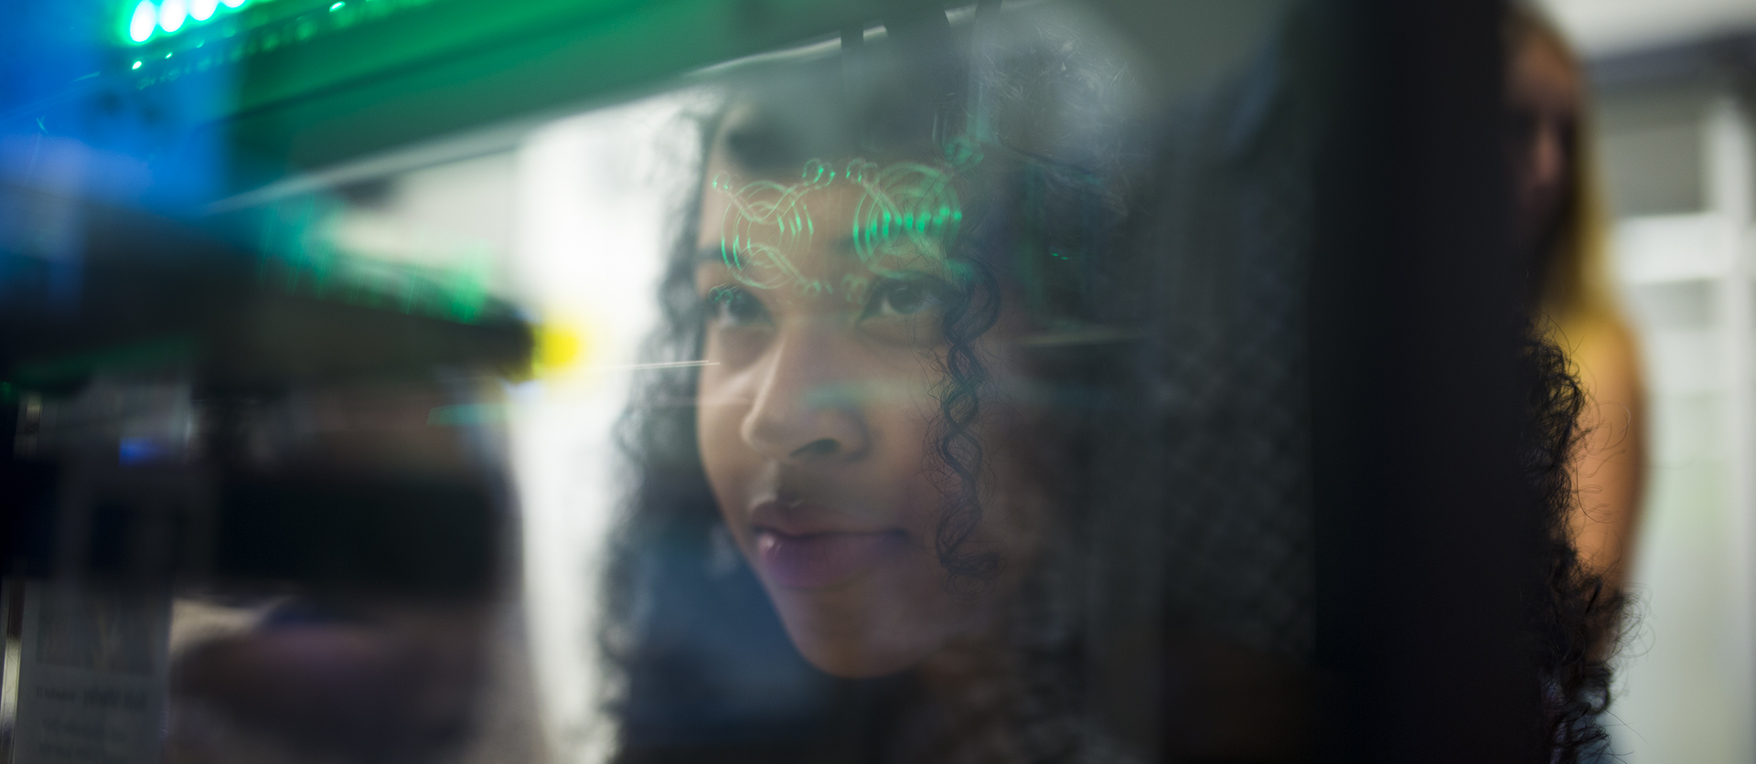
RESEARCH: TAMPA CAMPUS
Cutting-edge medical and engineering advances help make the world a healthier, safer place

Slide 42
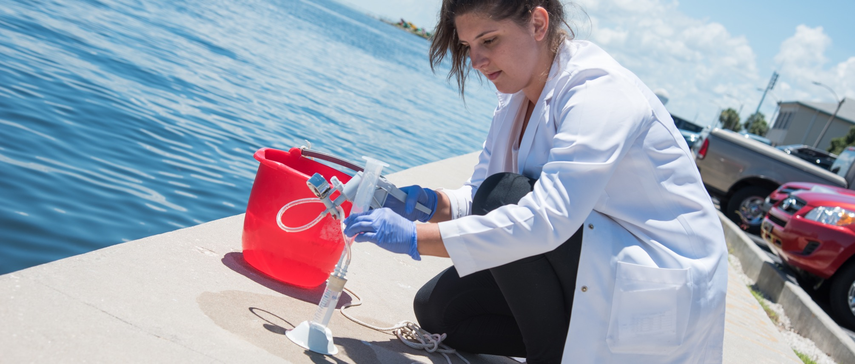
RESEARCH: ST. PETERSBURG CAMPUS
Sustainability initiatives help reduce our carbon footprint and create a greener world

Slide 43

RESEARCH: SARASOTA-MANATEE CAMPUS
Criminology advances help us understand the behavior behind crime and reform the criminal justice system

Slide 44
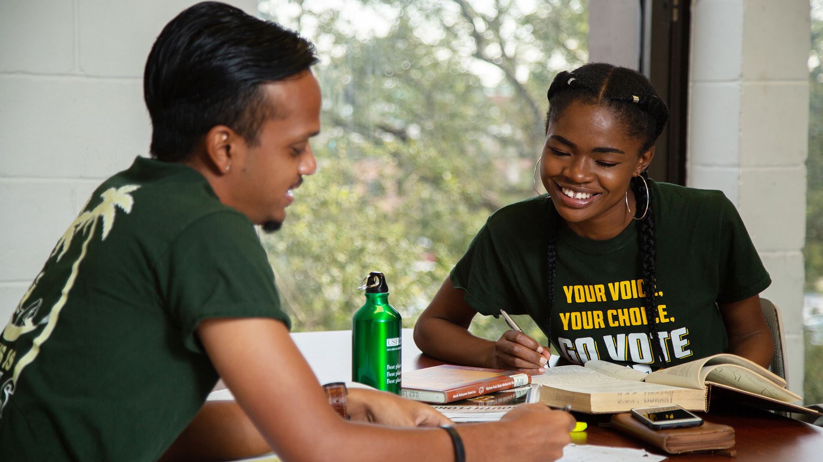
Outreach, Access and Social Responsibility

Slide 45
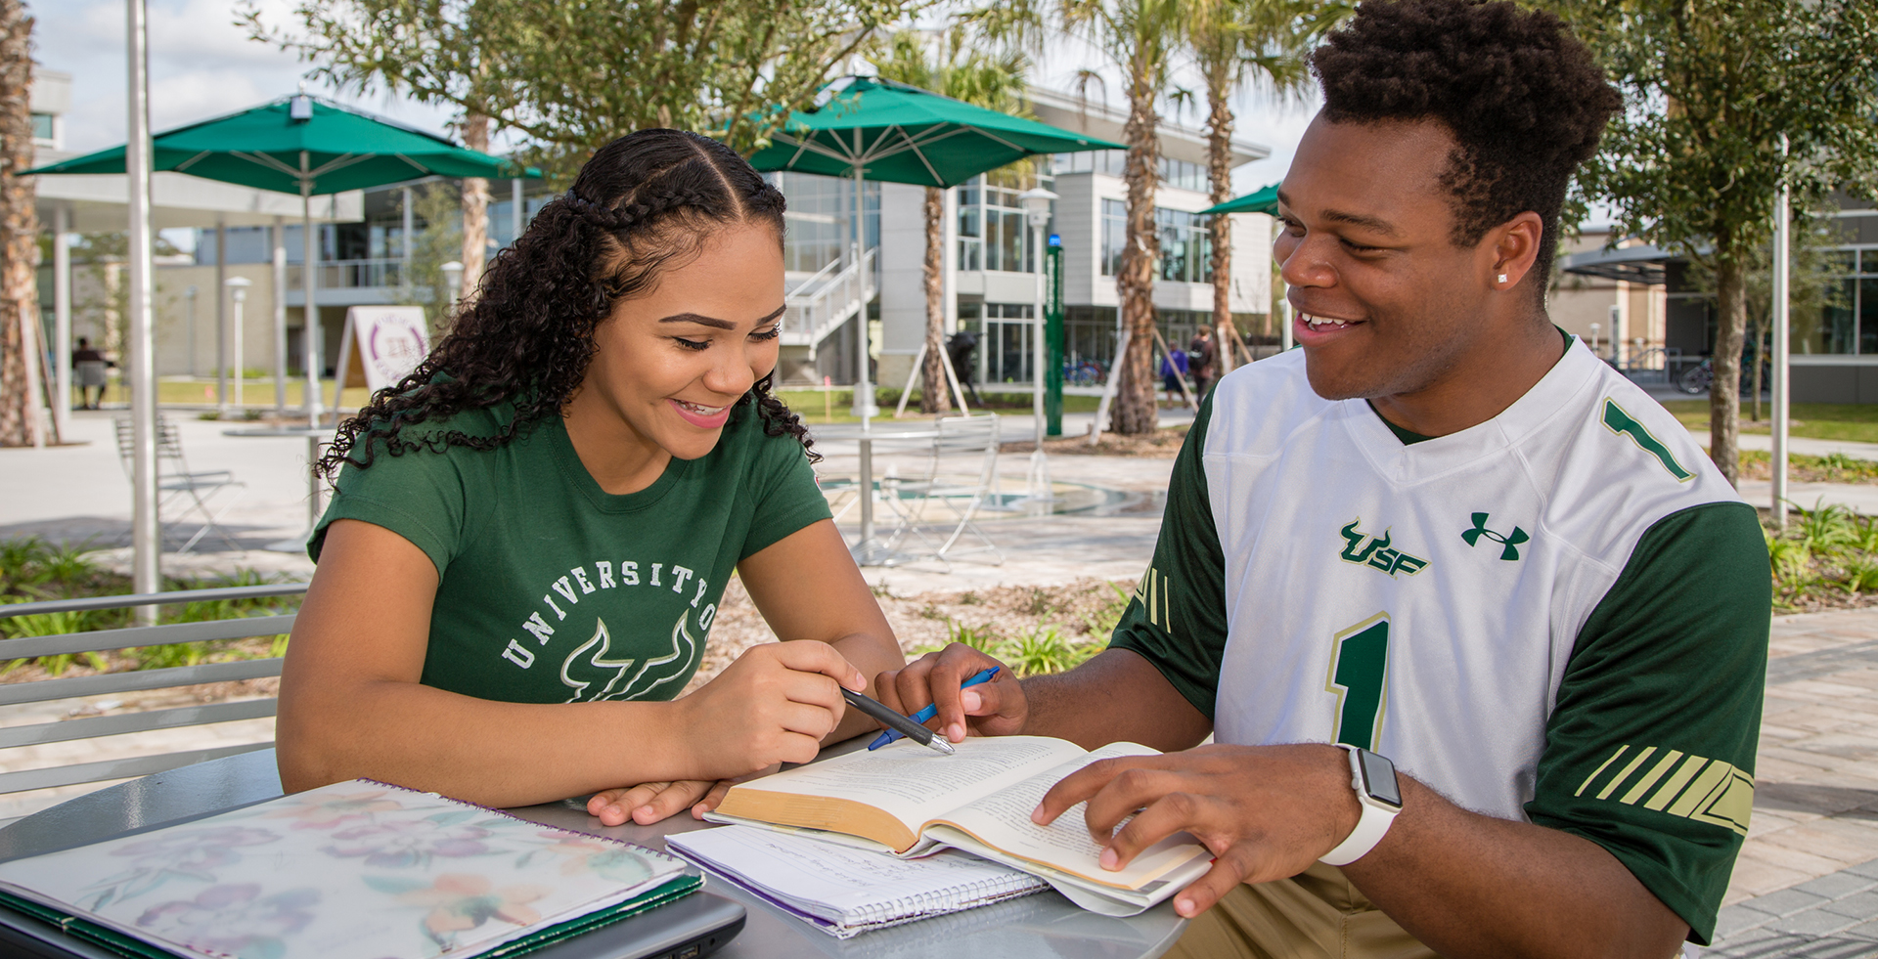
#18 among U.S. public universities in Social Mobility
- U.S. News and World Report (USNWR), 2022

Slide 46
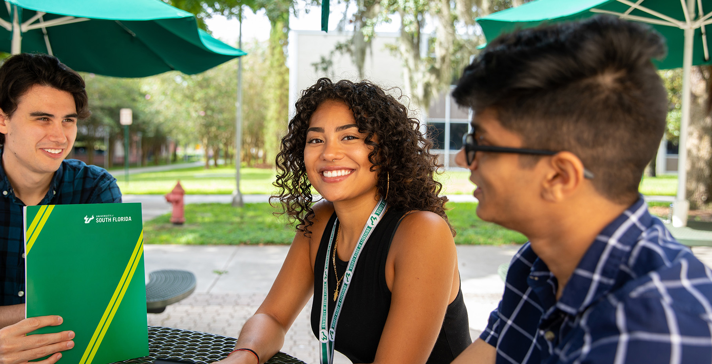
Diverse student body with students from 50 U.S. states and more than 145 countries

Slide 47
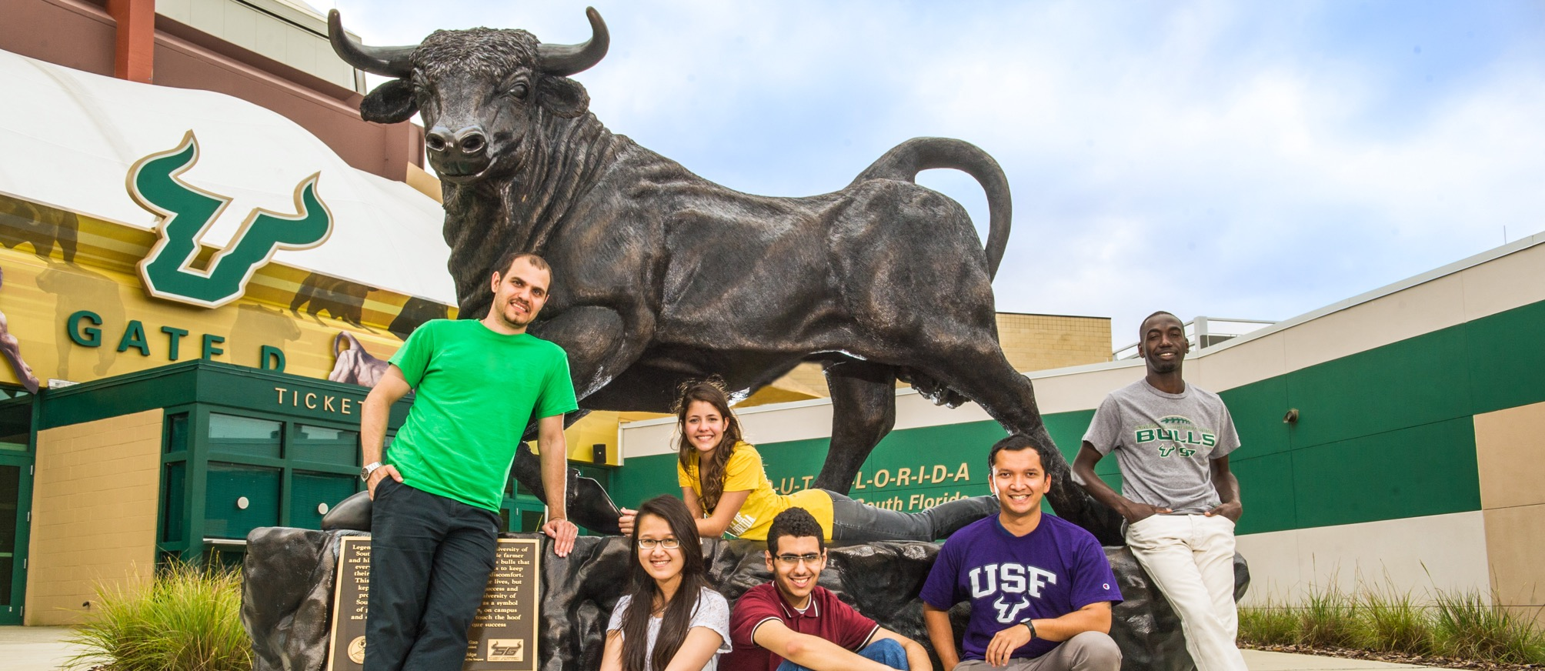
DIVERSITY: REDUCING INEQUALITIES STAT
#1 in Florida and #8 in the U.S. for reducing inequalities in higher education
- Times Higher Education, 2021

Slide 48
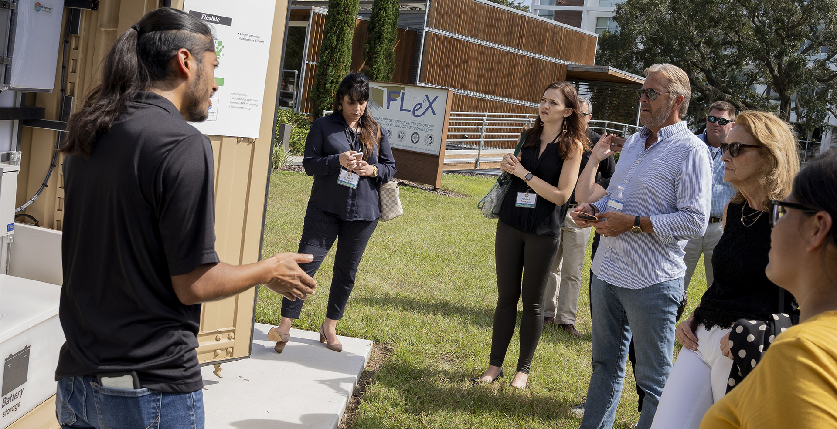
Top performer in the 2020 Sustainable Campus Index as a university dedicated to energy reduction and the development and use of clean and renewable energy sources.

Slide 49

admissions.usf.edu/toolkit

