Slide 1
UNIVERSITY OF NORTH FLORIDA

Slide 2
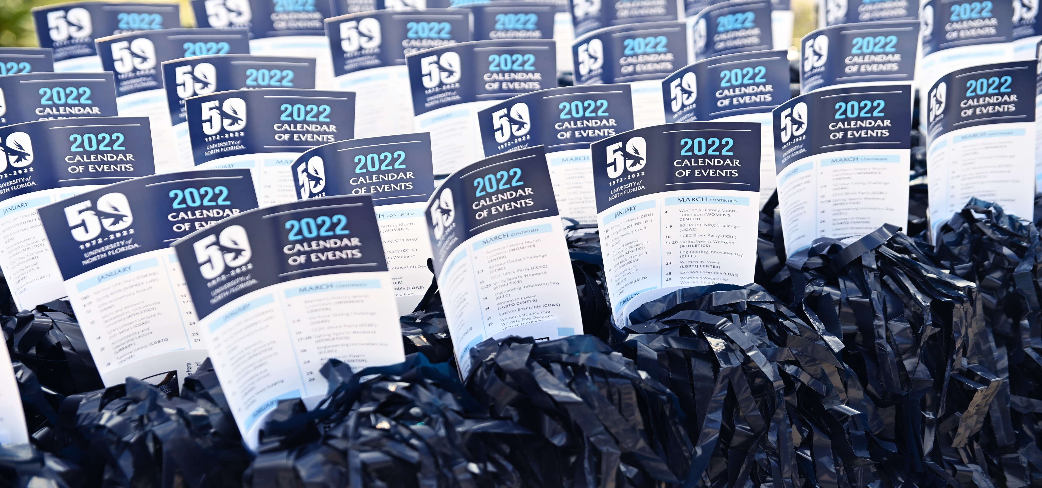
UNIVERSITY OF NORTH FLORIDA

Slide 3
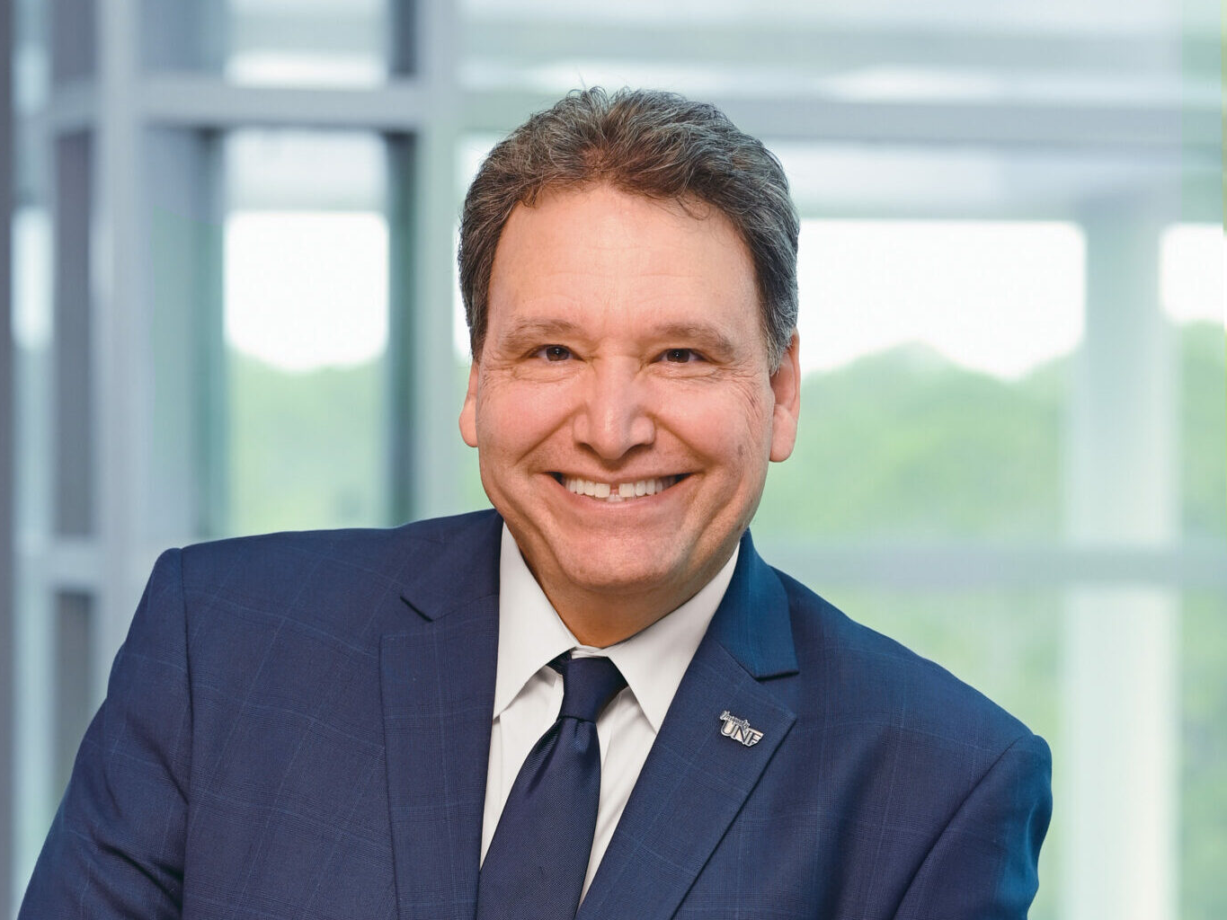
UNIVERSITY OF NORTH FLORIDA
Florida Board of Governors confirms Dr. Moez Limayem as UNF’s seventh president.
UNIVERSITY OF NORTH FLORIDA
Brooks College of Health

Slide 4
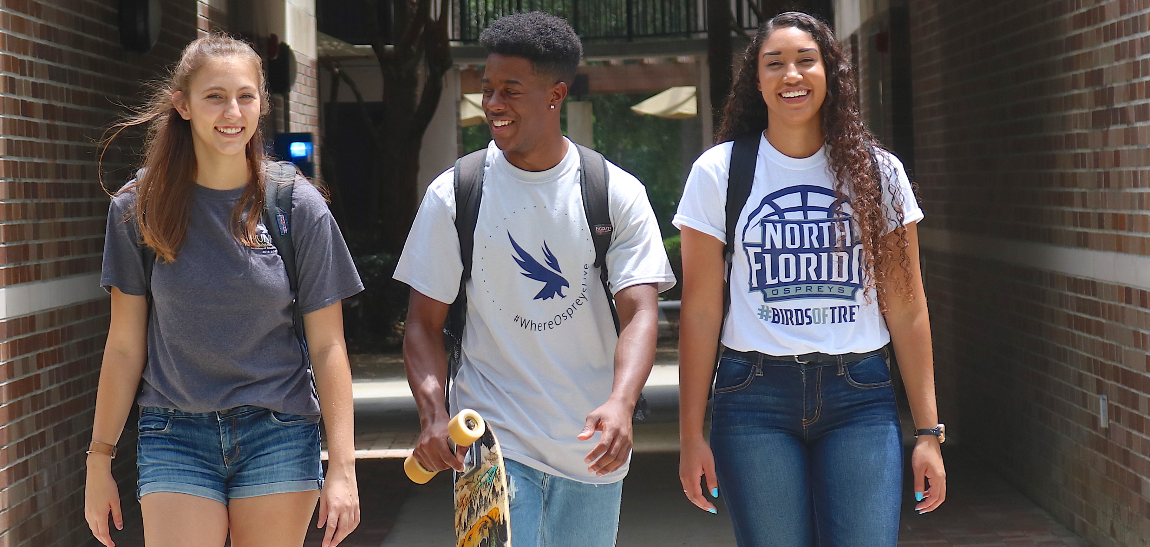
UNIVERSITY OF NORTH FLORIDA

Slide 5
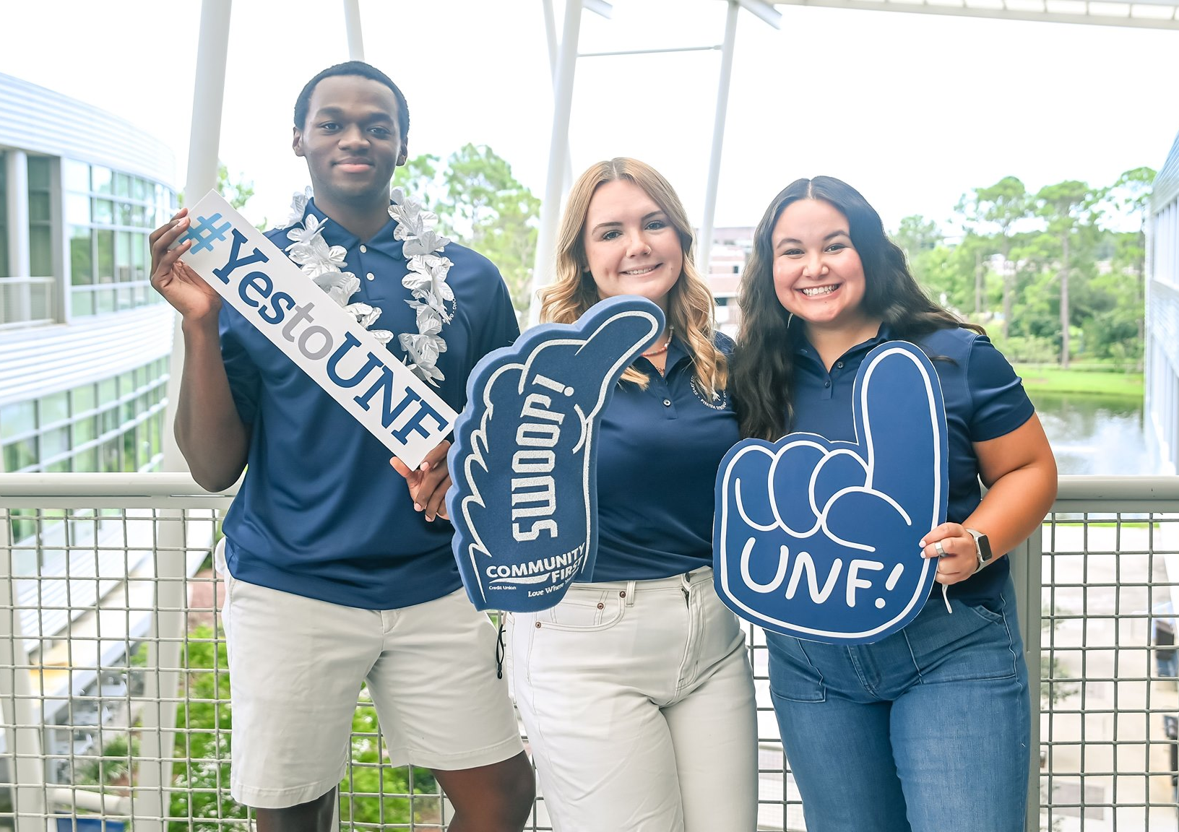
UNIVERSITY OF NORTH FLORIDA
In 2022, UNF enrolled its most diverse class in school history!
UNIVERSITY OF NORTH FLORIDA
www.unf.edu/admissions

Slide 6
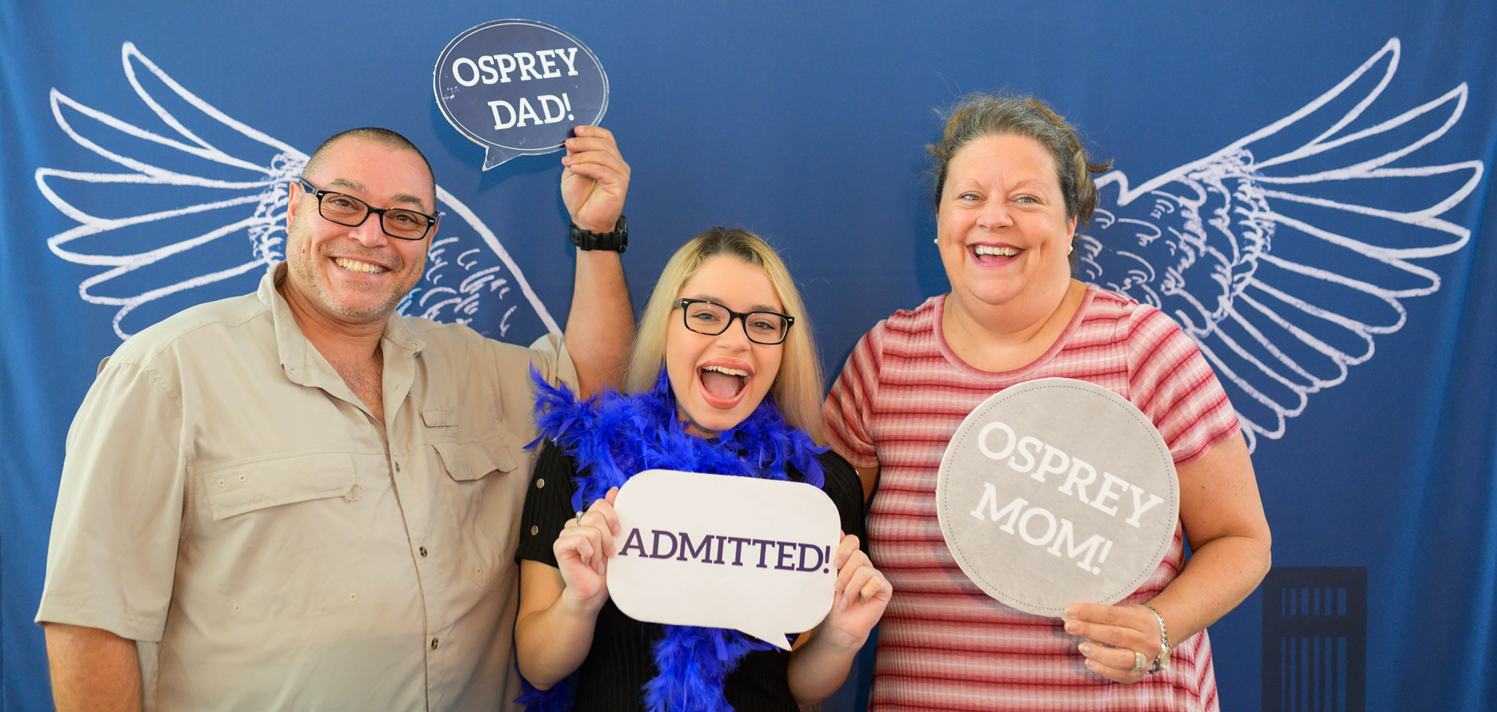
UNIVERSITY OF NORTH FLORIDA

Slide 7
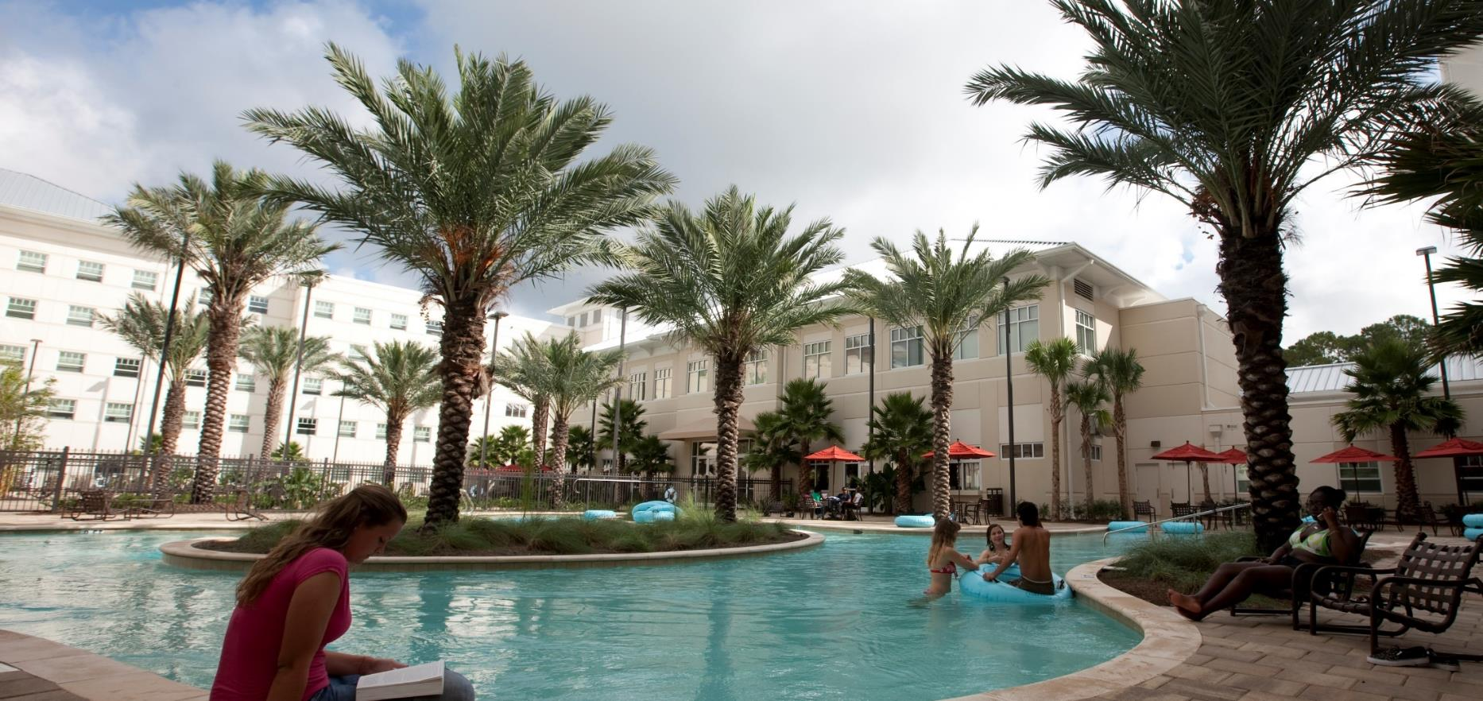
UNIVERSITY OF NORTH FLORIDA

Slide 8
UNIVERSITY OF NORTH FLORIDA
The Hicks Honors College offers stipends to students for research and study abroad.
UNIVERSITY OF NORTH FLORIDA
Hicks Honors College

Slide 9
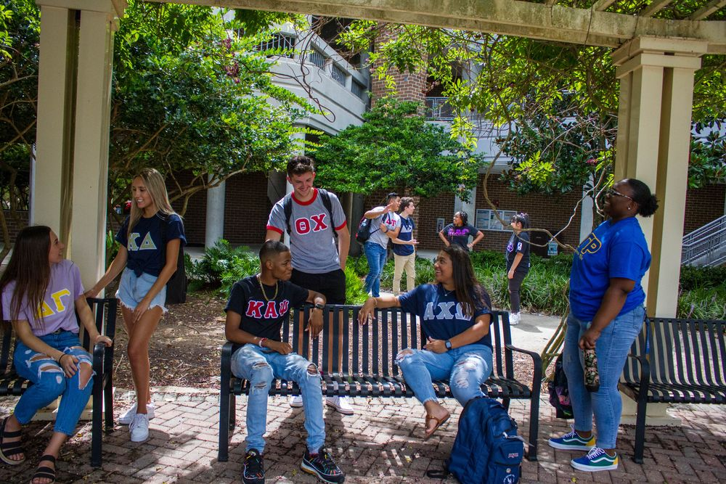
UNIVERSITY OF NORTH FLORIDA
More than 11,000 community service hours each year
All Greek GPA is above 3.8
5th largest FSL community in Florida
UNIVERSITY OF NORTH FLORIDA
Osprey Life
Osprey Life

Slide 10
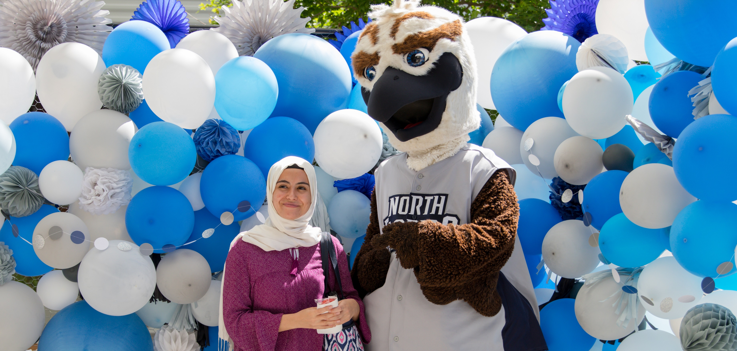
UNIVERSITY OF NORTH FLORIDA

Slide 11
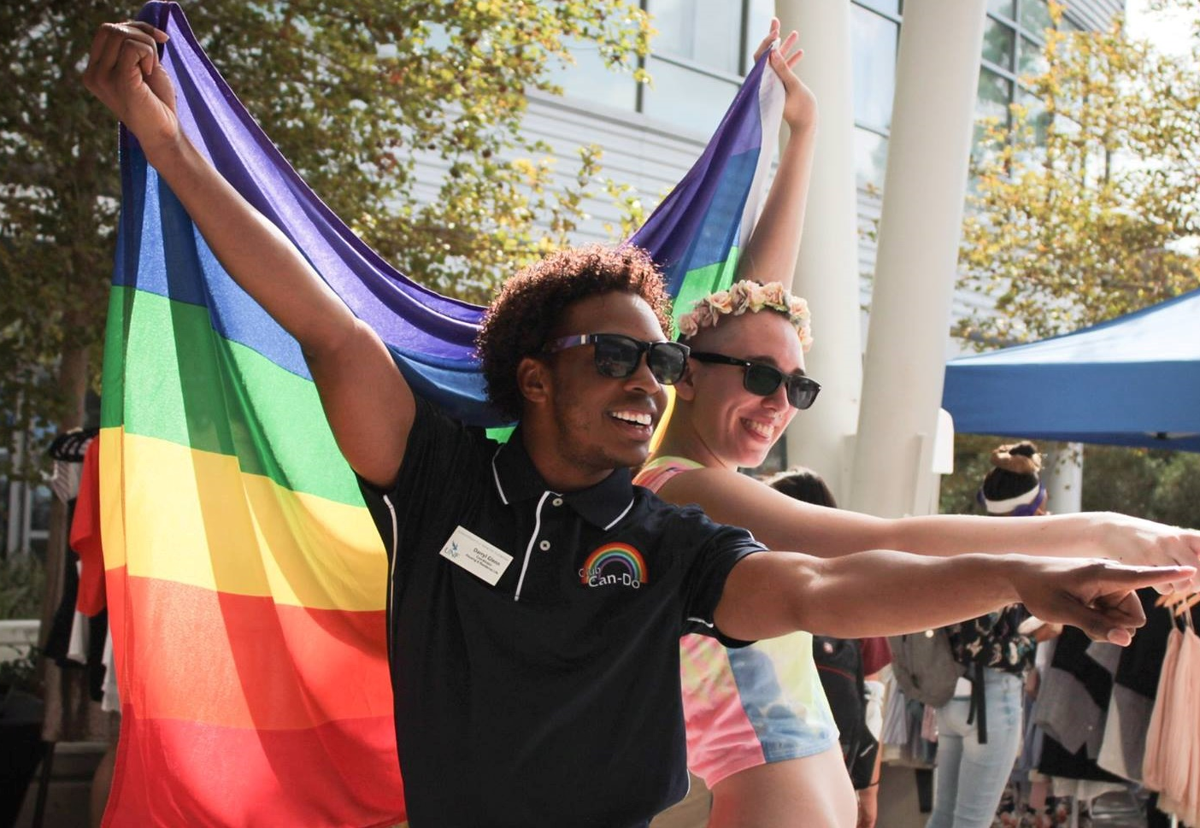
UNIVERSITY OF NORTH FLORIDA
UNF is recognized as “Best of the Best” by Campus Pride, the preeminent resource for LGBTQ advocacy in higher education.
UNIVERSITY OF NORTH FLORIDA
Osprey Life

Slide 12
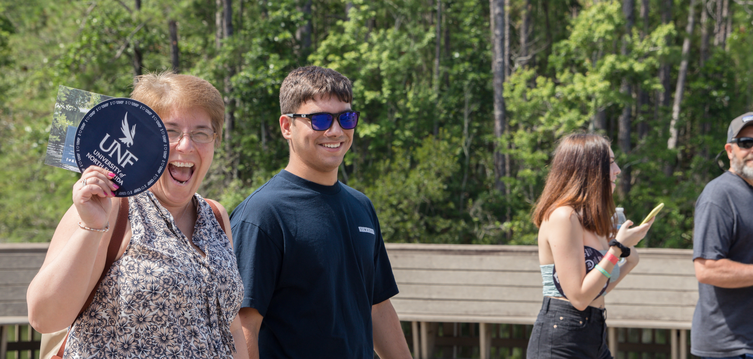
UNIVERSITY OF NORTH FLORIDA

Slide 13
UNIVERSITY OF NORTH FLORIDA
We now have over $1 million per year in MedNexus scholarships for Nursing students.
UNIVERSITY OF NORTH FLORIDA
Brooks College of Health

Slide 14
UNIVERSITY OF NORTH FLORIDA

Slide 15
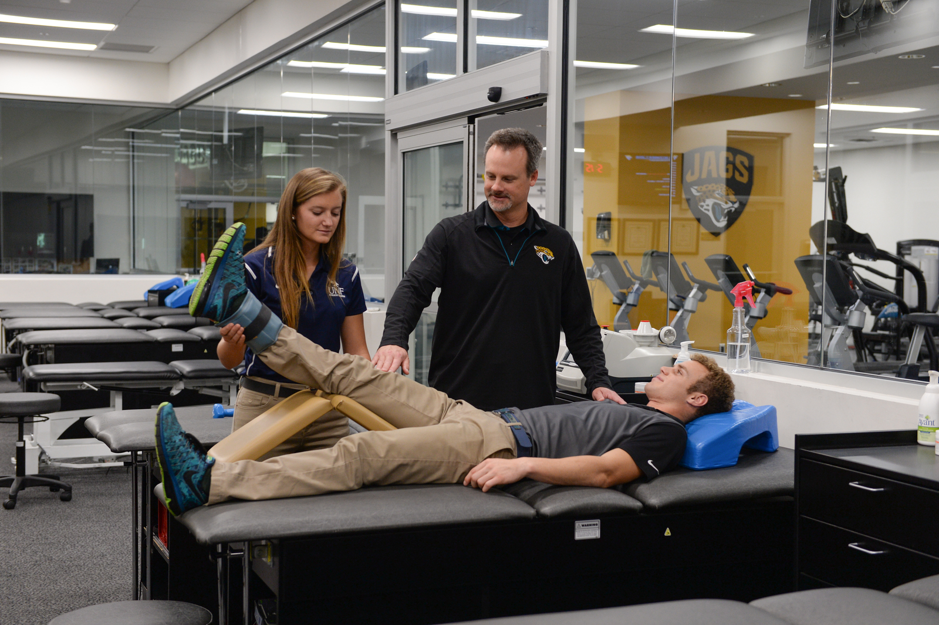
UNIVERSITY OF NORTH FLORIDA
77 percent of students take part in internships and other real-world experiences in their field prior to graduation.
UNIVERSITY OF NORTH FLORIDA
Student Success

Slide 16
UNIVERSITY OF NORTH FLORIDA

Slide 17
UNIVERSITY OF NORTH FLORIDA
UNF’s Archaeology Lab also made headlines when students unearthed artifacts in Big Talbot Island from a Native American village dating back four centuries.
UNIVERSITY OF NORTH FLORIDA
Student Success
High Impact Practices

Slide 18
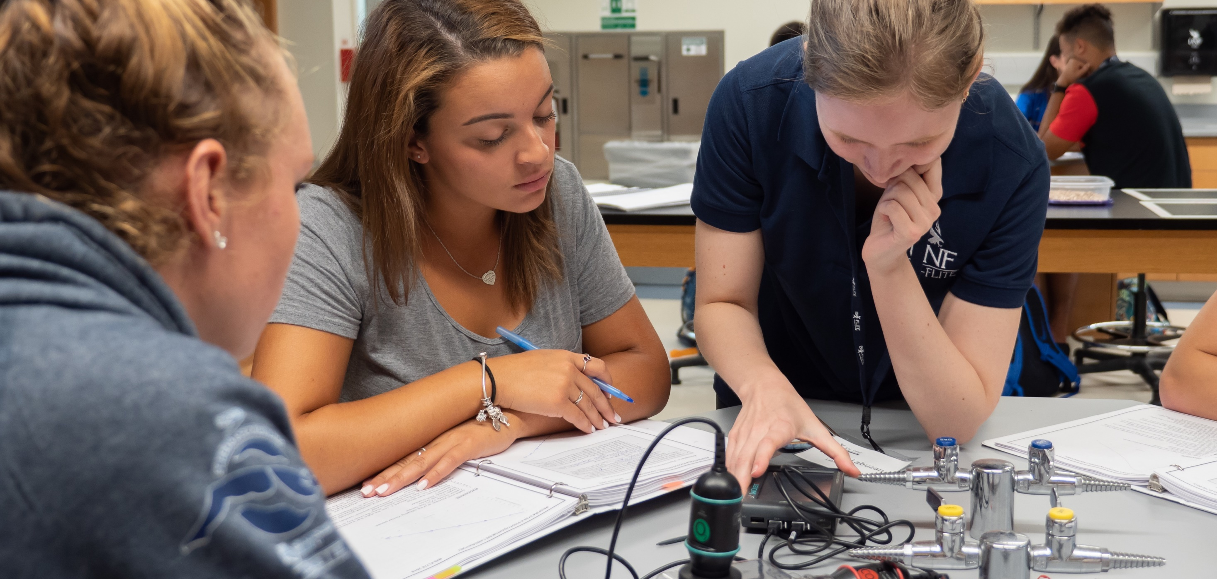
UNIVERSITY OF NORTH FLORIDA

Slide 19
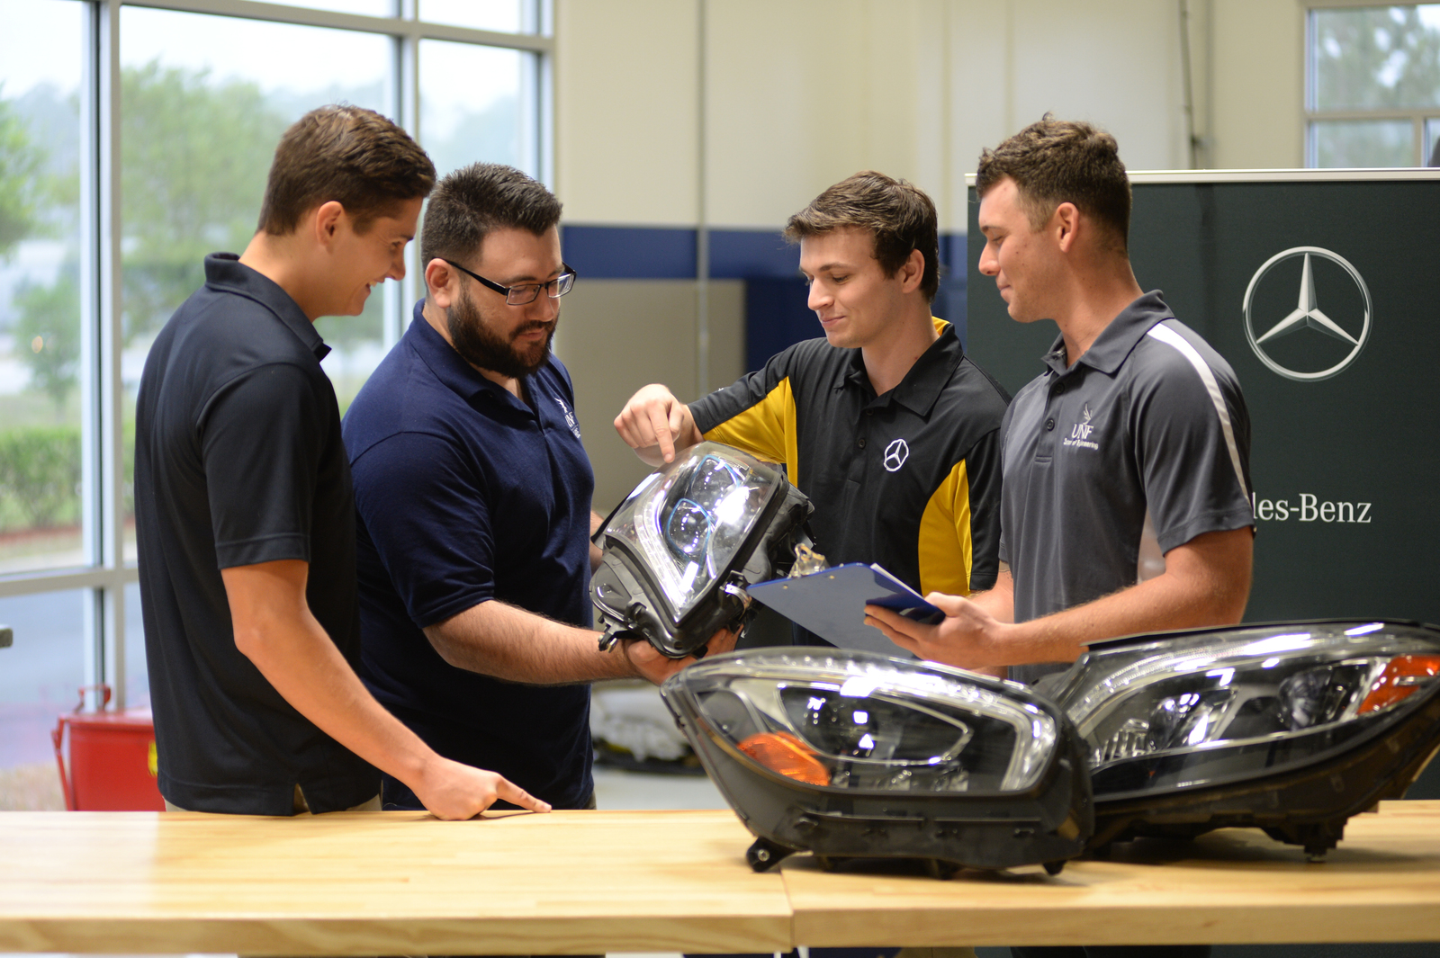
UNIVERSITY OF NORTH FLORIDA
New degree program in advanced manufacturing and a graduate degree in materials science and engineering to prepare students for the current revolution in the modern manufacturing sector.
UNIVERSITY OF NORTH FLORIDA
College of Computing, Engineering, and Construction

Slide 20
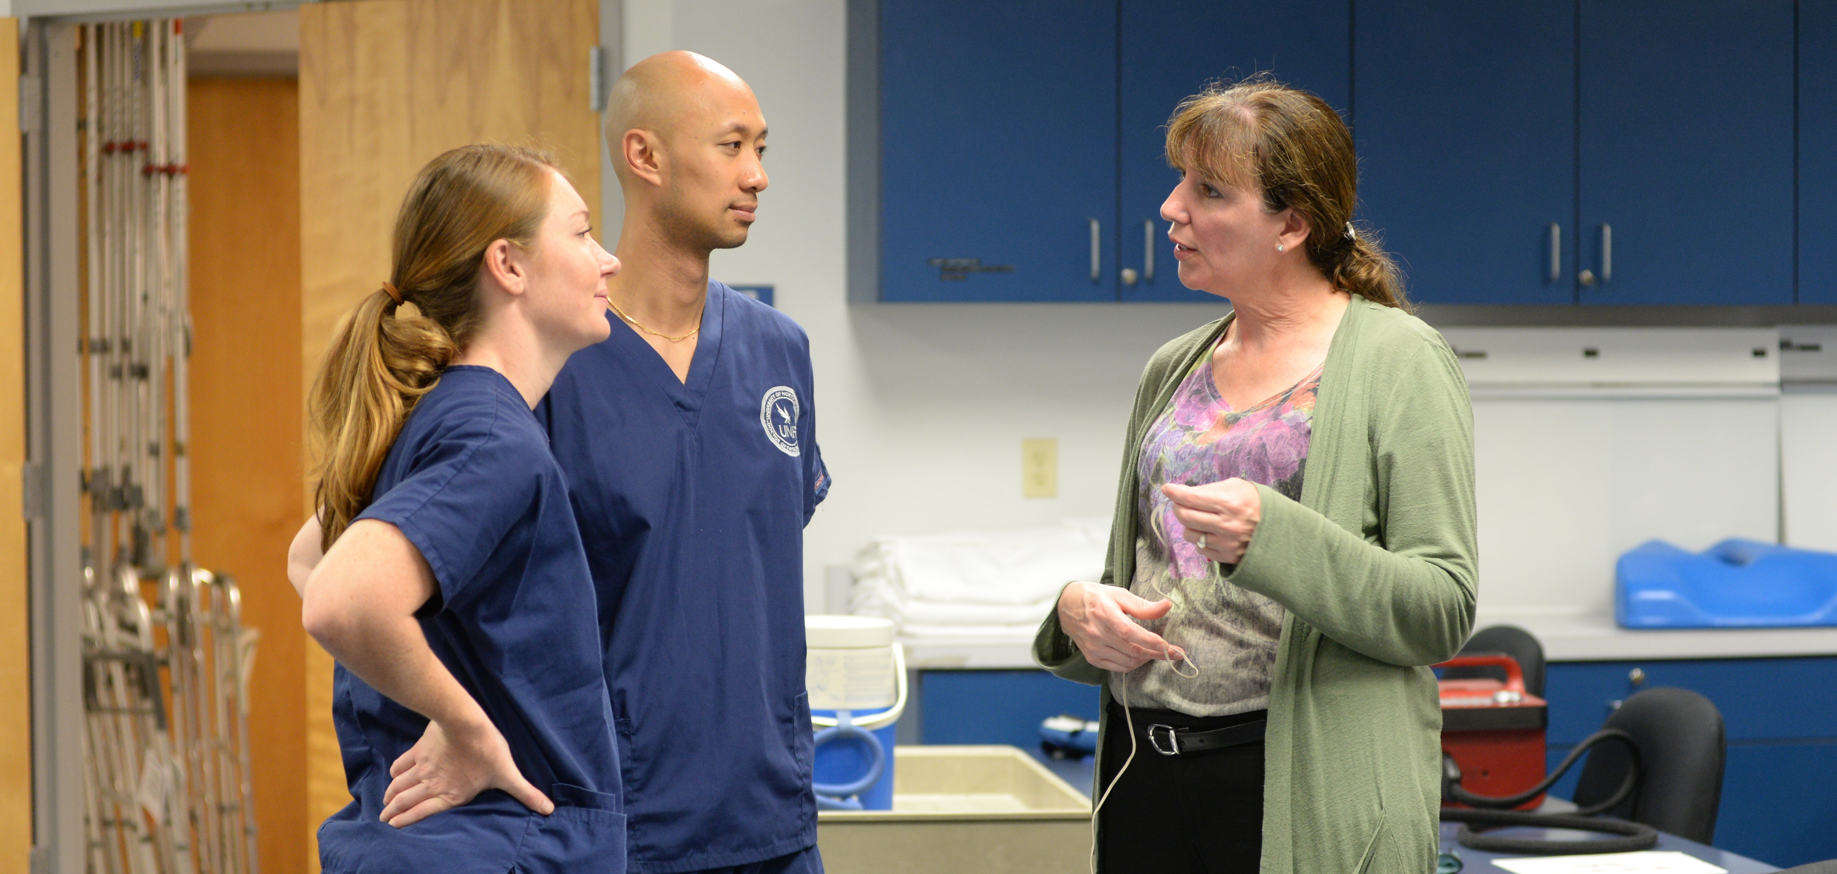
UNIVERSITY OF NORTH FLORIDA

Slide 21
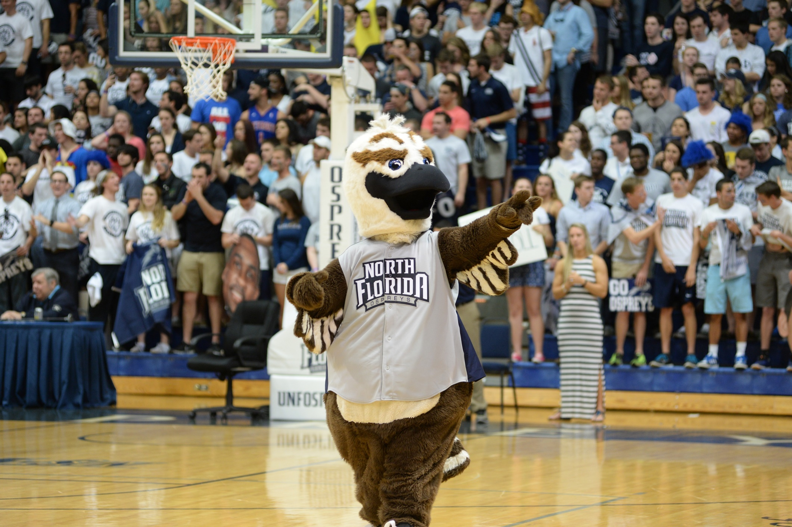
UNIVERSITY OF NORTH FLORIDA
$2.1 million investment from CSI Companies will help fund the renovation of the UNF Arena.
UNIVERSITY OF NORTH FLORIDA
19 NCAA Division I Sports

Slide 22
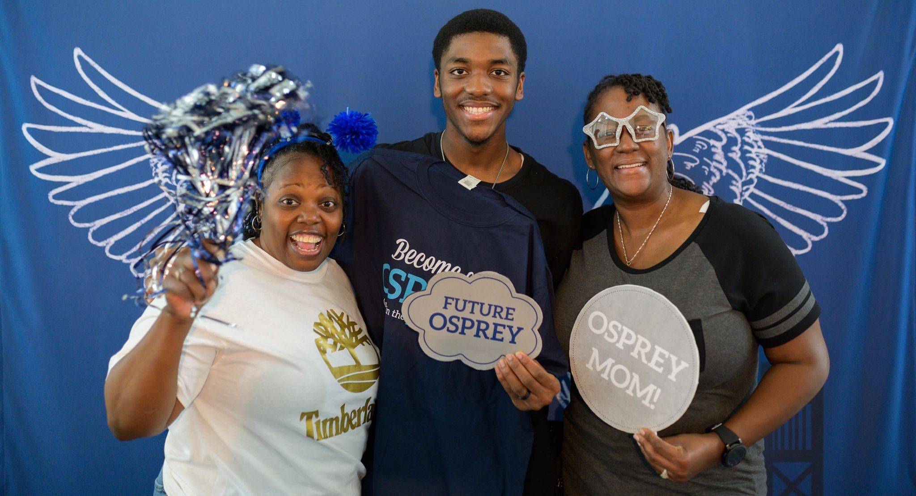
UNIVERSITY OF NORTH FLORIDA

Slide 23
Application Deadlines
May 1, 2023
June 1, 2023
November 14, 2022
Spring 2022
UNIVERSITY OF NORTH FLORIDA
Summer 2022
Fall 2022
www.unf.edu/apply

Slide 24
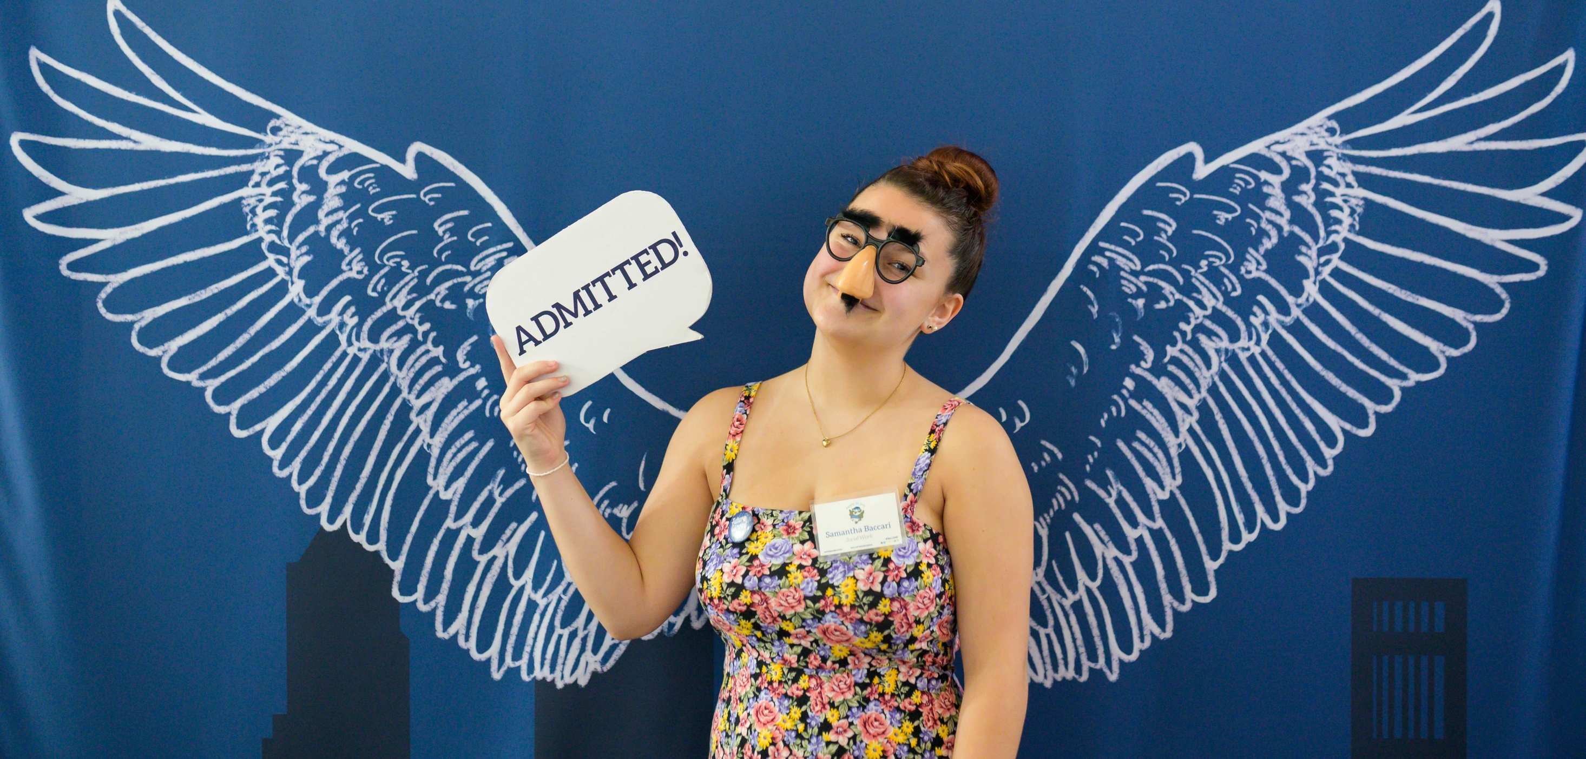
UNIVERSITY OF NORTH FLORIDA

Slide 25
Fall mid-ranges for admission
24 – 27
3.5 – 4.4
1180 – 1300
SAT
UNIVERSITY OF NORTH FLORIDA
ACT
GPA
www.unf.edu/apply

Slide 26
UNIVERSITY OF NORTH FLORIDA

Slide 27
Summer mid-ranges for admission
20 – 23
3.0 – 3.4
1050 – 1170
SAT
UNIVERSITY OF NORTH FLORIDA
ACT
GPA
www.unf.edu/apply

Slide 28
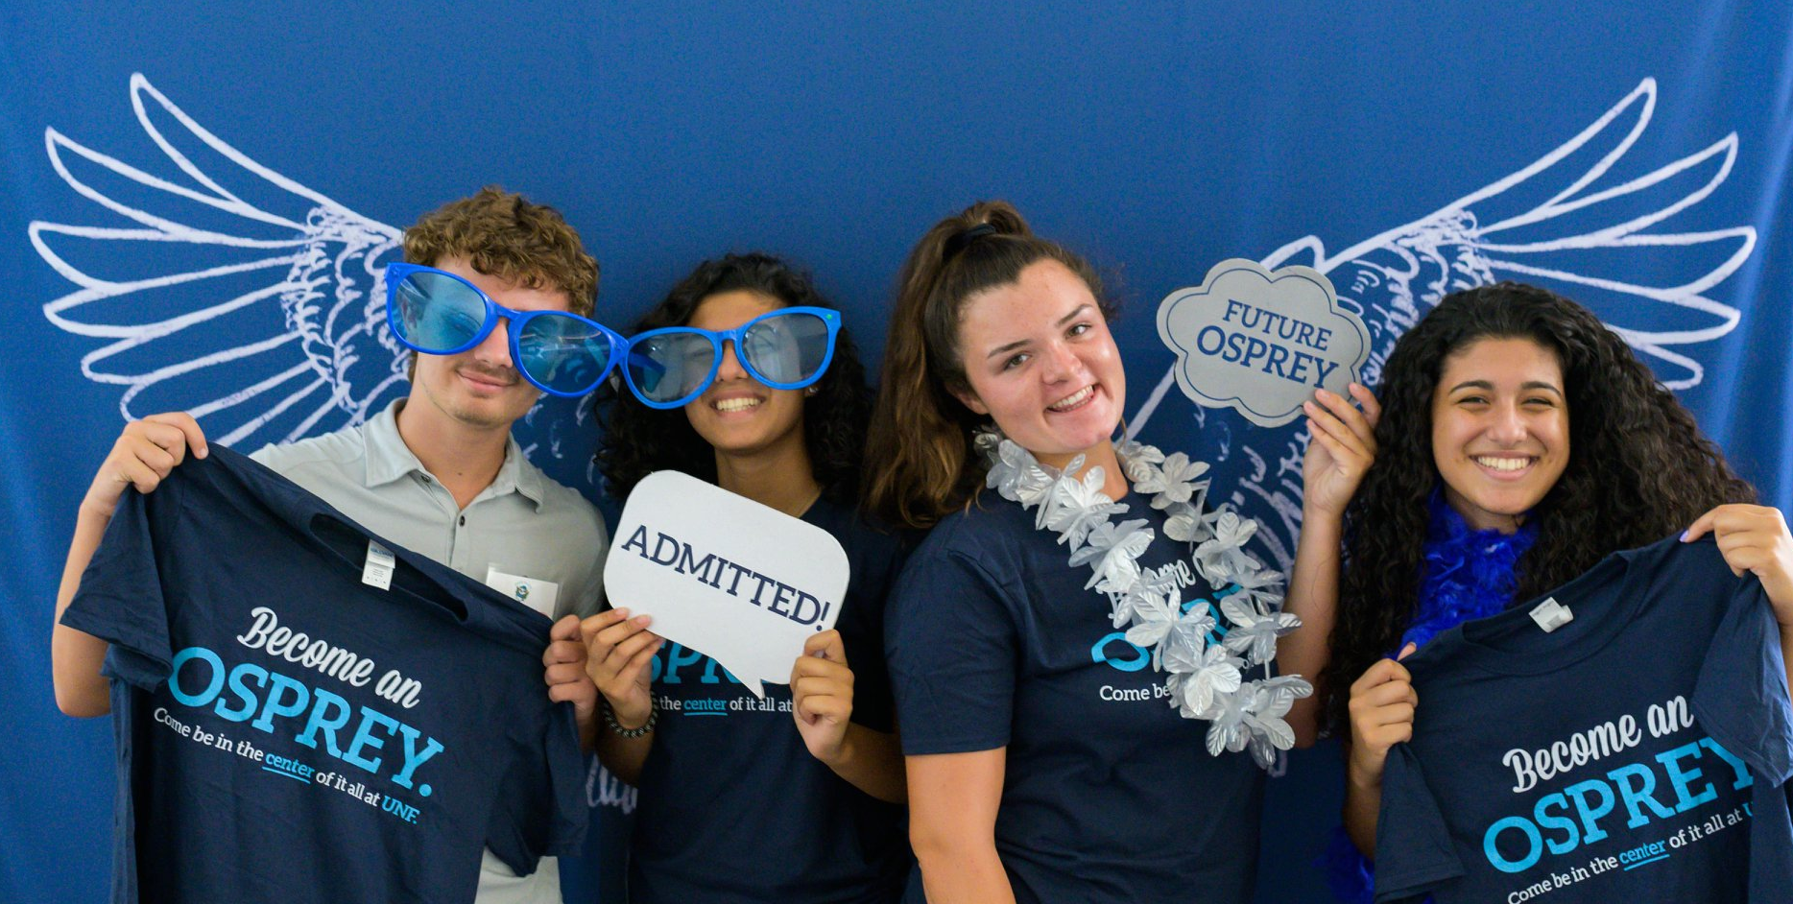
UNIVERSITY OF NORTH FLORIDA

Slide 29
Admissions Timeline
Institutional application opens: unf.edu/apply
On-site admission decisions at Apply in July events
Common App and SSAR become available
Rolling admissions
Financial aid and scholarship priority deadline
June 1
July
UNIVERSITY OF NORTH FLORIDA
Aug. 1
Aug. to July
Nov. 11
www.unf.edu/apply

Slide 30
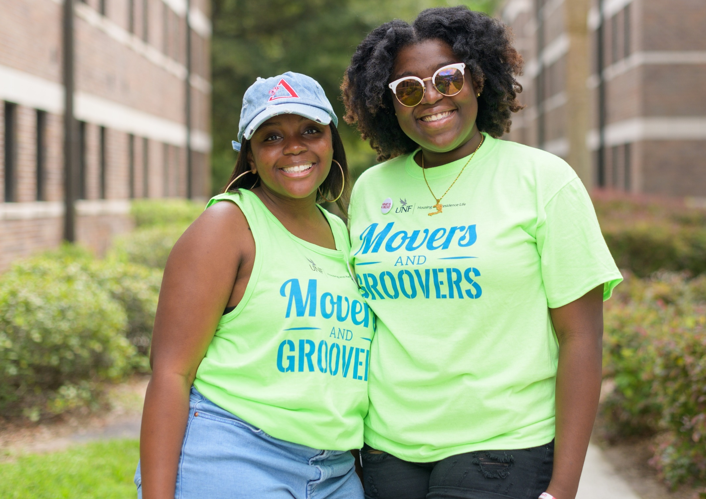
UNIVERSITY OF NORTH FLORIDA
The UNF financial aid and scholarship priority deadline is
November 1
UNF Scholarships
UNF Scholarships

Slide 31
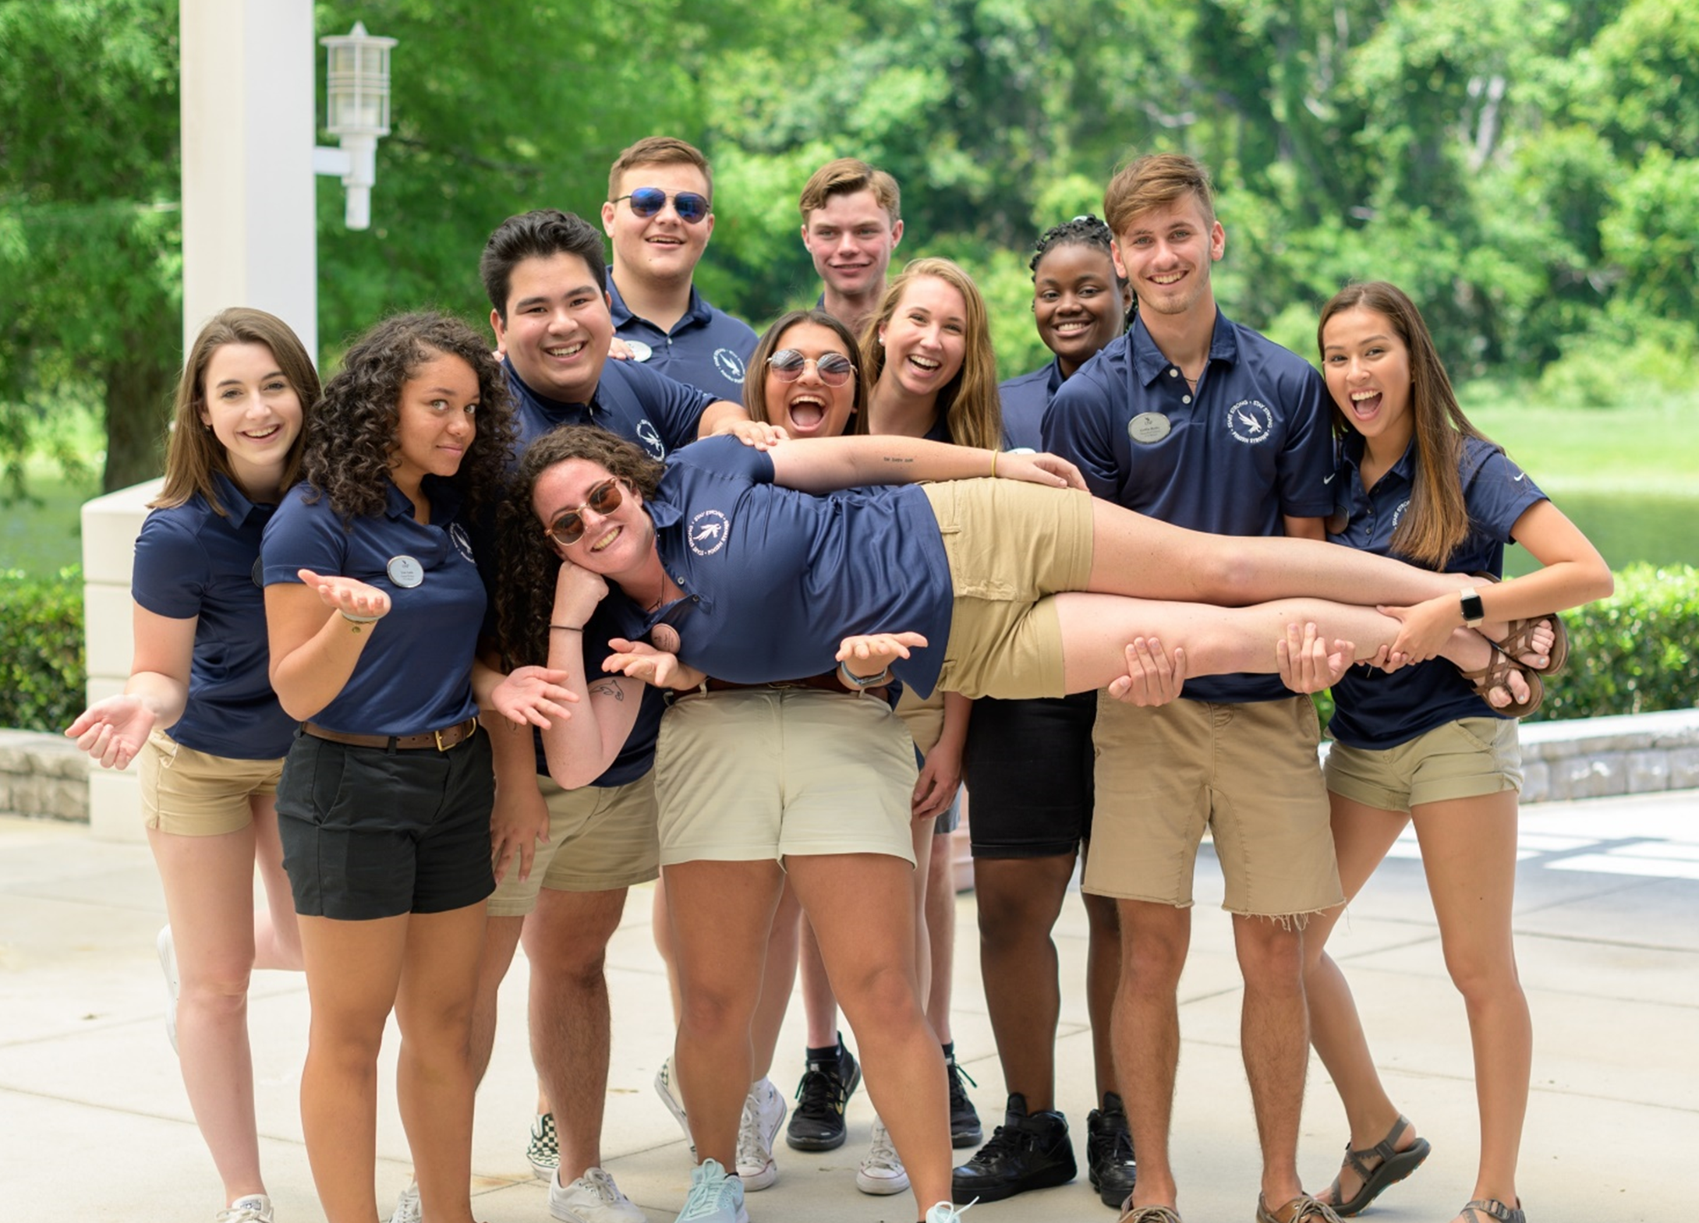
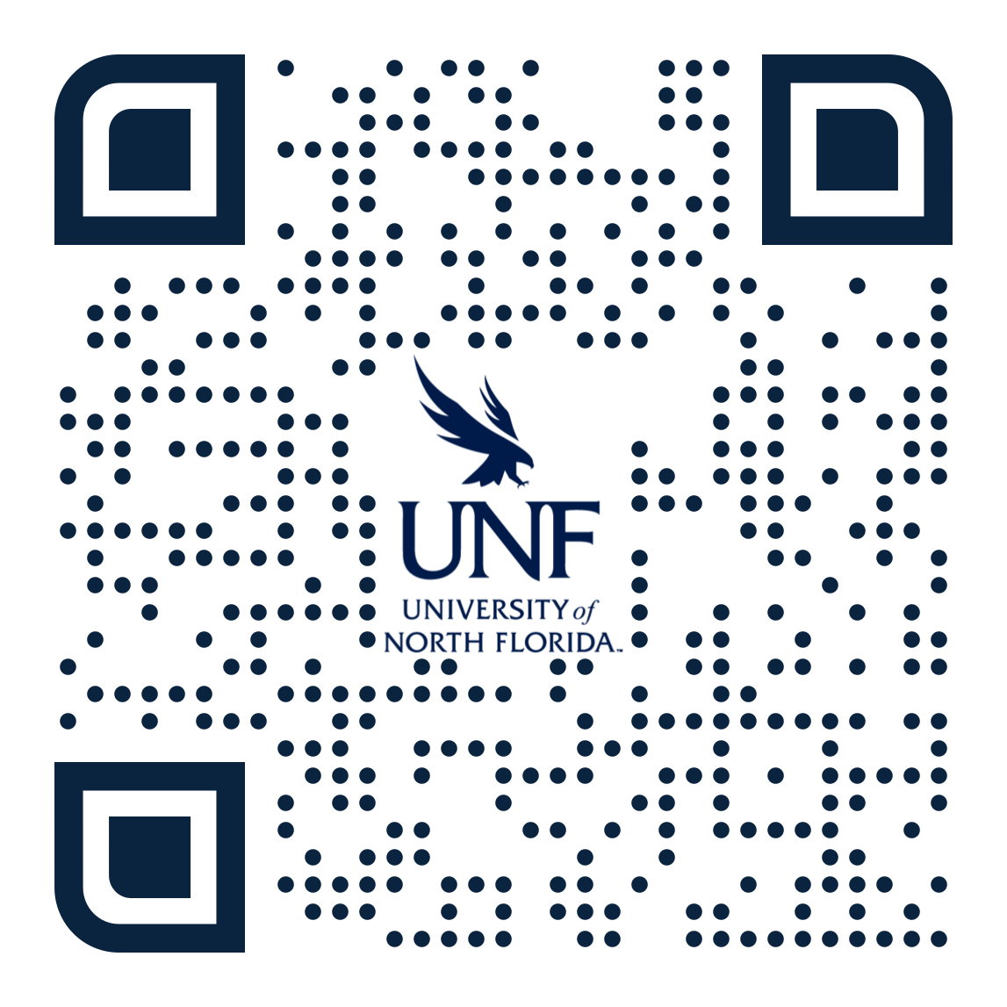
UNIVERSITY OF NORTH FLORIDA
Upcoming Events
UNIVERSITY OF NORTH FLORIDA
We invite you to visit campus!

Slide 32
UNIVERSITY OF NORTH FLORIDA

