Slide 1
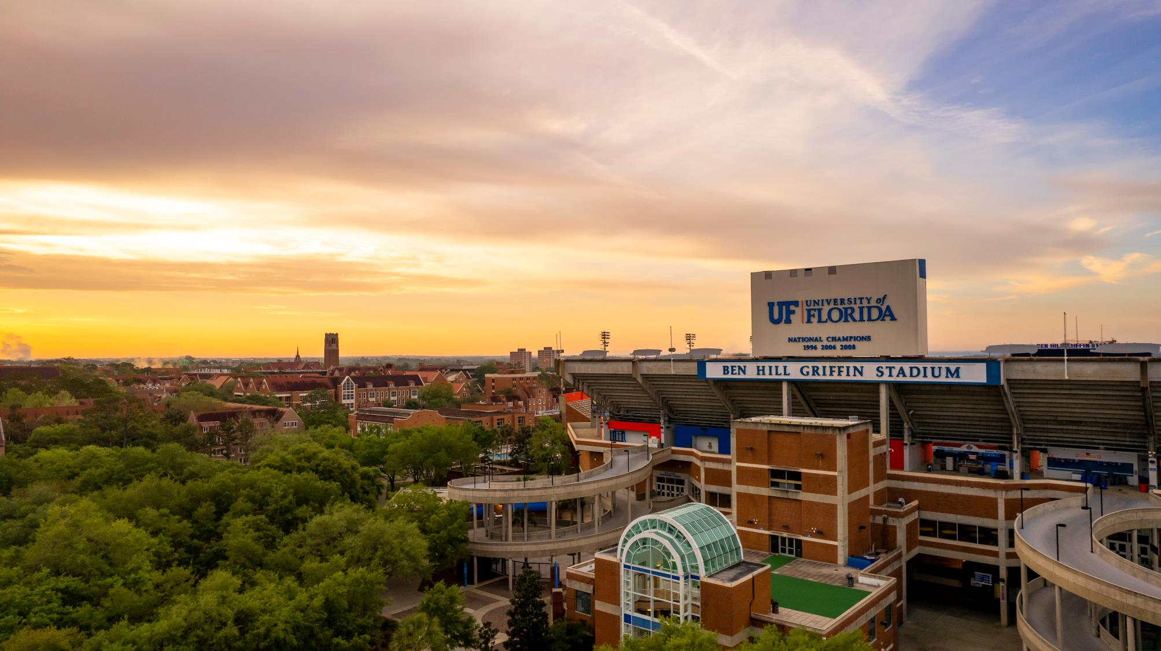
THIS IS
THE GATOR NATION
58,104
TOTAL STUDENTS ENROLLED
38,172
UNDERGRADUATES ENROLLED
49
U.S. STATES
2022 Enrollment

Slide 2
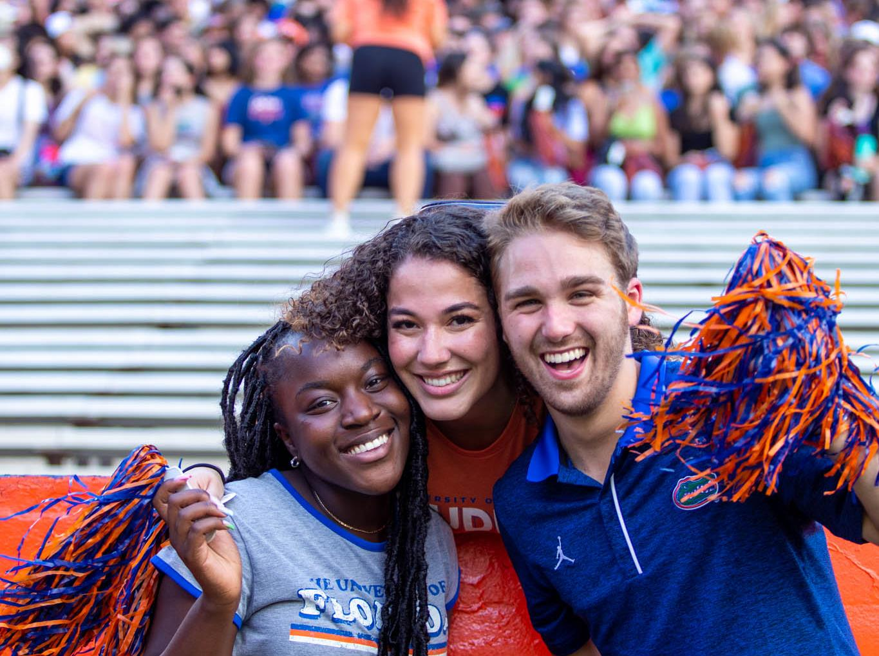
UF was ranked a Top 5 Public University by U.S. News & World Report in 2022.

Slide 3
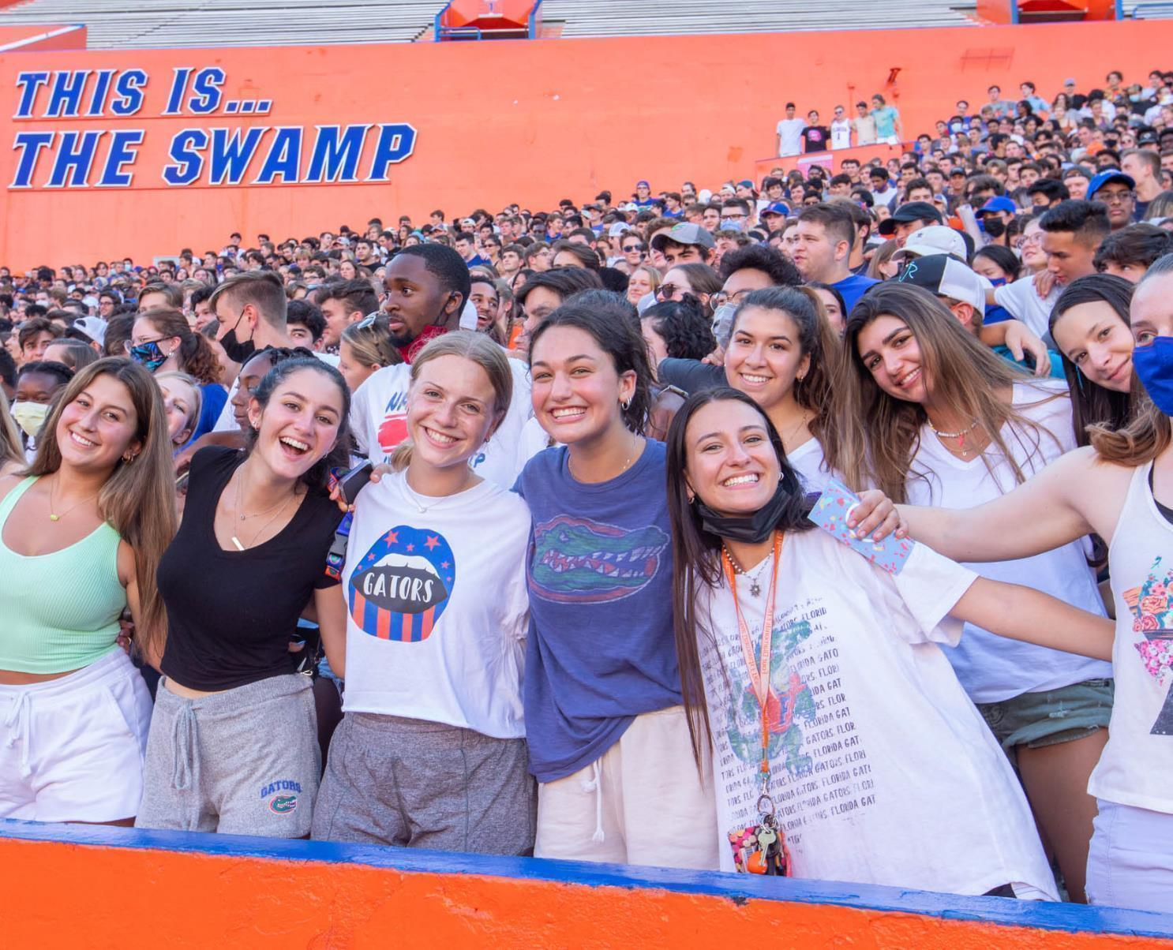
CLASS OF 2026
FRESHMAN
MIDDLE 50%
4.4 - 4.6
GPA
1350 - 1490
SAT
30 - 34
ACT

Slide 4
DATES AND
DEADLINES
AUG. 8
OCT. 1
NOV. 1
NOV. 15
DEC. 1
Freshman application opens
FAFSA form opens
Priority deadline for freshman application
SSAR deadline
Test score submission deadline
FEB. 24
MARCH
MAY 1
JULY 15
Admission decision notification for priority applications
Financial aid offers available at One.UF
$200 tuition deposit deadline to confirm enrollment
Admitted student deadline to send final transcripts

Slide 5
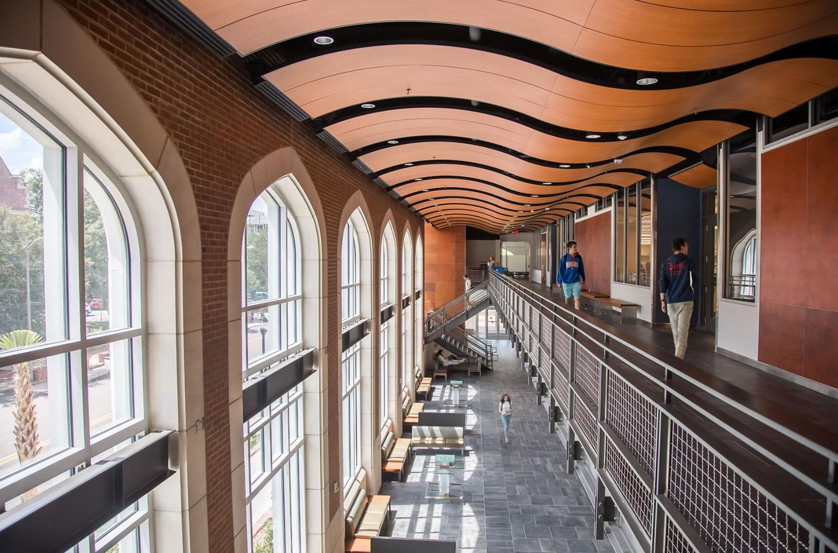
Few universities in the country
can match the breadth of
Powerhouse
our academic

Slide 6
120+
UNDERGRAD PROGRAMS

Slide 7
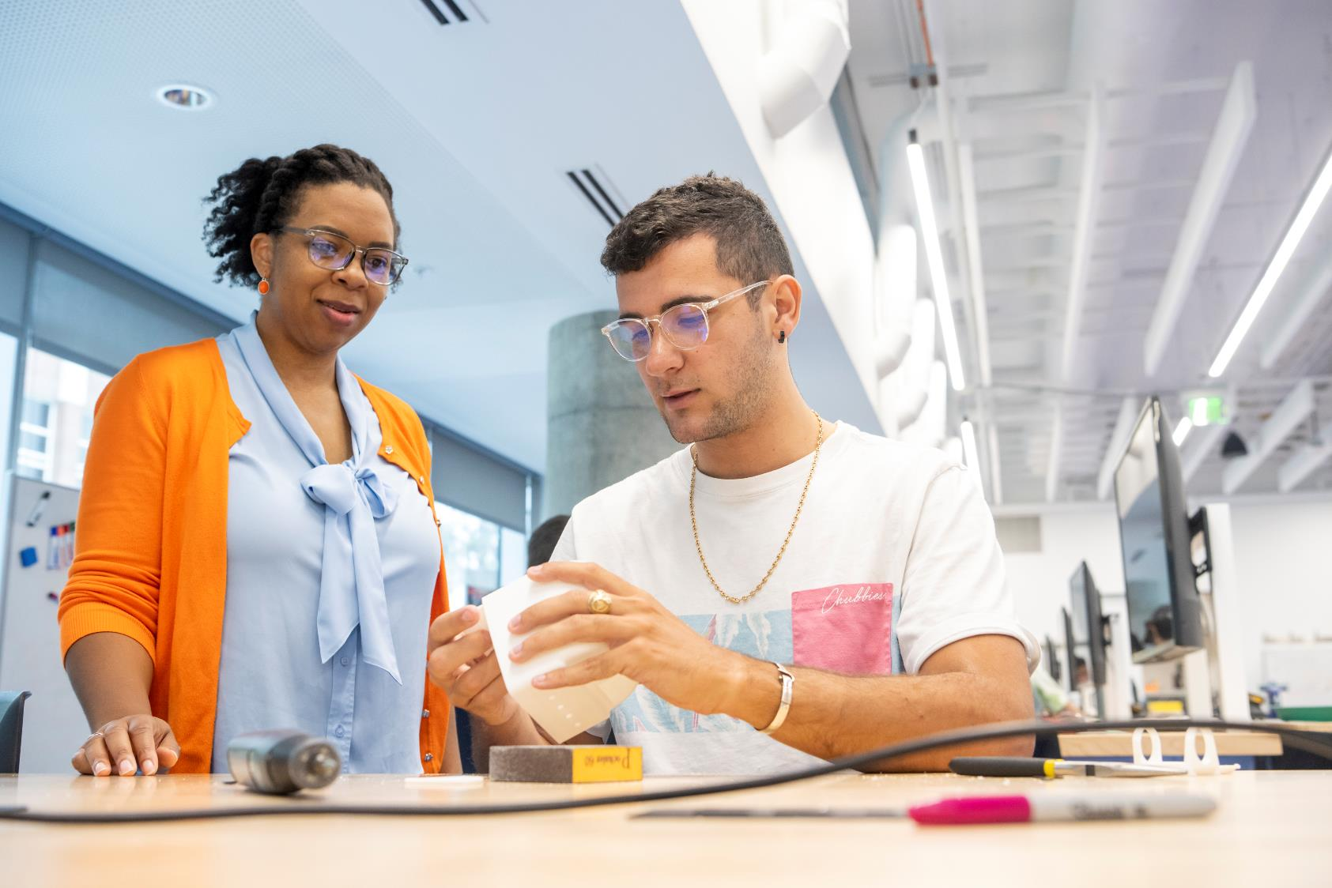
University of Florida
COLLEGES
College of Agricultural and Life Sciences
College of the Arts
Warrington College of Business
College of Dentistry
College of Design, Construction & Planning
College of Education
Herbert Wertheim College of Engineering
College of Health & Human Performance
College of Journalism & Communications
Levin College of Law
College of Liberal Arts & Sciences
College of Medicine
College of Nursing
College of Pharmacy
College of Public Health and Health Professions
College of Veterinary Medicine

Slide 8
Innovation Academy
PaCE
Pathways to UF
Gator Engineering
Gator Design & Construction

Slide 9
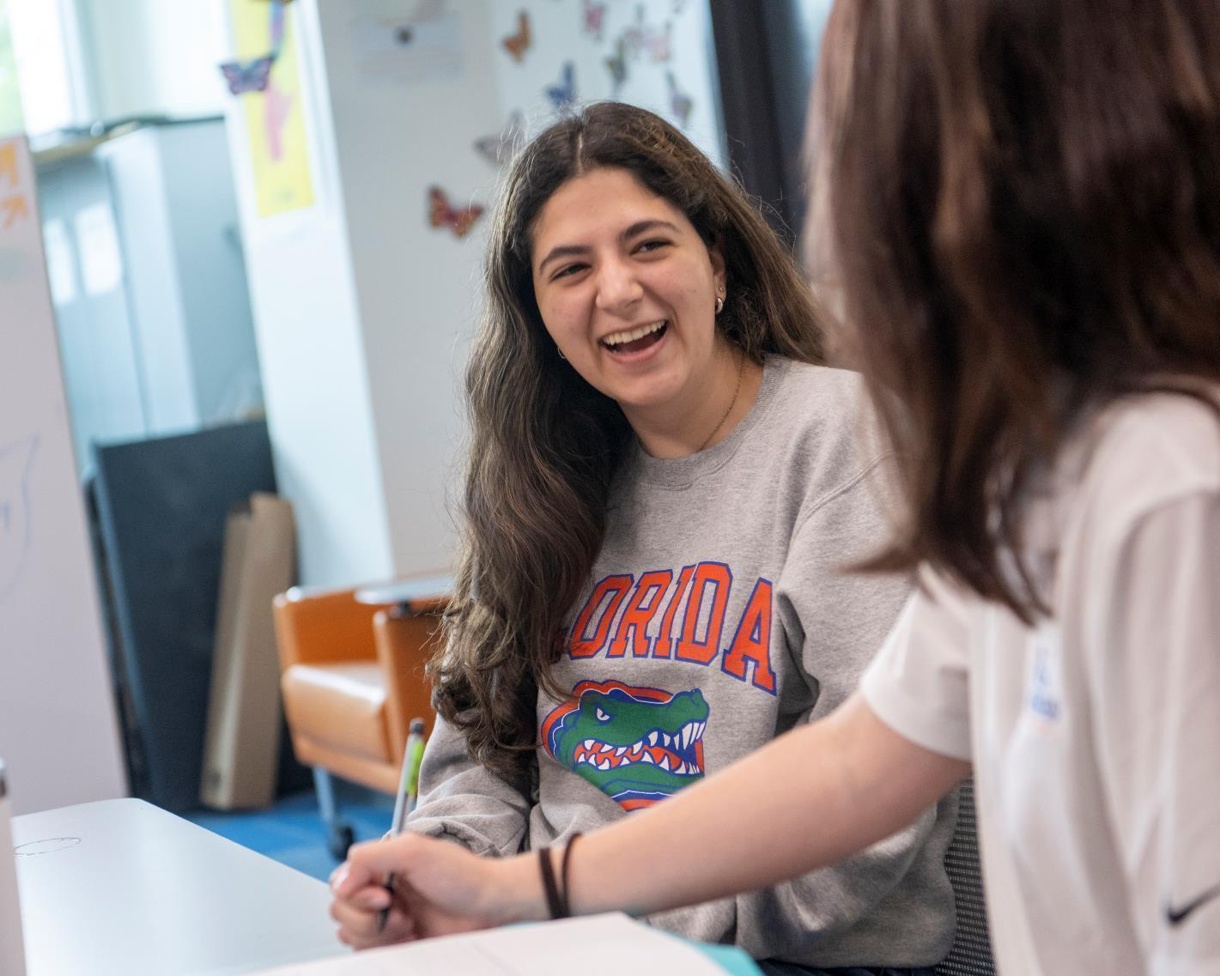
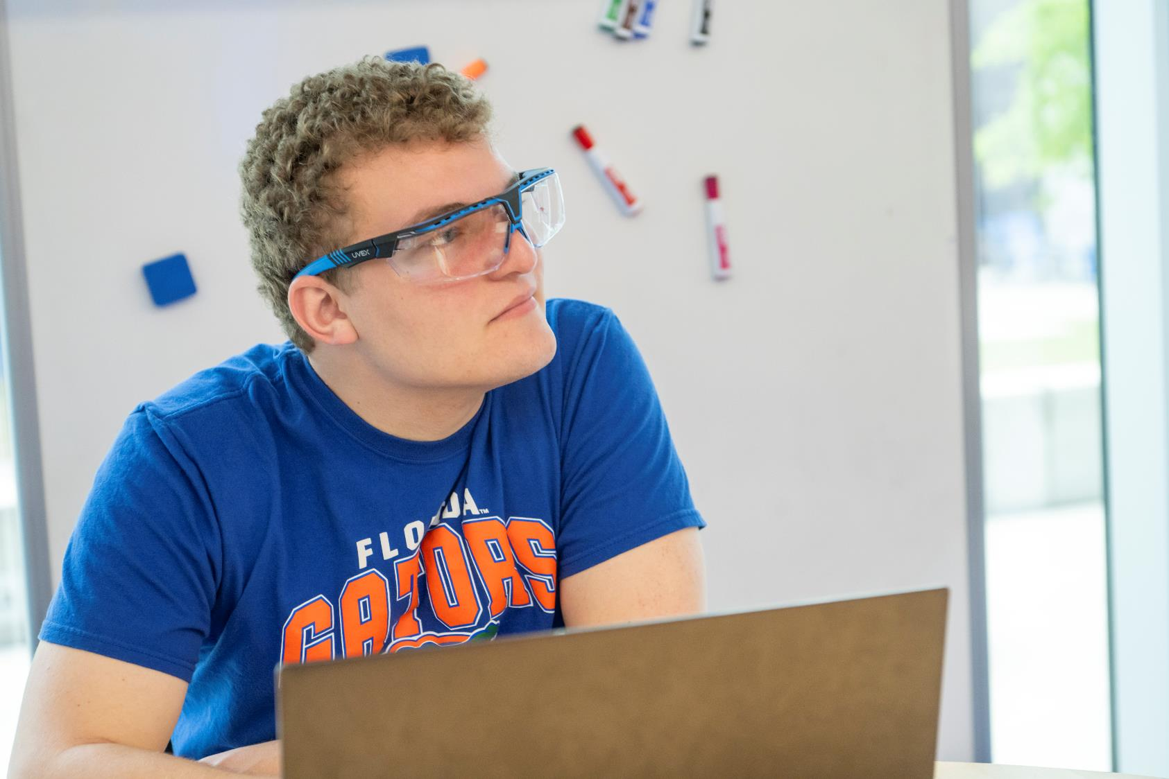
Innovation Academy
PaCE

Slide 10
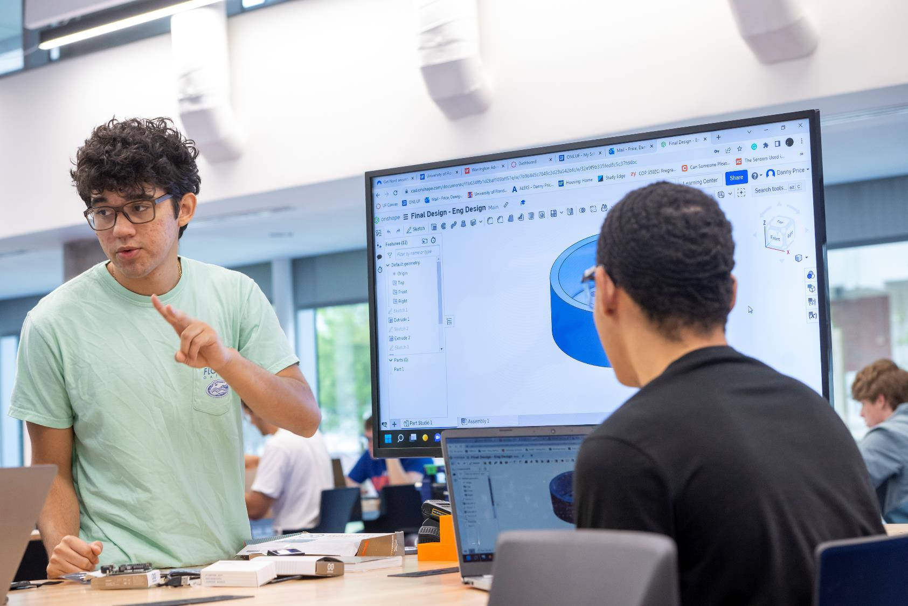
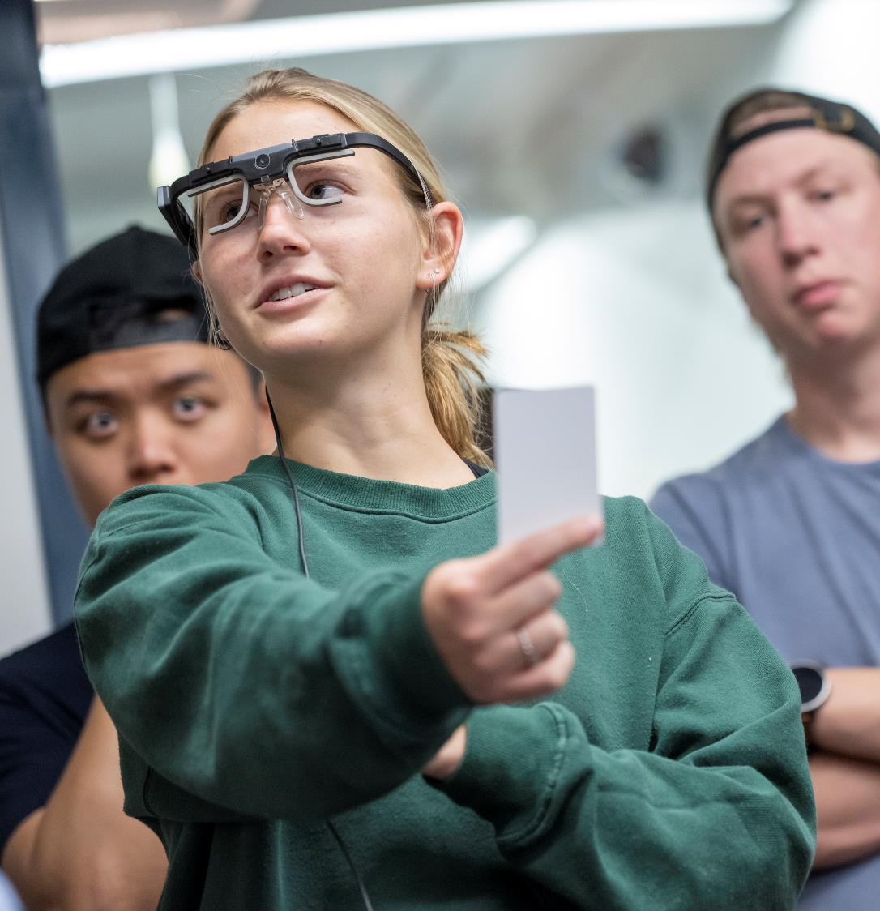
Gator Design & Construction
Gator Engineering

Slide 11
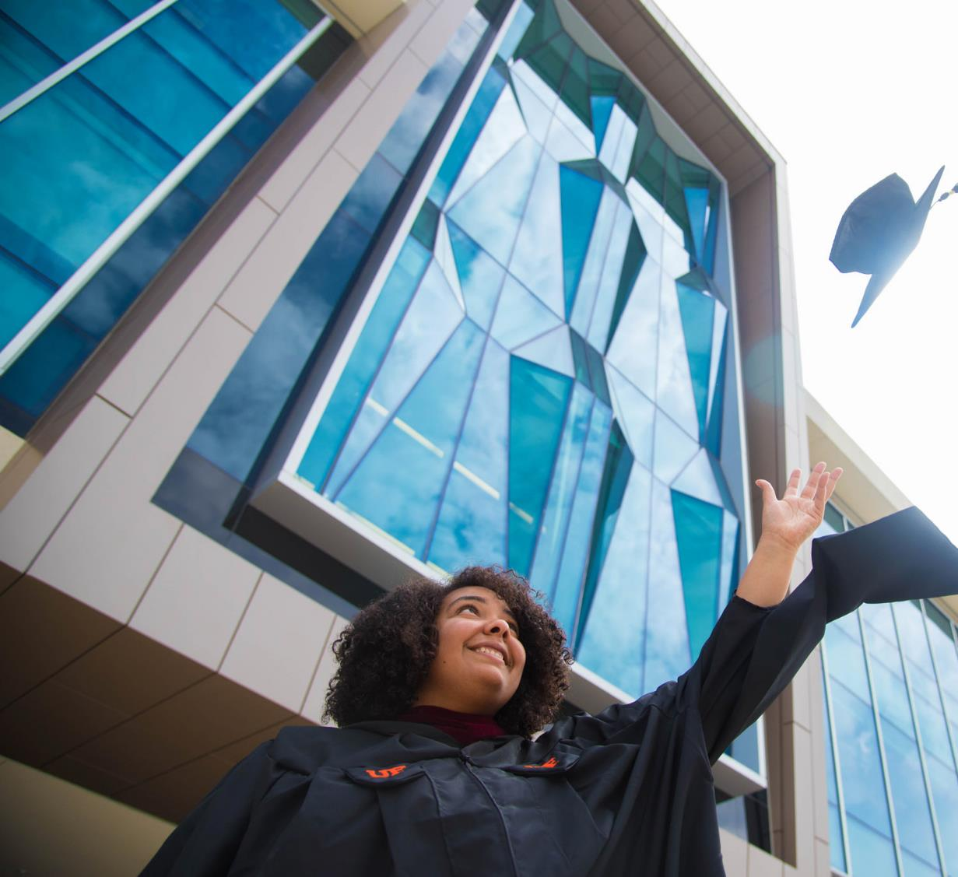
PROMISE
PROGRAM
Provides additional scholarly support and enrichment through Office of Academic Support
Students start in Summer B
Primarily serves first generation and/or low-income students who are Florida Residents
Often attend Title 1 or similar high schools serving a large portion of low-income students

Slide 12
MACHEN FLORIDA
OPPORTUNITY
SCHOLARS
Full cost of attendance is covered through grants and scholarships
No loans or work study
Who Qualifies?
First Generation
Florida Resident
Family income less than $55,000
Assets less than $35,000

Slide 13
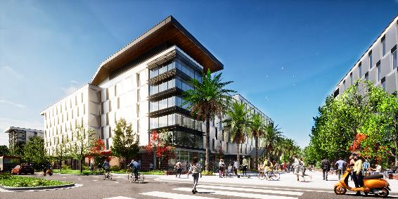
HONORS
One supplemental Honors essay in application to apply
New Honors Village opening in Fall 2023
Built around themes of Opportunity, Community, and Challenge
Honors Program graduate Aimee Clesi received Rhodes Scholarship in 2022

Slide 14
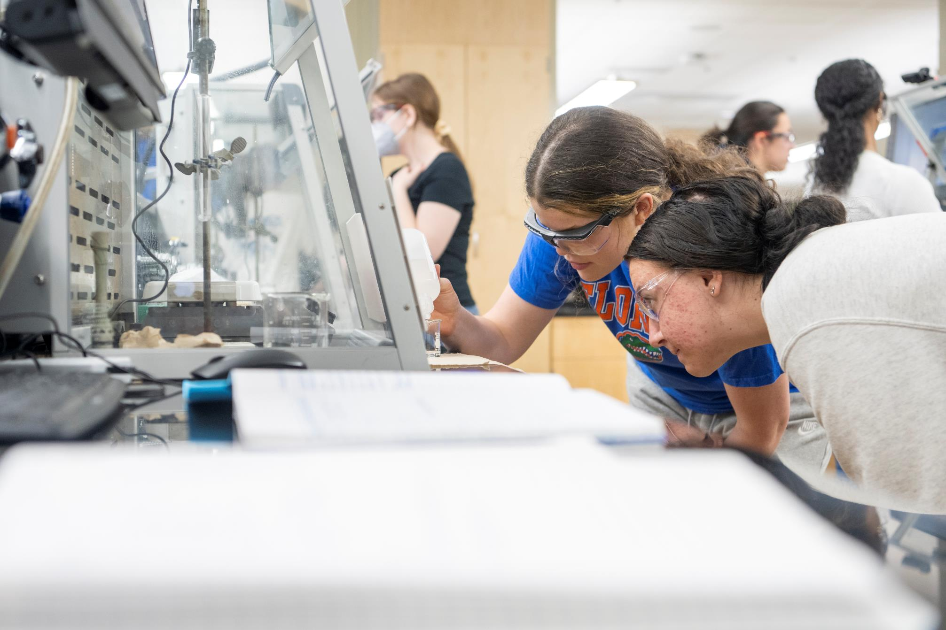
UF RANKS
FIRST
UF ranks first among public universities and second nationwide in a moving new discoveries from the lab and into the real world through research commercialization and STEM graduates.

Slide 15
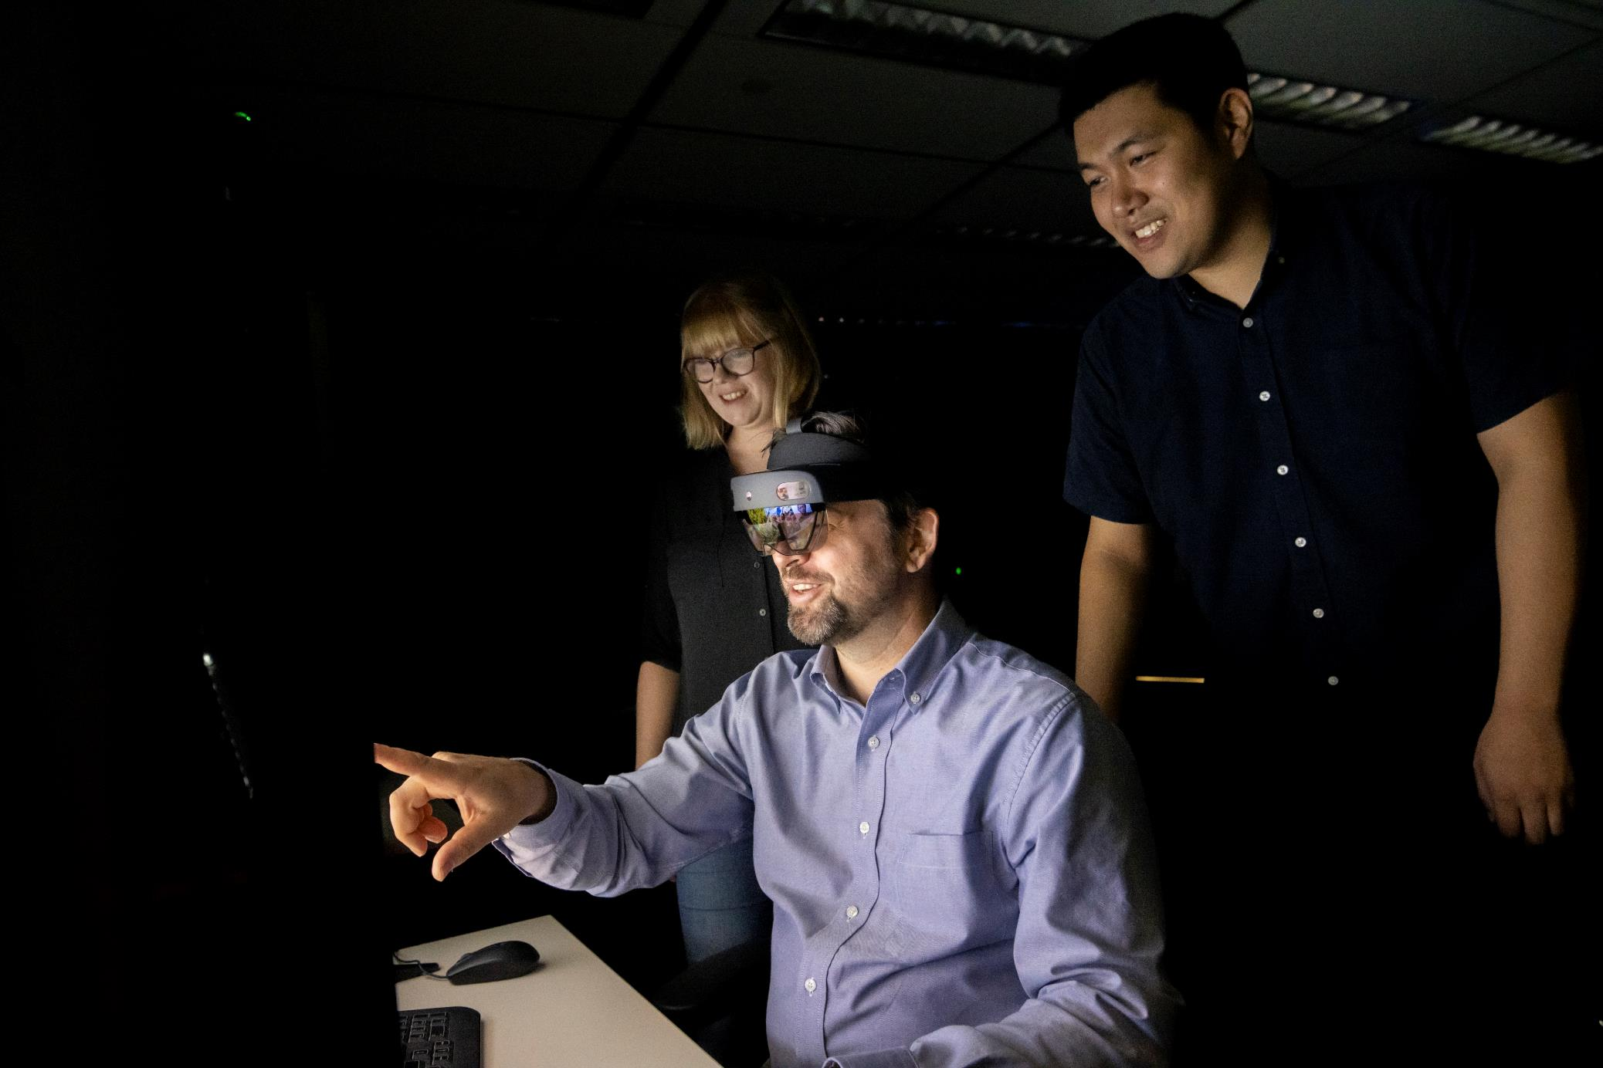
UF IS A RESEARCH
LEADER
We educate students who will become the next generation's scientists and engineers, teachers, and leaders in government and industry. The university earned more than $950 million in research funding last year.

Slide 16
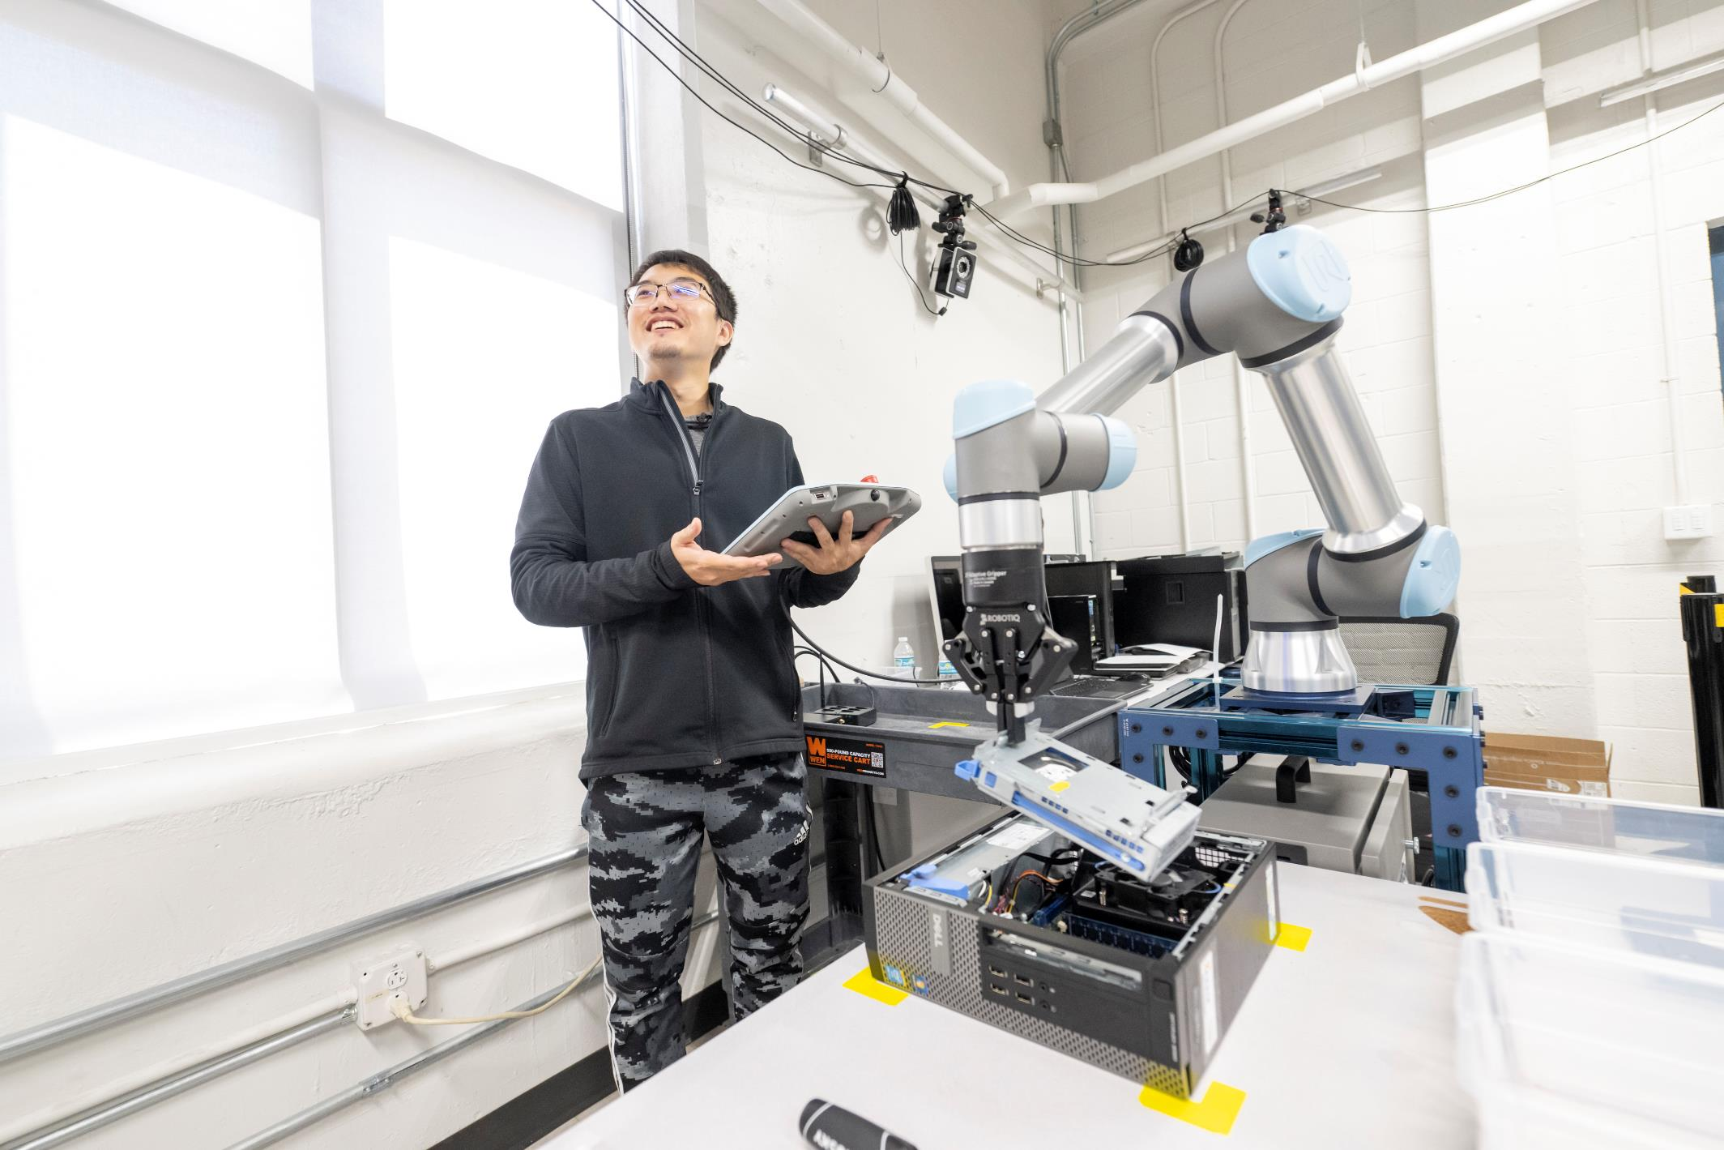
UF IS A TOP
INNOVATOR
U.S. News and World Report (2021) ranked UF as one of the nation’s Most Innovative Universities and a top school for undergraduate research.

Slide 17
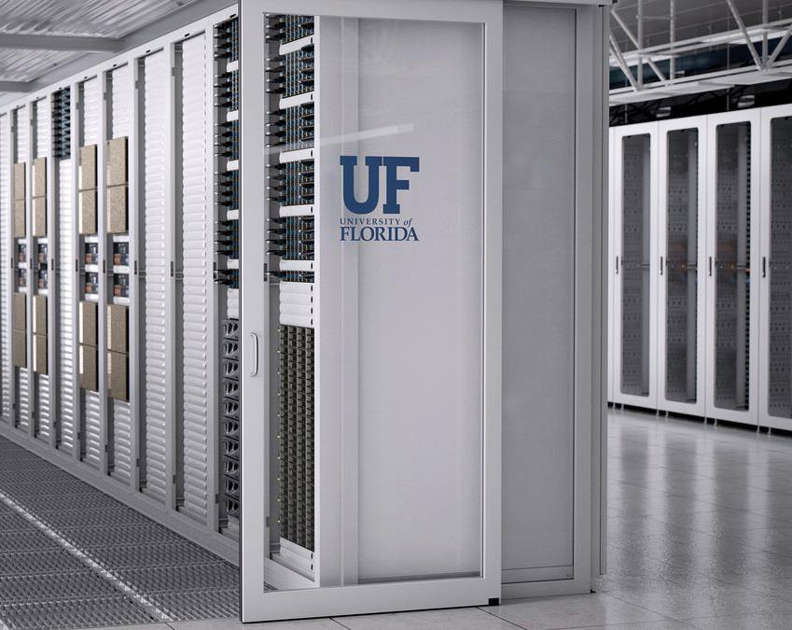
UF LEADS IN
ARTIFICIAL
INTELLIGENCE
HiPerGator AI, the most powerful AI supercomputer in the world, is right here on our campus.

Slide 18
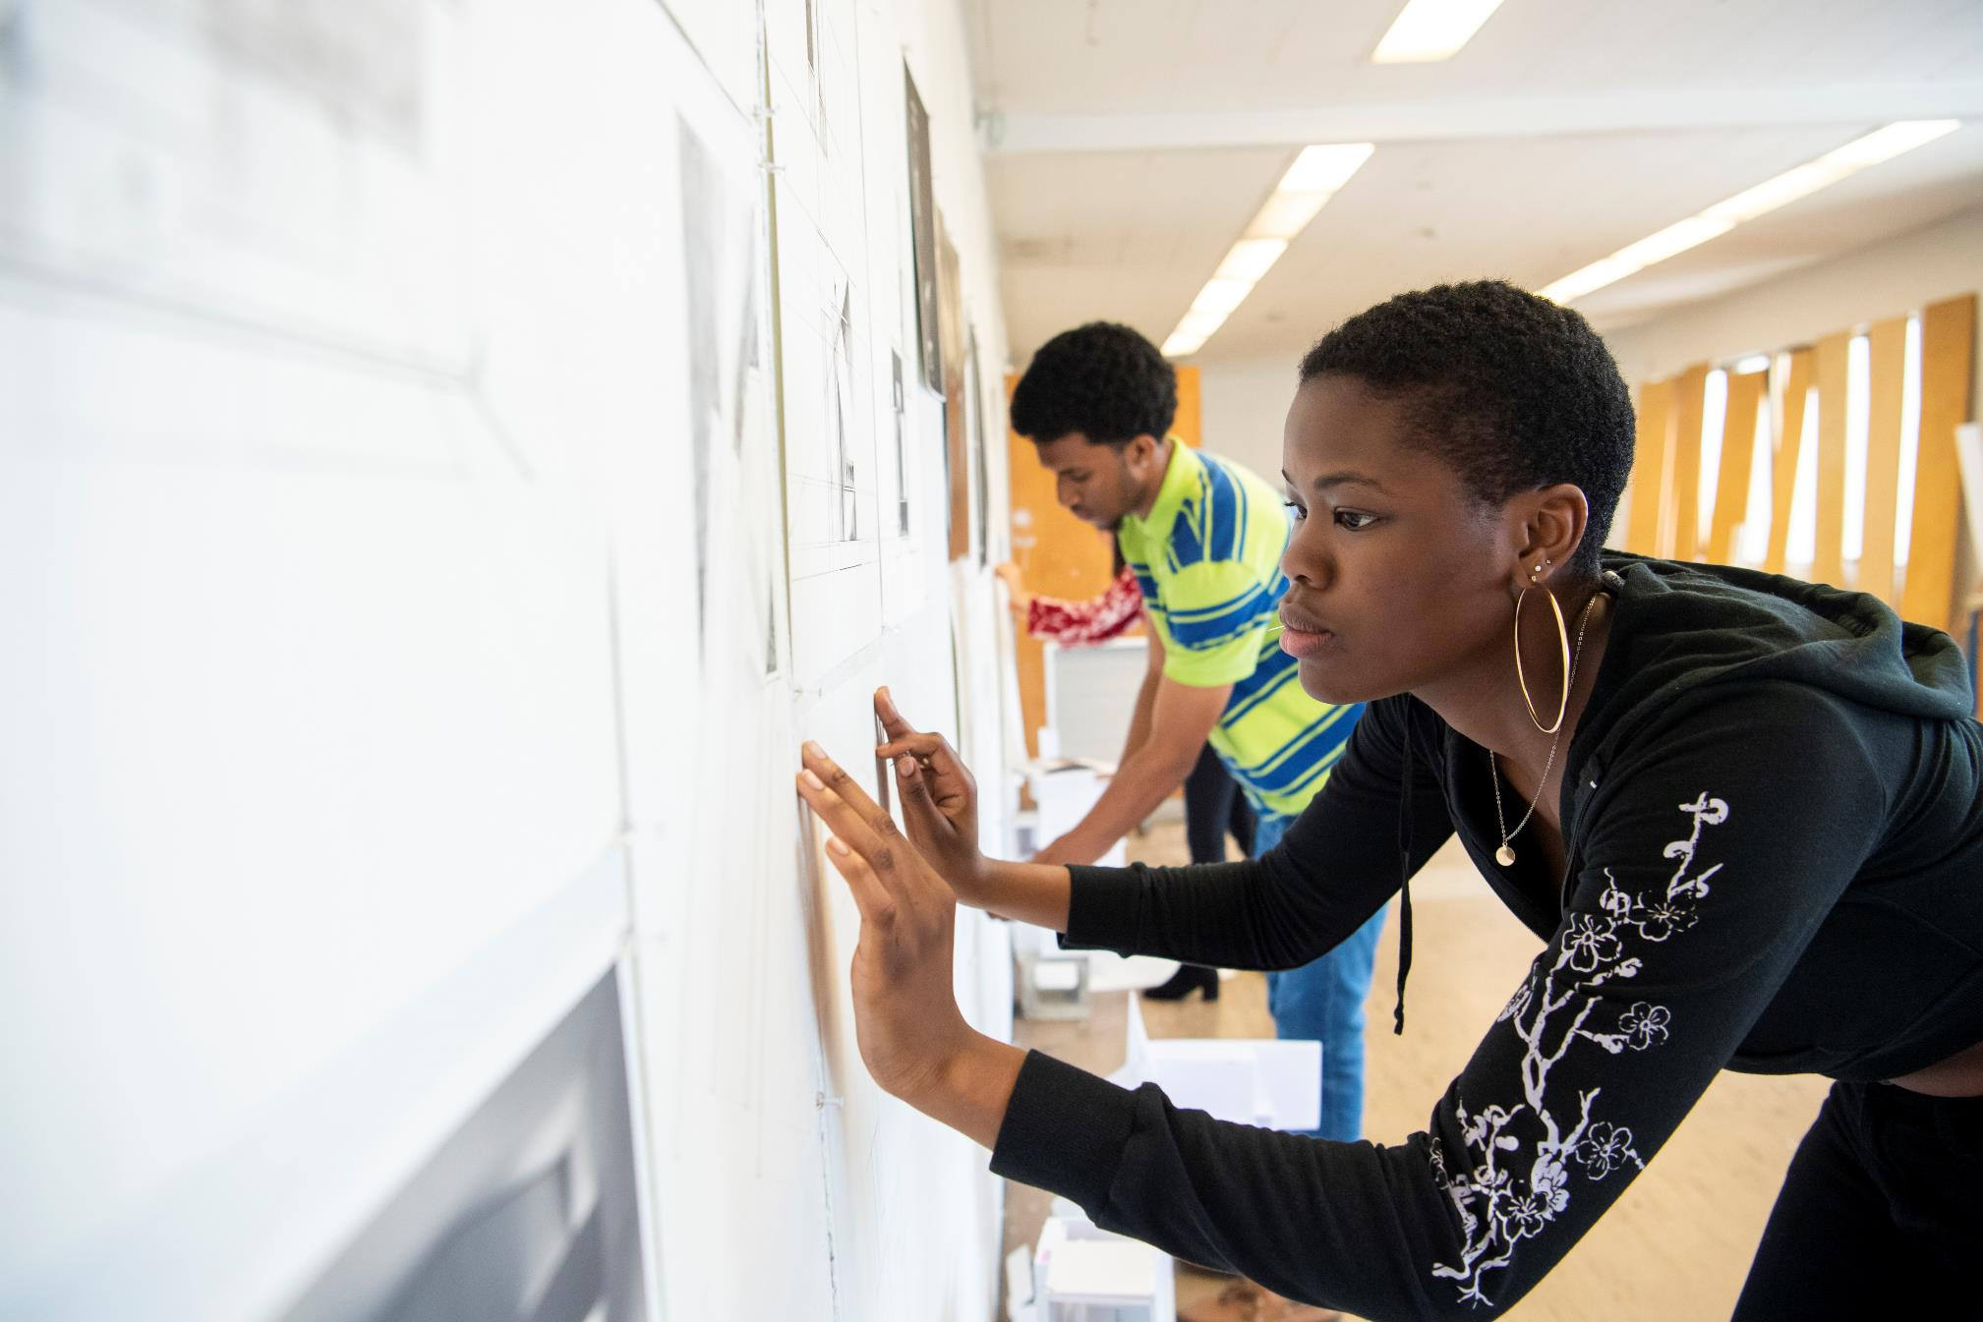
Exceptional
DOESN’T HAVE
TO BE EXPENSIVE.
NO. 1
Top 50 Best Value Colleges
(Value Colleges)
NO. 2
Best Bang for Your Buck
(Washington Monthly)
NO. 2
Kiplinger’s Best College Values

Slide 19
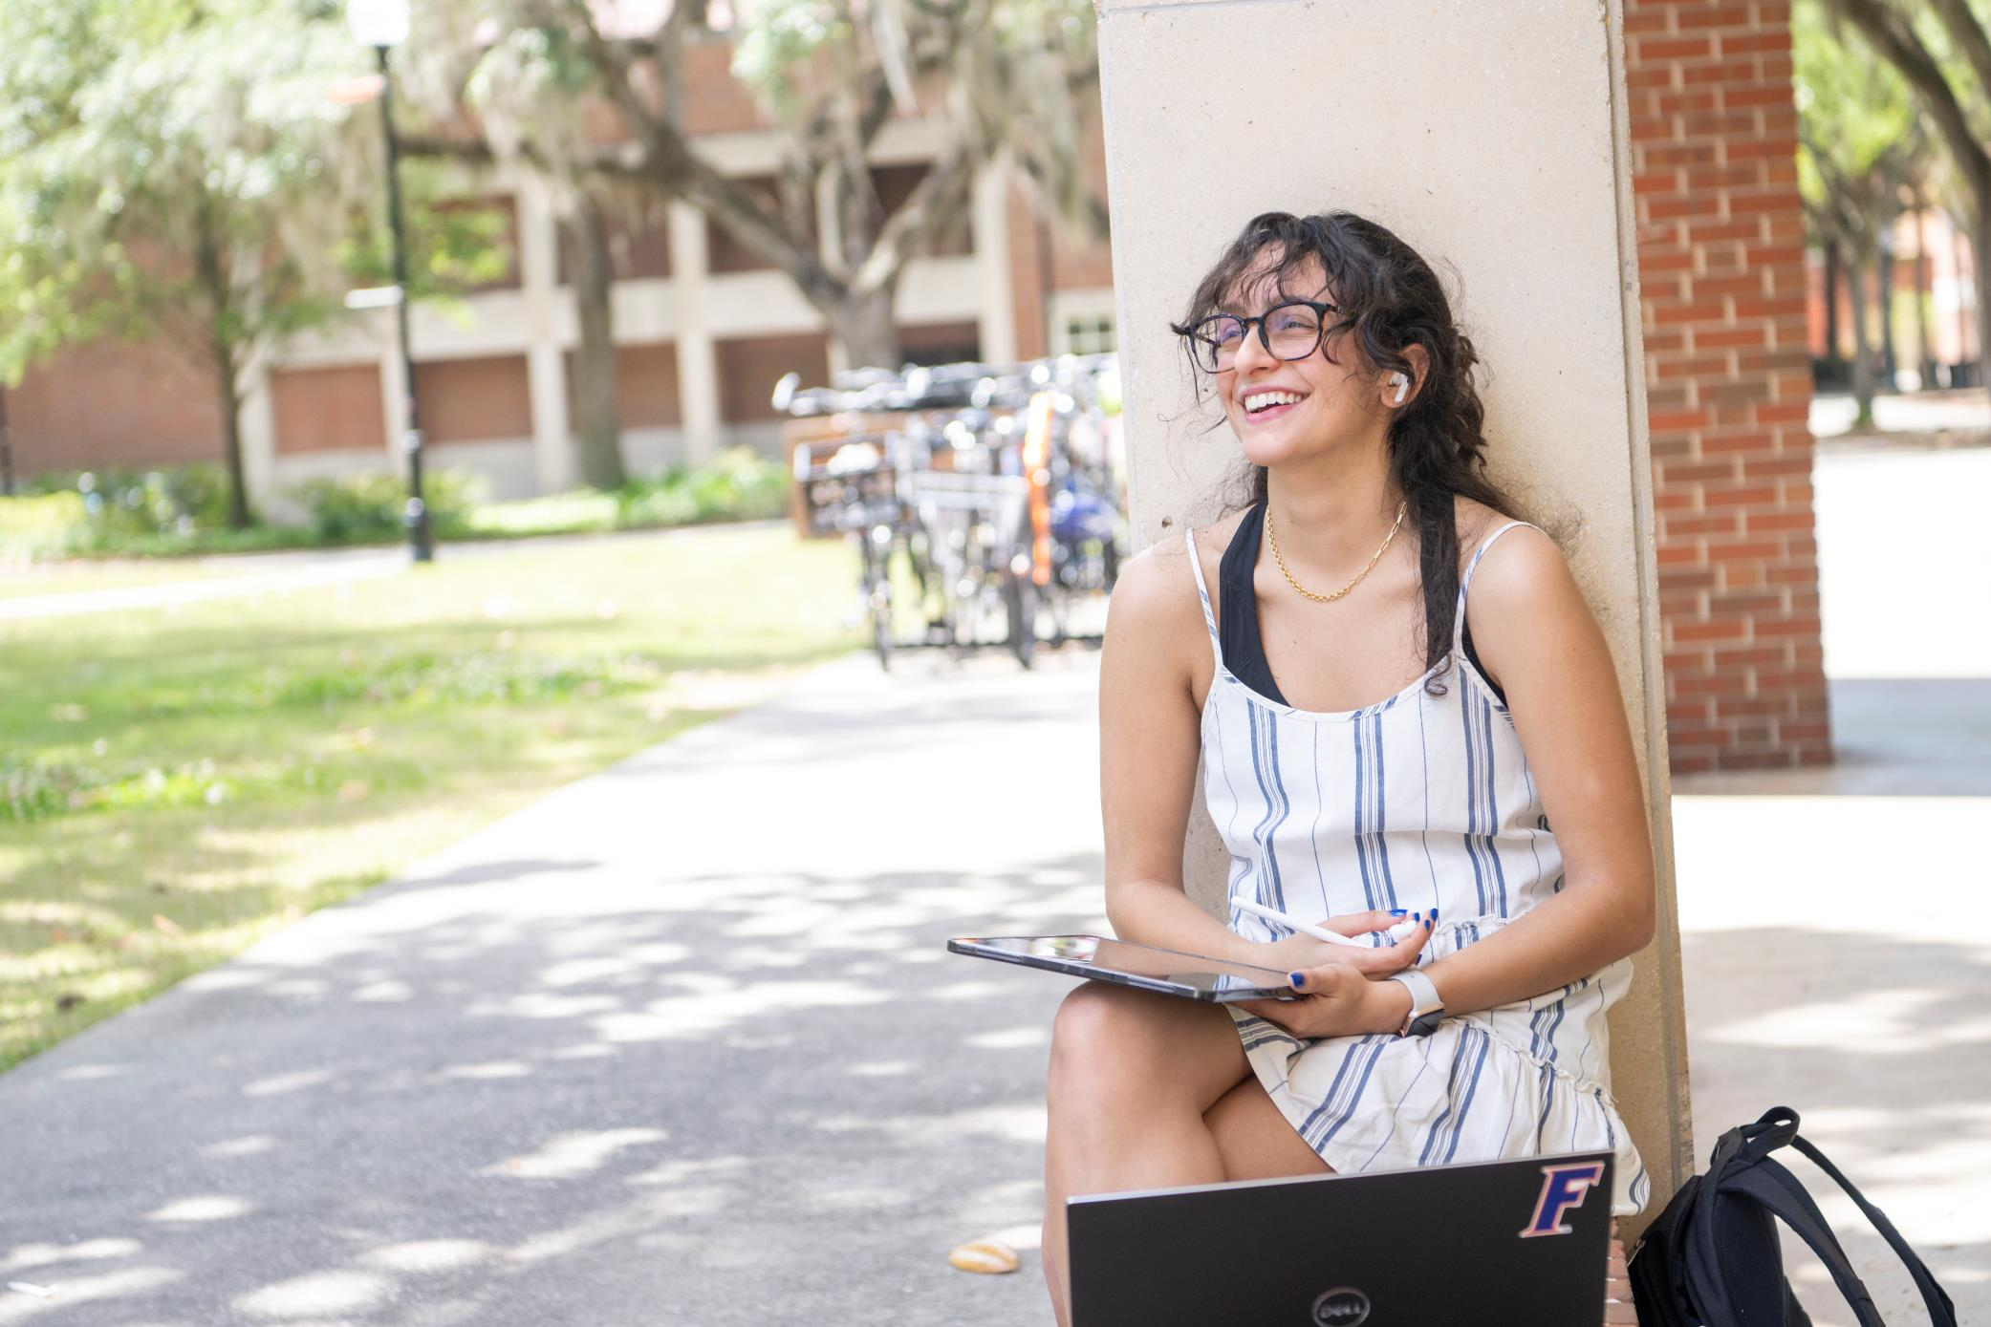
85%
of students receive
financial aid.

Slide 20
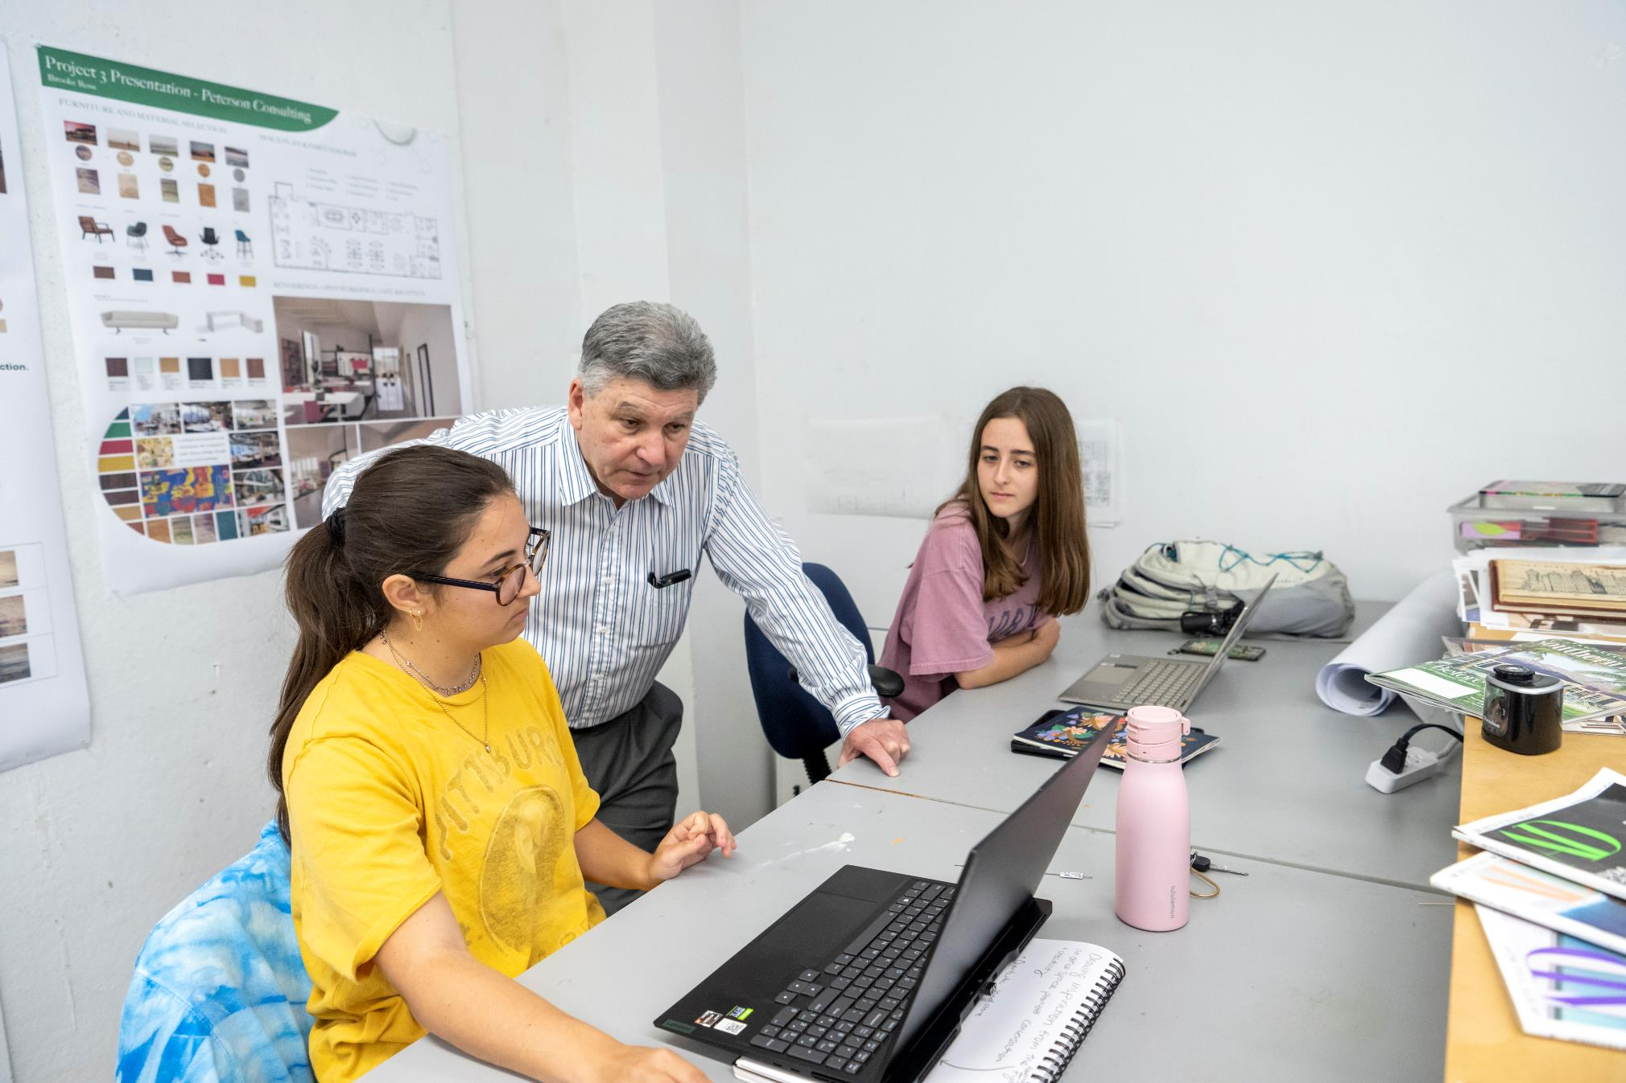
17:1
STUDENT-TO-FACULTY
RATIO

Slide 21
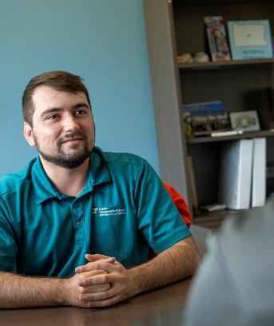
NATIONALLY RANKED
CAREER
CONNECTION CENTER
Career planning
Gator Career Closet
Internships
Mentorships
Career readiness check-in
Industry connections
Résumé reviews

Slide 22
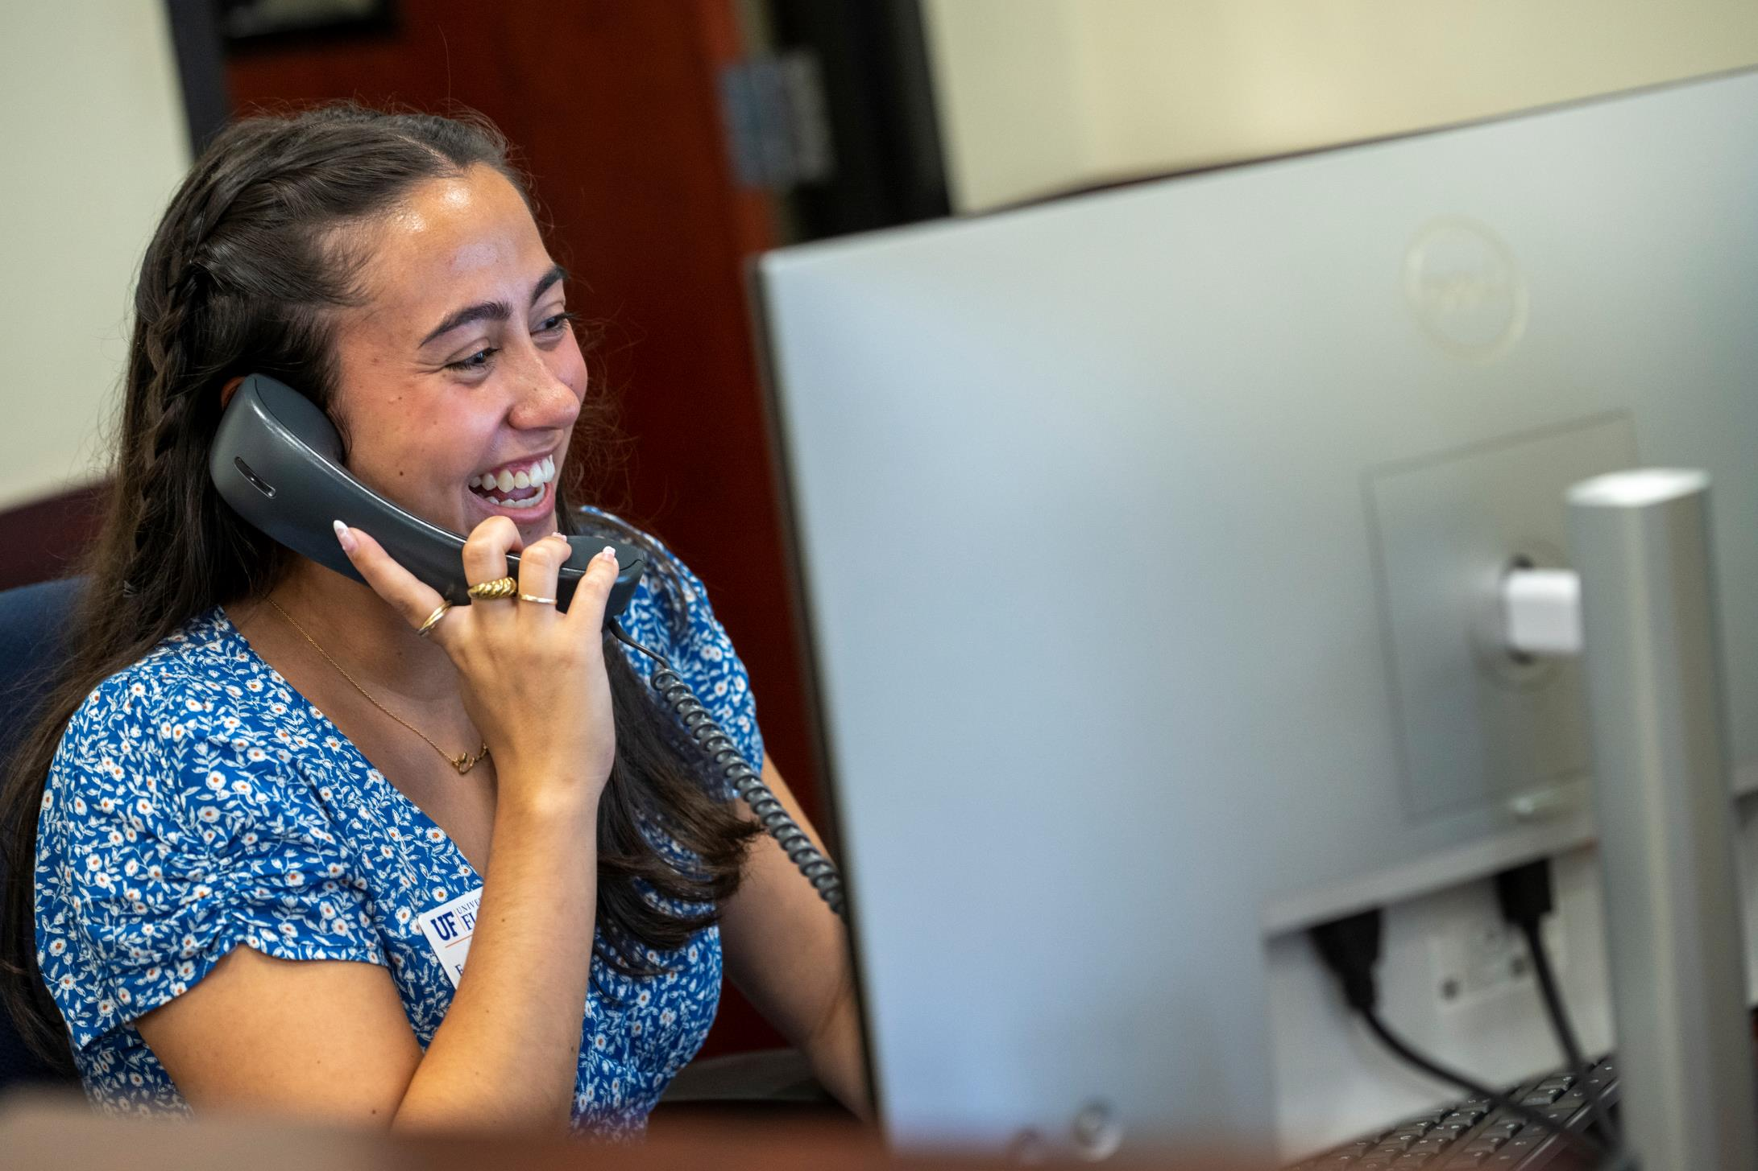
61%
of undergrads had at least one internship.
32%
of undergrads conducted research.
68%
of undergrads are employed part-time.

Slide 23
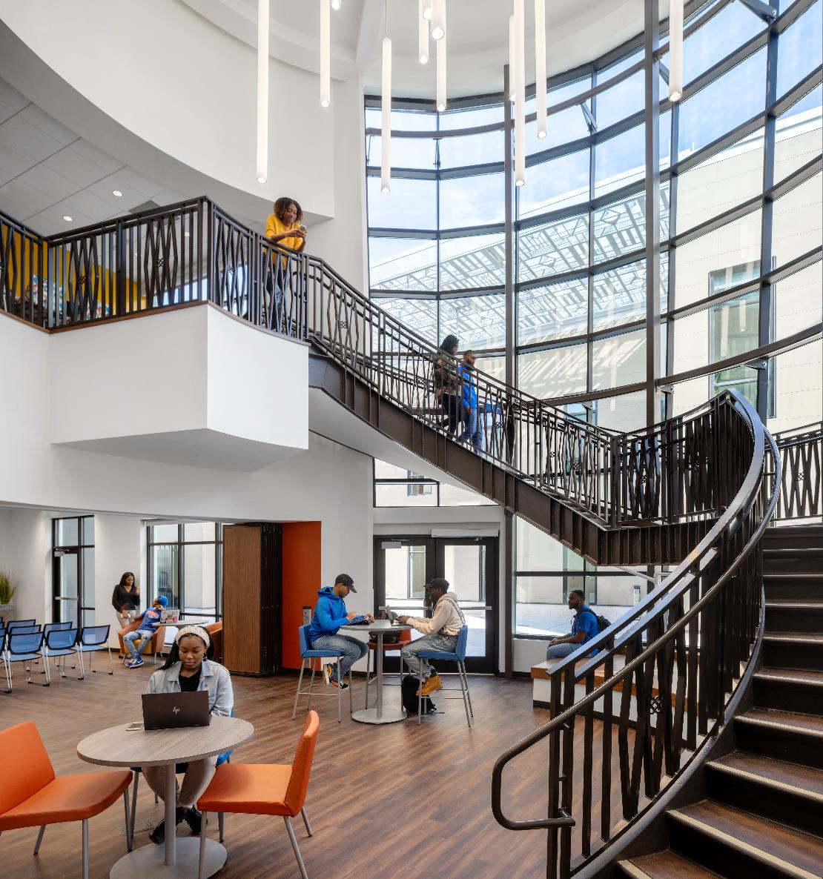
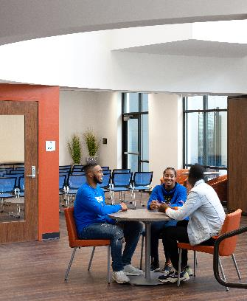
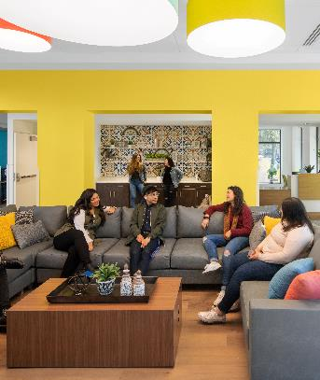
MULTICULTURAL
ENGAGEMENT
The Center for Inclusion and Multicultural Engagement celebrates and empowers diverse communities and advocates for an inclusive campus for all students across identities.
Office of Asian Pacific Islander Desi Student Engagement
Office of Black Student Engagement
Office of Hispanic-Latinx Student Engagement
Office of LGBTQ+ Student Engagement

Slide 24
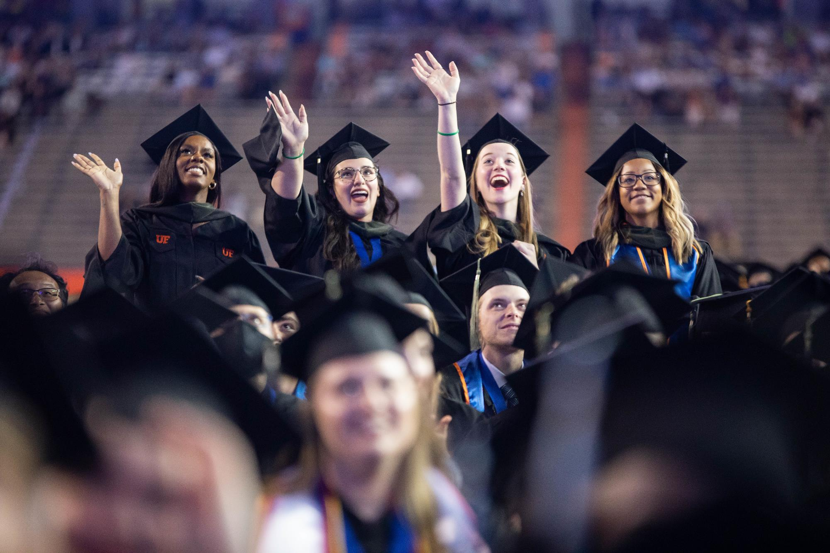
NO. 1
ONLINE PROGRAM
97%
RETENTION RATE
UF Online was ranked No. 1 by U.S. News & World Report in 2022

Slide 25
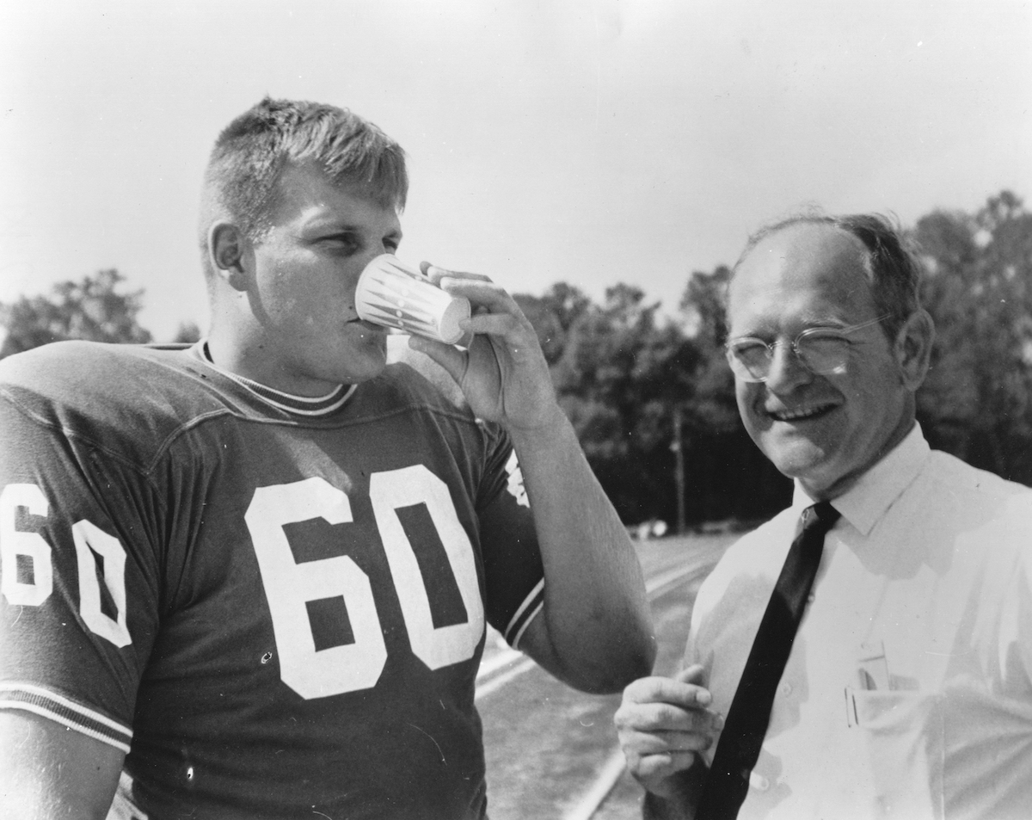
GATORADE
The world’s most popular sports drink is just one of the hundreds of commercial products resulting from UF.

Slide 26
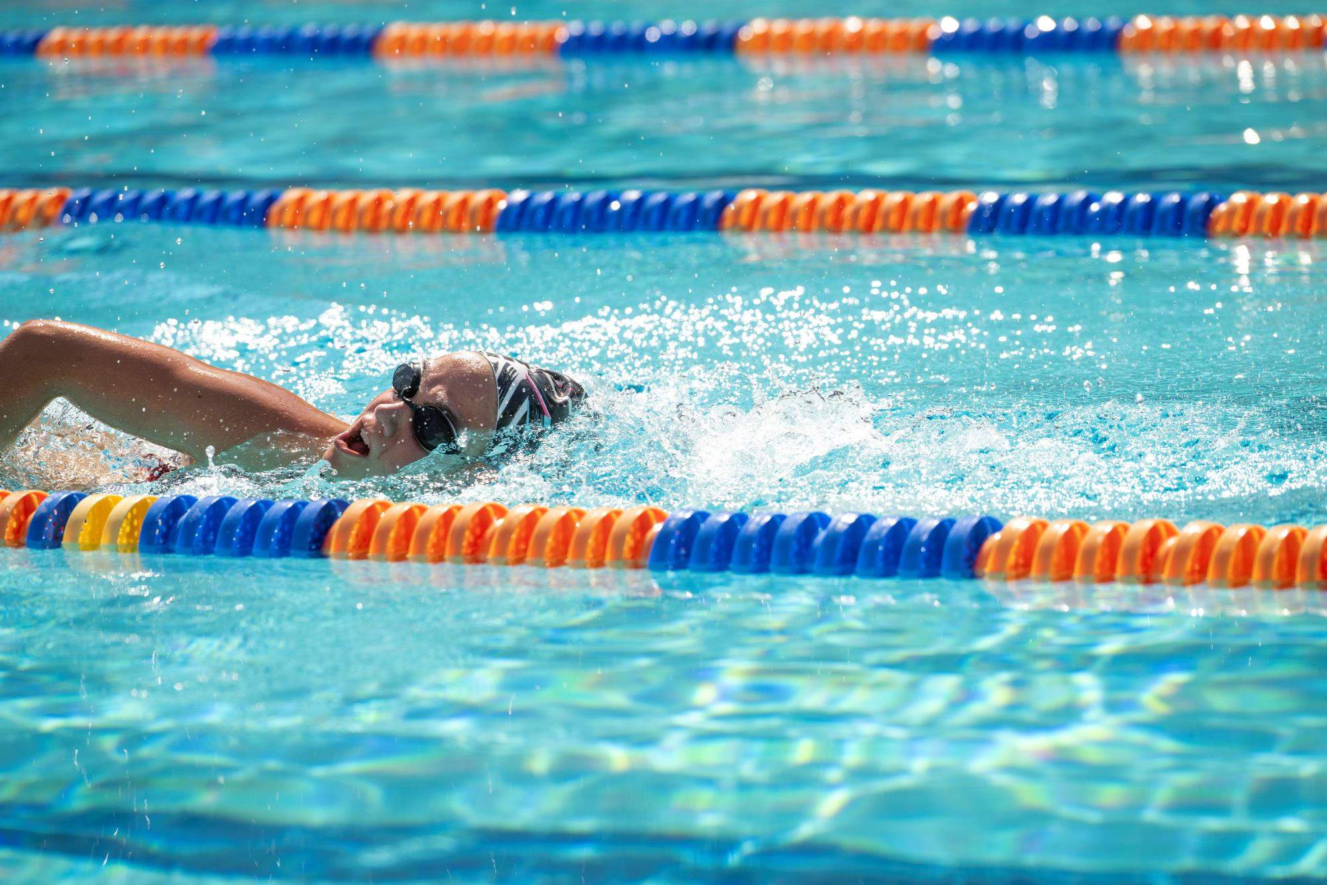
Since 1972, 180 Gators have participated in Olympic Games. We’ve won 144 Olympic medals!

Slide 27
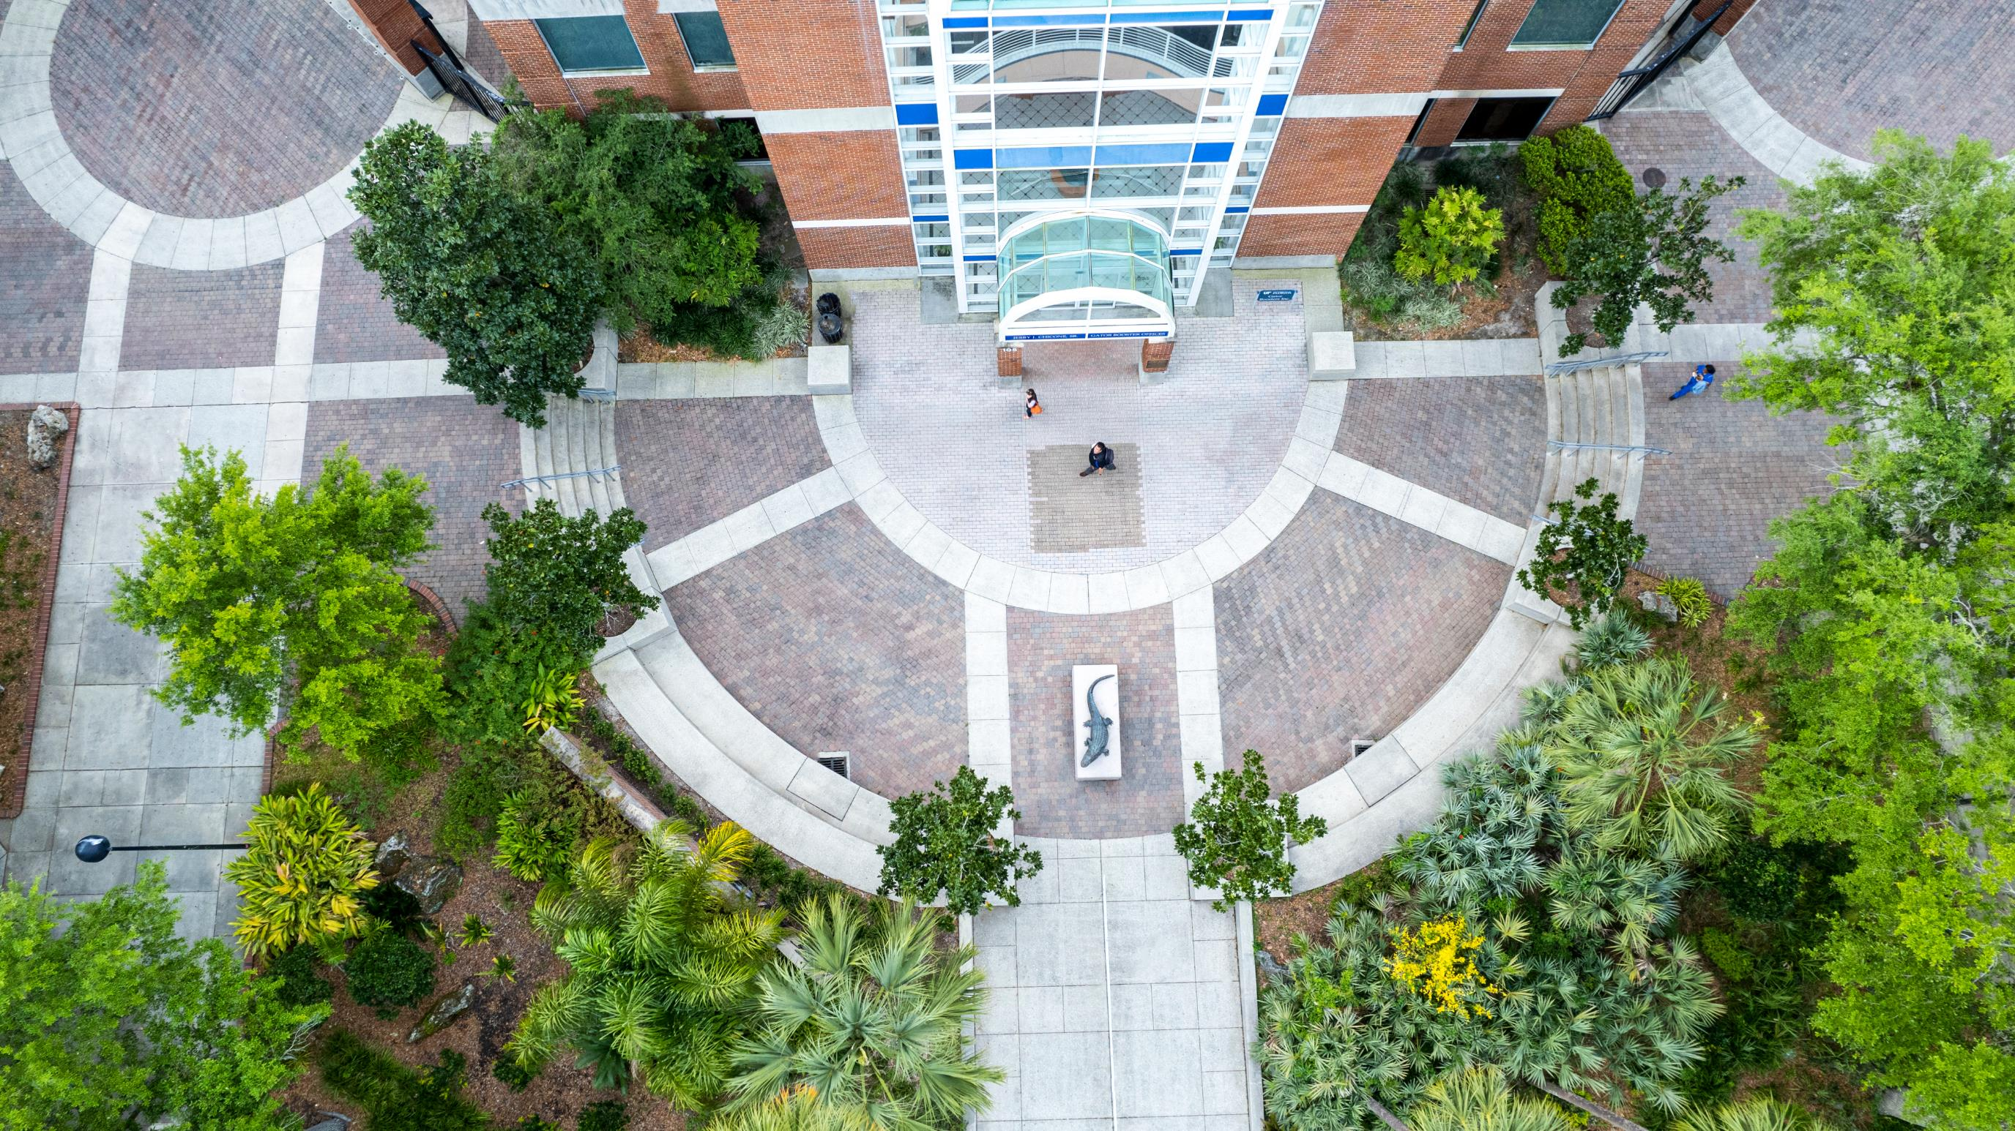
450,000+
ALUMNI WORLDWIDE

Slide 28
CONNECT WITH
ADMISSIONS
ADMISSIONS.UFL.EDU

