Slide 1
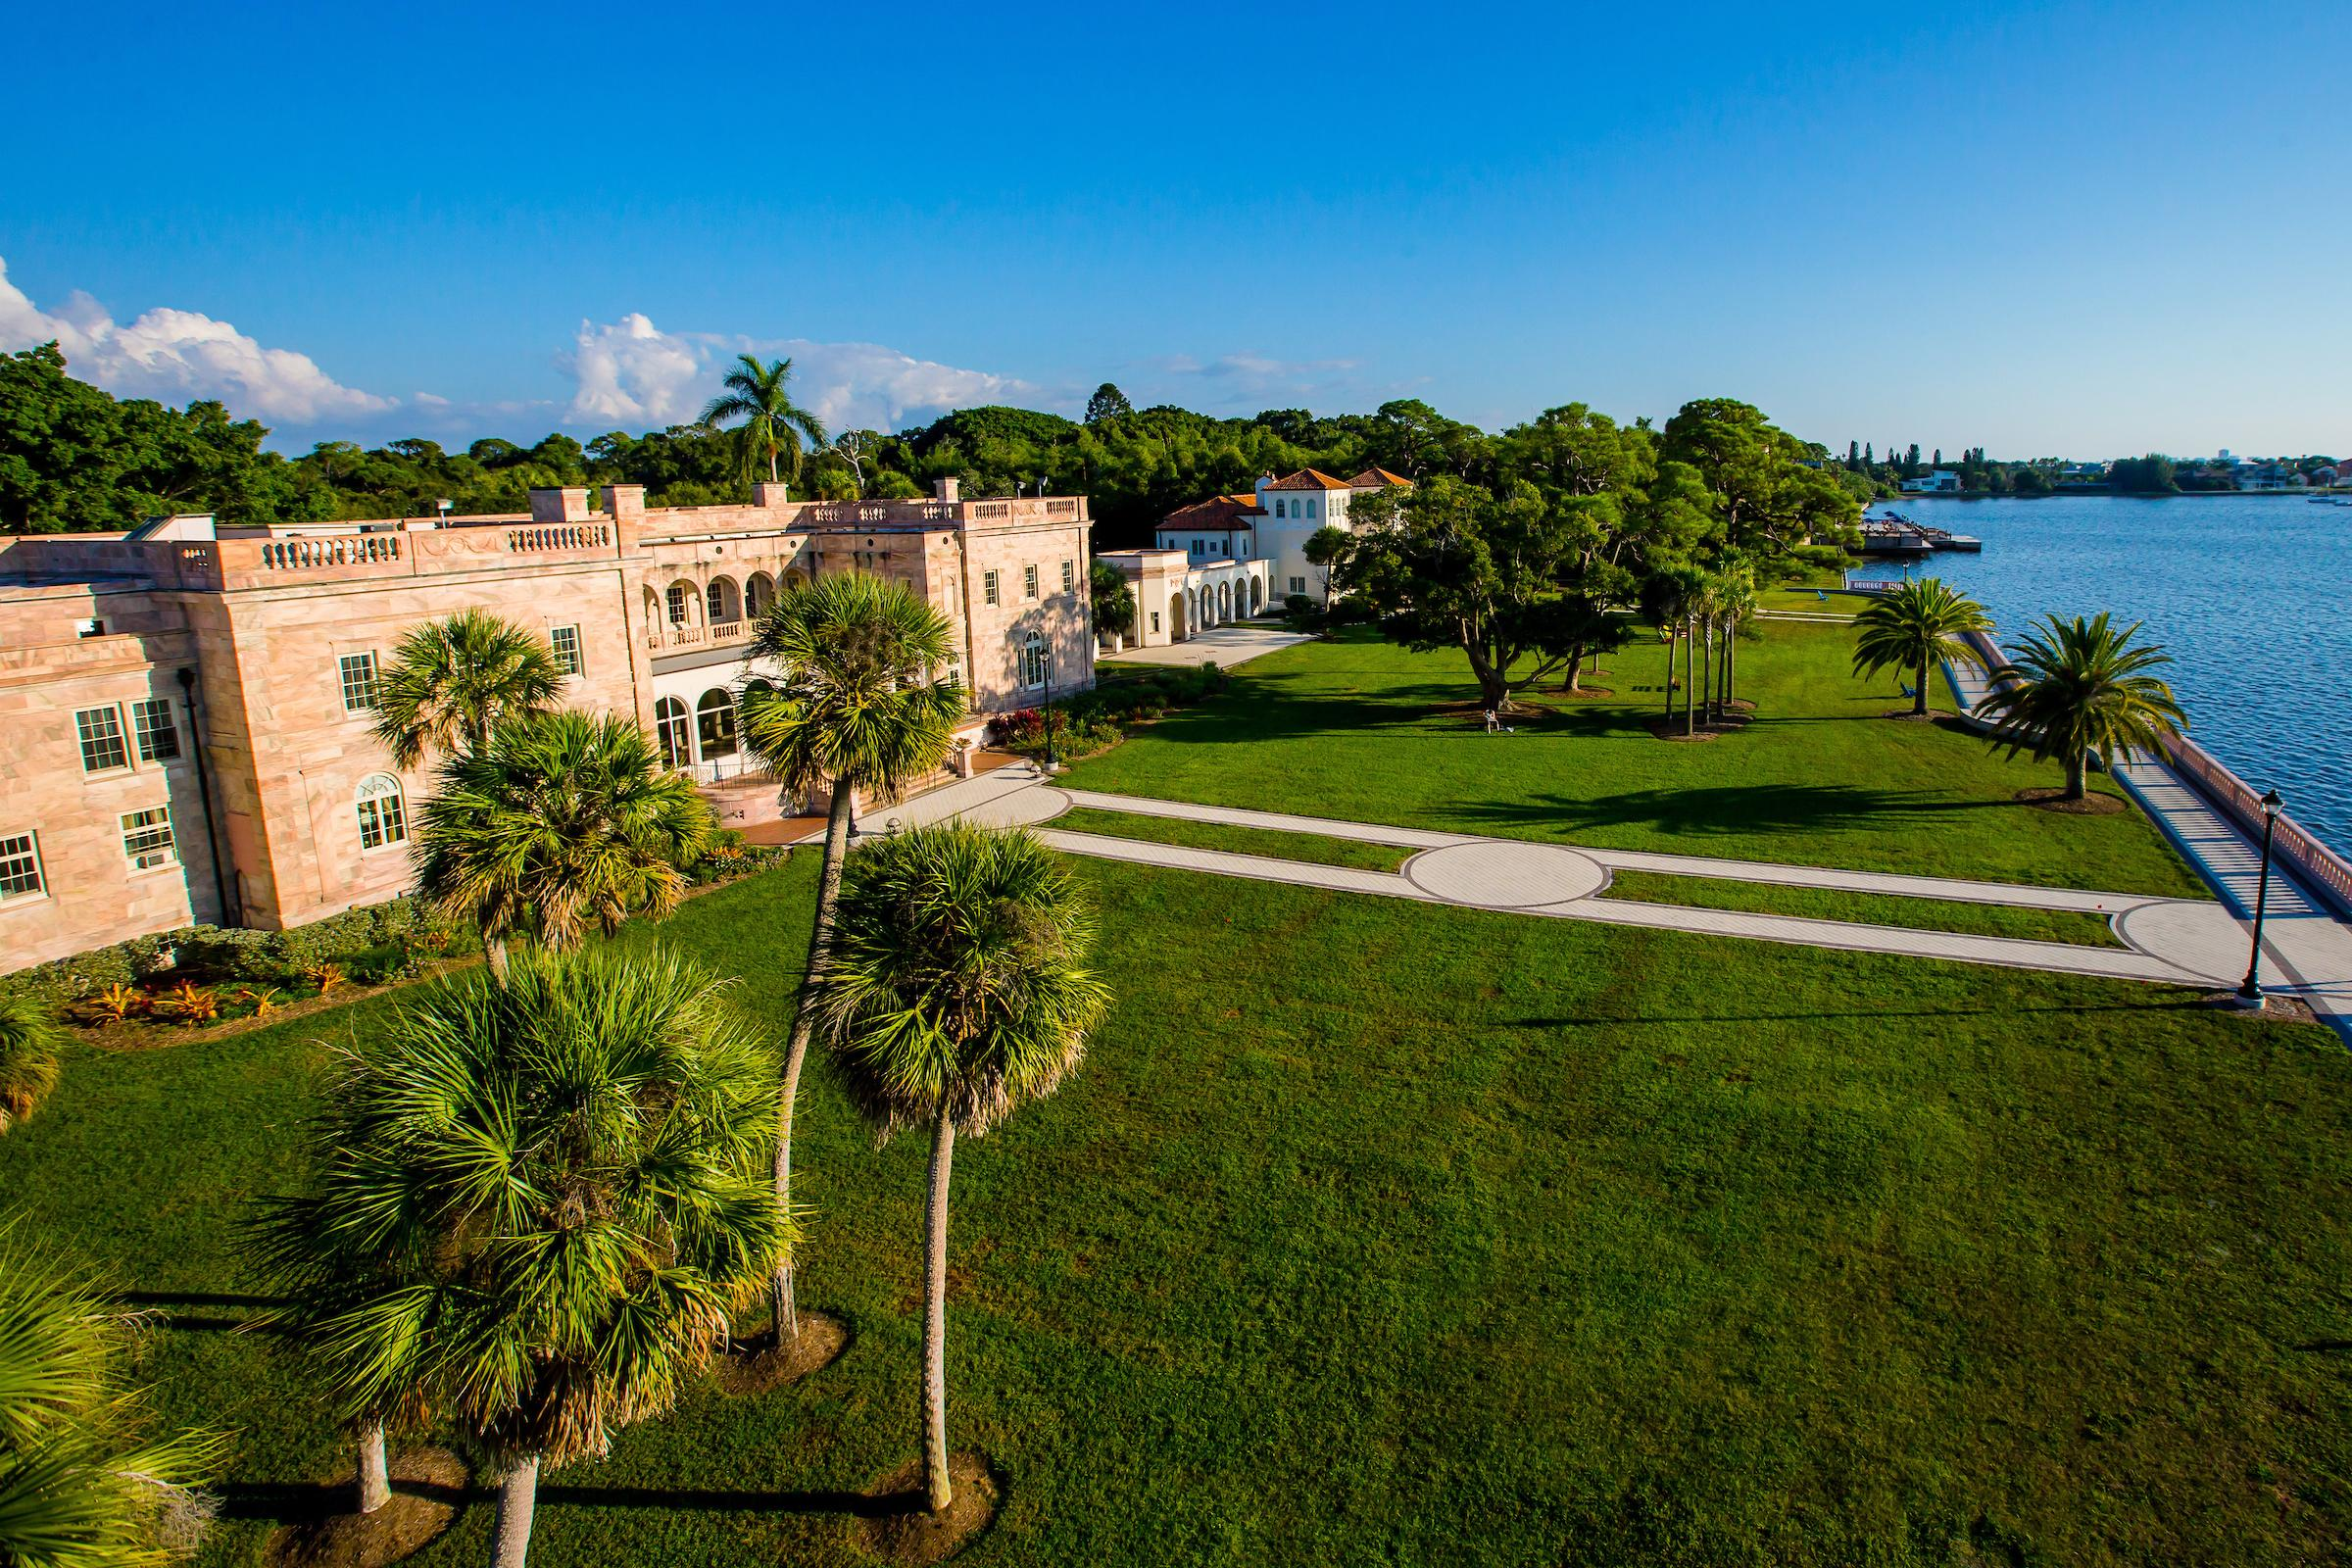

Slide 2
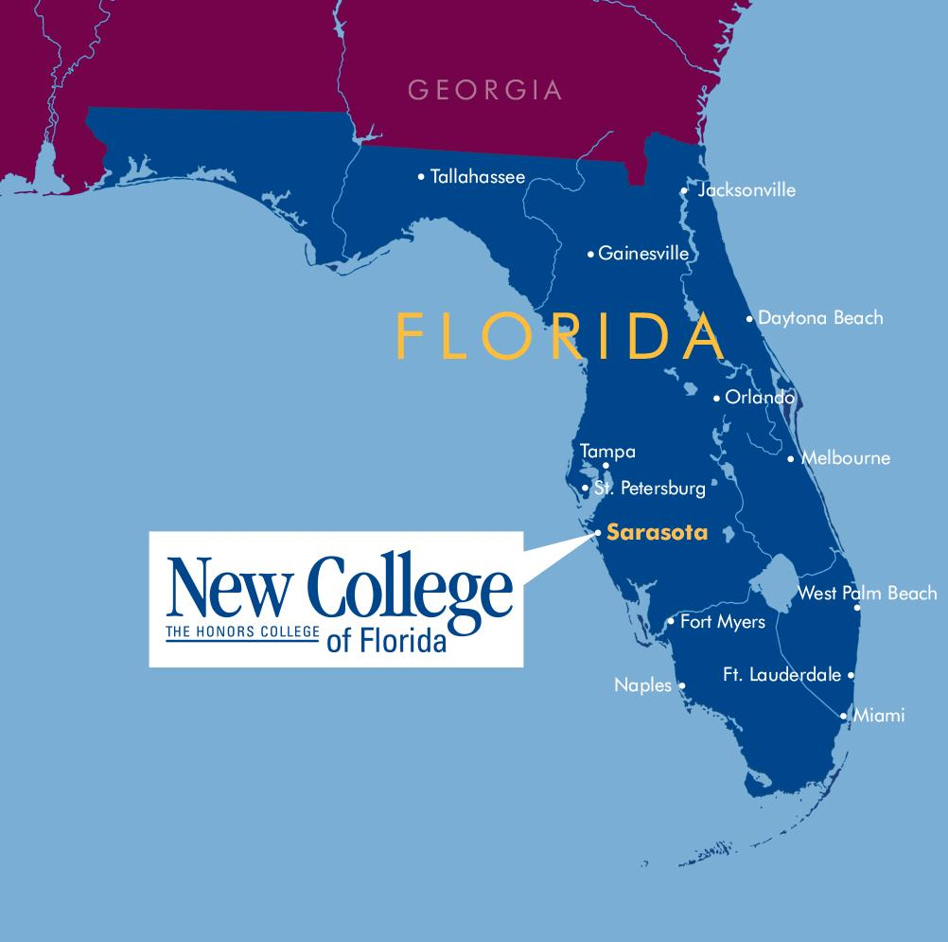
NEW COLLEGE OF FLORIDA
An affordable public honors college
12
average
class size
7:1
student to
faculty ratio
700
undergraduate
students
Notes:
What is New College of Florida?
Here at New College, we do things differently because we understand that developing the next generation of trailblazers is needed now more than ever.
New College is an education without boundaries. It's a community that fosters curiosity, independence, and initiative, risk taking and discovery, and lifelong relationships. To be a Novo is to be an original–someone seeking a transformative educational experience.
Public honors college
Member of the State University System of Florida
What does it mean to be an honors college?
Undergraduate focused, all classes are rigorous, small classes, personal attention from full-time faculty who know you by name.
700 students enrolled
#5 Public Liberal Arts College in the nation according to U.S. News and World report.

Slide 3
45+ AREAS OF CONCENTRATION: NCF.EDU/MAJORS
• Anthropology
• Applied Mathematics
• Art
• Art History
• Biology
• Biopsychology
• Chemistry (including Biochemistry)
• Chinese Language & Culture
• Classics
• Computer Science
• Creative Writing*
• Data Science
• Economics (including Finance*)
• English
• Environmental Studies
• French Language & Literature
• Gender Studies
• German Studies/
German Language & Literature
• Greek**
• Health, Culture & Societies*
• History
• Humanities
• International & Area Studies
(including Caribbean & Latin
American Studies, East Asian Studies
& European Studies)
• Latin**
• Literature
• Marine Biology
• Mathematics
• Medieval & Renaissance Studies+
• Music
• Natural Sciences
• Neuroscience*
• Philosophy
• Physics
• Political Science
• Psychology
• Public Policy+
• Quantitative Social Science*
• Religion
• Rhetoric and Writing**
• Russian Language & Literature
• Social Sciences
• Sociology
• Spanish Language & Literature
• Statistics
• Theatre, Dance & Performance
Studies
• Urban Studies
* Can only be completed as part of a joint
concentration
** Can only be completed as a secondary field
(minor)
+ Special program concentration

Slide 4
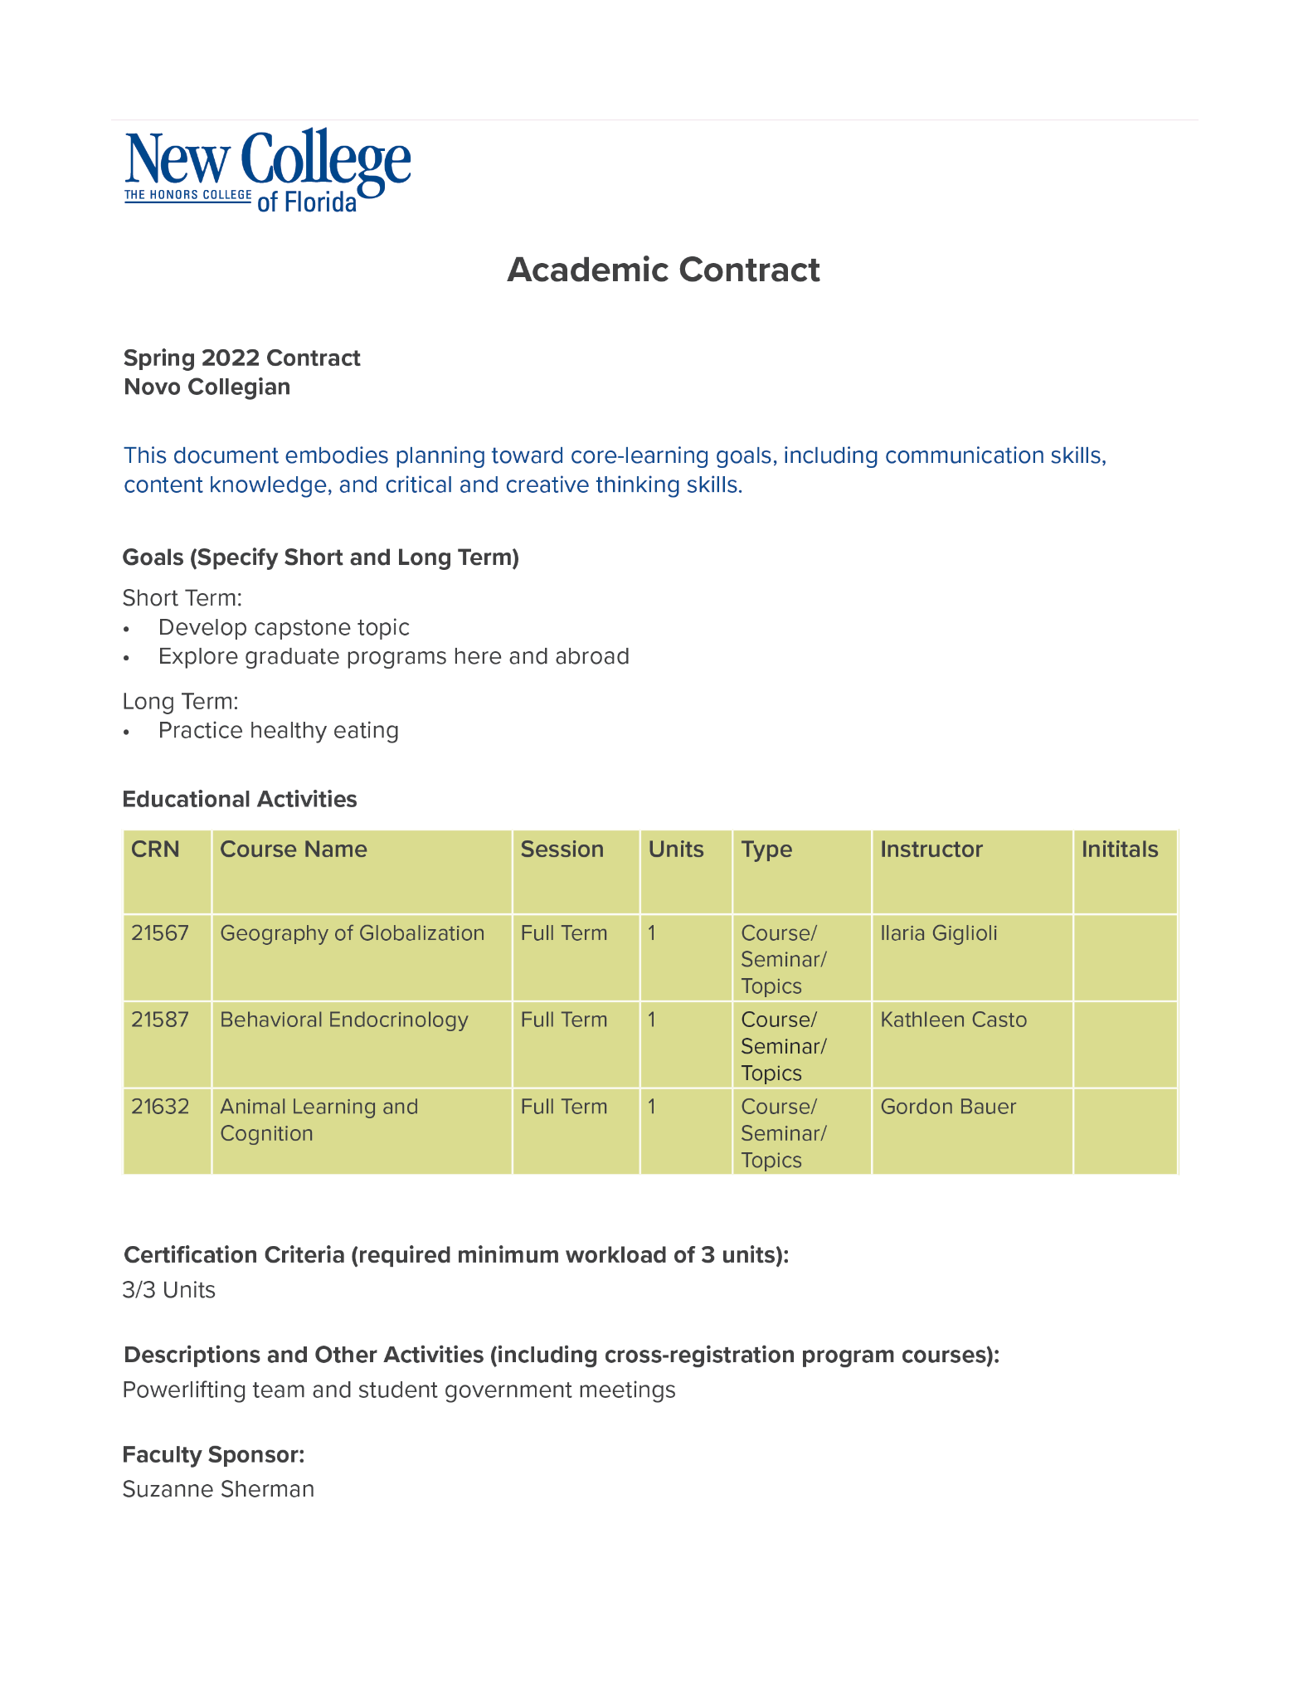
AN EDUCATION WITHOUT BOUNDARIES
CURIOSITY, INDEPENDENCE, INITIATIVE
Customize Your Curriculum
Tailored to you – your interests, passions, strengths,
areas of growth, short-and long-term goals
Academic Contract
An individualized plan that goes beyond courses
Independent Study Projects (ISPs)
Senior Capstone Project/Thesis
Notes:
At New College, students get to BE ORGINAL, BE THEMSELVES.
An Education Without Boundaries: Fostering curiosity, independence, and initiative.
Customized Curriculum:
Tailored to your interests, passions, areas of growth, short and long-term goals. The way we do that is through the academic contract system.
Contracts -
Academic Contracts - Rather than checking off a list of required courses, you collaborate with your faculty adviser on an academic contract that includes all of your classroom and cocurricular activities as well as goals for the coming semester.
Tutorials
An additional opportunity for students to embrace the flexible curriculum is to take advantage of a tutorial, which is a self designed or group designed course.
Independent Study Projects
One of the opportunities for hands-on learning at NCF is our Independent Study Project (ISP) Term. Thirty days in January dedicated to research, internship, study abroad, which students can do one on one with a professor or in small groups.
Capstone Project/Senior Thesis
Like an entrepreneur, every student comes up with an idea for a senior capstone project, finds the resources to create it, and advocates for its value before a faculty committee. Every student’s capstone will be different and will look different depending upon their area of concentration (e.g. literary analysis in humanities, experiment in STEM, artwork portfolio in the arts)

Slide 5
TAKE RISKS WITH
YOUR LEARNING
Narrative Evaluations
=
Meaningful Feedback
SAMPLE STUDENT EVALUATION
Notes:
Narrative Evaluations
A New College Education is an education without boundaries.
WE ENCOURAGE RISK TAKING. WE WANT STUDENTS TO TRY THINGS OUT
To reflect this philosophy, we believe that traditional letter or number grades do not encourage learning and instead hinder it.
So, just like in the professional world, instead of letter grades, we give detailed written evaluations which provides students with valuable feedback about learning and performance. This allows students to take risks with their learning instead of worrying about a GPA.

Slide 6
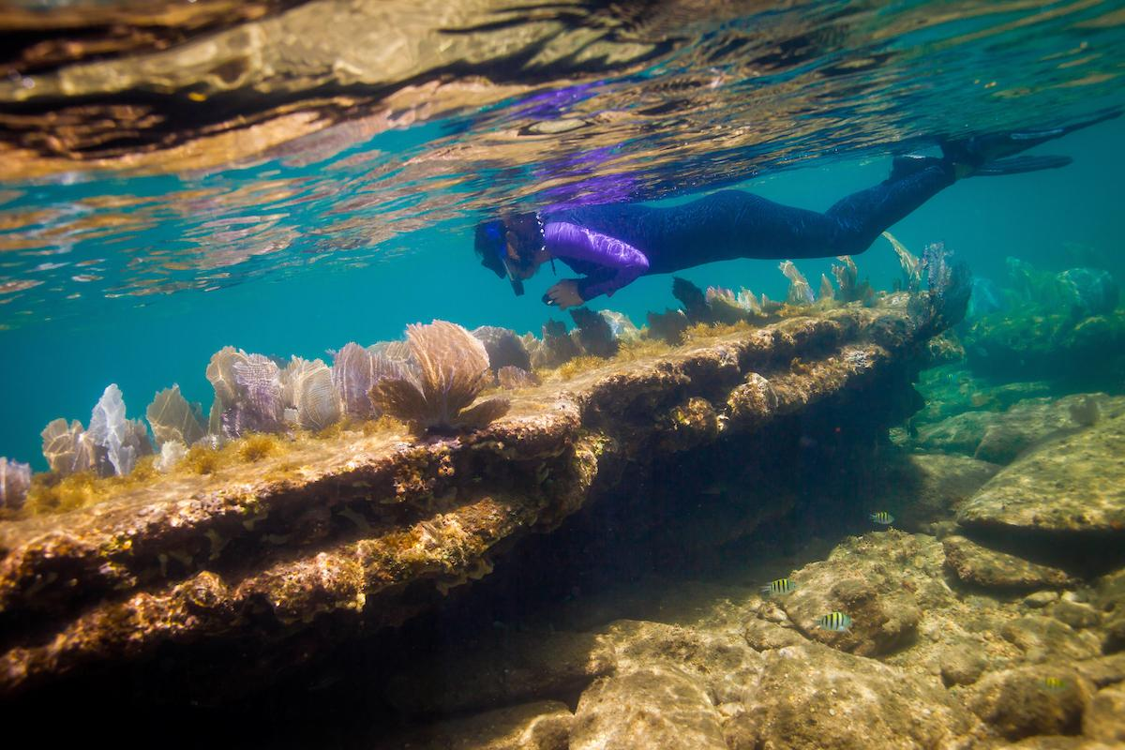
VALUABLE HANDS-ON LEARNING
93%
have 3 or more hands-on learning
experiences by the time they graduate
INDEPENDENT STUDY PROJECTS
Honduras Coral Reef Project
Nicholas Pracko, LGBTQ+ Intergenerational Conversations
Toni Ginsberg-Klemmt GismoPower Solar Carport
won Ozy Genius Award
Dance For Parkinson’s ISP
Birding New College
SENIOR CAPSTONE PROJECTS
Interpretations of Folk: Representing the Working Class and
Outside Art Through Instrument Design
Sarasota Bay: A Newly Defined Nursery Area for Blacktip
Sharks on the Gulf Coast of Florida
Cultural Gentrification: Hip-Hop & Racial
Epistemologies in the U.S.
Notes:
Hands-on Learning: At New College, students get hands-on, real world learning experiences that both employers and graduate schools value.
Learning environment encourages innovative thinking and an entrepreneurial mindset.
Independent Study Projects: Take place during the month of January where students are decided to one particular topic or project. Students can do research, study abroad, or do an internship for the 30 days in January. This is an opportunity for students to delve into a particular topic that interests them, regardless of whether it is related to their area of concentration or not. Students complete 3 ISPs before they graduate.
Graduate-level research opportunities: Because we are an undergraduate-focused college, our students get to conduct graduate level research alongside faculty starting their first year. Our students don’t have to wait in line to get this research experience like they do at larger universities.
Senior Capstone Project: Culminating experience for every NCF student. Every student comes up with an idea, finds the resources to create the idea, creates the idea, and advocates for its value in front of a faculty committee. Many of these projects solve real-world problems like a solar-powered cart port than won an Ozy Genius Award, a patent-pending algorithm for measuring climate change, a financial literacy program for teens, and a farmer’s market in a low-income rural community.

Slide 7
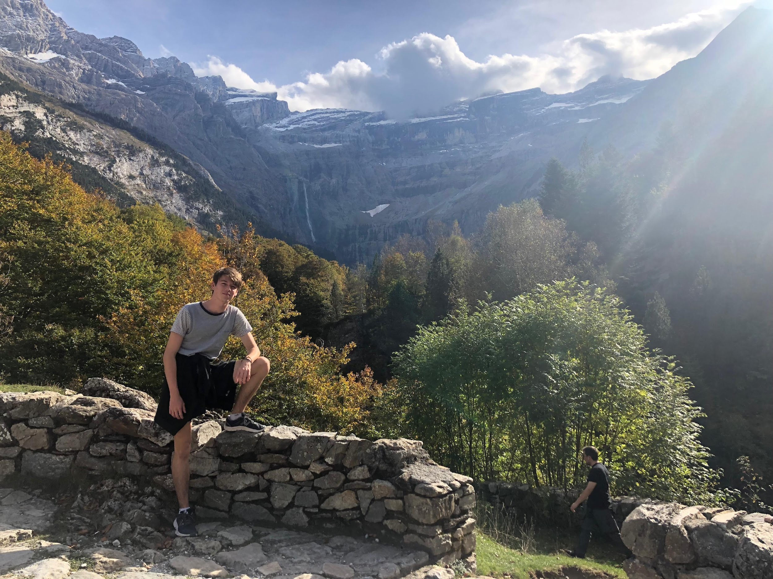
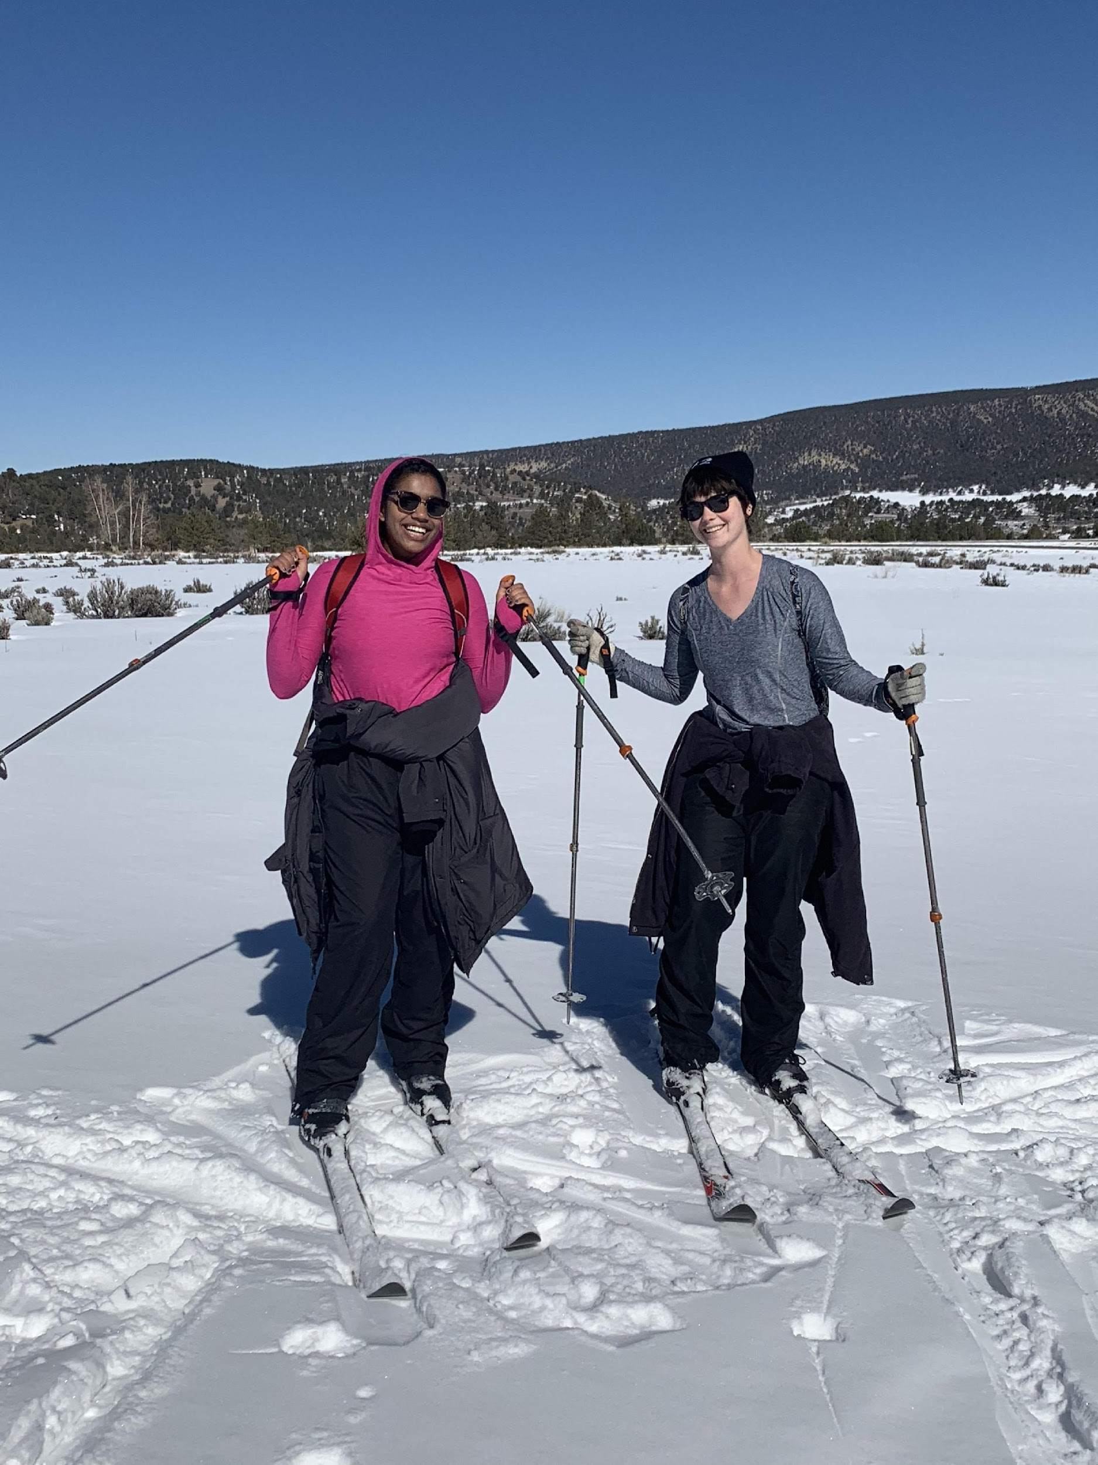
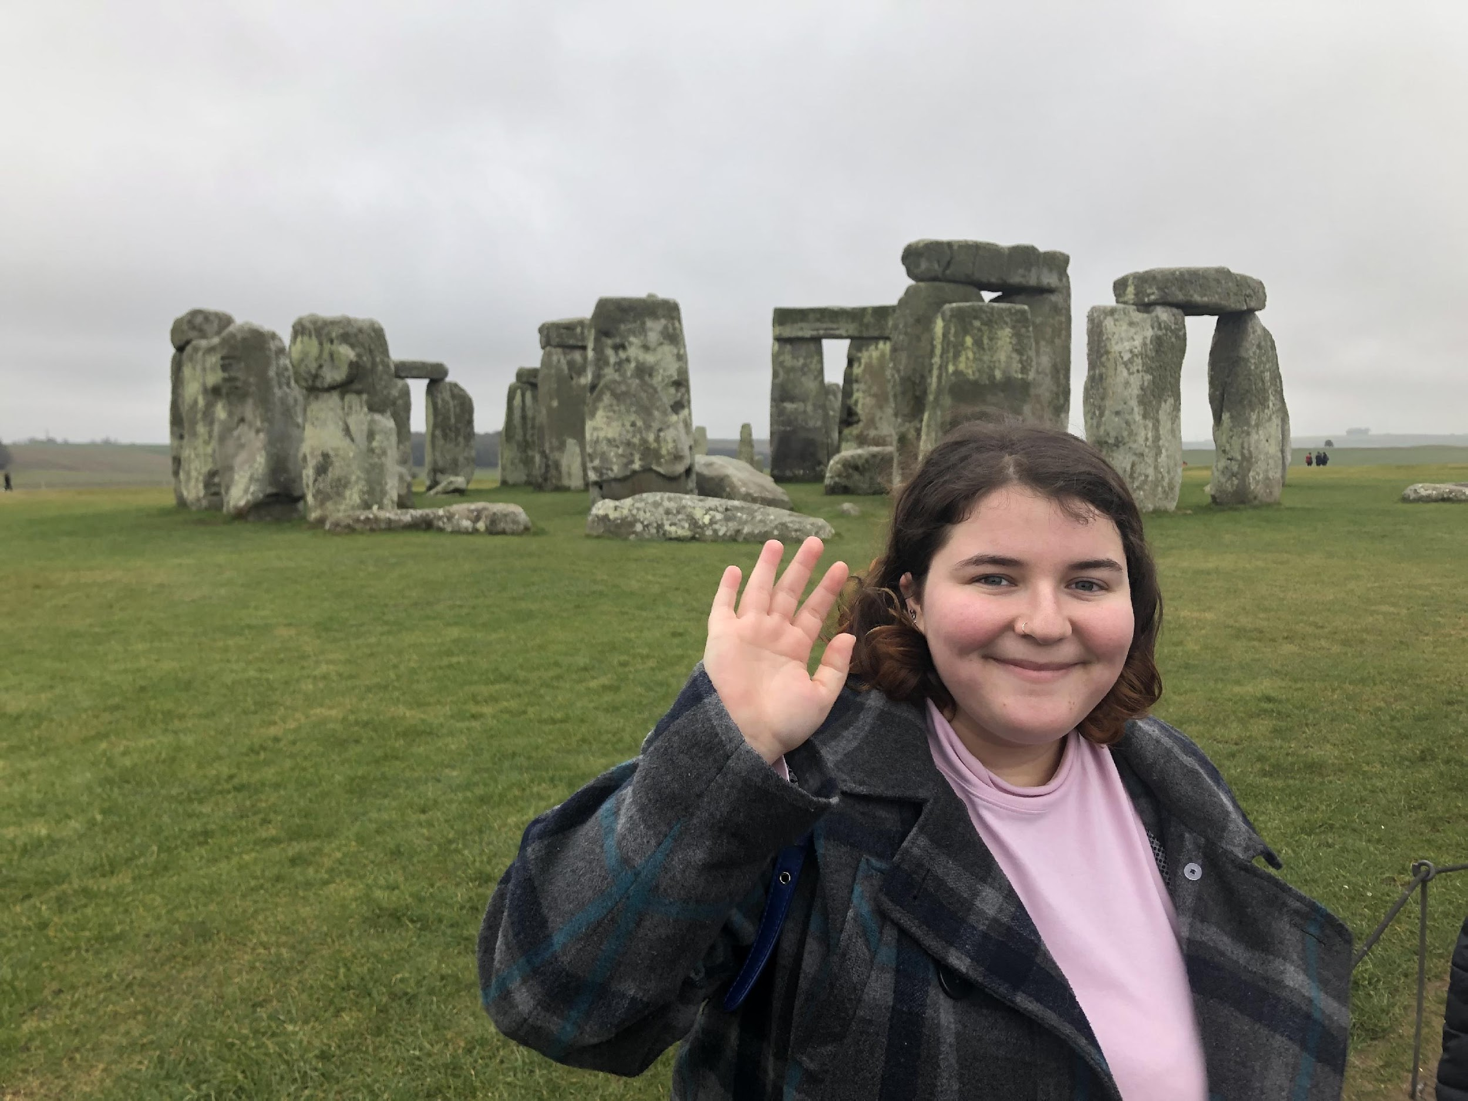
STUDY ABROAD & ADDITIONAL LEARNING OPPORTUNITIES
Study Abroad
National Student Exchange (NSE)
EcoLeague
Alaska Pacific University (Anchorage, AK)
College of the Atlantic (Bar Harbor, ME)
Dickinson College (Carlisle, PA),
Northland College (Ashland, WI)
Prescott College (Prescott, AZ)
Cross College Alliance
Ringling College of Art and Design
State College of Florida Manatee-Sarasota
The Ringling/Florida State University
University of South Florida Sarasota-Manatee

Slide 8
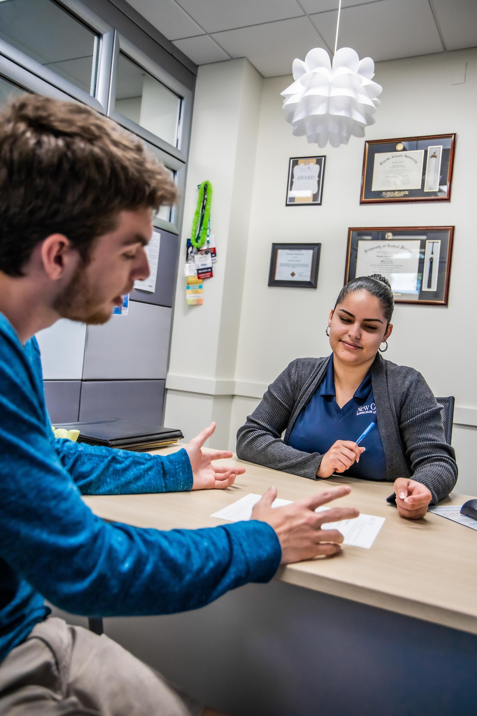
NOVO CAREER ADVANTAGE
Personalized Career Education
from Day 1
Individualized Support –
Faculty Advisor, Career Coach,
Alumni/Community Mentor
Internships
Research
New College Mentorship Network
Certificates
Marketing, Finance, Technology, Digital Media
83%
of New College graduates are employed or enrolled in graduate school within 4 months of graduation.
Notes:
Career Integration
At New College, we begin with the end in mind, and that’s why we emphasize career preparation and embed it into every aspect of the academic curriculum. In addition to a faculty advisor, every student is paired with a professional career coach, and our career services office has more career coaches per student than any university in the state.
Internships
Mock Interviews
Resume Building
Graduate school admission test prep (free)
Graduate and professional school preparation and advising (law, medicine, health)

Slide 9
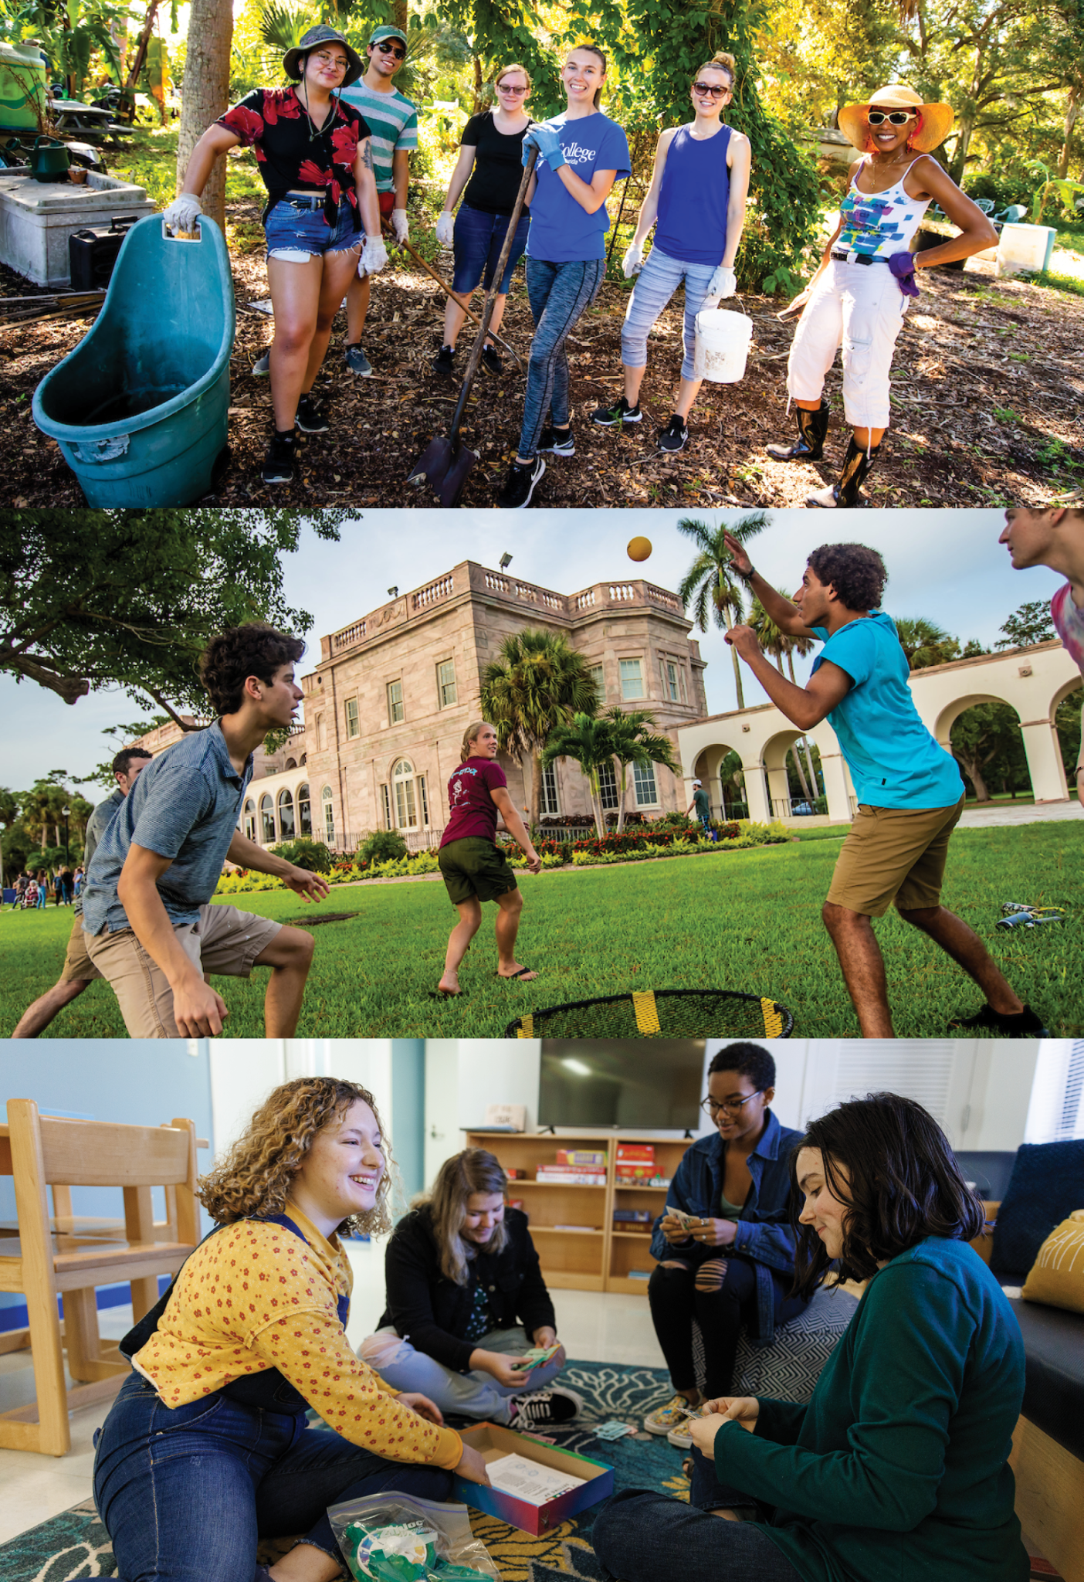
STUDENT LIFE
Residential Life
Volunteer
Clubs/Organizations
Personal and Professional Development
Pre-Med Club, Philosophy, New College Society of Physics Students, Psychology, Rotaract, New College Law Society, Economics, Association for Computing Machinery, Quizbowl, Mock Trial Team
Social Justice & Community Service
Black History Month Committee, Council of Green Affairs, Queery,
Democracy Matters, Student Coalition for Combating Homelessness & Poverty, Black Student Union
Sports
Aerial Club, Dive Club, Tennis, Powerlifting, Crew, Roller Skating, Swim, Volleyball, Dance, Aikido
Other Clubs
Acapellago, Anarchy Deathsticks, Windmill Theater Company
Notes:
Student Life & Support
Housing & Residence Life
Over 80 percent of the student population lives on campus for all 4 years.
Living learning communities or LLC’s - based on common interests like: sustainability, writing, outdoor adventure, and LGBTQ culture.
SAuCE (Student Activities & Campus Engagement)
More than 60 student organizations offer activities that range across hobbies, sports, community advocacy, and future professions.

Slide 10
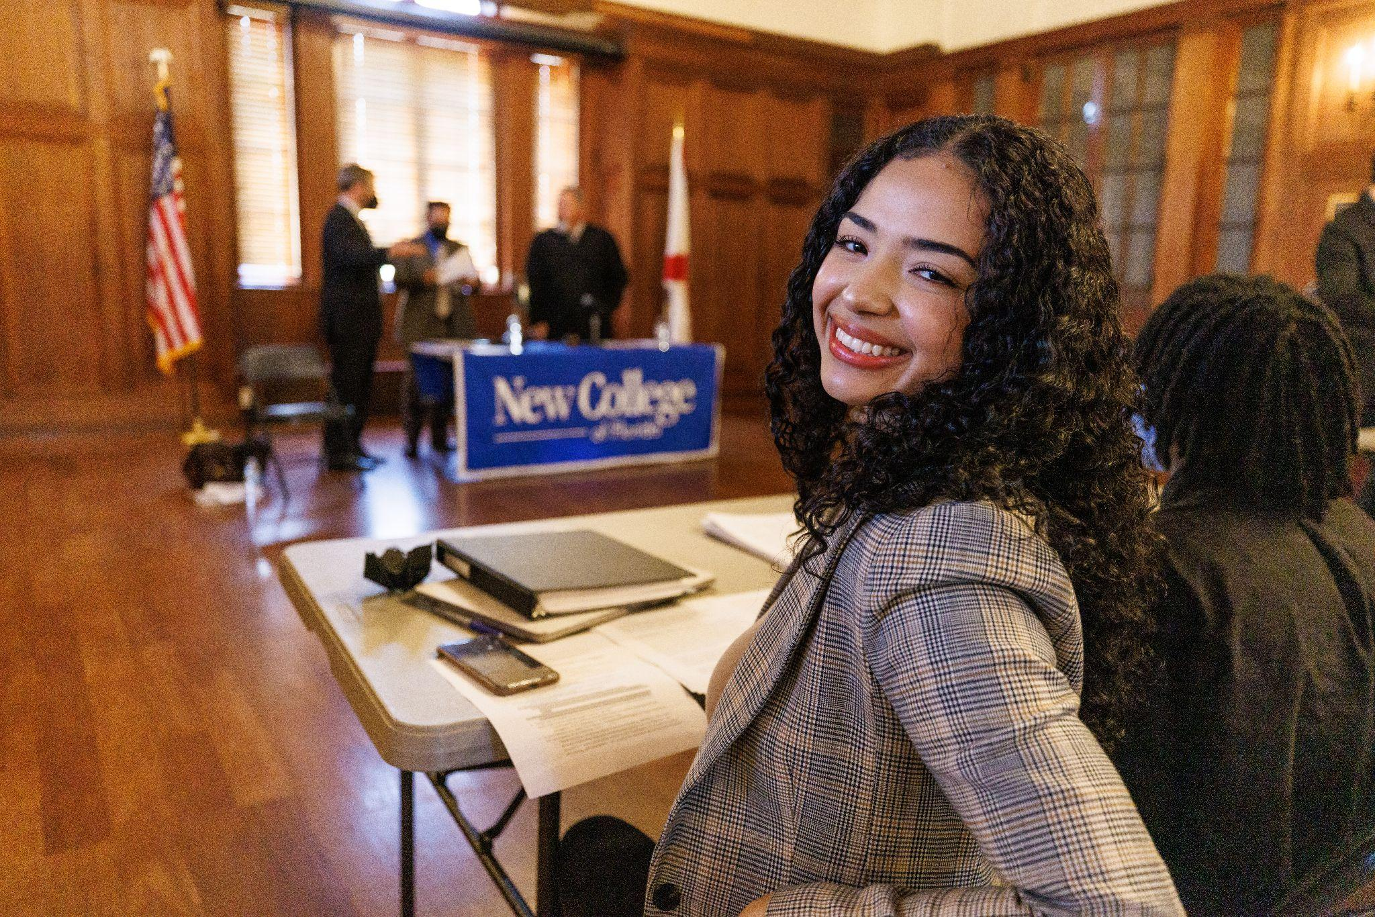
ADMISSION PROCESS: NCF.EDU/APPLY
How to Apply
Common Application or NCF Application (no fee required)
Personal Statement/Essay
Transcripts from each high school/college attended (official or self-reported)
SAT or ACT Scores (official or self-reported)
Counselor/Teacher Recommendations are optional
Fall 2022 Admitted Class Profile (middle 50%)
Deadlines
NCF GPA: 3.8 - 4.4
SAT: 1110 - 1320
ACT: 22 - 29
Nov. 1 - Early Action Deadline
Feb. 1 - Regular Application Deadline
Apr. 1 - Final Application Deadline
Notes:
Application Process
Common Application or NCF Application (no fee required)
Personal Statement/Essay
Transcripts from each high school/college attended (official or self-reported)
SAT or ACT Scores (official or self-reported)
Counselor/Teacher Recommendations are optional
Fall 2021 Admitted Class Profile (middle 50%)
NCF GPA: 3.68 - 4.31
SAT: 1100 - 1310
ACT: 23-30

Slide 11
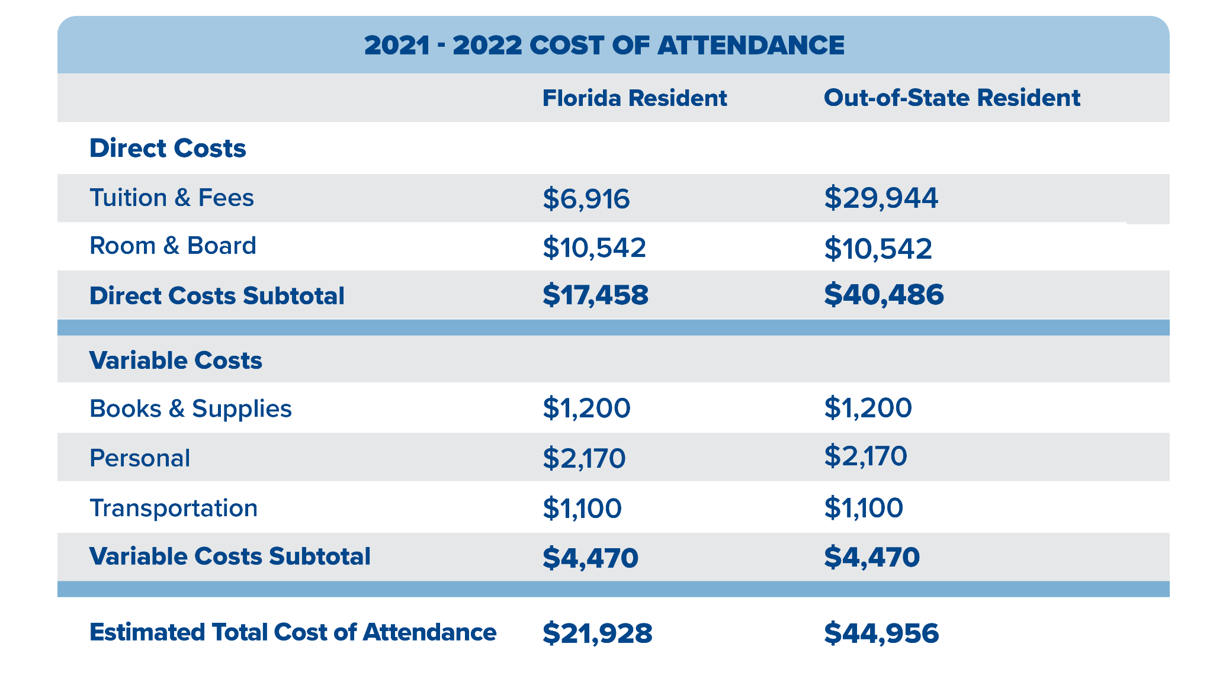
TUITION & COSTS
Notes:
Affordability:
New college is affordable! Our tuition and fees are $6,916 for an in-state student and $29,944 for an out-of-state student when compared to $50,000+ at many private colleges.
The state university system has not raised tuition and fees in 7 years.
Generous scholarships - almost every admitted student receives a scholarship
Average net cost after scholarships and financial aid is $6,110, and 59% graduate with zero debt.
Kiplinger’s, Fiske, and The Princeton Review rank New College among the top 30 “best value public colleges” in the nation.

Slide 12
SCHOLARSHIPS & FINANCIAL AID
NEW COLLEGE SCHOLARSHIPS (NO SEPARATE APPLICATION)
FLORIDA RESIDENTS | OUT OF STATE RESIDENTS
Four Winds Scholarship $1,000 - $3,000 per year $4,000 - $12,000 over 4 Years | Four Winds Scholarship $1,000 - $3,000 per year $4,000 - $12,000 over 4 Years Out of State Scholarship $10,000 per year $40,000 over 4 years
AVERAGE NET PRICE: $7,300 | AVERAGE NET PRICE: $13,600
FAFSA: Federal need-based grants, work study, loans. Visit fafsa.gov.
Notes:
Affordability:
New college is affordable! Our tuition and fees are $6,916 for an in-state student and $29,944 for an out-of-state student when compared to $50,000+ at many private colleges.
The state university system has not raised tuition and fees in 7 years.
Generous scholarships - almost every admitted student receives a scholarship
Average net cost after scholarships and financial aid for in-state students is $7,300 and 63% graduate with zero debt.
Kiplinger’s, Fiske, and The Princeton Review rank New College among the top 20 “best value public colleges” in the nation.

Slide 13
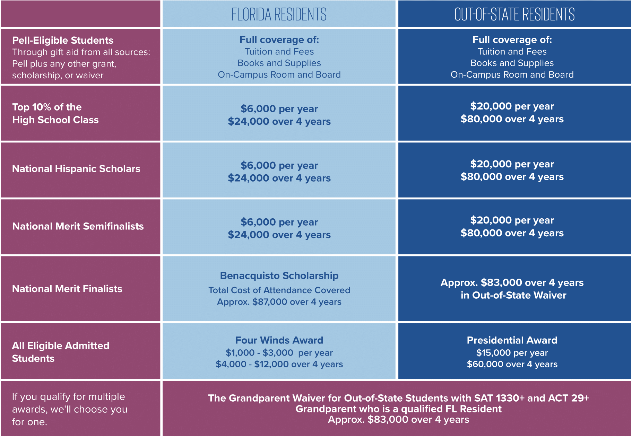
NEW COLLEGE OF FLORIDA SCHOLARSHIP AWARDS
FIRST-YEAR STUDENTS 2022-2023 | ncf.edu/scholarships
Notes:
NCF Scholarship Awards for First Year Students - 2022-2023 Year (NEW!)
Students automatically considered for these new scholarships when they apply for admission
Pell-eligible - FAFSA required
If a student qualifies for multiple, student will receive the award with highest dollar amount.

Slide 14
ADDITIONAL APPLICATION-BASED SCHOLARSHIPS
Priority Application Deadline: February 1
ncf.edu/scholarships
ARCHIMEDES STEM SCHOLARSHIP
First-year students demonstrating interest and involvement in STEM throughout high school.
Award: up to $40,000 over four years. Award in year one will be $10,000 with renewal contingent upon meeting Satisfactory Academic Progress (SAP) requirements.
JOHN JAKES WRITING SCHOLARSHIP
First-year and Transfer Students demonstrating interest and involvement in writing with a desire to
pursue careers in fields of writing. Award: non-renewable $2,000 scholarship during their first year of study.
SKESTOS SCHOLARS LEADERSHIP PROGRAM
First-year students demonstrating interest & involvement in leadership development through high school.
Award: up to $25,000 over four years.
Notes:
Application-based Scholarships
Require additional application. Students are invited to apply after they apply for admission
Archimedes STEM Scholarship: $40,000 over 4 years
Jakes Writing Scholarship: $2,000 in first year
Skestos Scholarship & Leadership Program: $25,000 over 4 years + 4-year leadership development program and certificate.

Slide 15
BARANCIK ACCESS LEADERSHIP SCHOLARSHIP
SARASOTA & MANATEE COUNTY FIRST YEAR & TRANSFER STUDENTS
The Barancik Access Leadership Scholarship is a New College scholarship program created to engage and support high potential students with ties to the Sarasota/Manatee area.
First-year seminar course Civitas
Peer mentor
Monthly leadership development programs
Award: up to $7500 each year for on-campus students; up to $2500 each year for off-campus students.
FAFSA (Free Application for Federal Student Aid) is required
How to Apply: Email invitation after applying for admission
Priority Application Deadline: December 1, 2021
Notes:
Barancik Access Leadership Scholarship - Specifically for SARASOTA & MANATEE COUNTY FIRST YEAR & TRANSFER STUDENTS
The Barancik Access Leadership Scholarship is a New College scholarship program created to engage and support high potential students with ties to the Sarasota/Manatee area.
●First-year seminar course Civitas
●Peer mentor
●Monthly leadership development programs
Award: up to $7500 each year for on-campus students; up to $2500 each year for off-campus students.
FAFSA (Free Application for Federal Student Aid) is required, as Barancik is a financial need-based scholarship.
Visit ncf.edu/scholarships for more information.
How to Apply: After applying for admission, Sarasota/Manatee county applicants will receive an email invitation inviting them to apply for the scholarship.
Priority Application Deadline: December 1, 2021
The priority application deadline for the Barancik Scholarship is December 1, 2021.

Slide 17
