Slide 1
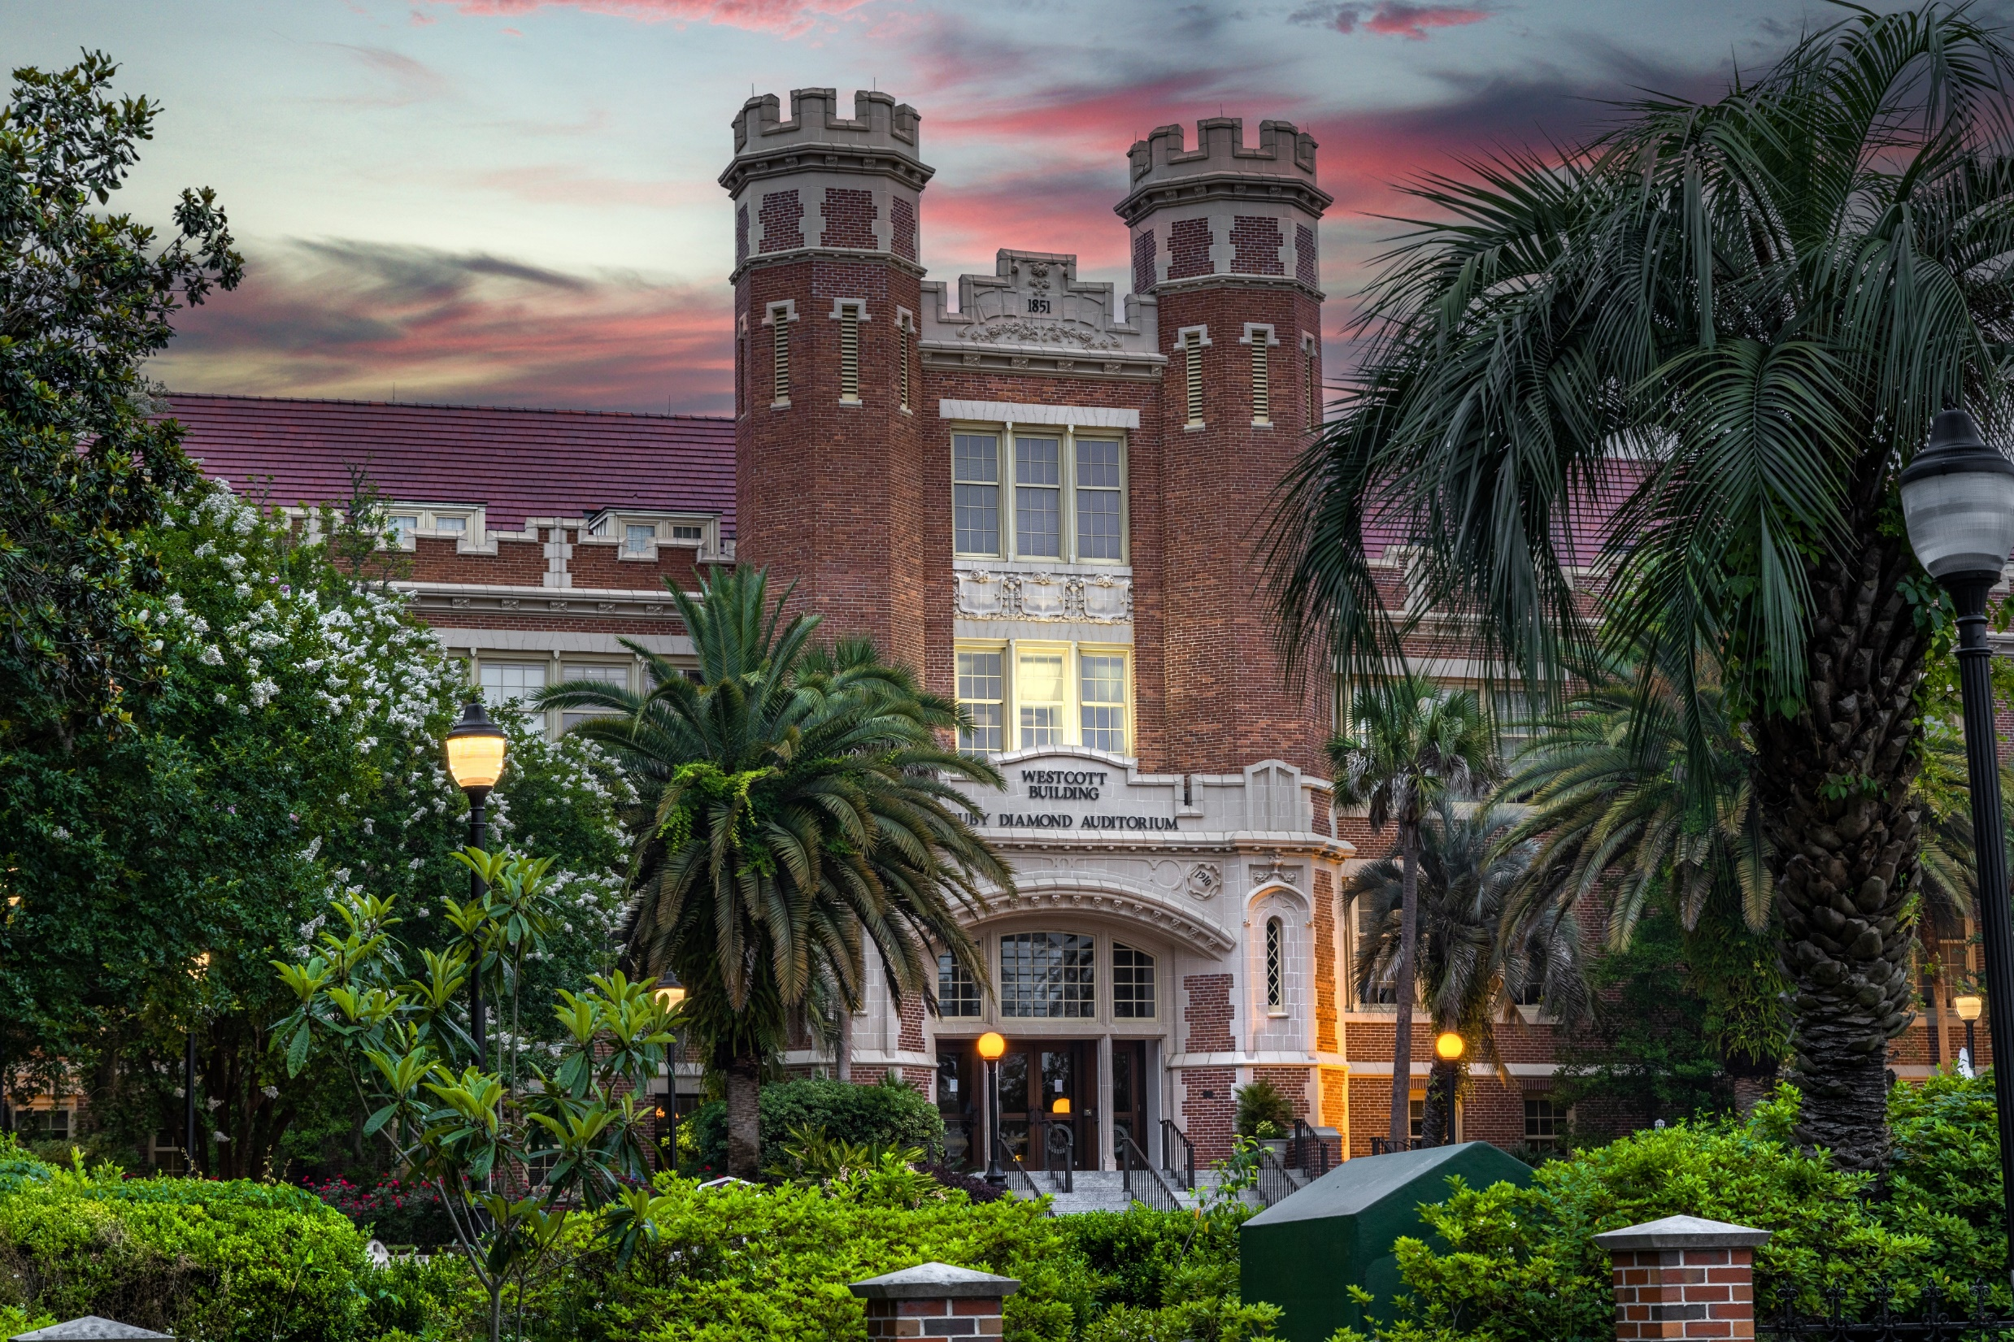

Slide 2
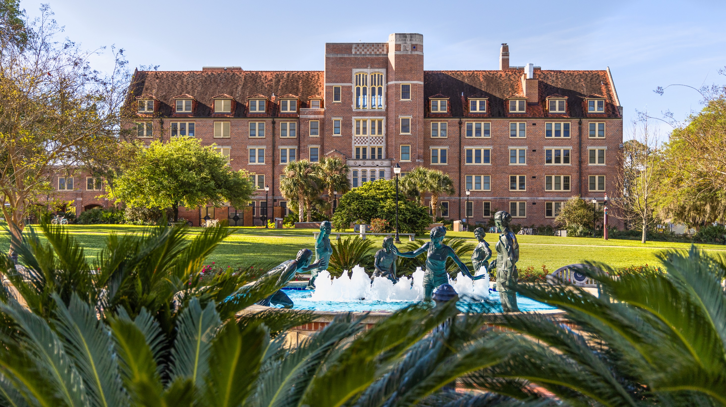

Slide 3
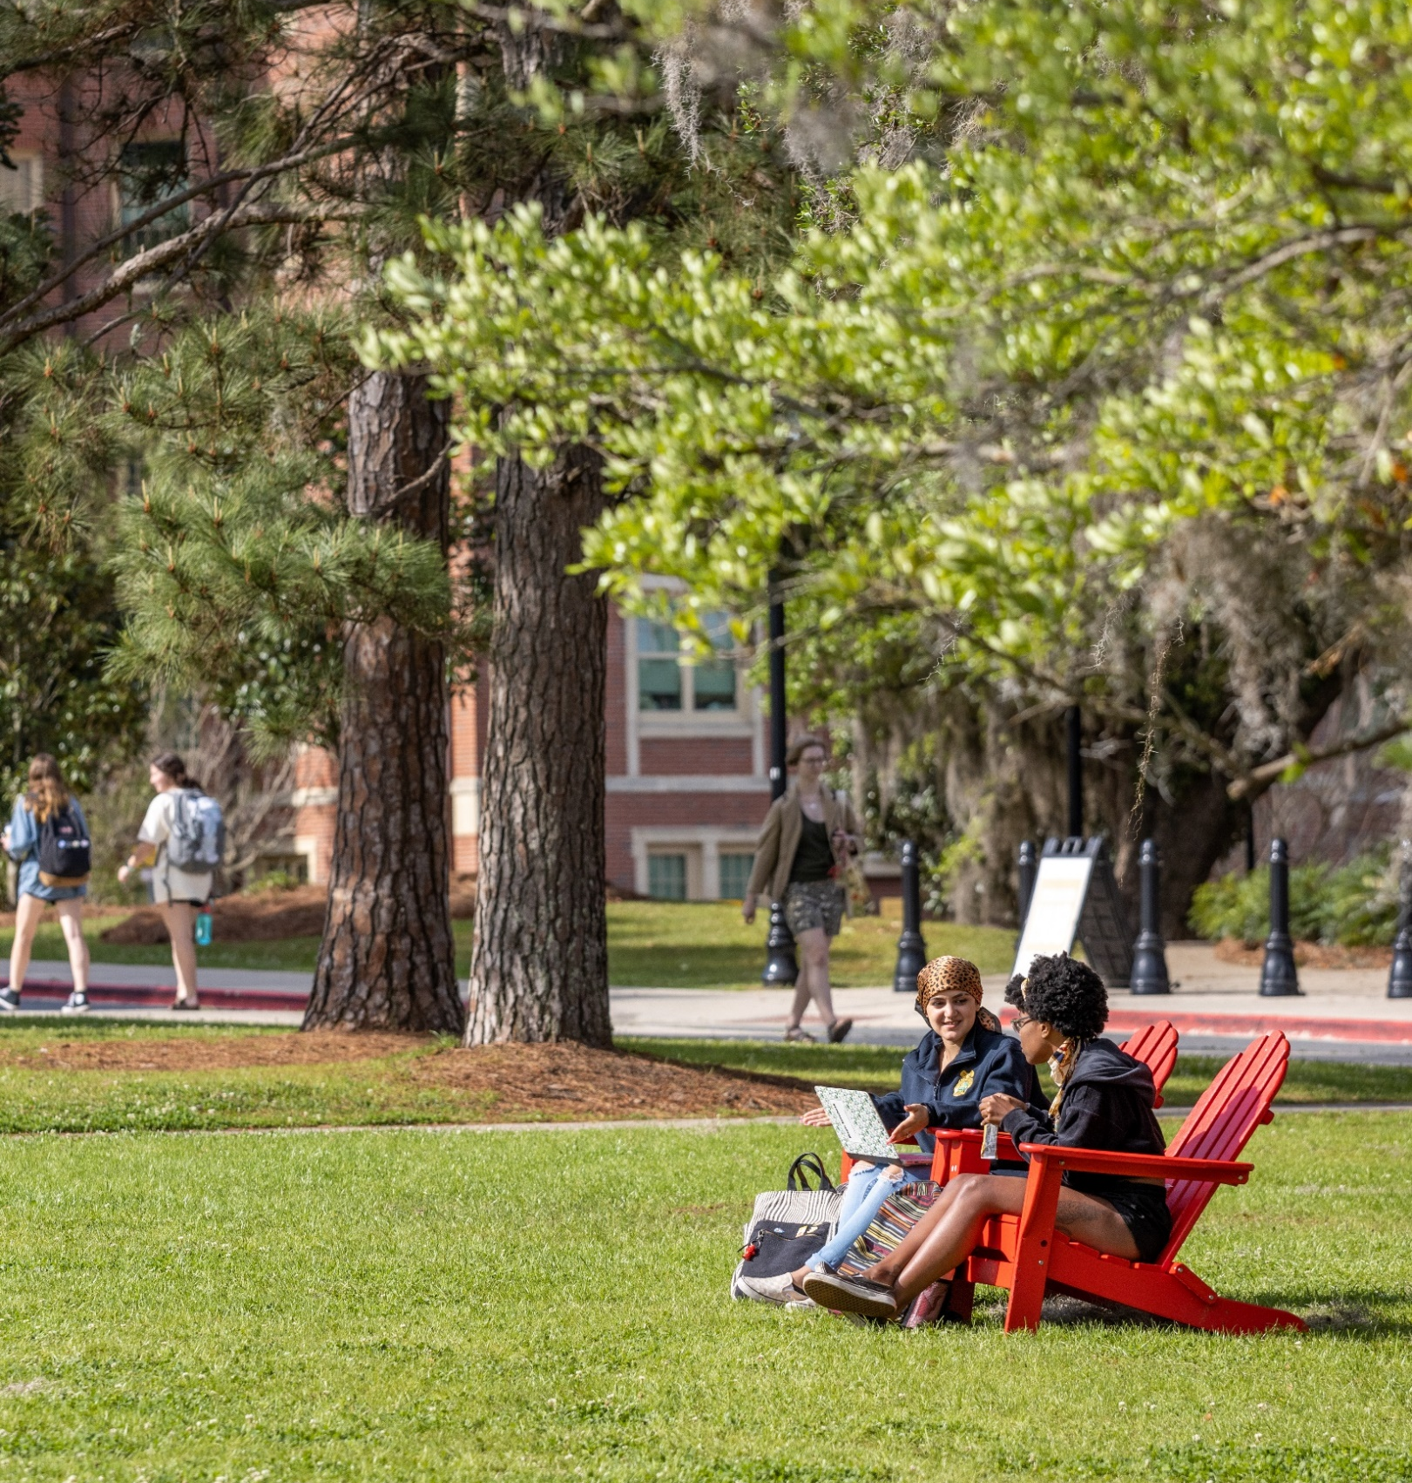
Committed to Value
#1
BEST VALUE COLLEGE AMONG FLORIDA PUBLIC UNIVERSITIES, U.S. News & World Report's "Best Colleges 2022" guidebook.
87%
87% OF UNDERGRADUATES IN THE ACADEMIC YEAR 2020-2021 RECEIVED SOME FORM OF NON-LOAN STUDENT FINANCIAL AID.
60%
MORE THAN 60% OF FIRST-TIME -IN-COLLEGE STUDENTS GRADUATE
WITH NO FSU DEBT.
9
YEARS
The cost of FSU’s tuition has remained unchanged for the past nine years.

Slide 4
Welcome Class of “22 - Convocation
Notes:
Let’s add caption Welcome Class of “22 - Convocation

Slide 5
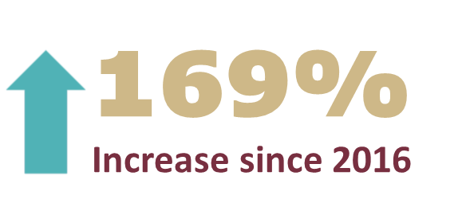
First-Year Application Numbers

Slide 6
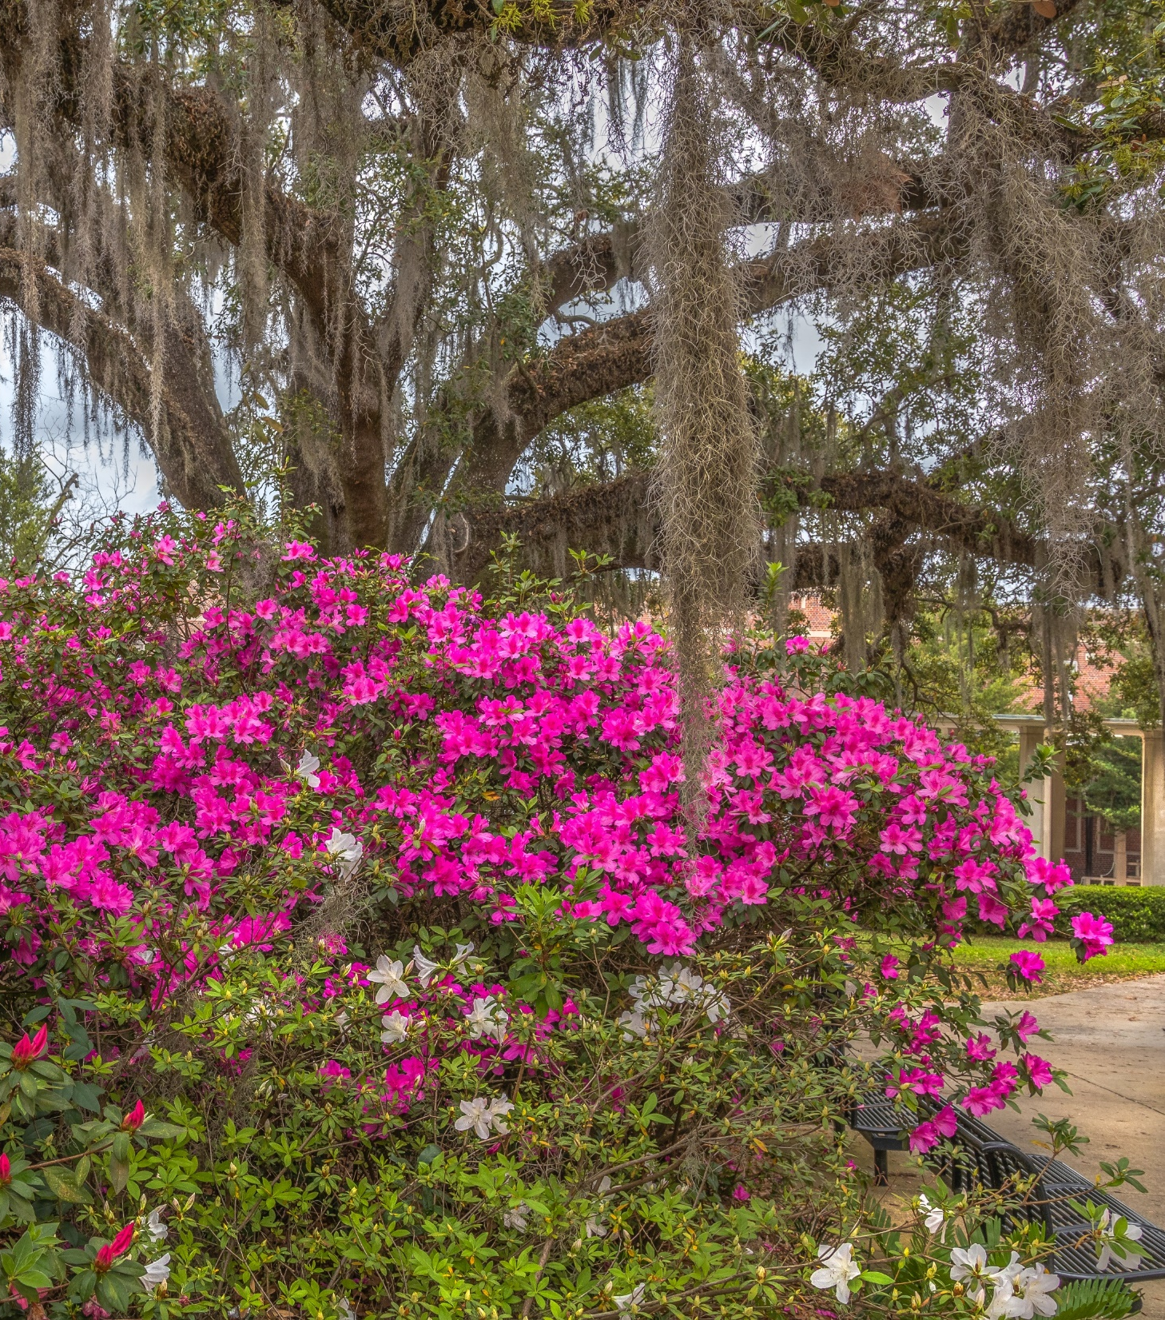
2022 Application Numbers
25%
Overall Admit Rate
In-State
37%
Admit Rate
Out-of-State
12%
Admit Rate

Slide 7
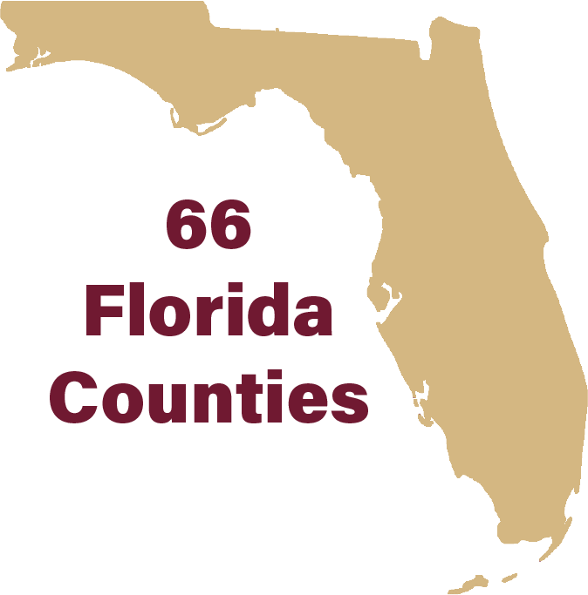
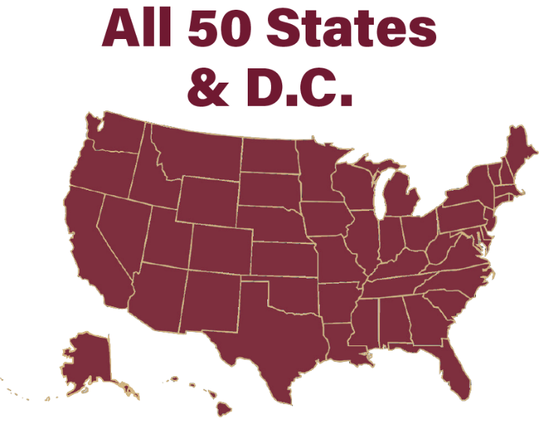
Admitted Student Attributes
+78,000 Applications Received
All 50 States, D.C., Puerto Rico, Guam, and Virgin Islands
Top Non-FL States | Top FL Counties
Georgia | Miami-Dade
New York | Broward
New Jersey | Palm Beach
Illinois | Hillsborough
Texas | Orange
Pennsylvania | Pinellas
North Carolina | Duval
Virginia | Saint Johns
Tennessee | Seminole
Ohio | Leon
All 67 Florida Counties
51 Countries
2811
807

Slide 8
FSU all over the world! 112 in FSA and 133 in FYA

Slide 9
Admitted Student Profile
Fall 2022
GPA: 4.3–4.6
SAT: 1300–1430
ACT: 29–32
Summer 2022
GPA: 4.1–4.5
SAT: 1210–1320
ACT: 26–29
*Represents the middle 50% of admitted students​.
76%
Rank in Top 10% of HS Class
22%
First-generation
19%
Pell Eligible

Slide 11
First-Year Application & Materials Deadlines
APPLICATION PLAN | APPLICATION & MATERIALS DEADLINE | DECISION RELEASE DATE
Early Action *Florida Students Only | October 15, 2022 | December 15, 2022
Regular Decision *All students | December 1, 2022 | February 15, 2023
Rolling Decision *All students | March 1, 2023 | Released on a rolling basis in early April
Students applying through the Common App will select the December 1 application deadline.
*Students will be placed in early action, regular, or rolling application plan based on the receipt of their materials.

Slide 13
Test scores
Per the Florida Board of Governors, Florida public universities are still requiring test scores.
Students can self-report their test scores. At least one test score must be submitted before the application deadline, but additional tests may be considered if provided by these dates:
APPLICATION PLAN | APPLICATION DEADLINE | Last score considered
Early Action *Florida Students Only | October 15, 2022 | November SAT (if scores are provided before December 1, 2022)
Regular Decision *All students | December 1, 2022 | December ACT and SAT (if scores are provided before January 1, 2023)
Rolling Decision *All students | March 1, 2023 | February ACT (if scores are provided by March 1, 2023)

Slide 15
ADMISSIONS DECISIONS
APPLICATION PLAN | APPLICATION & MATERIALS DEADLINE | POTENTIAL DECISIONS | DECISION RELEASE DATE
Early Action *Florida Students Only | October 15, 2022 | Admit Defer to Regular Decision Deny | December 15, 2022
Regular Decision *All students | December 1, 2022 | Admit Seminole Pathways Spring Transfer Admit Defer to Rolling Decision (excludes Early Action deferrals) Deny | February 15, 2023
Rolling Decision *All students | March 1, 2023 | Admit Seminole Pathways Spring Transfer Admit Waitlist Deny | Released on a rolling basis in early April

Slide 16
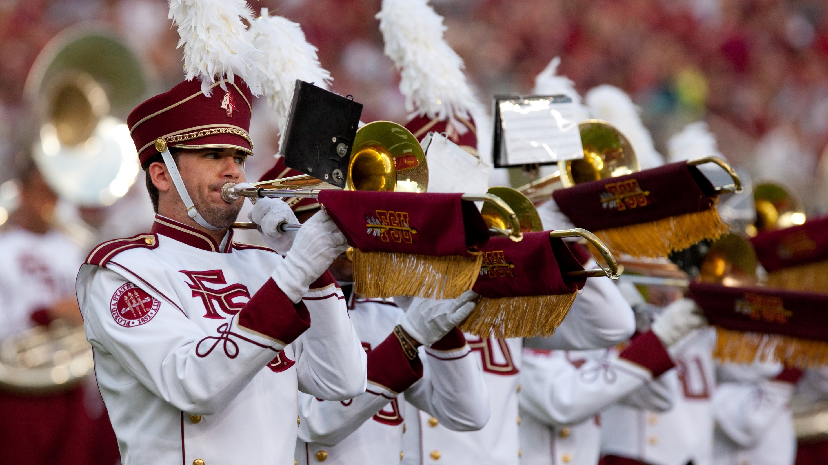

Slide 17
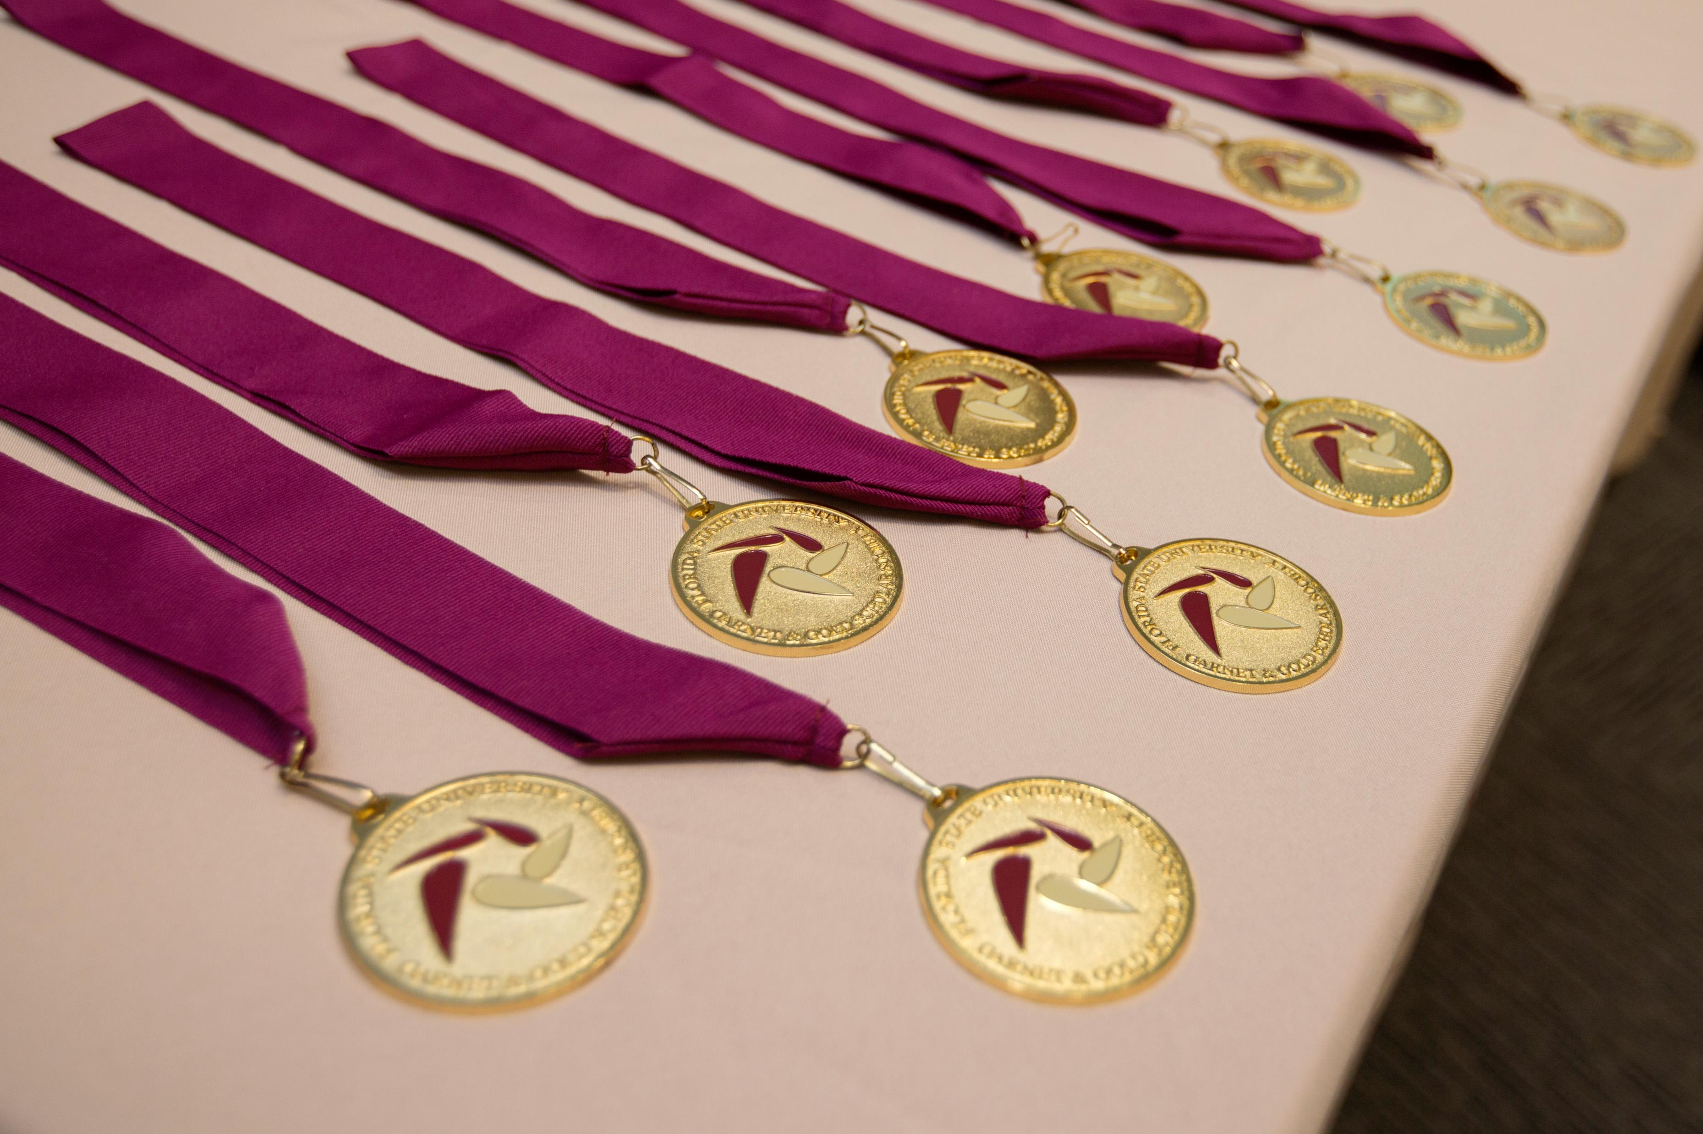
University Honors Program
Apply to Florida State University and select "Yes" to the question, “Are you interested in applying to the Honors Program?”
The Honors Application Deadline is December 1, 2022.
Students will be notified on February 15, 2023.

Slide 19
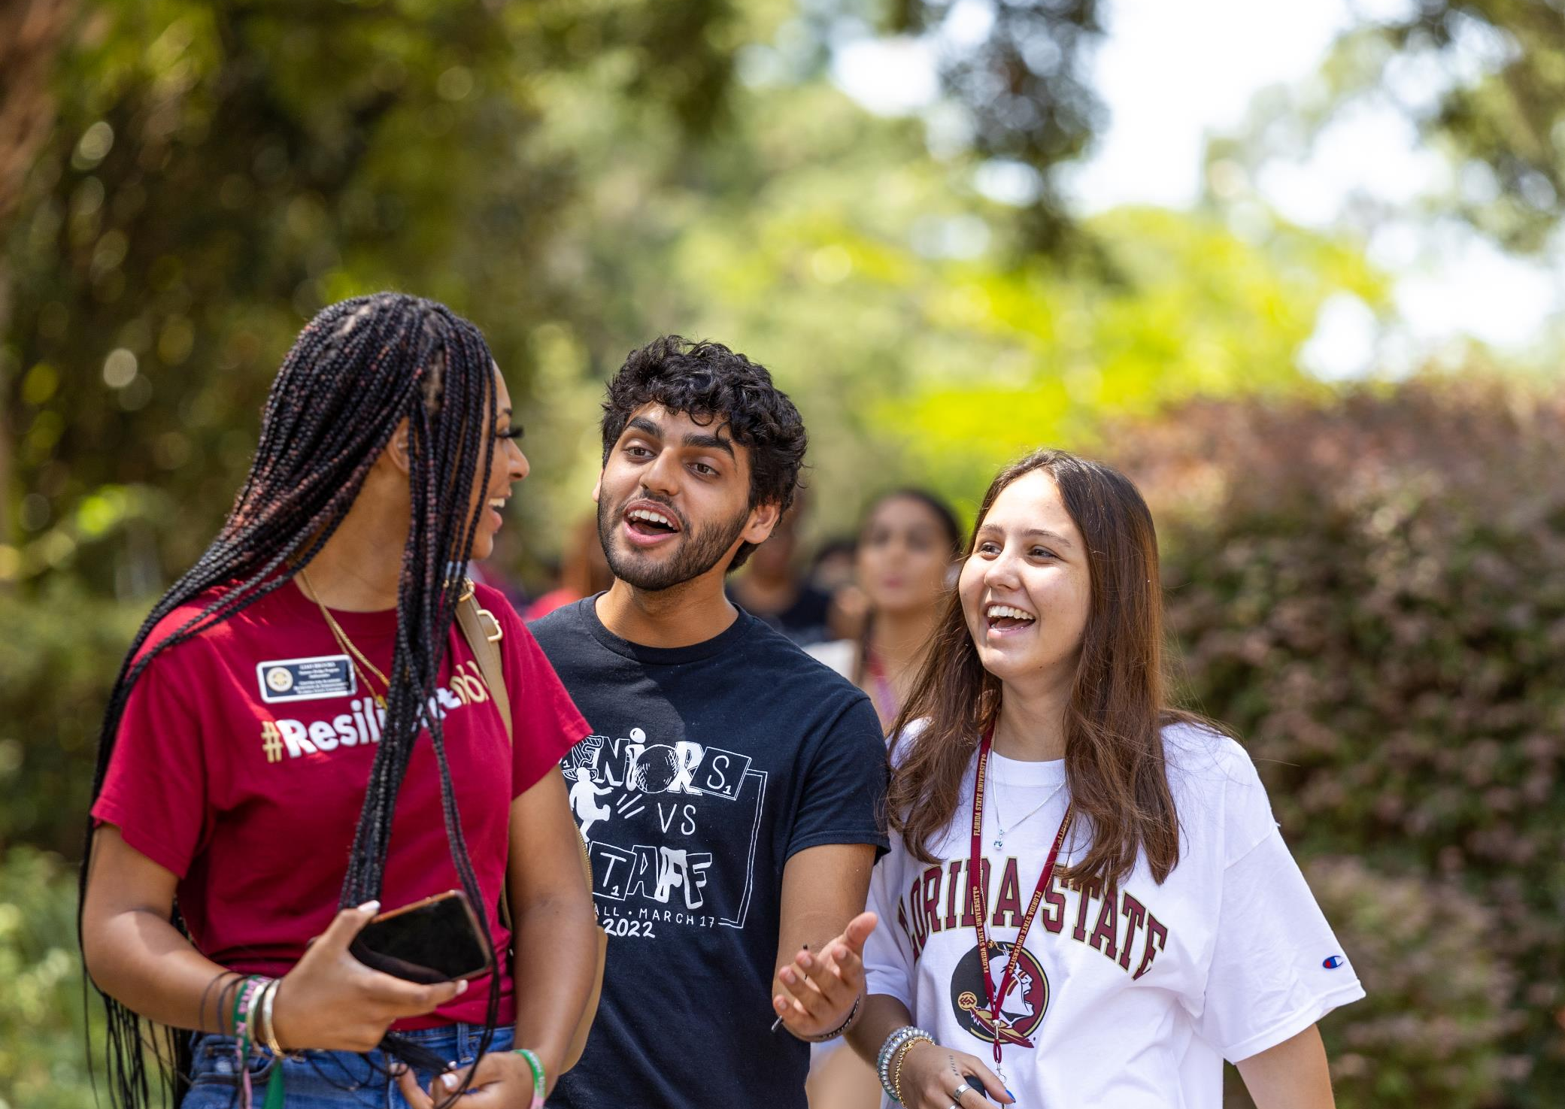
CARE Summer Bridge Requirements
Must be a first-generation-in-college student
Have a minimum 3.0 weighted academic GPA
Have a 19 ACT composite or 990 SAT total score
Complete all the minimum academic courses as determined by the state of Florida
Meet Florida residency requirements
Qualify for the Pell Grant as determined by the FAFSA for the 2022–2023 AND 2023–2024 aid years

Slide 20
Suwannee Dining Hall
Notes:
Indicate what this is

Slide 21
Holistic Review Process
Vires
Artes
The second torch, Artes, is skill. We want to see how students use their out-of-classroom time, whether that be through sports, clubs, organizations, family responsibilities, employment, or other achievements.
Resume – Academic and Non-academic Involvement
Mores
The third torch, Mores, is character. We are taking the information students have shared with us to learn who they are, any formative experiences they may have had, and what their life goals may be.
Essay – Resume – High School and Neighborhood Context
The first torch, Vires, is strength. Our focus in this area is rigor, grades, and courses taken while in high school. Each applicant is evaluated based upon the performance within the context of the student’s academic environment.
Transcripts – GPA – Course Rigor – High School Profile
Our application review process is a holistic and selective process, where no single criterion guarantees admission. Every application receives at least one read. Our holistic review process is centered on three of our institutional core values –
Vires, Artes, Mores.

Slide 22
Department of Earth, Ocean & Atmospheric Science
Notes:
Indicate on the slate the name of the building

Slide 23
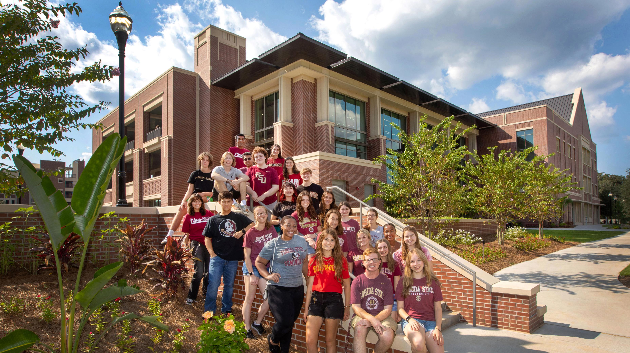
New Student Union

Slide 24
New bowling alley in the Student Union
Notes:
The new bowling alley

Slide 25
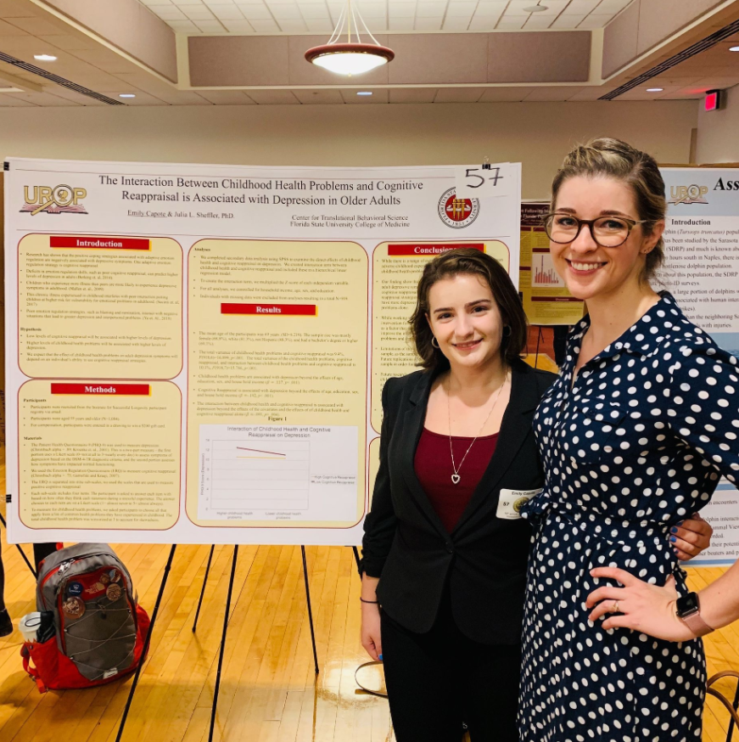
Newsworthy
New Majors
Human Rights & Social Justice
Materials Chemistry
Financial Planning *Panama City Campus
+150 Newly hired faculty members

Slide 27
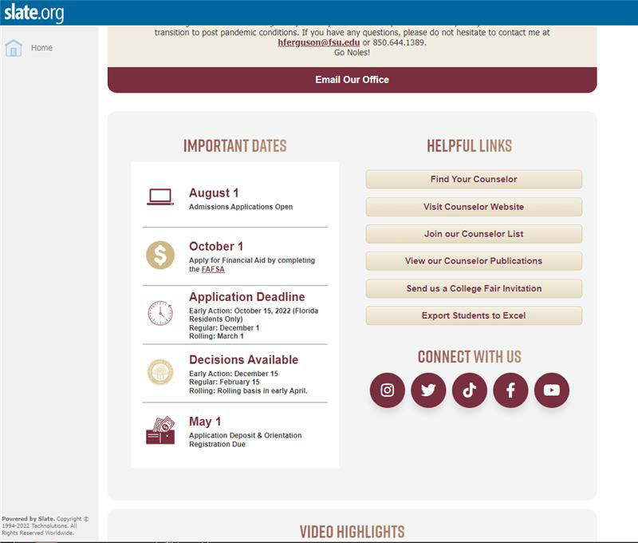
Counselor Resources via Slate.org

Slide 28
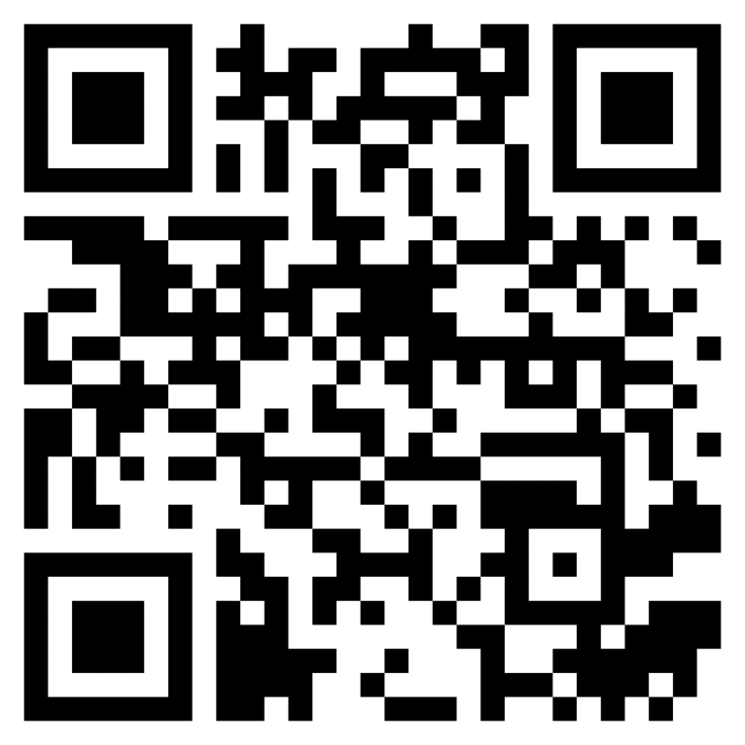
JOIN THE FSU COUNSELOR CONTACT LIST

Slide 30
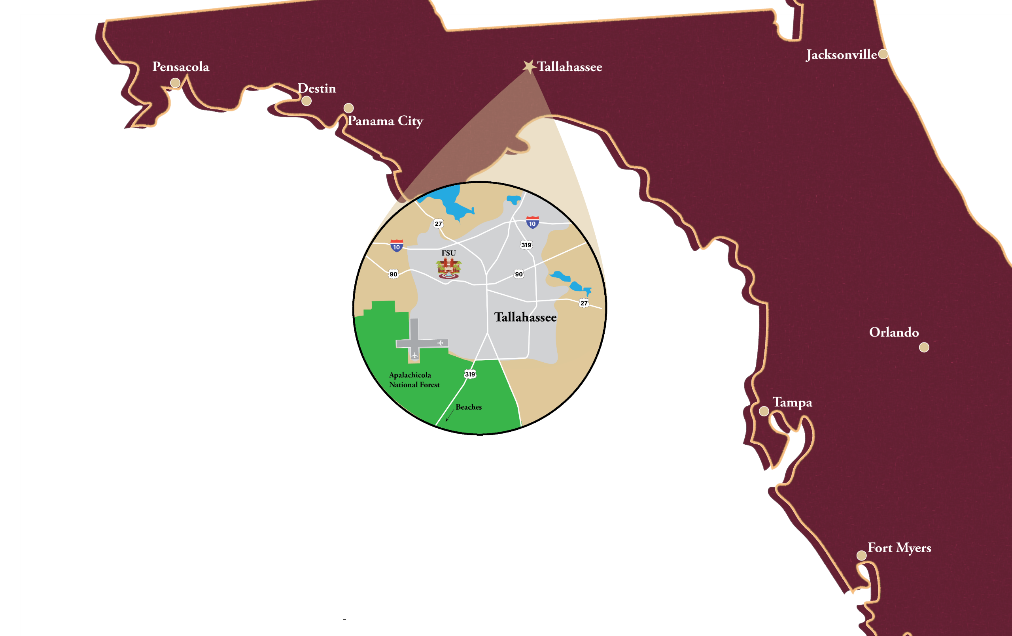
EXPERIENCE
FLORIDA STATE
Campus Tours | Virtual Tour | Virtual Presentations | Videos
visit.fsu.edu

