Slide 1
YOU UNDERESTIMATE
THE POWER
OF THE
DARK SIDE
STEM

Slide 2
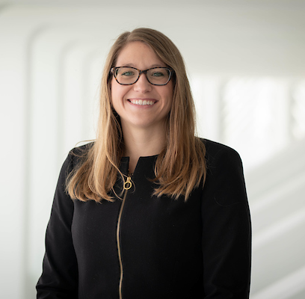
Michelle Powell Director of Admissions E: mpowell@floridapoly.edu P: 863-874-8634
M.S., Engineering, Florida Polytechnic University
B.A., Mathematics, McKendree University
Fun Fact: Pi Day is my favorite day of the year… and my wedding anniversary

Slide 3
Academic Profile
Acceptance Rate 44%
SAT 1290-1410
ACT 27-32
GPA 4.0-4.7

Slide 4
The Typical Florida Poly Student

Slide 5
Art Club President
Psychology Club
Poetry Club President
Soccer Team Captain
Football Team Captain

Slide 6
4-H President
Anime Club Secretary
Archery Captain
Art Club President
Astrophysics Club President
Baritone Section Leader
Baseball Team Captain
Basketball Team Captain
Battalion Commander in JROTC
Bowling Team Captain
Boy Scouts Patrol Leader
Broadcasting Club
Camp Counselor
Car Club Vice President
Chess Club President
Chess Club Vice President
Chorus President
Civil Air Patrol
Color Guard Captain
Co-President of Engineering Club
Debate Club
Drama Club President
Drum Major
Eagle Scout
Earth Club
eSports Captain
FBLA Coding & Programming Nationals Competitor
FBLA Treasurer
FBLA Vice President
FFA Board Member
First Lego League Mentor
Fishing Club Secretary
Flight Sergeant - Civil Air Patrol
Football Team Captain
French Horn Chair
French National Honor Society VP
Gaming Club President
Hockey Captain
IT Manager
JROTC Officer
Key Club Treasurer
Math Club President
Mu Alpha Theta President
Odyssey of the Mind
Owner of Game Development Company
Percussion Captain
Phi Theta Kappa President
Poetry Club President
President of Engineering Association
President of National Honor Society
Psychology Club
Quiz Bowl Team Captain
Robotics Club President
Robotics Team Lead Programmer
Rocket Club Vice President
Shift Leader
Soccer Team Captain
Spanish Club President
Student Government Association VP
Swim Team Captain
Teacher Assistant
Tennis Captain
Tennis Co-Captain
Track & Field Team Captain
Ultimate Frisbee Club President
Varsity Lacrosse Captain
Vex Robotics
Woodwinds Chair
Yearbook Co-Editor

Slide 7
Academics at Florida Poly

Slide 9
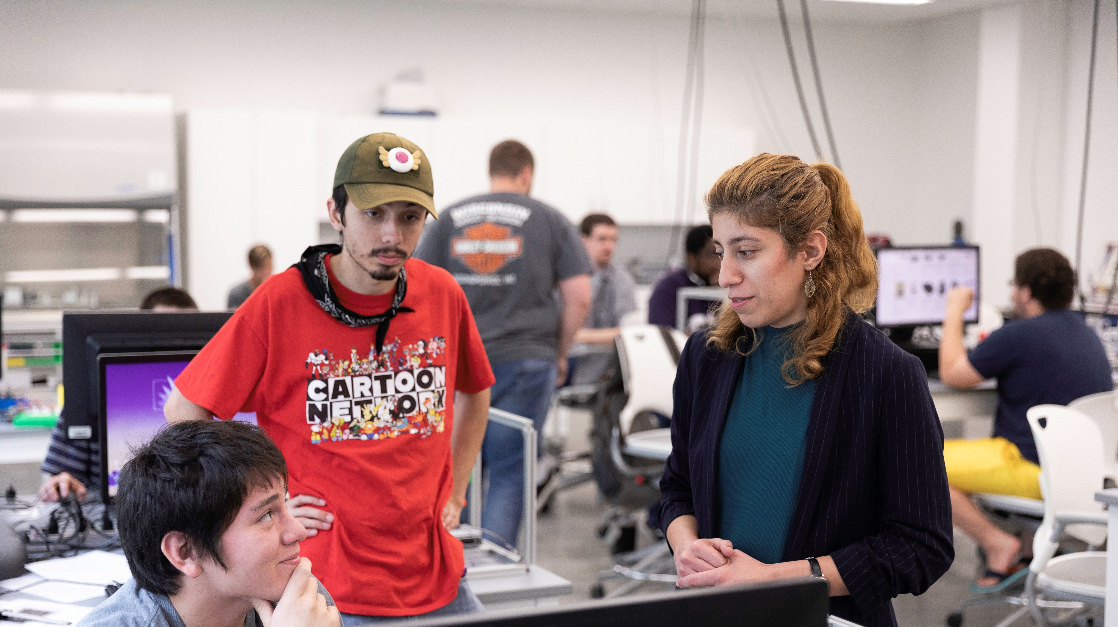
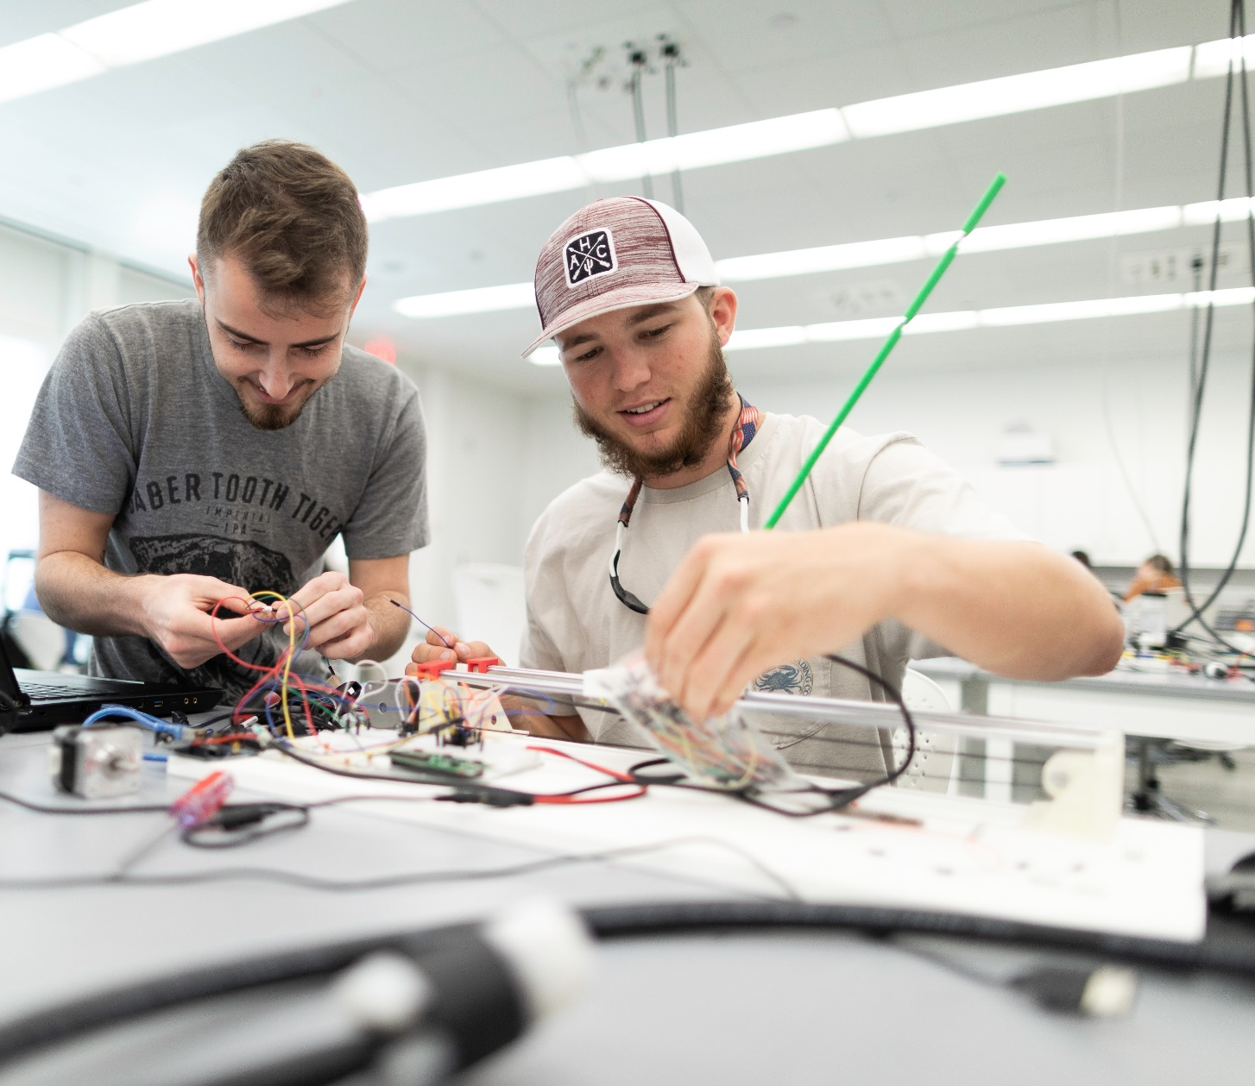
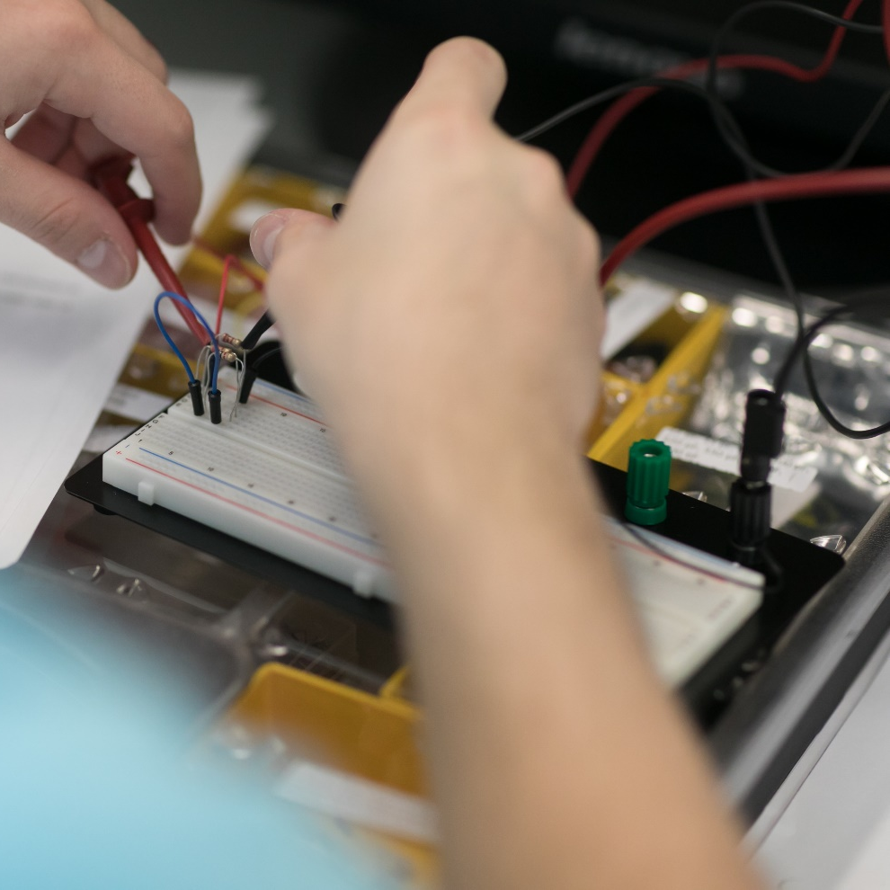
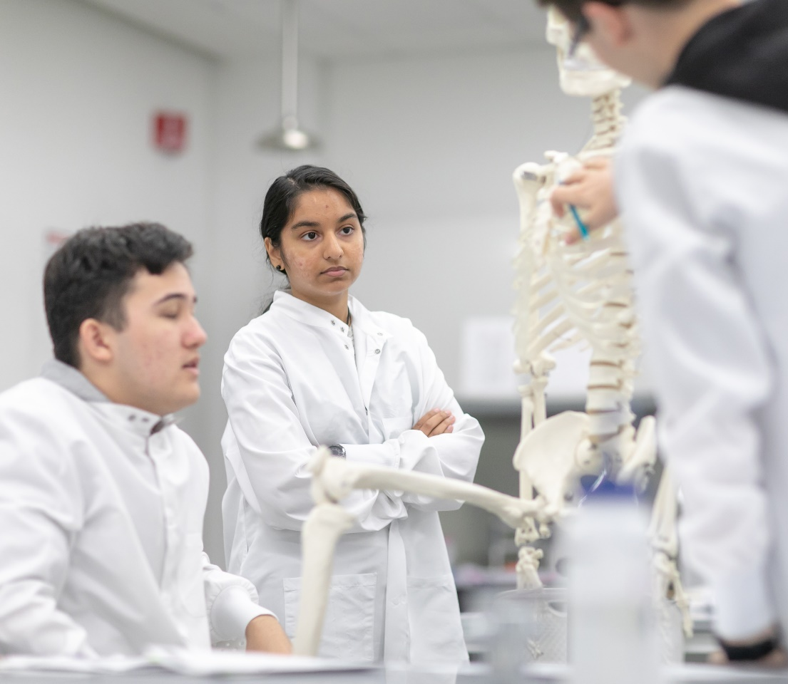
STEM Core
Methods in Applied STEM
Computation & Programming
Calculus
Physics with a Lab
Chemistry with a Lab
Applications in Mathematics & Engineering

Slide 10
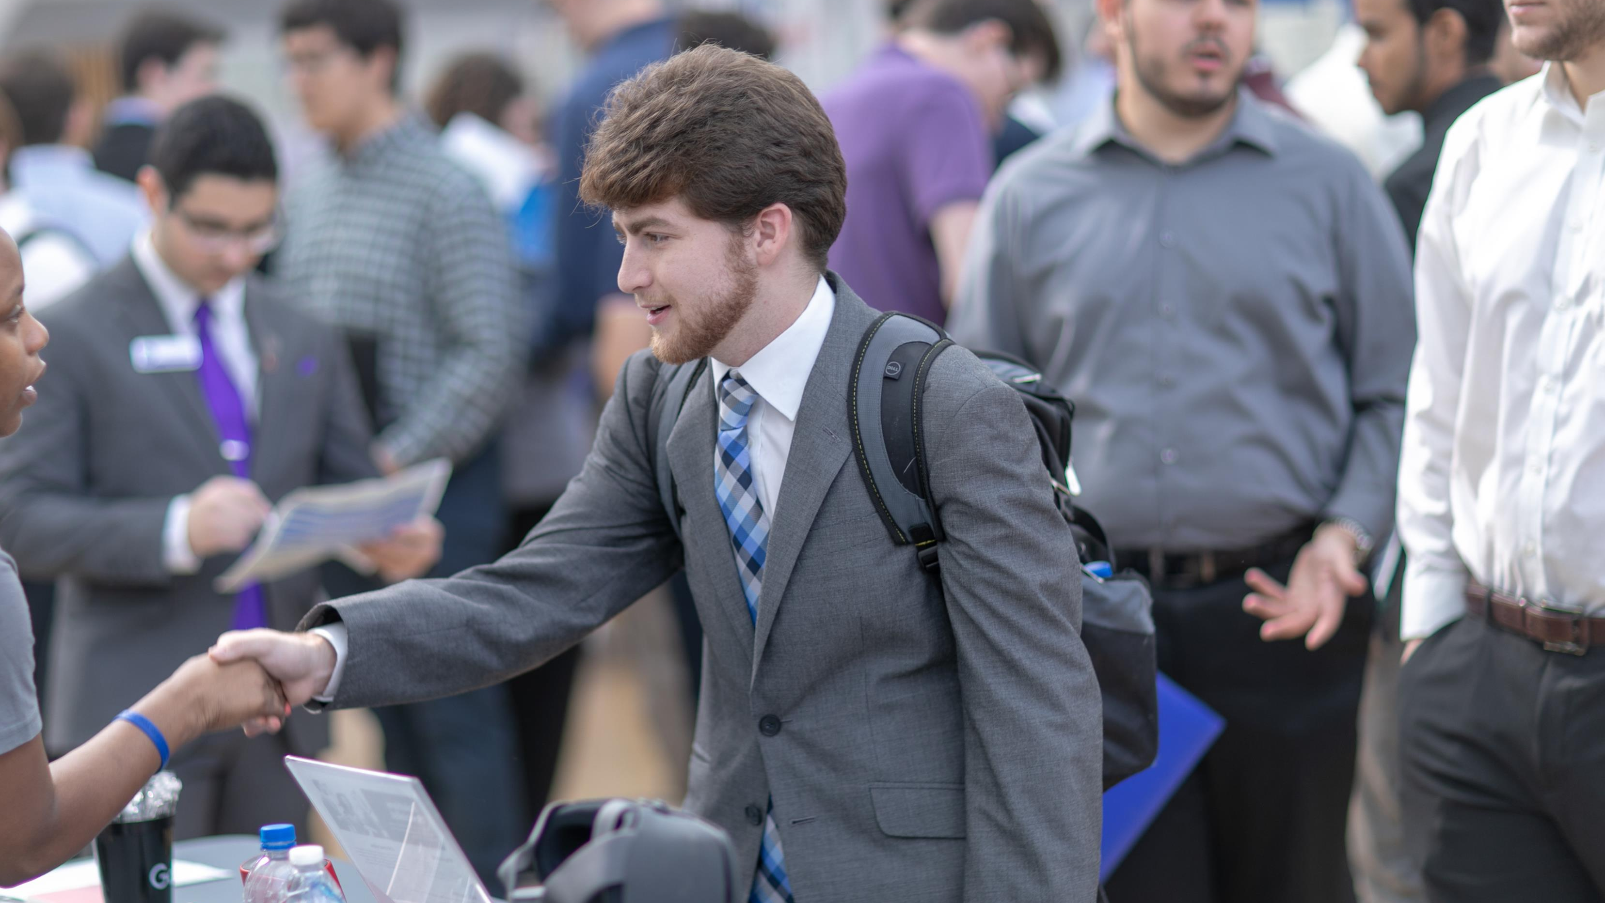
Internships have included…
3M Accudata Air Force Research Laboratory Amazon.com American Red Cross BEM Engineering Booz Allen Hamilton Charles Schwab Cisco Citibank Coleman Aerospace DataFirst Corporation Disney The FBI G.E. Healthcare GTE Financial Hobby Lobby Honeywell Hydro Solutions Consulting iD Tech IronRock Software JBT Corporation Lockheed Martin Mass Mutual Mnemonics, Inc. Mobile Modular NANOCANOPY National High Magnetic Field Laboratory NASA National Institute of Standards and Technology Nielsen Northrop Grumman Orlando Health Inc. Plexus Technologies Radiance Technologies Saddle Creek Logistics Services SEAD Software Siemens United States Air Force Universal USAID Colombia Walt Disney Parks and Resorts Walt Disney World West Pharmaceutical Services Kennedy Space Center

Slide 11
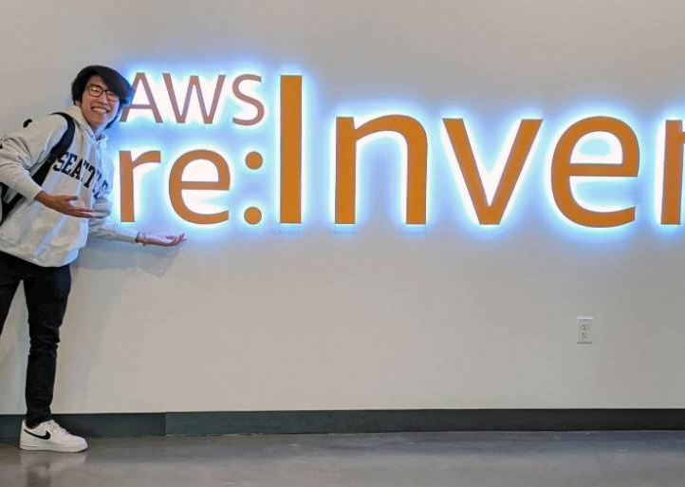
Ricardo Ota
Software Development Intern on the Alexa Team
Amazon Headquarters in Seattle, WA
Computer Engineering
Sao Paola, Brazil

Slide 12
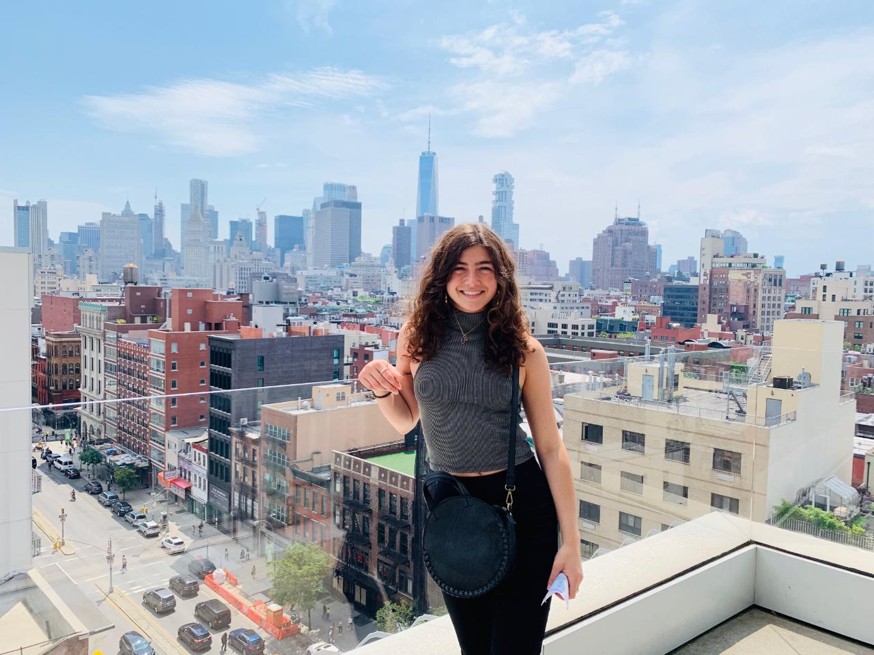
Chelsea Reeves
Electrical Engineering
Jacksonville, FL
Neuroanalytics Engineering internship
SPARK Neuro, a New York-based neuroanalytics company that measures emotion and attention to optimize advertising and entertainment

Slide 13
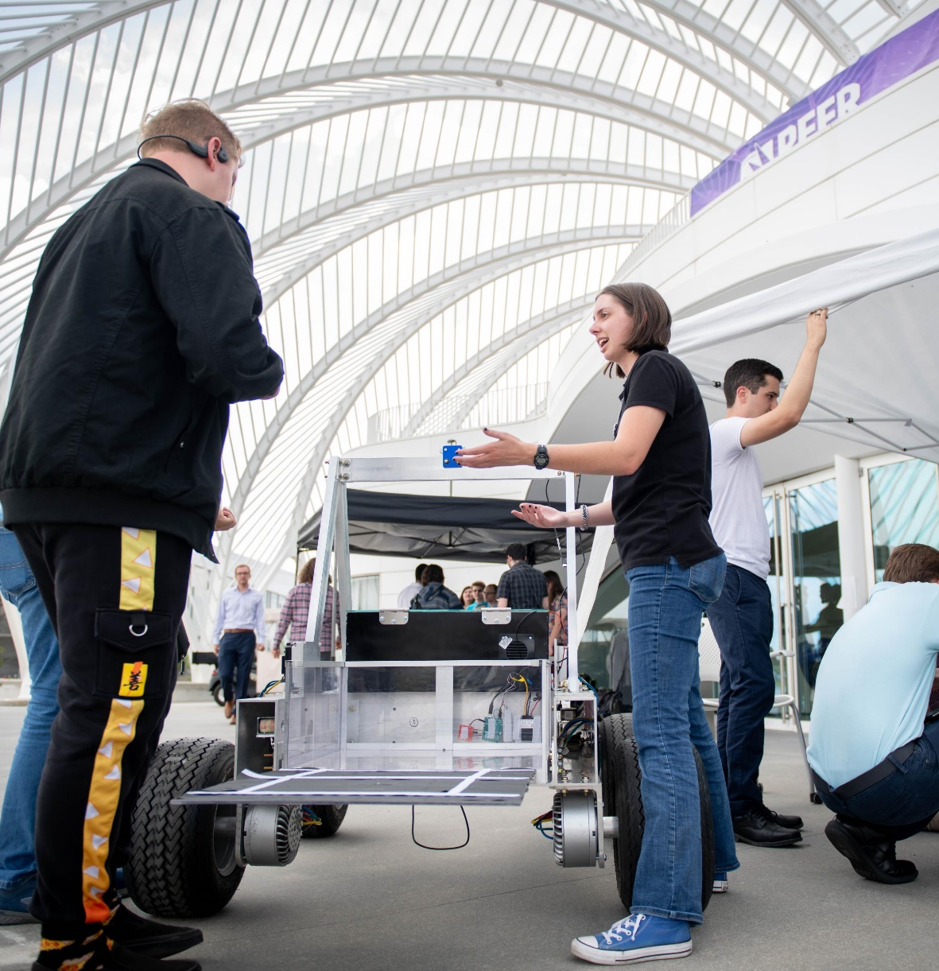
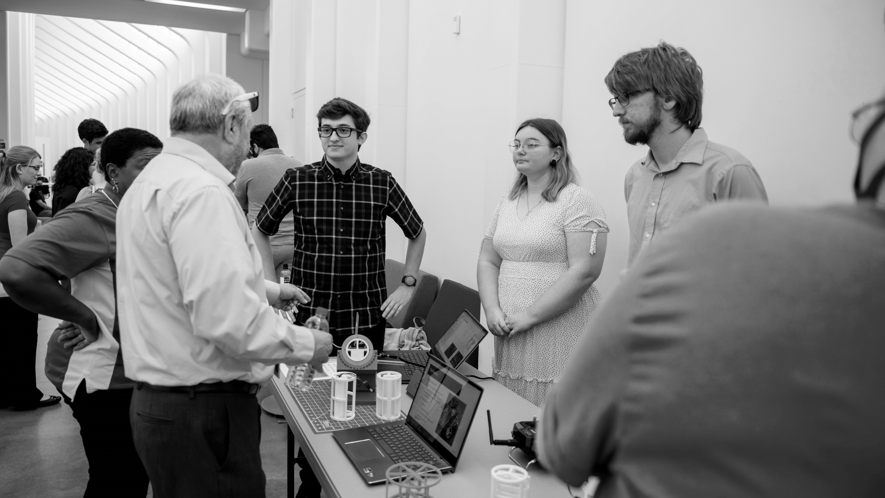
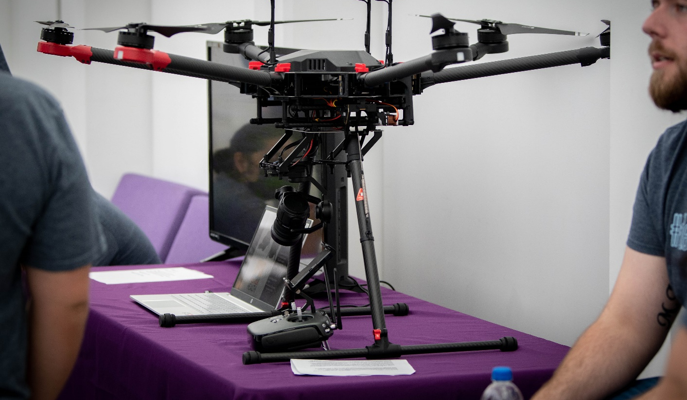
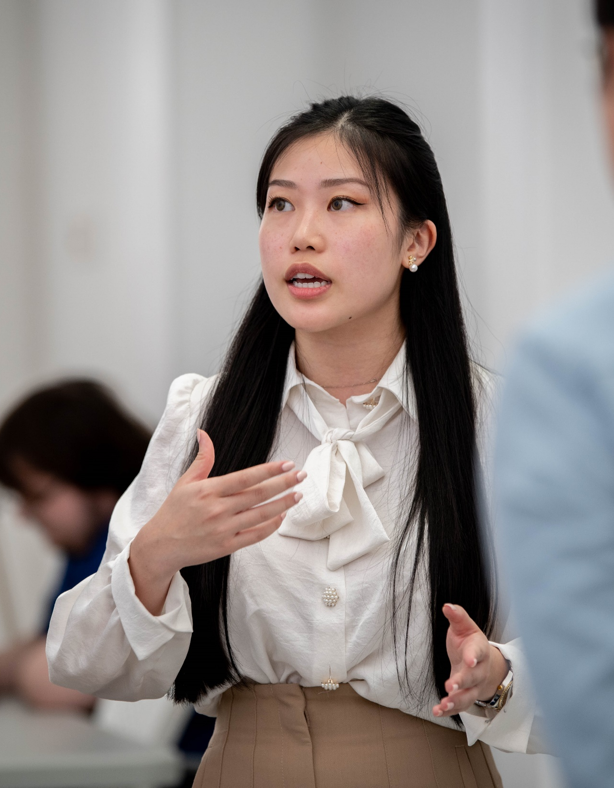
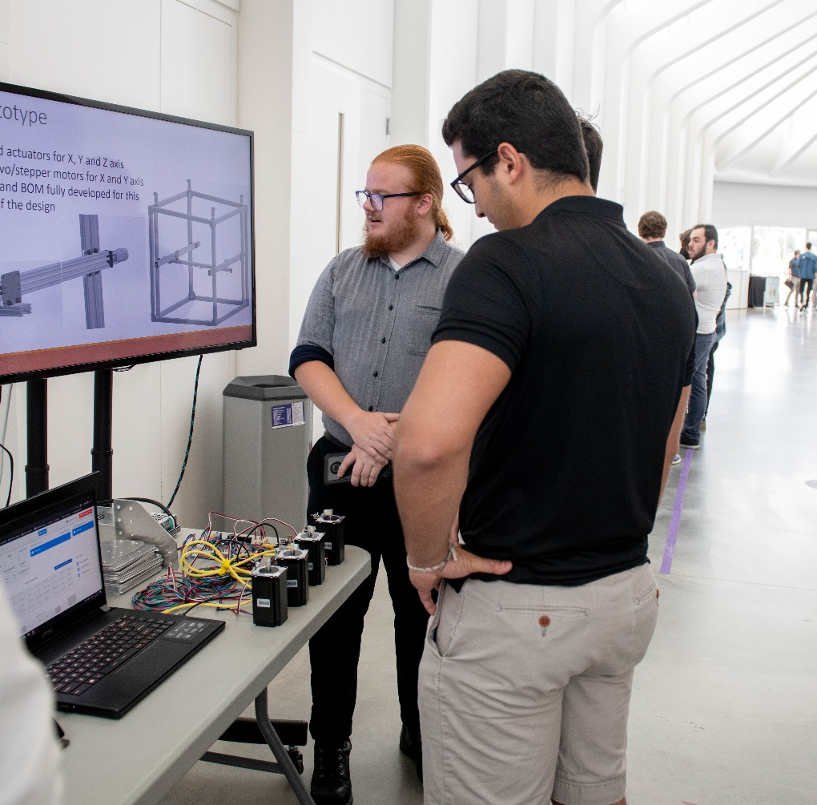
Senior Capstone

Slide 14
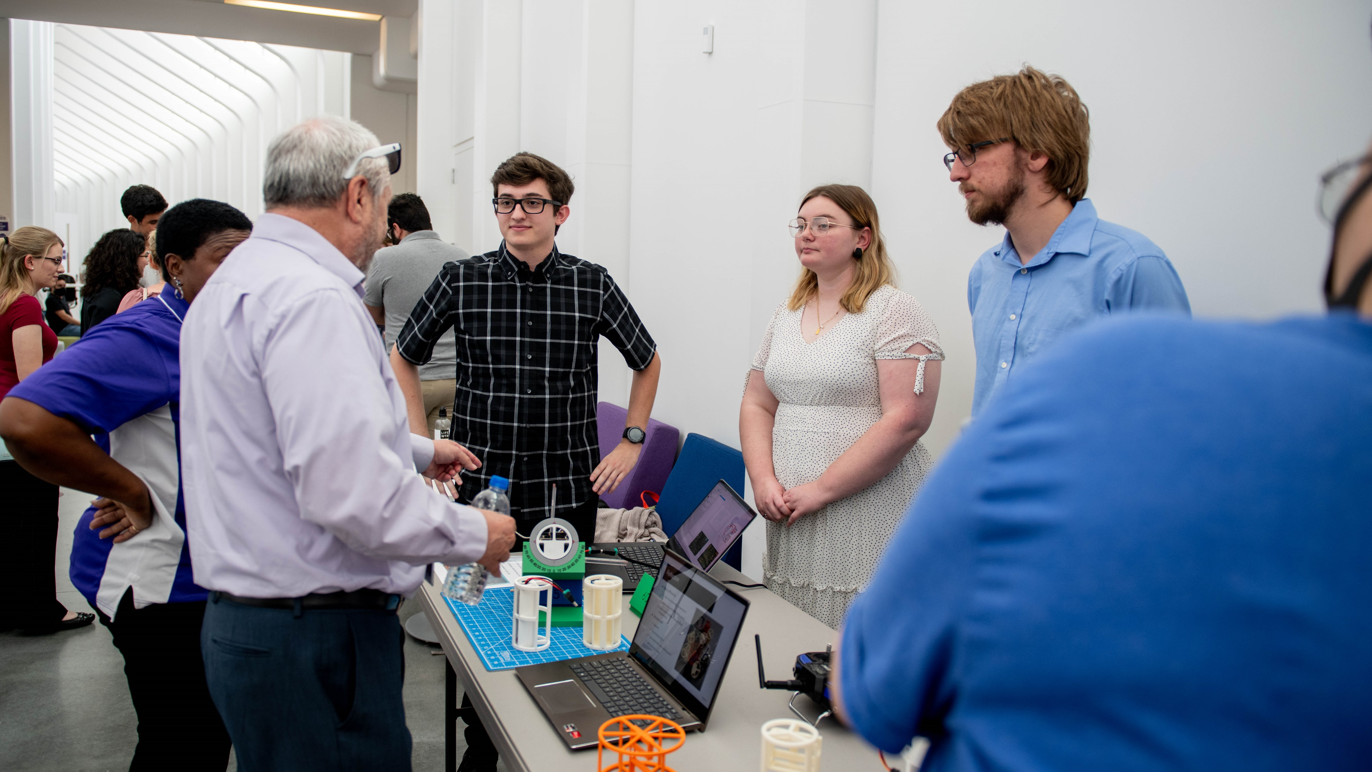
Former Capstone Projects
Advanced Glucose Monitoring Bionic Physical Therapy AI and Machine Learning
Large Format High Resolution 3D Printer Planetary Rover Predicting Quality Outcomes in Hospital Stays
Remote Monitor of Wastewater Robotic Advanced Power Cleaning teleSteth
Robotic Mowing Smart Drone Land Surveillance Supply Chain Analysis Switchblade ISR Variant
Thermoregulatory Transport Device for Biologics Facial Recognition Auto Check-in Kiosk
Vision Tracking Systems for Surgical Tray Equipment The Smarter Surgical Training Device
Robotic Palm Tree Trimmer MIT Radar Atmospheric Water Generation Child Alertness System
OiGO Deployment Distributed Mesh WiFi Networks Emergency Department Timeliness

Slide 15
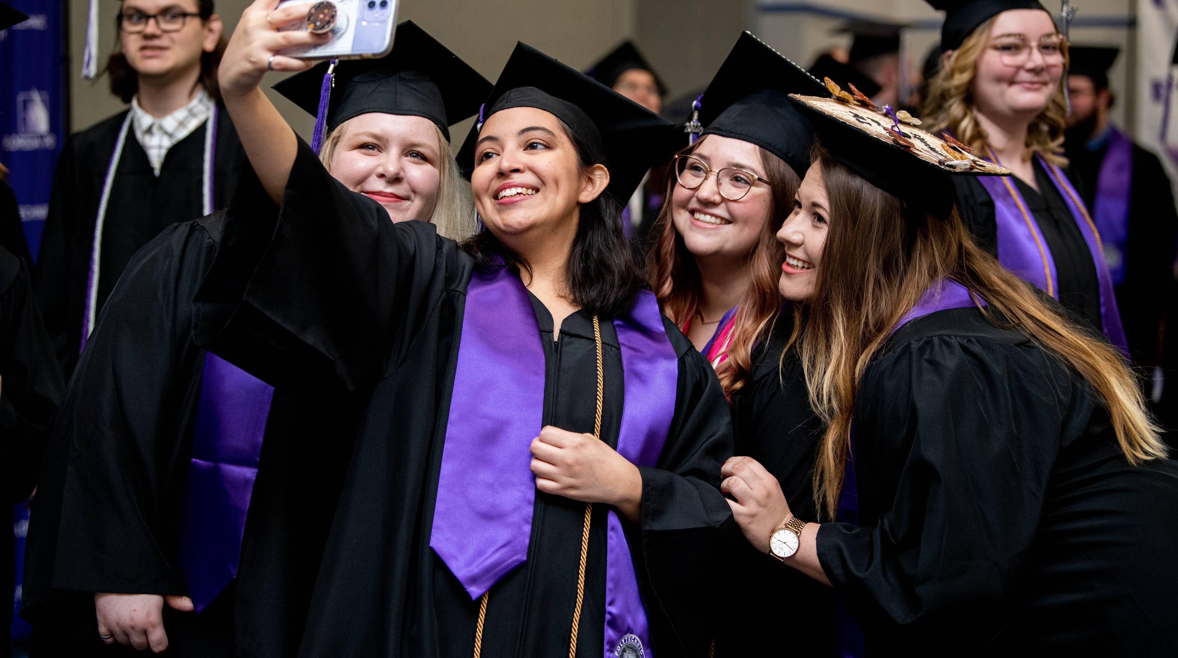
Business is All STEM
The Spaceship Company
Equinix
Sparton Electronics
Cognizant
Hensel Phelps
Siemens
Honeywell
Accusoft
Federal Communications Commission (FCC)
US Dept. of Defense
Collins Aerospace
The Walt Disney Company
Deloitte
Aerotek
Amazon
NASA
Kennedy Space Center
SpaceX
Price Waterhouse Coopers
Universal Studios
Citi
Northrop Grumman
BAE Systems
Lockheed Martin
Konica Minolta
Edwards Air Force Base
Booz Allen
Notes:
Slide Info: thank them for attending. Once the video is done their admissions ambassadors will come up to introduce themselves. Ask them to pass their cards to the center person if not already collected. Then place video and walk out.

Slide 16
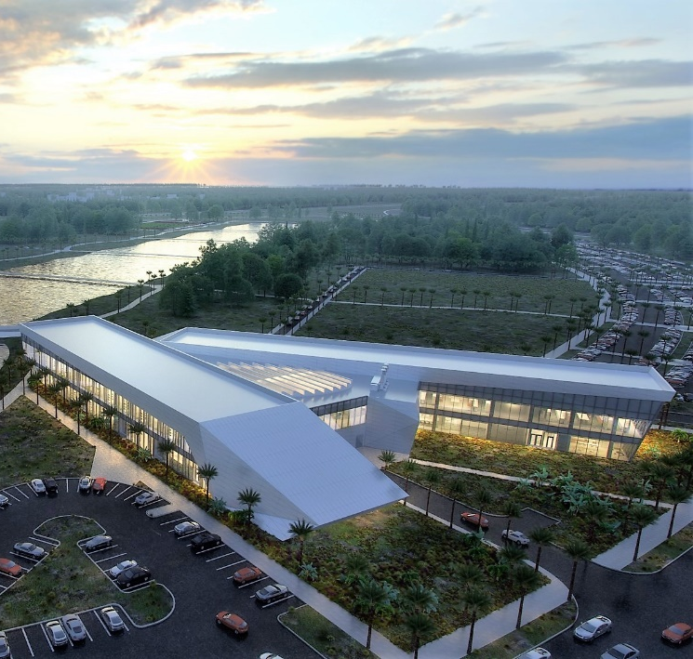
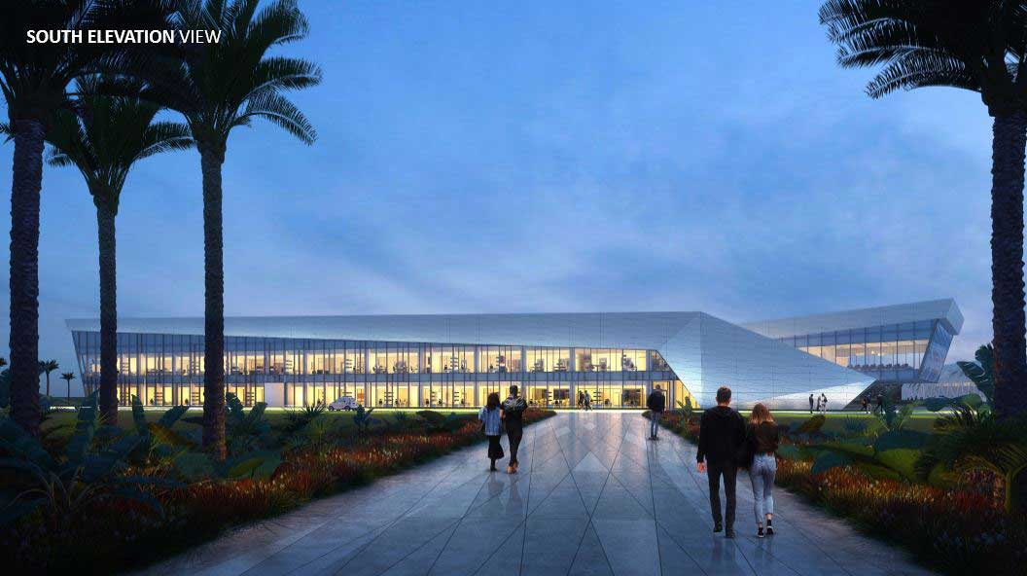
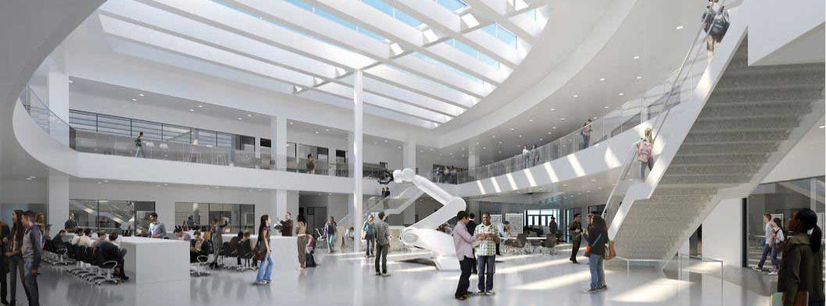

Slide 17
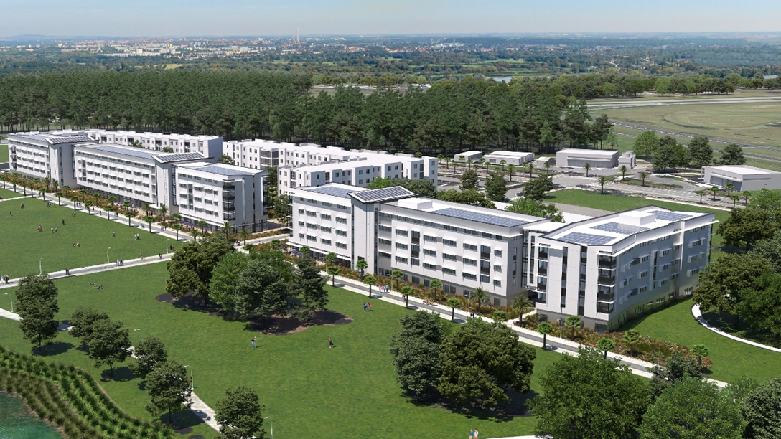
Growth to Meet Demand

Slide 18
Global Partnerships

Slide 20
Nov. 1st
Alexander Scholars
Priority Application and Scholarship Deadline
Selective Merit-Based Program
$40,000 Scholarship
Average SAT: 1515

Slide 21
Florida Poly
RANKED #1
PUBLIC COLLEGE
IN THE SOUTH

