Slide 1
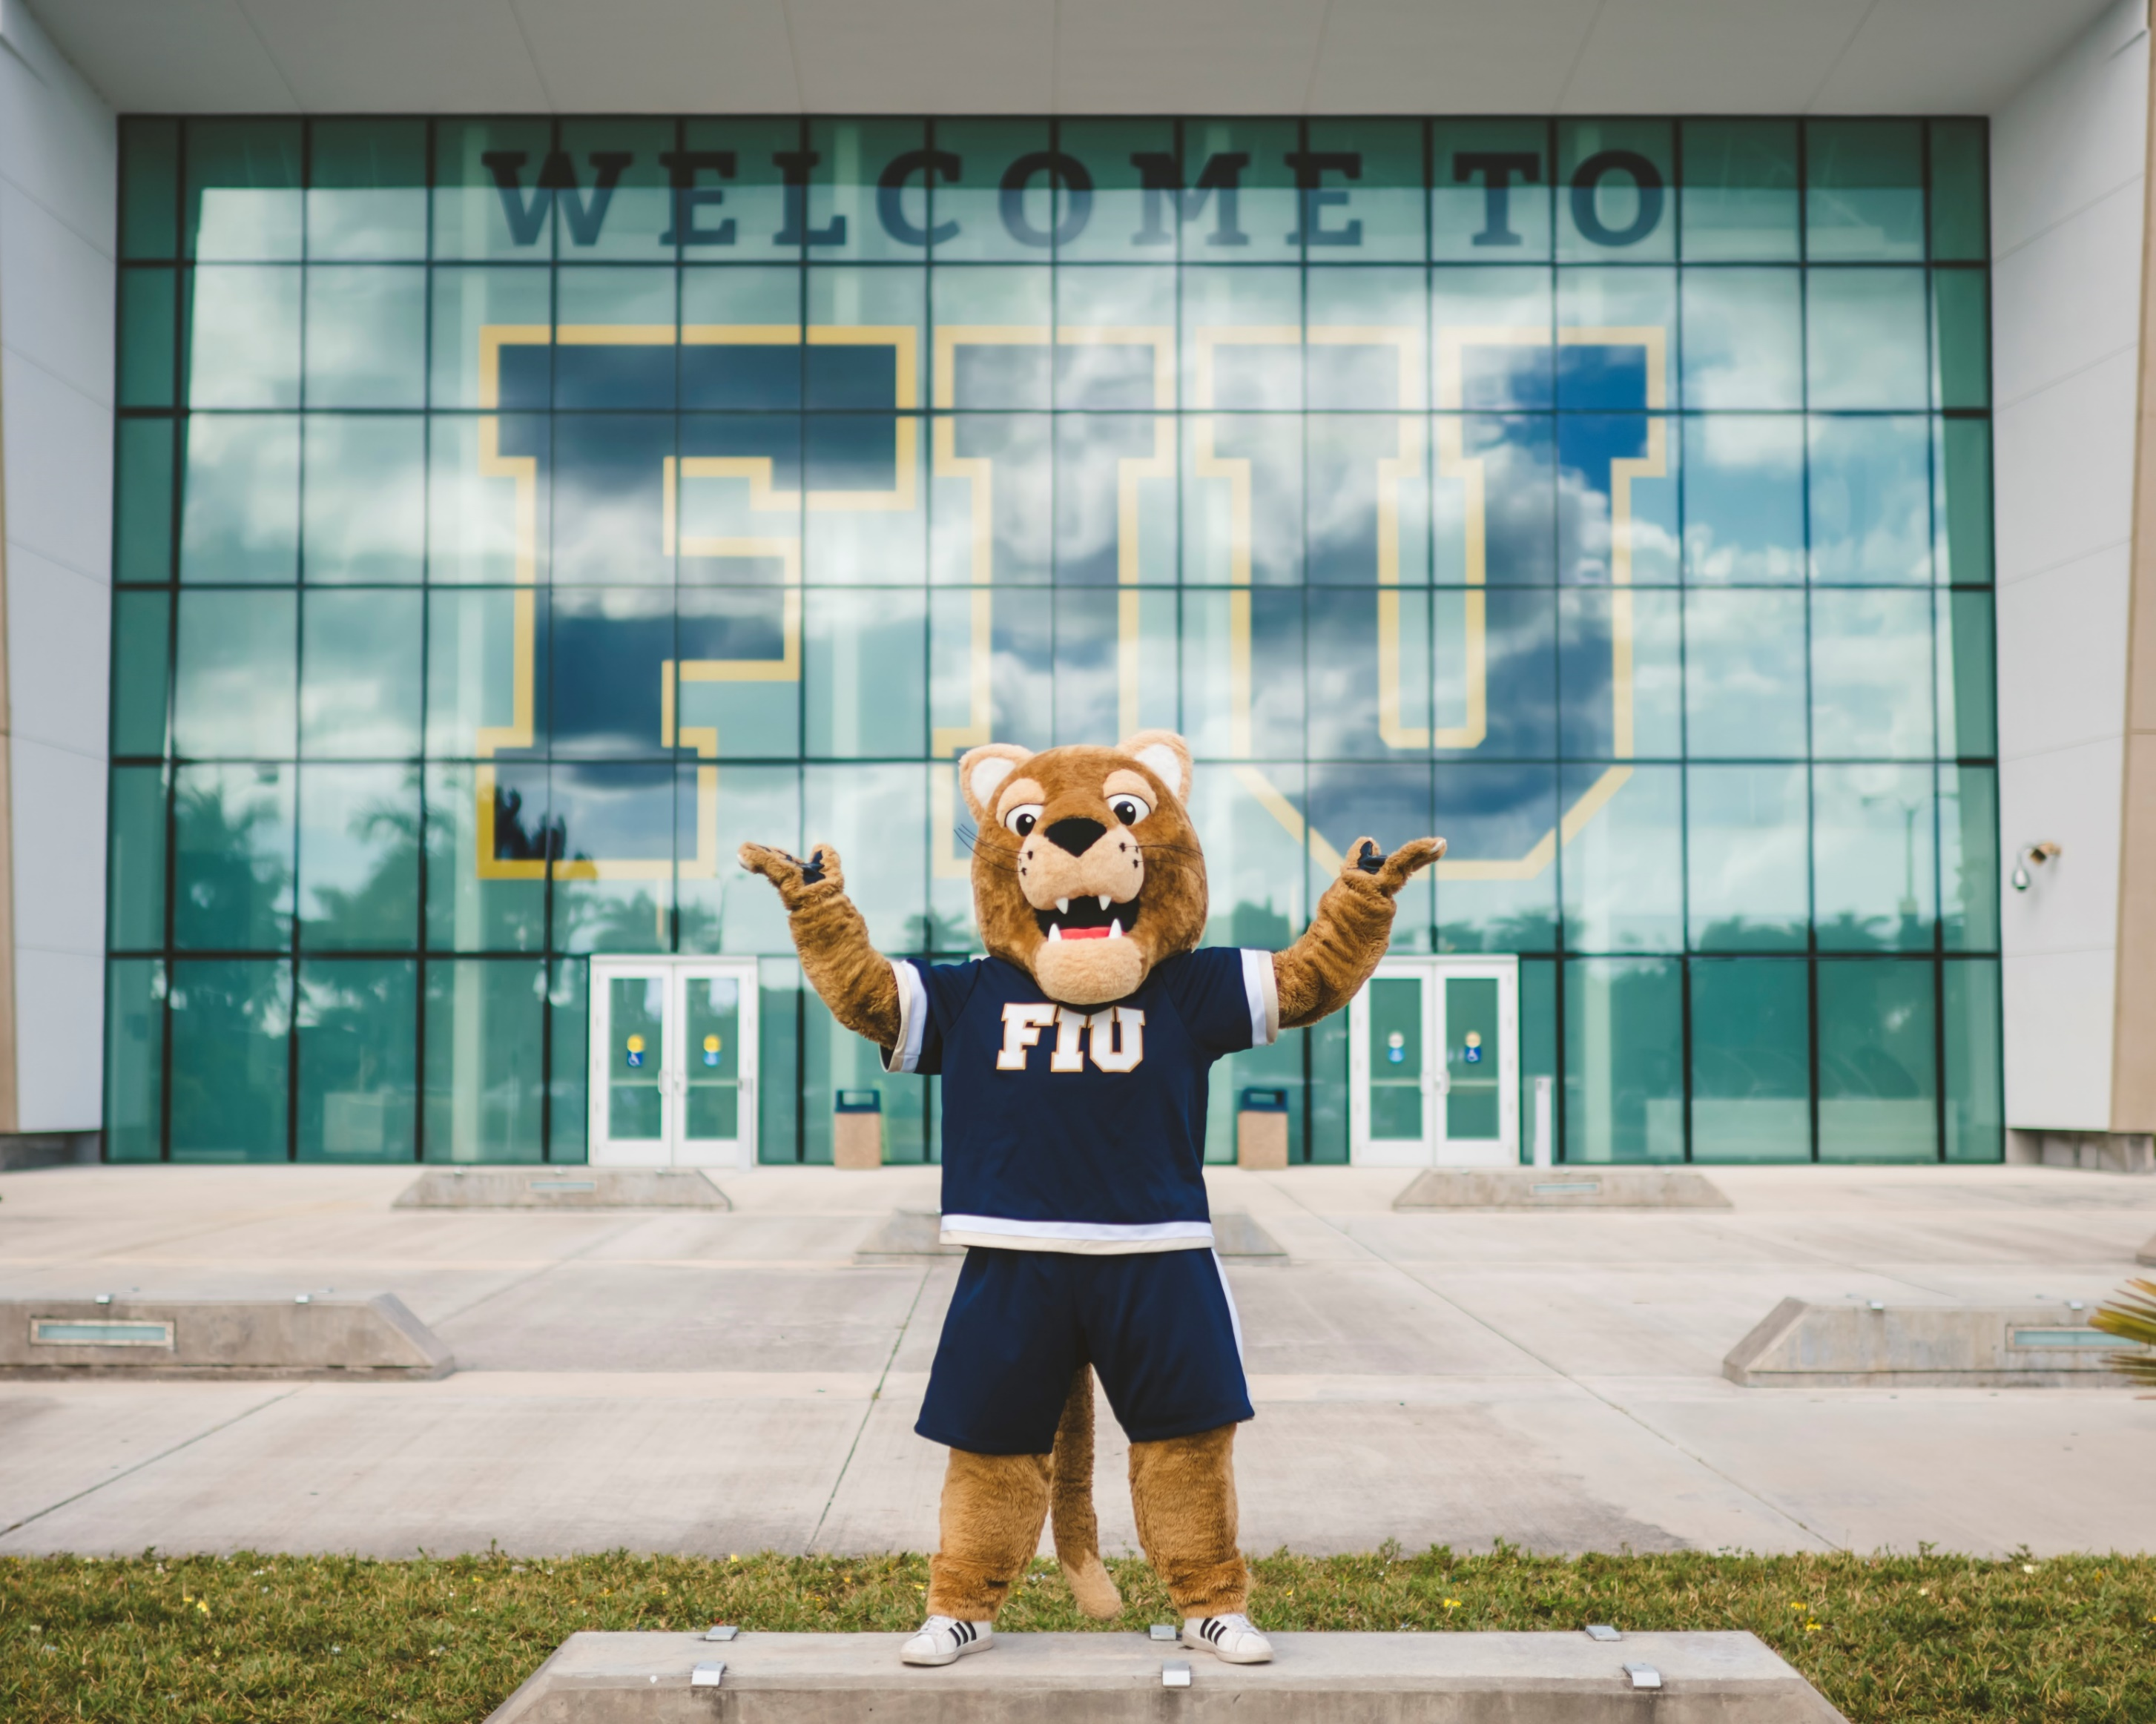

Slide 2
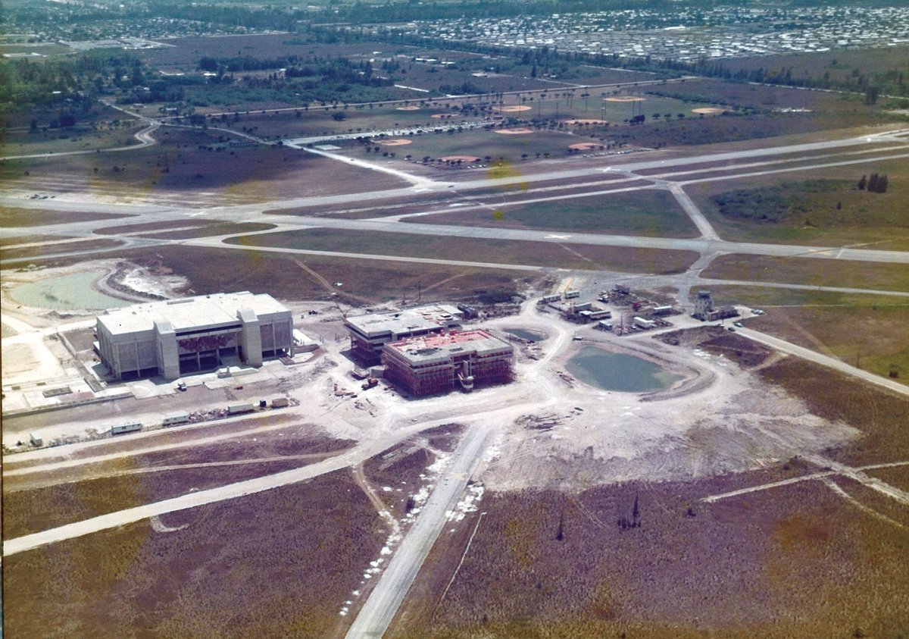
Founded 1965
Opened 1972

Slide 3
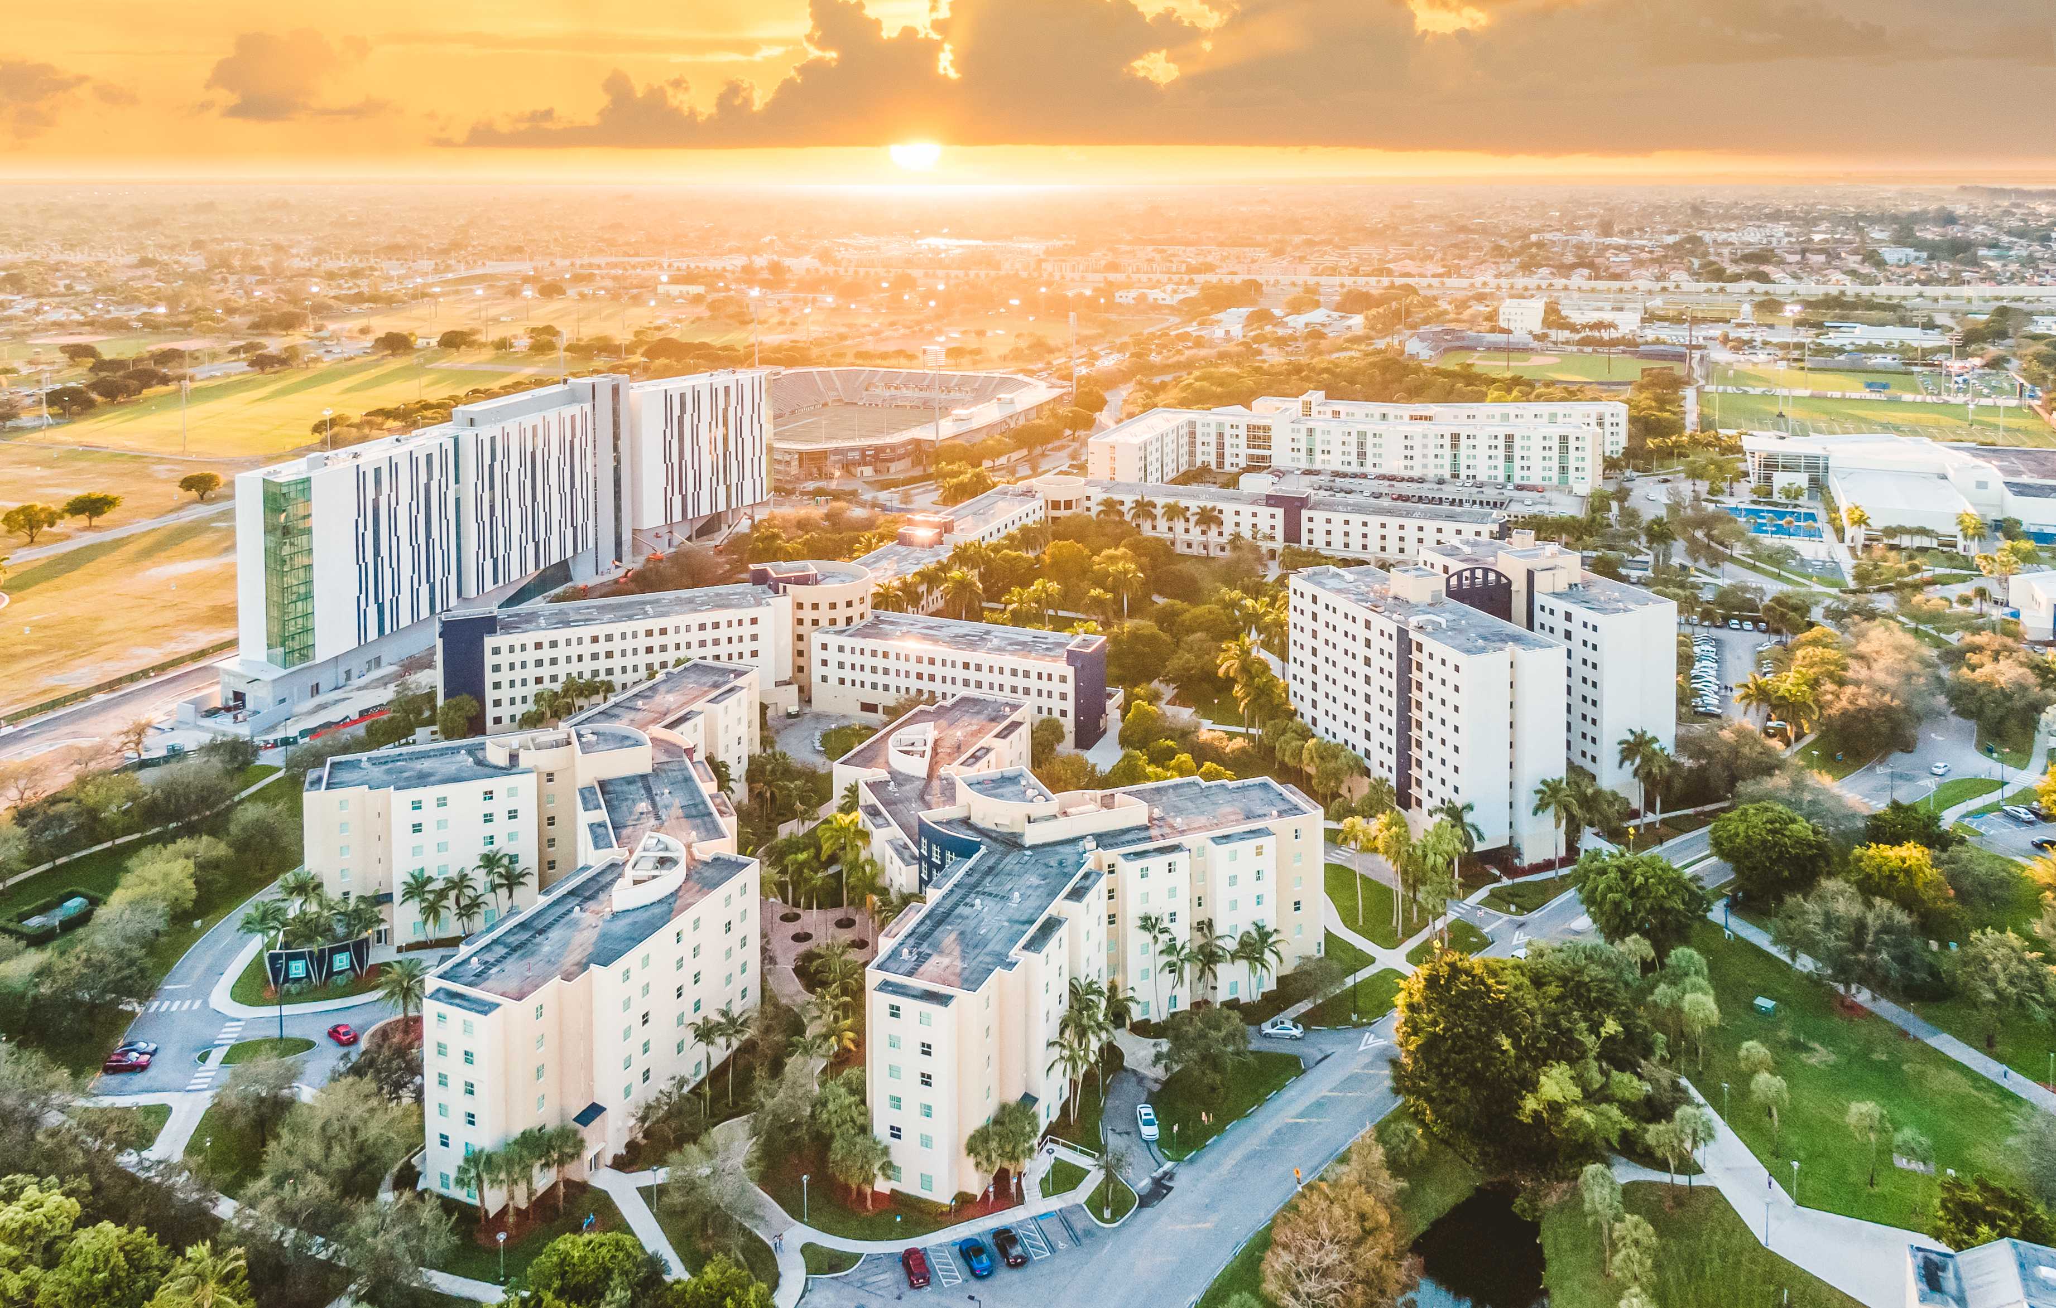
Present Day
2022

Slide 4
50 Years of making a REAL Impact
RI: Doctoral University – Very high research activity
Top 100 Public University
#1 Most diverse medical school
#2 International Business (BBA)
#3 International Global Policy & Administration
#5 Social Mobility – National Universities
Top 3 Florida Performance Metrics
#32 Washington Monthly

Slide 5
Introduction: A Different Kind of College Ranking
We rank FIU at number 32 because, in addition to solid contributions in service and research, it is very affordable and helps a large number of students eligible for Pell Grants start their lives and careers with a high-quality degree.
2022 Washington Monthly

Slide 7
Admissions Pathways
Top 10% Access to FIU
Early Fall STEP
Early Fall STEM, Engineering and Business STEP
Early Fall Direct
Fall STEM, Engineering and Business STEP
Fall Direct
Spring Direct
Connect4Success

Slide 8
2023 Deadlines
July 1 – Application opens
September 15 – FIU Common App (anticipated launch date)
September 15 – Decisions begin for complete applications
November 1 – Deadline to be admitted to participate in premier and micro scholarships
November 14 – Deadline to submit scholarship application & be connected to FIU on Raise.Me
April 3 – Application deadline
April 10 – Transcript/Test Score deadline
May 1 – Deposit deadline

Slide 9
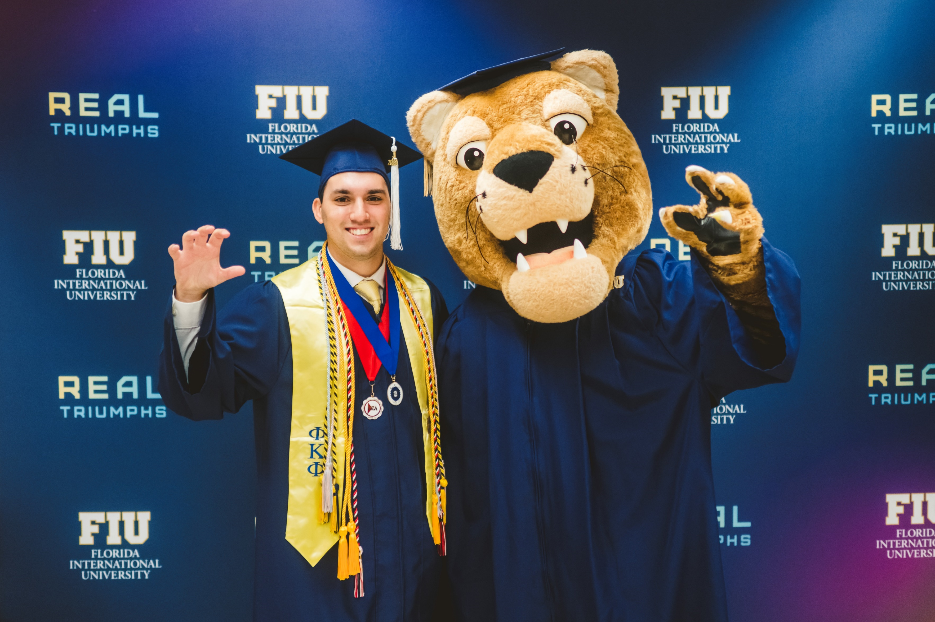

Slide 10
FIU Premier Scholarships
National Merit® Finalists
Full tuition, fees and books
Full room and board in Parkview Hall
Unlimited meal plan
Guaranteed research, mentor and admission to Honors College
FIU College Board National Recognition Programs
Full tuition and fees
Stipend for books and meals

Slide 11
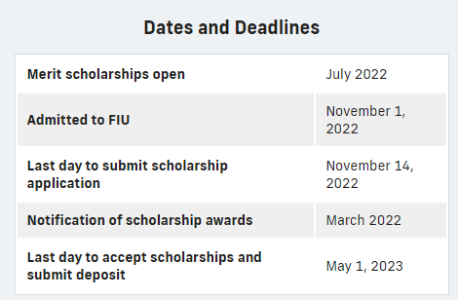
FIU Premier Scholarships
Presidential Premier
Full Tuition and Fees
Stipend for books
Ambassador Premier
75% tuition and fees
Stipend for books

Slide 12
Raise.Me
Be admitted to FIU by November 1
Complete RaiseMe profile and follow FIU by November 14
Last day to submit earnings March 1
Silver Knight, Dual Enrollment, 5000 Role Models added to earning opportunities

Slide 13
DACA, TPS or Undocumented Student Scholarships
TheDream.US
Application opens November 1, 2022
Application closes February 23, 2023
Hispanic Scholarship Fund
https://www.hsf.net/scholarship
Scholarship America Dream Award
https://scholarshipamerica.org/students

Slide 15
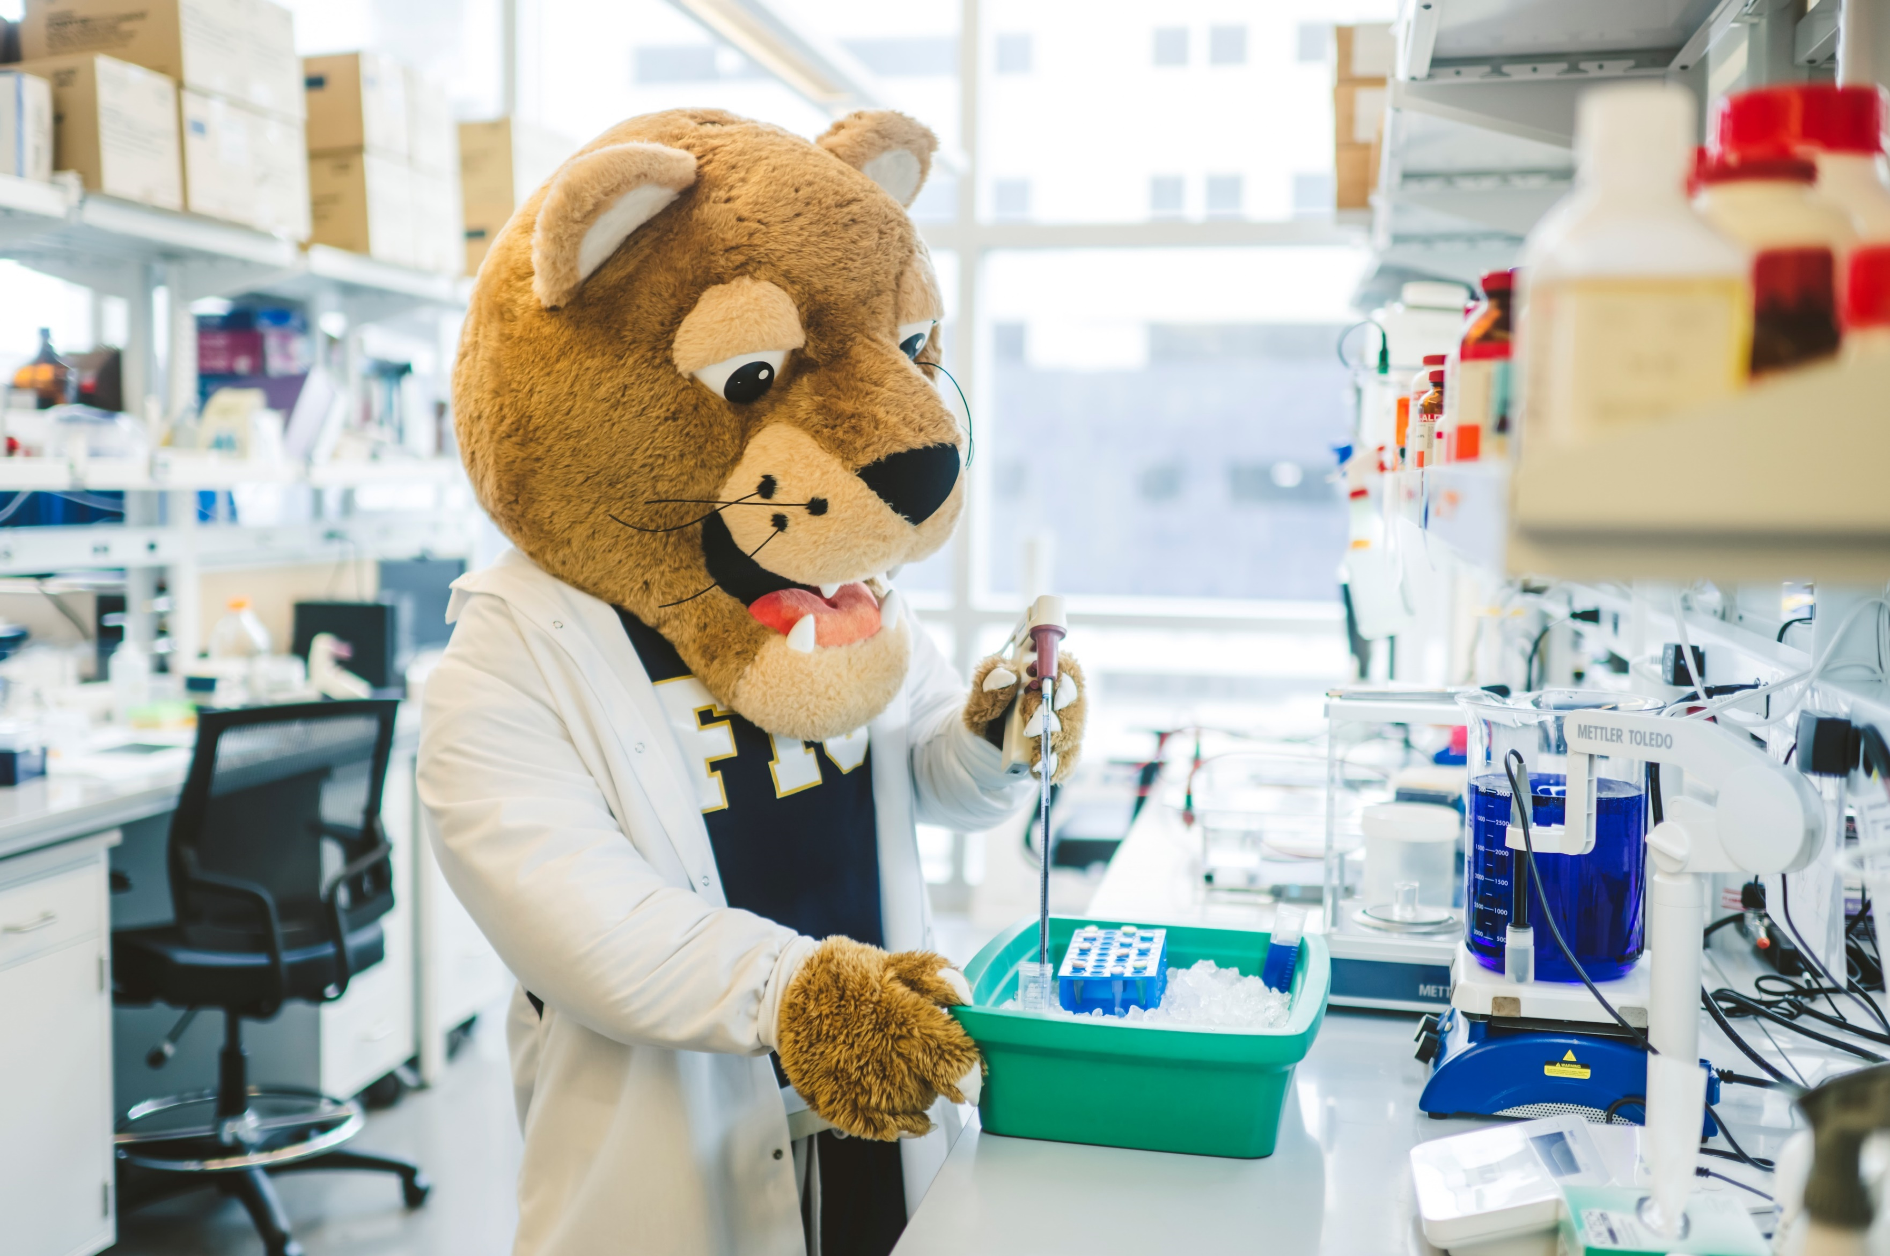

Slide 17
Welcome to Tamiami Hall
Opened FALL 2022
676 Beds
LEED Certified
Junior, Senior, Graduate standing
Views of downtown Miami and Football Stadium
Full kitchen
Fully furnished living room
In-Building laundry facilities

Slide 19
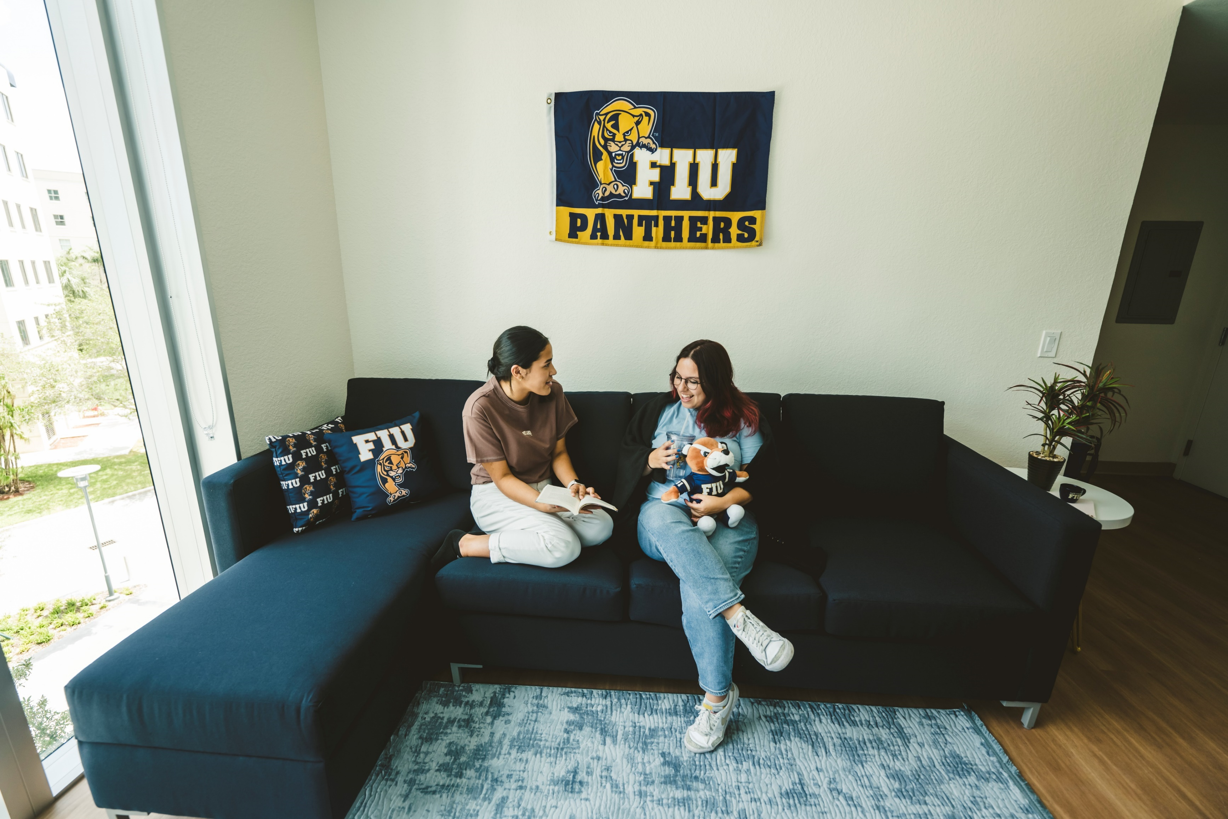

Slide 20
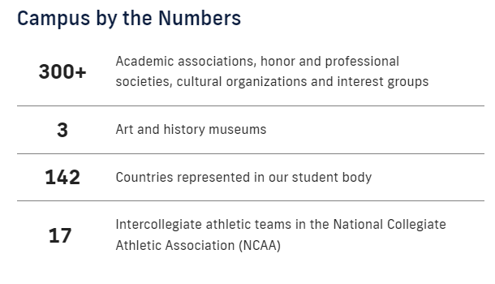

Slide 23
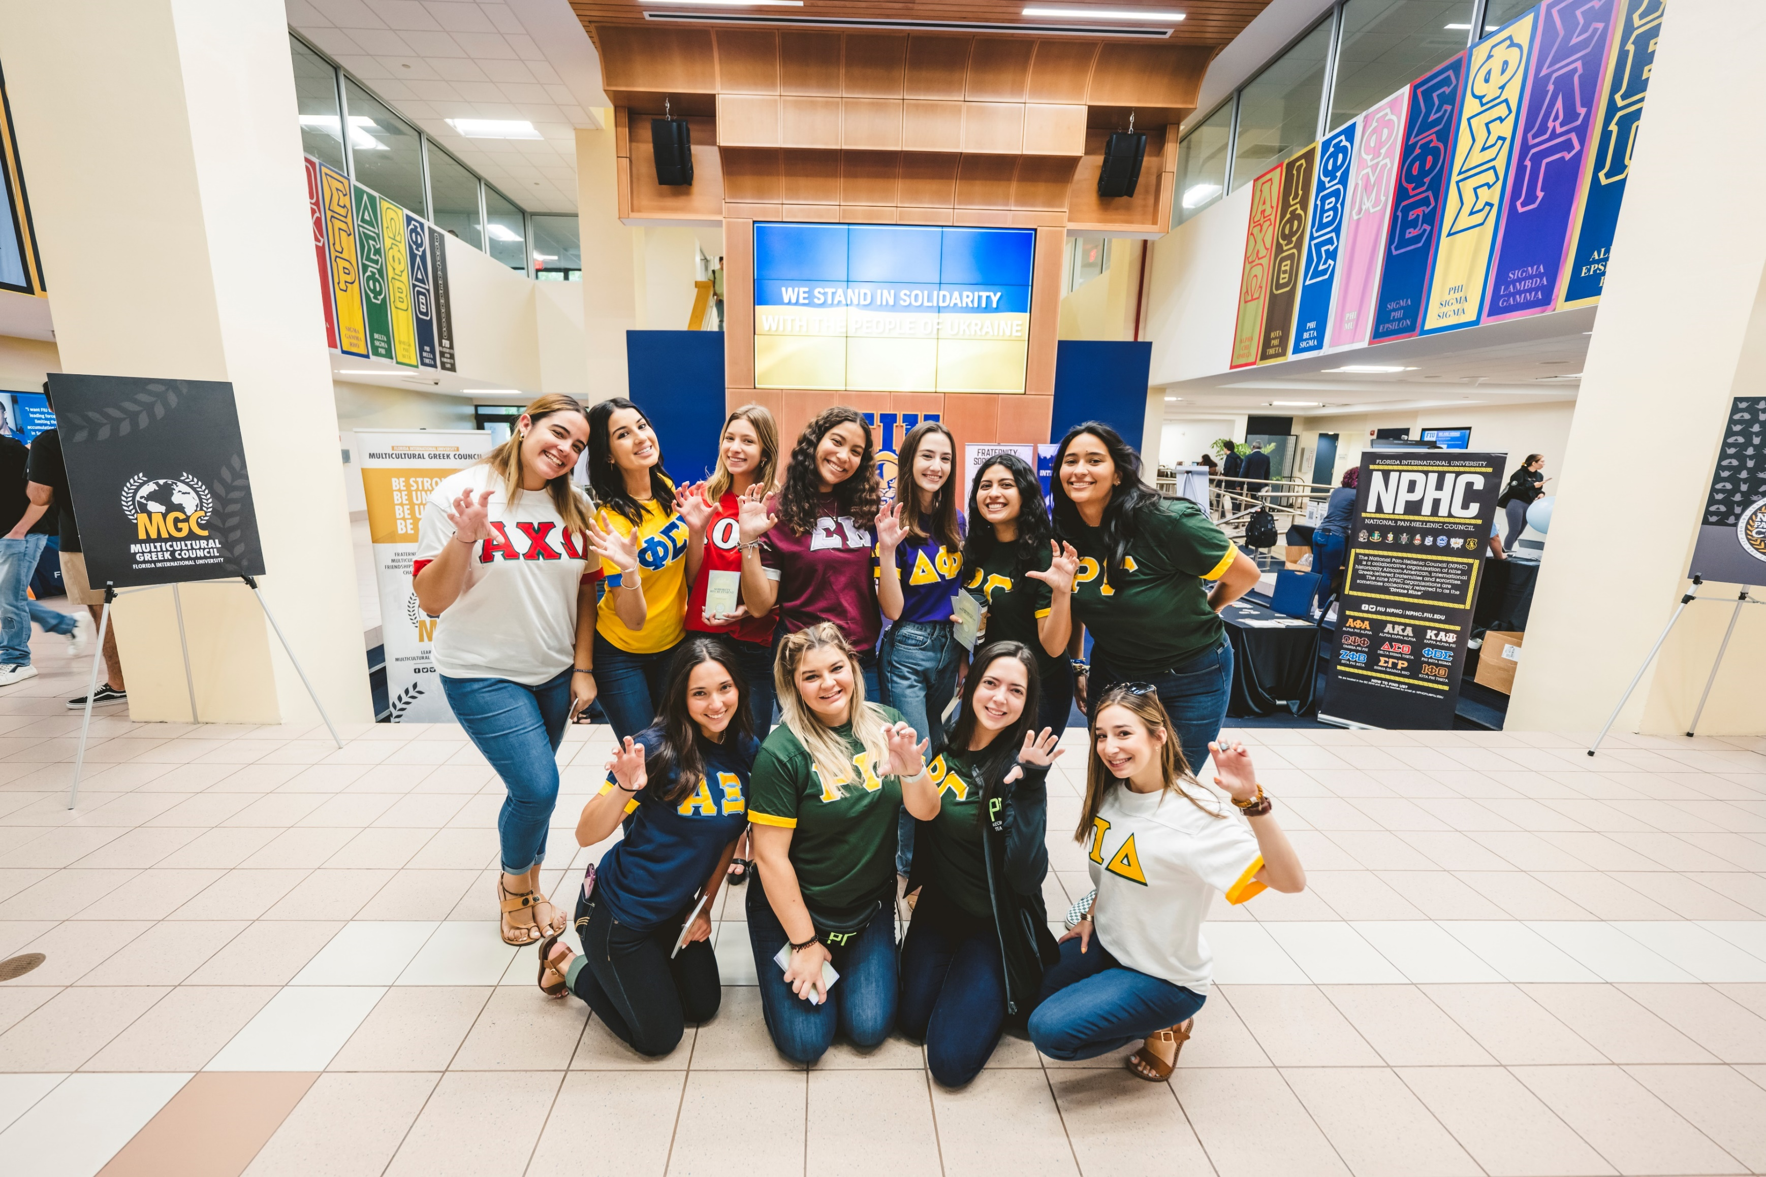

Slide 24
