Slide 1
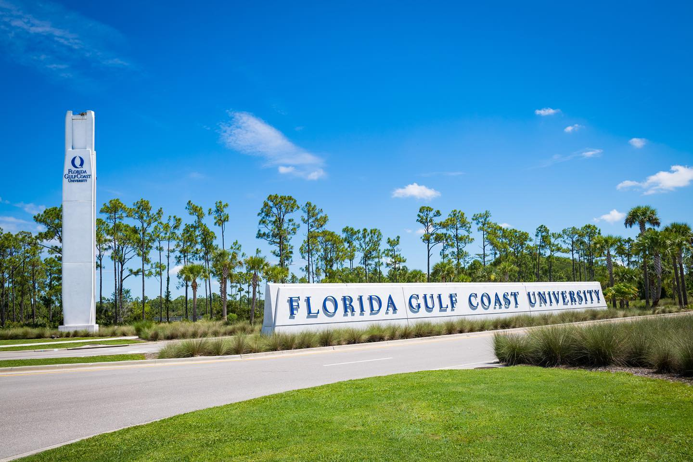
Florida Gulf Coast University
SUS Tour 2022
Dean R. Batchelder
Associate Director Of Admissions

Slide 2
FGCU Fast Facts
FGCU is 25 years old!
Our student enrollment has grown from 2,584 Fall 1997 to 15,971 Fall 2021
Tuition has not increased for nine consecutive years!
Student success is our #1 priority
81% of classes taught by full-time faculty
Student-to-faculty ratio 22:1
Service Learning and Environmental Sustainability are woven into curriculum
FGCU competes in NCAA Division I Atlantic Sun Conference
Notes:
College is a 4 year investment. It is a home away from home so you might as well love it!
3.0 million service hours since 1997 and 350 community partners: what does that mean? We match your academic goals to personal interests to help give back to community, gain experiences, and build relationships.
Sustainability: our programs and practices are nationally recognized. For ex: FGCU saved $400,00/yr by using efficient chiller plant operations to cool campus, 10 solar powered trash compactors reducing the frequency of trash pickup.

Slide 3
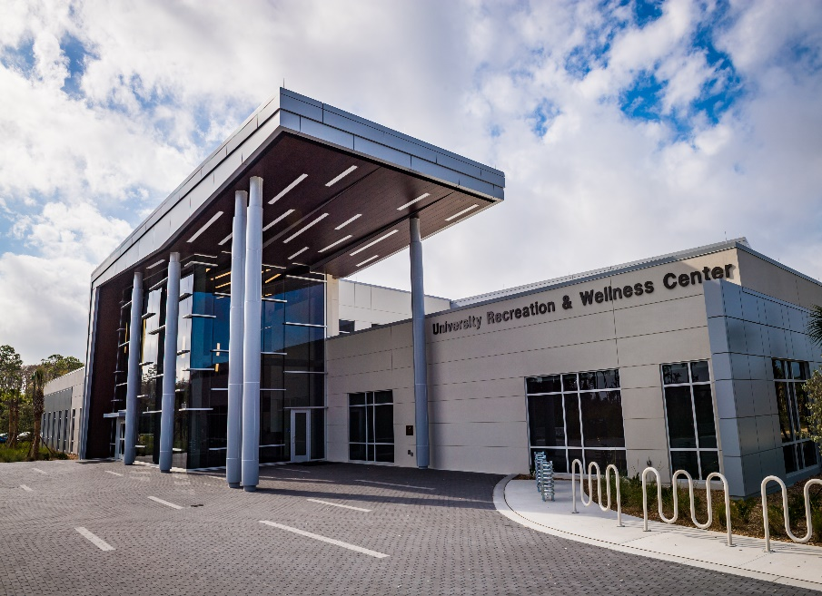
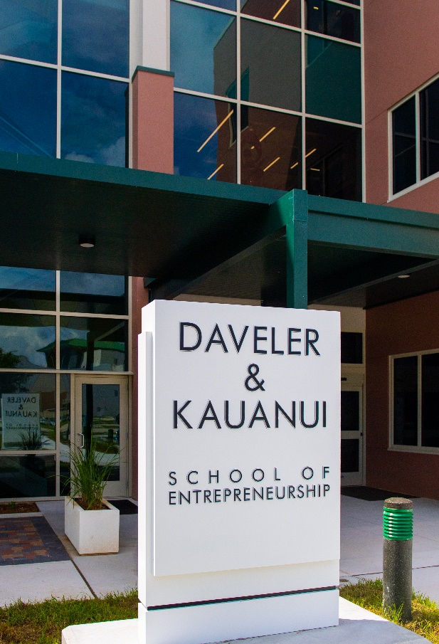
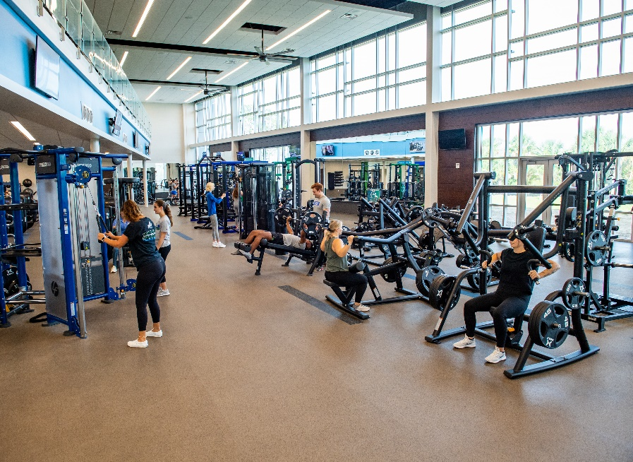
What’s New on Campus
Recreation and Wellness Center
Lucas Hall
Notes:
Our new Recreation and Wellness center is a two-story building with double gymnasium, group fitness room, multipurpose room, strength and fitness room, cardio deck, and an observation concourse.
Student success within our unique and interdisciplinary entrepreneurship programs has spiked a real demand for something big. They now have a new home on campus and the doors just opened for Fall 2021.

Slide 4
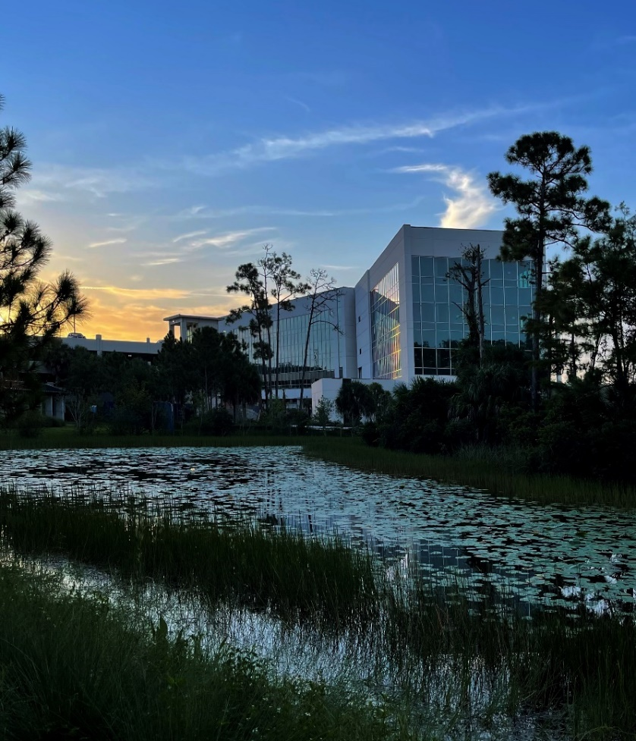
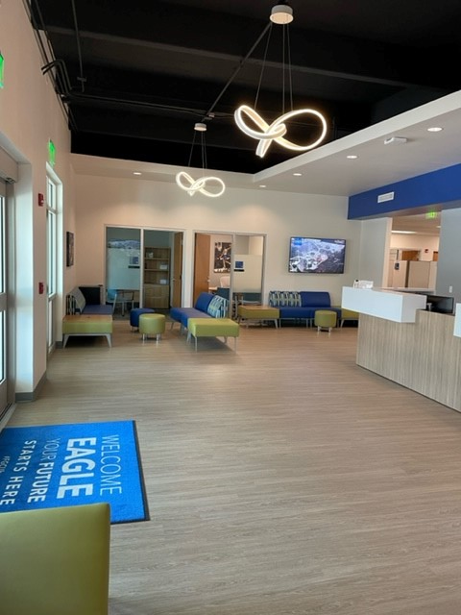
What’s New On Campus
Academic Building 9
(Home of the The Water School )
Renovated Undergraduate Admissions
Notes:
Located in the midst of Florida's complex freshwater and saltwater systems, The Water School is uniquely positioned to explore water-based issues. The newest school focuses on interdisciplinary studies and brings together 16 different programs including engineering, business, health and psychology to work under one roof.

Slide 5
Florida Gulf Coast University
64 majors and 54 minors this fall
Five academic colleges:
College of Arts & Sciences
Lutgert College of Business
College of Education
U.A. Whitaker College of Engineering
Marieb College of Health & Human Services
Notes:
In addition, we have the Honors College that has grown to over 1,000 students

Slide 6
Florida Gulf Coast University
Five schools
Bower School of Music & the Arts
Daveler & Kauanui School of Entrepreneurship
School of Nursing
School of Resort & Hospitality Management
The Water School

Slide 7
New Offerings
Daveler & Kauanui School of Entrepreneurship added BA in Digital Media Design
College of Arts and Sciences added BS in Physics
BA in Interdisciplinary Entrepreneurship Studies → BS Entrepreneurship
Notes:
Daveler & Kauanui School of Entrepreneurship added a new Digital Media and Design B.A. which has topics in interactive design, animation, motion graphics and video game design. We are excited to have another STEM/STEAM major added to our curriculum.
The B.A. in Interdisciplinary Entrepreneurship Studies is being replaced by the Entrepreneurship (B.S.) major, effective Fall 2021, by the School of Entrepreneurship

Slide 8
What’s New?
FTIC Pilot Cohort Pathway for STEM Majors
Starts Summer B 2023 with two courses
Housing
Academic Support (Tutoring, Supplemental Instruction)
Micro-Credentials/Digital Badges
Industry Specific*
Transferable Skills*
Continuing Education & Skills Academy
*Degree seeking FGCU students are not charged any additional fees

Slide 9
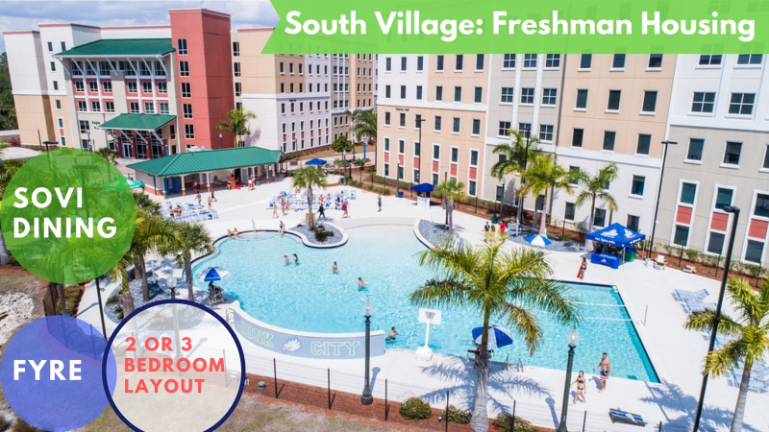
Notes:
Moving over to our housing, we offer 3 resort style housing facilities for our students.
South Village, called Sovi for short - is home to our freshman. There are two layouts, a two bedroom or a 3 bedroom layout. Both include a bathroom in the unit that is split. This means we are not dorm styled, students get their own bedroom and split a bathroom with only one or two other students. Sovi is also where Sovi Dining, our all you care to eat buffet is located.

Slide 10
FGCU Admissions How to Apply
Submit FGCU admissions application OR the Common App
Submit official transcripts
Submit official test scores
Notes:
Online application includes essay
No LORs needed

Slide 11
FGCU Admissions Application Deadlines
Fall
Early Action (Freshman only) November 1
Regular Decision March 1
Spring
Freshman December 1
Summer
Freshman March 1
Notes:
If you haven’t already submitted your admissions application, we hope when you leave here today that you will consider applying to FGCU. We have moved from rolling admission to Early Action which means…….
Early Action is non-binding, December notifications! Scholarships!
Regular Decision batches Jan - Apr

Slide 12
FGCU Admissions Scholarships
President’s Gold $5,000/yr FL Res, 3.9 wGPA 1320 SAT or 28 ACT
President’s Silver $3,000/yr FL Res, 3.5 wGPA 1220 SAT or 25 ACT
B & G Scholars $15,000/yr Non-FL Res, 3.9 wGPA 1320 SAT or 28 ACT
B & G Directors $10,000/yr Non-FL Res, 3.5 wGPA 1220 SAT or 25 ACT

Slide 13
Admissions Tips
Apply EARLY
Take the SAT/ACT multiple times
Tour our awesome campus
Check your status through your FGCU Gulfline account and read your emails
Email questions to admissions@fgcu.edu

Slide 14
Upcoming dates
Fall Eagle EXPO Saturday, October 15, 2022
Say Yes to the Nest Saturday, January 21, 2023
Spring Eagle EXPO Saturday, February 18, 2023
Say Yes to the Nest Saturday, March 25, 2023

Slide 15


