Slide 1


Slide 2


Slide 3


Slide 4


Slide 5


Slide 6


Slide 7


Slide 8


Slide 9


Slide 10


Slide 11


Slide 12
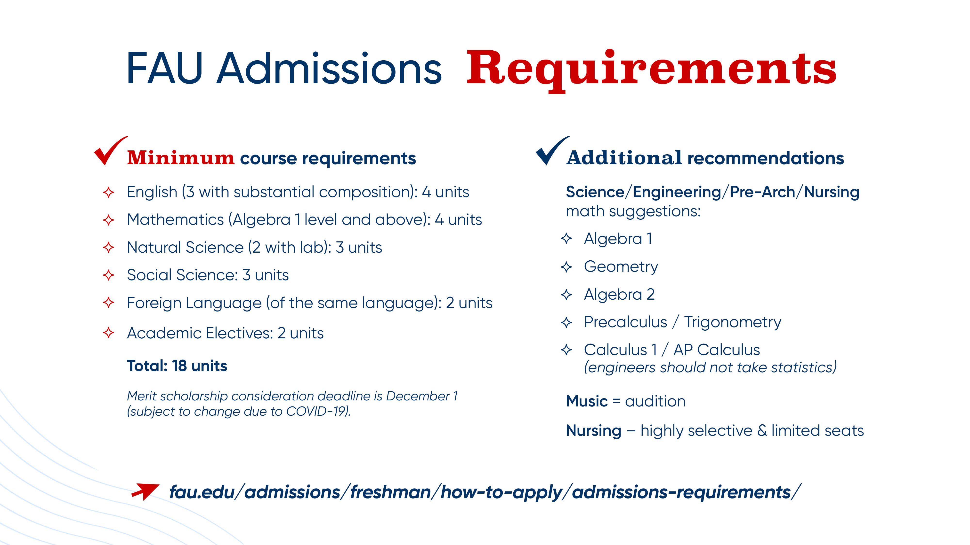

Slide 13
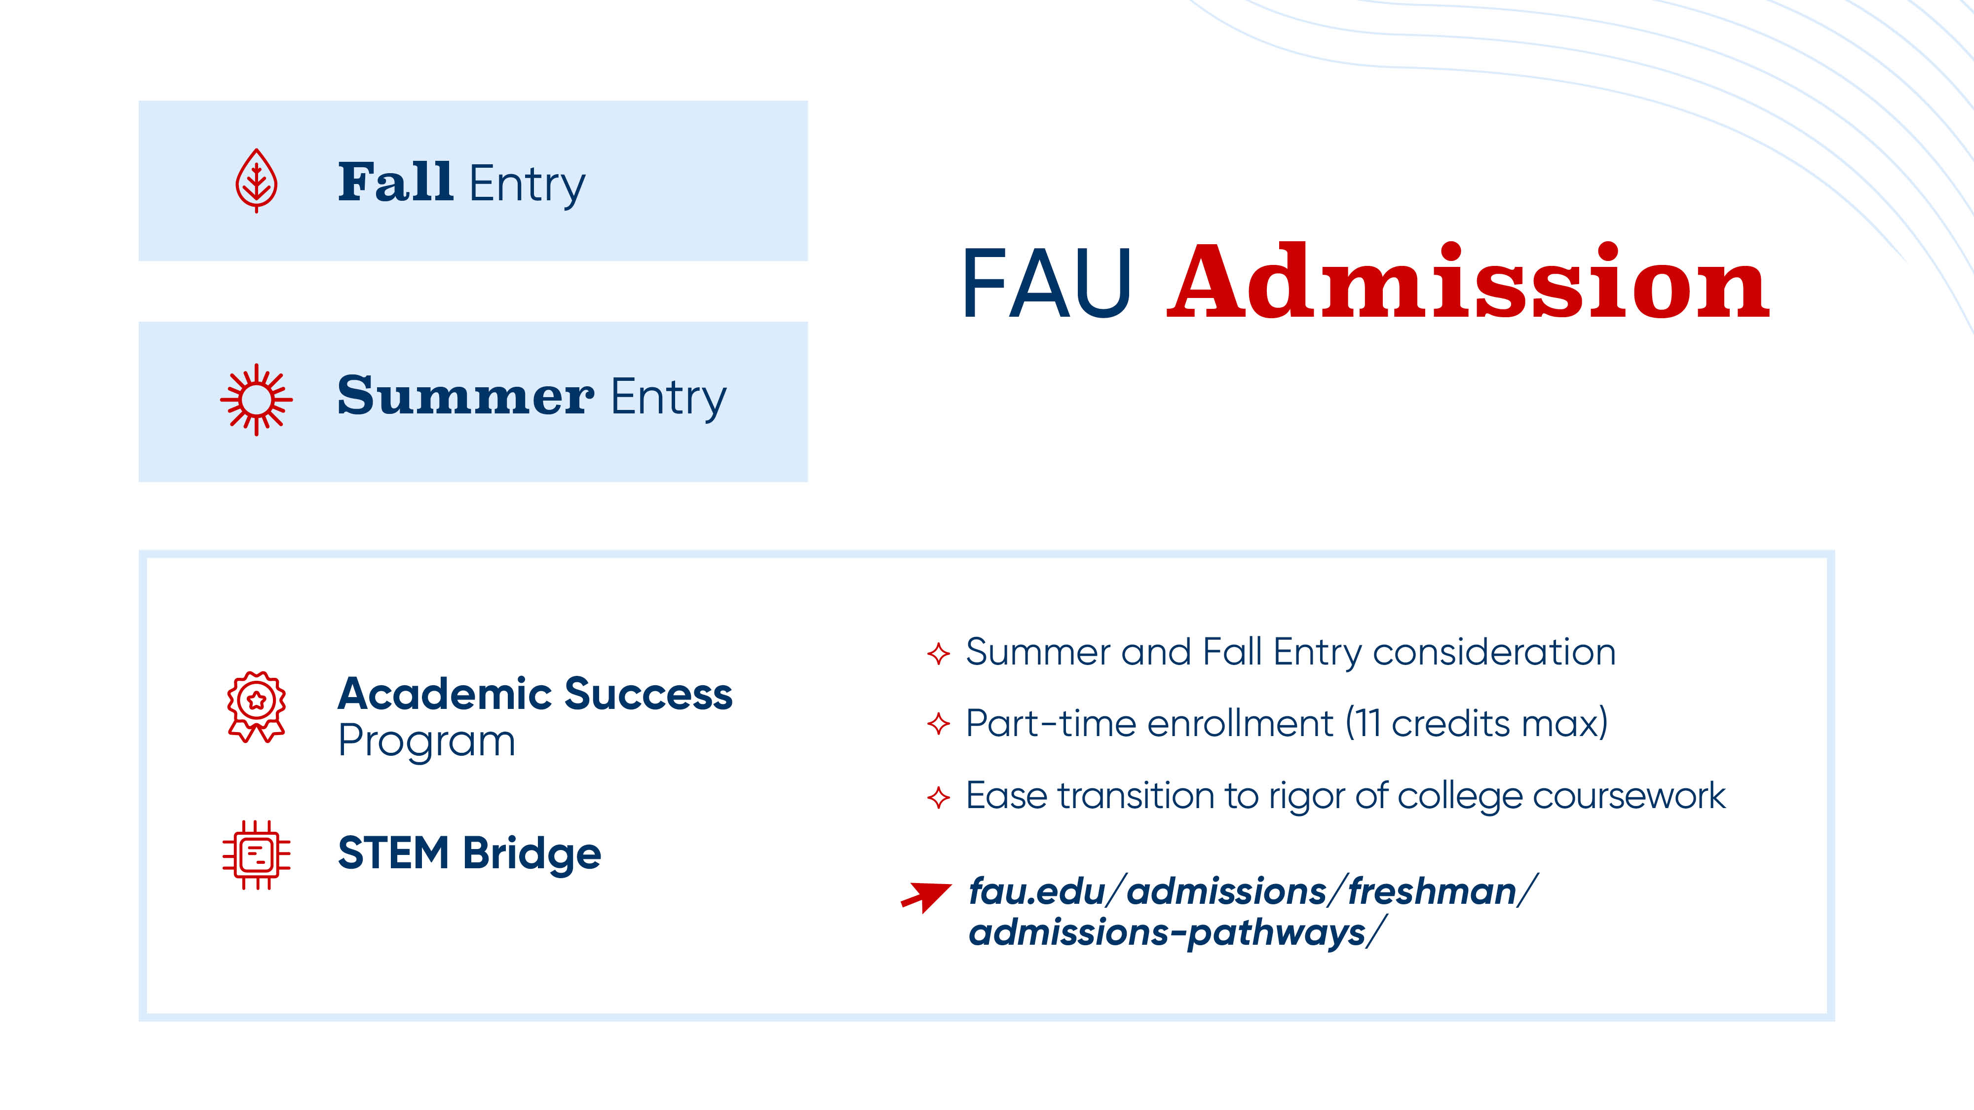

Slide 14


Slide 15

First-Year Application Deadlines
Student Type | Deadline | Decision Type
Priority First-Year | November 1st | Admit – Fall or Summer- including Jump Start, Academic Success, or STEM Bridge. Admit for Spring Deny
First-Year Merit Scholarship | January 15th
Nursing Direct Admit | January 15th | Admit, Admit to 2nd choice major or Deny
Final First-Year | April 15th | Admit – Fall or Summer- including Jump Start, Academic Success, or STEM Bridge. Admit for Spring Deny

Slide 16


Slide 17


Slide 18


Slide 19


Slide 20


Slide 21


Slide 22
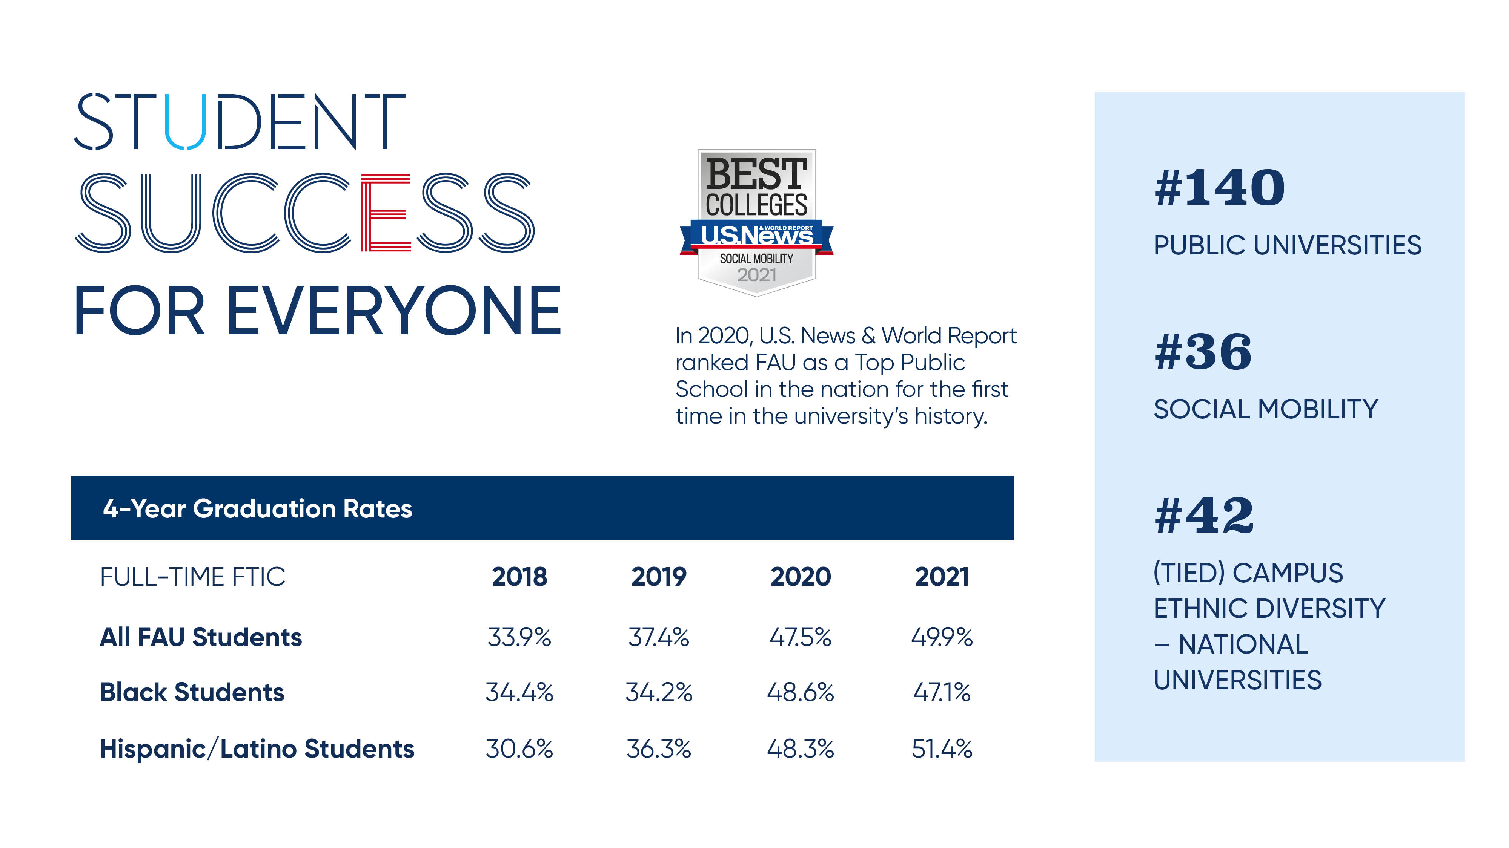

Slide 23


Slide 24


Slide 25


Slide 26


