Slide 1
The Future is Bright
UF Online Business Plan, 2019-2024
Evangeline Tsibris Cummings
Assistant Provost and Director of UF Online

Slide 2
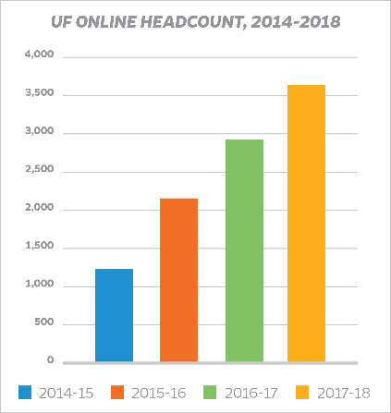
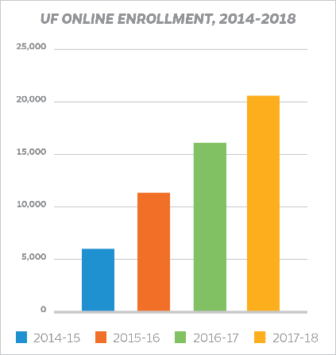
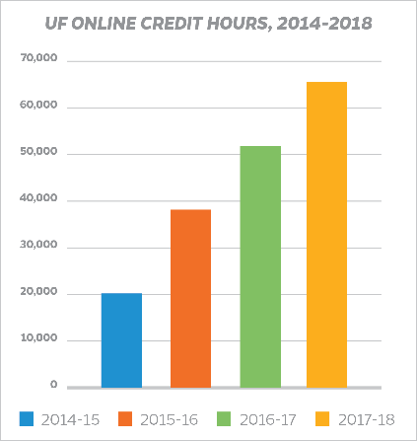
UF ONLINE ENROLLMENT TRENDS,
2014-2018

Slide 3
UF Online, 2019-2024 Agile Strategy Into Our Digital Future
Values
5-year Goals
Nimble Strategies
Core Management Practices
Guided by program values,
Informed by overarching 5-year goals,
Focused on our key objectives, strategies and sound investments, and
Fortified by Core Management Practices.
Ensuring UF Online remains a leader, deploying nimble strategies that work, continually improving during what will certainly be a transformative time in higher education.

Slide 4
Business Plan, 2019-2024 Goals Framework
Goal 1: Robust Student Learning via UF Online
Objective 1.1 UF Faculty leading in the area of research, innovation, course design, and delivery.
Goal 2: Smart Design and Delivery of Academic Programs
Objective 2.1 Delivery of the most workforce-relevant and rigorous academic programs and pathways.
Goal 3: Enriching and Supported Online Student Experience
Objective 3.1 Ensuring a remarkable…student experience by augmenting services and a new focus on co-curricular modules to foster career readiness.
Objective 3.2 Ensuring that each UF Online student has a dedicated academic advisor.
Goal 4: Strategic Marketing and Recruitment
Goal 5: Smart Growth and Data-Driven Operations

Slide 5
Enrollment Headcount Projections

Slide 6
Projected Revenue

Slide 7
Challenges and Opportunities, 2019-2024
Remaining nimble and having the data we need to make informed decisions.
Maintaining and continually improving student learning and engagement, while we rapidly expand our student population and programs.
Doubling our academic advising cadre over next 5 years while cross-training them: academic, career, and life coaching skills. Going from 1:250 to 1:100.
Learning more about our online students as we serve them. Our students are dynamic, varied in location, age, major, work situation, home situation, and course load.
Ongoing evolution of UF campus services, hours, and outreach, plus expanded ranks, to ensure a traditional campus can now serve an ever-expanding online, remote and diverse student body.
Continued attention on academic integrity and the unique challenges of fraud and abuse in the online learning environment.

Slide 8
THANK YOU

