Slide 1
State University System of Florida
Board of Governors meeting

Slide 2
Drug Adherence
eTect has an innovative solution to address a problem responsible for an estimated $290 billion per year in health care costs.
Notes:
You may not be aware, but we have a healthcare problem in the US that costs us an extra $290 billion each year – adherence to prescribed drug therapies.
$290 billion is the same size at the global semiconductor market in 2010.

Slide 3
No one knows
Over 8 million people participated in a clinical drug trial in 2009 at an average cost of $8000 per person.
More than one-third of patients do not take drugs as prescribed. Chronically ill patients are even less adherent.
Poor adherence results in poor outcomes.
Who takes their drugs as prescribed?

Slide 4
In real time
eTect’s ID-Cap system detects and reports when a patient ingests a pill or capsule
Notes:
In order to improve adherence, you must be able to measure it. This is the essence of eTect’s innovation. This pill I’m holding here can report when it has been ingested in real time.

Slide 5
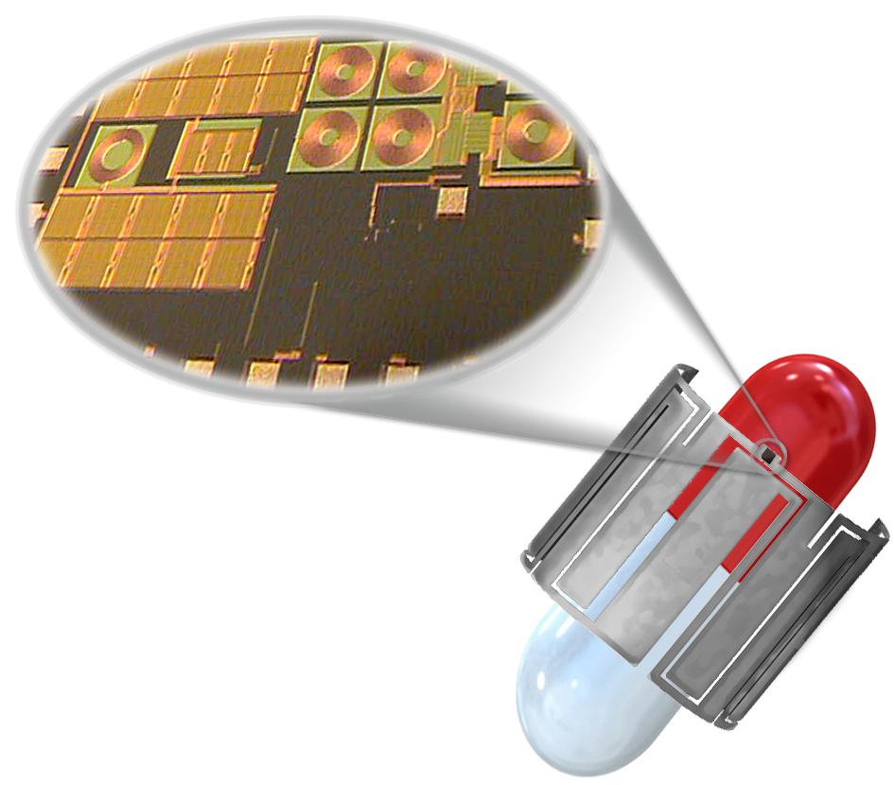
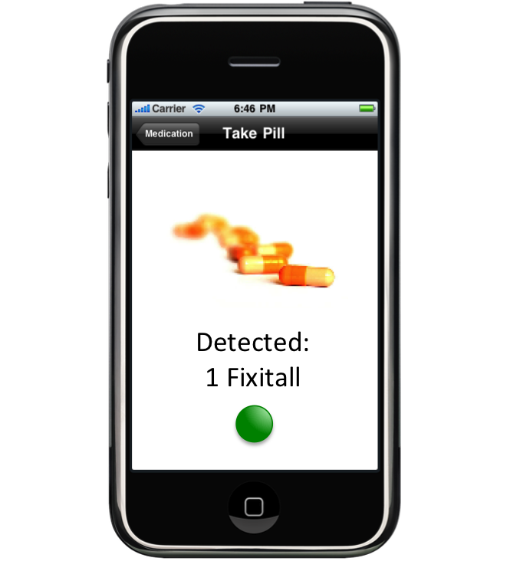
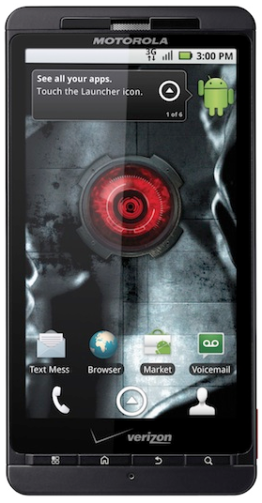
The Solution: ID-Cap
The Patient’s cell phone is running eTect’s medication reminder app. The report from the tag is passed through the cellular service provider to the patient’s personal adherence record.
Medication event information is now available in real time to the constituents of the clinical research or healthcare team as appropriate: pharma, CRO, healthcare providers, family, pharmacists, benefits organizations, or others.
Patient ingests the tagged pill
The ID-Cap tag is applied to the medicine. It can be applied at the time of manufacture or prior to distribution.
Pill Detected
Personal Adherence Record
Upon ingestion, the tagged pill reports to a wristband reader.
After entering the intestinal tract the tag breaks down into small particles and passes harmlessly through the body.
Notes:
Key points:
The tag is applied to the pill or capsule during or post manufacture.
As soon as it is ingested a special circuit begins to harvest energy from the body and report where the pill is in the digestive tract.
The pill reports to a small, wristband reader, similar to what I’m wearing here.
It will continue to report as it passes into the stomach and when the reader receives the message the pill has reached the stomach, the reader passes that information, along with information about the drug, through a mobile phone app to a personal adherence database.
The information in the database can be made available to authorized constituents of the healthcare system – healthcare providers, family, benefits providers, and importantly for our initial application – clinical researchers.
Oh, by the way, once the pill passes through the stomach, the tag disintegrates and passes through the digestive system – it has no interaction with the drug, and it has no effect on the patient.
We have successfully demonstrated all of the enabling technologies with an ingestible proof of concept pill that has been taken by members of our management team.

Slide 6
Value Proposition
Improved Adherence is shown
- in clinical trials to:
Reduce the duration of the study
Improve the quality of information collected
Reduce the overall cost of the study
- in prescription drug therapy:
Improve the outcome and quality of life for the patient
Reduce recurring visits to the healthcare provider(s)
Reduce healthcare cost for employers and benefits payers
Notes:
So why should we care if someone is not taking their drugs – what is the value proposition for monitoring adherence in real time?
Clinical trials are up to half of the cost of development of new drugs - improved adherence in clinical trials can significantly reduce the cost of the trial
Prescription drug therapy is based on a premise of adherence:
Improved adherence can improve the health and lower the cost of healthcare for the chronically ill.
A very specific example – the leading cause of transplant rejections is poor adherence to medication prescribed to prevent it.

Slide 7
Market Size (US market)
Therapeutic Area | Phase III Patients
Cardiovascular | 1,382,318
Infectious Diseases | 480,283
Cancers | 367,086
Metabolic Diseases | 267,343
Neurology | 257,154
Pulmonary Diseases | 106,945
Mental Health | 99,589
Of the top seven therapeutic areas, five are known to have adherence problems in clinical research
> 500,000 patients/yr x $1000/patient = $500 million/yr opportunity
Prescription drug patients in target therapies
Hypertension, >70 million patients Mental Health, >50 million patients
Cancers, >11 million patients HIV, Hepatitis, >700,000 patients
Notes:
I’ve alluded to the size of the markets served by our technology, but I’d like to give you a specific description of the size of our opportunity

Slide 8
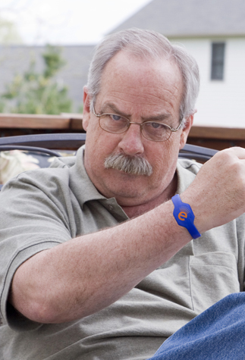
Business Model
eTect will provide adherence information as a service
Clinical research – fee per patient to the sponsor / CRO
Commercial medicine – fee per dose to the patient / benefits payer
eTect will offer technology and components to the pharmaceutical ecosystem for drug integration
ID-Cap tags, readers, and software
Notes:
Our business model allows us to serve customers with the approach that best fits the particular pharmaceutical or clinical research company – we will provide adherence information as a service – or – supply components, technology, and knowhow to companies wishing to implement their own systems.

Slide 9
Intellectual Property
Electronic Pills for Medication Compliance
Patent Issued, September 2010
CIP, Patent Pending, filed 2010
In vivo Communications Method
Patent Pending, filed 2009, exclusive option from UF
Biocompatible Conductive Inks
Patent Pending, filed 2010, exclusive option from UF
Additional patent opportunities identified, provisional filings in process
Notes:
eTect has a strong and growing intellectual property portfolio.

Slide 10
Leadership
Neil Euliano, Ph.D. – CEO
Founder and President of Convergent Engineering Inc., a Biomedical Engineering firm specializing in signal processing algorithms. Published over forty times, currently holds fourteen issued patents with approximately twenty pending patents, and has been the principal investigator for multiple programs for the National Institutes for Health, National Science Foundation, and industry sponsors. Ph.D. EE, University of Florida
Eric Buffkin – President
Founder of Pelagic Group, Identity Stronghold, Indian River Silicon. Former executive with Intellon Corp. and consulting executive to Entropic Communications. Over 20 years experience in integrated circuits market. BSEE, University of Florida; MBA, Rollins College
Rizwan Bashirullah, Ph.D. – Chief Science Officer
Assistant Professor, Electrical and Computer Engineering, University of Florida. Holds four issued patents. Fields of research include biomedical circuits, in vivo wireless interfaces and low power analog/digital VLSI. Ph.D. EE, North Carolina State University
Brent Myers, Ph.D. – Technical Lead
Wireless communications integrated circuits pioneer. Leader of development teams responsible for shipment of over 400 million integrated circuits while at Harris Semiconductor, Intersil, and Conexant. Ph.D. EE, Florida Institute of Technology
Dan Robinson, Pharm.D., Chief Pharma Officer
Developer of multiple applications for improved pharmacy health care outcomes, pharmacoeconomics, pharmaceutical care reimbursement, adverse drug reactions, drug usage evaluation, disease state management, adherence improvement, and clinical monitoring. BS in Pharmacy from the University of Georgia and a Ph.D. in Pharmacy from the University of Cincinnati.
Notes:
We have an experienced and talented team of entrepreneurs and engineers with tremendous experience in their field.

Slide 11
Impact of SURCAG
Immediate impact with prospective investors.
Short term use of funds
3.5 engineering positions
Test and Prototyping equipment
Longer term impact
Corporate HQ and R&D Center with 20+ engineering positions
Tag production – light & clean manufacturing

Slide 12
Contact Info
Eric Buffkin
President
eTect, LLC
4817 SW 34th St,
Suite 4
Gainesville FL 32608
352-367-8328 x102 phone
352-262-8947 cell
eric@etectbio.com

