Slide 1
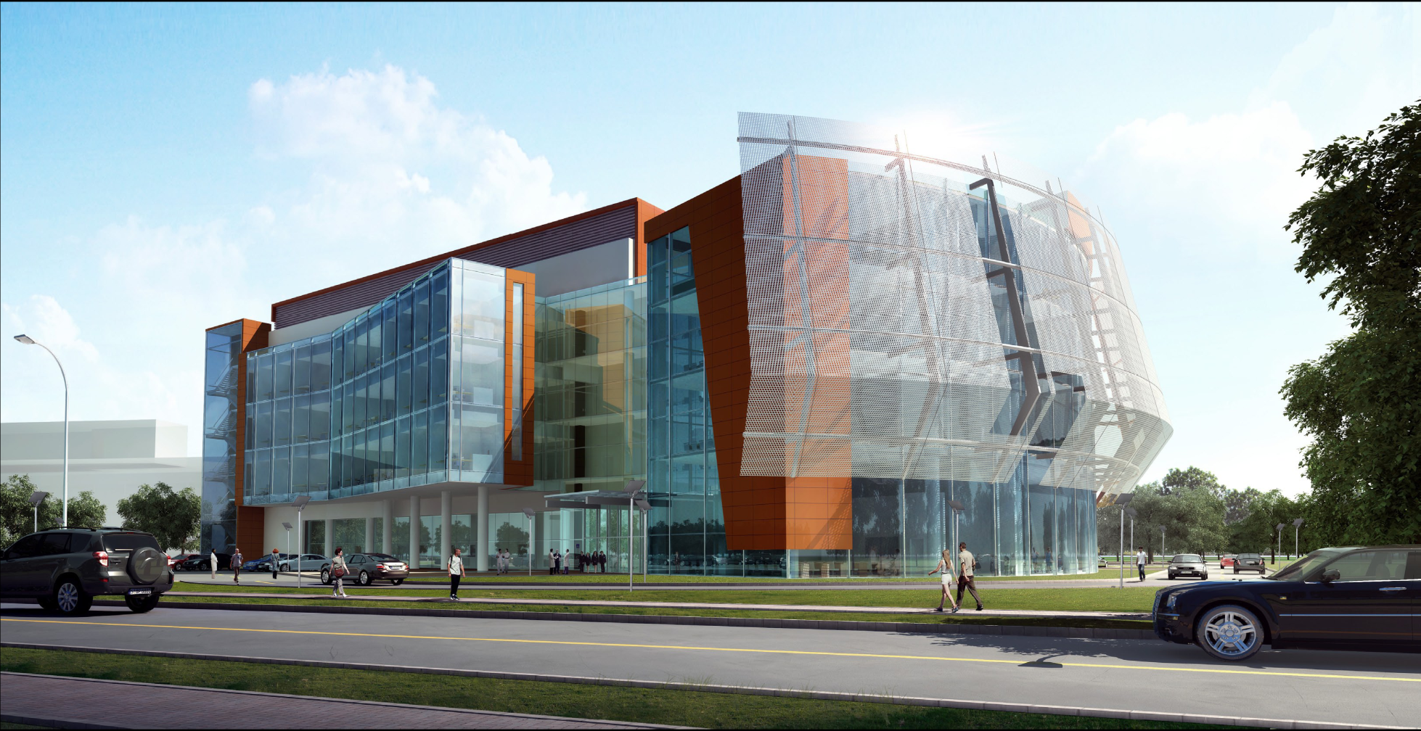
UF Research and Academic Center at Lake Nona
Presentation to Florida Board of Governors, March 17, 2010
Dr. Win Phillips – Vice President for Research
University of Florida

Slide 2
Overview
The University of Florida Research and Academic Center will be the next piece of the growing Biomedical cluster at Lake Nona and will be located adjacent to the Sanford-Burnham Medical Research Institute site within the science and technology park zone of the Lake Nona Development.
The facility is planned to be a 4-story 115,000 GSF building, which will include research, academic, office, conference, and support space to facilitate the UF mission.

Slide 3
Lake Nona Master Plan
University of Florida
Research Center at Lake Nona

Slide 4
UF & Burnham Institute Sites
Future
Phase
Burnham Institute
for Medical Research
University of Florida
Research and Academic Center

Slide 5
UF Site
SITE SUMMARY
UF Research and Academic Center
Gross Acreage: 5.27
BUILDING PROGRAM
Classroom & Student Spaces 13,862 (sf)
CDDC (Comprehensive Drug Development Center) 8,345 sf
Administration 2,706 sf
Research 28,266 sf
Public/Common Space 7,719 sf
Mechanical/Other 2,674 sf
Total Gross Square Feet 115,000 sf

Slide 6
UF Project Budget & Funding
Project Budget
$47,068,845 (Basic Construction Cost)
$2,020,000 (Site/Utility Infrastructure)
$11,899,555 (Other (including Fees, Inspections, FF&E, contingency)
$60,988,400 Total Project Budget
Project Funding
$6,000,000 (Previous Allocation 2008/09 PECO)
$54,988,400 (Remaining PECO Request)
$60,988,400 Total Project Funding

Slide 7
Building Rendering

