Slide 1
BOARD OF GOVERNORS
Student Affairs Committee
Excessive Alcohol Use on Campus:
An Introduction
University of Central Florida
June 18, 2009
Notes:
Maribeth: Intro and slides 1-3, 3-5 minutes

Slide 2
Common Sense
We cannot expect students to say “no” to harmful drinking and other drug use when their environment tells them YES.
Notes:
Maribeth: Intro and slides 1-3, 3-5 minutes

Slide 3
Setting the Context for Campus & Community Collaboration
“Basically, having programs to reduce binge drinking on college campuses in the absence of broad-based community interventions is a bit like rearranging deck chairs on the Titanic.”
Dr. Timothy Naimi, of the Centers for Disease Control
Notes:
Maribeth

Slide 4
Leadership is Critical
Notes:
Maribeth

Slide 5
College Drinking and Its Consequences: National Scope
1,700 alcohol-related unintentional deaths among students 18-24.
696,000 students between 18-24 are assaulted by another student who has been drinking
97,000 students between 18-24 are victims of alcohol-related sexual assault or date rape
Hingson 2005
Notes:
5
Chris: Scope of the problem slides 4-11. 7 minutes

Slide 6
College Drinking and Its Consequences: Statewide Scope
(2008 Florida Core Survey n=6,299)
Student drinking prevalence in the previous year:
2 in 3 reported drinking alcohol in the past 30 days
1 in 6 reported drinking 3xs per week or more
Negative consequences related to reported drinking:
1 in 3 reported driving under the influence.
1 in 6 reported being hurt or injured.
1 in 9 reported “having been taken advantage of sexually”
1 in 20 reported unsuccessful attempts to stop drinking
Notes:
6
Hangover: High-risk drinkers averaged 6.5 times annually.
Driving under the Influence: High-risk drinkers averaged 5 times annually.
Injuries: High-risk drinkers averaged almost 3 injuries annually.
Sexual assault: High-risk drinkers averaged 2.5 incidents annually.

Slide 7
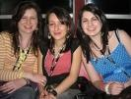
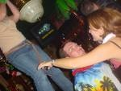
Contributing Factors in the Campus Environment
Many students arrive at college believing that heavy, even dangerous drinking is the norm, which can be reinforced by campus life.
Notes:
Chris

Slide 8
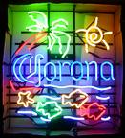
Contributing Factors in the Campus Environment
Students are bombarded by alcohol advertising, which glorifies the student drinking culture and promotes high-risk consumption.
Notes:
Chris

Slide 9
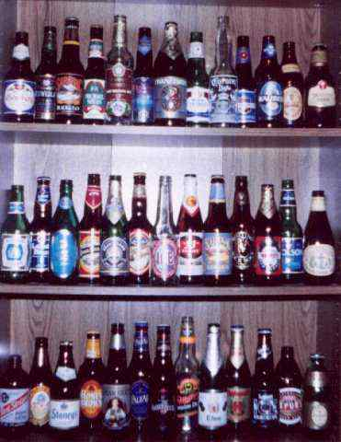
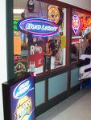
Contributing Factors in the Campus Environment
It is easy for college students to obtain free or inexpensive alcohol, either from acquaintances or local retail outlets.
Notes:
Chris

Slide 10
Contributing Factors in College Communities: Drink Promotions
Thursday, Free Drinks All Night to Everyone
Ladies Drink FREE til 12 Guys $1 Drinks til 12
Tuesday Drinking with Lincoln- Penny Drafts
Bombs Away Friday. $2 Jaeger Bombs $1 Drafts til 12
Monday, Free Drinks, Shots and Drafts til 12
All You Can Drink Sundays! FREE Wells and Drafts
Power Hour Wednesday! 60 Songs, 60Shots, 60 Minutes
Slamming Saturdays! $1 Cover before 11. $1 Drafts, $2 Wells, $3 Bombs
Wasted Wednesday! FREE Wells til 12. FREE Drafts all Night
Notes:
10
Chris

Slide 11
Key Strategies of a Comprehensive Campus & Community Approach
Individual factors (students)
Peer factors (students)
AND
Institutional factors
Community factors
Public policy
Environmental
Management
Notes:
Chris

Slide 12
Underage and Risky Drinking: A Campus & Community Concern
*2006-08 Underage Alcohol Related Deaths: 60
*FY2008-2009 Emergency Department Alcohol-Related Visits (under 21 years of age) Average 250 cases per month
Average cost $1.4M per month in charges. Reimbursement rate is approximately 10%
*Orange County Medical Examiner-Alcohol related data
**Local County Hospital ED Alcohol-Related Data (Under 21)
Notes:
12
Tom: slides 11-16

Slide 13
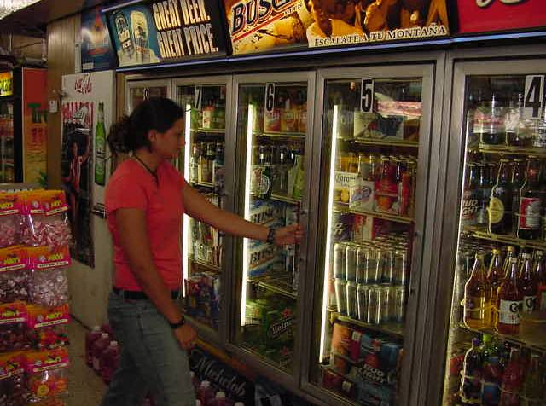
A Campus & Community Solution:
Coordination and Collaboration between:
University Efforts
Enforcement Efforts
Responsible Hospitality
Administrative Efforts
Notes:
13

Slide 14
University Efforts
Prevention and Intervention Priorities:
Provide at-risk students access to substance use screening, intervention and referral to treatment
Provide pre-matriculation online education and "booster" sessions provided in Residence Life
Support Peer Education & Advocacy
Support for Campus & Community Environmental Management Strategies
Notes:
14

Slide 15
Enforcement Efforts
Focus Areas:
- Vendor Compliance Checks
- House Parties
Key Issues:
- Increase Coordinated Enforcement Details
- Complaints in Residential Neighborhoods
- Legal Consequences of Underage Drinking
- Health-Related Consequences of Underage Drinking
Notes:
15

Slide 16
Responsible Hospitality
Focus Areas:
- Responsible Hospitality
- Vendor Training Programs
- High-Risk Drink Promotions
Key Issues:
- Short-Term vs. Long-Term Business Models
- Availability of Cost Effective Vendor Training Programs
- Illegal Access to Alcohol through Fake Identification and/or Inconsistent ID Checks
Notes:
16

Slide 17
Administrative Efforts: Winter Park Ordinances
Require a Permit to sell alcohol after 11:00 pm
3 violations within 3 month period results in reduced hours for alcohol sales
Illegal Open House Party Ordinance
Owners and landlords held responsible for illegal open house parties
First Violation – Written Notice
Second Violation - $1,000 Fine
Third Violation - $2,000 Fine
Notes:
17

Slide 18
Continuing the Conversation:
- Heightened Awareness on Campus
- Collaboration with Community Coalitions
- State University Best Practices
- State Statutes and Local Ordinances
For additional Information contact:
Maribeth Ehasz, Ph.D University of Central Florida
phone: 407 823 4372 email: mehasz@mail.ucf.edu
Tom Hall, University of Central Florida
phone:407 823 0869 email: tvhall@mail.ucf.edu
Maureen Miller, University of Florida
phone: 352-392-1161, ext 4261 email: emm@ufl.edu
Chris Franzetti, Florida State University
phone: 850-445-3674 email: chrisfranzetti@aol.com
A special thanks to Senta Goudy, State of Florida DCF, Beth DeRicco, Higher Education Center, and Bill DeJong, Outside the Classroom for their assistance in developing this presentation.
Notes:
18
FHE-ASAP is our state coalition. It has operated since 2001. FHE has __ member institutions.
Chris Franzetti of FSU is the Past Chair, Tom Hall of UCF is the current Chair, and Maureen Miller of UF is the Chair Elect.
FHE-ASAP will work with the BOG to identify best practices in the SUS system related to Substance use environmental prevention strategies.

